Slide 1
Updates to the ECAL endcaps geometry
Alessandro Ruggeri
DUNE-Italia Collaboration Meeting, Ferrara
29/10/2024

Slide 2
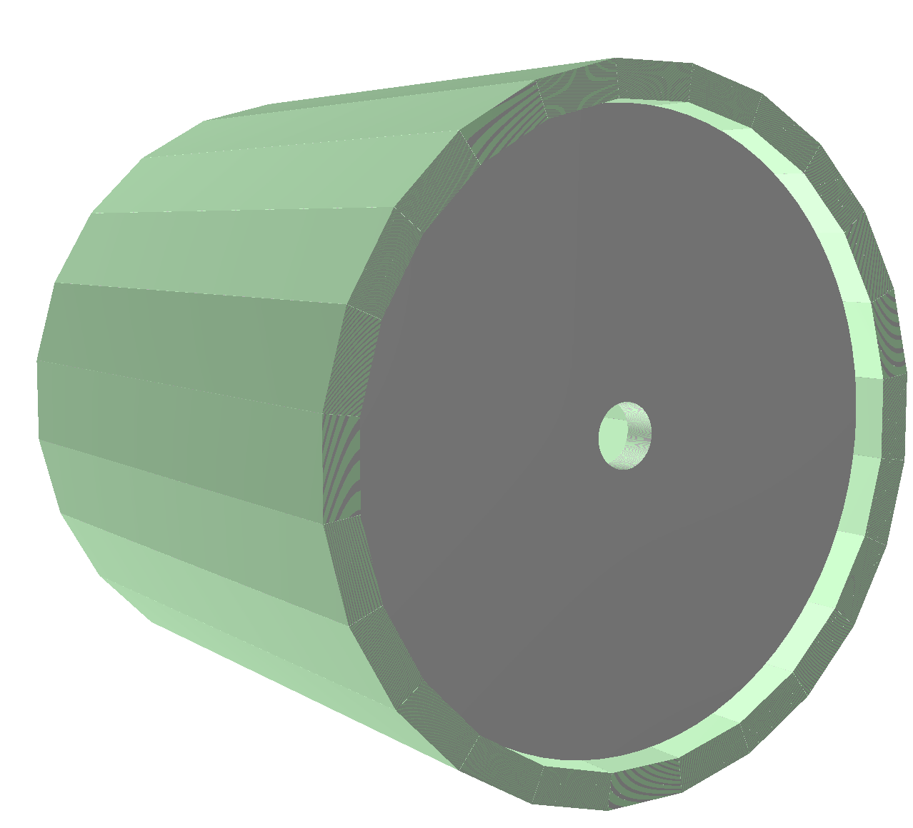
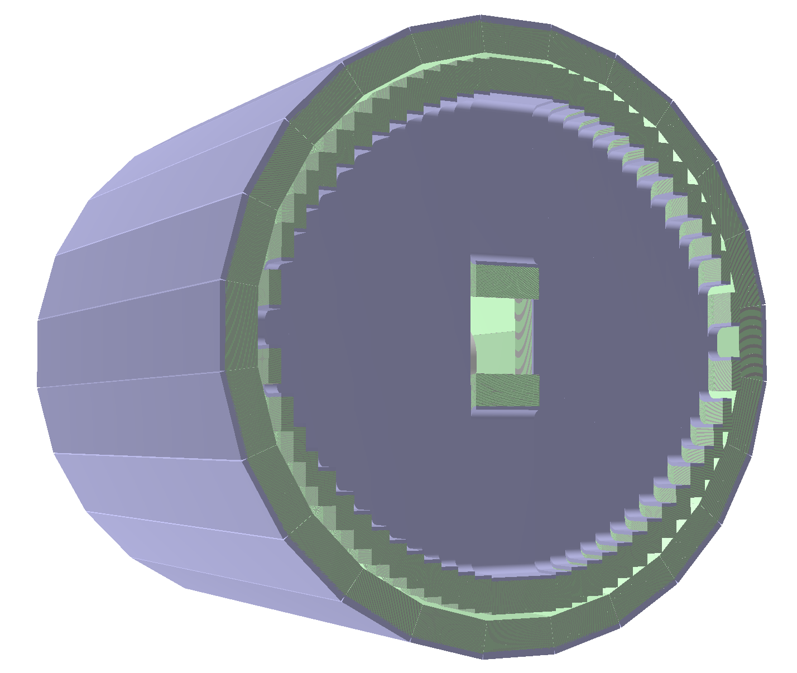
Updated endcap geometry
Realistic geometry implemented by Paolo Gauzzi in dunendggd branch-18.
Old geometry: disk-shaped endcaps with “virtual” modules
New geometry: fully modelled endcap models and Al back-plates

Slide 3
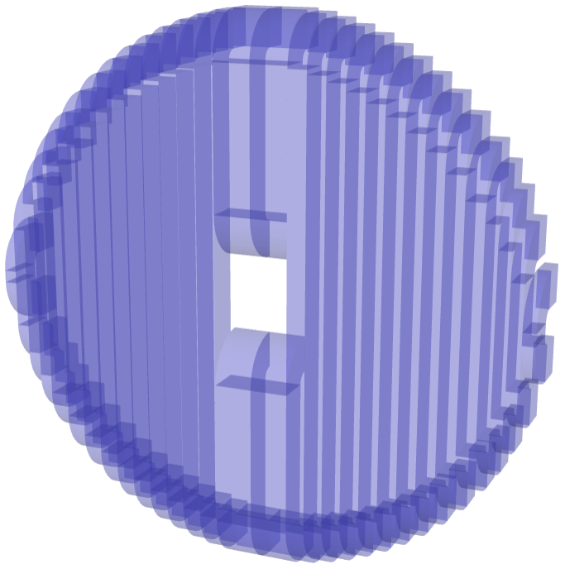
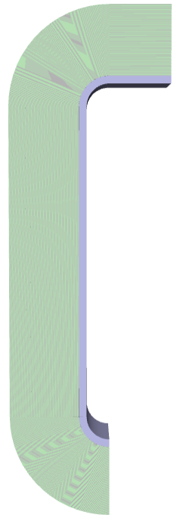
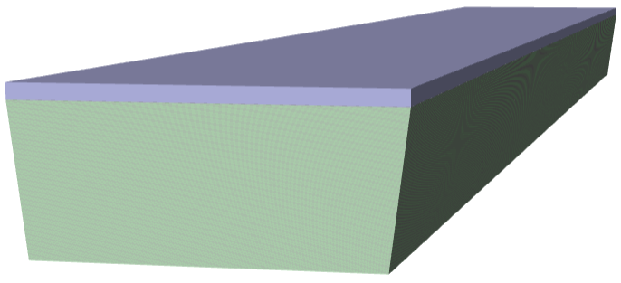
Updates to digitization
hor.
New endcap modules:
  composed of multiple sections
  varying length and shape
  Aluminium back-plate
Cell finding and indexing in SANDGeoManager
Path length to PMT (d1, d2) computation
depends on the module geometry
Hit reconstruction from TDCs in the new geometry
curv.
Al plate
d1
vertical
Al plate
d2
curv.
read-out volume
Updated barrel module

Slide 4

SANDGeoManager
Management of the SAND ECAL and tracker geometries
Extracts relevant quantities of cells and tubes from the TGeoManager object:
  encoding and decoding of IDs
  positions, dimensions, etc…
Accepts drift-chamber geometries thanks to V. Pia and G. Ingratta
Modified ECAL manager and added new class to manage endcap cells
ECAL cells path length computation and hit reconstruction
Currently working on sandreco branch-20

Slide 5
Digitization checks
sandreco digitization runs again from beginning to end
Checked the new indexing and extraction of cell info
Next step: hit position reconstruction from photo-signals
Barrel hits
barrel hits
Endcap hits
endcap hits

Slide 6
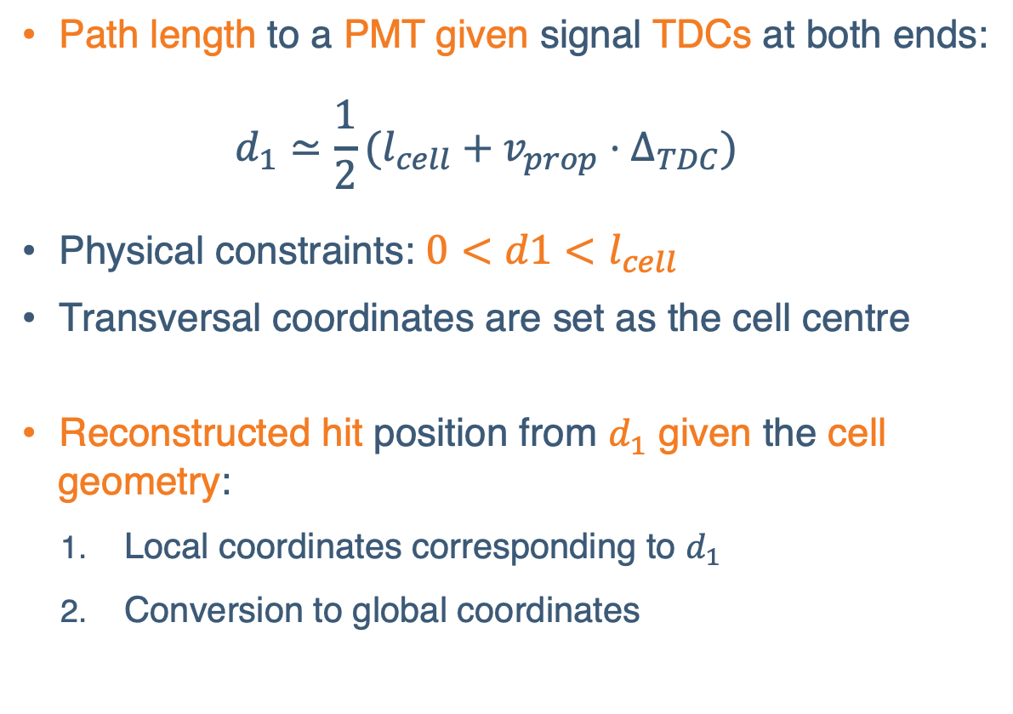
Hit position reconstruction
Path length to a PMT given signal TDCs at both ends:
  $$d_{1}≃\frac{1}{2}(l_{cell}+v_{prop}⋅Δ_{TDC})$$
Physical constraints: $0<d1<l_{cell}$
Transversal coordinates are set as the cell centre
Reconstructed hit position from $d_{1}$ given the cell geometry:
  Local coordinates corresponding to $d_{1}$
  Conversion to global coordinates
x10⁶

Slide 7
edepsim hit distribution
Hits corresponding to the first available photo-electron in a pair of photo-signals.

Slide 8
Hit reconstruction
Considering all photo-signal pairs in a cell → potential spurious matches

Slide 9
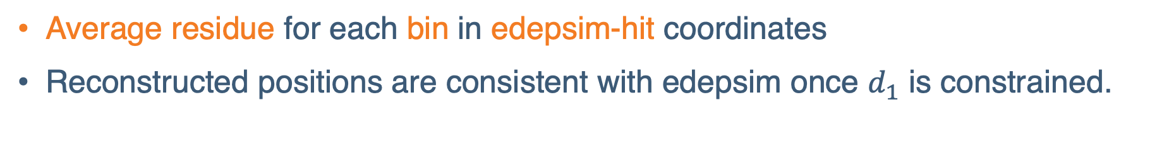
Spatial distribution of the residues
Average residue for each bin in edepsim-hit coordinates
Reconstructed positions are consistent with edepsim once $d_{1}$ is constrained.

Slide 10
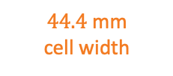
Direction-wise residues
Direction-wise residues are consistent with the cell directions in barrel and endcaps
$44.4$ mm
cell width

Slide 11
Conclusions and prospects
In dunendggd: increased the size of the magnetized volume for ROOT
node finding algorithm to work with the new endcap modules
  resulting overlaps must be solved before merging branch-18
  update strategy is to be decided
In sandreco: merge with develop branch in the near future:
  updated scintillation decay time
  SANDGeoManager for drift-chamber geometries
Waiting for a defined merge strategy for ECAL digitization

