Slide 1
Summary
Calorimeter module refurbishing .
Fermilab safety documentation.
Conclusions.

Slide 2
Calorimeter module refurbishing .
The steps envisage to consolidate the calorimeter modules:
Removing the outside tape and cleaning.
A visual inspection (report).
Measure the calorimeter modules.(Caliper or gages)
Preparation of the surface to improve the adhesivity to the tape.
Mechanical test on test specimens on tape and on glue.
Module repair procedures (tooling necessary).
Define the qualification Test on a repaired modules.
We need to get an approval of the Fermilab safety office on the qualification process of repaired modules.
We need to evaluate if we need to increase the calorimeter radii.

Slide 3
Removing the outside tape and cleaning.
After we can see the delamination of modules.
We have to try to scraped or pulling the tape or use abrasive pad or sand paper.
A visual inspection (report).
After we can make a visual inspection for each module and write a report.
Measure the calorimeter modules.(Caliper or gages)
Modules survey allow us to understand the status of the module and make a correlation between the module position and their final shape. (faceup position)
Preparation of the surface to improve the adhesivity to the tape.
This operation allow us to prepare the outside surface to guarantee a good adhesivity for tape.

Slide 4
Mechanical test on test specimens.
This test are necessary to validate that the modules repaired method.
We can examine a standard test on tape and glue.
For the tape Like adhesivity test (Standard Test Method for Peel Adhesion ASTM D3330)
For the Glue joint is the lap shear, pull test or peel ASTM D1002 or others. Some are useful for us for instance the tape a test on wrapping tape. For the Glue it will important to evaluate the capability of penetration inside the cracks the adhesivity on a surface that have glue traces.
Module repair procedures.
We need to write a repair procedure based on each the module status. A tooling will be necessary to repair the module.
Define the qualification Test on a repaired modules.
A qualification tests must guarantee an adequate safety level considering the module life: Handling transportation, storage and mounting, etc.

Slide 5
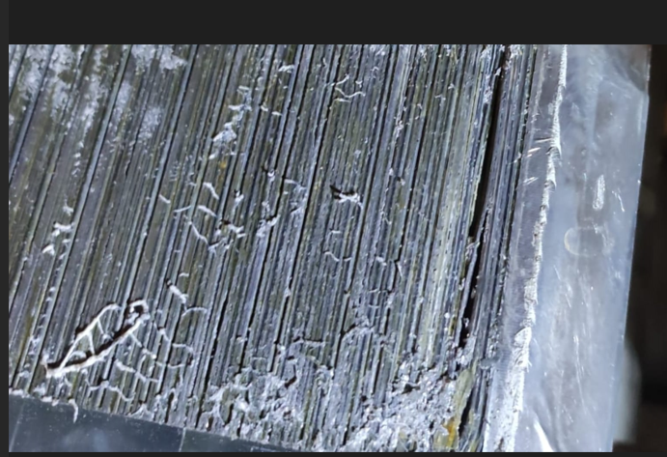
We need to get an approval of the Fermilab safety office on the qualification process of repaired modules.
It is important to have a Fermilab review or a judgment of our module restoring.
We need to evaluate if we need to increase the calorimeter radii.
On a basis of the modules shapes to avoid interferences we can increase the calorimeter radii. The radii increase can be 5 mm this will increase the nominal clearance between modules.

Slide 6
Conclusions
The module preparation and inspection can be carried in parallel with the R&D activities to defined the repair procedure. The cleaning and surface preparation requires to do some trial test. The inspection requires gages and caliper that we have to procure
Same materials like the glue e tape are procured and are in Frascati. A parts of module 0 can be use to experiment test.

