Slide 1
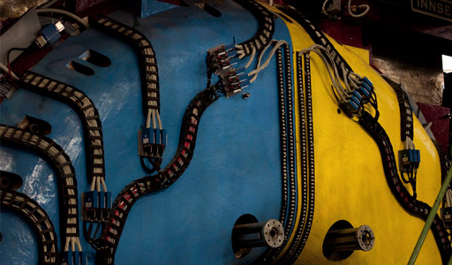
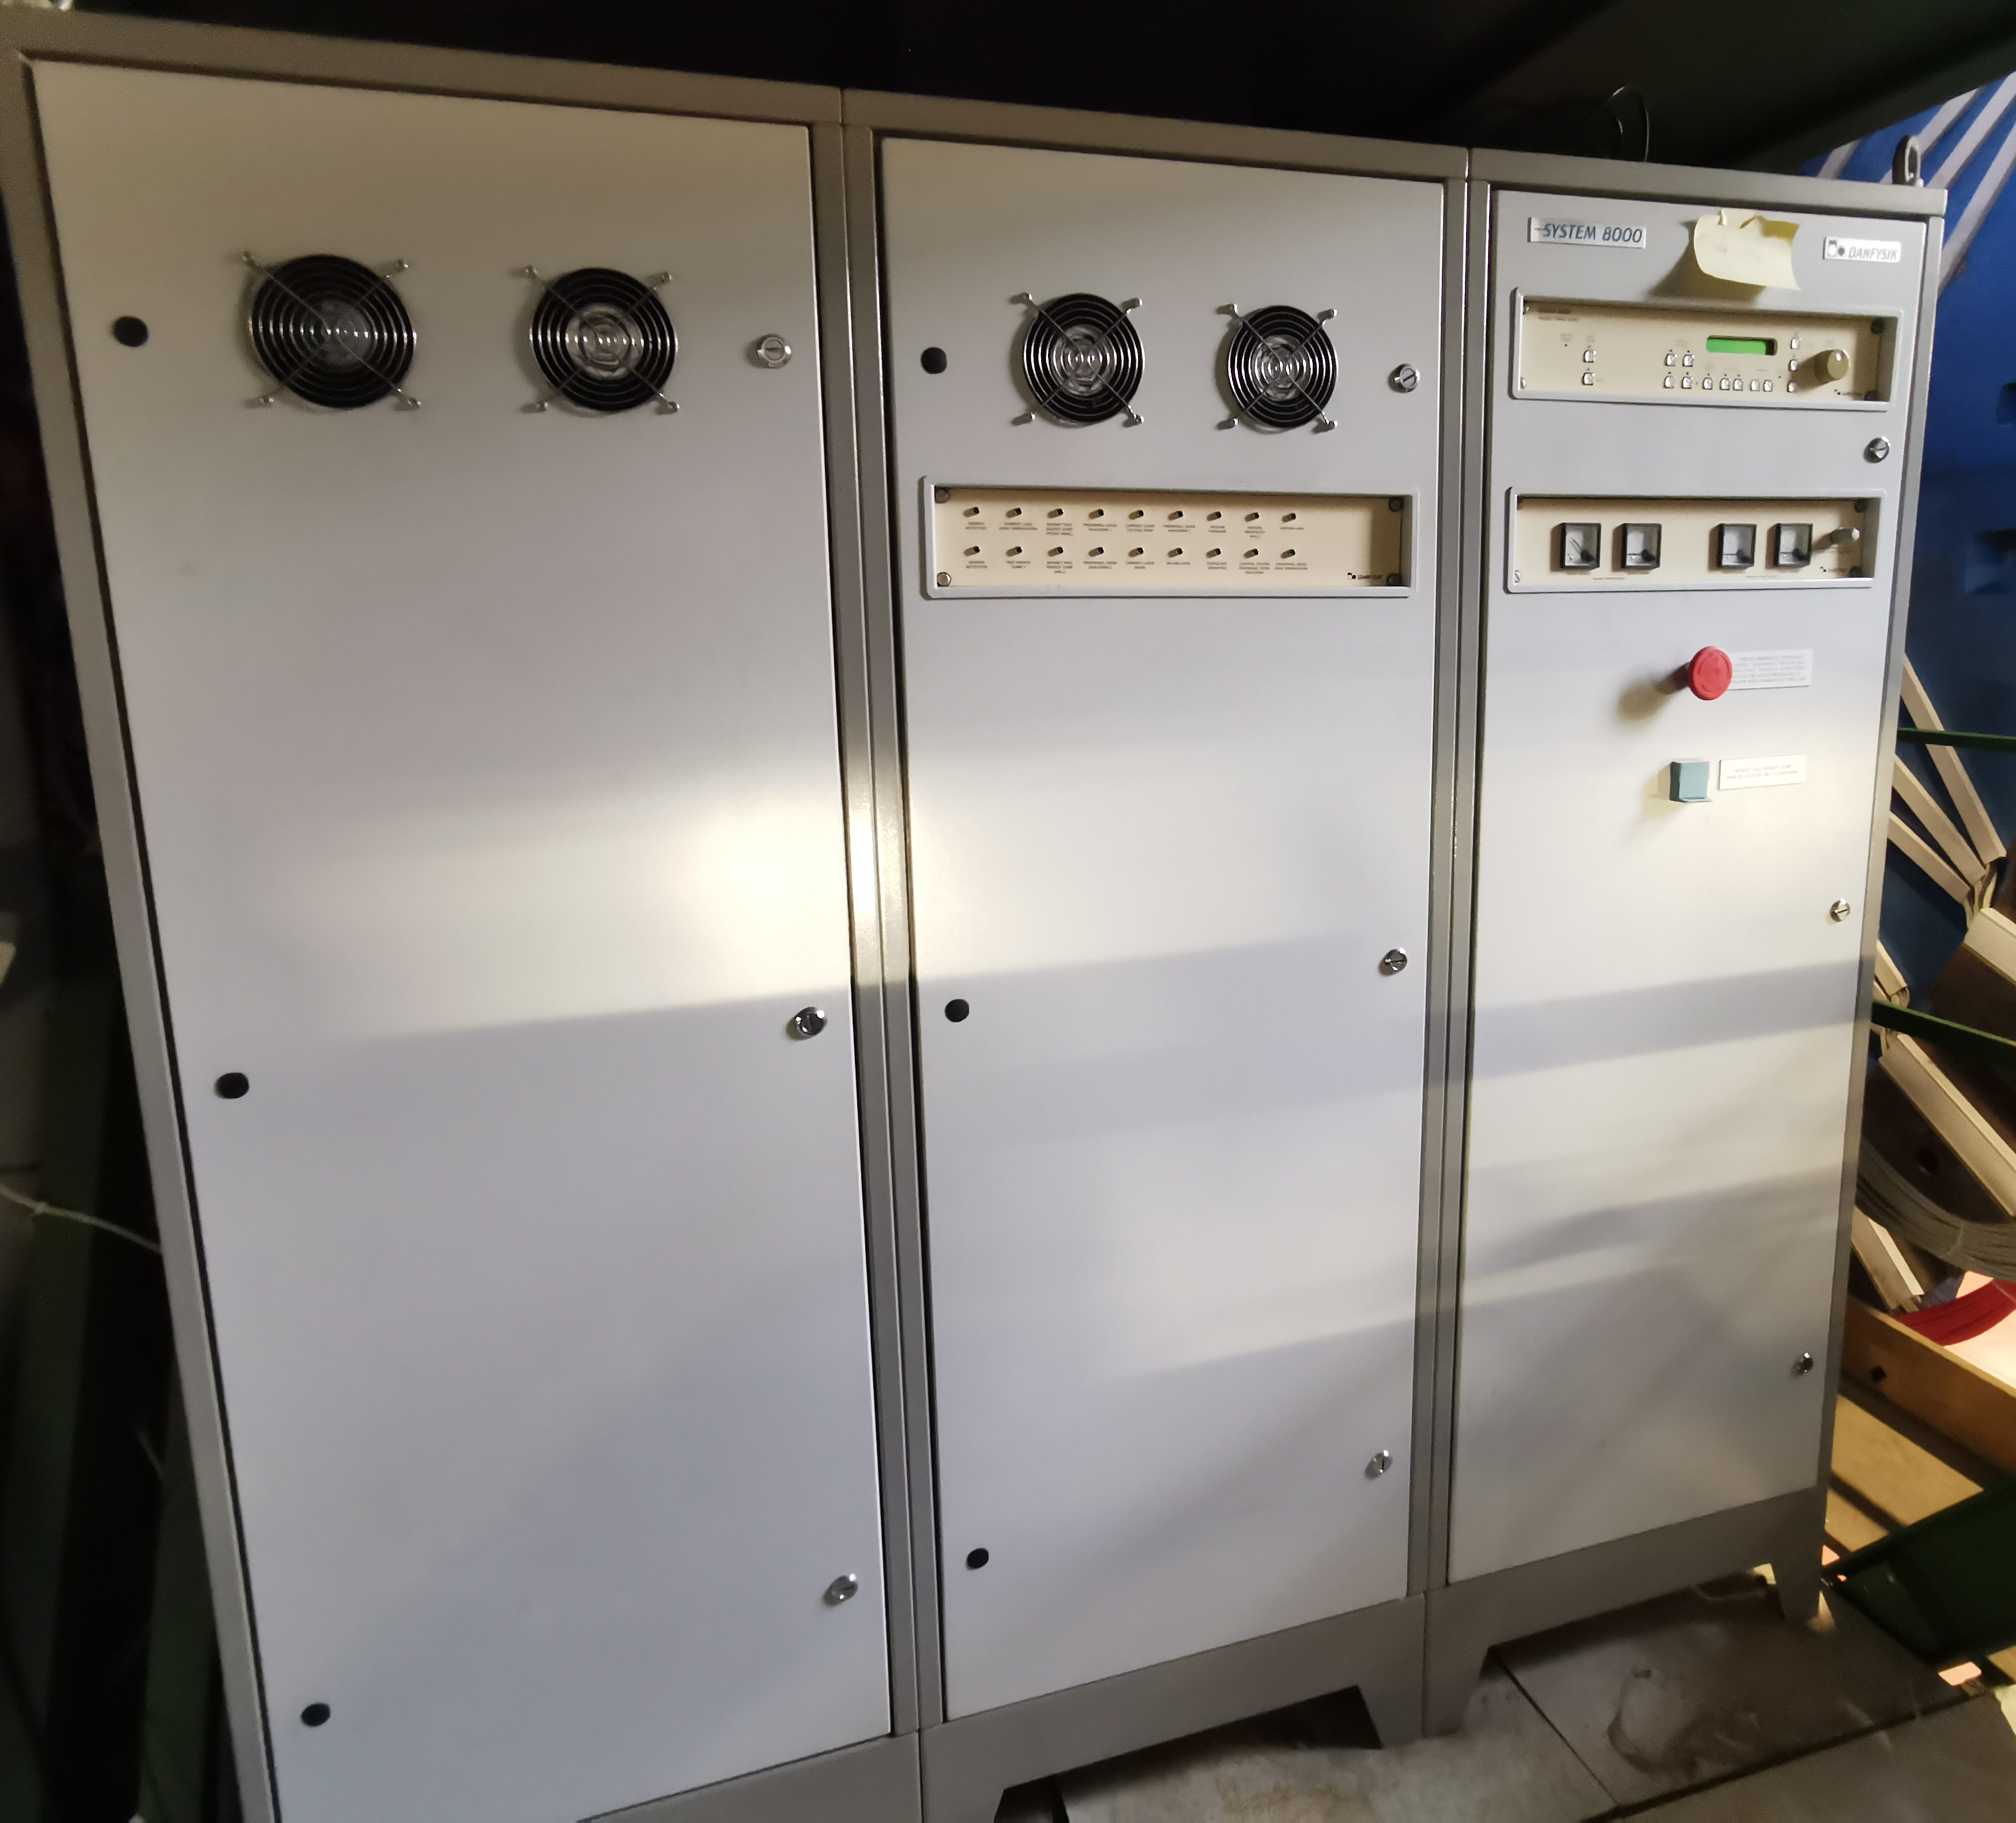
Magnet: Status of Power Supply
Meeting Annuale della Collaborazione DUNE Italia
Istituto Nazionale di Fisica Nucleare – Laboratori Nazionali di Frascati
Alessandro Vannozzi – Accelerator Division- Electrical Engineering Service

Slide 2
Power Supply System Procurement Status
The PS is shut down since the last KLOE-2 run (2018).
INFN is moving towards the old KLOE PS revamping option that could save money, time and it will keep a solid scheme and functionality.
Diagnostic Rack including Quench detector needs a functional tests.
INFN moved towards industrial partners with several years experience in power converters and automation system.
Power converter: OCEM SpA company provide a quotation for whole PS system procurement except diagnostic rack including Quench Detector (QD) revamping.
ASG quotation for QD and revamping was «not cheaper». ASG will play only the role of supervisor of personnel procured by INFN.
Several companies with expertise in automation could cover Diagnostic Rack including QD update. Market survey among several companies is ongoing.
A revamping of Control System is also needed (old one is based on LabView 6).
New Power Units (PU)
KLOE PS Revamping
Assembly of all components
F.A.T.
AUTOMATION COMPANY
Diagnostic Rack
Control system update

Slide 3
Power Supply Procurement Status and Performances
Required PS performances in line with the old PS.
After a market survey, a modular solution with several power units connected in parallel seems to be the state of the art configuration to find a compromise between reliability and component size.
Two solutions have been investigated.
Power modules provided by CAENELS + Revamping by OCEM SpA.
Power modules and revamping provided only by OCEM.
OCEM as unique provider was considered the best solution because of a better integration between old and new components and for future support simplicity.
Contract signed with OCEM company for study and design of the new PS including with test on all the saved parts (77.486 € +VAT)
Second contract to be signed with OCEM for parts procurement (including power units), assembly FAT and test at LNF support (185.180 € +VAT).
All the funds are now available also for the second contract.
DC OUTPUT RATINGS
Power range | 30 kW
Current range | 3000 A
Maximum output Voltage | 10 V
Nominal Ramp Rate | 0,6A/s
Output Polarity | Unipolar
STABILITY
Short term 30 min | +/- 10 ppm*
Long term 8 hours | +/- 10 ppm*
WATER COOLING
Flow Rate | 18-25 l/min
Inlet Water TemperATURE | 25-32°C
Current setting resolution | 18 Bit
Current readback resolution | 16 Bit 16 ppm
AC SUPPLY POWER
Mains voltage | 3x208VAC +/-10% 60Hz (With 400VAC connection for LNF Tests)
*These are nominal PS parameters, with the 3H magnet load they will be reduced

Slide 4
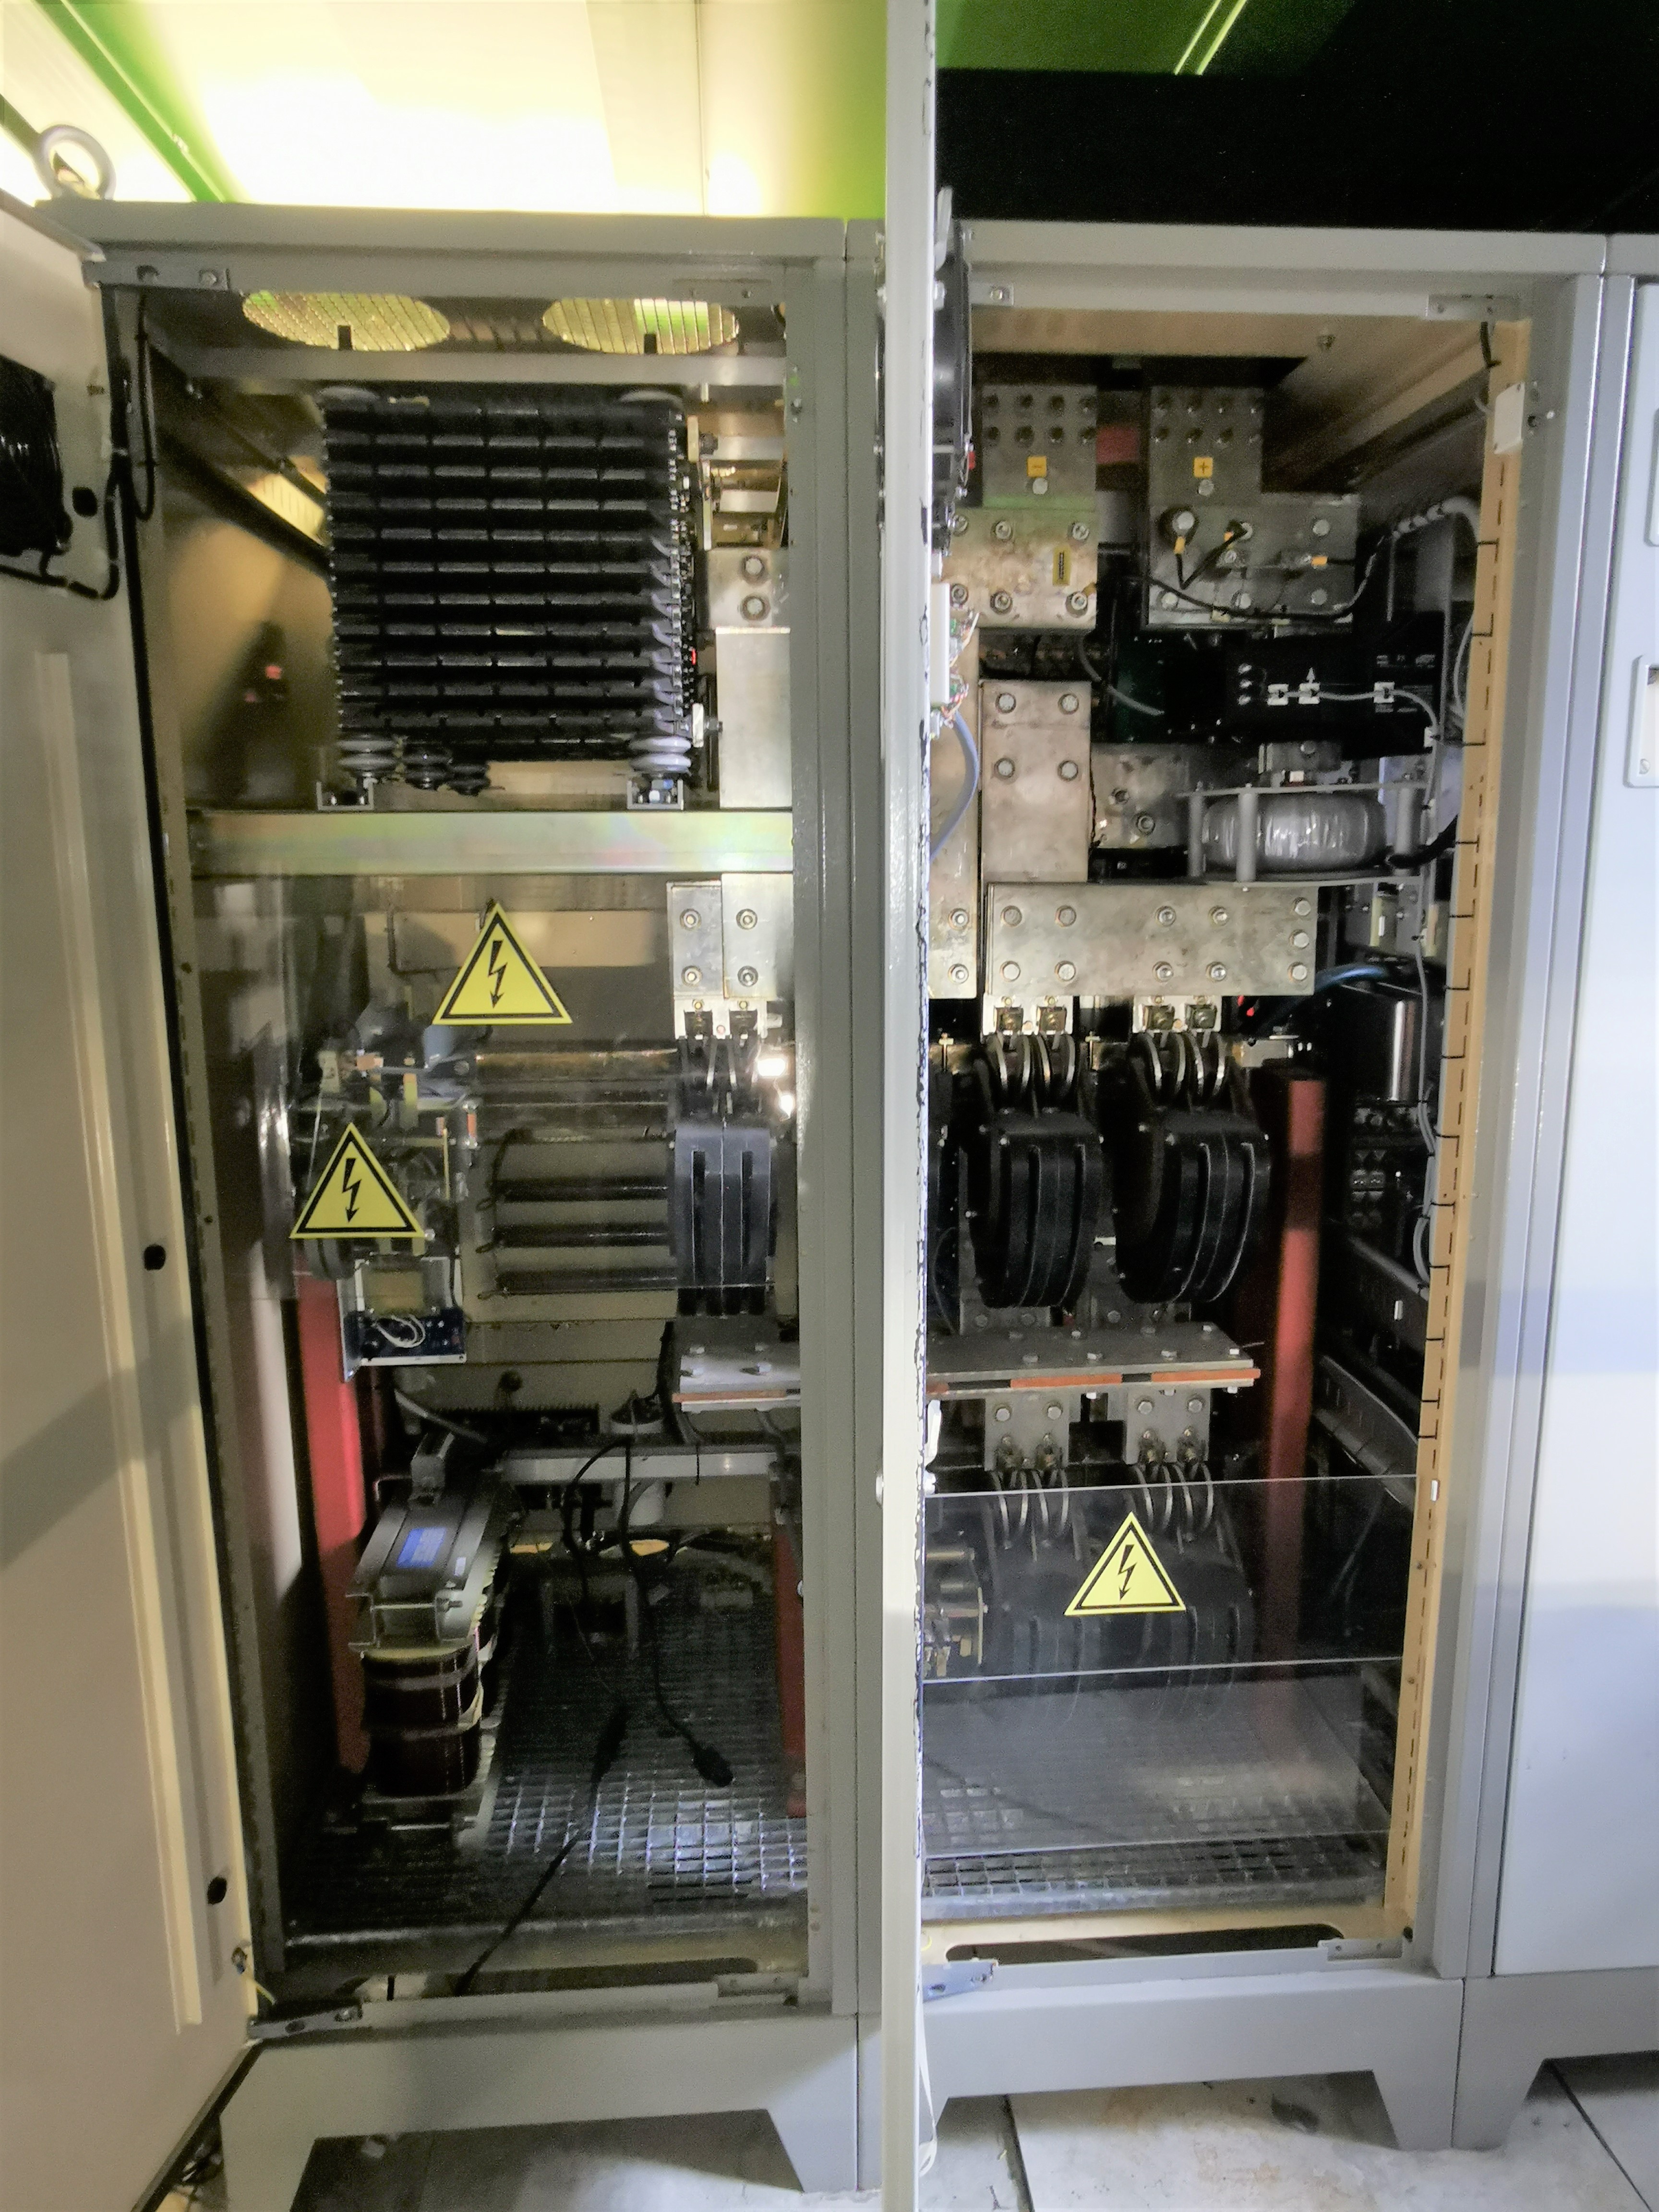
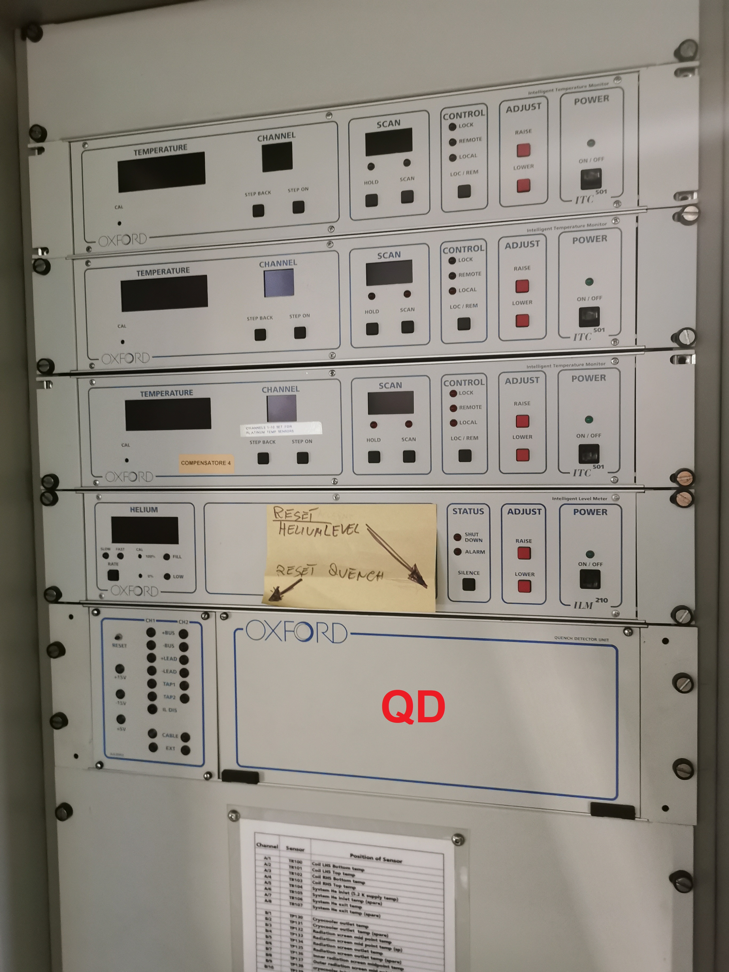
Power Supply Procurement Status
Main components who has to be substituted:
Cooling pipes of the transistors bank→ new power unit
Free wheeling diodes affected by several water leaks
High current contactors, Busbars and several other components passive components (i.e. Rdump) could be saved after functional tests
Diagnostic Rack with temperature, helium level sensors and Quench detectors needs functional tests.
Rdump
Contactors

Slide 5
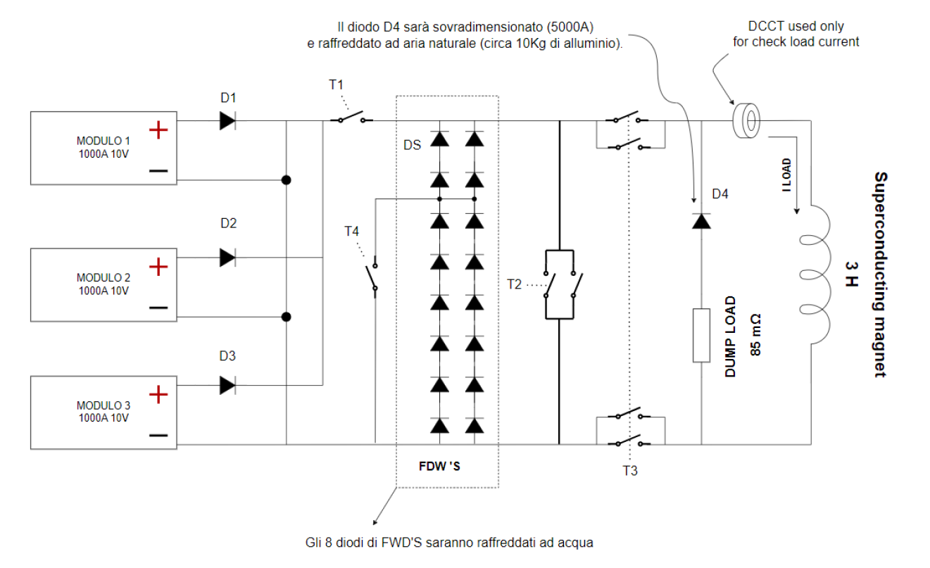
Power Supply Main Diagram
Magnet Quench Discharge in 50s, current flows through dump resistor (T3 open)
PS Internal Fault/Grid Fault
Current flows through FWD, discharge in 20 min, V=-7V (T1 open)
FWD Water Cooling Fault
Magnet short circuited with crow bar, discharge in 2,5 hours (Modules OFF)
Regulated Ramp Down
T1 open,T4 closed by-passing 6FWD→ V=-2V
SAVED COMPONENTS

Slide 6
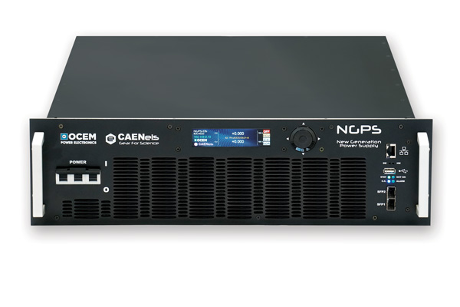
Power Supply and Ancillaries
The 3000 A maximum current will be delivered by the parallel of 3 x NGPS 1000 A, 10 V.
Current regulation with one DCCT per power module. Diode D4 will ensure that the readout of DCCT on the load will be equal to the sum of the three DCCTs
New PLC for the internal PS control will be installed.
The PLC will manage also the external interlock
The diodes will be water cooled and equipped with heatsinks.
The busbars will remain the same of the old PS. The are Al Bars and internally water cooled.
The PS revamping foreseen the supply of several PS ancillaries:
UPS for the auxiliaries (i.e. contacots relè), quench detector, and control power in case of AC power failure. At least 30 minutes back-up time.
Warm-up power supply: 25A, 230V power supply to bring it up to room temperature once it ceases to be superconducting.
Control Interfaces (TCP-IP Ethernet)
All the connections and bars between components including the new high current contactors (T1 and T4)

Slide 7
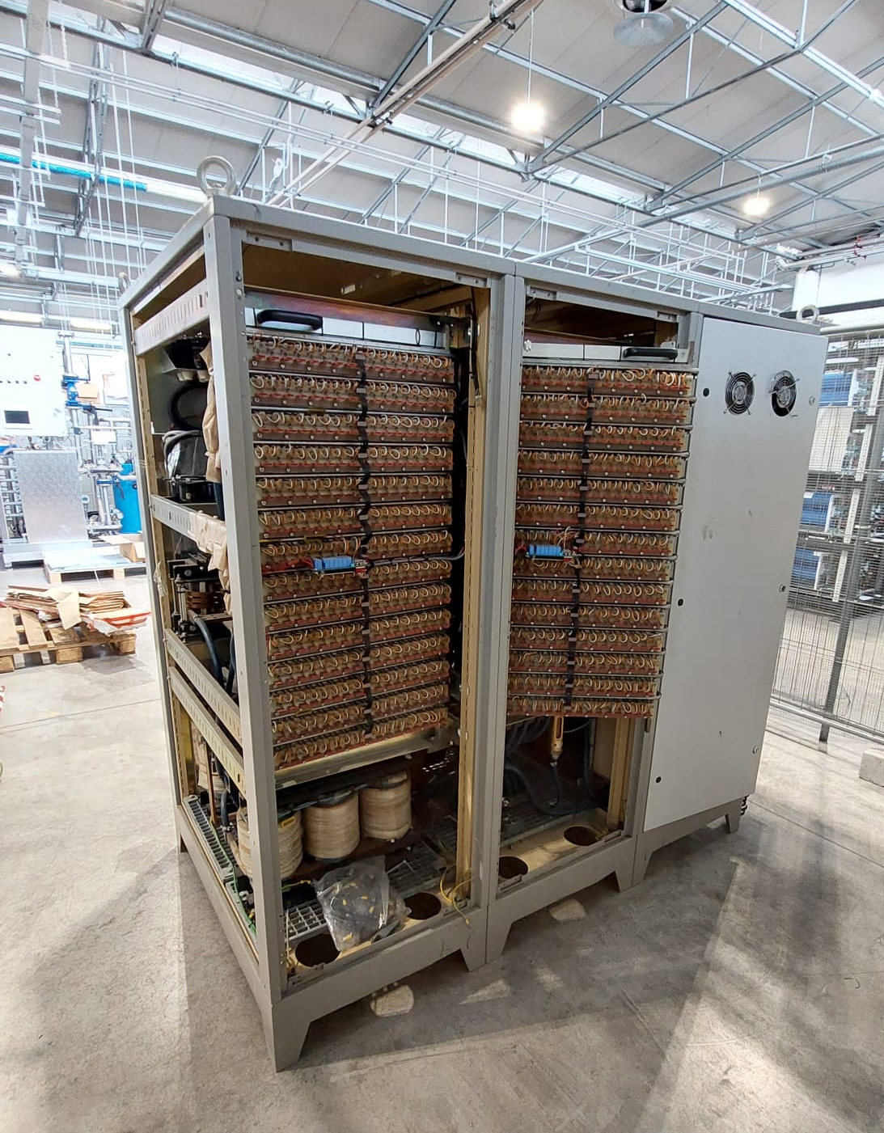
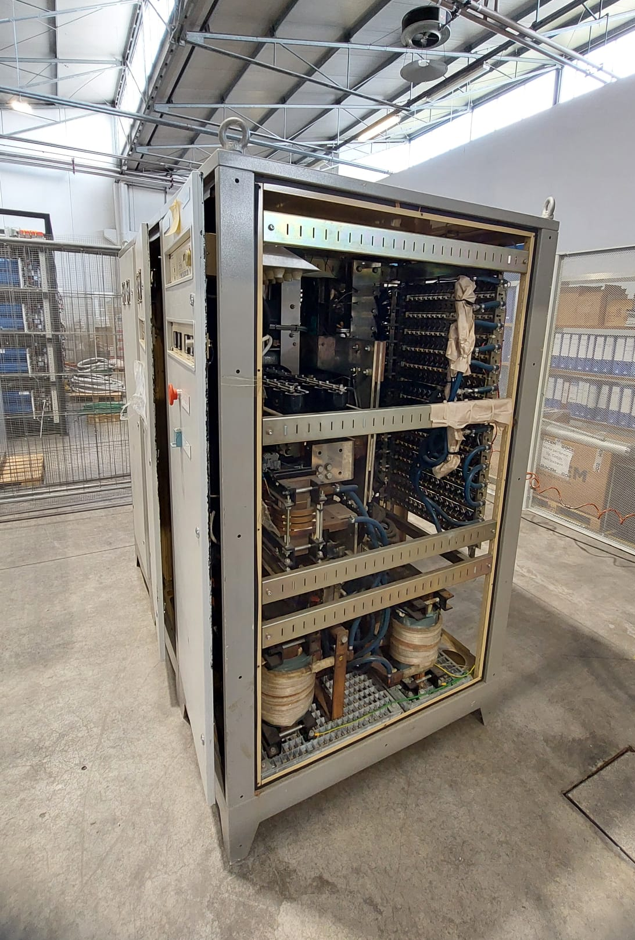
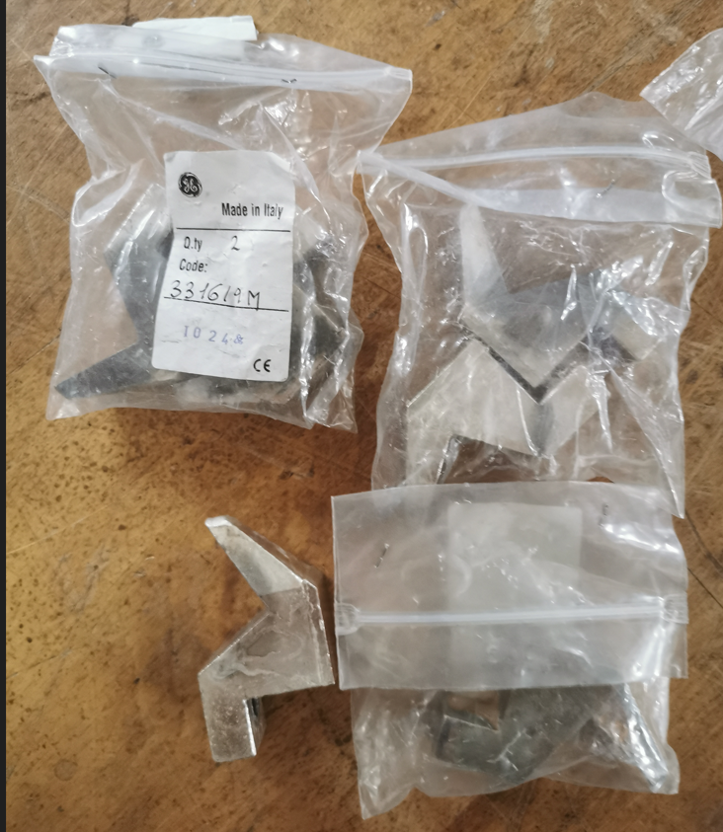
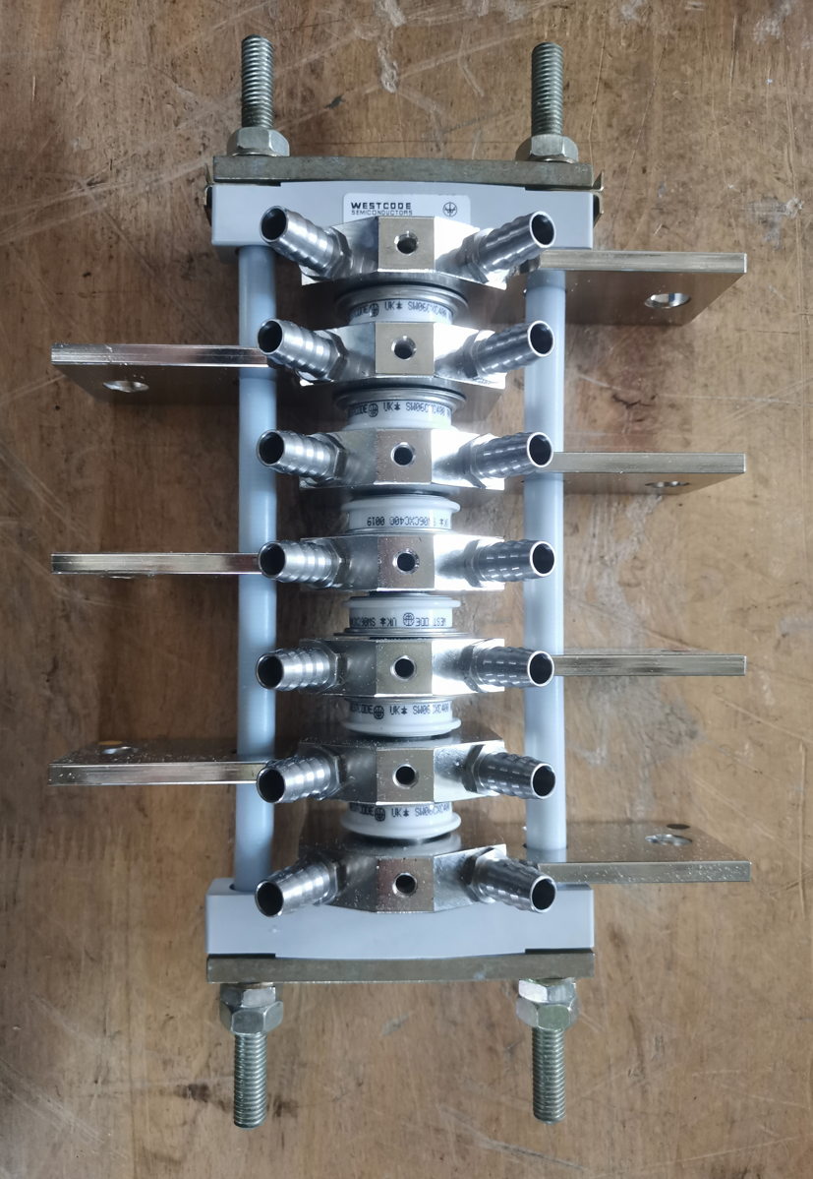
Last Updates from KoM with OCEM
Preliminary Analysis of new components needed for revamping with a proposed part list.
First block diagram of PS control has been proposed.
First simulations of quench, controlled ramp down, crowbar closing, and ramp down on free wheel diodes scenarios have been done for a first check of current and voltage waveform → good agreement with requirements but the components are not still the definitive ones (i.e. diodes).
Spare contacts of contactors and free wheel diodes will be delivered to OCEM within this week.
From Next week the first tests on contactors will start.

Slide 8
Magnet Control System
Magnet control system is based on an old LabView version (LabView 6)
An update is necessary, possibly only upgrading the system.
We are in touch with an Italian company with long experience in the automation field (Automate consulting srl) for the revamping of the magnet control system.
They are interested but they are not expert in Labview and they can’t release any certification. They propose to use an alternative system based on industrial SW → Acceptable by FNAL?
If no industrial solution are acceptable:
Continue the market surey for another company
Update from LabView 6 to last version could be done internally by LNF staff but without any certification.

Slide 9
Procurement Steps
POWER SUPPLY
Preliminary feasibility study (done)
Definitive PS design
Functional test of saved parts (i.e. contactors)
Eventual procurement of saved parts who won’t pass the functional tests
Assembly
F.A.T. (probably not on nominal 3H Load)
Interlocks
Current Ripple and Stability
Resolution
Auxiliaries test
Shipment to LNF for Test on real Load
DIAGNOSTIC RACK
Finalization of company market survey
Functional test including Quench Detector (QD)
Eventual procurement of saved parts who won’t pass the functional tests
FAT
Shipment to LNF for Test on real Load
MAGNET CONTROL SYSTEM
Market survey
Plan B: Evaluating alternative solution from LabView with industrial partner for the Control system update
Contract signing with company or update done by LNF staff
Set up and test

Slide 10
Installation at LNF and Time Estimation
INSTALLATION AT LNF
The whole system will be reassembled at LNF with the support of the Electrical Engineering service
A preliminary functional test will be done aiming to check the PS functionality, all the interlocks, the control system . No power will be delivered to the magnet in this phase.
The Power Supply power input will be compliant with power network USA standards. For test at LNF a dedicated transformer will be used aiming to make compatible the PS required voltage level with the voltage provided by Italian power network
The preliminary functional test as well as all the test at LNF will be attended by FNAL personnel.
Estimated Time
According to the first contract timeschedule, the design and test of spare parts should end within the end of 2024.
OCEM Complete Estimated Delivery Time: 10-12 months from order placement (September 2024). The work on Diagnostic rack will go in parallel to the PS.
The assembly of the whole system and the preliminary tests could take approximatively 2-3 weeks

Slide 11
Conclusions
After several iterations we have a definitive procurement configuration with OCEM as unique provider of the PS.
The revamping choice allows to save time and will ensure a full compatibility between magnet and PS and the unique provider will ease all the interactions and the system.
First contract signed with OCEM for preliminary study, design and tests on saved parts.
Second contract cost and time quotation to complete the procurement has been defined.
Funds already allocated for the second contract.
ASG quotation for Diagnostic Rack was not a “turn-key” solution and it was not cheaper.
A company who with expertise in automation can cover the requirements for Diagnostic Rack including QD. The market survey is ongoing.
Automate consulting srl is interested to provide a whole Magnet Control System not based on LabView→FNAL standard compliance?
Alternative company search is ongoing
From Next week the first tests on contactors will start.
The final PS delivery should be within September/October 2025.
Additional 2-3 weeks have to be considered for assembly and preliminary test at LNF.

Slide 12
Thank You for the Attention!

