Slide 1


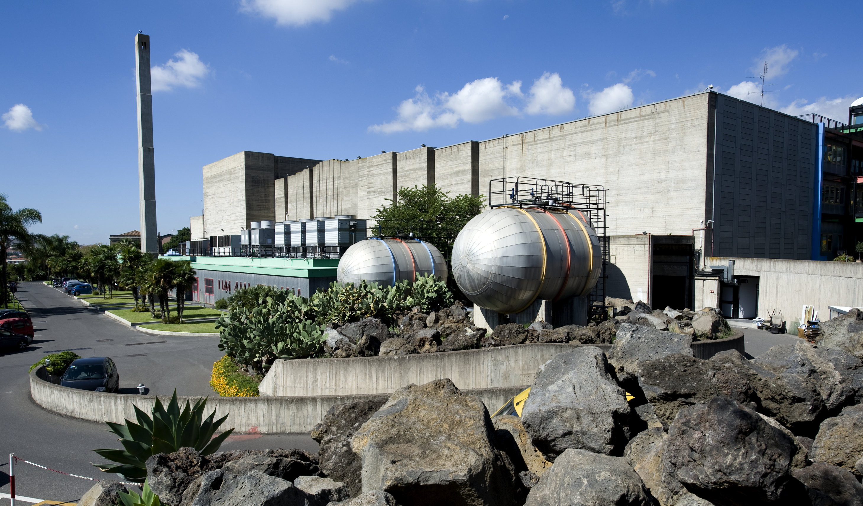
ECAL end-cap dismounting
Francesco Noto – Antonio Grmek
INFN - LNS

Slide 3
KICK OFF

Slide 4
SPECIAL TOOL MODULE 1

Slide 5
«RIBALTATORE» TOOL

Slide 6
SHIPPING

Slide 7
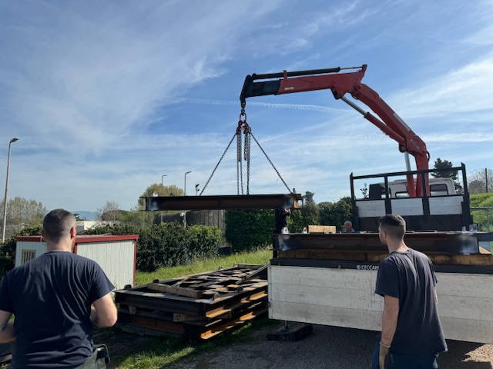
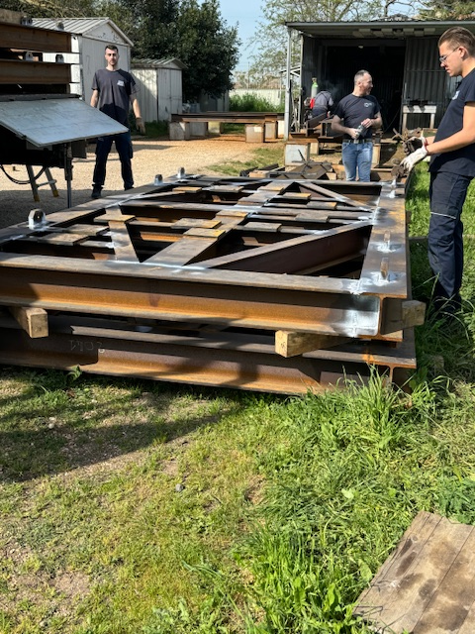
WORK IN PROGRESS

Slide 8
READY TO ASSEMBLY

Slide 9
TO DO LIST
WAITING SFERA’S REPORT
  DIMENSIONAL CALC
  CE CERTIFICATION
EMPTY TEST
FROM NOW ON WE’LL WORK WITH «TITOLO V» D.L. 81/08

