Slide 1
Evaporation Facility at Naples University
F. Di Capua on behalf of Napoli Group
30/10/2024
Notes:
Write “many thanks to …” on corresponding slides

Slide 2
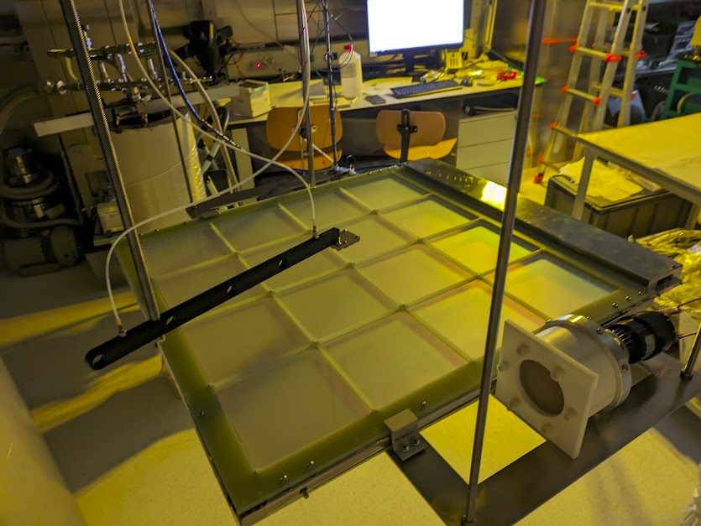
PTP coating for Far Detector 2
Evaporation of the cathod (320 double sided) and membrane (320+32 single sided) XA-VD modules
Evaporator design inherited from the Campinas evaporation chamber with
Relevant improvements:
larger chamber with 120 cm diameter providing +100% evaporation throughput wrt Campinas evaporator
multiple crucibles to assure more uniformity in the coatings and speed up the process
Pumping system sized to ensure 2 full coating processes/day
Evaporation system hosted in a ISO-6 Clean Room
Quality characterization in a dedicated experimental area at the Naples Physics Department

Slide 3
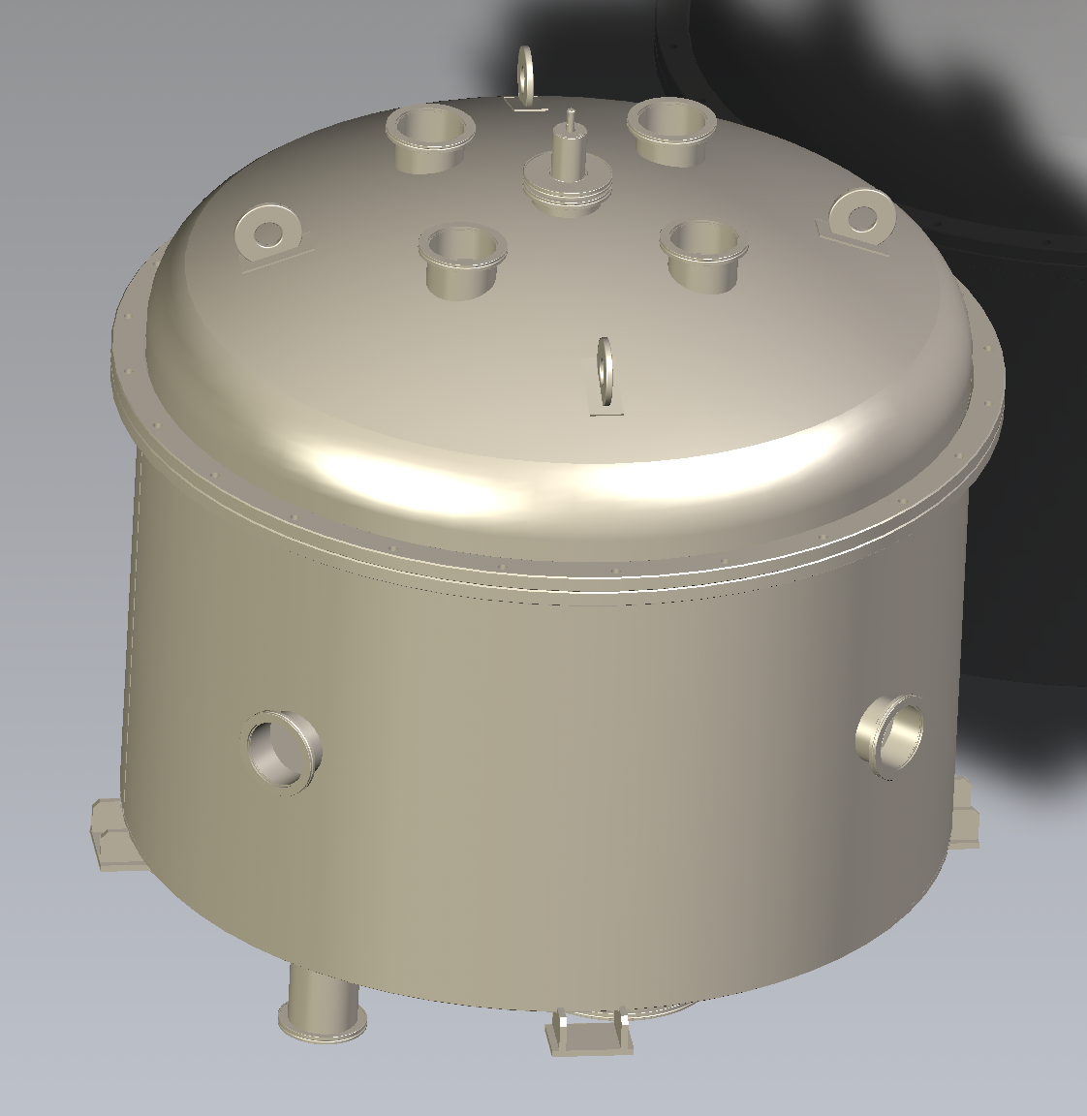
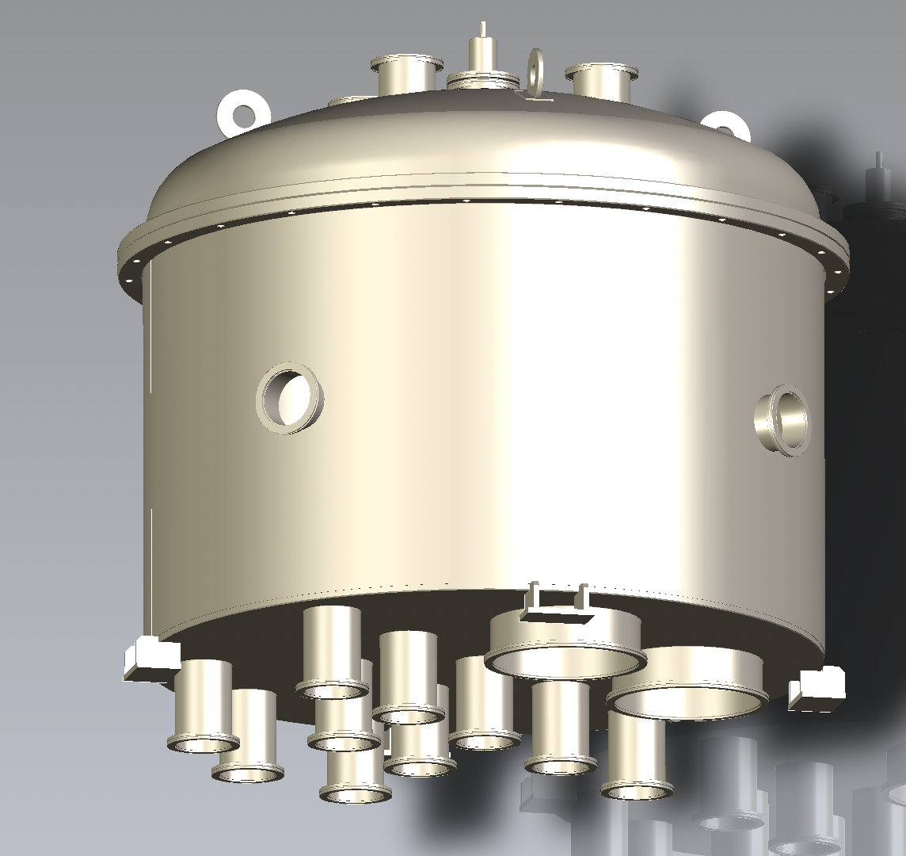
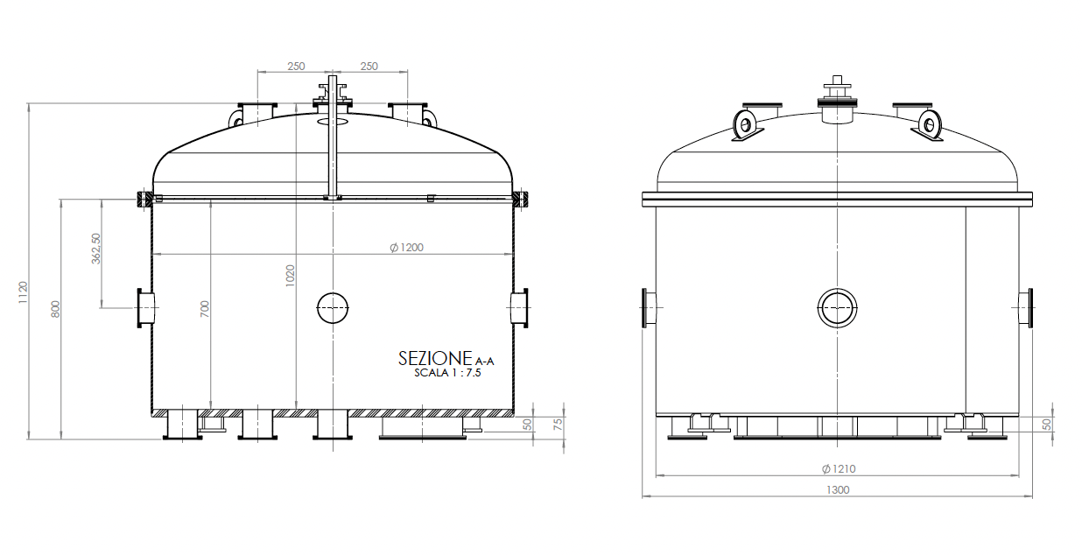
Chamber Design
Stainless Stell cylindrical vacuum chamber developped by custom design:
- 120 cm diameter
- 70 cm height
- removable dome flange
Multi-port flanges for crucibles (optimization of the position will be done in commissioning phase) and other tools
Motor with rotating feedthrough and disk holder connected to the top dome
Pumping station with a 40 m³/h (primary pump) and 2300 l/s turbopump
Three evaporation sources
Thickness measurement unit based on quartz sensor and oscillator

Slide 4
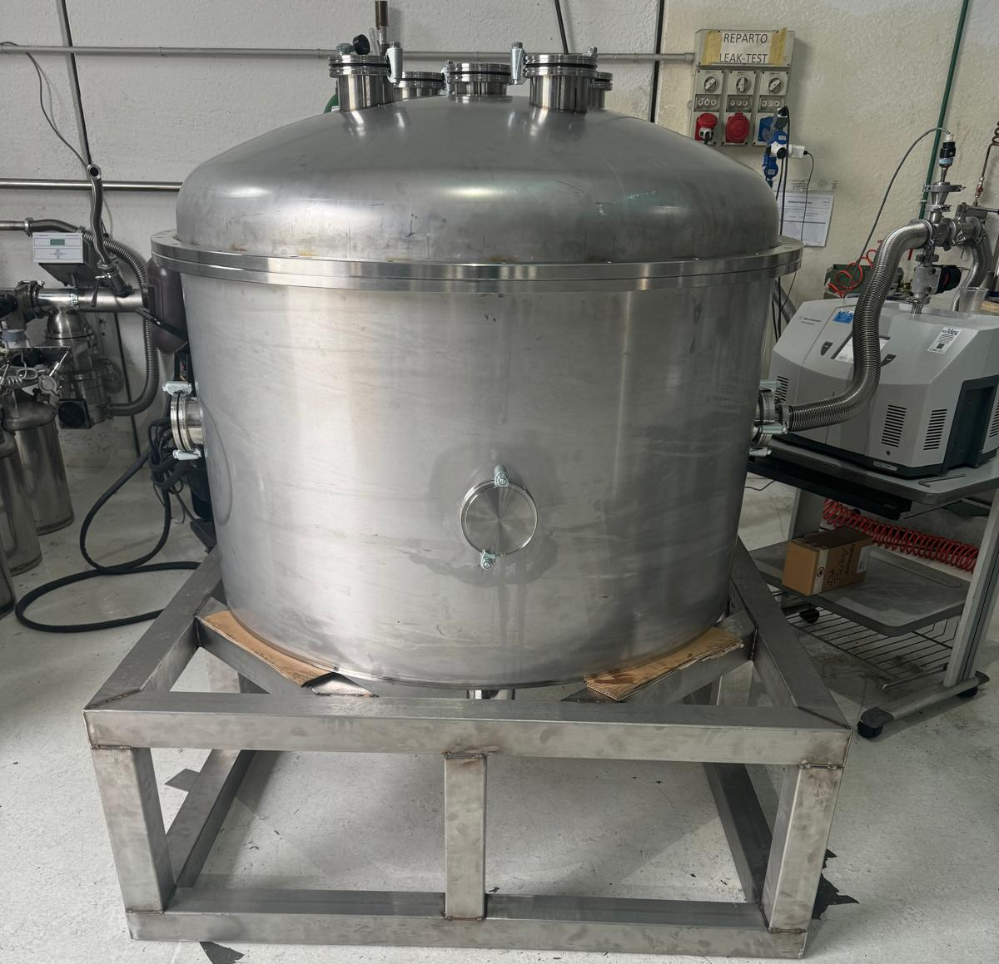
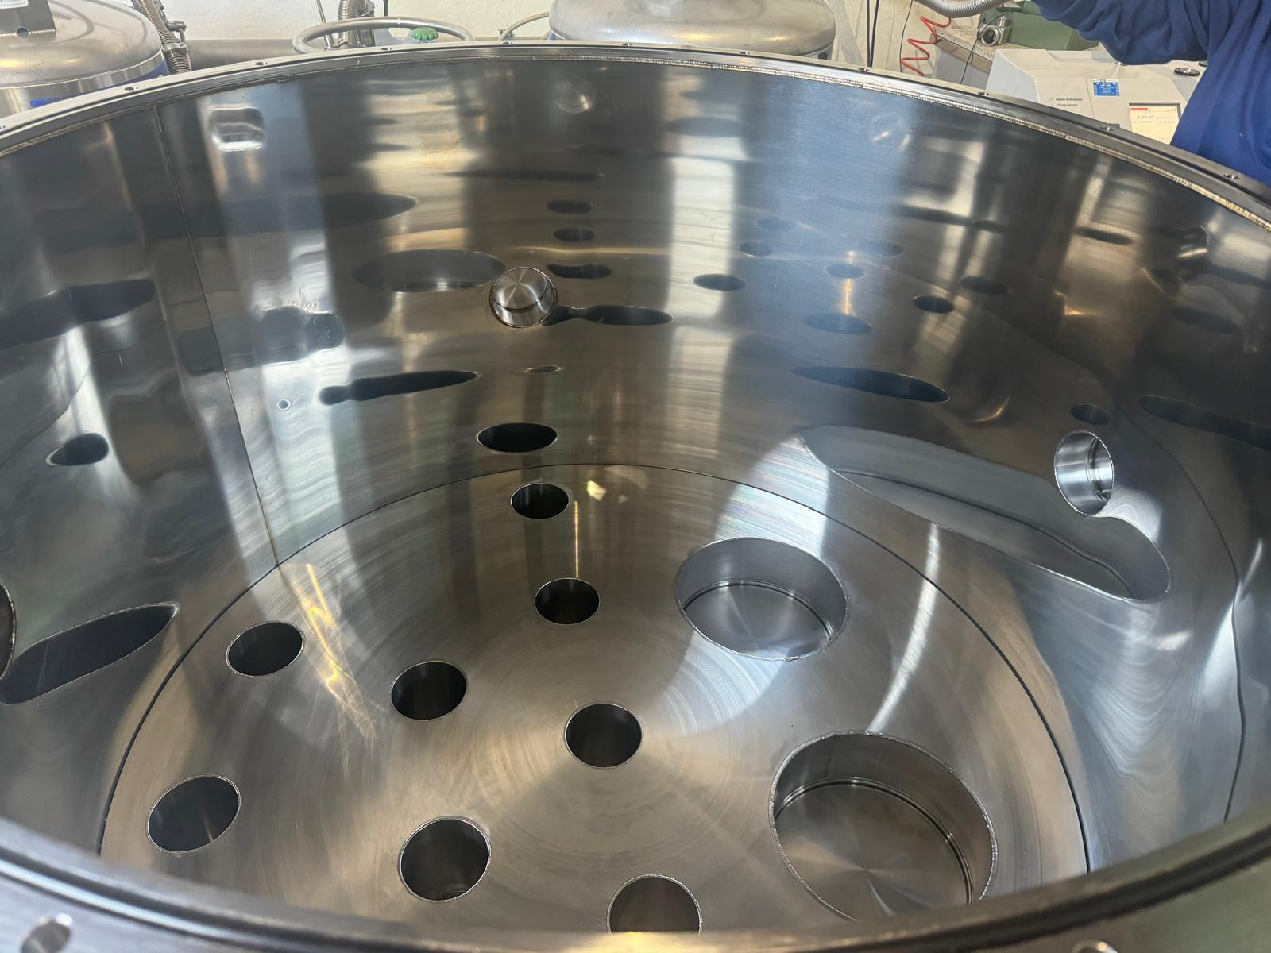
Status of vessel construction
Chamber produced
Motorized disk movement to be implemented by end of month
Helium leak test performed with leak rate <10⁻¹⁰ mbar/l/s
Inner part electropolished
Vessel ready be delivered to Naples by end of November 2024

Slide 5
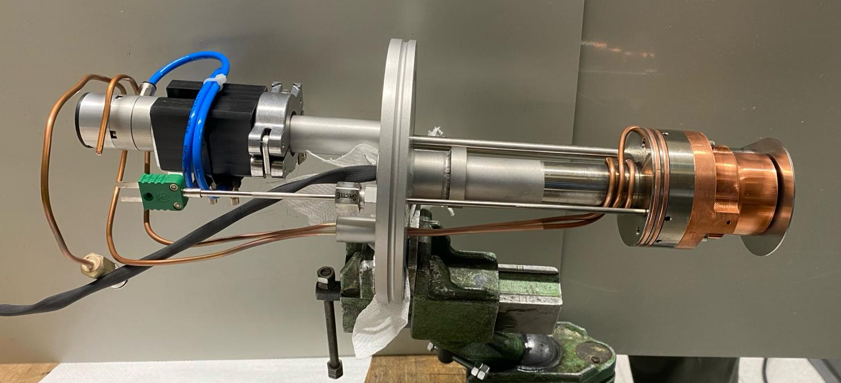
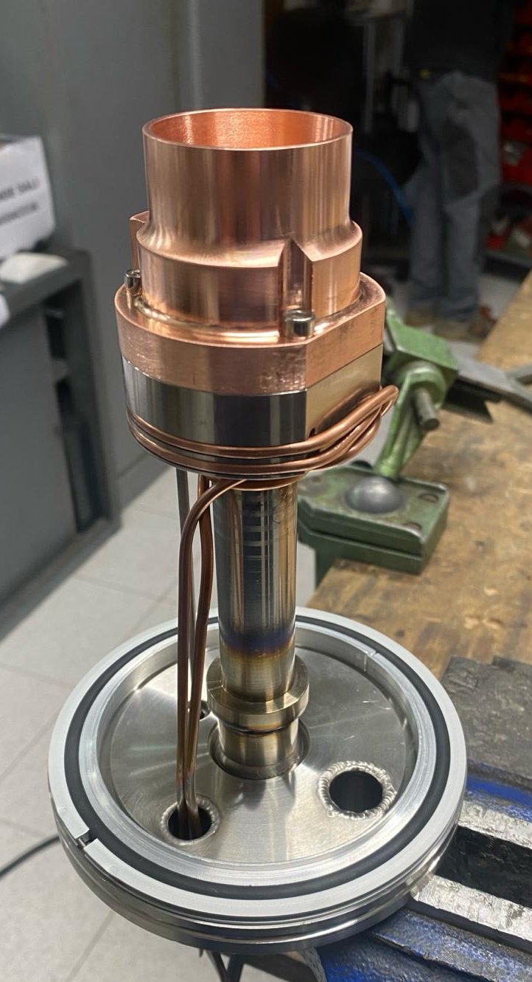
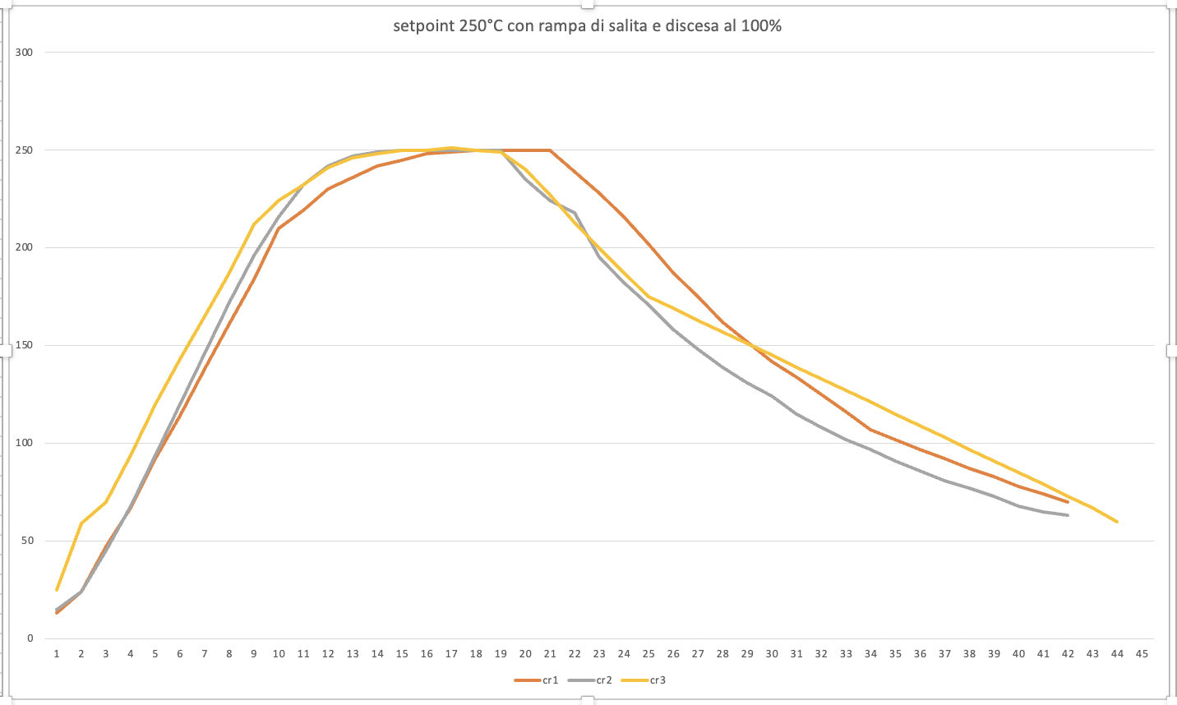
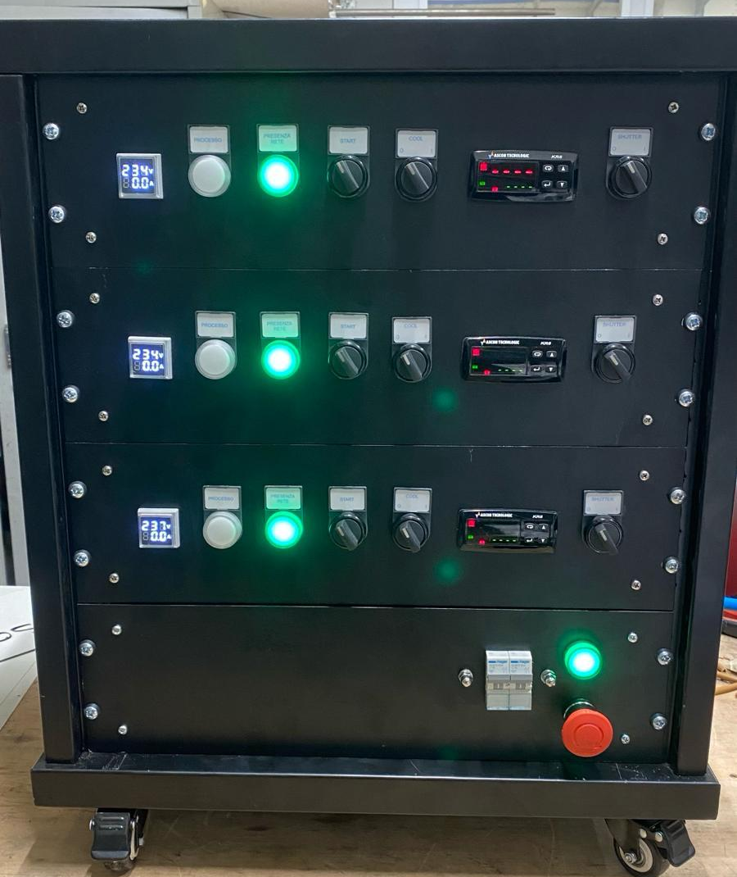
The crucibles
pneumatic opening
Custom design:
Volume of the cell $\sim$30 cm³
Copper crucible directly mounted in flange DN 100 ISO-K
Designed to host fused silica crucibles
1000 W heater
Electro-pneumatic opening and cooling system
Working temperature at 250-300 °C, maximum temperature 500°C
Production and test:
3 crucibles produced and tested
PID controlled temperature, with a very good set point stability
Control system hosting 3 power units and safety control
water cooling system
250°C

Slide 6
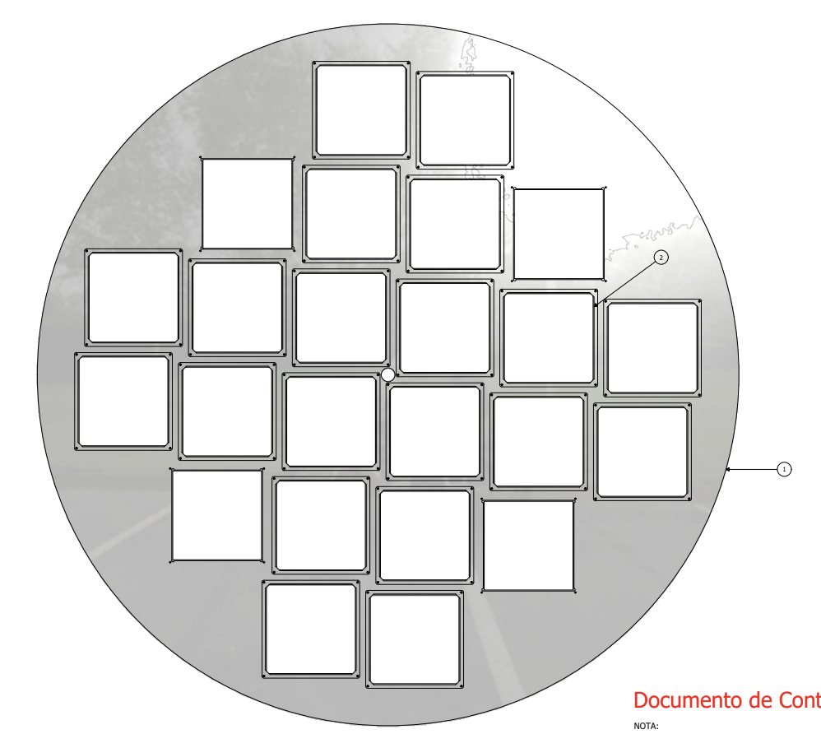
Development of tools for evaporation operations
Dedicated tools for handling and manipulation already designed
Parts in production
Substrate to be coated: dimension of 14,4×14,4 cm²
Disk holder for filters with 112 cm diameter
Up to 24 substrates for evaporation process can be accommodated

Slide 7
Vacuum evaporation operations
Phases of operations
Preparation
Mounting of the filters on a proper holder
Weighting of the reference samples
Mounting of the holder on the dome flange
Coating
Vacuum phase till ~5$×$10⁻⁶ mbar
Starting and monitoring of the evaporation
End of coating, breaking of the vacuum and back filling with gaseous nitrogen
Opening of the flange and removal of the coated filters
Quality Control
Visual inspection of the coatings
Placement of the filters in appropriate shipping boxes
Quality check of the reference samples

Slide 8
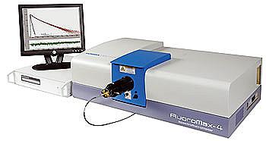
Quality tests
Protocol for quality process defined in agrement with UniCampinas Group
Visual check of the overall deposition process
Check of 10% of coated samples for each evaporation process
Measurement of mass densities with precision scale (O(10⁻⁵ g))
Conversion yield test: measurements with a spectrofluorimeter and comparison wrt a reference
Adhesion test: controlled immersion in liquid nitrogen (system under development)
Collaboration with UniNa Chemical Department and CNR-SPIN to set up an overall quality check procedure

Slide 9
FD2 evaporation site: programming of the operations
Main tasks of Naples Group:
Construction and completion of the evaporation facility
Set-up and validation of the evaporation process
Coordination and partecipation to the activities
Management of the facility and shipment of the filters in the assembly sites
System design to have a duration of whole evaporation process estimated in approximately 4-5 hours
Possibility to perform 2 cycles per day
 | Number of modules | Number of filters per module | Total number of filters
Membrane modules | 352 | 16 | 5632
Cathode modules (double side) | 320 | 32 | 10240
Spares | ?? | 10% ?? | 750
Total |  |  | 16622
2 shift for day: 8-10 hours
48 filters/day
Required 346 days (about 70 weeks)
2 years of operation involving 2 INFN technicians

Slide 10
Important dates
Clean room hosting evaporation activities will be completed by December 2024
Evaporator vessel in Naples by December 2024
Assembly and high vacuum test by January 2025
First Coating depositions, tuning and uniformity checks in February 2025
Validation (Megacell test in LAr) – March 2025 TBD
Quality check definition and its implementation February-March 2025 (Close collaboration with Campinas)

Slide 11
Conclusions
Main components for the new PTP evaporation site for Far Detector 2 have been developed and produced
All parts will be delivered to Naples by end of year
Clean room laboratory construction is ongoing and will be completed by end of 2024
Assemby, setting-up, characterization and validation in first quarter of 2025
Coating process can start after

Slide 12
Evaporation facility

Slide 13
Evaporation facility
Vacuum
Evaporation
System for
VESUVIO for DUNE experiment
Ultra
VIolet
Observation

Slide 14
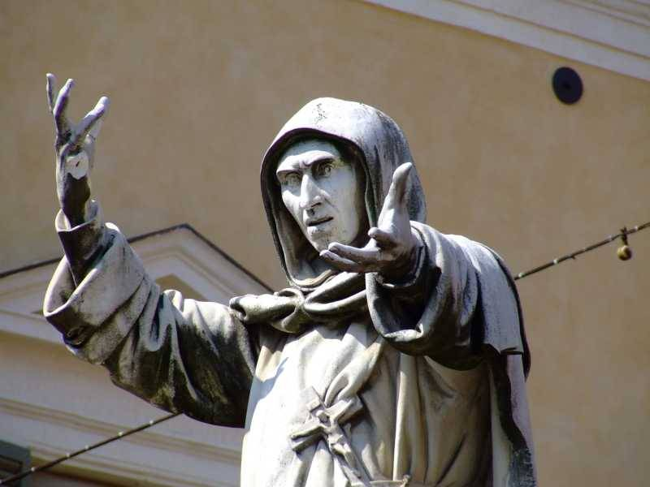
Thank you for your attention

