Slide 1

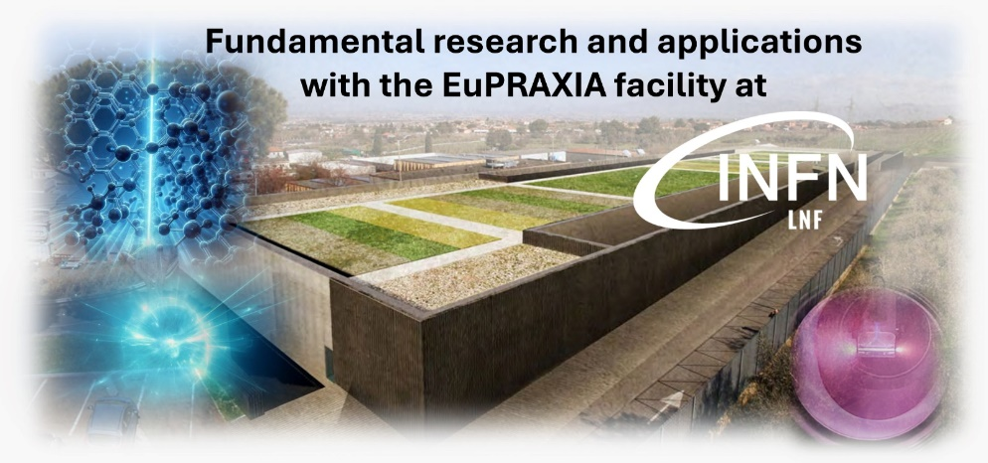
Lattice Dynamics in 2D-Materials on the pico- and femtosecond timescales.
Martina Dell’Angela
CNR-IOM, Trieste (IT)

Slide 2
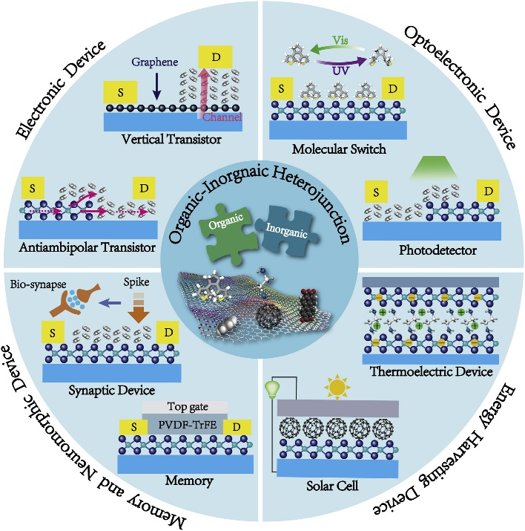
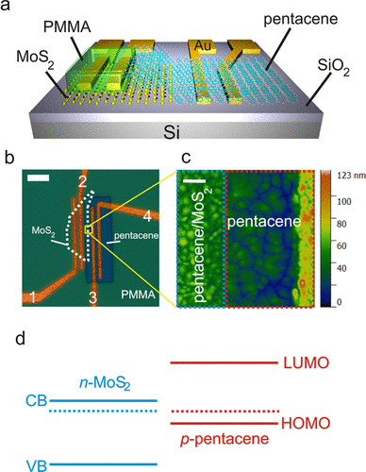
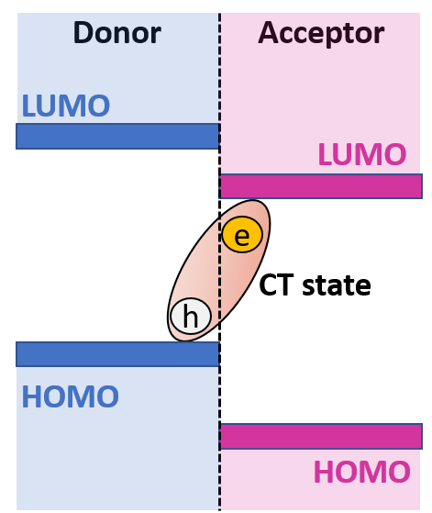
Organic-2D Heterojunctions
Ke Pei, Tianyou Zhai, Cell Reports Physical Science, 1(2020) 100166
D. Jariwala et al., Nano Lett. 2016, 16, 1, 497–503
Aim: Advance the knowledge on the charge transfer states formed at donor-acceptor heterojunctions to tailor materials selection

Slide 3
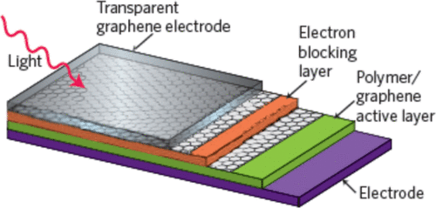
How do we use 2D materials in solar cells?
P. Jan et al, ACS Omega 2024, 9, 11, 12403-12425
We need a detailed knowledge of the out-of-equilibrium properties
We can use time resolved X-ray techniques to describe:
-charge dynamics = dynamics of the energy level alignment, formation of the CT states and charge separation
-lattice dynamics

Slide 4
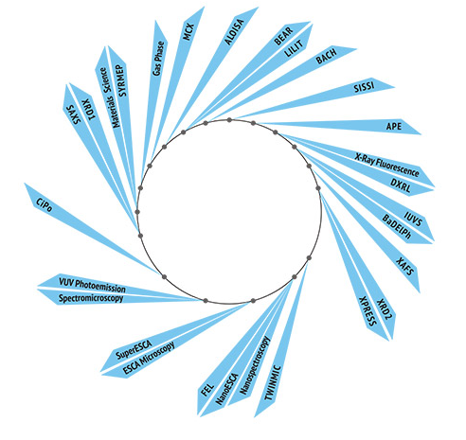
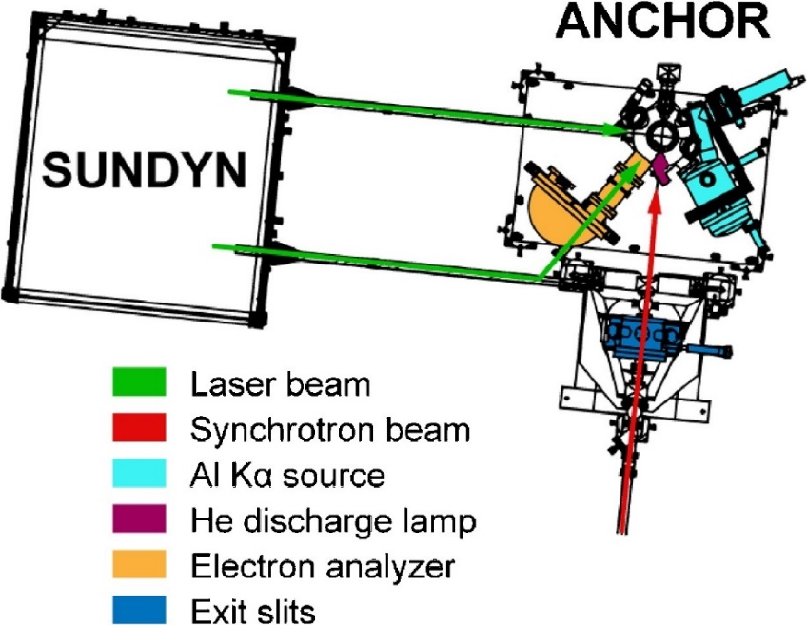

ANCHOR-SUNDYN endstation
Pump-probe set-up @ALOISA beamline
R. Costantini et al., J. Elect. Spec. Rel. Phen. 229 (2018) 7
Time resolved program currently ALOISA
friendly users

Slide 5
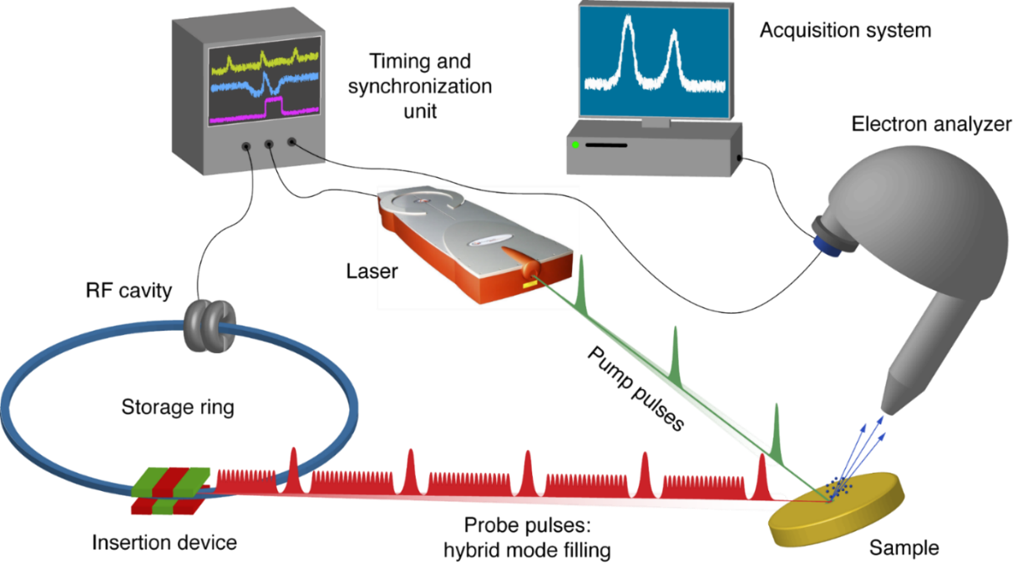
Pump-probe @ ANCHOR-SUNDYN endstation
XPS and XAS in Auger yield
Tangerine HP, Amplitude Systèmes
Average Power: 36W
Pulse Width: from 310fs to 10ps
Repetition Rate: from 175kHz to 2MHz
Pulse Energy: 150uJ at 200kHz
Wavelength: 1st: 1030 nm / 1.2 eV
2nd: 515 nm / 2.4 eV
3rd: 343 nm / 3.6 eV
4th: 257.5 nm / 4.8 Ev
OPA from 210 to 2600 nm
X-ray beam parameters
Pulse Width: 70-100ps
Revolution Freq.: 1.157MHz
Photon energies: 140-1000eV

Slide 6
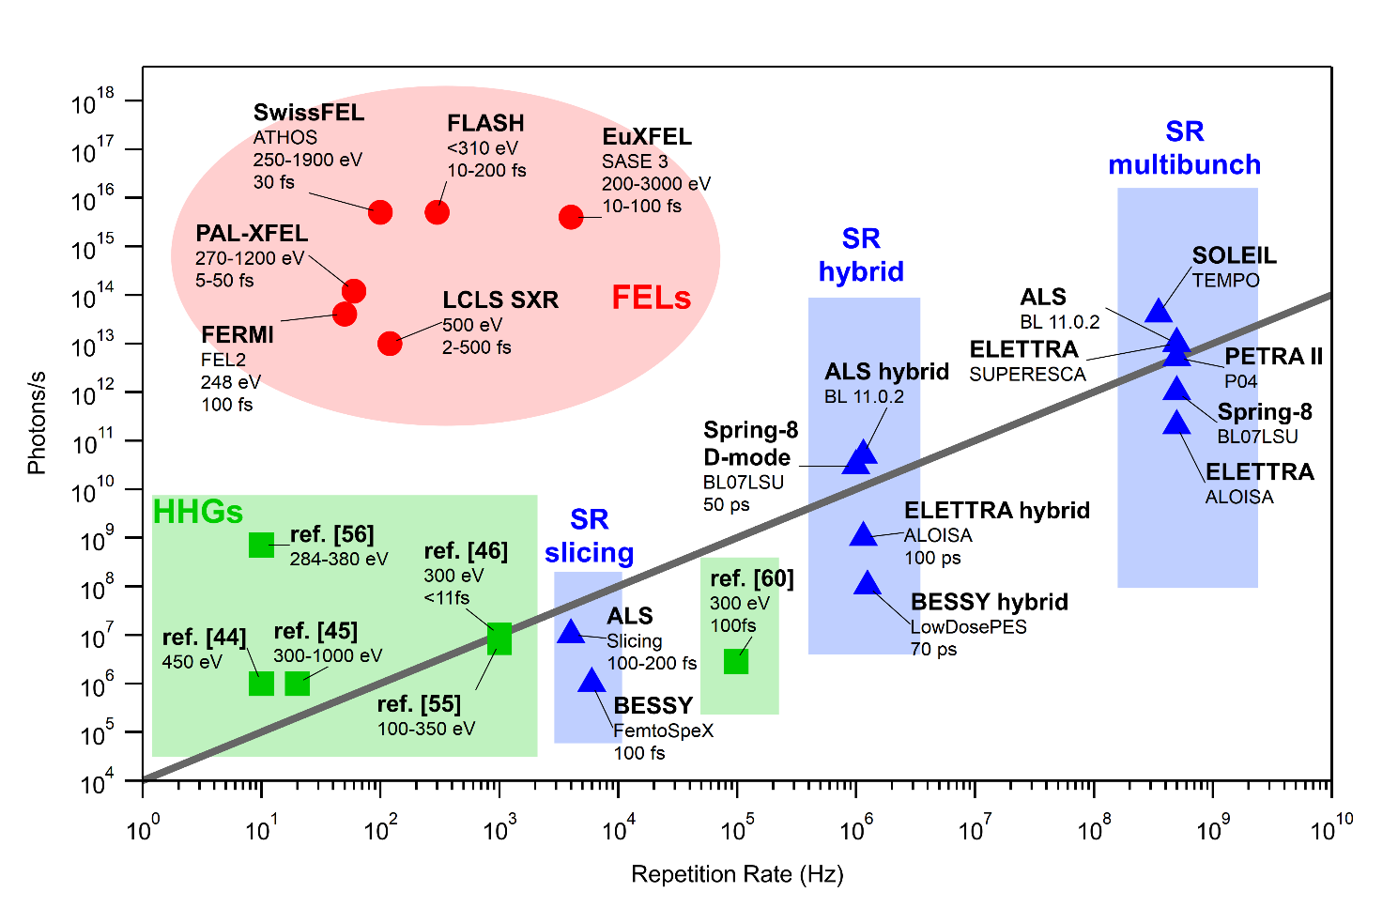
ANCHOR-SUNDYN is a “photoemission” set-up:
Time resolved photoemission at synchrotrons and
free electron lasers on model organic heterojunctions
XPS and XAS in Auger yield
Pulsed X-rays
Difficulties:
- space charge effects
(X-ray and optical)
- excitation density
(in general very low, although high
with respect to real device)

Slide 7
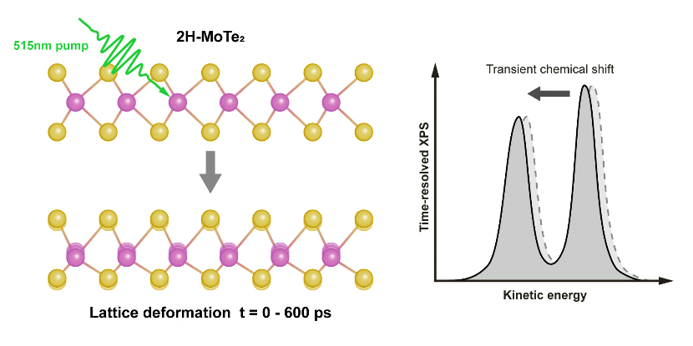
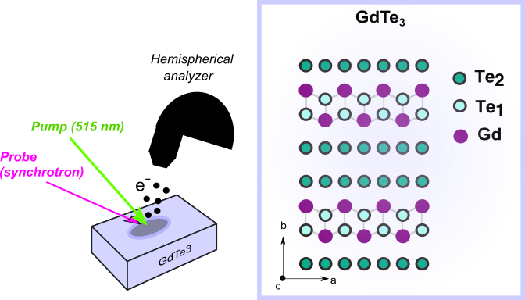
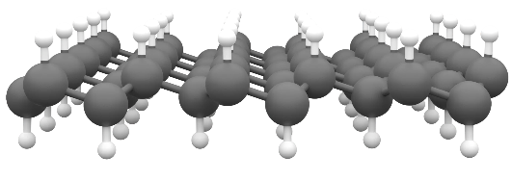
Lattice dynamics in 2D materials
Phase transitions
Chemical transformations
Photoinduced
2H 1T’ phase transition
Graphane dehydrogenation
CDW Melting in GdTe3
C
H
R.Costantini et al., Faraday Discuss., 2022, 236, 429-441
R.Costantini et al., Appl. Surf. Sci., 2023, 644, 158784
Submitted to PRB

Slide 8
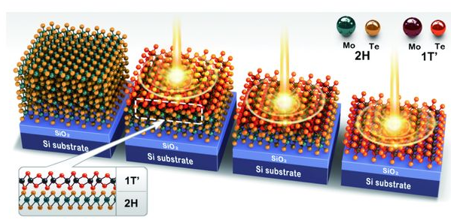
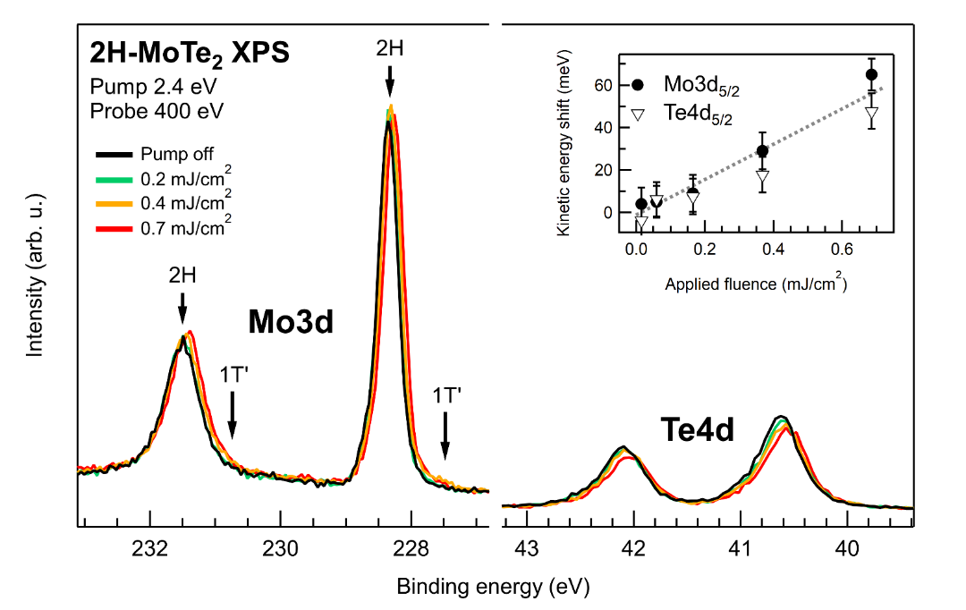
Photoinduced 2H → 1T’ transition in MoTe2
insulator → metal
Can XPS reveal the phase transition?
S. Cho et al., Science 349, 625 (2015)
Pump-probe XPS on 2H-MoTe2
R.Costantini et al., Faraday Discuss., 2022, 236, 429-441
metal

Slide 9
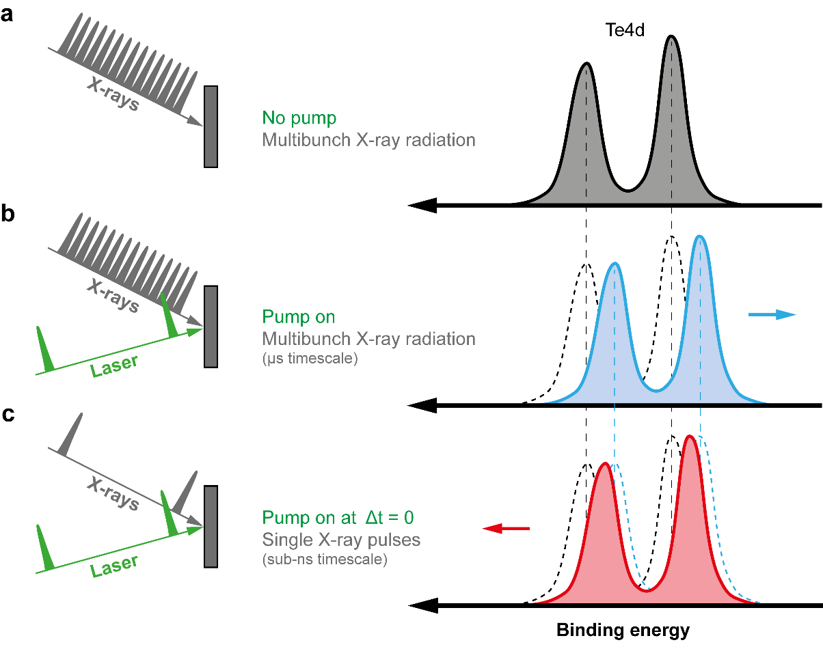
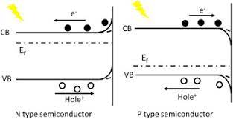
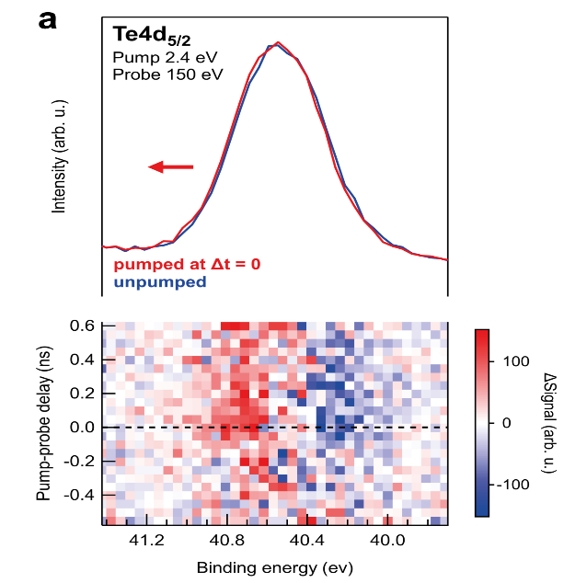
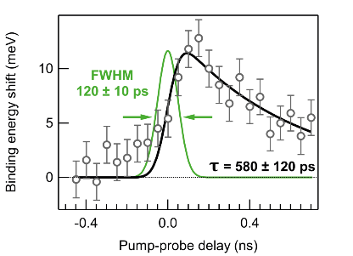
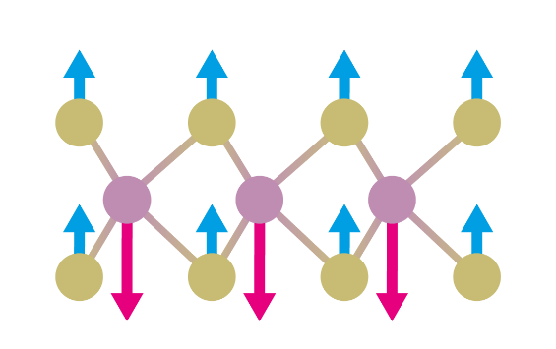


Pump-probe XPS on MoTe2
Microsecond timescale:
Surface photovoltage shift to lower binding energy
Sub- Nanosecond timescale:
Surface photovoltage shift to higher binding energy
Transient lattice distortions with comparable lifetime observed in X-ray and optical absorption
A. Britz et al., Struct. Dyn. 2021, 8, 014501
A. R. Attar et al., ACS Nano 2020, 14, 15829–15840
Z. Chi et al., J. Chem. Phys. 2019, 151, 114704
Giacomo Giorgi
Maurizia Palummo
R.Costantini et al., Faraday Discuss., 2022, 236, 429-441
9

Slide 10
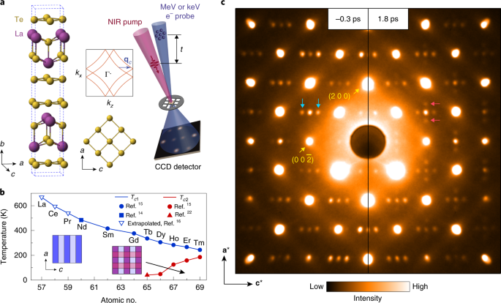
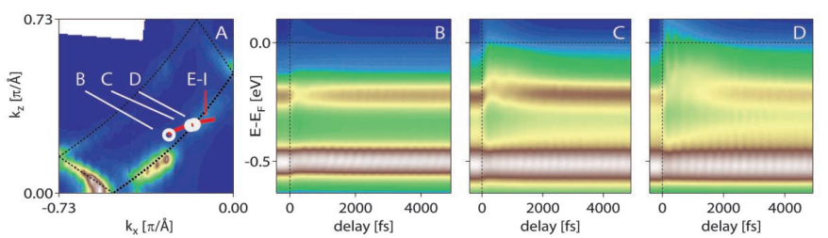
Charge Density Wave (CDW) Merlting in GdTe3
Photoexcitation can:
    melt the CDW
    rotate the CDW
TbTe3
A. Kogar et al, Nat. Phys. 16 (2020) 159
Coupling between the electronic and
ionic part of the CDW
F. Schmitt et al, Science 321 (2008) 5896

Slide 11
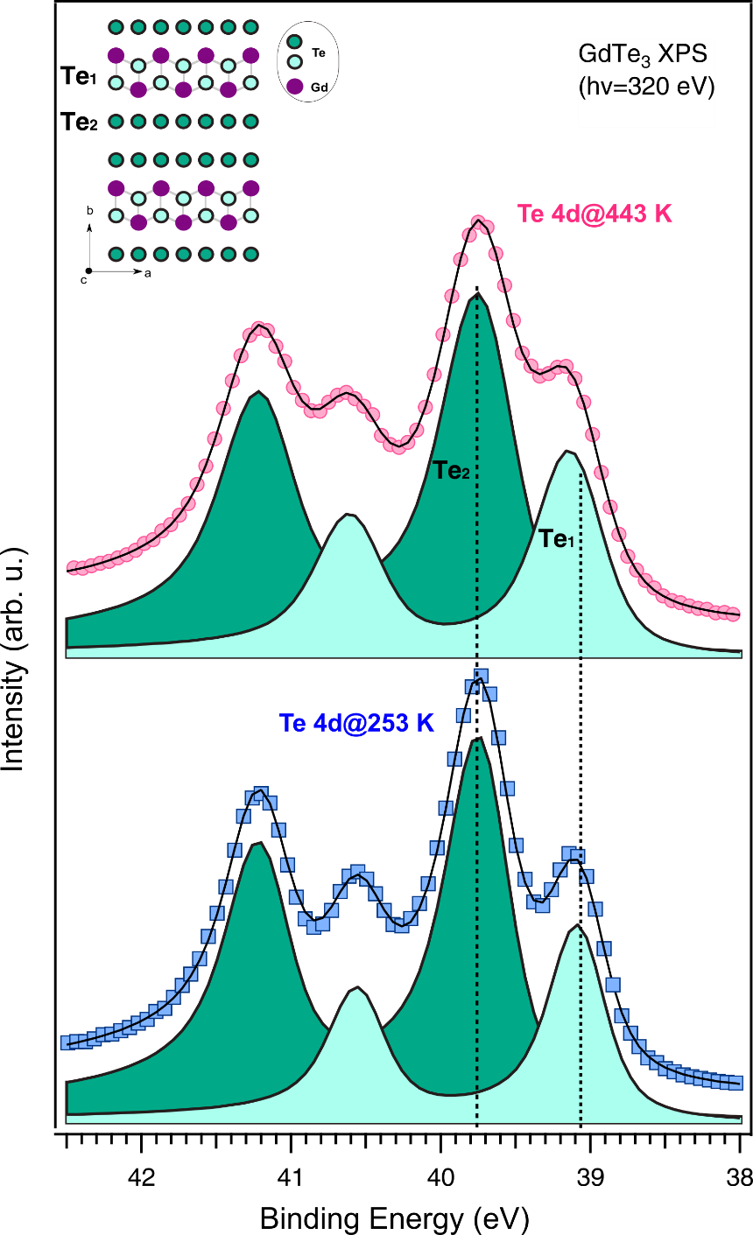
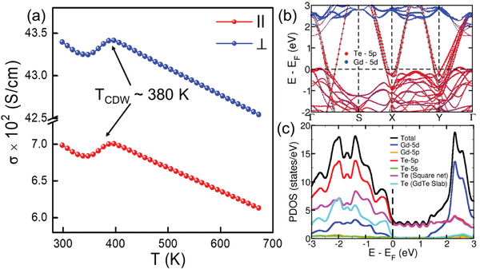
Thermal melting of the CDW in GdTe₃ as seen by the core levels
Above the CDW melting temperature the linearity in the relative distance between the two Te peaks is modified
P. Dutta et al., Adv. Fun. Mat. 34 (2023) 2312663

Slide 12
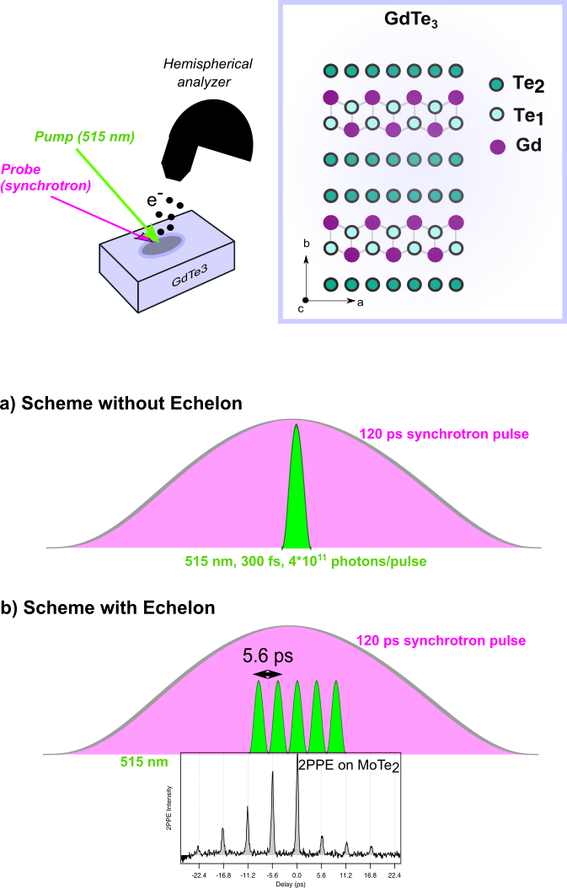
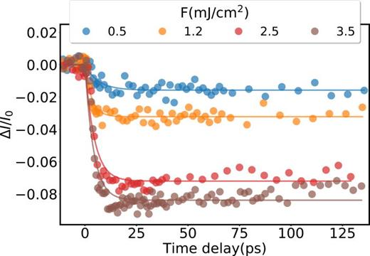
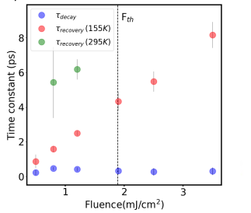
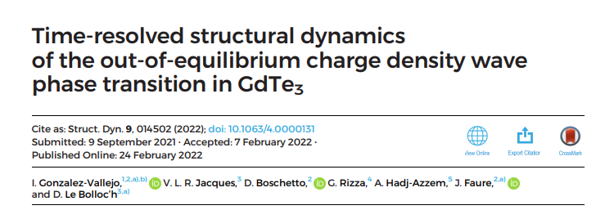
Light induced melting of the CDW in GdTe₃
Bragg Peak

Slide 13
Light induced Melting
of CDW in GdTe3
Temperature difference:
“sample heating”
By creating the pulse trains we “extend” the 6 ps lattice thermalization temperature (low repetition rate measurement).
We observe a new transient state.
LATTICE DEFORMATION
“Space Charge”
With Echelon
NEW Te species!
(0.5%)

Slide 14
Conclusions
Time-resolved XPS and XAS at synchrotrons allows to monitor lattice dynamics with sub-ns resolution
Complementary (but necessary) characterization with respect to other pulsed sources
Future upgrades of synchrotron facilities may offer temporal resolutions in the few ps range

Slide 15

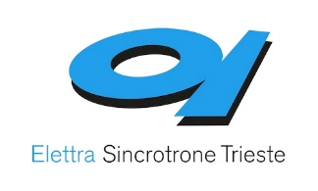
Acknowledgments
PRIN 2022 – „MEGS“
Roberto Costantini
Albano Cossaro
Alberto Morgante
Cesare Grazioli
Luca Schio
Marco Baron
Matteo Bevilacqua
Alberto Verdini
Luca Floreano
Giancarlo Panaccione
I. R. Fisher
Giacomo Giorgi
Maurizia Palummo
Federico Cilento
15

