Slide 1



EuAPS (EuPRAXIA Advanced Photon Source) first user facility based on plasma acceleration
Alessandro Cianchi
University of Rome Tor Vergata & INFN
On behalf of SPARC_LAB & Eupraxia collaborations

Slide 2
Outline
What we are going to do?
  Betatron source
Where?
  In the SPARC tunnel @ LNF
Who?
  INFN-LNF, INFN-Mi, CNR-Montelibretti, CNR-Potenza, Tor Vergata
To do what?
  Applications

Slide 3
Principal Investigator
M. Ferrario (INFN-LNF)
22.350.588,00
High repetition lasers
L. Labate (CNR)
Betatron X rays source
A. Cianchi (Tor Vergata)
High power lasers
P. Cirrone (INFN)
Milano
Milano
4.863.150,00
9.457.088,00
7.864.500,00
Pisa
Frascati/Roma Tor Vergata
Potenza
Catania
Management & Financial office
A. Falone (INFN)

Slide 4
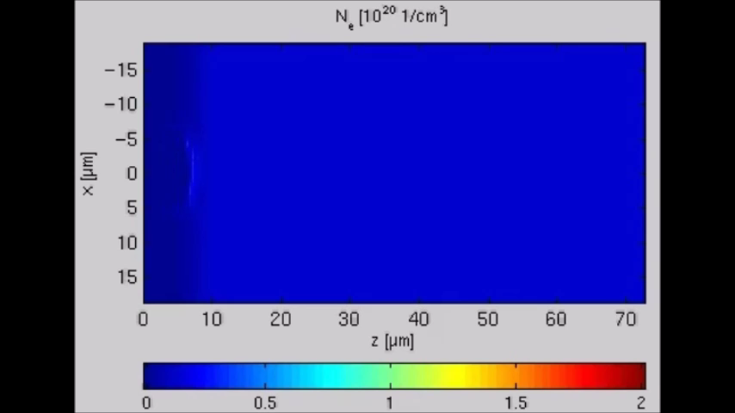
Plasma acceleration in a nutshell
High power laser ionize the gas and create a plasma bubble
Electron are self injected in the back of the bubble
These charges are accelerated by intense electric field (>GV/m)
The uncontrolled injection produces betatron oscillation

Slide 5

Plasma acceleration in a nutshell
High power laser ionize the gas and create a plasma bubble
Electron are self injected in the back of the bubble
These charges are accelerated by intense electric field (>GV/m)
The uncontrolled injection produces betatron oscillation

Slide 6
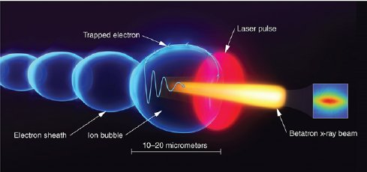
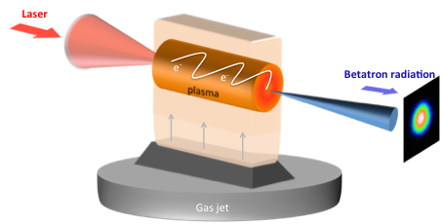
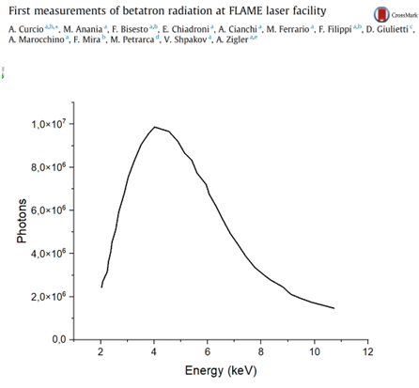
Betatron radiation emission
The radiation has its characteristics of both FELs and synchrotrons
  Large bandwidth similar to Synchrotrons
  Short pulse duration like a FEL

Slide 7

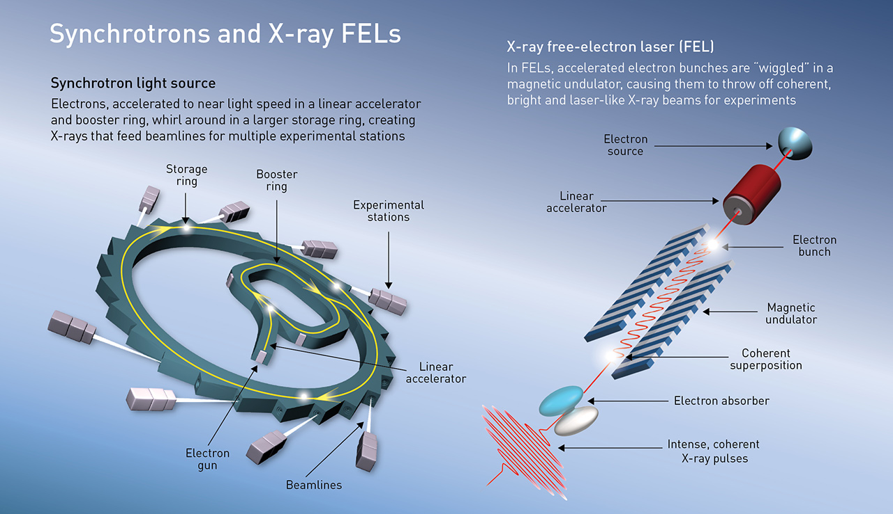
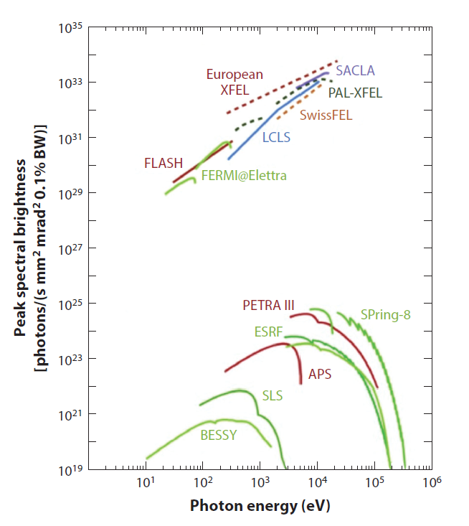
Synchrotrons vs FELs
Ph/ (s mm² mrad² 0.1% of bandwidth)
Patricia Daukantas Synchrotron Light Sources for the 21st Century Optics & Photonics News Settembre 2021

Slide 8
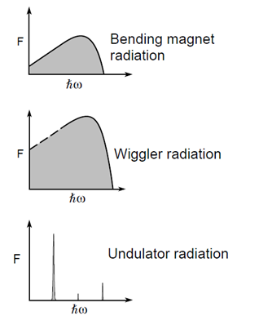

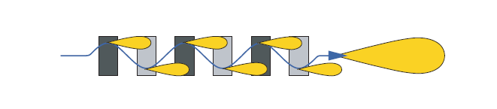
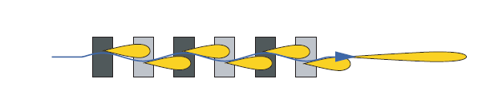
Wiggler or undulator?
K>>1
K≤1

Slide 9
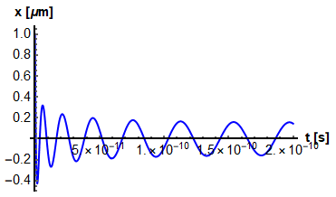
Damped oscillations and acceleration lead to inhomogenous brodening
Differently from a wiggler, the oscillation amplitude and frequency depend upon time.
Furthermore, each electron corresponds to a different initial amplitude (position of injection) : this will bring to an inhomogeneous broadening of the radiation spectrum.
In a magnetic undulator, the strength parameter is approximately the same for all electrons and depends only on physical constants and the magnetic field.
Each electron's strength parameter in a plasma focusing channel differs. It depends on the oscillation amplitude, leading to inhomogeneous broadening of the radiation spectrum and suppression of the spectral-angular correlations.
Another cause for inhomogeneous broadening is undoubtedly the energy spread, common to both a magnetic undulator and a plasma-focusing cannel.

Slide 10
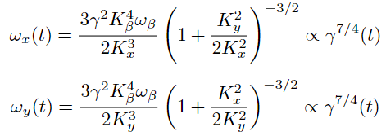




Betatron Radiation
Synchrotron Radiation
Critical frequency
On-axis
Peak
Power
Mean
Cumbersome expression, where Bessel K functions are integrated upon time.
No appearance of Bessel K_{5/3}.
This enhances low-frequency photons compared to the Synchrotron Radiation spectrum (effect of the acceleration).
Spectral Density
Courtesy A. Curcio

Slide 11
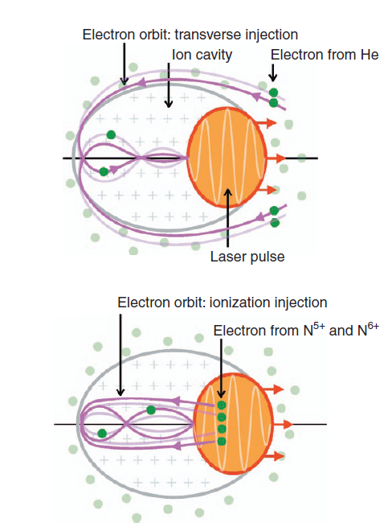
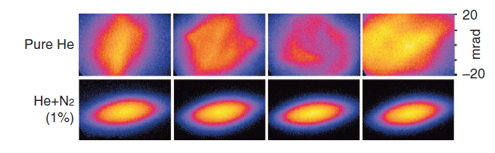
Ionization injection
Electrons that get accelerated have to travel along the cavity sheath and enter the cavity at the back.
It is found that these electrons originate from a ring-shaped region around the laser axis
In contrast, in the case of ionization-induced injection electrons are ionized inside the cavity, close to the maximum intensity of the laser. Injection can, therefore, occur longitudinally, and the initial position of trapped electrons is very different
It results in a better controlled injection and more beam stability
Döpp, Andreas, et al. "Stable femtosecond X-rays with tunable polarization from a laser-driven accelerator." Light: Science & Applications 6.11 (2017): e17086-e17086.

Slide 12
Expected Parameters
Parameter | Value | unit
Electron beam Energy | 100-500 | MeV
Plasma Density | 10¹⁸-10¹⁹ | cm⁻³
Photon Critical Energy | 1 -10 | keV
Number of Photons/pulse | 10⁶-10⁹
Repetition rate | 1 | Hz
Beam divergence | 3-20 | mrad

Slide 13
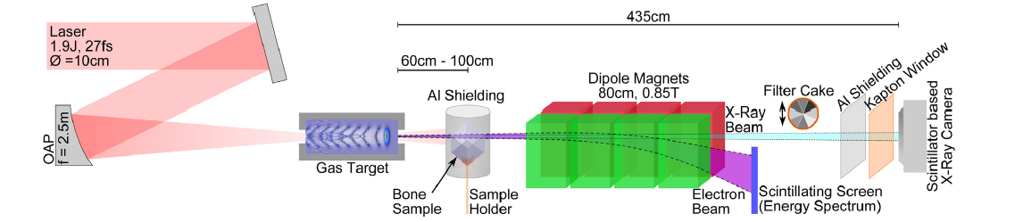
Example of gas cell
Laser 800 nm, 27 fs, 1.9 ± 0.1 J in a spot size of 30 μm (FWHM intensity), which
corresponds to a peak intensity of 5.5 × 10¹⁸ W∕cm² and a peak power of 70 TW resulting in 𝑎₀ ≈ 1.6.
Plasma density of 5×10¹⁸ cm⁻³
length 11 mm
Critical energy at 13.5 keV
About 700 pC, pure H₂
(1.6 ± 0.35) × 10⁹ photons/msr/s
Divergence of 12 × 6 mrad² (s.d.)
Götzfried, J., et al. "Research towards high-repetition rate laser-driven X-ray sources for imaging applications." Nuclear Instruments and Methods in Physics Research Section A: Accelerators, Spectrometers, Detectors and Associated Equipment 909 (2018): 286-289.

Slide 14
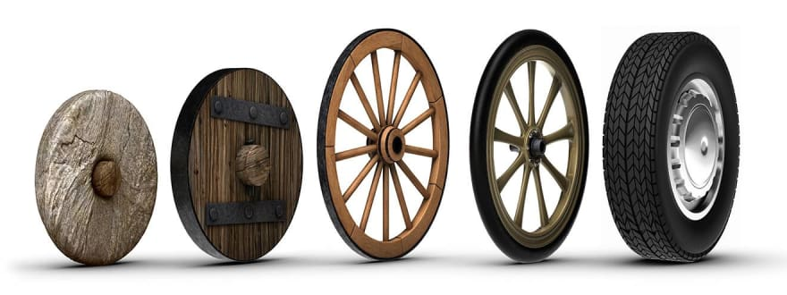
Betatron sources have already allowed performing X-ray measurements
EuAPS is not aiming at reinventing the wheel, but we can build up and improve moving from the wheels that have already been invented.

Slide 15
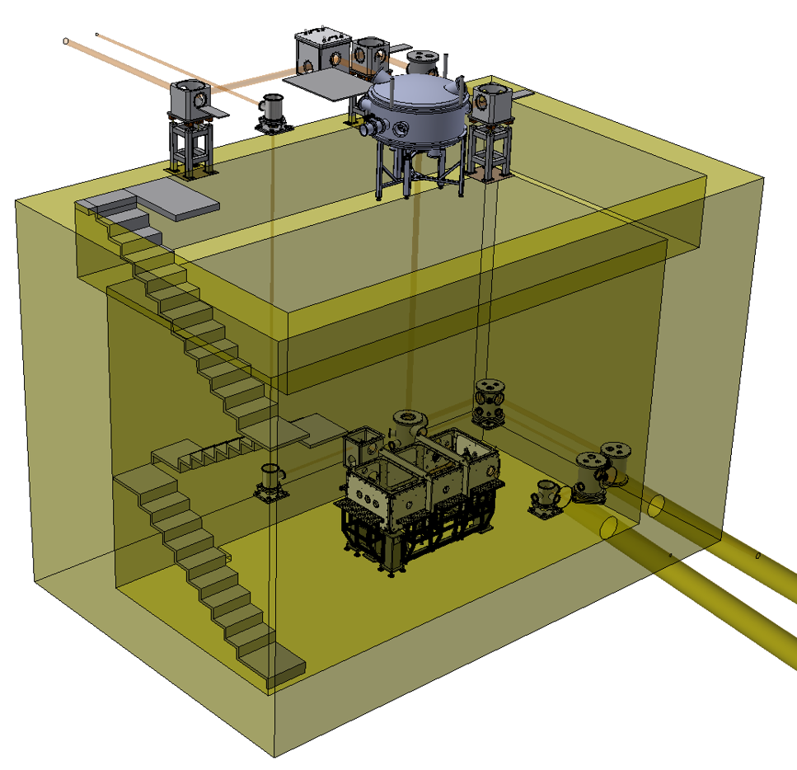
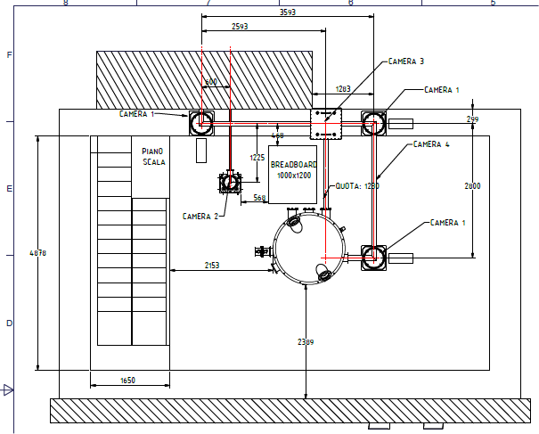
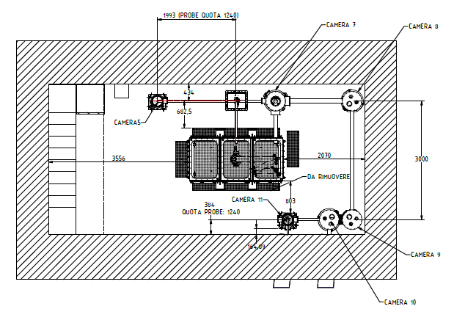
Flame building ground floor
Flame building underground floor
S. Lauciani

Slide 16
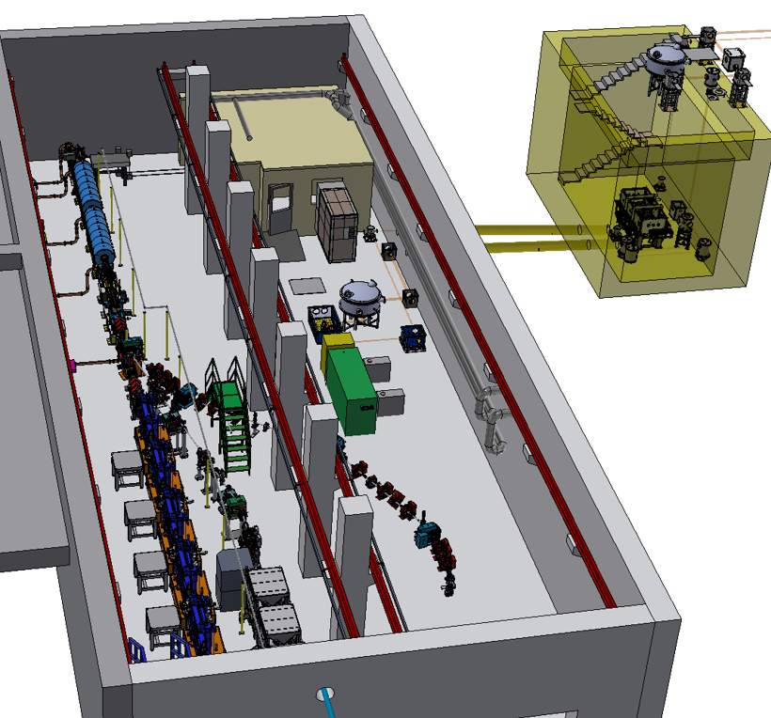
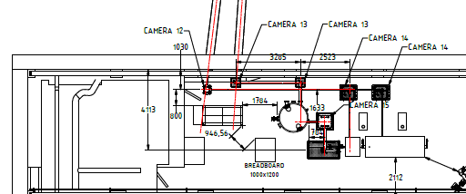
SPARC_LAB bunker
Layout in the SPARC bunker and connection with FLAME building
S. Lauciani

Slide 17
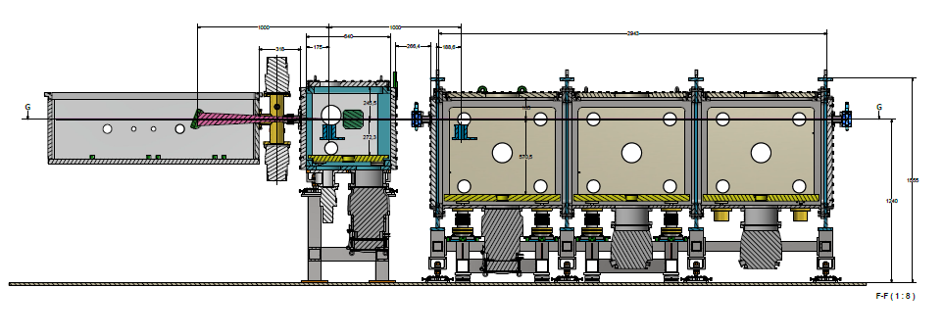
Interaction point and experimental chamber
Size: 80x80x300 cm
Weight: 4000 kg
Materials: Steel frame (AISI 316 L) and Aluminium panels (Al 6082 T6)
Complete modularity of the structure, with 3 units of 100 cm lenght.
Each unit has/can be slotted with:
Five flanges (4x 100 CF and 1x 150 CF), left and right side
Five flanges (4x 100 CF and 1x 200 CF) tops side.
Three flanges ( 3 x 100 CF) front and back side.
Each component and the whole camera can hold up to 10^-6 mbar vacuum.
V. Lollo

Slide 18
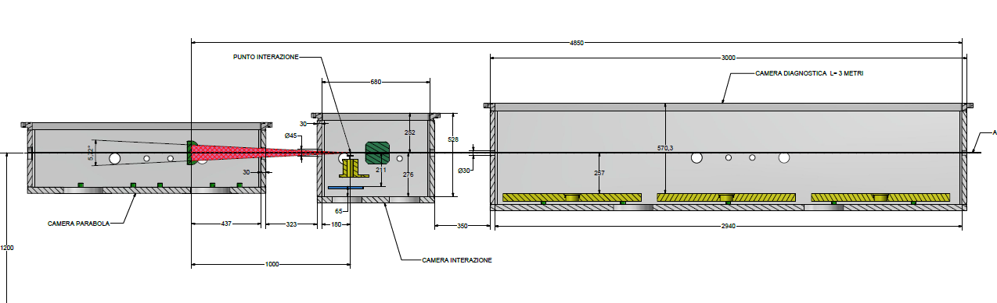
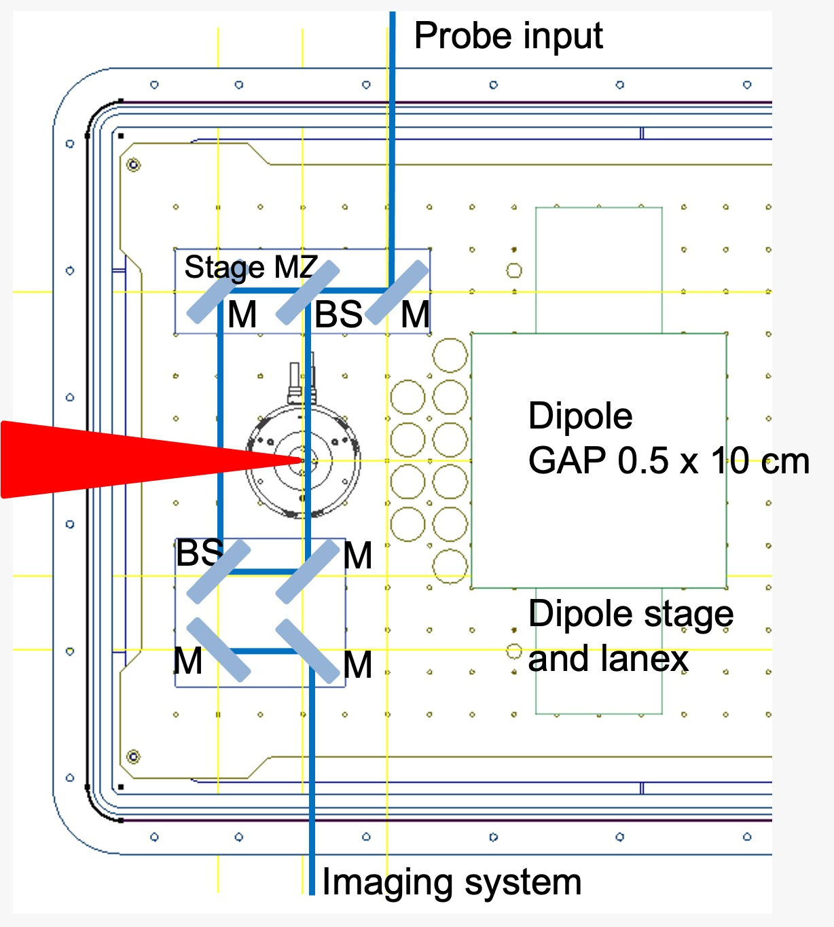
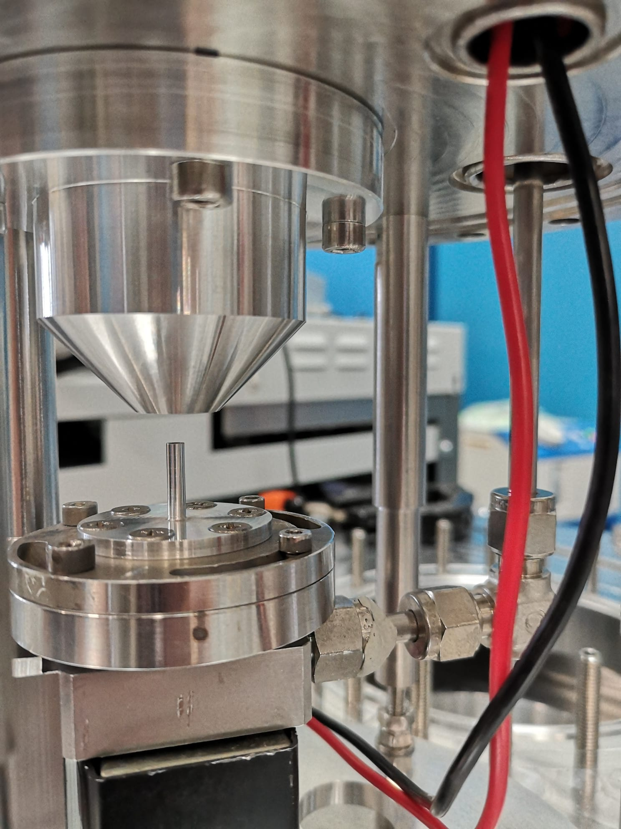
Interaction point
V. Lollo
Main issue is the pumping of 20-30 bar with repetition rate at least 1 Hz
The focusing parabola has to be at least at 10⁻⁴ mbar

Slide 19
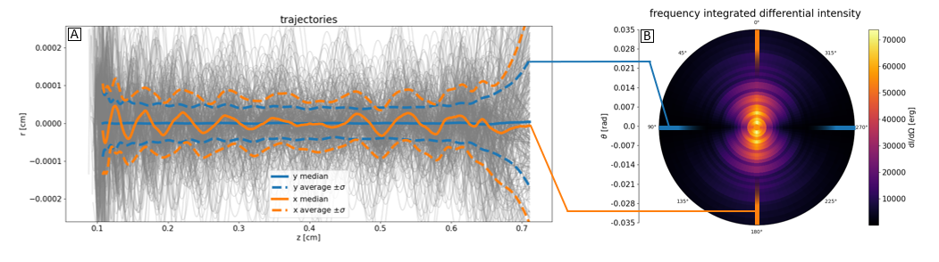
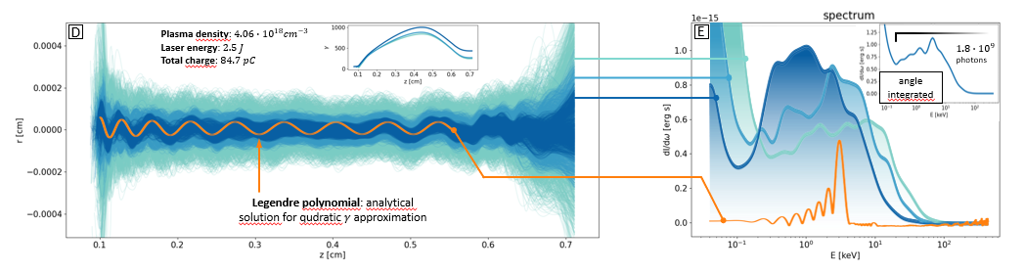
Ongoing simulations
Courtesy A.R. Rossi and A. Frazzitta

Slide 20
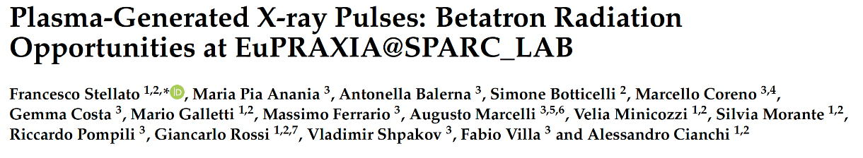
Photon Science @ EuAPS
Condensed Matter 7.1 (2022): 23.
Imaging of biological (and cultural heritage) samples
  Exploits the brilliance and coherence of betatron radiation, requires small divergence and good focusing
Static X-ray Spectroscopy
  Relatively easy, but does not exploit the radiation time structure
Ultra-fast X-ray spectroscopies exploiting ultra-short betatron pulses
  More complicated, requires timing between pump and probe pulses, but fully exploits the fs pulse duration
Time-resolved imaging (ultrafast dynamics)
Wide angle scattering, diffraction
  Depending on the samples, requires monochromatic beams with high flux
Courtesy F. Stellato

Slide 21
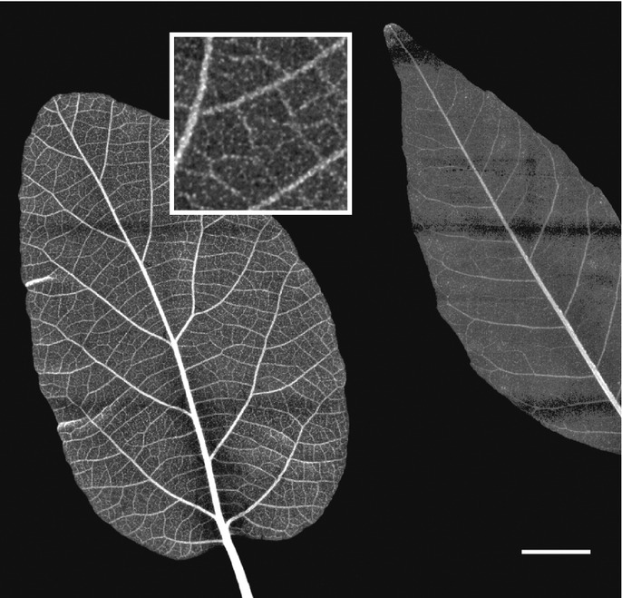
Imaging – The pilot experiment
Green science
X-ray imaging of leaves (and wood)
aiming at the (tens of) microns resolution
Experiments performed with the broad radiation spectrum filtered by different materials to obtain difference maps emphasizing the presence of heavy metal contaminants → pollution control
Reale et al. - MIDIX Soft X-rays microradiography

Slide 22
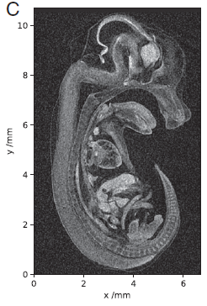
Imaging – CT and Phase Contrast
Betatron sources can fill the gap between synchrotrons and X-ray tubes for imaging and Computer Tomography (CT)
Guo et al. Scientific Reports 2019
Cole et al. PNAS 2018
Betatron sources have a spatial coherence that allows performing Phase Contrast Imaging (PCI). In PCI, one measures the difference in wavefront, while in “traditional” imaging one measures the difference in the X-ray absorption coefficient between different “objects”
PCI provides better contrast than radiography, especially when dealing with biological samples. Wenz et al. Nature communications 2015

Slide 23

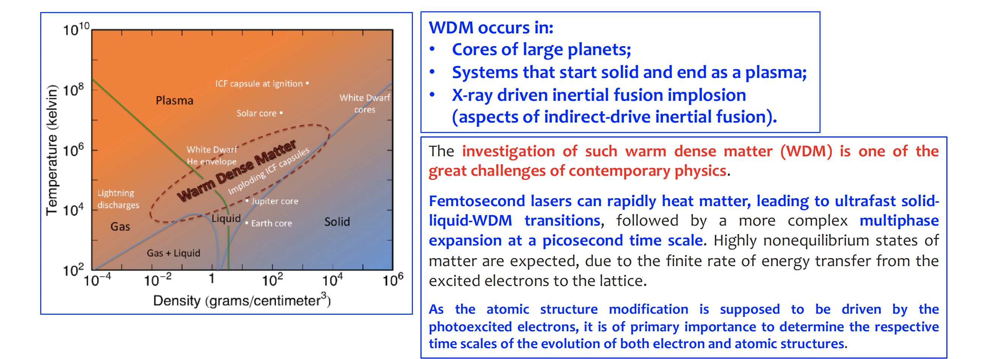
Material Science Applications: Warm Dense Matter (WDM)
Mahieu, B., et al. "Probing warm dense matter using femtosecond X-ray absorption spectroscopy with a laser-produced betatron source." Nature Communications 9.1 (2018): 3276.

Slide 24
Conclusions
EuAPS will be the first brick of EuPRAXIA, a user facility based on the radiation emitted by electrons plasma accelerated.
There are several challenges that we have to address to move from a single-shot proof of principle experiment to a user facility
Users will use an utterly innovative source with properties between Synchrotron radiation and FEL radiation paving the way to imagine and realize completely new experiments

Slide 25
Finally it’s over
Thank you for your attention

