Slide 1

255.5 keV photons can stop ANY relativistic electron
Detecting Unruh photons and trespassing the Schwinger’s limit at EupraXia with FICS
Can electrons emit photons of energy larger than their own?
Luca Serafini, Vittoria Petrillo and Sanae Samsam
INFN-Milano and Università degli Studi di Milano
Deep Recoil Inverse Compton Scattering revisited, how to stop (MeV’s, GeV’s, TeV’s …) electrons in a single-collision event: a portal towards quantum gravity?
From Thomson back-scattering to FICS, total transfer of energy/momentum from an electron to a photon, and how to generate GeV photons at EupraXia
Impacts in several fields: Plasma Physics (e⁻ / e⁺ trapping in plasma mirrors), Astro-Physics (cosmic γ-ray sources), QED & Quantum Gravity (Unruh radiation and overcoming the Schwinger’s limit)

Slide 2
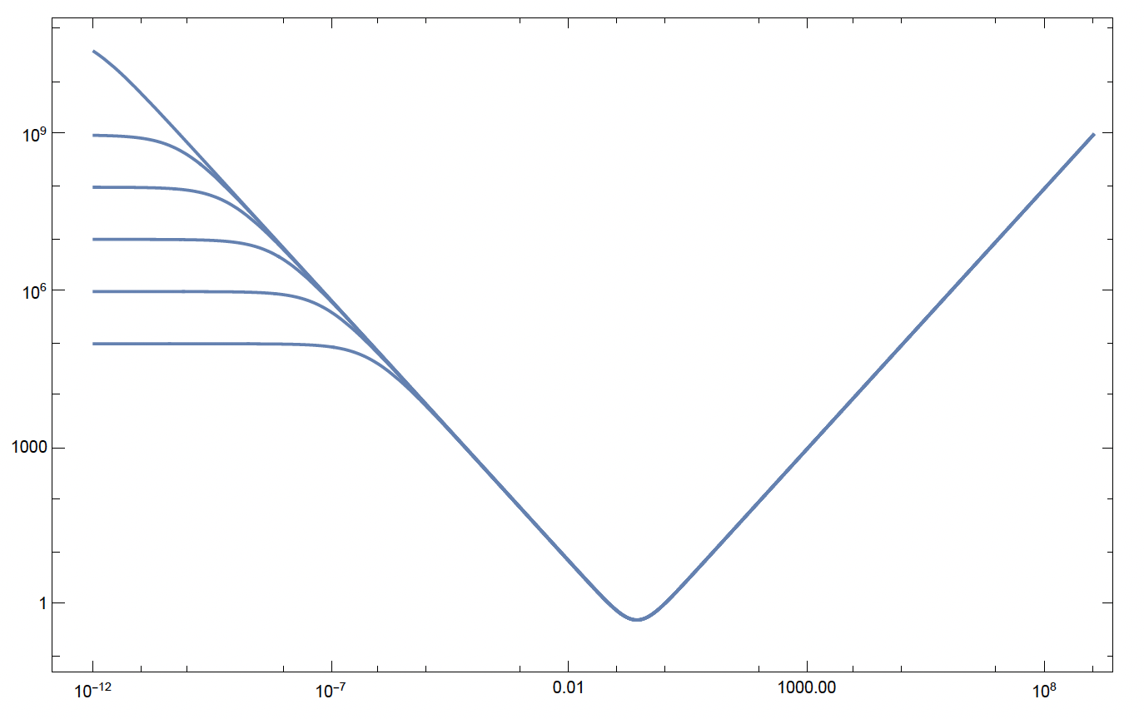
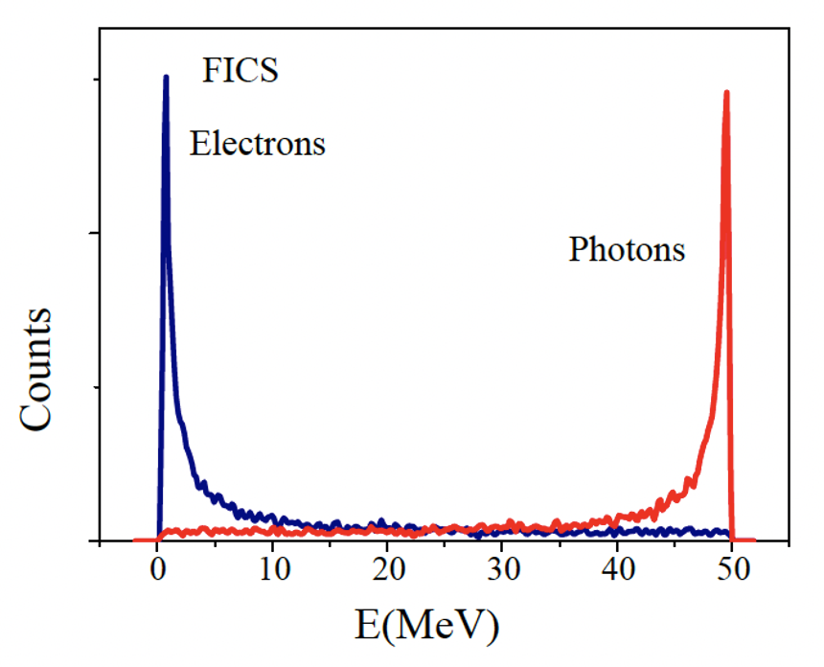
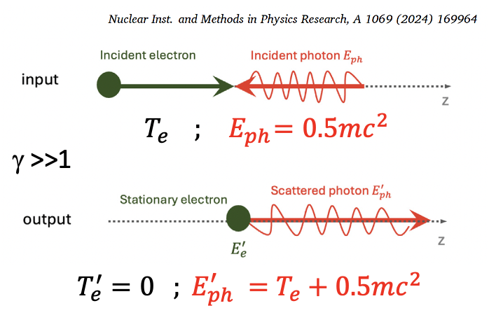
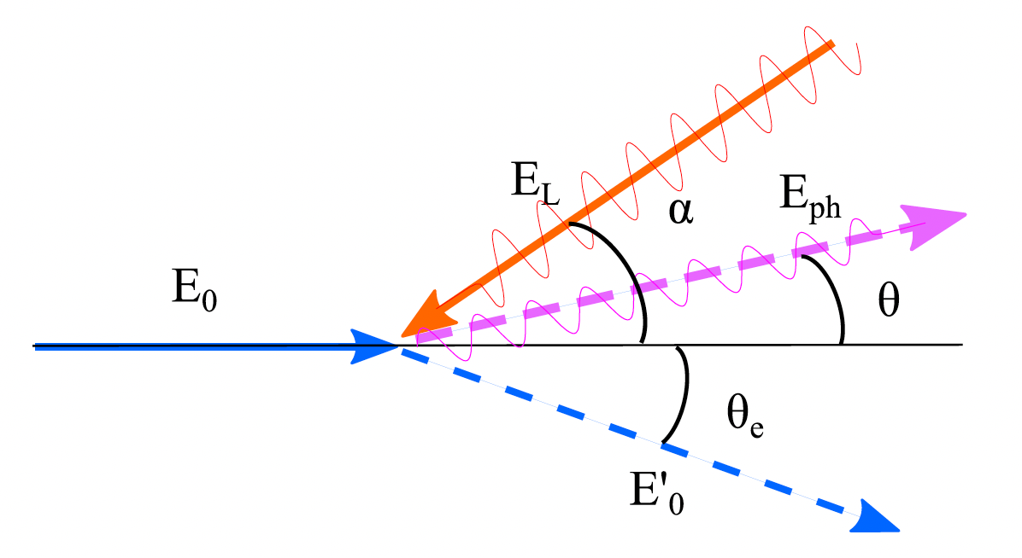




Full Inverse Compton Scattering: amazing power
of 255.5 keV photons to stop ANY colliding electron
100 PeV
0.5mc² = 255.5 keV colliding photons will
stop relativistic electrons of any energy E_{e} !
1 PeV
100 TeV
10 TeV
1 TeV
100 GeV
FCC-ee
EupraXia
E’_{e}
$$E_{ph}$$
$${E′}_{ph}$$
E’_{e} (MeV)
$$E_{e}$$
$${E′}_{e}$$
the most extreme acceleration
achieved in the universe ??
e⁻ at rest E’_{e}=mc²
C.M.B.R.
E_{ph} (MeV)
E_{ph}=1 meV
E_{ph}=1 eV
E_{ph} =0.5mc²
E_{ph}=1 μeV
*hadronic threshold (E_{cm} < 600 MeV) with 255.5 keV photons ≈ 360 GeV

Slide 3
Energy Budget towards γ -rays with high spectral density
25 GeV electrons would be needed to generate 2 MeV photons via synchrotron radiation (highest spectral density S 10¹² s⁻¹eV⁻¹, very small bdw 10⁻⁴)
850 MeV electrons were used to Channeling Radiate 2 MeV γ -rays (high S 10⁵-10⁶ s⁻¹eV⁻¹, broad bdw 10 %)
350 MeV e⁻s are needed to Inverse Compton Scatter 2 MeV γ -rays (good S 10⁴-10⁵ s⁻¹eV⁻¹, small bdw 10⁻³)
3.5 MeV electrons to bremsstrahlung 2 MeV γ -rays (poor S 1 s⁻¹eV⁻¹, very broad bandwidth)
2 MeV e⁻s to Symmetric Compton Scatter a photon target 2 MeV γ -ray photons (S 10⁴ s⁻¹eV⁻¹) spectral purification!

Slide 4
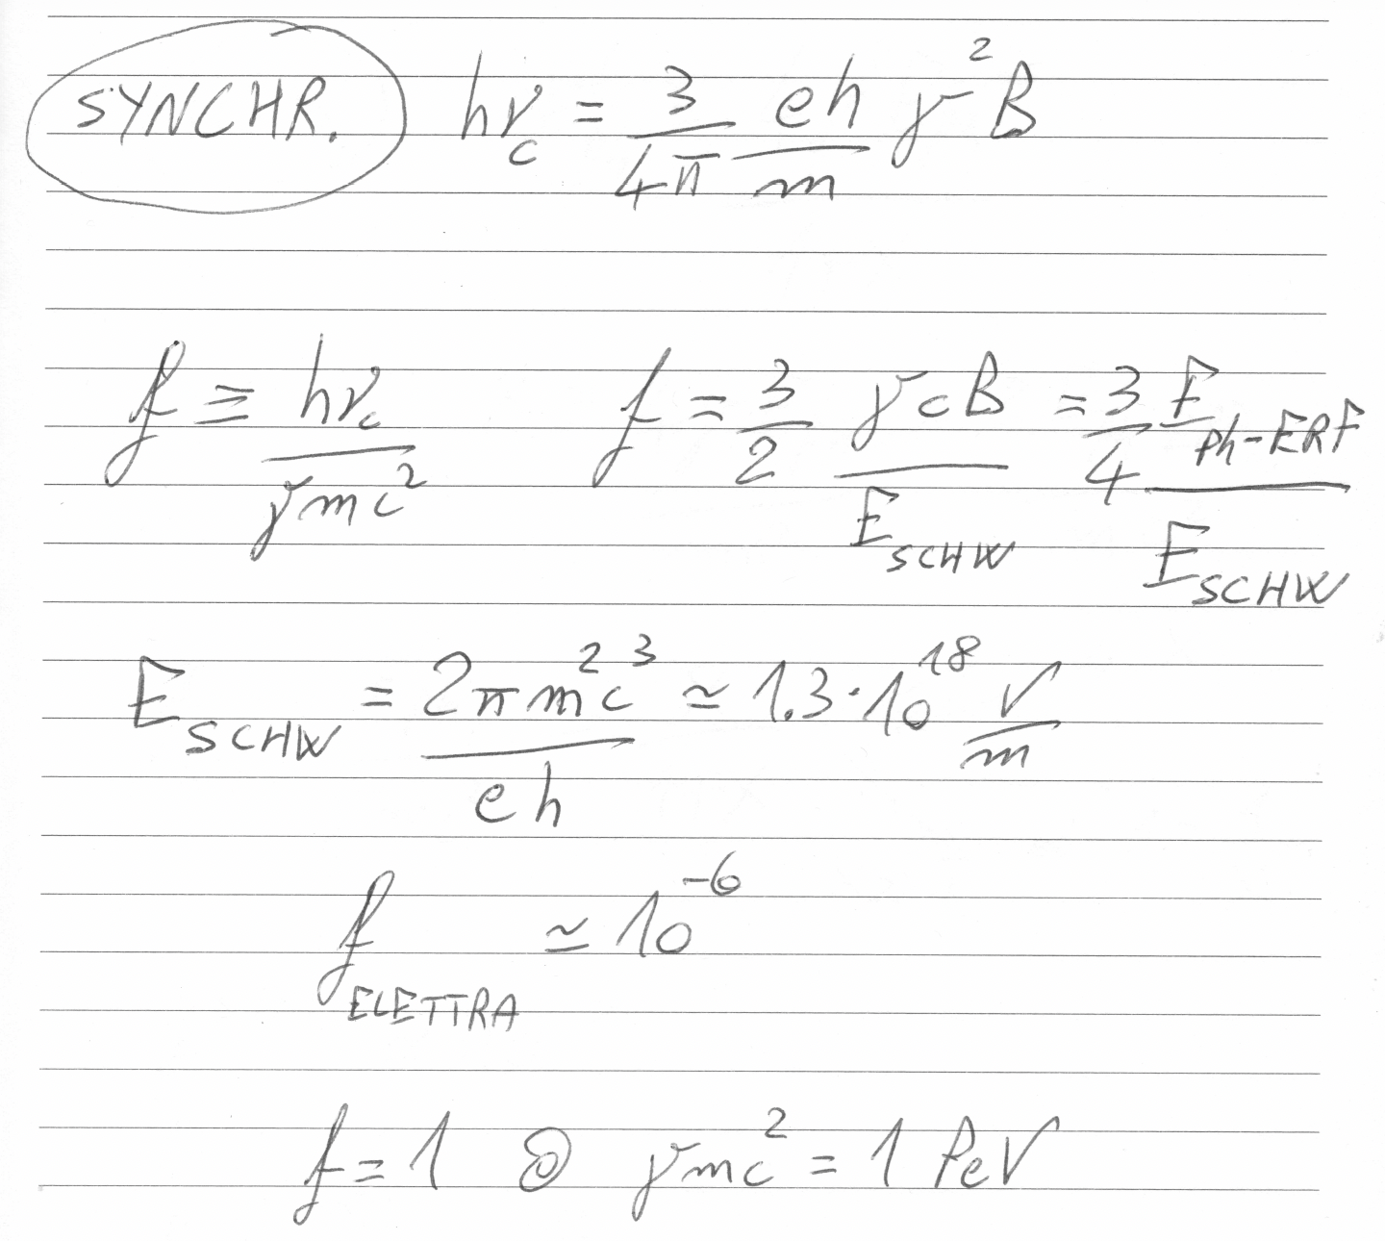

Slide 5
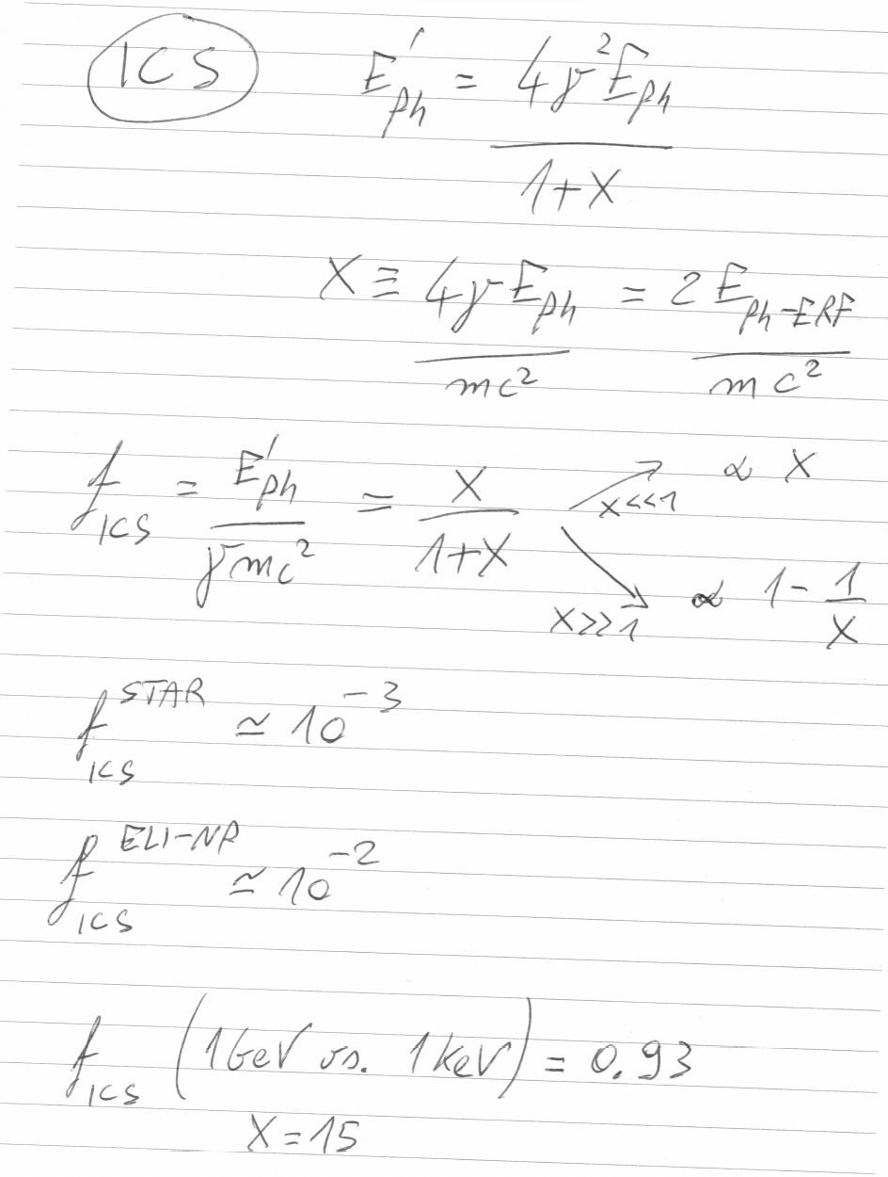

Slide 6
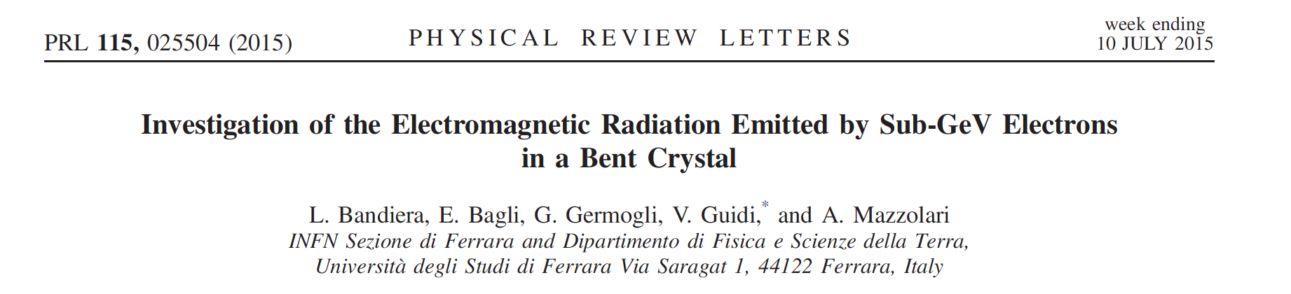
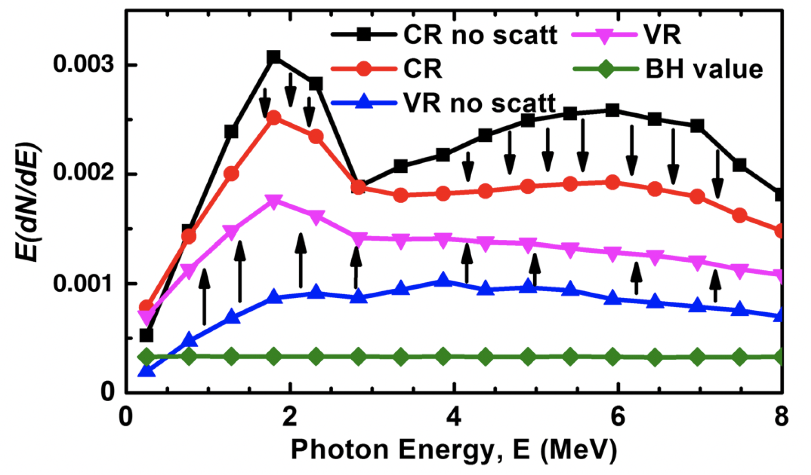
f_{CHANN} ~ 1%
Courtesy L. Bandiera

Slide 7
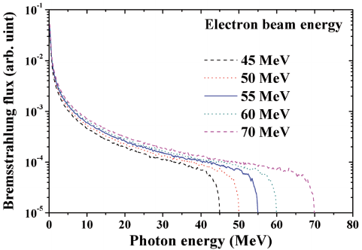
Bremsstrahlung is clearly not an option:
total electron energy loss not actually achievable
brilliance of bremsstrahlung sources is orders of magnitude smaller
f_{BREM} < 1
100% e⁻ energy loss

Slide 8
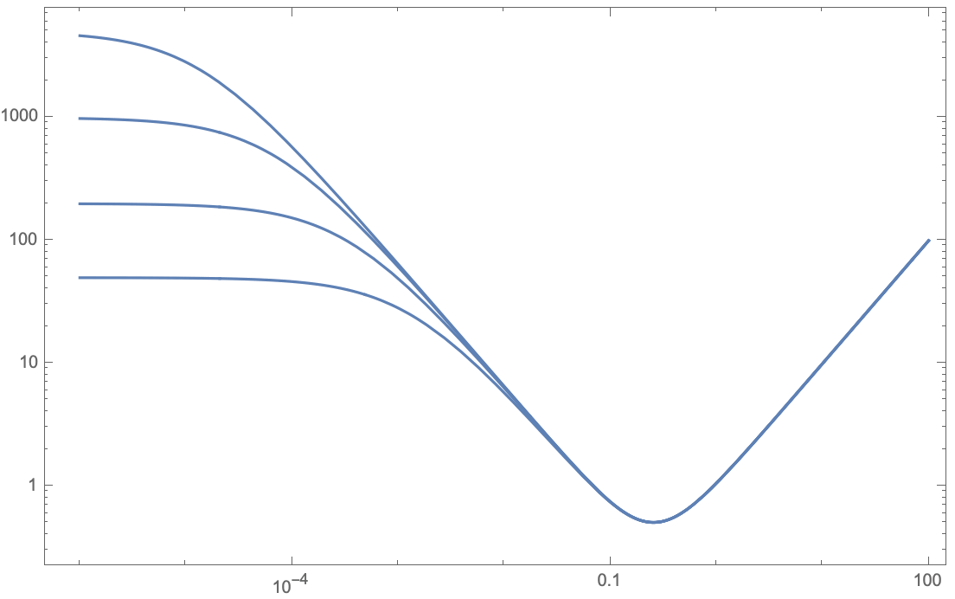




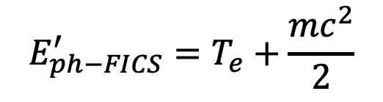
$$E_{e}$$
$${E′}_{ph}$$
in vacuum electron-photon collision
E’_{e} (MeV)
$${E′}_{e}$$
$$E_{ph}$$
5 GeV
f_{FICS} = 1 !!
FICS – Full Inverse
Compton Scattering
1 GeV
200 MeV
E_{e} = 50 MeV
$$E_{ph−FICS}^{′}=T_{e}+\frac{{mc}^{2}}{2}$$
E’_{e} =511 keV , T’_{e}=0
E_{ph} (MeV)
E_{ph} = 1 eV
E_{ph} = 1 keV
E_{ph} =0.5mc²

Slide 9
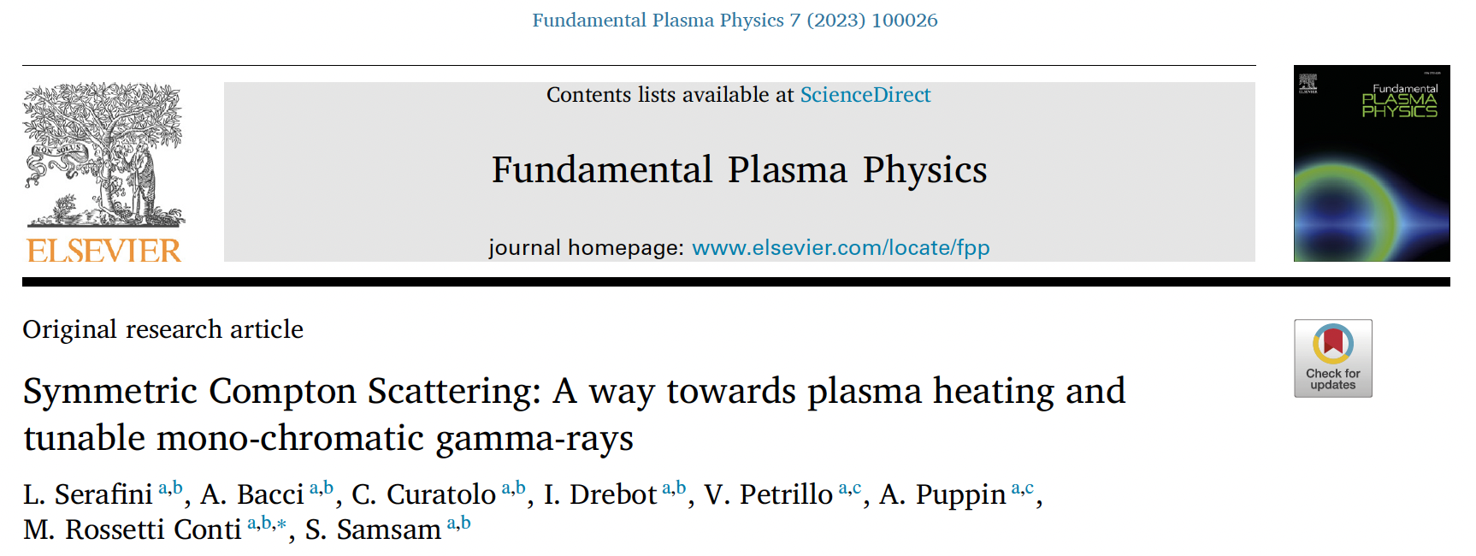
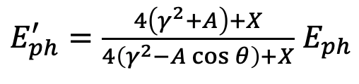





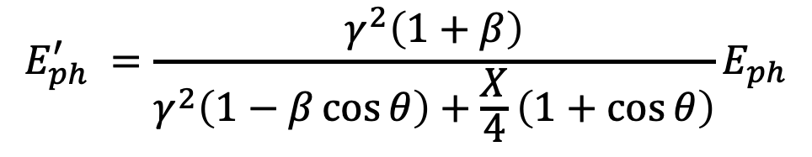
General formula valid for ANY compton scattering
$$E_{ph}^{′} =\frac{γ^{2}\left(1+β\right)}{γ^{2}\left(1−β\cos{θ}\right)+\frac{X}{4}\left(1+\cos{θ}\right)}E_{ph}$$
$$E_{ph}$$
$${E′}_{ph}$$
X ≡ 4γ² E_{ph} /E_{e}
A ≡ βγ²− X/4 = γ²(β− E_{ph} /E_{e})
$$E_{e}$$
$$if γ≫1$$
$${E′}_{ph}=\frac{4γ^{2}E_{ph}}{1+X+γ^{2}θ^{2}}$$
$${E′}_{e}$$
A=0 , i.e. Symmetric Compton Scattering cancels the γ²θ² correlation

Slide 10
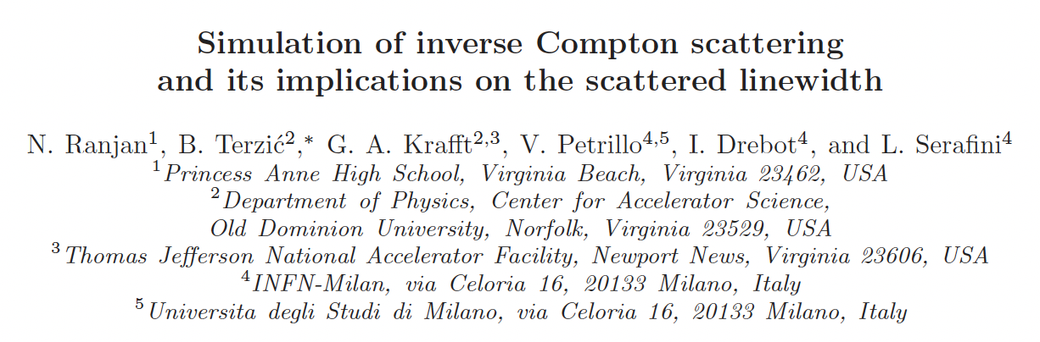
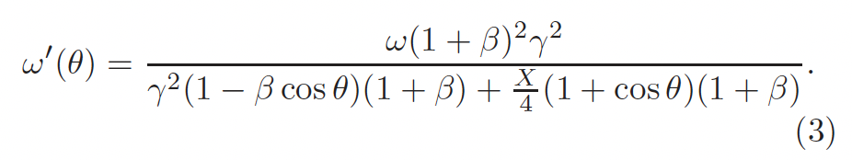
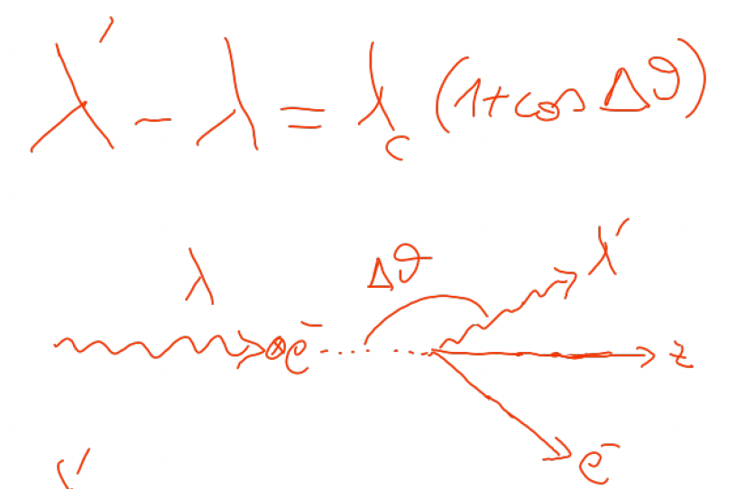

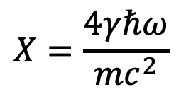



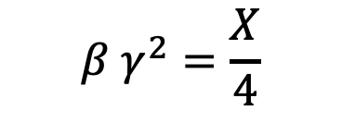
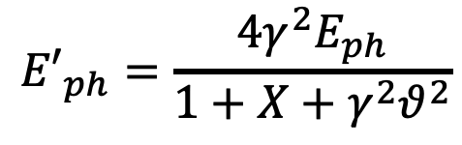
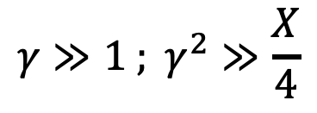

An invariant view at Compton effect - 1
(any inertial ref. frame)
Phys. Rev. AB (2018)
21, 030701
$$X=\frac{4γℏω}{mc^{2}}$$
Arthur Compton,
Nobel Prize 1927
A>0
$$γ≫1 ; γ^{2}≫\frac{X}{4}$$
A<0
A=0
photon looses energy
electron looses energy
$$β=0$$
S.C.S.
FICS !
I.C.S.
$$β γ^{2}=\frac{X}{4}$$
$${E′}_{ph}=\frac{4γ^{2}E_{ph}}{1+X+γ^{2}θ^{2}}$$
$${E′}_{ph}={βE}_{e}=βγmc^{2}$$
$$λ′≠∞$$
$${E′}_{ph}≠f\left(γ^{2}θ^{2}\right)$$
$$\lim_{X→∞}{{E′}_{ph}}=E_{e}$$
isolated e⁻ cannot absorb a photon

Slide 11
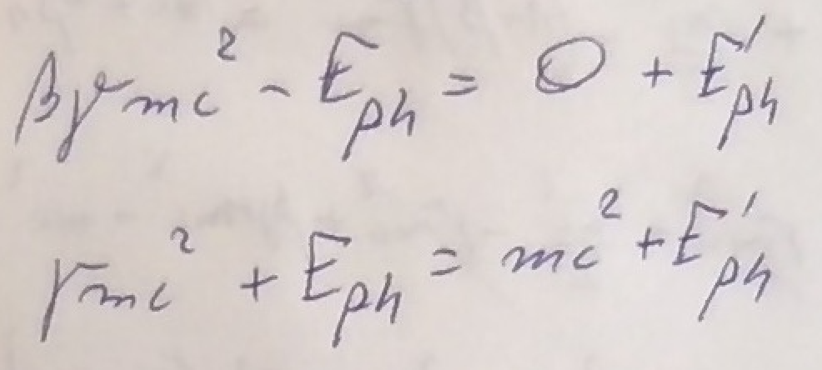
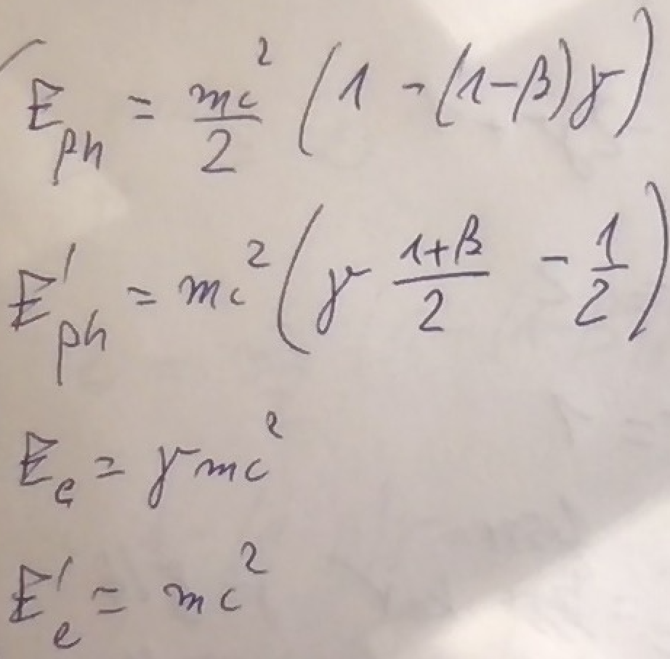






FICS equations
$$E_{e}$$
$$E_{ph}$$
$${E′}_{ph}$$
$${E′}_{e}$$
$${E′}_{e}=mc^{2}$$
$${T′}_{e}=0$$
Let’s focus on the
“turning point”
where electron starts
to be back-scattered:
FICS - Full Inverse Compton Scattering
FICS solutions
for any value of γ !

Slide 12
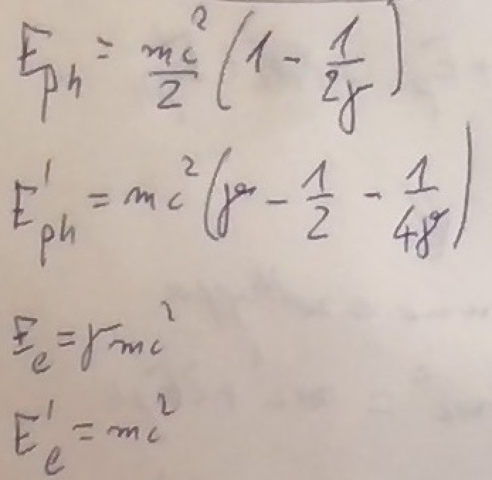
When γ >> 1 FICS solution becomes:
mc²/2 photons can stop any relativistic electron !
The fractional energy loss of FICS is 100%

Slide 13
Follin, Primakoff, etc
100 PeV
1 PeV
0.5mc² = 255.5 keV colliding photons will
stop relativistic electrons of any energy E_{e} !
100 TeV
10 TeV
1 TeV
100 GeV
FICS
E’_{e}
E’_{e} (MeV)
e⁻ at rest E’_{e}=mc²
C.M.B.R.
E_{ph} (MeV)
E_{ph}=1 meV
E_{ph}=1 eV
E_{ph} =0.5mc²
E_{ph}=1 μeV
our study

Slide 14
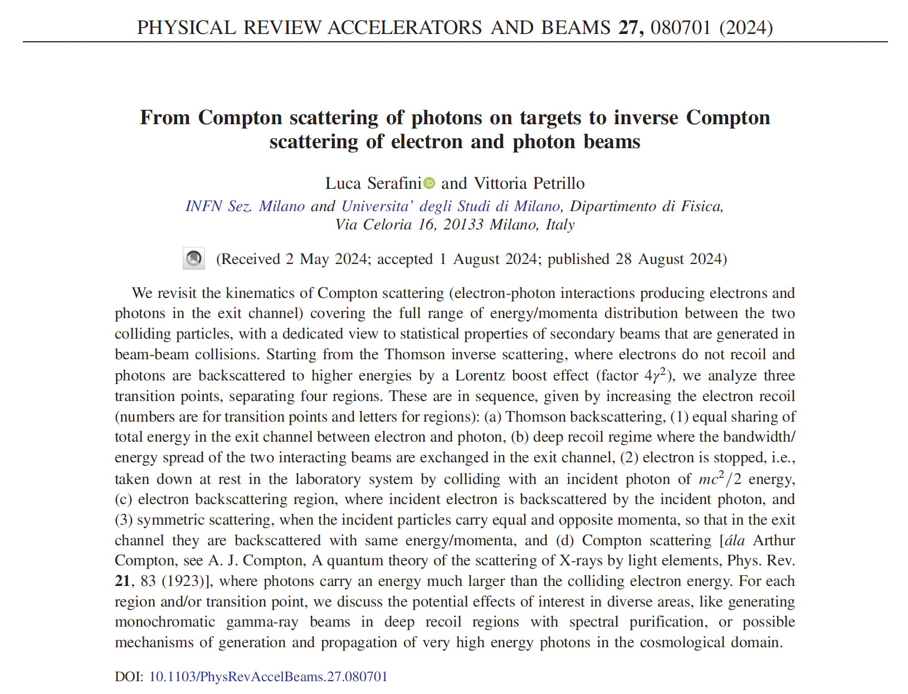
Good recap of the whole ICS history

Slide 15
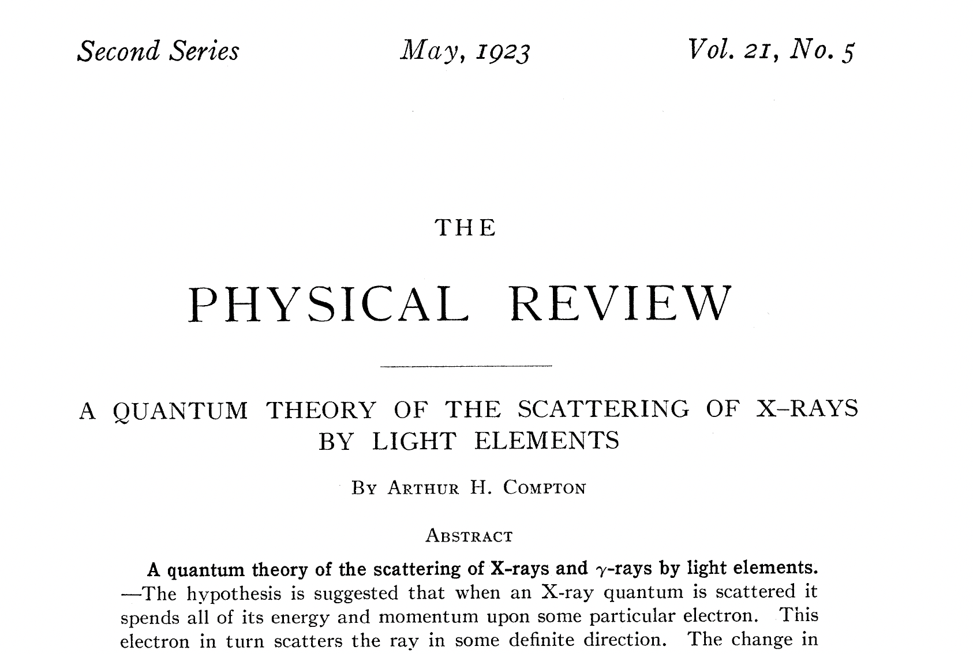
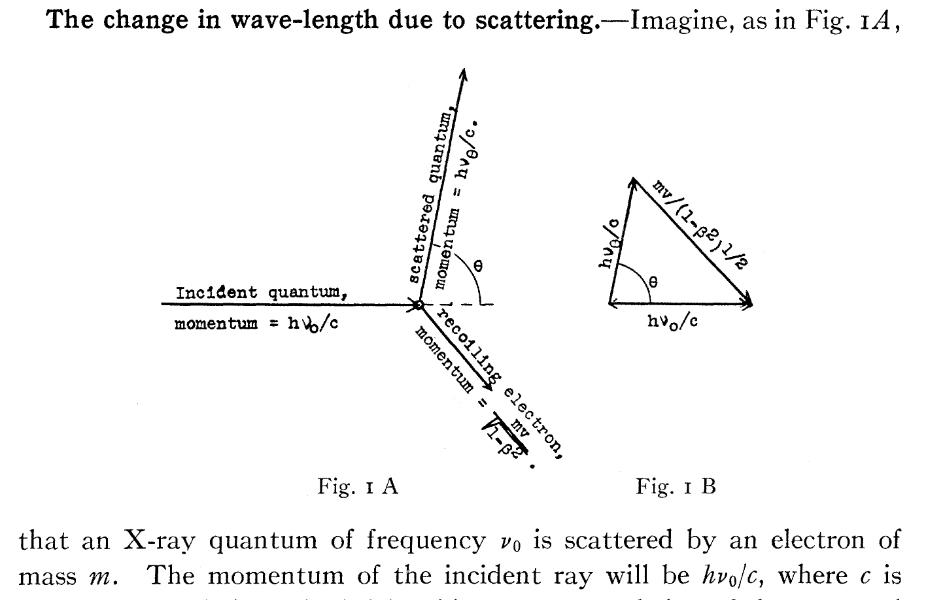
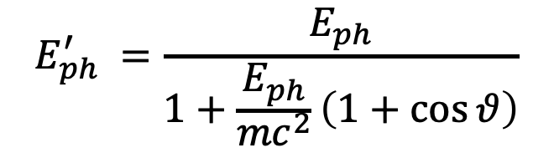
beginning of the story – the photon, quantum of energy
$$E_{ph}^{′} =\frac{E_{ph}}{1+\frac{E_{ph}}{{mc}^{2}}\left(1+\cos{θ}\right)}$$
angular correlation!

Slide 16
First physicists forced to think at Inverse Compton Scattering,
i.e. a mechanism by which electrons loose energy in favor to photons,
(opposite than direct Compton effect) were…
The developers of the Nuclear Bomb!
and, soon later,
first observers of cosmic rays in the upper atmosphere,
trying to figure out why there are many protons and very few electrons

Slide 17
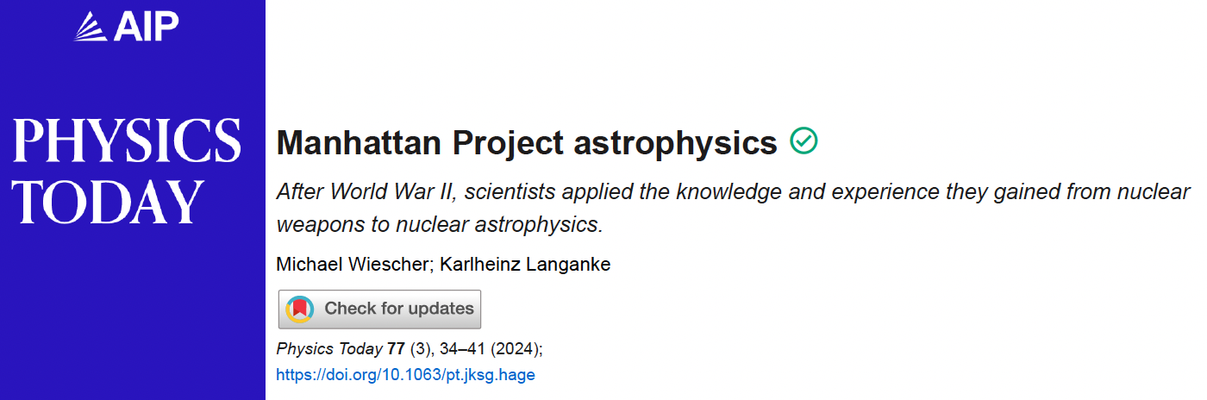
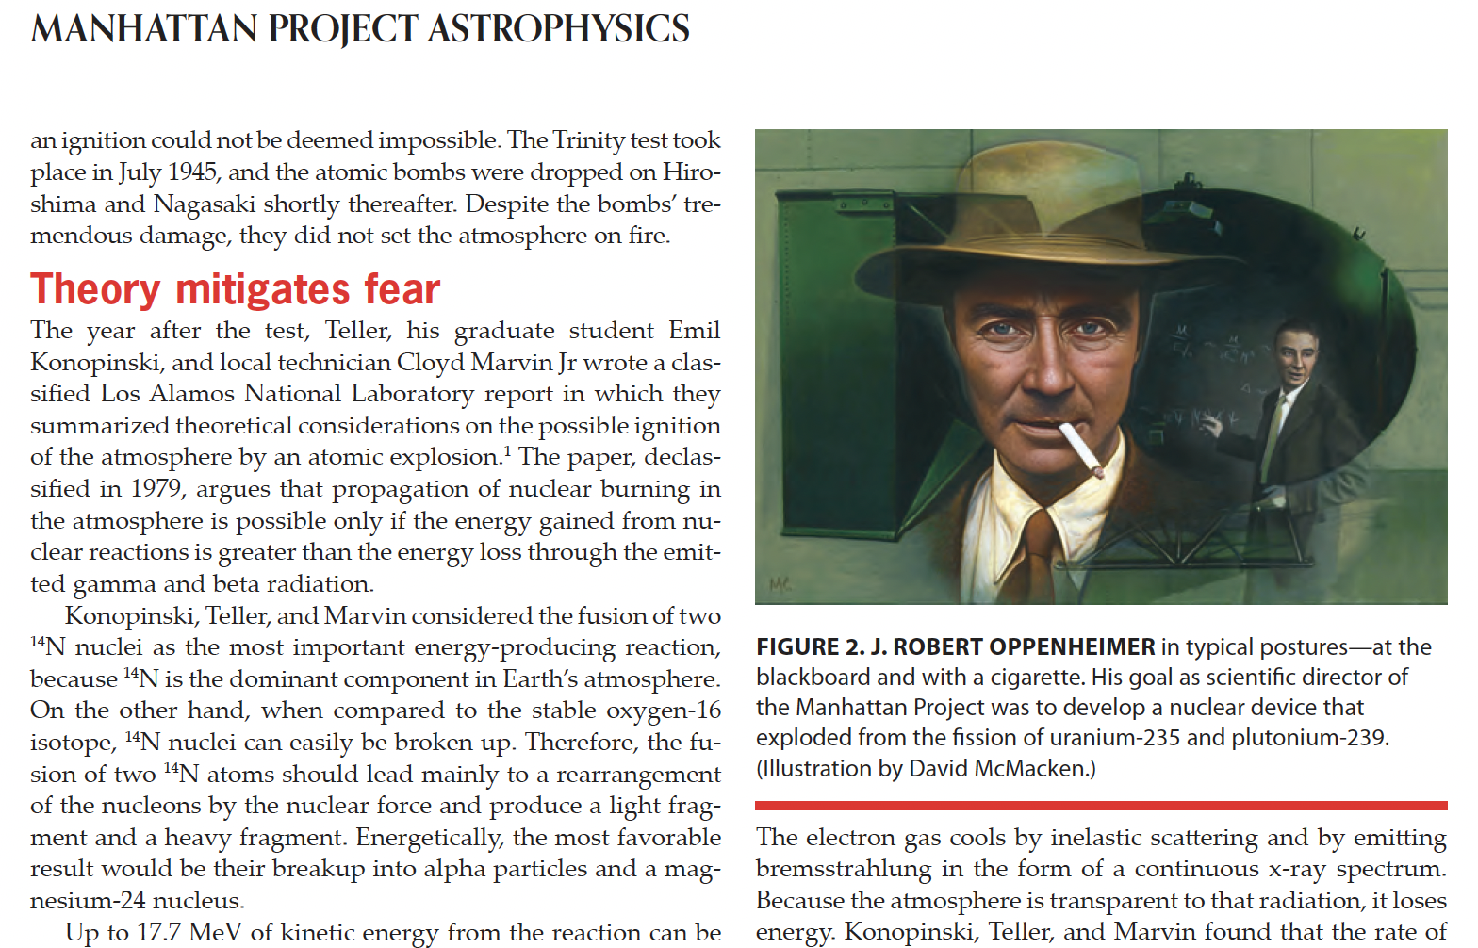
of initiating nuclear fusion
of the whole atmosphere!!!

Slide 18
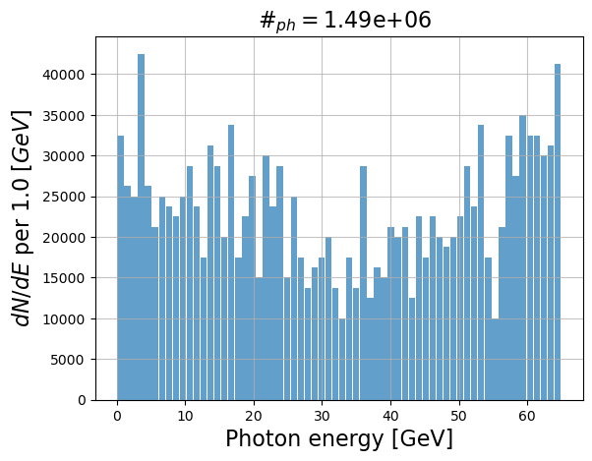
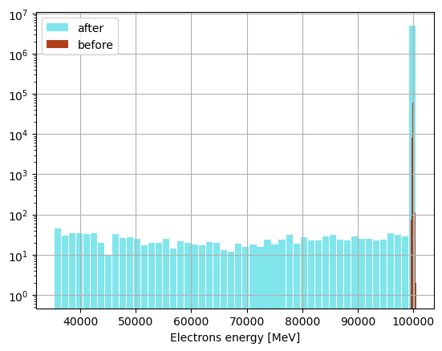
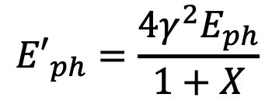
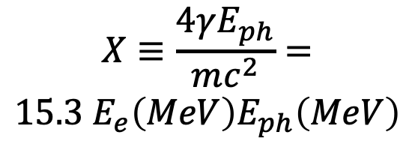
FCC-ee
primary electron beam 100 GeV
primary photon beam: optical laser
$${E′}_{ph}=\frac{4γ^{2}E_{ph}}{1+X}$$
$$X≡\frac{4γE_{ph}}{mc^{2}}=$$
$$15.3{ E}_{e}\left(MeV\right)E_{ph}\left(MeV\right)$$
X_{laser}=1.8
not negligible fraction of electrons
in the beam interact with laser
Thanks to Illya Drebot

Slide 19
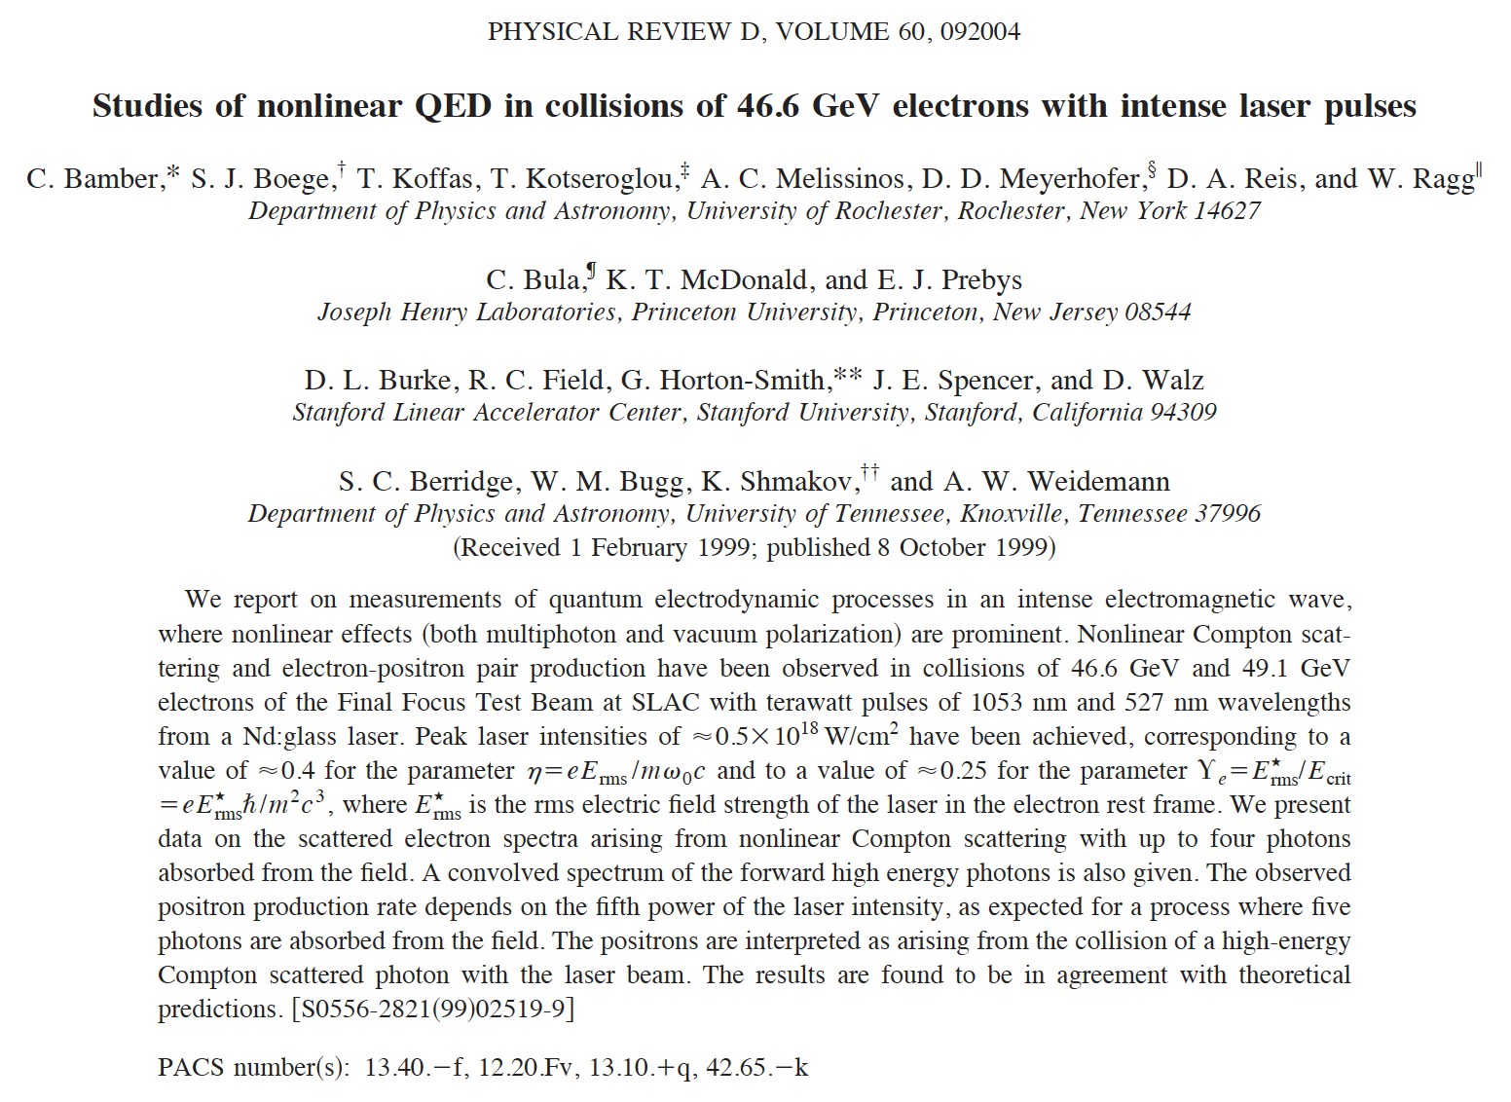
Largest value of recoil factor X achieved in
experiments so far is X=1.8 at SLAC in 1999
Colliding the XFEL photon beam (12 keV) with the
19.5 GeV electron beam would achieve X=3585 !!!

Slide 20
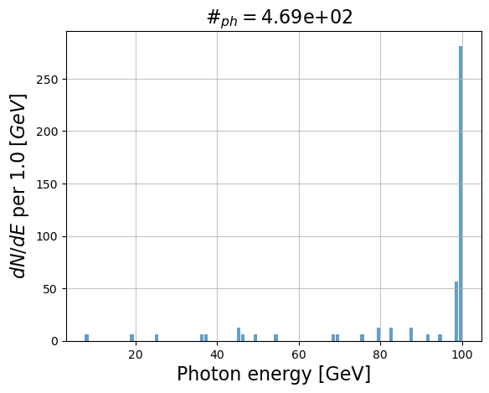
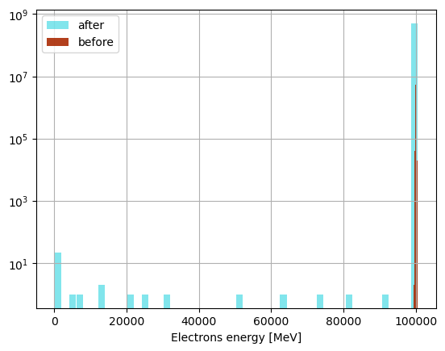
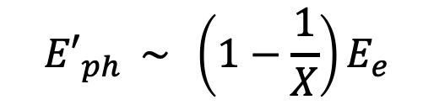
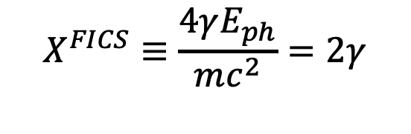
FCC-ee
primary electron beam 100 GeV
primary photon beam: 255.5 keV
Deep recoil Compton: X >> 1
$${E′}_{ph} \sim \left(1−\frac{1}{X}\right)E_{e}$$
$$X^{FICS}≡\frac{4γE_{ph}}{mc^{2}}=2γ$$
X_{FICS}=3.9*10⁵
Single particle energy extraction from the stored beam
in the form of 100 GeV photons
Thanks to Illya Drebot

Slide 21
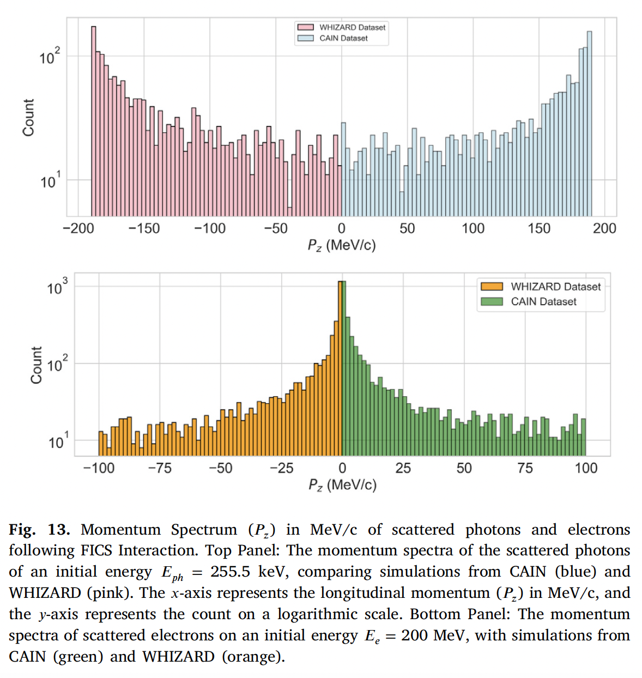
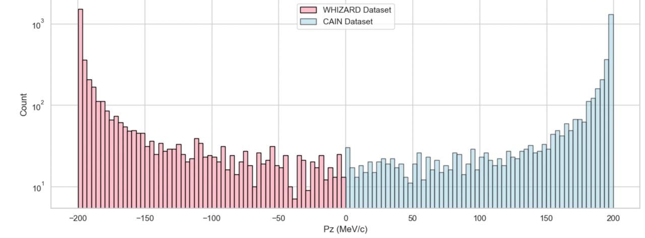
scattered photons
better statistics
with 200 MeV e⁻
scattered electrons

Slide 22
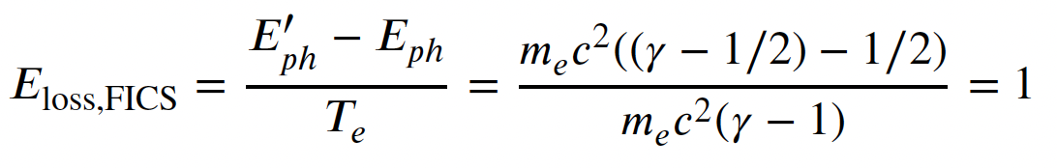
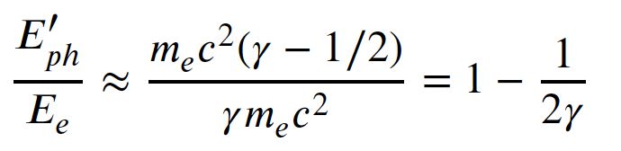
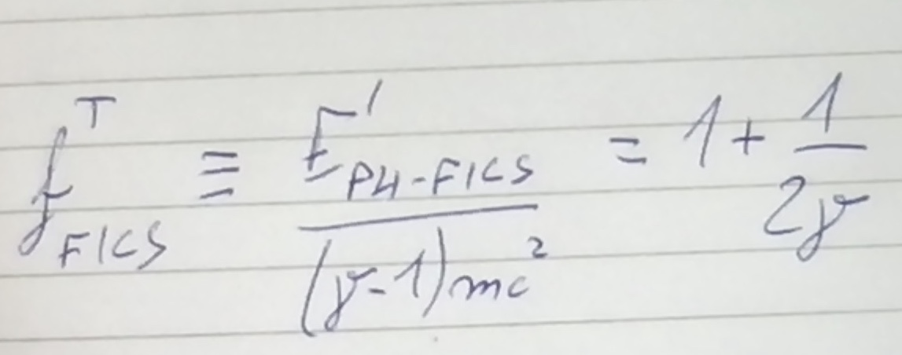
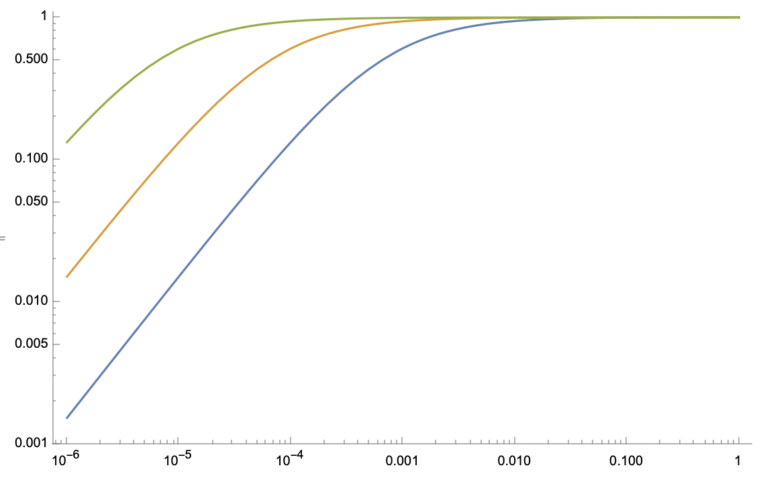
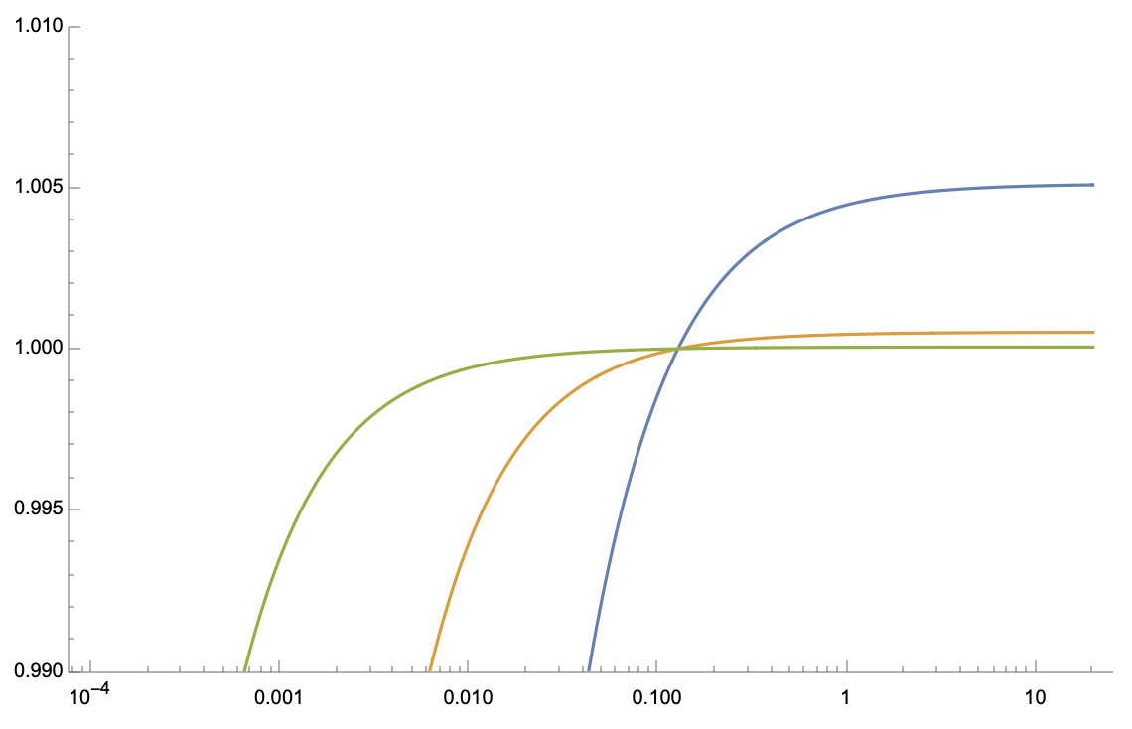
At FICS electrons emit photons with energy larger than T_{e}
T_{e}=10 GeV
f ^{T}_{FICS}
T_{e}=100 MeV
T_{e}=1 GeV
f ^{T}_{FICS}
T_{e}=10 GeV
T_{e}=1 GeV
T_{e}=100 MeV
E_{ph} (MeV)
E_{ph} (MeV)

Slide 23
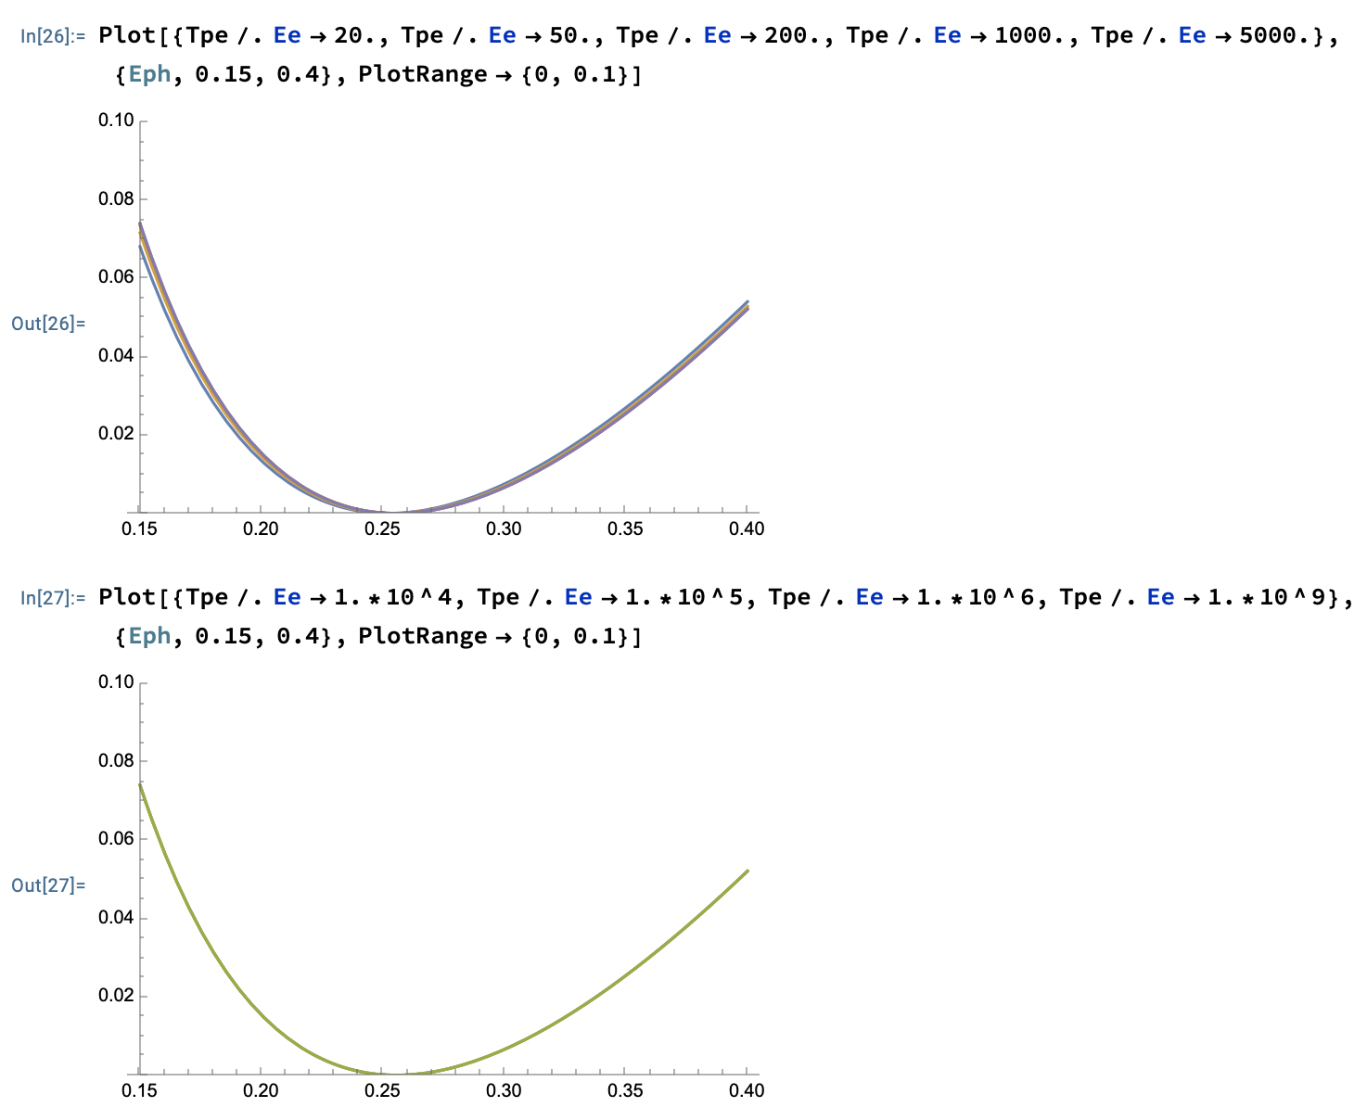
FICS has a shallow minimum:
residual electron kinetic energy T’_{e} around FICS is small
T’_{e} (MeV)
T_{e} = 20, 50, 200 (MeV),
1, 5 (GeV)
T_{e} = 10, 100 (GeV),
1 TeV , 1 PeV
T’_{e} (MeV)

Slide 24
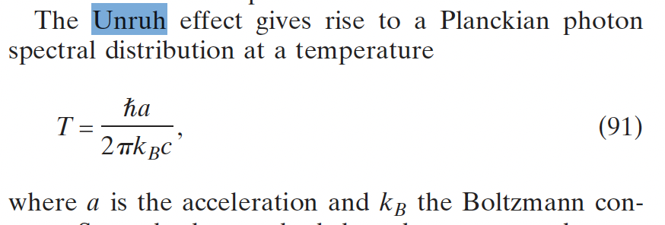
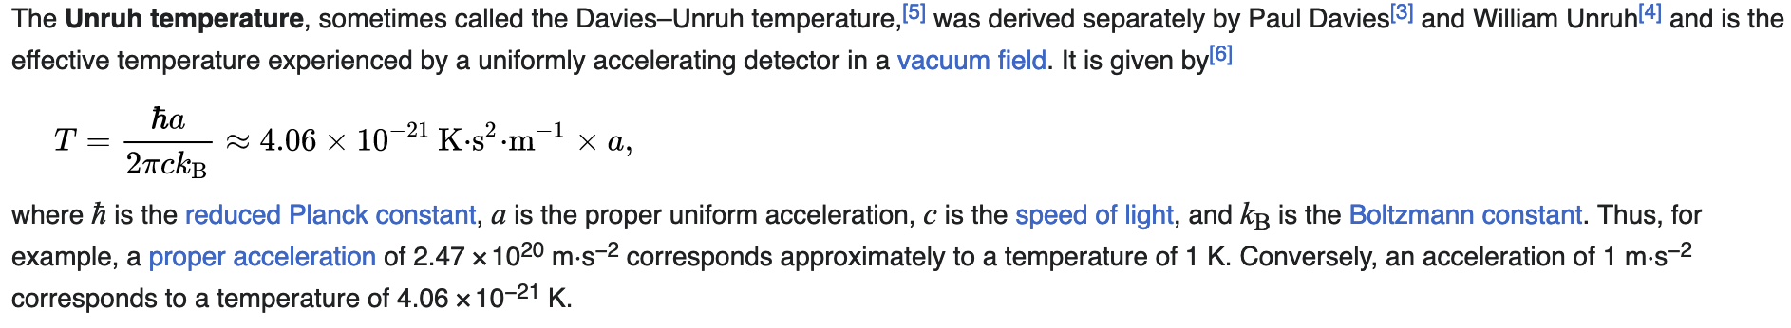
Black-hole a=10¹⁰ T=4.1.10⁻¹¹ K
Plasma acceleration (100 GV/m) a=1.8.10²² T=74 K
?? how about FICS ??

Slide 25


a_{FICS} (m/s²) = 7.3.10²⁸ * E_{e}(MeV)
T_{Unruh-FICS} (K) =3.1.10⁸ * E_{e}(MeV)
T_{Unruh-FICS} (MeV) = 0.026 * E_{e}(MeV)

Slide 26


Slide 27

FICS Relay in the cosmo - a possible mechanism to
propagate very high energy electrons in the universe
FICS
Direct
Compton
FICS, etc, etc

Slide 28



making a 255 keV bright photon beam is not an easy task…
FEL is challenging/expensive, ICS is not that bright, X-ray tube is even less bright --> very low luminosity
A photonic target may be a viable alternative option!
If we cannot take the photons onto the electrons we’ll take the electrons to the photons…
Credits: Adolfo Esposito (LNF) private communication
Ba-133 hollow cylinder
Specific activity 9.3 PetaBq/kg
equivalent to N_{ph} =3.4*10¹³ photons / cm³
gamma emission @ 276 keV and 356 keV
FICS
photons
FICS with 1 GeV EupraXia’s
drive beam before dump
e⁻ beam
$N_{ev−FICS}$ (s⁻¹)= $N_{e−}f(Hz)N_{ph}({cm}^{−3})L(cm)Σ_{KN} ({cm}^{2})$
$N_{ev−FICS}$ (s⁻¹)$≅$ 3.7
20 cm
1.1 mbarn

Slide 29

Clear experimental signature of FICS events:
1 GeV photons emitted forward within 1/γ angle (0.5 mrad)
Key aspect of deep recoil (X >>1) Compton back-scattering
(FICS is in deep recoil: X_{FICS} = 2γ )
Photon spectra do not depend on collision angle!
X (1 GeV vs. 255 keV) = 4000.

Slide 30

FICS @ EupraXia with photonic target
Spectra integrated over collision angle α
(from 45º to 180º, 85% of total solid angle)
and scattering angle θ: no angular dependence (deep recoil)

Slide 31




Slide 32

Grazie per l’attenzione
Thanks for your attention

Slide 34

Probably a_{laser} = 10²³⁻²⁵

Slide 35

Unruh radiation during FICS and SCS
a_{FICS} (m/s²) = 7.3.10²⁸ * E_{e}(MeV)
T_{Unruh-FICS} (K) =3.1.10⁸ * E_{e}(MeV)
T_{Unruh-FICS} (MeV) = 0.026 * E_{e}(MeV)
going from 100 MeV up to 2 GeV electrons the Unruh photons at FICS would
cover the 2.6 – 52 MeV range (easy detection in vacuum with low background)
a_{SCS} = 2.a_{FICS}
but E_{ph} must be = E_{e} in SCS, while in FICS E_{ph} = 255.5 keV

Slide 36






Total cross-section for MPP (muon pair production), Bethe-Heitler:
fraction of a μbarn at photon energies > 100 GeV onto electrons at rest
$$e^{−}+γ→e^{−}+{e^{+}}/{e^{−}}$$
$$e^{−}+γ→e^{−}+γ$$
$$e^{−}+γ→e^{−}+{μ^{+}}/{μ^{−}}$$
EXMP
Bethe-Heitler
$σ^{MPP}= αr_{μ}^{2}\left(\frac{28}{9}ln\left(\frac{2γhν}{M_{μ}}\right)−\frac{218}{27}\right)$ ${− σ}^{Borsellino}$
$$E_{CM}=2\sqrt{M_{e}γhν}$$
$$E^{′}=2γhν=\frac{E_{CM}^{2}}{2M_{e}}$$
$$E_{CM−FICS}=2M_{e}\sqrt{0.5γ}$$
E_{CM-FICS-FCCee}=320 MeV

Slide 37



Large Recoil in MPP damps the normalized emittance of the secondary generated muon beam
muon beam norm. emittance
cmp. MAP norm. emitt. 2.5.10⁴ nm.rad
after ionization cooling

Slide 38








X = 4 E_{e} E_{ph} /(mc²)²
A = βγ²− X/4
$${E′}_{ph}$$
$$E_{e}$$
$$E_{ph}^{′}=\frac{4{γ^{2}E}_{ph}}{1+X}$$
$$E_{e}^{′}=E_{e}{+E}_{ph}−\frac{4{γ^{2}E}_{ph}}{1+X}$$
$$E_{ph}$$
$${E′}_{e}$$
$$E_{tot}$$
E_{e} = 10 MeV
(MeV)
X
E’_{ph}
X=1
FICS
I.C.S.
low recoil
Thomson
X<<1
$$E_{ph−FICS}=\frac{{mc}^{2}}{2}$$
$$E_{ph−FICS}^{′}=T_{e}+\frac{{mc}^{2}}{2}$$
E’_{e}
S.C.S.
Arthur
Compton
effect
0.511 MeV
e⁻ at rest E’_{e}=mc²
deep recoil I.C.S.
E_{ph}
A >> 0
A=0
A<0
Lasers
XFEL’s
betatron-channeling
E_{ph} (MeV)

Slide 39


Slide 40
A simple yet fundamental question:
“Why do I need 150 Mega-electronVolt electrons to generate 350 kilo-electronVolt photons” ??
(STAR biased…)
(not to mention a storage ring based light source where a GeV electron beam radiates tens keV photons)
How to transfer maximum energy
from an electron to a photon…

Slide 41



Collisional radiation
(quantum nature of light essential: Inverse Compton Scattering, Deep Recoil ICS for e⁺ or μ⁺, μ⁻ secondary beam generation, Relativistic Rayleigh Scattering)
Gamma Factory @ LHC
deep recoil I.C.S.
I.C.S.
$$E_{ph}$$
$${E′}_{ph}$$
$$E_{e}$$
$${E′}_{e}$$
EXMP
low recoil
I.C.S. - STAR

Slide 42

255.5 keV 10^12 photons
### Electrons beam parameteres
n_macro=1e8; # Number of macroparticles
chargebunch = 1e-9; # Charge per electrons bunch [C] pico->10^-12 femto->10^-15
beam_energy_MeV=100e3; # initial beam energy MeV
energy_spread=0.1e-2; # initial relative energy spread (not in [%])
norm_emit_x=1e-6; # Normalised emittance x [m rad]
norm_emit_y=1e-6; # Normalised emittance н [m rad]
sigma_e_x=1e-6; # horizontal electron beam size [m]
sigma_e_y=1e-6; # vertical electron beam size [m]
bunch_length=1e-12*3e8; # initial bunch length [m]
### LASER parameteres
angle_deg=0; # in degree
pulseE=0.0361095; #laser puse energy [J]
sigLrx=10; #/2; % given in [mu m] micro meter like
sigLry=10; #/2; % given in [mu m] micro meter like laserwl=0.00549819; # laser wavelenth [nm] nano meters
sigt=1; #pulse length [ps]

Slide 43


Slide 44



Slide 45







The γ²θ² issue/disease
All radiation originated by a Lorentz Boost associated to relativistic emitting particles (electrons, heavy ions) is intrinsically poli-chromatic because of γθ correlation (energy boost of scattered photons depends on scattering angle, at θ=1/γ photon energy is 50% of max photon energy at θ =0 ) of single electron spectrum (on top of inhomogeneous effects)
True for all kinds of Undulatory and Collisional radiation (bremsstrahlung, wiggler/betatron, synchrotron, RRS, ICS), while resonant or amplified radiation (undulators, FELs), that are diffraction limited thanks to their beam quality, are not (or only partially) affected
$$E_{e}=γmc^{2}$$
$$E_{ph}$$
$${E′}_{ph}$$
$${E′}_{ph}=\frac{4γ^{2}E_{ph}}{1+X+γ^{2}θ^{2}}$$
$$E_{e}$$
$$X≡\frac{4γE_{ph}}{mc^{2}}=\frac{ 2E_{ph}^{ERF}}{mc^{2}}$$
$${E′}_{e}$$

Slide 46

Courtesy I. Drebot

Slide 47

Courtesy I. Drebot

Slide 48

General Compton Scattering geometry
between an incident electron E_{e} and a photon E_{ph}
at a collision angle α, photon E’_{ph} scattering angle θ
and electron E’_{e} scattering angle θ_{e}
$$E_{ph}$$
$${E′}_{ph}$$
$$E_{e}$$
$${E′}_{e}$$
$$E_{e}=γmc^{2}$$
$γ=1 Direct Compton effect$
$γ≫1 Inverse Compton$
Energy/momentum transferred from photon to e-
Energy/momentum transferred from e- to photon

Slide 49


We are not considering in this study non-linear effects due to photon (laser) pulse intensity
no collective multi-photon effects
only single electron-photon interaction
(à la Klein-Nishina, linear QED)
Courtesy Marcel Ruijter
Deep Recoil ICS
FICS
X --->

Slide 50

A. Compton 1923 - Direct Compton effect
First consideration and study of Inverse Compton Scattering….
During the development of the nuclear bomb!
The Manhattan Project
Will the back-scattered photons,
by hot electrons of the plasma
created in the initial stage of the
nuclear bomb explosion, release
energy from the fire-ball decreasing
its temperature???

Slide 51

fire-ball becomes transparent
to photons, that can take energy
off the fire-ball, limiting the
maximum temperature
down to a “safe” level

Slide 52

A. Compton 1923 - Direct Compton effect
J. Follin 1947 - Inverse Compton Scattering
first published (non classified) study on ICS*
Second motivation to study ICS in the late ‘40s was understanding why
electrons are almost missing in cosmic rays bombarding the upper atmosphere
Both directions (nuclear bomb and astrophysics) were looking for
a mechanism capable to transfer maximum energy from the electrons to the photons
* but unknown and not credited in the whole literature on ICS

Slide 53


Publication referenced by everybody in ICS community
as the first published paper on ICS

Slide 54

First idea by Milburn: use electron accelerators to perform
Inverse Compton Scattering in the laboratory vs. the cosmos

Slide 55


X=0.13
Σ=596 mbarn
Deep Recoil
and its 2 benefits:
spectral purification
and
suppression of γ²θ² desease
X=13
Σ=109 mbarn
X=1286
Σ=3 mbarn

Slide 56







Inverse Compton Scattering of photons on
relativistic electrons, θ < 1/γ
$$E_{ph}^{′}=\frac{4{γ^{2}E}_{ph}}{1+γ^{2}θ^{2}+X}$$
$$X=\frac{ 4E_{ph}E_{e}}{{\left(mc^{2}\right)}^{2}}$$
Thomson limit: X << 1
Deep recoil Compton: X >> 1
$$E_{ph}^{′}=\frac{4{γ^{2}E}_{ph}}{1+γ^{2}θ^{2}}$$
$${E′}_{ph} \sim \left(1−\frac{1}{X}−\frac{γ^{2}θ^{2}}{X}\right)E_{e}$$
$E_{ph}^{′}\left(θ=\frac{1}{γ}\right)=2{γ^{2}E}_{ph}$= $\frac{E_{ph}^{′}\left(θ=0\right)}{2}$
$${E′}_{ph}\left(θ=\frac{1}{γ}\right)\sim \left(1−\frac{2}{X}\right)E_{e}$$
$$note that E_{cm}=mc^{2}\sqrt{1+X }, if X≫1⇒X\sim {\left(\frac{E_{cm}}{mc^{2}}\right)}^{2}$$

Slide 57

Previous Seminars: 1) Cooling of Photons in Symmetric Compton Scattering (S.C.S.)
20% rms spread
input e⁻ beam
10 MeV, 10⁻⁴
rms en. spread
Electron
Cooling of
photons!!
2.10⁻⁴
rms spread
no energy-
angular
correlation
10⁻¹ spread
e- beam
is heated
C. Curatolo - Whizard

Slide 58


Previous Seminars:
2) Spectral Purification
in deep recoil I.C.S.
Broad-band incident
photon beam
from channeling radiation,
bremsstrahlung,
betatron radiation, etc
spectral purification
Deep Recoil Inverse
Compton Scattering
tunability

Slide 59

Lorentz boosted radiation (synchrotron, ICS, FEL, etc)
is strongly affected by the emittance of the electron beam
Courtesy C. Barty - LLNL

Slide 60



Deep Recoil suppresses the
γ²θ² disease and the bandwidth
broadening effect due to
electron beam emittance
according to
Petrillo-Serafini criterion
low recoil ICS
$$bw ≥\frac{2ε_{n}^{2}}{σ_{x}^{2}}$$
$$S_{d}∝\frac{\left\langle I_{e}\right\rangle U_{las}}{ε_{n}^{2}E_{x}}$$

Slide 61

Ultra-low emittance positron beams from deep recoil
electron-photon collider: 5 GeV ERL vs. 5 keV FEL, X=391
up to 10¹³⁻¹⁴ e⁺/s at 50 MeV within 5% en. spread
Son of
EXMP
E_{cm}=10 MeV
E_{cm}=346 MeV
0.5 MeV/c rms
transv. momentum
0.5-1*10⁻⁷ m.rad rms norm. transv. emittance with round beam (no-cooling)
V. Petrillo, A. Puppin – Whizard

Slide 62



FICS - Full Inverse Compton Scattering - how to achieve 10³⁰ m/s² acceleration to sense Unruh radiation
V. Petrillo, ad-hoc developed Montecarlo code for linear QED

Slide 63
$$E_{e}$$
$${E′}_{ph}$$
in vacuum electron-photon collision
E’_{e} (MeV)
$${E′}_{e}$$
$$E_{ph}$$
5 GeV
FICS – Full Inverse
Compton Scattering
1 GeV
200 MeV
E_{e} = 50 MeV
$$E_{ph−FICS}^{′}=T_{e}+\frac{{mc}^{2}}{2}$$
E’_{e} =511 keV , T’_{e}=0
E_{ph} (MeV)
E_{ph} = 1 eV
E_{ph} = 1 keV
E_{ph} =0.5mc²

Slide 64


From Feenberg-Primakoff

Slide 65

From Follin

Slide 66


Slide 67


Slide 68


residual electron kinetic energy T’_{e} at FICS
with 511./2. keV photons instead of
T’_{e} (MeV)
T_{e} (MeV)

Slide 70






Direct Compton γ =1, β =0 , X = 4E_{ph}/mc²
$$E_{ph−min}^{′}=\frac{E_{ph}}{1+{2E_{ph}}/{mc^{2}}}$$
$$E_{ph−min}^{′}=\frac{mc^{2}}{2}$$
$$if{ E}_{ph}≫mc^{2}$$
Very energetic photons are scattered back at 255 keV
and electrons pushed to E_{ph} + 0.5mc²
$$E_{e−max}^{′}=E_{ph}+\frac{mc^{2}}{2}$$
$$E_{e−max}^{′}=mc^{2}+E_{ph}−E_{ph−min}^{′}$$
$${ , if E}_{ph}≫mc^{2}$$
So FICS is the time reversal of Compton scattering
at infinitely large recoil
kinematics is similar for any particle interacting with photons
(protons, μ, neutrinos? hν_{inc}=0.5*m_{p}c² - next step in progress…)
It’s unbelievable how much you don’t know about
the game you’ve been playing all your life”
Mikey Mantle (big baseball player of the past, after Danilo Babusci INFN-LNF)

Slide 71

Stopping Protons with photons
Relativistic protons require 938/2 MeV photons
β_{prot}
GeV
E’_{ph-prot}
_{π-threshold}
E_{ph-prot}
pion
photo-production
MeV

Slide 72

electrons do not have internal degree of freedom (apart from spin)
while protons do have - protons can act as detectors of Unruh thermal
photon bath (they can “click”) - but protons cannot be driven to strong
accelerations by intense lasers… FICS is the only way??

Slide 73

30 MeV protons vs. photon beams of
different energies (110, 120, 170 MeV)

Slide 74


Slide 75


Checked with CAIN modified for protons (I. Drebot, A. Bacci)
only interacting protons
primary proton beam
+
interacting protons

Slide 76


Slide 77
We asked Chat-GPT again (Oct. 26th 2024),
after recommending her/him/it reading our 2 papers
10.1103/PhysRevAccelBeams.27.080701
https://doi.org/10.1016/j.nima.2024.169964
Now that Full Inverse Compton Scattering (FICS) demonstrates
that total energy transfer from an electron to a photon is
theoretically possible, it shifts our understanding of photon-
electron interactions, especially at high energies.
This interaction is unique because the electron can stop completely and transfer all its kinetic energy to the photon in a controlled, head-on setup.
This level of energy transfer efficiency has significant implications, potentially enabling precise photon energy boosts and offering new applications in particle accelerators and high-energy astrophysics.

Slide 78
Conclusions
Old Physics revisited shows new regimes of extreme electron-photon
beam collisions with potentials towards:
New generation Radiation Sources based on Spectral Purification
(ICS in deep recoil)
Amazing tests of stopping ultra-relativistic electrons in vacuum,
attaining extreme accelerations (many orders of magnitude higher
than any other mechanism) to detect Unruh radiation
Trapping/charging plasma mirror devices with electrons via S.C.S.
Universe opacity to high energy (TeV, PeV) photons: a Compton relay
based on FICS&Breit-Wheeler cosmic cascade. Cosmic gamma ray
sources and the role of FICS.

Slide 79





Full Inverse Compton Scattering
$$T_{e} ;{ E}_{ph}=0.5mc^{2}$$
Can electrons emit photons of energy larger than their own?
γ >>1
$$T_{e}^{′}=0 ; E_{ph}^{′} =T_{e}+0.5mc^{2}$$
Impacts in several fields:
Plasma Physics (e⁻ / e⁺ trapping in plasma mirrors), Astro-Physics (cosmic γ-ray sources), QED & Quantum Gravity (Unruh radiation and overcoming the Schwinger limit), measuring neutrino mass?

Slide 81







$$E_{ph}^{FICS}\left(T_{e}≤500 keV\right)$$
$$E_{ph}^{FICS}\left(T_{e}≤100 MeV\right)$$
$$\frac{mc^{2}}{2}$$
$$E_{ph}^{FICS}\left(T_{e}≤10 eV\right)$$

Slide 82

E_{e} = 200 MeV ; E_{ph}=255.5 keV
electron momenta distribution after FICS
electrons under-
going FICS
non interacting
electrons

Slide 83







FICS lay-out
Incident electron
Incident photon $E_{ph}$
input
z
Stationary electron
Scattered photon $E_{ph}^{′}$
output
$$E_{e}^{′}$$
z
Incident electron
Incident photon $E_{ph}$
input
z
Scattered photon $E_{ph}^{′}$
Quasi-Stationary electron
$$θ≤1/γ$$
output
z
$$E_{e}^{′}$$

Slide 84

β (T_{e}=255 keV) = 0.75

Slide 85
electrons undergoing FICS with photons back-scattered
between θ=0 and θ=1/γ have β < 0.75
back-scattered photons in FICS have energy E’_{ph} in the range
E’_{ph}(θ=0) = E_{e}(1-1/2γ) ; E’_{ph}(θ=1/γ) = E_{e}(1-1/γ)
to be compared with low recoil ICS, where
E’_{ph}(θ=0) = 4γ²E_{ph} ; E’_{ph}(θ=1/γ) = 2γ²E_{ph}

Slide 86



Slide 87


S.C.S. Spectra at different recoil factors X
back-scattering of the photon is most likely in deep recoil
if an electron/photon interaction occurs in deep recoil it must be back-scattering

Slide 88


Slide 89

Turning a radio-active Cobalt-60 fixed energy
gamma-ray source into a tunable sorce of gamma-rays
Previous Seminars:
3) Tunable mono-chromatic γ-rays using radio-active sources

Slide 90


2 spectral lines merged into a single tunable line

Slide 91


N. Ranjan et al., PRAB 21, 030701 (2018)
T_{e}=E_{e}-mc²
If E’_{ph} =T_{e} then T’_{e} = 0 !

Slide 92

Electron Recoil effect in γ-ray I.C.S. for Nuclear Photonics:
C.E.M. fails to evaluate the correct red-shift in the spectrum
with
electron recoil
without
electron recoil
ELI-NP-GBS
X < 0.03

Slide 93
So suprising that FICS was not mentioned nor described
in the previous literature on Compton direct/inverse Scattering
that
we really wanted to re-examine the first historical phases
of the studies on electron-photon QED interaction
How comes that nobody yet identified FICS as the only regime
of complete/full transfer in-vacuum of
energy and momentum between an electron and a photon?

Slide 94

Almost at the same time as Arutyunian and co-workers

Slide 95



First measured ICS – 500 MeV

Slide 96

Second measured ICS – 6 GeV

Slide 97



Many studies in the literature on electron-photon beam collisions collective/statistical properties (phase spaces, etc)

Slide 98


Relevance of recoil in electron-photon
beam-beam collisions

Slide 99


Slide 100


Slide 101













All quantities normalized to
the total energy E_{tot} = E_{e} + E_{ph}
E_{e} = 100 MeV
X(E_{ph})
$$λ^{′}−λ=λ_{C}\left(1−\cos{θ}\right)$$
$$λ_{min}^{′}−λ=2λ_{C}$$
${E′}_{ph−max} \sim 4γ2$ $E_{ph}$
I.C.S.
STAR, ELI-NP
DICS
SCS
A.H. Compton,
Phys. Rev. 21 (1923)
E’_{e} (E_{ph}) / E_{tot}
E’_{ph} (E_{ph}) / E_{tot}
E_{ph} / E_{tot}
$$E_{cm}=mc^{2}$$
FICS
$$X=1$$
$$X=4γ^{2}$$
$$E_{ph}=\frac{mc^{2}}{4γ}$$
Astro-physics?
$$E_{ph}=γmc^{2}=E_{e}$$
$$E_{cm}=2γmc^{2}$$
$$E_{cm}=\sqrt{2}mc^{2}$$
$$X=2γ$$
$$E_{ph}=\frac{mc^{2}}{2}$$
$E_{ph}^{ERF}=2γ\frac{mc^{2}}{2}$ = E_{e}
E_{ph} (MeV)

Slide 102

If you ask Chat-gpt :
“can an electron transfer its total kinetic energy to a photon?”
It will answer “no” - a wrong (or not updated) answer
This was done in June 2024
Courtesy S. Sanae

Slide 104

V. Petrillo, ad-hoc developed Montecarlo code for linear QED
1) low recoil 2) DICS (X=1) 3) deep recoil (X=8)

Slide 105

V. Petrillo, ad-hoc developed Montecarlo code for linear QED
electron back-scattering (X=12.000) 2) SCS (X=40.000)
3) Direct Compton (X=1.2.10⁵)

Slide 106


Slide 107

Spectral Purification of incident Channeling Radiation
Compact, sustainable, mono-chromatic gamma-ray source

Slide 108

Deep recoil cancels the γ²θ² disease/correlation, therefore strongly
decreases the dependence of the back-scattered photon beam
bandwidth on the electron beam transverse emittance

Slide 109
Courtesy L. Bandiera

Slide 110
γ -ray in-vacuum mono-chromatization, SCS at large Recoil
20% rms spread
Incoming e- beam 10⁻⁴ rms spread
Electron
Cooling of
photons!!
2.10⁻⁴
rms spread
no energy-
angular
correlation
10⁻¹ spread
e- beam
is heated
C. Curatolo - Whizard

Slide 111
Broad-band incident
photon beam
from channeling radiation,
bremsstrahlung,
betatron radiation, etc
spectral purification
Deep Recoil Inverse
Compton Scattering
tunability

Slide 112





Trapping electrons (positrons) into a magnetic bottle by SCS
at low recoil ( 72 keV photon beam heats up 5 keV e⁻ beam)
SCS - Symmetric
Compton Scattering
$${E′}_{ph}$$
$$E_{e}$$
$$E_{ph}$$
$${E′}_{e}$$

Slide 113



E’_{ph} - energy of scattered photon at θ
red shift at θ≠0
θ
scattered electron
E’_{e} = γmc² + E_{ph} – E’_{ph}
All I.C.S. X/γ ray Sources work at X<1 and A » 1
STAR (350 keV) X_{STAR} < 2.6.10⁻³ A_{STAR} > 10⁴
ELI-NP (20 MeV) X_{ELI-NP} < 0.026 A_{ELI-NP} > 2.4.10⁵
X = recoil parameter – twice the energy of the photon seen
by the electron in its own reference frame normalized to mc²

Slide 114

BriXSinO’s ICS source – Illya Drebot with CAIN –
ICS Moustache
BriXSinO T.D.R. @ www.marix.eu

Slide 115

$$E_{ph}^{′} =\frac{γ^{2}\left(1+β\right)}{γ^{2}\left(1−β\cos{θ}\right)+\frac{X}{4}\left(1+\cos{θ}\right)}E_{ph}$$
$$E_{ph}$$
$${E′}_{ph}$$
X ≡ 4γ² E_{ph} /E_{e}
A ≡ βγ²− X/4 = γ²(β− E_{ph} /E_{e})
$$E_{e}$$
$${E′}_{e}$$
A=0 , i.e. Symmetric Compton Scattering cancels the γ²θ² correlation

Slide 116
An invariant view at Compton effect - 1
(any inertial ref. frame)
Phys. Rev. AB (2018)
21, 030701
$$X=\frac{4γℏω}{mc^{2}}$$
Arthur Compton,
Nobel Prize 1927
A>0
$$γ≫1 ; γ^{2}≫\frac{X}{4}$$
A<0
A=0
photon looses energy
electron looses energy
$$β=0$$
S.C.S.
I.C.S.
$$β γ^{2}=\frac{X}{4}$$
$${E′}_{ph}=\frac{4γ^{2}E_{ph}}{1+X+γ^{2}θ^{2}}$$
$${E′}_{ph}={βE}_{e}=βγmc^{2}$$
$$λ′≠∞$$
$${E′}_{ph}≠f\left(γ^{2}θ^{2}\right)$$
$$\lim_{X→∞}{{E′}_{ph}}=E_{e}$$
isolated e⁻ cannot absorb a photon

Slide 117












An invariant view at Compton effect - 2
(any inertial ref. frame)
$$X=\frac{4γℏω}{mc^{2}}$$
A<0
A=0
A>0
photon looses energy
electron looses energy
$$\overset{⃑}{p_{e}}=−\overset{⃑}{p_{ph}}$$
Direct Compton
S.C.S.
I.C.S.
$$β=0 ; γ=1$$
$$X=4β γ^{2}$$
$${E′}_{ph}=\frac{4γ^{2}E_{ph}}{1+X+γ^{2}θ^{2}}$$
$$ν′=\frac{ν}{1+\frac{X_{DC}}{4}\left(1+\cos{θ}\right)}$$
$$E_{ph}=p_{e}c=βγmc^{2}$$
${E′}_{ph}=E_{ph}$ $∀θ$
$$γ →∞$$
$$X→∞$$
$${E′}_{ph}→E_{e}$$
$$E_{e′}→mc^{2}$$
$X_{DC}=\frac{4ℏω}{mc^{2}}$ $=\frac{4λ_{C}}{λ}$
$${E′}_{e}=E_{e}= γmc^{2} ∀θ$$
$$γ_{cm}=1$$
CM ref. frame = Lab ref. frame

Slide 118


Let’s consider the condition of maximum energy/momentum
transfer between electron and photon, i.e. θ = 0
$$E_{ph}$$
$${E′}_{ph}$$
$$E_{e}$$
$${E′}_{e}$$
$$E_{ph}^{′} =\frac{γ^{2}\left(1+β\right)}{γ^{2}\left(1−β\cos{θ}\right)+\frac{X}{4}\left(1+\cos{θ}\right)}E_{ph}$$
θ = 0
$$E_{ph}^{′} =\frac{2γ^{2}}{γ^{2}\left(1−β\right)+\frac{X}{2}}E_{ph}$$

Slide 119






θ = 0 corresponds to:
maximum energy of back-scattered photon $E_{ph−max}^{′}$
and
minimum energy of electron after scattering $E_{e−min}^{′}$
$$E_{ph−max}^{′}=\frac{4{γ^{2}E}_{ph}}{1+X}$$
Thomson limit: X << 1
Deep recoil Compton: X >> 1
$${E′}_{ph−max} \sim \left(1−\frac{1}{X}\right)E_{e}$$
$$E_{ph−max}^{′}=4{γ^{2}E}_{ph}$$
$${E_{TOT}=E}_{e}+E_{ph}=E_{e−min}^{′}+E_{ph−max}^{′}$$
$$E_{e−min}^{′}=E_{e}+E_{ph}−E_{ph−max}^{′}=E_{e}+E_{ph}−\frac{4{γ^{2}E}_{ph}}{1+X}$$

Slide 120
All quantities normalized to
the total energy E_{tot} = E_{e} + E_{ph}
E_{e} = 100 MeV
X(E_{ph})
$$λ^{′}−λ=λ_{C}\left(1−\cos{θ}\right)$$
$$λ_{min}^{′}−λ=2λ_{C}$$
${E′}_{ph−max} \sim 4γ2$ $E_{ph}$
I.C.S.
STAR, ELI-NP
DICS
SCS
A.H. Compton,
Phys. Rev. 21 (1923)
E’_{e} (E_{ph}) / E_{tot}
E’_{ph} (E_{ph}) / E_{tot}
E_{ph} / E_{tot}
$$E_{cm}=mc^{2}$$
FICS
$$X=1$$
$$X=4γ^{2}$$
$$E_{ph}=\frac{mc^{2}}{4γ}$$
Astro-physics?
$$E_{ph}=γmc^{2}=E_{e}$$
$$E_{cm}=2γmc^{2}$$
$$E_{cm}=\sqrt{2}mc^{2}$$
$$X=2γ$$
$$E_{ph}=\frac{mc^{2}}{2}$$
$E_{ph}^{ERF}=2γ\frac{mc^{2}}{2}$ = E_{e}
E_{ph} (MeV)

Slide 121




when recoil X is large electron swaps with photon,
maximum energy loss by the electron in favour to the photon
$$E_{ph−max}^{′}=\frac{{4E_{ph}{E_{e}}^{2}}/{{\left(mc^{2}\right)}^{2}}}{1+{{4E}_{ph}E_{e}}/{{\left(mc^{2}\right)}^{2}}}$$
$${ E}_{e−min}^{′}≈ { E}_{e}$$
X<<1
$$if γ≫1 { E}_{e−min}^{′}≈ { E}_{e} \frac{1+\left(1+X\right){E_{ph}}/{E_{e}}}{1+X}$$
X>>1
$${ E}_{e−min}^{′}≈ { E}_{ph}$$

Slide 122
100 PeV
1 PeV
0.5mc² = 255.5 keV colliding photons will
stop relativistic electrons of any energy E_{e} !
100 TeV
10 TeV
1 TeV
100 GeV
E’_{e}
E’_{e} (MeV)
e⁻ at rest E’_{e}=mc²
E_{ph} (MeV)
E_{ph} =0.5mc²
*hadronic threshold (E_{cm} < 600 MeV) with 255.5 keV photons ≈ 360 GeV

Slide 123



50 TeV electrons !!!!

Slide 125



Total cross-section for QED ( e,γ ) reactions
$$e^{−}+γ→e^{−}+{e^{+}}/{e^{−}}$$
$$e^{−}+γ→e^{−}+γ$$
$$E_{CM}=2\sqrt{m_{e}c2γhν}$$

Slide 126



Total cross-sections for Compton and Bethe-Heitler
E_{ph} = 255.5 keV (E_{e} from 50 MeV to 5 GeV)
Σ_{tot} (mbarn)
$$e^{−}+γ→e^{−}+{e^{+}}/{e^{−}}$$
$$e^{−}+γ→e^{−}+γ$$
E_{e} (MeV)

Slide 127




FICS low relativistic
E_{e} = 5 MeV
E_{e} = 2 MeV
E_{e} = 1 MeV
E_{e} = 0.8 MeV

Slide 128




FICS very low relativistic
E_{e} = 1.1 MeV
E_{e} = 0.8 MeV
E_{e} = 0.7 MeV
E_{e} = 0.6 MeV

Slide 129
Large Recoil in ICS damps the effect of large bandwidth incident photon beams onto the bandwidth of scattered photons
equivalent to FELs Kim-Pellegrini crit. on 3D inhomogeneous effects on photon bandwidth
beam
en. spread
diffraction
collimation
angle
incident
photons
en. spread
beam
emittance
non
linearity

Slide 131
where is the Continental Divide
between
Compton Scattering
and
Inverse Compton Scattering?
when the electron becomes
a projectile (as in ICS)
instead of
a target (as in Compton)?
Does it depend only on electron energy?
No, it depends only on asymmetry in colliding momenta

Slide 132







CM rest frame moves with
the photon in Direct Compton
CM rest frame moves with the electron in
Inverse Compton, FEL, Synchrotron light
$$γ_{cm}\sim γ$$
CM rest fr. slows down in Inv. Compton with deep recoil
CM rest frame is steady in Symmetric Compton
$$γ_{cm}=1$$
$$γ_{cm}≪γ$$
M. Rossetti Conti

Slide 133










$${E′}_{ph}$$
X ≡ 4γ² E_{ph} /E_{e}
A ≡ βγ²− X/4 = γ²(β− E_{ph} /E_{e})
$$E_{e}$$
$$E_{ph}$$
$E_{ph}^{′}=\frac{4\left(γ^{2}+A\right)+X}{4\left(γ^{2}−A\cos{θ}\right)+X}$ $E_{ph}$
$${E′}_{e}$$
I.C.S. low recoil X<<1
A ~ βγ² ~ γ²-1/2
${E′}_{ph−max} \sim 4γ2$ $E_{ph}$
$${E′}_{ph−max} \sim \frac{4γ^{2}}{1+X}E_{ph} \sim \left(1−\frac{1}{X}\right)E_{e}$$
I.C.S. deep recoil X>>1
A ~ βγ²-X/4 ~ γ²-1/2 - X/4
$${E′}_{ph−max} \sim { E}_{ph}\left(1+\frac{2A}{\left(1+β\right)γ^{2}}\right)$$
S.C.S. (A = 0) or
quasi-SCS ( |A| <<1)
$${E′}_{e−min} \sim {E_{e}−E}_{ph}\frac{2A}{\left(1+β\right)γ^{2}}$$
D.C. γ =1, β =0 , A = -X/4
$E_{ph−min}^{′}=\frac{1}{1+X/2}$ $E_{ph}=\frac{1}{1−2A} E_{ph}$

Slide 134


Direct Compton γ =1, β =0 , X = 4E_{ph}/mc²
$$E_{ph−min}^{′}=\frac{E_{ph}}{1+{2E_{ph}}/{mc^{2}}}$$
$$E_{ph−min}^{′}=\frac{mc^{2}}{2}$$
$$if{ E}_{ph}≫mc^{2}$$
Very energetic photons are scattered back at 255 keV
and electrons pushed to E_{ph} + 0.5mc²
$$E_{e−max}^{′}=E_{ph}+\frac{mc^{2}}{2}$$
$$E_{e−max}^{′}=mc^{2}+E_{ph}−E_{ph−min}^{′}$$
$${ , if E}_{ph}≫mc^{2}$$
General Formula expressed in terms of energies of
primary colliding particles, valid for any γ , A , X , θ
$$E_{ph−max}^{′}=\frac{\left(1+β\right)E_{ph}E_{e}}{\left(1−β\right)E_{e}+2E_{ph}}$$

Slide 135

X = 4 E_{e} E_{ph} /(mc²)²
$$E_{ph−max}^{′}=\frac{\left(1+β\right)E_{ph}E_{e}}{\left(1−β\right)E_{e}+2E_{ph}}$$
E_{e} = 10 MeV
(MeV)
X
E’_{ph}
E’_{e}
0.511 MeV
e⁻ at rest E’_{e}=mc²
E_{ph}
E_{ph} (MeV)

Slide 136


$$E_{ph−max}^{′}=\frac{\left(1+β\right)E_{ph}E_{e}}{\left(1−β\right)E_{e}+2E_{ph}}$$
E_{e} = 50 MeV
(MeV)
E’_{ph}
X
E’_{e}
e⁻ at rest E’_{e}=mc²
E_{ph}
E_{ph} (MeV)
255 keV photon to stop electron of any E_{e} !

Slide 137


$$E_{ph−max}^{′}=\frac{\left(1+β\right)E_{ph}E_{e}}{\left(1−β\right)E_{e}+2E_{ph}}$$
$$E_{e−min}^{′}=E_{e}+E_{ph}−E_{ph−max}^{′}=E_{e}+E_{ph}−\frac{\left(1+β\right)E_{ph}E_{e}}{\left(1−β\right)E_{e}+2E_{ph}}$$
$$E_{ph−max}^{′}=\frac{{4E_{ph}{E_{e}}^{2}}/{{\left(mc^{2}\right)}^{2}}}{1+{{4E}_{ph}E_{e}}/{{\left(mc^{2}\right)}^{2}}}$$
$${ E}_{e−min}^{′}≈ { E}_{e}$$
X<<1
$$if γ≫1 { E}_{e−min}^{′}≈ { E}_{e} \frac{1+\left(1+X\right){E_{ph}}/{E_{e}}}{1+X}$$
X>>1
$${ E}_{e−min}^{′}≈ { E}_{ph}$$
$$if E_{ph}=\frac{mc^{2}}{2} −\left(1−β\right)E_{e} ⟹{ E}_{e−min}^{′}=mc^{2}$$
255 keV photon to stop electron of any E_{e} !

Slide 138



$$if E_{ph}=\frac{mc^{2}}{2} −\left(1−β\right)E_{e}{ ⟹ E}_{e−min}^{′}=mc^{2}$$
$$if γ≫1 and E_{ph}=\frac{mc^{2}}{2}\left[1−\frac{1}{γ}\right] ⟹ { E}_{e−min}^{′}=mc^{2}$$
$$E_{ph}=\frac{mc^{2}}{2}\left[1−\frac{1}{γ}\right]$$
If the incident photon energy is given by
any relativitic electron (i.e. γ >> 1) will be stopped
in a head-on collision with such a photon
255 keV photons will stop electrons of any E_{e} as far as γ >> 1

Slide 139


$E_{ph}=\frac{mc^{2}}{2}\left[1−\frac{1}{2γ}\right]$ to stop any (relativistic) electron
Incidentally, the condition is almost the same needed to make the
total energy in the lab ref. frame (LAB) equal to the total energy in
the electron rest frame (ERF)
LAB total energy E_{LAB} = γ mc² + E_{ph}
ERF total energy E_{ERF} = mc² + 2γ E_{ph}
E_{LAB} = E_{ERF}
if
$$E_{ph}=\frac{mc^{2}}{2} \frac{2γ−2}{2γ−1} \overset{→}{γ→∞} \frac{mc^{2}}{2}$$

Slide 140




Generalization to any Collision Angle α , α = π head-on
$$E_{ph}^{′} =\frac{{4γ}^{2}\left(1−β\cos{α}\right)}{{4γ}^{2}\left(1−β\cos{θ}\right)+X\left(1−\cos{α}\cos{θ}+\sin{α\sin{θ}}\right)}E_{ph}$$
$$E_{ph}^{′} =\frac{γ^{2}\left(1+β\right)}{γ^{2}\left(1−β\cos{θ}\right)+\frac{X}{4}\left(1+\cos{θ}\right)}E_{ph}$$
α=π , head-on ⇒
in agreement with Eq.3 in N. Ranjan et al., PRAB 21, 030701 (2018)

Slide 141





$$E_{ph}^{′} =\frac{{4γ}^{2}\left(1−β\cos{α}\right)}{{4γ}^{2}\left(1−β\cos{θ}\right)+X\left(1−\cos{α}\cos{θ}+\sin{α\sin{θ}}\right)}E_{ph}$$
$$if γ≫1 and β≈1−\frac{1}{2γ^{2}} and θ≪1$$
$$E_{ph}^{′} =\frac{{4γ}^{2}\left(\frac{1−\cos{α}}{2}\right)}{1+γ^{2}θ^{2}+X\left(\frac{1−\cos{α}}{2}\right)}E_{ph}$$
$$E_{ph−max}^{′} =\frac{{4γ}^{2}\left(\frac{1−\cos{α}}{2}\right)}{1+X\left(\frac{1−\cos{α}}{2}\right)}E_{ph}$$
$if θ=0 E_{ph}^{′}$= $E_{ph−max}^{′}$
in agreement with Eq.1 in I. Drebot et al., EPL 120, 14002 (2017)

Slide 142





$$E_{ph−max}^{′} =\frac{{4γ}^{2}\left(\frac{1−\cos{α}}{2}\right)}{1+X\left(\frac{1−\cos{α}}{2}\right)}E_{ph}$$
$$E_{ph−max}^{′} ={4γ}^{2}\left(\frac{1−\cos{α}}{2}\right)E_{ph}$$
X <<1 ⇒
$$E_{ph−max}^{′} =\frac{{4γ}^{2}}{1+X}E_{ph}$$
α= π , head-on ⇒
α= π/2 , X << 1 ⇒
$$E_{ph−max}^{′} ={2γ}^{2}E_{ph}$$
$$E_{ph−max}^{′} =\frac{{4γ}^{2}}{X}E_{ph}=E_{e} ∀α ‼$$
X >>1 ⇒

Slide 143
γ -ray in-vacuum mono-chromatization, SCS at large Recoil
20% rms spread
Incoming e- beam 10⁻⁴ rms spread
Electron
Cooling of
photons!!
2.10⁻⁴
rms spread
no energy-
angular
correlation
10⁻¹ spread
e- beam
is heated
C. Curatolo - Whizard

Slide 144
Colliding a gaussian distributed (20% rms spread) broad-band
radiation beam, representing the first peak
of channeling spectrum at 2 MeV,
with a low energy (variable) electron beam (2,3,5,10 MeV)
Mono-chromatization, Tunability

Slide 145

SCS
Colliding the full spectrum
ICS
DC
Spectral purification
Compton Scattering across SCS

Slide 146


Trapping electrons (positrons) into a magnetic bottle by SCS
at low recoil ( 72 keV photon beam heats up 5 keV e⁻ beam)

Slide 147

S.C.S. – incident photon energy vs.
incident electron kinetic energy
E_{ph} (keV)
T_{e} (MeV)

Slide 148


Slide 149

60% of scattered electrons are (additively) trapped
into the magnetic bottle (w.o. any external field)

Slide 150

The Classical E.M. view (Maxwell eq.): Thomson Sources as synchrotron radiation sources with electro-magnetic undulator
FEL’s and Thomson/Compton Sources common mechanism:
collision between a relativistic electron and a (pseudo)electromagnetic wave
3 km
cm und. period λ_{u}
1-25 GeV
electrons
100-0.5 Å
photons
20-150 MeV electrons
0.8 μm laser λ
20-500 keV
photons
20 m

Slide 151

CALA
ELI-NP
HigS
STAR
ICS are the most effective “photon accelerators” (boost twice than FELs)
“4γ² boost effect”
Courtesy A. Variola

Slide 152

Spread of incidence angle
(resembles emittance)
cooling of
photons still
effective
as well as
heating of
electrons

Slide 153
E’_{ph} - energy of scattered photon at θ
red shift at θ≠0
θ
scattered electron
E’_{e} = γmc² + E_{ph} – E’_{ph}
All I.C.S. X/γ ray Sources work at X<1 and A » 1
STAR (350 keV) X_{STAR} < 2.6.10⁻³ A_{STAR} > 10⁴
ELI-NP (20 MeV) X_{ELI-NP} < 0.026 A_{ELI-NP} > 2.4.10⁵
X = recoil parameter – twice the energy of the photon seen
by the electron in its own reference frame normalized to mc²

Slide 154

To transform to the Lab ref. system we need to compute
Then apply a Lorentz transformation

Slide 155

I.C.S. : Inverse Compton Scattering
Inverse Compton Scattering: why Inverse?
(direct) Compton Scattering is performed by an energetic photon (X-rays) interacting with an atomic electron (eV)
Inverse Compton Scattering is performed by an energetic electron (MeV-GeV) onto a visible (eV) photon (“inverse” refers to the reaction kinematics, not the dynamics)

Slide 156





Deep Recoil I.C.S. helps attenuating the γ²θ² problem through slowing down of Lorentz boost γ_{cm}<<γ
7 GeV e⁻ beam
laser
UV FEL
X FEL
$$Ψ=\frac{γθ}{\sqrt{1+X}}$$
$$\overline{P}=\frac{\sqrt{2}ε_{n}}{σ_{x}\sqrt{1+X}}$$
X=0.13
X=13.
X=1300.
$$γ_{cm}=\frac{γ}{\sqrt{1+X}}$$
R. Hajima and M. Fujiwara, Narrow-band GeV photons
generated from an x-ray free-electron laser oscillator, Phys.
Rev. Accel. Beams 19, 020702 (2016). XFELO Project

Slide 157




incident electron
E_{e} = γmc²
incident photon E_{ph}
Lab Reference Frame
Kinematics of
Inverse Compton Scattering
a Cartoon
incident photon E*_{ph} = 2γ E_{ph}
Electron rest frame
E*_{e} = mc²
scattered photon at
θ=1/γ E’_{ph} =E’₀ /2
if E*_{ph} << mc² the photon is scattered
back elastically with same energy E*_{ph}
(zero recoil, Thomson limit)
scattered photon at θ
E’_{ph} =E’₀ (1-γ ²θ²)
Lab Reference Frame
after Scattering
θ=1/γ
θ
scattered electron
E’_{e} = γmc² + E_{ph} – E’_{ph}
energy of scattered photon at θ=0 E’₀ = 2γ E*_{ph} = 4γ² E_{ph}

