Slide 1
Electro-weak interactions: Studying β-decays in plasmas
Bharat Mishra, on behalf of the PANDORA collaboration

Slide 2
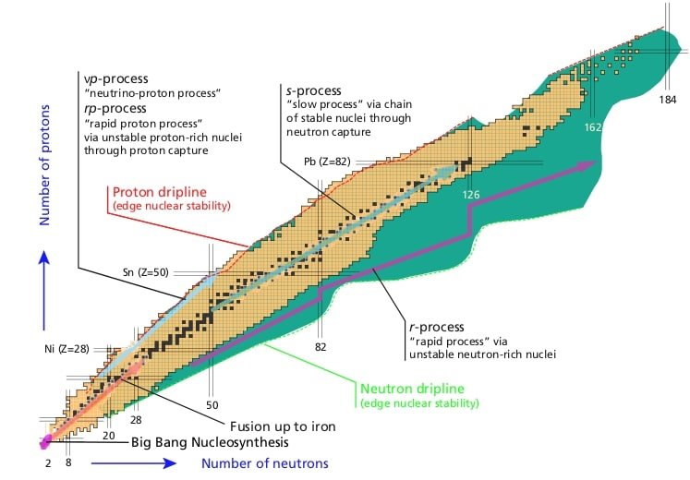
Neutron Capture Processes
Slow Neutron Capture (s-process)
Takes place inside AGB stars (main branch) and massive stars (weak branch)
Neutron density around 10⁵⁻⁶ cm⁻³ from either ¹³C(α,n)¹⁶O or ²²Ne(α,n)²⁵Mg reactions
τ_{n} ~ [d to yrs] competes with τ_{β} [d to yrs] to synthesise 60<A<208 elements in equilibrium
Rapid Neutron Capture (r-process)
Takes place in core collapse supernovae (CCSNe) and neutron star mergers (NSM)
Neutron density >10²⁰ cm⁻³
τ_{n} ~ [s] synthesises the heaviest element along each isotopic chain till freeze-out, followed by decay to stability
Chart of nuclei and nucleosynthesis pathways. R-process takes place far from the valley of stability and proceeds through waiting point nuclei.
T.R. Rodriguez, J. Phys. Conf. Ser. 503 (2014)

Slide 3
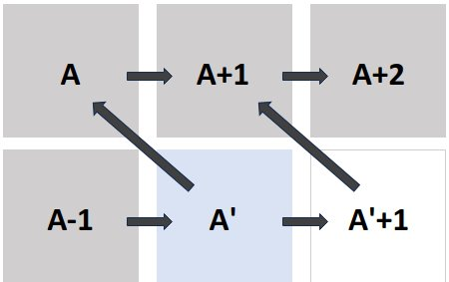
S-Process Abundance and Branching
Abundance of isotopes, particularly at branching points, depends on
Maxwell Averaged Cross Sections (MACS) of neutron capture and
β-decay rates
Plasmas affect β-decay rates

Slide 4
Fundamentals of β-Decay
β-Decay Processes
X = parent nucleus/atom (in general, system)
Y = daughter nucleus/atom (in general, system)
i = ionisation stage of the atom
Decay Energy
Decay Rate and log ft
Lepton phase volume
Decay half-life
Nuclear Matrix Element (NME)

Slide 5
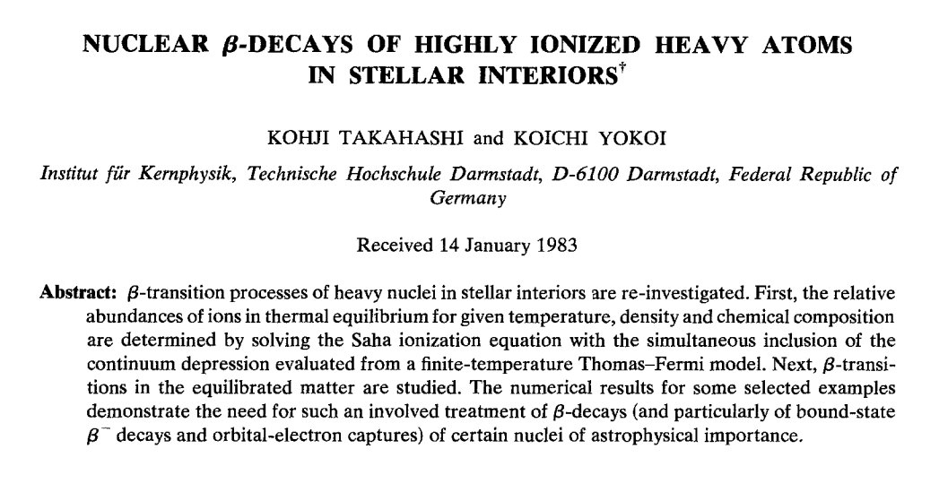
Systematics of In-Plasma Decay: Takahashi-Yokoi Model
Difference in ionisation energy
Difference in nuclear level energy
Difference in excitation level energy
Difference in IPD
i = ionisation stage of the atom (follows charge conservation)
j = excitation state of parent system
j' = excitation state of daughter system
A comprehensive model combining the work of other researchers (Konopinski, Bahcall, Daudel etc) to predict β-decay rates in LTE plasma
K. Takahashi and K. Yokoi, Nucl. Phys. A 404 (1983)
New decay channels can open, changing the decay rate
Ex. ¹⁶³Dy⁰⁺ is stable, but ¹⁶³Dy⁶⁶⁺ decays in days
¹⁸⁷Re⁰⁺ decays to ¹⁸⁷Os g.s. but at high ionisation stage,
it decays to ¹⁸⁷Os first excited state as well
F. Bosch et al, Phys. Rev. Lett. 77, 26 (1996)
M. Jung, F. Bosch et al, Phys. Rev. Lett 69, 2164 (1992)

Slide 6
Generalised Takahashi-Yokoi Model
TY model can be generalised to larger variety of plasmas
β-Decay Rates of Individual Ions
Ion Charge State Distribution in Plasma
In-plasma rates
Calculated with appropriate plasma model
Spatially uniform plasma with fixed n_{e} and kT_{e}
Stellar plasma
Non-uniform plasma with spatially-resolved n_{e} and kT_{e}
Laboratory magnetoplasma
Spatially non-uniform and temporally-evolving plasma
Laser-generated plasma
Experiments Observables Model verification
Nucleosynthesis models

Slide 7
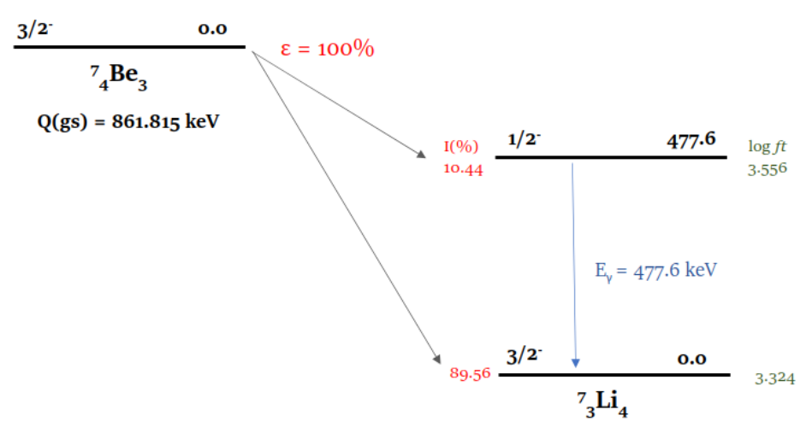
Electron Capture Decay of ⁷Be
Configuration-Dependent Lepton Phase Volume
Occupancy of orbital contributing to certain decay within relevant ionic configuration
Shape factor describing compatibility between nuclear and lepton wavefunction
Larger of squared radial component of electron wavefunction evaluated on nuclear surface
Q-value of decay when isotope in (i,j) charge state and level configuration
Configuration-Dependent Decay Rate
Plasma-Dependent Decay Rate
⁷Be undergoes EC decay to ⁷Li through 2 channels
Decay scheme taken from ENSDF database
CSD and LPD of radio-isotope ions
There are just two channels here, but the model can be generalised to include any number of channels, as long as those levels equilibrate faster than they β-decay, and the decay is energetically allowed

Slide 8
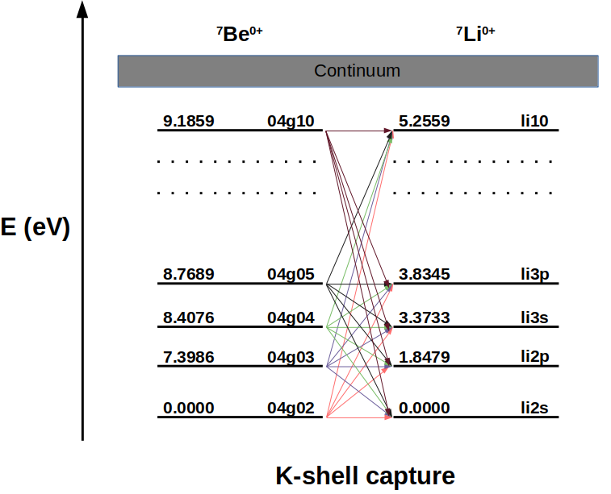
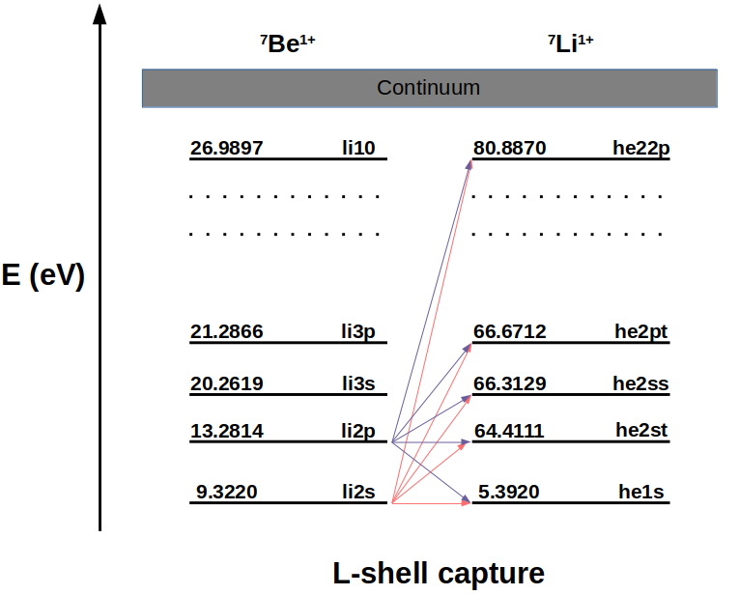
Electron Capture Decay of ⁷Be
Decay Energy
Difference in nuclear masses Q_{0,m}
Atomic data (level index, energy and electronic configuration) taken from FLYCHK
H.-K. Chung, M.H. Chen, Y. Ralchenko et al, High Energy Density Phys. 1, 1 (2005)
Difference in atomic configuration energy Δe^{ij}
Average difference in excitation energy between parent and daughter ions

Slide 9
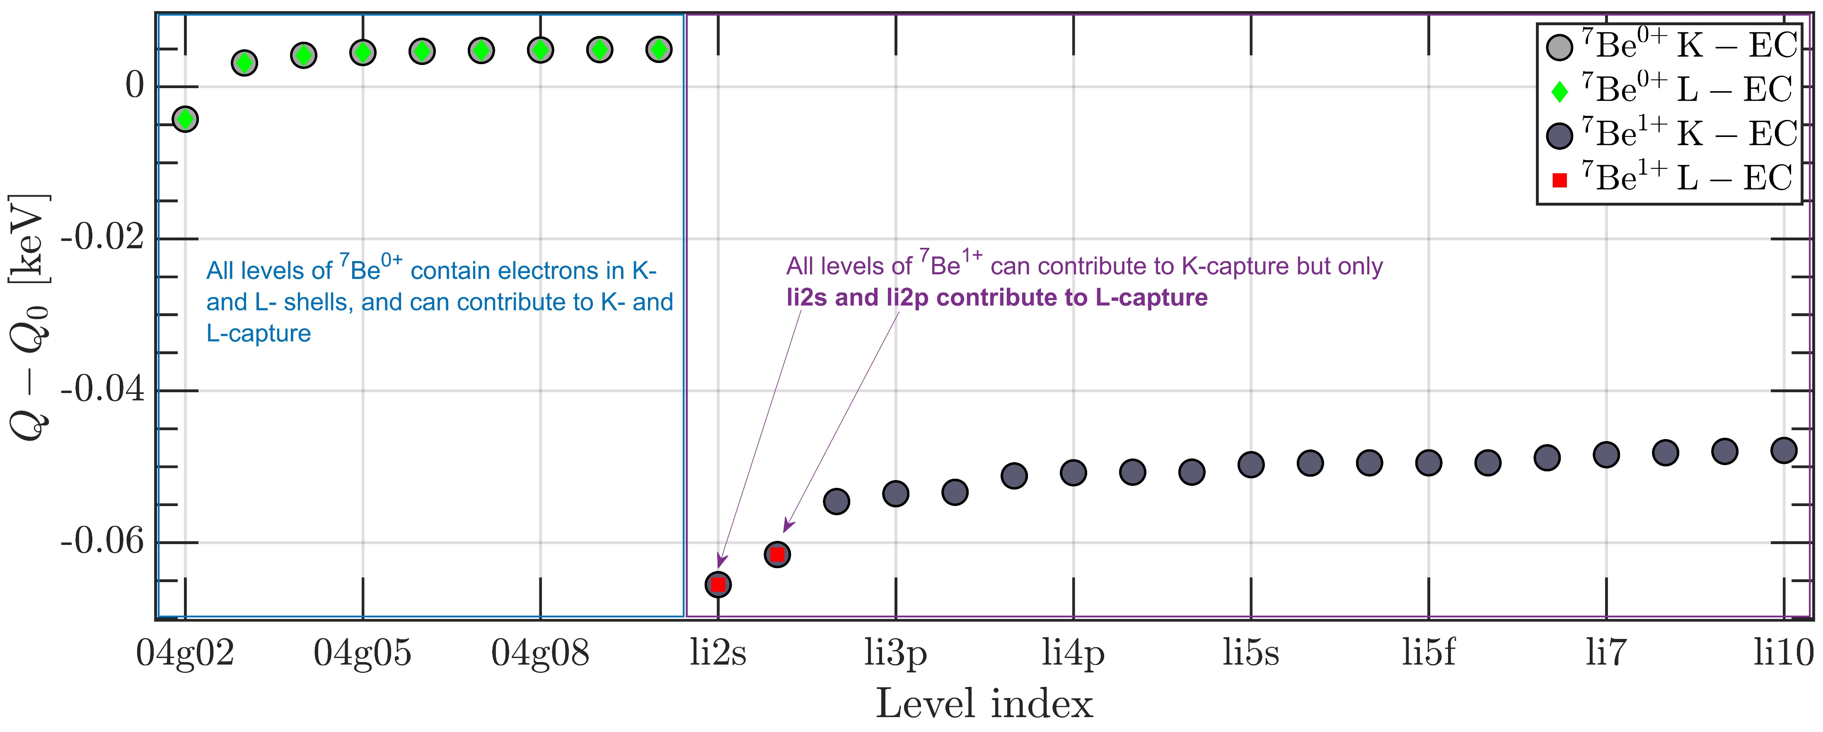
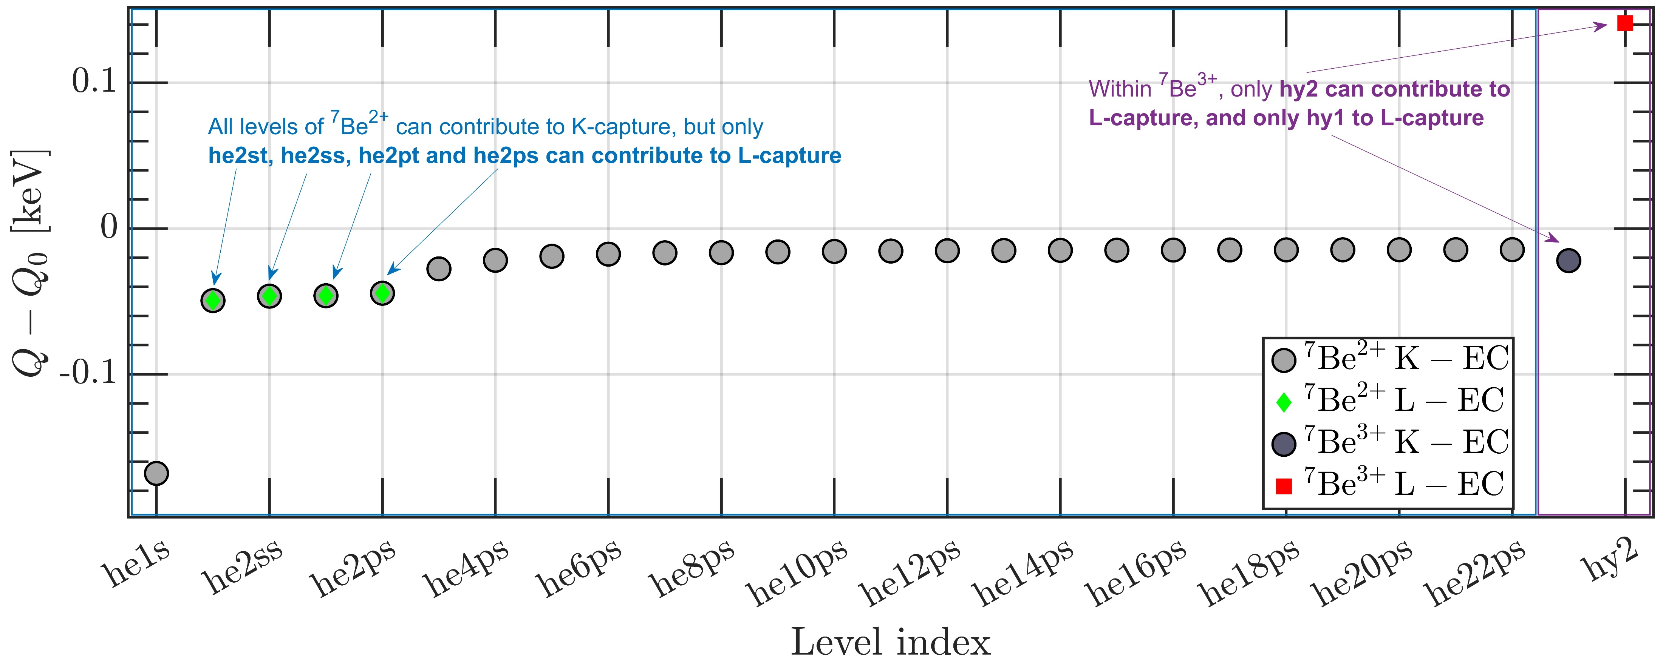
Electron Capture Decay of ⁷Be
Decay Energy
Difference in nuclear masses Q_{0,m}
Atomic data (level index, energy and electronic configuration) taken from FLYCHK
H.-K. Chung, M.H. Chen, Y. Ralchenko et al, High Energy Density Phys. 1, 1 (2005)
Difference in atomic configuration energy Δe^{ij}
Q_{gs}(ij)-Q_{0,gs} for different j in ⁷Be^{0+,1+} (left) and ⁷Be^{2+,3+} (right)

Slide 10
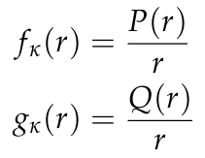
Electron Capture Decay of ⁷Be
Radial Wavefunctions
The radial wavefunctions describe the degree of overlap between the atomic orbitals and the nuclear surface. The wavefunctions are obtained by solving the Dirac equation in the central Coulomb field
V.M. Burke and I.P Grant, Proc. Phys. Soc.90, 297 (1967)
Eigenfunctions of Dirac equation
Volumetric wavefunctions
Electron radial wavefunction
Normalisation
Normalisation
Nuclear surface
Orbital κ (nl_{j})

Slide 11
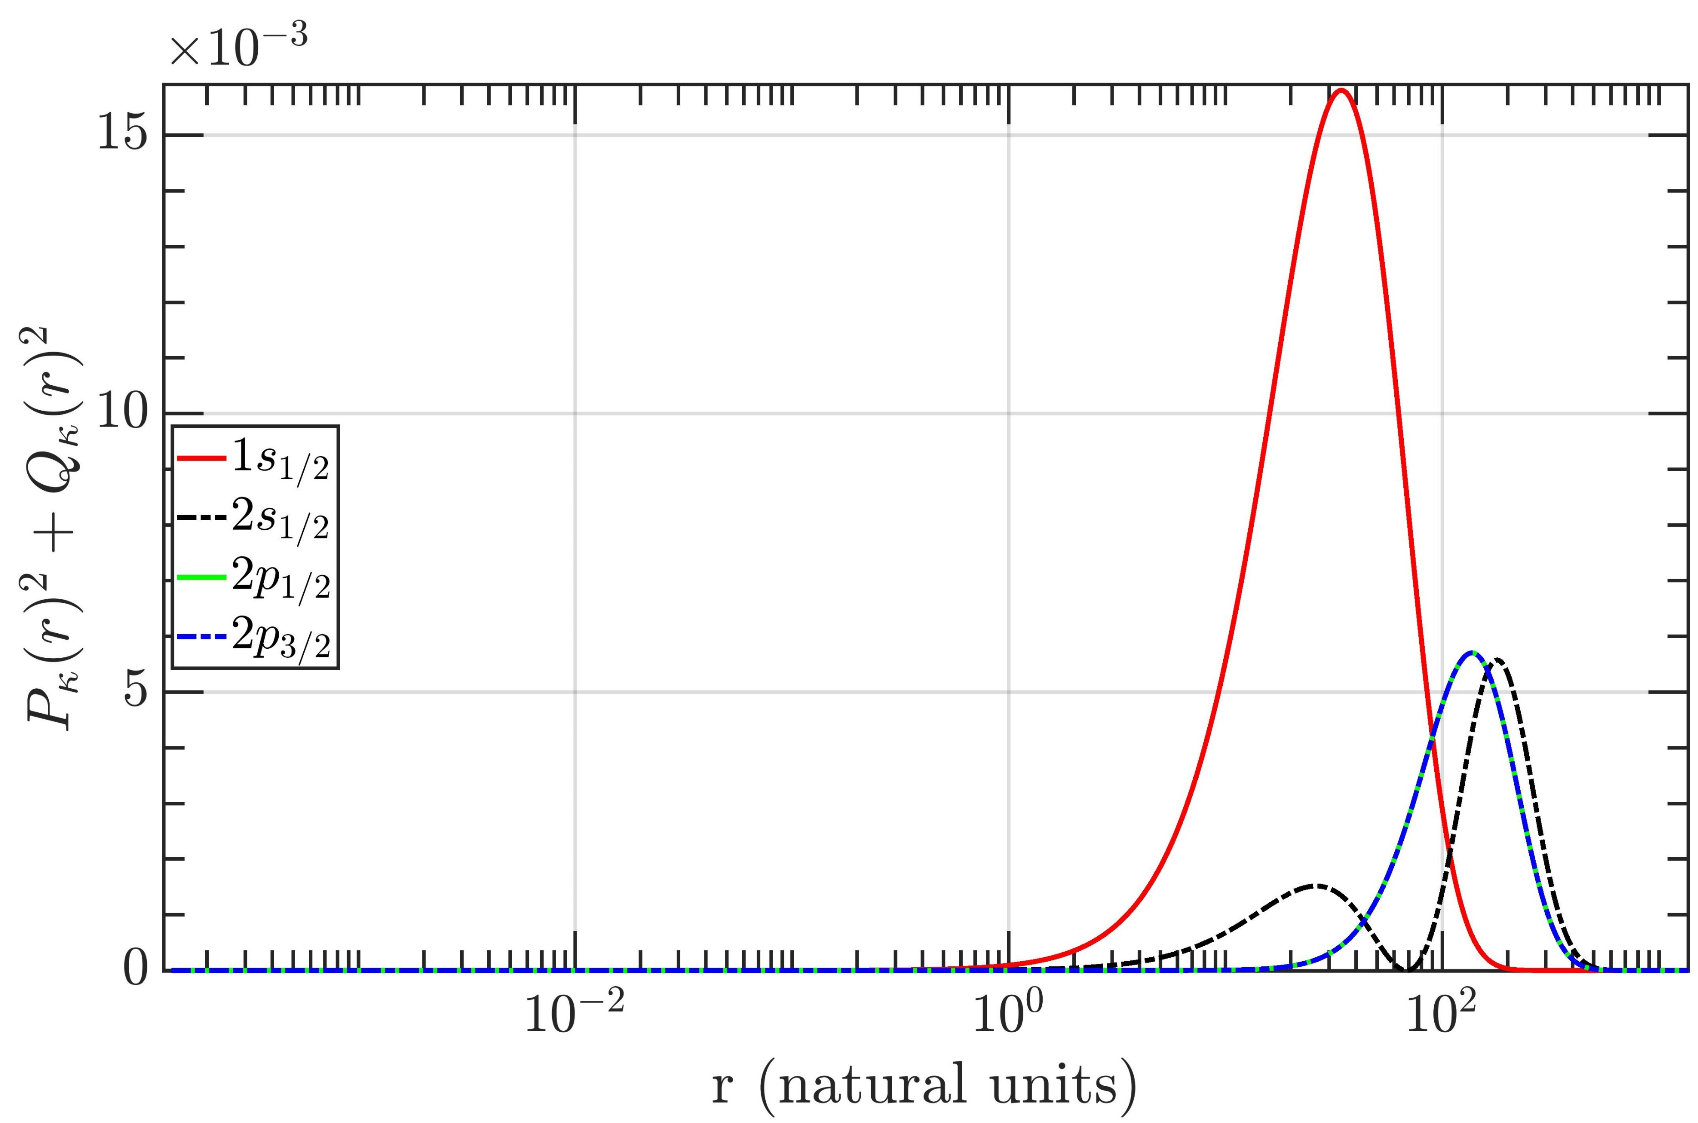
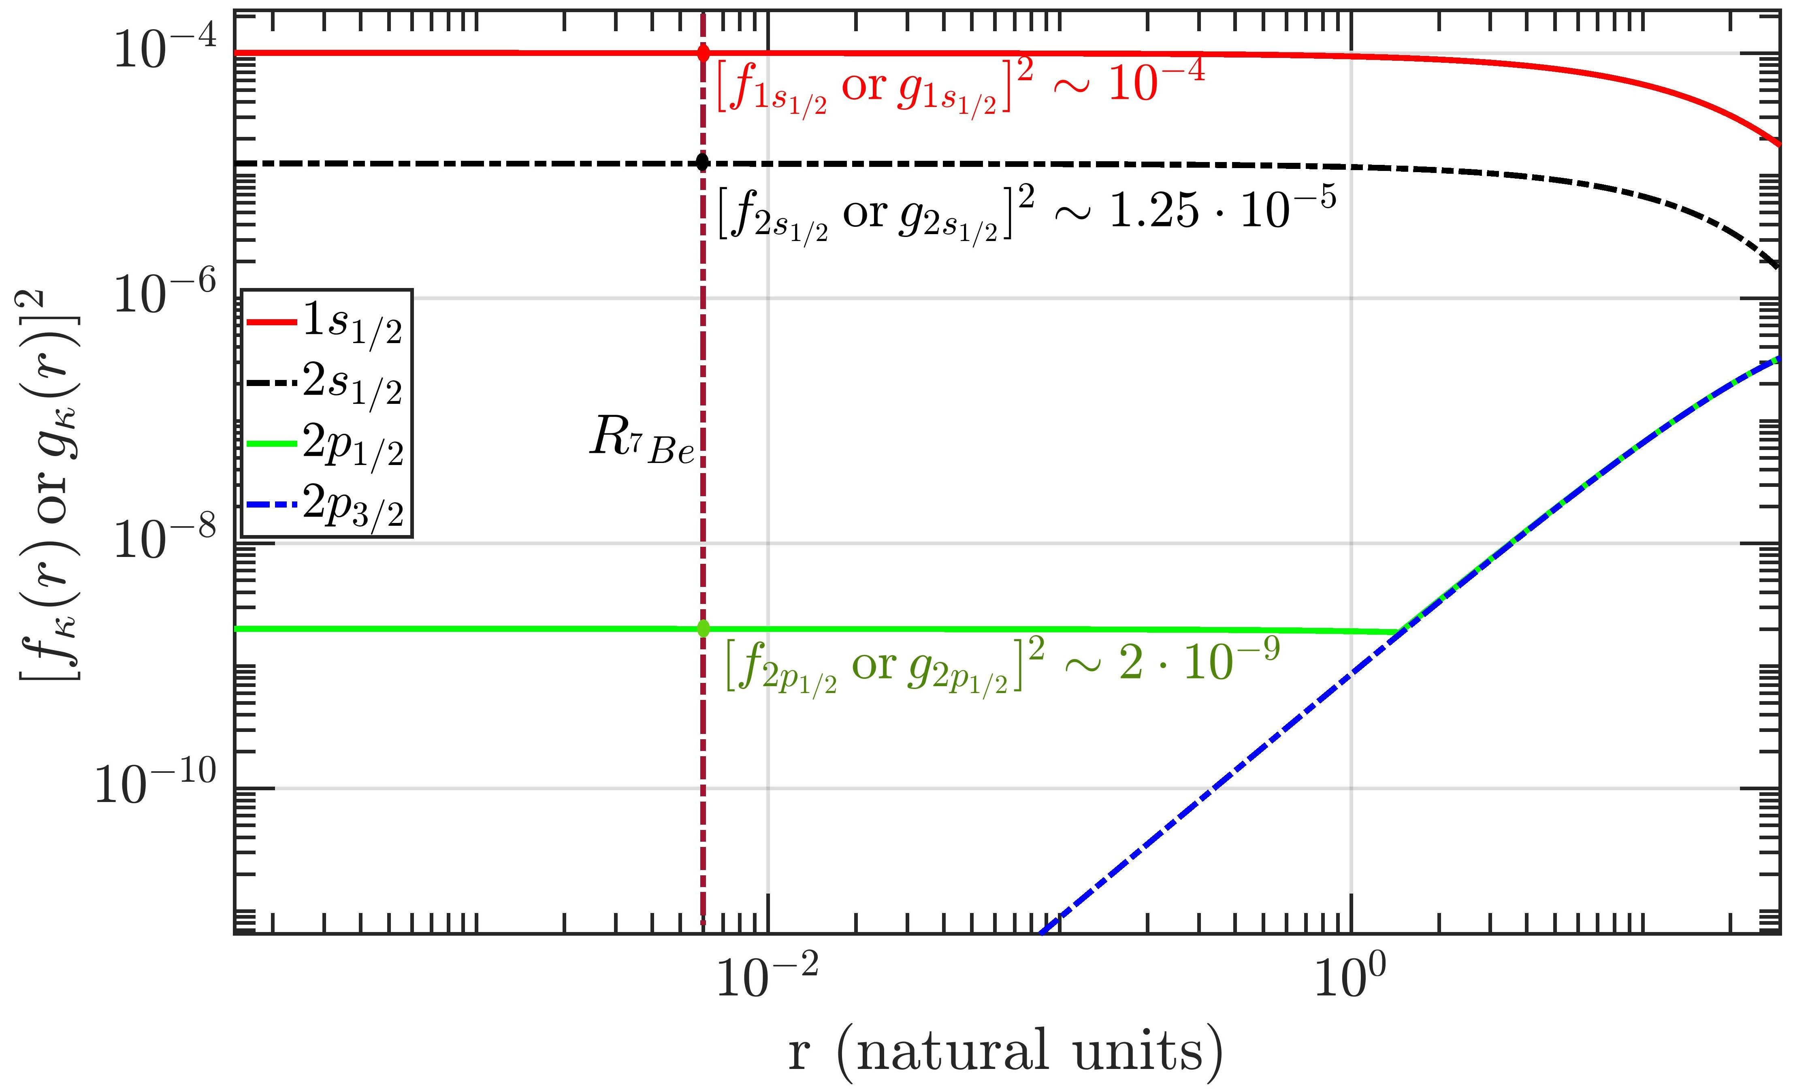
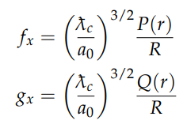
Electron Capture Decay of ⁷Be
Radial Wavefunctions
The radial wavefunctions describe the degree of overlap between the atomic orbitals and the nuclear surface. The wavefunctions are obtained by solving the Dirac equation in the central Coulomb field
V.M. Burke and I.P Grant, Proc. Phys. Soc.90, 297 (1967)

Slide 12
Electron Capture Decay of ⁷Be
Shape Factor
Conservation of total angular momentum implies that only certain electron orbitals can interact with the nucleus, depending on the spin and parity of the decay. Shape factors enforce selection rules.
L.M. Folan and V.I.Tsifronovich, Phys. Rev. Lett. 74, 499 (1995)
Electron radial wavefunction
Electron radial wavefunction
Orbital κ (nl_{j})
Angular momentum L
Spin S
I_{i}
I_{f}
Modified according to the decay channel

Slide 13
Electron Capture Decay of ⁷Be
Shape Factor
Conservation of total angular momentum implies that only certain electron orbitals can interact with the nucleus, depending on the spin and parity of the decay. Shape factors enforce selection rules.
L.M. Folan and V.I.Tsifronovich, Phys. Rev. Lett. 74, 499 (1995)

Slide 14
Electron Capture Decay of ⁷Be
Shell Occupancy
σ_{x} describes the occupancy of an orbital. To capture orbital electrons, the occupancy should be non-zero.
On ionising the atom, the number of electrons available in a shell decreases, and the capture phase volume decreases. Consequently, the EC decay rate goes down.
Electron radial wavefunction
Nuclear surface
Nuclear surface
Orbital κ (nl_{j})
Orbital κ (nl_{j})
Electron present in orbital, σ_{x}≠ 0
Capture possible
Electron absent from orbital, σ_{x}= 0
Capture impossible

Slide 15
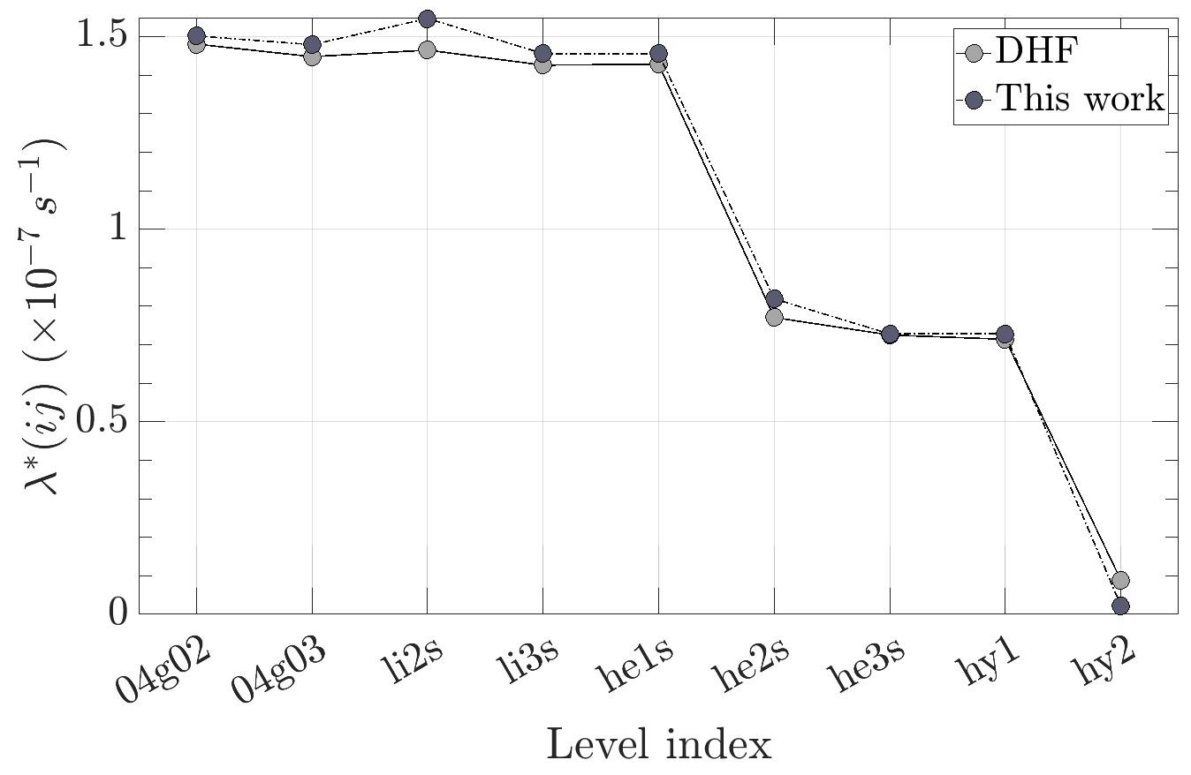
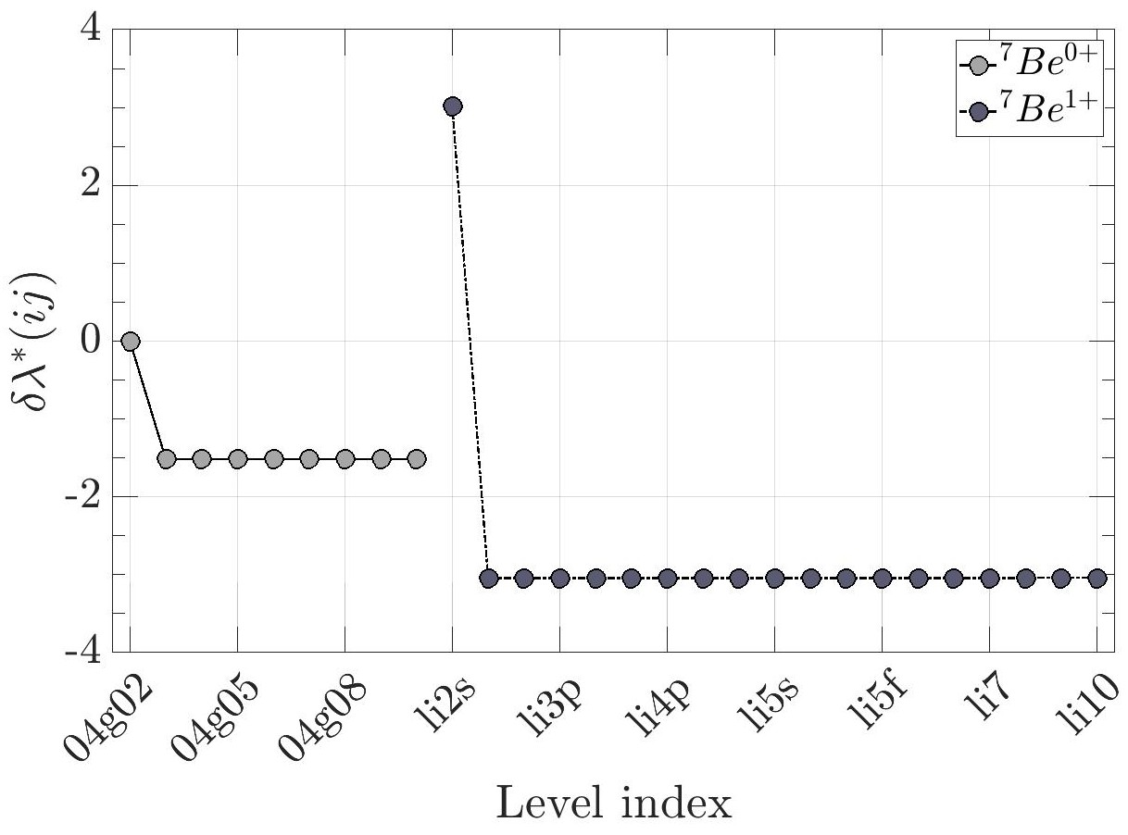
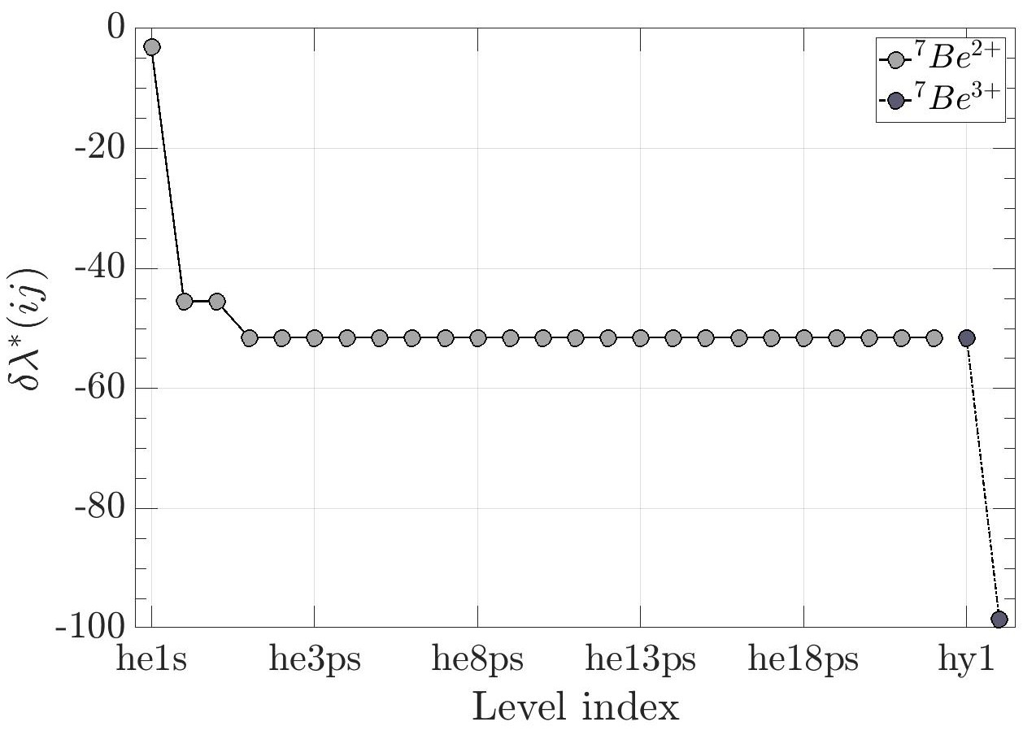
Electron Capture Decay of ⁷Be
Configuration-Dependent Decay Rate
Decay rate halved going from ⁷Be²⁺ in ground state to excited state because of loss of K-shell electrons.
Change in decay rate closely follows change in Q-value in neutral ⁷Be
Spike in decay rate arises from increase in L-shell occupancy, connected to lack of resolution in electronic configuration in ⁷Be⁰⁺ compared to 1+
Decay rate halved again going from ⁷Be³⁺ in ground state to excited state due to transfer of K-shell electron to L-shell.

Slide 16
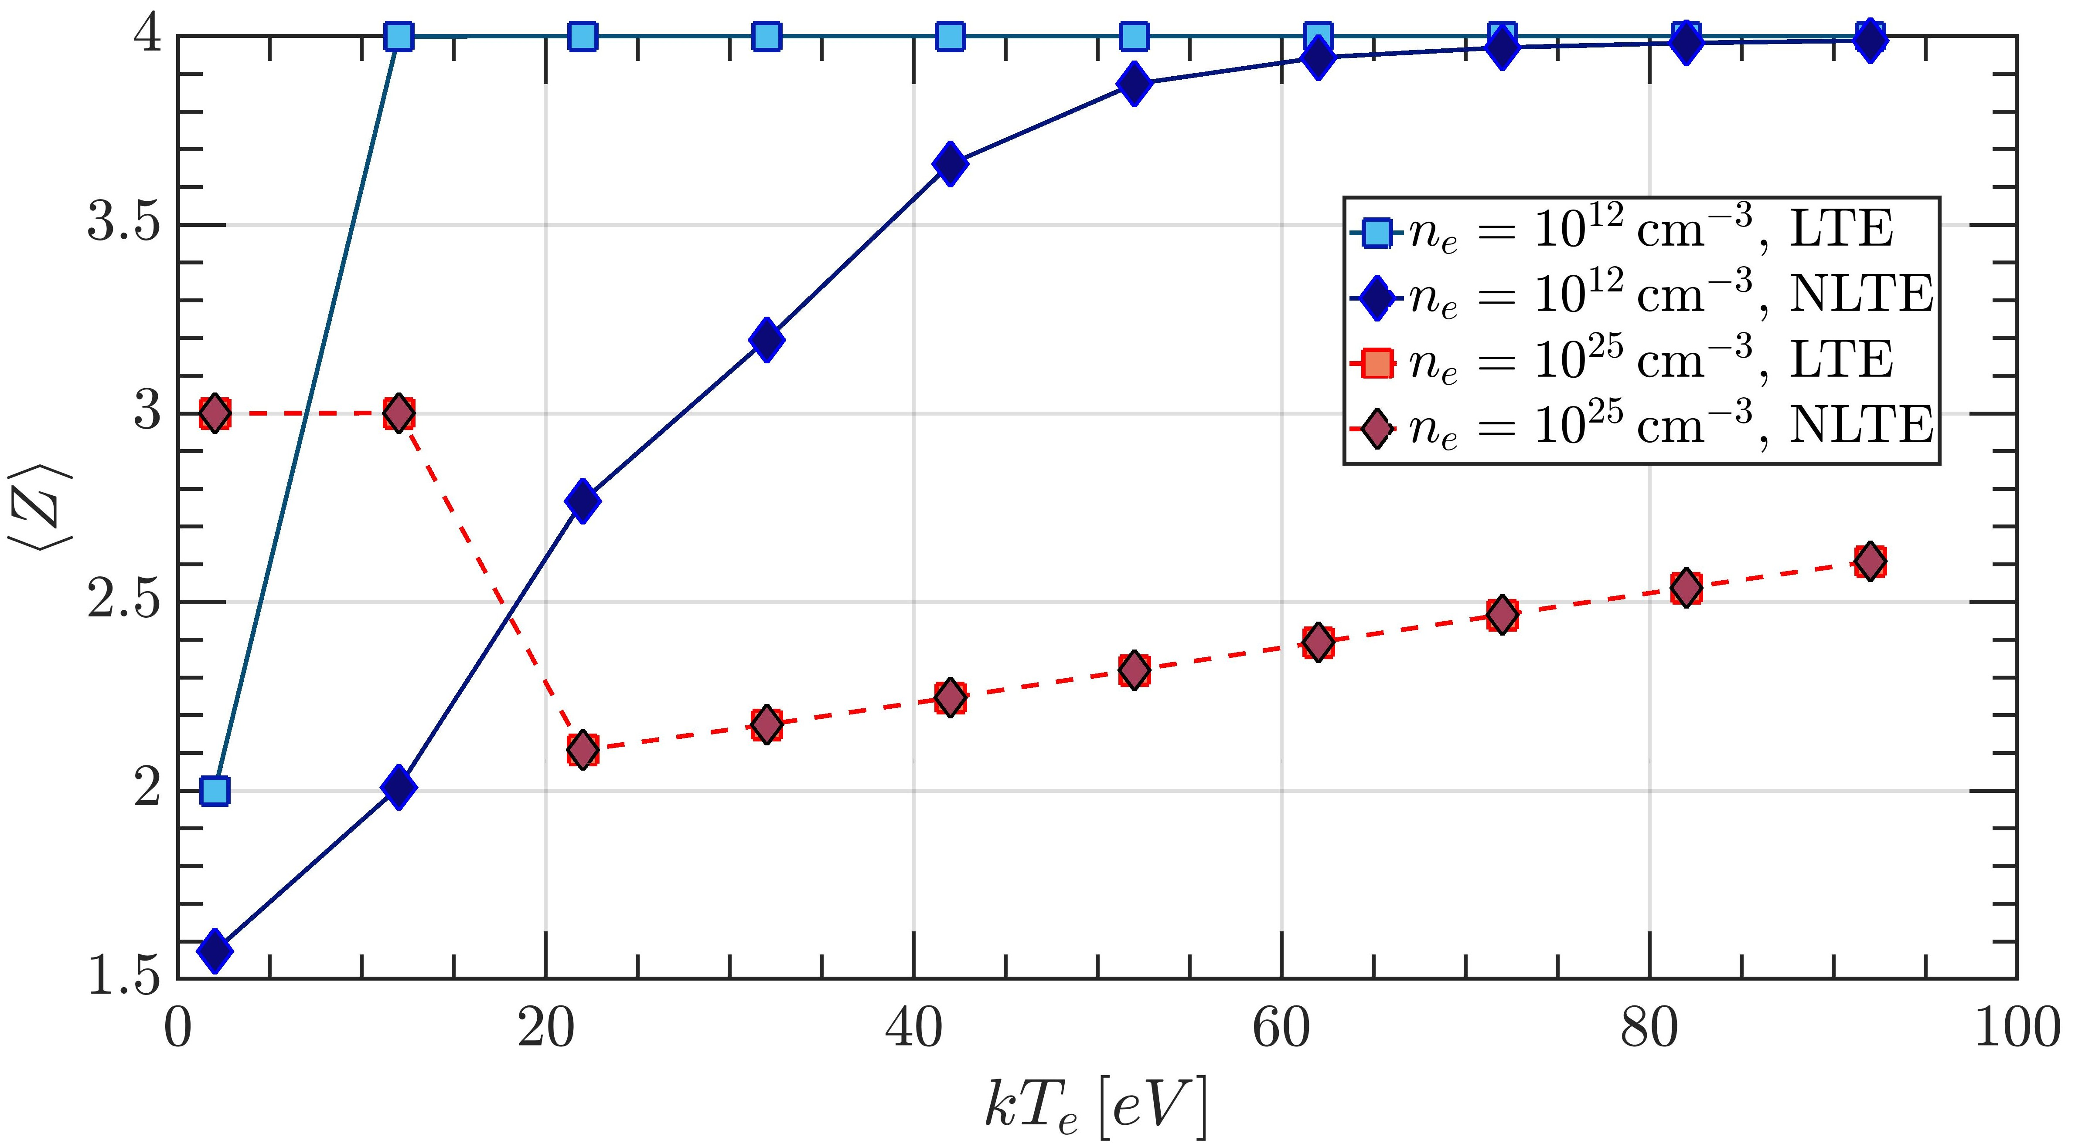
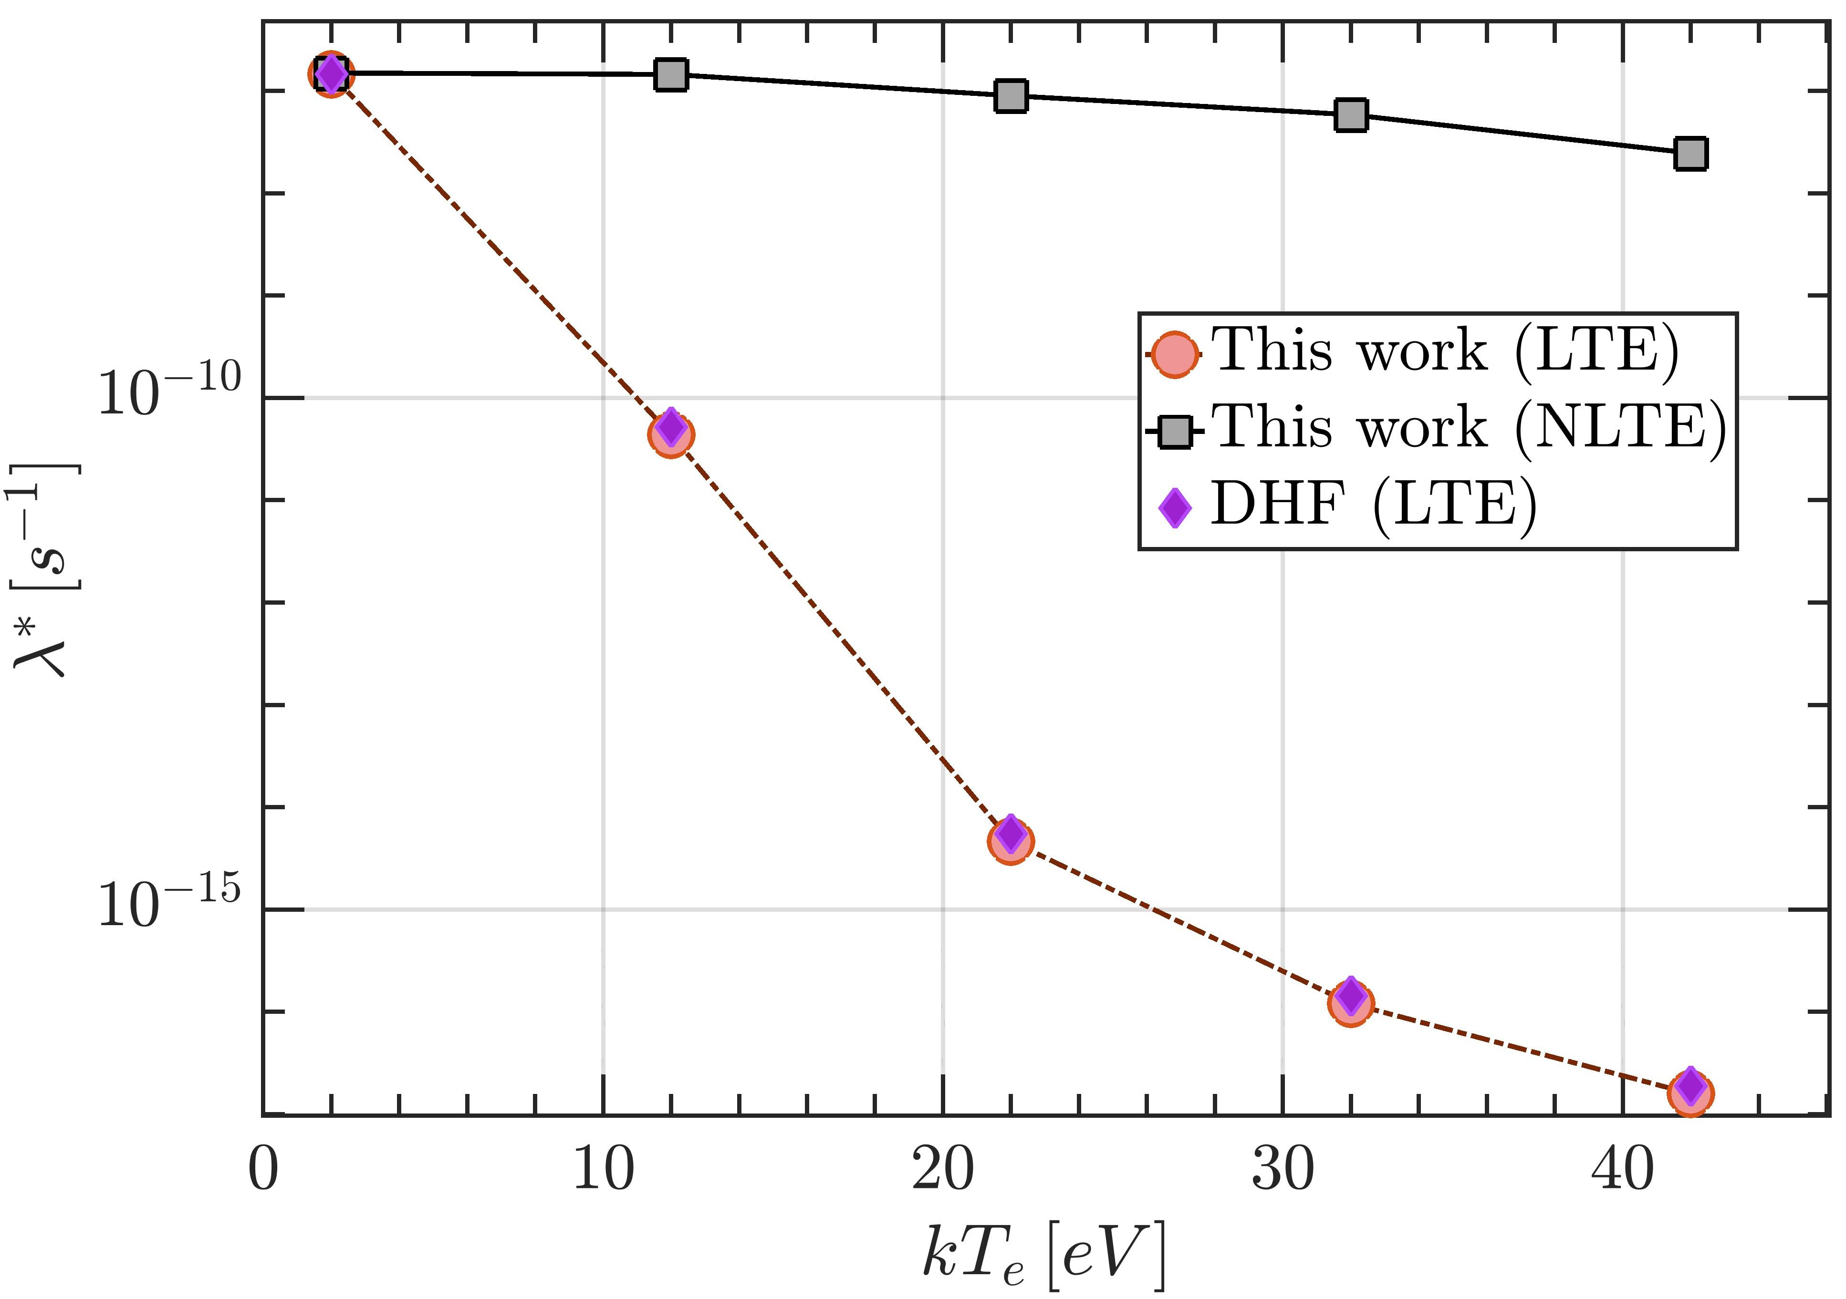
Electron Capture Decay of ⁷Be
Plasma-Dependent Decay Rate
The CSD and LPD of ions can be calculated according to the thermodynamic conditions (n_{e} and T_{e}) of the plasma, and according to its nature (LTE vs NLTE)
<Z> of ⁷Be ions in a uniform plasma with n_{e} = 10¹² cm⁻³, under LTE and NLTE conditions.
λ* of ⁷Be ions in a uniform plasma with n_{e} = 10¹² cm⁻³, under LTE and NLTE conditions.

Slide 17
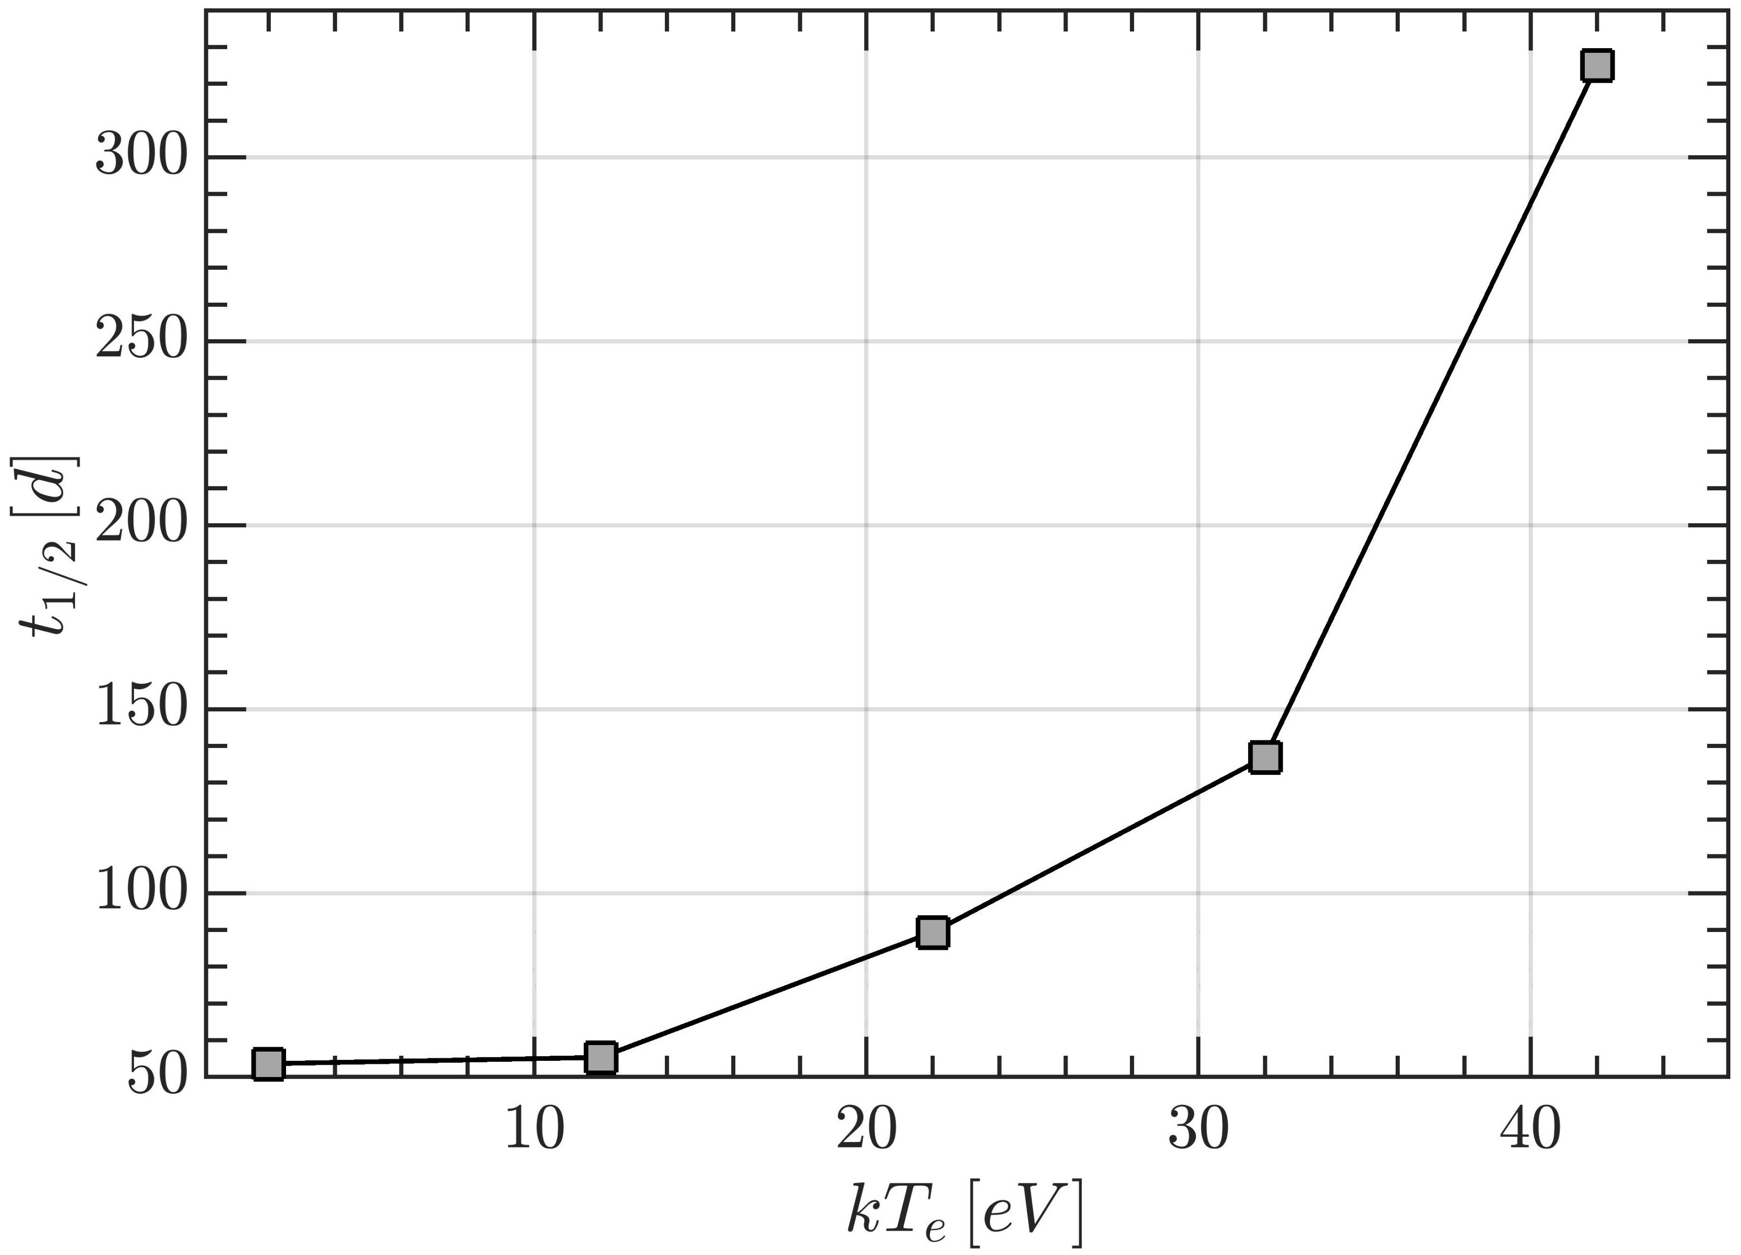
Systematics Model Validation
¹⁶³Dy⁶⁶⁺ t_{1/2} = 49.52 d calculated by Liu et al
S Liu, C Gao, and C Xu, Phys. Rev. C 104, 024304 (2021)
¹⁶³Dy⁶⁶⁺ t_{1/2} = 47⁺⁵₋₄ d measured by Jung et al
M. Jung, F. Bosch et al, Phys. Rev. Lett 69, 2164 (1992)
¹⁶³Dy⁶⁶⁺ t_{1/2} calculated = 49.77 d
t_{1/2} in ⁷Be⁰⁺ at ground state = 53.44 days with BR = 10.45%
ENSDF t_{1/2} = 53.22 ± 6 days and BR = 10.44%
B. Mishra et al, PRL (under review) http://arxiv.org/abs/2407.01787
Y. Litvinov et al, , Phys. Rev. Lett 99, 262501 (2007)
¹⁴⁰Pr⁵⁷⁺ λ calculated = 0.00145 s⁻¹

Slide 18
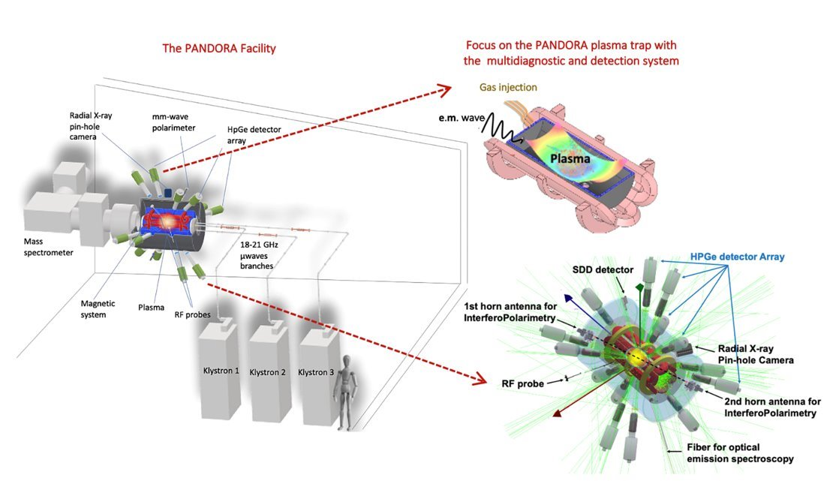
Application to Magnetoplasmas
PANDORA (Plasmas for Astrophysics, Nuclear Decay Observations and Radiation for Archaeometry)
Upcoming facility at INFN-LNS to perform in-plasma nuclear astrophysics
D. Mascali et al, Universe 8, 80 (2022)
First of its kind to use an electron cyclotron resonance (ECR) plasma as a medium to study β-decays and opacity
Multi-diagnostic system to be employed
SDD and CDD for soft X-rays
Mass spectrometer and Faraday cup for ion currents
HPGe detector array for secondary γ
5.6 m
4 m
2 m

Slide 19
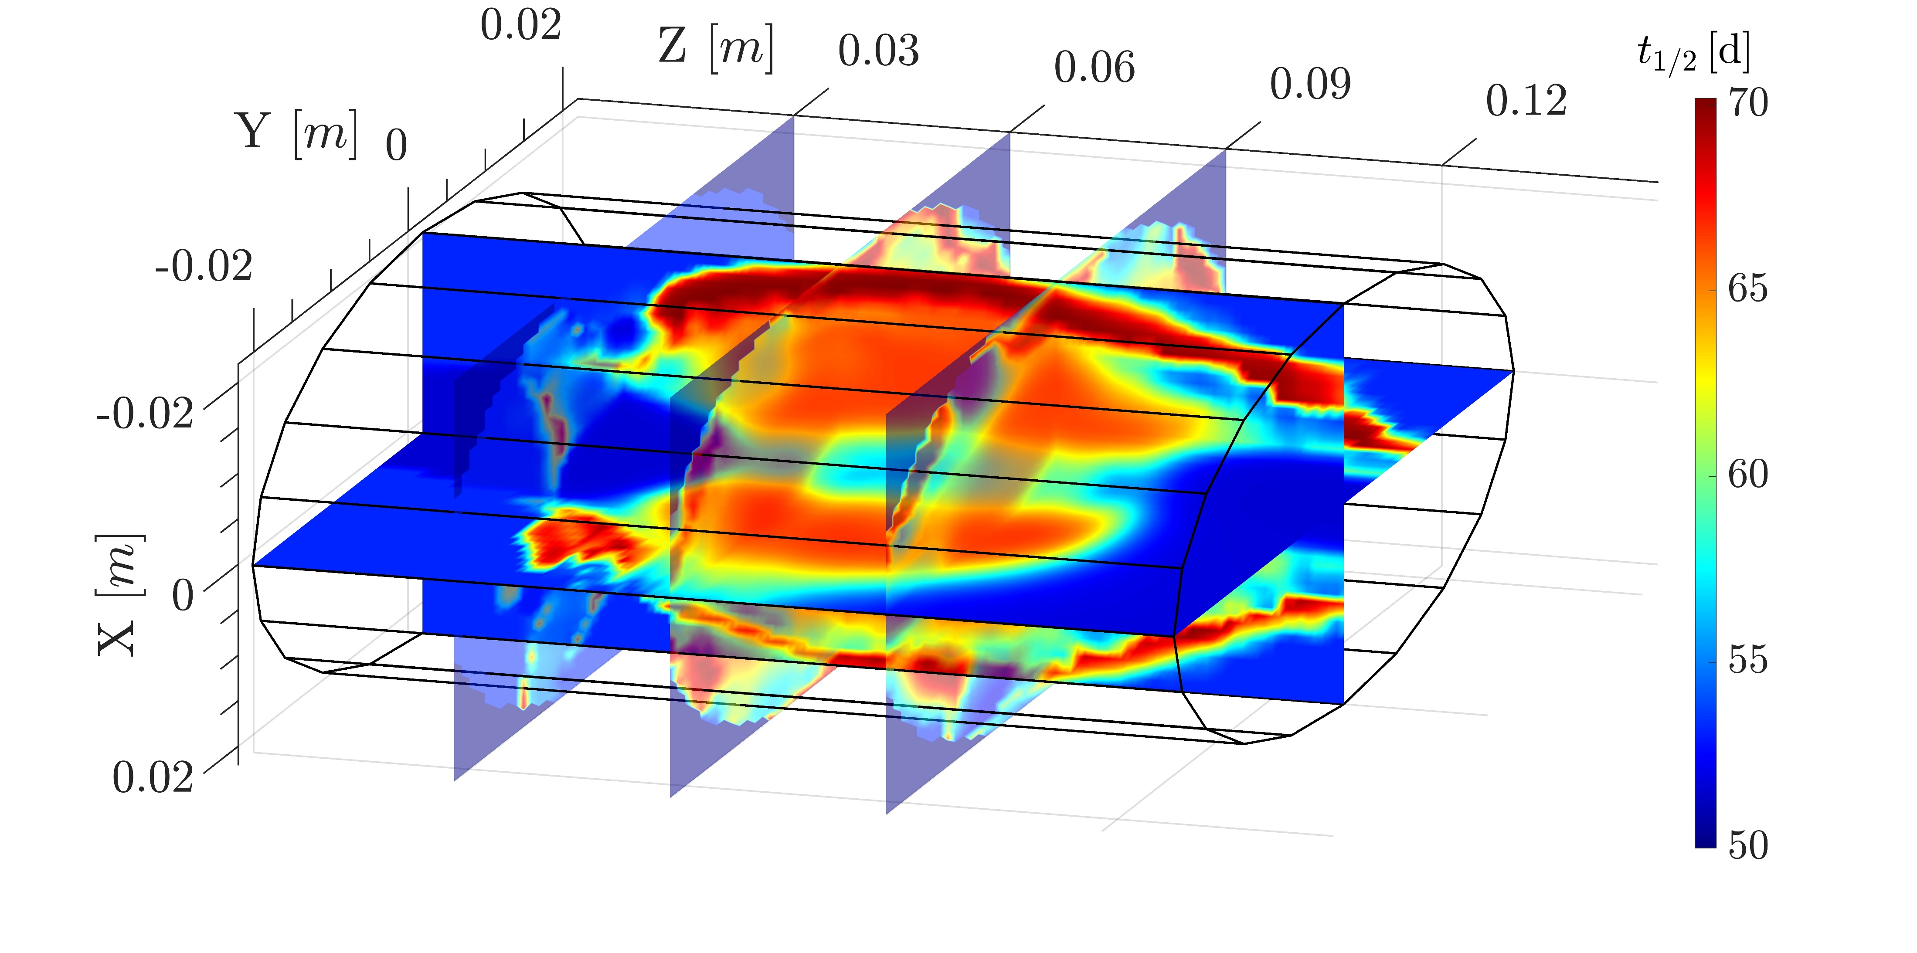
Application to Magnetoplasmas
The generalised systematics model can be applied to ECR magnetoplasmas by combining λ*(ij) with p_{ij} from PIC codes
Electron PIC simulations
Buffer ion PIC-MC simulations
Radioisotope ion PIC-MC simulations
Earlier talk by D. Mascali
3D distribution of ⁷Be t_{1/2} in a typical ECR magnetoplasma. The regions of higher t_{1/2} are indicative of presence of higher charge states

Slide 20
Electroweak Decays in Laser Plasmas
Plasma-induced decay rate modification in nuclear ground state → PANDORA
Contribution from all energetically possible decay channels, including nuclear excited states
Different parameter space for studying plasma effects
IPD – LTE CSD – Denser electron cloud
Laser plasmas can potentially unlock the means to study the hadronic contribution to decay rates in an environment more similar to stellar interiors

Slide 21
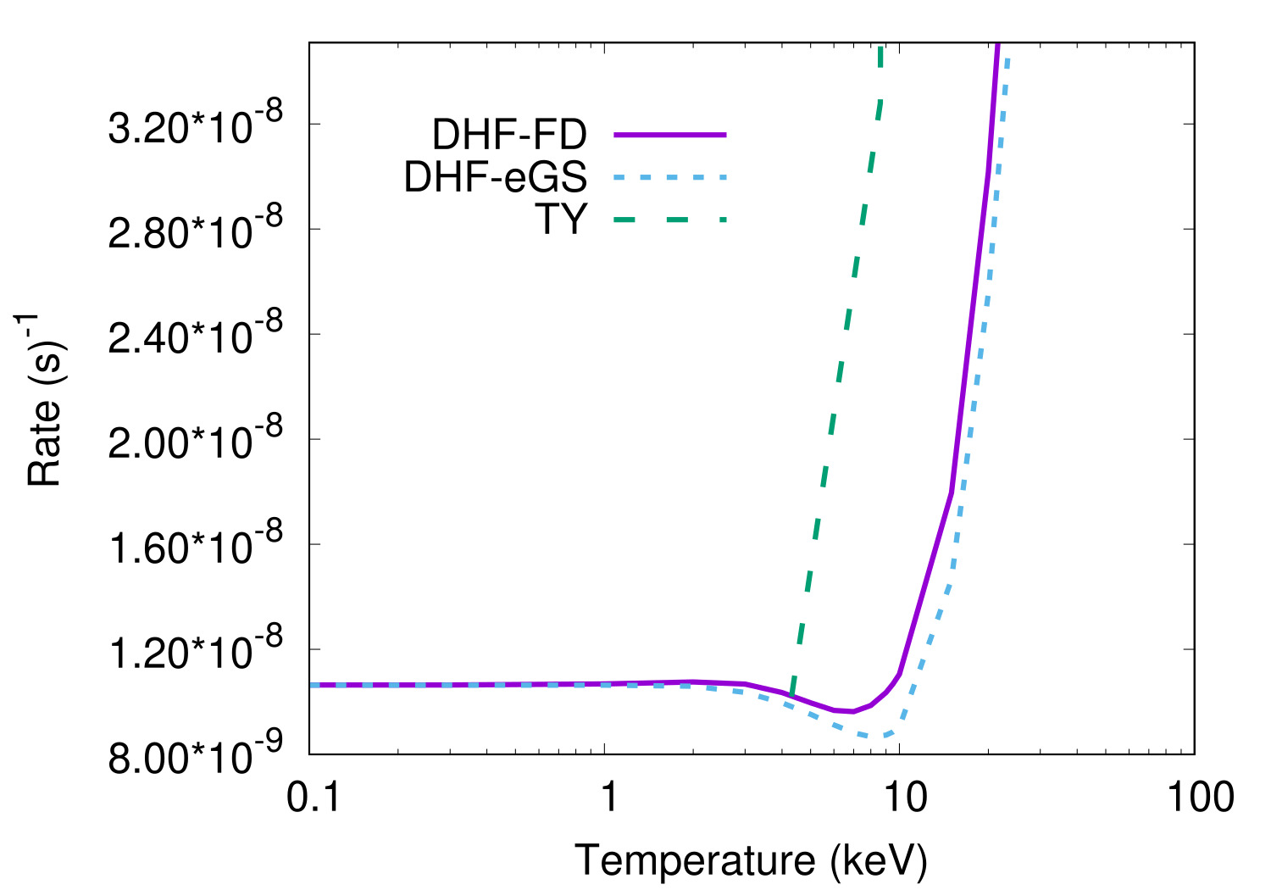
Decays from Excited Nuclear States - ¹³⁴Cs
¹³⁴Cs is important for stellar s-process nucleosynthesis around the N=82 peak. The abundances of Ba isotopes strongly depend on the β⁻ decay rate of ¹³⁴Cs
K-A Li et al, ApJ 919:L19 (2021)
S Palmerini et al, ApJ 921:7 (2021)
S Taioli et al, ApJ 933:158 (2022)
M Busso et al, Front. Astron. Space Sci. 9:956633 (2022)
The 60 keV level can significantly accelerate decay rates, but the log ft of the level is uncertain
Can we equilibrate this level in a laser plasma?
3⁺ ?
60.02 keV
5⁺
11.24 keV
4⁺
0.0 keV
Q(gs)=2058.7 keV
log ft = 6.49, 27.27%
4⁺
1969.9 keV
log ft = 9.65, 2.49%
3⁺
1643.3 keV
log ft = 8.88, 70.17%
4⁺
1400.6 keV
0⁺
0.0 keV
¹³⁴Cs
¹³⁴Ba

Slide 22
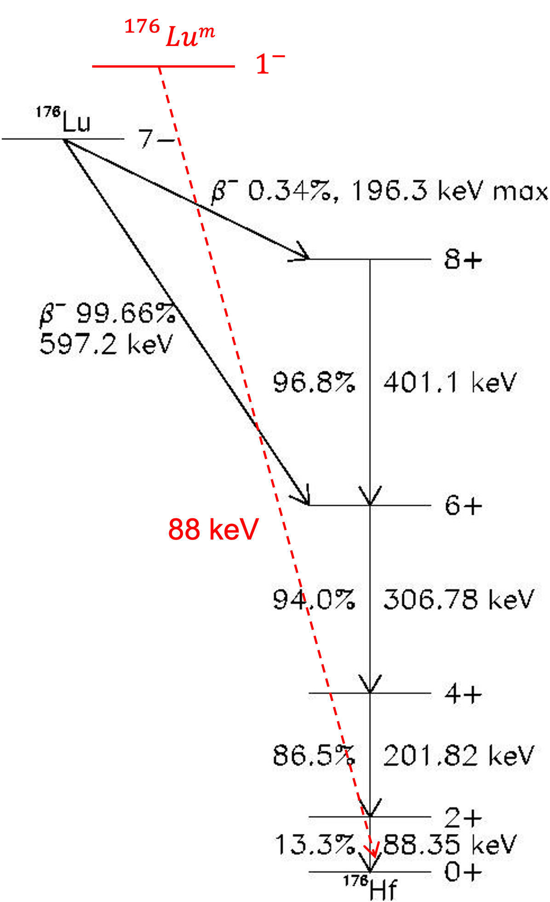
Decays from Isomeric Levels - ¹⁷⁶Lu
¹⁷⁶Lu is a long-lived isotope with a t_{1/2} =3.76x10¹⁰ y and is generally used as a cosmochronometer. ¹⁷⁶Lu^{m} has a t_{1/2} = 3.664 h. If the isomer is equilibrated with the ground state in stellar environment, the decay will be accelerated and ¹⁷⁶Lu will switch from cosmochronometer to cosmothermometer.
Laser plasmas could help understand the reaction rates of processes populating the isomer
Direct photoexcitation with broadband X-ray radiation
Low cross sections, does not directly populate the isomer
Neutron-induced excitation
T. Hayakawa, J. Phys.: Conf. Ser. 2894 012023 (2024)
Nuclear Excitation by Electron Capture (NEEC)
Mentioned by A. del Dotto yesterday
Y. Wu et al, PRL 120 052504 (2018)

Slide 23
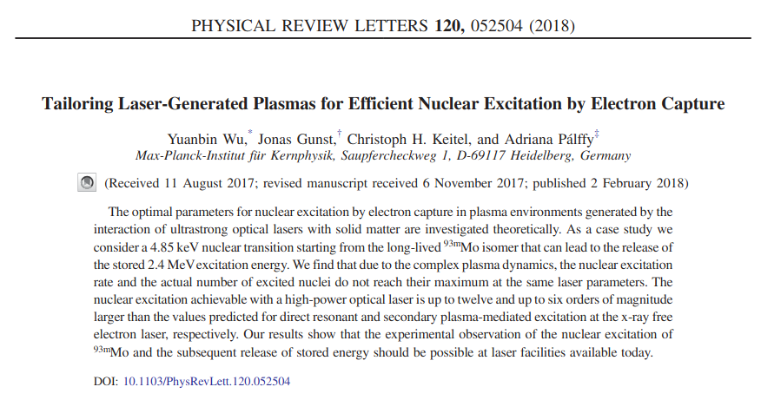
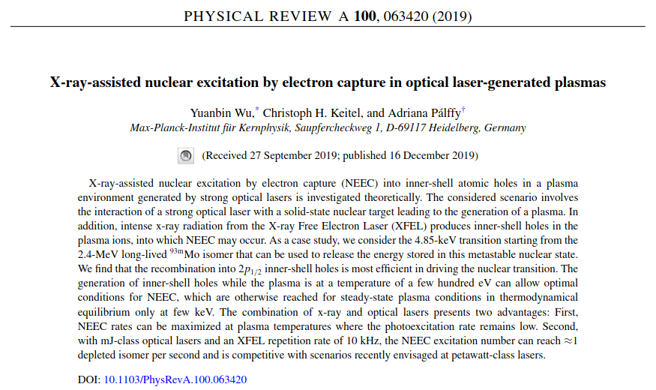
Nuclear Excitation by Electron Capture
Excited state
The process has 3 prerequisites:
Vacancies in inner orbitals (K, L)
Presence of continuum electrons of varying energies
Resonant nuclear transition
Easier physics case: ⁹³Mo^{m}
Continuum
K-shell
Ground state
Schematic of NEEC process
NEEC initiated and sustained by plasma itself
X-Ray assisted NEEC
Proposed experiments at EFEL and ELI. Could EuAPS be used to probe the process?
Yesterday's talks by A. Frizzata, V. Dompè and M. Opromolla

Slide 24
Conclusions
Plasmas can be a powerful environment to study modification of electroweak decays and validate models
Magnetic confinement
PRO:
Long-living plasma (order of weeks)
steady state dynamical equilibrium for density and temperature,
hence, over days/weeks constant values for charge state distribution of in-plasma ions
Online monitoring of plasma density, temperature, volume, eventual kinetic turbulence, at any energy domain in NLTE conditions
CONS:
Low density/high temperature plasma: NLTE conditions
Difficult “plasmization” of solid/metallic isotopes
No access to nuclear excited state studies (too low T)
Scenario can be different using plasma produced by HP lasers
PRO:
High density plasma, reaching LTE
Online production of RIBs is in principle possible
Possible nuclear excitation and therefore, complete study of in-plasma decay modification
CONS:
Difficult to implement diagnostics following on-lime the fast time-variation of plasma parameters
Short living plasma, with duration much shorter than typical lifetimes of isotopes involved in stellar nucleosynthesis

Slide 25
David Mascali
Domenico Santonocito
Angelo Pidatella
Eugenia Naselli
Giuseppe Torrisi
Giorgio Mauro
Giorgio Finocchiaro
Silvia Pisano
Alessio Galatà
THANK YOU FOR YOUR ATTENTION!
Alberto Mengoni
Stefano Simonucci
Sara Palmerini
Maurizio Busso
Simone Taioli
...and the PANDORA collaboration

Slide 26
Additional Slides

Slide 27
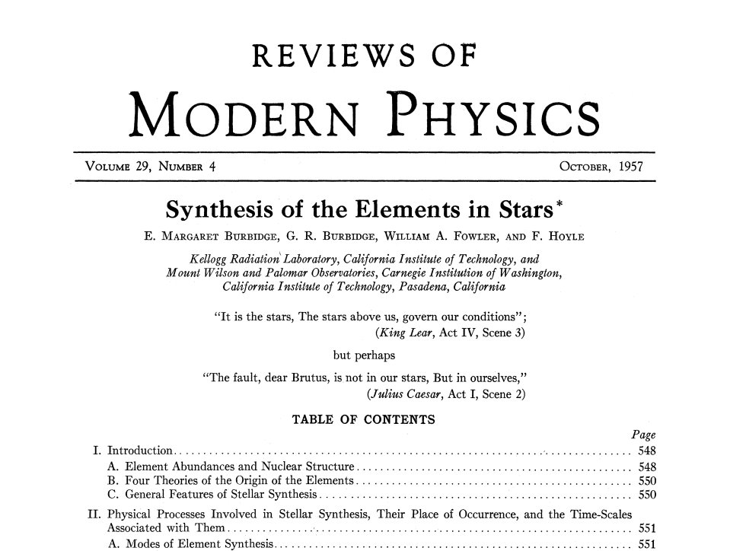
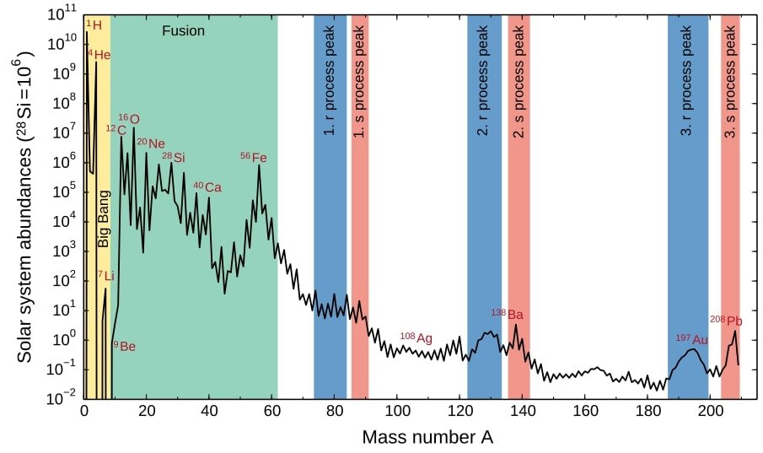
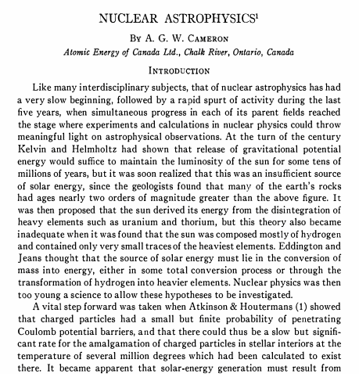
Elements of Nuclear Astrophysics
Elements till ⁵⁶Fe (iron peak) are synthesised through successive thermonuclear fusion reactions
99% of elements beyond the iron peak are produced through neutron capture reactions
A. Arcones and F. Thielemann, A&AR 31 (2022)

Slide 28
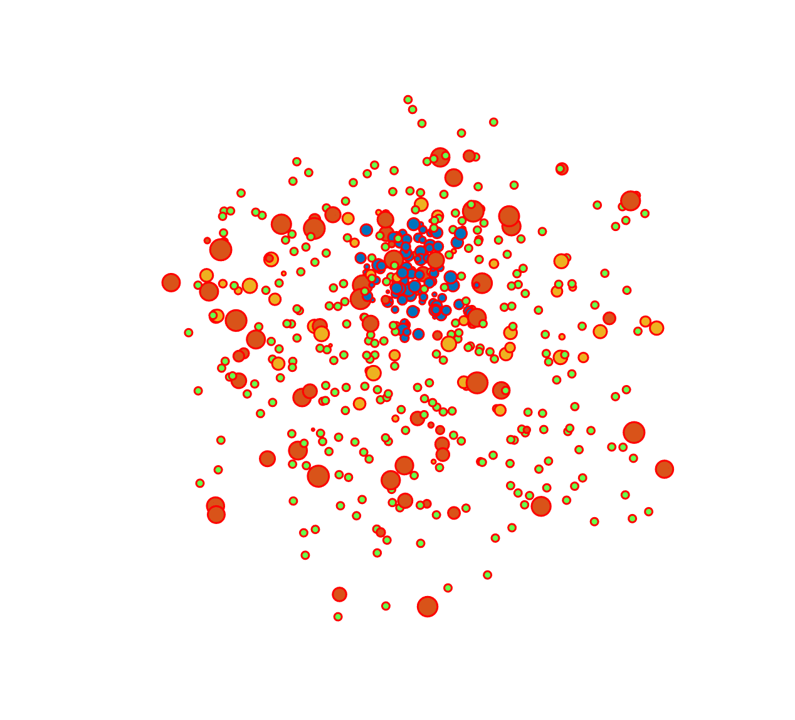
ECR plasma simulation pipeline
PIC SIMULATIONS FOR ELECTRONS
3D, steady-state maps of n_{e} and E_{e}
PIC-MC SIMULATIONS FOR PLASMA IONS
PIC-MC SIMULATIONS FOR ISOTOPE IONS
3D, steady-state maps of <Z> and n_{i}
3D, steady-state maps of <Z> and λ*
First level input to all codes and therefore precision needed
Observables: Soft X-ray spectroscopy, interferometry, polarimetry, profilometry, Thomson scattering
Second level input to in-plasma decay code
Observables: Faraday cup, optical emission spectroscopy, X-ray fluorescence
Observables: PANDORA
B. Mishra and A. Pidatella – INFN - LNS

Slide 29
3rd PANDORA Progress Meeting – Legnaro – October 7-8, 2024
Particle-in-Cell Simulations
PIC is a technique to simulate plasma.
Self-consistent, steady-state solution
N macroparticles, each representing a certain number of real particles, are initialised and transported according to equations of motion
The simulation domain is divided into a grid, and particle trajectories leaves traces at grid points which leads to an occupation map
Occupation maps are scaled to density maps according to some physical law, and fields are calculated on grid points using FEM/FDM
(i-1,j-1)
(i-1,j)
(i-1,j+1)
(i-1,j-1)
(i-1,j)
(i-1,j+1)
(i-1,j-1)
(i-1,j)
(i-1,j+1)
(i,j-1)
(i,j)
(i,j+1)
(i,j-1)
(i,j)
(i,j+1)
(i,j-1)
(i,j)
(i,j+1)
(i+1,j-1)
(i+1,j)
(i+1,j+1)
(i+1,j-1)
(i+1,j)
(i+1,j+1)
(i+1,j-1)
(i+1,j)
(i+1,j+1)
THEORY AND SIMULATIONS 1 – Gedankenexperiment for PANDORA – Plasma Modelling
B. Mishra and A. Pidatella – INFN - LNS

Slide 30
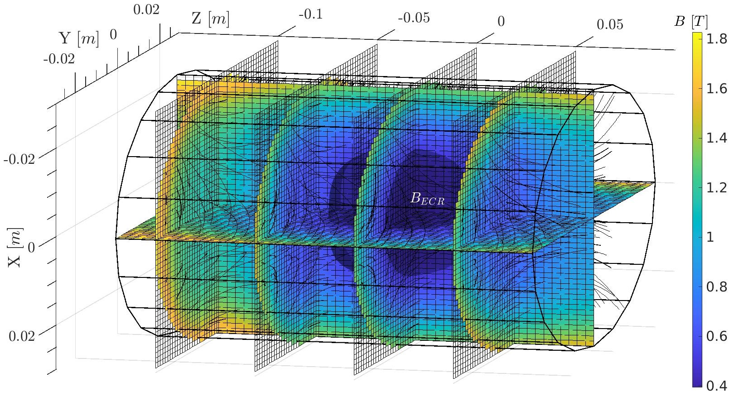
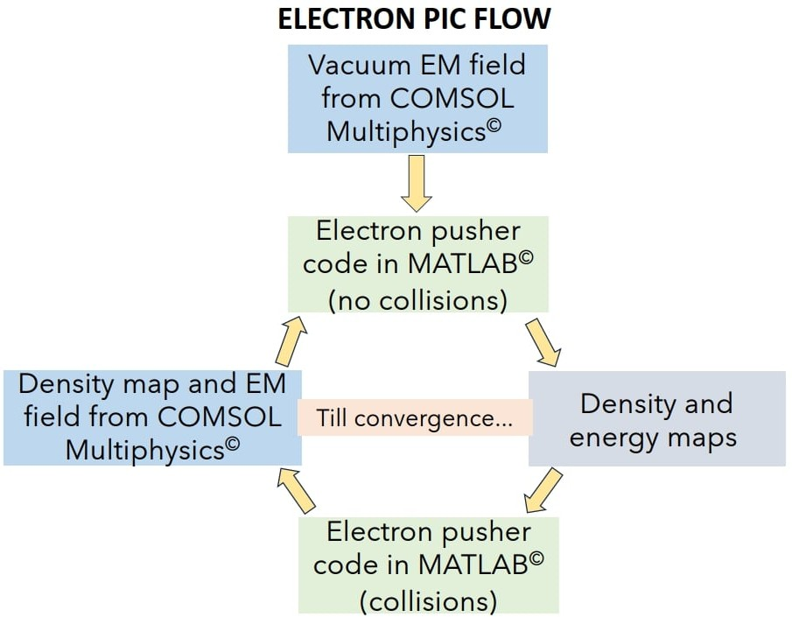
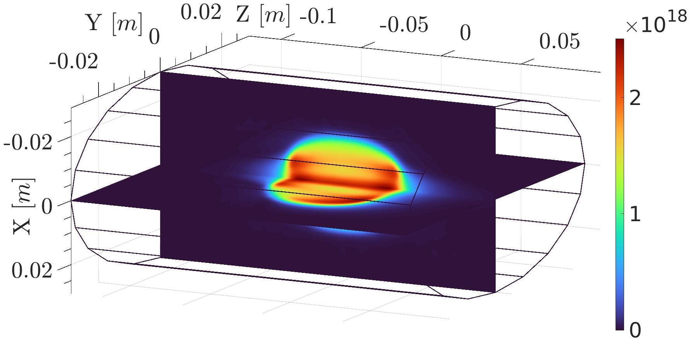
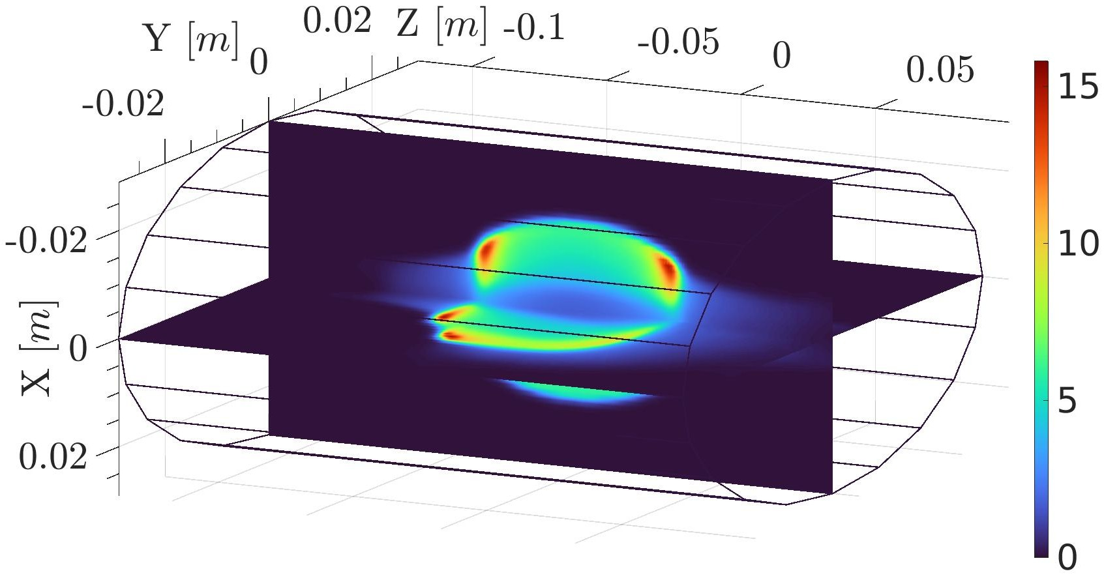
3rd PANDORA Progress Meeting – Legnaro – October 7-8, 2024
ECR Plasma Electron Simulations
PIC simulation for ECR plasma electrons
Description: Vlasov-Maxwell equation
Scaling: Plasma cutoff density
Self-consistency: Microwave EM field
D. Mascali, G. Torrisi et al , Eur. Phys. J. D. 69, 27 (2015)
G. Torrisi, D. Mascali et al, JEWA 28, 9 (2014)
A. Galatà et al, Front. Phys. 10, 947194 (2022)
R = 29 mm
L = 210 mm
Electron density n_{e} (m⁻³) and mean energy E_{e} (keV) maps for A-HPC obtained from PIC simulations.
THEORY AND SIMULATIONS 1 – Gedankenexperiment for PANDORA – Plasma Modelling
B. Mishra and A. Pidatella – INFN - LNS

Slide 31
3rd PANDORA Progress Meeting – Legnaro – October 7-8, 2024
ECR Plasma Ion Simulations
PIC simulations for ECR plasma ions:
Description: Vlasov-Maxwell equations + Balance equation
Scaling: Quasineutrality with electron density
Self-consistency: Electron density and energy maps
B. Mishra et al, Front. Phys. 10, 932448 (2022)
B. Mishra, EPJ WoC 275, 02001 (2023)
Ion Transport
Transport in EM fields under Lorentz force
Collisions by Fokker-Planck equation
MC Sampling
3 core modules
Electron impact ionization (EI)
Ion impact charge exchange (CEX)
Density Scaling
Iterative scaling of ion occupation map
THEORY AND SIMULATIONS 1 – Gedankenexperiment for PANDORA – Plasma Modelling
B. Mishra and A. Pidatella – INFN - LNS

Slide 32
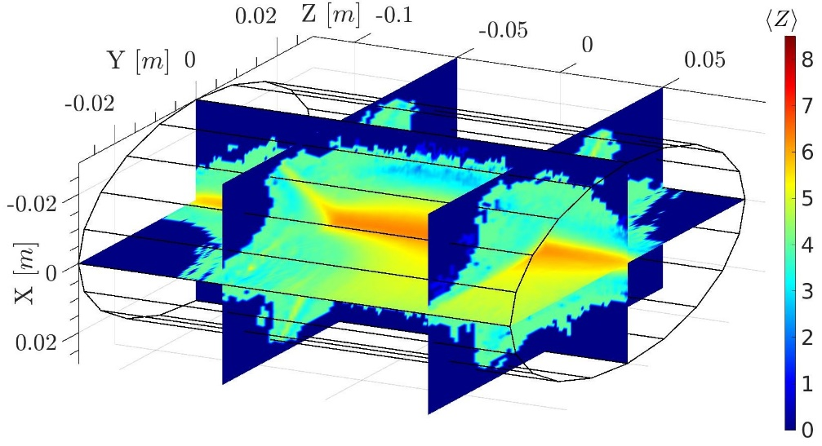
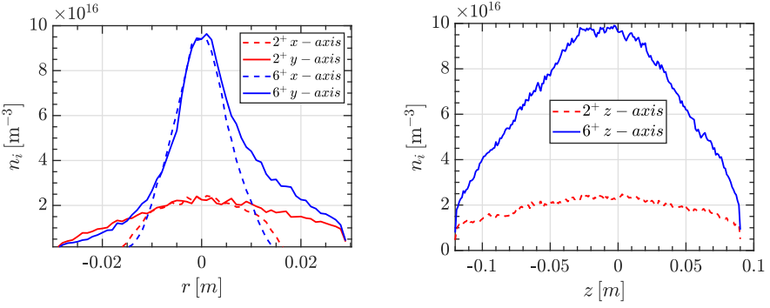
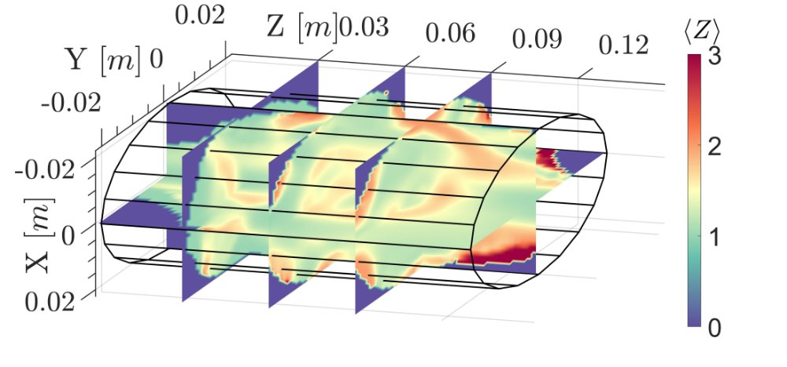
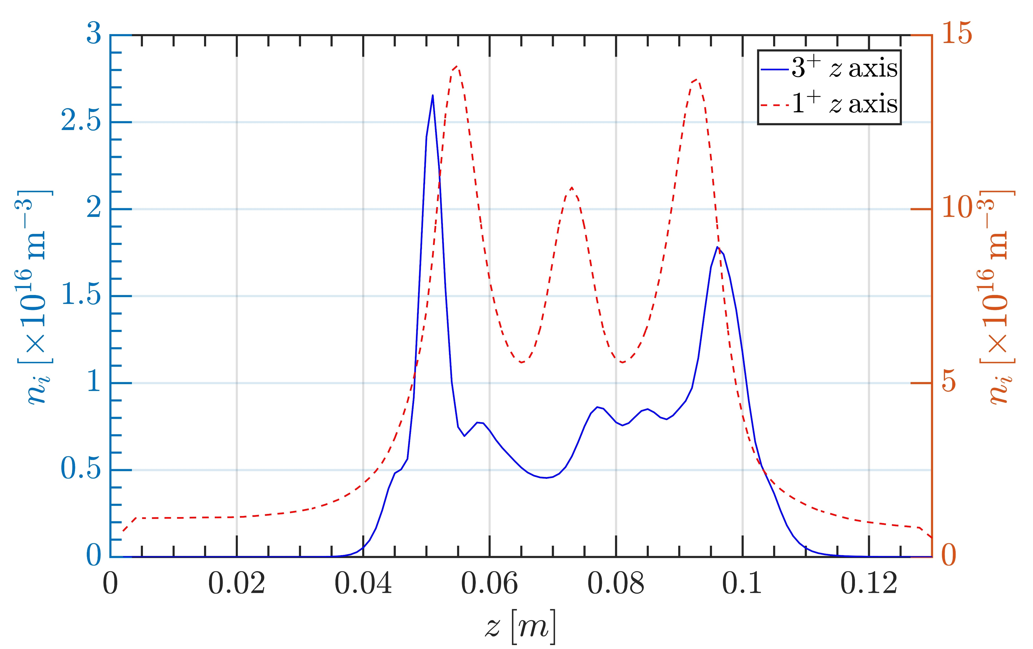
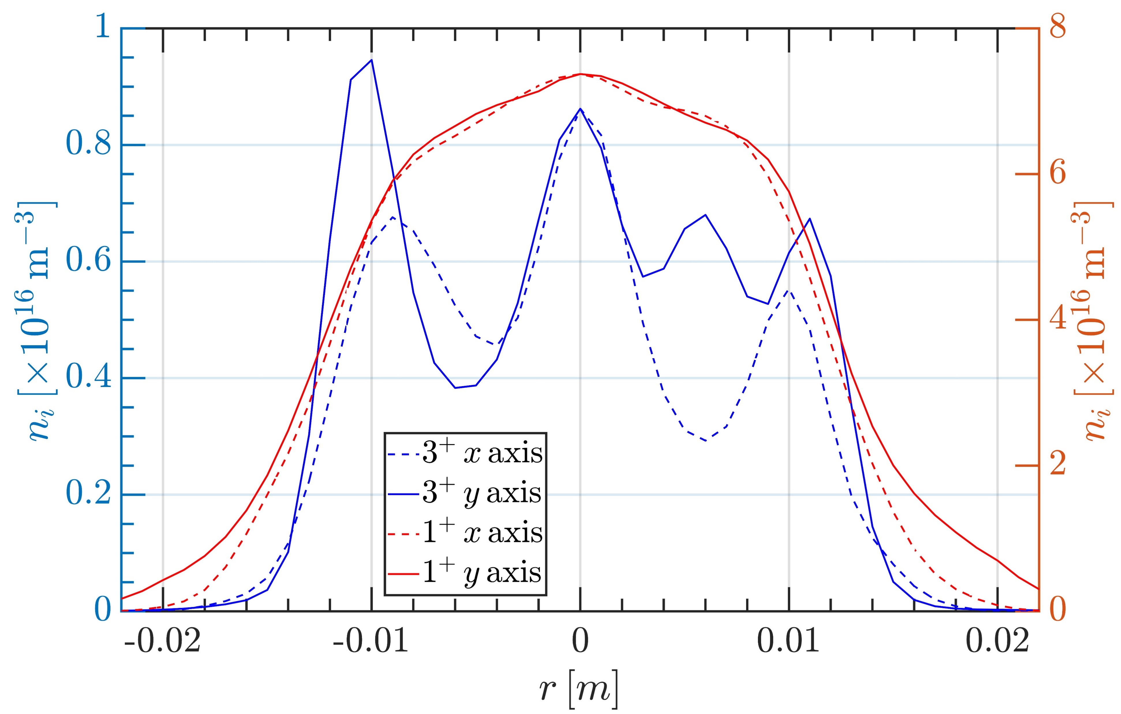
3rd PANDORA Progress Meeting – Legnaro – October 7-8, 2024
ECR Plasma Ion Simulations: Results
The main results of the PIC-MC simulations are 3D steady-state maps of ion density in for each ionisation stage and <Z>
Higher charge states tend to accumulate in the near-axis region because they are generated from lower charge states through EI in those same regions with high E_{e}, and they are strongly confined by E_{DL} and diffusion
<Z> of Ar plasma in A-HPC ECRIS as calculated using PIC-MC code (top) and of O plasma in LEGIS (bottom)
n_{i} of Ar²⁺ and Ar⁶⁺ in A-HPC ECRIS along the radius and axis in A-HPC (top) and same for O¹⁺ and O³⁺ in LEGIS (bottom)
Results may vary according to the geometry of the system, the magnetostatic field and type of ions (which govern particle transport), and steady state n_{e}, kT_{e} maps
THEORY AND SIMULATIONS 1 – Gedankenexperiment for PANDORA – Plasma Modelling
B. Mishra and A. Pidatella – INFN - LNS

Slide 33
3rd PANDORA Progress Meeting – Legnaro – October 7-8, 2024
ECR Plasma Simulations: Radioisotopes
Radio-isotope ions can be simulated using the same PIC-MC codes, but density maps will evolve according to mass number conservation, and rate-matrix will be more complex
B. Mishra, EPJ WoC 275, 02001 (2023)
Ion Transport
Transport in EM fields under Lorentz force
Collisions by Fokker-Planck equation
MC Sampling
For CSD
For LPD
Density Scaling
Scaling coefficient
Transfer coefficient
Concentration
THEORY AND SIMULATIONS 1 – Gedankenexperiment for PANDORA – Plasma Modelling
B. Mishra and A. Pidatella – INFN - LNS

Slide 34
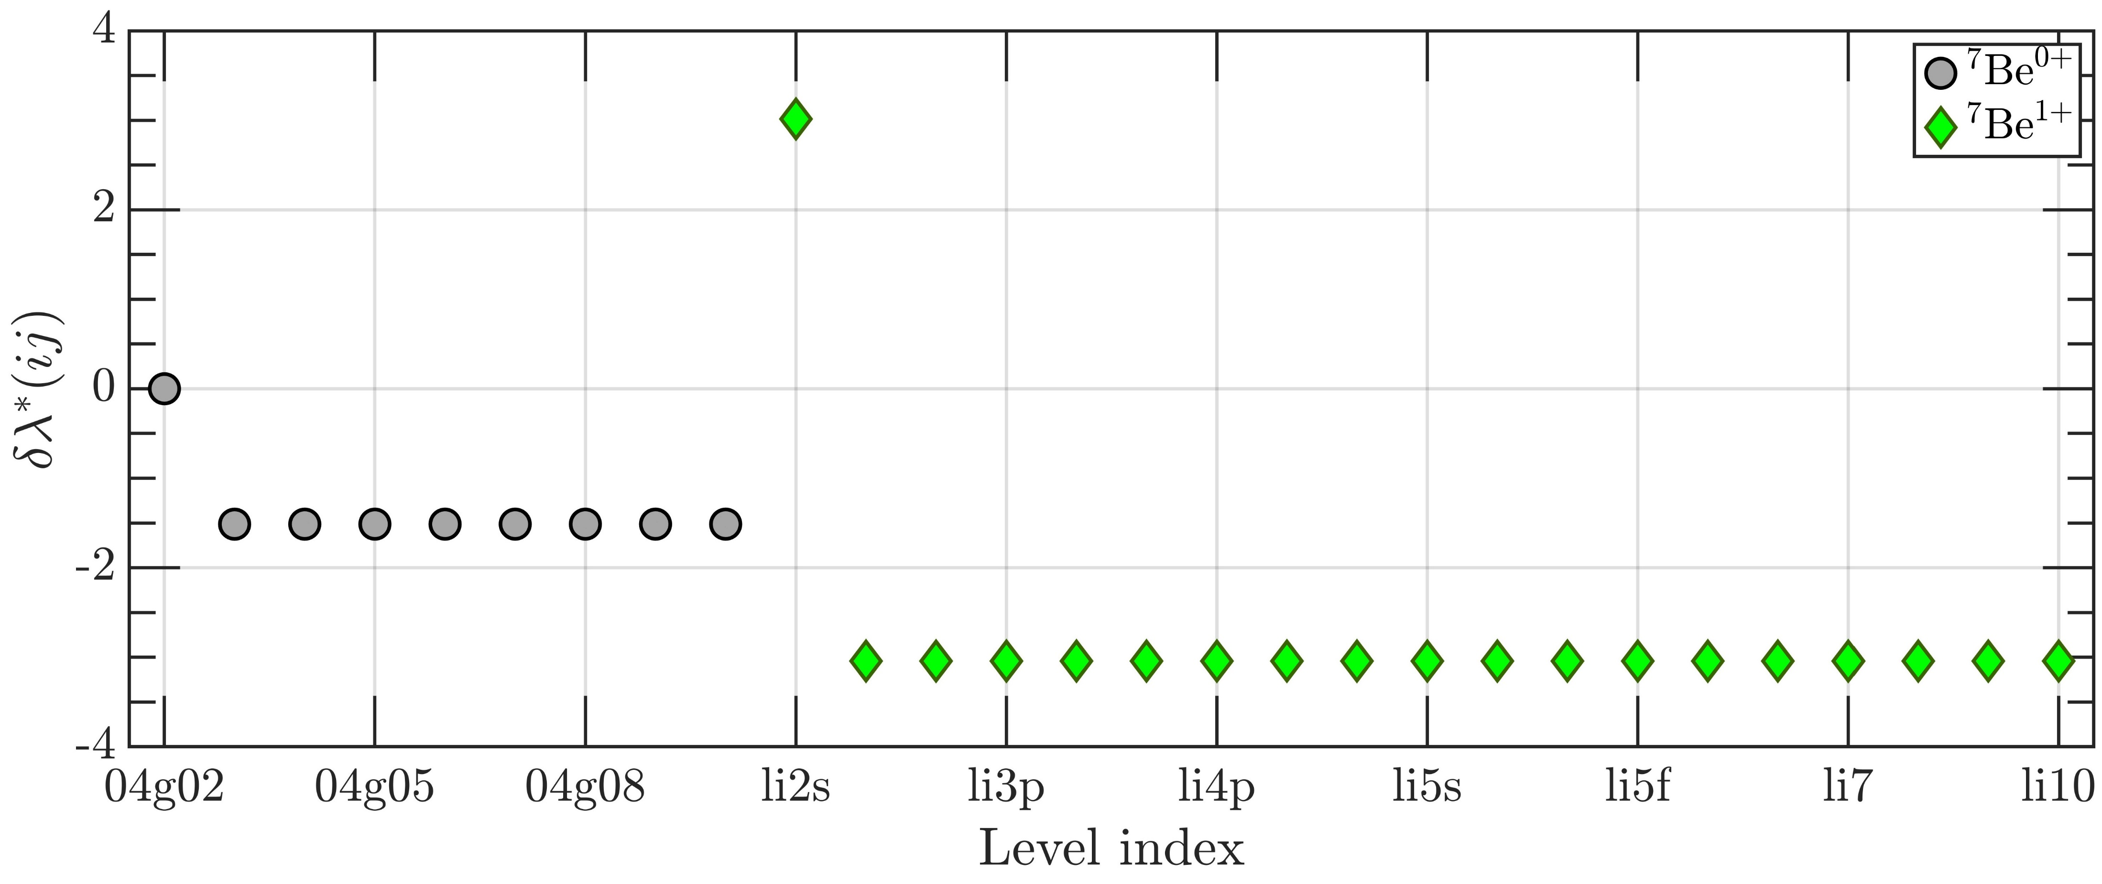
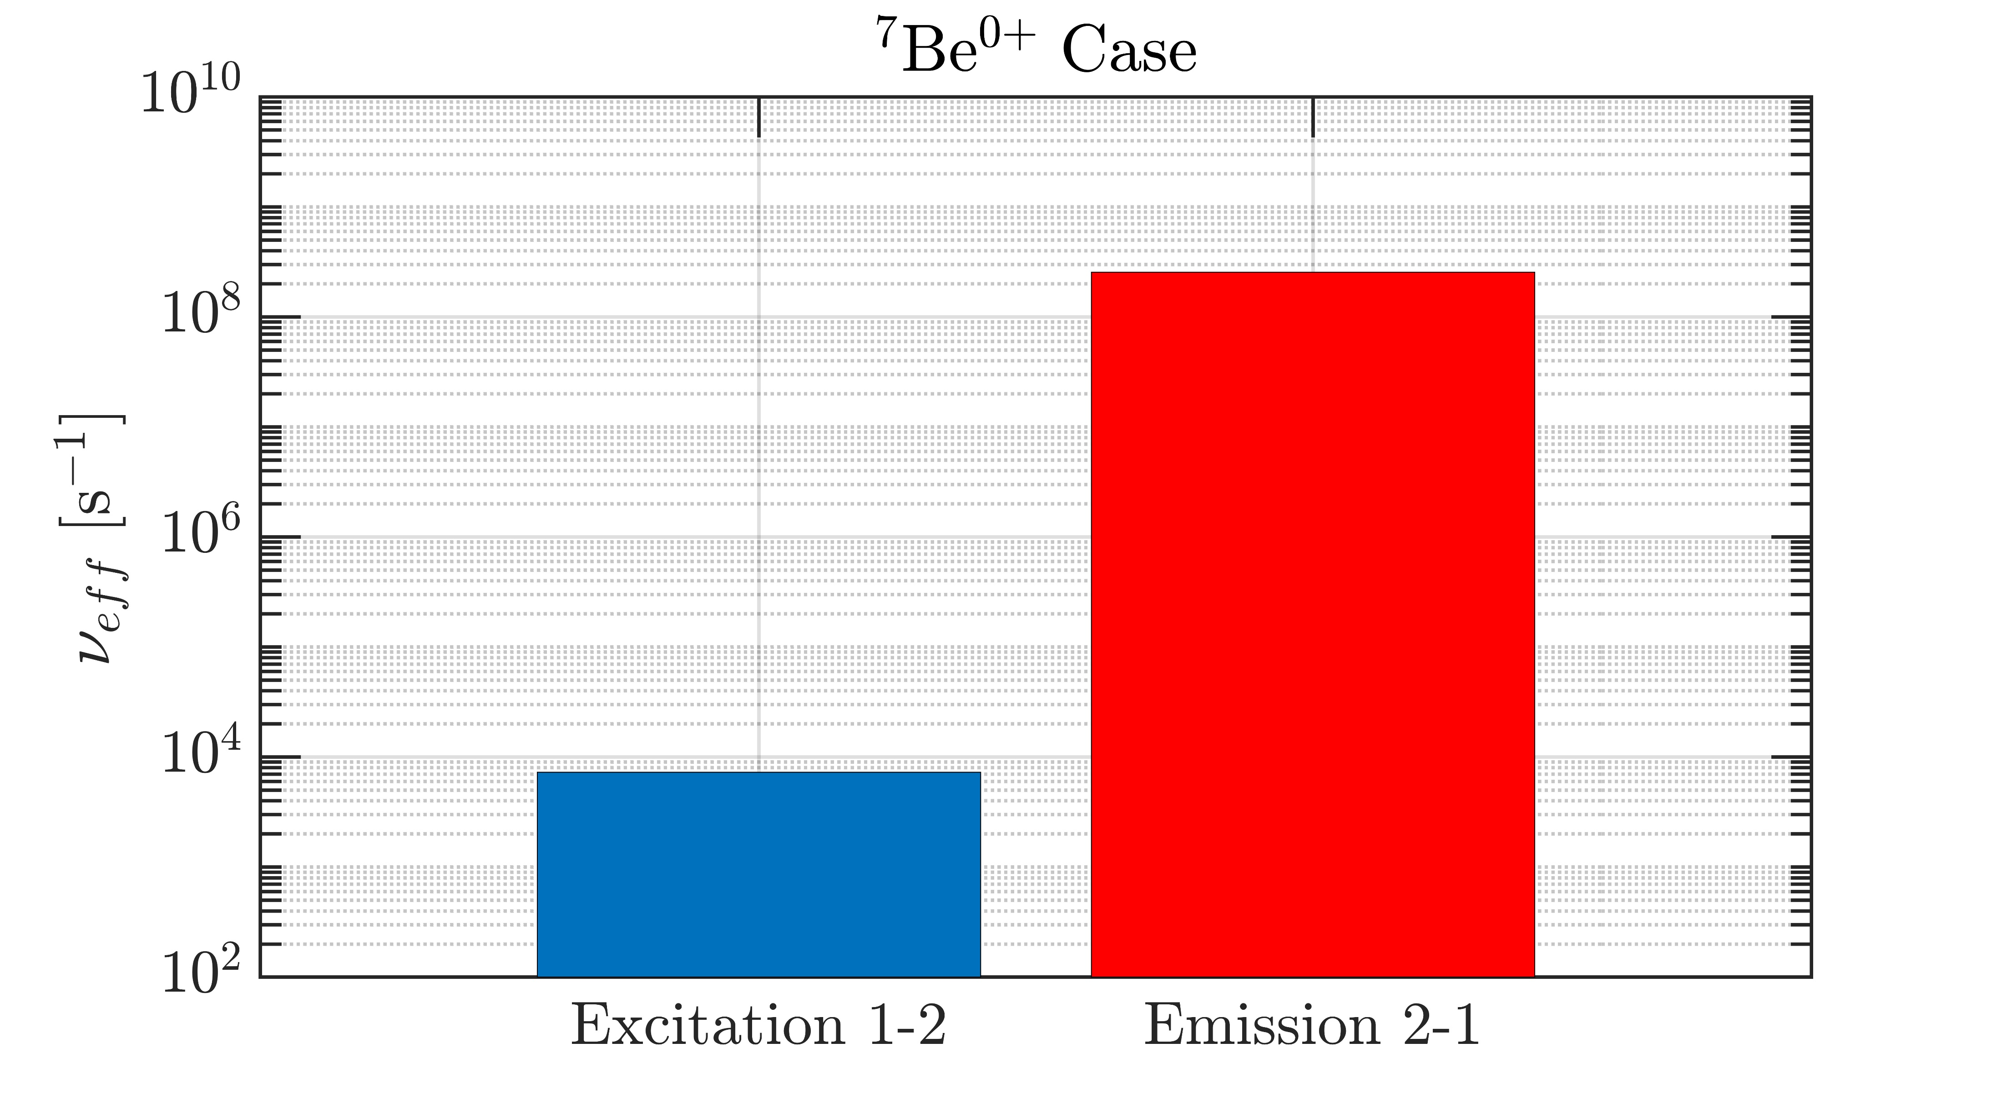
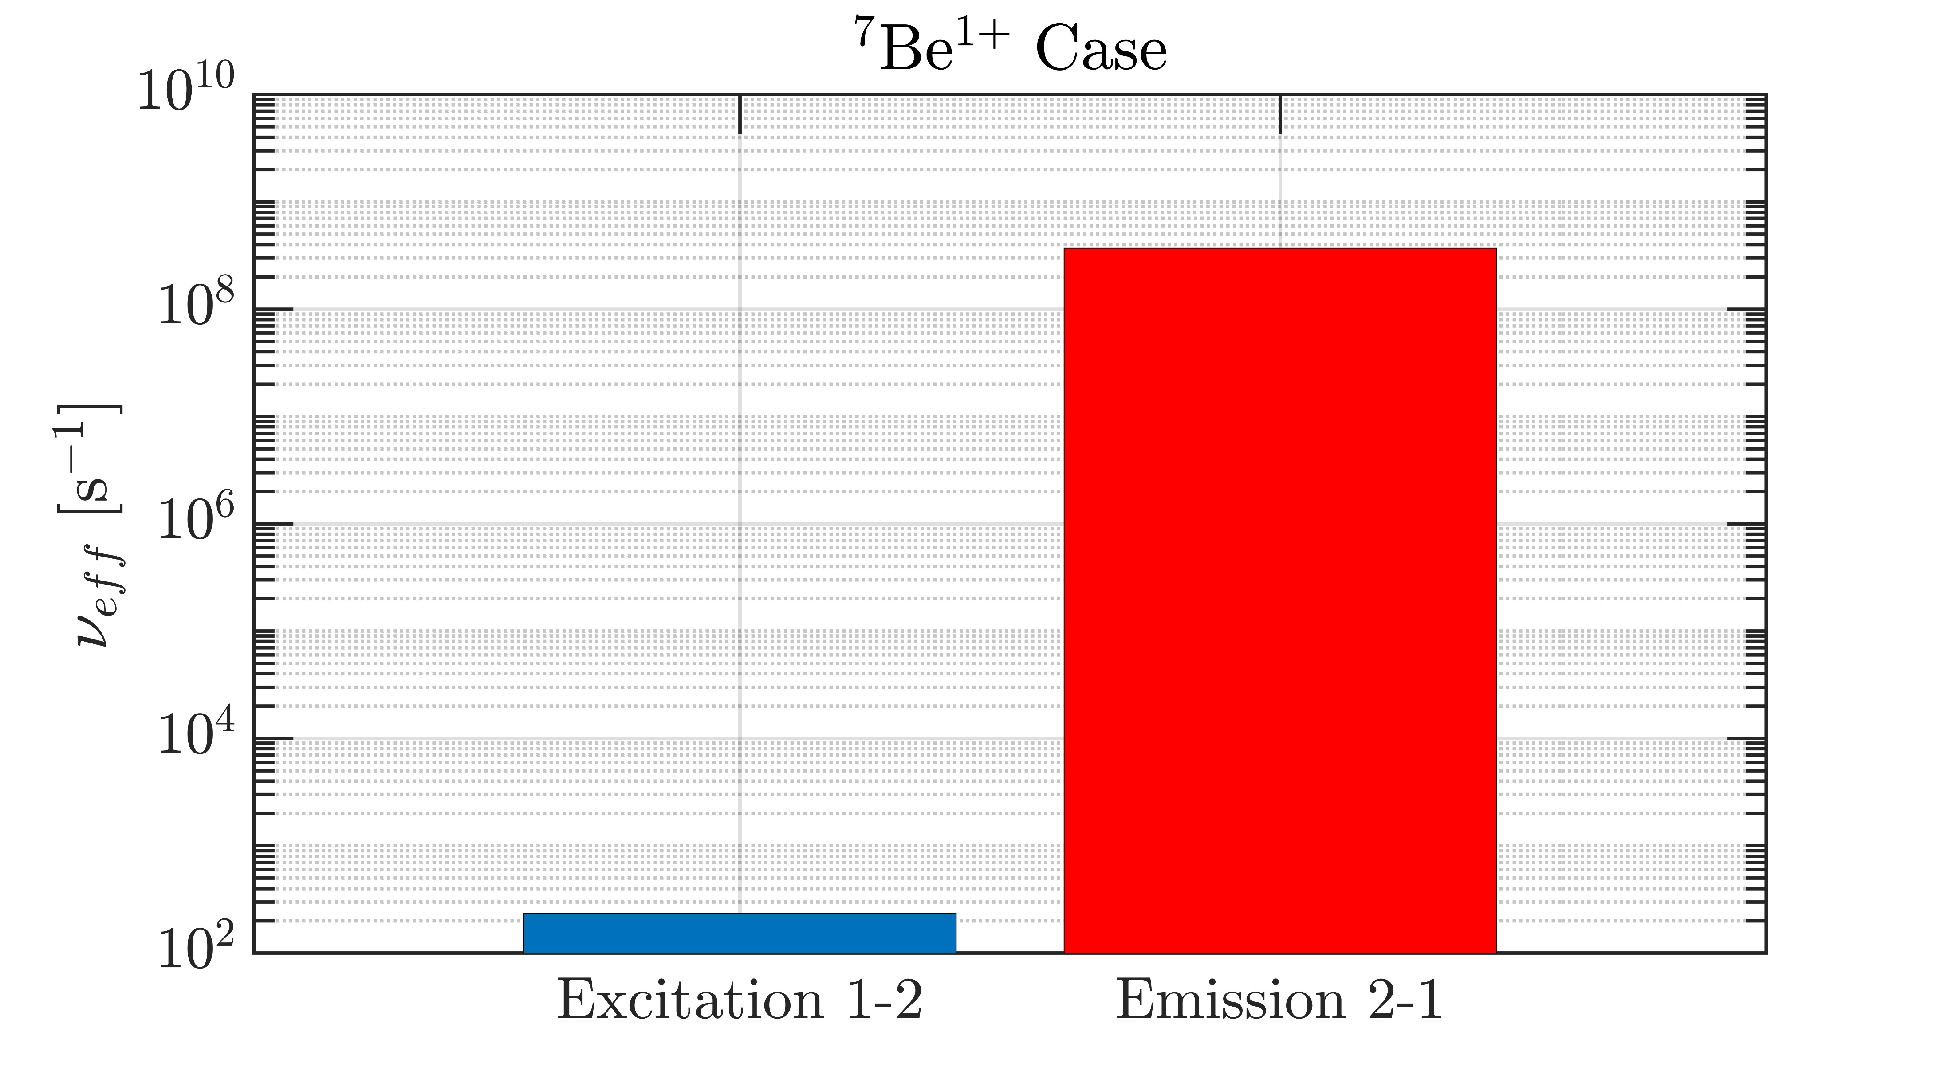
3rd PANDORA Progress Meeting – Legnaro – October 7-8, 2024
ECR Plasma Simulations: Radioisotopes
An attempt was made to verify whether the corona model can be applied to model LPD in ECR plasmas
F. Cittadini, Master Thesis
Electron impact collisional excitation rate
Superlevels
Spontaneous emission rate
Corona model NOT applicable. Each process needs to be balanced by its own inverse process
THEORY AND SIMULATIONS 1 – Gedankenexperiment for PANDORA – Plasma Modelling
B. Mishra and A. Pidatella – INFN - LNS

Slide 35
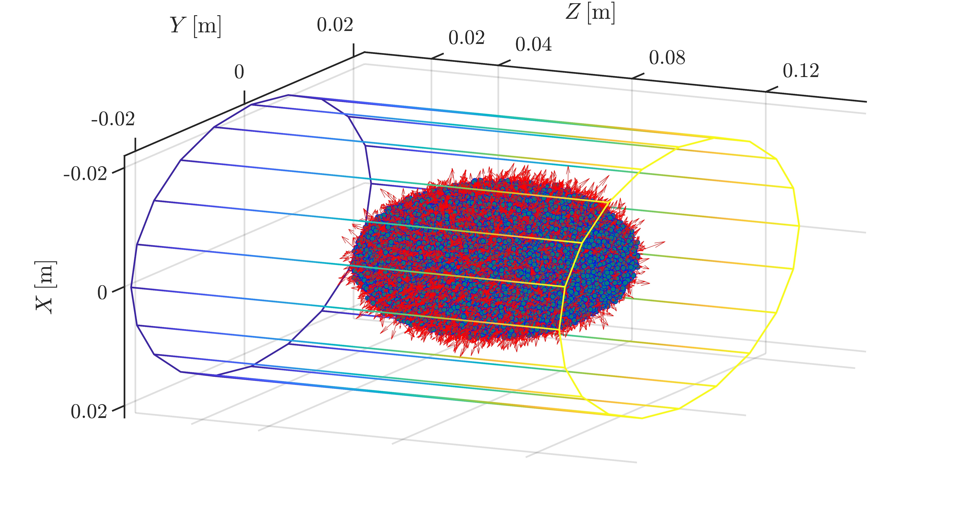
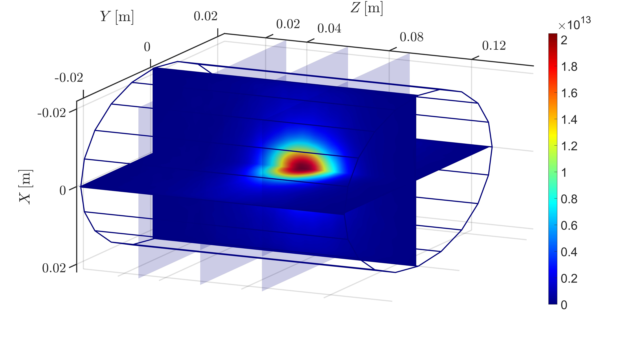
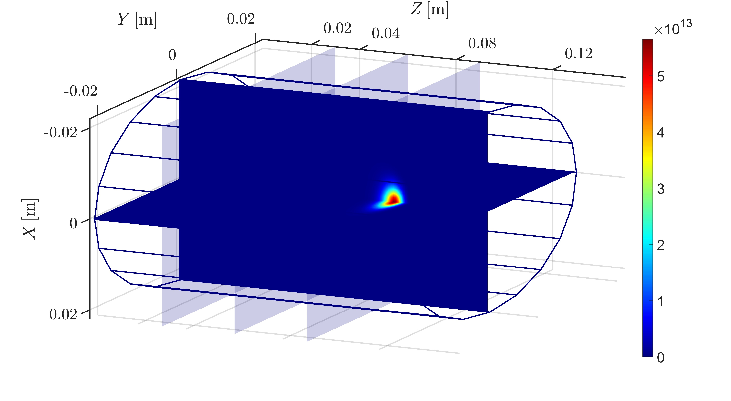
3rd PANDORA Progress Meeting – Legnaro – October 7-8, 2024
ECR Plasma Simulations: Radioisotope Results
The main results of the PIC-MC simulations are 3D steady-state maps of ion density, the CSD and the LPD. For now, all ions are taken to be in ground state, till collisional de-excitation is included in the atomic processes
First calculations show sharp contrasts in density distribution of ⁷Be⁰⁺ (left) and ⁷Be²⁺ (right) in the plasma, leading to very different CSD in different regions of the plasma
The initial distribution of ⁷Be⁰⁺ macroparticles was assumed to be a Gaussian plume (top right), just for sake of a gedankenexperiment.
The CSD and decay maps vary according to injection conditions
THEORY AND SIMULATIONS 1 – Gedankenexperiment for PANDORA – Plasma Modelling
B. Mishra and A. Pidatella – INFN - LNS

Slide 36
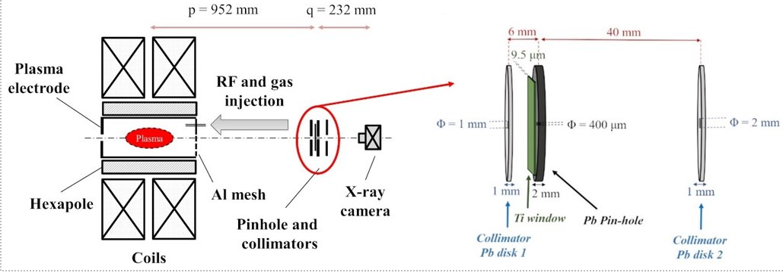
3rd PANDORA Progress Meeting – Legnaro – October 7-8, 2024
ECR Plasma Electrons Benchmark: Soft X-ray Spectroscopy
Plasma diagnostic technique developed by INFN – LNS, Catania and ATOMKI, Debrecen to study properties of warm/hot electrons in ECR plasma using volumetric and space-resolved soft X-ray spectroscopy (2 < E_{hν} < 30 keV)
R. Racz, D. Mascali et al , Plasma Sources Sci. Technol. 26, 075011 (2017)
D. Mascali et al, Rev. Sci. Instrum. 87, 02A510 (2016)
Volumetric X-ray emission from near-axis region, measured using SDD detector + collimator
Space-resolved X-ray emission from different plasma zones, measured using CCD camera + pinhole
THEORY AND SIMULATIONS 1 – Gedankenexperiment for PANDORA – Plasma Modelling
B. Mishra and A. Pidatella – INFN - LNS

Slide 37
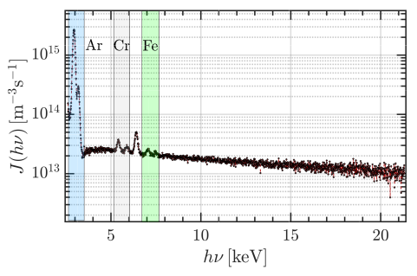
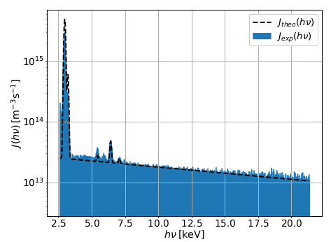
3rd PANDORA Progress Meeting – Legnaro – October 7-8, 2024
ECR Plasma Electrons Benchmark: Soft X-ray Spectroscopy
Raw data from SDD detector can be converted into X-ray emissivity density by calibration with Fe lines and correction for quantum efficiency and dead time
B. Mishra et al , Phys. Plasmas. 28, 102509 (2021)
B. Mishra et al, Cond. Matter (2021)
n_{e}n_{i} ~ 1.32x10³² m⁻⁶
expected n_{e} ~ 10¹⁶ m⁻³
k_{B}T_{e} ~ 21.15 keV
n_{e,loss} ~ 10¹² m⁻³
estimated j_{av} ~ 2-3 mA/cm²
EMISSIVITY MODEL REPRODUCES EXPECTED PLASMA PARAMETERS!
Plasma Emissivity Model
THEORY AND SIMULATIONS 1 – Gedankenexperiment for PANDORA – Plasma Modelling
B. Mishra and A. Pidatella – INFN - LNS

Slide 38
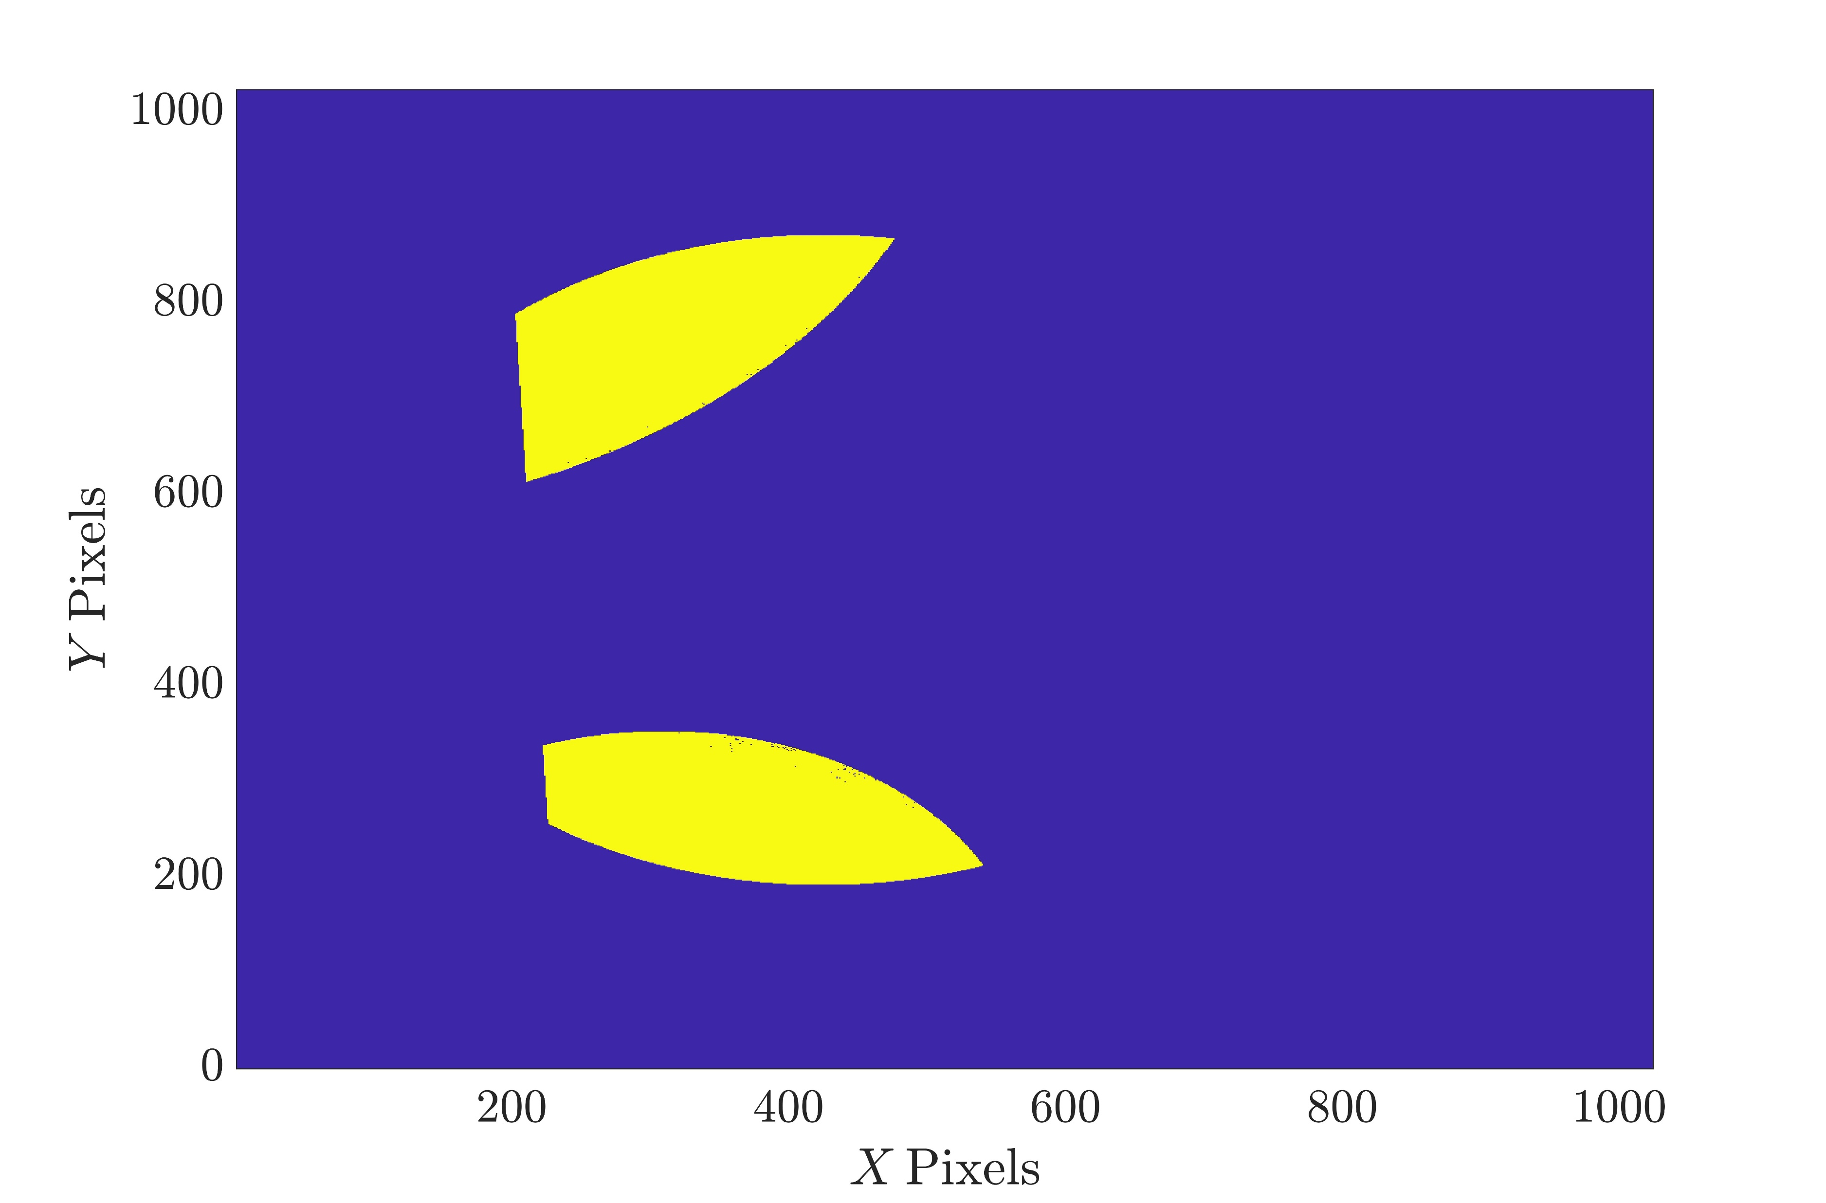
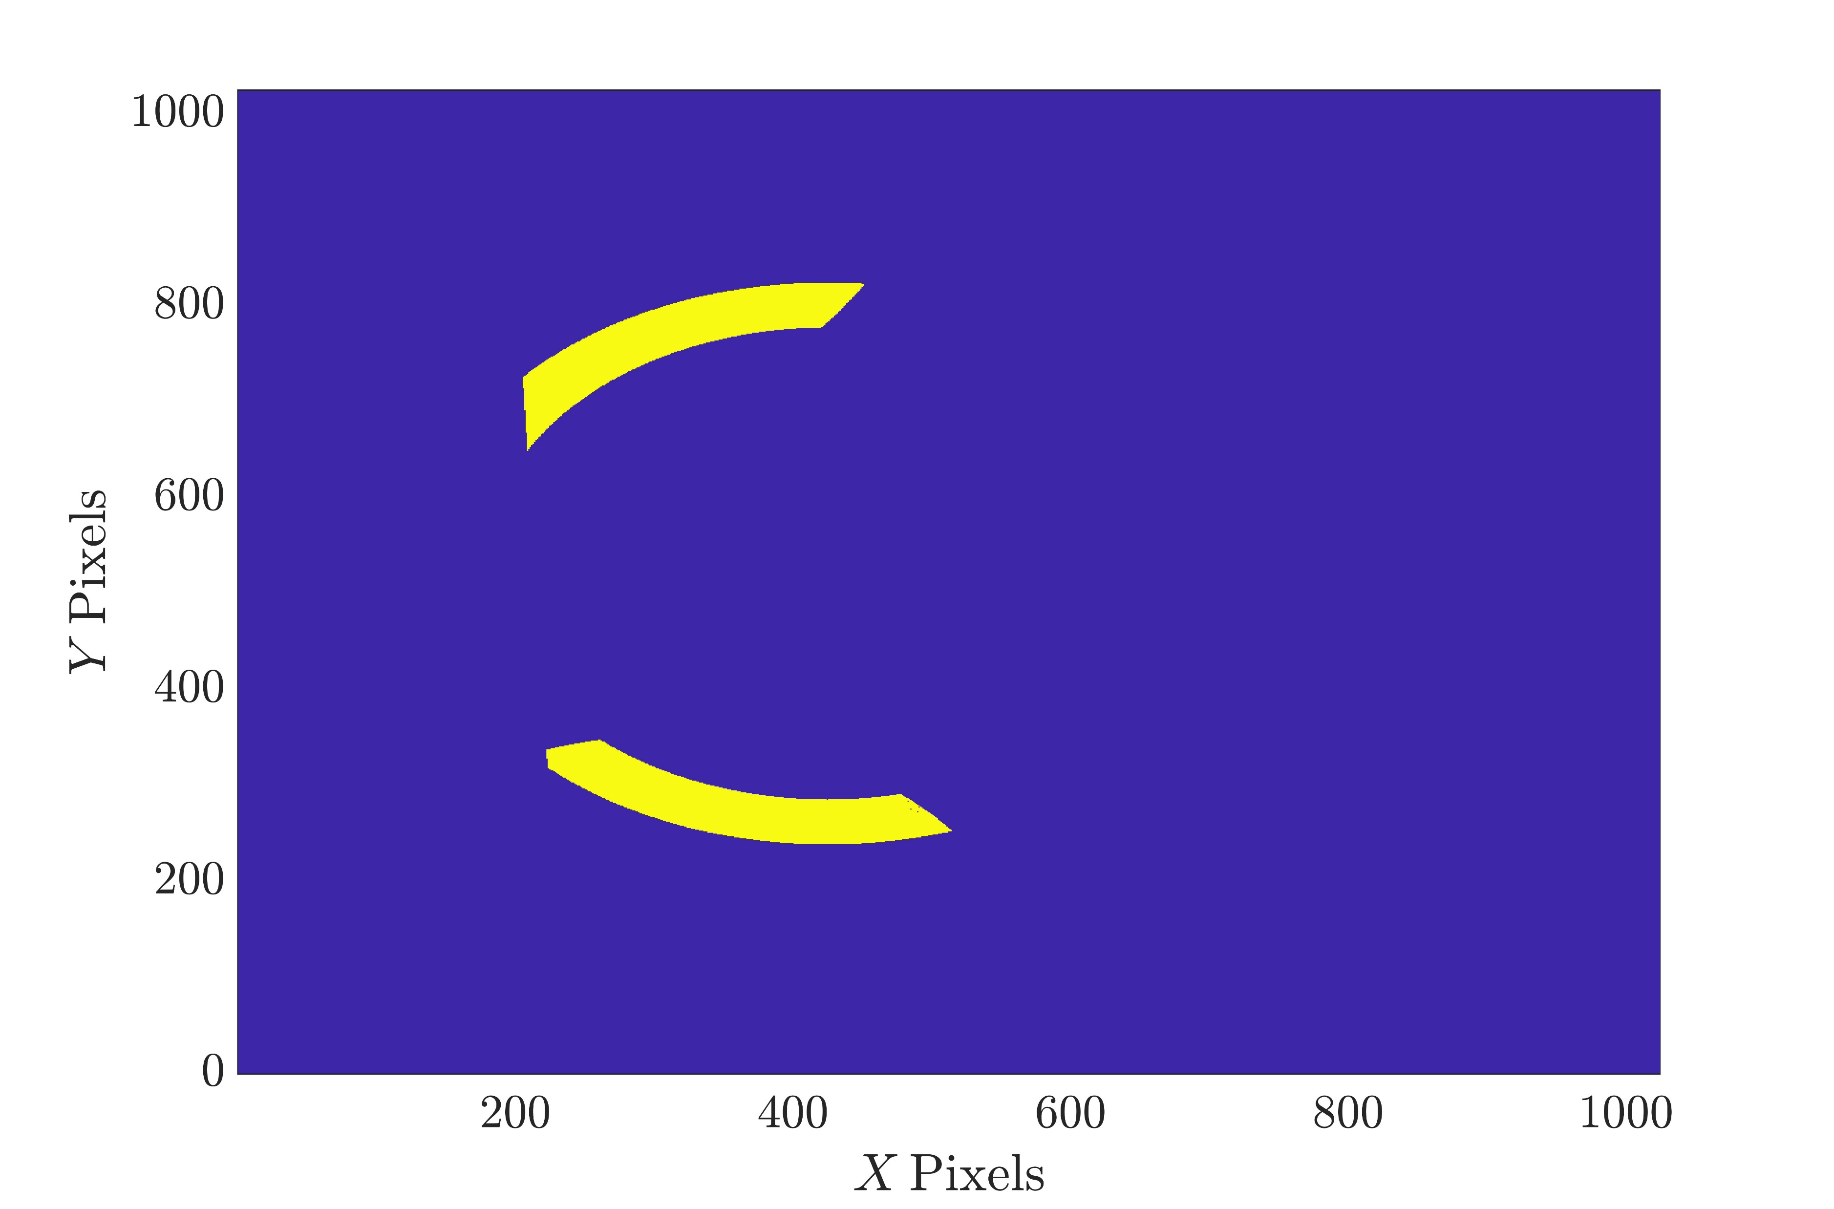
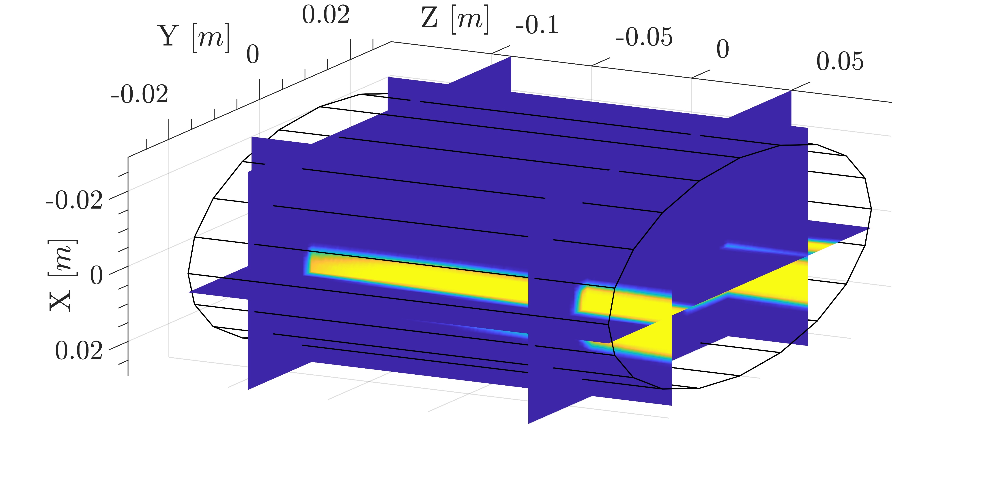
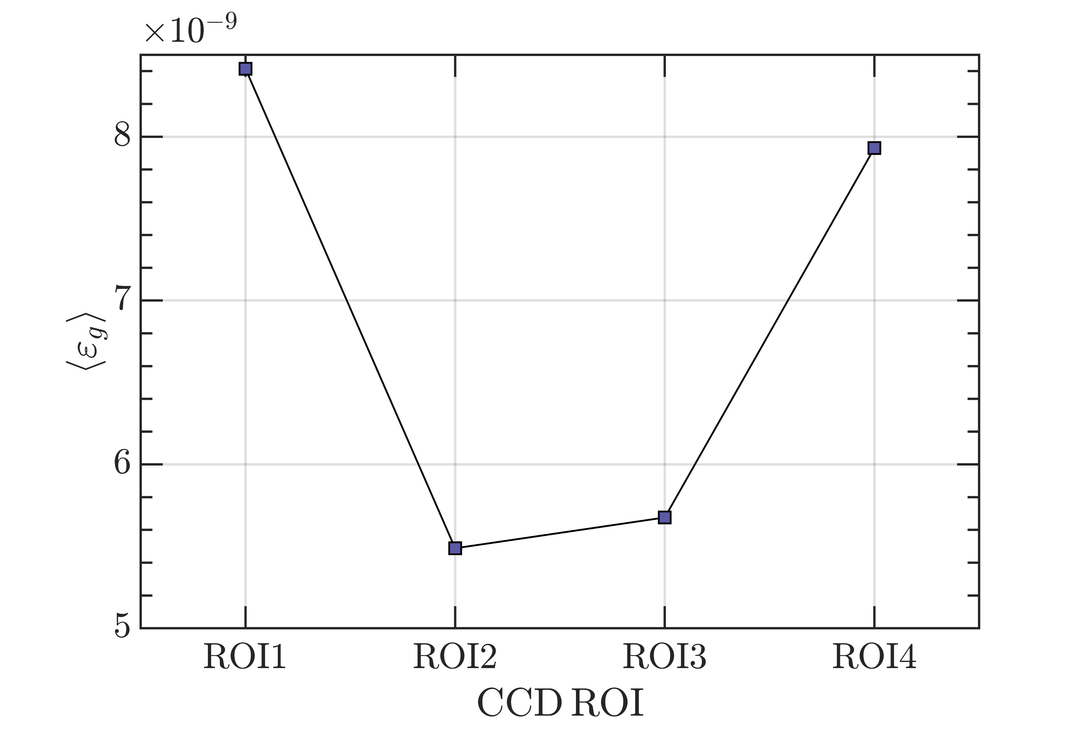
3rd PANDORA Progress Meeting – Legnaro – October 7-8, 2024
ECR Plasma Electrons Benchmark: Soft X-ray Spectroscopy
Groups of pixels (ROIs) can be selected on the CCD and raw binary data can be converted into soft X-ray spectrum using Single Photon Counting (SPhC) algorithm.
E. Naselli et al, Condens. Matter 7, 1 (2022)
G. Finocchiaro et al, Phys. Plasmas 31, 6 (2024)
X-Ray Emissivity Density
Soft X-ray spectrum can be converted into X-ray emissivity density J(hν) by calculating the emissivity volume V_{P} and geometrical efficiency Ω_{g}
Ray-tracing MC simulation
B. Mishra et al , Phys. Plasmas. (2021)
B. Mishra et al, Cond. Matter (2021)
Ray-tracing code evaluates the region of the plasma seen by CCD ROI
THEORY AND SIMULATIONS 1 – Gedankenexperiment for PANDORA – Plasma Modelling
B. Mishra and A. Pidatella – INFN - LNS

Slide 39
3rd PANDORA Progress Meeting – Legnaro – October 7-8, 2024
ECR Plasma Electrons Benchmark: Soft X-ray Spectroscopy
CCD ROIs
Warm electron n_{e} and kT_{e} can be extracted from the emissivity by performing an inverse σ-fit, neglecting spurious dips and Ti/Ta fluorescence peaks
X-Ray Emissivity Model
THEORY AND SIMULATIONS 1 – Gedankenexperiment for PANDORA – Plasma Modelling
B. Mishra and A. Pidatella – INFN - LNS

Slide 40
3rd PANDORA Progress Meeting – Legnaro – October 7-8, 2024
ECR Plasma Electrons Benchmark: Soft X-ray Spectroscopy
Extracting warm electron parameters from different plasma zones generates observables against which the PIC simulation results can be benchmarked
RESULTS MATCH WELL!
NEW TECHNIQUE WHICH MEASURES LOCAL DENSITY AND TEMPERATURE AND ALSO BENCHMARKS PIC SIMULATIONS.
THEORY AND SIMULATIONS 1 – Gedankenexperiment for PANDORA – Plasma Modelling
B. Mishra and A. Pidatella – INFN - LNS

Slide 41
ECR Plasma Ion Simulations Benchmark: Ion Current
The PIC-MC simulations can be benchmarked against certain observables from experiment for purposes of validation
Current profile in Faraday cup
Current recorded in the Faraday cup as a function of ion m/q ratio in A-HPC and corresponding current profile
MODEL PREDICTS CURRENT PROFILE QUITE SIMILAR TO MEASURED PROFILE!
ONE OF THE FEW COMPLETE AND SELF-CONSISTENT ECRIS MODELS
PIC-MC simulations also generate data on particles lost from the plasma domain, including walls, and extraction hole
29

