Slide 1


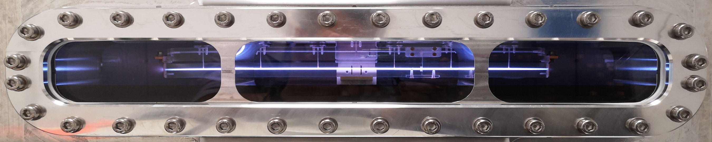
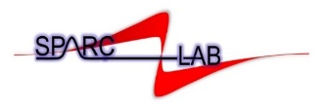
Fundamental research and applications with the EuPRAXIA facility at LNF
4 – 6 December 2024, Frascati, Italy
PLASMA_LAB test facility activities according to the EuXPRAXIA program
Angelo Biagioni
On behalf of the Sparc_lab collaboration

Slide 2
Outline
Introduction
Plasma_lab
Design of plasma accelerating modules
  Very long plasma sources
  Materials
  Plasma diagnostics
A. Biagioni | Fundamental research and applications with the EuPRAXIA facility at LNF 4 – 6 December 2024 2

Slide 3
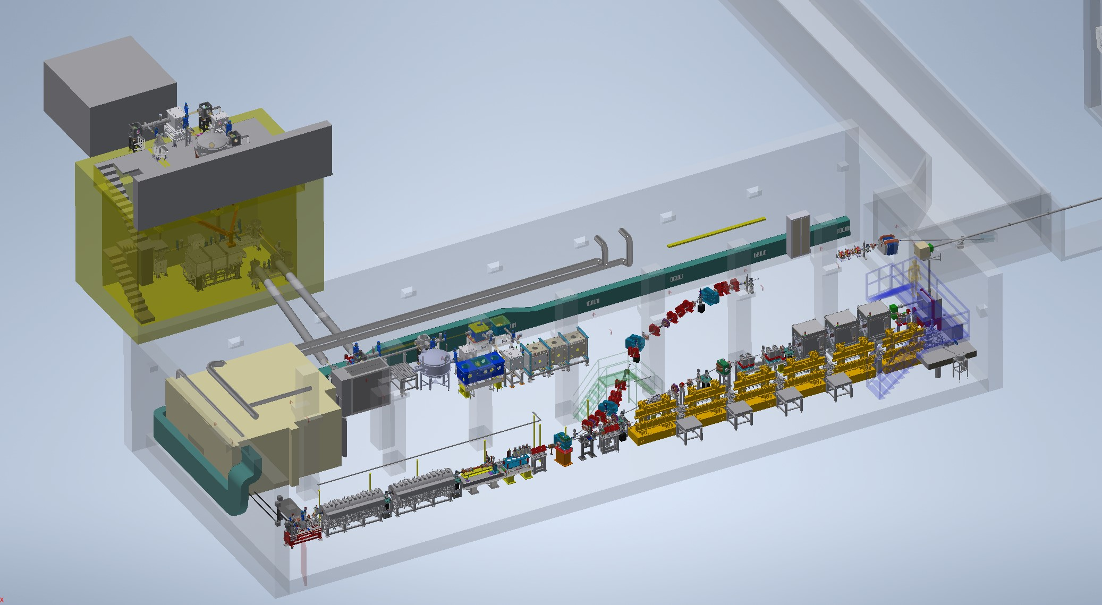
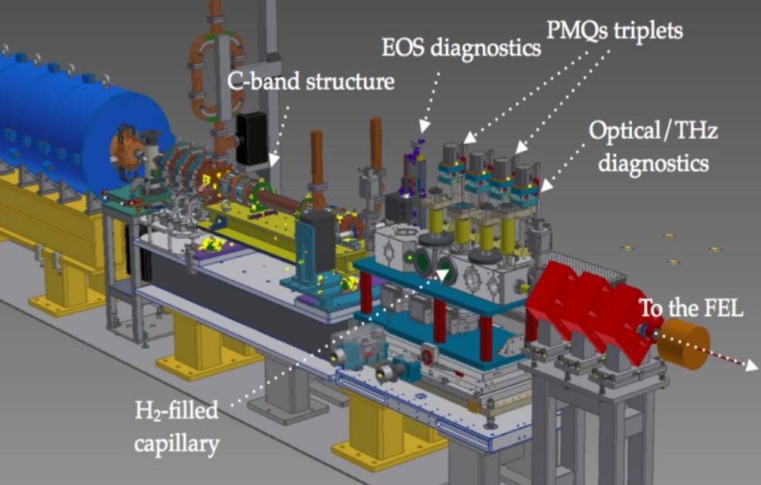
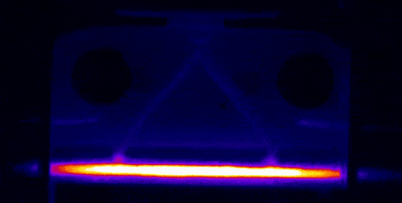
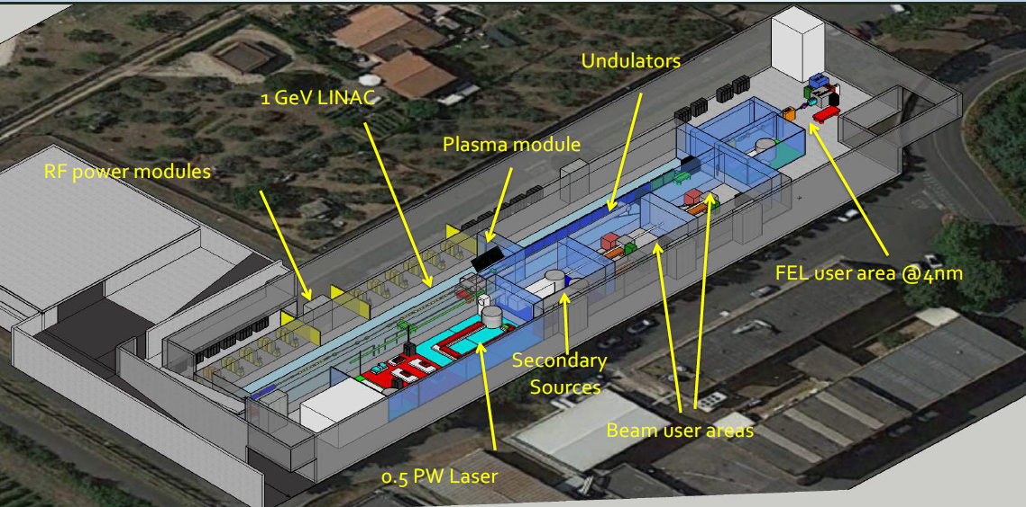
Introduction
SPARC_LAB test facility
Modulo accelerante
al plasma
Plasma source
Plasma accelerating module:
Plasma confinement
Materials
Gas injection systems
Plasma formation techniques
HV sources
Lasers
Plasma diagnostics
Vacuum system
EuPRAXIA@SPARC_LAB (ESFRI)
A. Biagioni | Fundamental research and applications with the EuPRAXIA facility at LNF 4 – 6 December 2024 3

Slide 4
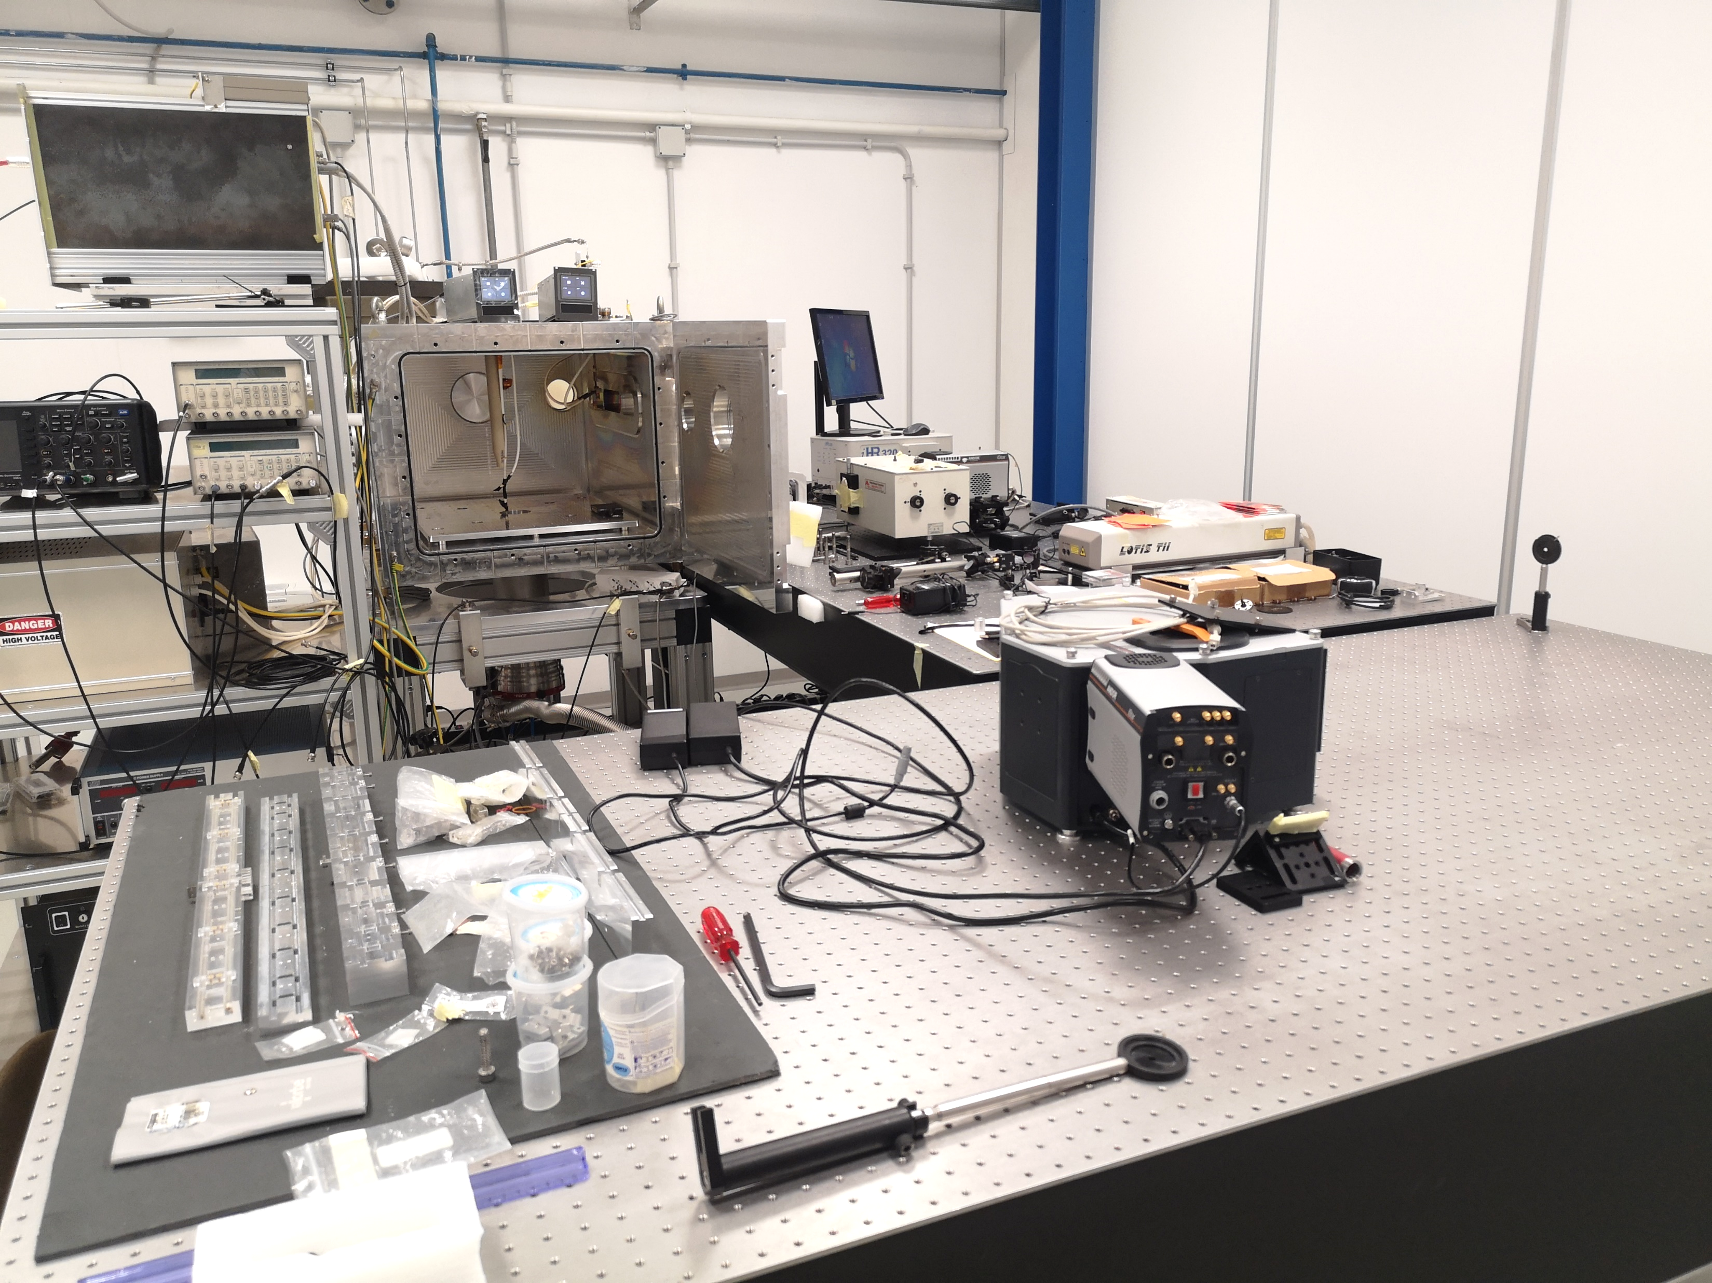
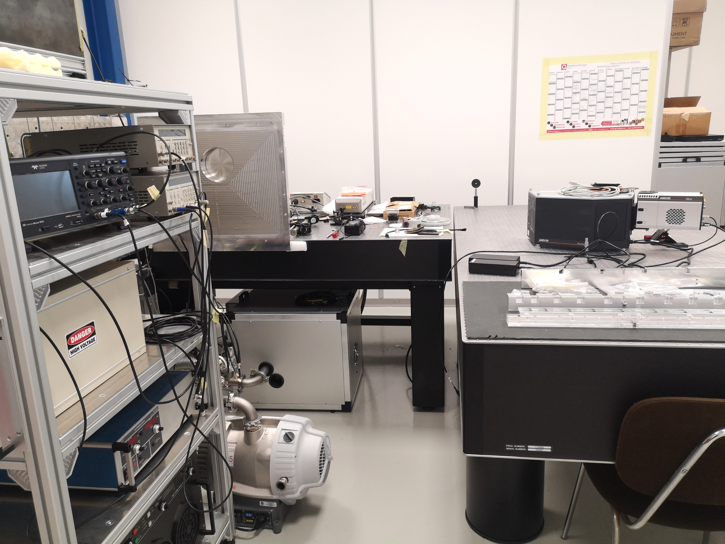
Plasma_Lab
The Plasma_Lab is dedicated to research and technological development activities for the design and characterization of plasma sources required for the realization of accelerator modules (in operation since 2018)
HV sources
A new compact laser will be mounted in January to test new plasma sources at High RR
Vacuum chambers
<
Laser
Plasma diagnostics
Vacuum systems
Discharge capillaries
Plasma acceleration experiments at SPARC_LAB test facility
EuPRAXIA@SPAC_LAB project
EuAPS project
A. Biagioni | Fundamental research and applications with the EuPRAXIA facility at LNF 4 – 6 December 2024 4

Slide 5
EuPRAXIA@SPARC_LAB: plasma accelerating module
1.1 GeV (1 GV/m 60cm capillary - density 10¹⁶ cm-3)
  Direct plasma discharge for 60cm long capillary
    Plasma stability
    Longitudinal profiles
  Plasma sources operating at 100 – 400 Hz
    Vacuum system requirements (neutral gas)
    Capillary’s longevity
    High-voltage sources for plasma formation
A. Biagioni | Fundamental research and applications with the EuPRAXIA facility at LNF 4 – 6 December 2024 5

Slide 6
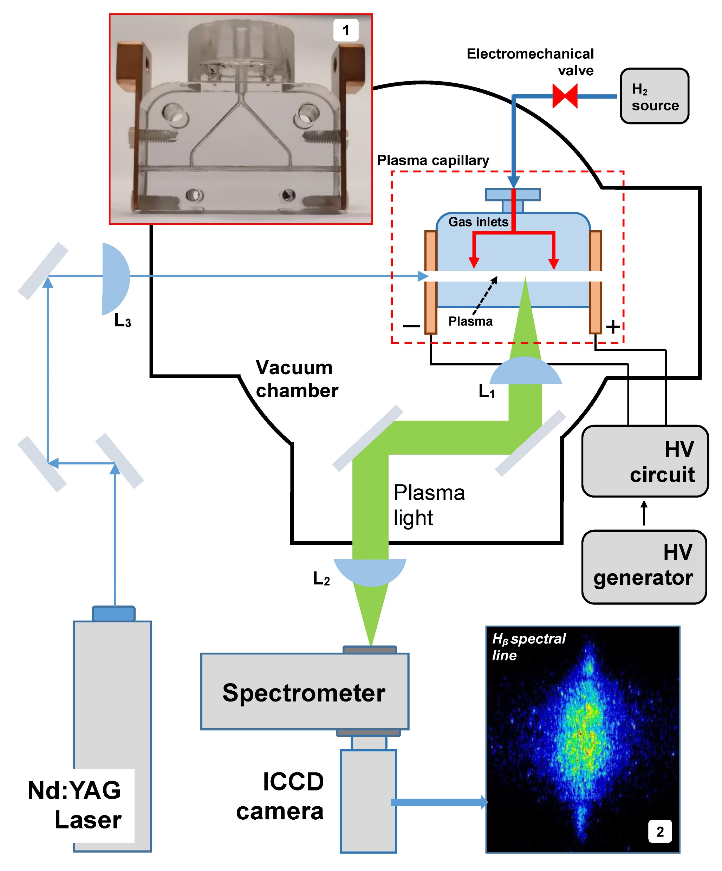
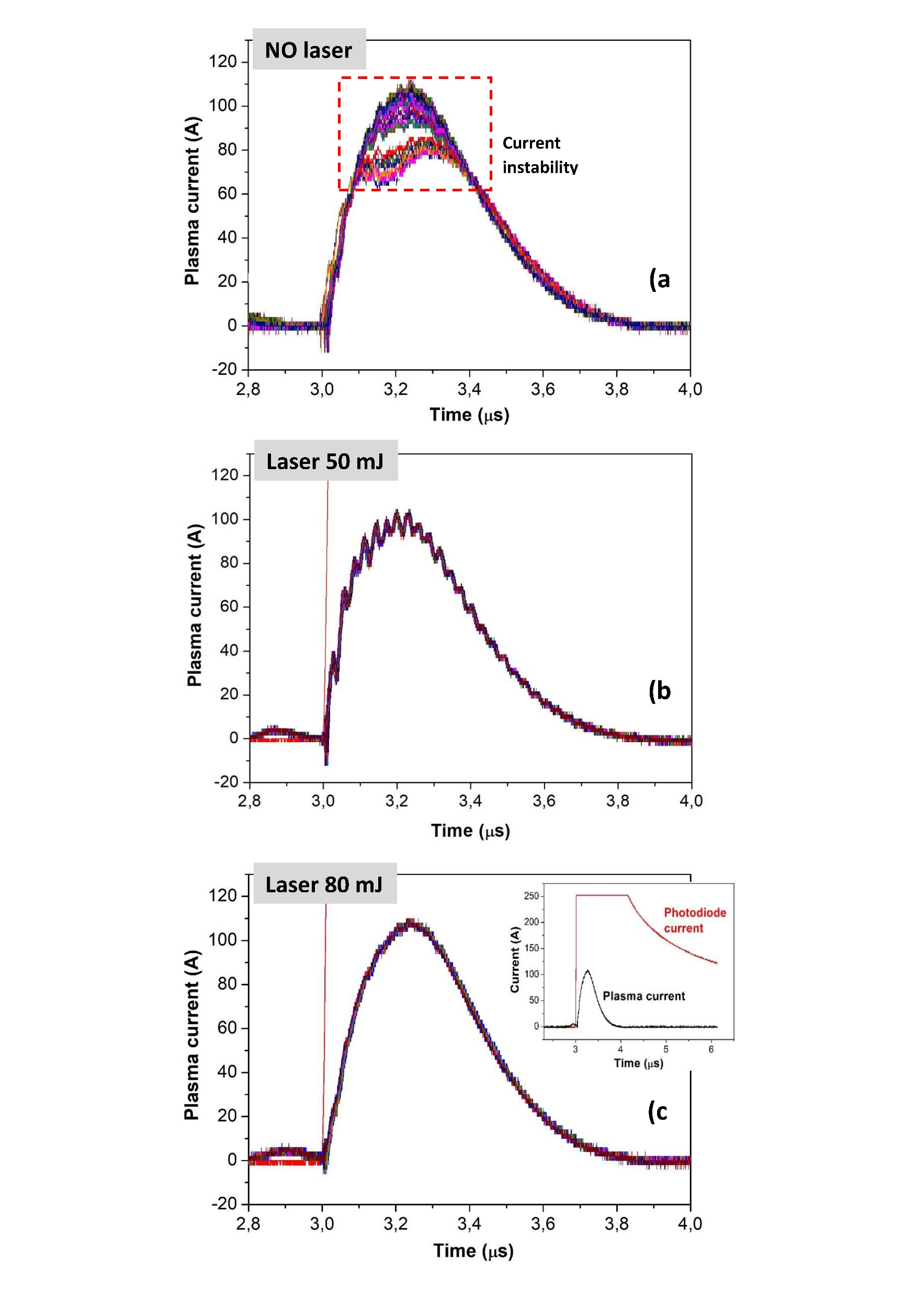
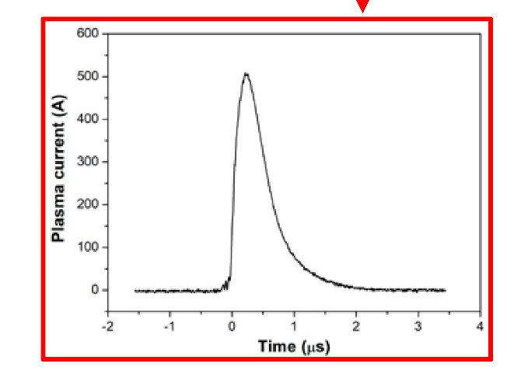

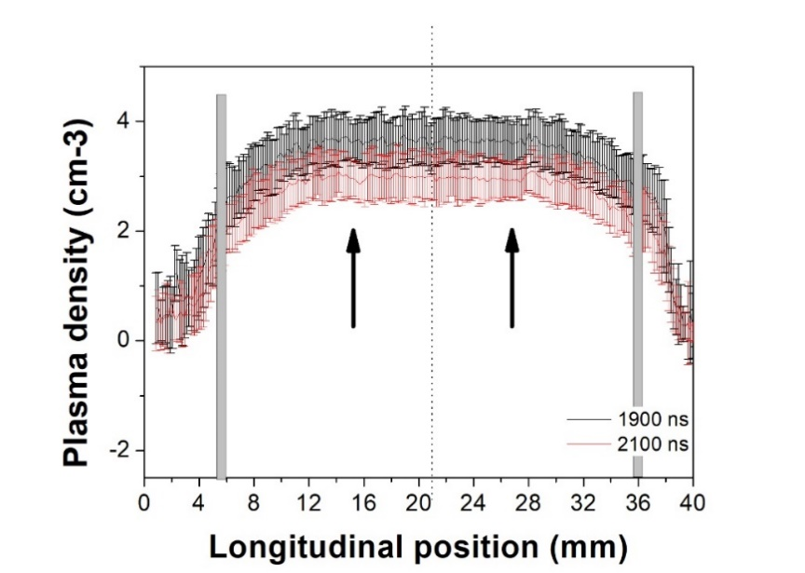
EuPRAXIA@SPARC_LAB: plasma accelerating module
HV-sources
x10¹⁷
Density profile
Laser stabilization
Plasma diagnostics
A. Biagioni | Fundamental research and applications with the EuPRAXIA facility at LNF 4 – 6 December 2024 6

Slide 7

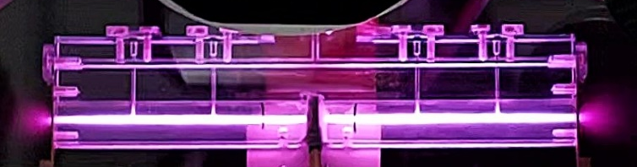
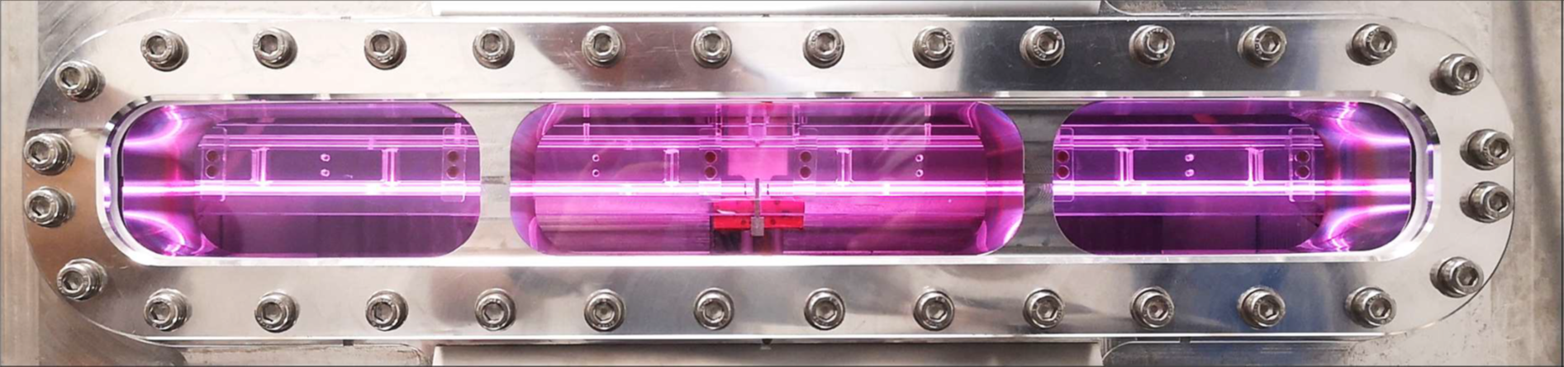
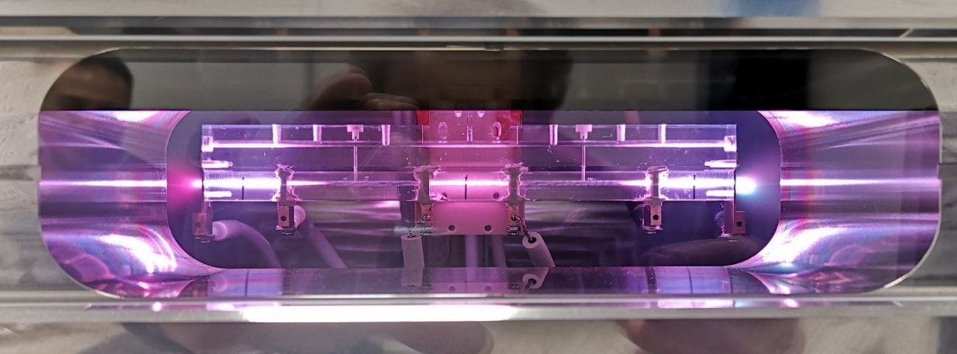
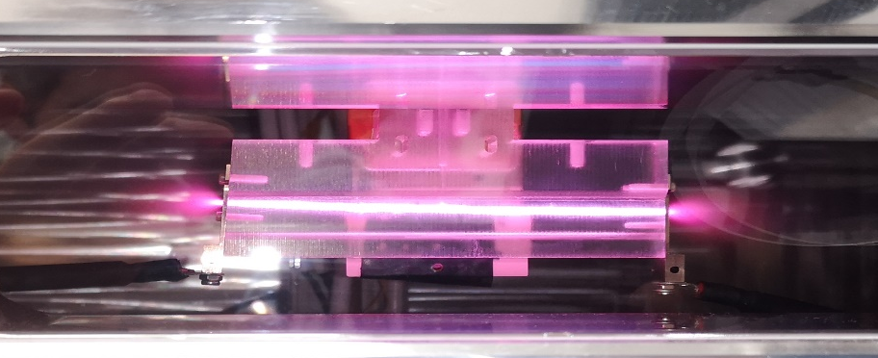
EuPRAXIA@SPARC_LAB: plasma accelerating module
Very long capillary
Segmented capillary
40cm
60cm
Design of m-scale capillaries for EuPRAXIA project by using segmented capillaries: design of HV-voltage circuits and discharge synchronization
Integrated capillary
Curved capillary for APD
Lens ON Acc ON Lens ON
Design of new geometries for curved channels: HV-circuits to allow high current pulses
Studies on cross-talk effects and HV-circuits to reduce the interaction among discharges through plsam ramps
A. Biagioni | Fundamental research and applications with the EuPRAXIA facility at LNF 4 – 6 December 2024 7

Slide 8
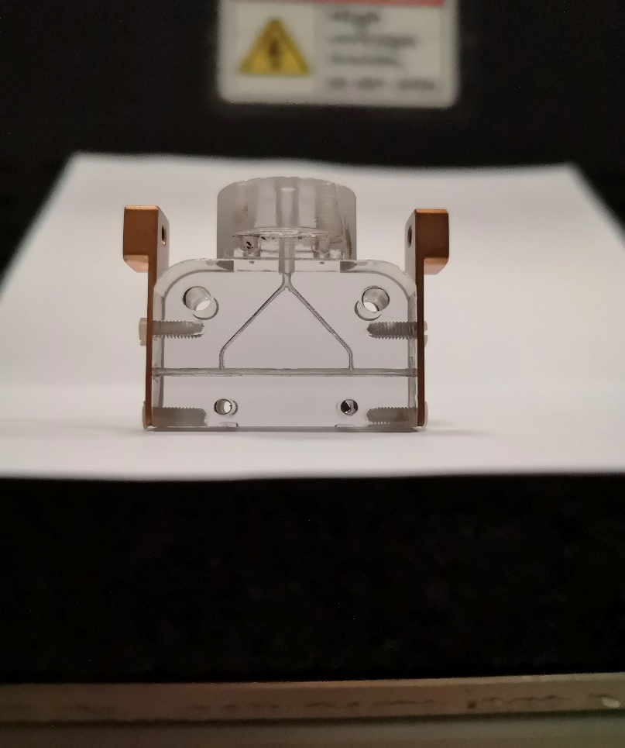
laser stabilization
Laser ON
Laser OFF
Electrode
HV pulse
D (500 pC) W (50 pC
D (500 pC) W (50 pC)
Gas inlets
Plasma channel
- 3cm capillary 25 MeV energy gain
- 800 MV/m acc. gradient
- Witness jitter 1.2MeV
Results obtained by turning ON/OFF the laser stabilizing the plasma discharge
The laser hits the negative electrode of the capillary 200 ns before the discharge trigger
Witness jitter with laser ON(OFF): 0.6(1.2) MeV
A. Biagioni | Fundamental research and applications with the EuPRAXIA facility at LNF 4 – 6 December 2024 8

Slide 9
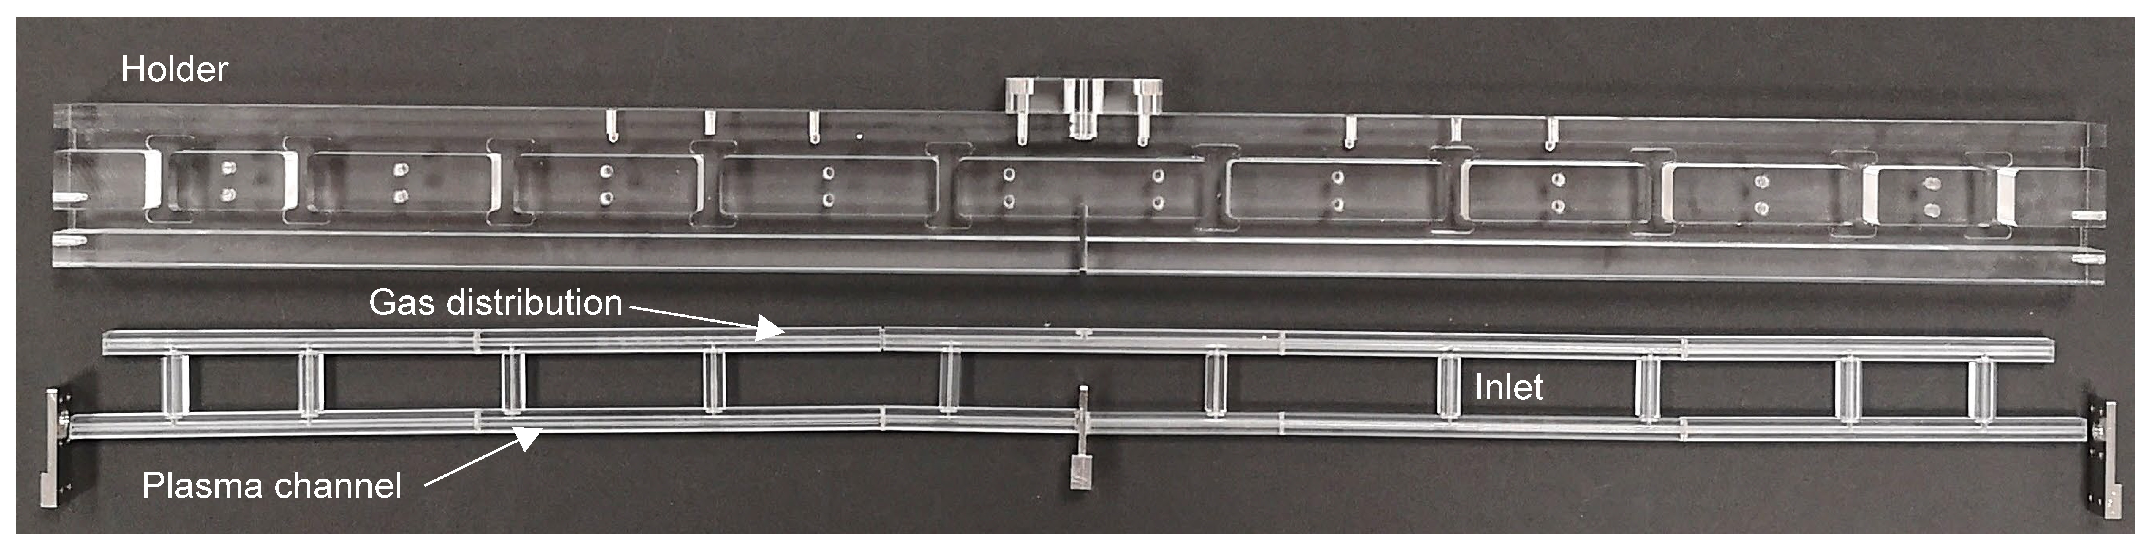
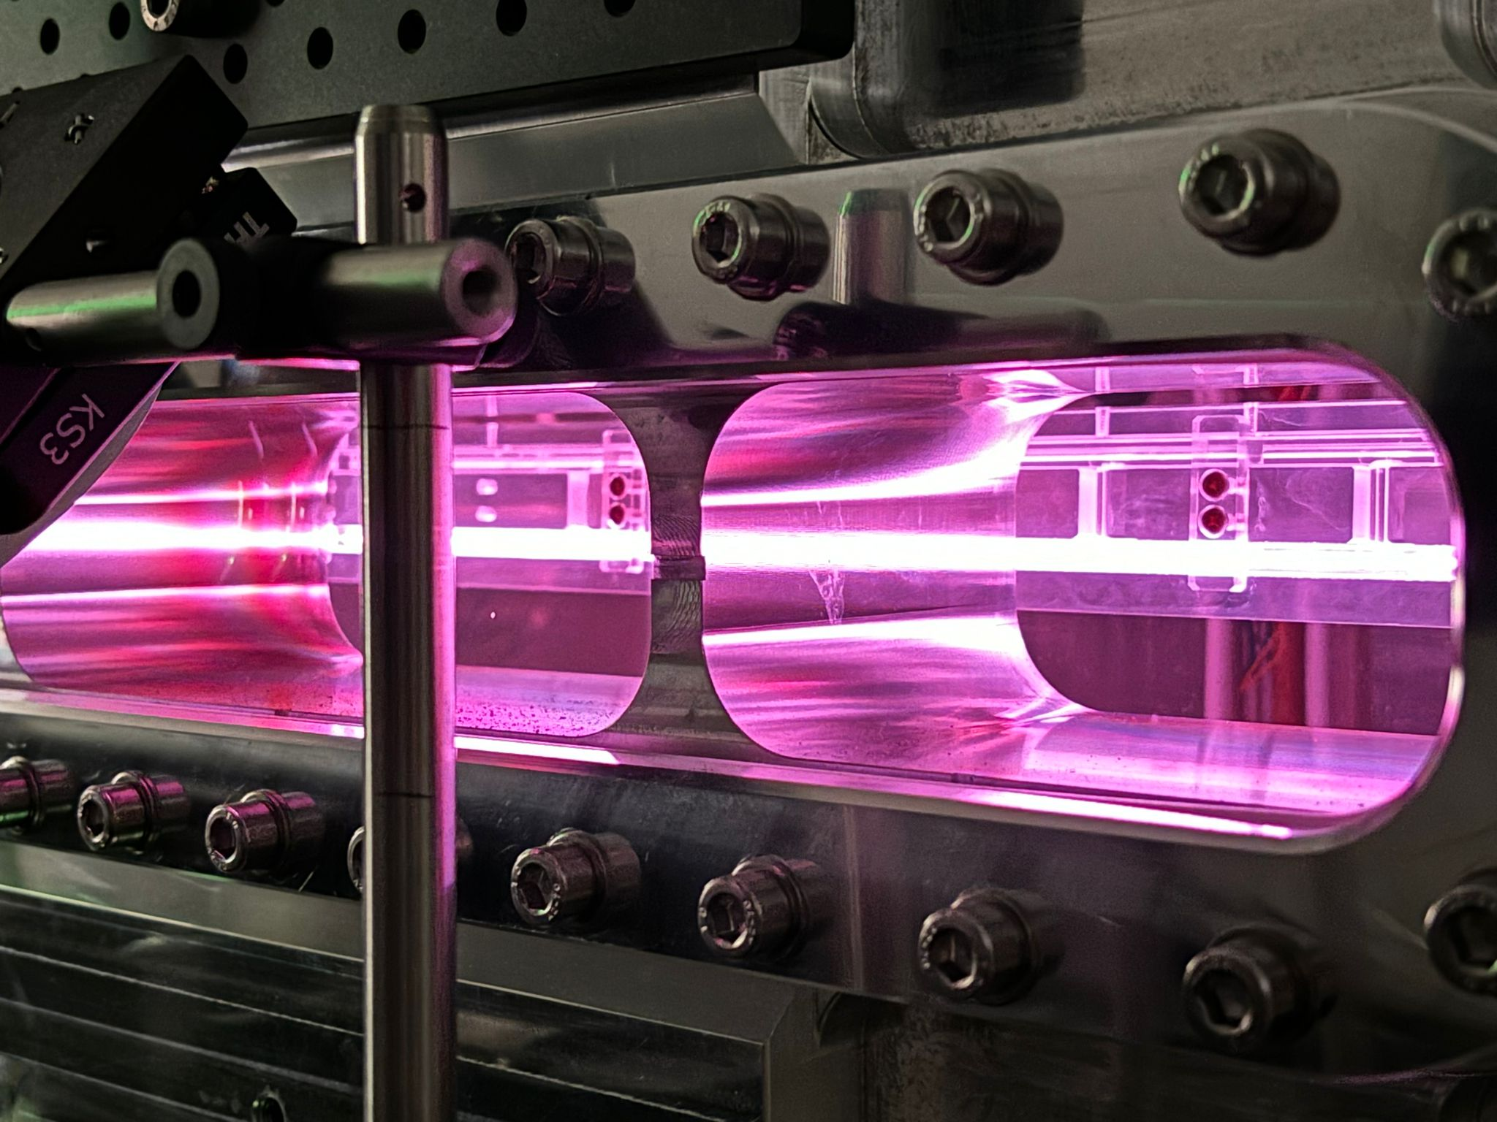
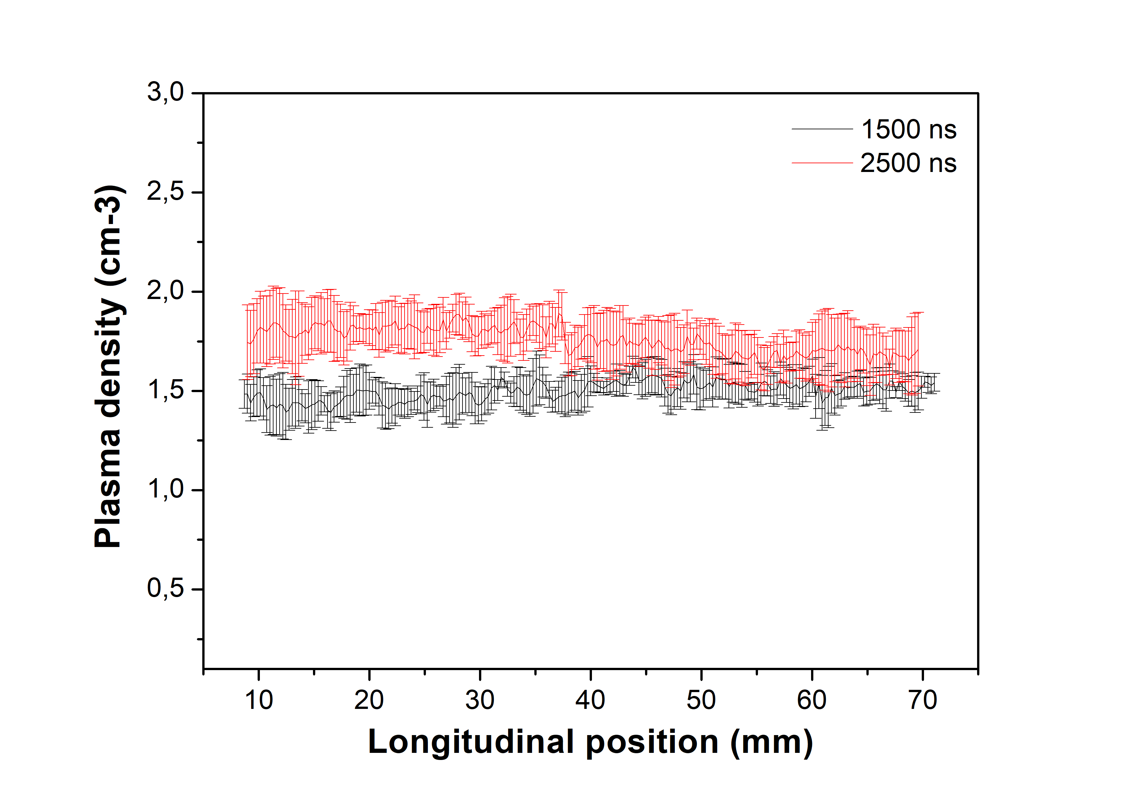
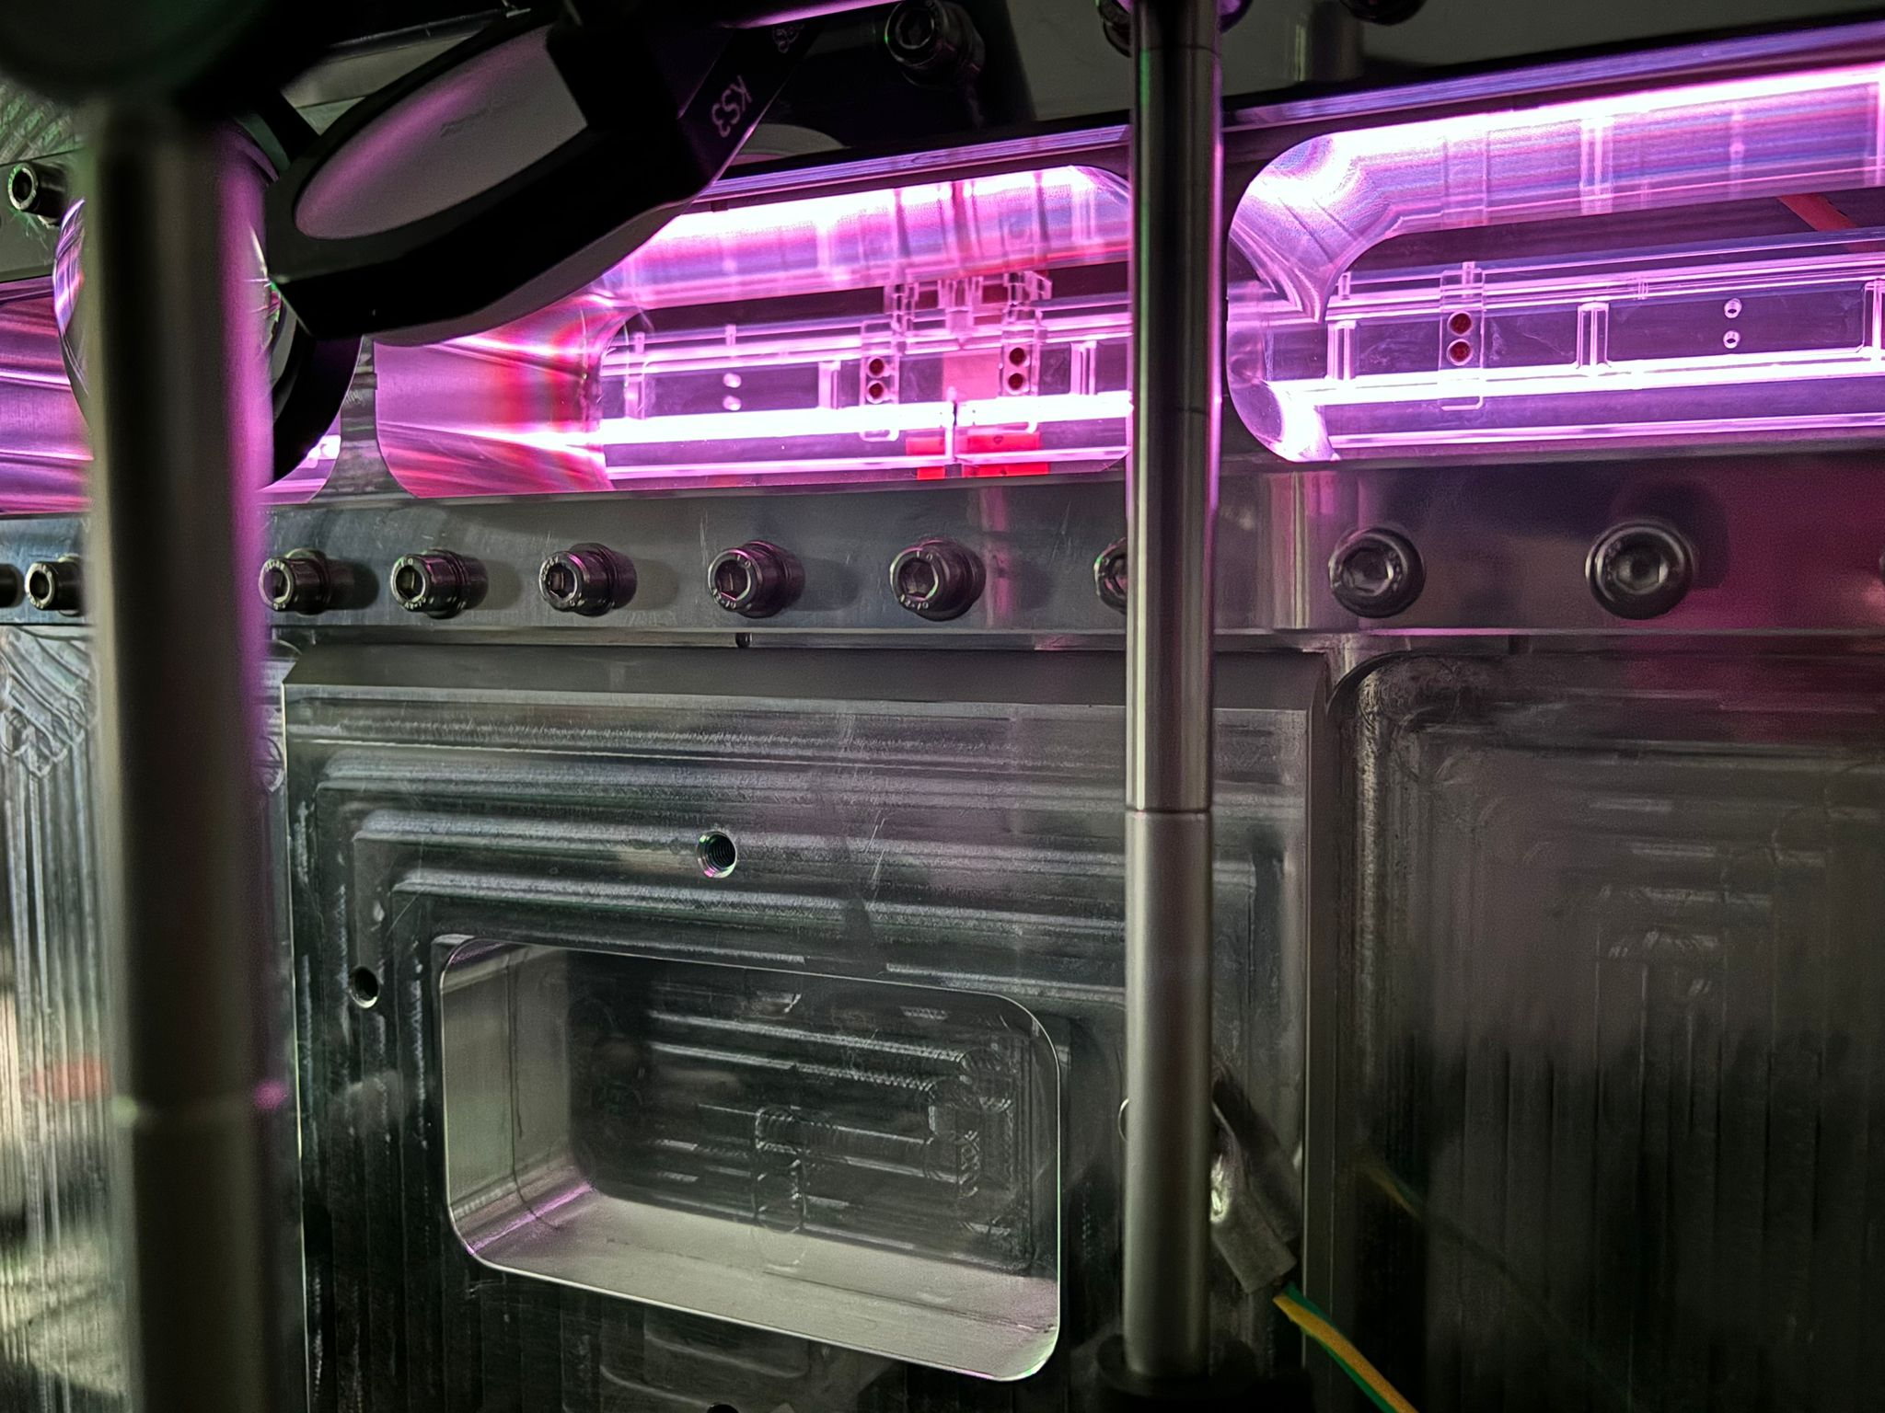
60 cm long plasma source
1.1 GeV (1 GV/m 600 MeV in 60cm long capillary - density 10¹⁶ cm-3 ):
  Fabrication by machining
  10 increasing diameter
  Density range 10¹⁶ -10¹⁷ cm⁻³
  13 kV with 500 A
  100 Hz rep Rate
10¹⁷
  V = 13 kV
  Ip = 500 A
A. Biagioni | Fundamental research and applications with the EuPRAXIA facility at LNF 4 – 6 December 2024 9

Slide 10
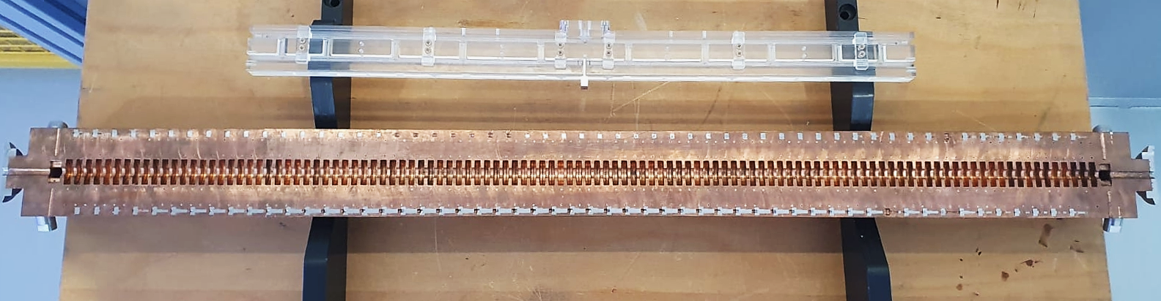
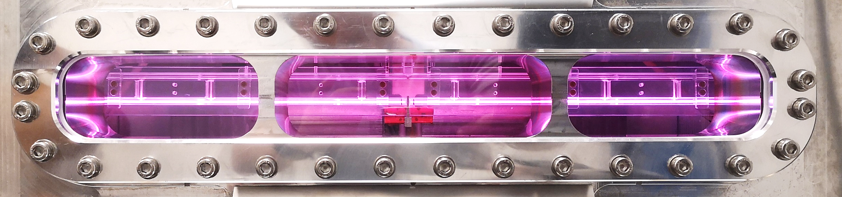
60 cm long plasma source
60 cm long Plasma accelerating module (1 GV/m)
100 cm long X-band structure (60 MV/m )
A. Biagioni | Fundamental research and applications with the EuPRAXIA facility at LNF 4 – 6 December 2024 10

Slide 11
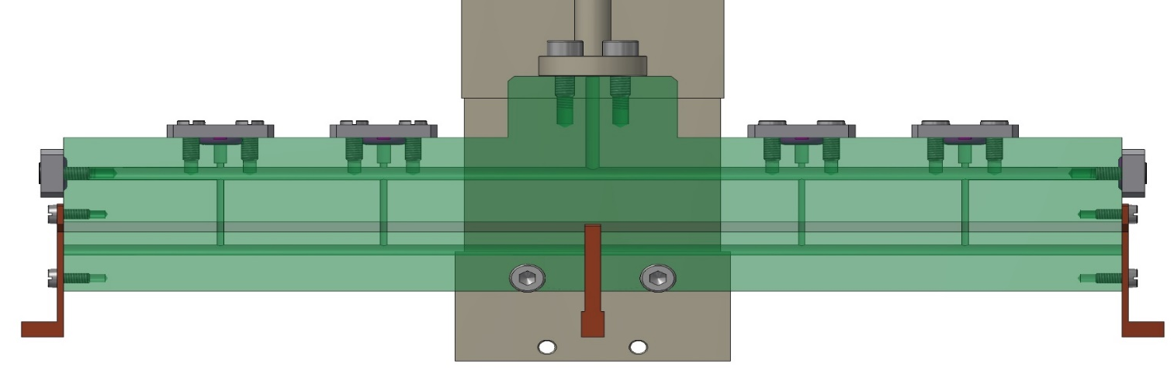

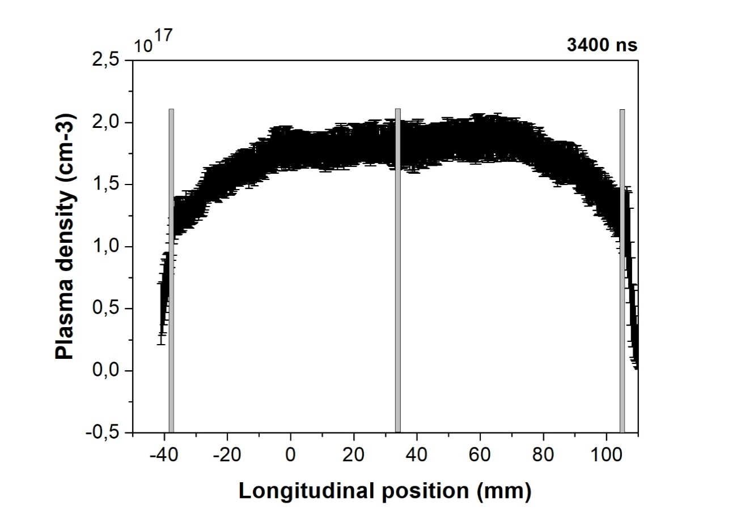
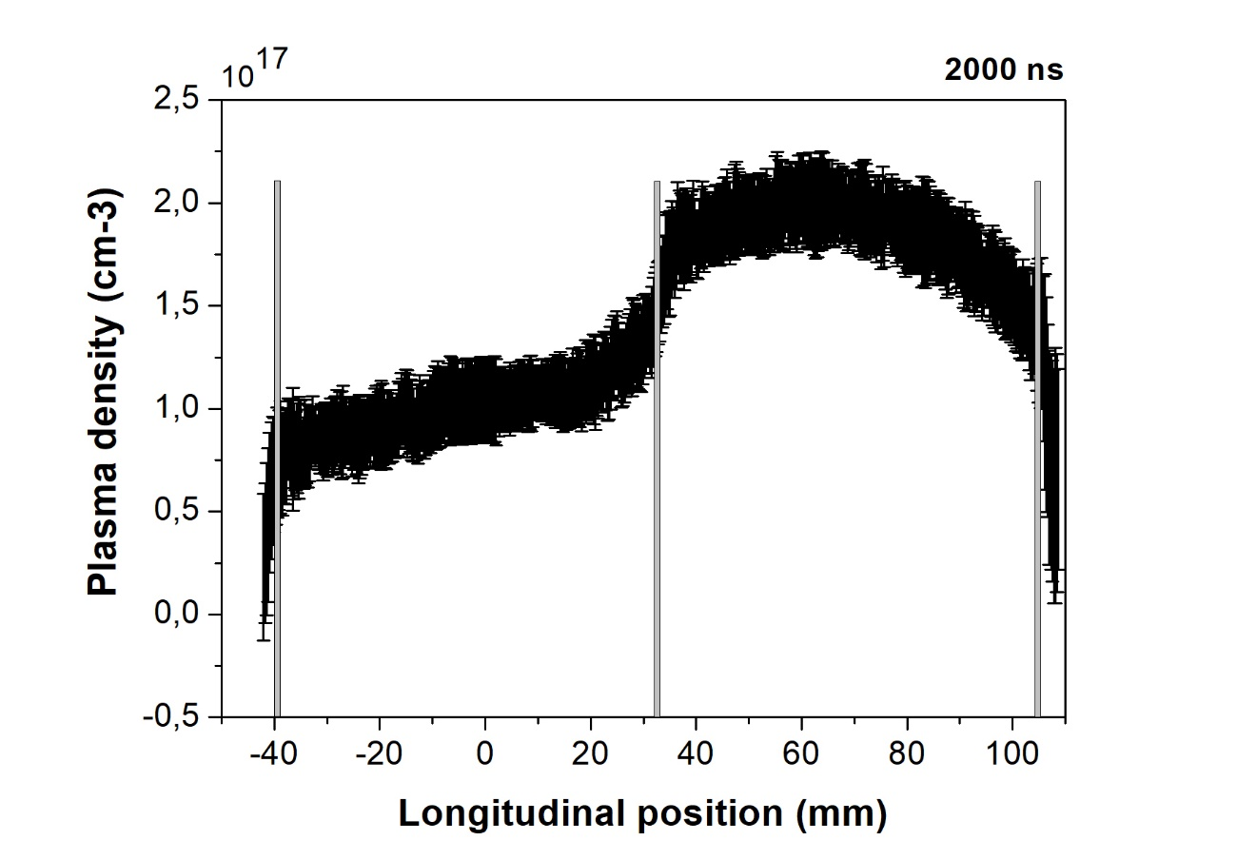
m-scale plasma sources
8 cm
Segmented capillary
El1
El2
Common
ground
    Plasma sources larger than 60 cm (m-scale) with HV pulses less than 10 kV
    Longitudinal density modulation by using voltage or pulse synchronization
    5 GeV case for EuPRAXIA (1.5 GV/m, m-scale capillary - density 10¹⁶ cm-3)
    Implementation of several components within compact structures
7.5 kV
7.5 kV
Plasma density (cm-3)
6 kV
7.5 kV
A. Biagioni | Fundamental research and applications with the EuPRAXIA facility at LNF 4 – 6 December 2024 11

Slide 12
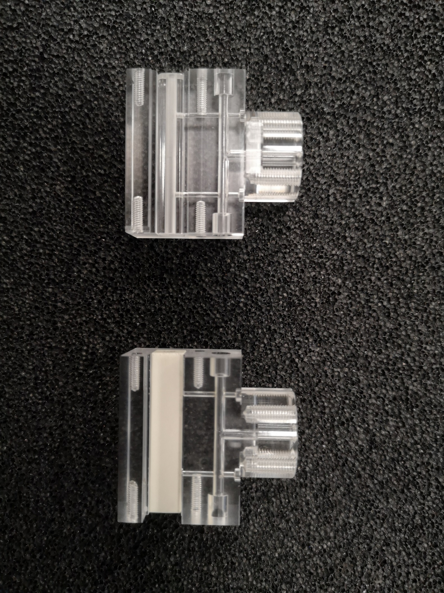
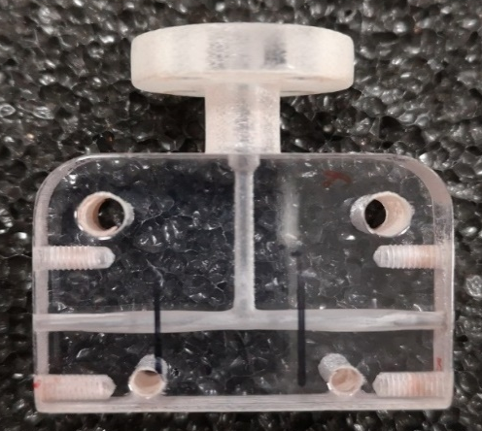
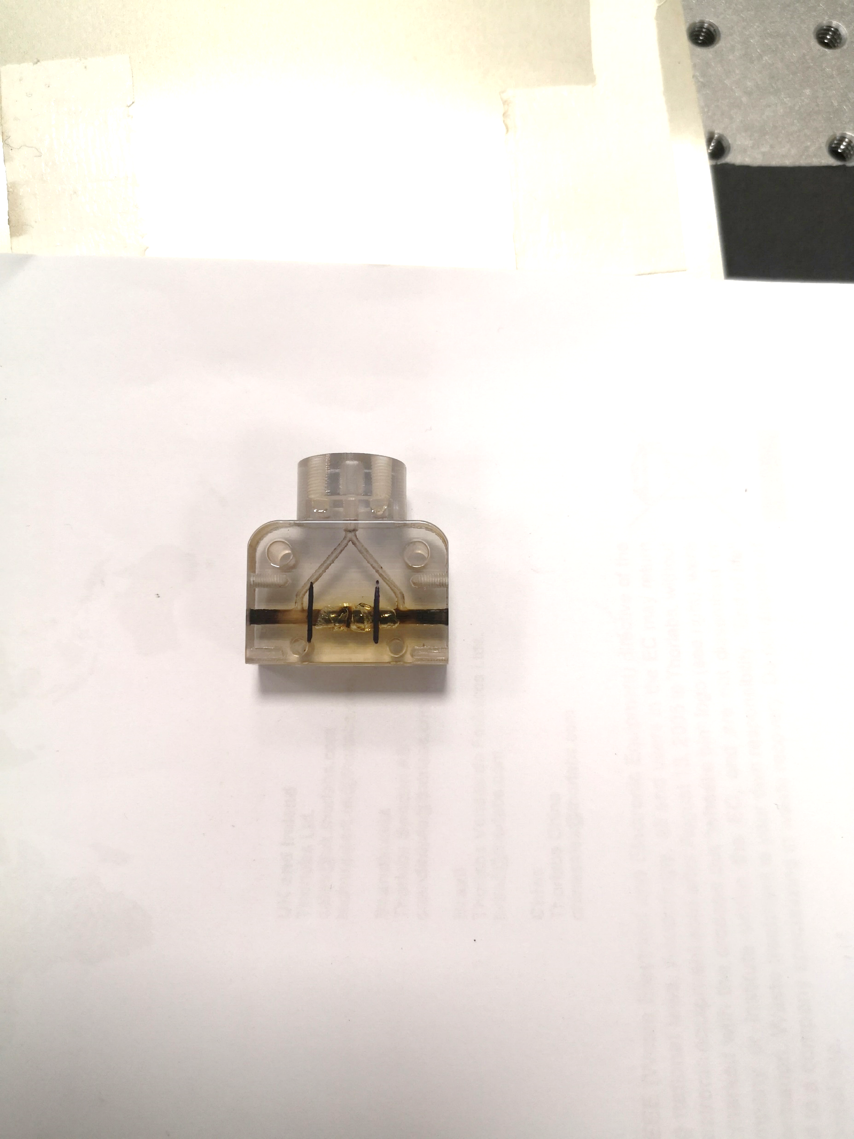
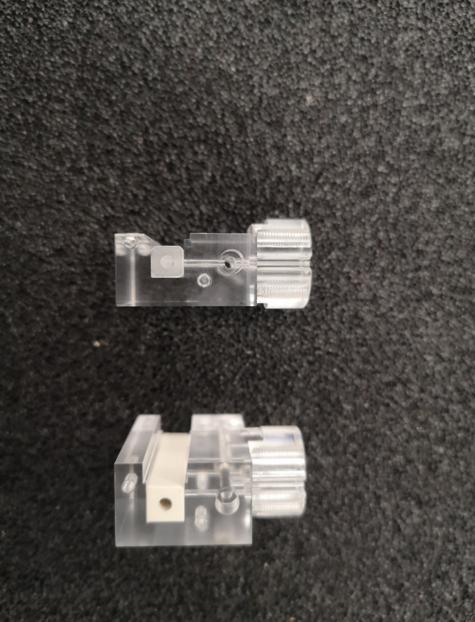
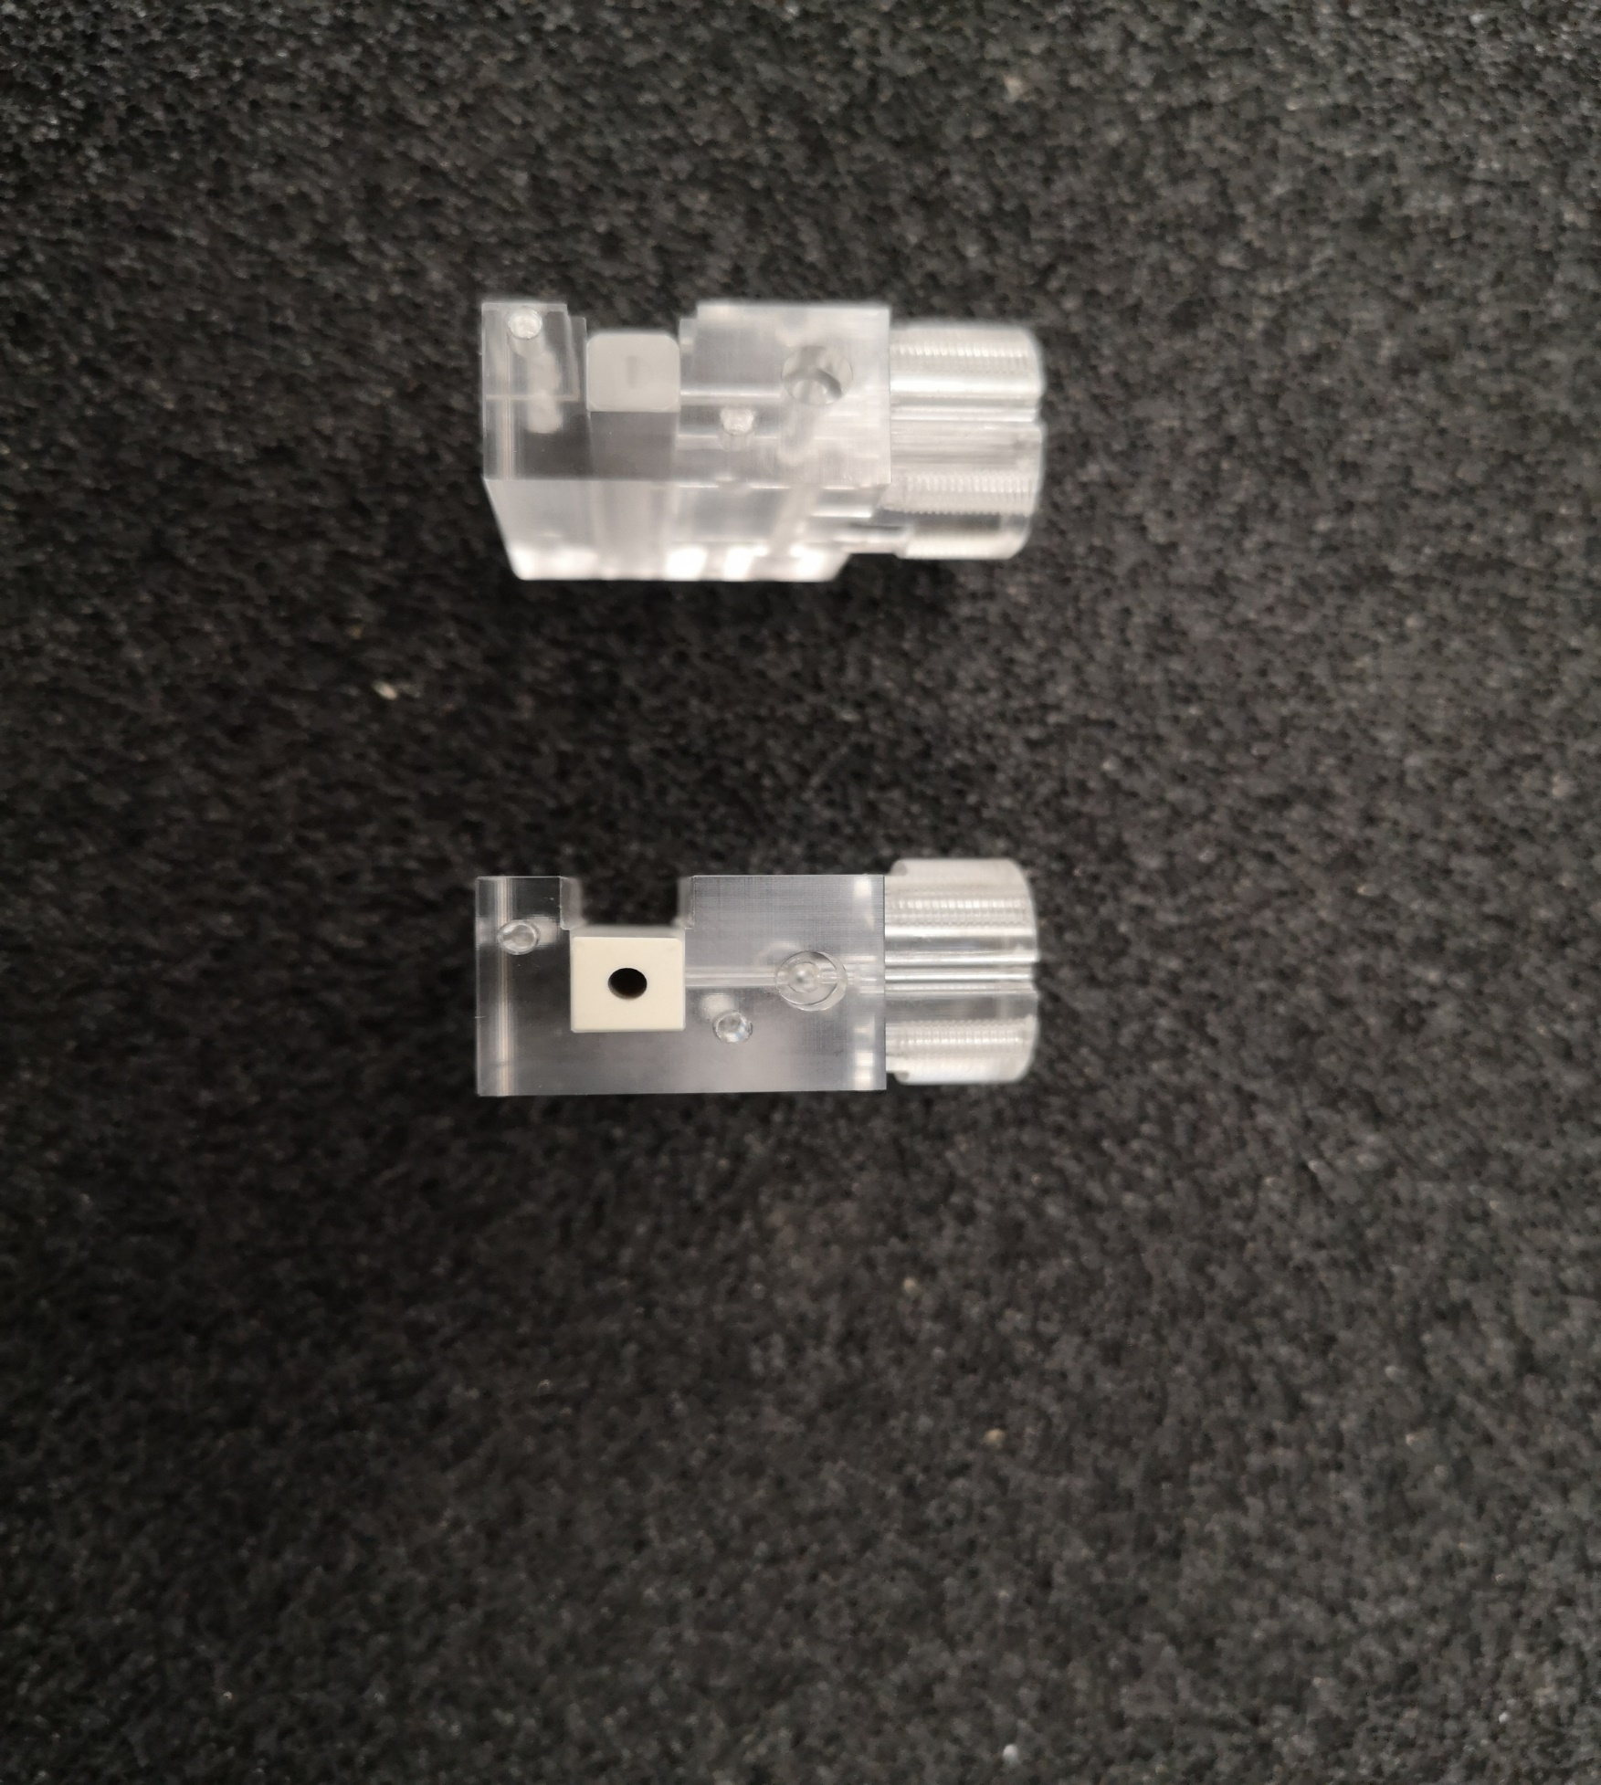
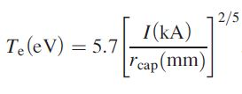
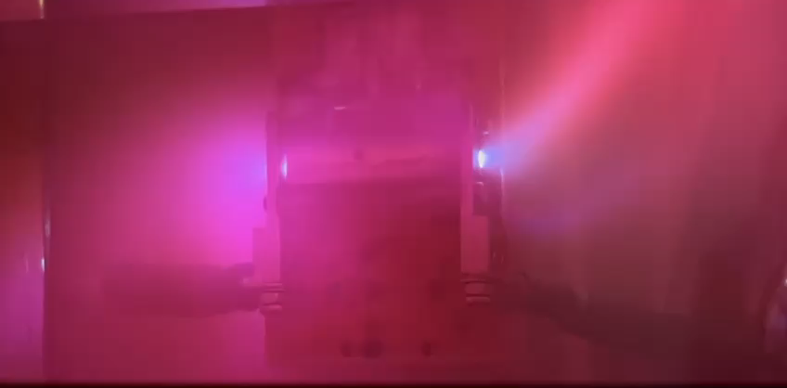
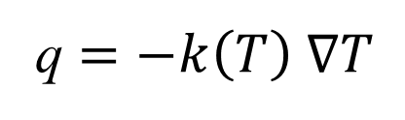
high repRate plasma sources
To operate at high repetition rate with gas-filled capillary-discharge the key point is the thermal dissipation
3D plastic materials
Sapphire
Ceramics
10⁵ shots/1 Hz
7x10⁴ shots/30 Hz
150 Hz repetition rate discharges 2x10⁷ shots No damages observed
~ 4 eV
q $=−k\left(T\right) ∇T$
40 W/mK at 25°C Sapphire
93 W/mK at 25°C Ceramics
k
A. Biagioni | Fundamental research and applications with the EuPRAXIA facility at LNF 4 – 6 December 2024 12

Slide 13
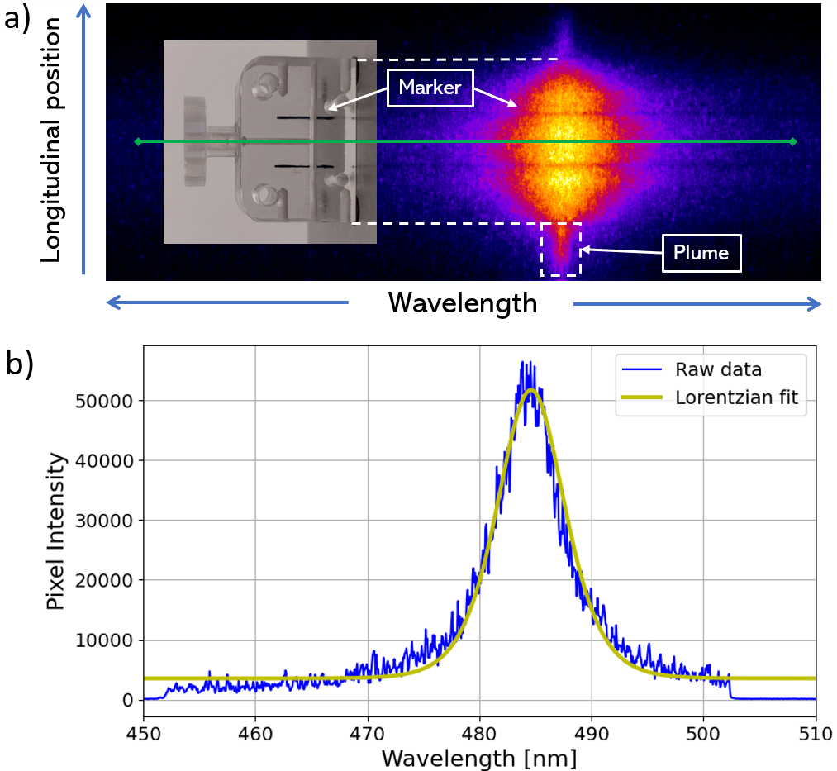
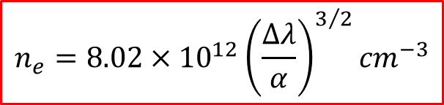
Stark broadening method
plasma diagnostics
The spectrometer acquires hydrogen spectral lines of Balmer series
Stark effect: correlation between plasma density and hydrogen spectral linewidth
Temporal and spatial resolved measurements of plasma density
$$n_{e}=8.02×{10}^{12}{\left(\frac{∆λ}{α}\right)}^{3/2}{cm}^{−3}$$
A. Biagioni | Fundamental research and applications with the EuPRAXIA facility at LNF 4 – 6 December 2024 13

Slide 14
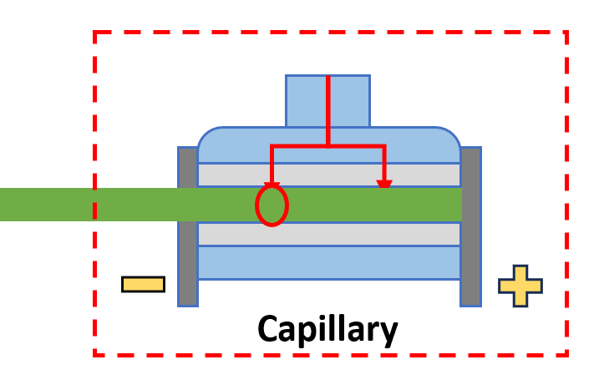
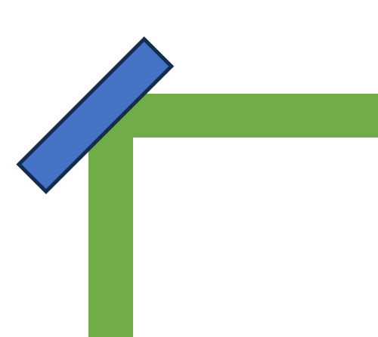
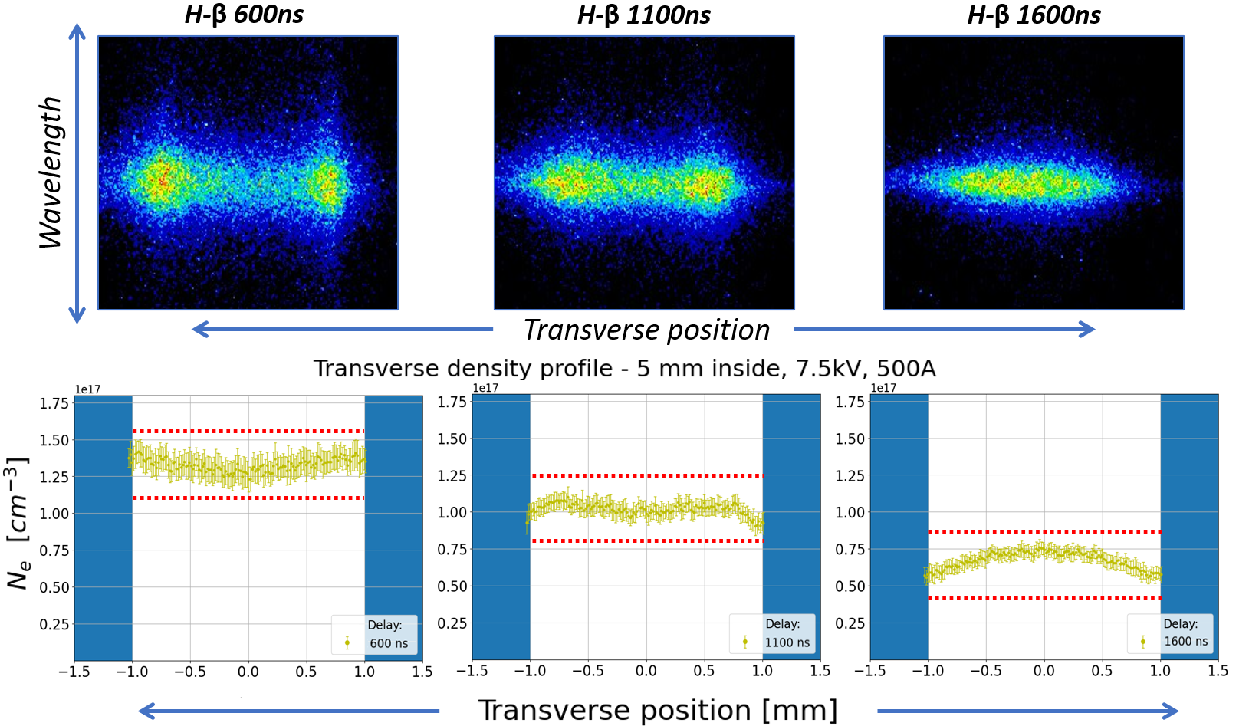
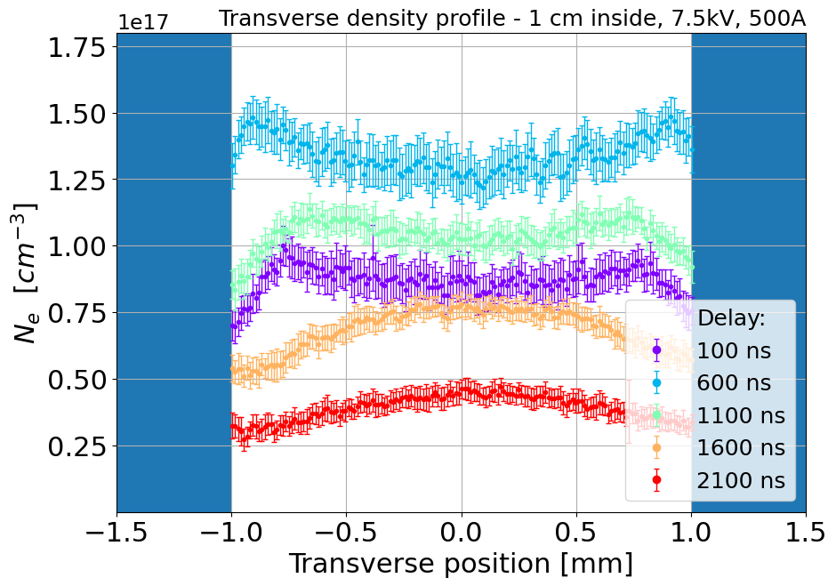
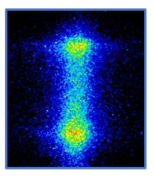
plasma diagnostics
Transverse Stark broadening method
Capillary
Imaging of plasma channel slices
Optical line shift for longitudinal scan
Time-resolved measurements
L1
H-β line
L2
ICCD camera
Transverse position
Spectrometer
Wavelength
A. Biagioni | Fundamental research and applications with the EuPRAXIA facility at LNF 4 – 6 December 2024 14

Slide 15
Thank you for your attention
Angelo Biagioni | INFN_LNF
Angelo.Biagioni@lnf.infn.it

