Slide 1
SPARC_LAB Test Facility
Martina Carillo
On behalf of the SPARC_LAB collaboration

Slide 2
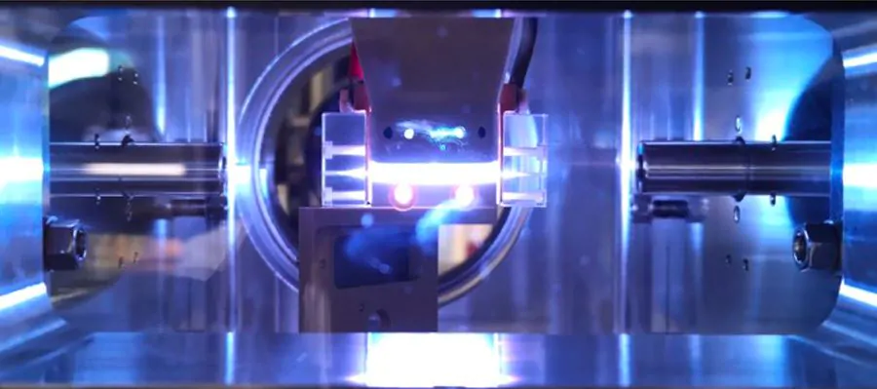
Outline
SPARC_LAB test facility
              Machine layout
Main Results:
              Energy spread minimization
              FEL driven by PWFA
              “All-in-one” capillary
              Curved Plasma Discharge Capillary
EuPRAXIA@SPARC_LAB
Martina Carillo

Slide 3
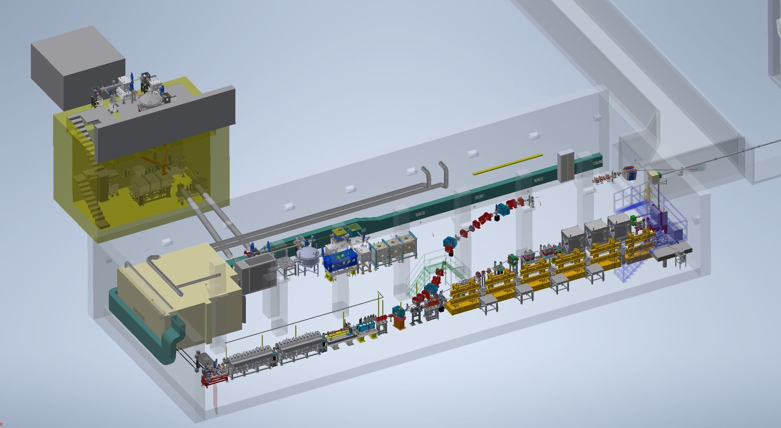
SPARC_LAB Test facility
FLAME
SABINA
EuAPS
Photo-cathode
laser
Free-Electron Laser
PWFA
Photo-injector
Fundamental research and applications with the EuPRAXIA facility at LNF

Slide 4
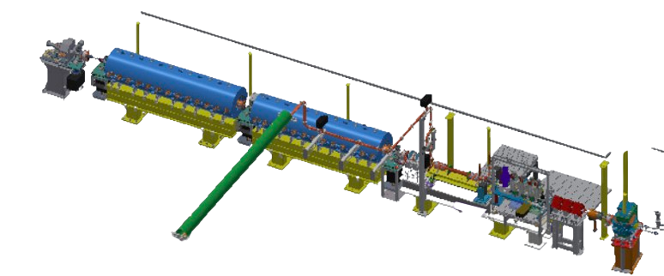
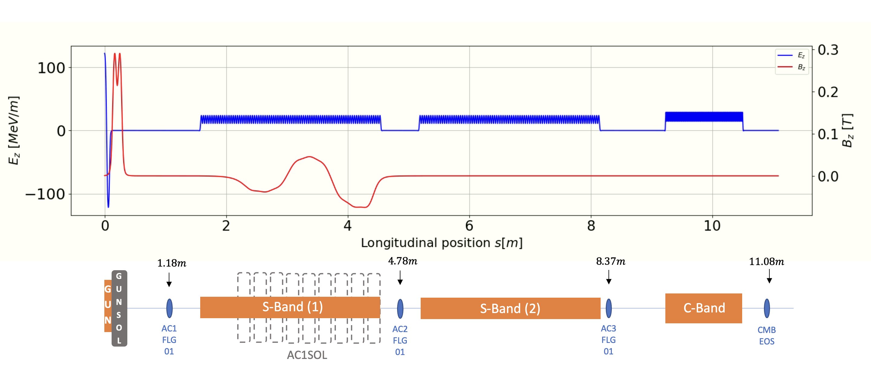
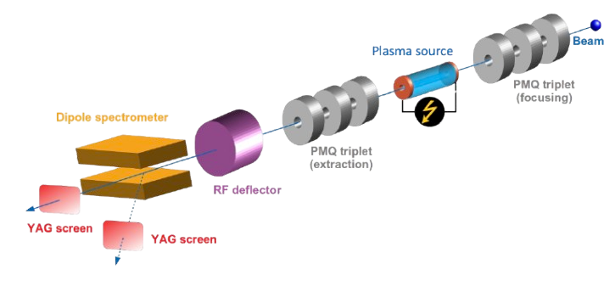
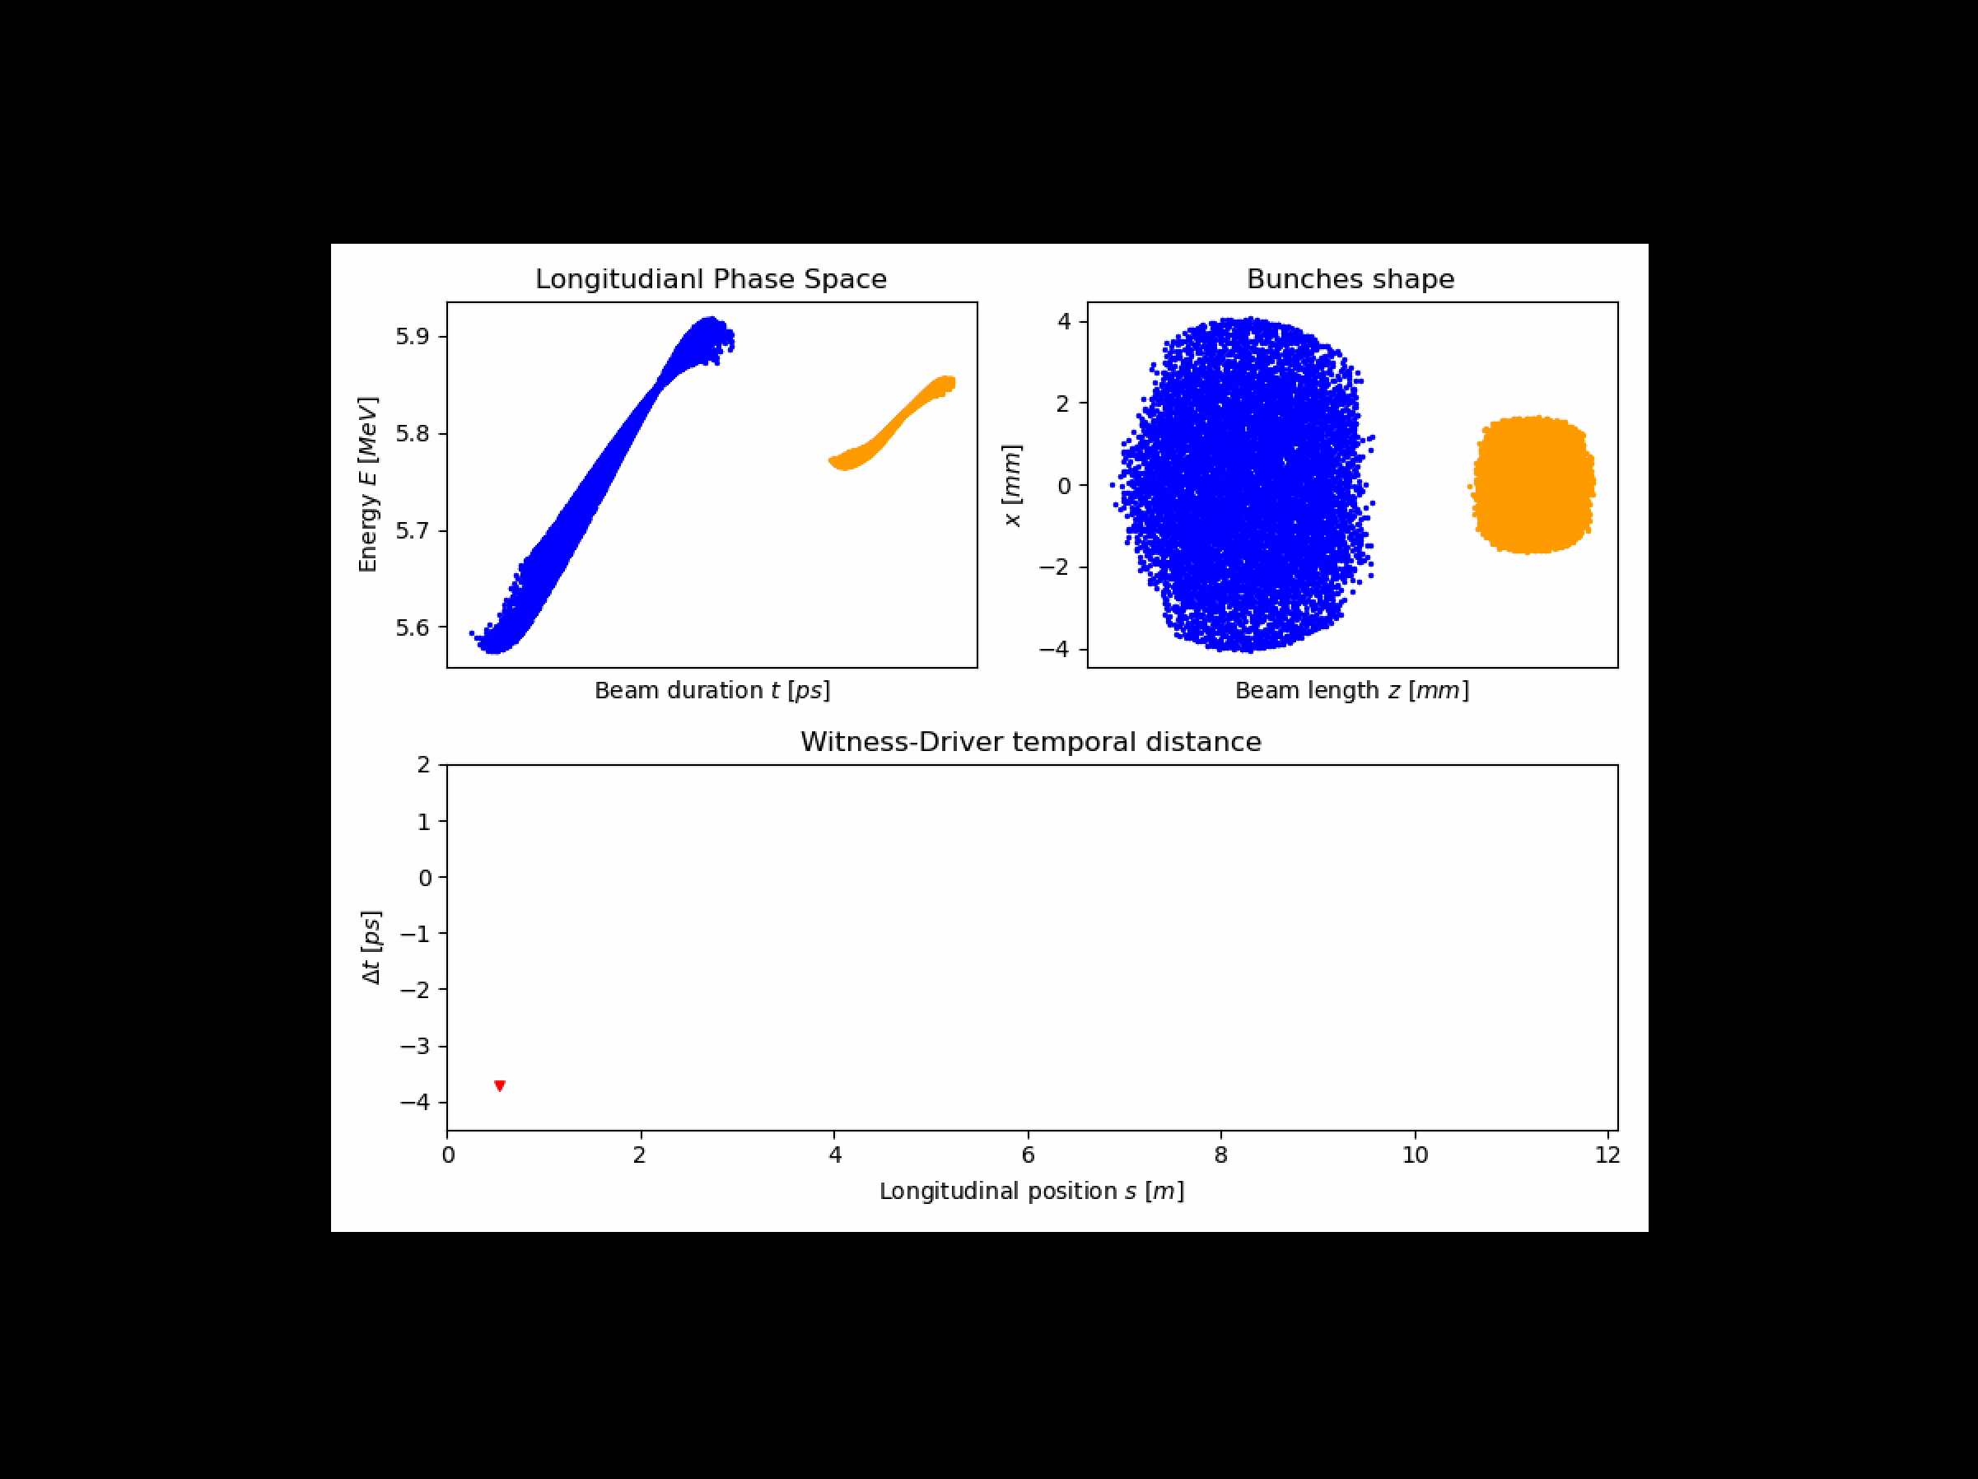
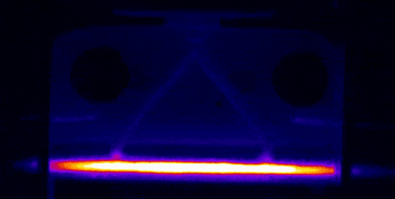
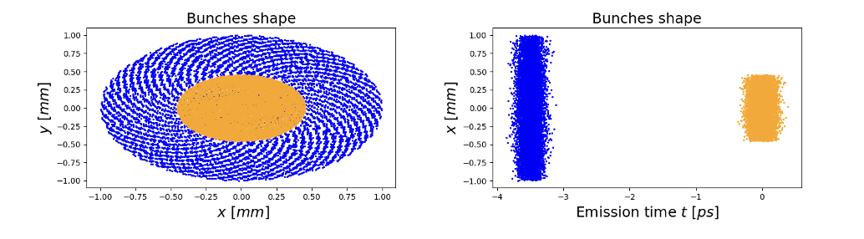
SPARC_LAB machine layout
[*]V. Shpakov, et al., Design, optimization and experimen-
tal characterization of RF injectors for high brightness electron beams and plasma acceleration, Journal of Instrumentation 17 (12), P12022
Photo-injector:
Plasma Chamber & Beam Diagnostic:
The first section of the LINAC works in the velocity bunching configuration
Two-bunches configuration produced directly at the cathode with laser-comb technique:
Biagioni, A., et al., Journal of Instrumentation 11.08 (2016): C08003.
Martina Carillo

Slide 5
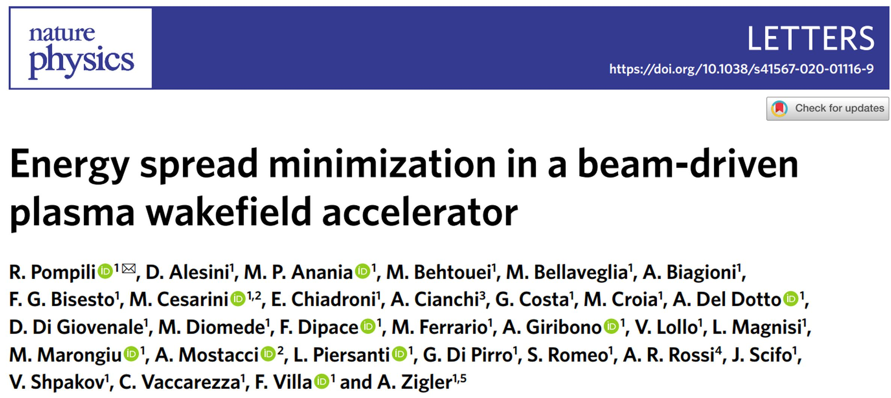
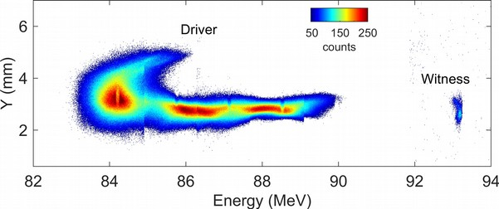
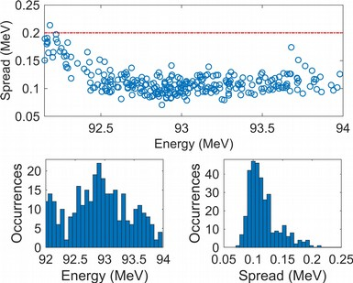
Enery spread minimization
The challenge lies in achieving high-quality, stable beams for high-brightness beam applications.
Low emittance
High current
Low energy spread
(see Plasma Wakefield Acceleration – ​ Advantages and Challenges​. L.Verra)
Stability analysis of the result:
4 MeV acceleration in 3 cm plasma with 200 pC driver: ~133 MV/m accelerating gradient
2x10¹⁵ cm⁻³ plasma density
Demonstration of projected energy spread compensation
  Spread from 0.2% to 0.12% ()
Martina Carillo

Slide 6
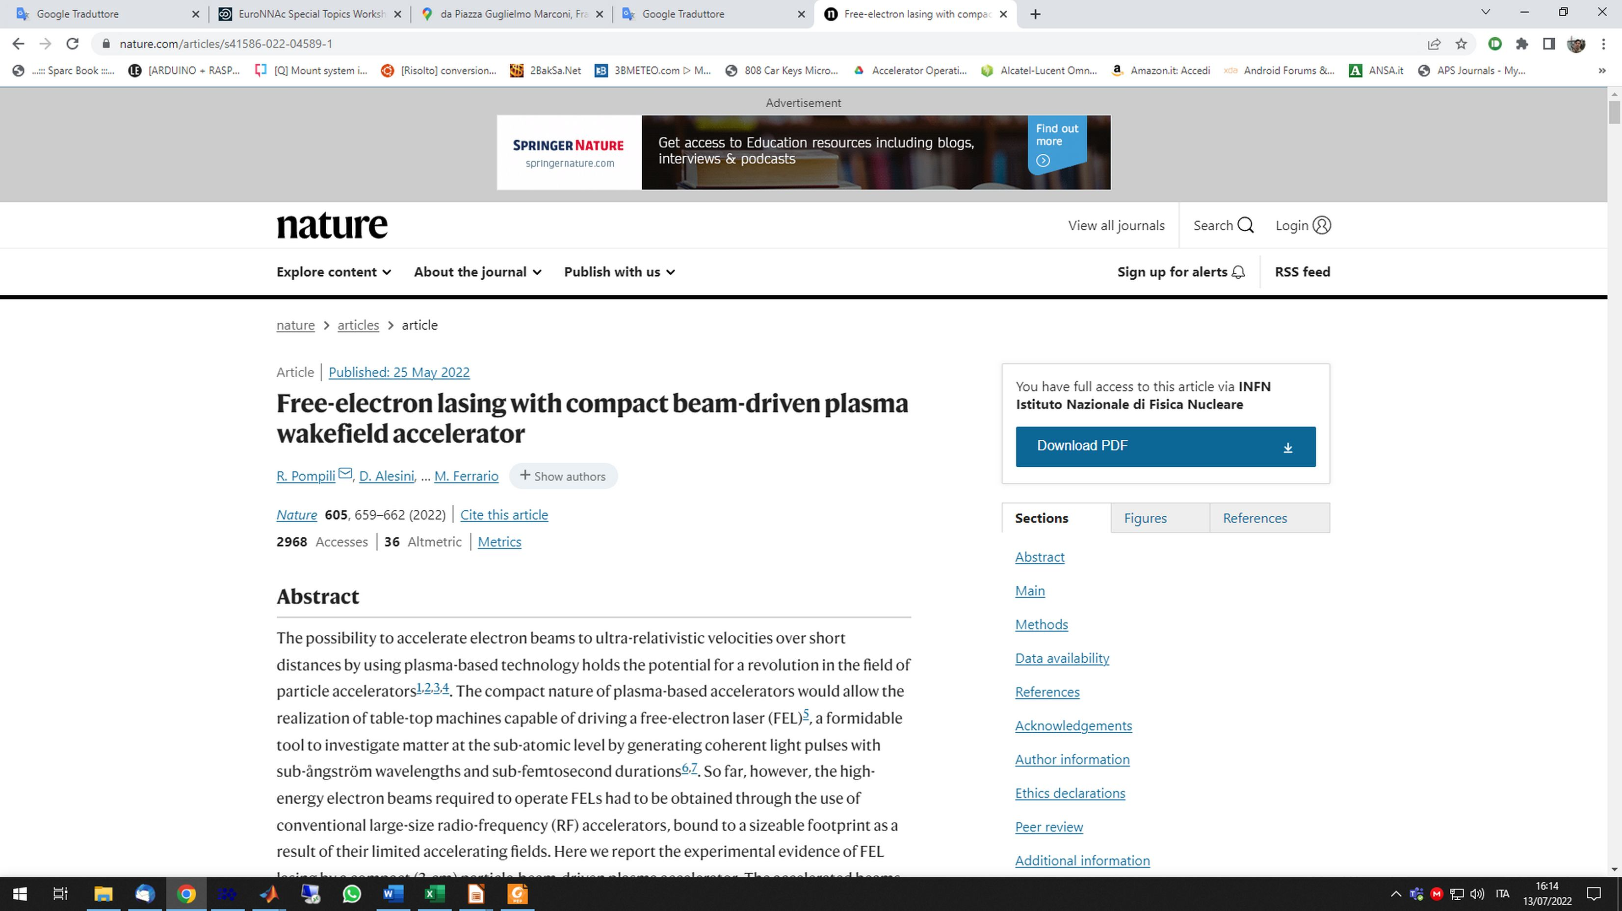
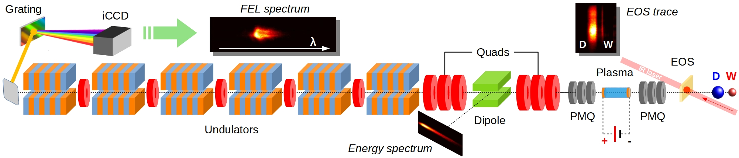
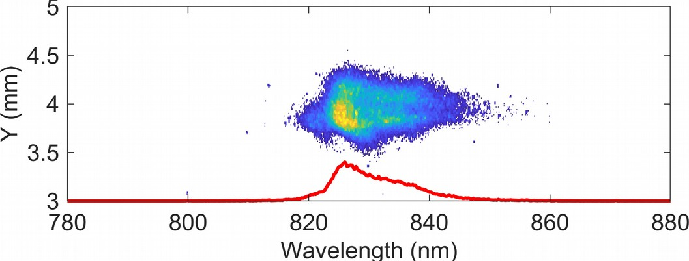
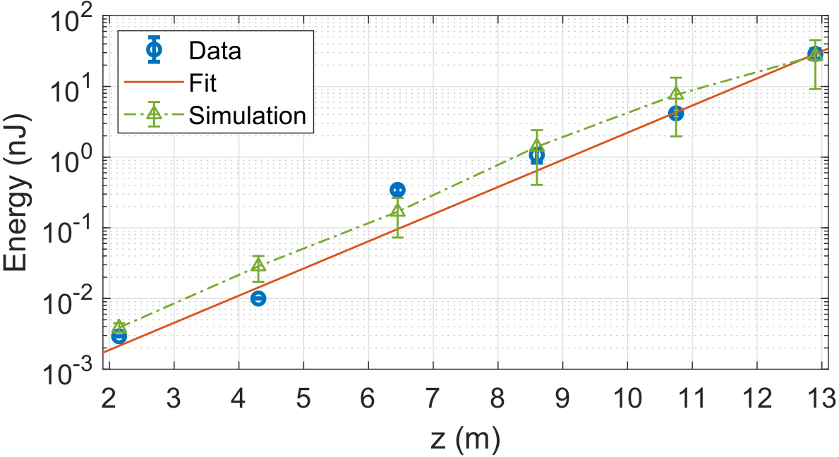
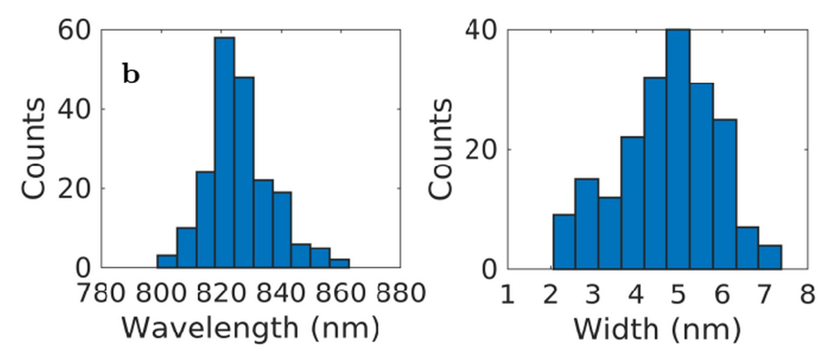
FEL driven by PWFA
The first proof of principle experiment demonstrating Self Amplified Spontaneous Emission (SASE) in a FEL from centimeter-scale beam-driven palsma wakefield accelerator (PWFA)
Exponential gain of FEL radiation energy: data taken with 6 (Si) photo-diodes downstream the undulators
Single-shot spectrum of the SASE FEL radiation emitted at 830 nm
Martina Carillo

Slide 7
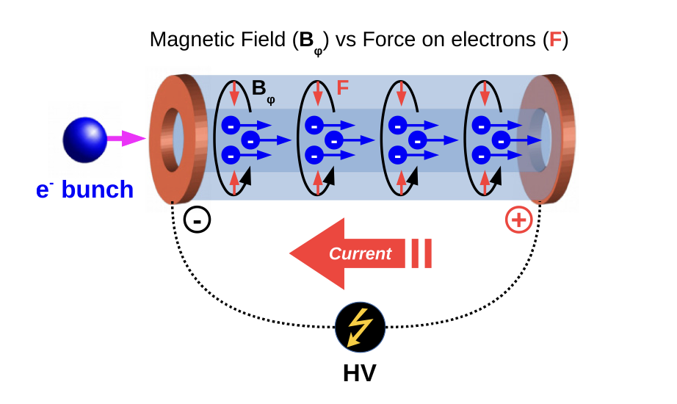
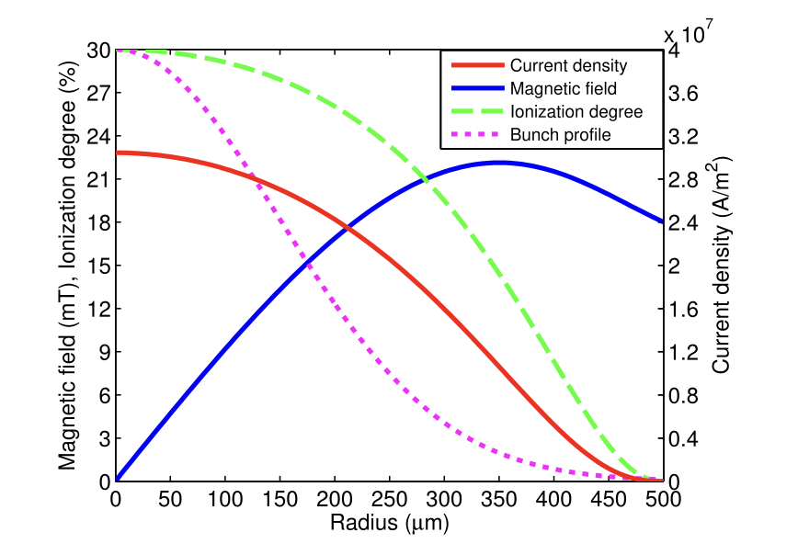
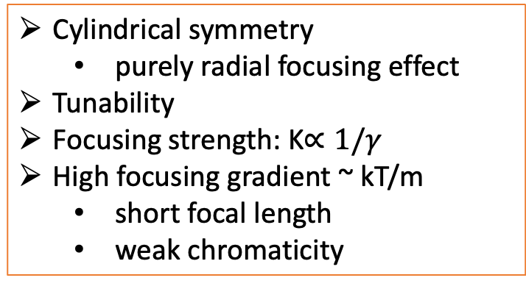
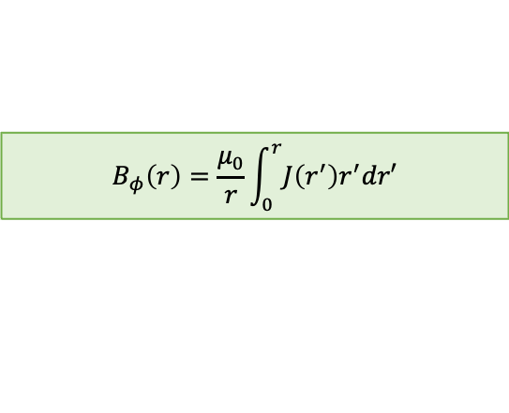
Plasma Lens
Plasma Lenses: Focusing Mechanisms
Passive Plasma Lens:
  Mechanism: Self-focusing.
  Process: Shielding produced by background plasma, which reorganizes to maintain overall neutrality after the passage of a driver beam.
Active Plasma Lens:
  Mechanism: Azimuthal magnetic field.
  Process: Generated by an externally driven axial current.
$$B_{φ}\left(r\right)=\frac{μ_{0}}{r}\int_{0}^{r}{J\left(r^{′}\right)r^{′}dr′}$$
[*]E. Chiadroni et al. Overview of plasma lens experiments and recent results at SPARC_LAB, Nuclear Inst. and Methods in Physics Research, A 909 (2018) 16–20
Cylindrical symmetry
  purely radial focusing effect
Tunability
Focusing strength: K$∝1/γ$
High focusing gradient ~ kT/m
  short focal length
  weak chromaticity
[*]R.Pompili, et al., Experimental characterization of active plasma lensing for electron beams, Appl. Phys. Lett. 110 (10) (2017) 104101.
Martina Carillo

Slide 8
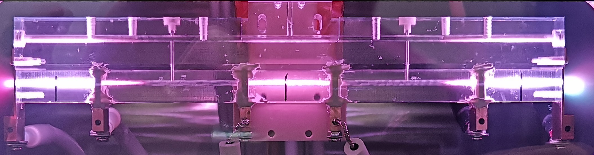

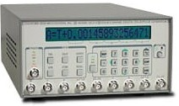
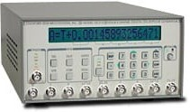
Compact Plasma Device for Acceleration and Focusing
[*]R. Pompili et al., Phys. Rev. E 109, 055202 – Published 3 May 2024
19 cm capillary length and 2 mm diameter
Laser pre-ionizes the gas, stabilizing the discharge and reducing jitter to a few nanoseconds
The high-voltage discharge currents are provided by three pulsers capable of generating up to 1.6 kA peak current
APL
PWF A
APL
drift
INFN patent by A. Biagioni, R. Pompili, V. Lollo, D. Pellegrini, M. Ferrario
drift
APL
PWFA
APL
The discharge current and plasma density can be independently tuned and controlled in each plasma stage.
e- beam
DDG
DDG
DDG
HV gen
Martina Carillo

Slide 9
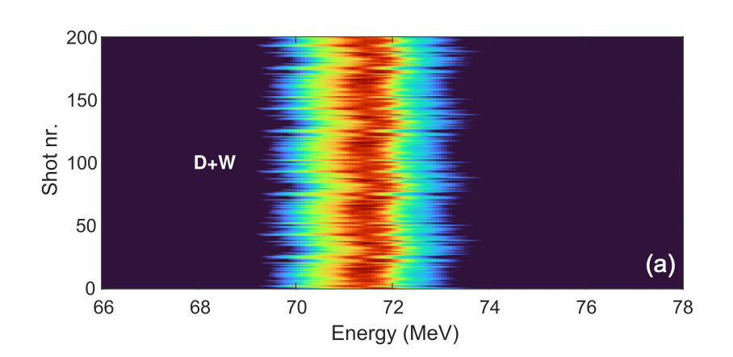
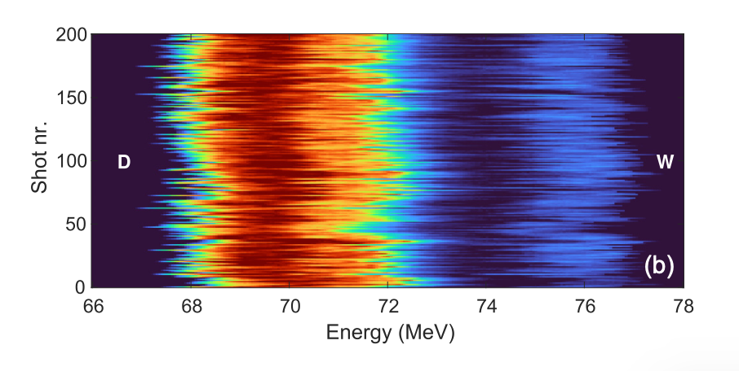
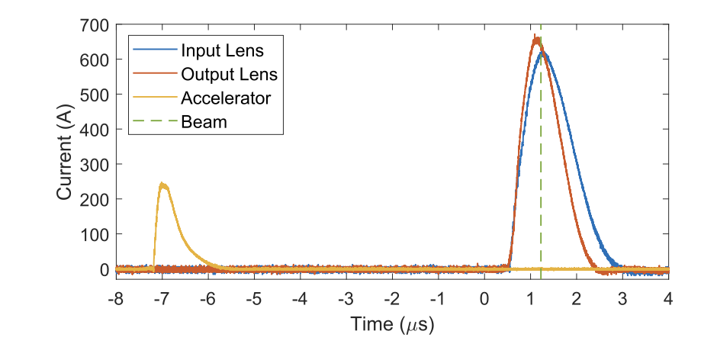
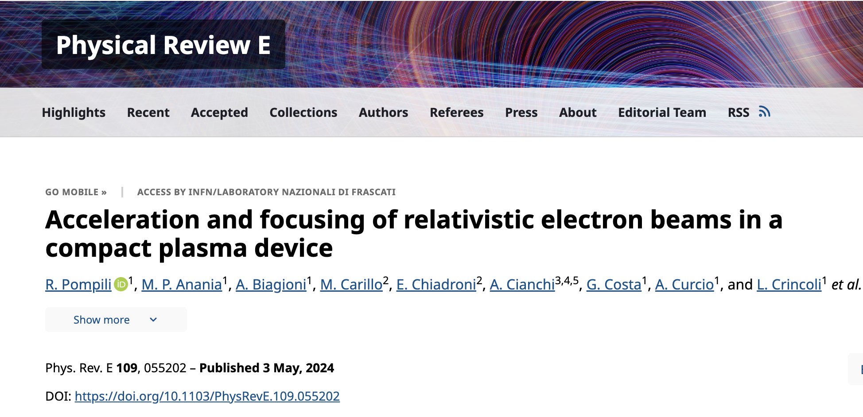


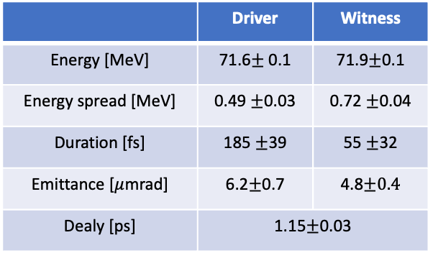
Experimental Results
SPARC_LAB RF photoinjector beams:
 | Driver | Witness
Energy [MeV] | 71.6$±$0.1 | 71.9$±$0.1
Energy spread [MeV] | 0.49 $±$0.03 | 0.72 $±$0.04
Duration [fs] | 185 $±$39 | 55 $±$32
Emittance [$μ$mrad] | 6.2$±$0.7 | 4.8$±0.4$
Dealy [ps] | 1.15$±$0.03
Witness Energy gain of 4.5 MeV over a distance of 3 cm
A proof-of-principle experiment merged three plasma stages into a compact device that can focus, accelerate, and extract a witness bunch in a plasma-based accelerator.
$${n_{p}}_{APL,1}≈2 × {10}^{17}cm^{−3}$$
$${n_{p}}_{PWFA}≈4 × {10}^{15}cm^{−3}$$
Martina Carillo

Slide 10
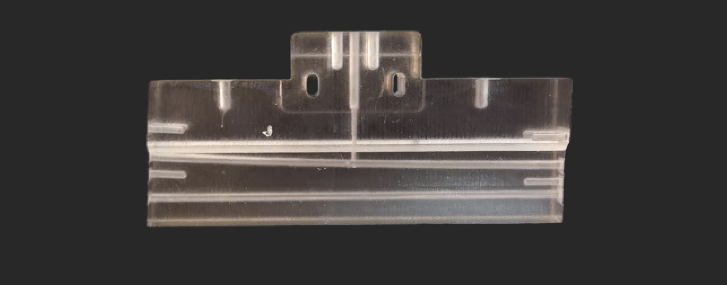
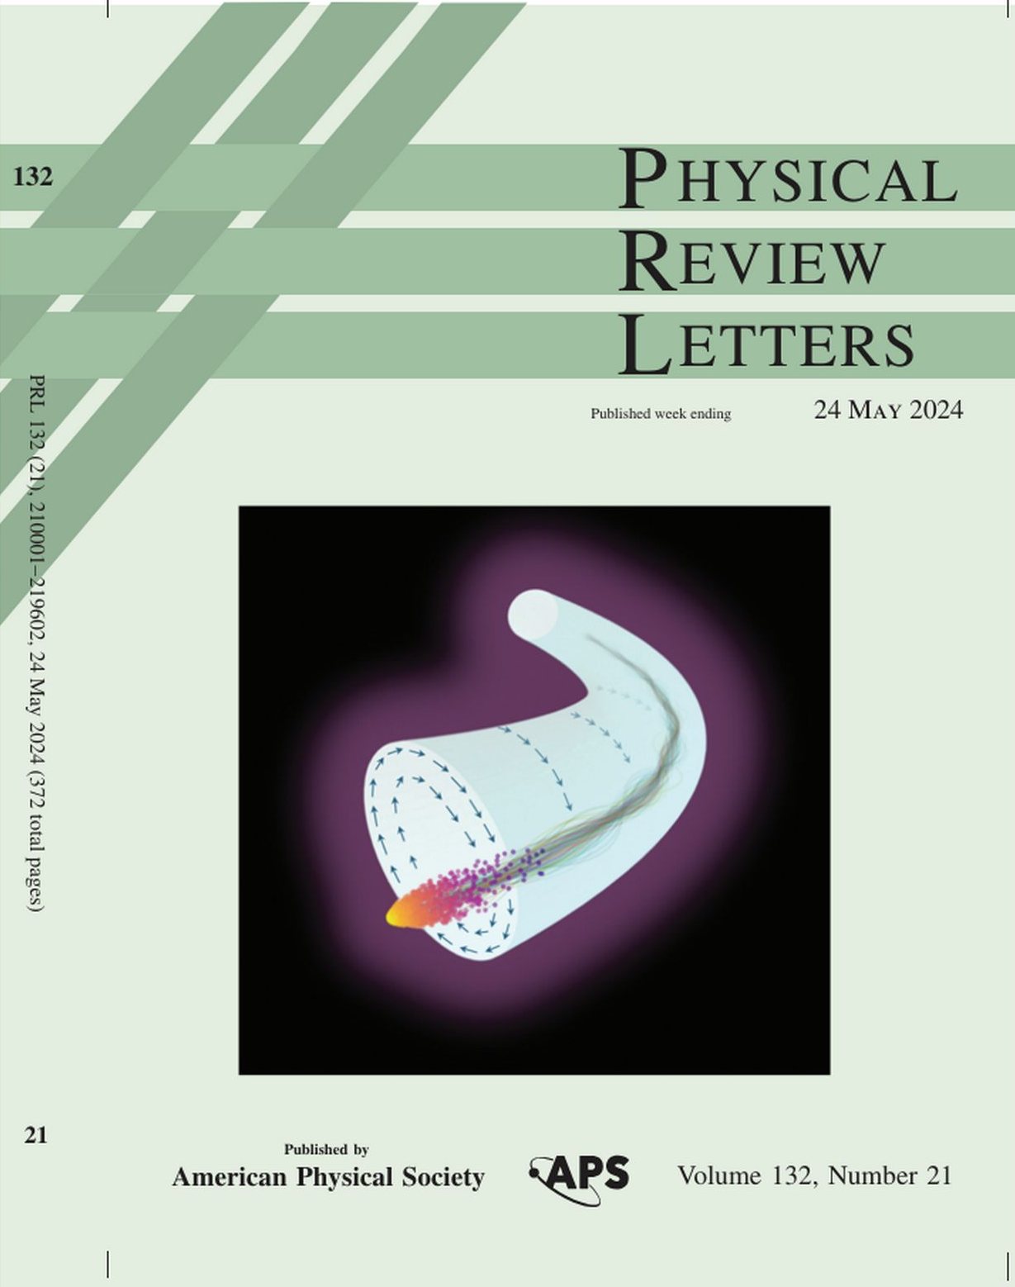
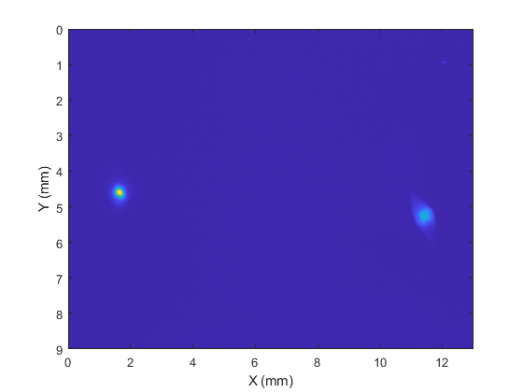
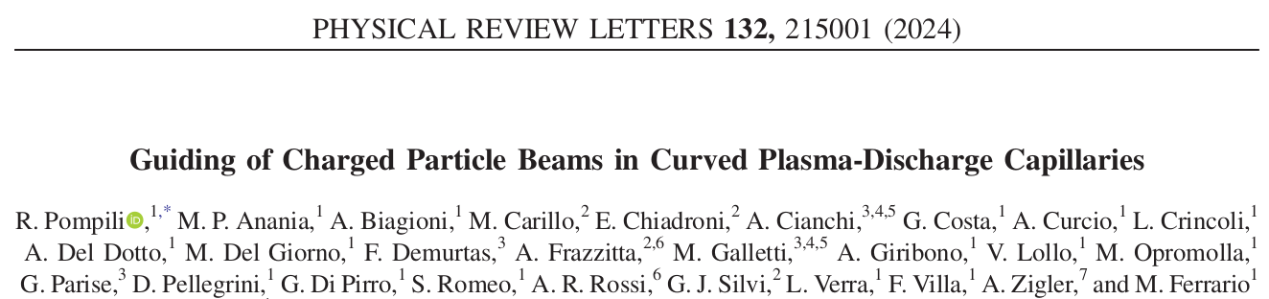
Curved Plasma-Discharge Capillaries
Vertical bending
3 mm offset
2mm hole
Beam
Hole for laser alignment
10 cm, Rbend ~1.6 m
We have used a 50 pC test beam on-crest (~1 ps)
The energy of the beam is set to 60 MeV
The beam is imaged on the YAG/GAGG screen located ~10 cm downstream the capillary exit
Capillary out
Capillary in
Discharge On
Martina Carillo

Slide 11
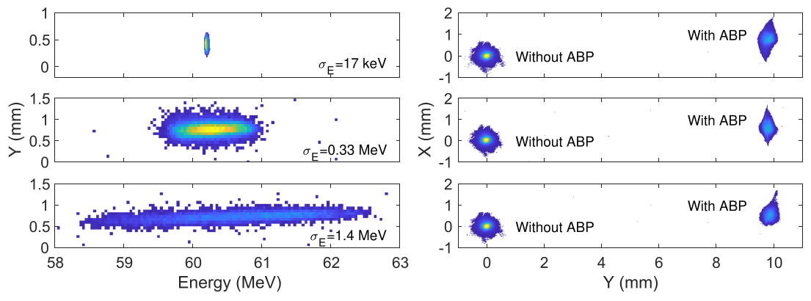
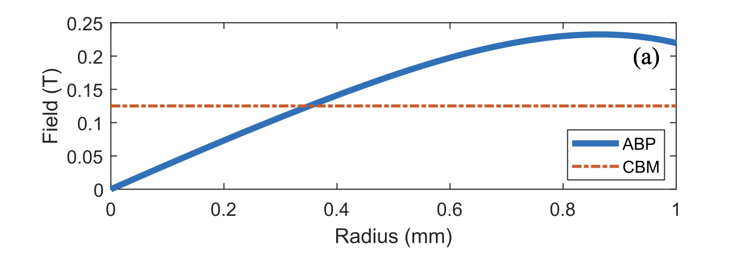
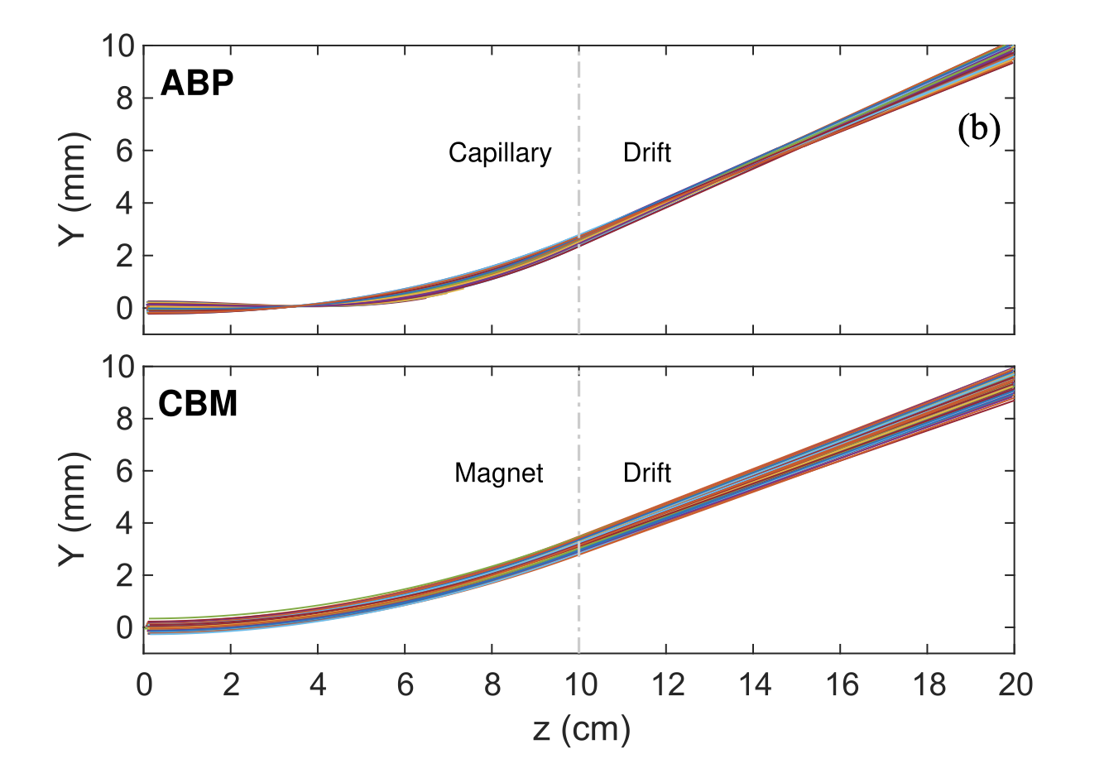
Active Bending Plasma
We tested the ABP deflection with three beam configurations having different energy spreads
  Goal: test the chromatic dispersion of the device
Findings: the output spot sizes is almost unaffected by the energy spread (especially on the bending plane)
  It indicates that the device operated almost in a dispersion-less way
Martina Carillo

Slide 12

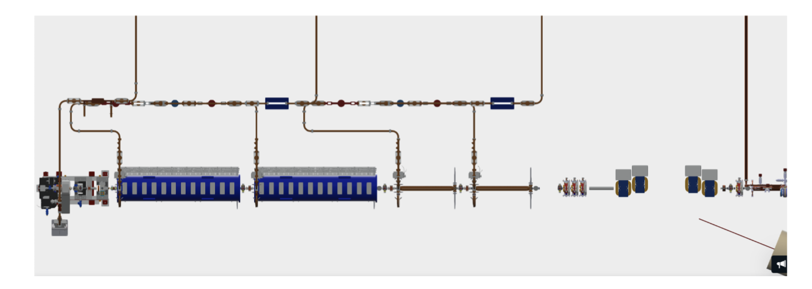
EuPRAXIA@SPARC_LAB
EuPRAXIA@SPARC_LAB injector:
SPARC_LAB is the test and training facility for EuPRAXIA@SPARC_LAB
Beam characterization, with particular emphasis on beam quality and stability, which are essential to meet the stringent requirements of the experiments envisioned by EuPRAXIA.
Validation of advanced technologies, such as plasma-based acceleration systems and high-intensity permanent magnets, to ensure reliable and consistent performance.
Optimization and calibration of operational systems, aimed at establishing stable configurations and efficient protocols, which are crucial for the implementation of EuPRAXIA.
Martina Carillo

Slide 13
Thank you for your attention
Martina Carillo

Slide 14
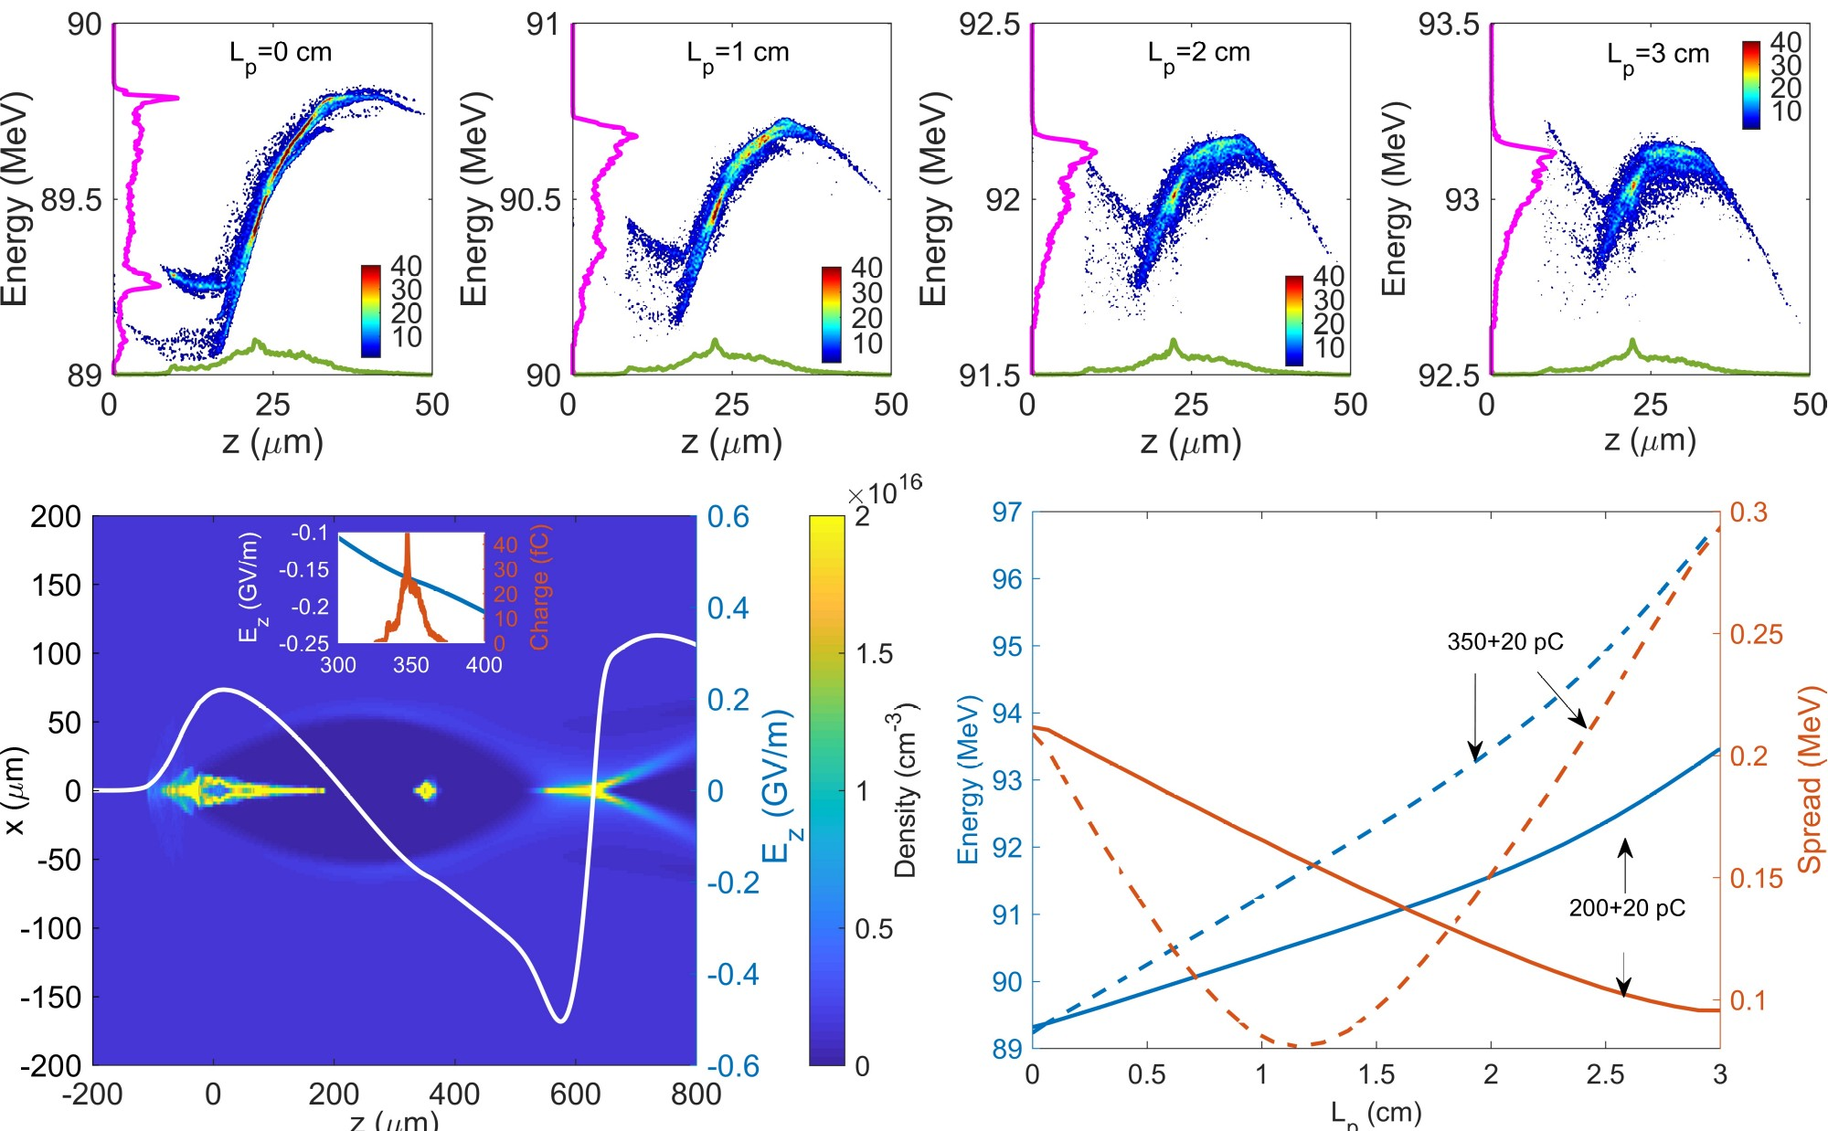
Assisted beam-loading technique
Pre-chirp to compensate wakefield slope
W
D

Slide 15
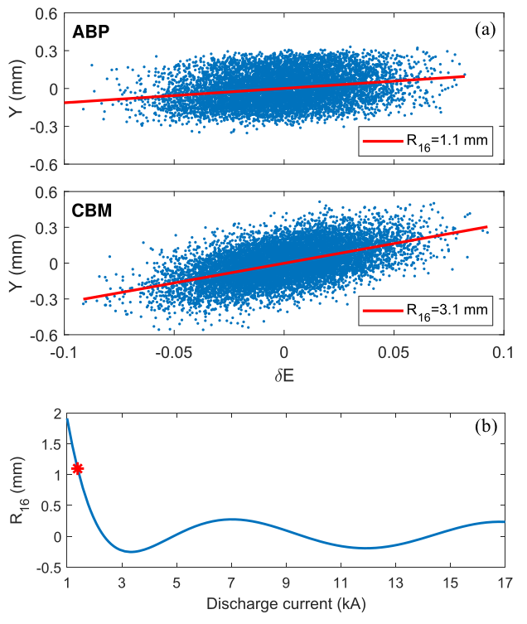
Dispersionless operation
YAP
+
-
GAGG
beam
We have used a 50 pC test beam on-crest (~1 ps)
The energy of the beam is set to 60 MeV
  1.6 m bending radius, ~4° deflection angle in 10 cm capillary
The beam is imaged on the YAG/GAGG screen located ~10 cm downstream the capillary exit
Compared to a conventional bending magnet (CBM), the R16 matrix (dispersion) term is reduced by a factor 3
  By tuning the discharge current the R16 can really be made zero → no need of dispersion matching optics downstream the bending!
14/
SPARC_LAB activity report
04/12/24

Slide 16


High Gradient Plasma acceleration
With plasma acceleration:
witness energy$=129 MeV$
Without plasma acceleration:
witness energy$=95.5 MeV$
$$∼1.1 GeV/m$$

Slide 17
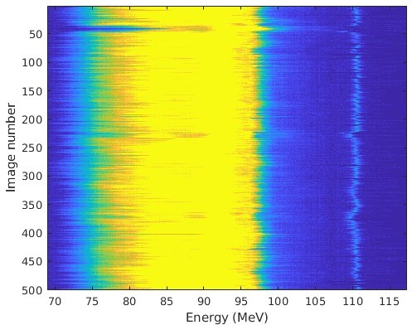
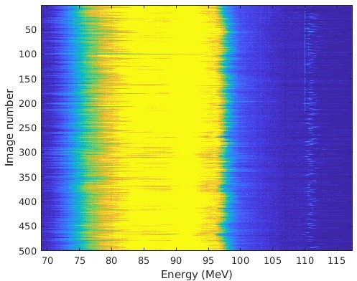
Plasma acceleration stabilization
Laser ON
Laser OFF
D (500 pC)
W (50 pC)
D (500 pC)
W (50 pC)
Results obtained by turning ON/OFF the laser stabilizing the plasma discharge
The laser hits the negative electrode of the capillary 200 ns before the discharge trigger
Witness jitter with laser ON(OFF): 0.6(1.2) MeV

Slide 18
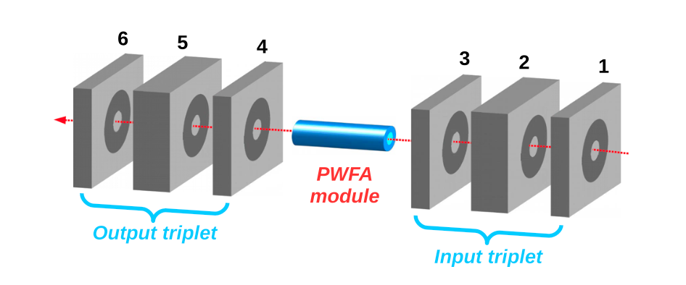
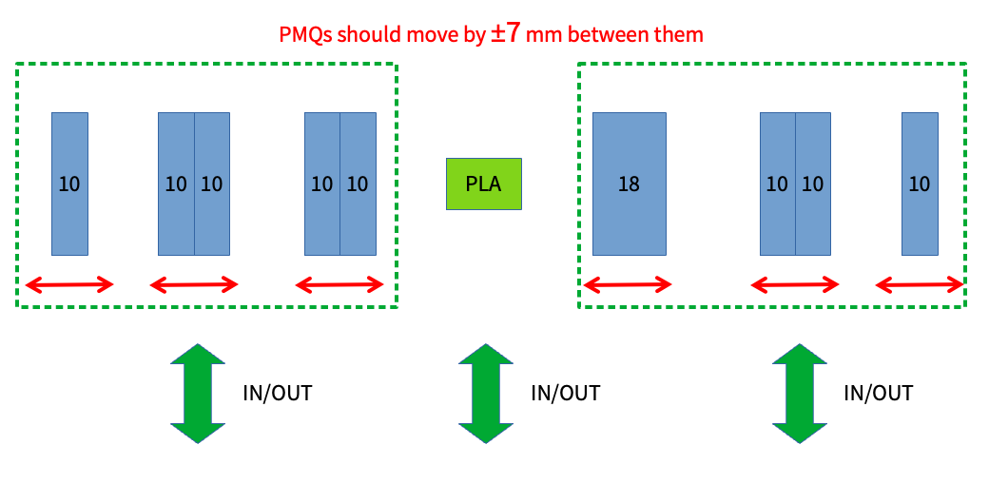
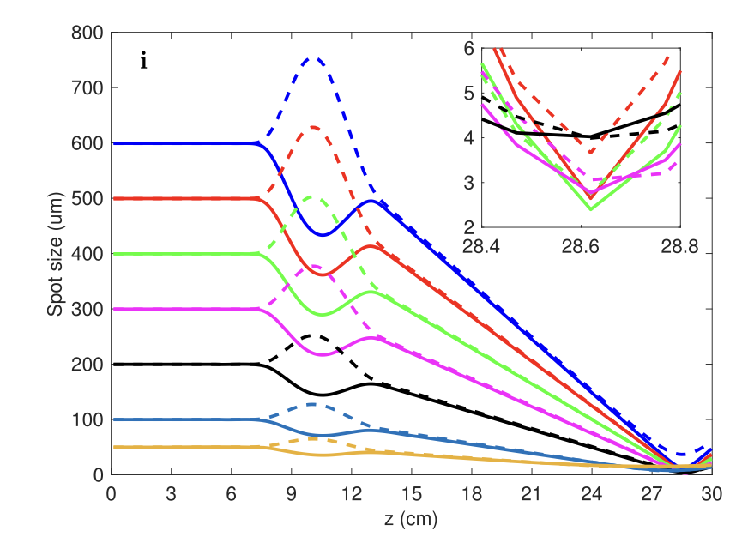
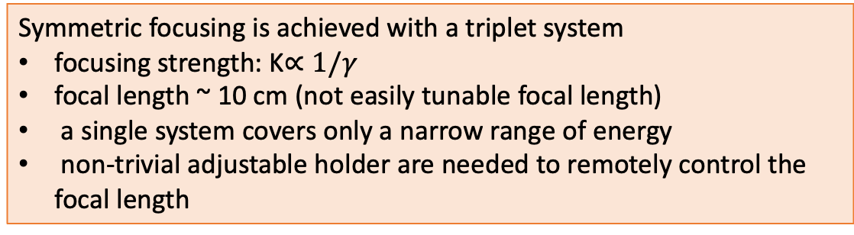
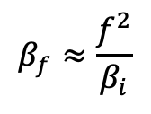
Injection/Extraction scheme in PWFA
PMQs currently represent the sate of the art:
[*]Pompili et al., Rev. Sci. Instrum. 89, 033302 (2018)
$$β_{f}≈\frac{f^{2}}{β_{i}}$$
Extraction of the accelerated bunch
Focus multiple bunches into PWFA module
Symmetric focusing is achieved with a triplet system
focusing strength: K$∝1/γ$
focal length ~ 10 cm (not easily tunable focal length)
a single system covers only a narrow range of energy
non-trivial adjustable holder are needed to remotely control the focal length

Slide 19
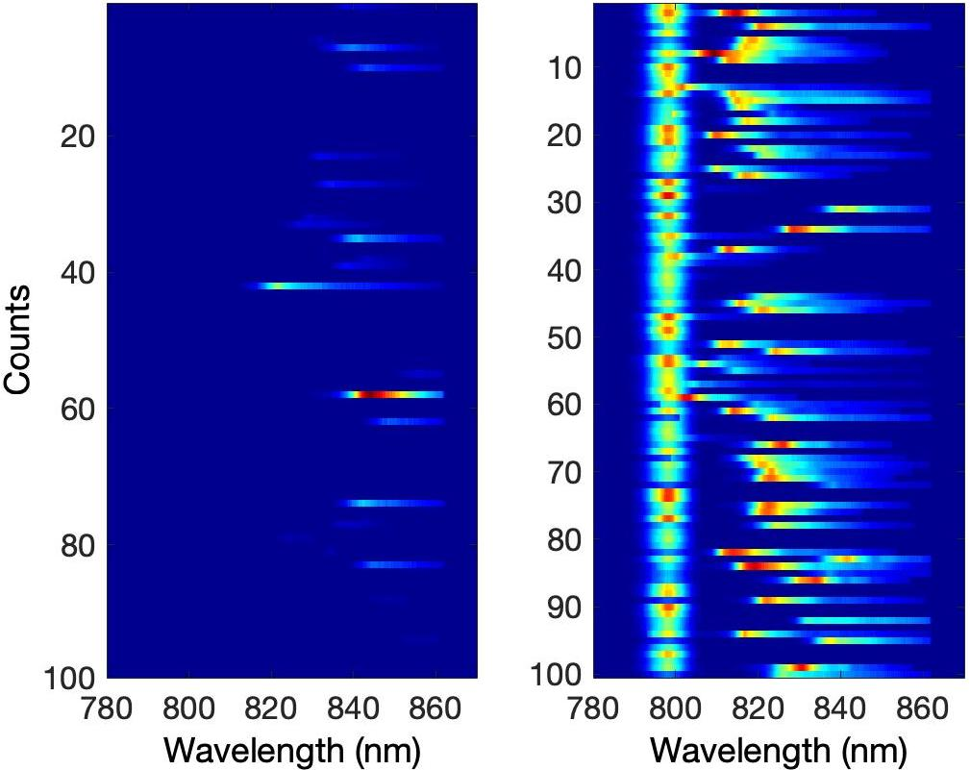
Seeded FEL Performances
laser
SASE
SEEDED
10³ ND filter used
@ 6th photodiode
FEL radiation output is largely stabilized by the seed laser, larger output energy
Undulators tuned for FEL radiation at ~830 nm → separated from the laser (793 nm)

Slide 20
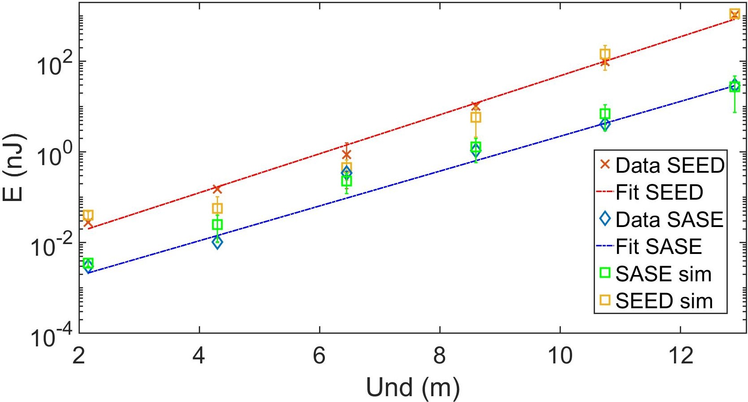
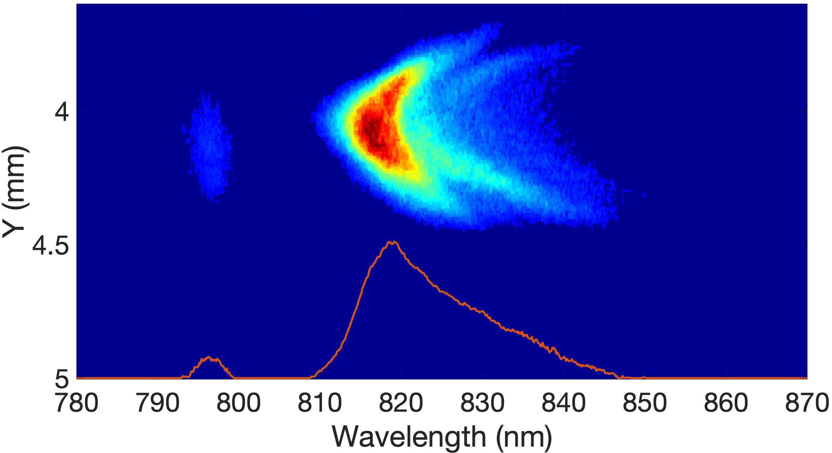
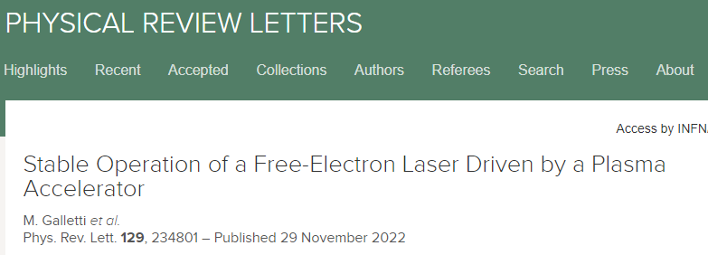
Exponential growth
~1 uJ (SEEDED)
~30 nJ (SASE)
laser
Experiment

Slide 21
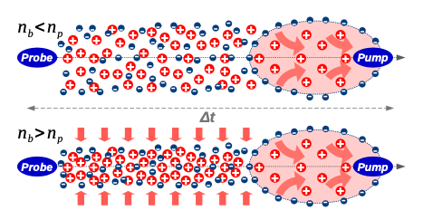






SPARC_LAB: Experimental results
Repetition rate for PWFA
A parametric study exploring a wide range of plasma density ($n_{p}≈[{10}^{13},{10}^{16}]{cm}^{−3}$) and pump and probe delay ($Δt=\left[0.7−13\right] ns$)
$Δ t$< 0.7ns

