Slide 1



EuPRAXIA@SPARC_LAB FELs
Fundamental research and applications with the EuPRAXIA facility at LNF
December 4th 2024
Michele Opromolla (INFN-LNF)
on behalf of the EuPRAXIA@SPARC_LAB WA6 collabotion team
L.Giannessi, F.Nguyen, A.Petralia, V.Petrillo, L.Sabbatini, A.Selce, A.Vannozzi, F.Villa,
C.Boffo, I.Balossino, M.Del Franco, M.Galletti, A.Giribono, A.Ghigo, A.Iovine, N.Mirian, C.Vaccarezza

Slide 2
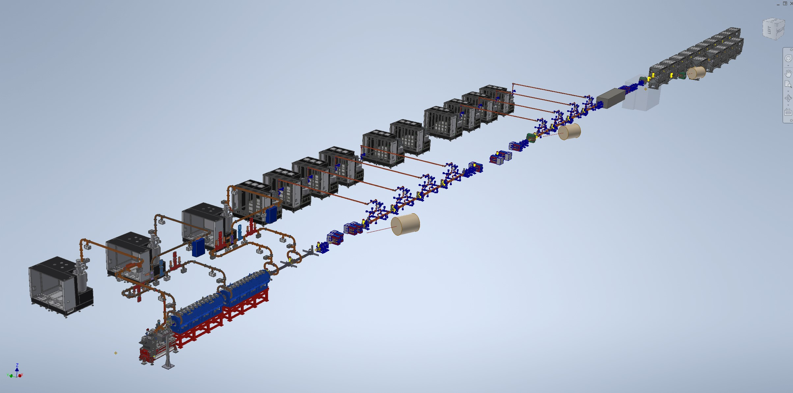
EuPRAXIA@SPARC_LAB Machine layout
  Soft-X ray SASE FEL – water window, optimized for 4 nm
  Driven by X--band LINAC + PWFA stage
AQUA
ARIA
  VUV seeded HGHG FEL (50-180 nm)
Seed
Modulator
Radiators
Dispersive
section
M. Opromolla - Fundamental research and applications with the EuPRAXIA facility at LNF, Frascati 12/04/2024
2

Slide 3
Outline
AQUA
Undulator magnetic design
FEL tuning range
Expected radiation performances
Foreseen photon Diagnostics and Beamline
ARIA
Undulator line
FEL tuning range and properties
Expected radiation performances
Foreseen photon Beamline
Summary
M. Opromolla - Fundamental research and applications with the EuPRAXIA facility at LNF, Frascati 12/04/2024
3

Slide 4
AQUA

Slide 5
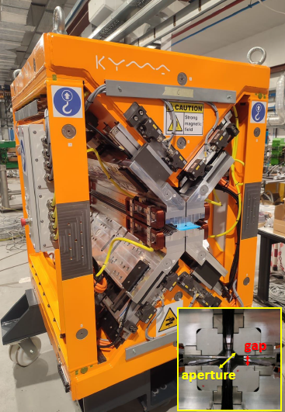
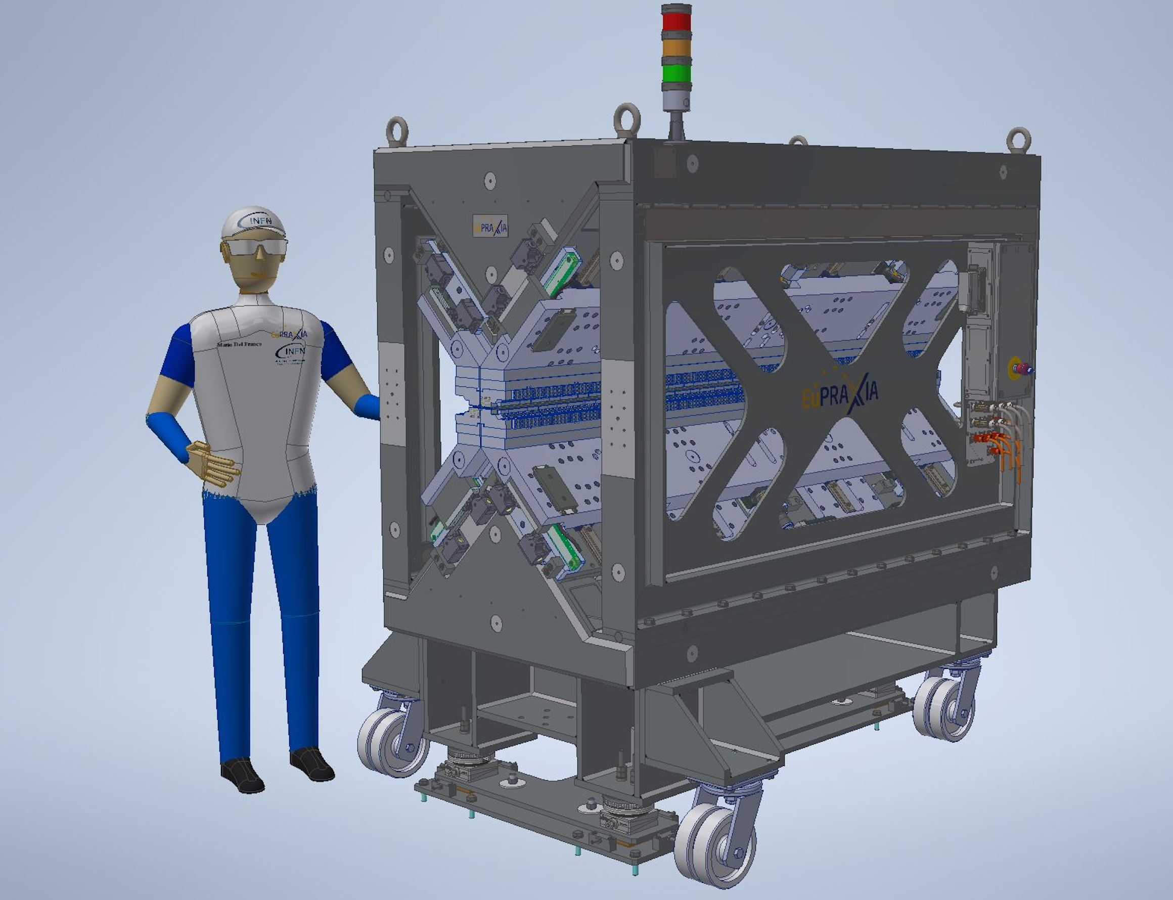
AQUA undulator
Target wavelength 3-4 nm @ 1 GeV: relatively short period required (12-20 mm)
Total available length ∼ 25-30 m, depending on linac spreader system, matching section, beam diagnostics and main beam dump.
Total undulator magnetic length: 20 m, 10 modules
Period length: 18 mm sufficient tuning range at fixed energy reach carbon /nitrogen K-edge
Polarization : variable fits with the requests from the scientific case
Type: Apple-X substantially higher field extended tuning range K_{max} independent of polarization → fully symmetric
Experience from the SABINA Undulator @LNF (KYMA)
Apple-X undulator:
increased PM field through “geometry”,
selectable polarization
Superconducting undulator
collaboration agreement with FNAL for
NbTi planar prototype
M. Opromolla - Fundamental research and applications with the EuPRAXIA facility at LNF, Frascati 12/04/2024
5

Slide 6
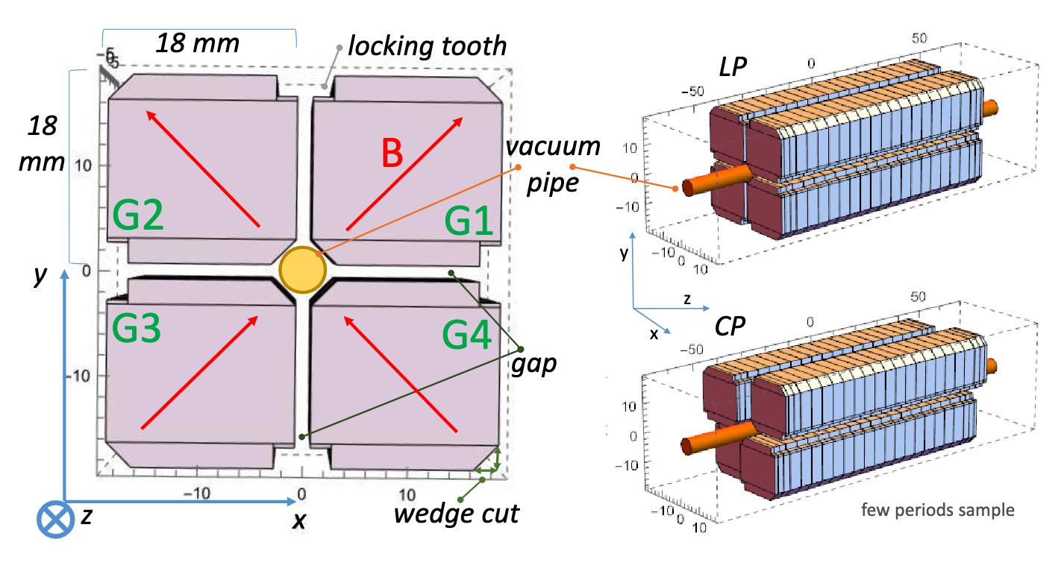
Apple-X undulator modeling and design
Remanent field Br = 1.35 T
Undulator period λ_{u} = 18 mm
Material NdFeB
4 blocks / period
# of periods (eff.) N = 110
L_{und}= 1990.4 mm (10 modules)
Pipe ext. diam. (mm) | 5.6
Pipe inner diam. (mm) | 5.0
Wedge cut (mm) | 2.8
φ aperture (mm) | 6.0
B_{max} (T) in LP | 0.935
K_{max} in LP | 1.572
K_{rms} (max=a_{w} in CP) | 1.111
max 𝜆₀ (nm) @ 1 GeV | 5.25
Modeling parameters
Interplay among aperture, magnetic strength, wavelength tunability and inner diameter constrained by wakefield effects on FEL performance
M. Opromolla - Fundamental research and applications with the EuPRAXIA facility at LNF, Frascati 12/04/2024
6

Slide 7
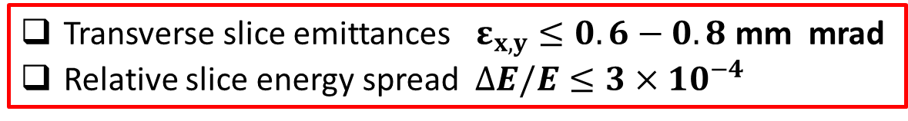
Electron beam parameter acceptance analysis
The undulator is engineered to amplify radiation at 4 nm from a suitable beam.
Required e-beam properties from a modified Ming-Xie model analysing the FEL performance vs. the e-beam emittance and energy spread.
This analysis assumes:
a Gaussian beam (in current, energy, energy spread, transverse momenta and spatial distributions)
duration 5 fs, peak current 1.5 kA, average beta functions β_{x}= β_{y} =10 m, emittances ε_{x}= ε_{y}
The most efficient FEL operation in both linear and circular polarization can be achieved for:
Transverse slice emittances $ε_{x,y}≤0.6−0.8$ mm mrad
Relative slice energy spread $ΔE/E≤3×{10}^{−4}$
M. Opromolla - Fundamental research and applications with the EuPRAXIA facility at LNF, Frascati 12/04/2024
7

Slide 8
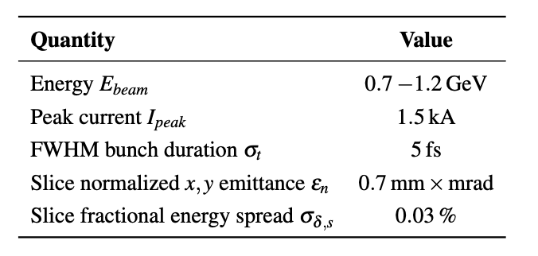
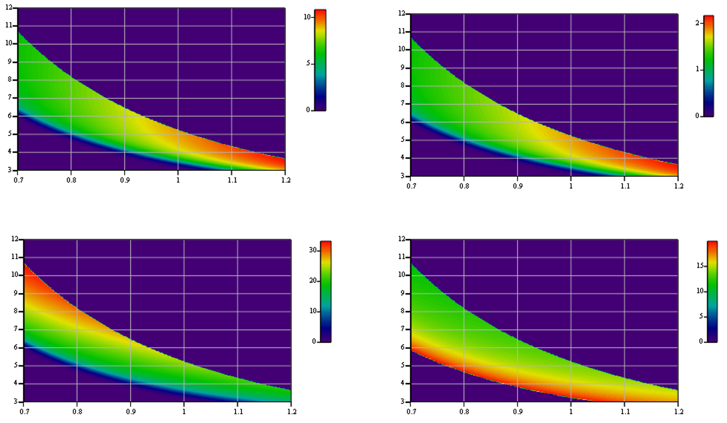
FEL tuning range – linear polarization
Analysis with a modified Ming-Xie model, assuming the reference e-beam:
Nphot/pulse
Pulse energy (μJ)
Wavelength (nm)
Wavelength (nm)
Wavelength (nm)
Sat Length (m) (magnetic)
extended range
(x10¹⁰)
Energy (GeV)
Energy (GeV)
Energy (GeV)
Tunability both in beam energy γm_{e}c²
and in undulator gap g_{u}
Limited lever arm in lin. Pol because of the lower gain:
shorter λ_{res} ⬅➔ lower K values ⬅➔ lower N_{γ}/pulse, longer gain length and saturation length
By increasing beam energy (other parameters constant) → chance to make 4nm with performance similar to longer wavelengths
M. Opromolla - Fundamental research and applications with the EuPRAXIA facility at LNF, Frascati 12/04/2024
8

Slide 9
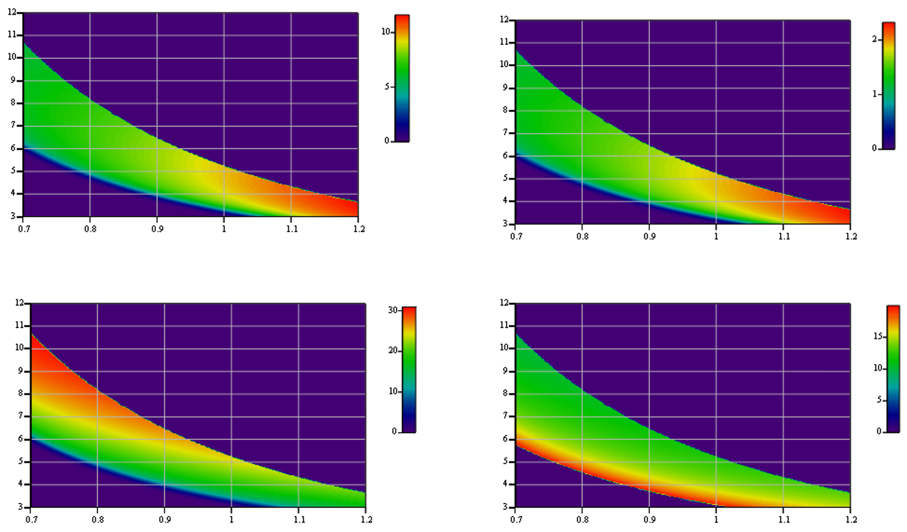
FEL tuning range – circular polarization
Thanks to its symmetry, the Apple-X undulator provides the same Krms in both linear and circular polarizations
Pulse energy (μJ)
Nphot/pulse
Wavelength (nm)
Wavelength (nm)
extended range
Wavelength (nm)
Sat Length (m) (magnetic)
(x10¹⁰)
Energy (GeV)
Energy (GeV)
Energy (GeV)
Wider undulator gap tunability in Circular Polarization
“water window” wavelengths probed with higher N_{γ} yield
By increasing beam energy (other parameters constant)
→ saturation length below 20 m, most of the available spectrum; chance to reach for 3nm
M. Opromolla - Fundamental research and applications with the EuPRAXIA facility at LNF, Frascati 12/04/2024
9

Slide 10
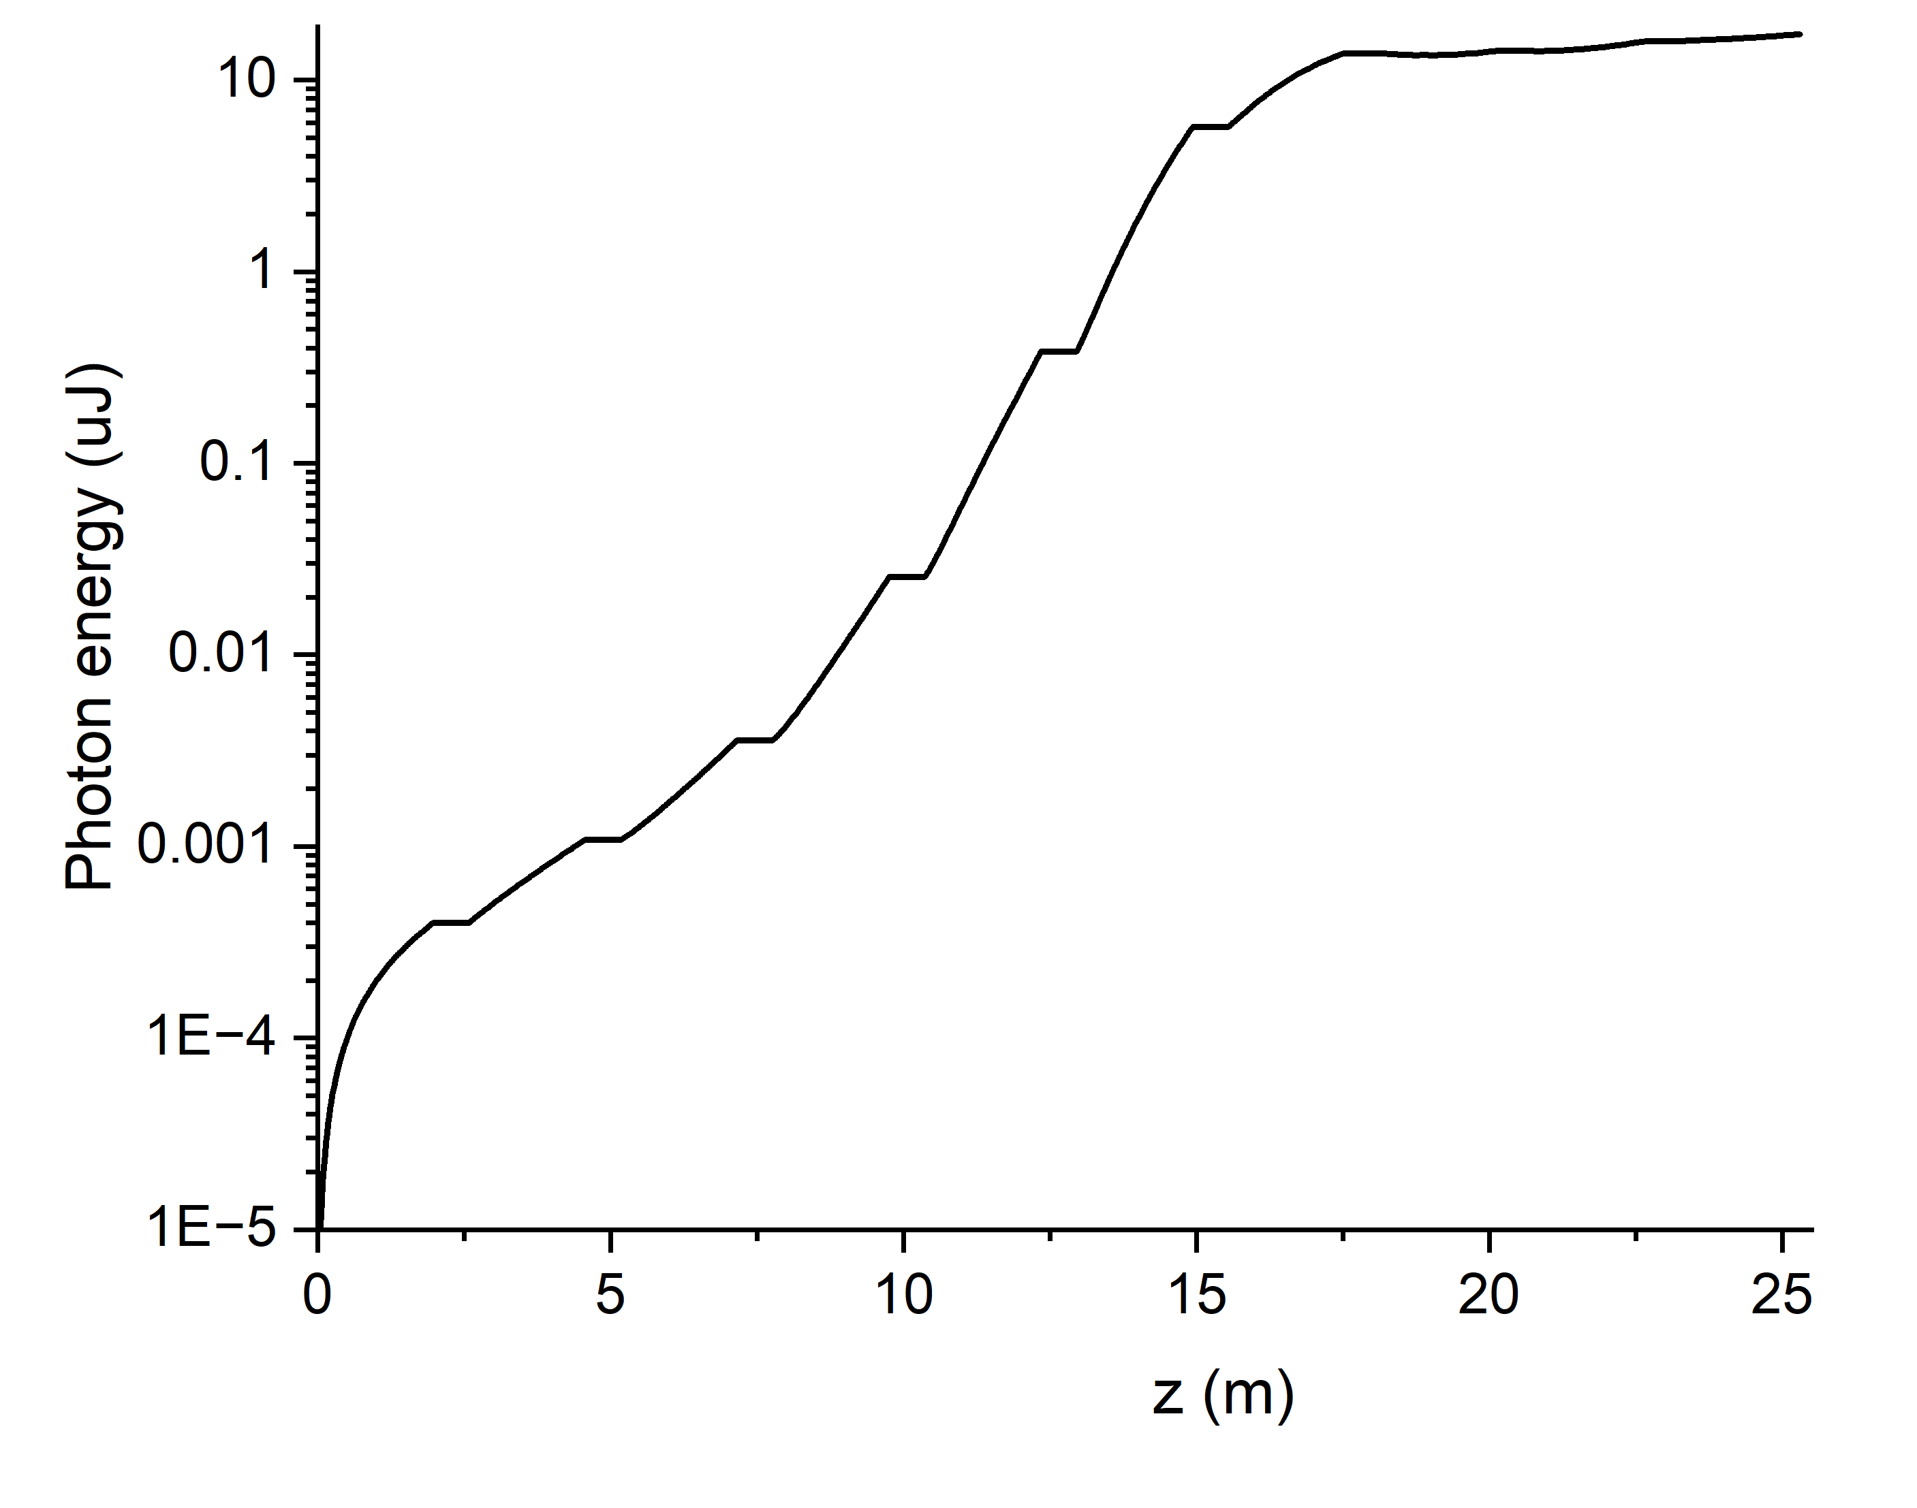
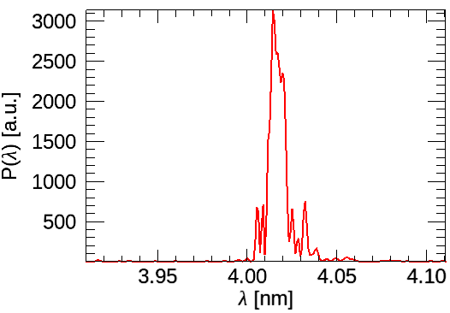
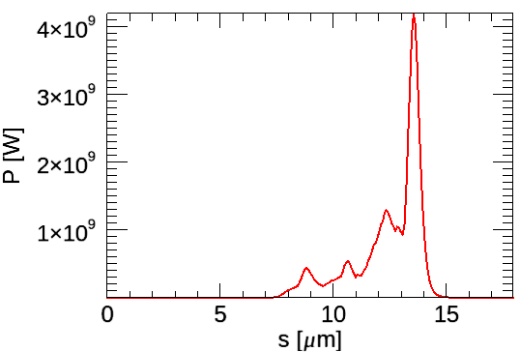
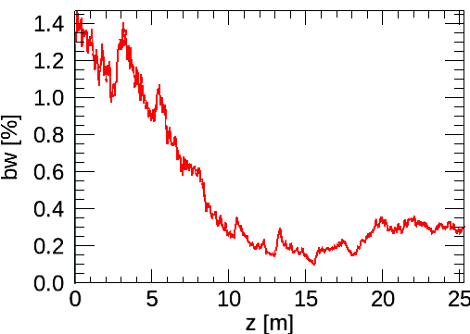

Expected electron beam and AQUA FEL performances
Desired/foreseen average e-beam parameters from PWFA
AQUA FEL theoretical performances
Parameter | Unit | Range | Simulated
Energy | GeV | 1-1.2 | 1
Charge | pC | 25-50 | 25
Rms Bunch length | µm | 2-4 | 2
Peak current | kA | 1.5-3 | 1.5
Slice emitX,Y | mm mrad | 0.6-0.8 | 0.7
Slice rel. energy spread | ‰ | 0.2-0.3 | 0.3
Energy growth
(CP)
Spectrum @25 m
Power @25 m
Bandwidth
evolution
On average, photon briliiance of about
${10}^{29}$- ${10}^{30} \text{ph}\text{/}\text{s}\text{/}\text{mm}\text{²/}\text{mrad}\text{²/0.1\% }\text{BW}$
10

Slide 11
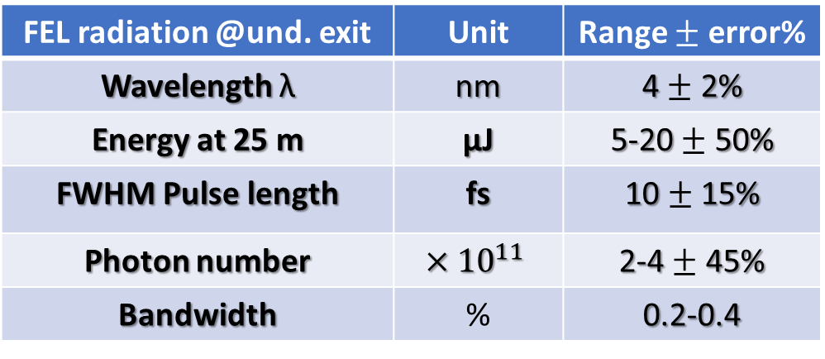
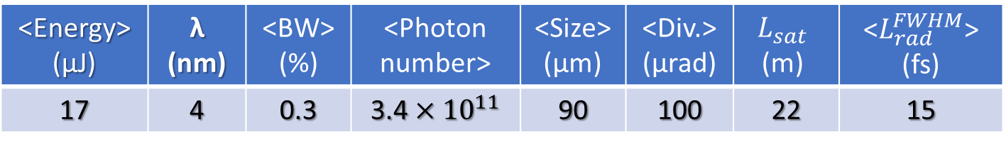

AQUA FEL performances
FEL performance in CP: ideal case of the Tested beam with Gaussian current profile
<Energy> (µJ) | λ (nm) | <BW> (%) | <Photon number> | <Size> (µm) | <Div.> (µrad) | $$L_{sat}$$ (m) | <$L_{rad}^{FWHM}$> (fs)
17 | 4 | 0.3 | 3.4 $×{10}^{11}$ | 90 | 100 | 22 | 15
Average pulse properties
at the undulator exit
Sources of FEL
radiation instabilities
FEL single-spike regime → intensity fluctuations
E-beam energy jitter → resonant wavelength jitter
Expected FEL performance and stability from start2end EuPRAXIA@SPARC_LAB beams
FEL radiation @und. exit | Unit | Range $±$ error%
Wavelength λ | nm | 4 $±$ 2%
Energy at 25 m | µJ | 5-20 $±$ 50%
FWHM Pulse length | fs | 10 $±$ 15%
Photon number | $$×{10}^{11}$$ | 2-4 $±$ 45%
Bandwidth | % | 0.2-0.4
>80% successful (>${10}^{11}$N_{γ} /pulse)
shots are expected
M. Opromolla - Fundamental research and applications with the EuPRAXIA facility at LNF, Frascati 12/04/2024
11

Slide 12
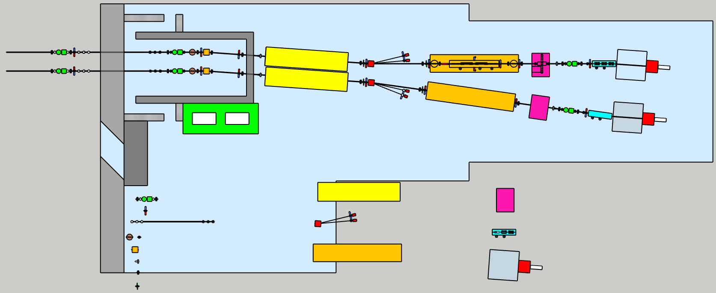
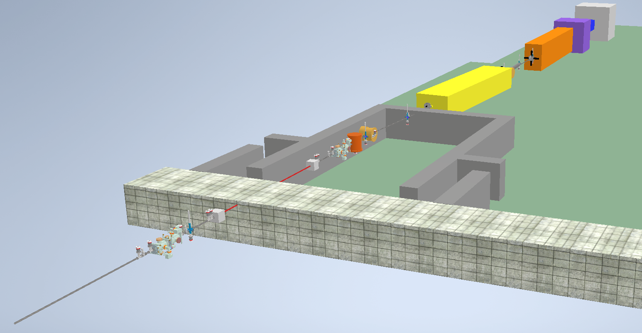
FEL Beamline
10m
30m
20m
AQUA beamline
12m
Laser hutch
Monochromator area
GDM
Polarization/time measure area
Screens
Gas absorber
Spectrometer
Apertures
K-B mirrors
Mirror
Solid attenuators/filters
Exp. Chamber area
Valves
Split & delay line area
BPM
Courtesy of F. Villa
12
M. Opromolla - Fundamental research and applications with the EuPRAXIA facility at LNF, Frascati 12/04/2024

Slide 13
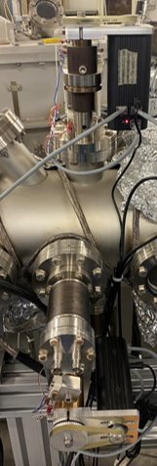
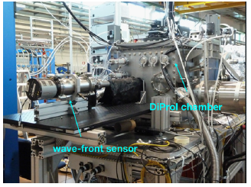
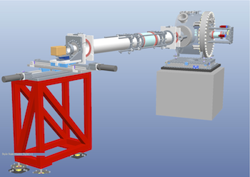
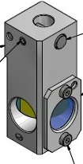
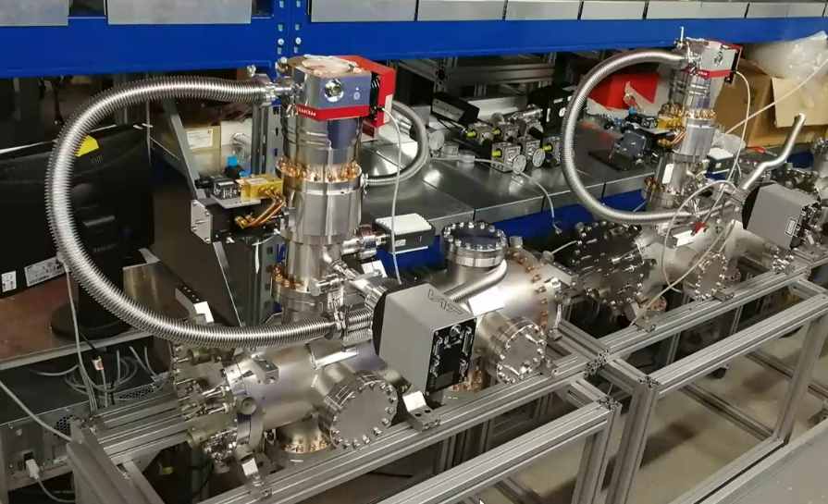
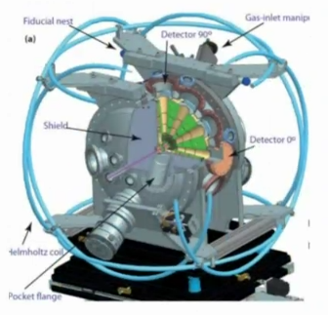
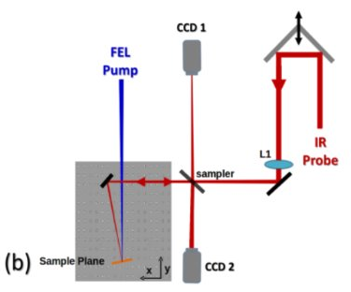
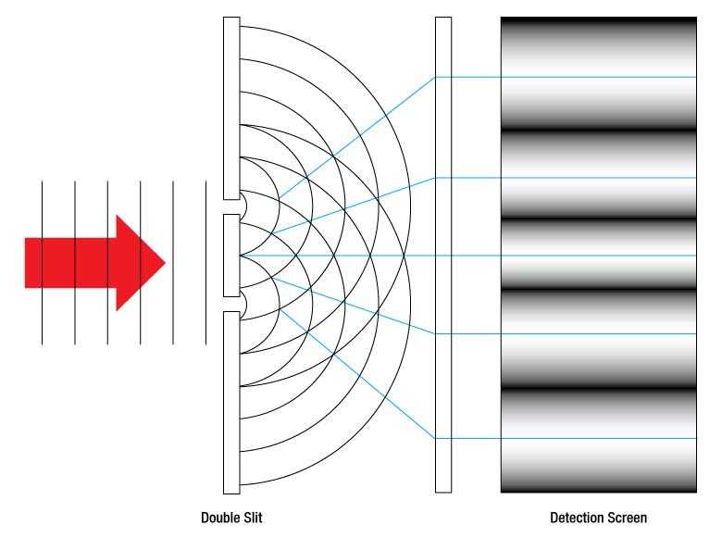
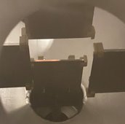
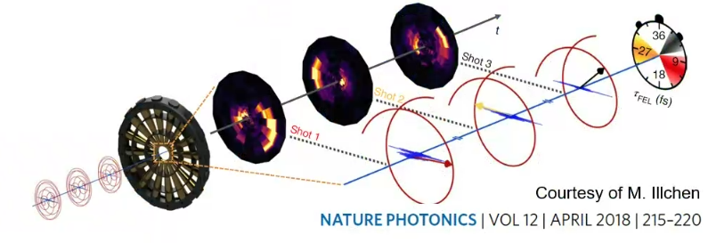
FEL Photon diagnostics
Courtesy of F. Villa
Wavefront sensors
Grating spectrometer
YAG screen
Gas Intensity Monitors and BPMs
Longitudinal measurements
Coherence measurements (transverse and longitudinal)
Transient reflectivity
Ionization streaking
Single-shot diagnostics
Multi-shot diagnostics
Intercepting diagnostics
Bladed BPM

Slide 14
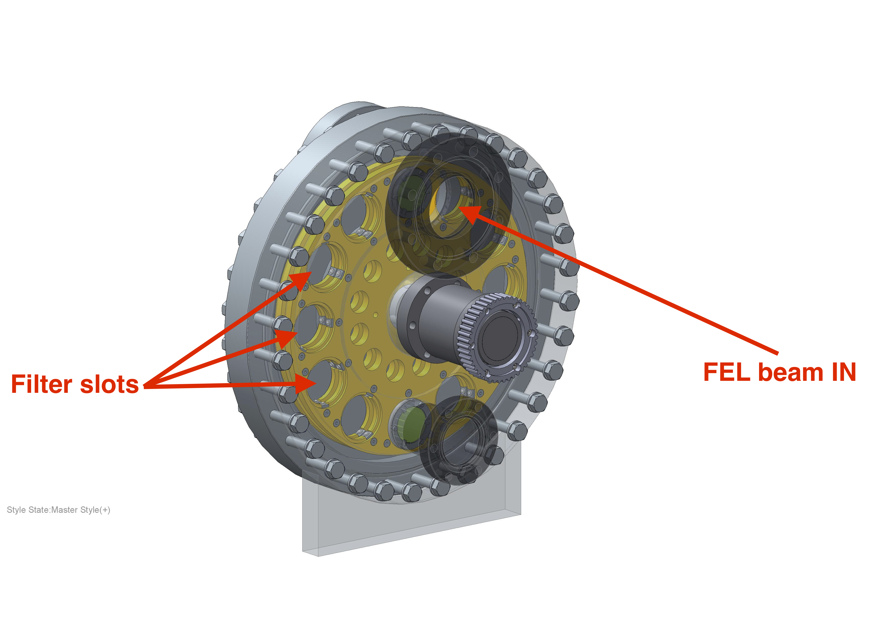
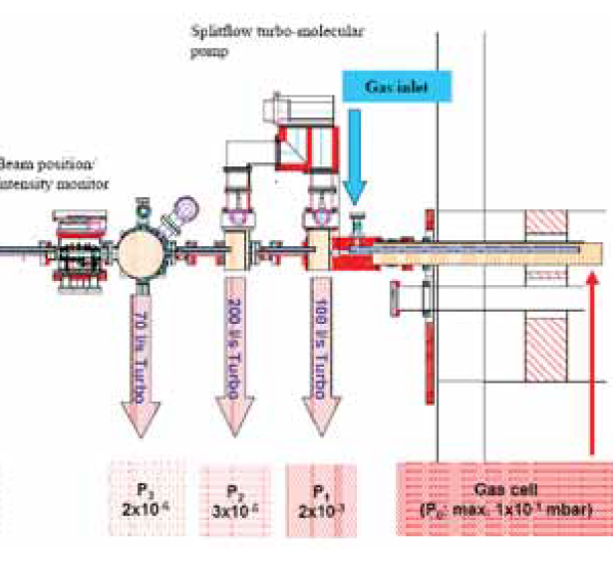
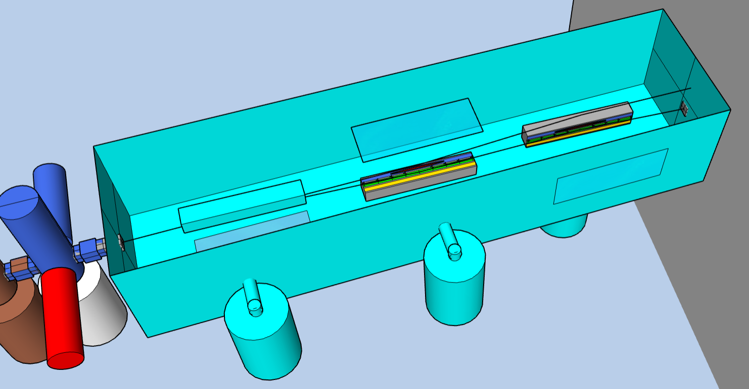
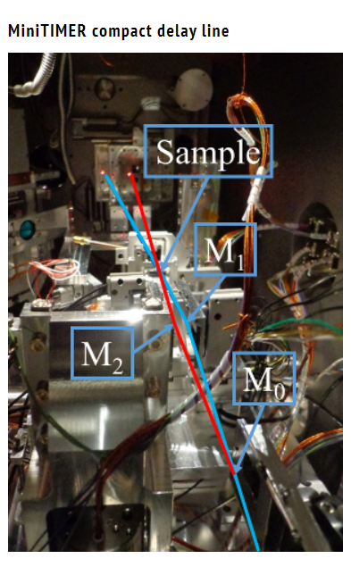
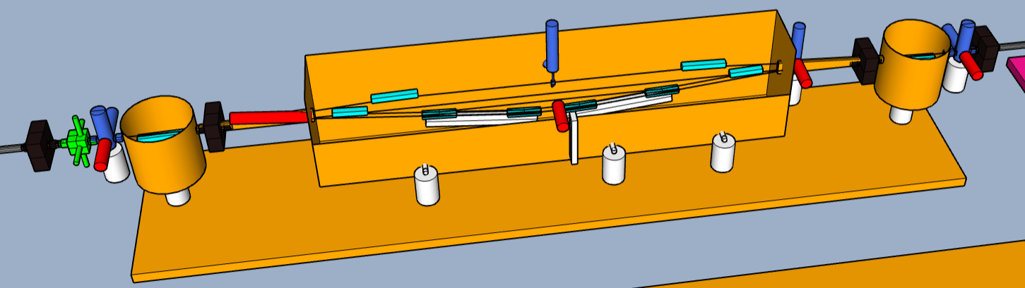
FEL optics and transport
Filters (solids and gas attenuators)
Bendable mirror in K-B configuration
for tunable final focus
Split and delay systems (10s ps or 100s fs range)
Courtesy of F. Villa
14
M. Opromolla - Fundamental research and applications with the EuPRAXIA facility at LNF, Frascati 12/04/2024

Slide 15
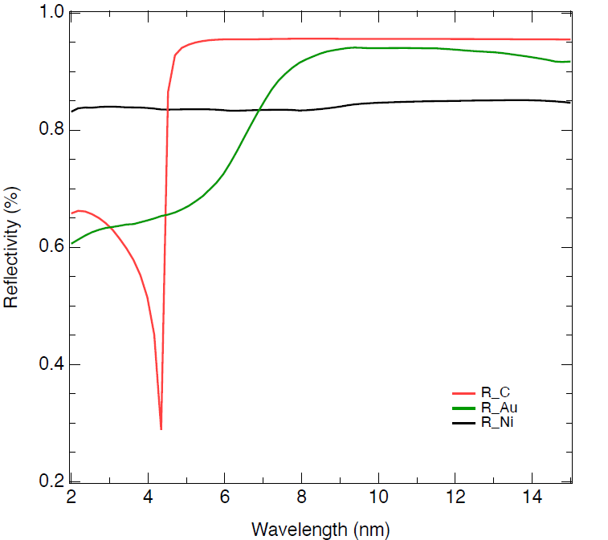
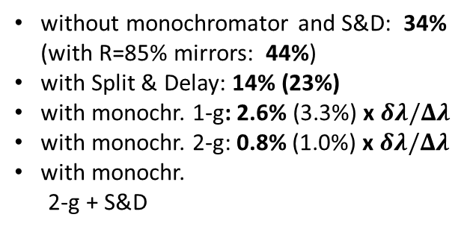

Preliminary estimations on losses
System | Transmission | #
Mirror chamber | 0.80 (0.85) | 1
BDA | 0.99 | 2
BPM | 0.98 | 2
Spectrometer | 0.75 (0.80) | 1
Monochromator | 0.08 to 0.02 | 1
Intensity monitor | 0.99 | 2
Time measurement | 0.99 | 1
Split & delay | 0.41 (0.52) | 1
attenuators | 1 to 0 | 3
YAG screens | 1 or 0 | 13
K-B focusing | 0.64 (0.72) | 1
Total transmission
AQUA FEL parameters
without monochromator and S&D: 34%
(with R=85% mirrors: 44%)
with Split & Delay: 14% (23%)
with monochr. 1-g: 2.6% (3.3%) x $δλ/Δλ$
with monochr. 2-g: 0.8% (1.0%) x $δλ/Δλ$
with monochr.
2-g + S&D
 | Linear Pol. | Circular Pol.
Central wavelength range | 4.0 nm, 310eV | 4.0 nm
Spectral bandwidth (rms, % to central wavelength) | 0.088% | 0.117%
Beam length (rms) | 3.50 fs | 3.76 fs
Beam transverse size (rms) | 133 um | 132 um
Beam divergence (half angle) | 0.023 mrad | 0.022 mrad
Photons per pulse | 2.33*10^11 | 2.77*10^11
Polarization (direction) | H | C
Repetition rate | 100 Hz | 100 Hz
: 0.32% (0.52%) x $δλ/Δλ$
Courtesy of F. Villa
15
M. Opromolla - Fundamental research and applications with the EuPRAXIA facility at LNF, Frascati 12/04/2024

Slide 16
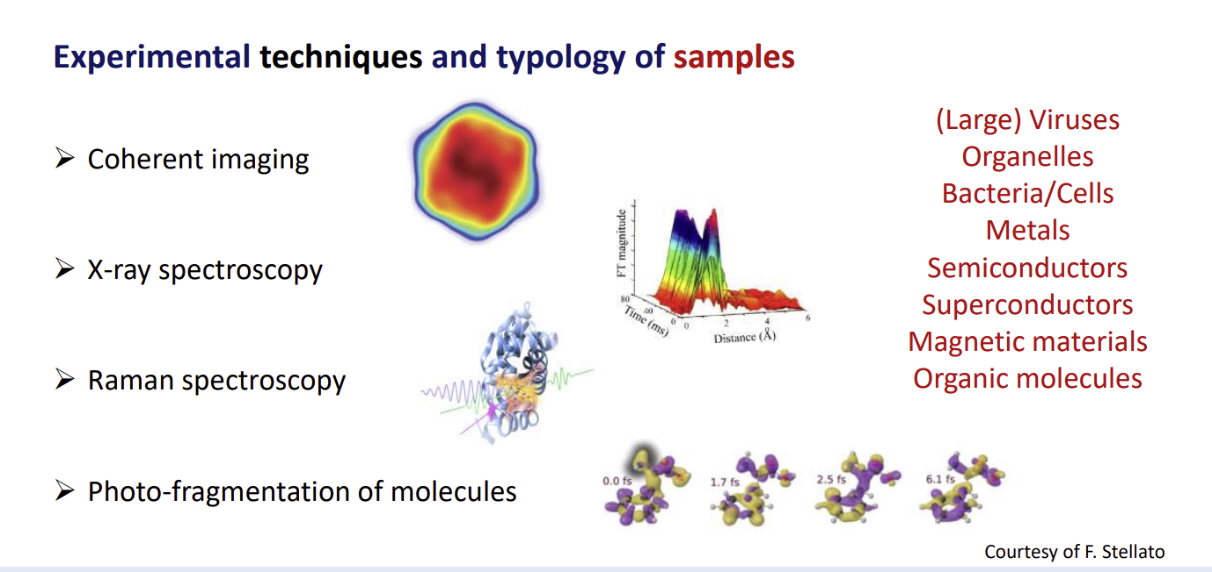
AQUA Beamline Scientific Case
Courtesy of F. Stellato
16
M. Opromolla - Fundamental research and applications with the EuPRAXIA facility at LNF, Frascati 12/04/2024

Slide 17
ARIA

Slide 18
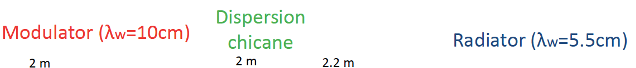
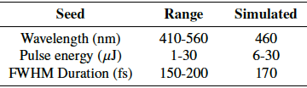
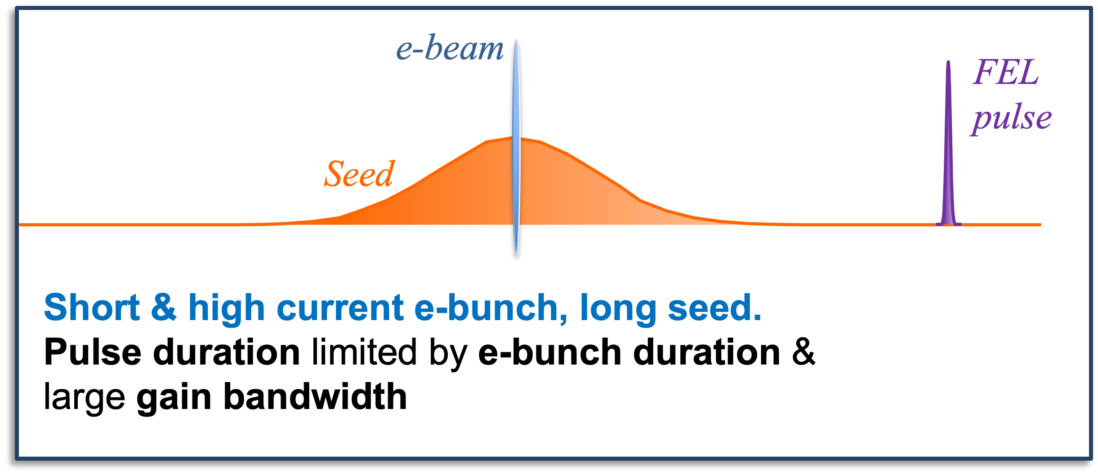
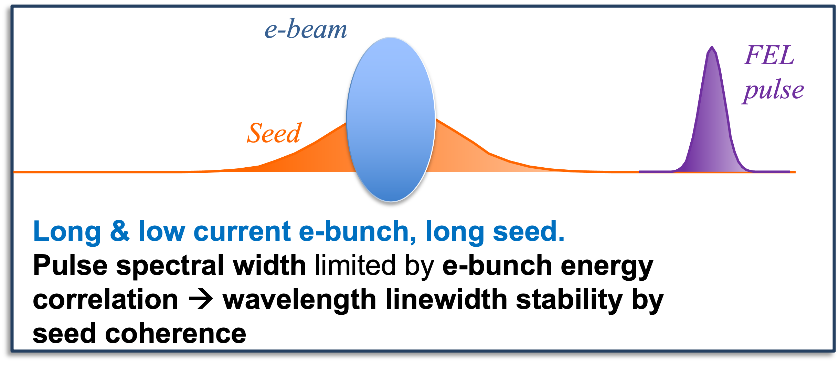
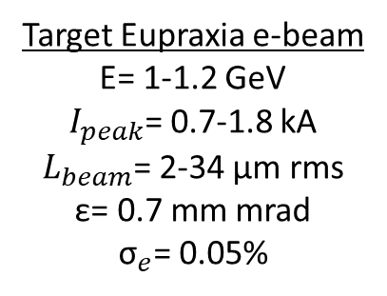
Baseline layout
M. Opromolla et al., FEL2022 TUP75 Proceedings
LINAC+PWA
LINAC
Target Eupraxia e-beam
E= 1-1.2 GeV
$I_{peak}$= 0.7-1.8 kA
$L_{beam}$= 2-34 µm rms
ε= 0.7 mm mrad
${\text{σ}}_{e}$= 0.05%
Different and complementary to long-e bunch, low current and short seed (FERMI style)
M. Opromolla - Fundamental research and applications with the EuPRAXIA facility at LNF, Frascati 12/04/2024
18

Slide 19
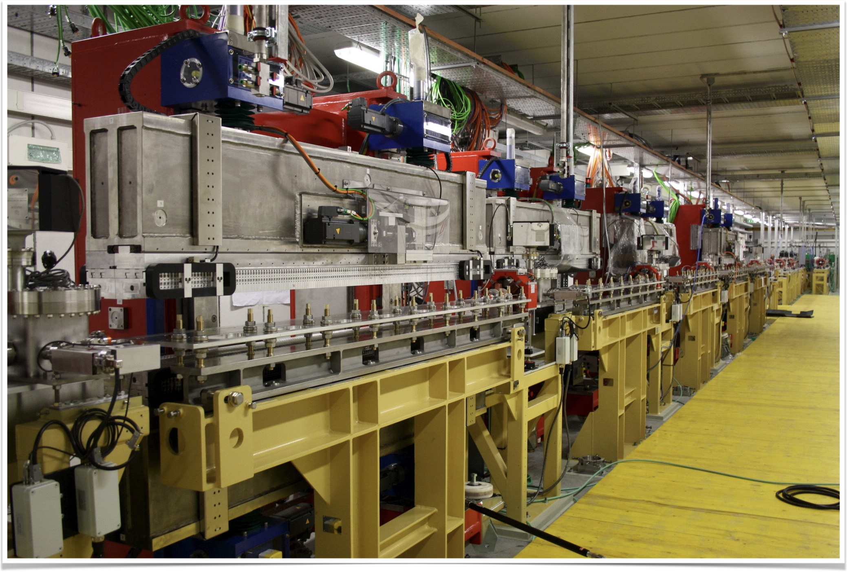
Radiator Undulators
Main features:
variable gap, variable phase for adjustable polarization (six motors)
𝛌_{u} = 55.2 mm, Np=42, L_{u}=2.4 m
working gap: 10 ÷ 32 mm
Similar to FERMI FEL-1 radiators built by KYMA in 2009-2010
Main Physical Specifications:
Phase error σ_{Φ} < 5 º rms
Trajectory offset error < 20 μm rms
Trajectory tilt error < 25 μrad rms
Peak-to-peak field error ΔB/B < 0.5% rms
Integrated Quadrupole (N/S) < 100 G
Integrated Sextupole (N/S) < 100 G/cm
Apple-II undulator, FERMI-style:
linear/circular polarization
Apple-X undulator, AQUA-style:
selectable polarization, optimal control
M. Opromolla - Fundamental research and applications with the EuPRAXIA facility at LNF, Frascati 12/04/2024
19

Slide 20
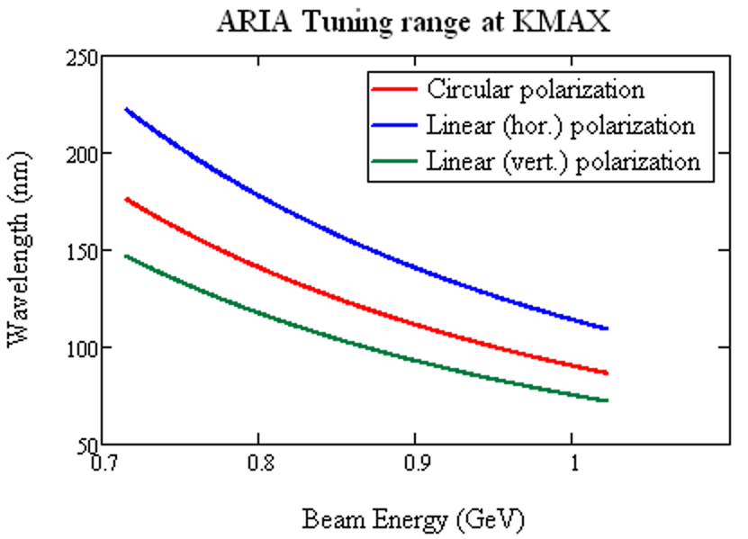
FEL tuning range
FEL:
Max harmonic = 10
Undulator K-range from FERMI FEL-1: K_{max} = 3.4 (CR), 4.35 (LV), 5.45 (LH)
Electron beam parameters:
Energy 1.0 -> 0.7 GeV
Energy spread 200 keV @ 0.8 kA -> 400 keV@1.5 kA
Duration: > 100 fs (long bunch mode, 200 pC)
    -> 8 fs (short bunch mode, 30 pC)
Emittance 2 mm mrad in long bunch mode 0.8 mm mrad in short bunch mode
Beta function 10 m
Seed laser:
minimum seed energy of 20 uJ
average seed spot size of 0.5 mm^2
independent on the wavelength
seed duration 400 fs (long seed)
-> 200 fs (short seed), possibly
no frequency chirp –spectral width close to FTL
M. Opromolla - Fundamental research and applications with the EuPRAXIA facility at LNF, Frascati 12/04/2024
20

Slide 21
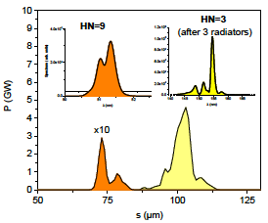
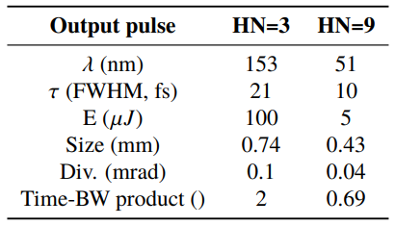
ARIA with short bunch & high current from LINAC+PWA
Seed: 460nm, 170 fs FWHM
Lower harmonics (≤ 5) saturate after two or three radiators only.
Radiation can be extracted beforehand, using the last radiator for multi-pulse/2-color generation
M. Opromolla - Fundamental research and applications with the EuPRAXIA facility at LNF, Frascati 12/04/2024
21

Slide 22
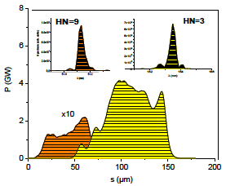
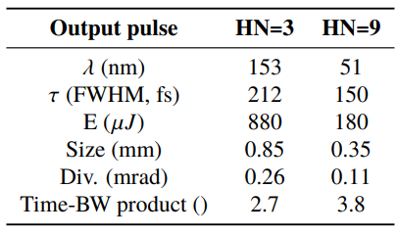
ARIA with long bunch & low current from LINAC
Seed: 460nm, 170 fs FWHM
Intensity and spectrum stable.
Ultra-narrow bandwidth pulses are produced with longer electron bunches
→ high intensity allows monochromator for spectrum enhancement
M. Opromolla - Fundamental research and applications with the EuPRAXIA facility at LNF, Frascati 12/04/2024
22

Slide 23
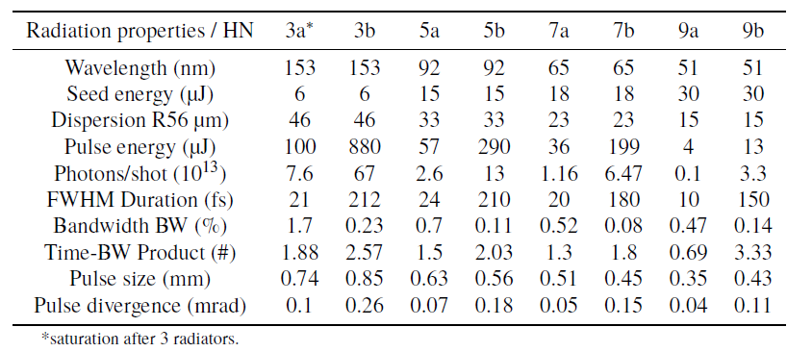
ARIA short summary
ARIA operates in High Gain Harmonic Generation and may cover the VUV spectral range down to 50 nm with an undulator similar to the one of FERMI FEL-1. Contrary to FERMI it uses a seed longer than the electron bunch and uses the electron bunch shaping and control capabilities of Eupraxia@SPARC_LAB for controlling the light pulse properties.
A commercial laser based on an Optical Parametric Amplifier should have the correct pulse energy and features to seed ARIA.
It fills a niche in the world FELs scenario:
No other seeded FEL facility covers the full range 50-180 nm, except for the DALIAN light source
Superposition with HHG sources, but without limitations on polarization, photon energy tuning & intensity
Synchronization with HHG sources or external lasers for multicolor pump-probe operation.
Radiation properties at saturation
Short beam (a) and Long beam (b) case
23

Slide 24
FEL Beamline
10m
30m
20m
AQUA beamline
12m
ARIA beamline
Laser hutch
Monochromator area
GDM
Polarization/time measure area
Screens
Gas absorber
Spectrometer
Apertures
K-B mirrors
Mirror
Solid attenuators/filters
Exp. Chamber area
Valves
Split & delay line area
BPM
Courtesy of F. Villa
24
M. Opromolla - Fundamental research and applications with the EuPRAXIA facility at LNF, Frascati 12/04/2024

Slide 25
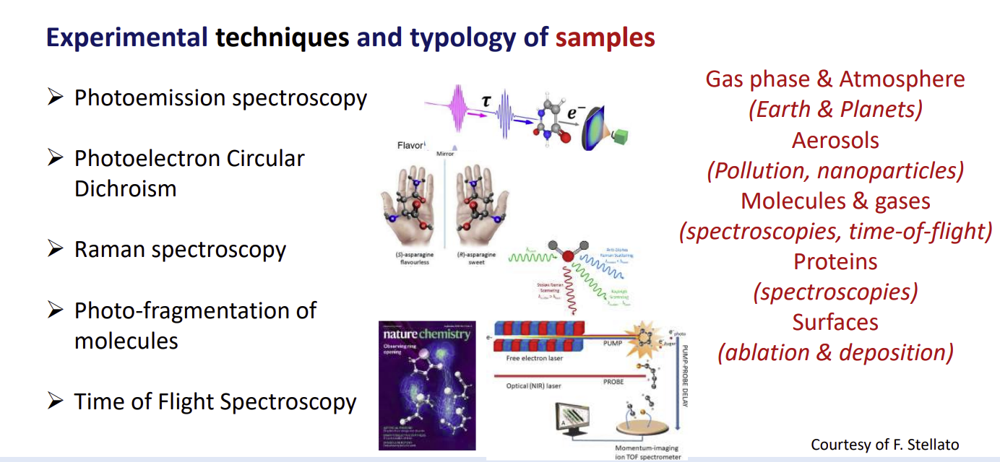
ARIA Beamline Scientific Case
M. Opromolla - Fundamental research and applications with the EuPRAXIA facility at LNF, Frascati 12/04/2024
25

Slide 26
Conclusions
The AQUA undulator line is optimized for 4nm-5.7nm → extended spectral range by tuning beam energy.
Ideal reference electron beam values as well as start-to-end beams from the EuPRAXIA@SPARC_LAB accelerator were used to perform 3D time dependent FEL simulations:
O(10) fs-long, O(10) µJ pulses with O(10¹¹) N_{γ}/pulse at 4nm were obtained
The FEL radiation stability has been discussed, shorter λ with higher E_{beam} or improved e-beam quality
Studies of new electron beam working points as well as stabilization methods are in progress
The ARIA FEL line is under study: this line will extend to VUV the spectral range covered by EuPRAXIA@SPARC_LAB
Feasibility and expected performance of such flexible and cost-effective VUV user facility delivering
15-100 fs-long FEL pulses close to Fourier transform limit are investigated
Selectable polarization VUV light allows to explore chirality and dichroism in biotic media
More detailed studies of photon diagnostics and experimental beamlines are in progress
M. Opromolla - Fundamental research and applications with the EuPRAXIA facility at LNF, Frascati 12/04/2024
26

Slide 27


EuPRAXIA_PP Survey
https://surveys.infn.it/index.php/718177
Courtesy of E. Principi
27
M. Opromolla - Fundamental research and applications with the EuPRAXIA facility at LNF, Frascati 12/04/2024

Slide 28
Thank you for the attention!

Slide 29
Supplementary slides

Slide 30
AQUA
  Magnetic design & tuning range -> vacuum chamber geometry
  Longitudinal and transverse wake-fields
  Analysis of SABINA Undulator and first lessons for the AQUA undulator
  Magnetic: field quality, field integrals, trajectory and FEL amplification
  Mechanical: stability and reproducibility tests

Slide 31
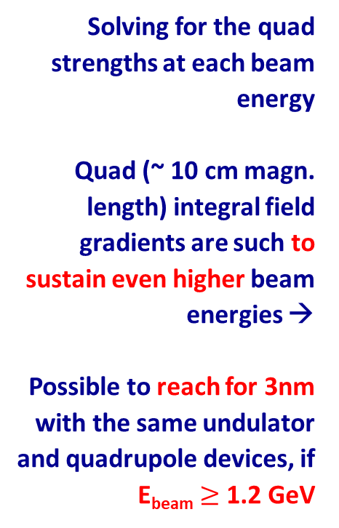
FODO analysis for both polarizations vs. Ebeam
Solving for the quad strengths at each beam energy
Quad (~ 10 cm magn. length) integral field gradients are such to sustain even higher beam energies →
Possible to reach for 3nm with the same undulator and quadrupole devices, if E_{beam} $≥$ 1.2 GeV
Courtesy of F. Nguyen

Slide 32
Tuning range: choice of the undulator period
FEL performance analyzed with Xie’s scaling formulae accounting for 60% filling factor
Courtesy of L. Giannessi
From the K vs. gap formulae of a planar PMU with remanent B_{r} = 1.2T, min. magnetic gap=6mm, beam stay clear=5mm:
18mm implies tuning range, plus saturation length contingency if operating at 4nm wavelength;
16mm improves the saturation length limit, but almost no tuning range
From the K vs. gap formulae of a planar NbTi SCU with beam stay clear=5mm:
2) 16mm improves the saturation length limit, and tuning range is granted as well
Courtesy of F. Nguyen

Slide 33
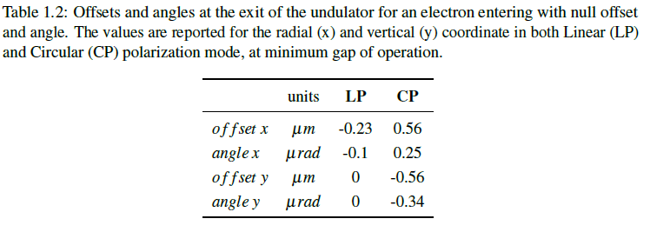
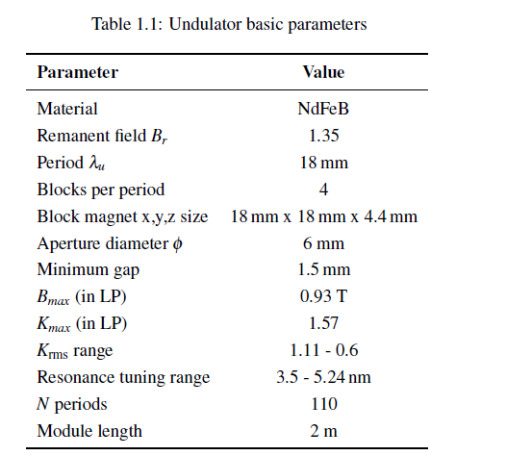



Undulator specs
23

Slide 34



Transverse resistive wall wakefields
Transverse RW wakefields induced inside the cylindrical Cu vacuum chamber of radius a=2… 3 mm affect the electron bunch orbit along the undulator line, depending on the initial transverse offset at entrance.
Analytical treatment based on K. Bane & G. Stupakov formulae and the relationship between transverse and longitudinal RW impedances are used to estimate the kick angle k_{T} parameter
Preliminary conclusions
Short bunch: Max kick: 2×10⁻⁵ mrad/m but outside the current peak
Long bunch: same order of magnitude, but superimposed to the current profile
Courtesy of F. Nguyen

Slide 35



Trajectory, matching
Examples of FODO matching
Quadrupole offset errors up to qx,y $≈8$0 μm do not hamper FEL lasing.
Quadrupole offset errors up to qx,y = 400 μm lead to an off-axis beam wander which can be pre-corrected with a corrector magnet (less than 10 mT if 3.6 cm-long), to ensure FEL amplification.
(Ideal correction is when correctors are embedded into the quadrupole, share same iron)

Slide 36



Summary of Apple-X undulator tolerance studies
The physical parameters and specification of the AQUA undulator system are established, most of the sensitivity studies have been carried out.
Mechanical stability tests of the SABINA APPLE-X modules were performed.
The constructive design of the components requires engineering development and design support from industry.
Future studies will include tolerance of undulator&bpm misalignments, specs of phase shifters.
RW wakefields
Transverse alignments
Magnetic field errors
Longitudinal RW wakefields do not hamper the FEL lasing
$±150 µm$ transverse offset
-> $≈$60 nrad kick
Symmetric (x=y) | off-axis injection
Offset | $$±25 µm$$
Tilt | $$±10 µrad$$
Rms field errors of few mT
1st (2nd) field error integrals $≤5 {10}^{−5} Tm (Tm^{2})$

Slide 37



SABINA

Slide 38


Lessons learned from the SABINA Undulator
Mechanical stability and reproducibility
In collaboraton with the Holographyc Interferometry & Fibre Optic Sensors (HIFOS) Laboratory at ENEA (ref. M. Caponero) we measured the deformations of the undulator guilders
Magnetic error analysis
Indication on the undulator feasibility comparing the SABINA undulator and the ideal RADIA model to reconstruct magnetic dipolar errors along the undulator

Slide 39



Undulator Mechanical tests on the SABINA undulator
FBG measurements
deformations in μm
CAD model by KYMA
1
2
A diffraction grating is produced by modifying the refraction index of the core of a fiber (FBG Sensors).
Rough approximation: the refractive index has a sinusoidal modulation along the axis of the fibre.
The sensor length is 10 mm, temperature and strain sensing at the level 0.1K - 1/10⁶ relative elongation sensitivity
3
Sensors
Courtesy of I. Balossino, A. Selce, A. Polimadei, A. Vannozzi, M. Del Franco, L. Sabbatini, M. Caponero

Slide 40




Brief summary of FBG strain measurements
Temperature dependence:
max deformation of 0.12 nm over 2.7 °C/15 hours
Mechanical
by moving the four arrays all together from the minimum gap to the maximum gap, and in small steps from minimum gap to 50 mm of gap opening
by shifting the phase at different undulator gaps. In Fig. (right) the effect of a phase shift with the undulator tuned at minimum gap is shown

Slide 41
FBG strain measurement conclusions
The wavelength shifts are perfectly reproducible. No hysteresis or values not correlated to a gap macroscopic movement were observed, except for the temperature dependence
The largest observed wavelength shift is ∼0.2 nm for the gap sensors and a factor 2-5 lower for the strain sensor devices
Gap sensors, the reference length is the plates separation. The plate sepatation cannot be measured an is virtually zero. In order to estimate an upper limit, we may consider that over an hypothetical 1 mm gap, the variation would be ∽ 150 nm. This has a negligible effect on the undulator field
Strain sensors, the reference length is the sensor length: the local deformation is ∽300 nm/cm.
These deformation values are compatible or lower than those calculated by finite elements methods and confirm the reliability of the undulator mechanical structure
A finite element model of the long AQUA undulator module should provide a suitable estimate of the expected structure deformation under the effect of magnetic forces

Slide 42
Undulator Mechanical tests on the SABINA undulator
FBG measurements
Distribution of sensors
Undulator tested for:
Temperature dependence over a rance of 3 °C
Magnetic forces: gap – phase variations opening
Sensors were used in two different ways:
as strain measurement, by gluing the fiber fully adhered to the surface of the magnet holder-plates;
as gap measurement devices, by placing the sensors between adjacent plates.

Slide 43



EuPRAXIA@SPARC_LAB electron beam and AQUA FEL performances
Last start2end electron beam working point with jitters FEL simulation of a single shot
Witness @undulator | Average | Std. Dev.
Energy (GeV) | 1 | 0.0107
Charge (pC) | 29.8 | 0.2
Peak current (kA) | 2.5
Proj. emitX (mm mrad) | 0.69 | 0.02
Proj. emitY (mm mrad) | 0.67 | 0.02
Proj. dE/E (%) | 0.44 | 0.015
Energy (µJ) | λ (nm) | BW (%) | Photon number | Size (µm) | Div. (µrad) | Lsat (m) | Lrad (fs) FWHM
13.54 | 4.004 | 0.3 | 2.7 $×{10}^{11}$ | 170 | 27 | 23 | 15

Slide 44




AQUA FEL performances: preliminary results from FEL statistics
FEL simulation statistics from the last simulated start2end e-beam working point, with jitters included
85/101 shots withphoton number per pulse $>{10}^{11}$
E-beam energy jitter → Radiation wavelength jitter
 | Unit | Average | Error | Relative error
Wavelength λ | nm | 4.0037 | 0.084 | 0.02
Energy at 25 m | µJ | 10.54 | 5.2 | 0.49
Photon number | $$×{10}^{11}$$ | 2.092 | 1.01 | 0.48
The FEL wavelength jitter reduces to $\sim$0.05 nm if only the photon pulses with >${10}^{11}$ photons are considered.
Work in progress ...

Slide 45
ARIA
Undulators, seed and tuning range

Slide 46




ARIA performances analysis
Based on Xie model
Short pulse mode
A = Long pulse mode
B = Short pulse mode
Wavelength (nm)
P. Energy (𝜇J)
P. Energy (𝜇J)
Wavelength (nm)
e-beam
Energy | 0.7 -> 1 GeV
Peak current (A - B) | 500 – 1500 A
E-bunch charge (A - B) | 200 - 30 pC
Emittances (A - B) | 0.8 mm - mrad
Energy spread (A - B) | 1.5 – 3.5 (x10⁻⁴)
Energy (GeV)
Energy (GeV)
Long pulse mode
Wavelength (nm)
Wavelength (nm)
P. Energy (𝜇J)
P. Energy (𝜇J)
Energy (GeV)
Energy (GeV)

Slide 47

Pulse duration
Estimated as the FT Limit of the bandwidth calculated with the Xie scaling relations
Pulse duration limit due
to gain bandwidth (fs)
Wavelength (nm)
Beam Energy (GeV)
e-bunch duration 15 fs – circular polarization – Aria beam parameters

Slide 48

Pulse duration
Estimated as the FT Limit of the bandwidth calculated with the Xie scaling relations
Pulse duration limit due
to gain bandwidth (fs)
Wavelength (nm)
Beam Energy (GeV)
e-bunch duration 8 fs – circular polarization – Aria beam parameters

Slide 49
Special modes of operation
The flexibility of this source can be used in a number of ways
e-beam
Multiple
FEL
pulses
Radiator
Seed
Seed +
Double e-bunch
Short & high current e-bunch, long seed.
Pulse duration limited by e-bunch duration & large gain bandwidth
(Flexible: can produce multiple phase-locked pulses)
Radiator tuned at
different harmonics
Chirped Seed +
Multicolor
FEL
pulses
e-beam
Double e-bunch
Seed
Some already explored !!
V. Petrillo, et al., Phys. Rev. Lett. 111, 114802 (2013) <- SPARC experiment in 2012
Ferrari, E., et al. Widely tunable two-colour seeded free-electron laser source for resonant-pump resonant-probe magnetic scattering. Nat Commun. 7, 10343 (2016).
Multiple pulses on a chirped seed: amplification of separated colors. Different colors can be further separated by amplification of different harmonics in the modulator (see ref. 3)

Slide 50


ARIA FEL performances

Slide 51


Long-bunch long-seed mode Linear Polarization
A: Seed range 320-400 nm
High energy range 100-50 nm – higher power
B: Seed range 600-800 nm
Continuous tuning in the range 60-180 nm
Pol. LH
Pulse energy (μJ)
Pol. LH
Pulse energy (μJ)
Minimum gap/max K
h=2
h=4
h=3
h=5
FEL Wavelength (nm)
FEL Wavelength (nm)
h=6
h=4
h=7
h=8
h=5
h=6
h=7
Beam energy (GeV)
Beam energy (GeV)
An OPA such as the TOPAS can seed the ARIA FEL line covering the spectral range 200-50 nm with a single OPA process 2HG (B). Improved performances below 100 nm can be achieved with the 4th HG process (A)
Courtesy of L. Giannessi

Slide 52


EuPRAXIA@SPARC_LAB FELs in the international panorama
FEL facility | Wavelength (nm) | Energy (µJ) | Photon # (${10}^{11}$) | Length (fs) | Rep rate (Hz)
AQUA | 4-10 | 10-20 | 1-5 | 10-20 | 100-400
FERMI | 4-100 | 10-500 | 1-50 | 50-100 | 50
FLASH | 4–60 | 10–500 | 1-100 | 10-200 | $${10}^{6}$$
LCLS | 0.12-4.5 | 10-3000 | 1-1000 | 1-100 | 100-${10}^{6}$
SACLA | 0.6-4.5 | 10-20 | 1-2 | 10-50 | 60
Swiss-FEL | 0.7-7 | 10-100 | 1-10 | 1-100 | 100
PAL XFEL | 0.6-6.5 | 10-1000 | 1-1000 | 10-50 | 60
ARIA | 50-180 | 1-500 | 100 | 1-200 | 100-400
FERMI | 20-100 | 10-500 | 1-10 | 50-100 | 50
FLASH | 4-60 | 10-500 | 1-10 | 10-200 | $${10}^{6}$$
Swiss-FEL | 30-100 | 10-200 | 0.5-5 | 1-100 | 100
DCLS | 50-150 | 50-500 | 5-50 | 100 | 50

Slide 53

Summary of experimental techniques and samples
Courtesy of F. Stellato
M. Opromolla - Fundamental research and applications with the EuPRAXIA facility at LNF, Frascati 12/04/2024

