Slide 1
Sources: Betatron Radiation
Andrea Frazzitta
INFN Milano
Sapienza University of Rome

Slide 2
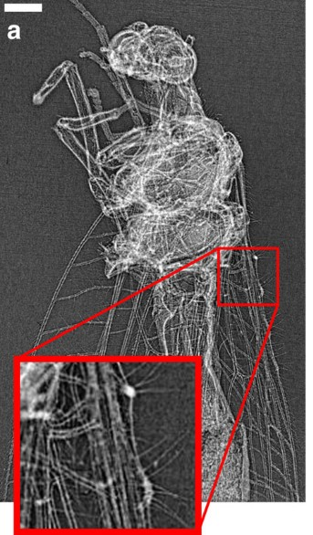
Outline
Betatron radiation: emission principles
Betatron radiation: spectral features
The EuAPS source: expected performance
Betatron radiation based phase contrast imaging. “Quantitative X-ray phase-contrast microtomography from a compact laser-driven betatron source” J. Wenz et al.
Notes:
I’ll go over the emission principles, showing the mechanics behind the radiation production, and then I’ll focus over some radiation features, and what has influence on them. In the last point I’ll briefly go over the local betatron source, but I won’t go in details as there will be a dedicated EuAPS project talk in the afternoon. Here is shown a phase contrast imaging example, performed with betatron radiation, but many other investigation techniques are suited for this kind of source.

Slide 3
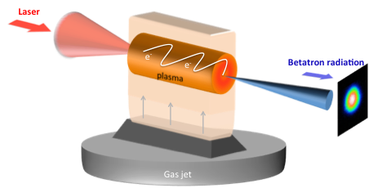
What is betatron radiation?
We refer to a compact, soft X-rays, laser wakefield based source
Not the most stable method, but it’s easy to set up, and gives high photon fluxes and ultrashort pulses, filling a gap between synchrotrons and FELs
Thanks to the small source size, it features a good level of spatial transverse coherence, that can be exploited for effective imaging
up to 10⁹ photons/shot
down to O(10) fs pulse duration
Notes:
First a general introduction to the topic: betatron radiation is a compact soft xrays source based on laser plasma wakefield technology. It may not be the most stable source but has several pros, like it’s easy to set up, gives high photon fluxes (up to 10^9 per shot) and ultrashort pulses (down to tens of fs), filling a feature gap between synchrotrons and FELs. And also, thanks to the small source size, it features a good level of spatial transverse coherence, that can be exploited for effective imaging

Slide 4
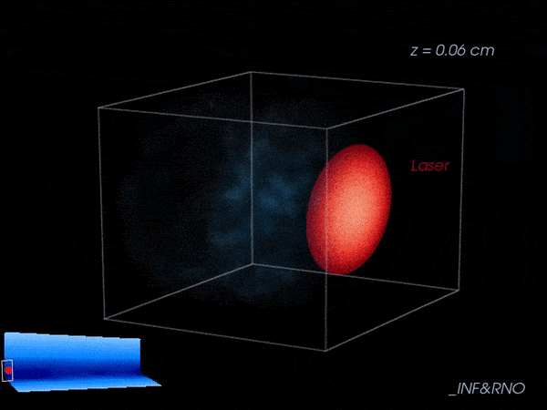
Providing radiators: self-injection
High power laser pulse ionizes neutral gas and creates a plasma wake (bubble regime)
Electrons get injected in the wake, undergoing relativistic accelerations in a few millimeters
Plasma waves (blue) excited by a petawatt laser pulse (red) at Berkeley Lab’s BELLA Center as it propagates in a plasma channel. Caption and credit: Carlo Benedetti/Berkeley Lab
Notes:
First step of our process is providing radiators: this happens in the left of this cartoon, where an high power laser pulse is focused over some neutral gas and locally turns it into plasma. But this is just the beginning: as it travels through plasma, the laser pulse is so strong to create a wakefield behind is trail, by literally displacing plasma electrons, and creating these plasma bubbles. In this nonlinear process, some of these plasma electrons are trapped inside the wake, as you see in this simulation, and they get accelerated to relativistic speeds in just some millimeters, becoming our radiation emitters. This process is called self-injection, and I want to stress out that requires just a laser pulse and some gas.

Slide 5
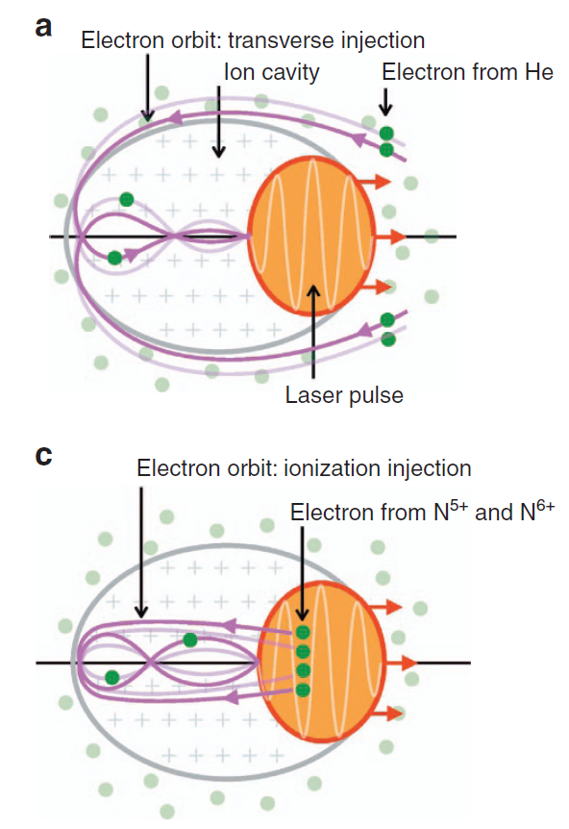
Self-injection VS Ionization injection
A
A – Self-injection: some of the main gas component ionized electrons oscillate around the bubble and get trapped inside the wake, with a typically unstable transverse injection.
B – Ionization injection: adding a doping gas with higher atomic number (e.g. nitrogen) some of the dopant electrons are ionized directly inside the bubble. This gives an intrinsically more stable longitudinal injection.
B
A
B
Image credits: A. Döpp et al. “Stable femtosecond X-rays with tunable polarization from a laser-driven accelerator” https://doi.org/10.1038/lsa.2017.86
Notes:
Actually there are more ways to inject electrons. One is pure self-injection, that you see in the cartoon A, and it’s based on transverse motion of main gas component electron: some of them cross the bubble boundary and get trapped, so as you may guess it’s an intrinsically unstable process, and gives strong shot-to shot variations as you see in this first row of radiation spots. Another option is ionization injection, the case B: here we add to the main gas some doping gas with higher atomic number, like nitrogen, so that some electrons have now higher ionization potential. What happens is that they get ionized directly inside the wake and with much lower transverse momentum, resulting in a more stable longitudinal injection, as you see down here in the radiation spots. Also, in this case, injection is more correlated with laser properties, so for example polarized radiation may be obtained.

Slide 6
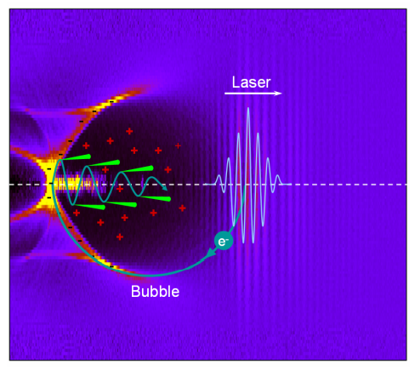
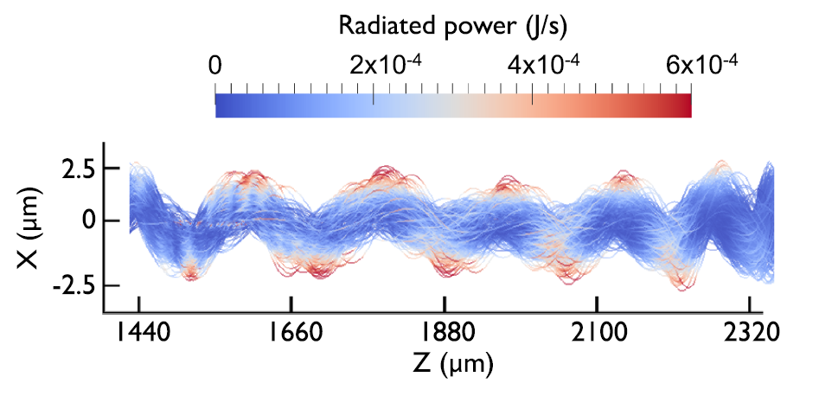
Providing radiation: betatron motion
The randomized injection results in transverse betatron oscillations, driven by the intense plasma focusing
Acting as an undulator, this gives ultrashort x-rays emission in a wide broadband spectrum
Notes:
Second step of our process is indeed providing radiation, and this happens in the right side of this cartoon. The random injection process in any case gives transverse betatron oscillations of electrons, driven by the strong plasma focusing, with wavelengths of just some hundred microns. The transverse acceleration gives intense longitudinal xray emission within just some milliradians of divergence. This is similar to how undulators work, but in this case with electrostatic force. The xray pulse duration is mainly given by electron bunch length, and can be as short as tens of femtoseconds if we neglect diffraction, so is suitable for time-resolved imaging techniques.

Slide 7
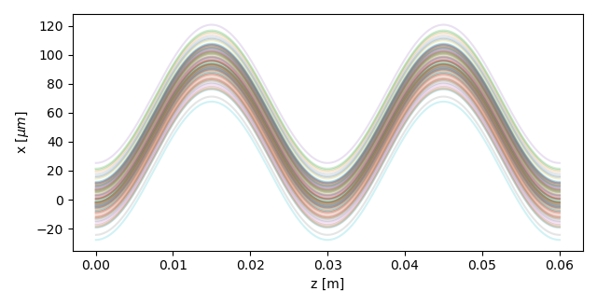
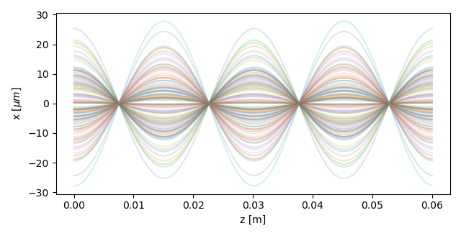
Betatron motion: trajectory crossing
undulator trajectories
While in a magnetic undulator the oscillation amplitude is given by particle energy and undulator strength K, inside the bubble it’s given by the axial offset
This gives an intrinsic K-spread due to the source size (beam spot), greater in case of on axis injection
parallel
plasma bubble trajectories
The nearly continuous K distribution reaches very low values, enhancing low energy spectral intensity
$$K =γ k_{β} r_{β}$$
oscillation amplitude
particle energy
betatron wavenumber
crossing
Notes:
I said it’s similar to an undulator, but there are relevant differences. First it’s more similar to a wiggler, since the average undulator strength is much greater than 1. Undulator strength K is this fundamental parameter that defines spectral properties. We have separate harmonics for K<1, nearly continuous spectrum for K>1. But it’s also different from a wiggler: in a wiggler particle trajectories are basically parallel, and they have more or less the same amplitude and so giving the same radiation emission. Instead self injection gives a big spread in oscillation amplitude, giving trajectory crossing, and resulting in a spread of undulator strength, as it depends on oscillation amplitude. So in general, betatron radiation becomes a mixed and broad emission.

Slide 8
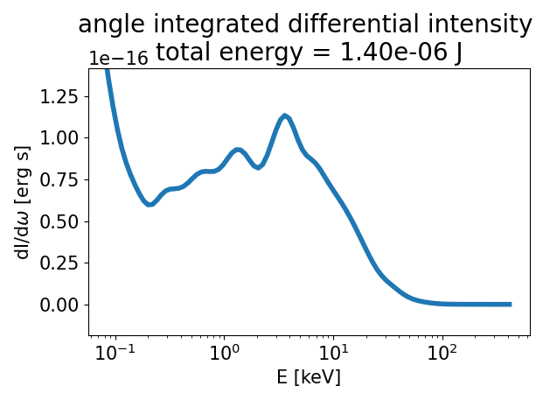
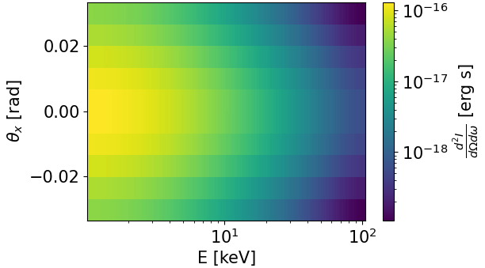
Spectral features
<
Broadband synchrotron-like spectrum with enhanced low energy intensity: detailed features depend on beam evolution inside the wakefield
In general, beam energy evolution increases spectral broadening
It features low energy-angle correlation, due to the high average undulator strength ( $K≈O(10)$ ) that prevails over relativistic doppler shift
Notes:
Indeed, this in blue is the spectrum we get from a typical betatron source, and as we compare it with a synchrotron spectrum in orange, we see that it fits well for high enegy, while it deviates and is higher for lower energy. This is mainly due to the fact that the radiator, the electron beam, changes its properties during emission. In particular, beam energy evolution gives the final spectrum shape, like a sort of modulation over a synchrotron spectrum, and in general it has the effect to increase spectral broadening. Also, the high average undulator strength prevails over relativistic doppler shift of radiation, giving low energy-angle correlation as you see in this angle resolved spectrum.

Slide 9
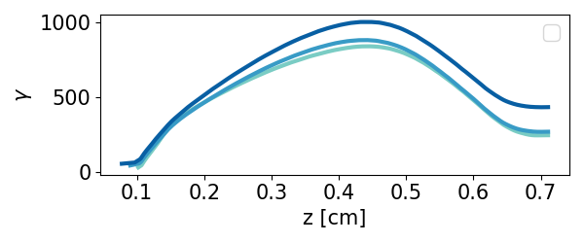
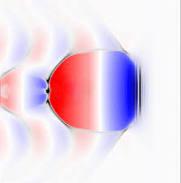
Spectrum shaping: dephasing control
beam energy
Dephasing: laser pulse travels slower than the electron beam, due to plasma refractive index, causing a phase slippage from acceleration to deceleration
Given the radiation critical frequency $ω_{c}\left(t\right)∝γ^{7/4}(t)$, the beam slowdown affects spectral shape, drifting from the synchrotron-like profile
Dephasing control can be attained through gas density modulation: e.g. an “M” shaped profile should give beam injection followed by a complying bubble size evolution
accelerating phase
decelerating phase
dephasing compensation
Notes:
Going back to the deviation from synchrotron spectrum, here’s the reason behind: first, critical frequency depends on energy, so the great electron beam energy variation stretches the synchrotron spectrum. But also there is what is called dephasing: as you se here the beam energy grows and then decreases. This happens because the beam travels at light speed, while the laser pulse is slower due to plasma refractive index. So at some point the beam slips out of the accelerating region of the wakefield (in red) and moves into the decelerating region (in blue). This energy drop adds low energy photons to the spectrum and can be exploited or reduced for spectral shaping. To compensate for dephasing, plasma density profile can be tuned to make the wakefield adapt to the beam slippage respect to the laser pulse. As you see in this animation, the trailing beam is kept into the accelerating region by progressively shrinking the bubble with a density ramp-up.

Slide 10
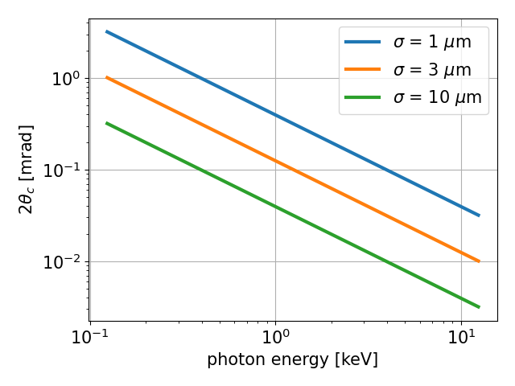
Spatial coherence
Given the K-spread and the mix of betatron phases, lower boundary of spatial coherence angle is calculated from van Cittert–Zernike theorem.
Numerical simulations parametric scans also look for the smallest possible electron beam spot, trying to reach O(1) mrad of coherence angle
Spatial coherence is a relevant parameter for phase contrast imaging: coherence size of at least 15x imaging resolution is required, threshold highlighted in dashed red
$$θ_{c}=\frac{λ}{πσ}$$
Notes:
Coming now to radiation geometric properties, as you may have guessed this is basically an incoherent source. But at the same time it is quite collimated and very small. So this can give some reasonable transverse coherence thanks to wavefront propagation. Here I present some simple calculation that turned out to be quite accurate, and shows the coherence angle in milliradians as a function of photon energy, plotted for some values of electron beam transverse spot. Through simulations we are looking for the best compromise between total photon number and electron beam spot size, hoping to reach even higher coherence levels. In dashed red you see an estimate of the minimal required coherence to perform phase contrast imaging for example, showing that with a 1um rms spot beam we could perform phase contrast up to 2keV photons.

Slide 11
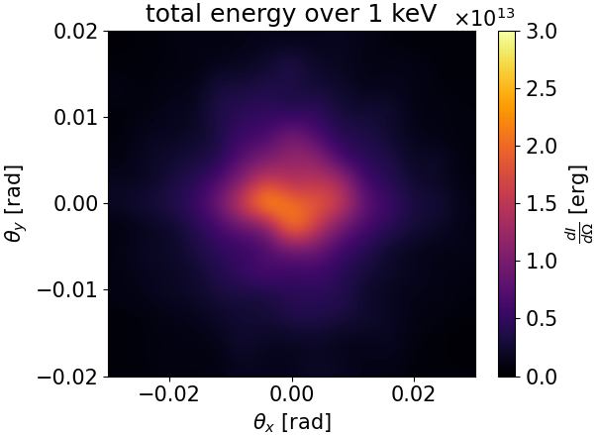
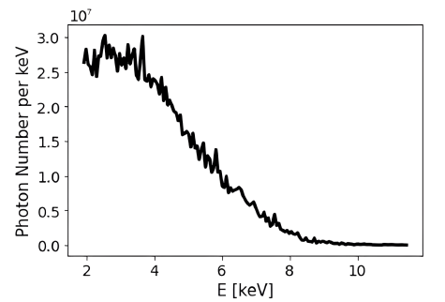
Expected Parameters
 | Value | Unit
Electron beam Energy | 100-500 | MeV
Plasma Number Density | 10¹⁸-10¹⁹ | cm⁻³
Photon Critical Energy | 1 -10 | keV
Number of Photons/pulse | 10⁶-10⁹ | -
Repetition rate | 1 | Hz
Beam divergence | 10-20 | mrad
Pulse duration | 30-200 | fs
simulated radiation spot
measured photon spectrum
Notes:
Finally, some typical values of interesting parameters, that should align with the betatron source that is being developed for the EuAPS project, here in LNF. I end with this slide and leave some room for some questions

Slide 12
Possible applications
In order of increasing difficulty
1- Static imaging ​
2- Static absorption spectroscopy​
3- Static emission spectroscopy
​4- Time-resolved pump-probe absorption spectroscopy
​5- Time-resolved pump-probe emission spectroscopy​
6- Time resolved imaging (plasma dynamics).
Courtesy F. Stellato
Check EuAPS@Frascati talk this afternoon at 15:30 for details!

Slide 13
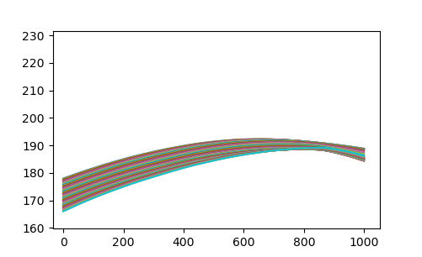
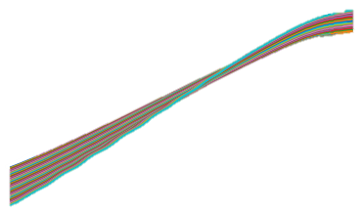
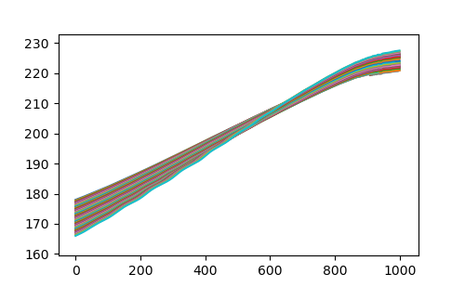
$$γ$$
$$ω_{c}\left(t\right)∝γ^{7/4}(t)$$
$$γ$$
Notes:
What does compliant mean? Check these model animations on the right, where you see the driver in red, the faster injected beam in blue, slowly reaching the driver, and the plasma distribution around.
In the upper case of strong dephasing, beam energy is lowered after some point, and so does the critical energy, getting the spectrum to fold back on itself towards lower photon energies
In the lower case the gas density is raised as the driver moves through and the bubble gets smaller and smaller, leaving the beam in its rear part where the field is accelerating, so reaching higher photon energies as well and showing the relevance of a proper gas density profile shaping

Slide 14
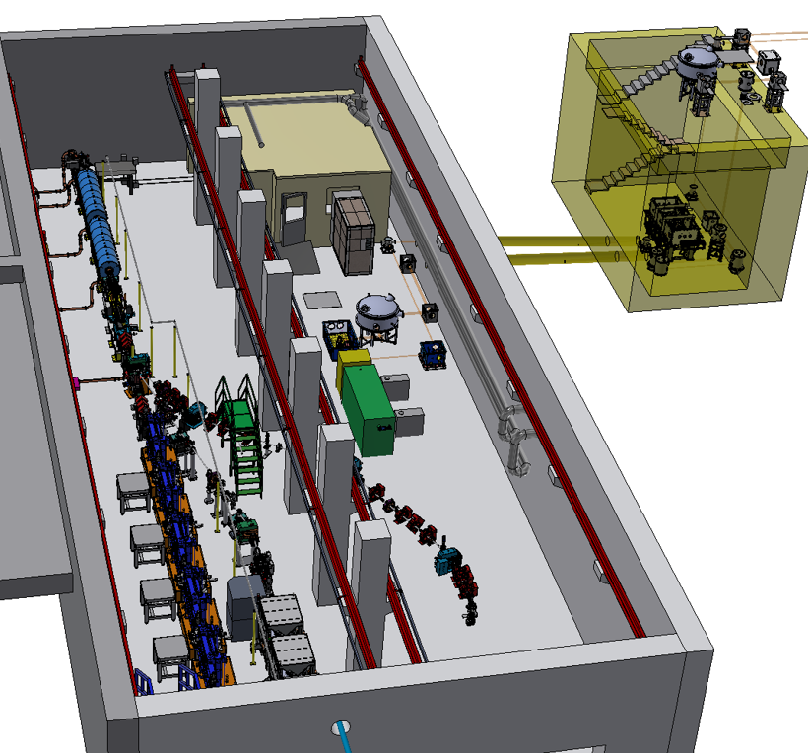
The EuAPS source
Notes:
So let’s start some inception inside the actual EuAPS betatron radiation source… ths is the sparc bunker and on the left we see the linac and the undulator line for Eupraxia plasma driven FEL. On the right we find the EuAPS facility

Slide 15
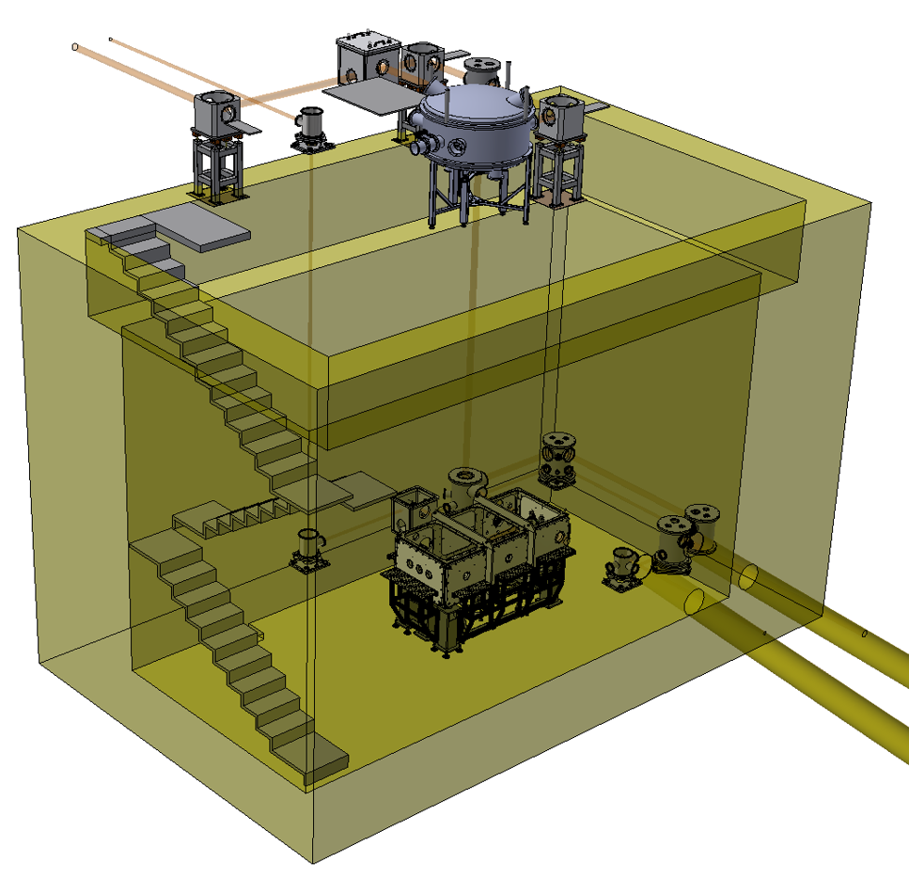
The EuAPS source
FLAME building
Notes:
The first main element is the flame building, Flame is a (dati flame) out of this image and here you see the photon beam transport line, currently feeding a test laser-gas interaction point positioned down here. For the final setup the laser pulse will be transported out of the building, straight into the spark bunker

Slide 16
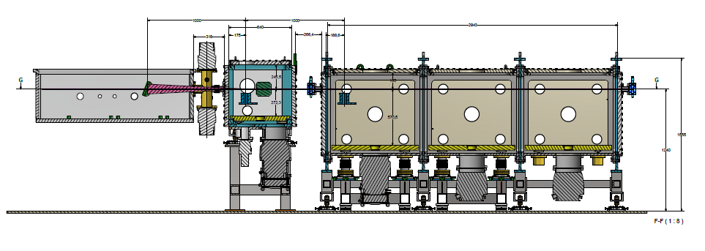
The EuAPS source
Interaction point
Experimental chamber
$$≈3m$$
Notes:
And towards the final interaction point and experimental chamber that you see highlighted in the bunker on the left and in a detailed plan view on the right. The experimental chamber will be 3 meters long, giving room for (?)

Slide 17
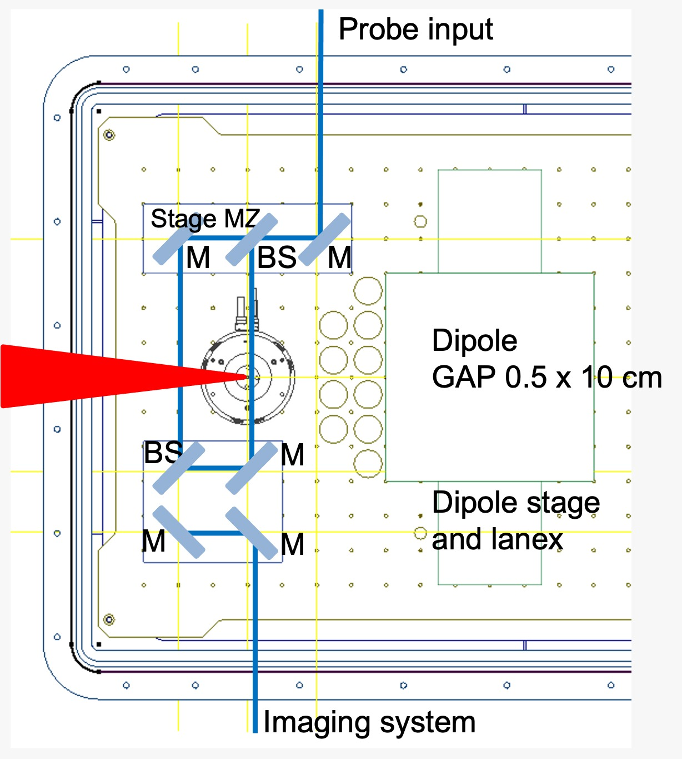
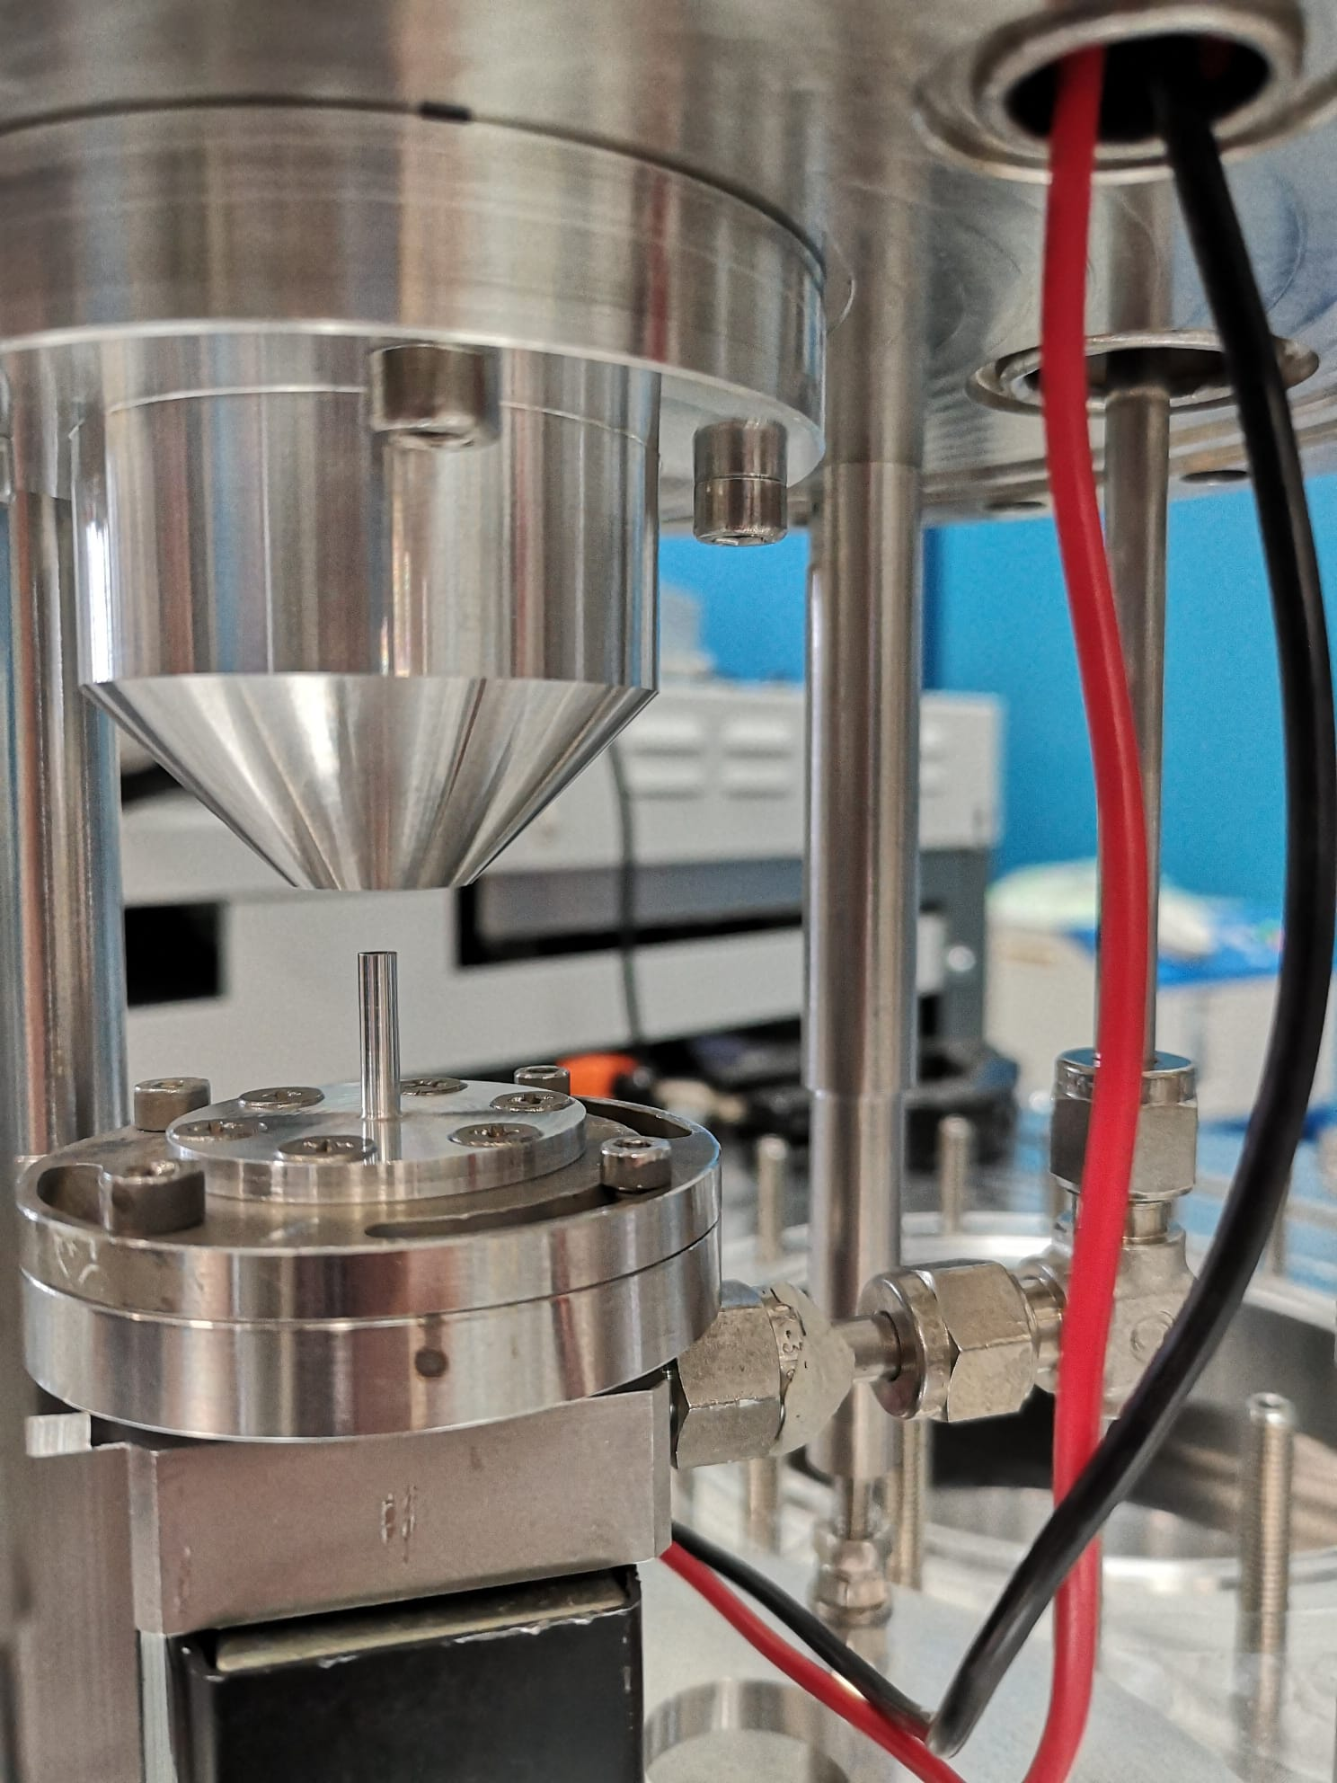
The EuAPS source
Interaction point
Interaction chamber detail
Gas jet nozzle and collector setup
Notes:
But let’s go in some more detail about the actual setup, so…

Slide 18
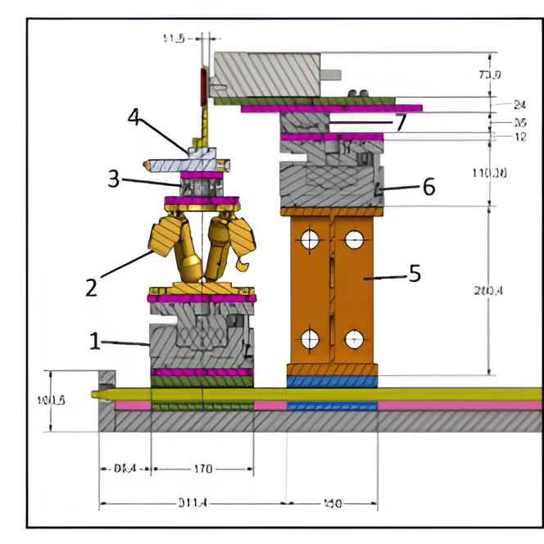
The EuAPS source
Experimental chamber
Sample Block
11,5
73,9
24
35
12
110,36
XYZ linear stages, one rotary stages + hexapod for a sample placement precision around ±0,05 µm and ±20 mdeg
X-ray Camera, imaging array 2048 x 2048, 15 x 15 µm pixel size, positionable in a 10 x 10 x 2.5 cm³ range
280,4
100,5
95,4
170
311,4
150
Camera Block
Notes:
Tabella sample block/camera block?

Slide 19
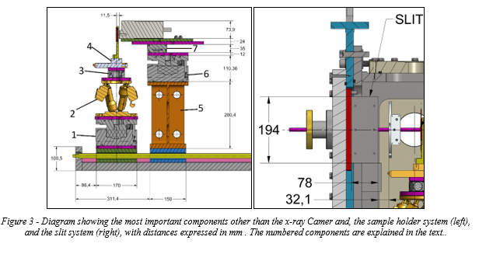
Inside the user chamber
1 - Linear stage XY, 25 mm travel range, 25 N load max, 133x35x20 mm size, 0,73 kg weight, stainless steel/aluminium.
2 - Rotary stage, 360° rotation, 0.125 Nm maximum torque, 50 N max load, ±20 mdeg accuracy, 0,7 kg weight, 194x90x70 mm size, Stainless Stee.
3 - Hexapod, ±17 mm travel range, 5 kg load capacity, Repeatability to ±0.06 µm, 2.2 kg weight, lower circular base 136 mm, higher circular base 100 mm, height 114 mm, stainless steel/aluminium
4 - Linear stage (z-direction, perpendicular to the ground), 40 mm travel range, 0,02 mm Spindle pitch, 0,05 µm resolution, 150 N max load, 0,3 Nm Min. Drive Torque, weight 7.5 kg, size 170x170x90 mm, aluminium.
Not Numbered - Custom-built sample holder, 200 g weight, 133x23,5x7 mm size (with angular step for bolts), stainless steel.
The X-ray Camera handling devices (hereby called collectively Camera Block) will be built with the subsequent devices:
5 - Custom Built steel pillar, 280x150x250 mm (higher base 170x170 mm) size, 6 kg weight, stainless steel.
6 - Linear stage (z-direction, same as Sample Block)
7 - Linear XY stage, 100 mm travel range, 20 µm accuracy, 1 mm Spindle pitch, 1200 N max load, 0,1 Nm drive torque, 1 kg weight, 80x144x35 mm size, aluminium/stainless steel.
Not Numbered - X-ray Camera, imaging array 2048 x 2048, 15x15 µm pixel size, 2.3 kg weight, 217.6x102.3x7.39 mm size, aluminium/stainless steel.

Slide 20
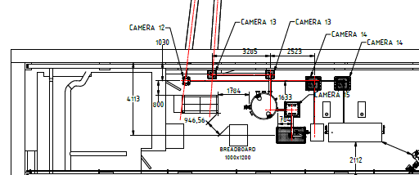
SPARC_LAB bunker
Layout in the SPARC bunker and connection with FLAME building
S. Lauciani

Slide 21
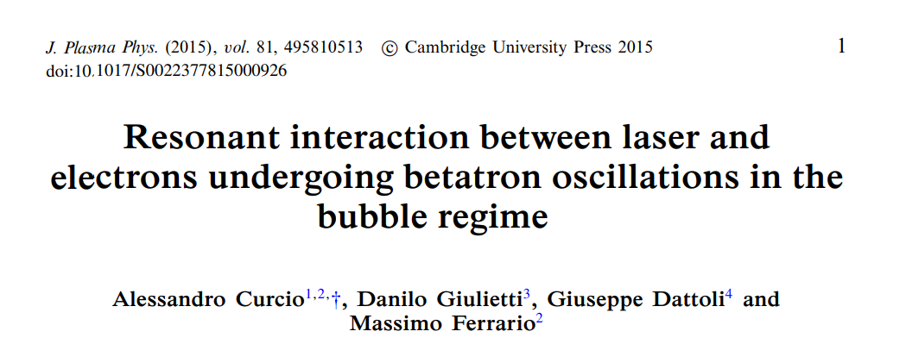
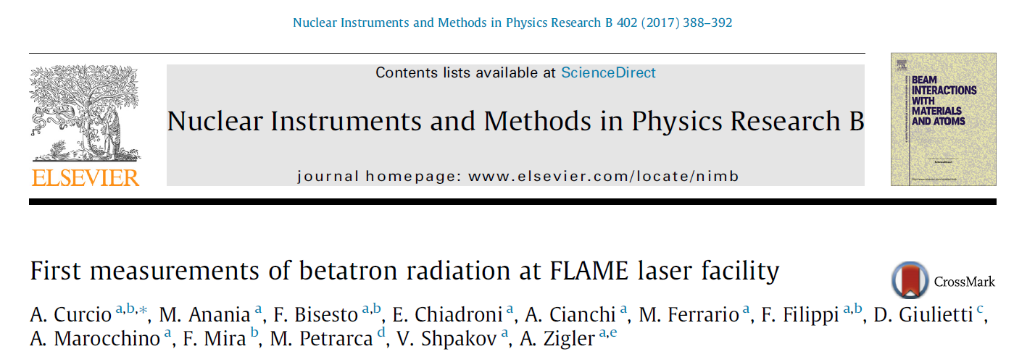
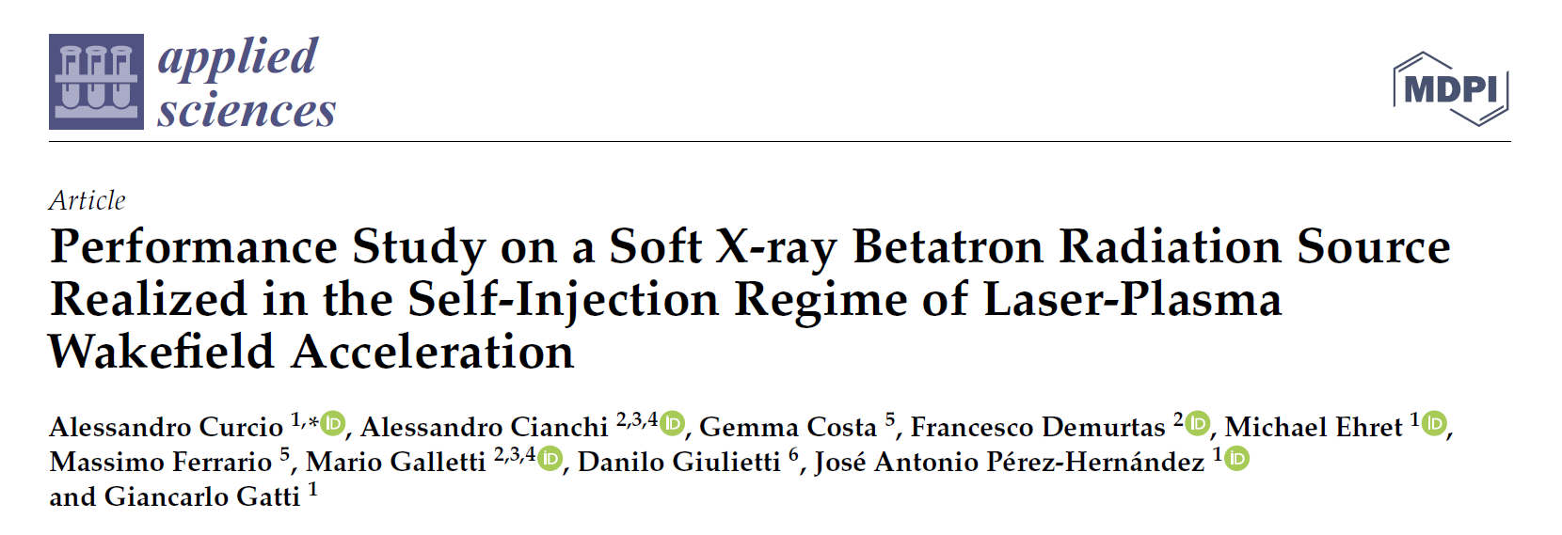
Betatron was always a hot topic

Slide 22
High power laser ionize the gas and create a plasma bubble
Electron are self injected in the back of the bubble
These charges are accelerated by intense electric field (>GV/m)
The uncontrolled injection produces betatron oscillation

Slide 23
Betatron radiation
Betatron radiation is emitted by electrons accelerated in a plasma due to their wiggling motion
There are betatron oscillations in any accelerator, but their contribution is negligible
In a plasma stage, there are about tens of oscillations in a few hundreds of $μm$of accelerating length

Slide 24
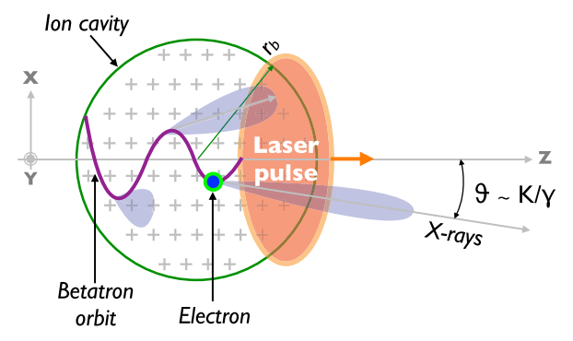
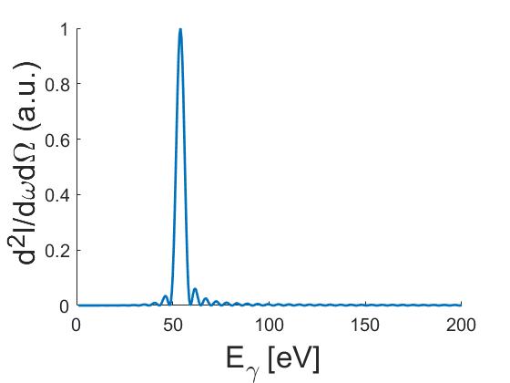
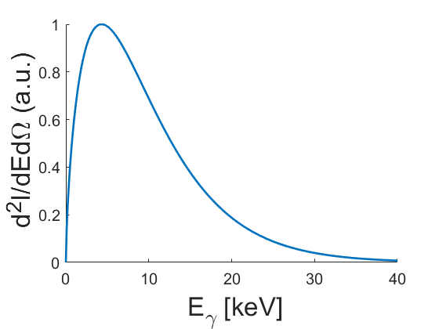
Aperture angle
$K<1$
Undulator regime
Electron Lorentz factor
$K≫1$
Wiggler regime
Undulator parameter
Betatron wavenumber
$$K=γk_{β}r_{β}$$
Oscillation amplitude
Critical energy
$$E_{c}∝γ^{2}ω_{β}K$$
Betatron frequency

Slide 25
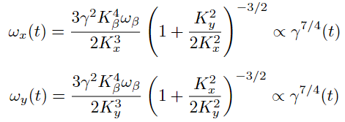
Betatron Radiation
Synchrotron Radiation
Critical frequency
On-axis
Peak
Power
Mean
Cumbersome expression, where Bessel K functions are integrated upon time.
No appearance of Bessel K 5/3.
This brings to an enhancement of low-frequency photons compared to Synchrotron Radiation spectrum (effect of the acceleration).
Spectral Density
Courtesy A. Curcio

Slide 26
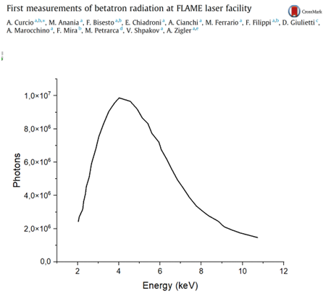
Betatron radiation emission
The radiation has its own characteristics of both FELs and synchrotrons
Large bandwidth as Synchrotrons
Short pulse duration like a FEL

Slide 27
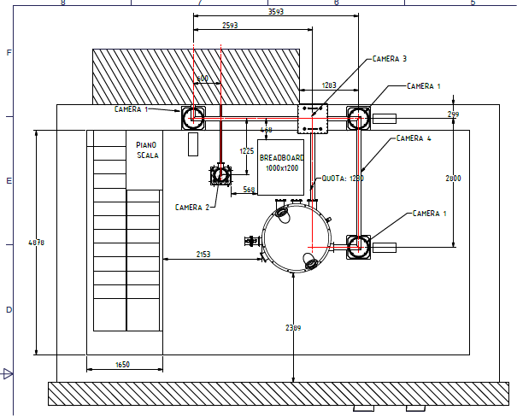
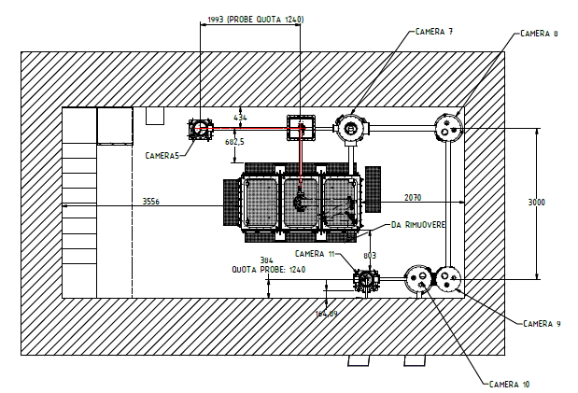
Flame building ground floor
Flame building underground floor
S. Lauciani

Slide 28
SPARC_LAB bunker
Layout in the SPARC bunker and connection with FLAME building
S. Lauciani

Slide 29
Interaction point and experimental chamber
Drawings completed
All purchasing procedures completed
V. Lollo

Slide 30
Interaction point
V. Lollo
Main issue is the pumping of 20-30 bar with repetition rate at least 1 Hz
The focusing parabola has to be at least at 10⁻⁴ mbar
Prototype system developed and tested

Slide 31
Timeline
Installation in FLAME in progress until 15/2/2025
Upgrade laser FLAME up to March 2025
Installation in SPARC up to May 2025
Setup and startup May/July 2025
Beam to users September/November 2025

Slide 32
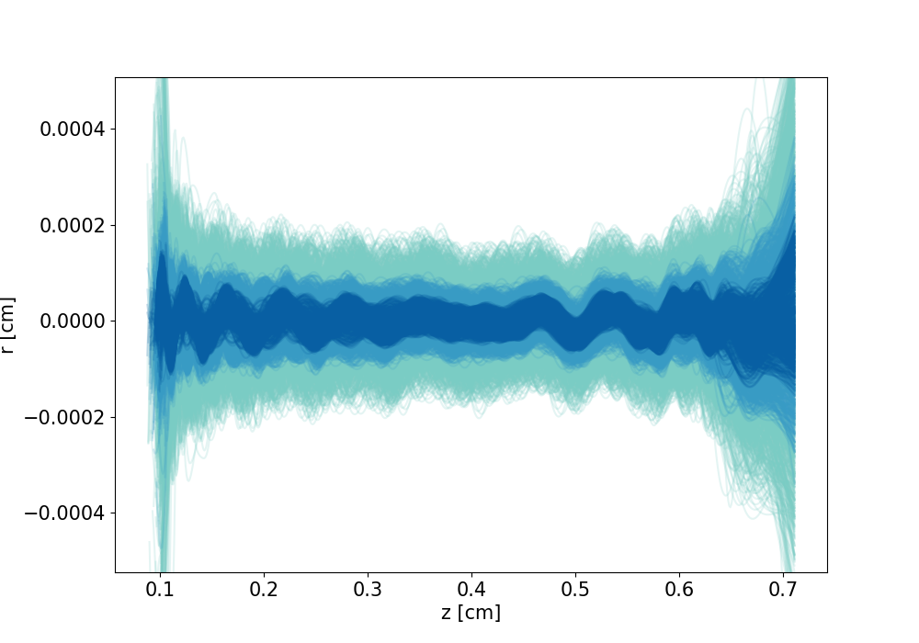
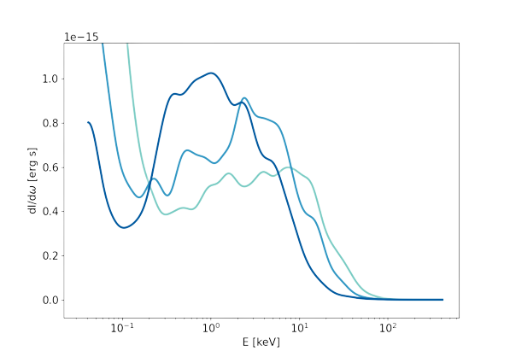
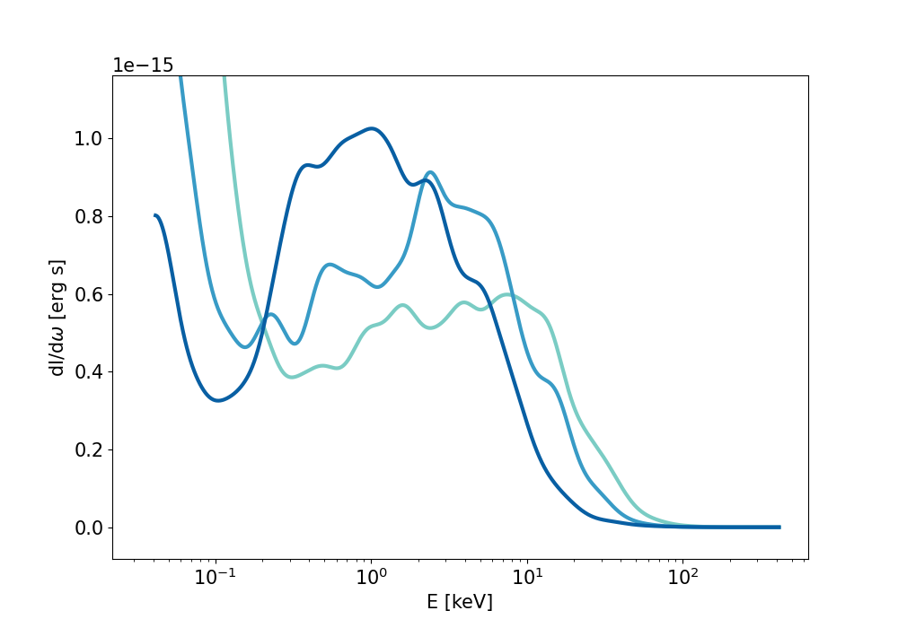
Spectral features
Broadband synchrotron-like spectrum with enhanced low energy intensity: detailed features depend on beam evolution inside the wakefield
In general, beam energy evolution increases spectral broadening
Detailed numerical analysis show that for ionization injection, the beam core emits with higher spatial coherence
beam
Notes:
Tough a well separated harmonics emission could teoreticallhy be possible, in simulated and measured cases the ondulator strength is on the order of tens, so we find Broadband synchrotron-like spectrum with enhanced low energy intensity, because of the reason

