Slide 1
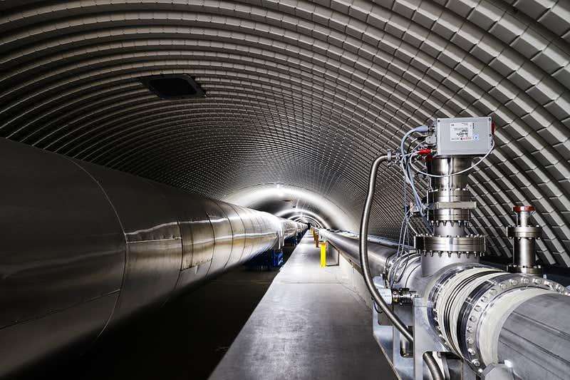
SQUEEZE
Integrated Squeezed Light Source

Slide 2
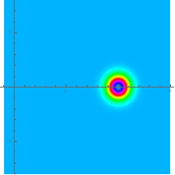
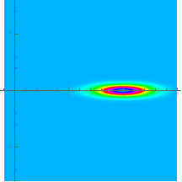
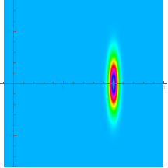













Squeezed states of light
Electric Field Quadratures
Phase noise
$$\hat{E}=\left[X_{1}+{\hat{∆X}}_{1}\right]Cos\left(ω_{0}t\right)+\left[{\hat{∆X}}_{2}\right]Sin\left(ω_{0}t\right)=X_{1}\left[1+{\hat{∆X}}_{1}/X_{1}\right]Cos\left(ω_{0}t−{\hat{∆X}}_{2}/X_{1}\right)$$
Amplitude noise
Minimum Uncertainty States
$$∆X_{1}{∆X}_{2}=1$$
Coherent State
Phase squeezing
Amplitude squeezing
$$X_{2}$$
$$X_{2}$$
$$X_{2}$$
$${∆X}_{1}$$
$${∆X}_{1}$$
$${∆X}_{1}$$
$${∆X}_{2}$$
$${∆X}_{2}$$
$${∆X}_{2}$$
$$X_{1}$$
$$X_{1}$$
$$X_{1}$$
3.5 dB
3.5 dB

Slide 3
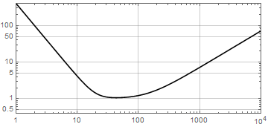
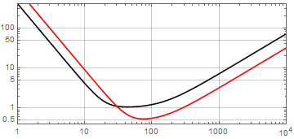
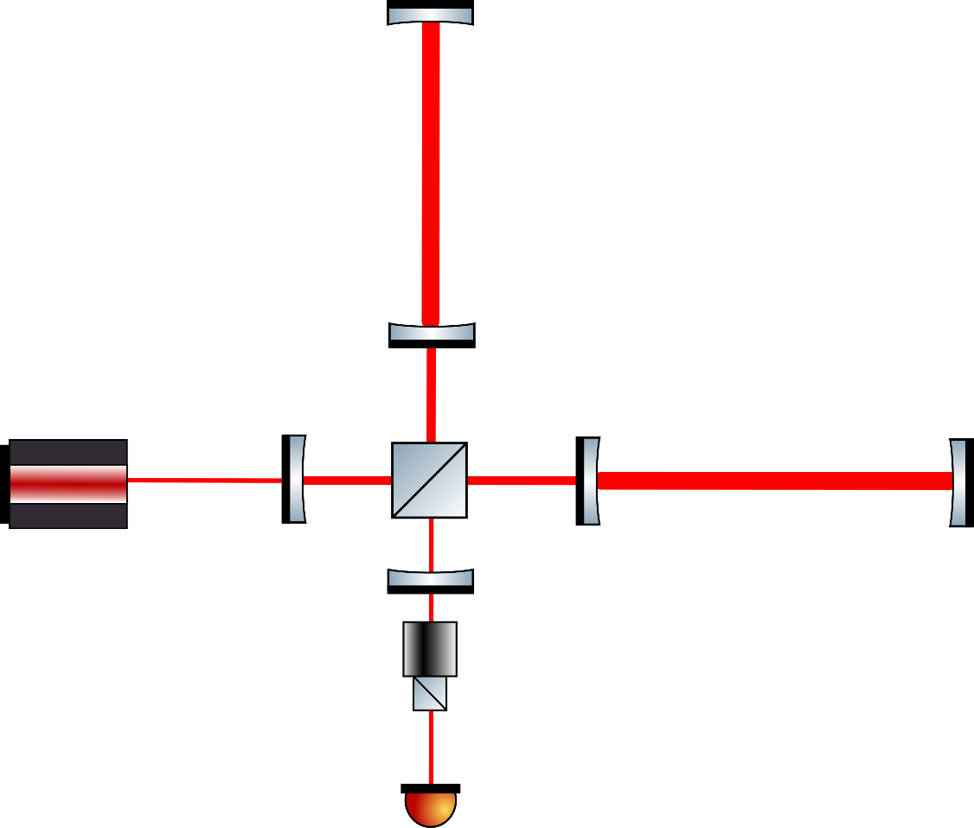
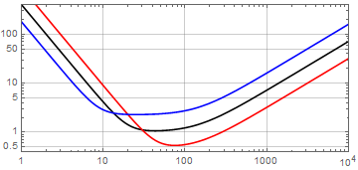
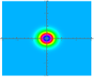
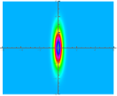
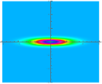
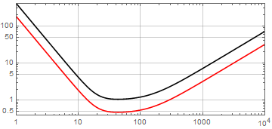
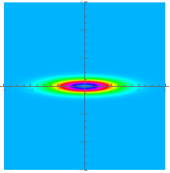
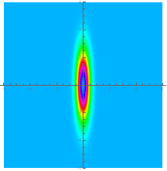
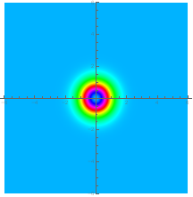
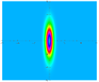
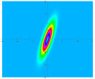
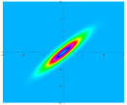
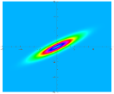
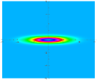

Squeezing and GW detectors
Quantum noise can be manipulated with squeezed light
$$∆X_{1} generates shot noise$$
$$(high frequency)$$
$$∆X_{2 }generates radiation$$
$pressure noise (low$
$frequency)$

Slide 4
Not only GW applications
Quantum computing
J. Zhao et al.,“A high-fidelity heralded quantum squeezing gate”, Nature Photonics volume 14, pages 306–309 (2020)
T. Kashiwazaki et al., “Over-8-dB squeezed light generation by a broadband waveguide optical parametric amplifier toward fault-tolerant ultra-fast quantum computers”, https://arxiv.org/abs/2301.12658, (2023).
Quantum comunication
T. Gehring, “Implementation of continuous-variable quantum key distribution with composable and one-sided-device-independent security against coherent attacks”, Nature Comunications 6, 8795 (2015).
Metrology
A. I. Lvovsky. Squeezed light - Quantum Physics https://arxiv.org/abs/1401.4118
Spetroscopy
J. Junker et al. “High precision cavity spectroscopy using high-frequency squeezed light” Opt. Express (2021), 29, 6053
Biology
W. Yang et al., “A Bright Squeezed Light Source for Quantum Sensing”, Chemosensors (2023), 11, 18
Others
Long Ma, “Generation of higher-order orbital angular momentum squeezed light”, Optik - International Journal for Light and Electron Optics 251 (2022) 168357

Slide 5
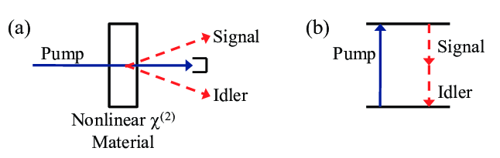
Squeezed light production
Squeezed state generation requires nonlinear processes.
Several methods explored (4 wave mixing, ponderomotive effect, kerr effect,..)
The most efficient exploits the cavity enhanced parametric down conversion in $χ^{(2)}$ crystals
Parametric Down Conversion
OPA: Optical parametric Amplification

Slide 6
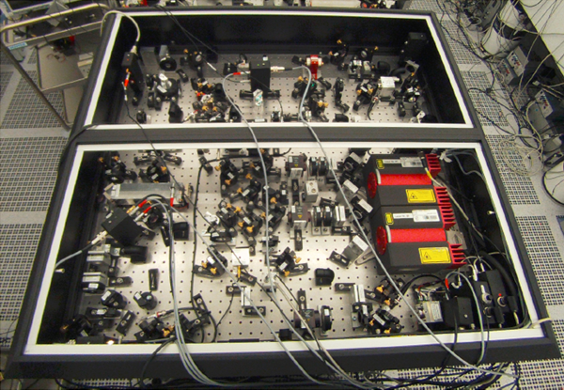
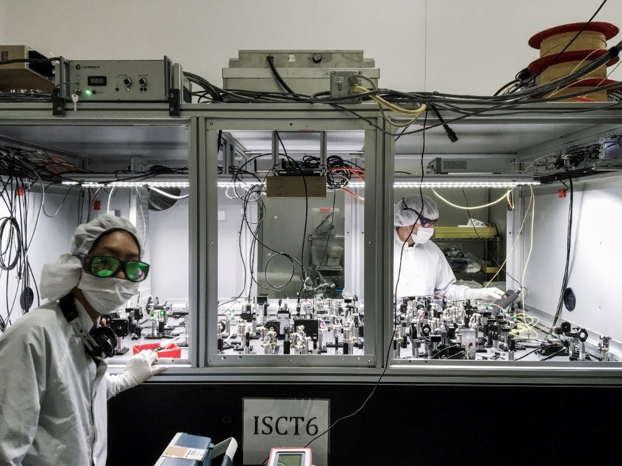
Real squeezer boards
Virgo AEI
squeezer
In addition to the OPO a squeezer board includes
  Pump power generator (SHG:Second Harmonic Generator)
  Pump power stabilizer (MZI:Mach Zehnder Interferometer)
  Phase and frequency modulators (EOM, AOM)
  Auxiliary control laser (coherent control laser, Sub Carrier laser..)
  Beam mode cleaners
  Faraday isolators
  Phase Locked Loop optical set-up
  Diagnostic homodyne detector
LIGO
squeezer
Most of these components can be integrated in a LNOI chip
LNOI:Lithium Niobate On Isulator

Slide 7
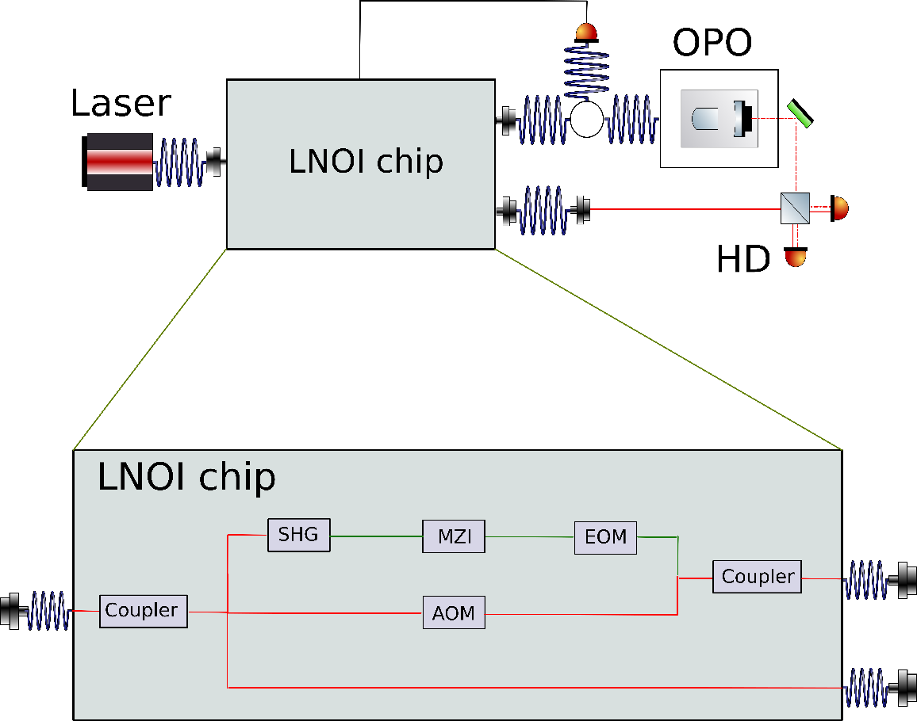
Task#1: hybrid squeezer
Explore the potential of integrated optics to provide sources for the generation and control of squeezed light.
Investigation of the properties of these sources at frequencies (audio) of interest for ET.
LNOI chip
  Pump power generator (SHG:Second Harmonic Generator)
  Pump power stabilizer (MZI:Mach Zehnder Interferometer)
  Phase and frequency modulators (EOM, AOM)
Squeezing generation and diagnostic
  External OPO cavity
  External Homodyne detector (HD)

Slide 8
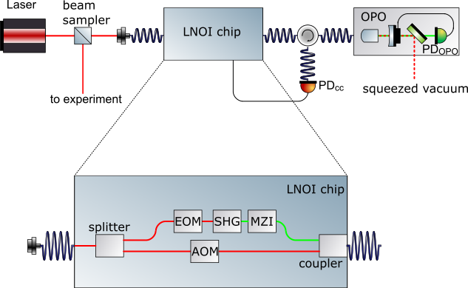
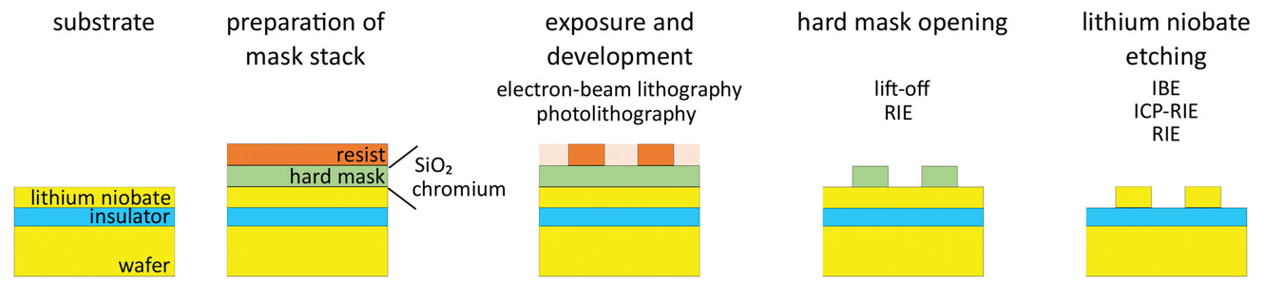
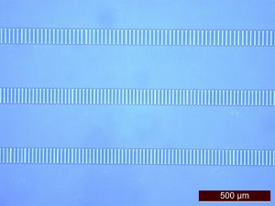
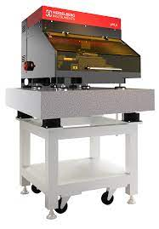
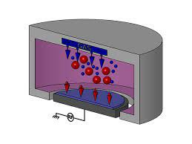
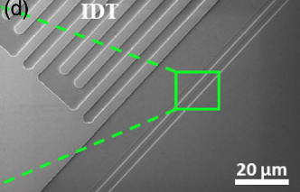
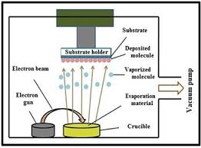
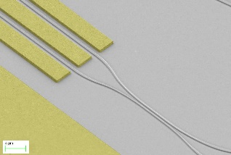
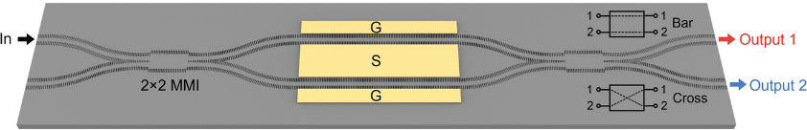
Hybrid squeezer source realization
The different functionalities can be obtained on a LiNbO3-on-Insulator wafer by a common fabrication procedure:
to experiment
realization
Optical lithography
E-beam evaporation
Reactive Ion etching

Slide 9
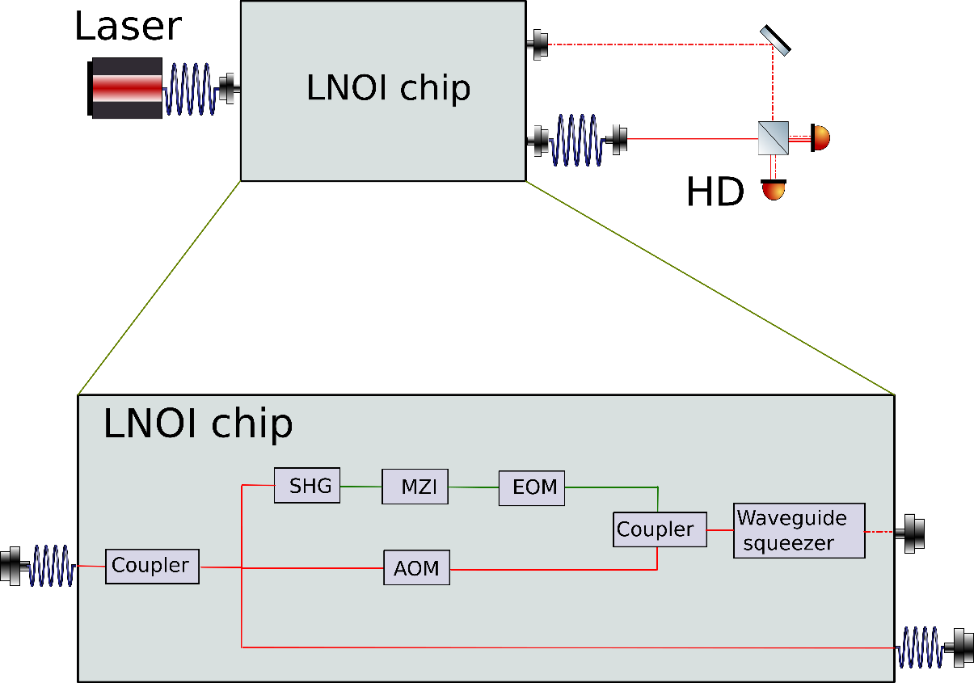
Task#2: fully integrated squeezer
Realization of a waveguide integrated squeezed source.
Investigation of the properties of these sources at frequencies (audio) of interest for ET.
LNOI chip
  Pump power generator (SHG:Second Harmonic Generator)
  Pump power stabilizer (MZI:Mach Zehnder Interferometer)
  Phase and frequency modulators (EOM, AOM)
  Waveguide squeezer
Squeezing generation and diagnostic
  External Homodyne detector (HD)

Slide 10
Composition and time table
Involved sections:
Padova |  | TIFPA
Marco Bazzan | 20% | Matteo Leonardi (Resp) | 40%
Jean-Pierre Zendri | 20% | Mirko Lobino | 20%
PhD* | 80% | Igor Gonzalez (PhD) | 30%
 |  | Hamza Hasnaoui | 30%
* PhD in material science supported by “progetto frontiere quantistiche”
Three years project:
Year | Padova | TIFPA
2025 | Design and manufacturing of the integrated SHG. Low noise electronics for squeezing controls. * | Implementation of the CC loop on an existing waveguide squeezer
2026 | Application of low-noise electronics to squeezing generation in waveguide (commercial). Integrated Mach Zehnder Interferometer Low noise homodyne detectors * | Squeezing generation in waveguide (commercial), low frequency optimization.
2027 | Integration of all the components in a single device: optimization at low frequencies Integrated electro(acousto)-optic modulators | Integration of all the components in a single device: optimization at low frequencies
* Planned activity carried out as part of the ET-Italy (CNS2) project

Slide 11
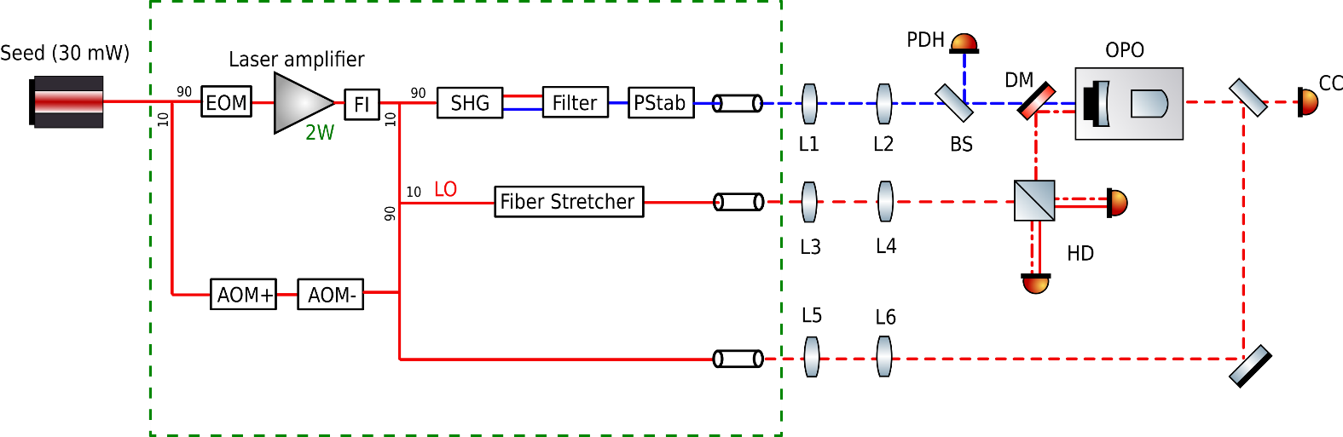
Collaborations and synergies
The research plan involves a strong collaboration with ET-Italia (CNS2)
In particular, ET-Italia (Zendri 40%, Bergnoli 20%, 50% technological PhD ) will deal with the development of ET-compatible low noise control electronic.
The electronics will be characterized and optimized for an hybrid squeezer in which the sources are provided by a fiber optic system provided by the DFA “progetto frontiere quantistiche”.
Moreover the entire setup is expected to give valuable indications for the design of the integrated optic circuit.

Slide 12
Request for 2025
Requests for 2025
 |  | Cost (included VAT) [keuro]
Wafers for integrated optics | Cons | 10
Consumables for the LNIO process | Cons | 3
Contribution for the use of the clean room | Cons | 5
Coupling optics | Apparati | 10
Electronic components for Temp. stabilization | Cons | 2
External process | Cons | 5
* The costs for the development of the missing electronics are supported by ET-Italia
Support from the Section
- One month of mechanical workshop for mechanical supports

Slide 13
Backup Slides

Slide 14
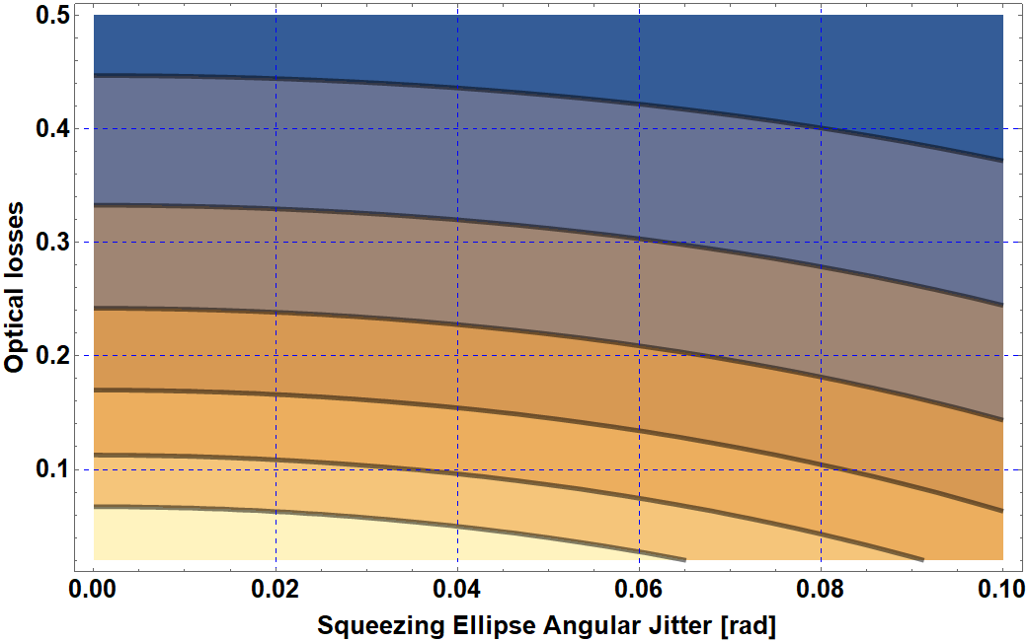
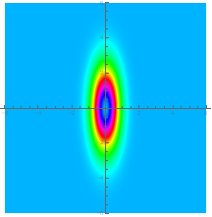
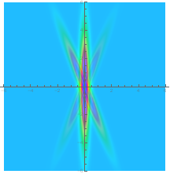


Squeezing degradation
Produced 10 dB
Optical losses:
Losses
3 dB
IN
OUT
4 dB
5 dB
6 dB
7 dB
8 dB
Squeezing ellipse angular jitter:
$${∆X}_{1}$$
Required:
High quality Optics (superpolished, low absorbtion materials, AR coating).
Fast and low noise phase stabilization loops.
$${∆X}_{1−actual}$$

Slide 15




Perspectives: GW R&D
Advanced techniques for the next GW detector generation
  Coupled cavity for optimal FDS generation,
  Squeezed light coupled with white light cavities
S. L. Danilishin ,F. Ya. Khalili H. Miao, Living Reviews in Relativity volume 22, Article number: 2 (2019)
  High order spatial mode squeezing
  Quantum non demolution and BA evading techniques
  Advanced control strategies
  Bright light squeezing generation
  FDS
  T. Zhang, H. Miao, A. Freise, Phys. Rev. D, 101(8), 082002, 2020
  J. Heinze et al. Phys. Rev. Lett, 128, 083606, (2022)

