Slide 1
FEROCE
Front-End Rdma Over Converged Ethernet
Area di ricerca: Rivelatori, Elettronica, Calcolo
Responsabile nazionale: Andrea Triossi (Unipd – INFN Padova)
Unita partecipanti: INFN sezione di Padova
Laboratori Nazionali di Legnaro

Slide 2
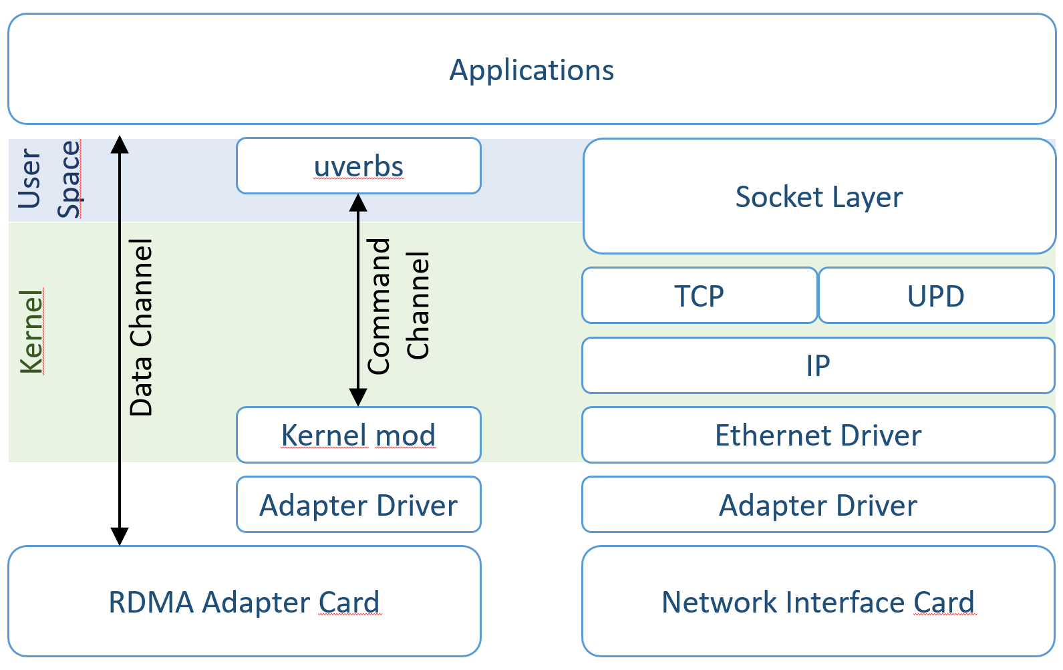
Objectives
Processing power is important as an efficient data movement
In a DAQ system a large fraction of CPU is engaged in networking
Data manipulation (several copies)
Latency increase and throughput reduction
Zero-copy is obtained by adding RDMA layer to the network stack
FEROCE wants to move the adoption of the network protocol to the data producer
Front-end initiates the RDMA transfer
No point-to-point connection between front-end and back-end
Dynamical switching routing according to node availability

Slide 3
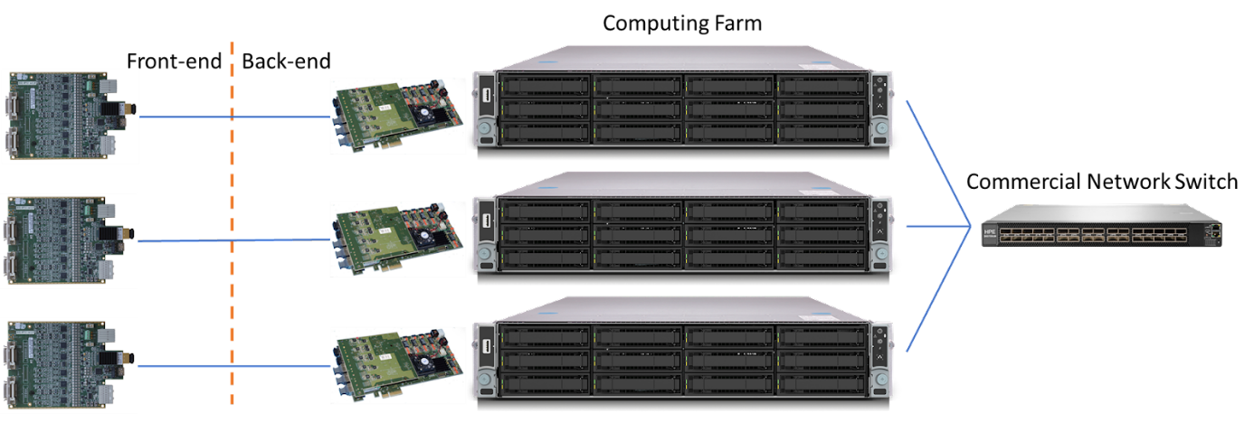
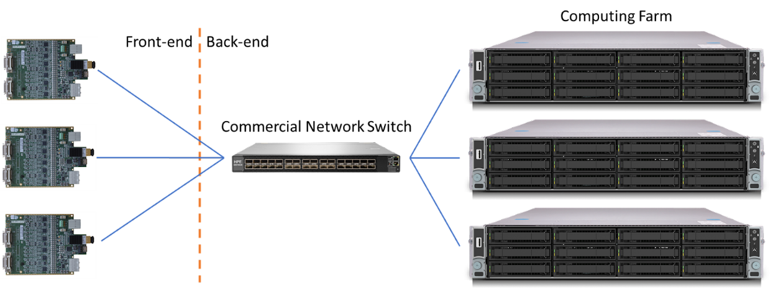
Methodology
Several network stacks implementing RDMA
InfiniBand, RoCE, iWARP…
RoCE (RDMA over Converged Ethernet)
Based on Ethernet networks
Industry-standard
Multi-vendor ecosystem
RoCE v2 packet switching (layer 2 and 3)
FPGA are already used for implementing network stacks
Data center
ATLAS

Slide 4
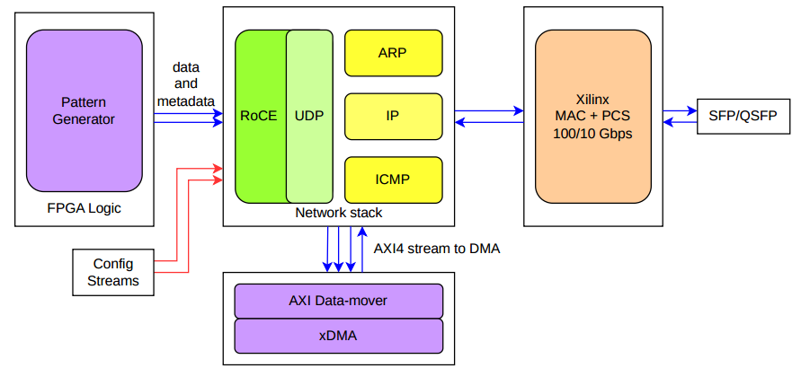
Study of the exiting libraries
Open-source libraries
ETH Zurich Network Stack
Entirely written in HLS
10/100 Gbps via Xilinx 10G and 100G MAC IPs
xDMA, DDR4 memory and recently HBM support
This module writes/reads data to/from the Host machine’s memory through the xDMA
An AXI data-mover is used to translate the AXI4 stream into AXI memory mapped (and viceversa)
Queue Pair’s information is exchanged using AXI stream ports
A debug port is present to send data directly from the FPGA logic TX DATA port

Slide 5
Example RDMA WRITE from FPGA
Generate the Queue Pair parameter from the receiver side and allocate memory
Remote QP number
Remote Virtual Address
Registration key (to access the memory)
Remote Packet Sequence Number (PSN) needed to check stream’s structure
Send such parameter to FPGA on a sideband channel (e.g. ipbus/TCP-IP)
Pack the parameters in the configuration AXI streams ports
Stream data through the data AXI stream port
Notify somehow the receiver that the transfer is completed (Immediate message/sideband)
Dump the buffer

Slide 6
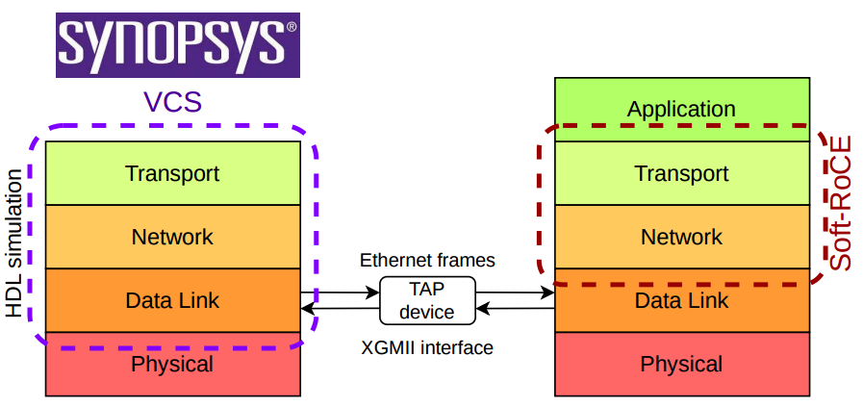
Testing of UDP, TCP and RoCE V2
Dynamic VCS simulation
TUN/TAP
DPI-C (Direct Programming Interface) used to link C functions with RTL simulation
Modifications in MAC and in DDR interface
RDMA WRITE tested successfully with a 10G MAC
RoCE firmware simulator sends data to Soft-RoCE end-point
Results presented at two international conferences TIPP and TWEPP
Proceeding here

Slide 7
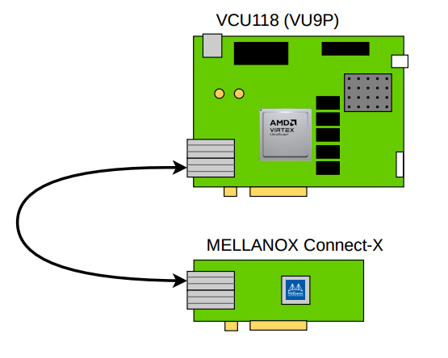
Hardware implementation
UDP and TCP stacks deployment on VCU118
Good bandwidth results for TCP (> 60Gbps with two connections)
Hard to close the timing (even in HLS doesn’t close)
Porting to Vivado 22.2 was needed (intelligent runs)
RoCE v2 stacks deployment on VCU118
Several issues were found before successfully transmit data (also present in simulation)
New CRC32 module developed (RTL, not HLS) see backup slides for details
Occupancy:

Slide 8
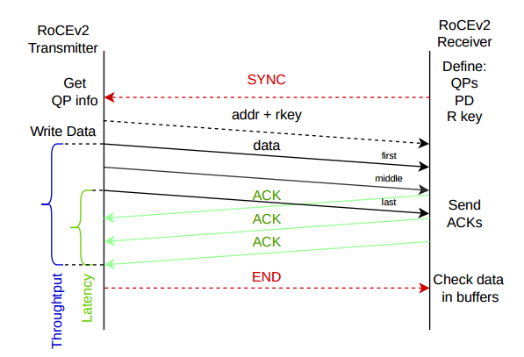
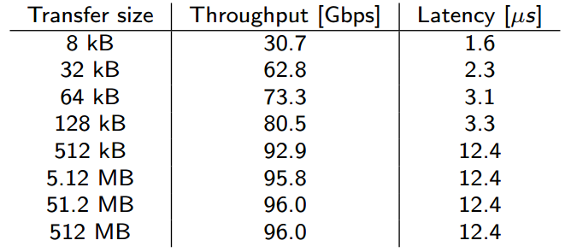
Latency and throughput
Latency is computed averaging the time from each packet’s transfer start and its acknowledge (round trip)
Throughput is computed considering the payload size and the time from first packet sent and last acknowledge received
First transfer in the QP must be small (warm-up), it’s needed to for caching the QP info (NIC side), otherwise packet loss is observed
After that, no packet loss is observed, need more tests though

Slide 9
Networking activities
Learned to use ibverbs for writing RDMA capable applications
Building testing environment, based on two virtual machines with soft-roce
First communication test between two applications, using rdma connection manager (RDMA CM) for connection handling
RDMA write from one VM memory to the other
CM removal, manual handling of the connections and out-of-band communication
Removal of one of the VM, substitution with dynamic simulation
Verified the same operations also with real hardware
Test between two servers equipped with Connect-X 6, the same application works
Point-to-point connection
linux-rdma/perftest package used for performance measurement
For instance, ib_write_bw used for measuring the bandwidth of an RDMA WRITE
Test of several configuration of message size and number of messages
Measured up to 93 Gbps
Tuning of the host parameters (e.g. NIC Buffer, MTU, etc.)

Slide 10
Ongoing efforts
Congestion tests on a 10G network
Two senders / one receiver link saturation
Flow Control or RoceV2 congestion management throttle the sender without triggering retransmission
Next steps
Repeat tests on a 100G network (Nvidia switch received)
Rewrite RoCE TX module at RTL, only for RDMA WRITE (with immediate)
Open-source network stack for low level layers (UDP, IP, ARP…)
Tested in dynamic simulation towards soft-ROCE
GitHub code
Talk accepted at CHEP 2024
Next steps
Add re-transmission module (depending on 100G congestion test)
Rewrite RoCE RX module at RTL, to decode ACK/NACK/CNP packets
Porting of the ROCE network stack on Microchip FPGA (evaluation board received)

Slide 11
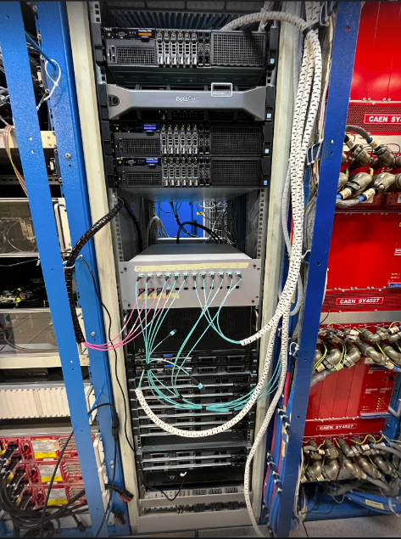
Prospective applications
CMS (CSN1)
L1T Scouting is a project aiming at acquiring the L1 primitives at the full bunch crossing rate
It is meant for HL-LHC but a demonstrator based on commercial electronic is already deployed
At present as DAQ link it adopts a light version of the TCP/IP protocol at 100G

Slide 12
Research group
Padova
Marco Bellato (0.1)
Antonio Bergnoli (0.2)
Gabriele Bortolato (0.3)
Daniele Mengoni (0.15)
Matteo Migliorini (0.3)
Fabio Montecassiano (0.2)
Jacopo Pazzini (0.15)
Andrea Triossi (0.3)
Marco Zanetti (0.1)
LNL
Damiano Bortolato (0.15)
Total FTE: 1.95

Slide 13
Project organization
Two working package
WP1 Front-end firmware core
WP2 Application layer and emulation
Four milestones
31 Dec 2023 M1.1 Setting up of a global-oriented simulation environment for a small appliance of the RoCE stack (WP1)
31 Dec 2023 M1.2 Testing a RoCE network based on COTS products (WP2)
31 Dec 2024 M2 Complete test of the scalable RoCE firmware stack for front-end (WP1+WP2)
31 Dec 2025 M3 Complete test of the developed firmware on a radiation tolerant front-end FPGA (WP1+WP2)
DONE
DONE
ON TRACK

Slide 14
Richiesta finanziaria
La parte di apparati è dettagliata come segue:
2025 1x GPU NVIDIA 10kE

Slide 15
Backup

Slide 16
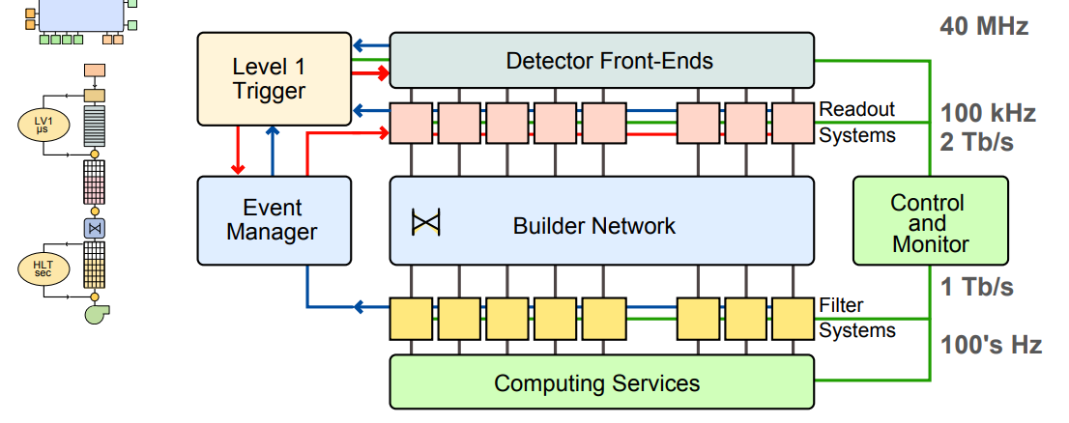
Methodology
For instance, two levels CMS TDAQ system
Several layers of hardware (FE, BE, Read out units, Event manager, Filter units)

Slide 17
Methodology
RDMA+Ethernet (RoCE) would simplify
Cost reduction -> no need of custom back-end electronics
Scalability -> add commercial switch
Commercial standard -> inherit of low-level software
Event Manager remains for scheduling the RDMAs to the available servers of the HLT and distributing the load

Slide 18
FW activities
Commercial RoCE cores don’t fulfill our requirements
Large footprint -> mono direction, only one transfer type (send)
Large memory for retransmission -> private network, reliable UDP
Development of the firmware block needed by a RoCE endpoint
Small appliance of RoCE stack
Small scale FPGAs
No external memory or soft-core processor
Setup a global-oriented simulation environment
Language heterogeneity
Dynamic simulation (next slide)
Test of the RoCE stack on evaluation platform
Capability of scale down the datapath
100GbE/10GbE/1GbE
Many small distributed endpoints
Commercial switch port aggregation
Porting the front-end RoCE core to flash-based FPGA (radiation environment)
No technology dependent IPs or proprietary compilation tools

Slide 19
Injection of live traffic into digital simulator
Works only on Linux machines
Tun/Tap based
Tap is a raw ethernet interface into user space
The method uses DPI-C interface of SystemVerilog
Imports C++ classed into SystemVerilog
Exports SystemVerilog tasks into C++ programs
A C++ program opens Tap interface and passes raw ethernet input packet to SystemVerilog testbench
SystemVerilog testbench passes raw ethernet output packets to C++ program
A client program reads and writes to Tap interface
HDL simulator
Application
Transport
Transport
Network
Ethernet
frames
Network
Data Link
TAP
Data Link
Physical
Physical

Slide 20
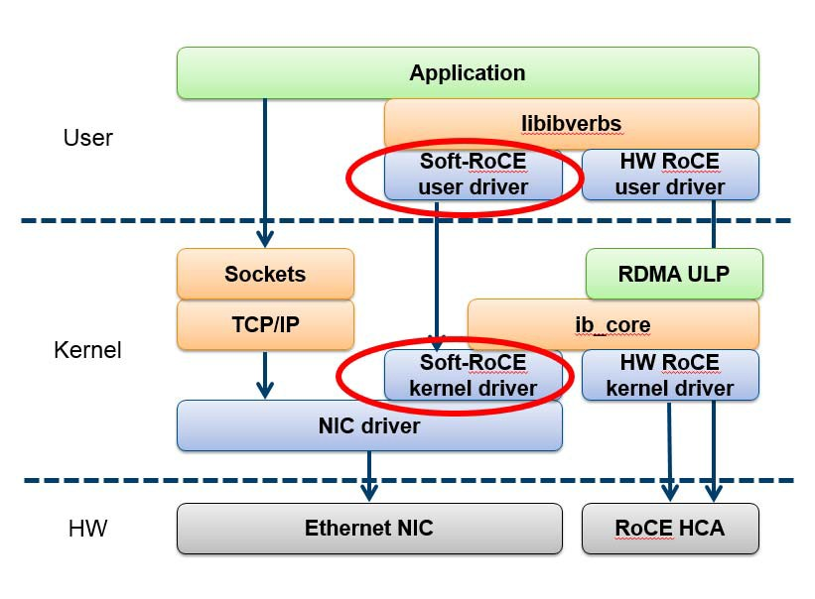
Networking activities
MEMORY
FE DEVICES
PCIe
Real-time processing of streaming data from FE devices with zero-copy access to memory
Unburdening CPU by serving data directly to GPU memory
RDMA to GPU (GPUDirect)
Enabling CUDA-based applications on front-end data
Expected activities
Emulating the RoCE transport in SW (via Soft-RoCE drivers) to enable testing of RDMA over Ethernet-enabled servers before the RoCE networking HW procurement
Deployment of networking hardware devices and qualification of the infrastructure in terms of throughput, latency and congestion avoidance
Test the commercial-available SW to move and control the data flow from RoCE to GPU
MEMORY
FE DEVICES
PCIe

Slide 21
Project organization
G. Bortolato
Two working package
WP1 Front-end firmware core
WP2 Application layer and emulation
Four milestones
31 Dec 2023 M1.1 Setting up of a global-oriented simulation environment for a small appliance of the RoCE stack (WP1)
31 Dec 2023 M1.2 Testing a RoCE network based on COTS products (WP2)
31 Dec 2024 M2 Complete test of the scalable RoCE firmware stack for front-end (WP1+WP2)
31 Dec 2025 M3 Complete test of the developed firmware on a radiation tolerant front-end FPGA (WP1+WP2)

Slide 22
G. Bortolato

Slide 23
G. Bortolato

Slide 24
G. Bortolato

Slide 25
G. Bortolato

Slide 26
G. Bortolato

Slide 27
G. Bortolato

Slide 28
G. Bortolato

