Slide 1

CUPRUM-TTD (2023-25)
Planned activities and Budget Requests 2025
^{67/64}CU PRoduction and Use in Medicine – Target Technology Development

Slide 2
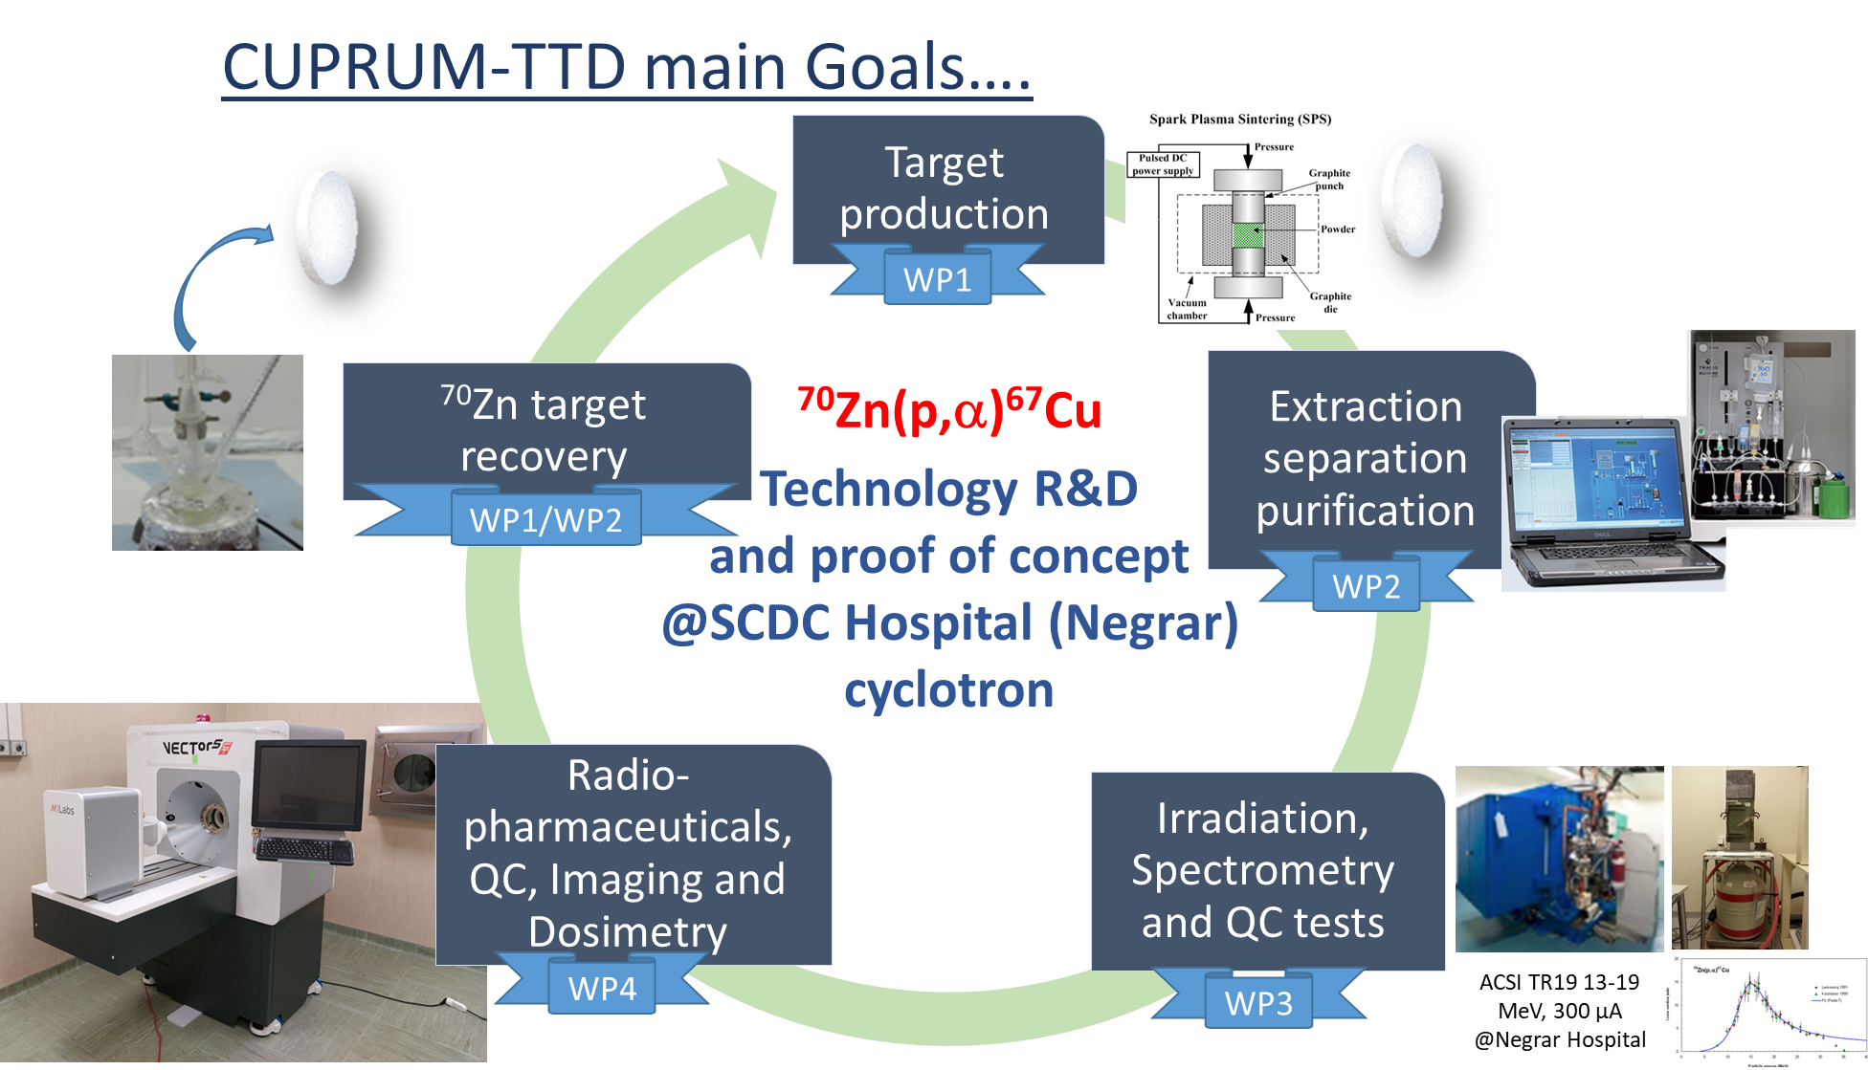
CUPRUM-TTD (2023-2025) main project goals
To develop a reliable technology aimed at producing clinical-grade batches of ⁶⁷Cu- ⁶⁴Cu by small medical cyclotrons on a routine basis.
to acquire a robust and reliable target manufacturing technology to produce ⁷⁰ZnO target
to manufacture targets able to sustain beam power levels from medical cyclotrons (i.e. 18-20 MeV, 2/3 kW max);
to develop/optimize the radiochemistry separation/purification methods: Zn→Cu to achieve a clinical-grade ⁶⁷Cu radionuclide;
in-vitro cells studies with ⁶⁷Cu-labelleded RPs using NOTA derivate as chelating agent;
phantom imaging studies of produced ⁶⁷Cu with pre-clinical and clinical SPECT;
to develop/optimize technology for the costly ⁷⁰Zn-enriched target material recovery.
CT-SPECT-PET

Slide 3
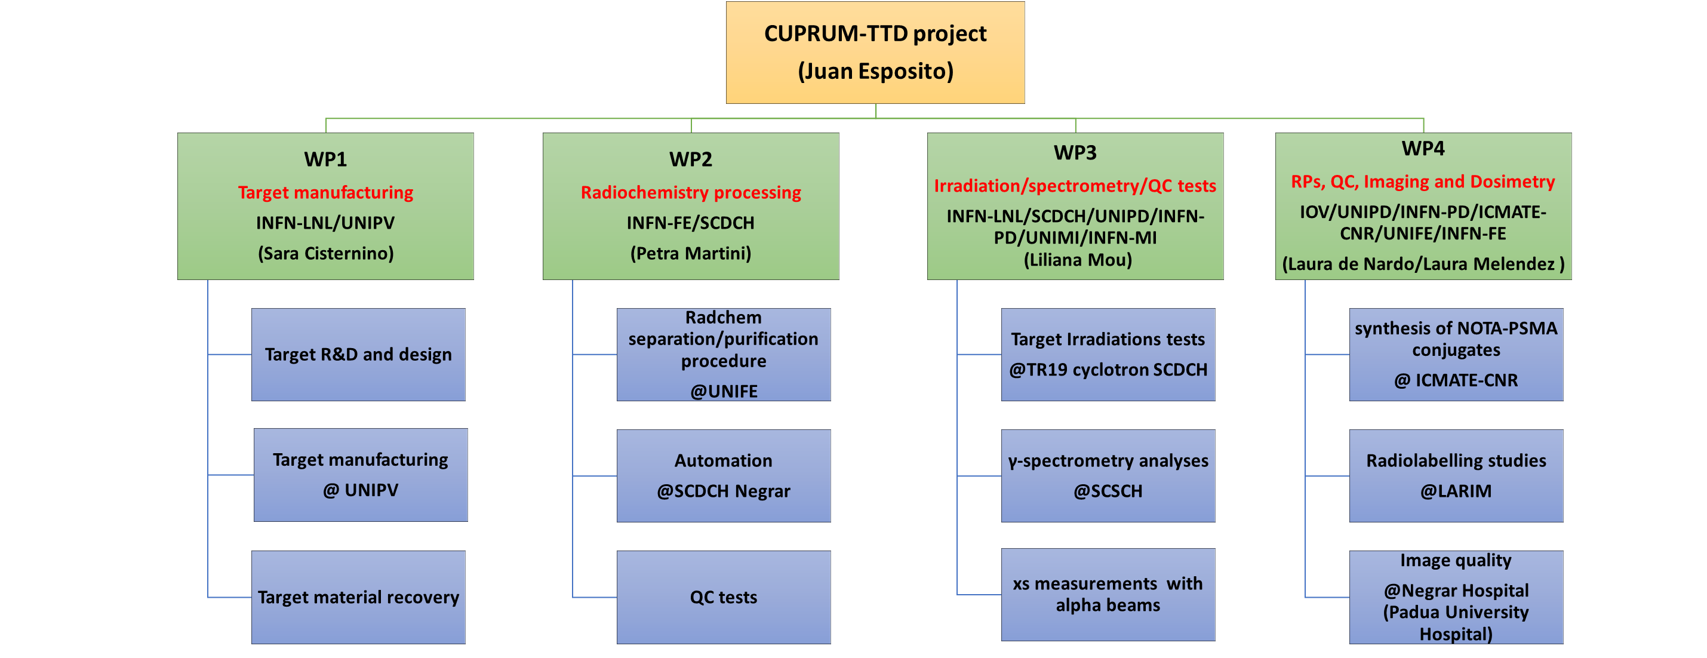
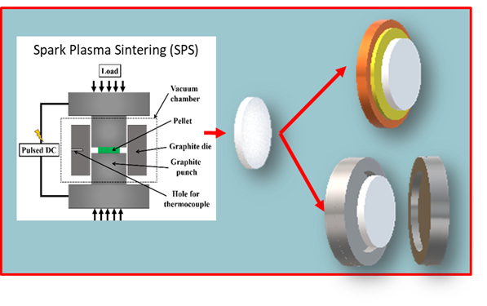
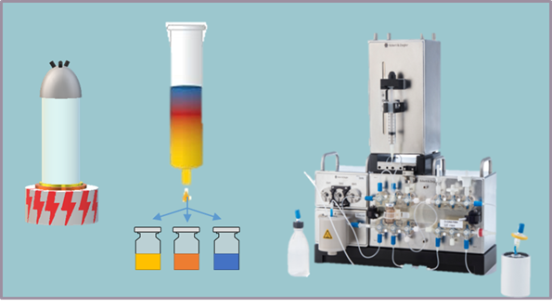
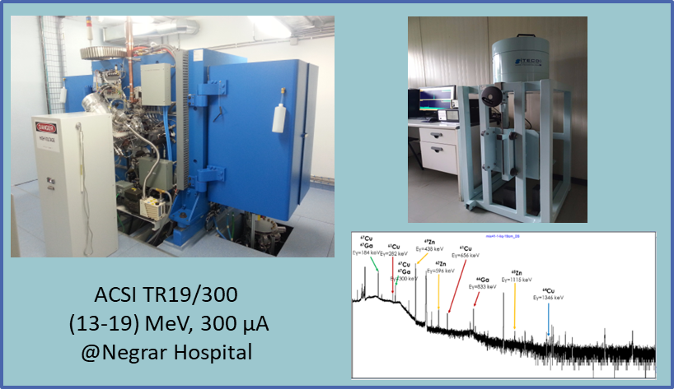
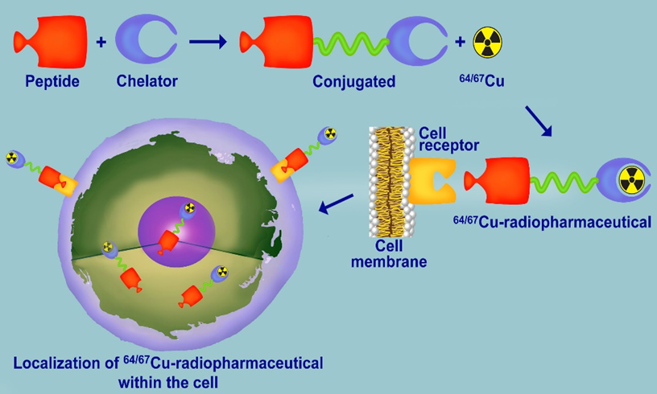
CUPRUM-TTD project organization
CUPRUM-TTD project is organized in Work Packages (WP),interacting each-other in a synergic way
WP3
Liliana Mou | LNL
Gaia Pupillo
Juan Esposito | UNIFE INFN-Fe
Emiliano Cazzola | HSCDC
Giancarlo Gorgoni
Luciano Canton | UNIPD INFN-PD
Francesca Barbaro
Lucia De Dominicis
Flavia Groppi | UNIMI INFN-MI
Simone Manenti
Fiorella M. Cagnetta
Michele Colucci
WP1
Sara Cisternino | LNL
Juan Esposito | UNIFE INFN-Fe
Alisa Kotliarenko
Giorgio Keppel | Osp. SCDC
Umberto A. Tamburini | UNIPV
WP4
Laura De Nardo/ Laura Melendez-A. | INFN-PD IOV
Alessandra Zorz | IOV
Marta Paiusco
Michele Bello | UNIPD INFN-PD
Diego Cecchin
Cristina Bolzati | ICMATE CNR
Giov. Di Domenico | UNIFE INFN-Fe
Angelo Taibi
WP2
Petra Martini | INFN-FE UNIFE
Alessandra Boschi
Francesca Porto
Teresa Ghirardi | UNIFE INFN-Fe
Licia Uccelli
Lorenza Marvelli
Emiliano Cazzola | HSCDC
Giancoarlo Gorgoni

Slide 4
CUPRUM-TTD Timetable and milestones planned
First 18 months activities

Slide 5
Resume on R&D activities performed (as of June 2024)

Slide 6
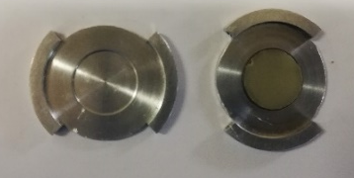
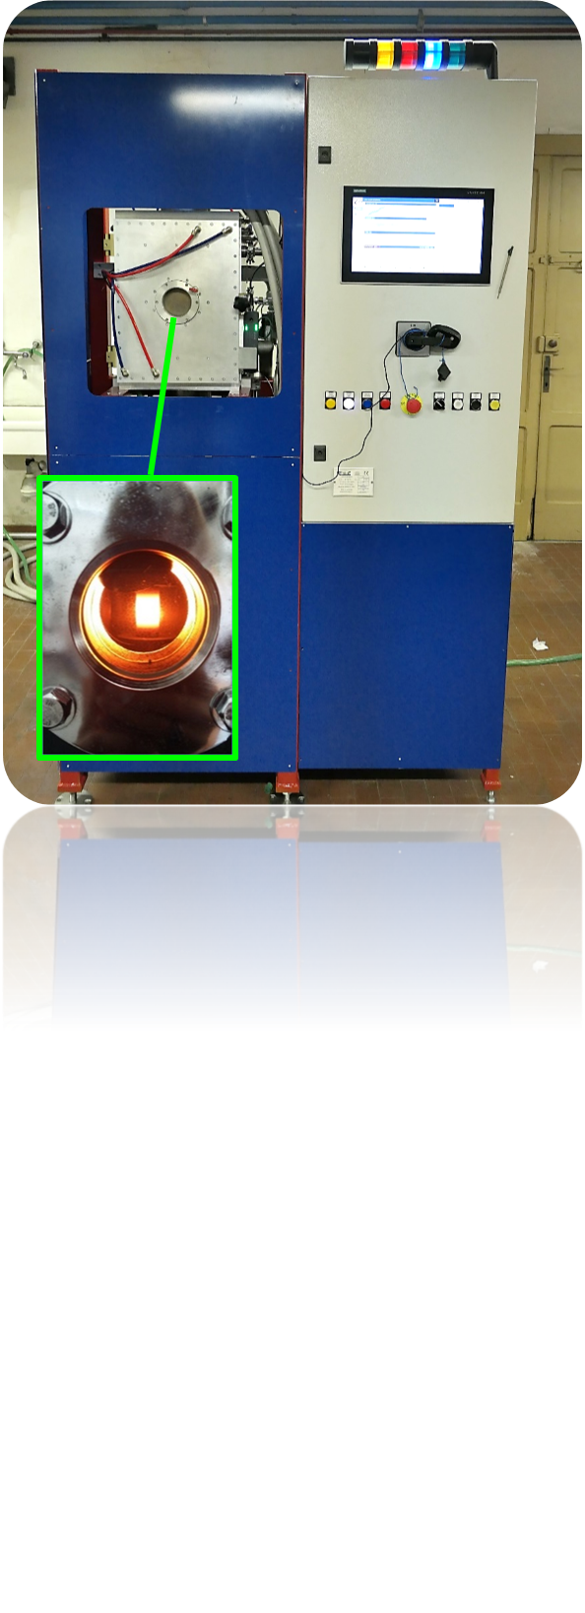
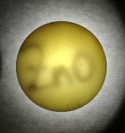
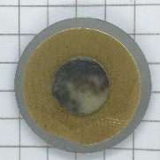
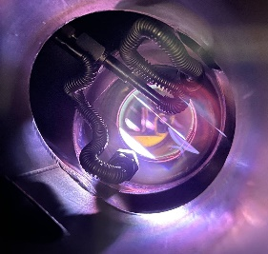

CUPRUM-TTD WP1 (LNL+FE): Target manufacturing, characterization, and material recovery
D1: no. 2-3 ZnO targets for surface analyses investigations (WP2); D2: no. 5 ZnO targets for cold test chemical processing optimization (WP2); D3: 3 ⁷⁰ZnO targets for production test; D4: recovered ^{nat}ZnO powders.
Main activities
Target manufacturing:
Final Target material
2.0 g [⁷⁰Zn]ZnO-enriched material already purchased (~ 20$/mg) –
1 target 500 mg → ~ 4 targets manufacturing
WP1
Sara Cisternino | LNL
Juan Esposito
Alisa Kotliarenko
Gaja Piteo | UNIPD/LNL
U. Anselmi-Tamburini | UNIPV
Petra Martini | UNIFE
Alessandra Boschi
Francesca Porto
Giorgia Speltri
Lorenza Marvelli
SPS technique
Sintering of ZnO powder → pellet in a holder for irradiation
Sintering of ZnO powder and target system investigation (ZnO/Au/Nb)
@ Pavia (S. Cisternino and G. Piteo)
Optimization of ZnO pellet sintering
ZnO powder and pellets to Ferrara University for chemistry and recovery studies (WP2)
ZnO pellets for irradiation with the capsule & composite target (WP3)
ZnO – baking adhesion trials
@ LNL/UNIPD (S. Cisternino, A. Kotliarenko, G. Piteo)
SEM, XRD analysis and heat treatments for residual carbon removal
Magnetron Sputtering technique
- Investigation of thick ZnO deposition onto different substrates (Au/Nb – DLC)
Suspended activities because SPS technique is more promising at this stage of the project
A. Kotliarenko et al., First Results on Zinc Oxide Thick Film Deposition by Inverted Magnetron Sputtering for Cyclotron Solid Targets Production. Materials, 16, 10, 3810, 2023. DOI: 10.3390/ma16103810
Activities shared with WP2
Target recovery and recycling in collaboration with WP2

Slide 7
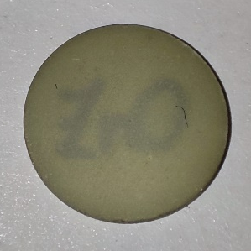

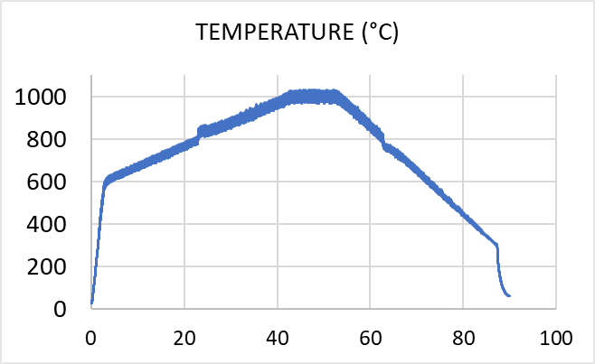
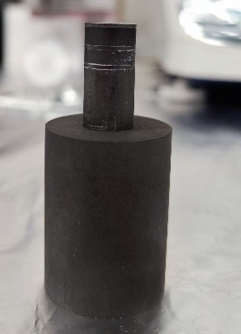
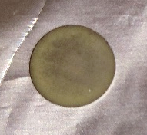


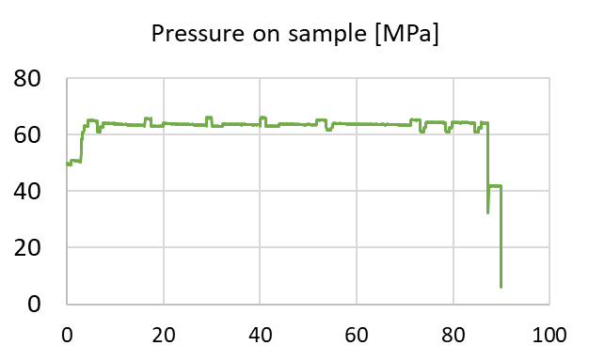
CUPRUM-TTD WP1 (LNL): ^{nat}ZnO pellets SPS R&D program underway
N of EXP | Mass [mg] | SPS parameters |  |  |  |  |  | Results
N of EXP | Mass [mg] | step | Temp. [°C] | Force [kN] | Pressure on sample [MPa] | Time [min] | Heating rate [°C/min] | mass after [mg] | mass lost [mg] | thickness [µm] | density [g/cm3] | %bulk density
(n=41) | 263.9 ± 5.9 | 1 | 600 | 4 | 51 | 0,1 | 200 | 255.9 ± 10.4 | 8.0 ± 7.8 | 612.4 ± 23.1 | 5.3 ± 0.1 | 95.0 ± 2.1
 |  | 2 | 1000/850 | 5 | 64 | 10 | 10
 |  | 3 | 300 | 5 | 64 | 0,1 | 20
(n=3) | 267.5± 1.2 | 1 | 600 | 4 | 51 | 0,1 | 200 | 261.7± 0.6 | 5.7± 1.0 | 626.8± 2.0 | 5.3± 0.0 | 94.8± 0.2
 |  | 2 | 850 | 5 | 64 | 10 | 10
 |  | 3 | 300 | 5 | 64 | 0,1 | 20
Reproducible Exp
Sintering of 3 pellets at once (in series)
Cross-section view
TOP
CENTRAL
BOTTOM
1 cm
1 cm
1 cm
Density [g/cm³] / % bulk (n=5) | 5.31±0.09 / 94.7±1.6% | 5.35±0.08 / 95.3±1.4% | 5.29±0.09 / 94.4±1.6%
Mass densities and the microstructure are compared to the one-pellet-sintered

Slide 8
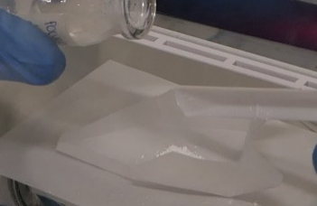
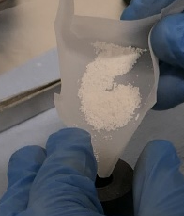

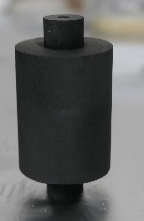
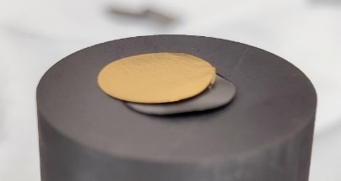
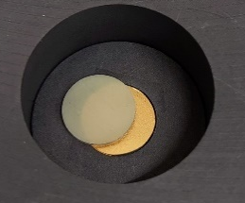
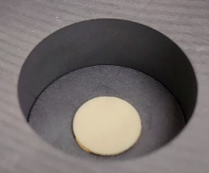
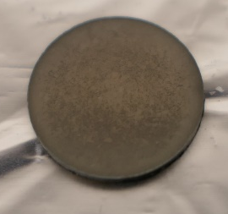
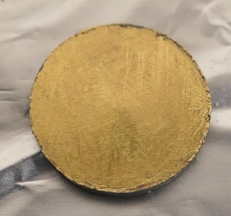

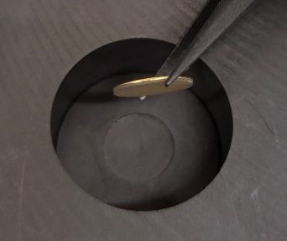
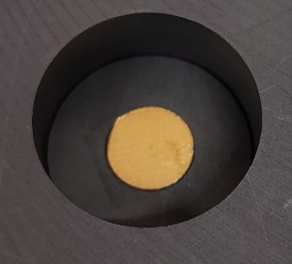
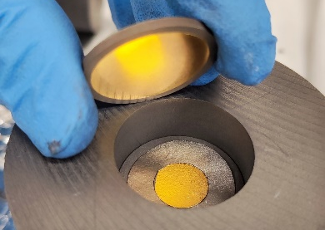
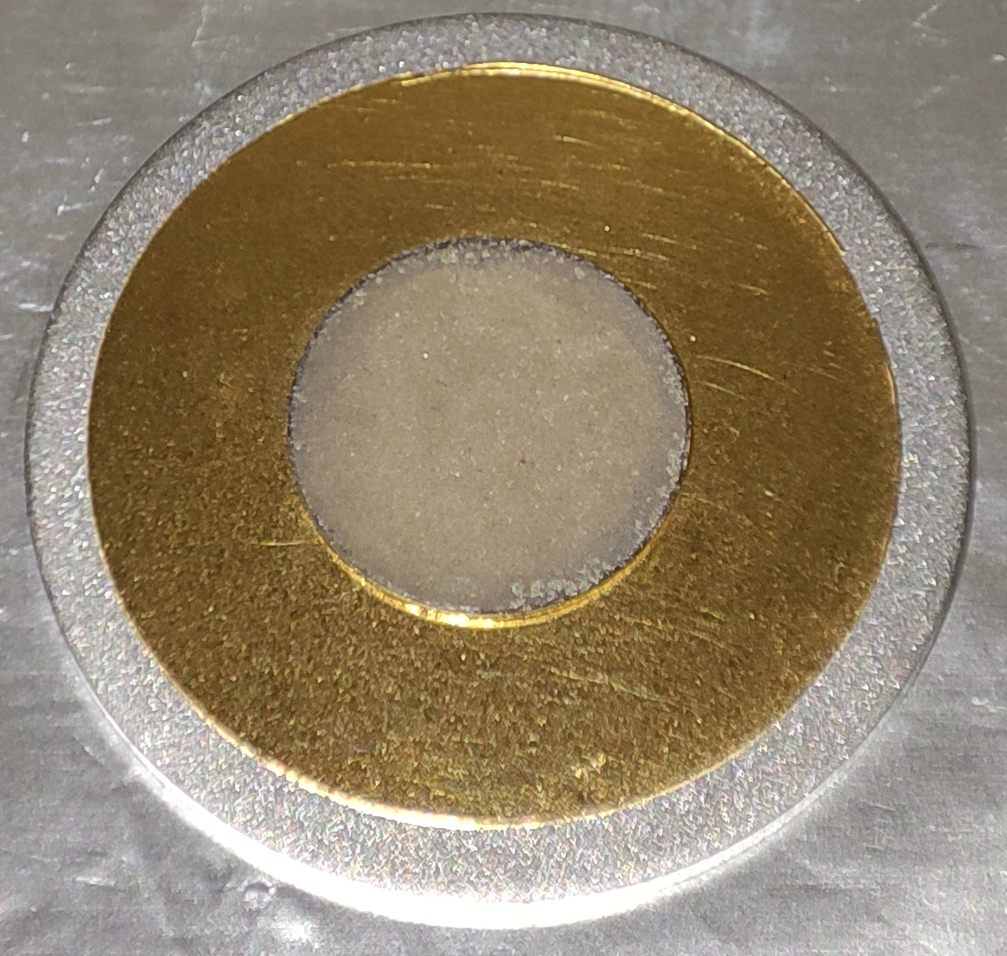
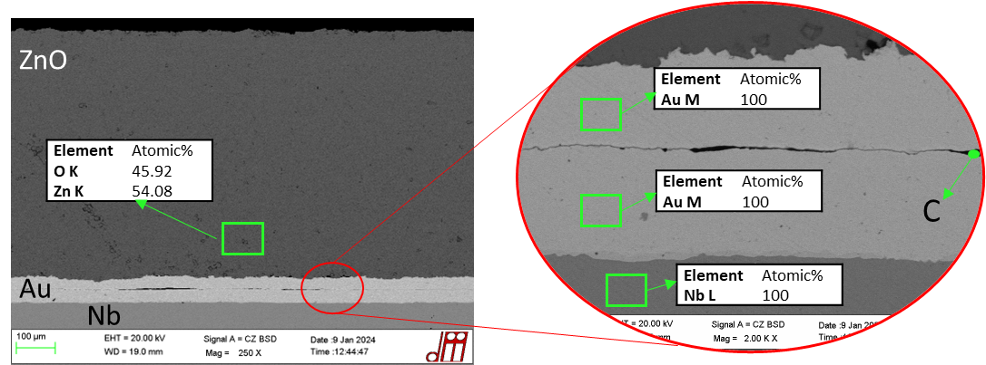

CUPRUM-TTD WP1 (LNL):
New target configuration - ZnO pellet bonding to backing (Au/Nb) by SPS
SEM cross section of pellet
1.
ZnO pellet preparation
2.
Au-foil-layered ZnO pellet
ZnO
1+2 in one sintering process (3 sample simultaneously)
SEM cross section of target
3.
Adhesion of ZnO-Au to backing (Au-Nb)
#9 targets from ZnO commercial powder were already realized and tested under irradiation and used for radiochemical processes

Slide 9
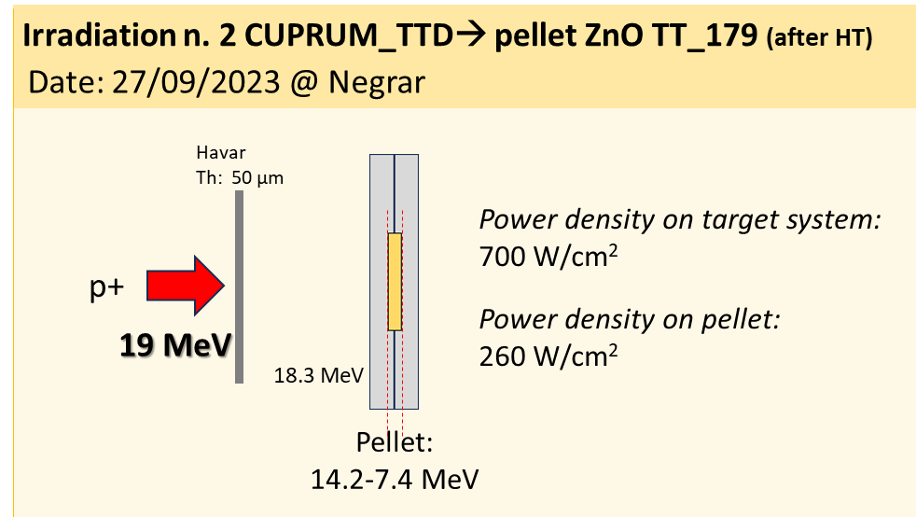
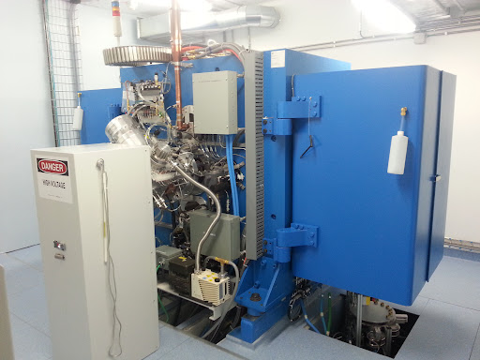
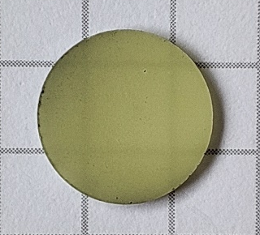
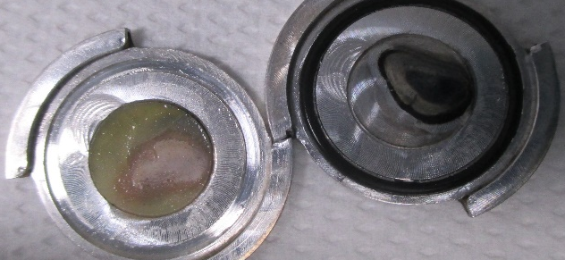
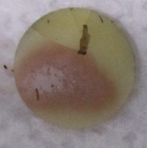


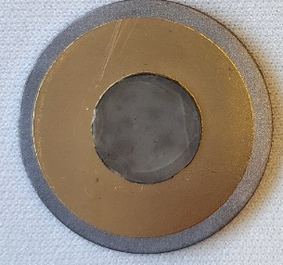
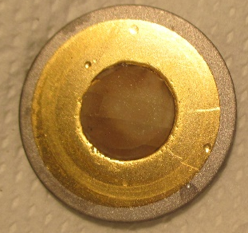

CUPRUM-TTD WP1 (LNL+FE): Irradiations for thermomechanical test
#2 irradiations 15-30 µA; 19 MeV; 5 min
@ ACSI TR19/300 Sacro Cuore Don Calabria Hospital cyclotron
Pellet in Al holder configuration:
Prior irradiation
Prior irradiation
After irradiation
Main considerations
- Not easy to open the capsule
- The pellet is attached to the capsule;
- Energy on pellet 14 MeV, not optimal for ⁶⁷Cu production
System suitable when low radioactivity batches are needed for research purposes
ZnO-Au/Au-Nb configuration
Targets manufactured by SPS LARAMED technology withstand the maximum proton beam current intensity available at SCDCH cyclotron (solid target station available)
Several irradiation and radiochemistry dissolution/separation/purification tests were performed based upon this target configuration
#4 irradiations 15-25-35-50 µA; 19 MeV; 5 min
Max beam power areal density achieved = 1.2 kW/cm²
Prior irradiation
After irradiation

Slide 10

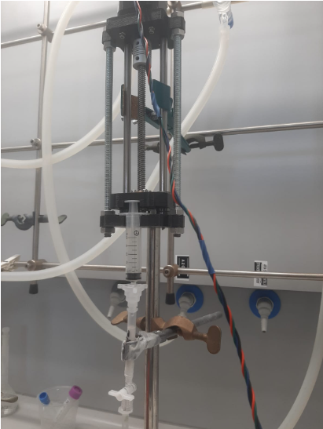
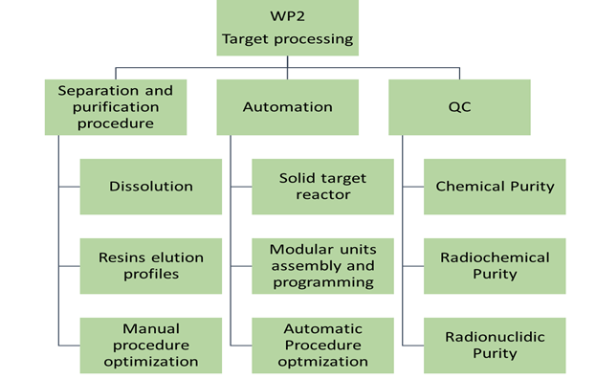
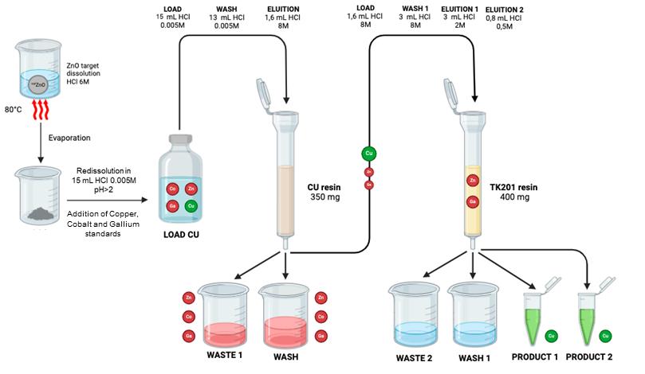
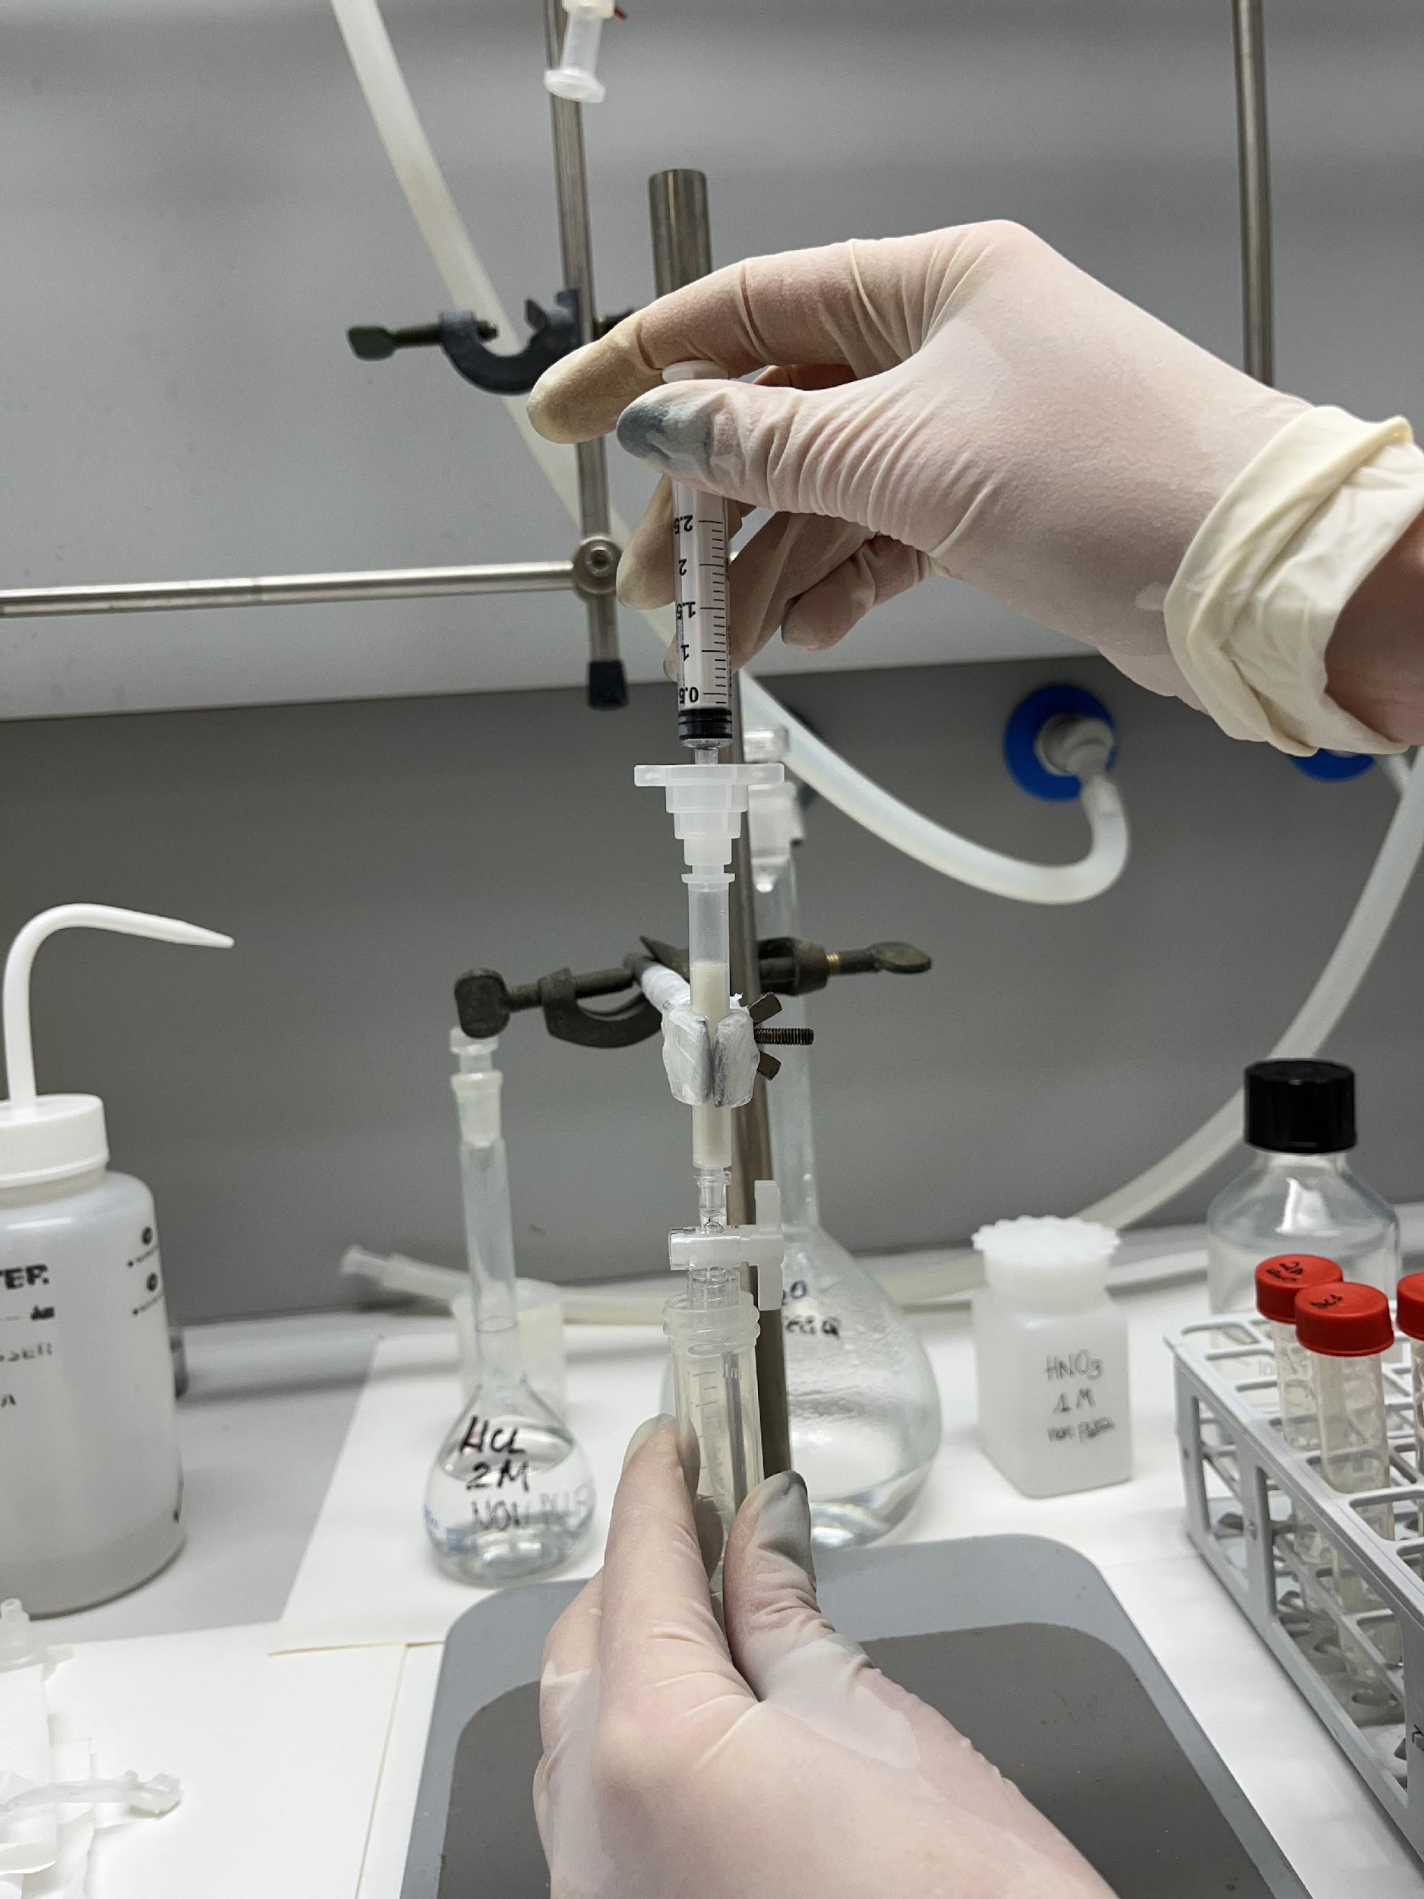
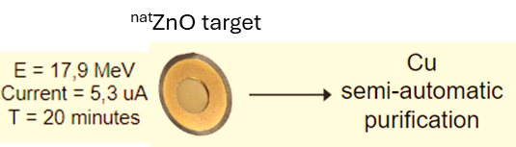
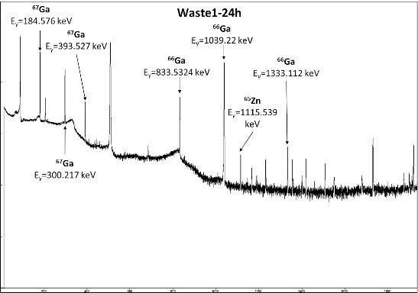
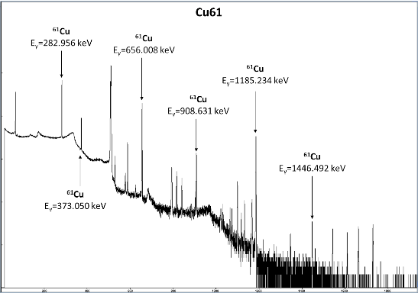
CUPRUM-TTD WP2 (FE): Target radiochemistry processing
D5: Zn/Cu separation and purification procedure D6: semi-automatic module for the separation and purification of ⁶⁷Cu from ZnO target D7: ⁶⁷Cu radiochemistry product quality assessment
Cold tests for protocol optimization
ICP-MS analysis revealed that in the final product Ga, Co and Zn content is below the instrumental detection limit.
Recovery yield >98% (reproducibility tests are ongoing)
Hot test for validation and SEMI-automation
WP2
Petra Martini | INFN-FE UNIFE
Alessandra Boschi
Francesca Porto | UNIFE INFN-Fe
Licia Uccelli
Lorenza Marvelli
Giorgia Speltri
Emiliano Cazzola | HSCDC
WASTE
PRODUCT
γ-spectrometry analysis revealed that in the final product no Ga, Co and Zn radioisotopes are present
Difficulties in the automation and reproducibility of the results due to old and incomplete module (valves not working properly, no gas/air flow control, no pressure control, syringe pumps not calibrated etc….)
  NOT SUITABLE FOR ENRICHED TARGET PROCESSING TEST
Recovery yield ongoing determination
First γ spectra obtained @SCDCH

Slide 11
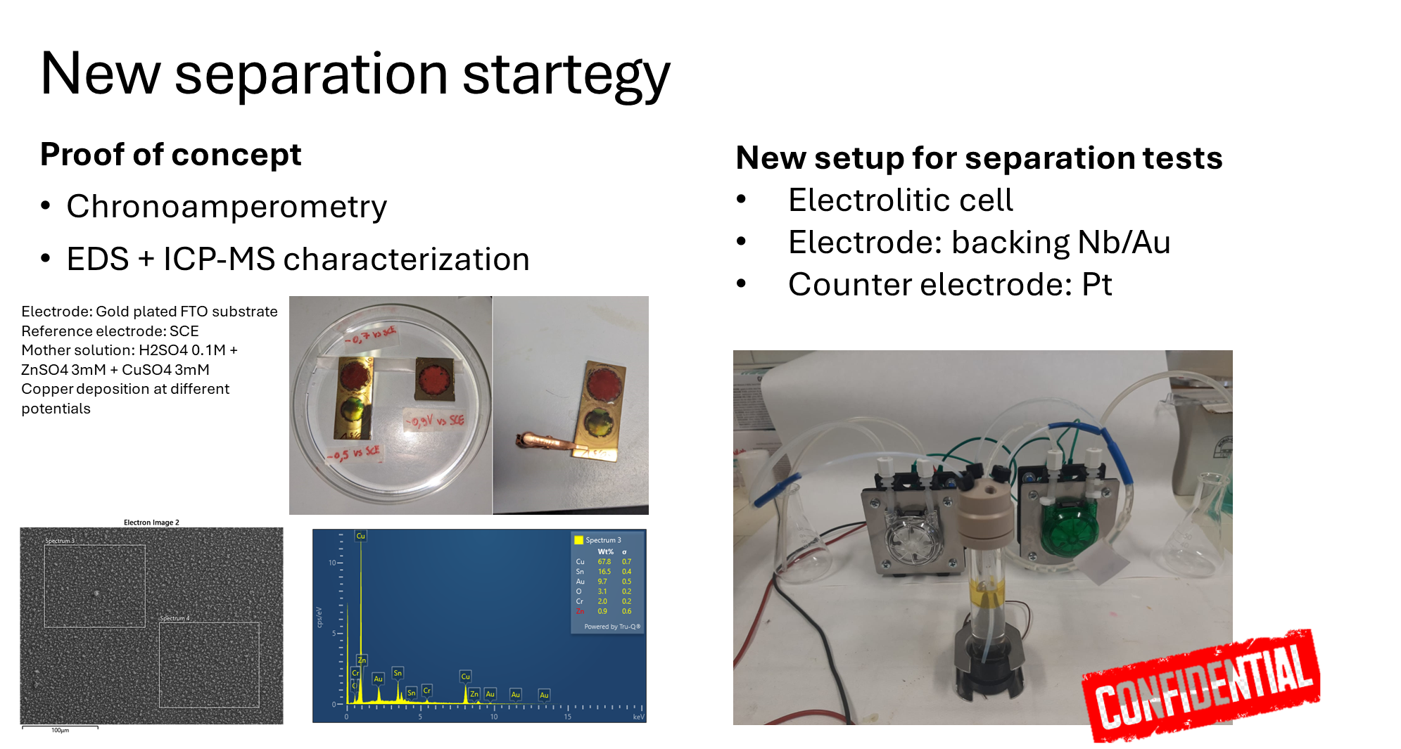
CUPRUM-TTD WP2 (FE): Target radiochemistry processing
D5: Zn/Cu separation and purification procedure D6: semi-automatic module for the separation and purification of ⁶⁷Cu from ZnO target D7: ⁶⁷Cu radiochemistry product quality assessment
strategy
WP2
Petra Martini | INFN-FE UNIFE
Alessandra Boschi
Francesca Porto | UNIFE INFN-Fe
Licia Uccelli
Lorenza Marvelli
Giorgia Speltri
Emiliano Cazzola | HSCDC

Slide 12
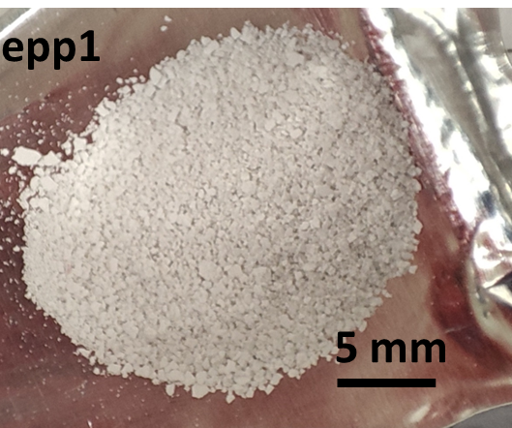
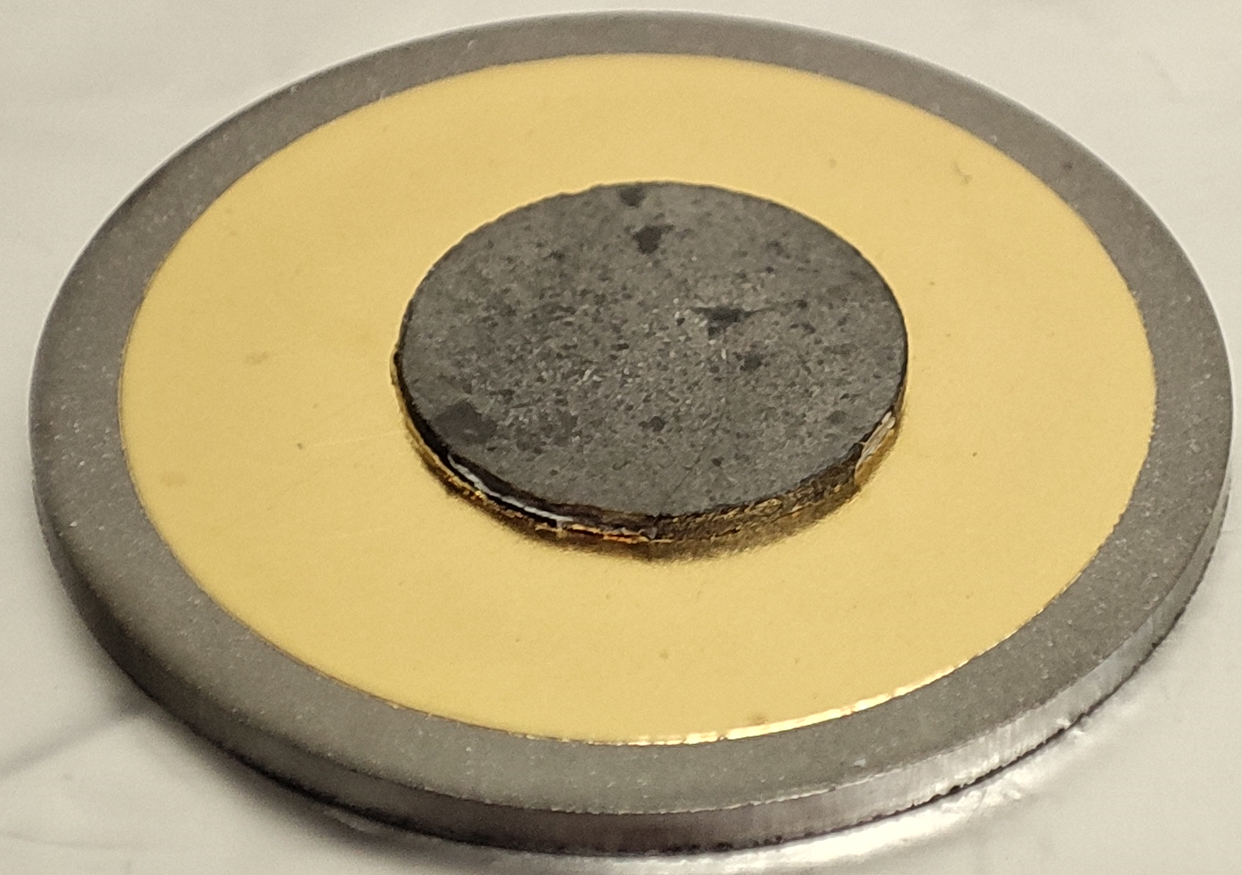
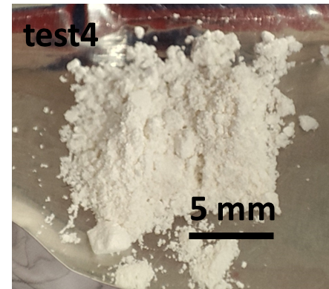
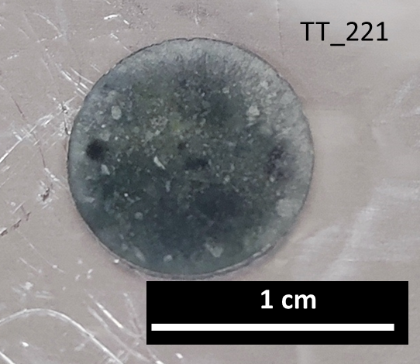
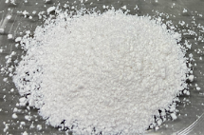
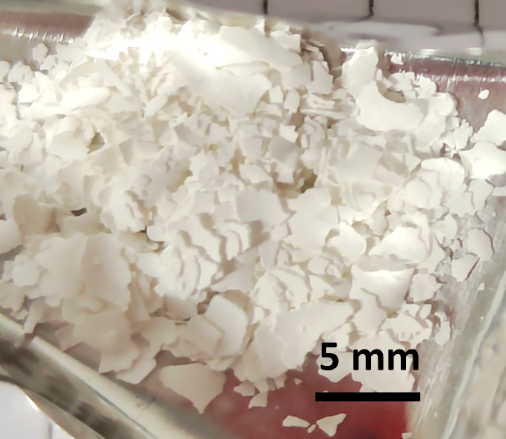








CUPRUM-TTD WP2 →support to WP1 (LNL+FE):
ZnO recovery processes – closing the Zn target material cycle
WP1 and WP2
ZnO recovery process steps performed in different conditions:
- Dissolution of pellet or powder in HCl or use of eluate from radiochemistry process
- Precipitation with NaOH at different temperatures
- Evaporation and final calcination
Optimization experiments and analysis of powders and targets still ongoing…
First results:
Sample 212
Cold dissolution planned for SEM analysis
at 25°C
(from pellet)
at 18°C
(from pellet)
SEM analyses ongoing
ZnO pellet density ~ 95%
ZnO pellet density ~ 95%
at 0°C
(from powder)
Flakes→ evaporation condition to be optimized
at 0°C (from pellet)
Modified evaporation protocol
Sample 247
irradiation and radiochemical purification planned
Recovery yield 84.8%±3.6%
ZnO pellet density ~ 84%
at 0°C
at 0°C
Sample 268
irradiation and radiochemical purification planned
From Zn-rich eluate from radiochemical separation protocol (from powder)
Starting material: Zn-rich eluate from radiochemical separation protocol (from pellet)→ simulation of real exp
Recovery yield 99%
ZnO pellet density ~ 55%
Recovery yield → to be optimized
ZnO pellet density ~ 65%

Slide 13




CUPRUM-TTD WP3 (LNL-MI-PD): Irradiation, γ-spectr. and QC test
WP3
Liliana Mou | LNL
Gaia Pupillo
Lucia De Dominicis | UNIFE INFN-Fe
Juan Esposito
Emiliano Cazzola | HSCDC
Giancarlo Gorgoni
Luciano Canton | UNIPD INFN-PD
Yuliia Lashko
Francesca Barbaro
Flavia Groppi | UNIMI INFN-MI
Simone Manenti
Fiorella M. Cagnetta
Michele Colucci
Irradiation runs on ^{nat}ZnO/^{nat}Ni for targets and related spectrometry measurements
selection of beam parameters suitable to yield small batches of ⁶⁷Cu/ ⁶⁴Cu based on theoretical calculations;
^{nat}-ZnO target irradiations for thermomechanical stability tests
3 irradiation runs on ⁷⁰ZnO for first batches of ⁶⁷Cu;
2-3 irradiations runs on ^{nat}Ni and ⁵⁹Co with alpha beams for ^{61,64,67}Cu optimization production (xs meas. @ARRONAX) UNIMI+INFN-Mi
2 irradiations runs on thick target of ⁶⁴Ni for TTY, RNP, SA det.
γ-spectrometry analysis for yield and RNP determination
Milestones and deliveries planned
M9: ^{nat}ZnO targets irradiation for thermomechanical stability tests M10: ^{nat}ZnO targets irradiations for radiochemical separation optimization procedure M11: γ-spectrometry meas. to determine radiochemical procedure efficiency (^{nat}Zn/^{nat}Ni targets) M12: 3 irradiations on ⁷⁰ZnO targets for ⁶⁷Cu batches production (2 irradiations on ⁶⁴Ni targets for ⁶⁴Cu). M13: γ-spectrometry meas. to determine the activity and RNP of ⁶⁷Cu produced by irradiation of ⁷⁰Zn targets M14 xs measurements for alternative nuclear reaction route with alpha beams ⁶⁴Ni(α,p)67Cu (energy range 30 – 15 MeV) as well as ⁵⁹Co(α,2n)⁶¹Cu
D8: RNP determination of the produced ⁶⁷Cu radionuclides from ⁷⁰ZnO/⁶⁴Ni D9: xs measurements determination with alpha beams for alternative ^{6x}Cu productions

Slide 14






CUPRUM-TTD WP3 (MI): Investigations on alternative nuclear reaction routes with alpha beams ⁵⁹Co(α,2n)⁶¹Cu
Four irradiation performed with α particles in the 14-59 MeV energy range at GIP ARRONAX.
Copper isotopes
Gamma spectrometry continued at LASA labs for 4/8 months after irradiations for long lived RN.
Other contaminants
TTY and RNP
determnation
Optimized parameters for 61Cu
Irradiation time: 7 h
α energy: 59 MeV
Energy losses: 44 MeV
TTY ⁶¹Cu = 1800 MBq/µA
RNP > 99% 4h after EOB
To do in 2024/2025

Slide 15


CUPRUM-TTD WP3 (PD): theoretical activities on alternative nuclear reaction routes to yield ⁶⁷Cu → ⁶⁸Zn(t,α)⁶⁷Cu
UniPD/INFN-PD
F. Barbaro
L. Canton
Y. Lashko
Started investigation of the triton production route: ⁶⁸Zn(t,α)⁶⁷Cu
Comparison with the “standard” production routes: ⁶⁸Zn(p,2p)⁶⁷Cu, ⁷⁰Zn(p,α)⁶⁷Cu
Bibliography study and data search
Started simulation analysis with Nuclear Reaction Codes Talys
Supervision of a master thesis on this topic

Slide 16






CUPRUM-TTD WP4 (PD-IOV-CNR-UNIFE): RP activities (Synthesis of new
Cu conjugates)
D10: NOTA-PSMA conjugates D11 A reproducible method to obtain Cu-PSMA RPs with high radiochemical yield D12: Minimum activity and dimension of the tumour to obtain good imaging
WP4
Laura De Nardo/ Laura Melendez-A. | INFN-PD IOV
Alessandra Zorz | IOV
Marta Paiusco
Michele Bello | UNIPD INFN-PD
Diego Cecchin
Cristina Bolzati | ICMATE CNR
Giov. Di Domenico | UNIFE INFN-Fe
Angelo Taibi
As the LARIM laboratory, built in the 1993, did not comply with current safety regulations on the use of experimental animals (2014) and on the use of radioactive material (2020), it was necessary to close it for ~ 1 year to be able to completely renovate it.
Both civil/electric renovation works are about to be completed.
The planned activity of synthesis of new conjugates (M15) will be started in the 4th quarter of 2024.

Slide 17
CUPRUM-TTD WP4 (PD-IOV-CNR-UNIFE): RP activities (Synthesis of new
Cu conjugates)
Feasibility of Radiopharmaceutical research studies within LNL→ LARIM (Padua Univ.)
LARIM is located close to SPES building.
Now under renewal of HVAC/Electric/safety plants (Dec. ’23 –July ’24)
Expected to re-start first operations (new instr. included) on Sept/Oct ‘24
HPLC instrumentation in the radiochemistry lab
Last-generation small animal scanner: MILABS Vector 5 CT
Set of phantoms with different geometries
Radiochemical and Biological hoods

Slide 18



CUPRUM-TTD WP4: Cellular dosimetry calculations
D10: NOTA-PSMA conjugates D11 A reproducible method to obtain Cu-PSMA RPs with high radiochemical yield D12: Minimum activity and dimension of the tumour to obtain good imaging
Input data required: specific uptake and internalization in PSMA-positive and -negative PCa cells.
MIRDCell calculations for ⁶⁷Cu and ⁶⁴Cu in spherical clusters of cells by assuming 100% subcellular distribution of radionuclides in Cytoplasm, Nucleus or Cell Surface provide preliminary information about dosimetric results to be obtained with a realistic distribution of RPs.
WP4
Laura De Nardo/ Laura Melendez-A. | INFN-PD IOV
Alessandra Zorz | IOV
Marta Paiusco
Diego Cecchin | UNIPD INFN-PD
Cristina Bolzati | ICMATE CNR
Giov. Di Domenico | UNIFE INFN-Fe
Angelo Taibi
%N, %Cy, %CS→N

Slide 19
CUPRUM-TTD project 2025 FTE (subject to further refinement)
Personnel and FTE distribution expected among units taking part
LNL | FTE | INFN-Fe | FTE | INFN-Mi | FTE
Esposito J. (R.Naz.-Loc.) | 0.50 | Martini P. (R. Loc) | 1.00 | Groppi F. (Res. Loc) | 0.40
Pupillo G. | 0.25 | Taibi A. | 0.10 | Manenti S. | 0.25
Mou L. | 0.20 | Di Domenico G. | 0.20 | Cagnetta F.M. | 0.45
Cisternino S. | 0.70 | Boschi A. | 1.00 | Colucci M.**** | 0.60
De Dominicis L. | 0.40 | Uccelli L. | 1.00 |  | 1.70
Melendez-Alafort L.** | 1.00 | Marvelli L. | 1.00
Bello M. | 0.80 | Porto F.* | 1.00
Piteo G. | 1.00 | Speltri G.* | 1.00
Anselmi-Tamburini U. | 0.20 |  | 6.30
Cazzola E. # | 1.00 |  |  | TOTALE FTE | 17.55
Gorgoni G.# | 1.00 | INFN-Pd | FTE
Cecchin D. § | 0.20 | De Nardo L. (R. Loc) | 0.80
 | 7.25 | Canton L. | 0.20
 |  | Barbaro F. | 0.60
 |  | Paiusco M. ** | 0.20
 |  | Zorz A. § | 0.20
 |  | Bolzati C.*** | 0.20
 |  | Lashko Y. | 0.10
 |  |  | 2.30
* studenti PhD associate INFN-Fe (da nov 2023)
** personale IOV associato LNL
*** personale CNR associato INFN-Pd
**** studente PhD associato INFN-MI
§ personale UNIPD associato INFN-LNL
# personale SCDCH associato INFN-LNL

Slide 20
Summary overall budget request CUPRUM-TTD FY2025
Sezioni / Lab | Missioni | Consumo/ Altri consumo | Trasporti | Manutenzione | Inventario | apparati | Sp- servizi | Tot. per sez/lab | FTE previsto
LNL | 7,0 | 10,0 | 0,0 | 0,0 | 0,0??? | 0,0 | 0,0??? | 17,0 | 7.25
FE | 4,0 | 15,0 | 2,0 | 0,0 | 17,0 | 0,0 | 0,0 | 38,0 | 6.30
PD | 1,0 | 7,0 | 0,0 | 0,0 | 0,0 | 0,0 | 0,0 | 8.0 | 2.30
MI | 8,5 | 8,0 | 8,5 | 4,0 | 0,0 | 0,0 | 0,0 | 29,0 | 1.70
TOTALE | 20.5 | 40.0 | 10.5 | 4.0 | 17.0 | 0.0 | 0.0 | 92.0 | 17.55
*Consumables: Solvents for HPLC analysis, reagents for stability test, buffers and cell culture media, Sep-Pack cartridges for radiopharmaceutical purification, plastic and glassware (4Keuro).
64Cu to radiolabel the developed Radiopharmaceuticals (2x10mCi) (3keuro)

Slide 21


Further developments or applications
  SPES-MED (Gr III, 2024-26)
  Nuclear cross section measurements
  ⁶⁸Zn,⁷⁰Zn(p,x)⁶⁷Cu,⁶⁴Cu for proton beams with energy higher than 70 MeV, in collaboration with the i-Themba facility (LNL team, 1 and 2 year);
  ⁷⁰Zn(p,x)⁶⁷Cu,⁶⁴Cu in the energy range 25-50 MeV at SPES (LNL team, 3 year)
  DECURTA DEvelopment of 67Cu-Radiopharmaceuticals for Theranostic of prostate cAncer (Bando IOV Ricercatori Sanitari 2023) PI Laura Alafort Melendez
[Pupillo, G. et al. Radiochim. Acta 108, 593–602 (2020)]

