Slide 1
TIMEPIX4 – nuova sigla
G.Collazuol
INFN Padova
CdS 2024/7/5
Acronym: TIMEPIX4 Project duration: 3 years (2025, 2026, 2027) Research area: Interdisciplinary / Detectors Principal Investigator: Massimiliano Fiorini (INFN Sezione di Ferrara) Participating Units: Ferrara, Laboratori Nazionali del Sud, Napoli, Padova, Pisa, Trieste Ambito: : DRD4 - WG1 (Gaseous) / WP2 (Vacuum Based) Aims: exploiting TIMEPIX4 chip => to develop detector systems beyond State-of-the-Art
Applications:
Ultra-fast, high granularity MCP based photon detector => HEP
X-ray, gamma ray and particle imaging w/ semiconductors => Medical Physics
Photons detection and Tracking and w/ gas detectors => Padova proposal
Gruppo Padova-Trieste (gas/photon detectors)
Staff: G.Collazuol, S.Levorato, F.Tessarotto (INFN-TS)
Post-Doc: D.D’Ago, D.Henaff
Dottorandi: M.Feltre, M.Mattiazzi
TIMEPIX4
Notes:
1

Slide 2
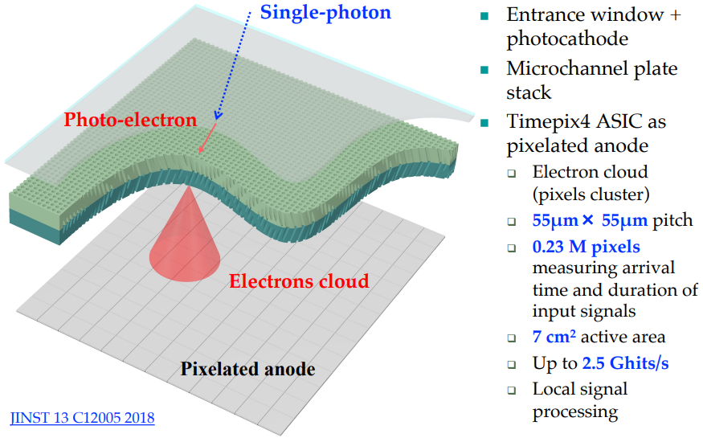
Hybrid vacuum photon detector - MCP / TIMEPIX4
TIMEPIX4

Slide 3
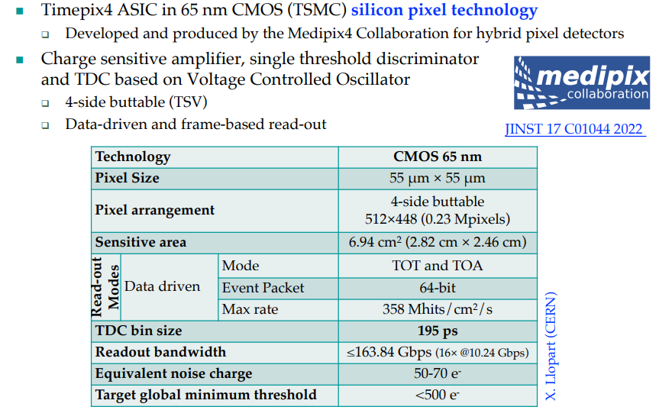
INFN access to TIMEPIX4 – MEDIPIX collaboration
TIMEPIX4

Slide 4
Padova Interests & contribution
TIMEPIX4
Aim
study of both Optical and Charge readouts with internal multiplication
based on resistive and capacitive micro-pattern gas detectors (MPGD)
Target sensitivity spectrum of the optical readout => VUV and DUV light
Target sensitivity for primary charge readout => single electron
Methods
Coupling MicroMegas resistive embedded Anode (Resistive layer, eg DLC) with TIMEPIX4
Couping nano-diamond / DLC photo-cathodes to ERAM
Applications
detailed gas detector studies
Micro-imaging detectors (tracks & x-rays)
new robust x-ray & VUV & DUV gas-based detector

Slide 5
ERAMs used for the new TPC of T2K
ERAMs are built at CERN MPGD Lab
TIMEPIX4

Slide 6
TIMEPIX4

Slide 7
TIMEPIX4

Slide 8
TIMEPIX4

Slide 9
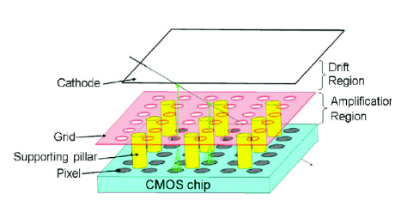
Coupling ERAMs + TIMEPIX4 chip = ERAPIX
Applications
very fine grained tracker
and X ray detector
Resistive layer (DLC)
Insulating layer
Key points addressed (simulation and measurements) by TIMEPIX4
Choice of Diamond-Like-Carbon (DLC) resistivity
and thickness of insulator layer (between pads and DLC)
R x C => charge spread velocity
Geometry and dimension of grid/mesh with respect to pad
Geometry in order to avoid Moire`- like effect
➔ Build prototype
TIMEPIX4

Slide 13
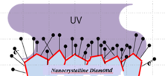
Coupling H-ND cathode + ERAMs + TIMEPIX4 chip
Applications
very fine grained photo-det
VUV-DUV imaging
Photo
Cathode
Resistive layer (DLC)
Insulating layer
Key points addressed (simulation and measurements) by TIMEPIX4
behavior of the hydrog. nano-diamond photo-cathode withT2K gas
study HV configuration and detector geometry for optimizing photo-electron collection and drift
➔ Build prototype
TIMEPIX4

Slide 14
TIMEPIX4 – WP2 timeline and milestones
TIMEPIX4

Slide 15
Resources @ INFN Padova
TIMEPIX4
FTE Padova 2024/7 => 100%
G.Collazuol 10 %
S.Levorato 5 %
F.Tessarotto 5 %
D.Henaff 20 %
D.D’Ago 30%
M.Feltre 30%
Preventivi 2025
Consumo per circa 15kEuro
Missioni (CERN) per 4kEuro
Richieste 2025 in Sezione PD
Servizio Elettronica
programmazione FPGA TimePix4 (collaborazione con INFN FE) ~ 3m.p.
(overlap – con richiesta ADA-5D)
Servizi Tecnici ed Elettronici
Servizio Progettazione Meccanica
Servizio Officina Meccanica

Slide 16
ASPIDES
2025 Dtz5 => Nuova sigla 2026
G.Collazuol
INFN Padova
CdS 2024/6/27
Acronym: ASPIDES - A CMOS SPAD and Digital SiPM Platform for High Energy Physics Project duration: 3 years (2025, 2026, 2027) Research area: rivelatori ed elettronica Principal Investigator: Lodovico Ratti (Universita` e INFN Sezione di Pavia)
Participating Units: Pavia(PV), Bari (BA), Bologna (BO), Milano (MI), Napoli (NA),
Padova (PD), Torino (TO), Trento (TIFPA)
Ambito: DRD4 - WG1 (dSiPM) / WP1 CMOS SPAD
Aims: development technology platform for the design, production and commissioning of digital silicon photomultipliers (dSiPMs) => detectors with single-photon sensitivity and embedded functionalities
Applications:
scintillation and Cherenkov light detection in dual-readout calorimetry
RICH detectors and large area neutrino detectors => involvement Padova
Gruppo Padova-Trieste (silicon/gas/photon detectors)
Staff: G.Collazuol, S.Levorato, F.Tessarotto (INFN-TS), R.Stroili, L.Silvestrin
Post-Doc: D.D’Ago, D.Henaff
Dottorandi: M.Feltre, M.Mattiazzi
ASPIDES
Notes:
16

Slide 17
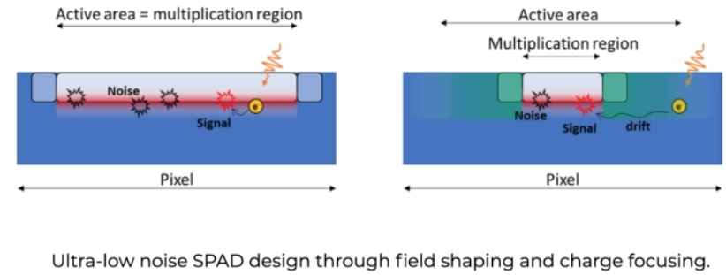
ASPIDES will deliver 2D CMOS monolithic sensors
ASPIDES
Target technology
110 nm CMOS image sensor process
Main features
Noise mitigation
- Optimization for ultra-low noise spad cell
- Single SPAD control (on/off)
- threshold adjustment capabilities for noise rejection (output validation)
Photons counting
- fully digital output, obtained through a completely digital processing chain
- or through analog, Q/V or I/V transformation and final A/D conversion
- asynchronous counting with wide (1e3) dynamic range of simultaneous photons
Timing features
- time of arrival of the first photon
- photon pulse duration (width)
w/ 100ps resolution
- … additional features available
to measure accurately
shape of photon pulse evolution)
Notes:
17

Slide 18
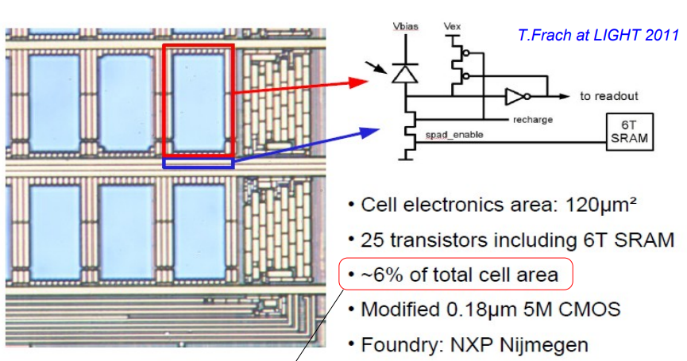
ASPIDES will deliver 2D CMOS monolithic sensors
ASPIDES
The technology offers SPADs with a DCR of around 100 kHz/mm2 , a PDP close to 50% at l=450 nm and excess voltage of 6 V and a sufficient integration density to pack all the needed functions in the available area without unacceptably degrading the sensor PDE
Notes:
18

Slide 19
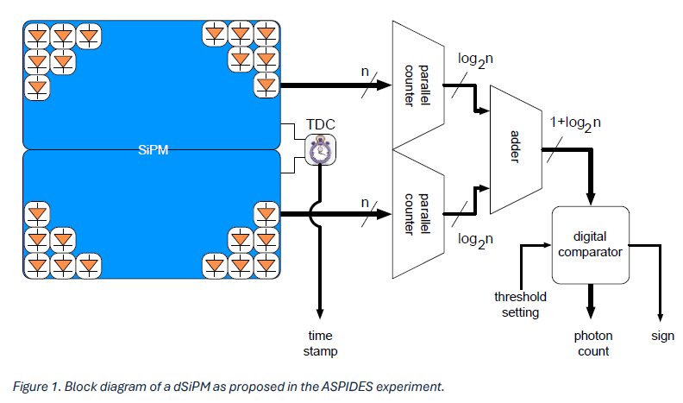
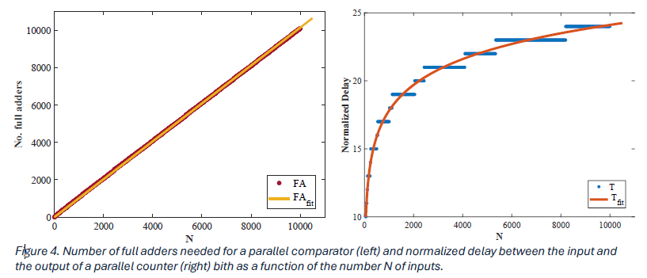
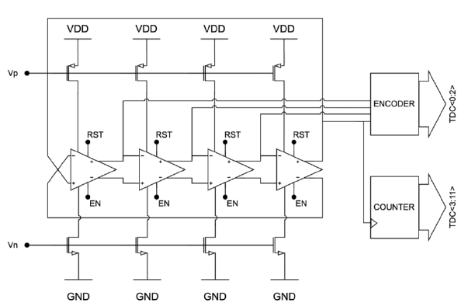
ASPIDES will deliver 2D CMOS monolithic sensors
ASPIDES
Photon counting might be performed through a parallel counter based on adder trees, usually employed in digital multipliers to perform the sum of partial products (digital compressors as they reduce n bits into ⌈𝑙𝑜𝑔2𝑛⌉ bits)
Possible alternative is mixed analog and digital approach
based on I/V or Q/V conversion, followed by an ADC
(current steering circuit integrated in each individual micro-cell
to summing node when the micro-cell is hit and a trans-resistance amplifier or a charge preamplifier provides a measurement of the overall signal)
The time of arrival of the first photon will be measured by means of a time to digital converter (TDC) triggered by the first hit micro-cell through an OR-tree (or by a transition of one of the bits at the parallel counter output).
Block diagram of a 12-bit ring-oscillator-based TDC
Notes:
19

Slide 20
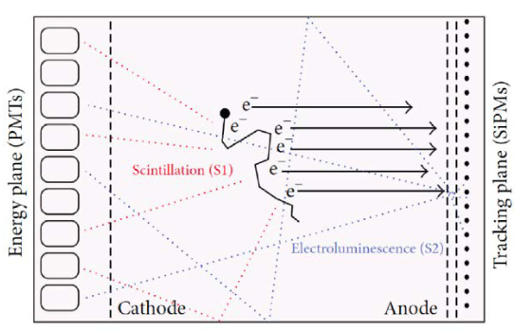
ASPIDES will deliver 2D CMOS monolithic sensors
ASPIDES
Project Deliverables
A prototype chip, including structures such as mini-SiPMs with O(1000) micro-cells with different pitch and single electronic blocks (e.g., TDC/QTC) for characterization purposes
A final demonstrator, with full scale SiPMs and optimized fill factor for dual-readout calorimetry
Involvement in Padova
1) Characterization
Investigation of radiation tolerance both to ionization and displacement damage
Study device operation in cryogenic conditions or high pressure and different radiators
PDE to light from 200nm to 1000nm
2) Applications
Fucussed / Imaging
Cherenkov applications
Optical Readout
for High Pressure TPC
(H2 / CO2 / Ar + CF4)
(High Pressure TPC => Padova in DRD1)
Notes:
20

Slide 21
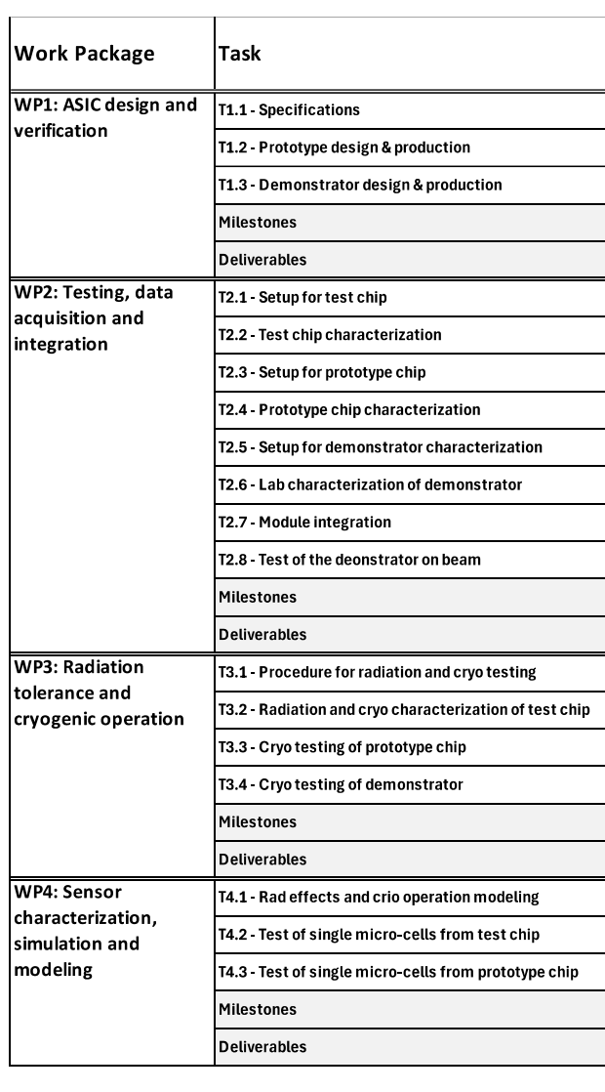
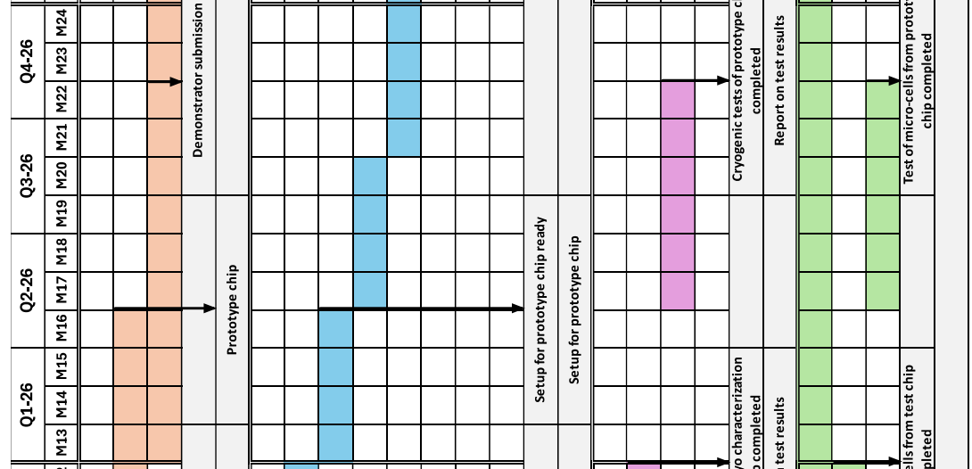
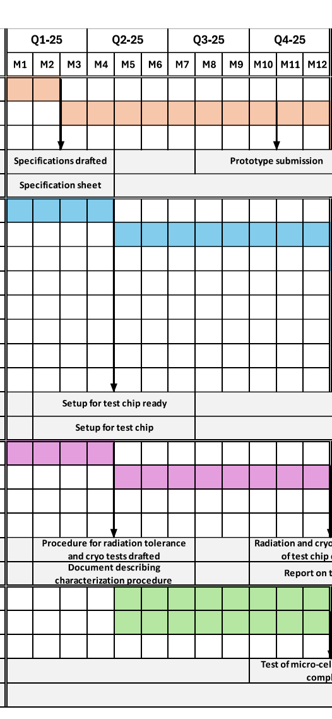
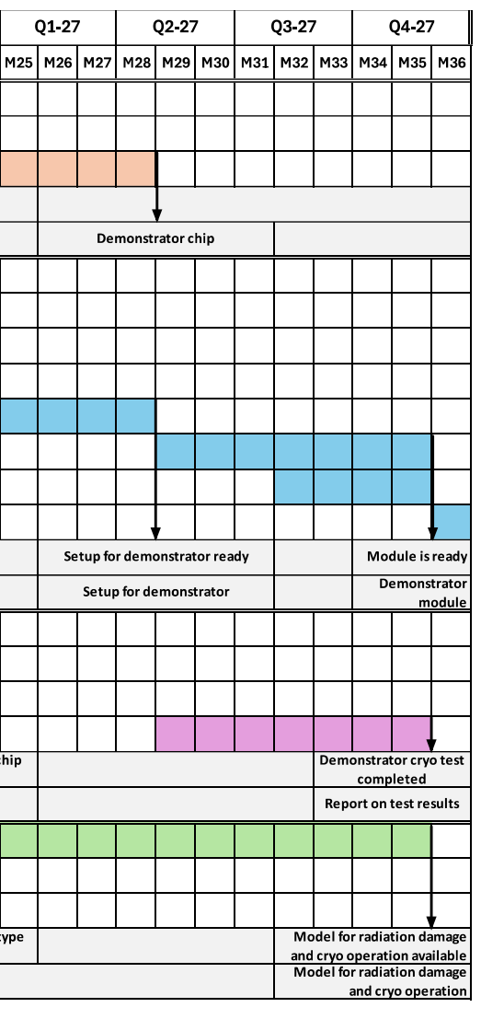
ASPIDES timleine
ASPIDES
Notes:
21

Slide 22
ASPIDES
Resources @ INFN Padova
FTE Padova 2024/7 => 40% ! Nel 2026 finito ADA_5D potremo superare 1 FTE
G.Collazuol 10 %
S.Levorato 5 %
F.Tessarotto 5 %
D.Henaff 10 %
R.Strolili 10%
L.Silvestrin (10%)
Preventivi 2025
Consumo per circa 10kEuro
Missioni (Italia) per 4kEuro
Richieste 2025 in Sezione PD – non ci sono richieste per il 2025
Servizio Elettronica
Servizi Tecnici ed Elettronici
Servizio Progettazione Meccanica
Servizio Officina Meccanica
parts for a small volume prototype high pressure TPC – 1 m.p.

Slide 23
Additional material

