Slide 1
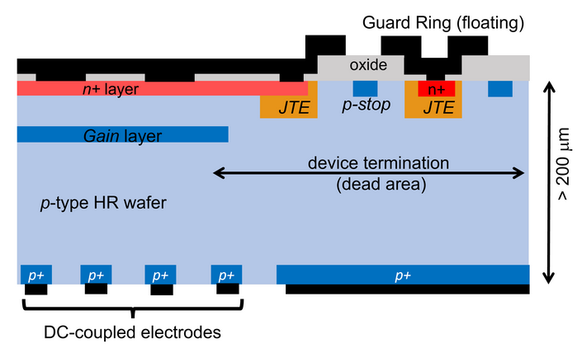
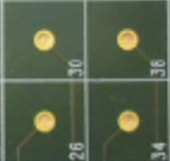
Avalanche Diodes Array – ADA-5D
University of Pisa & INFN Pisa / University of Siena & INFN Pisa
University of Padova & INFN Padova / University of Pavia & INFN Pavia
University of Trento & TIFPA / Fondazione Bruno Kessler FBK (Trento)
G.Collazuol
INFN Padova
CdS 2024/7/5
Development thick LGADs and related large dynamic range electronics
- large pixels (3mm x 3mm)
- sensor thickness 200-300 um
Example of thick LGAD implementation
mini-TILE (2.4cm x 2.4 cm):
16 FE = 8 x 8 LGADs
Each FE chip, connected to 4 LGADS, implements:
- double gain linear range to cover > 1000 m.i.p.
- internal ADC
- internal TAC + ADC conversion
- Track & Hold
FE chip
Notes:
1

Slide 2
ADA-5D
TARGET APPLICATION = space experiments … tight requirements
Charge & Timing 5D detector: x,y,z, charge, time (5D)
Charge measurement:
- large dynamic range > 1000 m.i.p.
- charge resolution for proton < 0.1 => 200-300 μm sensors for primary ionization
Timing measurement:
- sub-ns resolution (e.g., for 10 – 20 cm flight path → 100 ps)
Space resolution and granularity:
- modest granularity (3mm x 3mm pixels) to cover large O(m²) sensitive area
- an independent TRACKER is in charge of the fine spatial resolution
Power budget:
- VERY challenging < 150 W/m²
Radiation hardness:
- modest problem for space experiments < 10¹¹ 1 MeV neq (TID ~100 krad)

Slide 3
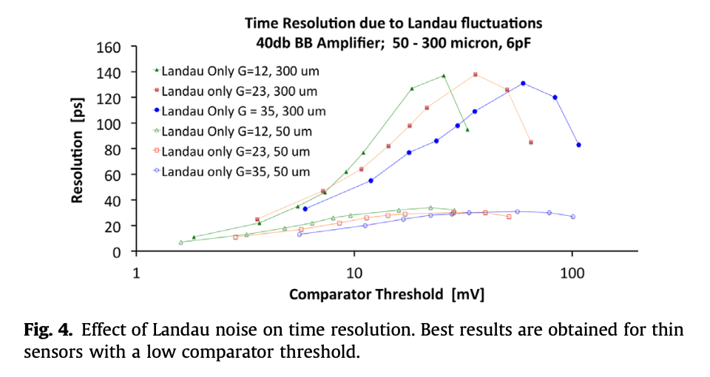
ADA-5D
Gain and Time resolution
with G ~ 10-20 dominant term in time resol. is the Landau tails jitter
~ 100ps feasible with a low threshold (ok as S/N>30 for 1 m.i.p)
e.g.: 100 ps resolution with:
300 um thickness
G=23
threshold ~ 20 – 30 mV
z
Nuclear Instruments and Methods in Physics Research A 845 (2017) 47–51

Slide 4
ADA-5D
Activities in 2024
TIFPA - caratterizzazione laser IR di campioni LGAD FBK con spessore 275um
Pisa - ottimi risultati con CR muons tests con elettronica di r/o APIX/ASAP
Pavia – completata produzione prima versione ASIC di FE (TAC, no ADC) => sotto test
FBK - primo batch di LGAD per ADA_5 in consegna a Luglio 2024
Padova
- TIMEPIX3 silicon based tracker (only electronics)
Padova = 10GHz RF amplifier for single channels readout
Test Beam @ SPS ions => November 2024
Activities in 2025
TIFPA - caratterizzazione laser IR di campioni LGAD FBK con spessore 275um
Pavia – nuova versione del ASIC con on-chip ADC e interfaccia digitale per R/O
FBK - secondo batch di LGAD
Padova
Digital readout fast digital readout board
Telescope tracker based on TimePix4
Test Beam @ SPS ions => November 2025

Slide 5
ADA-5D
Resources @ INFN Padova
FTE Padova 2024/7 => 50%
G.Collazuol 10 %
M.Feltre 30%
M.Mattiazzi 30%
Preventivi 2025
Consumo per circa 10kEuro
Missioni (CERN) per circa 5kEuro
Richieste 2025 in Sezione PD
Servizio Elettronica
programmazione FPGA TimePix4+ SiPixels (collab. con INFN FE) ~ 3m.p.
Servizi Tecnici ed Elettronici
elettronica ancillare TimePix4 (collab. con INFN FE) ~ 1m.p.
Servizio Progettazione Meccanica
disegno setup telescopio (collaborazione con Stefano Levorato) ~ 1m.p.
Servizio Officina Meccanica
meccanica telescopio ~ 1m.p.

Slide 6
Additional material ADA-5D

Slide 7
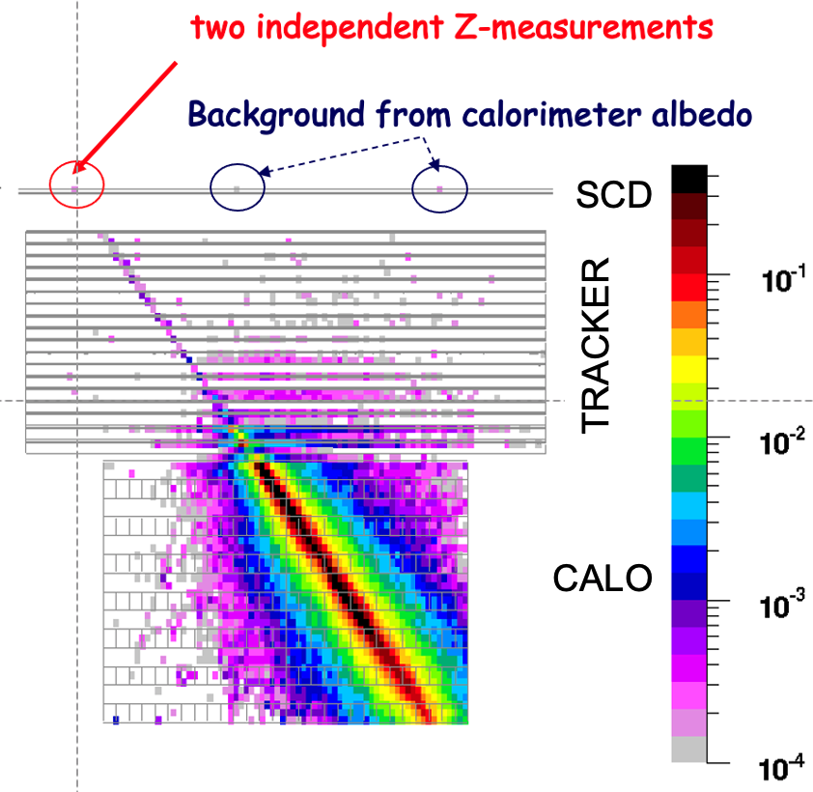
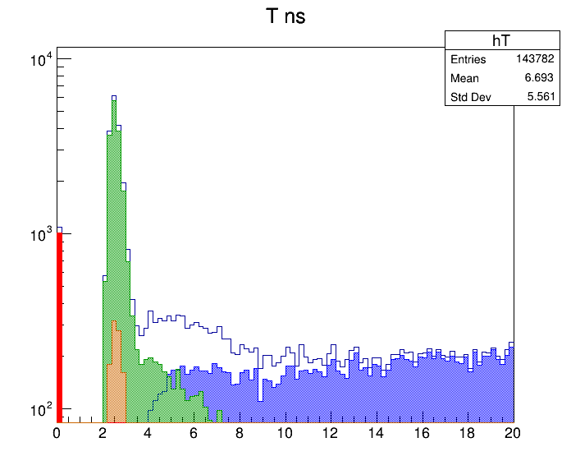
ADA_5D
Charge & Timing 5D detector (x,y,z, charge, time) based on LGAD sensors for the next generation of multi-TeV calorimetric experiments in space
CHARGE IDENTIFICATION of cosmic-ray ions
with charge 1 ≤ Z ≤ 30 via multiple dE/dx ∝ Z²
in a pixelated sub-ns Charge-ToF detector (SCD)
Backscattering (BSC) from calorimeter generates fake hits in SCD and tracker, degrading charge-ID as energy increases.
FLUKA simulation of 1 TeV incident carbon nucleus
Arrival time (ns) of BSC from calorimeter on SCD:
a GEANT4 simulation with 30cm flight path
ADA_5D concept: BSC rejection with a
high resolution ToF measurement
secondaries from BSC photons interacting in SCD
BSC electrons
- large dynamic range > 1000 m.i.p
- 100 ps time resolution (e.g. for 20 cm flight path)
- large pixels (3mm x 3mm) to cover large O(m²) sensitive area
- indipendent TRACKER for fine track resolution
- challenging power budget < 150 W/m²
- modest Rad Hardness required in space < 10¹¹ 1 MeV neq
BSC All
BSC neutrons
incident protons at t=0

Slide 8
TILE (9.6 cm x 9.6 cm): 16 mini-tiles
= 256 FE = 16 x 8 x 8 = 1024 LGADs
mini-TILE (2.4cm x 2.4 cm):
16 FE = 8 x 8 LGADs
Each FE chip, connected to 4 LGADS, implements:
- double gain linear range to cover > 1000 m.i.p.
- internal ADC
- internal TAC + ADC conversion
- Track & Hold
FE chip

Slide 9
LARGE AREA DETECTOR concept: N tiles per row x M rows
Example of 1 row equipped with N tiles and readout on either side

