Slide 2
Contents
Introduction
From the Pioneering Age to the big Projects
The explosion driven by the big Projects
The TESLA Collaboration and its impact

Slide 3
Contents
Introduction
From the Pioneering Age to the big Projects
The explosion driven by the big Projects
The TESLA Collaboration and its impact

Slide 4
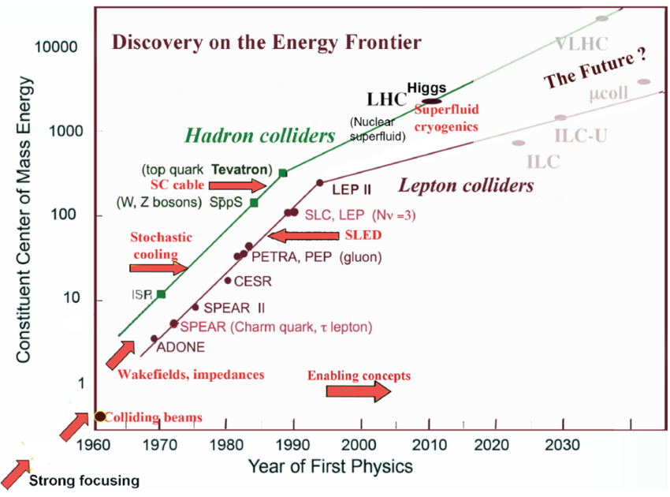
Livingston chart for Colliders
CEPC-hh
CEPC
K. Yokoya, 2014

Slide 5
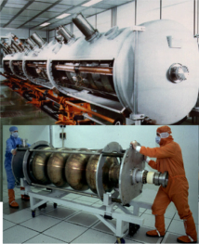
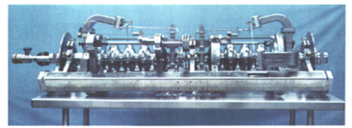
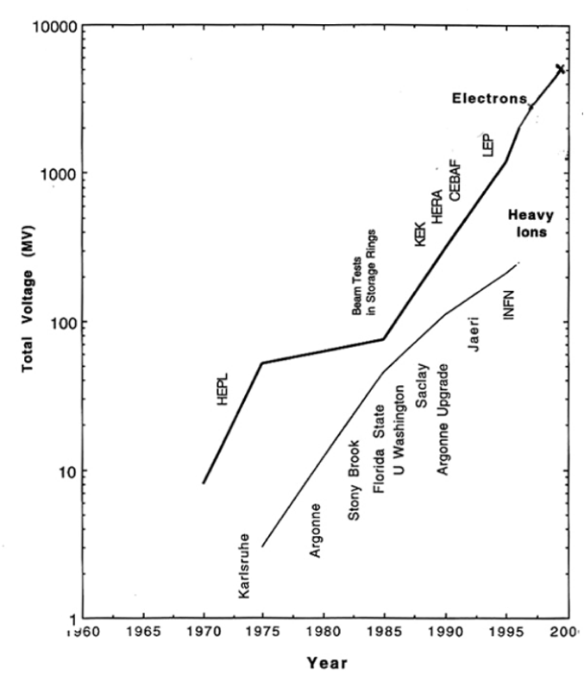
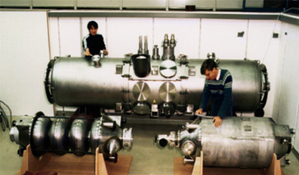
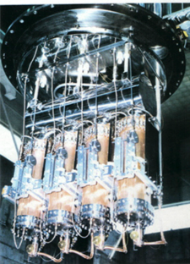
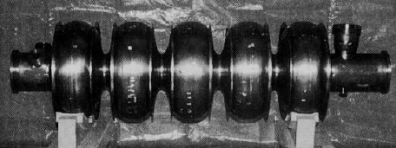
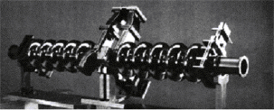
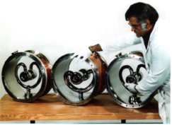
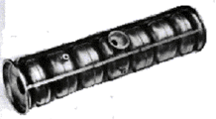
SCRF From HEPL to year 2000
“Livingston Plot” from Hasan Padamsee

Slide 6
Energy gain and dissipated power
To transfer energy efficiently to particles, very high electric field is required
In any structure (cavity) holding an electromagnetic field, both dissipated power and stored energy scale quadratically with the fields
The efficiency of a cavity depends on:
  Its quality factor, Q
  driven by the surface resistance, R_{s}
  Its shunt impedance, r
  function of the cavity geometry
  and of the surface resistance, R_{s}
For efficient acceleration Q, r and r/Q must all be as high as possible
U is the energy stored in the cavity
P_{diss} is the power dissipated on its surface
. ΔV is the voltage seen by the beam
“r over Q” is purely
a geometrical factor
Good material for maximum Q and r (that is minimum P_{diss})
Good design for maximum r/Q

Slide 7
Cavity lumped circuit model and R_{S}
A cavity at the fundamental mode has an equivalent resonant lumped circuit
L
R
C
Q determines the frequency band Δf
R proportional to Q determines P_{diss}
R depends inversely on the cavity R_{s} through a geometrical factor
In practice, for a given geometry and a given accelerating field the surface resistance R_{s} plays the crucial role of determining the dissipated power, that is the power required to sustain the field

Slide 8
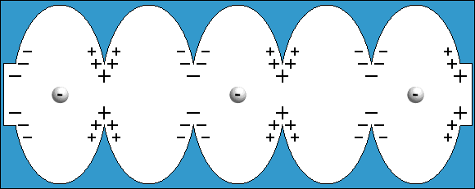
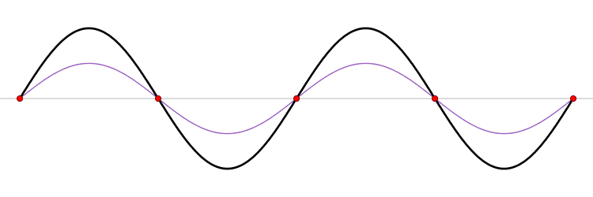
Acceleration via RF Cavity
An accelerating space, usually called radio-frequency (RF) cavity, is nothing but a container crossed by the beam in which is stored a non conservative electric field (rotational) that, when the bunch of particles is passing through, is found to be properly orientated in the desired direction.
Standing Wave
TM₀₁₀ mode

Slide 9
RF to transfer Energy to the Beam
In the accelerator the world RF takes care of all the variety of items that are required to accomplish this task of creating a region filled of electromagnetic energy that can be sucked by the beam while crossing it.
An “RF power source” is used to fill, via a “coupler”, the “RF cavity”, or resonator that is the e.m. energy container from which the beam is taking its energy.
What we ask to a good cavity?
High Q for low losses
Small R_{s} for high Q
U = stored energy
P_{diss} = dissipated power
R_{s} = surface resistance
G = cavity geometrical factor

Slide 10
Superconductivity whenever possible
For a good but not perfect conductor ( ), the fields and currents penetrate into the conductor in a small layer at the cavity surface (the skin depth, δ )
With RF fields, a SC cavity dissipate power, not all electrons are in Cooper pairs.
SC
SuperConducting
NC or RT
NormalConducting
Nb
Cu
In NC linac a huge amount of power is deposited in the copper structure: MW to have MV
  Pulsed operation and Low Duty Cycle
Superconductivity, drastically reduces the dissipated power. But some drawbacks
  Higher complexity: refrigeration and cryomodules
  Higher technology: cavity treatments
  Carnot and refrigeration plant efficiencies
  Simpler geometries: lower shunt impedance
And two big advantages:
  Large bore radius: less beam losses
  CW or high duty cicle preferred

Slide 11
Superconductivity as soon as possible
Whatever geometry the cavity has, the power dissipated by Joule effect is proportional to its surface resistance and to the square of the field inside it.
At first, it was not clear that superconductivity had much value for RF technology. When a superconductor is exposed to a time-varying electromagnetic field, the electrons that are not coupled as Cooper pairs lead to energy dissipation in the shallow layer of the superconductor surface in which the electric and magnetic fields are dancing together to sustain the rotational electric field that transfer the energy to the beam.
But it was soon realized that in the practical frequency range of RF accelerators, from a few hundred MHz to a few GHz, the use of SRF cavities would produce in any case a significant gain. It was simply a question of developing the technology, and that required investment and big projects.

Slide 12
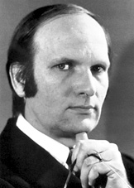
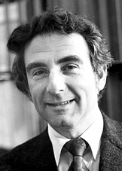
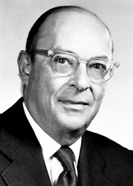
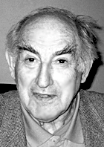
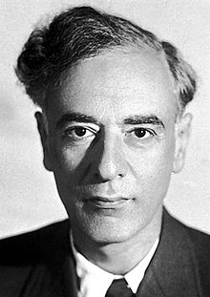
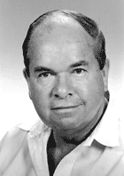
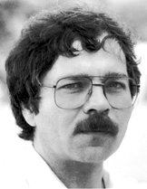
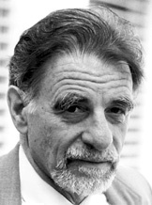
Superconductivity: Historical Overview
1908 Liquefaction of helium (4.2 K)
1911 Zero resistance
1933 Meissner effect
1935 Phenomenological theory of H. & F. London
1950 Ginzburg – Landau theory
1951 – 2 types of superconductors (Abrikosov)
1957 Bardeen – Cooper – Schrieffer microscopic theory
1960 Magnetic flux quantisation
1962 Josephson effect
1986 High temperature superconductors (Bednorz – Müller)
Bardeen – Cooper – Schrieffer (BCS)
Ginzburg
Landau
Abrikosov
Bednorz
Müller

Slide 13
Surface resistances in NC and SC Cavities
Normal conducting
Superconducting
λ = London penetration depth
δ = skin depth of microwave
for good conductor：
Surface resistance：
BCS theory
H_{t}
H_{t}
λ
Δ/k_{B} = 1.9 T_{C}
δ
normal
P = RF losses
i_{s}
T=T_{c}
i_{s}
Surface currents
Surface currents
Metal
Superconductor
2Δ
super
T=0
Q₀= ωU/P = G/R_{s}

Slide 14
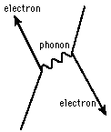
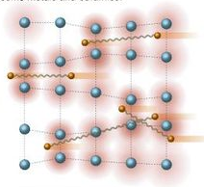
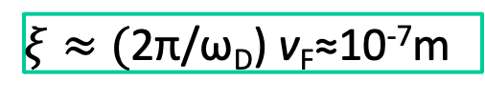
Cooper pairs and Zero Resistance
Pairing of electrons close to the Fermi level into Cooper pairs through interaction with the crystal lattice
  Boson (no Pauli exclusion principle)
  All Cooper pairs condense to the same ground state
  Coherent wave functions → no scattering → zero resistance
Size of a cooper pair is large compared to the lattice constant and is related to the coherence length ξ
Estimated size of a cooper pair:
Relaxation time of the lattice: 2π/ω_{D}≈10⁻¹³s
Electrons move with v_{F}≈10⁶m/s
Distance between electrons forming a cooper pair:
$ξ≈\text{(}\text{2}\text{π}\text{/}\text{ω}\text{D}\text{)}$ v_{F}≈10⁻⁷m

Slide 15
The Real Surface Resistance
R_{s} = R_{BCS} + R_{res}
R_{res}
due to surface defects, contamination, trapped magnetic field and other
niobium @ 1300 MHz
R_{res}=0

Slide 16
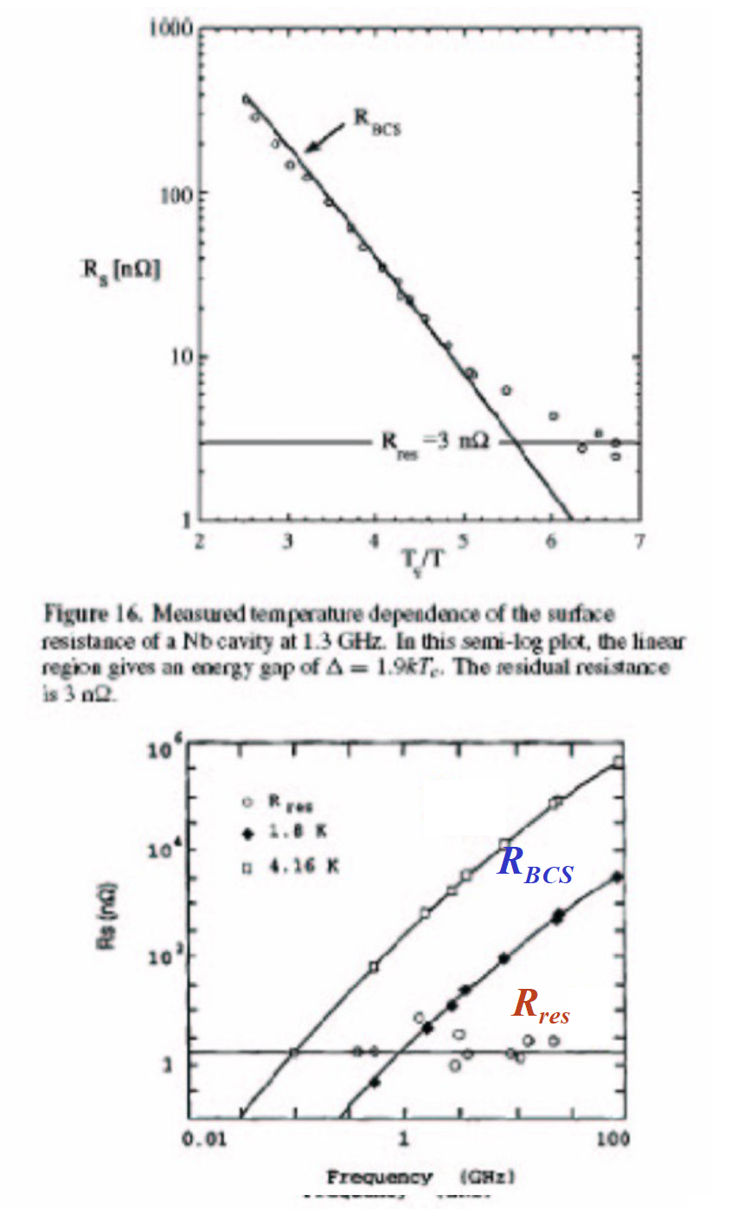
More about Residual Resistance
Constant R_{res} at T 0 for small H₀ is inconsistent with the BCS theory
Mechanisms of R_{res} are likely unrelated to superconductivity
Field, temperature and frequency dependences of R_{res} are partially understood
Effect of surface oxides (hydrides), trapped flux, defects and more fundamental mechanisms
R_{res} ≈ 1-20 nΩ

Slide 17
Superconducting RF vs NC-RF
Power dissipated on the cavity walls to sustain the field is:
ambient pressure boiling He
Good, but the gain of up to 6 order of magnitudes is not guaranted and it’s not for free
superfluid helium

Slide 18
What we need to use SRF
The power is deposited at the operating temperature of few K
We need to guarantee and preserve the 2 K environment
Cavity is sensitive to pressure variations; only viable environment is sub-atmospheric vapor saturated He II bath
We need a thermal “machine” that performs work at room temperature to extract the heat deposited at cold
The Thermal machine efficiency is just a fraction of the Carnot efficiency
Less favorable Geometrical Factor G

Slide 19
Contents
Introduction
From the Pioneering Age to the big Projects
The explosion driven by the big Projects
The TESLA Collaboration and its impact

Slide 20
From pioneering age to first real success
The High-Energy Physics Lab at Stanford University was a pioneer in applying SRF to accelerators, demonstrating the first acceleration of electrons with a lead-plated single- cell resonator in 1965.
Also in Europe, in the late 1960s, SRF was considered for the design of proton and ion linacs at KFK in Karlsruhe. In order to be superior to the competing technology of normal-conducting RF, a moderate field of few MV/m was necessary. By the early 1970s SRF has been introduced in the design of particle accelerators, but results were still modest and a number of limiting factors had to be understood.
The first successful test of a complete SRF cavity at high gradient and with beam was performed at Cornell’s CESR facility at the end of 1984, involving a pair of 1.5 GHz, five-cell bulk niobium cavities with a gradient of 4.5 MV/m. This cavity design was then used as the basis for the CEBAF facility at Jefferson Lab.

Slide 21
From HEPL to year 2000
“Livingston Plot” from Hasan Padamsee

Slide 22
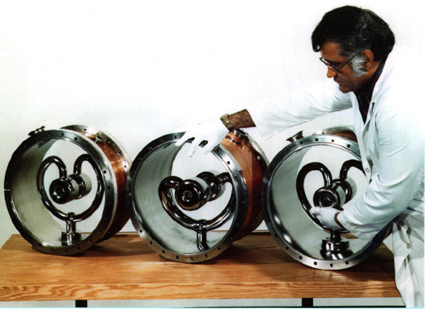
From the pioneering age to 1984
Argonne National Labs
ATLAS: Heavy-ion Linac
Originated at Caltech
Implementd and used in other labs
for β ~ 0.1
Stanford University
HEPL: Electron Linac for FEL
First multicell electron cavity: β = 1

Slide 23
Limiting Problems
Material properties
    Moderate Nb purity (Niobium from the Tantalum production)
    Low Residual Resistance Ratio, RRR Low thermal conductivity
    Normal Conducting inclusions Quench at moderate field
Cavity treatments and cleanness
    Cavity preparation procedure at the R&D stage
    High Pressure rinsing and clean room assembly not yet introduced
Microphonics
    Mechanical vibrations in low beta structures High RF power required
Multipactoring
    MP has been the major limit for HEPL, and electron linacs to 1984
    Pill-box like geometry: higher shunt impedance but higher MP problems
Quenches/Thermal breakdown low RRR and NC inclusions
Field Emission
    General limit at those time because of poor cleaning procedures and material

Slide 24
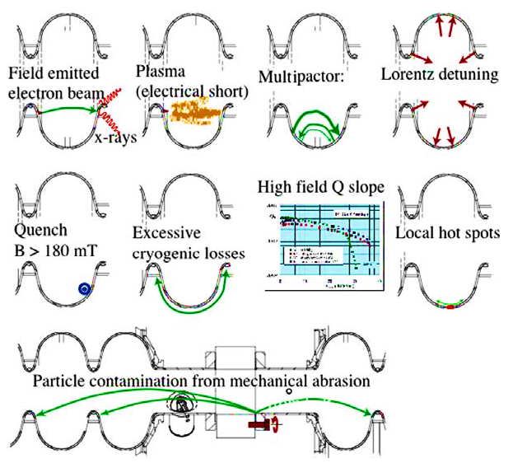
SC cavities may have various “illness”

Slide 25
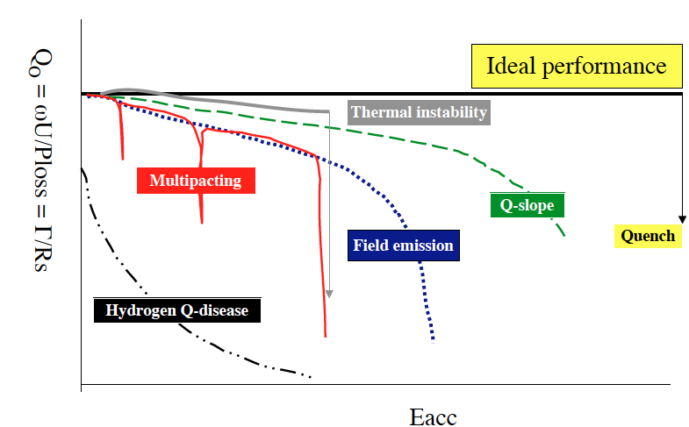


Performance Limitations of SRF cavities
There are two parameters which define the performance of an SRF cavity: Quality factor and the accelerating gradient
The quality factor. Remember:
Q₀ =G/R_{S}=$ω$U/P_{loss.} G = geometry factor
$$R_{S} \text{∝} exp⁡(−Δ/(kb T))$$
The accelerating gradient can be limited by the peak surface electric field (field emission) or the peak surface magnetic field (quench)
E_{acc} ∝ B_{peak}
E
B

Slide 26
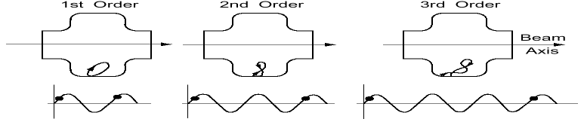
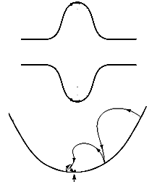
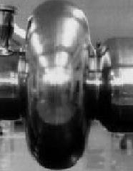
1970’s: Multipacting
Understanding: Electron avalanche Resonant mulitiplication due to secondary emission
High Field
Solution: Spherical/
elliptical cavity shape
1980: Gradients rise
From 2-3 MV/m => 5 – 6 MV/m

Slide 27
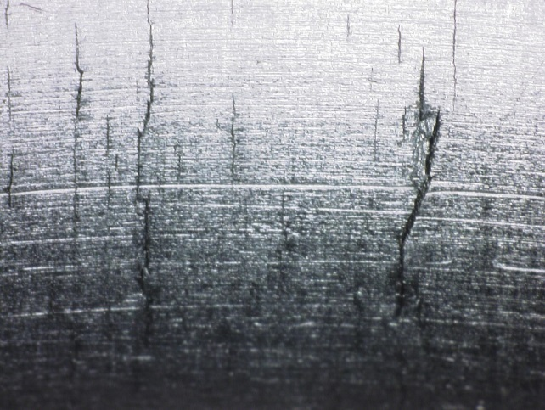
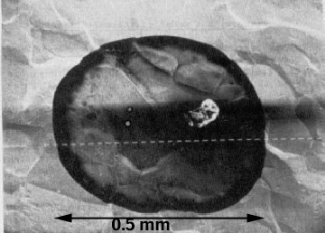
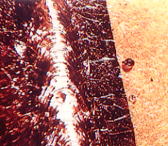
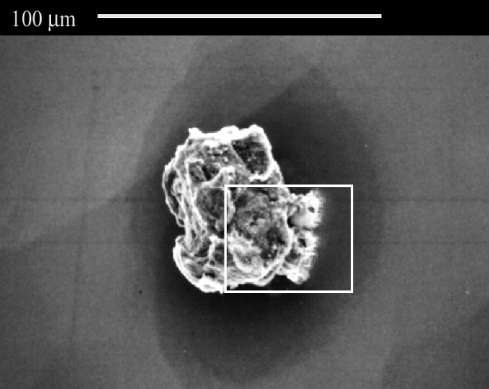
Surface Defects Examples
For decades Niobium has been a by-product of Tantalum production
Inclusion
Cracks
Holes
Nb on niobium surface
Sputter balls
Cu
Foreign materials

Slide 28
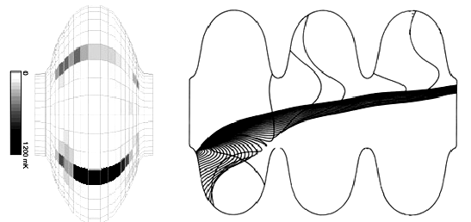
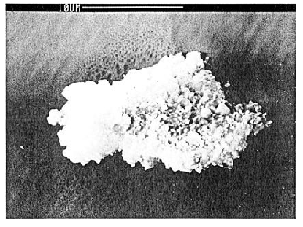
Field Emission
Field emission is normally caused by foreign particle contamination
  Emitted electron current grows exponentially with field
  Reaching the surface accelerated electrons produce cryo-losses and quenches
  Part of the electrons reaches high energies: Dark Current
Particle causing field emission
Temperature map of a field emitter
Simulation of electron trajectories in a cavity
Pictures taken from: H. Padamsee, Supercond. Sci. Technol., 14 (2001), R28 –R51

Slide 29

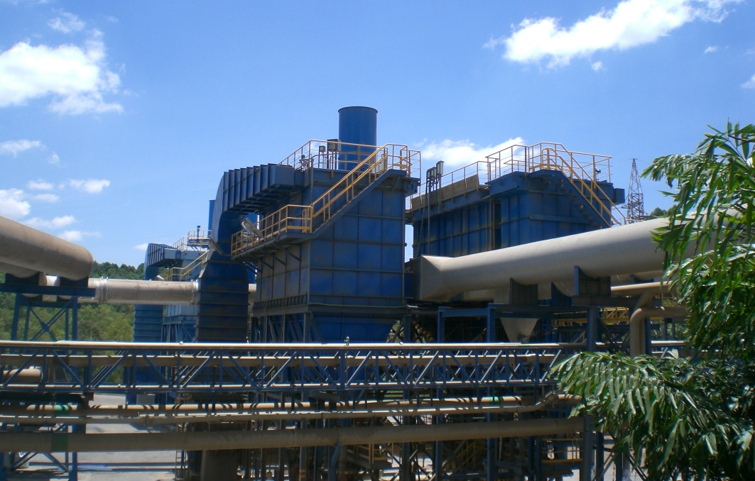
The way from ore to pure Nb
The world's largest niobium deposit is located in Araxá, Brazil owned by Companhia Brasileira de Metalurgia e Mineração (CBMM). The reserves are enough to supply current world demand for about 500 years, about 460 million tons. The mining of weathered ore, running between 2.5 and 3.0% Nb₂O₅, is carried out by open pit mining. By chemical processes the ore is concentrated in Nb contents (50 –60 % of Nb₂O₅)

Slide 30
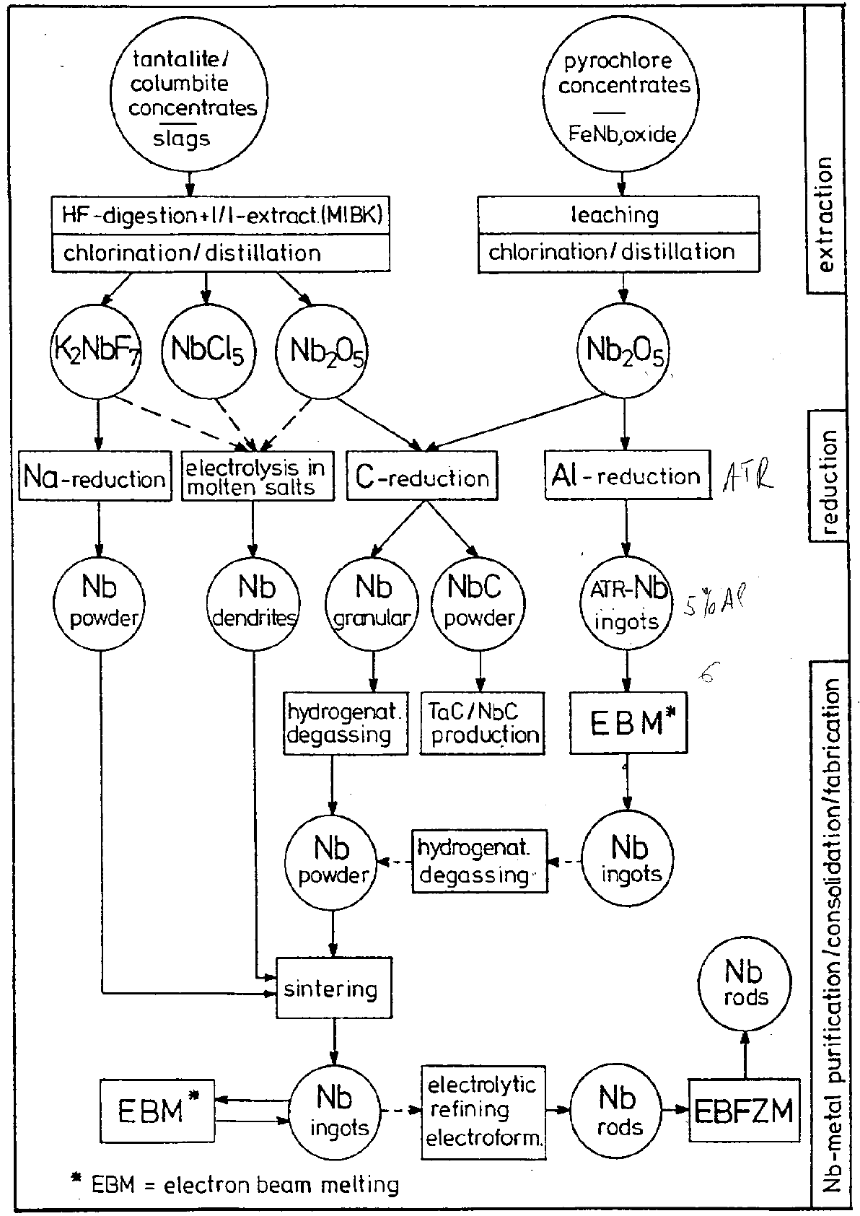
Main routes of Nb fabrication process
Classical routes for Nb, consist of the carbothermic reduction of Nb₂O₅ and the aluminothermic reduction of Nb₂O₅ followed by EBM.
An alternative route of niobium fabrication and alloying is powder metallurgy. For special applications it may be convenient to produce powder with high purity hydriding. The production of high-grade niobium with small Ta-concentration can be performed via the sodium reduction of purified K₂NbF₇.

Slide 31
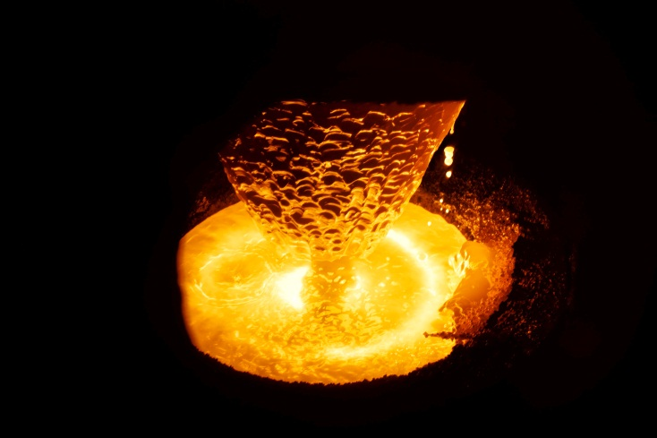
Electron Beam Melting of Niobium
Electrode (Rotating)
During of the ingot melts, molten metal globules fall into a pool on the ingot which is contained in a water cooled copper crucible. Impurities are evaporated and pumped away. Power impact is maintained to keep the pool molten out to within a few mm of the crucible wall. During melting the ingot formed is continuously withdrawn through the crucible.
Electron Beam Gun
Focus & Aiming Coils
Electron Beam
Vacuum
Molten Pool
Water Cooled Crucible
Ing.

Slide 32
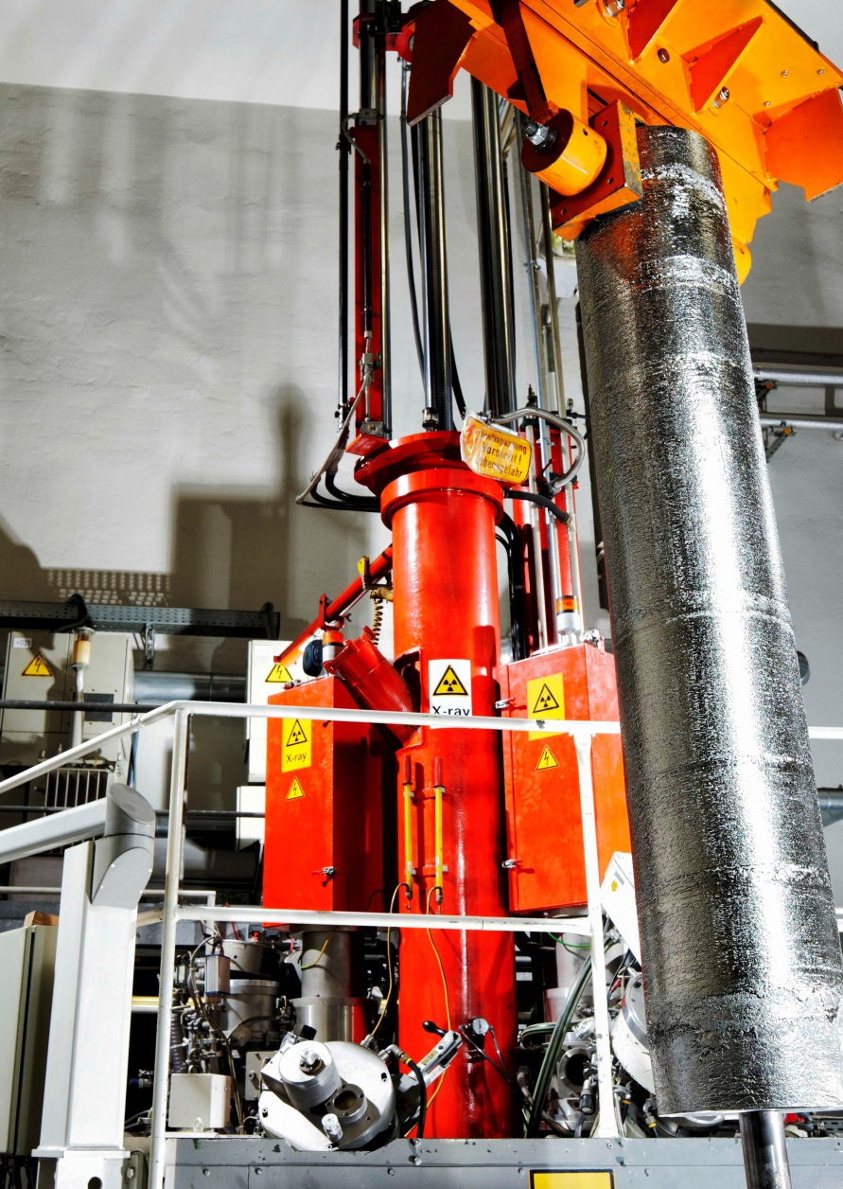
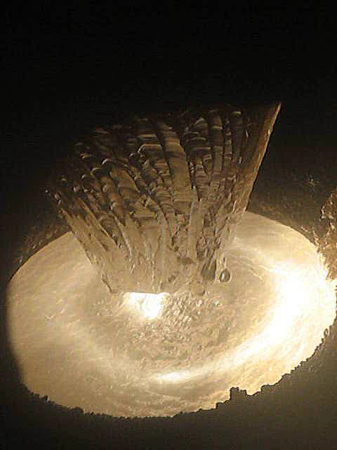
Electron Bem Melting
EB Melting of Nb Ingots at Fa. HERAEUS (Germany)
As a result of the increasing demand for refractory metals in the last few decades, the electron-beam furnace has been developed to a reliable, efficient apparatus for melting and purification.
One problem sometimes observed with e-beam melted ingots is the nonhomogeneous distribution of impurities. The skin of the ingot contains more impurities than the inside. Top to bottom inhomogeneity.

Slide 33
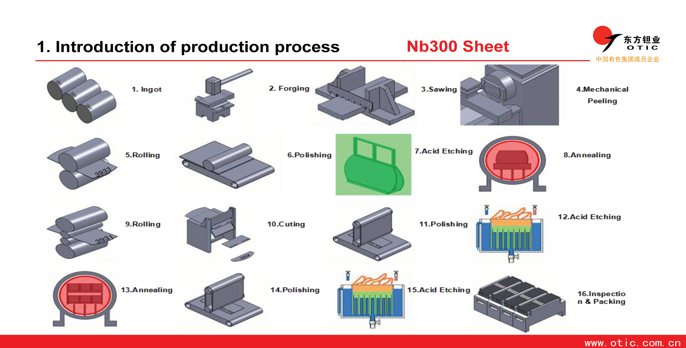
Nb Sheets Fabrication at OTIC

Slide 34
Nb Sheets Fabrication at Tokyo Denkai
Mother material
Forging
Cutting
Pressing
Milling
Annealing
1st EB melting
Rolling
Levering
2nd, 3rd etc. EB melting
Polishing
Chemical polishing
Separate from base plate
Rolling
Inspection

Slide 35
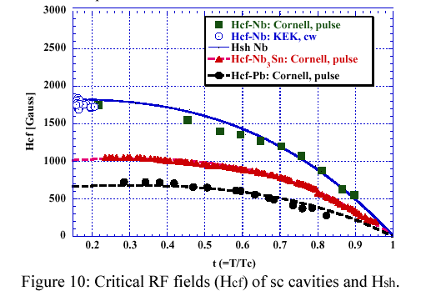
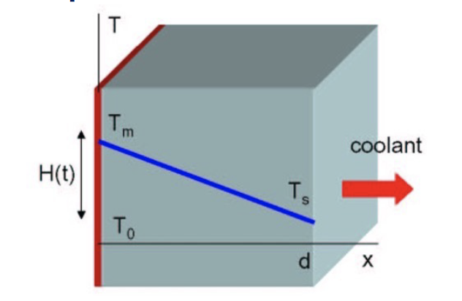
Other Physical Limits
Critical Magnetic Field Limit
Vortex state of trapped Magnetic Field
Limited thermal conductivity
  Thermal Conductivity of the bulk Nb
  Kapitza resistance at the surface
B_{max} ≤ 180 mT

Slide 36
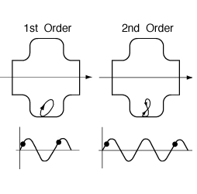

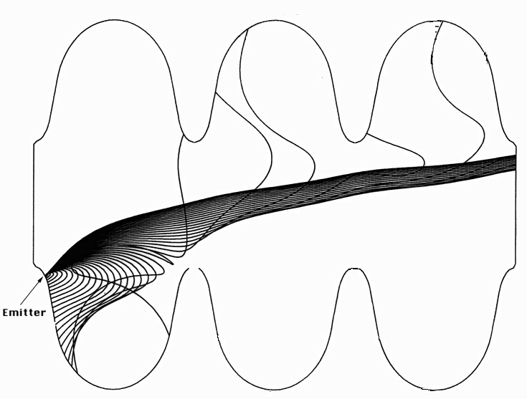
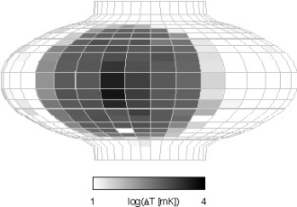
Synthesis: R&D waiting for big projects
Understanding Multipactoring
    A few computer codes developed
    Spherical shape realized at Genova and
    qualified at Cornell & Wuppertal
Understanding Field Emission
    Emitters were localized and analyzed
    Improved treatments and cleanness
Cure thermal Breakdown
    Higher RRR Nb
    Deeper control for inclusions

Slide 37
1984/85 The Cornell Brake-throug
First great success
A pair of 1.5 GHz cavities developed and tested at Cornell: 4.5 MV/m
Chosen for CEBAF at TJNAF for a nominal E_{acc} = 5 MV/m

Slide 38
Contents
Introduction
From the Pioneering Age to the big Projects
The explosion driven by the big Projects
The TESLA Collaboration and its impact

Slide 39
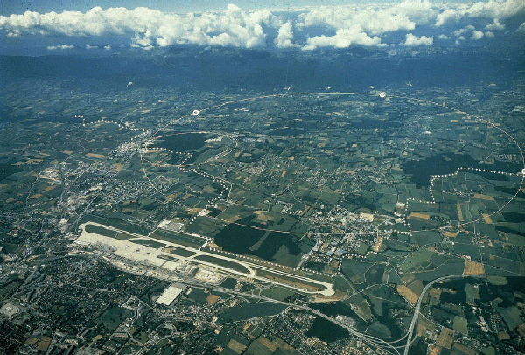
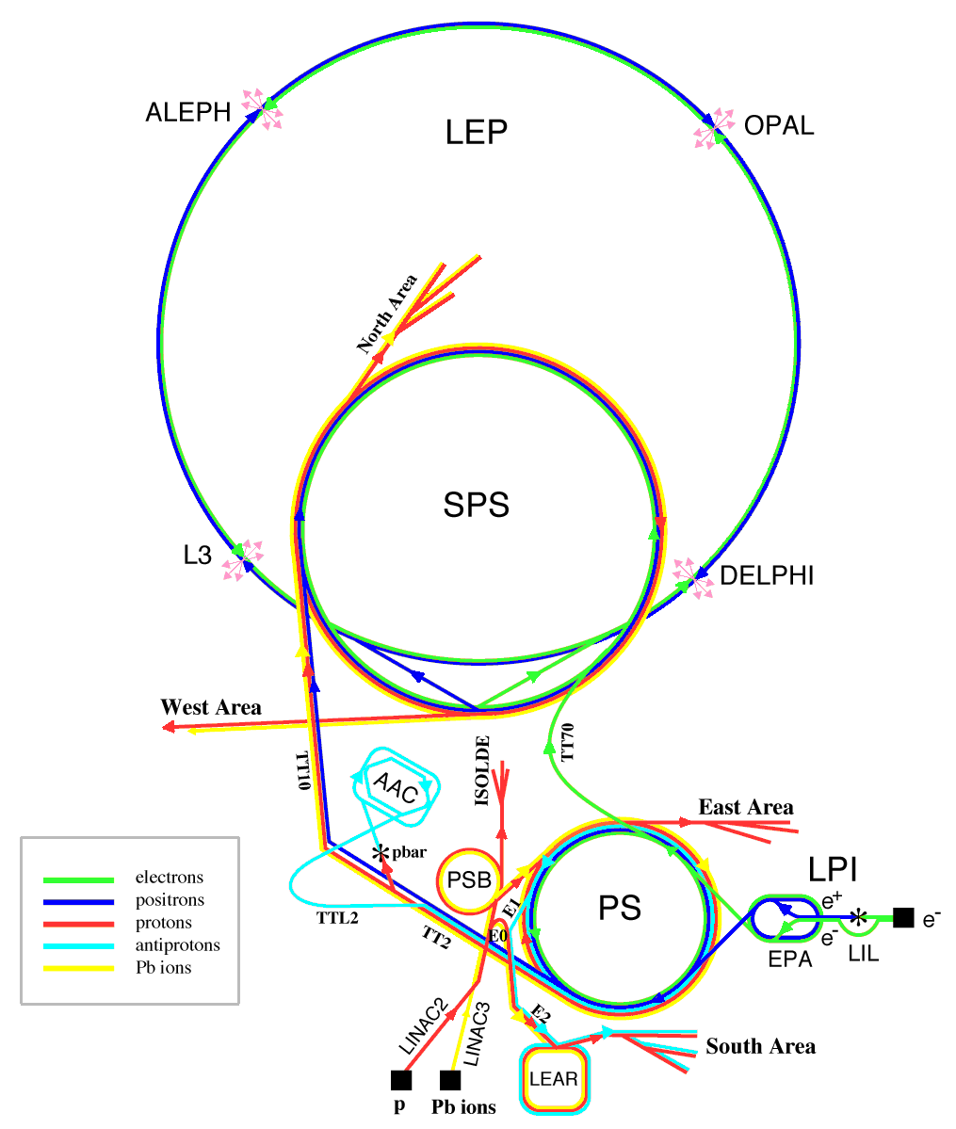
Exponential grow from middle ‘80
Multi-cell, β = 1, cavities for large storage rings
  KEK/TRISTAN – (from 1987 to 1989)
    200 MV peak RF voltage to the beam per revolution
    32 x 5-cell cavities @ 508 MHz
  DESY/HERA – (from 1991 to 1993)
    75/30 MV peak RF voltage to the electron beam
    One string of 16 x 4-cell cavities @ 500 MHz
  CERN/LEP II – (SC upgrade from 1996 to 2000)
    > 3.65 GV peak RF voltage to the beam per revolution
    288 x 4-cell cavities @ 352.2 MHz (256 Sputtered)
Multi-cell, β = 1, cavities for recirculating linacs
  TJNAF/CEBAF – (from 1995 to 1999)
    600 MV RF voltage to beam per linac pass
    338 x 5-cell cavities @ 1497 MHz RF

Slide 40
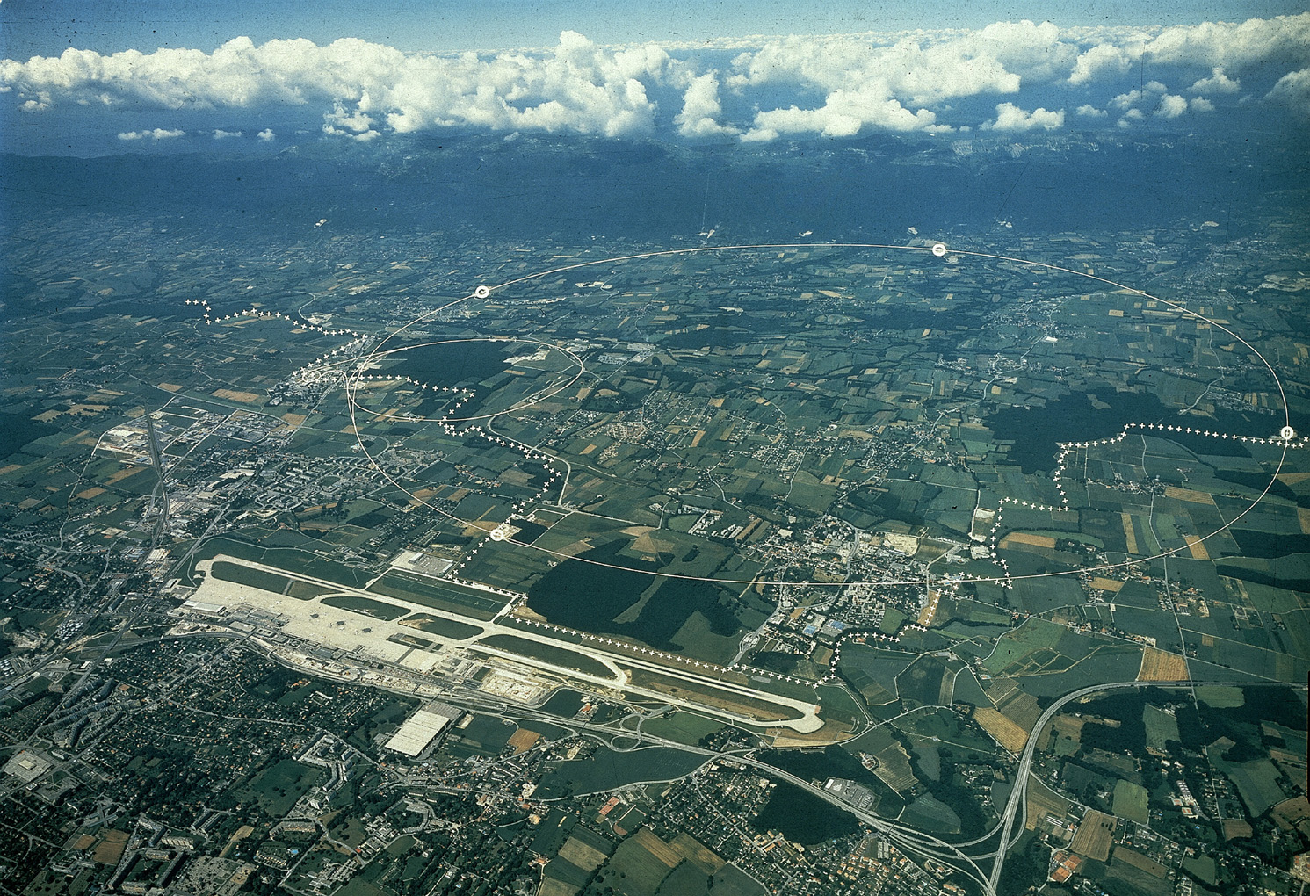

Large project impact on SRF technology
In 1985 the successful test of a pair of SC cavities in CERS opened the door to the large-scale application of SRF for electrons
The decision of applying this unusual technology in the largest HEP accelerators forced the labs to invest in Research & Development, infrastructures and quality control
The experience of industry in high quality productions has been taken as a guideline by the committed labs
At that time KEK, TJNAF and CERN played the major role in SRF development, mainly because of project size
The need of building hundreds of cavities pushed the labs to transfer to Industry a large part of the production
The large installations driven by HEP produced a jump in the field
R&D and basic research on SRF had also a jump thanks to the work of many groups distributed worldwide
LEP
CEBAF

Slide 41


First Industrial Production in Japan (1988 – 1995)
The first mass-production of SRF Cavities in the world
SRF Cavity for TRISTAN at KEK
Bulk-Nb - 508MHz - 5-Cell Cavity
32 SRF cavities were fabricated by Mitsubishi and operated in TRISTAN

Slide 42





TRISTAN SRF from KEK to MHI
KEK 1981
1995

Slide 43

TRISTAN Cavities Fabrication (1986)
Original KEK Movie of the full cycle for the production and test of the TRISTAN SRF System, including
complete production cycle of one of the TRISTAN SC Cavities at Mitsubishi
Cavity vertical test at KEK
Two cavity cryomodule assembly
Cryomodule horizontal test in a bunker

Slide 44


CEBAF Recirculating Linac
Aerial view of the CEBAF site
CEBAF important achievements
First large recirculating linac
Large cryogenic plant at 2 K
R&D on fabrication and treatments for Nb
Large plants for preparation and RF tests
Great experience on SRF linac operation
Excellent SRF reliability demonstrated
Set the background for SNS
A pair of 5-cell 1.5 GHz CEBAF cavities

Slide 45
Lessons learned from CEBAF
Processing and conditioning improve cavity performances, when not limited by material defects (hard quench)
Field emission moves to higher field
Accelerating Field improves with time
2 K operation very reliable and well understood
All ancillaries perform quite well
Maximum energy and beam current above the design values
CEBAF performances finally limited by the installed cryo-power and RF-power

Slide 46

A great success for CEBAF
Lost Time Totals June'97-May'01
Excellent reliability of SRF technology
High availability for physics
The only warm-up for the vvvIsabelle Hurricane
CEBAF
1.5 % in FY 01
0.0 % in FY 01

Slide 47


LEPII and HERA
4-cell, 352 MHz, L_{act}=1.7 m
32 bulk niobium cavities
  Limited to 5 MV/m
  Poor material and inclusions
256 sputtered cavities
  Magnetron-sputtering of Nb on Cu
  Completely done by industry
  Moderate Q-slope at 350 MHz
  Field emission above 8 MV/m
  Average E_{acc} = 7.8 MV/m – cryo-limited
4-cell, 500 MHz, L_{act}=1.2 m
16 bulk niobium cavities
  Limited to 5 MV/m
  Poor material and inclusions
  Q-disease for slow cooldown
  In HERA power coupler limited

Slide 48

LEP 2 Cavities and Modules

Slide 49



LEP-2 Cavities in Industry

Slide 50
A great success for LEP II
Accelerating Field Evolution with time
Final energy reach
limited by
allowable cryogenic power
from G. Geschonke’s Poster for the ITRP visit to DESY
100 GeV: 3500MV
Mean Nb/Cu
6.9 MV/m
96 GeV:
Mean Nb/Cu
6.1 MV/m
104 GeV: 3666MV
Mean Nb/Cu
7.5 MV/m
design

Slide 51




Installed Cryomodules
TRISTAN - 1986
LEP-II - 1998
CEBAF - 1995

Slide 52


Important technological steps
Use of the best niobium (and copper) allowable in the market at the time
Industrial fabrication of cavity components with high level quality control
Assembly of cavity components by Industry via Electron Beam welding in clean vacuum
Use of ultra pure water for all intermediate cleaning
Use of close loop chemistry with all parameters specified and controlled
Cavity completion in Class 100 Clean Room
  Final cleaning and drying (UV for bacteria and on line resistivity control)
  Integration of cavity ancillaries
That is
New level on Quality Control

Slide 53

New linacs for Heavy Ions
  New Projects
    Stony Brook
    JAERI,
    Washington University
    Argonne upgrade,
    Legnaro
  Improved cavity designs
  Higher accelerating fields, limited by:
    Microphonics
    No beam vacuum separation
Group of four Quarter-wave cavities for the JAERI Heavy-ion Linac

Slide 54
Same lessons learned
Bulk Niobium is preferred to push for gradient and quality factor
Magnetron sputtering looks better in some cases (LHC) when beam current is more important than accelerating field
Cryogenics systems are highly reliable and produced by industry
SRF ancillaries can be designed to be as reliable as the one required by the Normal Conducting RF technology
  2 K operation and SRF quality controls end up to be a plus
For high gradient, E_{acc}, and high quality factor, Q, Niobium quality has to be pushed to the possible limit
Quality control during cavity production and surface processing has to be further improved. High Pressure Rinsing can make the difference
Basic R&D and technological solutions must move together
When fabrication procedures are fully understood and documented, Industry can do as well and possibly better

Slide 55
Contents
Introduction
From the Pioneering Age to the big Projects
The explosion driven by the big Projects
The TESLA Collaboration and its impact

Slide 56



The TESLA Collaboration
Develop SRF for the future TeV Linear Collider
Basic goals
  Increase gradient by a factor of 5 (Physical limit for Nb at ~ 50 MV/m)
  Reduce cost per MV by a factor 20 (New cryomodule concept and Industrialization)
  Make possible pulsed operation (Combine SRF and mechanical engineering)
Major advantages vs NC Technology
  Higher conversion efficiency: more beam power for less plug power consumption
  Lower RF frequency: relaxed tolerances and smaller emittance dilution
as in 1992
Björn Wiik

Slide 57


First Steps of the TESLA Game
Major contributions from: CERN, Cornell, DESY, CEA-Saclay, INFN-LASA
9-cell, 1.3 GHz
TESLA cavity parameters
R/Q | 1036 | W
E_{peak}/E_{acc} | 2.0
B_{peak}/E_{acc} | 4.26 | mT/(MV/m)
Δf/Δl | 315 | kHz/mm
K_{Lorentz} | ≈ -1 | Hz/(MV/m)²

Slide 58

TESLA cavity design and rules

Slide 59



TTF: a new infrastructure at DESY
TTF as operated for SASE FEL

Slide 60





Preparation of TESLA Cavities

Slide 61

High Temperature for RRR Improvement
Heat Treatment Furnace at Jlab up to 1400C, reproduced at DESY

Slide 62


Eddy Current Scanner for Nb Sheets
Scanning results
Rolling marks and defects are visible on a niobium disk to be used to print a cavity half-cell.
Surface analysis is then required to identify the inclusions

Slide 63


Learning curve with BCP
3 cavity productions from 4 European industries: Accel, Cerca, Dornier, Zanon
Cornell
1995
<E_{acc}> @ Q₀ ≥ 10¹⁰
<E_{acc}> @ Q₀ ≥ 10¹⁰
at Q = few 10⁹
<2001>
<1999>
<1997>
Improved welding
Niobium quality control
Module performance in the TTF LINAC
5-cell

Slide 64
3rd cavity production with BCP
Still some field emission at high field
Q-drop above 20 MV/m not cured yet
Just AC67 discarded (cold He leak)
Q-drop
TESLA original goal
Vertical CW tests of naked cavitis

Slide 65
Two major contributions for higher field
In-Situ Baking (120-140 °C) from CEA-Saclay (Bernard Visentin)
  Cures Q-drop at High Field
    Formation of a uniform Nb₂O₅, dielectric, layer on the surface
      Reduction of the normal conducting dissipation from NbO and NbO₂
    Diffusion of the high oxygen concentration in the superconducting layer
      Better BCS performances, i.e. lower surface resistance
Electro-polishing (EP) from KEK (Kenji Saito)
  Improves field emission and maximum field
    Much smoother surface, less local field enhancement
      Better cleaning with high pressure water rinsing
      Q-drop cure by in-situ baking more efffective
      High temperature (1250 °C) heat treatment avoidable

Slide 66

Results on AC70 – 1 (2004)
EP at the new DESY plan 800°C annealing 120°C Backing
TESLA 800 specs:
35 MV/m @ Q₀ = 5 × 10⁹

Slide 67
In-situ Baking effect
Thermal breakdown
Strong degradation of the quality factor - No field emission!
Power limit of the amplifier

Slide 68



Electro-Polishing for 35 MV/m
Coordinated R&D effort: DESY, KEK, CERN and Saclay
Nb sheet as delivered
Main difference between BCP and EP: smoothening of grain boundaries.
After 120 µm of BCP
After120 µm of EP

Slide 69

EP & Baking for 35 MV/m
EP at the DESY plant
Low Field Emission
800°C annealing
120°C, 24 h, Baking
high field Q drop cured
High Pressure Water Rinsing
Vertical and System Test in 1/8th Cryomodule
Few nW residual resistance
Negligible Field Emission
Electro-Polishing (EP)
instead of
Buffered Chemical Polishing (BCP)
less local field enhancement
High Pressure Rinsing more effective
Field Emission onset at higher field
In Situ Baking
@ 120-140 ° C for 24-48 hours
to re-distribute oxygen at the surface
cures Q drop at high field

Slide 70

First Electro-Polishing @ Nomura (KEK)

Slide 71


Reference EP System at DESY

Slide 72

EP System in Industry (RI)

Slide 73

EP System in Industry (EZ)

Slide 74
Comparison between BCP and EP
The main difference between BCP and EP is that of smoothening the grain boundaries
After 120µm BCP
After120µmEP
Nb sheet as delivered

Slide 75

But life is much more complicate!!!
b
a
c
d

Slide 76

Field Emission pushed to higher field
Radiation Dose from the fully equipped cavities while High Power Tested in “Chechia”
“Chechia” is the horizontal cryostat equivalent to 1/8 of a TTF Module
Radiation dose producing
50 nA of captured Dark
Current: that is the TESLA safe limit giving
200 mW of induced cryo-losses at 2 K
BCP Cavities @ E_{acc} = 25 MV/m
BCP = Buffered Chemical Polishing
EP = Electro-Polishing
EP Cavities @ E_{acc} = 35 MV/m

Slide 77
TESLA Cavities: all tests to June ‘05
Taking into account all data from 1995
90
80
70
60
50
40
30
20
10
0
1/1/1995
1/1/1997
1/1/1999
1/1/2001
1/1/2003
1/1/2005

Slide 78


Cryomodule & Assembly as Crucial as Cavity
Three cryomodule generations developed by INFN in collaboration with Industry (Zanon) to:
improve simplicity and performances
minimize costs
“Finger Welded” Shields
Reliable Alignment Strategy
Sliding Fixtures @ 2 K
Required plug power for static losses < 5 kW/(12 m module)

Slide 79

WPMs to Qualify Cooldown & Alignment
WPM = Wire Position Monitor
Monitoring of cold mass movements during cool-down, warm-up and operation
2 WPM lines with 2 x 18 sensors
4 sensors per active element
8 mm bore radius
1 WPM lines
1 sensors per active element
25 mm bore radius
1 WPM line
7 sensors/module
25 mm bore radius
Cry 1
Cry 2
Cry 3
Module 1
Module 2 & 3
Module 4 & 5

Slide 80






The INFN Cryomodule for XFEL & ILC

Slide 81

ILC: Pictorial View of the Winner

Slide 82




European XFEL: completed in 2016
https://www.youtube.com/watch?v=p3G90p4glQA
3.4km
http://www.xfel.eu/

Slide 83


Thank you for your attention

