Slide 2
Contents
Introduction
Pioneering Age driven by Nuclear Physics
Colliderrs driven by High Energy Physics
The Photon Adventure
Accelerators and Society

Slide 3
Contents
Introduction
Pioneering Age driven by Nuclear Physics
Colliderrs driven by High Energy Physics
The Photon Adventure
Accelerators and Society

Slide 4
Introduction
Particle accelerators have been conceived and developed to investigate the nature of matter and its fundamental governing laws. Beyond their relevance in terms of knowledge, a variety of applications have been developed, that are having a great impact on several fields, from applied science to human health and security.
Bibliography
Jacow (Particle Accelerators Conference database)
http://www.jacow.org/
The CERN Accelerator Schools
https://cas.web.cern.ch/previous-schools

Slide 5
Particles
Particles are the building blocks of our Universe
  They can be elementary or complex
  They can carry a variety of different properties
Since the origin, our knowledge grown using particles, well before conceiving their existence and understanding what they were.
  Light is made up of particles, called photons, and our eyes are very sensitive and sophisticated particle detectors
  Our star, the Sun, is sending us a huge flux of photons:
    they warm up the matter letting life to occur
    they are reflected by matter letting our eyes to see
Microscopes have been invented to match our eyes capabilities with the photons coming from small objects, but
  The light photons are too “big” to see very small object
  The “size” (wavelength) of the photons limit the resolution of what can be seen.

Slide 6
Particle accelerators to see smaller
Because of “Quantum Physics”, also massive particles, as electrons, protons and neutrons, are waves, with an associated wavelength, i.e., “size”: λ = h/(mv)
The wavelength depends on their rest mass and their kinetic energy
Developing a proper particle beam and a proper “eye”, objects of very small size can be “seen” and studied.
_______________________________
Mass and energy are two aspects of a common nature. The conversion from one aspect to the other is following the Einstein equation: E = mc²
Giving two particles, moving one against the other, an energy much bigger than the one associated to their mass, their collision creates new particles.
As high is the energy available at the collision point, as close we are to the conditions at the origin of the universe, just after the Big Bang

Slide 7
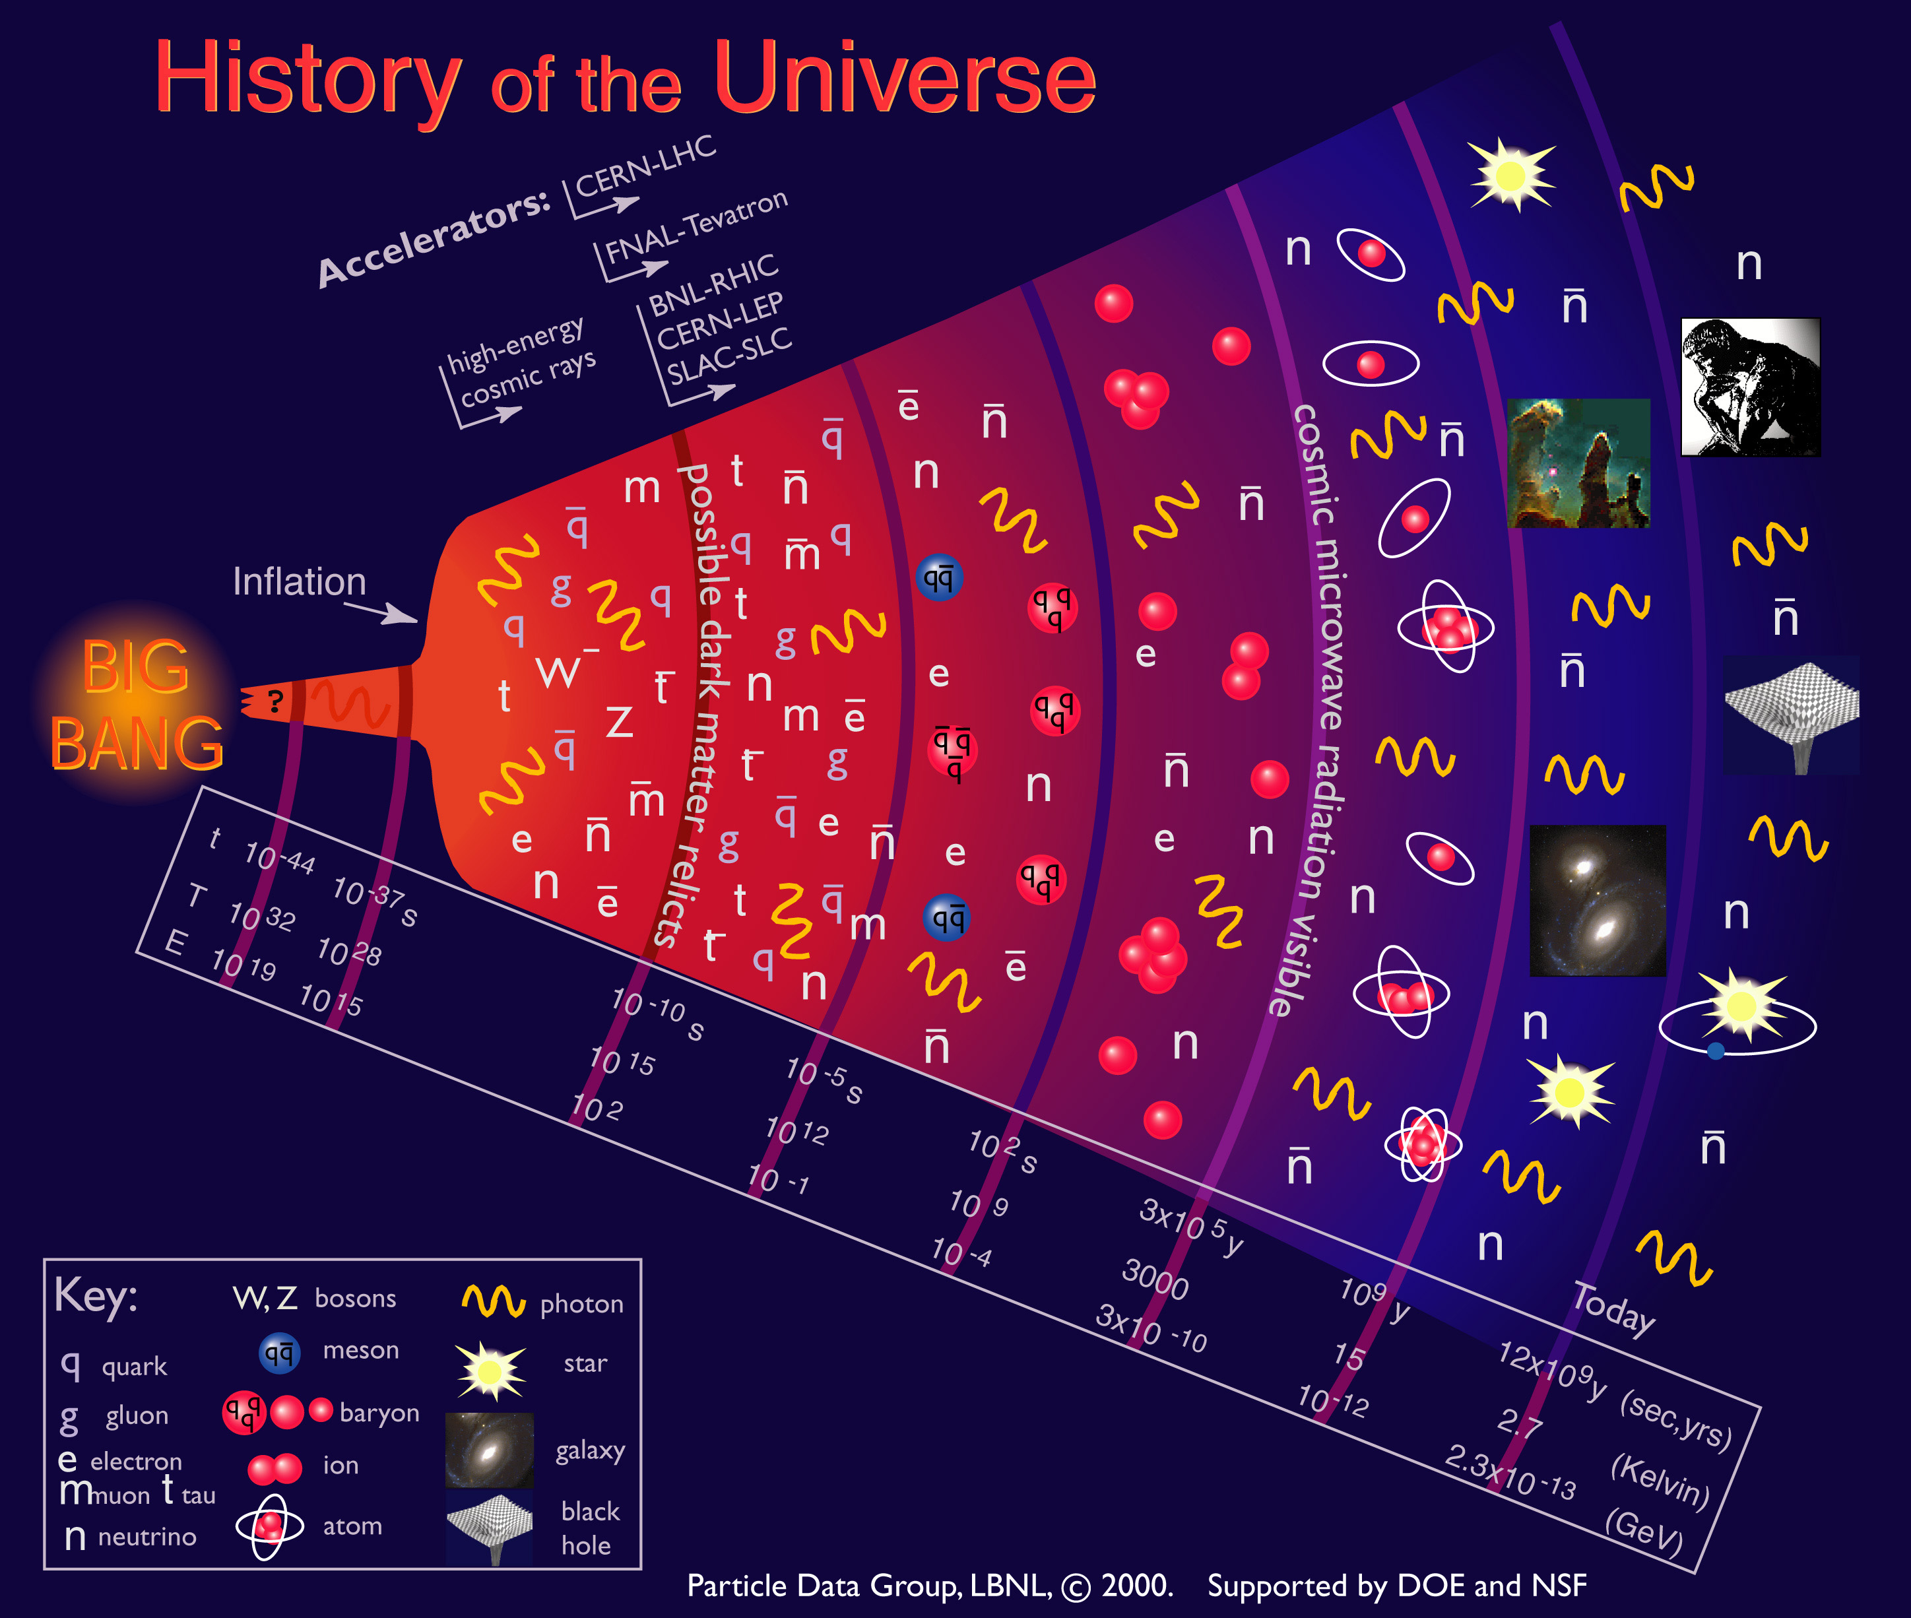
History of the Universe

Slide 8
Large Instruments for Science and Society
Particle Accelerators
  To study what is extremely small
    Nuclei are excited and their behavior observed
    Particles are created from energy and analyzed
    Short wavelength photons and neutrons are indirectly generated to observe the invisible world
  As intense particle sources for applications
    cancer therapy and radio-isotope production
    nuclear waste transmutation to reduce toxicity
    intense photon beams for: micro-lithography, food, catalysis, etc.
Large Telescopes
  To study what is extremely far away and big
    Viewing far in space and time
    Observing large phenomena at their extreme conditions

Slide 9
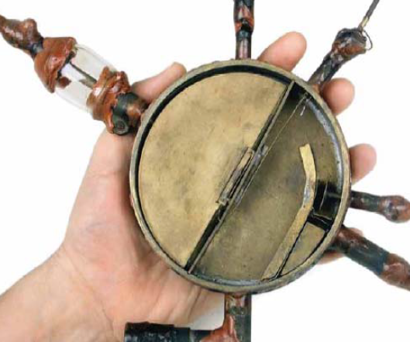
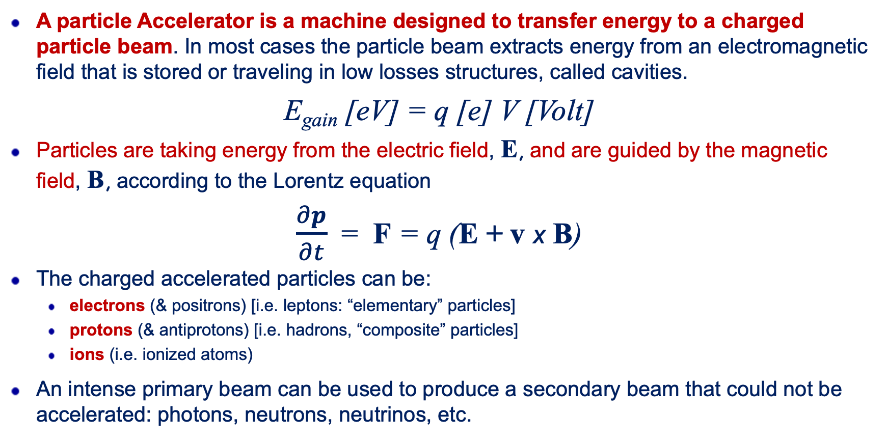
What is a Particle Accelerator ?
A particle Accelerator is a machine designed to transfer energy to a charged particle beam. In most cases the particle beam extracts energy from an electromagnetic field that is stored or traveling in low losses structures, called cavities.
E_{gain} [eV] = q [e] V [Volt]
Particles are taking energy from the electric field, E, and are guided by the magnetic field, B, according to the Lorentz equation
$\frac{∂p}{∂t}$ = F = q (E + v x B)
The charged accelerated particles can be:
  electrons (& positrons) [i.e. leptons: “elementary” particles]
  protons (& antiprotons) [i.e. hadrons, “composite” particles]
  ions (i.e. ionized atoms)
An intense primary beam can be used to produce a secondary beam that could not be accelerated: photons, neutrons, neutrinos, etc.

Slide 10
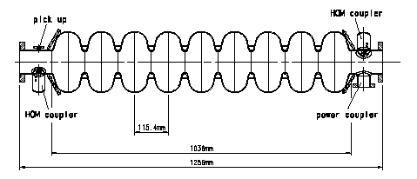
Acceleration inside a TESLA Cavity
An electromagnetic field is resonating inside the “cavity”. The electric field inverts its direction according to the frequency determined by the cavity resonator shape.
If the charged particle beam has the proper synchronism, moving from one cell to the other it sees always the field in the right direction and gains energy: E_{gain} = q · V
Electric Field
電場
Particle
(陽)電子

Slide 11
Particle Accelerator Components
Source
Accelerator
User
source of charged particles
electrons, protons, heavy ions, special cases: positrons & anti-protons
accelerating elements
radiofrequency cavities to provide the electric fields that transfer energy to the particles
beam guiding elements
mainly magnetic, in order to maintain (focus) the beam on the wanted trajectory
and to provide the orbit (closed for a synchrotron) in the case of a circular machine
vacuum and beam diagnostics
high vacuum is needed to avoid perturbation of the beam by collisions with residual
gas, and beam diagnostics assure the monitoring of the beam trajectories
user installations
experimental set-ups including targets, spectrometers, detectors, patients, etc.

Slide 12
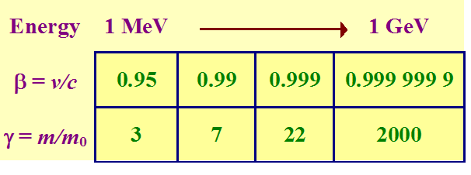
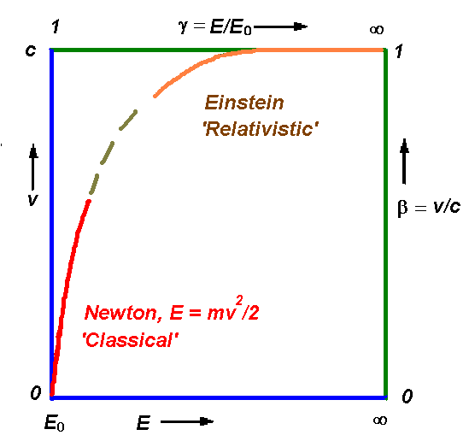
Acceleration ?
Modern accelerators can accelerate particles to speeds very close to that of light.
At low energies, the velocity of the particle increases with the square root of the kinetic energy (Newton).
At relativistic energies, the velocity increases very slowly asymptotically approaching that of light (Einstein).
It is as if the velocity of the particle ‘saturates’.
One can pour more and more energy into the particle, giving it a shorter De Broglie wavelength so that it probes deeper into the sub-atomic world.
What does special relativity tell us,
e.g. for an electron?
The speed increases, but not as spectacularly as the mass. In fact, it would be more correct to speak of the momentum (mv) increasing.

Slide 13

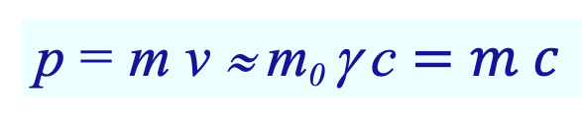
Energy and Mass
m = γ m₀ E₀ = m₀ c²
γ = (1-β ²)^{-1/2} β = v/c
E = m c ²
Momentum
Kinetic energy
p = m v ≈ m₀ γ c $=m c$
when v ≈ c
K = E – E₀ = (γ - 1) m₀ c²
Speed of light: c ≡ 2.99792458 ⋅ 10⁸ ms⁻¹
Energy unit: 1 eV = 1.6021 ⋅ 10⁻¹⁹ J
Electron rest energy: E₀ = 0.511 MeV/c²
Proton rest energy: E₀ = 938 MeV/c²

Slide 14
Contents
Introduction
Pioneering Age driven by Nuclear Physics
Colliderrs driven by High Energy Physics
The Photon Adventure
Accelerators and Society

Slide 15
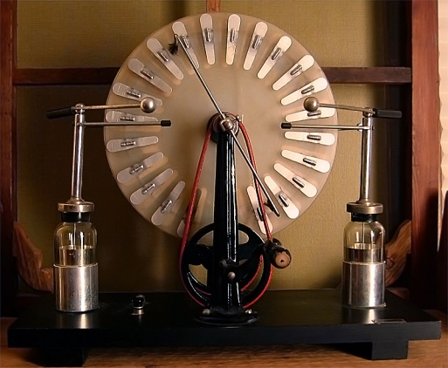
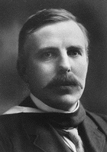
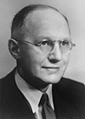
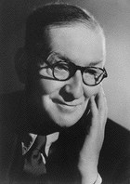
Energy Evolution
<100 keV electrons from Wimshurst-type machines:
1895 Lenard electron scattering on gases (Nobel Prize 1905 for work on cathode rays).
1913 Franck and Hertz excited electron shells by electron bombardment.
Few MeV from natural alpha particles:
1906 Rutherford bombards mica sheet with natural alphas
1919 Rutherford induces a nuclear reaction with natural alphas.
To go ahead an accelerator was needed for physics research
  1928 Cockcroft & Walton start designing an 800 keV generator encouraged by Rutherford.
  1932 Cockcroft & Walton construct first “high-energy” accelerator, 700 eV, and produce first artificially generated nuclear reaction: p + Li -> 2 He
  1932 Lawrence and Livingston construct first cyclotron giving 1.2 MeV protons
http://www.youtube.com/watch?v=Zilvl9tS0Og

Slide 16
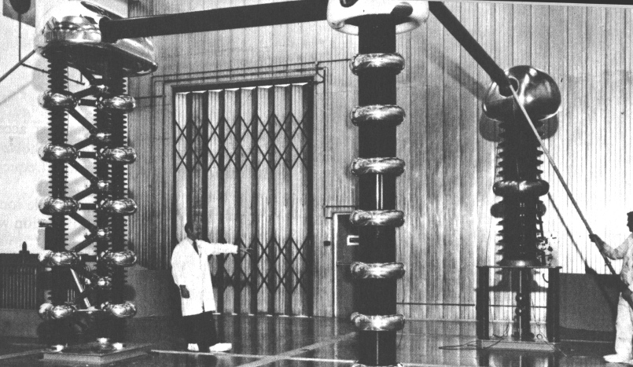
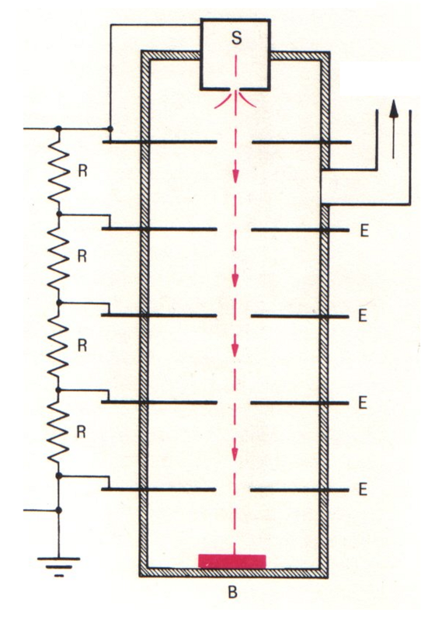
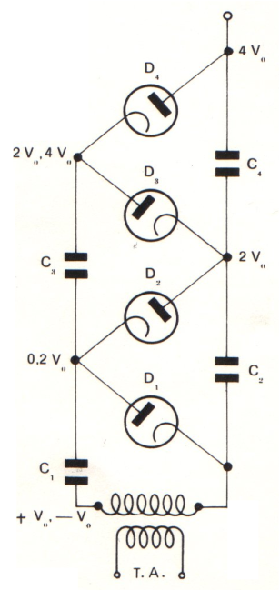
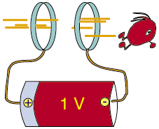
Cockroft & Walton Generator/Accelerator
Electrostatic Accelerator
▽ ✕ E = 0
MULTI-TURN
Cockcroft-Walton generator injecting protons into the synchrotron at Rutherford laboratory (1964-1978).
The Cockcroft-Walton accelerator allows to reach high beam currents, of interest for many applications, but the voltage is practically limited to somewhat above 1 MV, because of breakdown of insulation

Slide 17
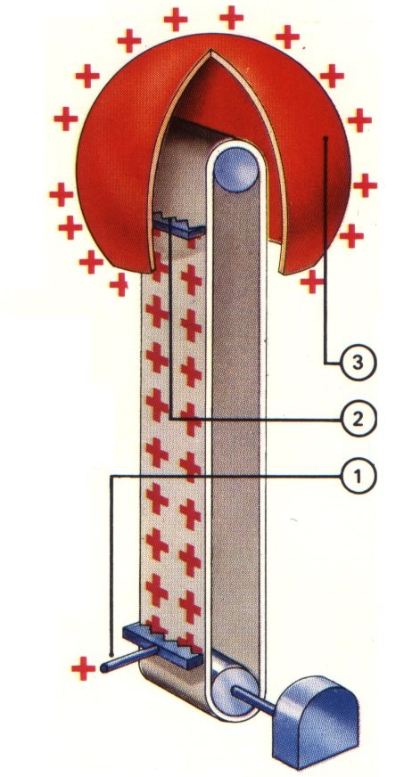
Van de Graaff Accelerator Principle
High voltage for electro-static accelerator
the concept of charge transport (see left) has been introduced by R. J. van de Graaff
a comb-like electrode (1) sprays charges on an insulating conveyor belt (the high-voltage generator typically being again a rectifier multiplier)
The conveyor transports the charges inside the sphere-shaped terminal (3), which forms in fact a Faraday cage
The charges are collected by a second comb like electrode (2) which is connected to the sphere
consequently, the charges accumulate on the outside of the sphere and the inside get charge free, ready to accept further charging
In practice, one can reach up to 25 MV, provided one uses (expensive) SF₆ gas for limiting breakdowns

Slide 18
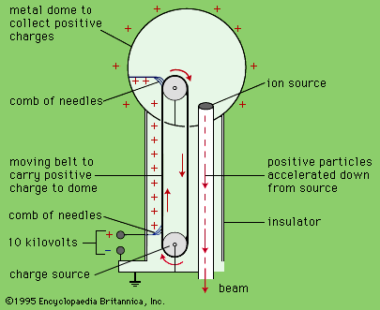
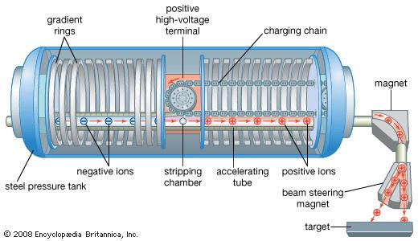
The Van de Graff (1929) and the Tandem
The Van de Graff Accelerator
The Tandem Accelerator
In the Tandem, also invented by van de Graaff, the voltage is used twice: source and target are at ground voltage and a stripping foil change the charge state in the positive high voltage terminal
MULTI-TURN

Slide 19
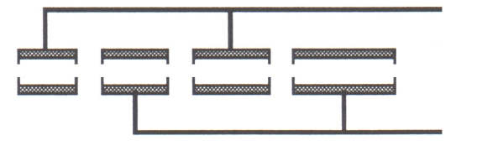
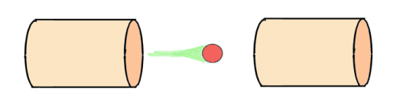
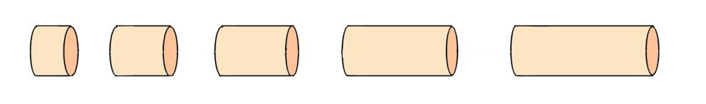
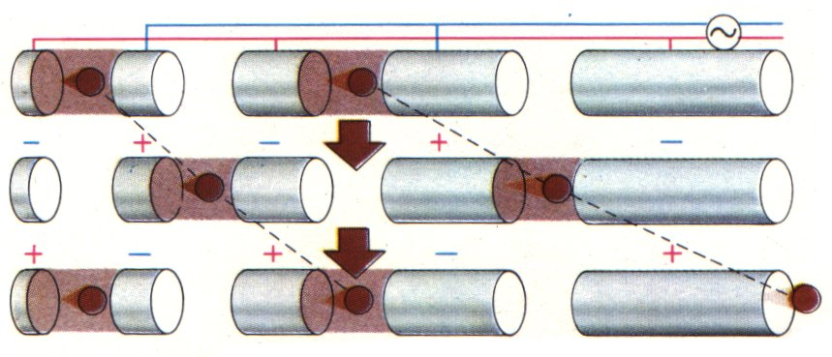
The Wideroe Linear Accelerator (1928)
With a DC accelerator the electric field E is constant, ▽✕E = 0 and the field can be used once.
consider now such a column, but driven with an alternating voltage, in such way that consecutive electrodes are connected to opposite polarity of the RF generator, ▽✕E = 0 , field can be used many times
suppose now, that the RF frequency is such that it accelerates the particle between electrodes 1&2 (and also 3&4), whereas the field is opposite, at that moment, between accelerating gaps, 2&3 and 4&5, respectively
if this particle arrives now at the gap between 2&3, when the RF has changed to opposite phase, acceleration occurs again, and so on.
note that while the polarity change occurs, the particle is in the field-free space of the drift tube of such a Wideroe linac. Further, to stay in phase with the RF, as the speed of the particle increases, the length of the drift tubes has to increase
GND
R
R
R
R
-HV
+
-
+
1
2
3
4
5
π mode

Slide 20
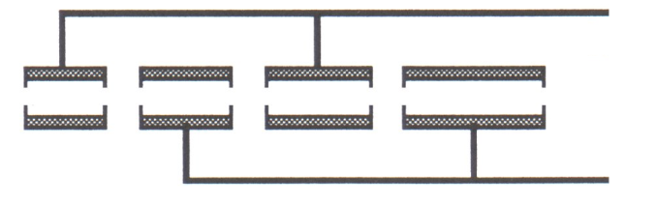
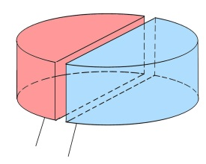
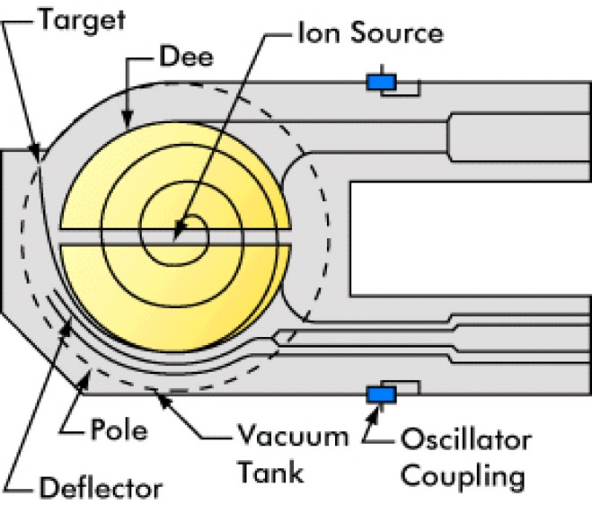
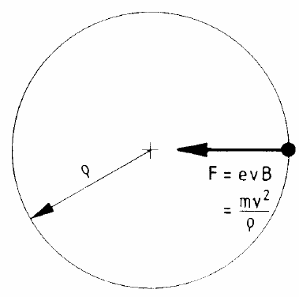
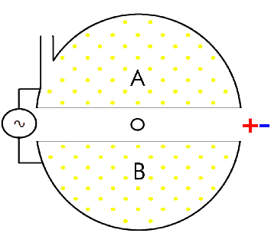
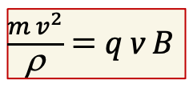
RF acceleration: Cyclotron
Folded Wideroe Linac in a constant magnetic field
$\frac{{m v}^{2}}{\text{r}}$ = q v B
For m and B = constant
also f_{rev} = constant
E_{c} /A [MeV] = K_{cycl.} (Z/A)²

Slide 21
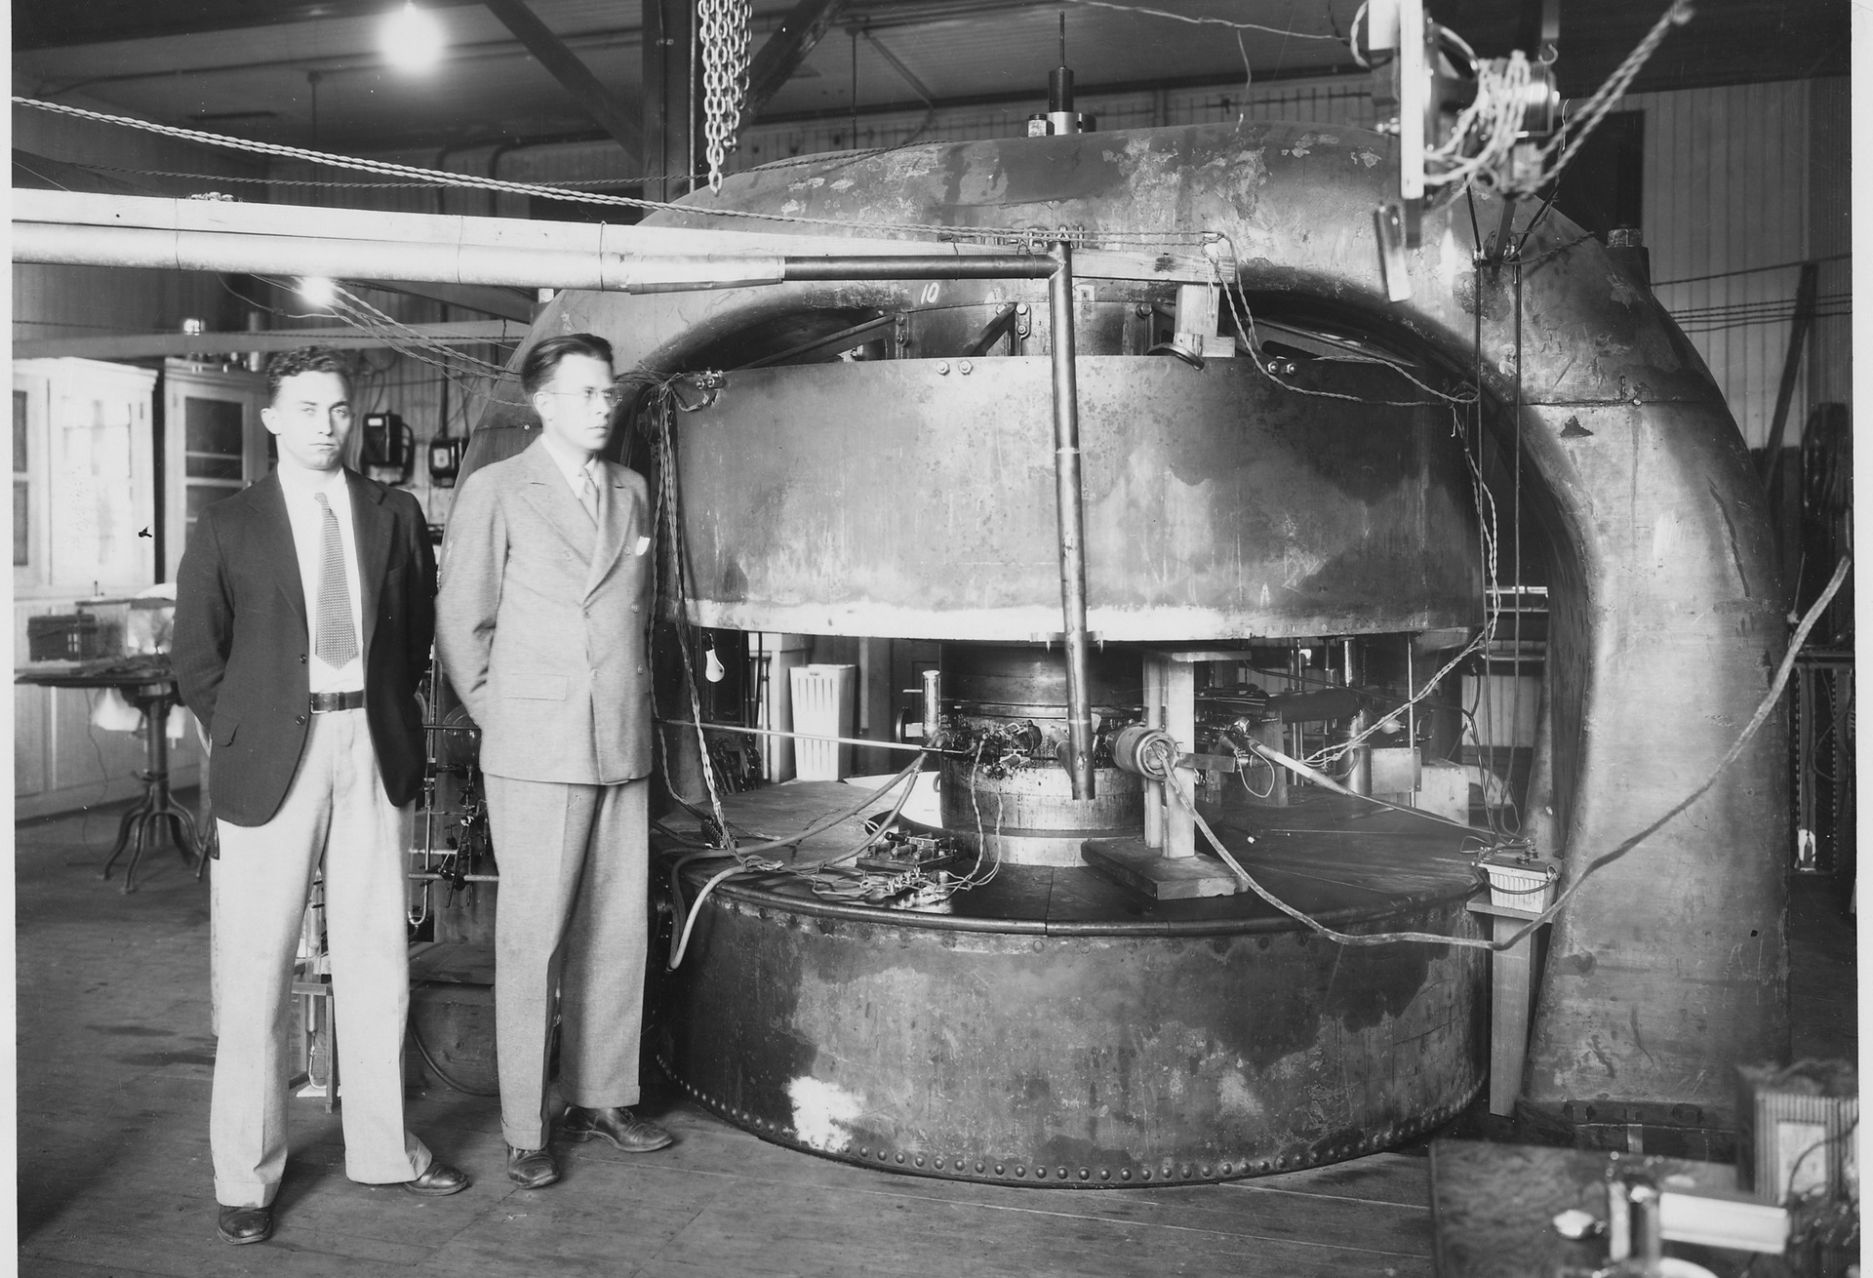
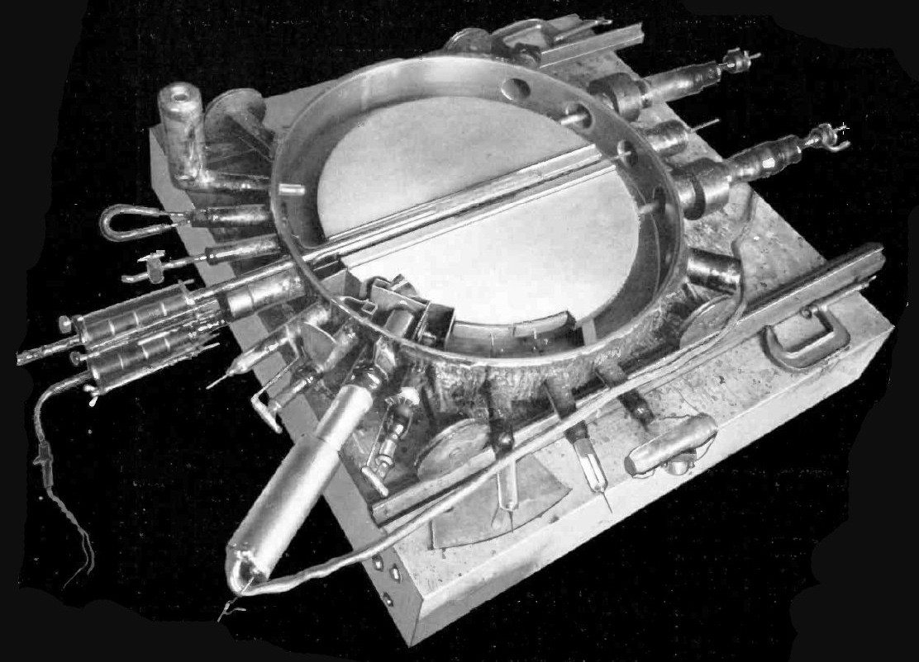
The First real Accelerator at Berkeley (1932)
M. Stanley Livingston and Ernest O. Lawrence (right) in front of Lawrence's 69 cm (27 in) cyclotron at the Lawrence Radiation Laboratory. The curving metal frame is the magnet's core, the large cylindrical boxes contain the coils of wire that generate the magnetic field. The vacuum chamber containing the "dee" electrodes is in the center between the magnet's poles.
Vacuum chamber of Lawrence 69 cm (27 in) 1932 cyclotron with cover removed, showing the dees. The 13,000 V RF accelerating potential at about 27 MHz is applied to the dees by the two feedlines visible at top right. The beam emerges from the dees and strikes the target in the chamber at bottom.

Slide 22
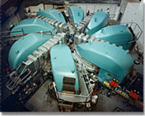
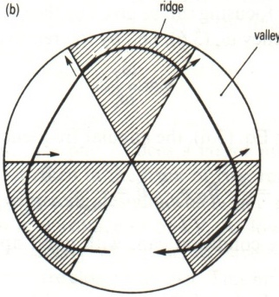
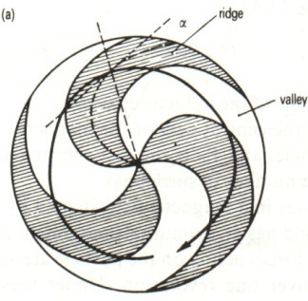
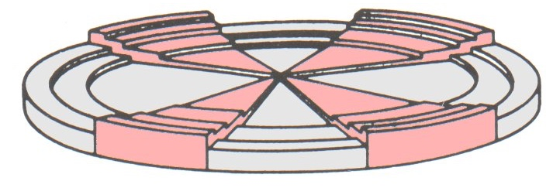
The PSI Cyclotron Facility
The K=590 cyclotron of the PS facility is a 8 separated sector machine with 4 accelerating cavities
The injection energy of 70 MeV iprovided by another cyclotron
The accelerator is in operation since the 1970's, and has been very carefully
optimised for this long period
The exceptional experience gained at PSI allows now to approach an intensity of almost 2 mA
These high current 590 MeV proton beams feed the SINQ spallation neutron source
The SINQ solid metal target has been temporarily replaced by the prototypical (e.g. for an ADS) molten metal target
MEGAPIE (see right)
accelerating cavity sector magnet

Slide 23
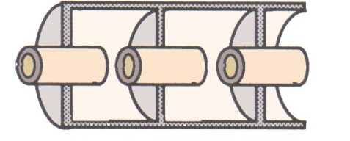
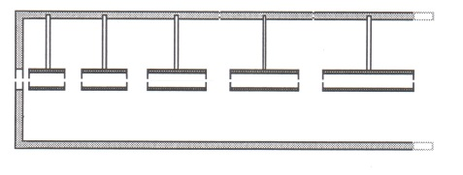

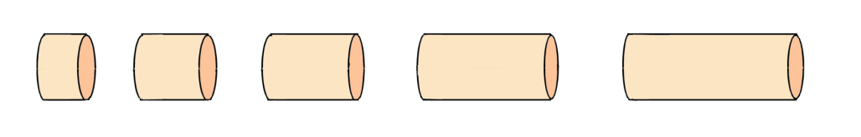
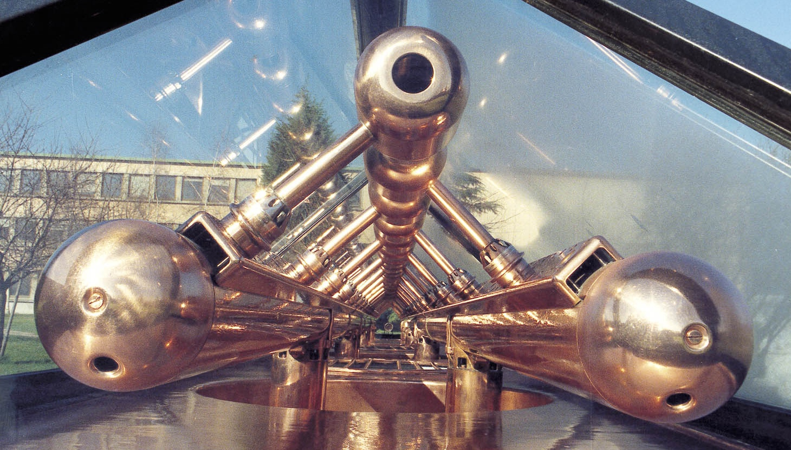
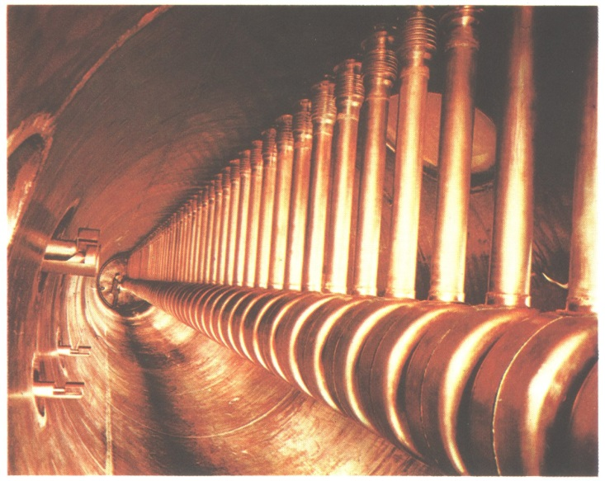
French Linear Accelerators in 1946
π mode
2π mode
Historical examples: a Wideroe type structure
(ALICE heavy ion injector, IPN Orsay)
A drift tube linac (DTL – Alvarez type)
(Saturne, CEA Saclay)

Slide 24
Some Milestones for Accelerators
1928 Cockcroft&Walton develop a 700kV electrostatic accelerator based on a voltage multiplier.
1928 first Linac by Wideroe based on the concept of resonant acceleration.
1929 Lawrence invents the cyclotron.
1944 MacMillan, Oliphant & Veksler develop the synchrotron
1946 Alvarez builds a proton linac with Alvarez structures (2π mode)
1954 Courant, Livingston and Snyder implant strong focusing at the Brook- haven Cosmotron Synchrotron
1956 Kerst stresses in a paper the concept of a collider
1961 Colliding beams demonstrated at Frascati (AdA)
1970 Kapchinski & Telyakov invent the radio-frequency quadrupole (RFQ).
mid 70‘s superconducting magnets for cylotrons and synchrotrons considerably boost the performance (energy for size), in particular for colliders
mid 80’s the development of superconducting accelerating cavities provides very high power conversion efficiency, and CW operation for high luminosity

Slide 25
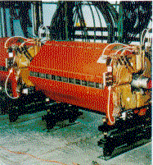
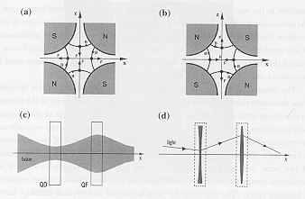
Transverse “Strong Focusing”
Alternating gradient (AG) principle (1950’s)
A sequence of focusing-defocusing fields provides a stronger net focusing force.
Quadrupoles focus horizontally, defocus vertically or vice versa. Forces are proportional to displacement from axis.
A succession of opposed elements enable particles to follow stable trajectories, making small oscillations about the design orbit.
FermiLab quadrupole
Technological limits on magnets are high: iron saturation and dissipated power for high current
Superconducting magnets are required for high field
Solenoids are preferred at low energy, with high space charge forces: continuous focusing

Slide 26
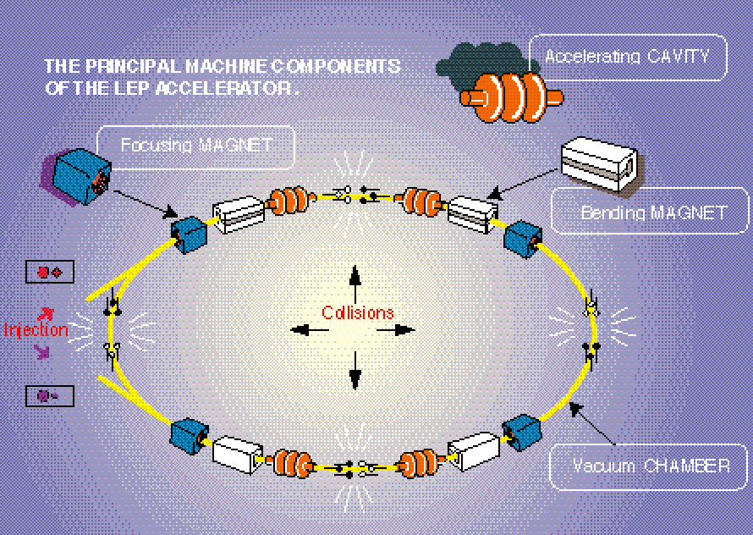
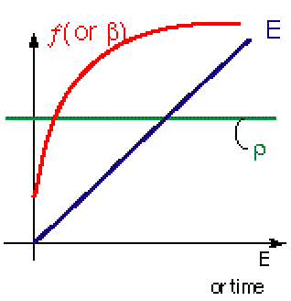
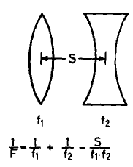

RF acceleration: Synchrotron
The LEP Example
Cyclotron: constant B
Synchrotron: constant ρ
Accelerating cycle
β = v/c
Strong focusing concept
For v ≈ c
E [GeV] ≈ 0.3 B [T] ·ρ [m]

Slide 27
Contents
Introduction
Pioneering Age driven by Nuclear Physics
Colliderrs driven by High Energy Physics
The Photon Adventure
Accelerators and Society

Slide 28
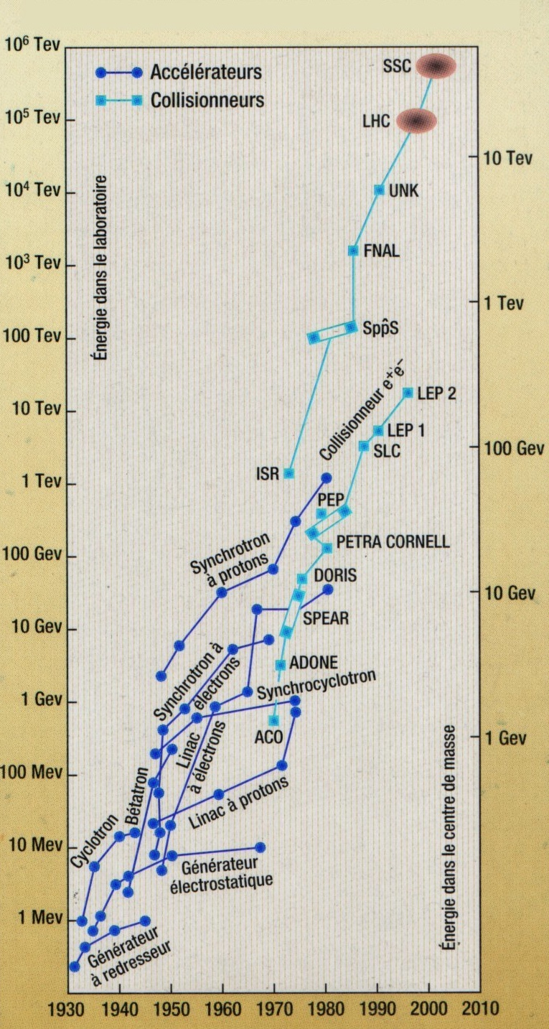
The Livingston Chart
Around 1950, Livingston made a quite remarkable observation: Plotting the energy of an accelerator as a function of its year of construction, on a semi-log scale, the energy gain has a linear dependence.
50 years later, that was still true.
In other words, builders of accelerators have managed exponential growth, every ten years, roughly a actor of 33 is won.
Note that for a given "family" of accelerators, generally, saturation of maximum energy sets in after some time.
After 2000 this behaviour is lost

Slide 29
The Livingston Chart
Around 1950, Livingston made a quite remarkable observation: Plotting the energy of an accelerator as a function of its year of construction, on a semi-log scale, the energy gain has a linear dependence.
50 years later, that was still true.
In other words, builders of accelerators have managed exponential growth, every ten years, roughly a actor of 33 is won.
Note that for a given "family" of accelerators, generally, saturation of maximum energy sets in after some time.
After 2000 this behaviour is lost
beam-beam
beam-target

Slide 30
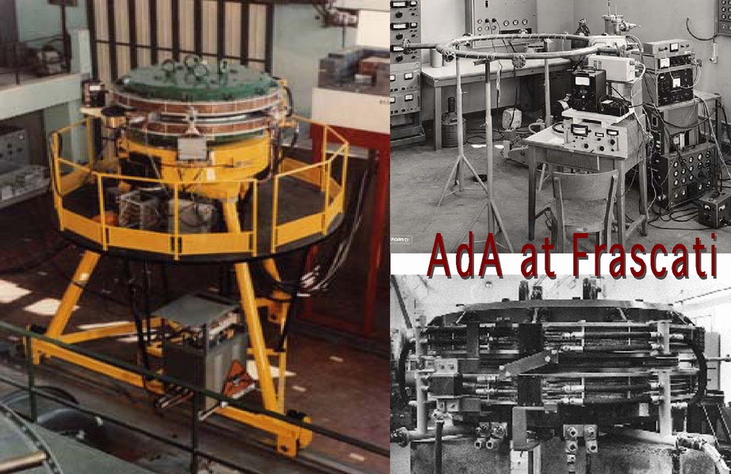
1961: AdA the first Collider

Slide 31
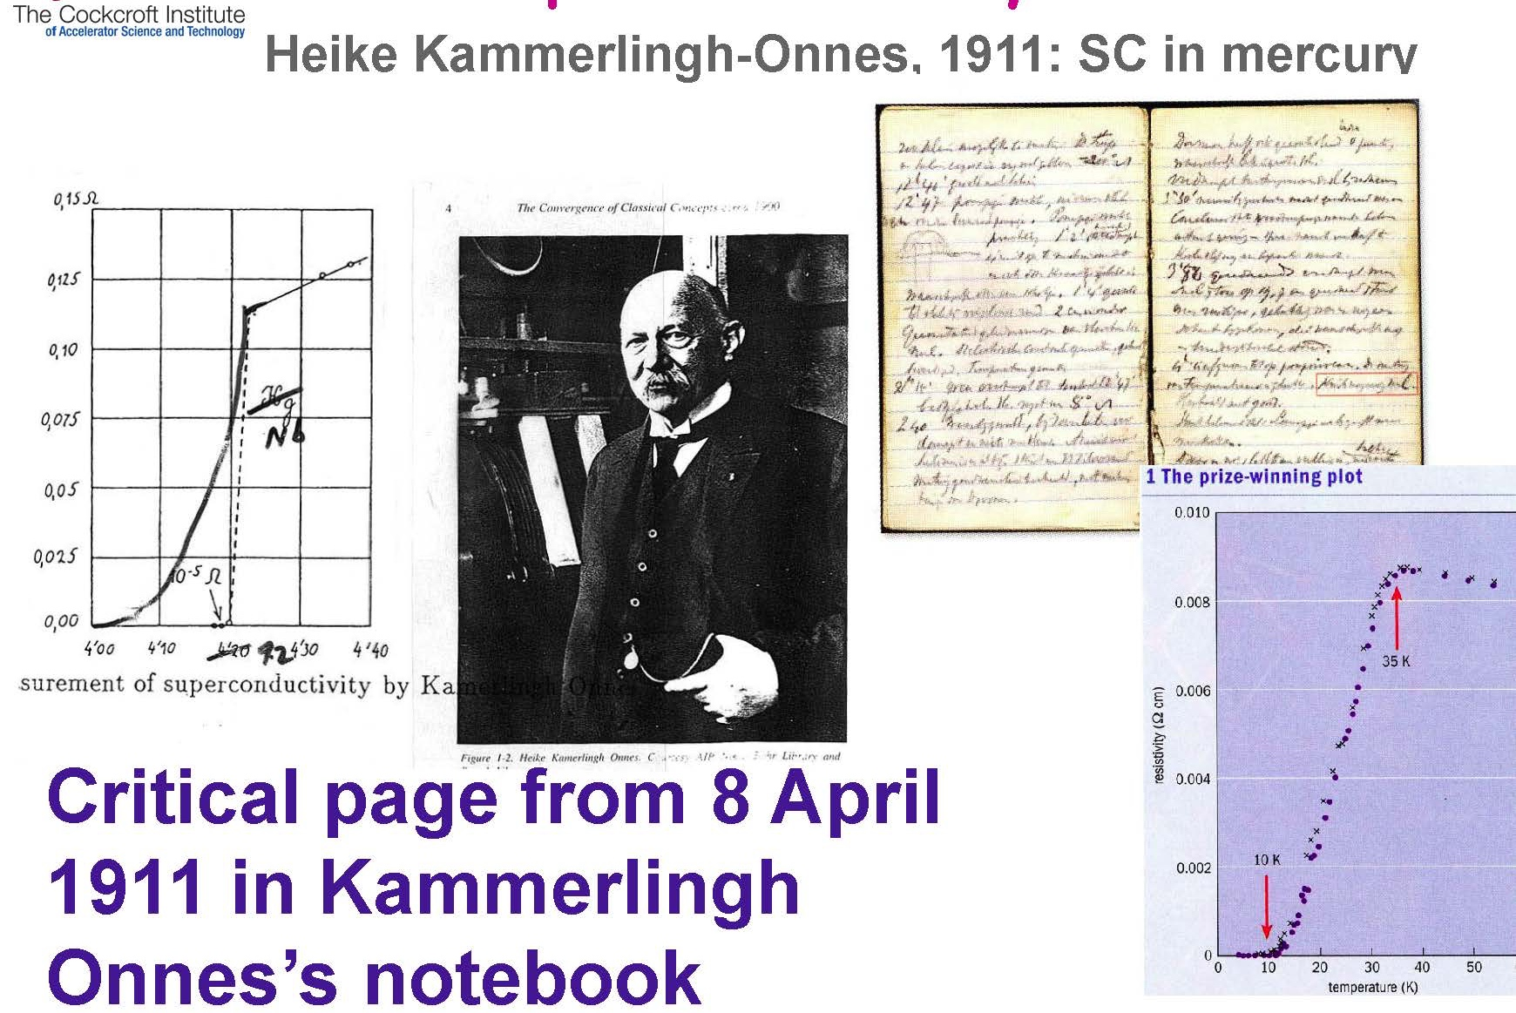
Superconductivity

Slide 32
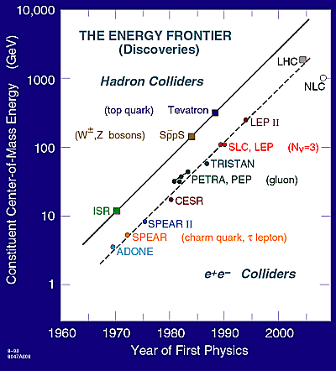
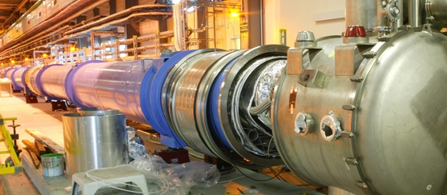
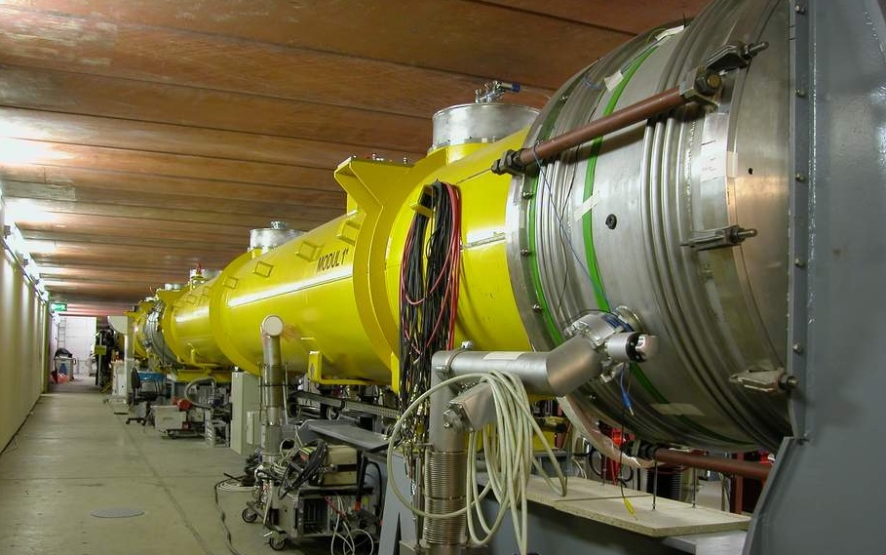
Energy Frontier and Accelerator Technology
Superconducting Dipoles
∅ = 38”
ILC-CEPC
LHC Dipole String
Superconducting RF Cavities
ACC 4 & ACC 5 in TTF
∅ = 38”
ILC Cavity String

Slide 33




Superconducting Magnets for Higher Energy

Slide 34

One of LEP 2/LHC cryogenic plants (4.3MW)

Slide 35


Superconducting RF for Beam Power (CW)
LEP II & CERN
32 bulk niobium cavities
  Limited to 5 MV/m
  Poor material and inclusions
256 sputtered cavities
  Magnetron-sputtering of Nb on Cu
  Completely done by industry
  Field improved with time
  <E_{acc}> = 7.5 MV/m (Cryo-limited)
4-cell cavities
352 MHz, L_{act}=1.7 m
CEBAF & Jlab
338 bulk niobium 5-cell cavities – 1.5 GHz
Produced by industry & Processed at TJNAF in a dedicated infrastructure

Slide 36

LEP @ LHC in the CERN area

Slide 37

The LEP Accelerator Complex @ CERN
Aerial view of the CERN site with an indication of the circular LEP tunnel
Linacs and synchrotrons were used to inject in the 28 km synchrotron where both electron and positrons were accelerated up to 100 GeV to collide with a centre of mass energy of 200 GeV
LHC now in commissioning is making use of most of the LEP injection accelerator complex

Slide 38


From LEP to LHC

Slide 39

LHC Layout

Slide 40


Basic Physics Discovery before LHC

Slide 41


Unification of forces

Slide 42

Standard Model Chart before LHC (2008)

Slide 43
LHC General Parameters (protons)

Slide 44
Higgs Particles and Higgs Field
Higgs Particles
  also called: God Particles and Holy Grail of Particle Physics
  They are spin=0 Bosons
  The Higgs is neither matter nor force
  The Higgs is its own antiparticle
  The Higgs is just different
  This would be the first fundamental scalar ever discovered
Higgs Field
  Neutral scalar field that fills the entire universe
  Particles traveling through the universe interact with this field & become massive
  Importantly, the W and Z bosons receive mass but not the photon in the Standard Model
  The Higgs field is thought to fill the entire universe.
  Could give a handle on dark energy (scalar field) ?
Higgs Particles as a very powerful probe of new physics

Slide 45


Simulations of Higgs events at CERN/CMS
CERN-EX-9710002_05
CERN-EX-9710002_10

Slide 46



SM Higgs mass from LEP2 & Tevatron
Fumihiko Takasaki
May 20, 2006
${ m}_{H}={117}_{−45 }^{+67 }$GeV/$c^{2}$

Slide 47

Why we insist for leptons ?
Leptons (e⁻, e⁺, μ⁻, μ⁺) are Fermions, i.e. matter constituents
e⁺
e⁻
E_{react.} = E_{c.m.} = 2 E_{beam}
Hadrons (p, , ions) are complex composite particles
Fighting for Luminosity
u
u
u
d
u
d
p
p
E_{react.} << 2 E_{beam}
Gluon-Gluon Collision
E_{react.} cannot be controlled and it is unknown

Slide 48


Higgs event Simulation Comparison
LHC
ILC
e⁺ e– → Z H
Z → e⁺ e–, H → b

Slide 49
Relation of LHC and ILC
C. Pagani - ISLC08 - Lecture 1
Oak Brook, October 20, 2008
Since the ILC will start after the start of LHC, it must add significant amount of information. This is the case!
Neither LC nor HC’s can draw the whole picture alone. ILC will add new discoveries and precision of ILC will be essential for a better understanding of the underlying physics.
There are probably pieces which can only be explored by the LHC due to the higher mass reach. Joint interpretation of the results will improve the overall picture
In the Higgs Boson Scenario
LHC will make the discovery
ILC will behave as a Higgs Boson factory to precisely determine its properties and the consequences for physics beyond the standard model

Slide 50

Linear Collider Conceptual Scheme
C. Pagani - ISLC08 - Lecture 1
Oak Brook, October 20, 2008
Final Focus
Demagnify and collide beams
Main Linac
Accelerate beam to IP energy without spoiling DR emittance
Bunch Compressor
Reduce σ_{z} to eliminate hourglass effect at IP
Damping Ring
Reduce transverse phase space (emittance) so smaller transverse IP size achievable
Positron Target
Use electrons to pair-produce positrons
Electron Gun
Deliver stable beam current

Slide 51







Competing technologies for the ILC Linac
C. Pagani - ISLC08 - Lecture 1
Oak Brook, October 20, 2008
1.3 GHz - Cold
11.4 GHz - Warm
30 GHz-Warm

Slide 52


Competing RF Structures for the ILC Linac
NC Traveling wave
v_{ph} ≈ c and v_{g} < c Nornal Conducting
SC Standing wave
v_{ph} = 0 and v_{g} = 0 Super Conducting
C. Pagani - ISLC08 - Lecture 1
Oak Brook, October 20, 2008
NLC/GLC: f = 11.4 GHz
CLIC f = 30 GHz
TESLA: f = 1.3 GHz
π mode
Remembering that the power dissipated on the cavity walls to sustain a field is:
standing wave case
a pulsed operation is required to reduce the
time in which the maximum allowable field is
produced to accelerate the particles

Slide 53
All Linear Colliders are pulsed
All the LCs must be pulsed machines to improve efficiency. As a result:
duty factors are small
pulse peak powers can be very large
C. Pagani - ISLC08 - Lecture 1
Oak Brook, October 20, 2008
<1 µs-1ms
<10-200 ms
RF Pulse
100 m - 300 km
Bunch Train
……
1-300 nsec
…………………....
gradient
with further input
Beam Loading
without input
accelerating field pulse:
filling
loading

Slide 54
Fighting for Luminosity
C. Pagani - ISLC08 - Lecture 1
Oak Brook, October 20, 2008
L = Luminosity
N_{e} = # of electron per bunch
σ_{x,y} = beam sizes at IP
IP = interaction point
n_{b} = # of bunches per pulse
f_{rep} = pulse repetition rate
P_{b} = beam power
E_{c.m.}= center of mass energy
Parameters to play with
Reduce beam emittance (ε_{x} .ε_{y} ) for smaller beam size (σ_{x}.σ_{y} )
Increase bunch population (N_{e} )
Increase beam power
Increase beam to-plug power efficiency for cost

Slide 55

ILC: Pictorial View of the Winner

Slide 56
Glossary
Units of Energy : eV (Electron Volt)
MeV ; Mega Electron Volt : 10⁶ eV
GeV ; Giga Electron Volt : 10⁹ eV
TeV ; Tera Electron Volt : 10¹² eV
Particle Masses
Electron : 0.5 MeV/c², Proton : 938 MeV/c²
Cross section : σ
nb : 10⁻³³ cm² , pb : 10⁻³⁶ cm² , fb : 10⁻³⁹cm²
Luminosity : L
Number of Particle collisions per unit time per unit area
e.g. : the KEKB recorded L = 1.6 x10³⁴ cm⁻²sec⁻¹
Integrated Luminosity : ∫ L
Luminosity integrated over some time interval,
e.g. : the KEKB recorded ∫L = 10³⁹cm⁻² = fb⁻¹ in a day.

Slide 57
About Orders of Magnitude
Linear Sizes in the Universe
    Quark 10 ⁻¹⁹ m
    Proton & Neutron 10 ⁻¹⁵ m
    Atoms 10 ⁻¹⁰ m
    Cells 10 ⁻⁸ - 10 ^{–3} m
    Human being 10 ⁰ m
    Earth 10 ⁷ m
    Sun 10 ⁹ m
    Solar System 10 ¹³ m
    Milky Way 10 ²¹ m
    Univers 10 ²⁶ m

Slide 58
Just for fun
Linear Ratio between the sizes of
the universe and the quark
45 digits
60 digits are used for encrypting codes !

Slide 59

Standard Model Chart including LHC (2014)

Slide 60

Basic Knowledge after LHC

Slide 61
Different attitudes by different actors
Most of the major actors are taking advantage of the developed cold technology investing in large infrastructures for applied science
CERN concentrated the efforts in the LHC upgrade toward a100TeV, 100km, Hadron Collider, while resurrecting the interest on CLIC and Muon Colliders.
US and China focused their attention on the more accessible neutrino Physics, well matched with the growing impact of astrophysics
Japan organized the effort to adapt the ILC to the lower energies demanded by a high luminosity boson factory
China, following the large ring idea, inverted the priorities focusing on the design of an Higgs Factory first.

Slide 62



Beyond the Standard Model ( > 2035 ) e⁺-e⁻
e⁺e⁻ Colliders
Competing Projects
FCC-ee
CLIC
ILC 250

Slide 63
FCC-ee collider parameters (F. Zimmermann)
parameter | Z | WW | H (ZH) | ttbar
beam energy [GeV] | 45 | 80 | 120 | 182.5
beam current [mA] | 1390 | 147 | 29 | 5.4
no. bunches/beam | 16640 | 2000 | 393 | 48
bunch intensity [10¹¹] | 1.7 | 1.5 | 1.5 | 2.3
SR energy loss / turn [GeV] | 0.036 | 0.34 | 1.72 | 9.21
total RF voltage [GV] | 0.1 | 0.44 | 2.0 | 10.9
long. damping time [turns] | 1281 | 235 | 70 | 20
horizontal beta* [m] | 0.15 | 0.2 | 0.3 | 1
vertical beta* [mm] | 0.8 | 1 | 1 | 1.6
horiz. geometric emittance [nm] | 0.27 | 0.28 | 0.63 | 1.46
vert. geom. emittance [pm] | 1.0 | 1.7 | 1.3 | 2.9
bunch length with SR / BS [mm] | 3.5 / 12.1 | 3.0 / 6.0 | 3.3 / 5.3 | 2.0 / 2.5
luminosity per IP [10³⁴ cm⁻²s⁻¹] | 230 | 28 | 8.5 | 1.55
beam lifetime rad Bhabha / BS [min] | 68 / >200 | 49 / >1000 | 38 / 18 | 40 / 18

Slide 64


CEPC CDR Baseline Layout
H
W and Z
CEPC collider ring (100km)
CEPC booster ring (100km)
CEPC Linac injector (1.2km, 10GeV)

Slide 65

Beyond the Standard Model ( > 2050 ) μ⁺-μ⁻
Proton-driven Muon Collider Concept 3-10 GeV
The design is driven by the short muon lifetime = 2.2 μs

Slide 66

Beyond the Standard Model ( > 2050 ) p-p
FCC-hh

Slide 67
Contents
Introduction
Pioneering Age driven by Nuclear Physics
Colliderrs driven by High Energy Physics
The Photon Adventure
Accelerators and Society

Slide 68
The “small” photon adventure
1 Angstroms is the size of
one atom
Normal inorganic molecules
are sizing a few Angstroms
Biological molecules and
cells are much bigger but
they are composed by atoms
1 Angstroms = 10⁻¹⁰ m
Human eye detects photon
wavelength ranging from
4,000 to 7,000 Angstroms
(4^{x}10⁻⁷ to 7^{x}10⁻⁷ m)
Image resolution is limited by the photon wavelength
To see what is smaller than 4,000 Angstroms we need:
  Smaller photons, with respect to the visible light
  A different detector, with respect to our eyes
Particle accelerators give energy to electrons
Bending the energetic electron trajectory
photons are produced
High energy produces small photon wavelength,
that is X-rays
Energy lost [GeV] per turn

Slide 69

X-ray sources and X-ray Lasers
X-ray (from synchrotron sources) have opened the Ultra-Small World
Coherent X-ray (from XFEL) for the Ultra-Small and Ultra-Fast Worlds
Ultra Small
Ultra Fast
© John N. Galayda

Slide 70


Brilliance vs Photon Energy
FEL
&
X_FEL
Synchrotron
Light
Sources
Atom size
Atom size
FEL = Free Electron Laser
λ_{ph} [μm] = 1.24 / E_{ph} [eV]

Slide 71
Synchrotron light sources for X-rays
Synchrotron light is used for
  Physics and Chemistry
    Crystallography
    Material science
    Fast Chemical Reactions
  Biology and Medicine
    Structural Biology
    Biological Imaging
    Medical Imaging
    Microbeam radiotherapy
  Engineering
    Lithography
    Micromachining

Slide 72


Synchrotron Radiation and XFEL
http://www.xfel.eu/
Undulators
line spectrum
much higher intensity
extremely focused

Slide 73




Modulation of the electron bunches
undulator
entrance
half-way
saturation
full
saturation
GENESIS simulation of the TTF parameters
Sven Reiche (UCLA)

Slide 74




European XFEL: completed in 2016
https://www.youtube.com/watch?v=p3G90p4glQA
3.4km
http://www.xfel.eu/

Slide 75

Eu-XFEL & LCLS-II use TESLA SRF Tech.
Injector
1.3 GHz module
≈ 150 MeV
3.9 GHz 3rd harm.
≈ 25 MeV
L1
4 modules
(1 RF station)
L2
12 modules
(3 RF stations)
L3
80 modules
(20 RF stations)
E-XFEL
SASE2
300 kW
1 Module
A2
A3
A4
A5
A6
A25
A1
AH1
0.24 kW
5 kW
SASE1
9 kW
300 kW
SASE3
n.c.Gun
1.3 GHz
6 MeV
LH, Dogleg, BC0
130 MeV
BC1
600 MeV
BC2
2.4 GeV
Collimation
6 to 17.5 GeV
300 kW
0 m
40 m
240 m
470 m
1460 m
2130 m
2440 m
3100 m
3300 m
LCLS-II

Slide 76

The 3 major facilities use the TESLA. Tech.
Hans Weise @ FEL2021

Slide 77

Satellite Picture of the three XFEL Facilities
Hans Weise @ FEL2021

Slide 78
Two more funded in China for Soft X-Ray
S3FEL
Shenzhen Superconducting Soft X-Ray FEL
2.5 GeV CW SRF accelerator

Slide 79
Two more funded in China for Soft X-Ray
DALS
Dalian Advanced Light Source
2.5 GeV CW SRF accelerator

Slide 80
Contents
Introduction
Pioneering Age driven by Nuclear Physics
Colliderrs driven by High Energy Physics
The Photon Adventure
Accelerators and Society

Slide 81

Particle Accelerators for cancer therapy
Particles are used to kill the tumor cells, stopping their reproduction
Not all cancers are sensitive to the same particles
The tissues around the cancer can be damaged
The level of damage depends on the particles used and on the complexity/cost of the system
  Radio-therapy with photons (X-ray)
    An electron linear accelerator produces a 20-30 MeV electron
    beam that produces photons through a tungsten target
    The machine is simple and thousands have been installed
  Hadron-therapy with protons or carbon ions, ¹²C
    Cyclotrons or Synchrotrons are both used.
    The beam energy determines the penetration depth into the biological tissue
    They can be much more “precise” but the cost is 10 to 100 times higher

Slide 82
Hadrons are better that Photons (X-ray)
X-ray

Slide 83



Hadron therapy at the MGH – Michigan
The 230 MeV Cyclotron
The gantry
The treatment room

Slide 84




Cyclotrons for Isotope Production
IBA cyclotron at ARRONAX
PET trace series of General Electrics
70 MeV
35kW
10 MeV
1kW
T. Sounalet, Arronax
M. Jensen, RISO

Slide 85

Isotopes for PET (positron emission tomography)

Slide 86
ADS - Accelerator Driven System

Slide 87
The subcritical core

Slide 88



From Physics Today, May 2006
(Yucca Mountain)
150 km
55000 tons in 100 temporary repositories in 39 States
2000 tons/y produced in USA 70000 tons is the total Yucca Mountain capacity
Safety analysis after 1 My required for licensing !

Slide 89


Las Vegas Sun
Funds cut to zero in 2011

Slide 90








Most Accelerators are built not for Science
About 30,000 accelerators are in use worldwide (2015)
  Sales of accelerators > $ 2 B /yr and growing
  Accelerators touch over $ 500B/yr in products
  Major Impact on our economy, health, and well being
Some Products:
Shrink wrapped food
Radial Tires
Aircraft
Digital Electronics
N. Lockyer

Slide 91



Accelerators: Essential Tools in Industry - 1
Ion Implantation
Accelerators can precisely deposit ions modifying materials and electrical properties (boron, phosphorous)
Semi Conductors
  CMOS transistor fabrication of essentially all IC’s
  CCD & CMOS imagers for digital cameras
  Cleaving silicon for photovoltaic solar cells
  Typical IC may have 25 implant steps
Metals
  Harden cutting tools
  Reducing friction
  Biomaterials for implants
Ceramics and Glasses
  Harden surfaces
  Modify optics
  Color in Gem stones!
N2 ions reduce wear and corrosion in this artificial femur
N. Lockyer

Slide 92




Accelerators: Essential Tools in Industry - 2
A wide-range of industrial applications makes use of low-energy beams of electrons to drive chemistry
0.1-10 MeV up to MW beam power electrostatic, linac, betatron accelerators
Electron Beam Irradiation
Improved heat resistance of coatings, wire and cable, crosslinking polymers, radial tires, etc)
1500 dedicated facilities worldwide
N. Lockyer

Slide 93



Accelerators: Essential Tools in Industry - 3
Electron beam printing
Conventional printing requires use of enormous amounts of solvents that are created, evaporated, and must be disposed of … all with significant environmental impact
EB printing can print 12 colors at a speed of 10 m/s with water based inks
EB’s also enables new packaging methods for food (foil-glue-foil)
Your milk carton or potato bag may have been manufactured with this technology
Electron Beam Packaging
N. Lockyer

Slide 94








Electron Beam Welding and Machining
Deep welds, low weld shrinkage
Dissimilar or refractory metals, etc
Widely used in automotive and aerospace industry
Drill 3000 holes/sec!
Fuel injectors
Turbo chargers
Weld gear boxes
Harden gears
Jet engines & Gas turbines
N. Lockyer

Slide 95

Accelerator Driven Chemistry
Thermal energy is very strongly
coupled to Translational,
Rotational and Vibrational
modes of the energy absorber.
Ionization, bond rupture and
other processes leading to
chemical reactions occur
only in the high energy region
of the Maxwellian tail.
Ionizing radiation is almost entirely absorbed by the electronic structure of absorber, which increases the energy level of its orbital electrons.
Activation
Energy
Ionizing radiation
Energy in the form of large quanta have more pronounced chemical effects than energy in the form of small quanta (ie processes can occur at lower temperatures ➔more efficient!)
.Effective & efficient generator of reactive species
N. Lockyer

Slide 96





Accelerators: Food Preservation
Low-energy beams of electrons can help beat food-borne Illness
~60 people die from food-borne illness in the U.S. each week
Food poisoning is estimated to cost the US $152 billion a year.
Electron beams and/or X-rays can kill bacteria like E. coli, Salmonella, and Listeria.
Currently in use for: Spices, fruit, lettuce, ground beef, milk, juice, military rations…
Many more opportunities exist
Barriers = cost & public acceptance
N. Lockyer

Slide 97


Accelerators for Security
More than two billion tons of cargo pass through U.S. ports and waterways annually.
Accelerators are used for cargo scanning and “active interrogation” to detect special materials
N. Lockyer

Slide 98




Accelerators for the Environment: Coal
41% of all electrical power worldwide is generated by burning coal
The three major actors, China, India and the US are still using a lot of of coal for electrical power generation.
Emission of NOx and SOx is a serious environmental issue
Accelerators can treat flue gas turning NOx and SOx into fertilizer
1st step towards sequestration of CO₂
N. Lockyer

Slide 99


Accelerators for the Environment: Flare Gas
Many wells produce both oil and natural gas, but not all gas is recoverable
  Remote, so pipelines are not economical
  Produce a burst of gas for only a few years
  Methane is a powerful green house gas… so most companies “Flare” stranded gas at the well
World wide $ 30 B/yr of gas is flared
  Equal to 25% of the natural gas usage of U.S.
  Adds CO₂ with no useful work for mankind
Some Company can convert gas to liquid hydrocarbons but requires large plants for high temperature/pressure reactions
Mobile accelerators could in principle break C-H bonds to efficiently convert stranded gas to liquid hydrocarbons at the well head, could also lower viscosity of heavy oils
Gas flares in ND
N. Lockyer

Slide 100

Portable Accelerator to avoid Flare Gas
Trailer mounted high power electron accelerators
Natural gas turbines provide the local electrical power
Liquid hydrocarbons created can be mixed and collected with crude oil produced by the well
Potential high revenues!
1 well flares ~ $ 5 M/yr for 1-2 yrs
Accelerator and RF Power
Gas turbine generator
Unconverted Nat Gas + Hydrogen drives gas turbine for power
Nat Gas
+ heavy oils
Liquid hydrocarbons
N. Lockyer

Slide 101


Thank you for your attention

