Slide 1
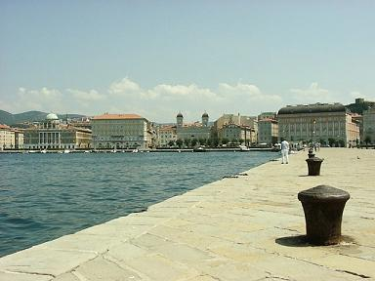



SuperB SVT
Silicon Sensor Geometry Optimization
Irina Rashevskaya, Luciano Bosisio
INFN-Trieste e Università di Trieste

Slide 2
First evaluation of Sensor dimensions
We assume the layer dimensions given by Filippo in London
  the r-phi cross-section remains the same as in BaBar
  the length of the barrels is increased by a factor of ~1.5
  the wedge sensors retain the same size as in BaBar
We minimize the number of sensors in each ladder, with the following constraints:
  6 sensor models, fitting within a 150 mm wafer
  8 sensor models, fitting within a 150 mm wafer (a dedicated sensor for each barrel ladder type, plus the wedge sensor)
  6 sensor models, fitting within a 100 mm wafer, fabricated on either
    100 mm wafers
    150 mm wafers

Slide 3
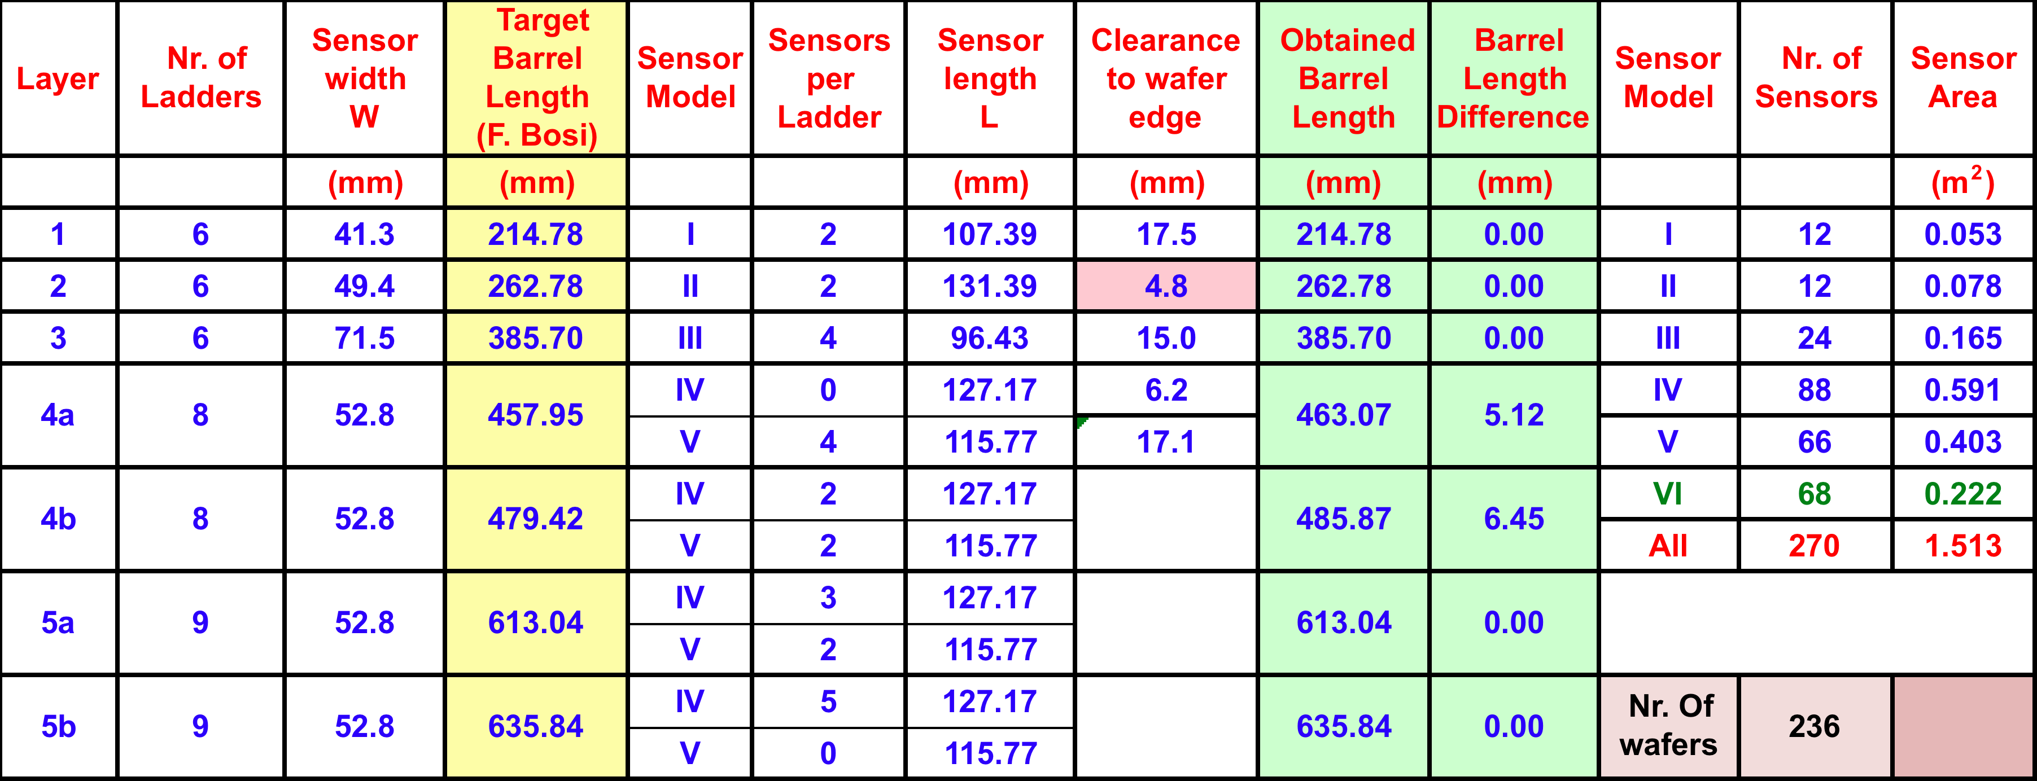
(a) Sensors fitting on 150 mm wafers
Six different sensor models
odd number of sensors/ladder in layer 5
even number of sensors/ladder in layer 4
236 wafers (150 mm)
6 mask sets (150 mm)

Slide 4
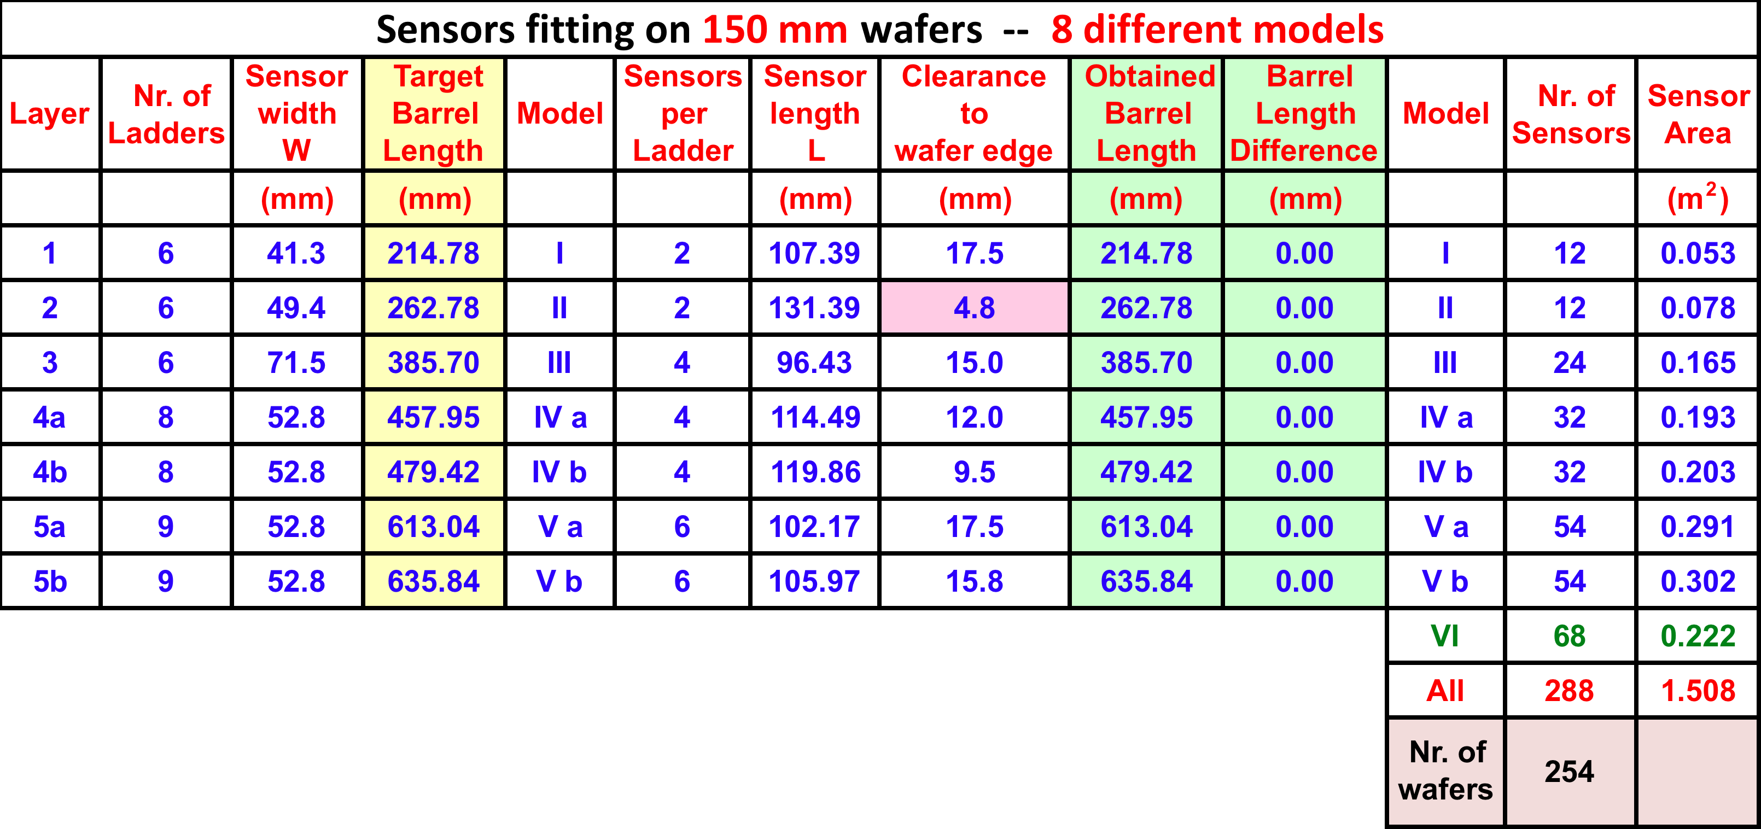
(b) Sensors fitting on 150 mm wafers
Eigth different sensor models
Each barrel layer has its own dedicated sensor
even number of sensors in each ladder
  (=> symmetric forward/backward readout possible).
254 wafers (150 mm)
8 mask sets

Slide 5
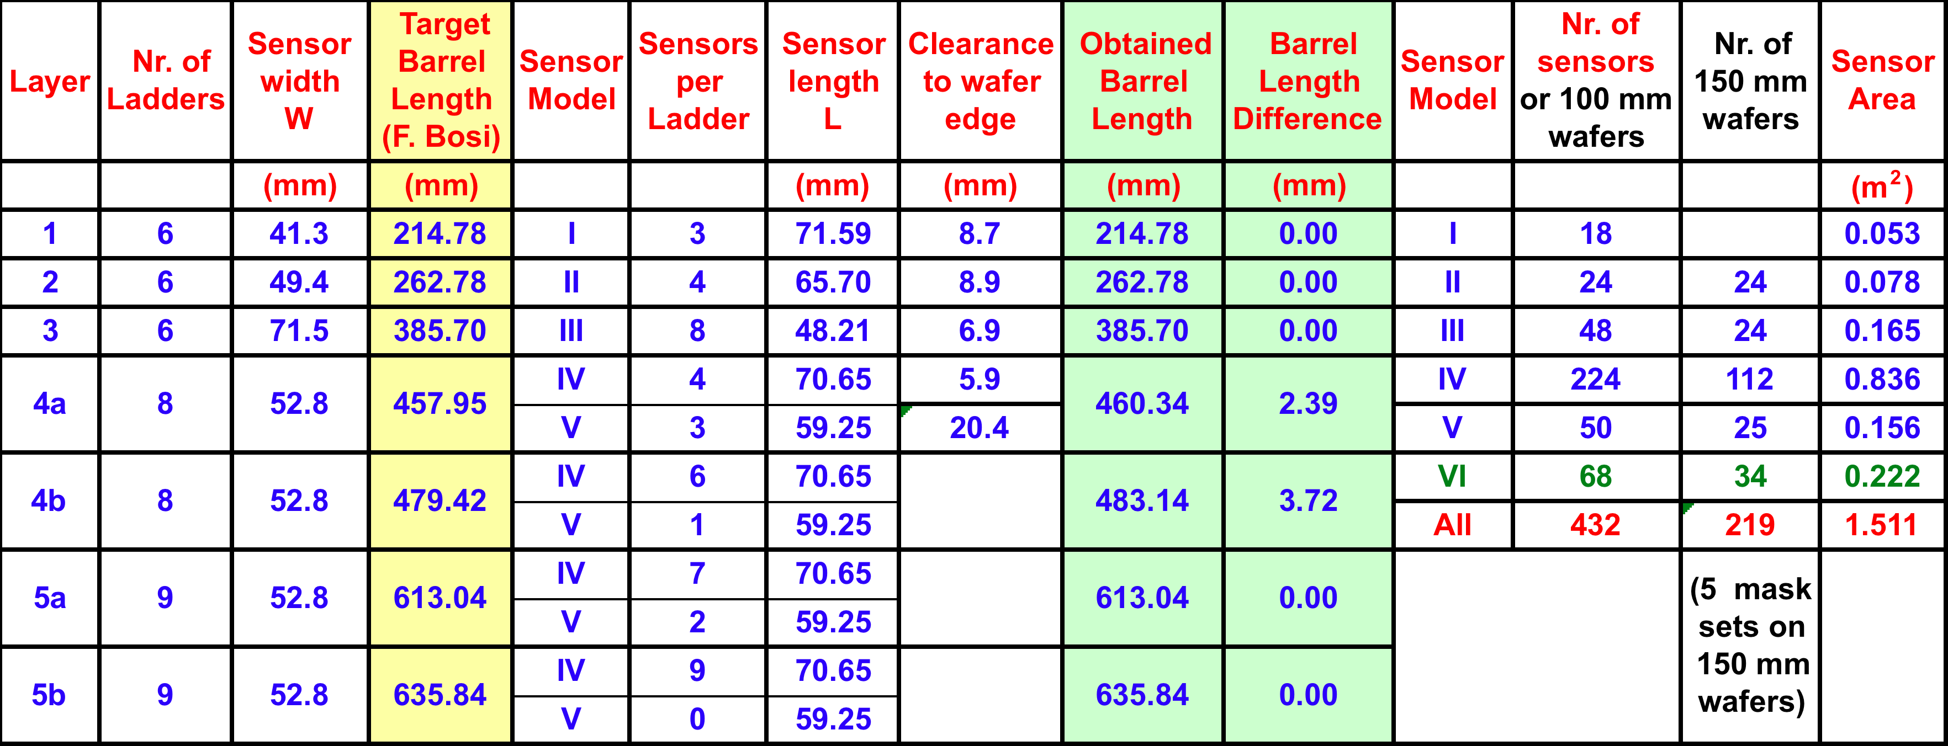
(c) Sensors fitting on 100 mm wafers
Six different sensor models
odd number of sensors in each ladder
  (no symmetric readout possible on phi side)
432 wafers (100 mm) or 219 wafers (150 mm)
6 mask sets (100 mm) or 5 mask sets (150 mm)

Slide 6
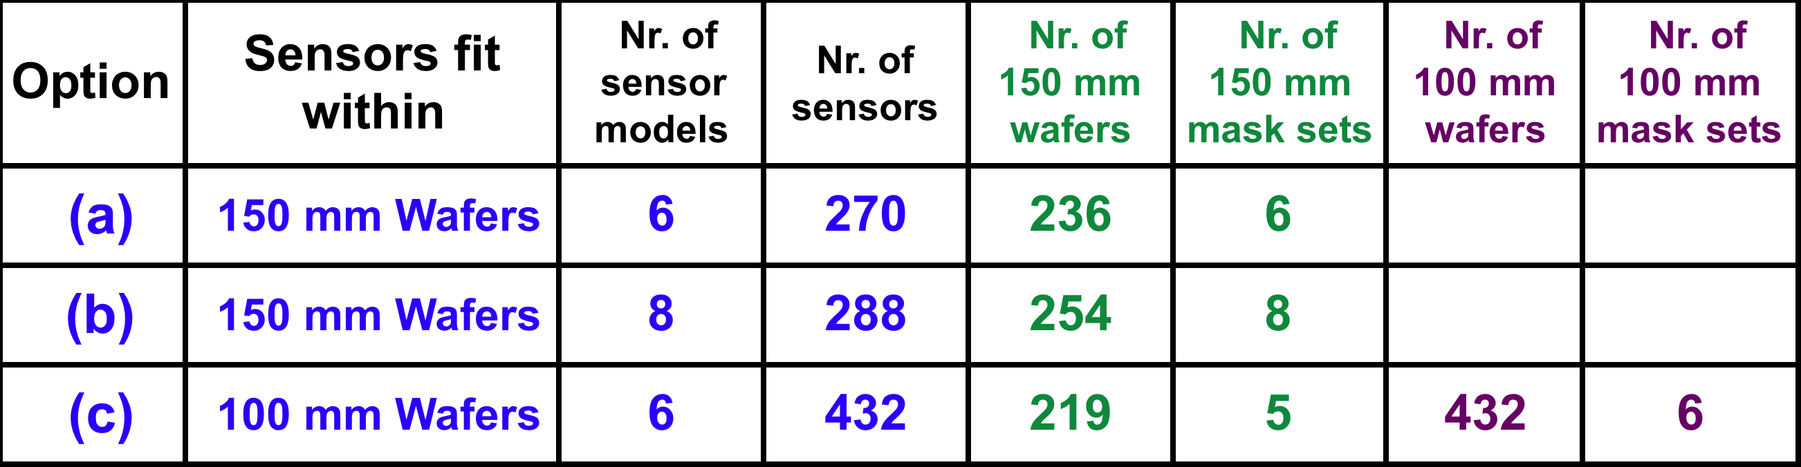
Summary of the three options
The cost of the various options is difficult to evaluate.
We feel that the differences would not be large (± 15% ?).
Option (c) on 100 mm wafers is likely the most expensive, on 150 mm wafers the least expensive.
We think that we should favour the efficiency of testing and assembly, and the performance of the detector (minimize dead regions).
  => option (a) is preferred, or option (b) if we require a symmetric forward/backward readout.

Slide 7
Further points
Possible sensor suppliers on 150 mm wafers:
    Micron
    Sintef
    Hamamatsu (320 um thickness)
    CiS (Erfurt, D) (within 2013)
    FBK-irst (Trento) (2014?)
Several open points to be addressed:
  strip pitch and ganging scheme on n-side
  realistic S/N evaluation
  realistic cost evaluation
Some questions (to be answered soon):
  do we want a symmetric forward/backward readout?
  can we consider reducing the number of ladders in layers 4 – 5 ?
    (at a first appraisal, it appears difficult to realize)

