Slide 1
Introduzione al progetto PICO Physics for all
Elisa Velcani
PID, 18 ottobre 2024

Slide 2
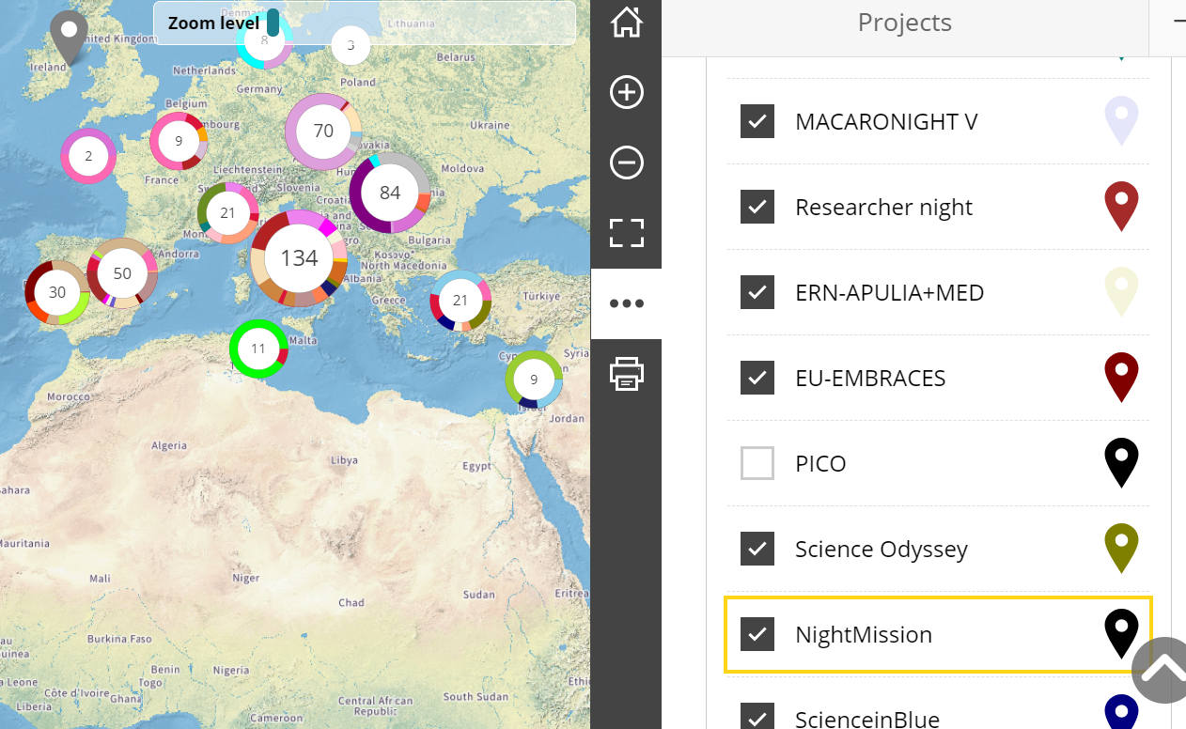
MSCA and Citizens
Bringing research and researchers closer to the public at large.
Find out more about MSCA and Citizens

Slide 4
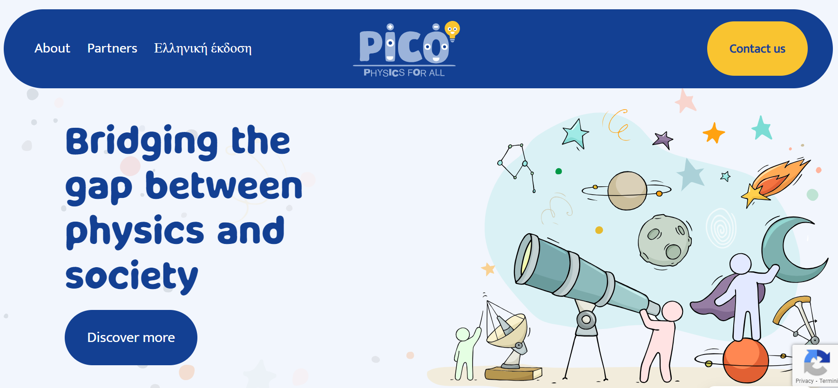
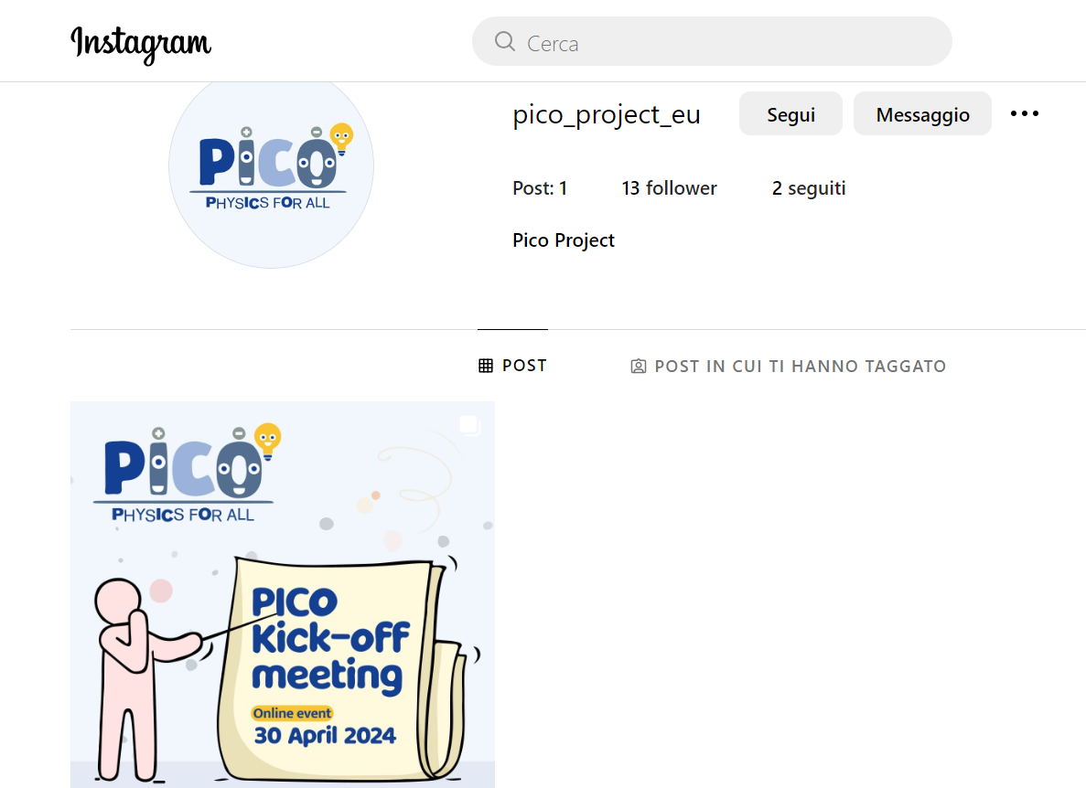

Slide 5
