Slide 1



Dimostratori didattici per l’astronomia e la fisica fondamentale: il progetto Frontiers
V. Boschi (INFN), M. Chaniotakis (Ellinogermaniki Agogi), G. Vannoni (PCCP)
Frontiers has been funded within the framework of the European Union Erasmus+ programme

Slide 2





was an EU funded project bringing together research and educational institutions from all over Europe (2018-2021)
Frontiers (https://frontiers-project.eu/)
Scientific Research
Science Education
Teacher Training Networks and Astrophysics Outreach

Slide 3
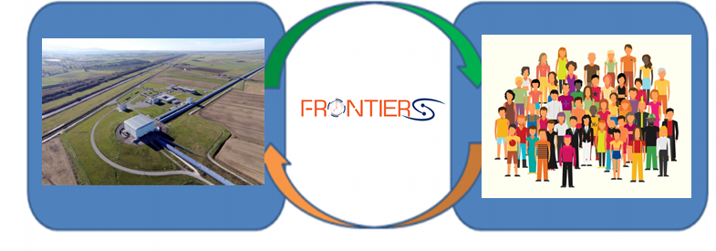
Aiming to bridge the gap between frontier science and education as well as society
The FRONTIERS tool-kit
Offering authentic research experience for students, teachers, and the general public.
Adopting an inquiry based approach.
Developing open, digital educational resources for everyone to use.
Creating and supporting national and international communities.
Offering short and long term courses for teachers and students.
Engaging the public through events such as Virtual Visits to Research Infrastructure.

Slide 4
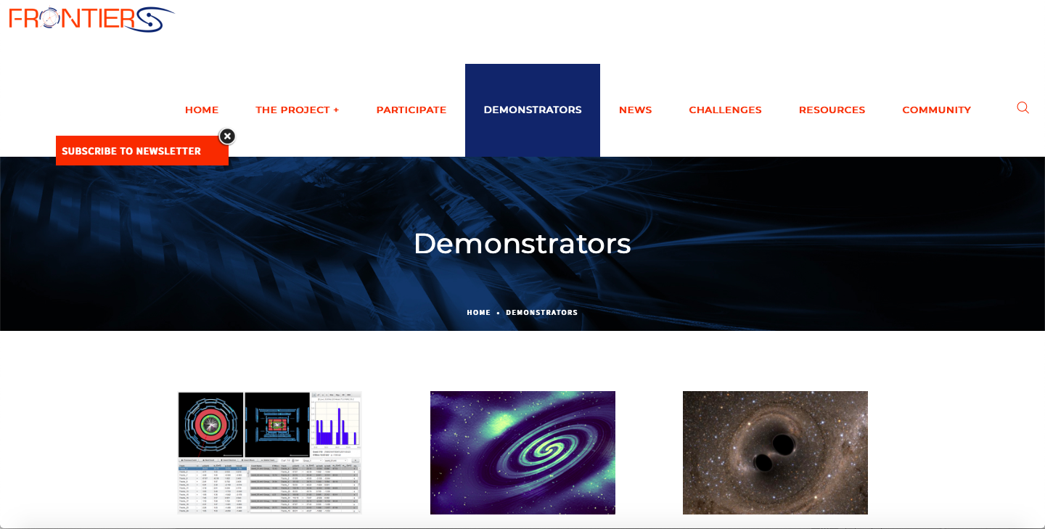
The demonstrators
  21 pedagogical scenarios for secondary school.
  Fully online ready to use in 5 different languages (English, French, Italian, Greek, Portuguese).
  Follow an inquiry methodology.
  Free, open source, completely editable and adaptable.
http://www.frontiers-project.eu/demonstrators/

Slide 5
Adopting the inquiry based science education pedagogy
Learners are engaged by scientifically oriented questions.
Learners give priority to evidence which allows them to develop and evaluate explanations that address scientifically oriented questions.
Learners formulate explanations from evidence to address scientifically oriented questions.
Learners evaluate their explanations in light of alternative explanations, particularly those reflecting scientific understanding.
Learners communicate and justify their proposed explanations.

Slide 6

Adopting the inquiry based science education pedagogy
Orienting and Asking Questions
Conclusions- Evaluation
Hypothesis Generation and Design
Analysis and Interpretation
Planning and Investigation

Slide 7
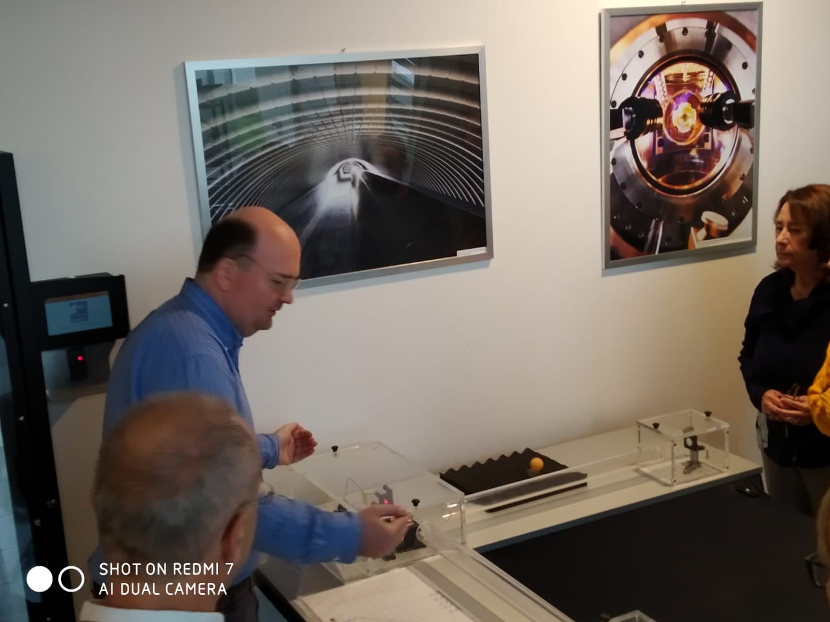
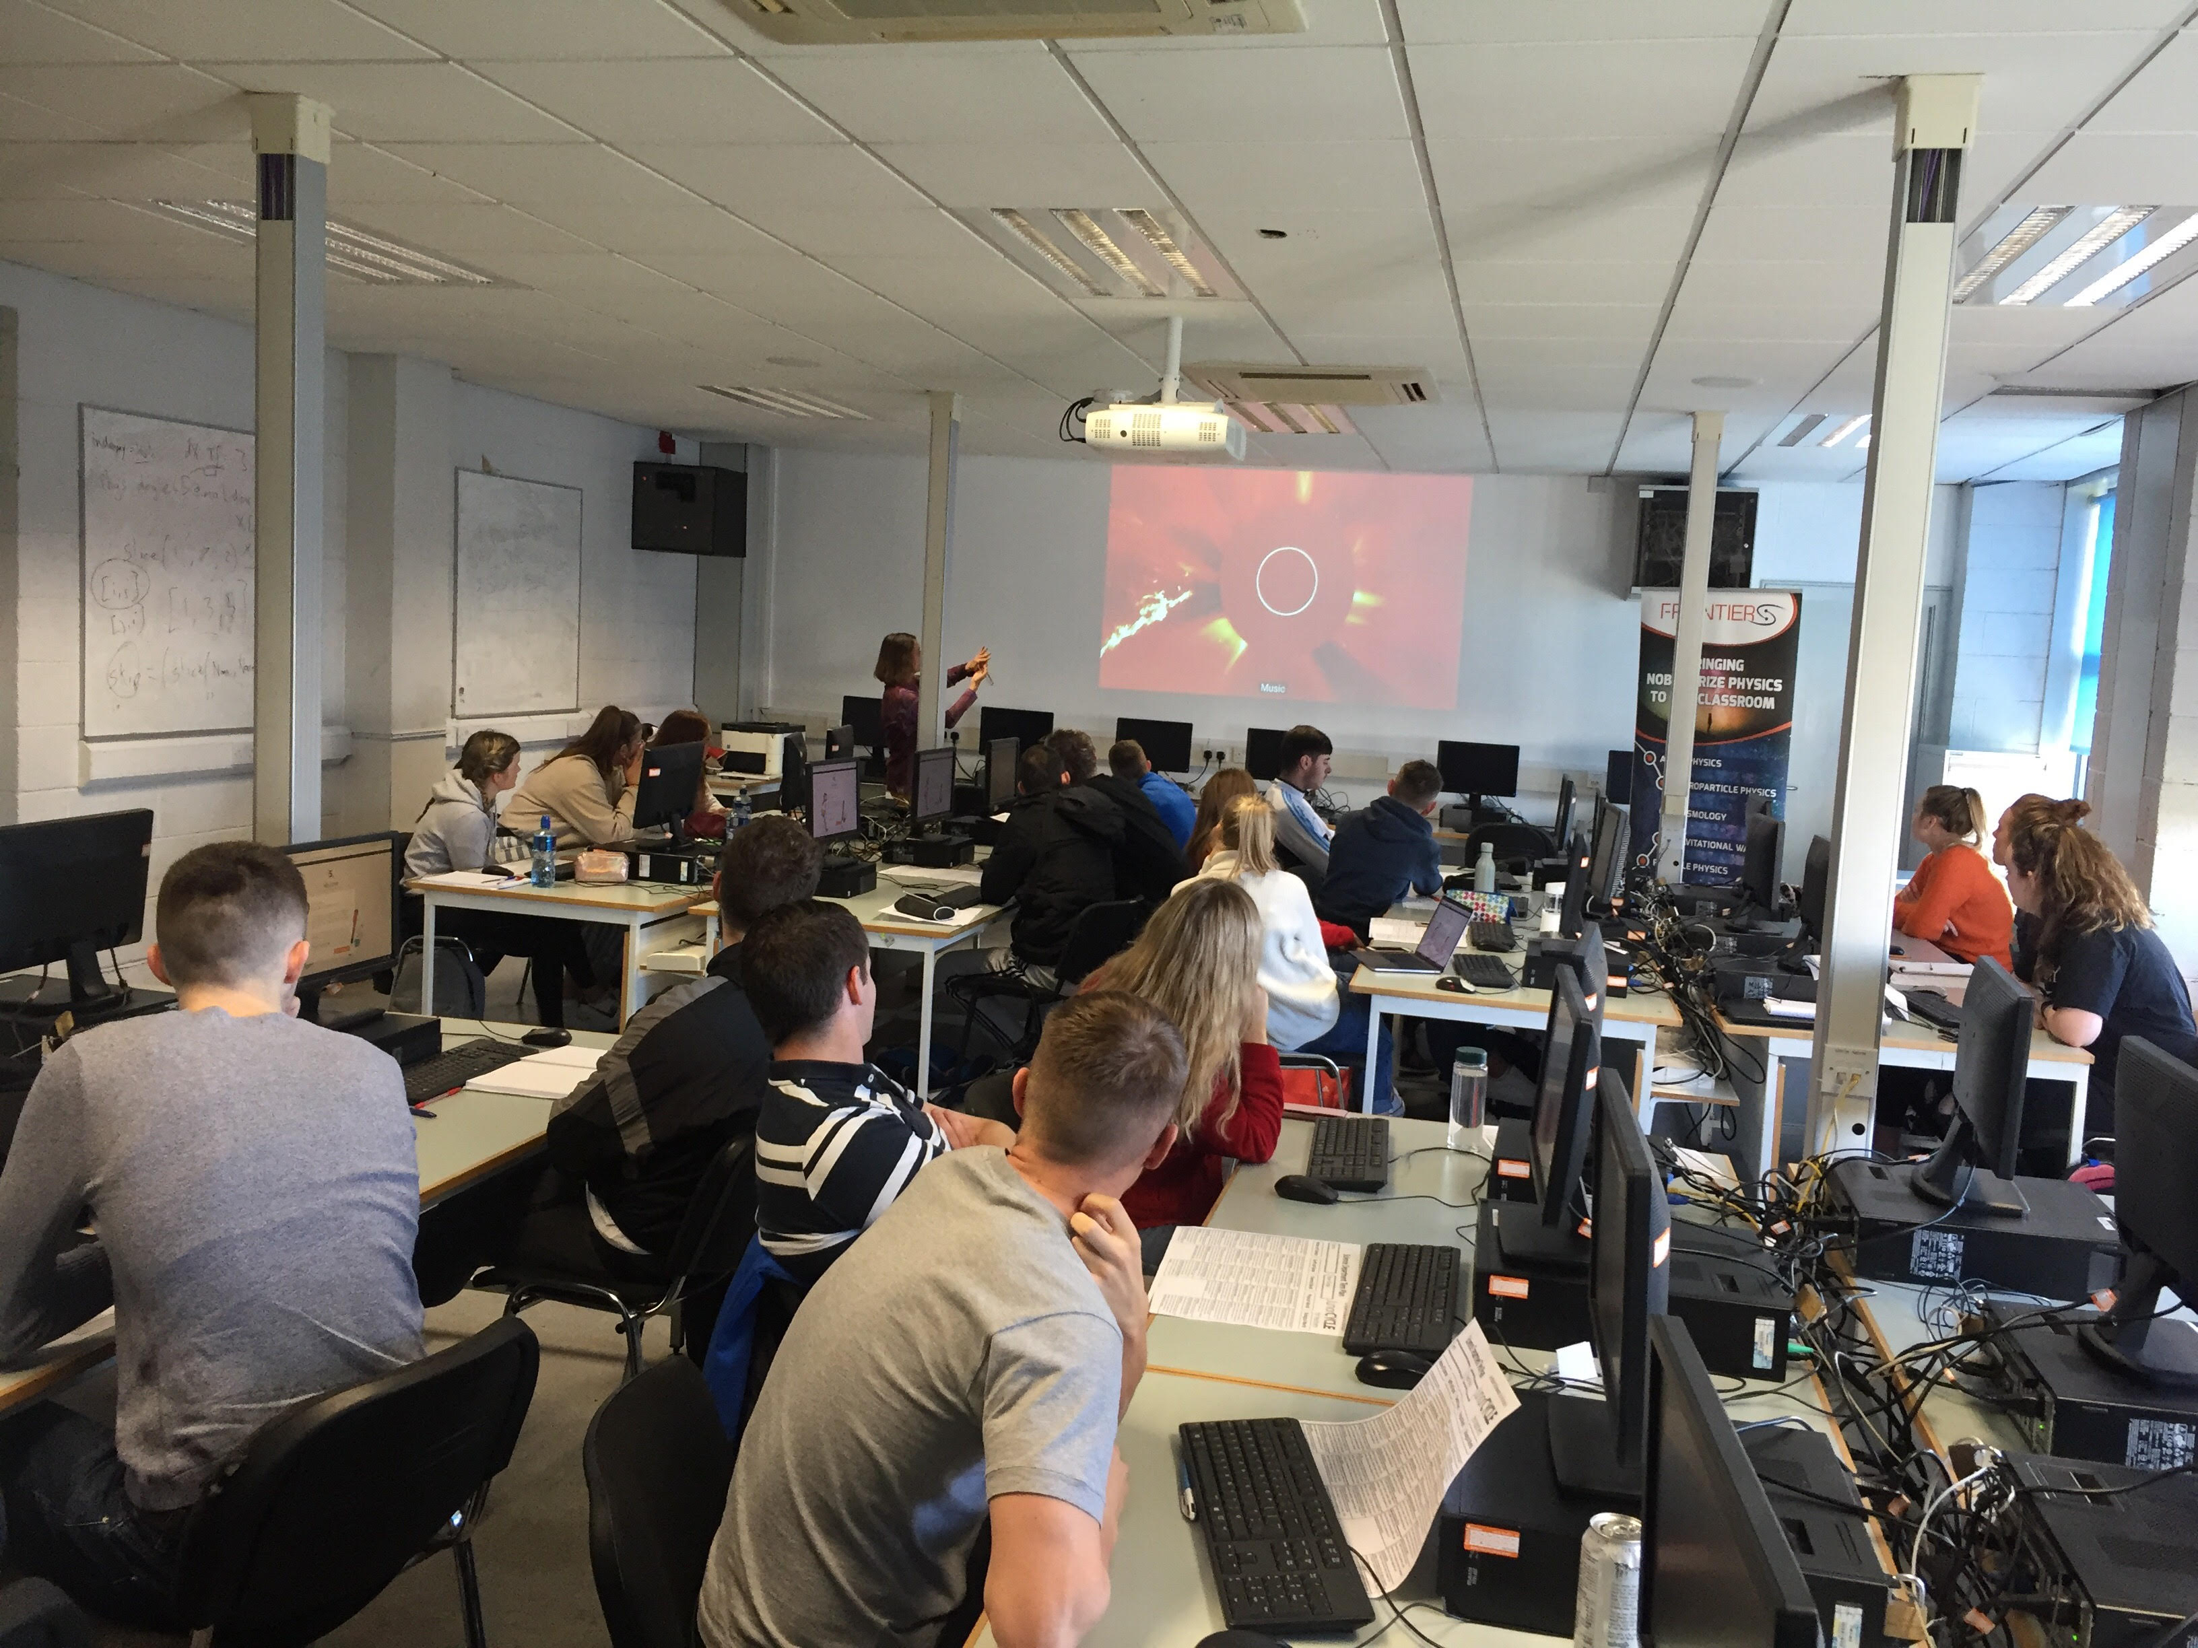
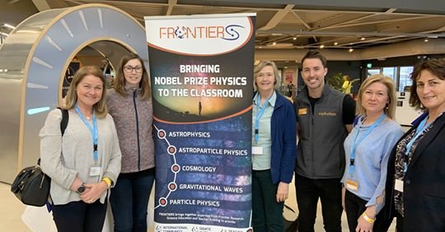
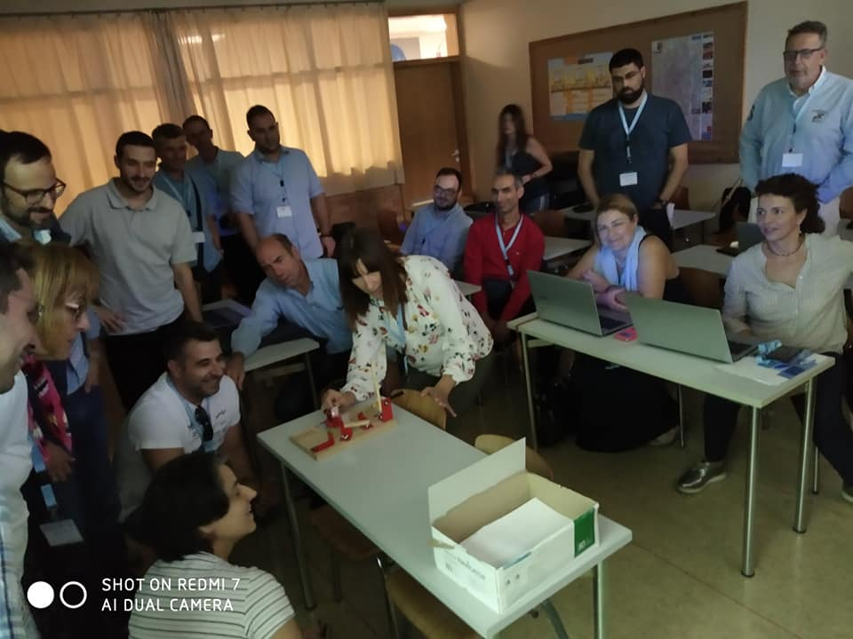
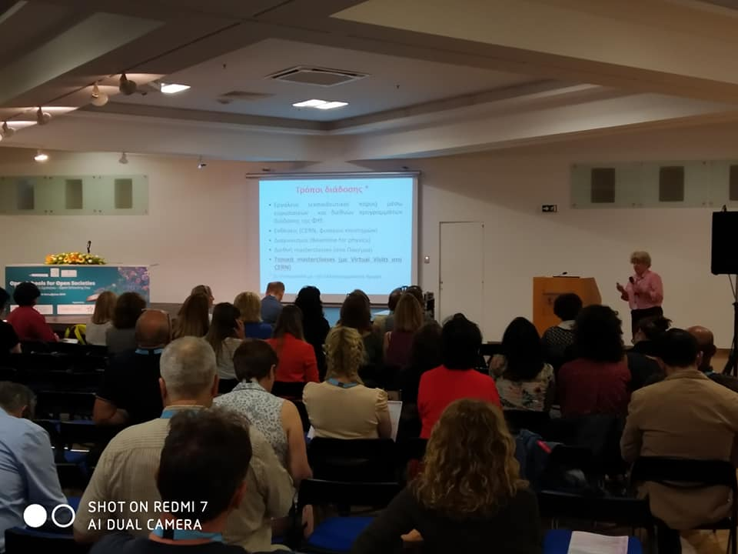
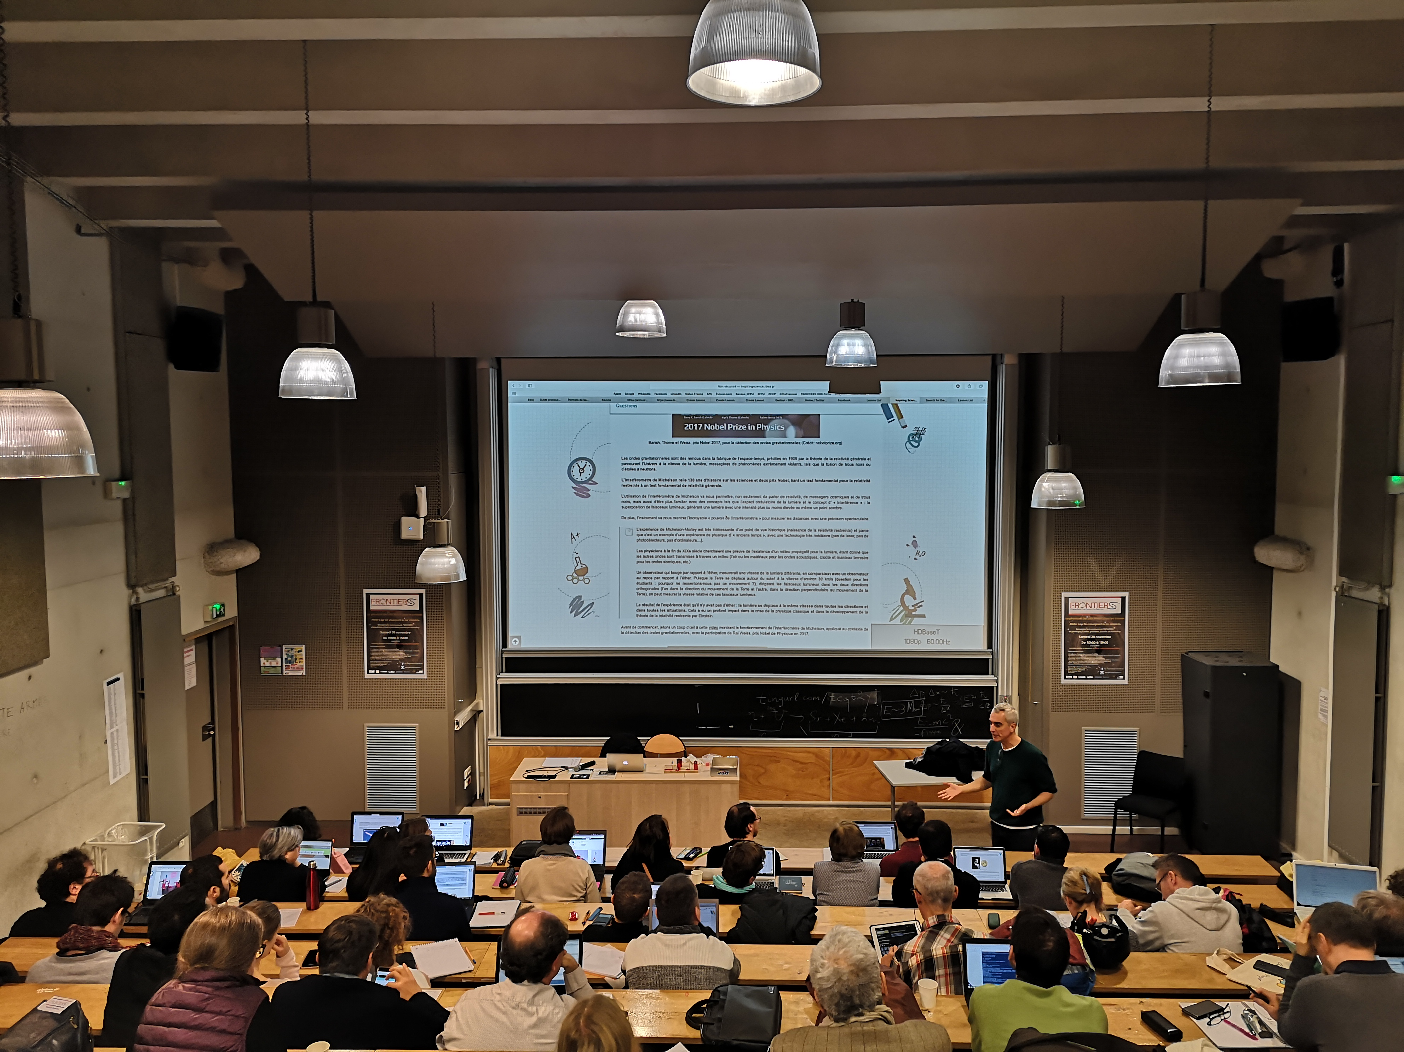
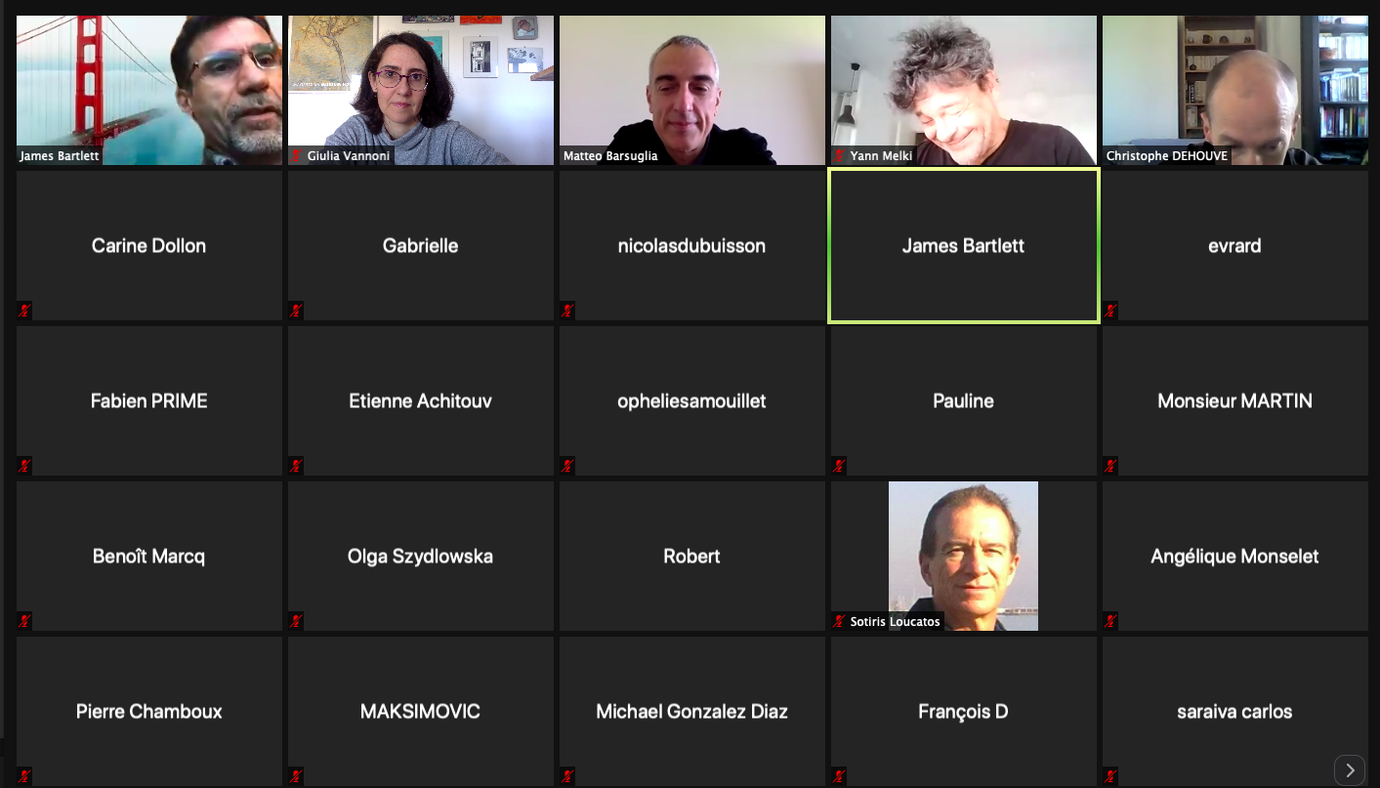
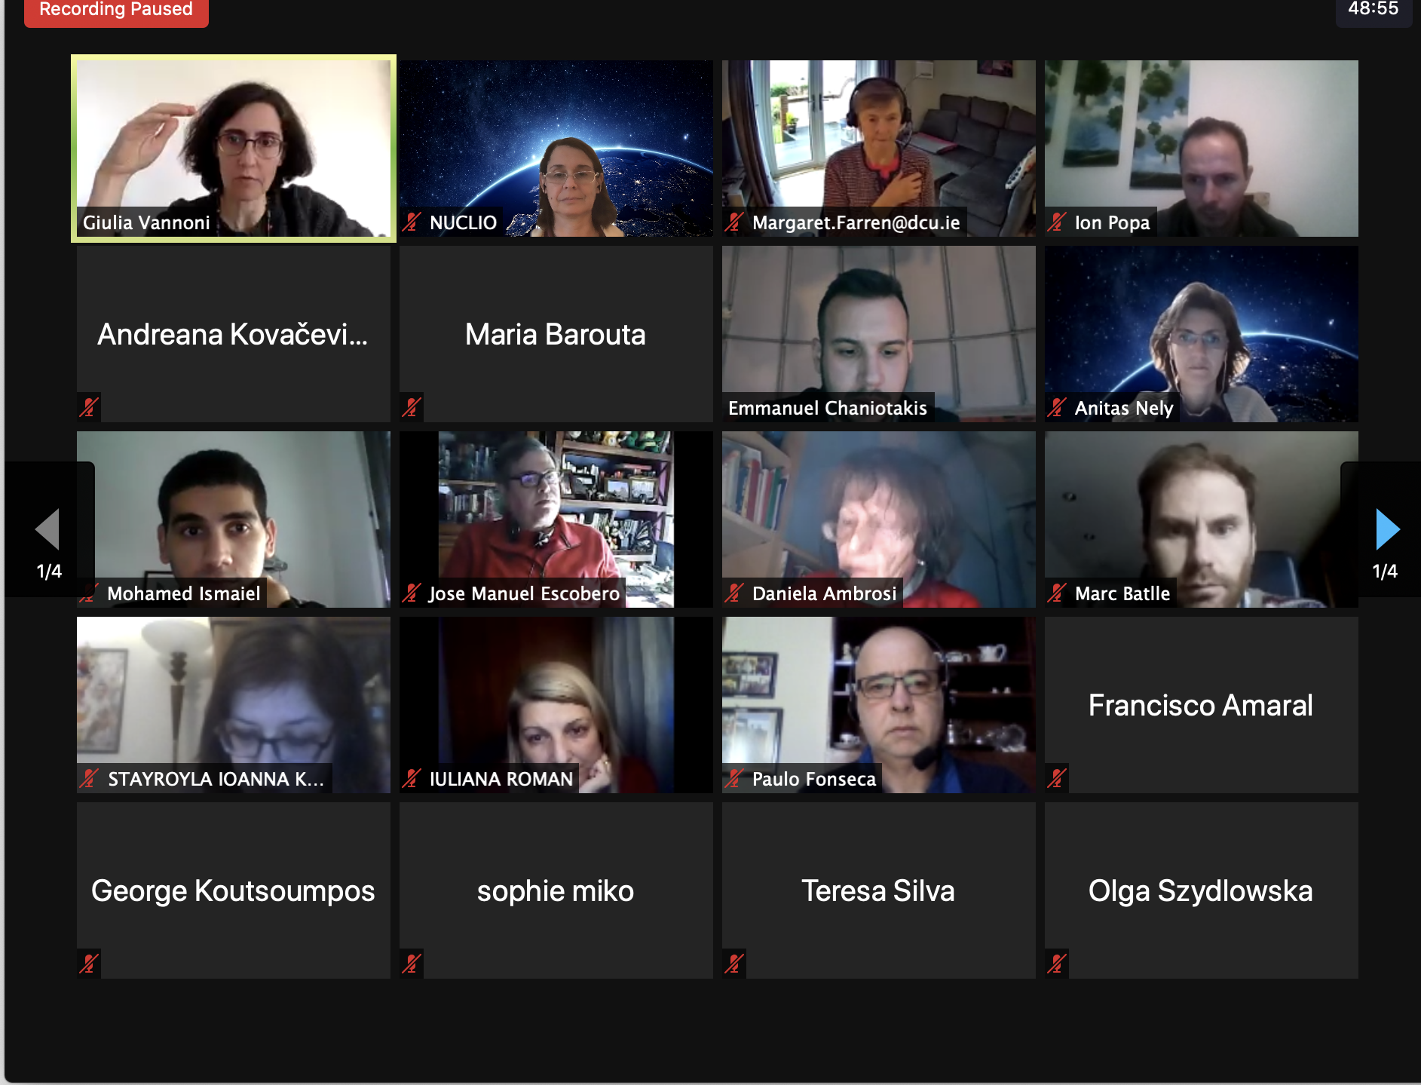
Training and support
  Year-round training workshops for continuous professional development
Pre-COVID
During the pandemic

Slide 8
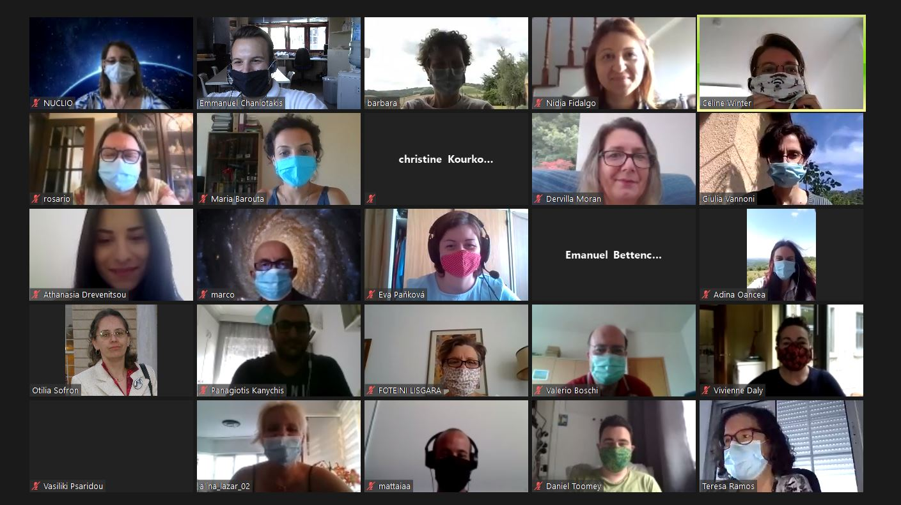
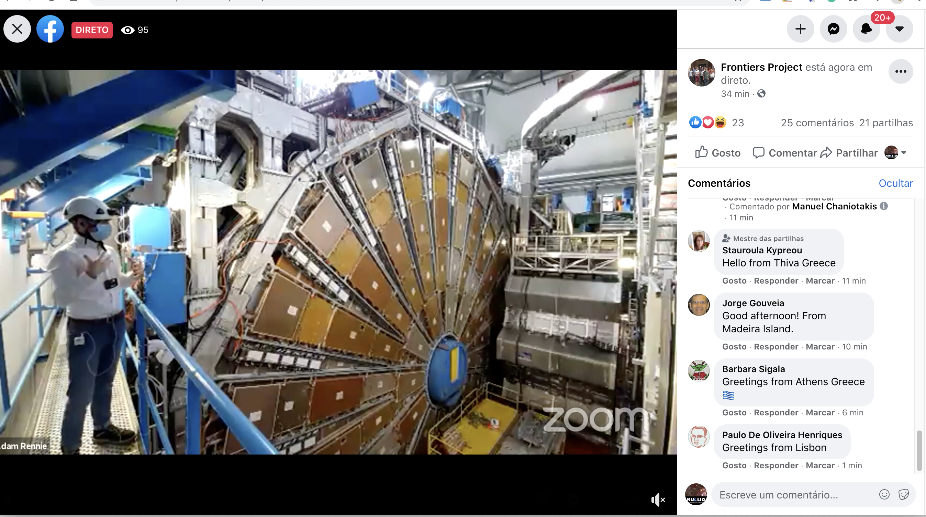
Training and support
  International online Schools
E-Summer School:
13 – 24 July 2020
https://indico.ego-gw.it/event/73/timetable/
E-Winter School:
29 January – 7 February 2021
https://indico.ego-gw.it/event/133/timetable/

Slide 9
E-Winter School
206 registered participants from India to Chile.
Peaks of over 80 participants simultaneously connected on Zoom.
34 participants to Working Groups.
9 new pedagogical scenarios produced.
Over 4 000 people reached on Facebook over the first weekend.
  Training forced to transfer online by pandemic:
  Challenge won: high attendance, effectiveness unaffected.
  Opened up new possibilities
          → local to global participation.
          → offering access to RIs around the World.

Slide 10



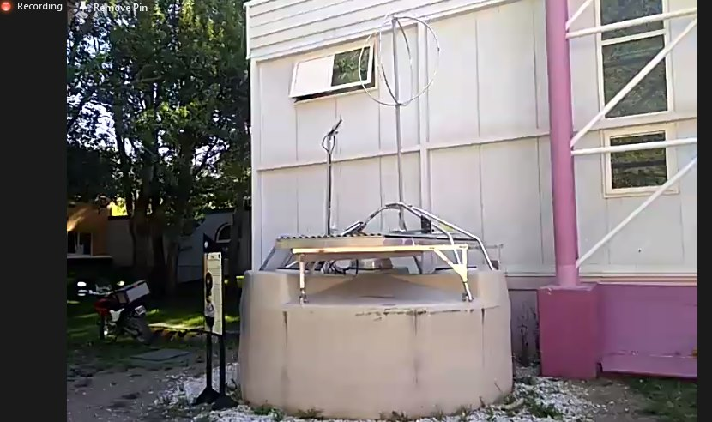
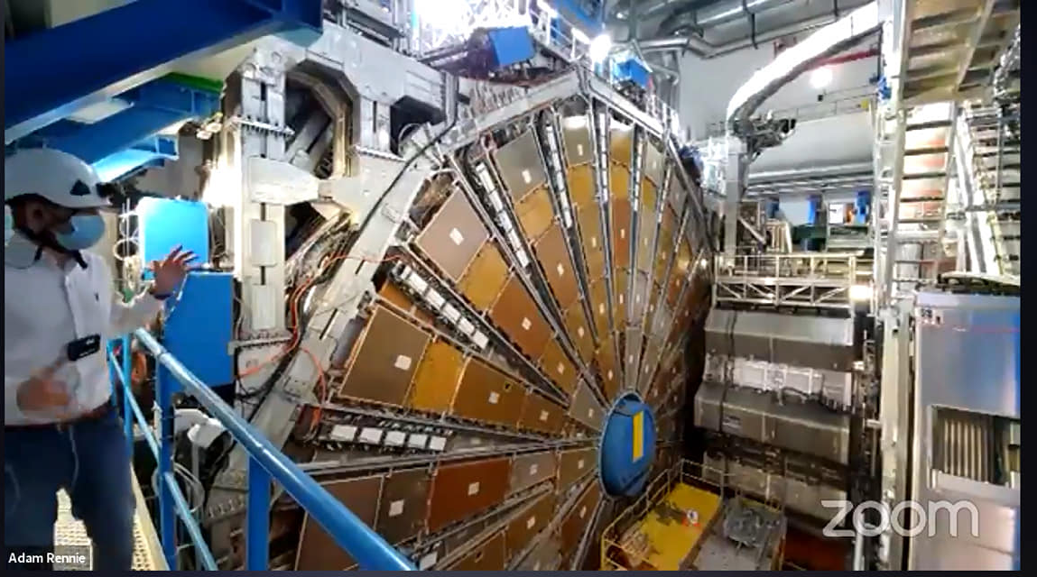
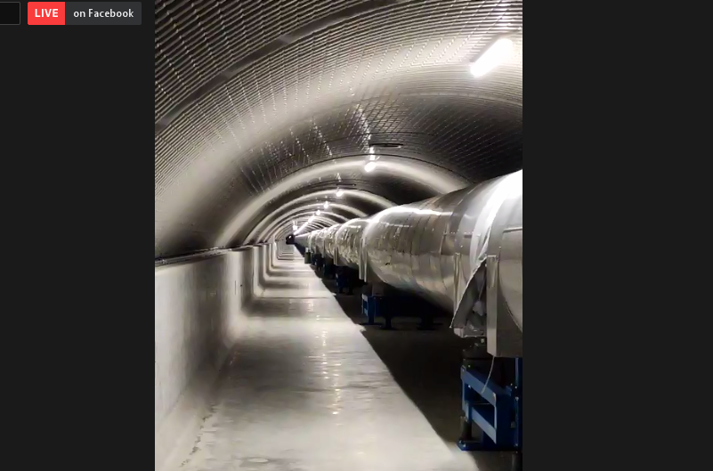
Virtual Visits
Virtual Visits were organized to: ATLAS@CERN, the Virgo Gravitational Wave Detector in Italy, and the Pierre Auger Observatory in Argentina.

Slide 11
FRONTIERS reach to the public
  FRONTIERS science education project with strong communication profile.
  More than 700 teachers in the FRONTIERS network.
  More than 2000 students reached throughout project activities.
  Social media page with more than 1000 members and large visibility.
  FRONTIERS constantly posts research infrastructure and frontier science news for the general public and education community.
  Public events of FRONTIERS shared by big institutions/ other EU funded projects.

Slide 12
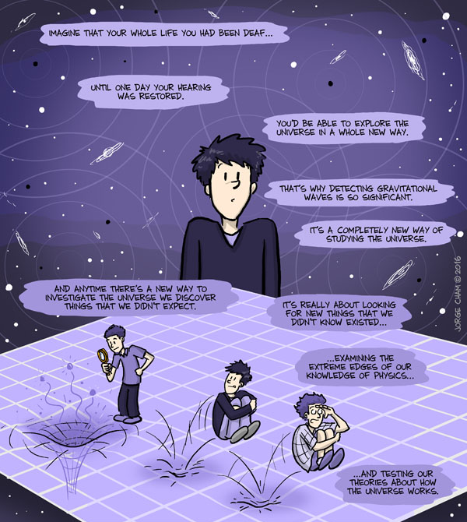
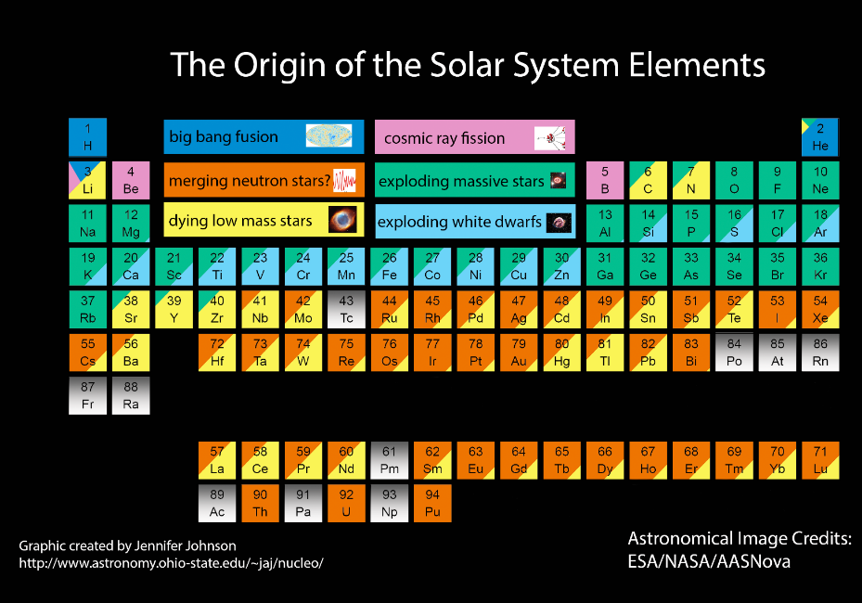
GW Astronomy

Slide 13


Virgo and LIGO sensitivity
Imagine to drop a glass of wine (or water) in the ocean…….
Ocean Surface (S):
70% x 4π x R_terra^2 =
0.7 x 4 x 3.14 x (6.37e6 m)^2
~ 3.6e14 m^2
Volume of the glass (V):
~ 0.25e-3 m^3
Increase of the global sea level:
h ~ V / S ~ 1e-18 m
This is the level of sensitivity we need to reach with GW detectors !!

Slide 14
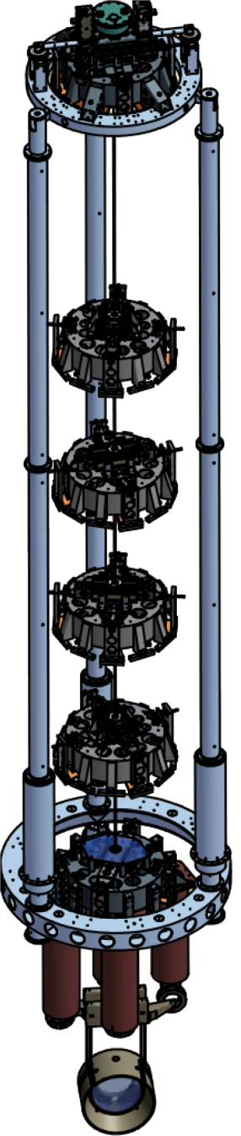
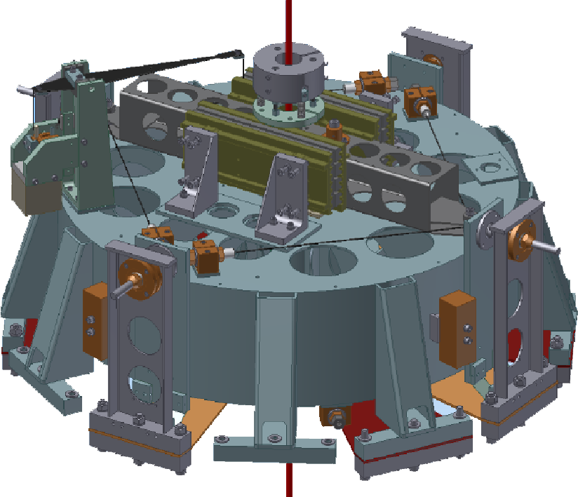
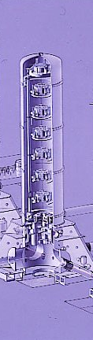
VIRGO superattenuator
It’s able to attenuate the seismic motion of the mirrors by more than a factor 10¹² (a million of a million times)
Standard filter
Suspended mirror

Slide 15

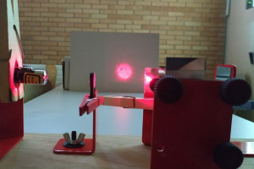
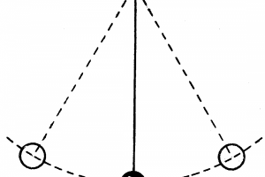
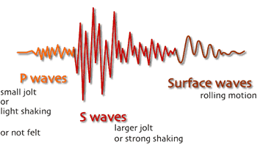

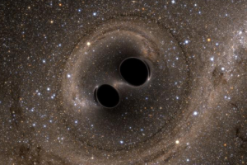
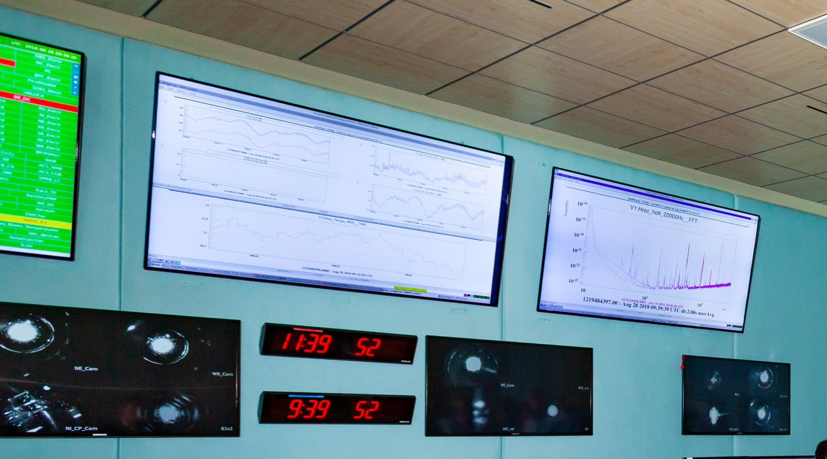
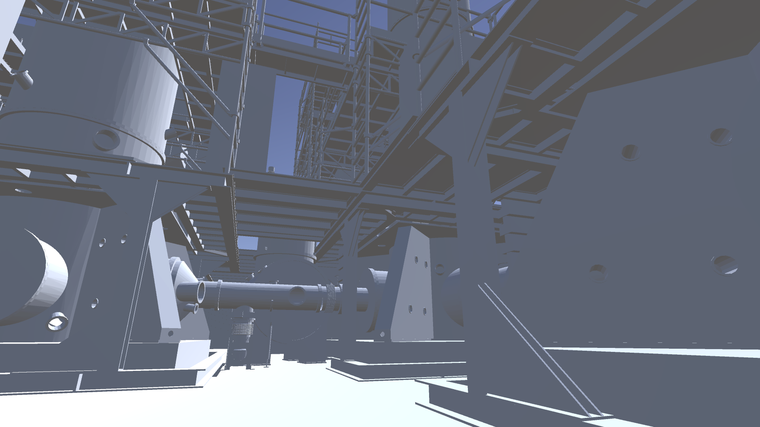
GW Module
The demonstrators
Discovering and building a Michelson interferometer
The pendulum
Earthquake Interferometer
Finding Black Holes in a Chirp
Gravitational Wave Noise Hunting
Control (Class)room
VIRGO Virtual Visits
http://www.frontiers-project.eu/gravitational-wave-astronomy/

Slide 16
GW Demonstrators
Build an interferometer in your class!
We will assemble a Michelson interferometer using a small construction kit developed by NIKHEF, the Dutch National Institute for Subatomic Physics, a high energy and astroparticle physics laboratory in Amsterdam, Netherlands, which participates to the Virgo experiment.
The NIKHEF interferometer costs around € 70 + VAT. The same interferometer can also be built with simple optical components.

Slide 17

GW Demonstrators
The pendulum
In this lesson we will explore the pendulum, a very simple mechanical system but at the same time an extremely powerful tool for exploring physical phenomena such as oscillations, gravity, the transmission of vibrations and also the concepts of speed, acceleration, energy and resonance.

Slide 18
GW Demonstrators
Control (class)room
Whether you are detecting gravitational waves or measuring colliding particles, the control room is where all the magic happens !!

Slide 19
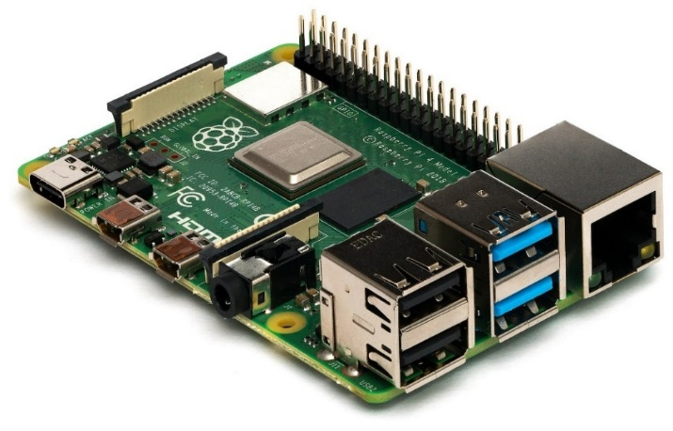
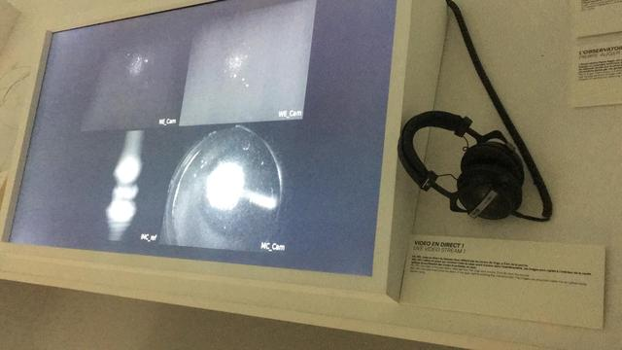
GW Demonstrators
Control (class)room
Using simply a set of PCs or Raspberry PIs you can have all the data shown in the control room in your class !!

Slide 20
GW Demonstrators
Earthquake interferometer
How can you use Virgo data ? Control room data constitute a powerful tool to understand how the environment interact with the detector
What is the effect of the wind on Virgo ?
What is the effect of the sea waves ?
What happen when an earthquake reach the Virgo site ?

Slide 21
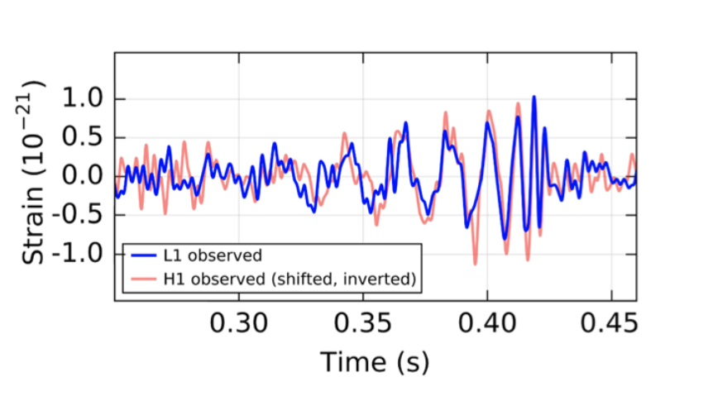
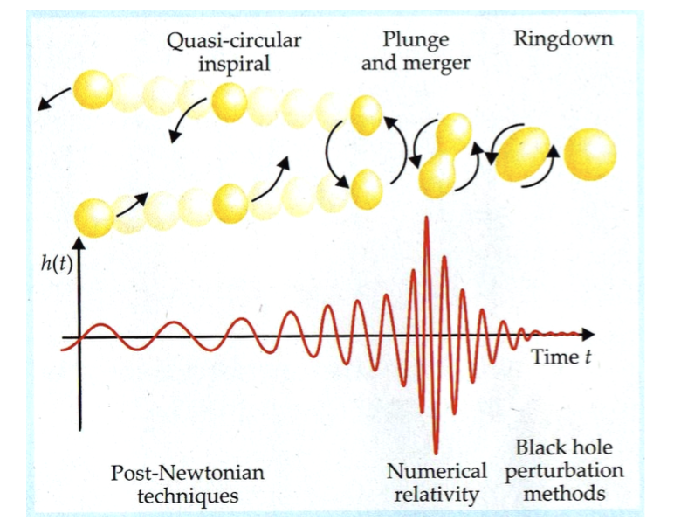
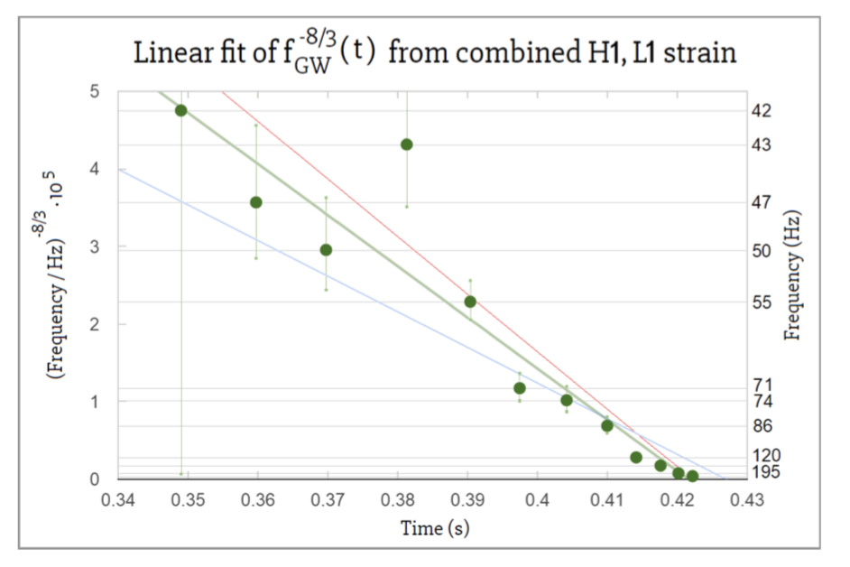

GW Demonstrators
Finding black holes in a chirp
Using LIGO/Virgo data, students will learn how to determine the masses and the radius of a binary system, to identify the two objects as black holes, and what are the fundamental properties and parameters of a black hole.

