Slide 1
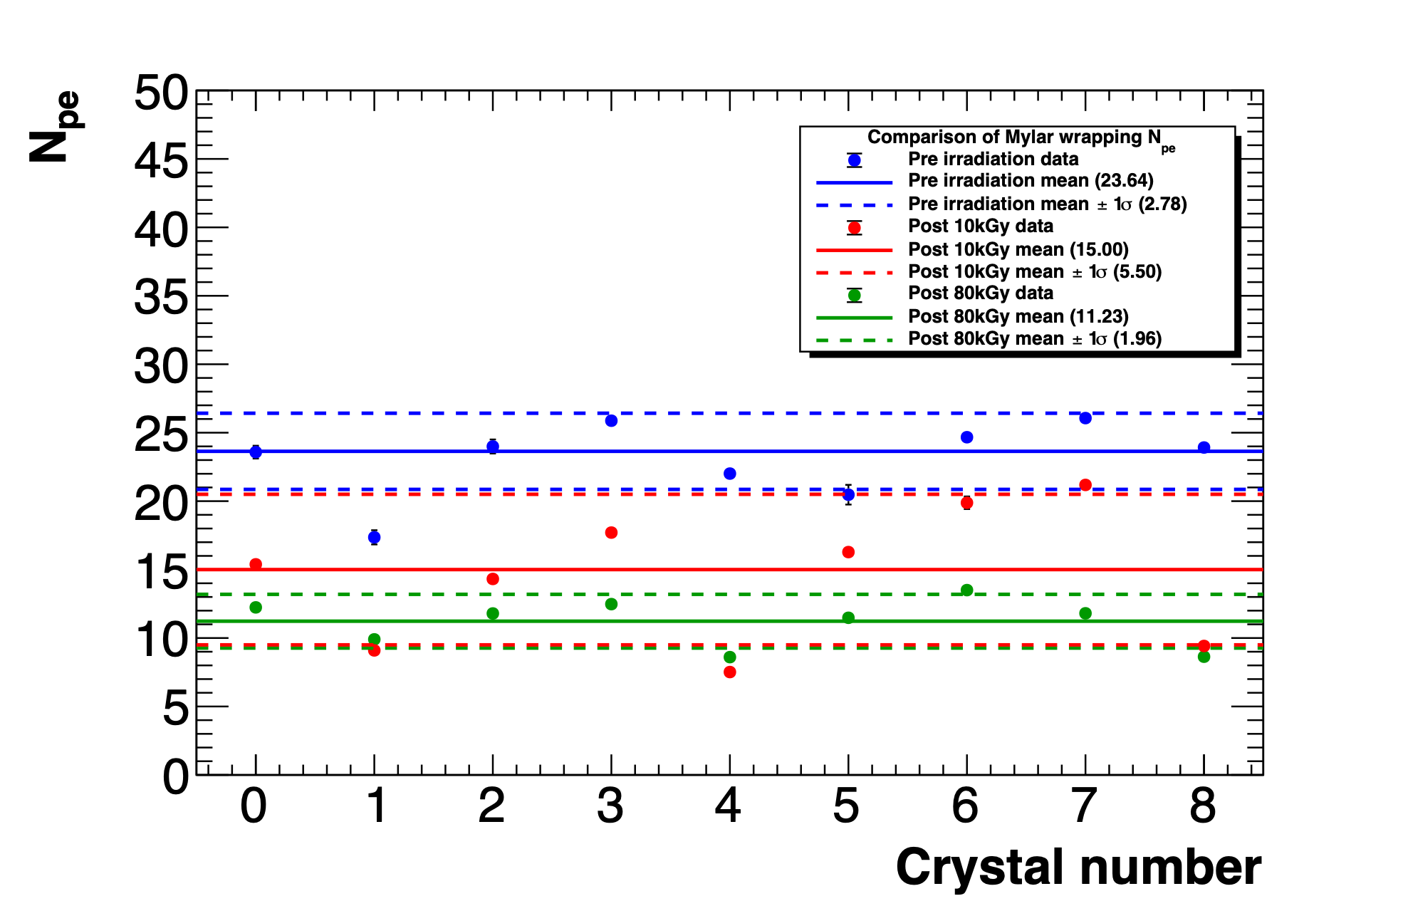
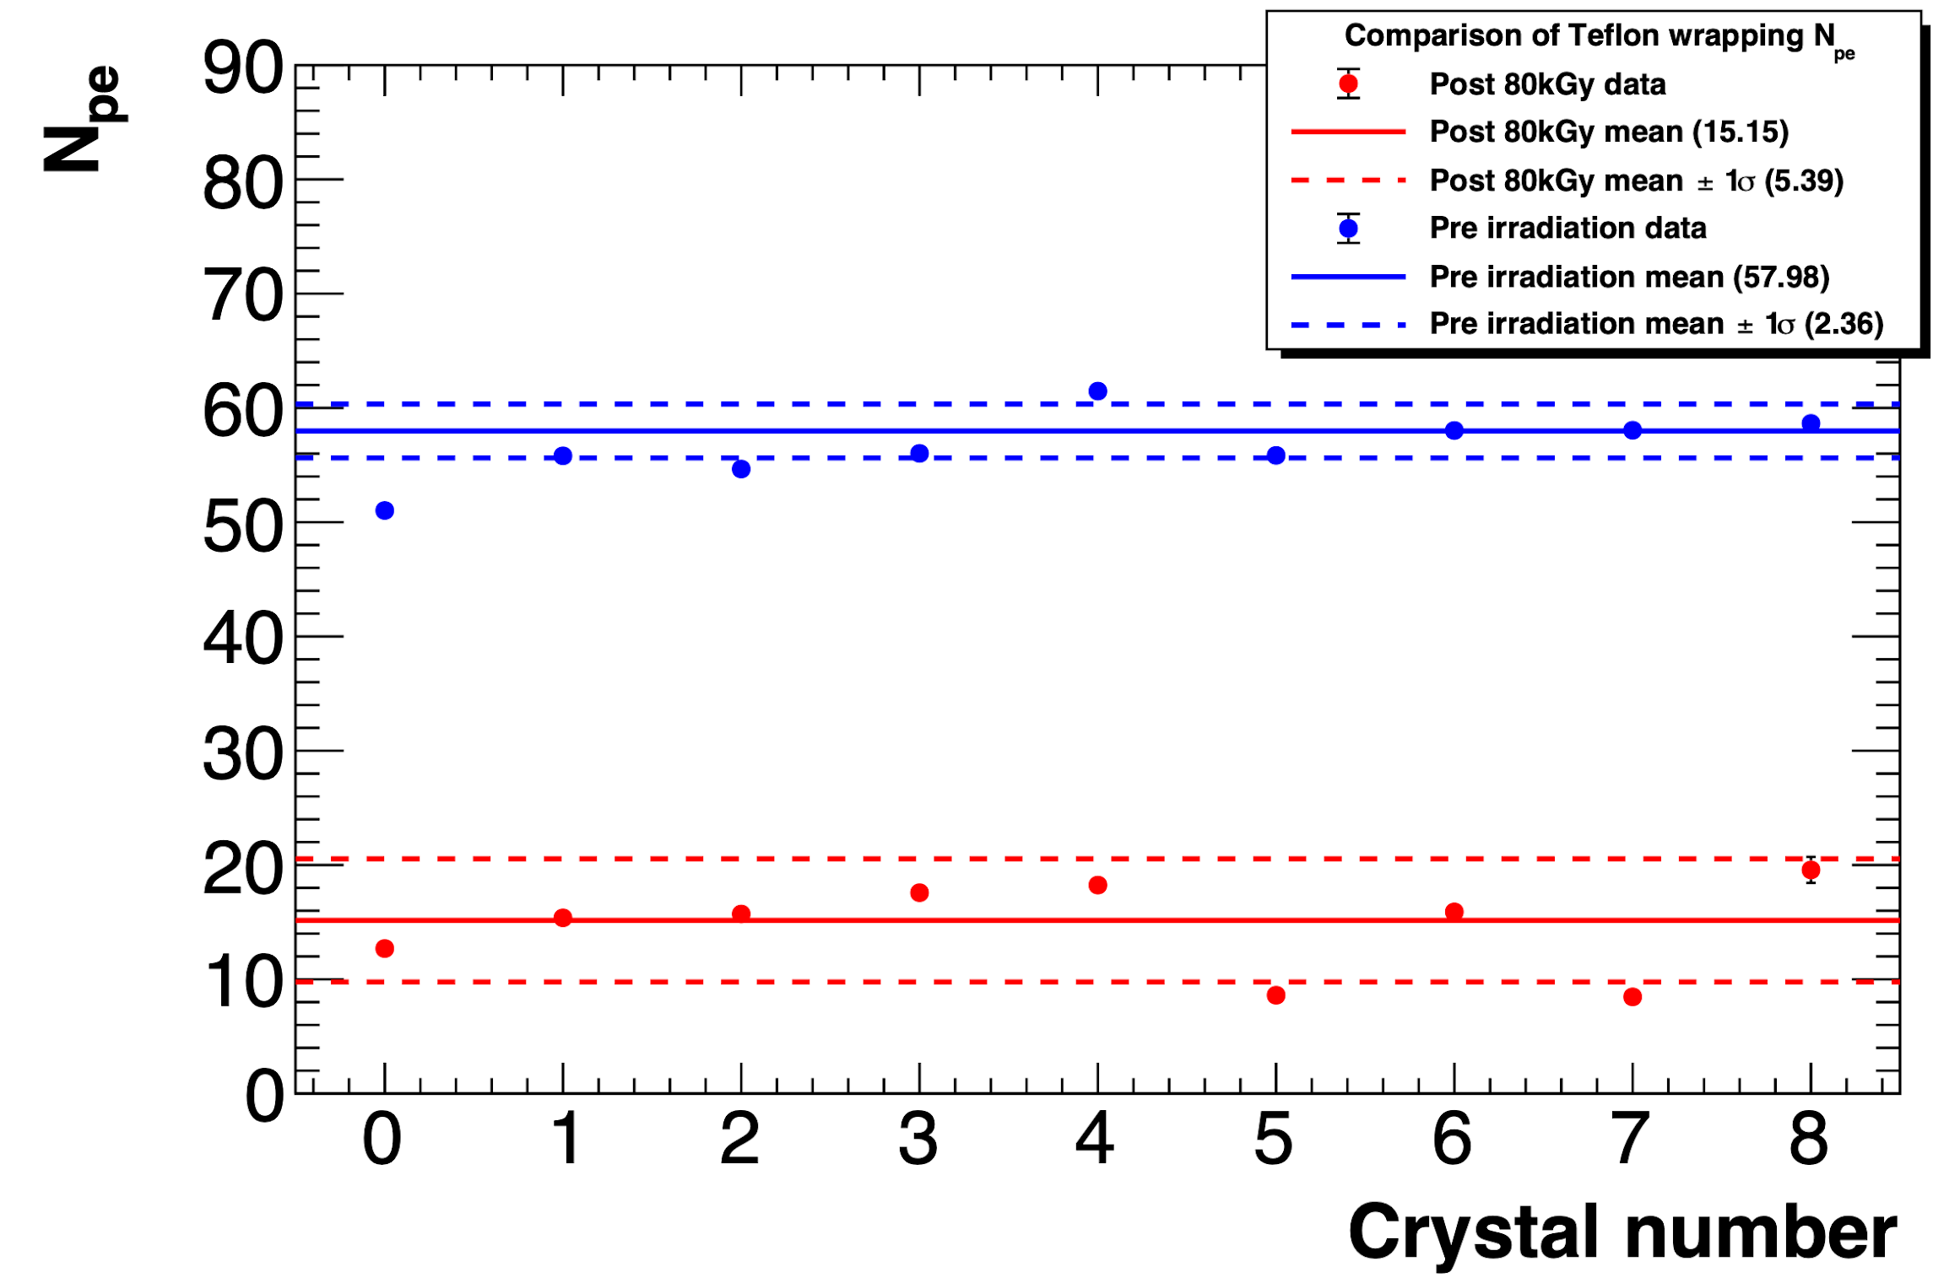
Beam test @ BTF: crystals
Two different wrappings tested, Teflon and Mylar
LY loss evaluated through variation in charge and number of photo-electrons
Telfon wrapping
Mylar wrapping
Npe values of PbF₂ pre and post 80 kGy
irradiation
Npe values of PbF₂ pre, after 10 kGy and
after 80 kGy irradiation
Notes:
allows an easy assembly of the calorimeter and allows to assemble the calorimeter with submodules arranged in series and in parallel to obtain any configuration needed.
MZB which provides signal amplification and shaping, along with all slow control functions - individual bias regulation, temperature and current monitoring

Slide 2
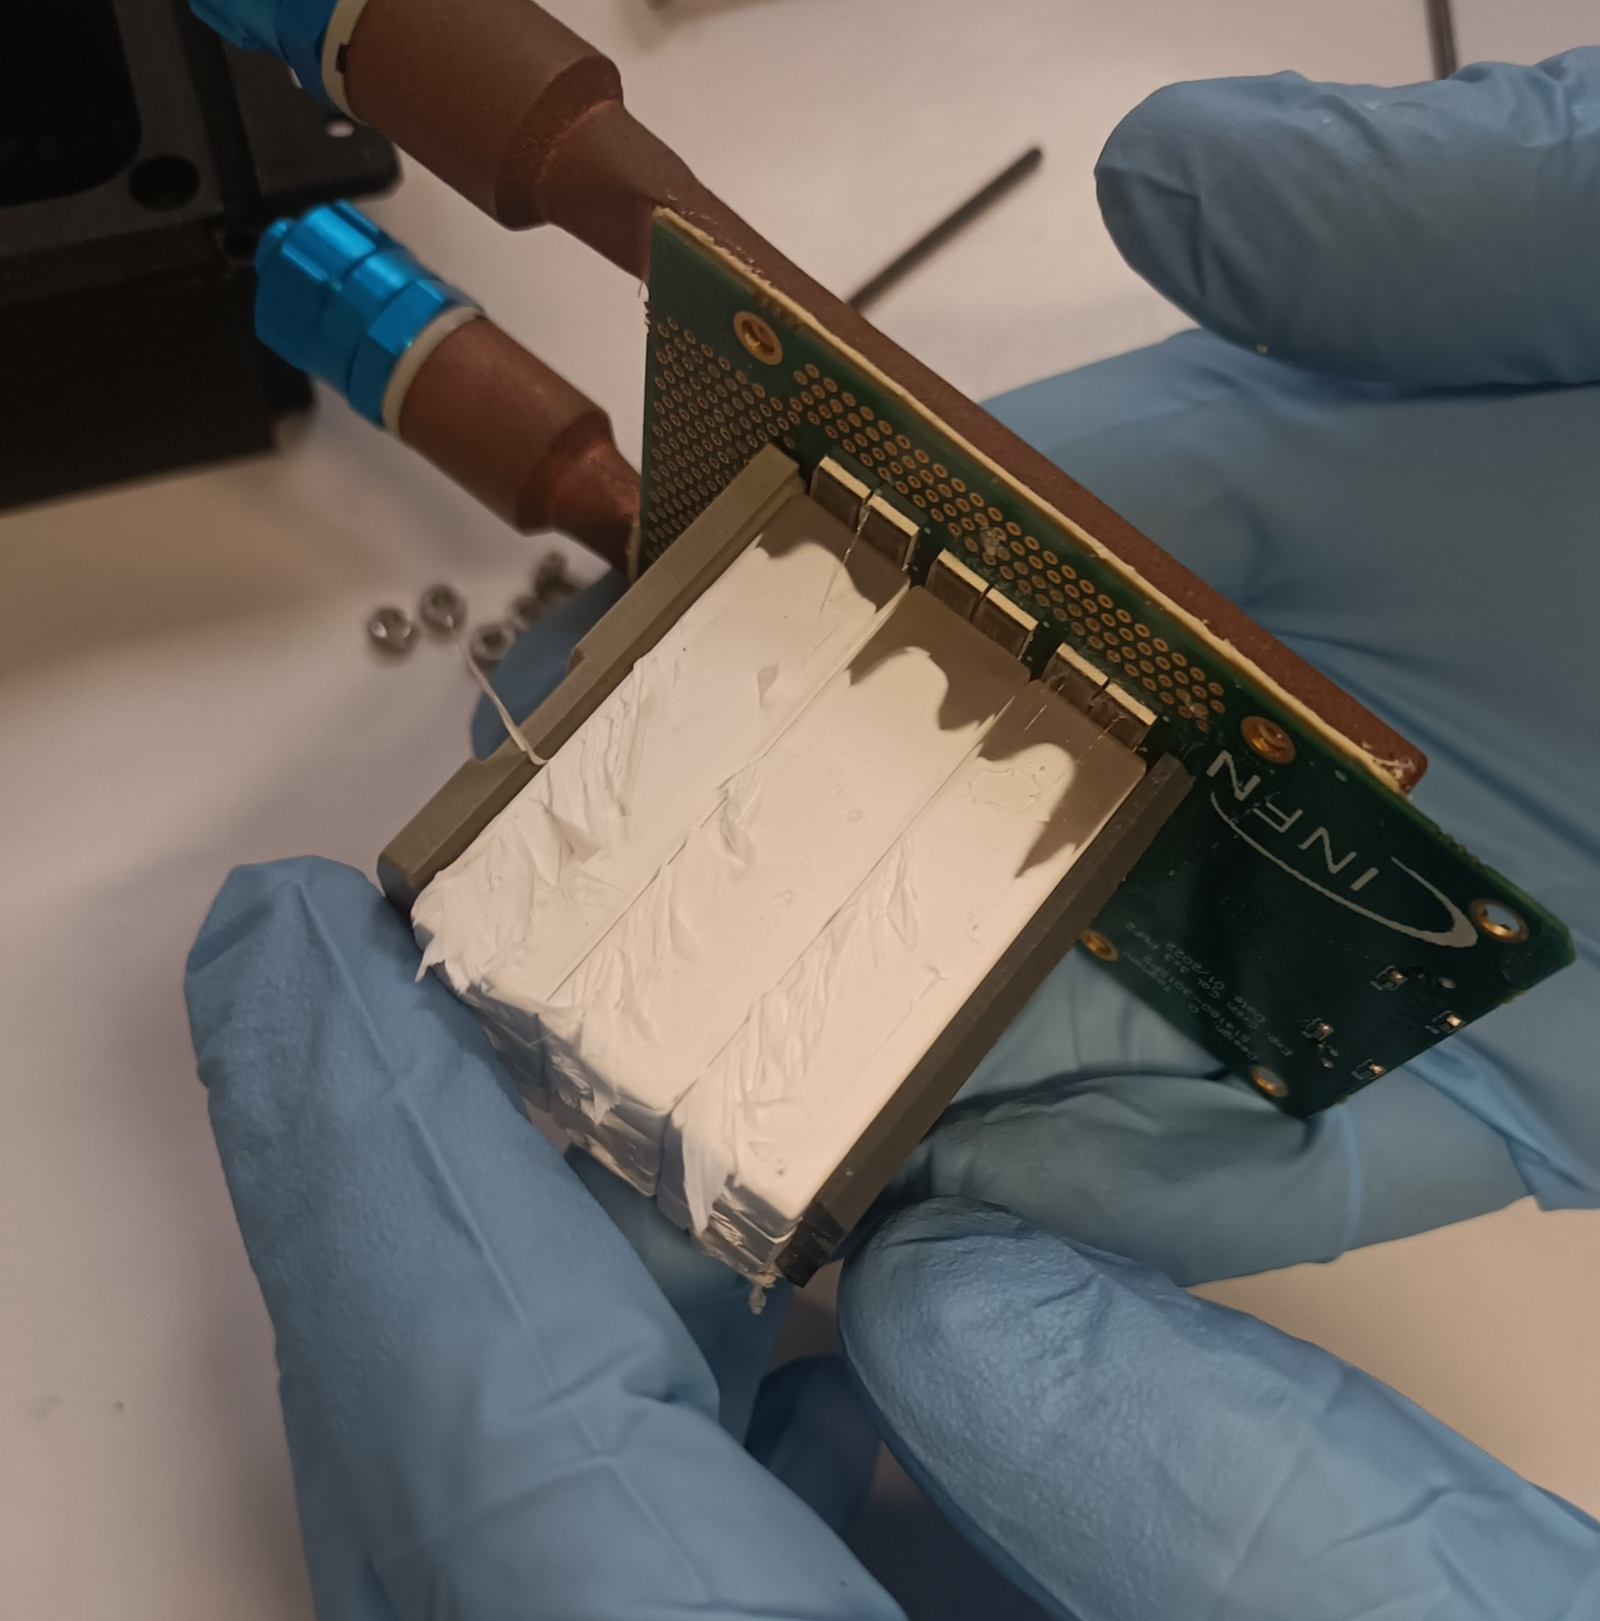
Beam test @ BTF: considerations
Considerable variability in the crystals' response to radiation, despite SICCAS claiming the use of high-purity (>99.9%) PbF₂ powder for crystal growth
Crystals evident loss of transparency
Transparency loss was uniform length-wise in the crystals
Teflon was damaged and brittle
SiPM pedestal increases significantly with the absorbed dose
New test planned to evaluate SiPMs PDE loss and optical grease degradation
Notes:
allows an easy assembly of the calorimeter and allows to assemble the calorimeter with submodules arranged in series and in parallel to obtain any configuration needed.
MZB which provides signal amplification and shaping, along with all slow control functions - individual bias regulation, temperature and current monitoring

Slide 3

Summary 2023 - 2024
Time resolution: < 40 ps for single crystals, for E_{dep} > 1 GeV
Radiation resistance: PbF₂(PWO-UF) robust to > 35(200) Mrad and SiPMs validated up to 10¹⁴ n_{1MeV}/cm² displacement-damage eq. fluence
Use PbWO-UF or LYSO in the first calorimeter layer.
Conduct new irradiation tests and monitor Cherenkov light variations with a blue laser.
Simultaneously test crystals with SiPMs and SiPMs alone.
Next steps (2024 - 2025)
We submitted and won an Italian grant for the project CALORHINO: An innovative radiation-hard calorimeter proposal for a future Muon Collider Experiment.
→ funds assigned for the development of a 5x5 x4(layers)
Crilin prototype: 1 M_{R} – 16.8 X₀
60 ps /E[GeV] ⊕ 8 ps
DRD6-WP3 from 2025
Expanding upon the PRIN prototype to a 9x9 x5(layers) configuration, with a target of 2 M_{R} – 22 X₀.

Slide 4
Crilin Module Prototype
9x9 crystals/layer – 5 layers
Aluminum matrix to hold the crystals:
  50-100 µm thickness between crystals
  Thicker (~ 2mm) in the external envelope with microchannels for cooling
Kapton strip for polarization and output signal:
  Handles polarization and output signals for each channel of two SiPMs in series.
Connectors at the back
of the 5 assembled modules.
95 mm
95 mm
94 mm
90.5 mm
Notes:
allows an easy assembly of the calorimeter and allows to assemble the calorimeter with submodules arranged in series and in parallel to obtain any configuration needed.
MZB which provides signal amplification and shaping, along with all slow control functions - individual bias regulation, temperature and current monitoring

Slide 5
PRIN - Abbiamo fondi per:
Riempire gli 81x5 cristalli e 81x2x5 SiPM
Elettronica per 100 canali 5x5 cristalli per layer
ELETTRONICA (soluzione PRIN)
Mezzanine per fornire Vbias ai SiPM (un bias ogni 9 SiPM), amplificazione veloce a ~ 1m dal calorimetro
Abbiamo bisogno di una risoluzione temporale <50 ps e di una risoluzione sulla carica <1%
Ogni mezzanina contiene 3 moduli da 9 canali → tot. 27 canali a mezzanine → tot. 4 mezzanine ~15keur
2 board di flash adc CAEN v2745 (4 Vpp – 125 Ms/s) + un canale fast ogni 9 per timing con flash adc CAEN v1742 (2 Vpp – 5 Gs/s) ~35keur

Slide 6
Preventivi 2025
Adattare un asic esistente per fare timing con ToT + ADC lento per la carica. Con un asic si potrebbero leggere i ~400 canali del prototipo senza sovraccarico di flash adc.
  Proposta di uno studio di fattibilità dell’applicazione di un asic ed eventuale realizzazione della board di interfaccia.
  10-15k su Torino e 5k su LNF.
Test ad Enea Casaccia di cristalli + SiPM e SiPM soli per scorporare le dipendenze del danno da radiazione. Test in presa dati diretta al crescere della dose con laser blu.
Poche spese non coperte dal PRIN necessarie per la realizzazione e test della matrice.

Slide 7
RICHIESTE 2025 |  | keuro | SJ
Consumi | Test irraggiamento con laser blu cristallo+SiPM e SiPM da solo a Casaccia fino a 80kGy | 3.5
 | Scheda interfaccia mezzanine con board con asic TOPHIR2 | 5
 | Cavi interfaccia tra connettori sul kapton e mezzanine (x125 canali) | 3
Inventariabile | Modulo caen A5818 controllo digitizer |  | 4.5
Missioni | Metabolismo 3.9 FTE | 20
 | Test beam CRILIN al CERN ed attività correlate di integrazione |  | 10
 | Conferenze e riunioni in preparazione prossima Strategy | 5
DRD6 Tak3
350 chs to acquire with respect
PRIN expectation of 100 chs
RICHIESTE DRD Crilin |  | keuro
Consumi | Mezzanine boards | 40
Inventariabile | Moduli CAEN V2745 64ch x 4board | 80
Institute 1 : INFN-LNF, Frascati (Italy)
Institute 2 : INFN-Padova, Padova (Italy)
Institute 3 : INFN-Torino, Torino (Italy)
Institute 4 : INFN-Trieste, Trieste (Italy)
Institute 5 : HZDR, Dresden (Germany)
Institute 6 : DIPC, San Sebastián (Spain)

