Slide 1
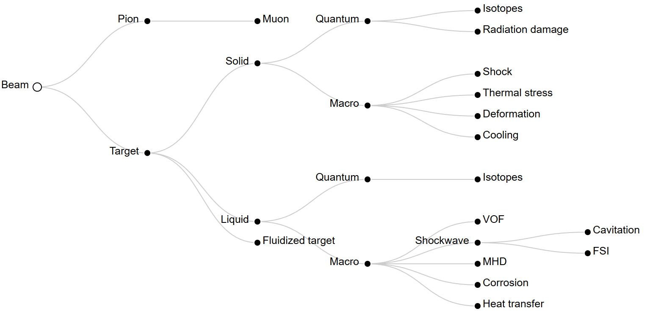
Application of liquid lead as target material for muon production: status and perspectives
Muon4Future, Venice 2025
Luca Tricarico¹, Carlo Carrelli²
¹University of Bologna, ²Enea - FSN

Slide 2
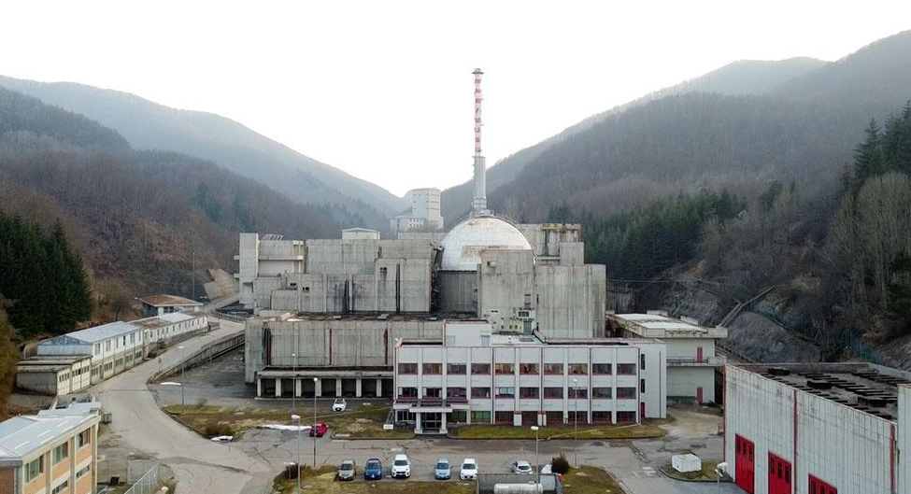
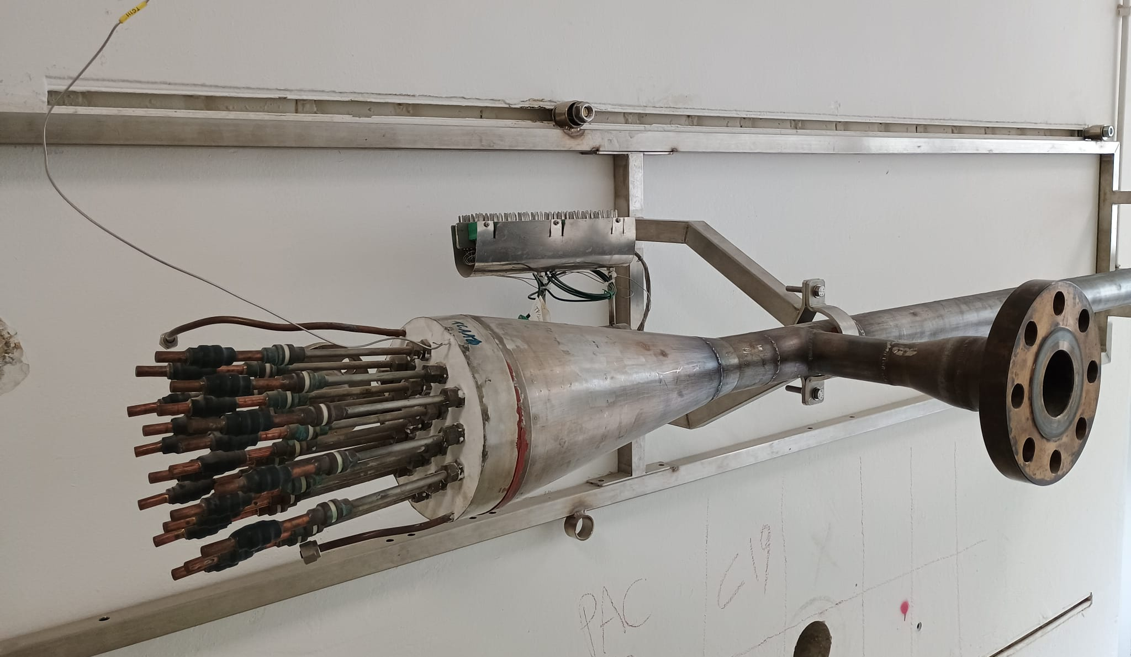
Presentation
ENEA Brasimone: Heavy Liquid Metals (HLMs) research lab
Nuclear Fusion: Gen-IV
Nuclear Fission: Tritium Breeding from liquid Pb-Li
Capabilities
Experimental design – P&ID, test components
Numerical simulation – CFD, FEM, RELAP, SIMMER
Corrosion and chemical analysis
Facilities
Nuclear Fission: NACIE-UP, CIRCE, HELENA etc..
Nuclear Fusion: HeFus, Triex etc..

Slide 3
Presentation
ENEA – CERN collaboration
Aims to use HLMs technologies for BIDs
Work done
CFD Investigations on Heavy Liquid Metal Alternative Target Design for the SPS Beam Dump Facility, 2024
Current work
Liquid lead target for the IMCC
Liquid lead loop for the FCCee dumper

Slide 4
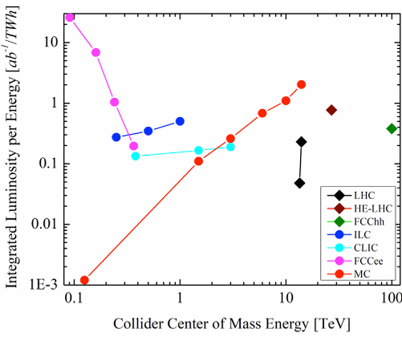
Beam characteristics
Beam
Hight energy deposition: 1-250 J/g
Pulse length from ns to seconds
Magnetic field: 0-20 T
Target request
Hight thermal resistance: thermal load
Hight density: particles production
¹
¹G. Stephen , R. Tor , S. Vladimir, Challenges of Future Accelerators for Particle Physics, Volume 10, 2022, 10.3389/fphy.2022.920520

Slide 5
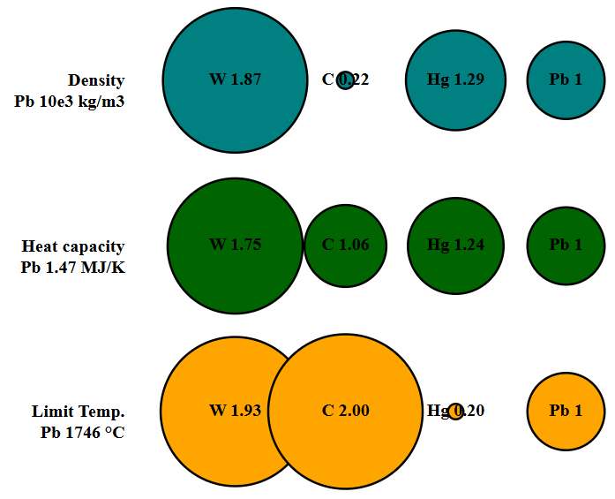
Target options
Solid target
Graphite
Tungsten
Aluminium
-> Well know technology
Liquid target: Heavy Liquid Metals (HLMs)
Mercury
Lead-Bismuth Eutectic (LBE)
Liquid lead
-> Pre-industrial technology
Fluidized bed
-> Conceptual technology

Slide 6
Target options: comparison
Solid target problems¹
Fatigue stress: high cycle temperature
Deformation: shock wave reflection
Radiation damage: low Z elements production
Liquid target problems
Shock wave on beam windows
Fluidized bed
Corrosion: lifetime structure
¹Belov, V. et all, Liquid metal target for NLC positron source, 2001.

Slide 7
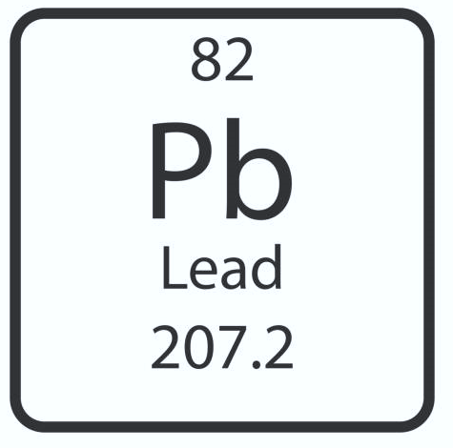
Liquid lead characteristic
Thermophysical proprieties:
Density: 10660~9000kg/m3
Melting point: 327 °C
Boiling point: ~ 1723 °C
Saturation vapour pressure: 10^-2Pa (500 °C)
Technological aspects:
Cold spots: local freezing
Protect atmosphere: argon cover gas
Steel corrosion up to T> 450°C (slow process, 10^3 hrs)
Poor wetting properties: no moving parts are preferred
Velocity under 1 m/s is preferred
High piezometric gradient
Radiological aspects under proton beam (ADS experiments)
Polonium production¹
Neutron production
¹Toshinsky, G. , Dedul, A. , Komlev, O. , Kondaurov, A. and Petrochenko, V. (2020) Lead-Bismuth and Lead as Coolants for Fast Reactors. World Journal of Nuclear Science and Technology, 10, 65-75. doi: 10.4236/wjnst.2020.102007.

Slide 8
Liquid target: past solutions
Paper in literature: main projects
Particles Accelerators
Next Linear Collider (NLC)
BNL E951 at the AGS
Merit – mercury jet at 20 m/s 15-20 T
IMCC – current study on liquid lead
Spallation Neutron Source (SNS)
MEGAPIE – Lead-Bismuth Eutectic (LBE)
ISOLDE
ISOLDE – various liquid metals

Slide 9
Liquid target: past solutions
P. Rusi 1998
MODELING & ANALYSIS OF AGS (1998) THERMAL SHOCK EXPERIMENTS
Keys aspects:
Static mercury
Average power 1 MW
Shock wave and cavitation up to 10 MPa (0.5s)
Rise time temperature 1e7 °C/s inside the beam interaction aria
The liquid target solves the fatigue strain but creates shock wave on the beam windows
S. H. Kim 2000
EXPERIMENTAL STUDIES ON ROLE OF SCATTERING CENTERS ON WAVE ENERGY ATTENUATION
Keys aspects:
The scattering centres, bubbles of compressible gas within the target that reduces the shock wave propagation
Ultrasonic driver for simulating the shockwave

Slide 10
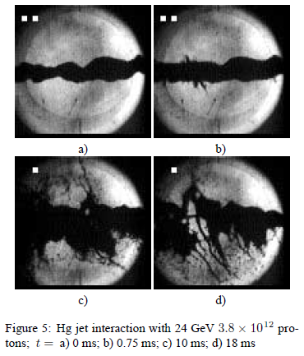
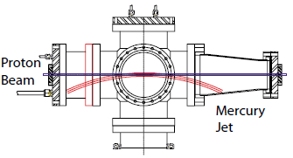
Liquid target: past solutions
H. Kirk 2001
TARGET STUDIES WITH BNL E951 AT THE AGS
N. Simos 2001
THERMODYNAMIC INTERACTION OF THE PRIMARY PROTON BEAM
WITH A MERCURY JET TARGET AT A NEUTRINO FACTORY SOURCE
Keys aspects:
Mercury jet
Shock wave up to several GPa and cavitation
Destruction of the mercury jet

Slide 11
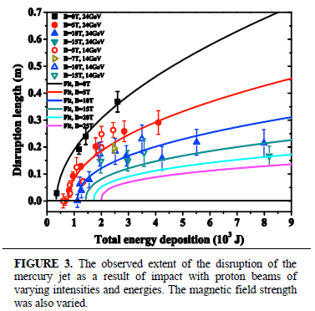
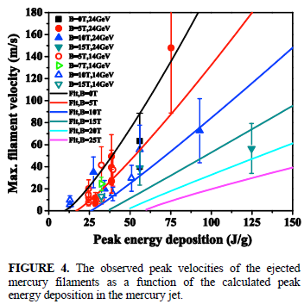
Liquid target: past solutions
H. G. Kirk 2010
RECENT RESULTS FROM THE MERIT EXPERIMENT
Keys aspects:
Mercury jet
Stability of jet under magnetic field

Slide 12
Liquid target: past solutions
Literature review conclusions
The fast energy deposition creates thermal shock waves
The shock waves can reach the beam windows and the nozzle
The scattering centres (bubbles gas inside the target) reduce the shock wave damage
The jet solution works
The magnetic field increases the stability of the jet

Slide 13
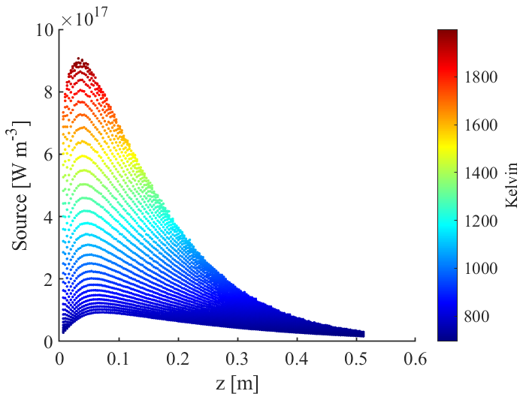
Liquid target: prospective
Proton beam IMCC (CERN 2023)
Beam power: 2-4 MW
Pulse beam: 2ns length with 5 Hz
Magnetic field: 20 T
Energy deposition (liquid lead 2MW): 100 J/g
Power deposition – z axis Contour of temperature into the liquid lead.
(data source CERN (2023), 2 MWs target).

Slide 14
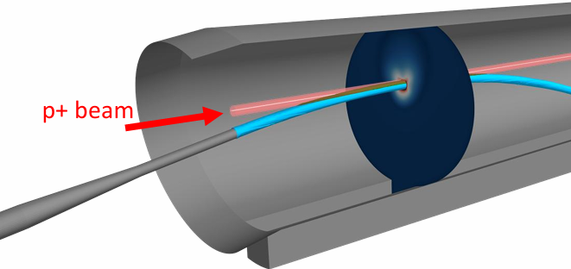
Liquid target: prospective
Liquid lead target option for IMCC
Liquid lead curtain - ENEA-CERN 2023-2024
Hight mass flow rate – poor muon production
Liquid lead jet
Liquid lead jet at 4 m/s – S. Candido (CERN 2025)
Shock wave and cavitation model
Shock wave based on Mie–Grüneisen Equation of State
2D simulation on Lead Bottom Stream Target LBST
Liquid lead jet – S. Candido CERN 2025.
Shock wave study LBST – L. Tricarico ENEA 2025.

Slide 15
Recap
Liquid lead is an ideal candidate as target material
Hight density, hight thermal capacity
Keys information from the literature
Scattering centres or jet solutions are the best options
Physical model
Shock wave on order of GPa
MHD is drag force for the instabilities
Cavitation
Next steps
Cavitation model for liquid lead
Compete model VOF – MHD – Cavitation – FSI – Shock wave
Experimental campaign?

Slide 16
Thanks for the attention
luca.tricarico@studio.unibo.it

