Slide 1
May 27th 2025 High - Intensity Muon Beams (HIMB) project or how to improve the most intense continuous muon source in the world
Giovanni Dal Maso for the HIMB project

Slide 2
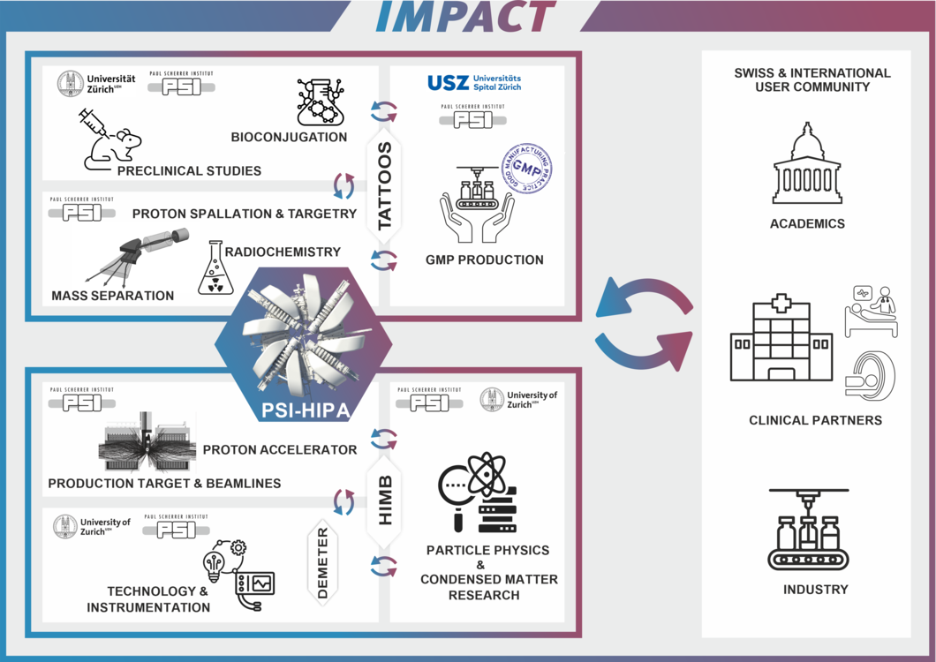
IMPACT
Isotope and
Muon
Production using
Advanced
Cyclotron and
Target technologies
https://www.psi.ch/en/impact/overview

Slide 3
IMPACT
Isotope and
Muon
Production using
Advanced
Cyclotron and
Target technologies
https://www.psi.ch/en/impact/overview

Slide 4
The HIMB project
The High-Intensity Muon Beams project aims to develop two new beamlines capable of delivering up to 10¹⁰ μ⁺/s.
Two key points to do so:
Substition of the old TgM station with a new one for higher particle production.
Construction of two high capture/transport efficiency beamlines based on solenoids.
Beneficial for both precision particle physics and materials science (Science Case April 2021 [1])

Slide 5
The HIMB project
The High-Intensity Muon Beams project aims to develop two new beamlines capable of delivering up to 10¹⁰ μ⁺/s.
Two key points to do so:
Substition of the old TgM station with a new one for higher particle production.
Construction of two high capture/transport efficiency beamlines based on solenoids.
Beneficial for both precision particle physics and materials science (Science Case April 2021 [1])
More details in our Conceptual Design Report (January 2022) [2]

Slide 6
What to do with HIMB?
Motivations

Slide 7
Science Case Workshop [1]
https://indico.psi.ch/e/himbws

Slide 8
A biased choice: charged Lepton Flavor Violation

Slide 9
A biased choice: charged Lepton Flavor Violation

Slide 10
A biased choice: muon Spin Rotation (μSR)
With μSR measurements it is possible to probe the magnetic properties of a material.
The energy of the muons defines the depth in the sample.
HIMB would allow to:
Increase the Low Energy muons (< 30 keV) rate by more than 10, now ~4.5 10³ μ⁺/s.
Explore the sub-surface gap in depth

Slide 11
Muon beams at PSI
How to produce muons?

Slide 12
The High Intensity Proton Accelerator (HIPA) facility

Slide 13
The High Intensity Proton Accelerator (HIPA) facility

Slide 14
The High Intensity Proton Accelerator (HIPA) facility

Slide 15
The High Intensity Proton Accelerator (HIPA) facility

Slide 16
The High Intensity Proton Accelerator (HIPA) facility

Slide 17
Muon production
The 590 MeV protons impinge on the targets, producing pions that decay to muons.
Depending on where they are created, we have:
Surface and sub-surface muons (5-30 MeV/c): pion decay at rest.
Cloud muons: pion decay in flight.

Slide 18
Muon production
The 590 MeV protons impinge on the targets, producing pions that decay to muons.
Depending on where they are created, we have:
Surface and sub-surface muons (5-30 MeV/c): pion decay at rest.

Slide 19
Muon production
The 590 MeV protons impinge on the targets, producing pions that decay to muons.
Depending on where they are created, we have:
Surface and sub-surface muons (5-30 MeV/c): pion decay at rest.
Cloud muons: pion decay in flight.

Slide 20
Muon production
The 590 MeV protons impinge on the targets, producing pions that decay to muons.
Depending on where they are created, we have:
Surface and sub-surface muons (5-30 MeV/c): pion decay at rest.
Cloud muons: pion decay in flight.
Due to the high intensity and low momentum, surface muons are the most interesting for many experimental applications as they can be stopped in thin targets.

Slide 21
The new target region

Slide 22
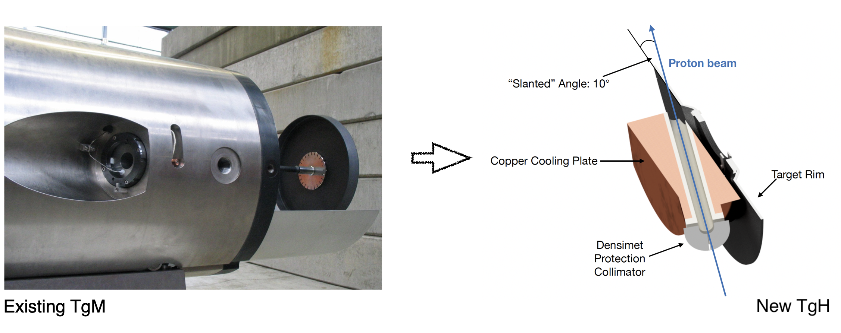
TgH: design
The exsisting Target M station will be substituted with a high-intensity version using a slanted target geometry:
Thicker target: 5 mm → 20 mm
Slanting angle: 10 deg
Muon collection sideways

Slide 23
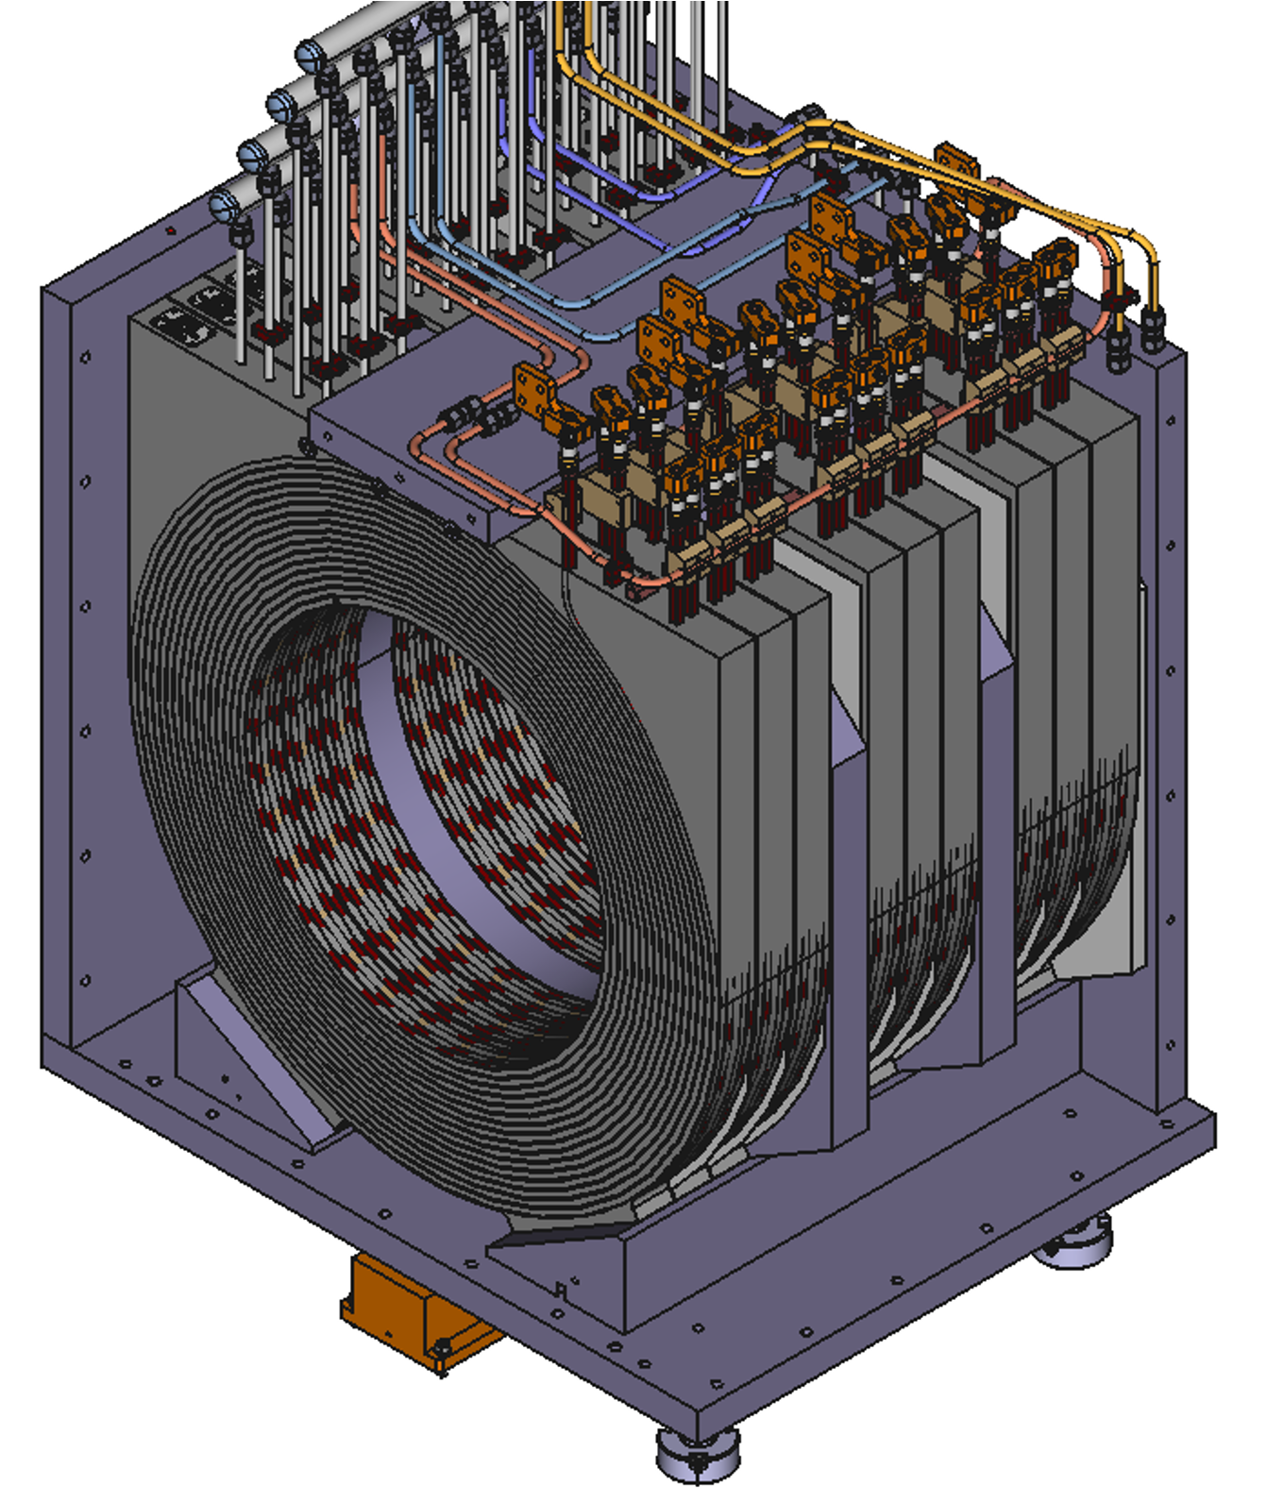
Split capture solenoids
We cannot surround our target with a unique solenoid → let’s split it:
Two normal conducting, radiation-hard solenoids close to the target for capture (very similar to ones used in the existing μE4 beamline at PSI)
Central field ~0.4 T

Slide 24
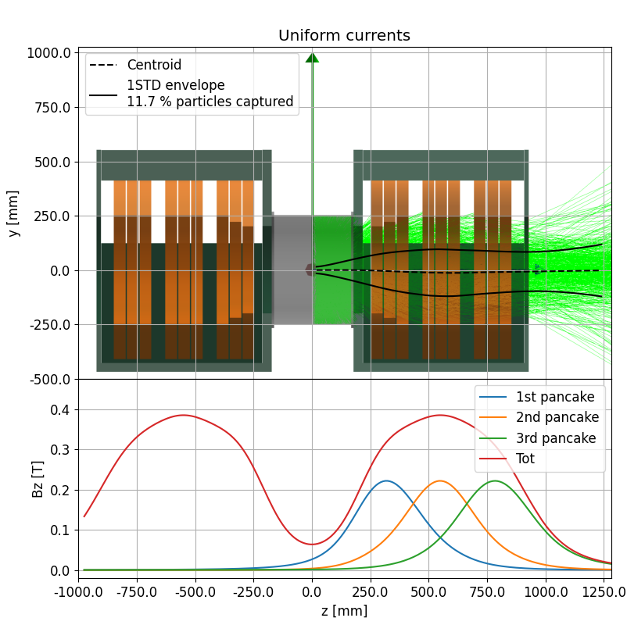
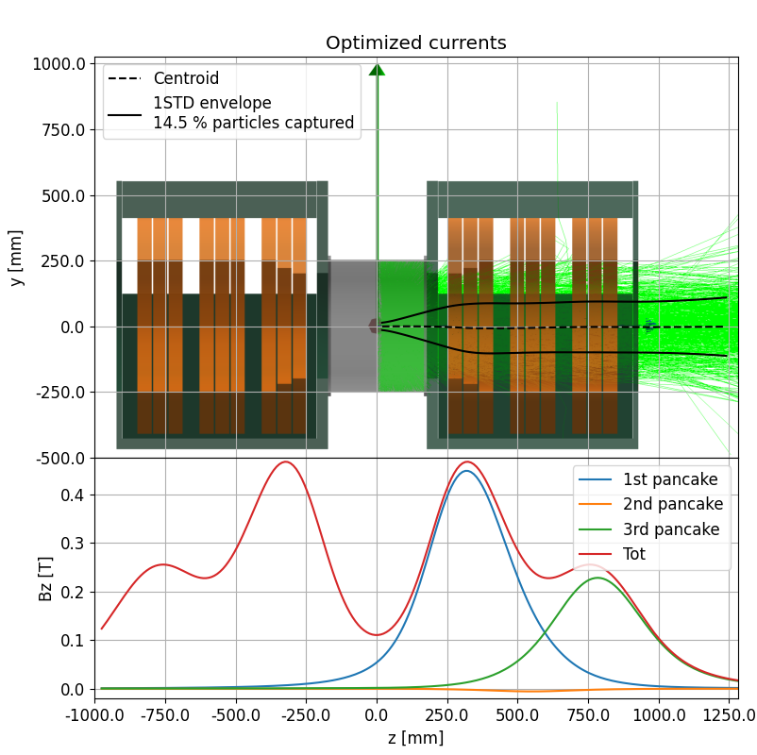
Graded capture solenoids
The axial magnetic field has a gradient optimized to maximize capture and transmission:
Strong field close to the target → increased capture
Lower field for focusing down stream → increased transmission
The introduction of a gradient improves the absolute rate by 27%.

Slide 25
Particle production at TgH

Slide 26
Particle production at TgH

Slide 27
Particle production at TgH

Slide 28
Particle production at TgH
Transmission
up to 80 MeV/c

Slide 29
The beamlines

Slide 30
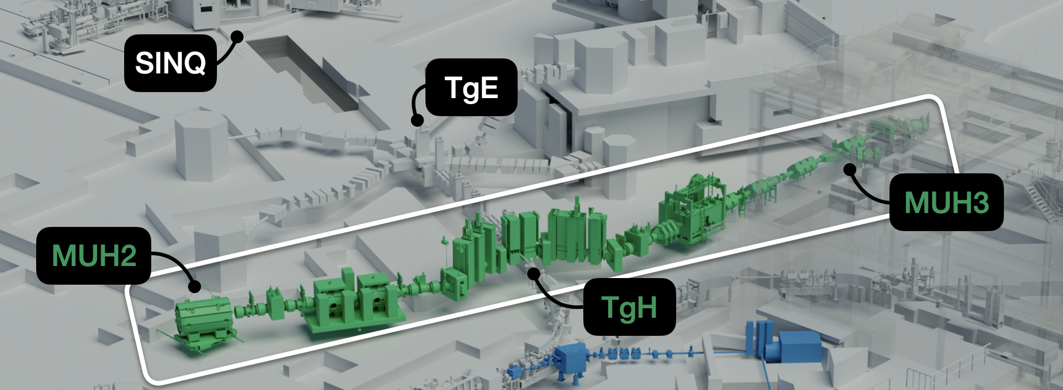
Beamlines layout
Intensity is boosted by increasing the transport efficiency: two new high intensity solenoid-based muon beamlines at 90 deg angle w.r.t. the proton beam.
The solenoids along the beamlines will not be radiation hard and the magnetic fields can be higher than in the target region.

Slide 31
MUH2
Aimed at particle physics experiments, highest rates exceeding 10¹⁰ μ⁺/s @ 2.4 mA .

Slide 32
MUH3
Upgrade of existing ᴨM3:
New solenoid-based front end with > 10¹⁰ μ⁺/s @ 2.4 mA transmission.
The quadrupole section is upgraded to propagate through a spin rotator to two μSR instruments.
Few 10⁸ μ⁺/s @ 2.4 mA to both channels with ~20 mm beamspot sizes.

Slide 33
Problem
Many optimizations/single particle tracking simulations (G4beamline models with high-fidelity fieldmaps). Expensive problem → hyperparameter search algorithms.
Bayesian optimization:
Probabilistic approach to parameter space exploration, next trial to test is that expected to give the maximum improvement
𝒪(10) parameters/one or many(multi) figures of merit
Genetic algorithms:
Evolutionary approach to function maximization, fittest individuals are used to produce the next generation
> 𝒪(20) parameters/many figures of merit

Slide 34
Problem
Bayesian optimization:
Probabilistic approach to parameter space exploration, next trial to test is that expected to give the maximum improvement
𝒪(10) parameters/one or many(multi) figures of merit
https://github.com/AnotherSamWilson/ParBayesianOptimization

Slide 35
Problem
Bayesian optimization:
Probabilistic approach to parameter space exploration, next trial to test is that expected to give the maximum improvement
𝒪(10) parameters/one or many(multi) figures of merit
Genetic algorithms:
Evolutionary approach to function maximization, fittest individuals are used to produce the next generation
> 𝒪(20) parameters/many figures of merit
From Saravanan et al. [3]

Slide 36
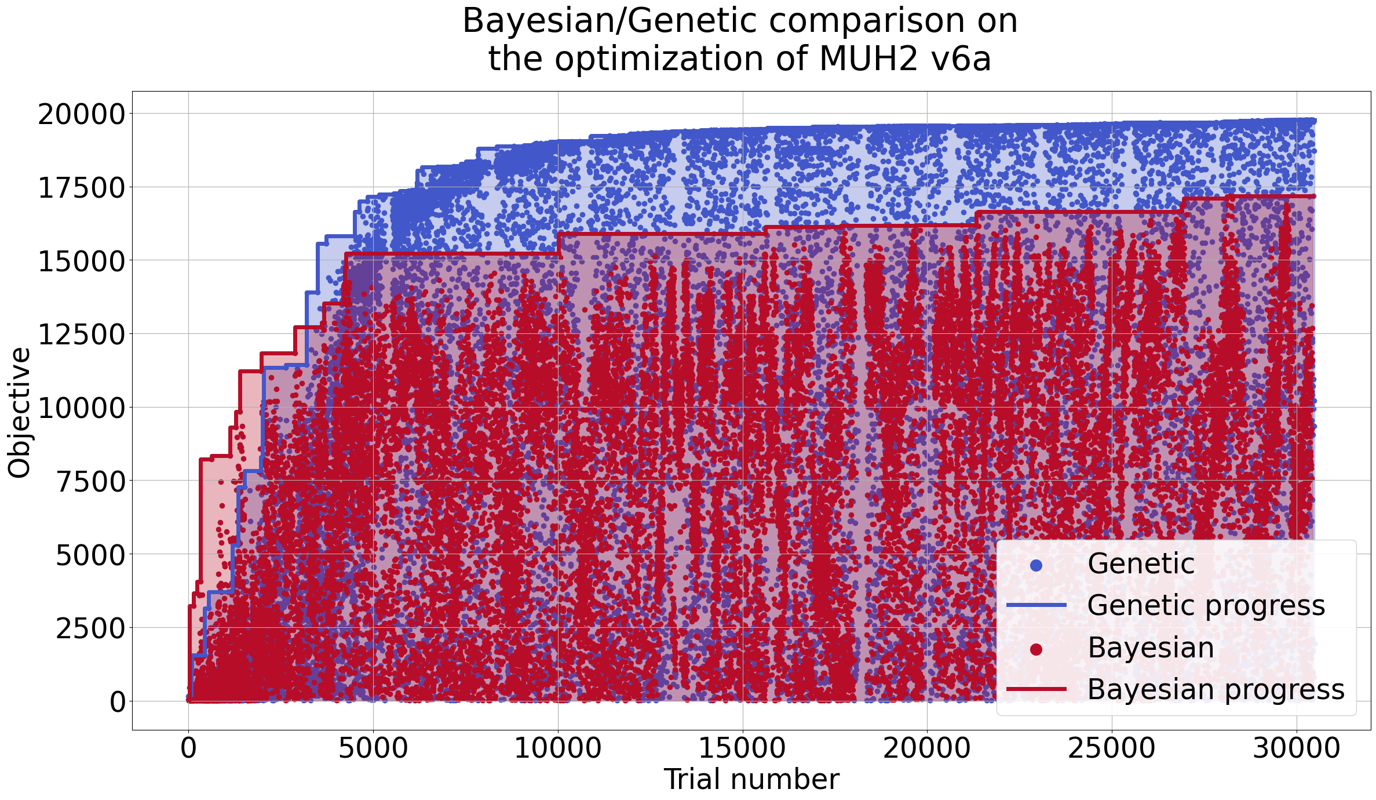
Comparison
21 free parameters are optimized here for MUH2 transmission.

Slide 37
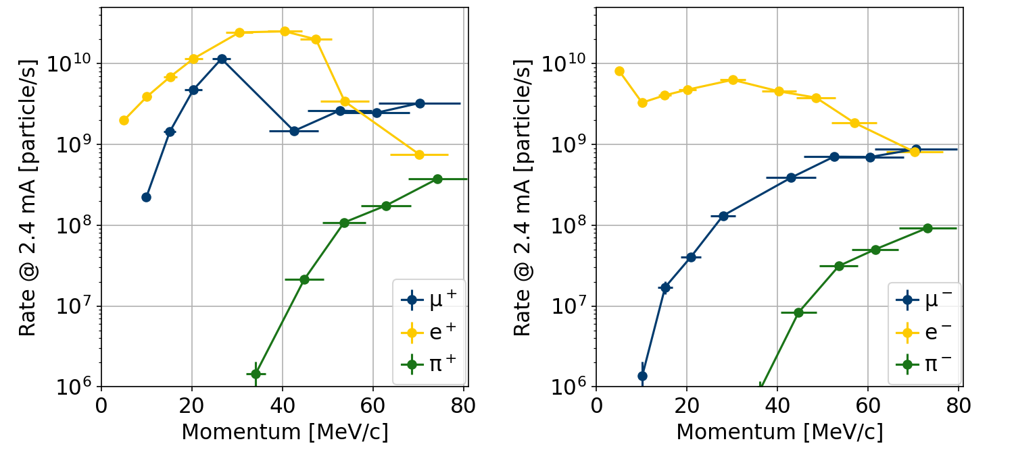
MUH2 deliverable rates

Slide 38
MUH2 deliverable rates

Slide 39
MUH3 transmission
MUH3 optimization in steps:
Maximize transmission until septum (mono objective)
Maximize transmission to the two experimental areas (double objective)
Separately optimize the final focus on the μSR detectors

Slide 40
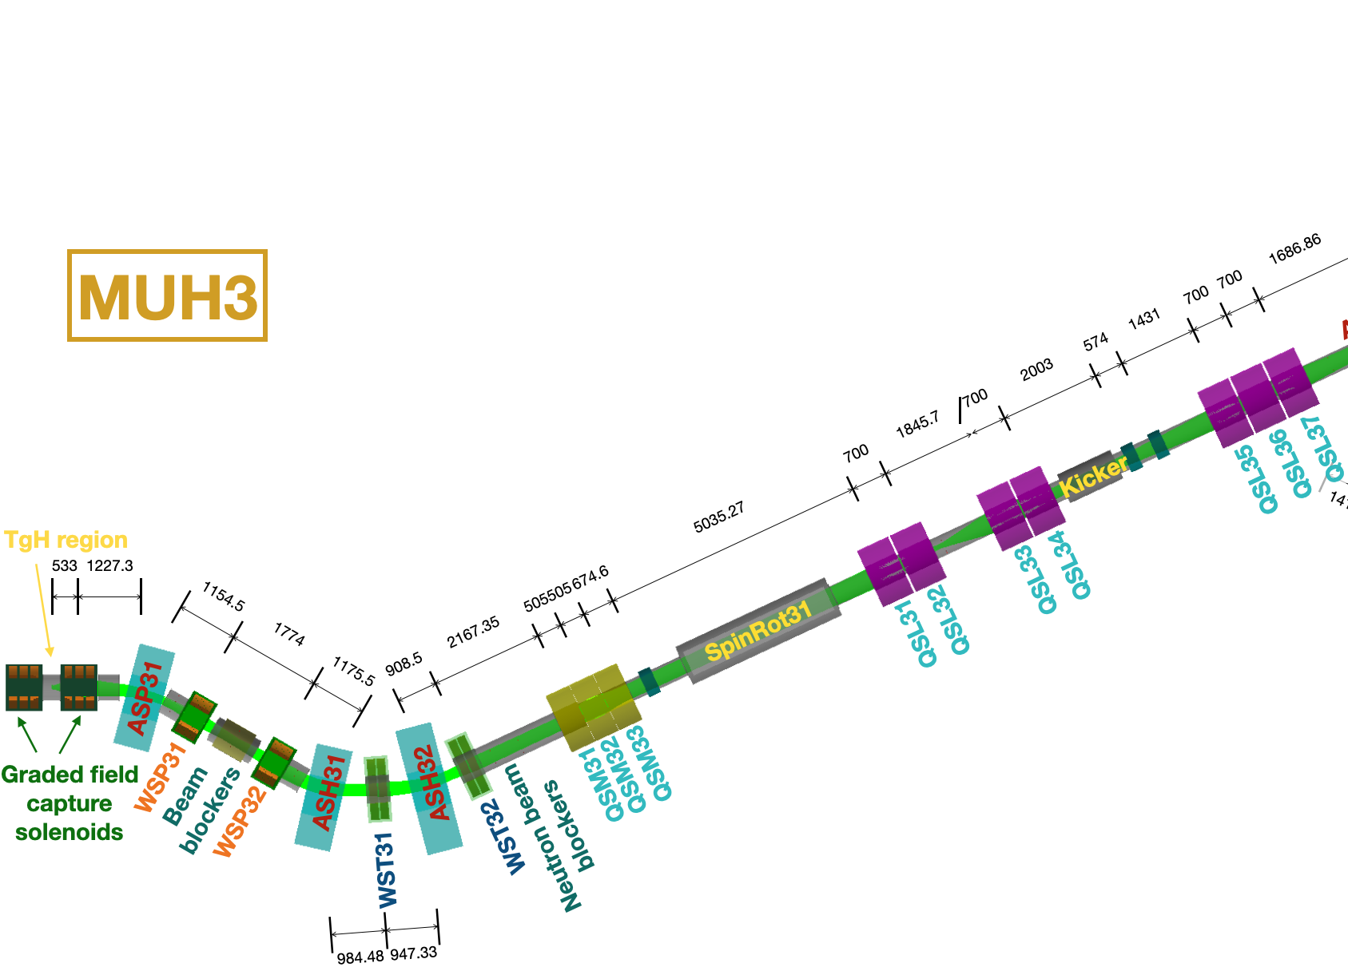
MUH3 transmission
MUH3 optimization in steps:
Maximize transmission until septum (mono objective)
Maximize transmission to the two experimental areas (double objective)
Separately optimize the final focus on the μSR detectors

Slide 41
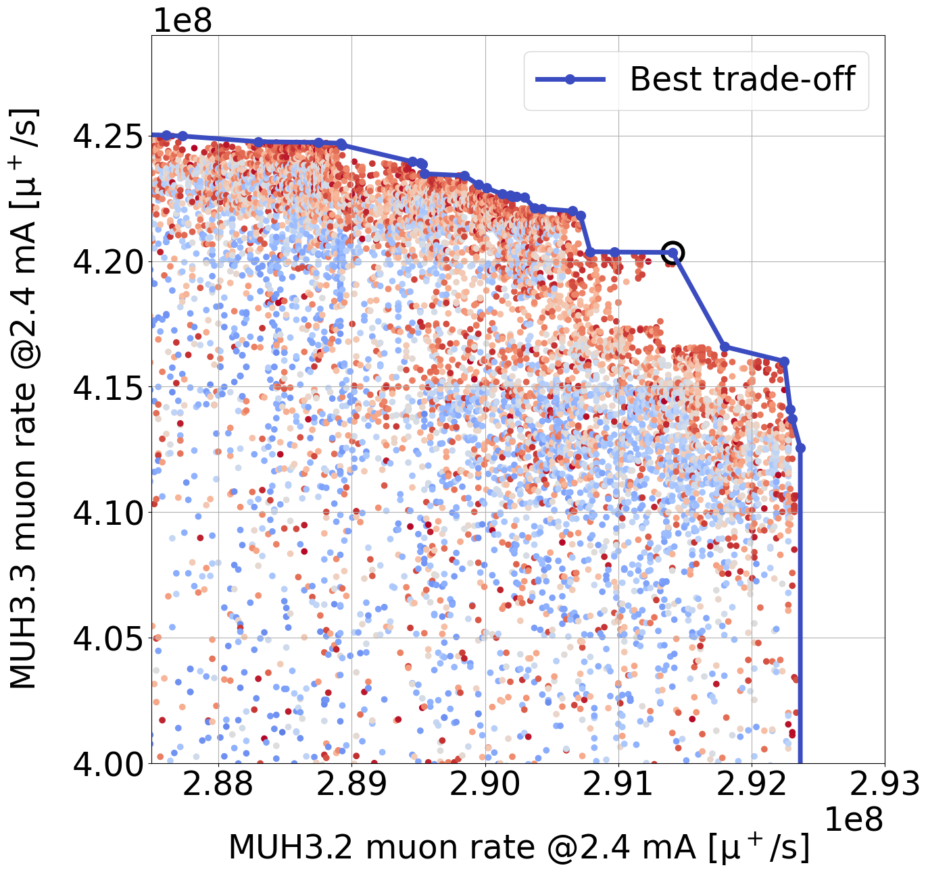
MUH3 transmission
MUH3 optimization in steps:
Maximize transmission until septum (mono objective)
Maximize transmission to the two experimental areas (double objective)
Separately optimize the final focus on the μSR detectors

Slide 42
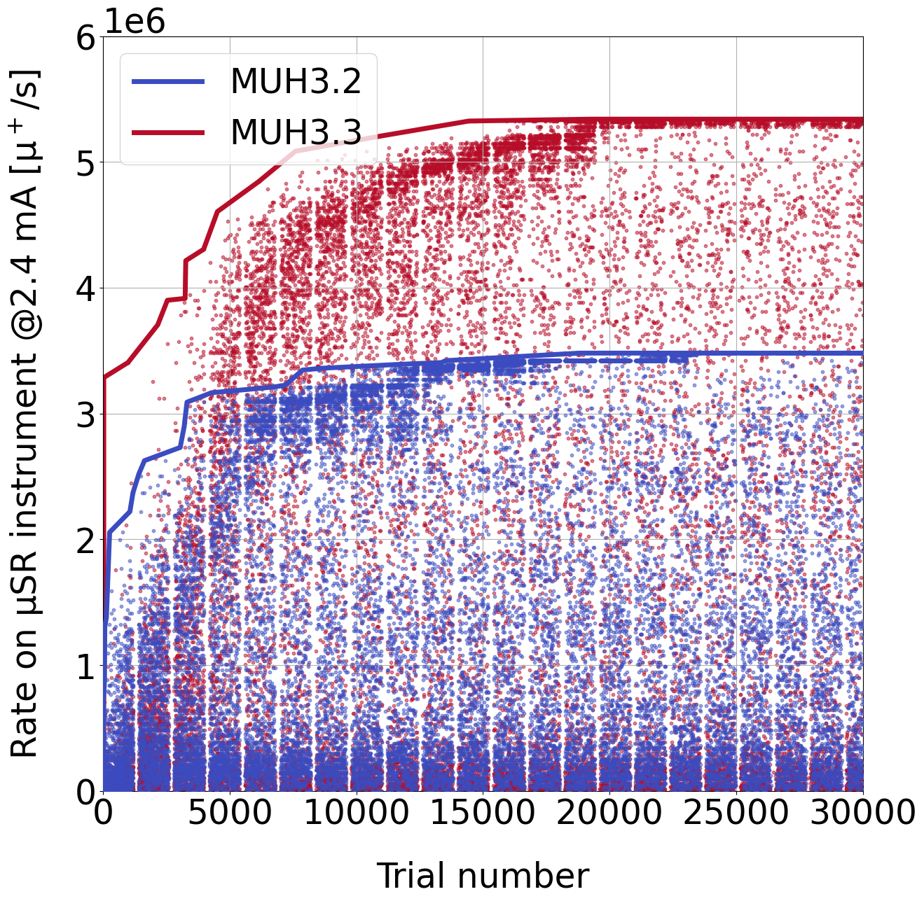
MUH3 transmission
MUH3 optimization in steps:
Maximize transmission until septum (mono objective)
Maximize transmission to the two experimental areas (double objective)
Separately optimize the final focus on the μSR detectors (~40 times higher rate)

Slide 43
Additional studies – MUH3, low power tune
The power consumption of the HIMB beamlines will be high.
Instead of controlling the rate with slits only, we studied alternative tunes to deliver lower rates with lower power consumption.

Slide 44
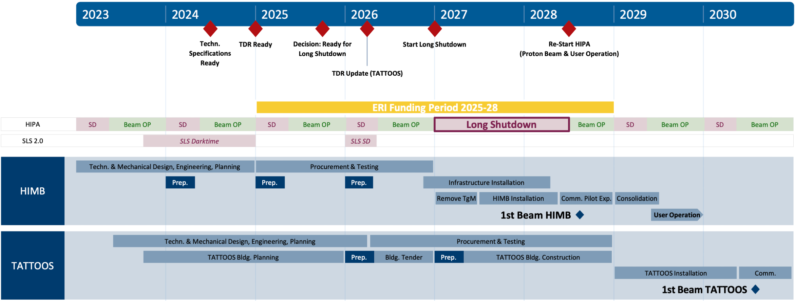
Conclusions
Scientific review passed with highest ranking in summer 2022.
Funding officially approved by the Swiss parliament at the end of 2024
Long shutdown of ~1.5 years beginning of 2027
Commissioning and pilot experiments at HIMB starting mid 2028, at TATOOS mid 2030

Slide 45
Thank you for your attention!

Slide 46
Bibliography
[1] M. Aiba et al., Science Case for the High-Intensity Muon Beams HIMB at PSI. Nov. 2021. arXiv: 211.05788 [hep-ex].
[2] R. Eichler and et al., IMPACT conceptual design report. 2022. url: https://www.dora.lib4ri.ch/psi/islandora/object/psi%3A41209.
[3] R. Saravanan et al., Evolutionary optimal trajectory planning for industrial robot with payload constraints. Oct. 2008. doi: 10.1007/s00170-007-1169-7
[4] W. Lyu et al., Multi-objective bayesian optimization for analog/RF circuit synthesis. June 2018. doi: https://doi.org/10.1145/3195970.3196078

Slide 47
Back-up

Slide 48
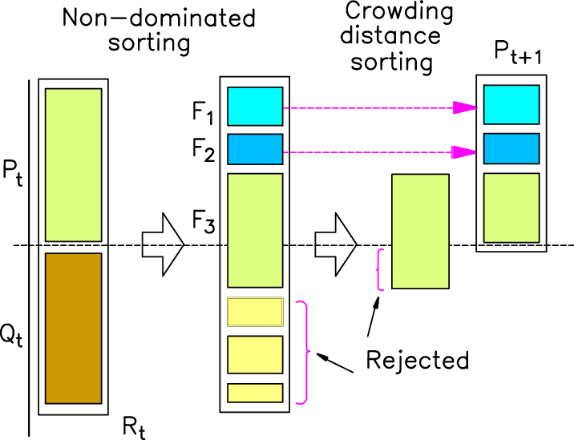
Non-dominated Sorting Genetic Algorithm II
The basic idea is to define a population where each individual is characterized by his genes, namely the parameters of the problem:
At each epoch the individuals mix through breeding, crossover, mutation ...
The population is classified based on dominance and crowding distance.
From Saravanan et al. [3]
From Lyu et al. [4]

Slide 49
Target H

Slide 50
MUH2 envelope - latest

Slide 51
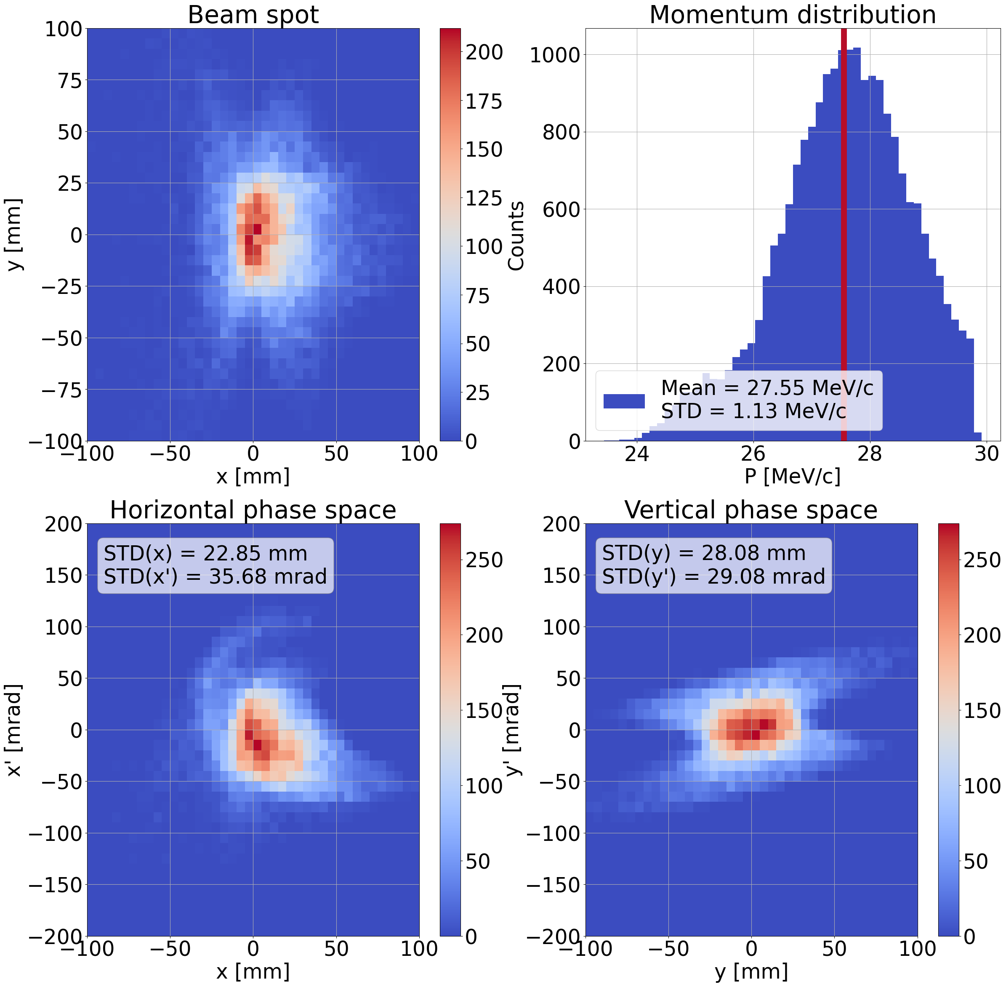
MUH3 final phase spaces - latest

Slide 52
Bayesian optimizer for beam commissioning
Various tests performed at PSI through 2023 and 2024 to automatically commission different muon beamlines (πE5, μE4, πM3, πE1).
First promising results obtained exploiting available dead times.

