Slide 1
Physics perspectives, synergies, and challenges at a muon-ion collider
Darin Acosta
T.W. Bonner Nuclear Laboratory
Notes:
A speculative but hopefully an interesting proposition!

Slide 2
Outline
The Muon-Ion Collider concept
Deep Inelastic Scattering physics potential
SM (and BSM) physics potential
Interesting experimental challenges at a MuIC
Synergies with a muon collider and other programs
Summary
A dedicated workshop on this concept was held December 2023:
https://muic2023.rice.edu/

Slide 3
Context: The Electron-Ion Collider (EIC) at BNL
International facility already CD1 approved by the U.S. DOE Nuclear Physics program.
Culmination of a 2 decade process
Science to begin in the 2030s
EIC Conceptual Design Report recently released. Salient points:
Electron beam energy up to 18 GeV
Hadron beam energy up to 275 GeV
√s = 20 -- 140 GeV
Luminosity 10³³ -- 10³⁴ Hz/cm²
Polarized electron, proton and ion beams (any species)
Physics goals:
ep and eN deep inelastic scattering
Nucleon spin structure
Gluon saturation scale (Q_{S})
But what comes after 🤔
Notes:
Context of initial idea about the proposal, how it was born

Slide 4
Muon-Ion Collider Concept and Motivation
The concept of a muon-proton collider has been discussed in the literature since ~28 years ago
Our initial concept proposed an upgrade successor to the EIC
E_{lep} → 100X higher, √s → 10X higher
But worth considering for any high-energy muon accelerator facility
Leverage community interest for a muon collider and its associated technology, and apply toward an initial science demonstrator: a muon-hadron collider
Planning should start now, given the ~2 decade path to project approval…
Basis of proposal for a MuIC at BNL:
Acosta and Li, NIM A1027 (2022)
MuIC science case further explored in U.S. Snowmass contribution: Acosta et al., 2023 JINST 18 P09025
+ various works in progress with students

Slide 5
The Muon-Ion Collider In a Nutshell
Probe a new energy scale and nucleon momentum fraction in Deep Inelastic Scattering using a relatively compact machine (add new PDF data!)
√s ~ 1 TeV
Q² up to 10⁶ GeV²
x as low as 10⁻⁶
Provide a science case for a TeV muon storage ring demonstrator toward a multi-TeV μ+μ- collider:
Precision PDFs in new regimes (incl. spin at BNL)
QCD studies, including at extreme parton density
Precision EWK and QCD measurements
Higgs and other SM particle production
BSM / LFUV sensitivity with an initial muon
Facilitate the collaboration of the nuclear and particle physics communities, and join with innovative muon collider efforts Re-use existing facilities (e.g. upgrade the EIC at BNL, or co-develop with a MC at FNAL or CERN)
i.e. an extension of the EIC program and equivalent to the LHeC program, but with a muon accelerator
Well beyond the EIC
Luminosity depending
Broad science program helps share costs, and re-use helps economize
Notes:
Concept and motivation on 1 slide

Slide 6
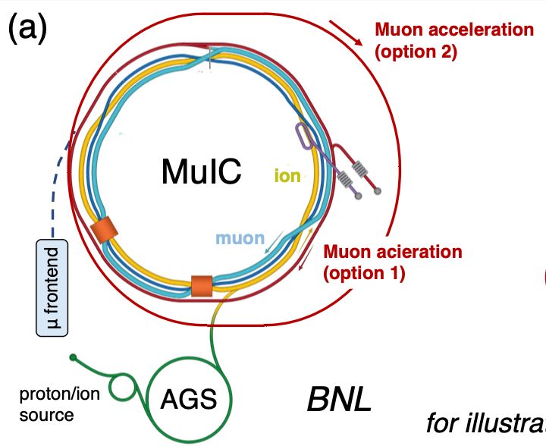
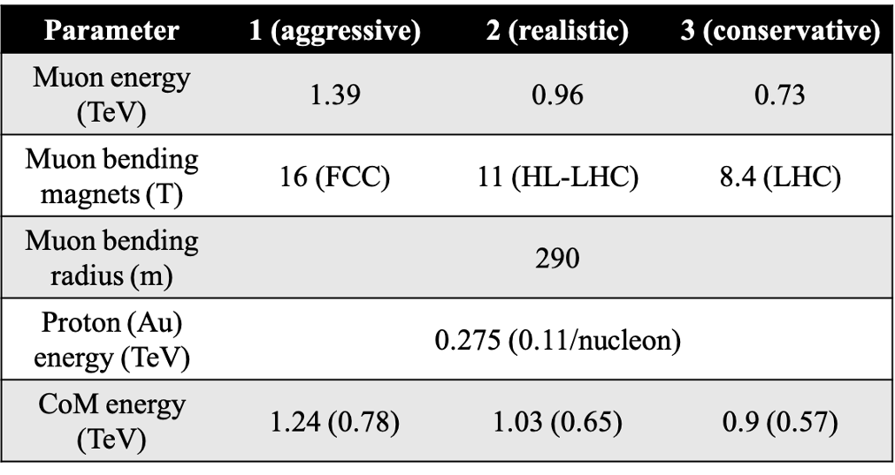
A Muon-Ion Collider at BNL
Acosta and Li, NIM A 1027 (2022) 166334
Replace e with μ beam at EIC
[10 GeV → 1000 GeV]
Bending radius of RHIC tunnel: r = 290m
Achievable muon beam energy: 0.3Br
Au
for illustration only
√s = 1 TeV !
7-8X increase over EIC energy

Slide 7
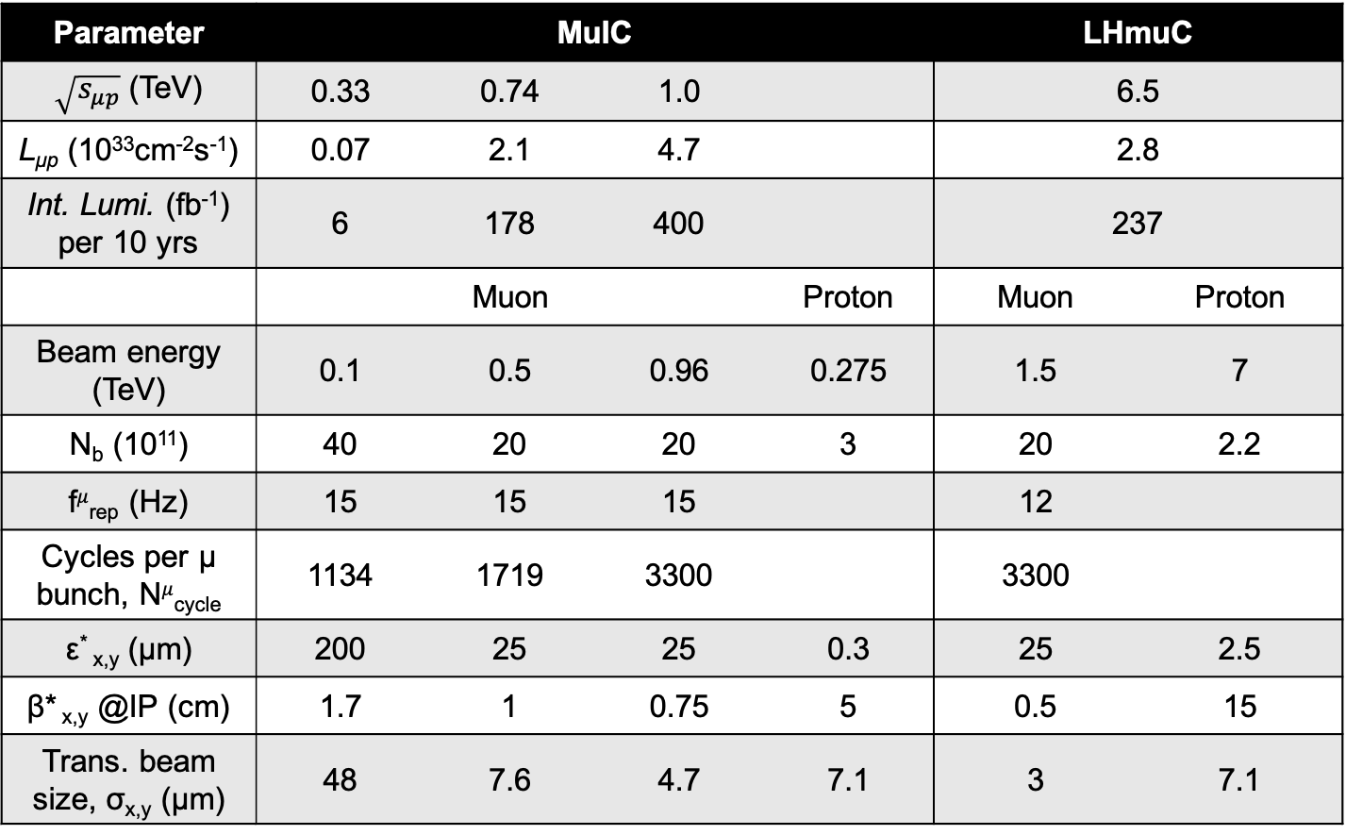
A Muon-Ion Collider at BNL – Parameters
Acosta et al., JINST 18, P09025 (2023)
BNL options
Taken from MuC parameters and BNL hadron ring
→ 2.0
← √s
← Luminosity estimate overestimated 10−100X due to beam-beam effects (needs further dedicated optimization)
← Beam energies
Staging: RLAs + RCS1 + RCS2
→ 1.0
Staging options reduce number of acceleration stages required for muon beam
Muon Collider parameters + BNL/EIC and LHC proton beam parameters
→ Symmetric 1 TeV collider?
Notes:
Energy

Slide 8
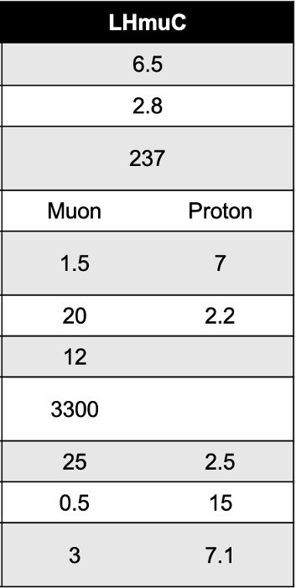
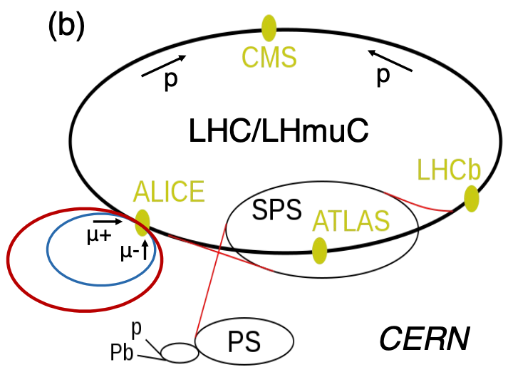
A Muon-Ion Collider at CERN, “LHmuC”
A variation of the LHeC concept with a TeV-scale muon beam replacing the 50 GeV electron beam
Could accommodate a μp collider option if an initial 1.5+1.5 TeV μ⁺μ⁻ collider is sited at CERN (Intl. Muon Coll. Collab. design)
Equivalent √s would actually exceed that of a 3 TeV μ⁺μ⁻ collider
n.b. Assumes LHC remains, and tunnel does not house the muon collider RCS accelerators…
← Similarly unrealistic and needs study

Slide 9
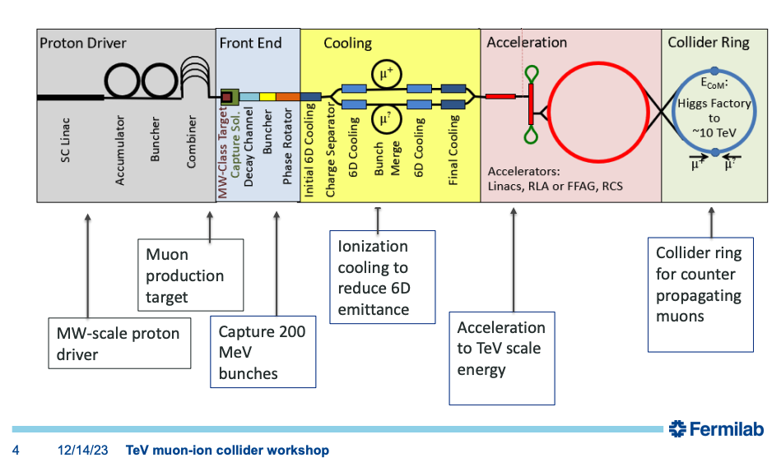
A Muon Acceleration & Collider Complex
Recirculating Linacs + Rapid Cycling Synchrotrons
From Diktys Stratakis, link
(or FFAGs)
μ+ accelerators also could accelerate protons/ions if no other existing hadron beam infrastructure
see e.g. R.Losito’s talk
Extensive. In principle no show stoppers, but requires R&D and investment.
Proton driver also synergistic with high intensity neutrino programs.
Other non-ionization cooling options possible (e.g. JPARC laser+aerogel, see Shusei Kamioka’s talk, arXiv:2410.11367)

Slide 10
A BNL “Site Filler” – Max Size of Accelerating Rings
Maximum accelerator size on BNL site:
D ≈ 4.45 km
Circumference: ~14 km
Adapt Fermilab MuC 15.5 km “site filler” plans for a MuIC: RCS 1 achieves √s = 0.7 TeV and RCS 2 √s > 1 TeV
RLAs alone (no RCSs) could reach √s ~ 0.25 TeV
In principle could fit up to a RCS 3’ to go to E_{μ} ~3 TeV
Collider
RCS 1
RCS 2
RCS 3’
n.b. The accelerating rings are larger than the collider ring because of the need of rapid cycling magnets
Notes:
RLAs alone could reach 63 GeV, sqrt(s)~0.25

Slide 11
Physics Opportunities

Slide 12
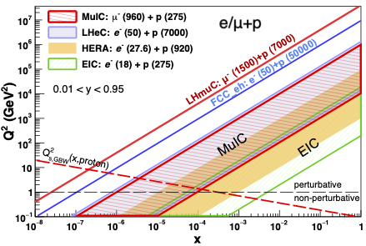
DIS Reach in x and Q² for ℓp Collisions
MuIC expands the DIS reach at high Q² and low x by 1–3 orders of magnitude beyond HERA and the EIC
Coverage of MuIC at BNL is nearly identical with that of the proposed Large Hadron electron Collider [1] (LHeC) at CERN with 50 GeV e⁻ beam
Coverage of a mu-LHC collider at CERN (LHmuC, with E_{μ}=1.5 TeV) would significantly exceed even that of the FCC-eh option of a 50 TeV proton beam with 50 GeV e⁻ beam
[1] LHeC: 2021 J. Phys. G: Nucl. Part. Phys. 48 110501 [2] GBW model: Phys. Rev. D 59, 014017 (1998)
n.b. Even a ≈20 GeV muon beam colliding with LHC would have √s > 2×HERA Would only need a PS-sized storage ring, equivalent to LHeC or BNL MuIC programs

Slide 13
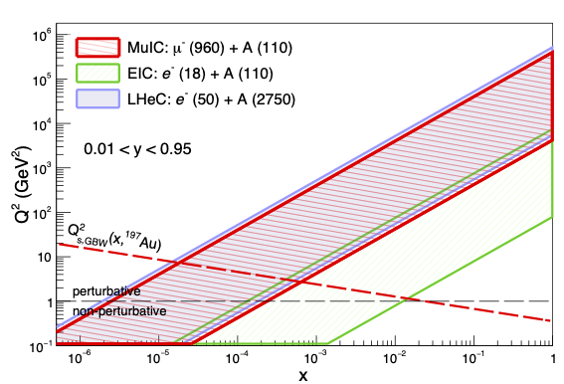
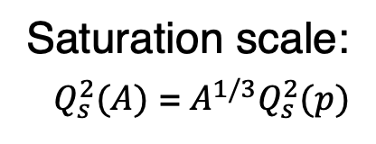
DIS Reach in x and Q² for ℓA Collisions
Can explore well the predicted gluon saturation regime in ions at low x in the GBW model [2]
A MuIC at BNL also can scan a wide range of ion species, and with beam polarization
[2] GBW model: Phys. Rev. D 59, 014017 (1998)

Slide 14
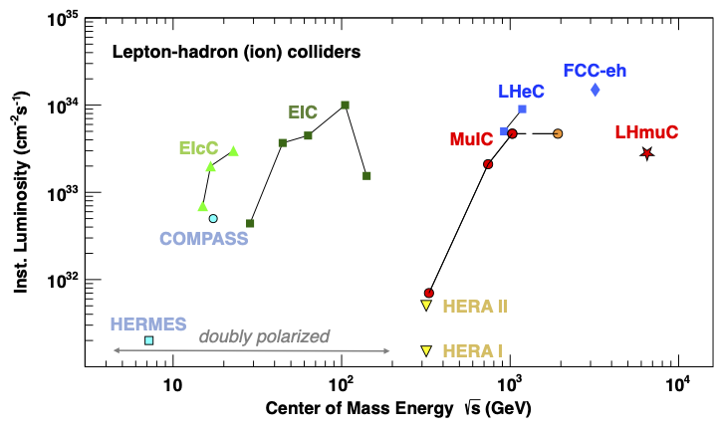
DIS Evolution – Past and Proposed Machines
beam-beam effects limit luminosity, so needs dedicated study
← Staging →

Slide 15
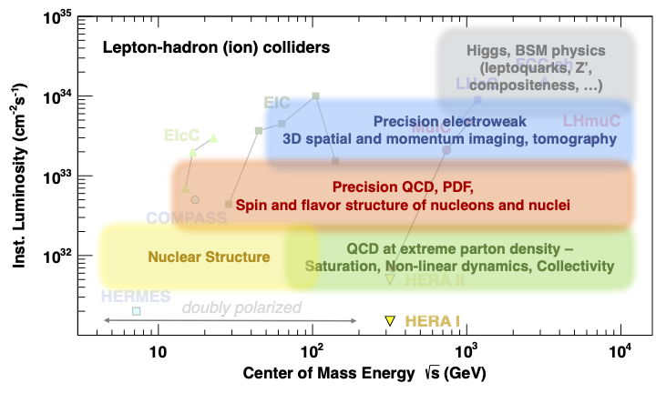
DIS Evolution and Physics Landscape

Slide 16
DIS Evolution and Physics Landscape
Precision electroweak, Higgs, and BSM physics would be limited if luminosity <10³²

Slide 17
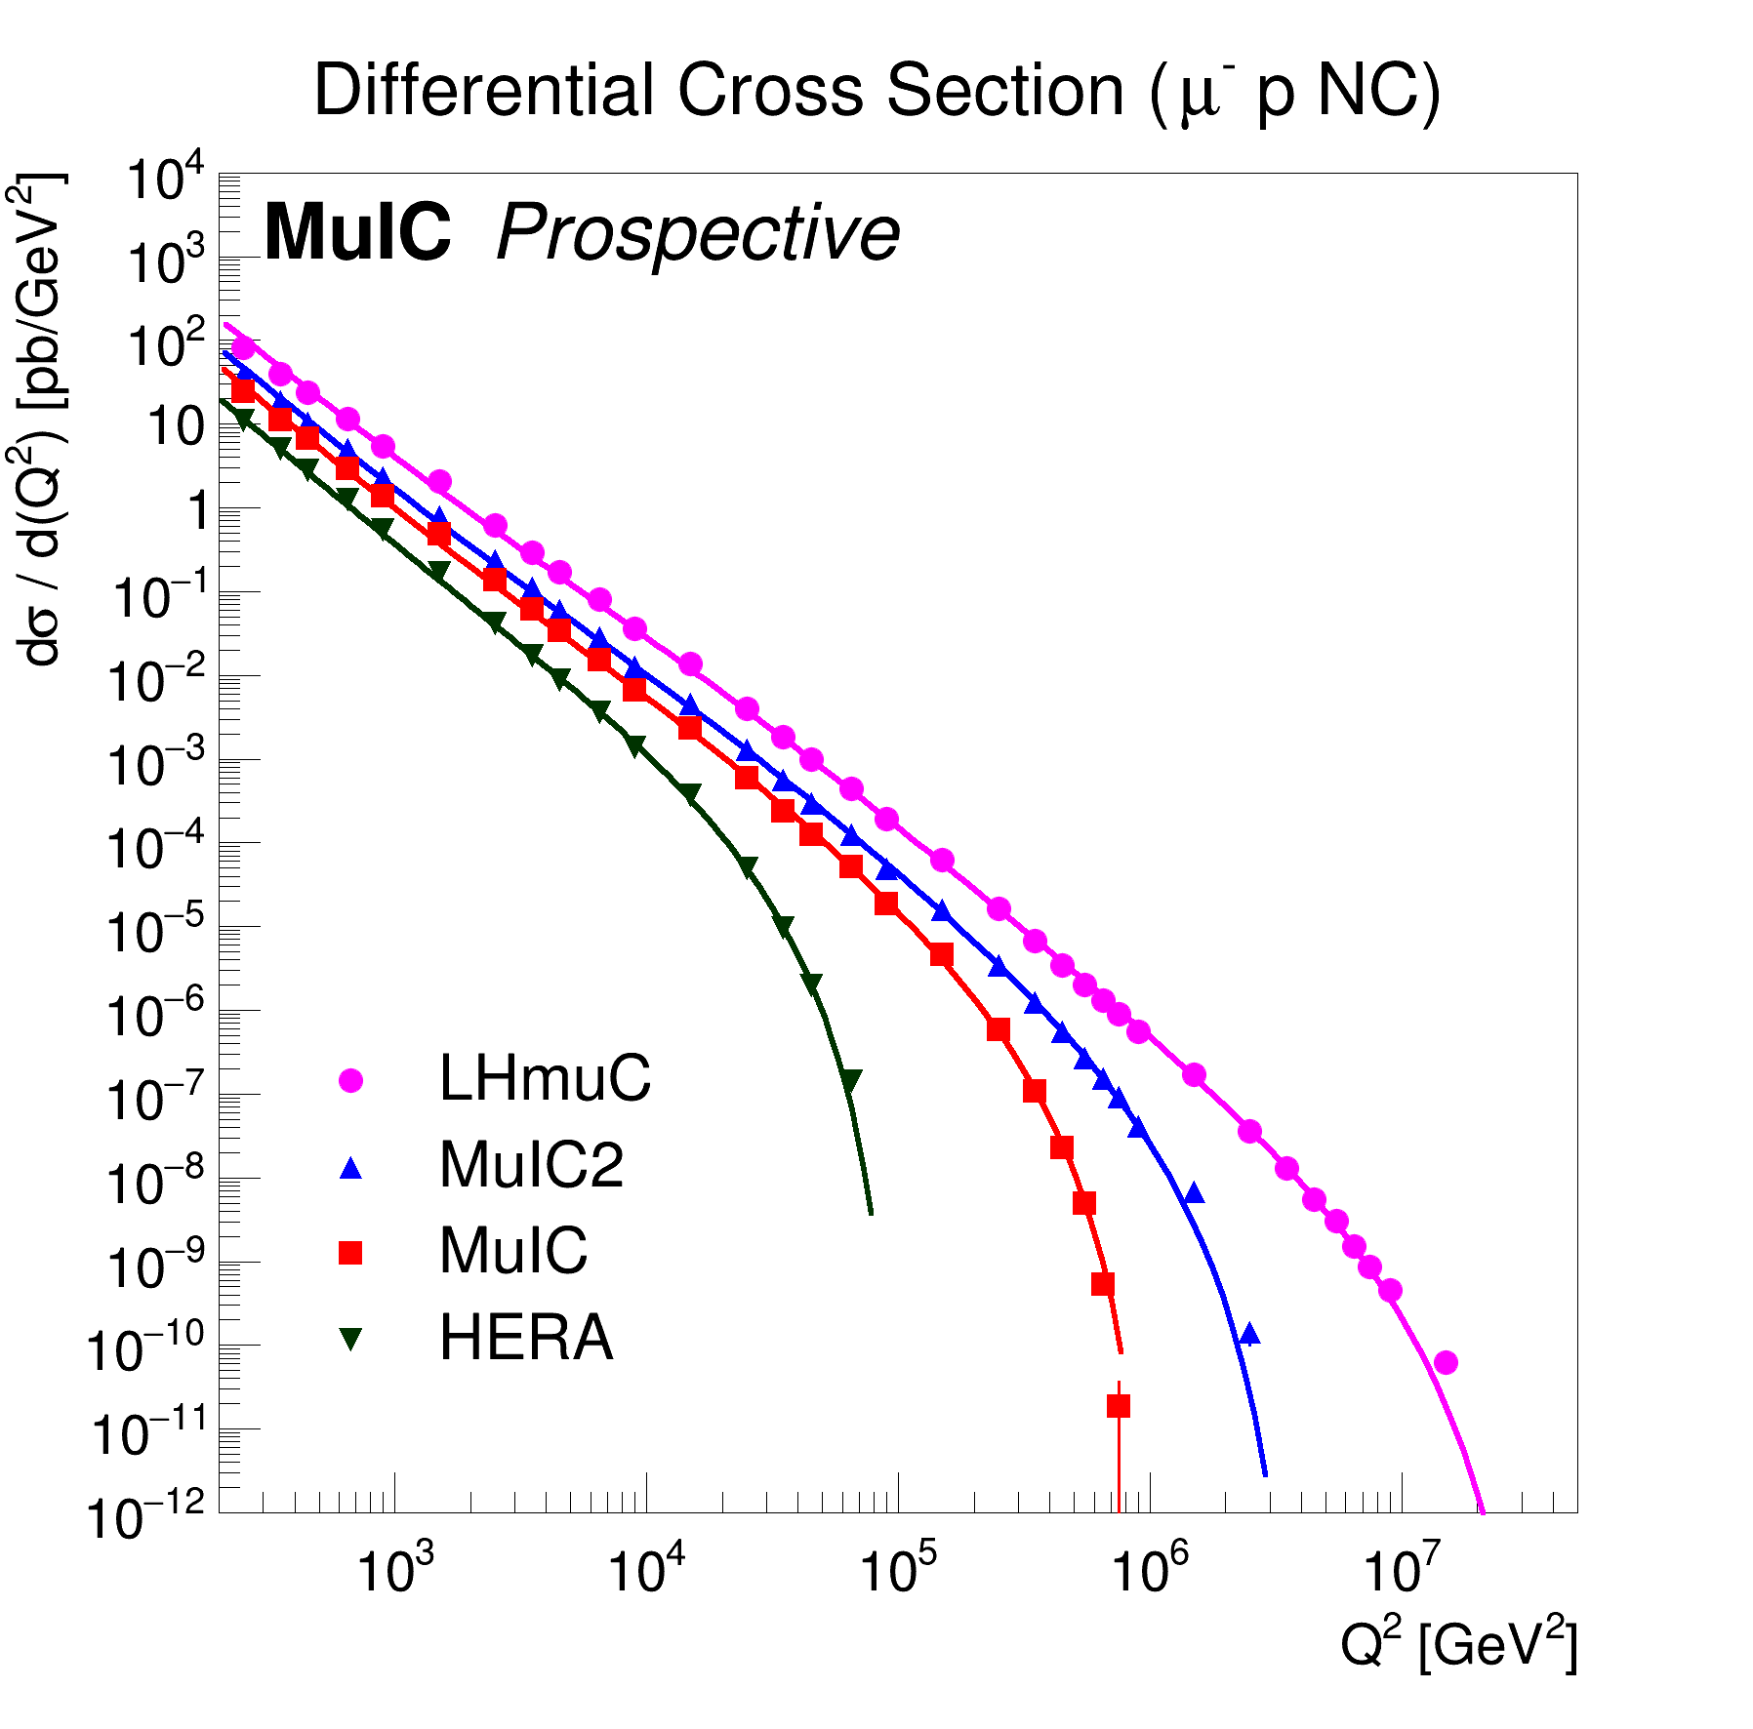
DIS Differential Cross Sections in Q² for Different Machines
Computed with Pythia8 and NNPDF2.3 PDF set, 0.1 < y < 0.9
NC DIS across machines
HERA reach
6.5 TeV
2 TeV
1 TeV
0.3 TeV
MuIC can probe well beyond HERA and the electroweak scale
Highest Q² reach will require the largest luminosity (10³³–10³⁴ Hz/cm²)
But, measurements at lower Q² and x can benefit from luminosity orders of magnitude smaller: ~HERA luminosity (10³¹) for the electroweak scale.
Notes:
Xsec larger than HERA at low Q2 -> even less lumi
Illustrates need for more lumi than HERA for highest Q2

Slide 18
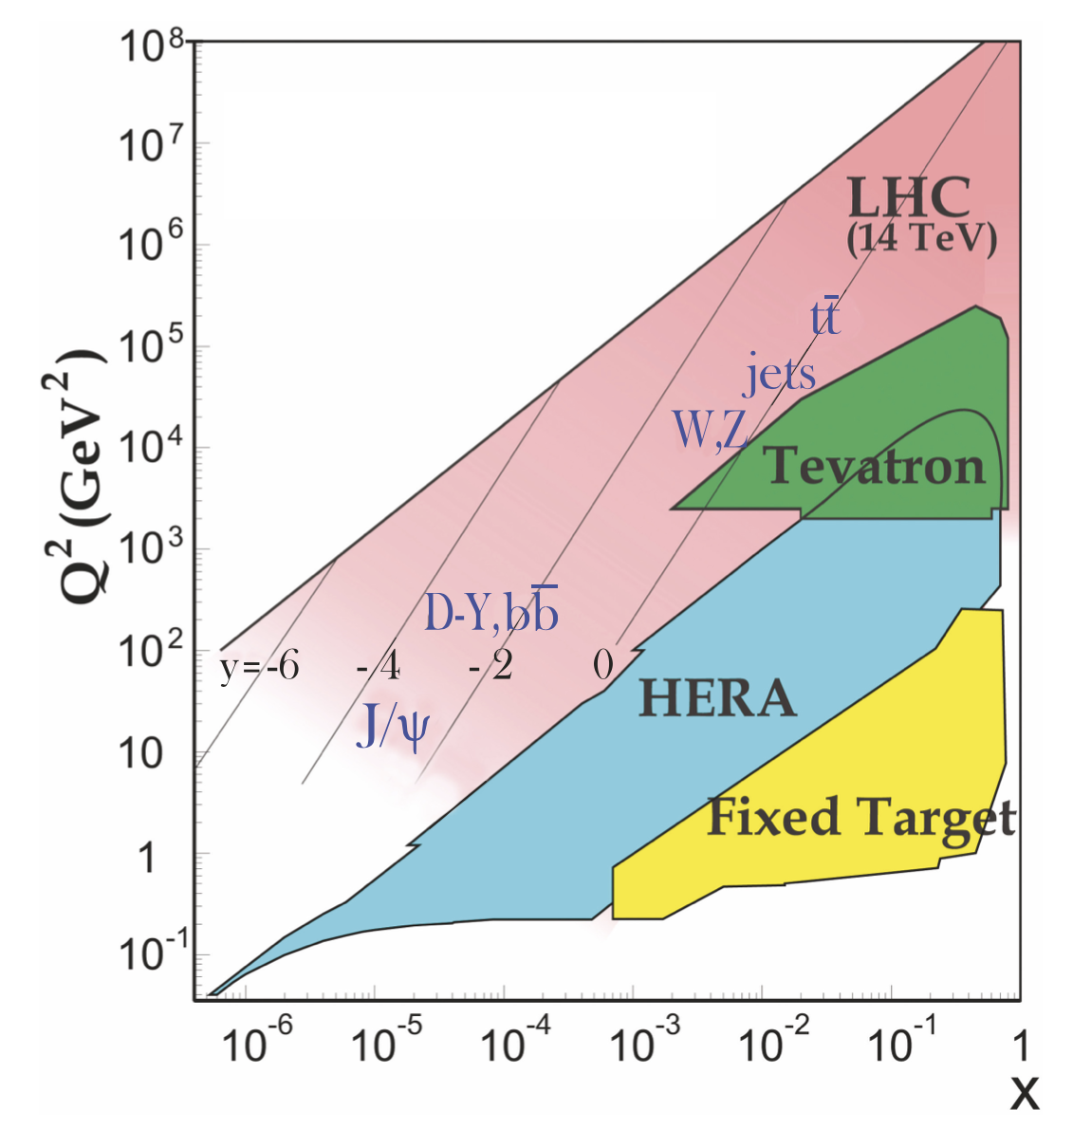
MuIC Measurements are Complementary to (and input for) Hadron Colliders
PDG
DIS PDF measurements with an electroweak probe can more cleanly decouple QCD and quark flavor over hadron collider measurements
The MuIC (or LHeC) can probe the parton densities directly at, or near, the scale for Higgs production at the (HL)LHC, and for a future 100 TeV FCChh
PDF uncertainties are generally a limiting factor for calculation precision
Reducing uncertainties on pp cross sections to ~1% is critical for Higgs coupling tests
Useful (necessary?!) input for a future FCChh program
As HERA was for the LHC program
MuIC
Notes:
Likely can measure PDFs with HERA-like luminosity, significantly less stringent than muon collider

Slide 19
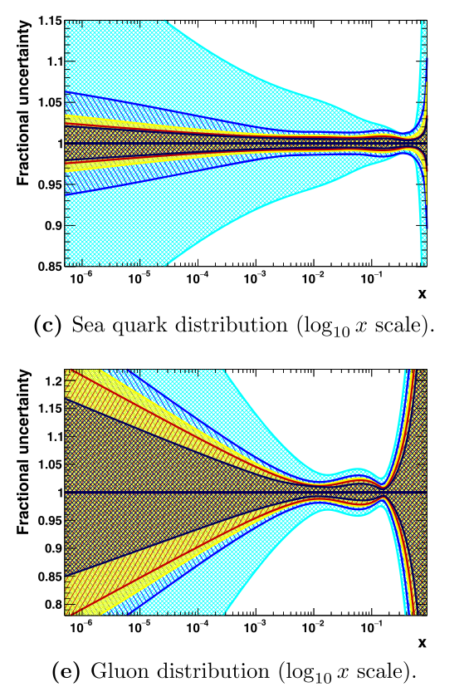
Potential Expected PDF Uncertainties
HERA
With LHeC
From LHeC CDR:
2021 J. Phys. G: Nucl. Part. Phys. 48 110501
Q² = 1.9 GeV²
L = 5, 50, 1000 fb⁻¹
Adding DIS measurements greatly improves the precision at mid- to low-x
e.g. improves precision of SM Higgs production cross section at pp colliders
Sea quark
HERA
With LHeC
Gluon

Slide 20
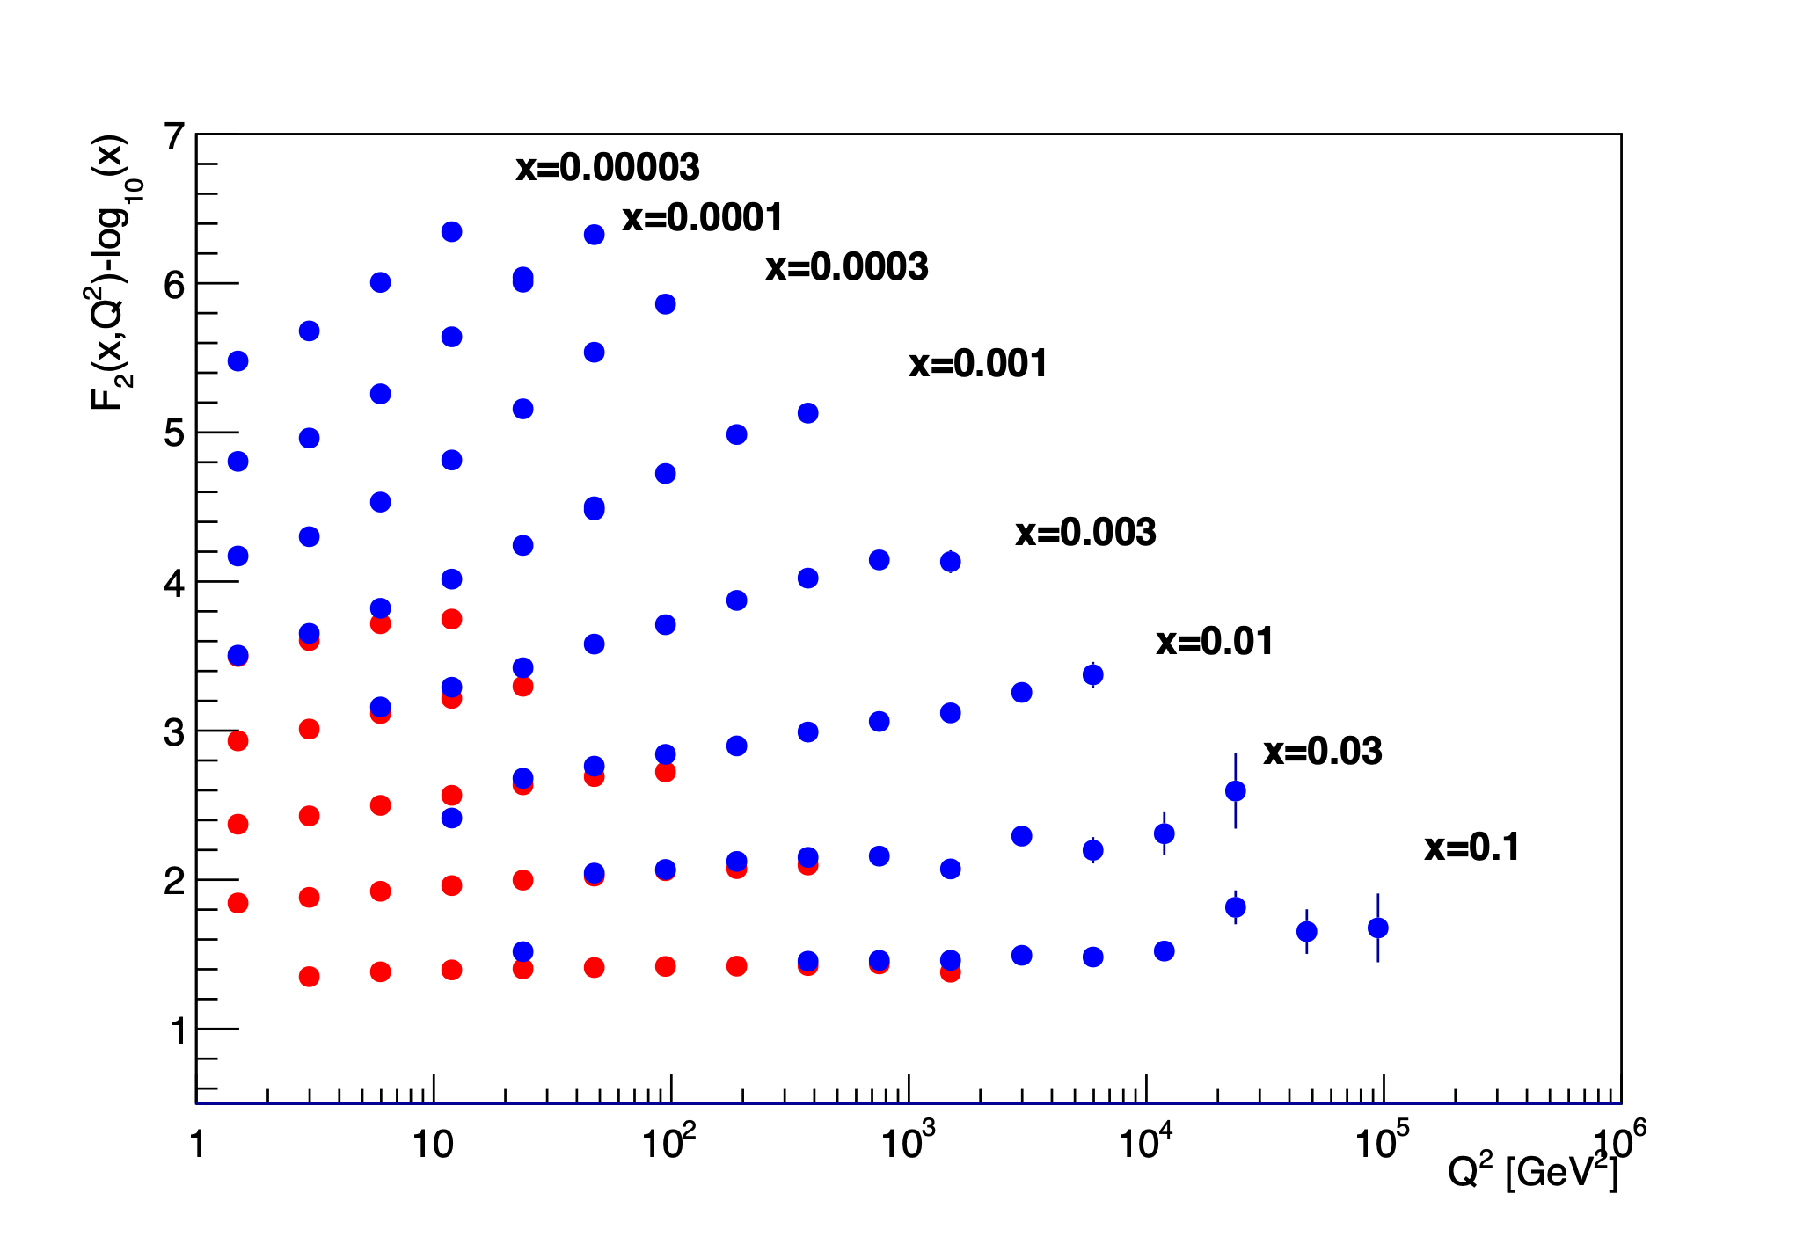
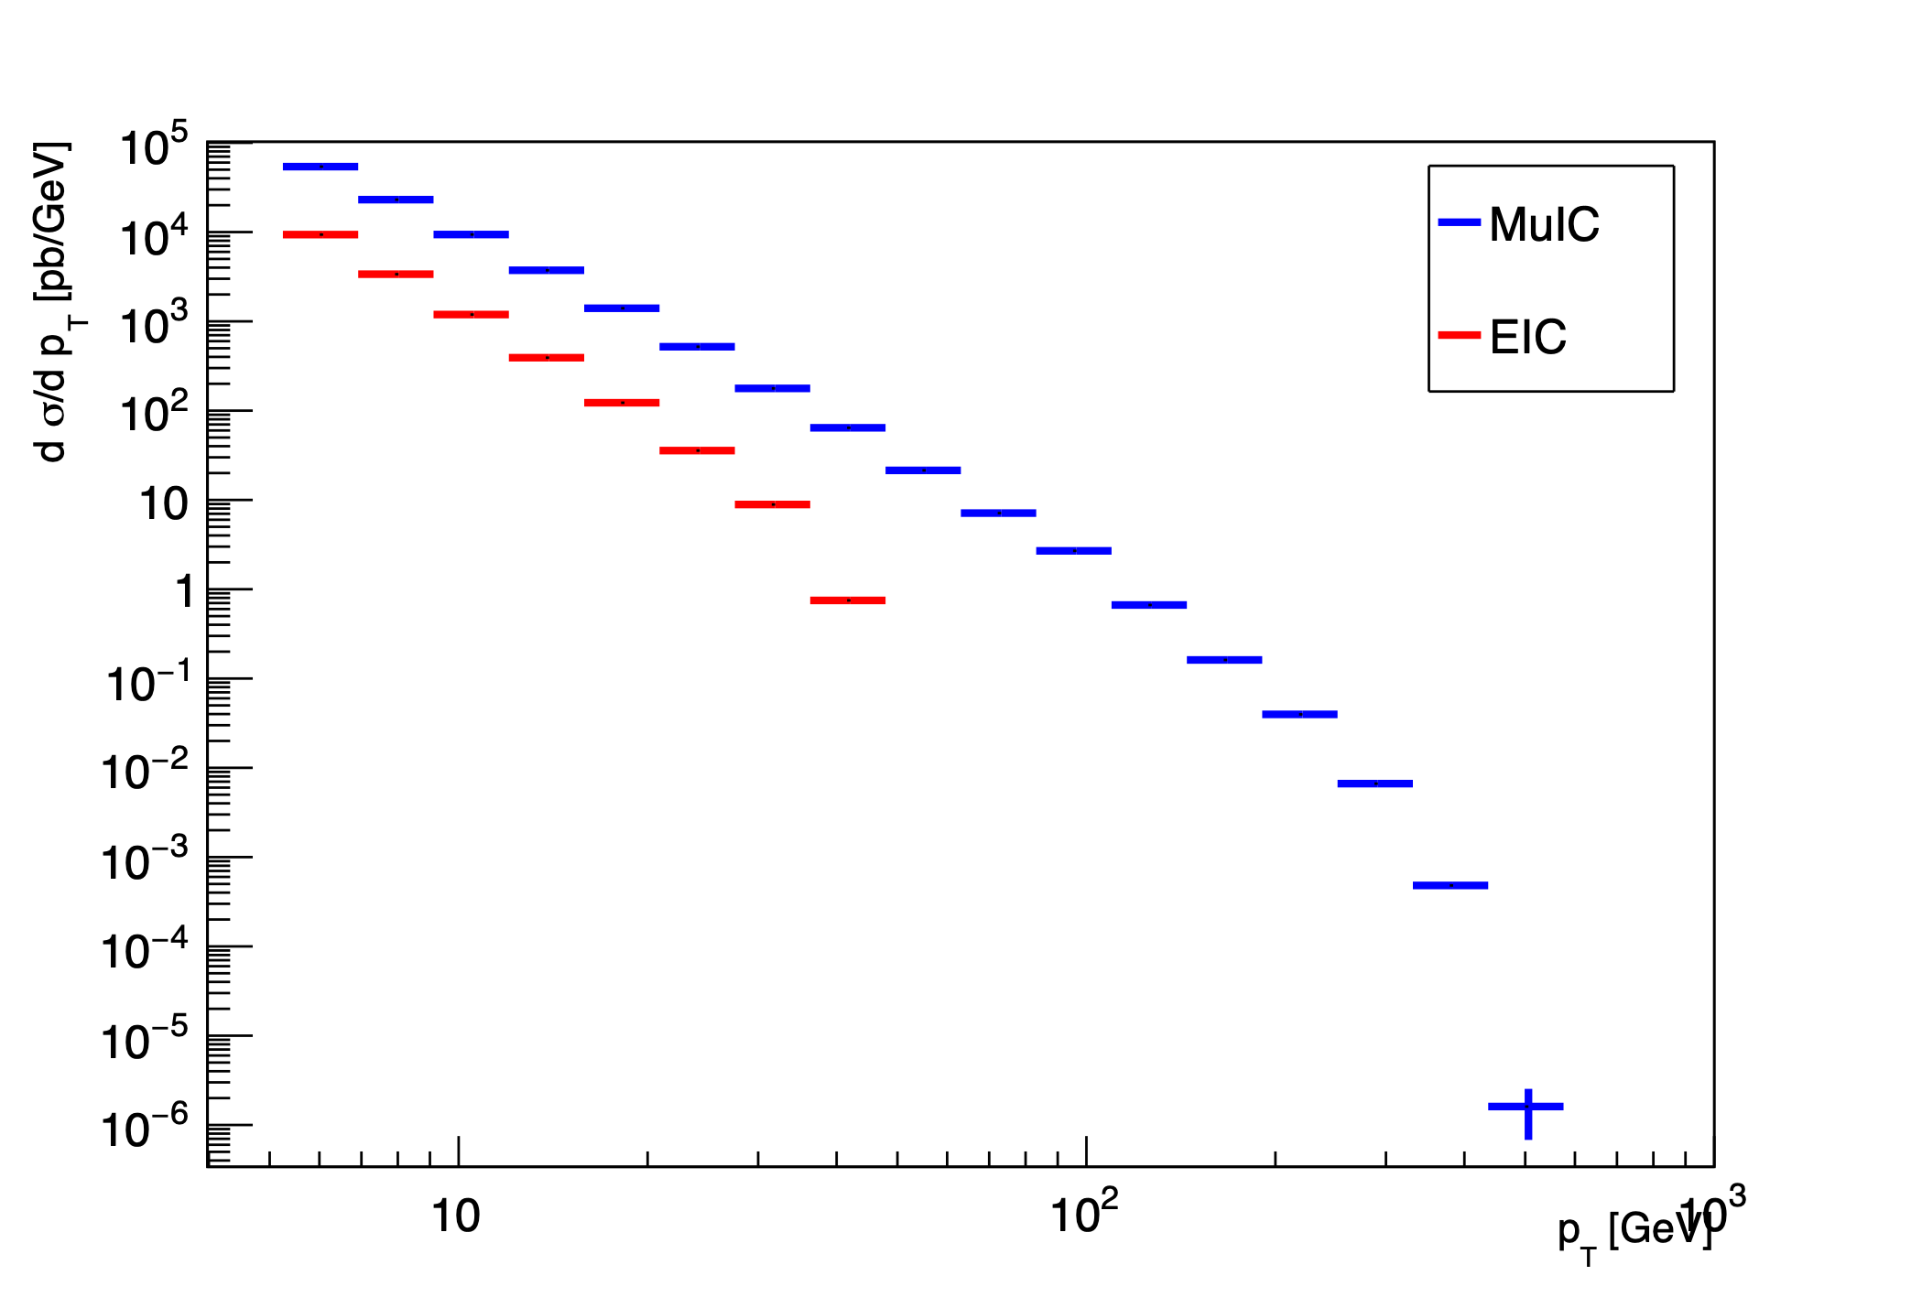
MuIC Potential for Structure Function & QCD Measurements
MuIC
EIC
F₂ Structure function projection of EIC vs MuIC
Single jet P_{T} spectra projection of EIC vs MuIC
Pseudo-data representing one year (at 5x10³³ Hz/cm²) of running, ~40 fb⁻¹
Notes:
Extend range in Q2 and x. Jet Pt -> jet and alphas measurements

Slide 21
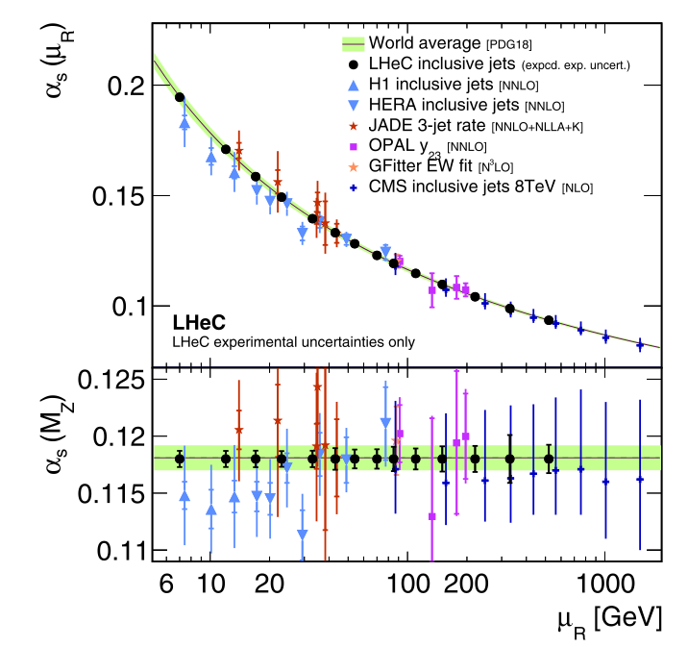
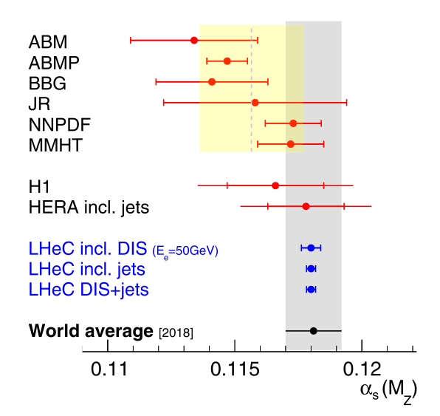
QCD and the Running of 𝛂_{S}
Measurements can span a broad range to measure α_{S}(Q²) in a single experiment
From DIS inclusive jet cross section measurements, F_{L} measurements, and from QCD evolution fits to structure function data
Removes some inter-experiment systematics
From the LHeC CDR:
Inclusive jets with expected uncertainties for 1 ab⁻¹ →
(JES uncertainty: 0.5%)
Expected 𝛂_{S} (M_{Z}) uncertainties
±0.00038
Even 50 fb⁻¹ (~1 year) is competitive
+EIC
LHeC / [ MuIC]

Slide 22
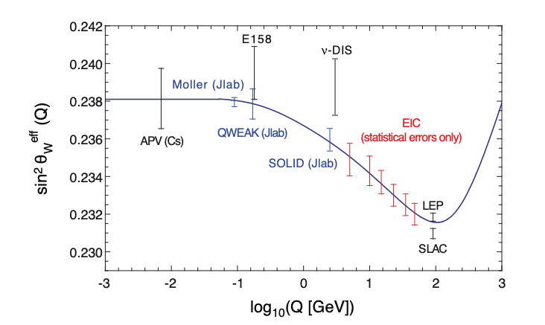
Sin² θ_{W}^{eff} Measurements
Potential to probe the effective weak mixing angle, and its running
Probe parity violating couplings with polarized leptons and nuclei
MuIC could extend the EIC scale coverage (as would LHeC)
Beam polarization (including muon), and the ability to change beam from 1H → 2H at BNL, will further help disentangle couplings from PDFs
Needs dedicated study for a MuIC
MuIC
EIC arXiv:1212.1701

Slide 23
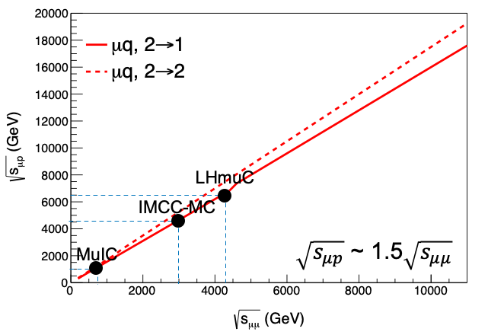
Particle Production, Equivalent Reach for μp vs. μ⁺μ⁻
Equivalent parton luminosity of a μp collider for 2→1 and 2→2 processes compared to a μ+μ− collider →
We find that a μ⁺μ⁻ collider is equivalent to a μp collider of 50% higher √s, in terms of its discovery potential
So with 50% higher √s you can probe much of the same particle physics with a μp collider, luminosity being equal.
In terms of Higgs boson production, for example, both are vector boson colliders since VBF is the dominant cross section
A 1.5x7 TeV LHmuC has √s = 6.5 TeV
Equivalent to ~4.3 TeV μ+μ−
In turn equivalent to ~30 TeV pp
Notes:
So with 50% higher energy, you can probe much of the same particle physics! Just as with comparing mumu with pp

Slide 24
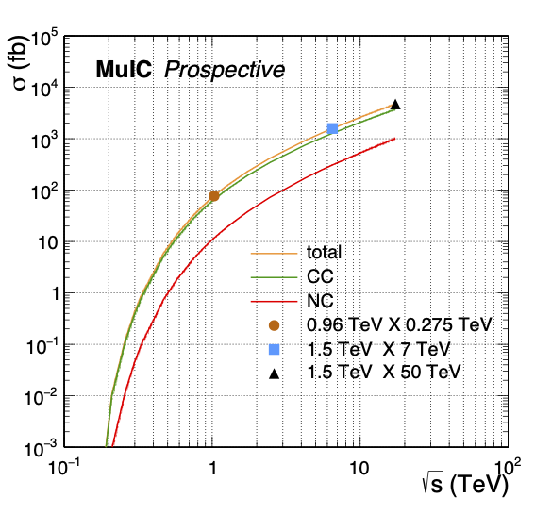
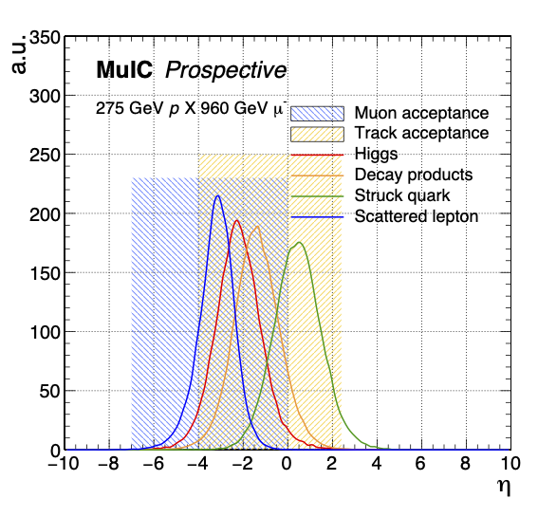
Higgs Physics: MuIC as a VBF Collider
JINST 18 P09025 (2023)
Vector Boson Fusion mode
σ grows with √s, with CC exchange larger than NC
Cross section comparable to LHeC and μ⁺μ⁻ colliders
Polarization can increase cross section
Acceptance
All final state objects, other than the muon, are in central region of detector (in contrast to LHeC, where products are +3 units of η higher)
CC NC
Computed with MadGraph

Slide 25
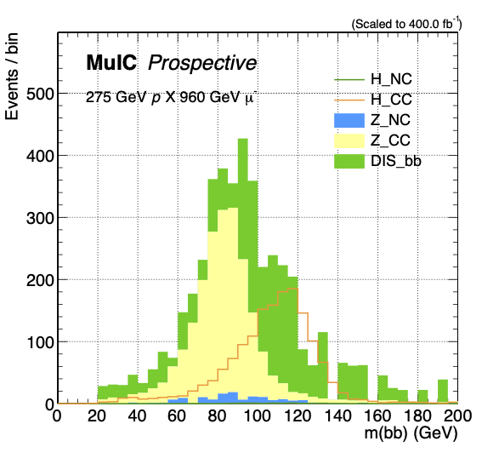
Higgs →bb with MuIC
JINST 18 P09025 (2023)
A pseudo-analysis for H→bb
Requirements that enhance CC VBF process over NC DIS bb background:
3 jets in final state (2 b-tagged)
muon veto, MET
Higgs p_{T}
S/B ~ 1 for H→bb
Expect ~900 selected H→bb in 400 fb⁻¹ (10 years*) @ 1TeV MuIC
Increases by factor 10 at LHmuC
Delphes study
* at L=5x10³³ Hz/cm²

Slide 26
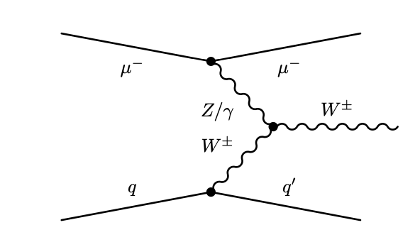
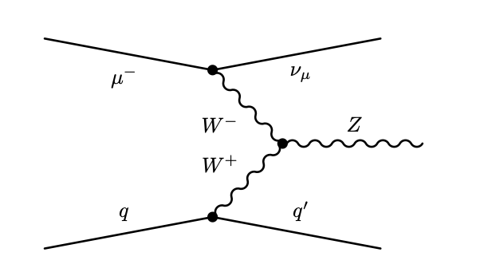
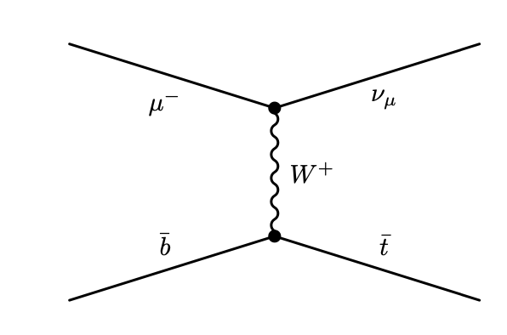
Other SM Particle Measurements
Vector boson production, e.g.
Sensitive to triple gauge couplings
σ(W) = 19 pb for 1 TeV MuIC
2.1 × 10⁴ leptonic W → lν decays into each lepton flavor for 10 fb⁻¹
Single top production
Direct measurement of |V_{tb}|
σ(t) = 1.0 pb for 1 TeV MuIC
Potential for precision coupling measurements (and maybe mass measurements) with larger σ at higher √s and higher luminosity)

Slide 27
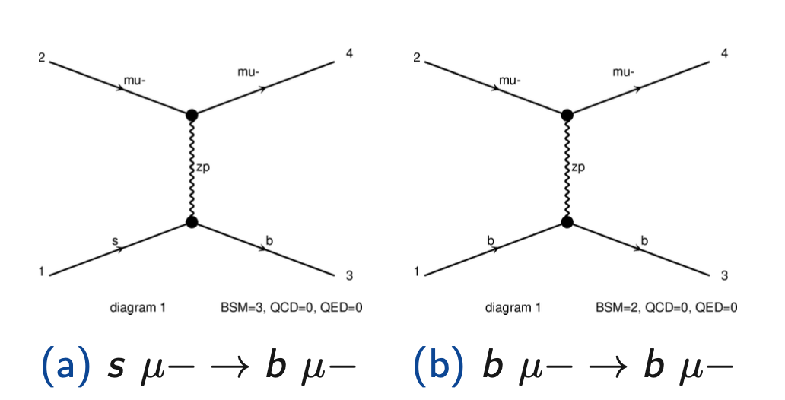
Probing Models Relevant to LFU Violations
As a straw case, consider the Z’ models and couplings discussed e.g. in M.Abdullah et al., Phys. Rev. D 97, 075035 , that couple via O9 operator mostly to 2nd generation leptons (μ) and 2nd and 3rd generation quarks (s, b) to explain anomalies in B meson decays.
$g_{μ}$ and $g_{s}$ are flavor conserving couplings
$δ_{bs}$ parameterizes non-flavor conserving couplings
to fit lepton flavor universality violations
Study through interference with NC DIS
flavor conserving coupling therefore dominates
Which admittedly are now diminished with latest LHCb measurement that is compatible with the SM
μ μ μ μ
Z '
Z '
s b b b

Slide 28
Probing Models Relevant to LFU Violations
Work in progress: DA, O.Miguel Colin
Perform pseudo-analysis using a cut-and-count approach on the reconstructed Q² from the muon, optimized for sensitivity
Apply b-tagging and mis-tagging efficiencies to final state jet
b, c, light: 70%, 10%, 1%
Derive expected limits
Conclusion: generally need high √s, i.e. LHmuC (120 fb⁻¹), to be competitive with HL-LHC (3000 fb⁻¹) for this model

Slide 29
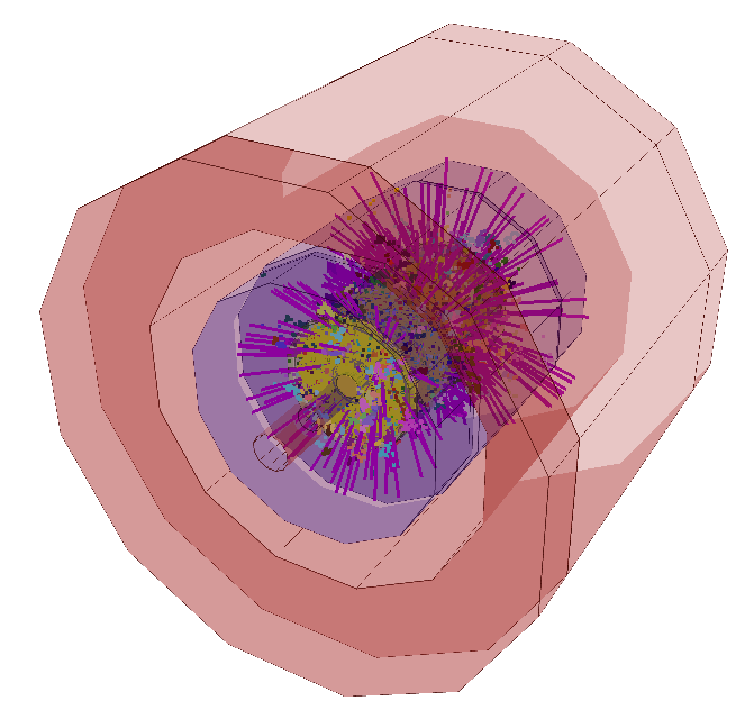
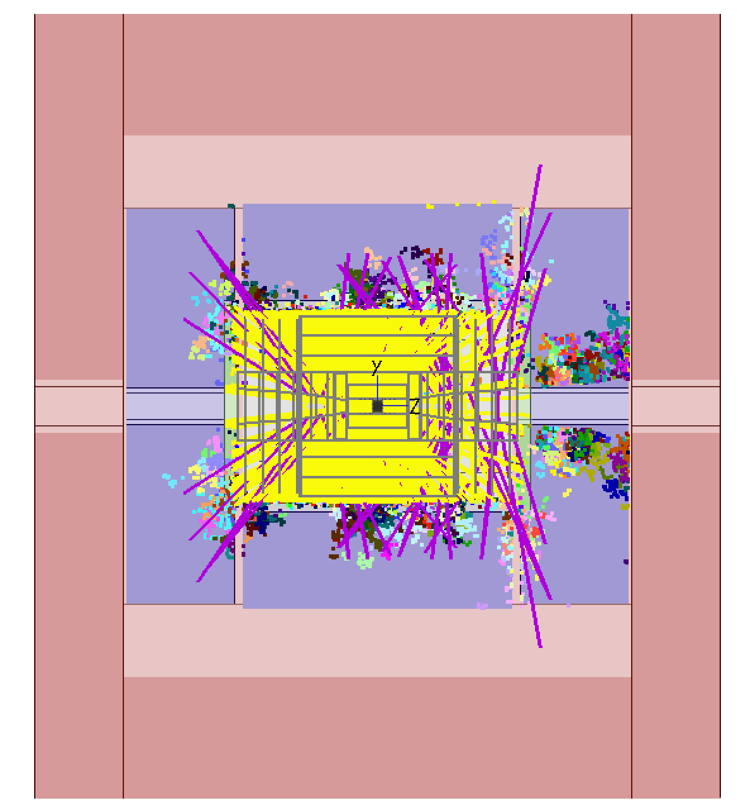
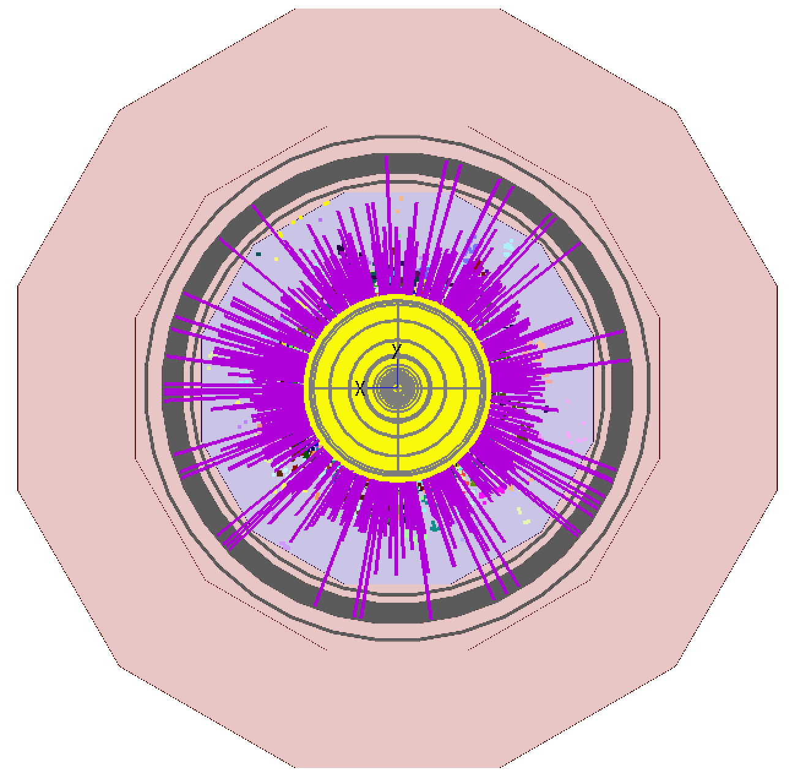
Detector Considerations & Challenges
μp Simulation with beam induced backgrounds (BIB)

Slide 30
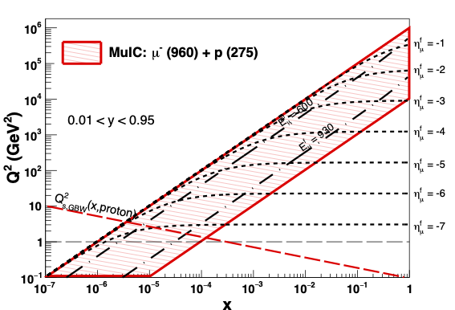
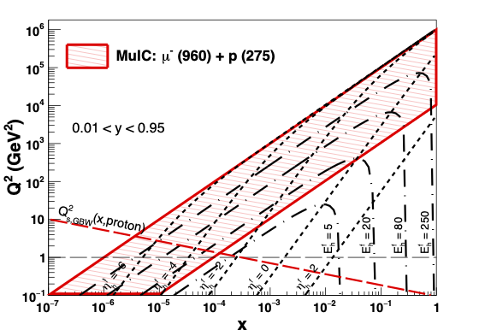
MuIC Kinematics (E,η in Q² - x plane)
E_{μ}=1 TeV E_{p}=0.3 TeV
Scattered muon Scattered jet
Backward tagging of muons to η= −7 (2 mrad) Hadronic system −5 < η < 2.4
Quite different from EIC and LHeC kinematics
Notes:
With TeV muon

Slide 31
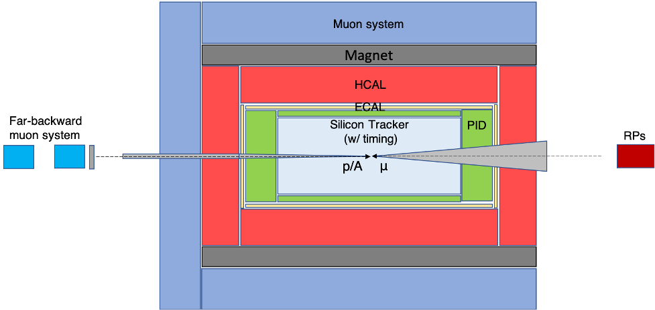
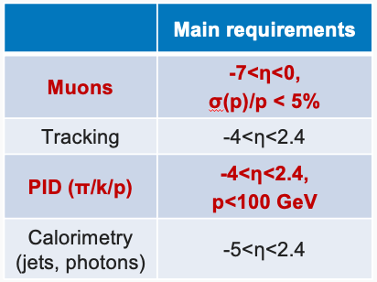
Detector Considerations and Challenges
Starting point: μ⁺μ⁻ conceptual detector design
Hadron PID over a wide phase space, with good timing measurements to reduce BIB
Measurement of muons at high |η|→7 (far-backward) up to TeV scale
Useful also for an experiment at a μ⁺μ⁻ collider to measure luminosity from Bhabha scattering and to tag/veto NC VBF processes
For MuIC, ideally would remove one shielding nozzle, keeping only on incoming muon side, but would need study.
But coexistence with μ+μ− collisions in the same experiment requires keeping it
“Wish list”
$$η∈(−7,−2.4)$$
p→
←μ
−5<η<2.4

Slide 32
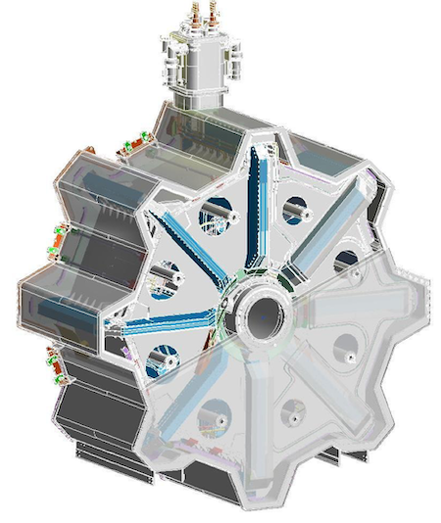
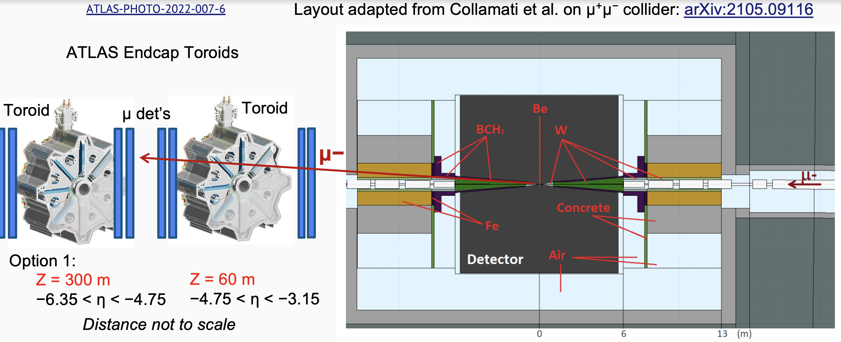
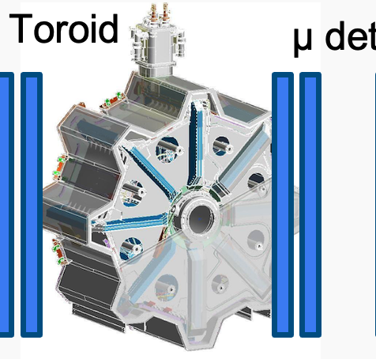
A Far Backward Muon Spectrometer Design Study
To begin to address some of the feasibility questions for a MuIC experiment, we initiated a GEANT-4 feasibility study of a downstream muon spectrometer
Studied TeV muon scattering and energy loss in the tungsten shielding cone (covers |η|>2.4)
For the scenario where we cannot remove it
Exploring using an (ATLAS) endcap toroidal magnet design as a realistic strawman design
In contrast to instrumenting the nozzle (challenging with BIB!), and provide magnetic bending
Study muon tagging and momentum measurements, and the impact on physics measurements
$R_{in}=$ 1.05 m
$R_{out}=$5.1 m
L = 4.5 m
$B_{in}=4.1$T
$∫B⋅dl=$ 4−18 T・m
Z= 660m Z= 140m Z=28m 7.2>|η|>5.6 5.6>|η|>4.0 4.0>|η|>2.4
Small angles require large distances from IP

Slide 33
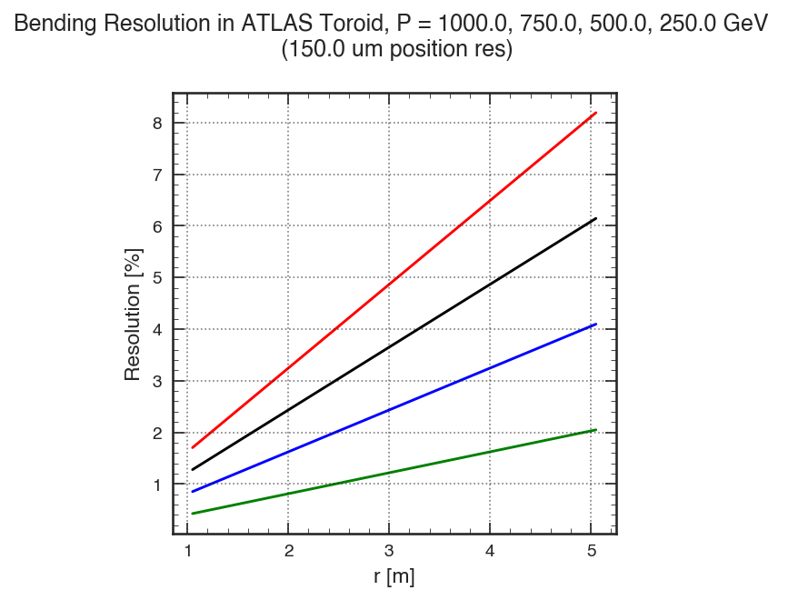
Straw Momentum Resolution with Ideal Toroid
Assuming ~150 μm detector resolution in front and behind toroid.
Idealized model, i.e. take with a grain of salt
$\frac{σ}{p}=\left[\frac{p}{TeV}\right]∗\left[\left(1.6\frac{\%}{m}\right)\left(r−1.05m\right)+1.7\%\right]$
Average ~5% @ 1 TeV, ~25% at 5 TeV (*)
Not including energy loss fluctuations in shielding
Resolution linear with R
(*) Would prefer < 10% for invisible Higgs decay measurements at μμ collider [arXiv:2303.14202]

Slide 34
Synergies with a μ⁺μ⁻ Experiment

Slide 35
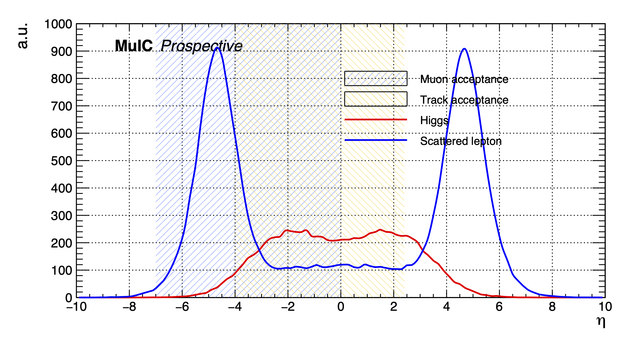
VBF Higgs Production for a 10 TeV μ⁺μ⁻ Collider
Pseudorapidity distribution for the scattered lepton in VBF Higgs production to tag NC processes (and potentially measure invisible Higgs decays)
5 x 5 TeV:
Scattered muons are in far backward and forward regions, similar to MuIC, so similar detector need as MuIC
Other interesting μμ physics processes also could lead to forward muons
μ+
μ+

Slide 36
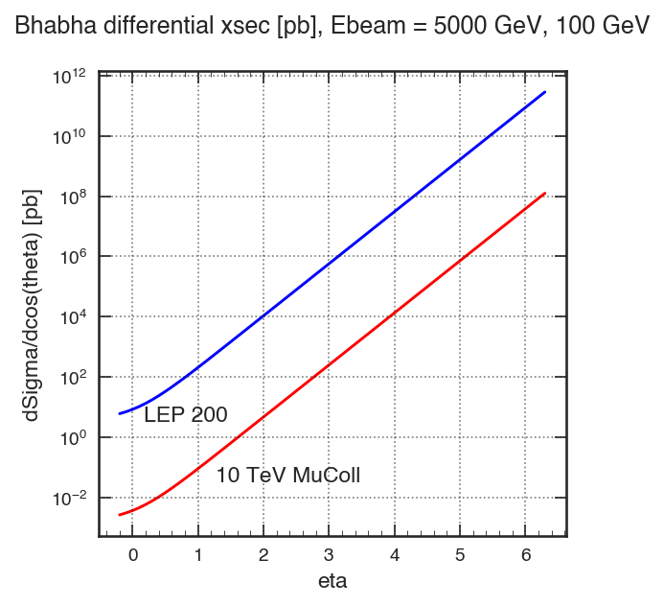
Bhabha Scattering for μ⁺μ⁻ Luminosity Measurement
For the luminosity measurement at a μ⁺μ⁻ collider expt.
$\frac{dσ}{d\cos{θ}}$ =
$\frac{πα^{2}}{s}\left[\frac{\left(1+\cos^{2}θ\right)}{2}+\frac{\left(5+2\cos{θ+\cos^{2}{θ}}\right)}{{\left(1−\cos{θ}\right)}^{2}}−\frac{{\left(1+\cos{θ}\right)}^{2}}{\left(1−\cos{θ}\right)}\right]$
Cross section scales as 1/s
Therefore, cross section and rates are 2500X less with a 10 TeV MC vs. LEP 200 GeV
For similar rates as LEP, need to slide lepton coverage forward by 2 units of rapidity
⇒ |η| > 2.4
Need very forward muon spectrometers

Slide 37
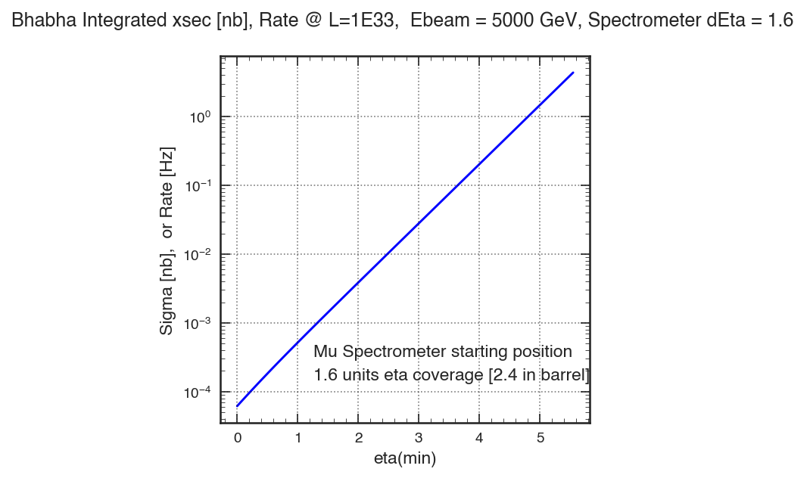
Bhabha Scattering Integrated Cross Section @10TeV
For MuColl luminosity measurement, need forward muon coverage for reasonable rates (~Hz)
← Integrated cross section in nb for a spectrometer with 1.6 units of η coverage
Same as rate in Hz for L=1E33
Only central muon coverage with |η|<2.4:
L=1E33: 0.35 mHz (45 min per event!)
L=1E35: 0.035 Hz (30s per event)
Forward coverage with 2.4<|η|<4.0
L=1E33: 8.5 mHz (2 min per event!)
L=1E35: 0.85 Hz (1.3s per event)
Forward coverage with 4.0<|η|<5.6
L=1E33: 0.2 Hz (5s per event)
L=1E35: 20 Hz (0.05s per event)
Forward coverage with 5.6<|η|<7.2
L=1E33: 4.8 Hz
L=1E35: 480 Hz
Beyond central
Same as VBF coverage

Slide 38
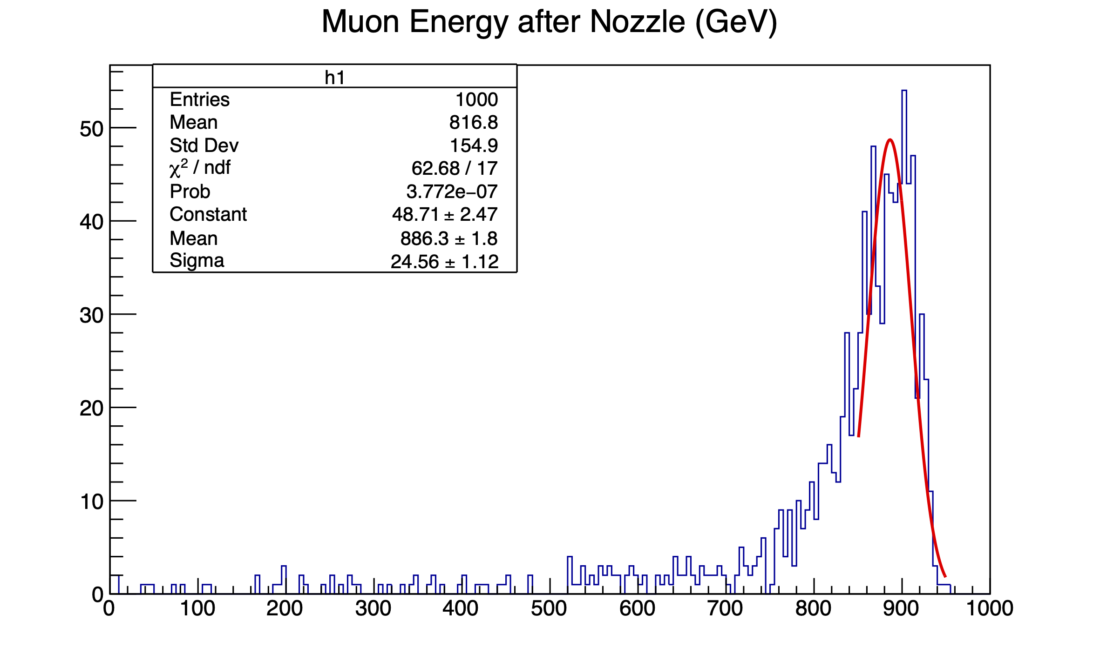
Muon Energy and Angle Measurements
Do the 6m long tungsten shielding cones disturb the muon measurement?
GEANT simulation for 1 TeV muons:
~10% peak loss, radiative tail toward larger losses
Expect ~10% loss also for 5 TeV muons
Could be calibrated out, though some spread if a momentum measurement is necessary
Angular scattering of muons ~ 1/E
5 TeV: $σ_{θ}≈0.14$ mrad (0.008º)
1.5 TeV: $σ_{θ}≈0.48$ mrad (0.03º)
Tiny effect for Bhabha scattering
More critical for DIS measurement at large |η|
→ Should be able to tag Bhabhas downstream even through shielding cones

Slide 39
Challenge: Luminosity Measurement for Muon-proton Collisions?
Luminosity measurement via the μp → μpγ process (analog to HERA and EIC measurement) would be challenging at a MuIC with the large BIB
May already have a large γ flux even if all other charged particles are swept away
Need another normalization process?

Slide 40
Physics Synergy: Strengthening the Muon Collider Case
The ultimate machine target for a muon collider is √s ~ 10 TeV and L ~ 10³⁵ Hz/cm² for the main physics cases
What if achieving either √s or L ultimately becomes a challenge? ☹ Do we still deliver compelling science ?
Accommodating also muon-ion collider runs in the same facility as a muon collider expands the science case, even for lower energies and lower luminosity
In the worst case that μμ collider technology is ultimately limited, this would provide the structure function input for a future hadron collider machine
In the best case, muon-ion collisions share a fraction of the operations time for a broad science program (like heavy-ion runs at the LHC)

Slide 41
Summary and Conclusions
Collisions of a TeV-scale muon beam with a high-energy proton/ion beam provides a novel way to explore a new regime in DIS at high Q2 and at low x
Options include BNL (√s = 1-2 TeV) as an EIC upgrade, a CERN ”LHCmuC” (√s up to ≈6.5 TeV), and FNAL with a μC depending, on how all these programs develop
High luminosity could be a challenge, and needs dedicated accelerator study
However, there is much to study at lower luminosity
Science includes PDFs (μp and μN) and QCD in novel regimes, but also electroweak and BSM physics with sufficient luminosity
Improved PDFs are also necessary input to future (and current!) hadron colliders
Join forces with the EIC community and with the LHeC and muon collider proponents
Many synergies with muon collider development, and between nuclear, particle, and intensity frontier neutrino physics programs

Slide 42
Acknowledgements
This work is in part supported by the Department of Energy, United States grant numbers DE-SC0010103, DE-SC0023351 (D.A.), DE-SC0005131 (W.L.)

Slide 43
Backup

Slide 44
Dedicated MuIC Workshop @ Rice, December 2023
https://muic2023.rice.edu/
Today’s talk incorporates a synthesis of some of the things discussed at this workshop for MuIC planning, and some works in progress

Slide 45
Motivation for Muon Accelerators
From the U.S. HEPAP P5 Committee 2023 report:
Perhaps a MuIC could be a first science demonstrator

Slide 46
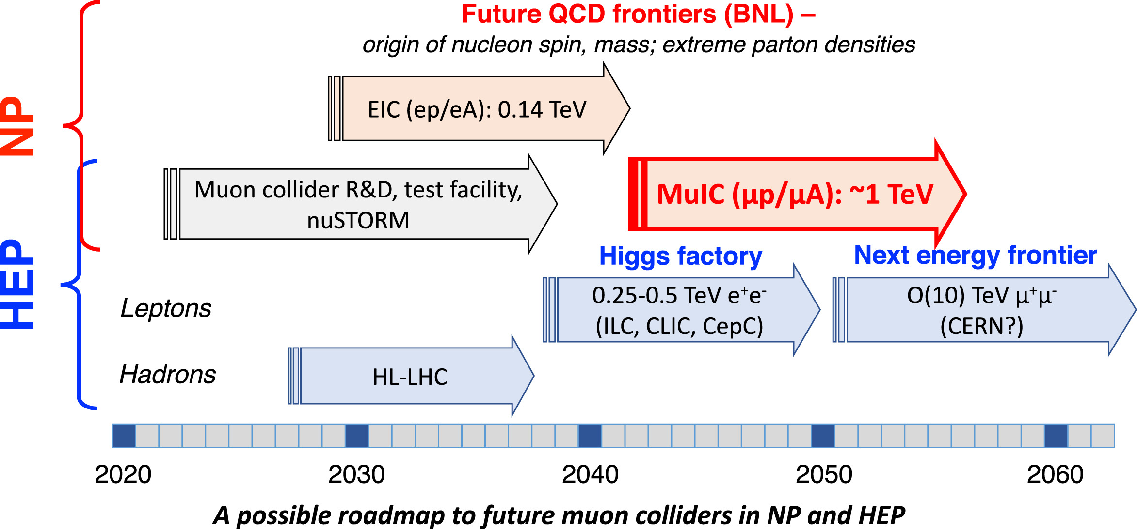
Possible Timeline

Slide 47
Alternative Cooling Idea for μ+ Only
From Katsuya Yonehara, link
Capture μ+ with electrons in aerogel (so ultracold), and ionize with laser
No ionization cooling needed!
Development at KEK J-PARC for g–2/EDM experiment
P.Bakule et al., arXiv:1306.3810
J.Beare et al, arXiv:2006.01947
Could create 2×10¹⁰ μ+
100X less than initial Acosta/Wei numbers, but in direction of lowering neutrino bkg but still enabling novel DIS measurements
Could also achieve up to 50% polarization!
Very small emittance, 1.5μm
See: https://cerncourier.com/a/muons-cooled-and-accelerated-in-japan/

Slide 48
A 10 TeV Muon Collider at Fermilab (Site Filler)
From Diktys Stratakis → link
Linac + RLAs get to 63 –173 GeV
+ RCS 1 gets to 0.45 TeV
+ RCS 2 gets to 1.7 TeV
+ RCS 3 + 4 gets to 5 TeV
Could become MuIC staging options
The accelerating rings are larger than the collider ring because of the need of rapid cycling magnets

Slide 49
A 10 TeV Muon Collider at Fermilab (Site Filler)
From Diktys Stratakis → link
Just Linac + RLAs would allow
E_{μ} = 63 GeV ⇒ MuIC √s = 0.25TeV (<HERA)
E_{μ} = 173 GeV ⇒ MuIC √s = 0.4TeV (>HERA)
Extension for FNAL MuC design
Circumference of RCS 1 is 6.3 km
E_{μ} = 0.45 TeV ⇒ MuIC √s = 0.7TeV (2× HERA)
Circumference of RCS 2 is 10.5 km
E_{μ} = 1.7 TeV ⇒ MuIC √s > 1TeV (in principle)
Do these fit on BNL site?

Slide 50
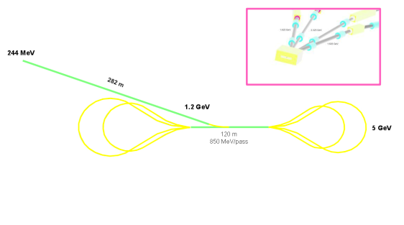
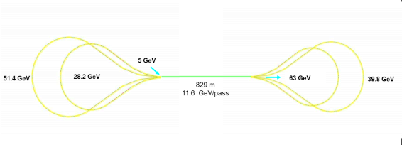
Recirculating Linear Accelerators
Linac + RLA 1
0.25 → 1.2 GeV
1.2 → 5 GeV (5 passes)
RLA 2
5 GeV → 63 GeV (4.5 passes)
Up to 173 GeV for FNAL MuC

Slide 51
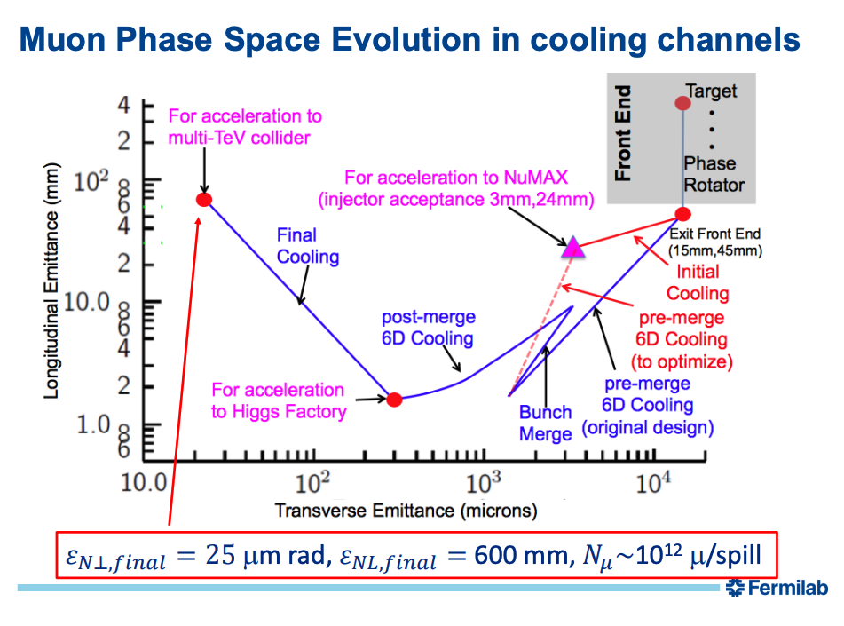
Muon Cooling
From Katsuya Yonehara, link
Ionization cooling + acceleration
RF cavities
High field solenoids (10’s of T)

Slide 52
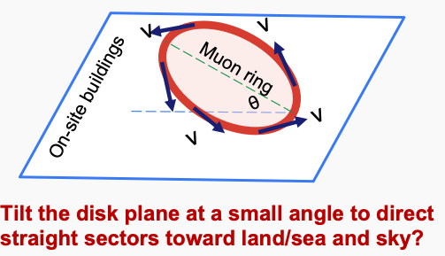
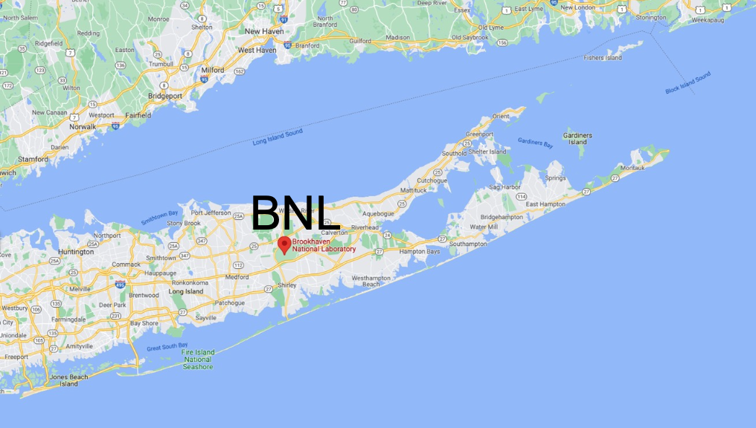
Beam Induced Background, and Neutrino Radiation
Muon colliders entail a significant beam induced background from μ decays and subsequent interactions with materials
Experiment requires shielding, high granularity, and excellent time resolution
But this challenge has much in common with hadron collider experiments with high pileup
The abundant neutrinos pose a radiation risk from the highly collimated beam just before it exits the ground, particularly from any long straight sections
Dose depends inversely on the square of the opening angle (~1/γ) and on the energy: $∝E^{3}$
Thus the radiation at 1 TeV is only 1% of that at 5 TeV, for example
And at low luminosity and energy, collider may be perfectly fine on the surface
Otherwise situate deep underground, or on a “remote island”
With a small tilt, BNL might be considered such an island! ☺

Slide 53
Neutrino Radiation Background
Collimated beams of neutrinos from muon decays exist along beam line
For neutrinos near surface, those that interact just before exiting ground can pose a long-term radiation dose for stationary objects
Long straight sections further intensify this radiation
The radiation grows with $E$, and the collimation effect as $E^{2}$
Hence studies to place ring deep underground for wider spread of radiation at surface
For a 1 TeV MuIC with a single muon beam compared to a 10 TeV muon collider, the overall radiation hazard is reduced by a factor:
2 (one beam) × 5³ (energy dependence) × 10-100 (bunch charge reduction) ≈ 2.5×10⁴
Radiation hazard is much less of a concern in comparison
But is it negligible?
Solid angle $∝1/γ^{2}$
μ’s
ν’s

Slide 54
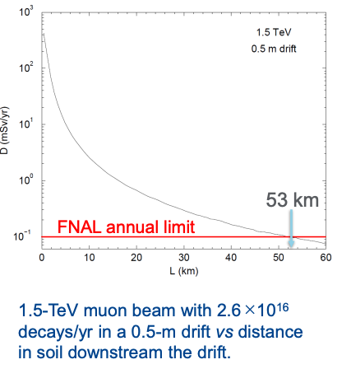
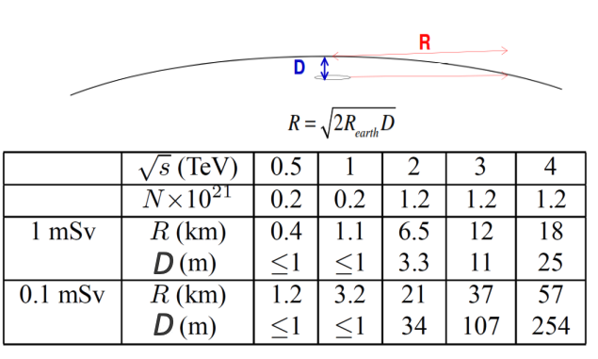
Neutrino Radiation Background
N.Mohkov, Snowmass MC Workshop 2022
Dose vs distance traveled in soil for 1.5 TeV MC to meet 0.1 mSv/yr from just 0.5m straight section →
MuIC at BNL might need ~50m straight section at IR? (100X longer!)
Bunch intensity reduction for MuIC: 10 – 100X (cancels↑)
Energy reduction factor for 1 TeV: (1.5)³ = 3.4X
⇒ Still need significant depth: ~34 m
Lower beam energy to ~0.5 TeV (0.5³ → 10X)
⇒ Depth ~3m (i.e. near surface)
Or lower beam energy to 0.7 TeV (0.7³ → 3X), and reduce straight sections to < 15 m (3.3X) [10X overall]
(~3m depth)
8km
(~34m depth)
28km
(~107m depth)
√s = 0.74 TeV

Slide 55
Flip side of neutrino background
Turning the radiation argument around, can a highly collimated neutrino beam be useful for a high-energy neutrino DIS experiment?
Perhaps with more data than collected in the past, if not in energy, for fixed target?
Also makes for a “neutrino-hadron collider” in principle, but with very much lower luminosity
Blow-up of transverse beam size area in 50m section (~10⁶ X)
Rate of muon decays (~1000X less v per muon for 1000 turns per μ lifetime)
Fraction of decays in straight section (~100X less for 50m/4000m)
⇒ Luminosity ~11 orders of magnitude smaller: L ~ 10²⁰ (?)
Also how to disentangle from muon-hadron DIS?

Slide 56
Nuclear Structure and Spin at the MuIC
Transverse Spatial Distributions of Partons
Generalized parton distributions (GPDs)
Spin Structure and the Nucleon Spin Puzzle
From EIC Yellow Report
MuIC can extend EIC measurements to x ≈ 10⁻⁵, and nucleon polarization is possible at BNL

Slide 57
A lab for QCD and Nuclei at the MuIC
A promising observable to probe the dense gluonic medium inside a heavy nucleus is the decorrelation in azimuth from back-to-back of the muon-jet system
μ
jet
EIC
MuIC
$$(28 weeks at 50\% duty cycle→\sim 40 {fb}^{−1})$$

Slide 58
QCD and the Running of 𝛂_{S}
Measurements can span a broad range to measure α_{S}(Q²) in a single experiment
From DIS inclusive jet cross section measurements, F_{L} measurements, and from QCD evolution fits to structure function data
Removes some inter-experiment systematics
From the LHeC CDR:
Inclusive jets with expected uncertainties for 1 ab⁻¹ →
(JES uncertainty: 0.5%)
Expected 𝛂_{S} (M_{Z}) uncertainties
±0.00038
Even 50 fb⁻¹ (~1 year) is competitive
LHeC / MuIC
+EIC

Slide 59
Sin² θ_{W}^{eff} Measurements at M_{Z}
Drell-Yan angular distribution at LHC
Future DIS expts.
Potentially comparable (or better) sensitivity than past measurements
CMS-PAS-SMP-22-010
PoS EPS-HEP2021 (2022) 485
Nucl.Phys.A1026(2022)122447
EIC: ±0.0001
LHeC: ± 0.00021
MuIC similar?
LHC: ± 0.00031

Slide 60
Higgs →cc ?
Charm decay channel is difficult at the LHC, so it could be an opportunity
However, it is also challenging for the MuIC:
20X smaller Branching Ratio for H→cc vs. H→bb
Smaller c-tagging efficiency
More DIS background
Similar pseudo analysis by P.Ahluwalia, S.Sekula, et al.: arXiv:2211.02615
Yielded only a handful of events – not so promising
Did not yet include mis-tagged light dijet background
However, there may be topological features to utilize to discriminate signal
Perhaps more optimism in LHeC CDR
Machine learning (BDT) analysis
~7% (20%) precision on coupling for CC (NC) production with 1 ab⁻¹
So there may be potential at MuIC

Slide 61
Probing Models Relevant to LFU Violations
Work in progress: DA, O.Miguel Colin
Perform pseudo-analysis using a cut-and-count approach on the reconstructed Q² from the muon, optimized for sensitivity
Apply b-tagging and mis-tagging efficiencies to final state jet
b, c, light: 70%, 10%, 1%
Derive expected limits
Conclusion: generally need high √s, LHmuC (120 fb⁻¹) to be competitive with HL-LHC (3000 fb⁻¹) for this model

Slide 62
Probing Leptoquarks Relevant to LFU Violations
Work in Progress
Studies focused on LQ models inspired by B and μ anomalies
S3 type LQ (F=2, LL coupling, μb), $λ=0.1$, M = 500 GeV shown here
Consider interference with SM DIS in both s- and t-channel
Negative interference term subtracts from SM DIS diff. xsec
Try Z’ cut-and-count method on reconstructed Q² to estimate sensitivity
Conclusion: much more sensitive than Z’ search
Generally because final state muon is more central than for Z’ interference
On-shell mass reconstruction also to be studied
s, b
$$μ$$
b
$$\overline{b}$$
$\overline{s}$, $\overline{b}$
$$μ$$

Slide 63
Kinematics
Scattered muon (far backward→ central with Q²) Scattered jet (More central)
Backward tagging of muons to η= −7 Hadronic system −5 < η < 2.4
0
2.4
−5
−7
Quite different from EIC kinematics

Slide 64
A Far Backward Muon Spectrometer Design Study
Work in progress: DA, O.Miguel Colin, M.Munyi
← Near Toroid coverage
← Far Toroid coverage

Slide 65
Example of Shielding Impact on Muon Measurements
A 1 TeV muon loses ~20% of its energy going through the 6m tungsten cone, with a long tail
Also, multiple scattering smears the outgoing angle (larger impact on measurements)
This affects measurements:
e.g. 30% smearing for Q² = 20 GeV² → from reconstructed muon quantities
So ideally we would like to remove the shielding cone in the backward direction for MuIC (but we will study if ML can recover performance)

Slide 66
MuIC Synergies
Siting a muon collider at a facility with a high energy hadron ring opens up a very interesting additional, complementary science program
Would be an exciting upgrade to the EIC
But siting at FNAL or CERN is also very interesting and synergistic
Re-use of some existing hadron accelerator infrastructure may help allay some cost
And can still benefit from a lower initial muon beam energy if collided with TeV scale hadron beam
A MuIC provides a science case for an initial muon collider demonstrator
Luminosity demands for proton/nuclear structure measurements at extreme parton density (low x) are much less stringent than the ultimate needs for Higgs studies, etc.
Similar detector needs to future μ⁺μ⁻ and FCC-hh experiments
Good timing for background mitigation, high eta muon spectrometer(s)
A MuIC would address particle physics, nuclear physics, and intensity frontier interests
Two communities to join in detector development and construction
Joint funding from particle and nuclear physics programs? (as for the LHC program)

Slide 67
Machine Learning Methods to Reconstruct DIS Variables
Work in progress: O.Miguel Colin, A.Amarilla
The lepton method, or any of the other well-known DIS approaches (DA, JB) do not use all of the available scattering information, and have (different) regions of good and poor resolution
We started using a machine-learning approach to reconstruct Q², x, and y as a proxy for the best method we can use
Applying this to gen level final state particles, smeared by detector resolutions
Input variables:
muon energy (outgoing)
muon eta (outgoing)
Shower - Sum of energy deposited in calorimeter
Shower - Sum of momentum in x direction
Shower - Sum of momentum in y direction
Shower - Sum of momentum in z direction
Shower - Sum of (energy - momentum in z direction)
Reconstructed Jaquet-Blondel Angle (Direction of shower)
Reconstructed Lepton Method: Q^2, x, y
Reconstructed Jaquet-Blondel Method: Q^2, x, y
Reconstructed Double Angle Method: Q^2, x, y

Slide 68
Machine Learning Methods to Reconstruct DIS Variables
Work in progress: O.Miguel Colin, A.Amarilla
Uses detector variable smearing as in Acosta and Li, NIM A 1027 (2022) 166334 , but not yet any smearing from a shielding cone
Aiming to get better resolution than any single standard approach
Still a work in progress (e.g. need to improve x resolution)
Can be used to optimize necessary detector resolutions and coverage

Slide 69
DIS Resolution Studies
Resolutions of reconstructed Q², x and y with 3 methods Q² vs. x plane:
Lepton only
Simple assumptions of detector resolutions to smear particles from PYTHIA 8
100%
50%
10%
Hadron only
Q²>10
Double angle
Muons: 10% at 1 TeV, η > −7
Hadrons: −4 < η < 2.4 (shielding)
Notes:
Lepton Q2 based almost entirely from angle

Slide 70
Comments on Luminosity
Ketenoglu et al. (Mod. Phys. Lett. A 37 (2022) 2230013) discuss that previously listed MuIC beam-beam tune-shifts are too high, and obtain lower values by lowering N_{μ} by factor 100 to get: L ≈ 10³¹ – 10³² Hz/cm²
Christoph Montag at the MuIC workshop made similar remarks in his talk
Space charge effects, intrabeam scattering (down factor 240)
Beam-beam effects (reduce by factor 100, but could increase μ bunches by 100)
Hadron beam emittance growth from muon replacement
Suggests increasing beam emittances, lowering muon bunch charge by factor 7, and using 1200 proton bunches (colliding with one at a time)
Luminosity reduced by factor 100 : L ≈ 5 × 10³¹ Hz/cm²
Larger beam sizes will lead to challenges for IR design and reduced detector acceptance
But effects improve at higher beam energy
Colliding with multiple proton bunches at a time also could increase luminosity (≈ 10³²)
On the plus side:
Increasing emittance may relax cooling requirements
Lowering N_{μ} decreases neutrino radiation background vs. MuC

Slide 71
VBF Higgs Production for a 10 TeV μ⁺μ⁻ Collider
Pseudorapidity distribution for scattered lepton in VBF Higgs production
5 x 5 TeV
Scattered muons in far backward and forward regions similar to MuIC

Slide 72
VBF Higgs Production for μ⁺μ⁻ Collider
Pseudorapidity distribution for scattered lepton in VBF Higgs production
7 x 7 TeV
Scattered muons in far backward and forward regions

