Slide 1
Muon beams manipulation with crystals
A. Mazzolari

Slide 2
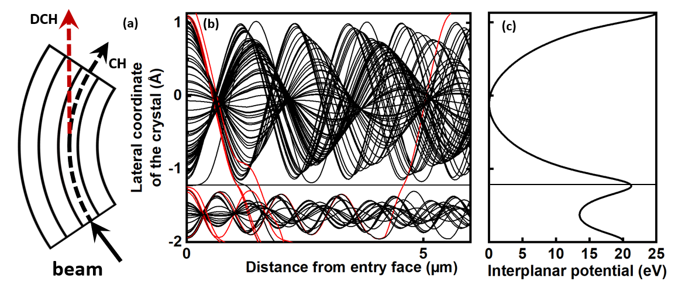
Coherent effects in crystals
Planar channeling
Particles reaching the crystal within the «critical angle» for channeling feels interatomic potential and are deflected
Observed for the first time in the late ‘70 @ Dubna, then spread worlwide (FNAL, CERN, etc…)
Steering efficiency as high as 85%, limited by «dechanneling»
Optimal for high‐energy (GeV–TeV) beams
Key applications: beam extraction, precision steering, crystalline‐undulator radiation sources

Slide 3
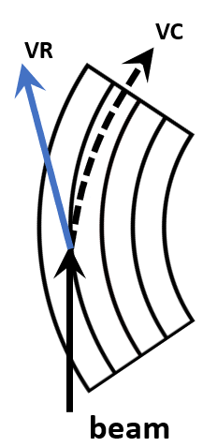
Coherent effects in crystals
Volume Reflection in Bent Crystals
Coherent deflection by the averaged potential of curved lattice planes
Deflection angle ≈ 2 critical angle for channeling with ≈ 100 % beam acceptance
Efficiency 95–99% across GeV–TeV energies (limited by “volume capture”)
Simplified crystal alignment requirements
Key applications: beam steering, collimation, halo extraction

Slide 4
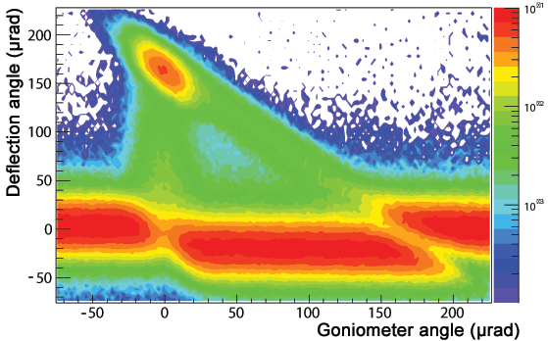
Coherent effects in crystals
400 GeV proton beam
Deflection at channeling ~ 160 μrad
Channeling efficiency ~ 60%
Volume reflection deflection at about 13.5 μrad
Fraction of diverted particles larger that 97%
Large acceptance
1 → Primary beam
2 → Channeling
3 → Dechanneling
4 → Volume reflection
5 → Volume capture
6 → Primary beam
2
5
3
1
6
4

Slide 5
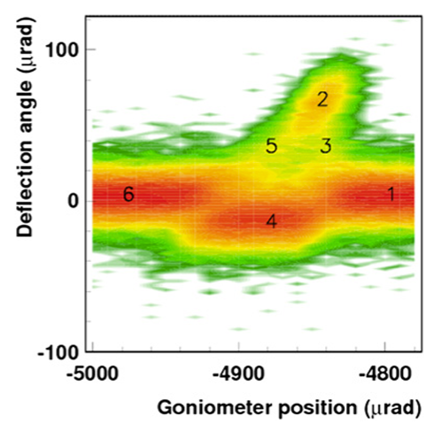
Coherent effects in crystals
Positively charged particle beams
(400 GeV protons)
Negatively charged particle beams
(180 GeV pions)

Slide 6
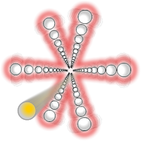
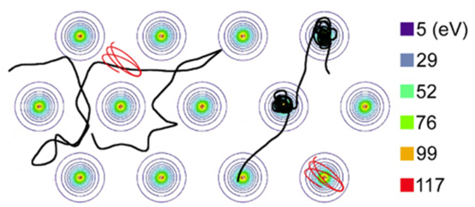
Coherent effects in crystals
Crystal axis mechanically aligned to the beam direction
Particles feels so called «axial potential», about 6 times. stronger than «planar potential»→axial channeling

Slide 7
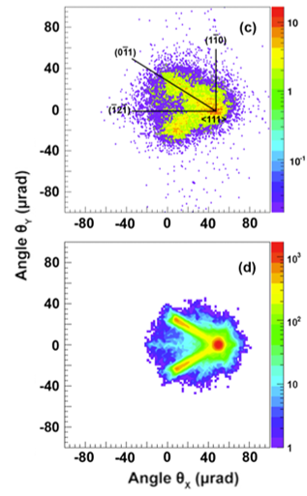
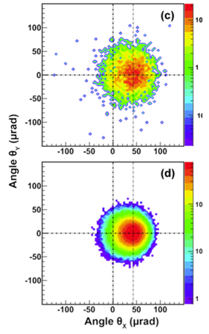
Coherent effects in crystals
400 GeV proton beam@SPS
150 GeV negative
pions beam@SPS

Slide 8
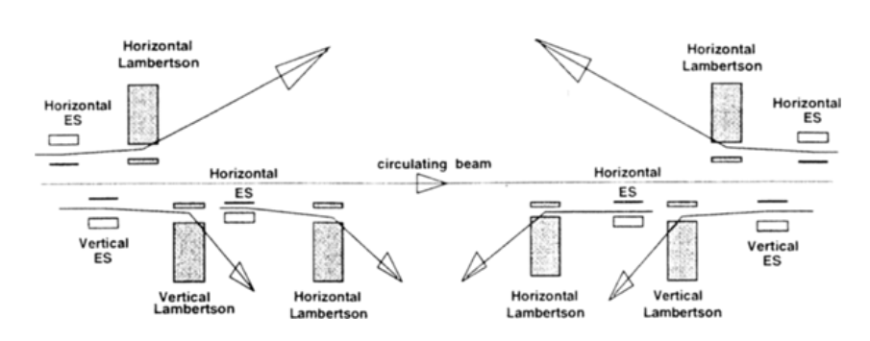
Primary beam manipulation
Collimation of beam (like LHC)
Beam extraction
Beam shadowing (i.e. in assistance of electrostatic beam scraping)
Beam focusing
10.1063/1.56430
arXiv:1809.06164

Slide 9
Coherent effects in crystals
E.m. processes: occuring for charged particles or high-energy photons
PROS
High steering power up to hundreds of Tesla dipole
Low material budget (<0.1X₀)
Zero power consumption
Selective interaction with discrete section of beam/ halo
CONS
Require precise alignment between particles and crystal
Parameters scale typically with E or E^{1/2}
For some effects lower efficiency in negative charged particles

Slide 10
Application in accelerators
Beam halo collimation (tested with protons and ions at LHC)
Beam halo extraction (U70, FNAL, CERN)
Beam focusing: both long (meters) and short (cm) focusing length
Beam shadowing: currently developing crystal to assist Mu2e proton beam extraction

Slide 11
Crystal-assisted beam collimation
Unavoidably particles diverge from desired trajectory and form a halo around beam
Traditional approach stops the halo with a series of amorphous absorber
Cons: development of showers in collimators
BEAM
Coll >1m
BEAM
Abs
Channeled particles in bent crystal while being steered avoid strong scattering: shower development strongly suppressed
High efficiency in removing halo from beam in controlled manner
Crystal
few mm
shower
Abs

Slide 12
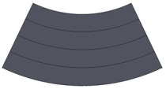
Anticlastic deformation
Beam
55 mm
R_{p}
R_{a}
4 mm

Slide 13
Crystals for LHC beam collimation
Thickness along the beam: 4.0±0.1 mm
Height < 55 mm.
Weight < 150 g
Channeling plane: (110)
Channeling axis: <111> or <110>
Miscut for planar channeling: < 10 μrad.
Torsion: < 1 μrad/mm
Bending angle: 50-55 μrad
Dislocation density < 1 cm²
Beam
Specifications defined in collaboration with CERN

Slide 14
Crystals for LHC beam collimation
Deterministic polishing
Lower the angle between crystal’s surface and its atomic planes
Chemo-mechanical
Borrowed from silicon micromachining
Ultra-high precision optics
SEM, TEM, µ-Raman, AFM, HR-XRD
Silicon micromachining
Analytical techniques asses the “quality” of crystal’s surfaces
Analytical sciences
Crystal
Nuclear reaction analysis
Fizeau interferometry
Laser interferometry
Records the topography of the crystal’s surfaces
Rutherford back-scattering
Investigate the first atomic layers of the crystal

Slide 15
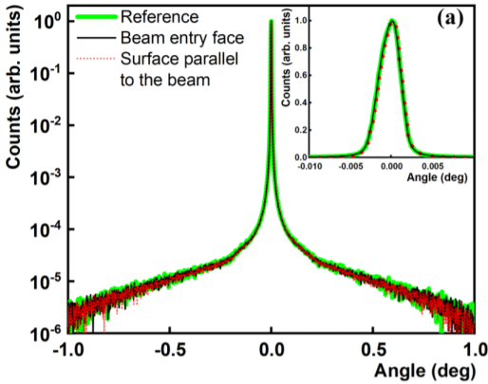
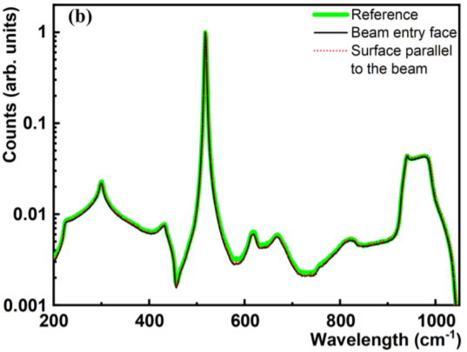
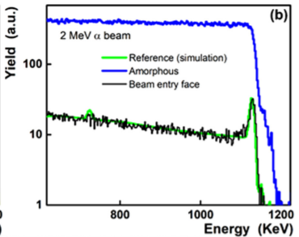
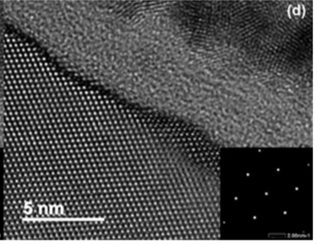
Crystals for LHC beam collimation
Essential to have surfaces free from sub-surface lattice damage: a dedicated manufacturing process have been established
A large set of characterization techniques is exploited to validate the manufacturing process.
HR-XRD probe up to few tens of microns
µ-raman (probe up to few microns)
RBS-Channeling (probe up to few hundred nm)
TEM (probe the first atomic layers)
Beam

Slide 16
Double crystal setup EDM/MDM measurement
P. Hermes (CERN)

Slide 17
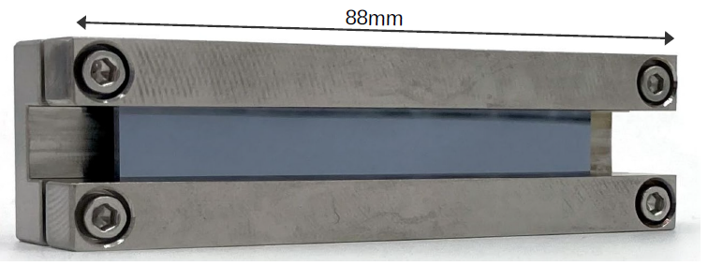
Manufacturing of «long» crystals
Manufacturing and characterization approach similar to the one used for «short» crystals. Bending angle several mrad
Special care must be paid to uniformity of bending radius.

Slide 18
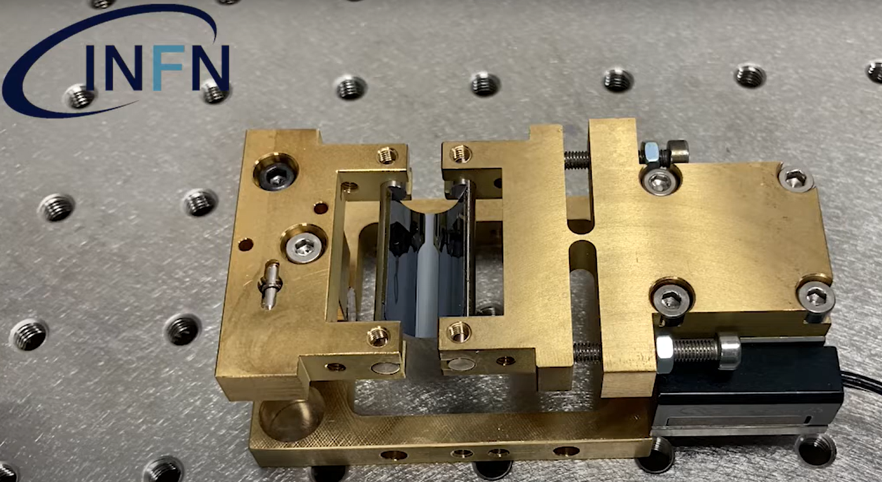
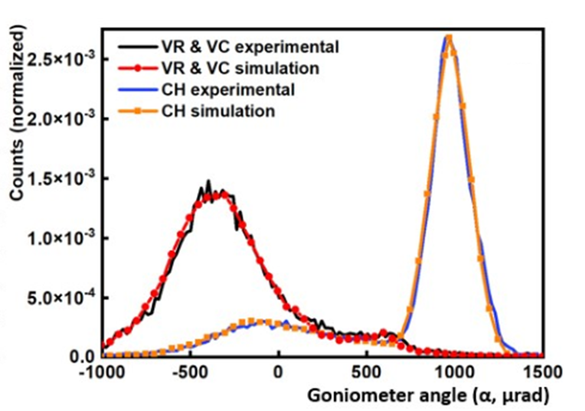
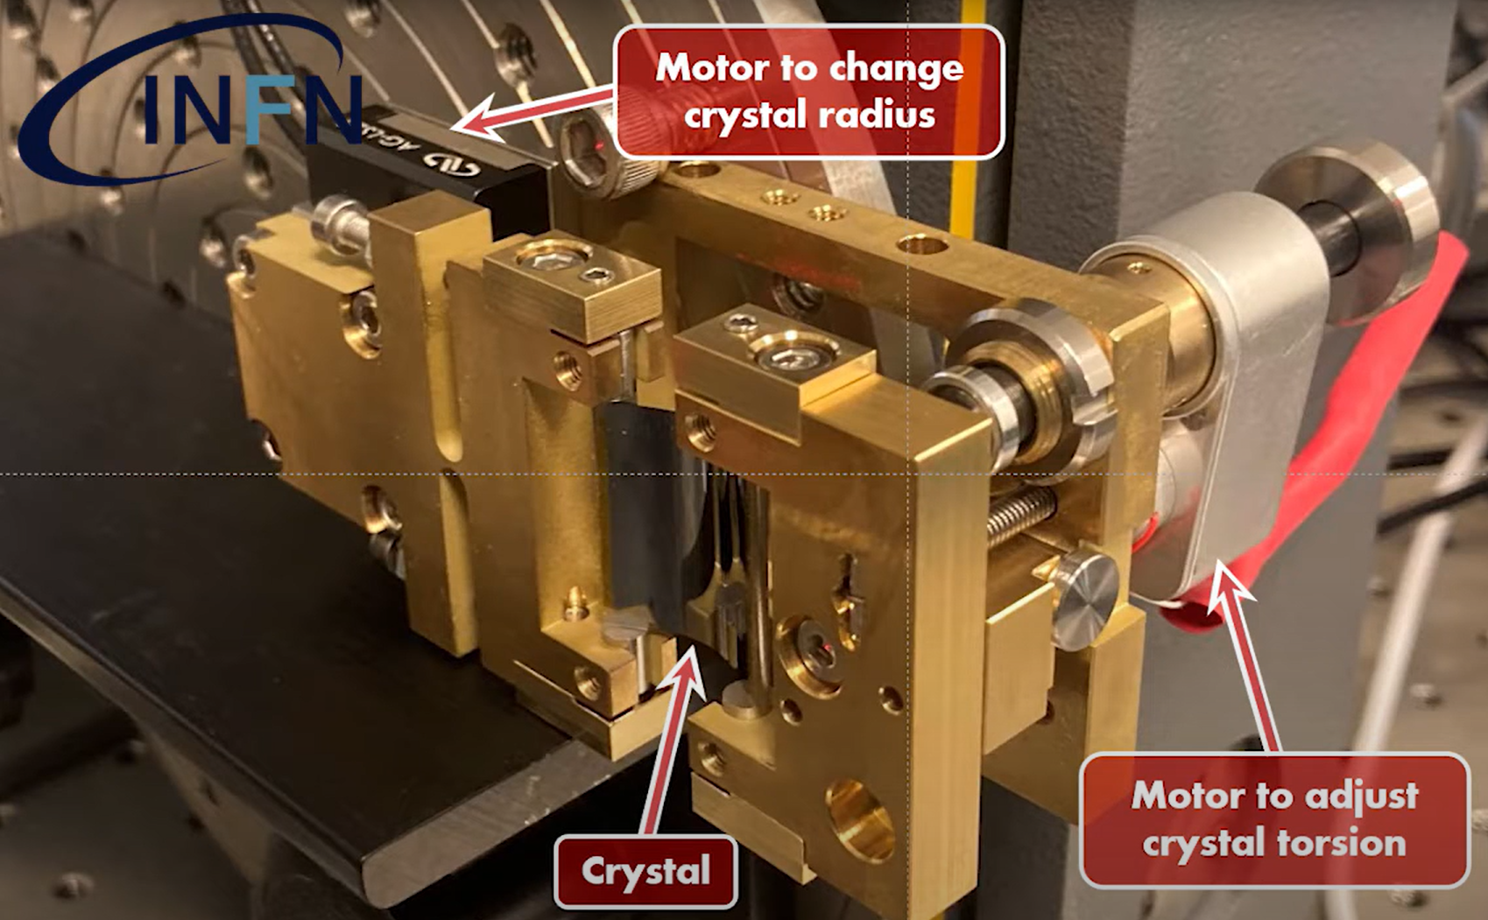
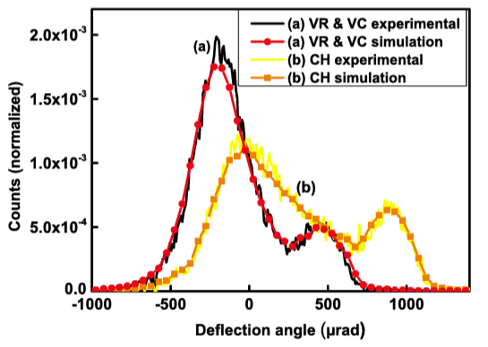
Ultra-thin crystals
QUASI-MOSAIC DEFORMATION
530MeV e+
855MeV e-

Slide 19
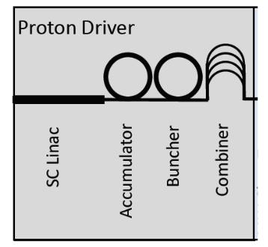
Applications at LINAC
5GeV (or 10 GeV) protons are well suited for planar channneling
Bent crystal can assist collimation of beam
Beam shadowing of delicate portion of insertion devices to reduce beam losses

Slide 20
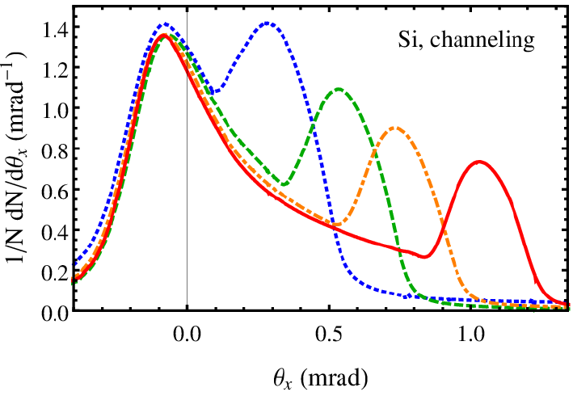
End of cooling
530MeV e+
Particle energy 339MeV
Thin crystals (15-30μm thickness) to redirect halo particles into accelerator stage
Planar channeling
Axial channeling
Volume reflection
855MeV e-

Slide 21
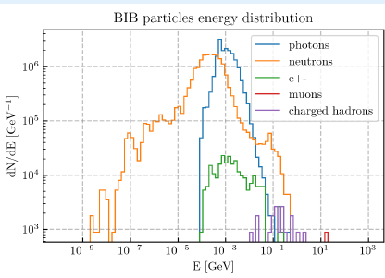
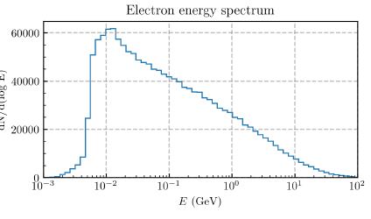
Crystal application with BIB
Low energy and large energy spread are detrimental to crystals applications (also low efficiency for diffraction of photons and neutrons)
2 MeV mirroring with very thin crystals (100 nm) was already performed experimentally, but strict energy spread condition
For incoherent e+/e- pairs, (higher energy) channeling in bent crystal might be of assistance (see slide 7)
D. Calzolari, ICHEP 2024

Slide 22
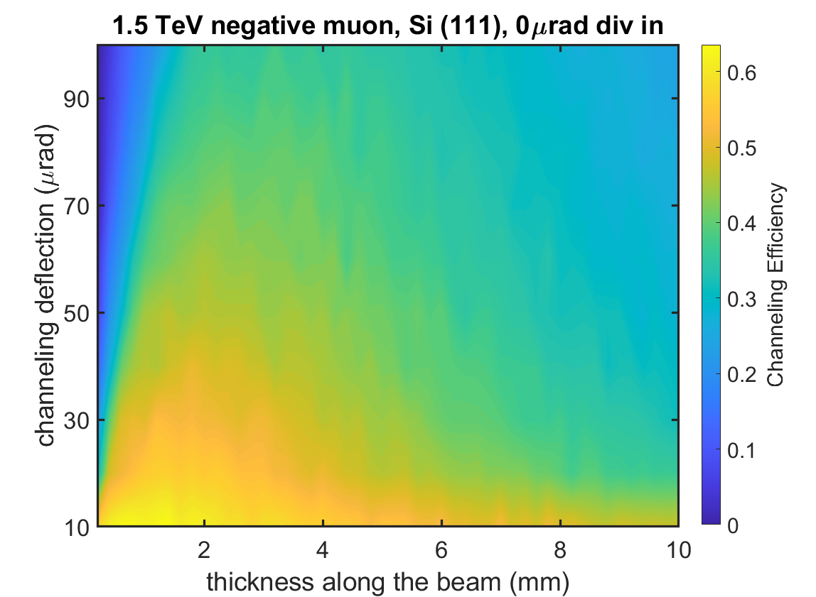
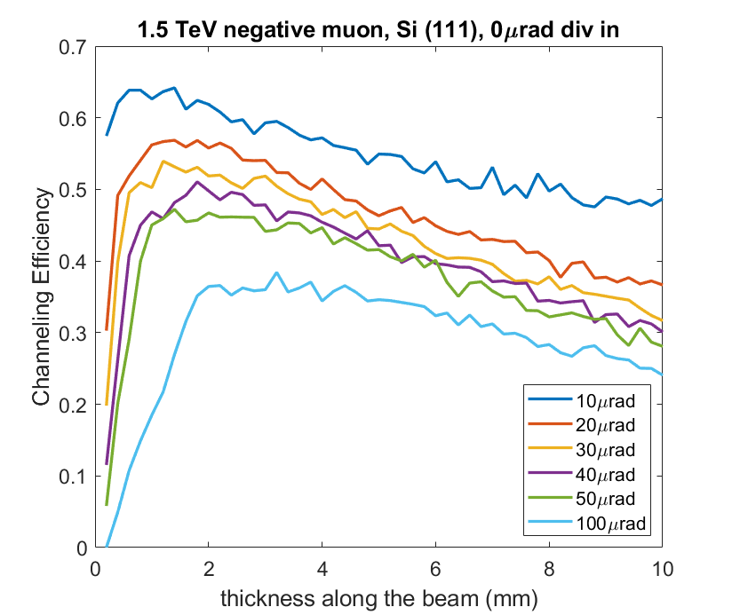
μ⁻ planar channeling efficiency 1.5TeV
1mm<Optimal crystal length <2mm, possible increase with multi-turn efficiency

Slide 23
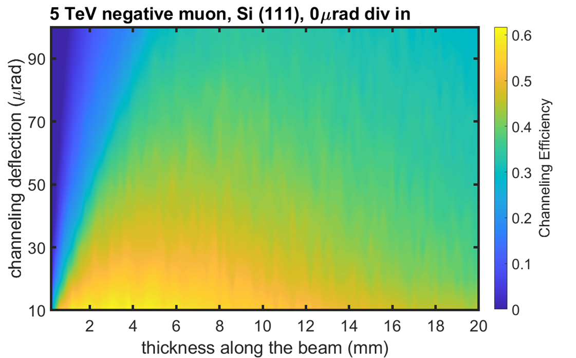
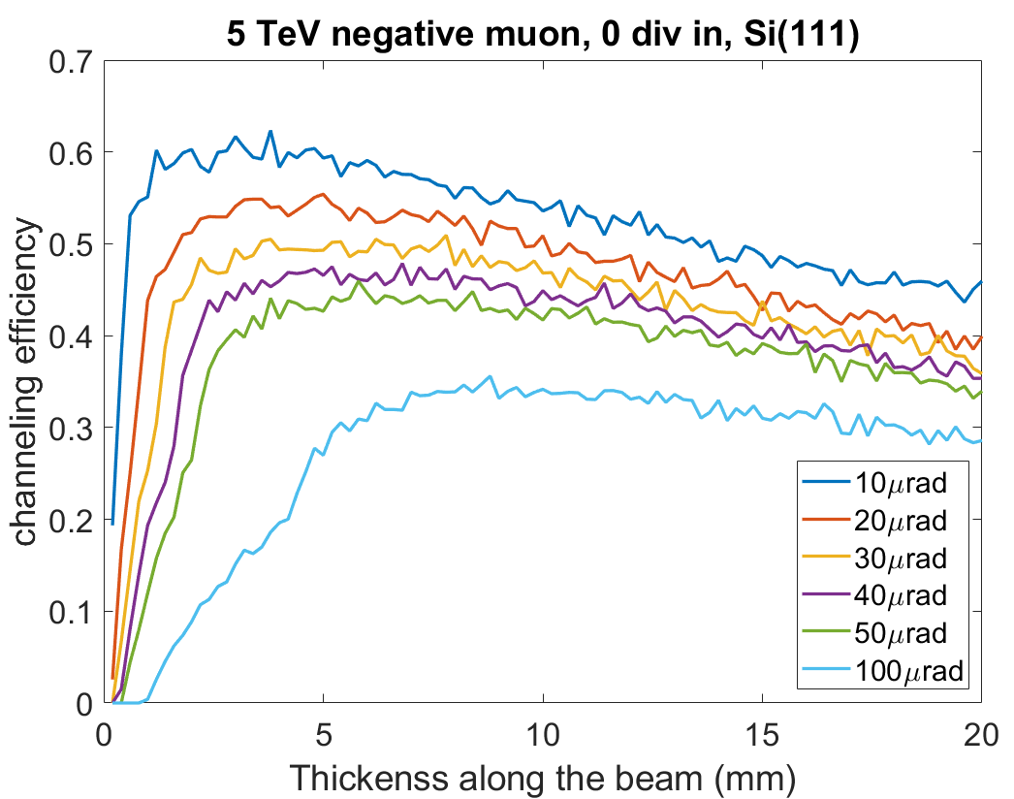
μ⁻ planar channeling efficiency 5TeV
2mm<Optimal crystal length <5mm, possible increase with multi-turn efficiency

Slide 24
Conclusions
Different kind of coherent effect in crystals can be optimized
Each application strongly depends on beam parameters and requirements in each portion of the muon collider machine
Strong inputs are well accepted to design suitable crystal-assisted schemes

Slide 26
Backup slides

Slide 27
Crystal-assisted beam manipulation
Past uses:
U70 proton beam extraction
Spin precession measure of Σ+ baryons at FERMILab
Present and Past Proposal
UA9: SPS collimation, septum shadowing, extraction
CRYSBEAM: LHC beam extraction
SELDOM: charmed baryons spin precession
SHERPA: positron slow extraction at LNF
DESY electron baem extraction
Current R&D
LHC ion beam collimation
“INFN KE4350/EN/HL-LHC” between INFN and CERN was signed: 4 crystals collimators have been already provided to CERN by INFN Ferrara

Slide 28
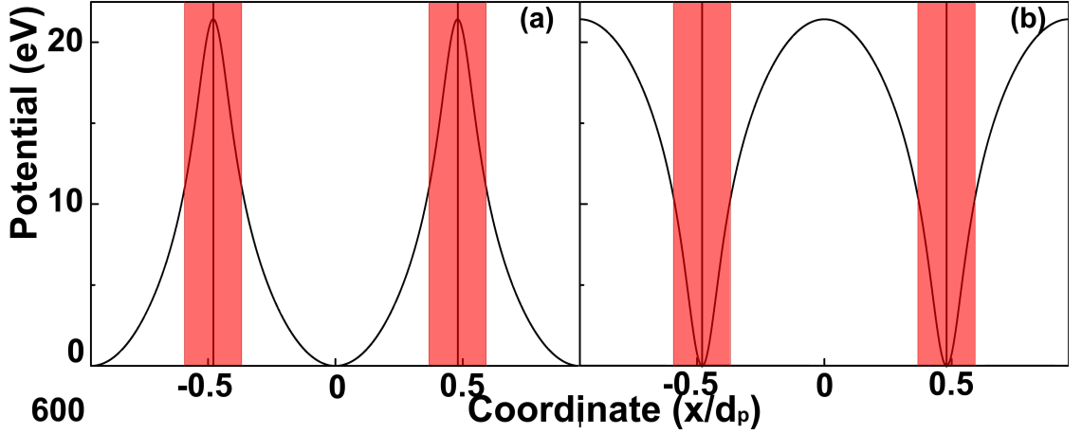
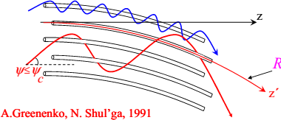
Negative particle steering
May 29, 2024 Laura Bandiera, INFN Ferrara
9
Planar channeling is significantly less efficient for negative particles, as incoherent scattering with atomic nuclei is enhanced instead of being suppressed.
Axial Stochastic Deflection was first proposed by А.А. Greenenko and N.F. Shul’ga in 1991
Experimentally observed by H8-RD22/UA9 collaboration at CERN in 2008 for protons and in 2009 for π– mesons
The mechanism involve over-barrier motion: particles scattering converge stochastically along the axis direction. Efficient for both positive and negative particles

Slide 29
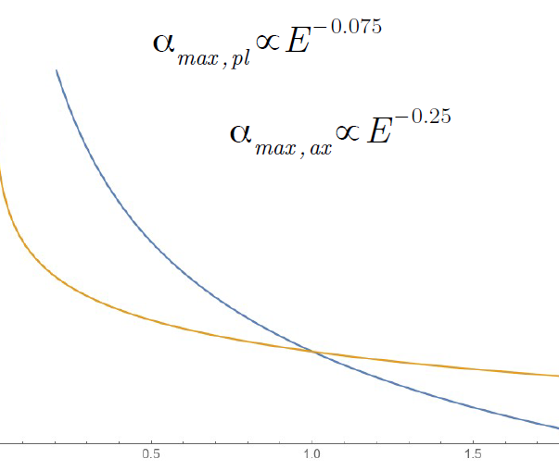
Axial Stochastic Deflection and Planar channeling
Negative particles in planar channeling exploit weaker potential and more incoherent nuclear scattering wrt positive case
Stochastic axial deflection has the potential to steer efficiently both negative and positive particles
Maximum deflection angle scale with different power law: E^{-0.075} (planar) vs E^{-0.25} (axial)

Slide 30
Comparison of planar and axial stochastic deflection at 1 TeV
A large simulation campaign has been carried out with both muon and anti-muon of 1 TeV/c momentum
Optimal radius of curvature has been obtained for deflection angles from 2 μrad up to 200 μrad
Cases for 200μrad, 50μrad are presented as example in this work

Slide 31
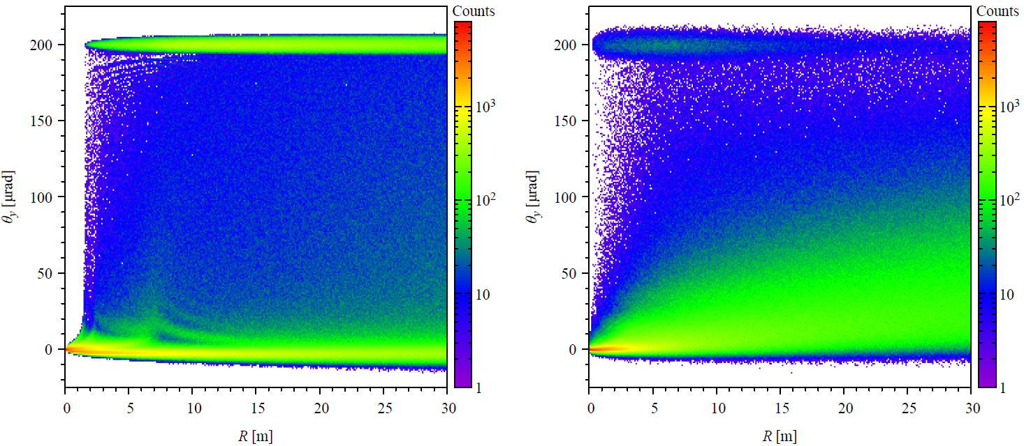
Large angle deflection μ- (200μrad)
(111) plane
<110> axis
Courtesy of I. Kyryllin
Better single pass efficiency with planar channeling
Optimal radius of curvature for R ~6-7m

Slide 32
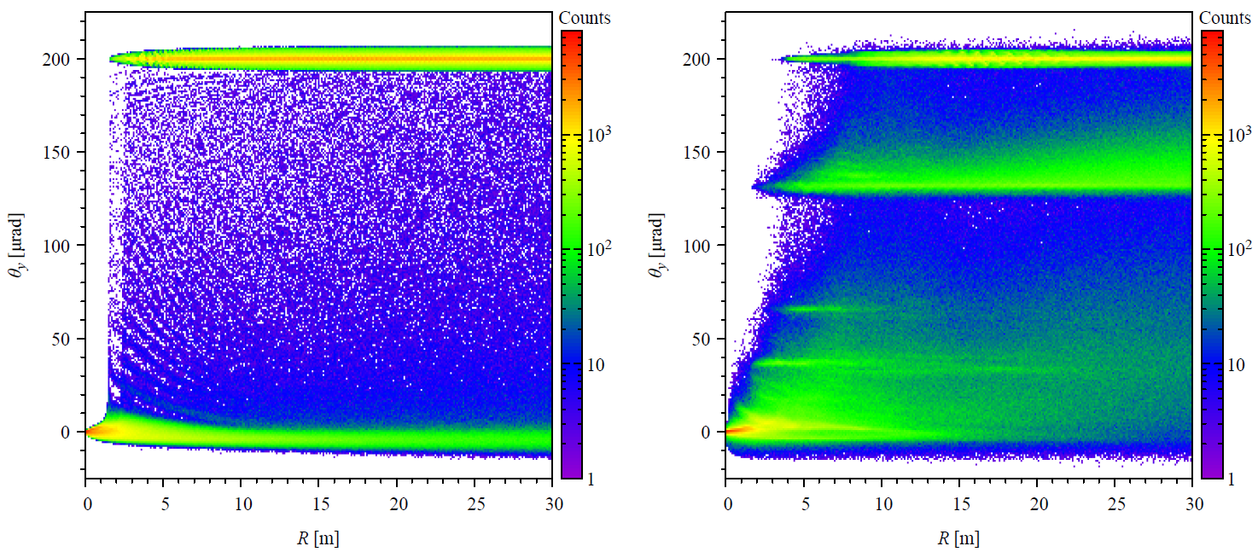
Large angle deflection μ+ (200μrad)
(111) plane
<110> axis
Courtesy of I. Kyryllin
Better single pass efficiency with planar channeling
Optimal R between 15-20m

Slide 33
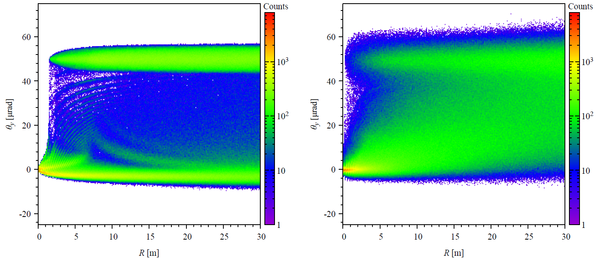
Small angle deflection μ- (50μrad)
(111) plane
<110> axis
Courtesy of I. Kyryllin
Better single pass efficiency with planar channeling
Optimal R between 20-25m

Slide 34
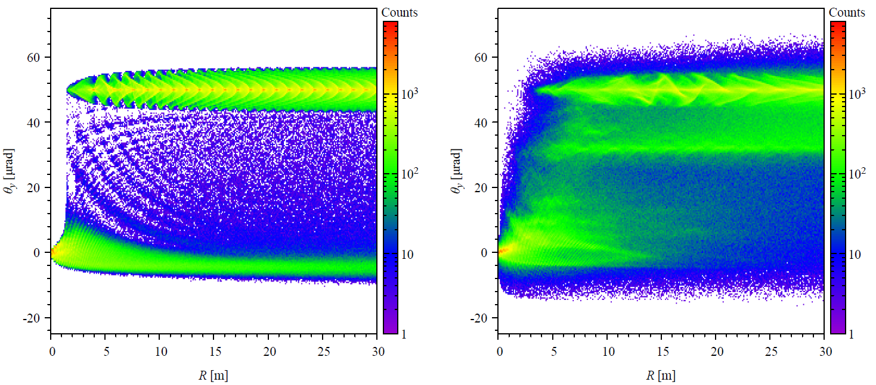
Small angle deflection μ+ (50μrad)
(111) plane
<110> axis
Courtesy of I. Kyryllin
Better single pass efficiency with planar channeling
Optimal R between 15-20m

Slide 35
μ- planar channeling efficiency 1.5TeV
1mm<Optimal crystal length <2mm, possible increase with multi-turn efficiency

Slide 36
μ- planar channeling efficiency 5TeV
2mm<Optimal crystal length <5mm, possible increase with multi-turn efficiency

Slide 37
Conclusion
Comparison of axial stochastic deflection and planar channeling as steering mechanism for TeV muon was carried out. Planar channeling was more efficient option as we reach multi-TeV scale
Optimal single pass efficiency condition was obtained for 1.5 TeV and 5 TeV negative muon case.
Future study of volume reflection phenomena such as Multiple Volume Reflection in One Crystal and Multiple Volume reflection in a series of aligned bent crystals.

Slide 38
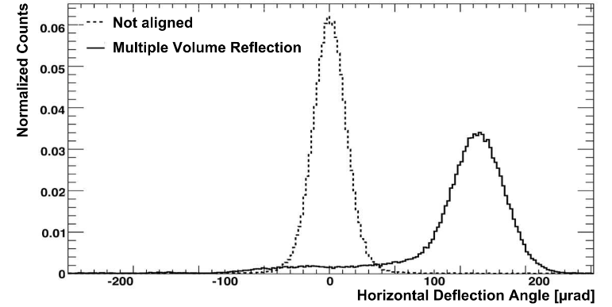
Multiple Volume Reflection
Volume reflection deflects small angle, but a series of crystals can add up steering with high efficiency
This can provide deflection comparable with channeling, with good efficiency for both negative and positive particles
Or near axial alignemtn, multiple volume reflections can occur in a single crystal (MVROC)
10.1088/1748-0221/7/04/P04002
10.1016/j.physletb.2009.11.026

