Slide 1



Development in Muon Ionisation Cooling
Muon4Future 2025
R. Losito, CERN

Slide 2
Outline
Introduction to ionisation cooling
Enabling technologies
  Absorbers
  RadioFrequency
  Magnets
Integration of a cooling cell
Demonstrator (see also presentation from D. Banerjee on Tuesday)
Conclusions

Slide 3
Introduction to ionisation cooling
After production, muons are charge separated but have a too large 6D emittance. A reduction of about 5 orders of magnitude before acceleration is necessary to ensure the required luminosity at the experiments.
Among the several techniques studied in the past, the most promising is Ionisation Cooling

Slide 4
Introduction to ionisation cooling

Slide 5
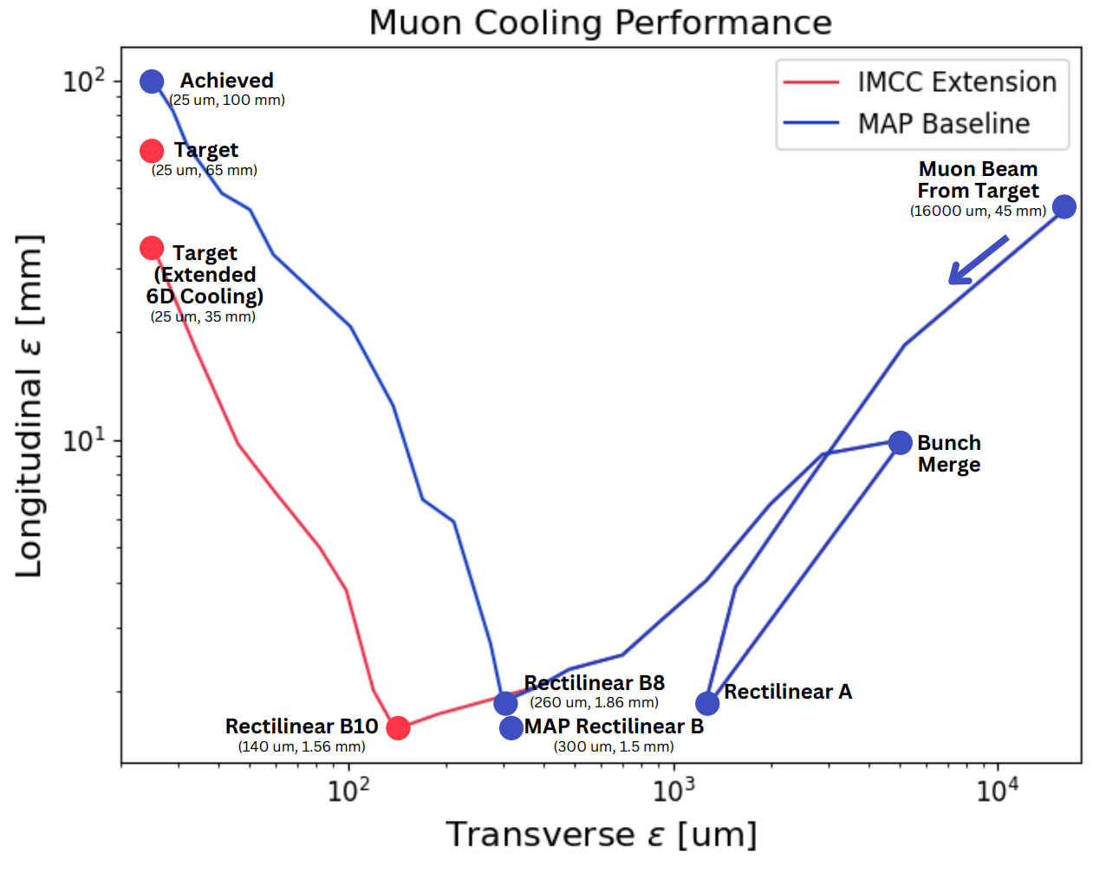
Introduction to ionisation cooling
The US-MAP first proposed a cooling scheme based on ionization cooling that achieved the required reduction of 6D emittance within a factor of 2 (Stratakis & Palmer, doi 10.1103/PhysRevSTAB.18.031003, 2015)
The IMCC improved the design taking into account the technology developments occurred in the last 10 years, in particular with HTS magnets, and the theoretical performance today exceeds the requirements (Rogers, Jury, Zhu, https://doi.org/10.48550/arXiv.2504.21417 , p. 77, Taylor IMCC 2025 annual meeting)

Slide 6
Enabling technologies
The beam dynamics design assumes “ideal” conditions, where ideal solenoidal fields, ideal pillbox cavities and ideal absorbers provide each one a precise function with state of the art or projected performances, considered feasible yet very challenging
Confirming the feasibility and integrating the limitations of real world is a challenging process, that involves iterations between hardware design and beam simulations
This process started thanks to the EU project MuCol, in particular with
  WP 4: Muon Production and cooling
  WP6 : RadioFrequency
  WP7 : Magnets
  WP8 : Cooling cell integration

Slide 7
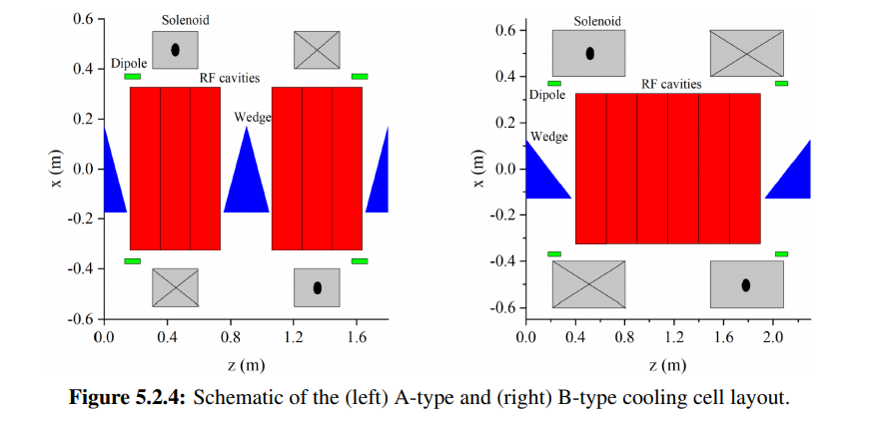
Introduction to ionisation cooling: cooling cells

Slide 8
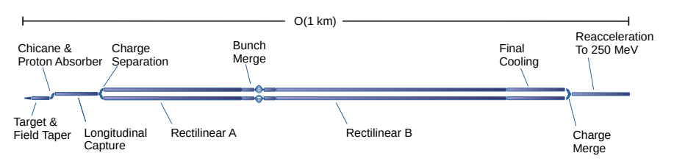
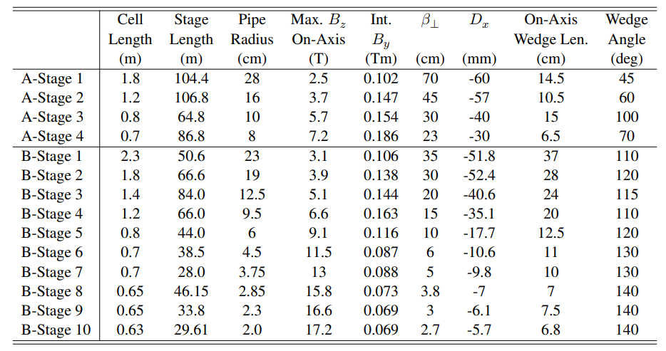
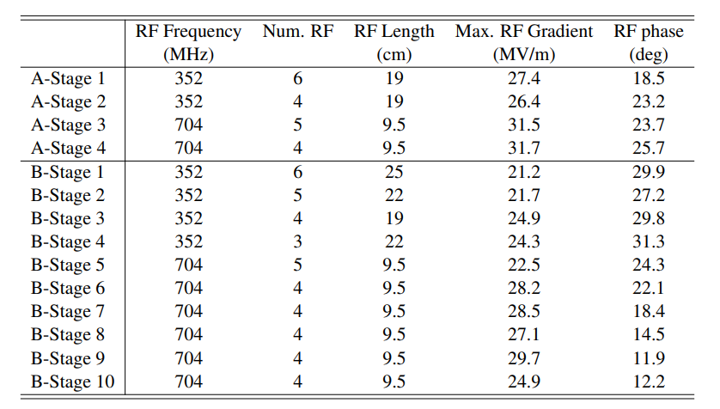
Introduction to ionisation cooling: cooling cells

Slide 9
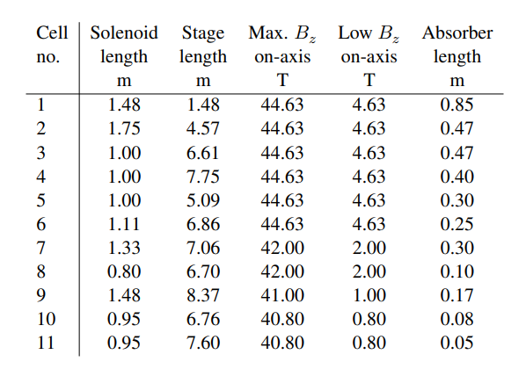
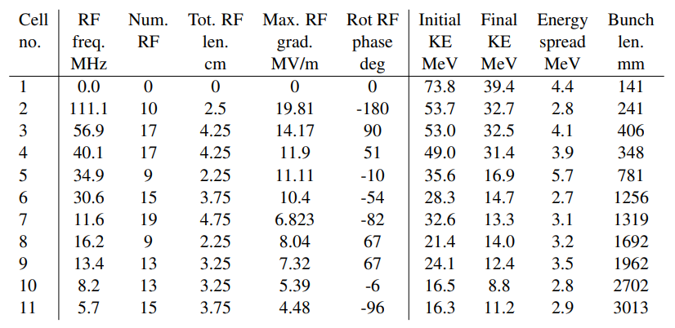
Introduction to ionisation cooling: cooling cells

Slide 10
Enabling technologies:
Absorbers
Absorbers are used to reduce the momentum, both transverse and longitudinal of muon beams, by ionisation
Absorber material has to be chosen carefully to avoid (or limit) multiple scattering, that act against cooling
Liquid (or gaseous) H₂ is the perfect material, but it is very difficult to handle: energy deposed causes “explosions” of pressure.
It has to be contained by as thin as possible windows. Thin windows do not sustain large pressure increase…
LiH has been proposed as an alternative. Tested by MICE, it looks promising, and has been adopted by the IMCC for rectilinear cooling
For final cooling, using saturated H2 vapor might be possible, as its density is sufficiently low (limited pressure increase) and we have sufficient length to get the required effect.
At the moment the beam dynamic design does not yet reflect entirely this considerations. A multiparametric optimization will be launched in the next months.

Slide 11
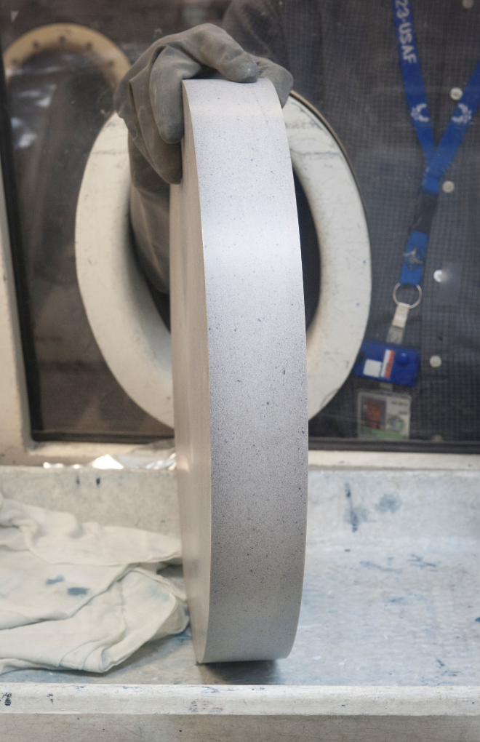
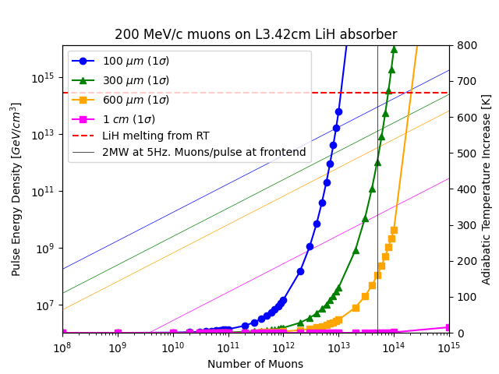
LiH absorbers
Challenges
Uncommon absorber material (lack of experience). Unknown material properties, nor behaviour under irradiation.
Reactive. Manufacturing to be mastered
Status
Collected experience from MICE.
Initial thermo-mechanical considerations.
Ongoing discussions with possible suppliers.
Required R&D
Define manufacturing procedure and procure/build a prototype
Define the required safety handling and storage procedures. Define the risks and hazards associated with its operation (and post irradiation)
Characterization and possibly beam test.
HIPed LiH absorber used at MICE
Study of possible beam parameters/temperature limitations for LiH

Slide 12
Enabling Technologies:
RadioFrequency
The RF cavity in the cooling cell is used to give back longitudinal momentum to the muon beam
Beam dynamics defines mainly two parameters:
  accelerating voltage
  Iris diameter (admissible aperture) to minimize losses
The RF design has to take into account many other parameters
  RF frequency
  Number of cells
  Ratio between accelerating and peak gradient
  Type of RF coupling from cell to cell
  Expected breakdown rate in magnetic field
  Space available inside the solenoids for the cavity itself and to fit ancillaries (antennas, cables, waveguides…)
  Beam loading and available (and realistic) RF power

Slide 13
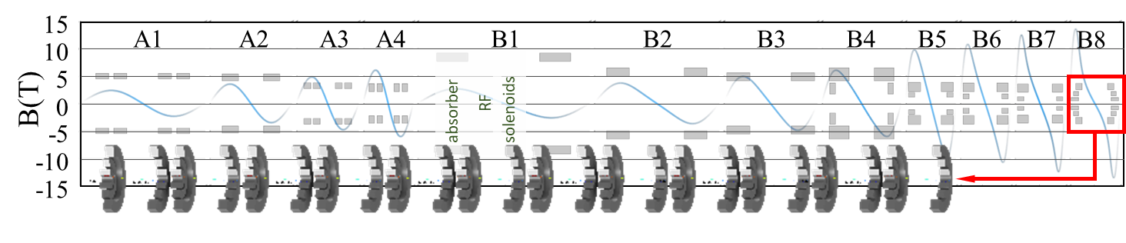
Enabling Technologies:
Magnets
Magnets (dipoles and solenoids) have to ensure two functions:
  Solenoids: Focalisation
  Dipoles: provide the right profile to the dispersion function so to have the right transverse momentum profile on wedge absorbers.
The effective B field flips from up to +15T to -15T on axis, creating huge forces among adjacent solenoids.
Moreover, the field on the solenoid structure may became much higher, with mechanical stresses that require very bulky constructions.

Slide 14
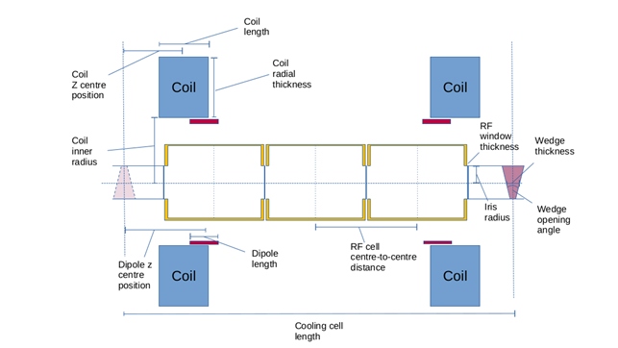
Enabling Technologies:
Cooling cell integration
Given all the constraints, an initial configuration for the cooling cell has been agreed among the various experts for the complete 3D integration of a cooling cell.
Number of RF cells in a cavity has been reduced from 5 to 3
Length reduced from 1m to 0.8 m.
Dimensions of solenoids, dipoles etc… agreed
Documented in a report:
DOI 10.5281/zenodo.11402737

Slide 15
Enabling Technologies:
Magnetic forces
LATTICE OPERATION
(nominal, beam operation)
SINGLE CELL
ONE CELL
absober
Dipole
RF cavity
Solenoid
FORCE
FORCE
Test of each cell at full field is mandatory.
A magnet design fulfilling both operative conditions looks challenging!
Periodic cell array: magnets with alternated polarity.
So far we are working only on Periodic array cell

Slide 16
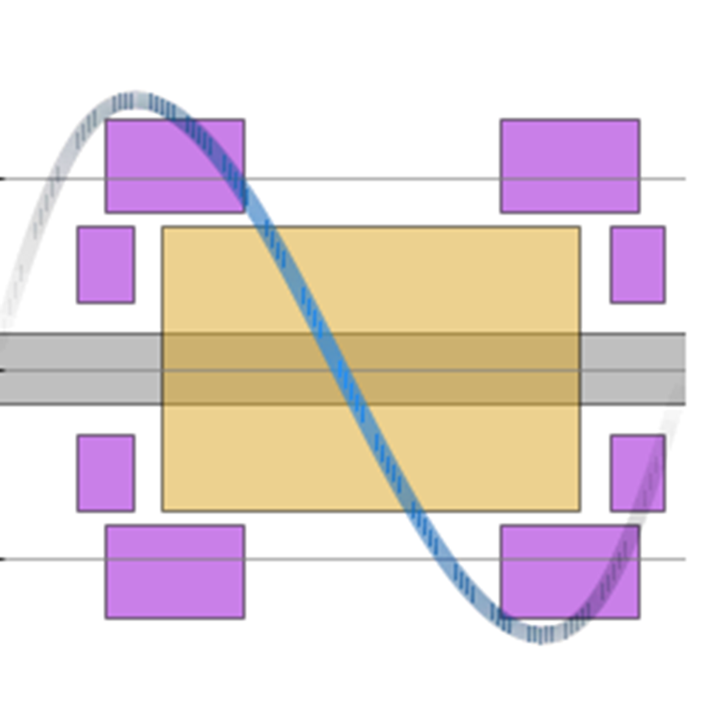
Enabling Technologies:
Cooling cell components
Magnetic cell with optimized field
RF cavity 704 MHz – Flat top geometry

Slide 17
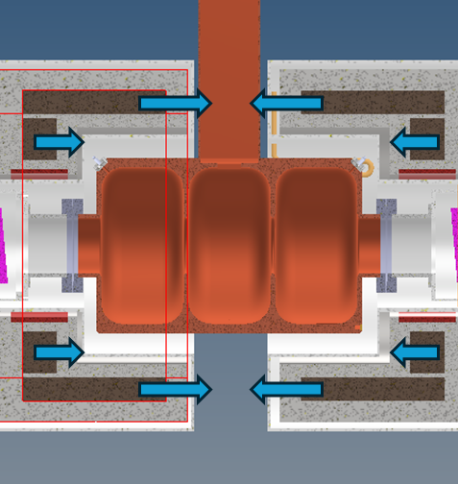
Enabling Technologies:
Magnetic forces
Axial forces on coils
(lattice operation)
The stress on the supporting structure can reach ranges between 400÷600 MPa
Not so far from limits of the material…

Slide 18
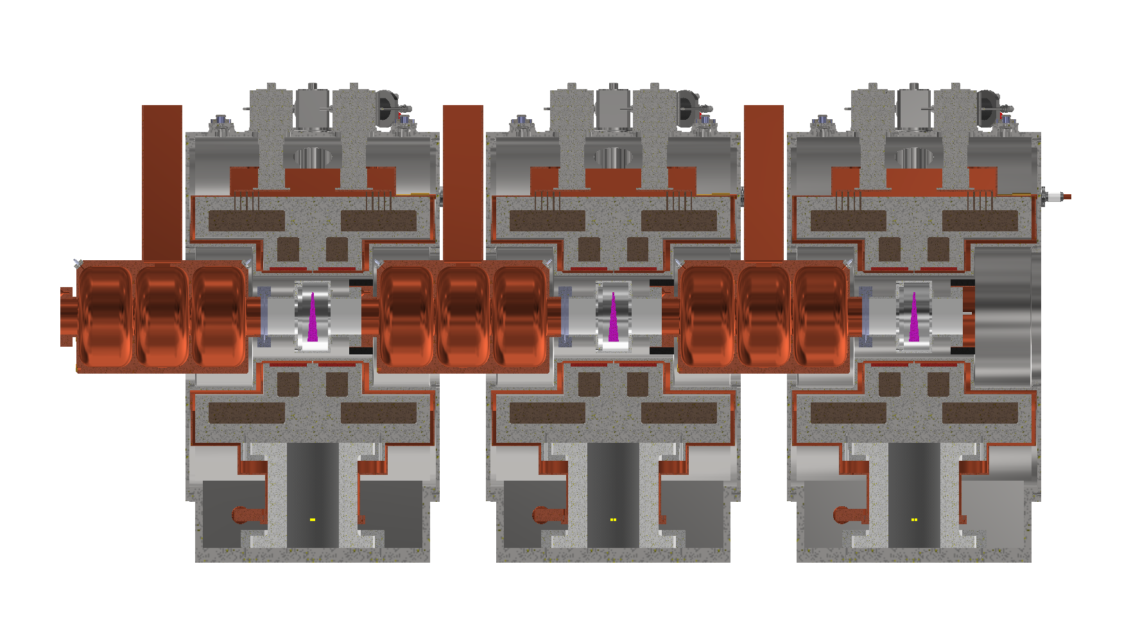
Enabling Technologies:
Cryostat
RF power WG
Dipole
Coils
RF cavities
Cooling Cell
Absorber
Magnet Stucture
Intercell Cryostat

Slide 19
Enabling Technologies:
RadioFrequency
The demanded RF field is quite high at the frequency of interest (704 MHz).
It is fundamental to keep a low ratio between accelerating and peak Electric field to reduce the breakdown rate, and limit the RF power to be fed to the cavity for a given accelerating voltage.
It is therefore preferred to have diaphragms from cell to cell to increase the R/Q, with magnetic coupling on the cell walls.
Diaphragms ideally are made of Be or Al
This limits the admissible aperture as coupling needs space!
Finding optimum dimensions will require several iterations with beam physics…

Slide 20
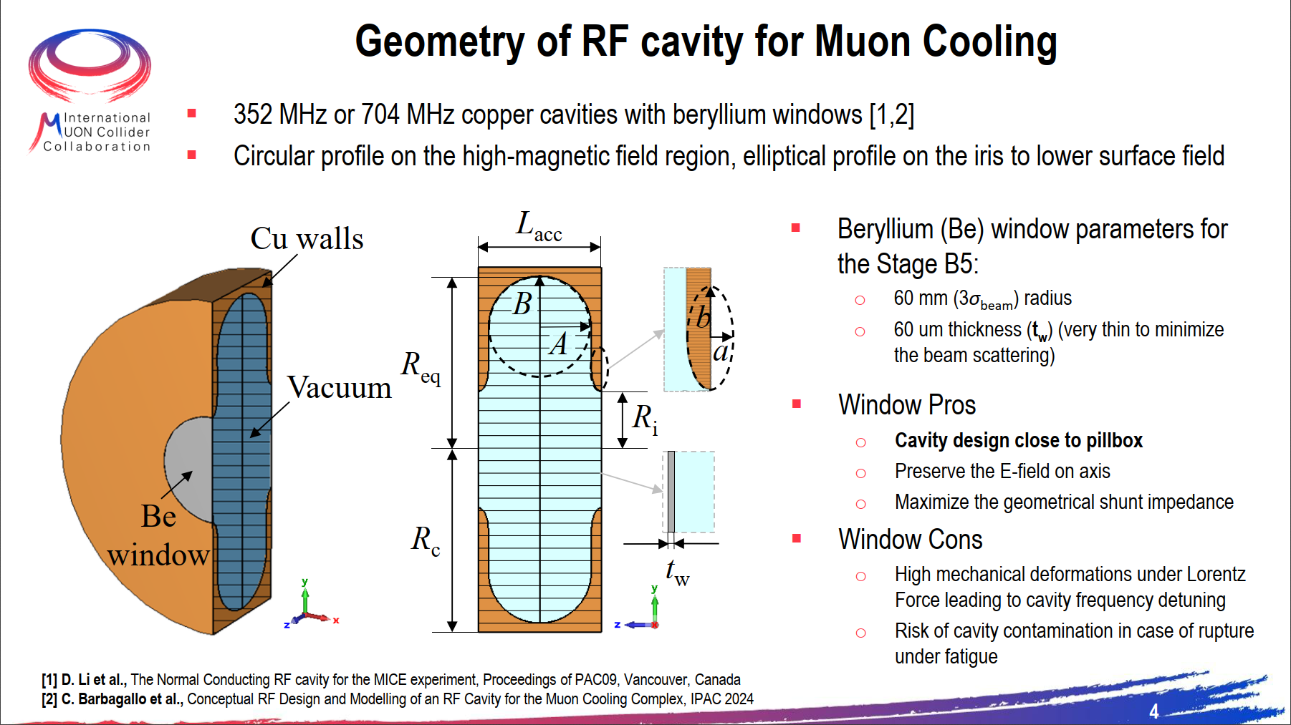
Enabling Technologies:
RadioFrequency and bam loading
Courtesy C. Barbagallo, CERN

Slide 21
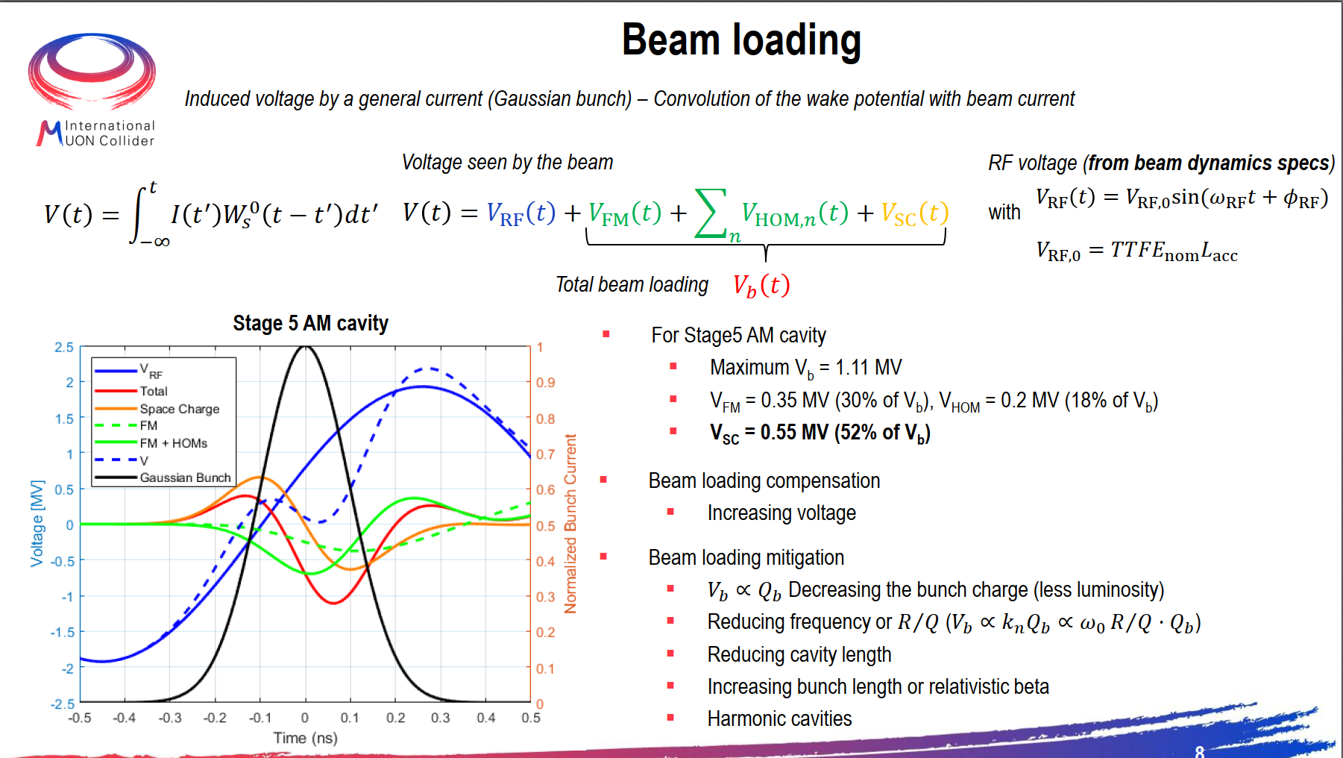
Courtesy C. Barbagallo, CERN

Slide 22
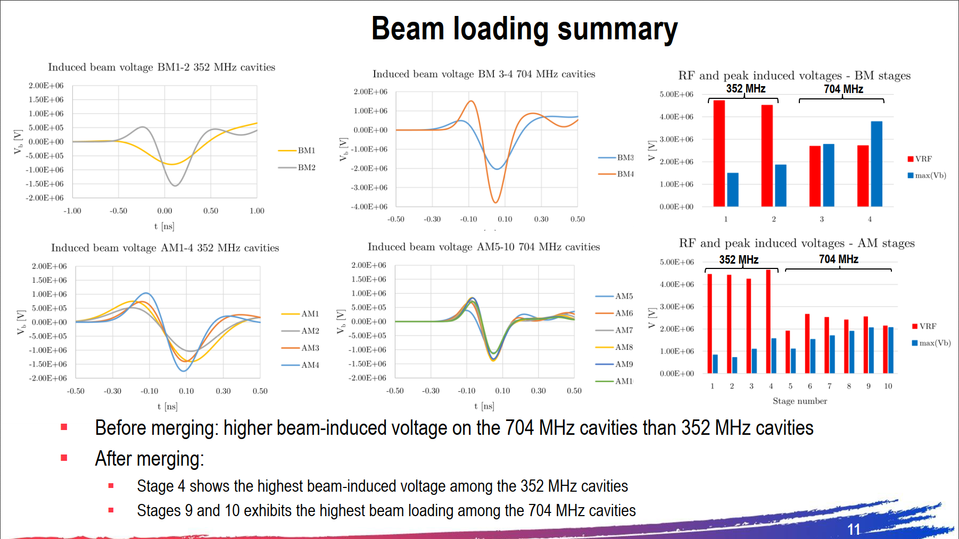
Courtesy C. Barbagallo, CERN

Slide 23
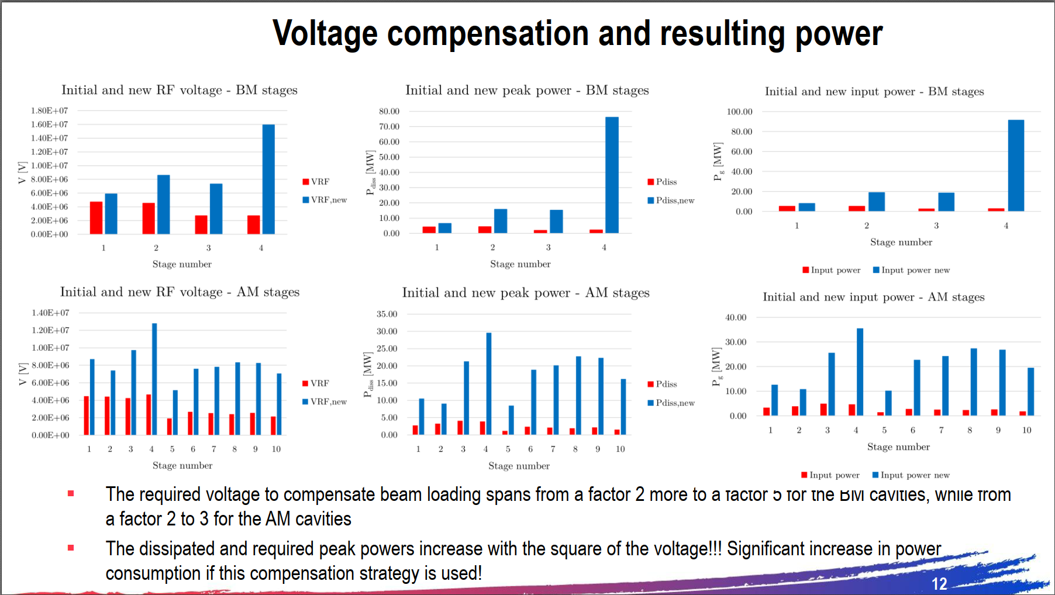
Courtesy C. Barbagallo, CERN

Slide 24

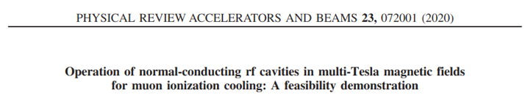
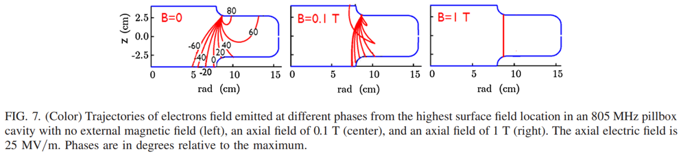
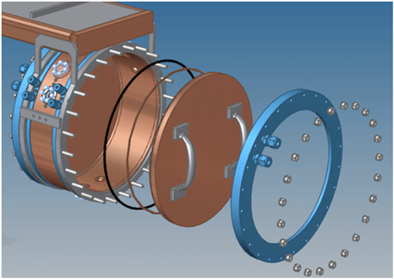
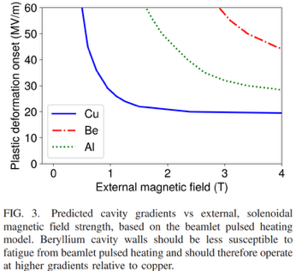
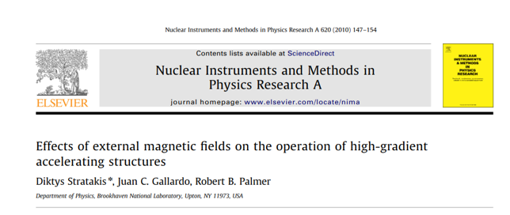
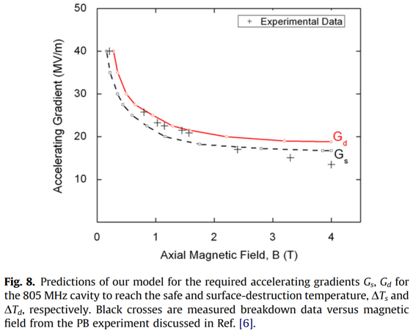
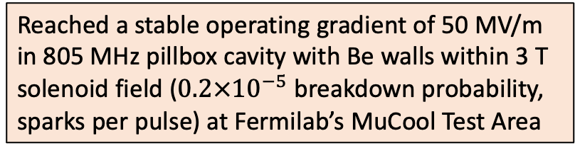
RF cavity operation in external magnetic fields
Reached a stable operating gradient of 50 MV/m in 805 MHz pillbox cavity with Be walls within 3 T solenoid field ($0.2×{10}^{−5}$ breakdown probability, sparks per pulse) at Fermilab’s MuCool Test Area
RF Tests Needed to Translate these Results in Practical Cavity Designs and Explore New Possibilities
Notes:
Evidence of high multipactor activity in solenoid fringe fields

Slide 25
Enabling Technologies:
Cooling Cell Integration
Several workshops have been organized among beam physicist, magnet, RF and beam intercepting devices experts. They were fundamental to understand the limits for each aspect and helped to define trade-offs among the conflicting requirements
It is important to underline that we are now at a phase were prototyping and tests are fundamental to make further progress!

Slide 26
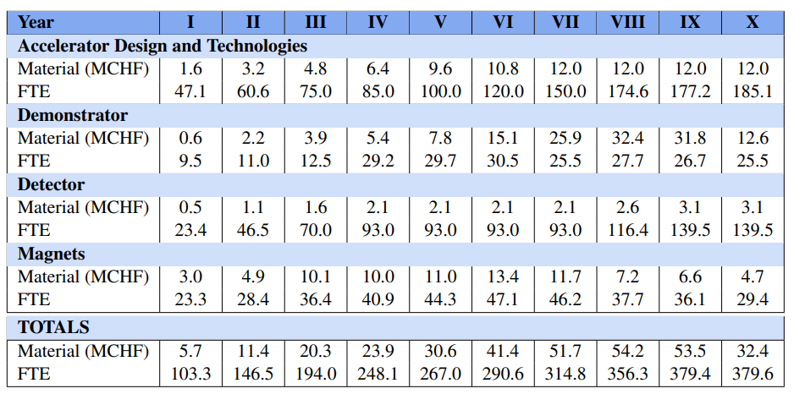
R&D Program
Iterations, prototypes and tests require resources! An R&D programme has been submitted to the LDG and the European Strategy for Particle Physics.
~300 MCHF and 1800 FTE will be necessary in 10 years!

Slide 27
R&D programme on ionisation cooling: phases

Slide 28
R&D programme on ionisation cooling: timeline

Slide 29
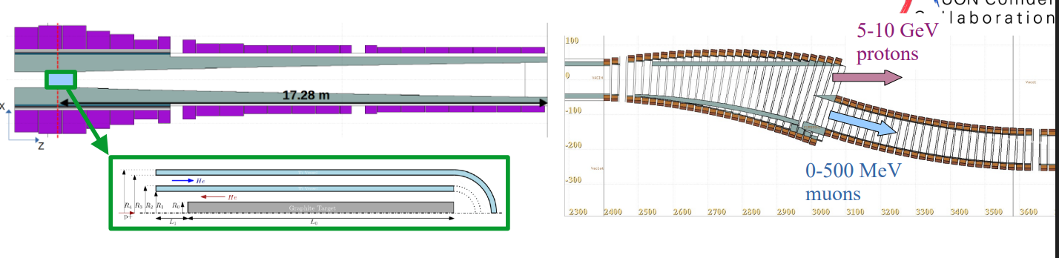
Demonstrator
We expect intensities around 10⁶÷10⁸ μpp

Slide 30
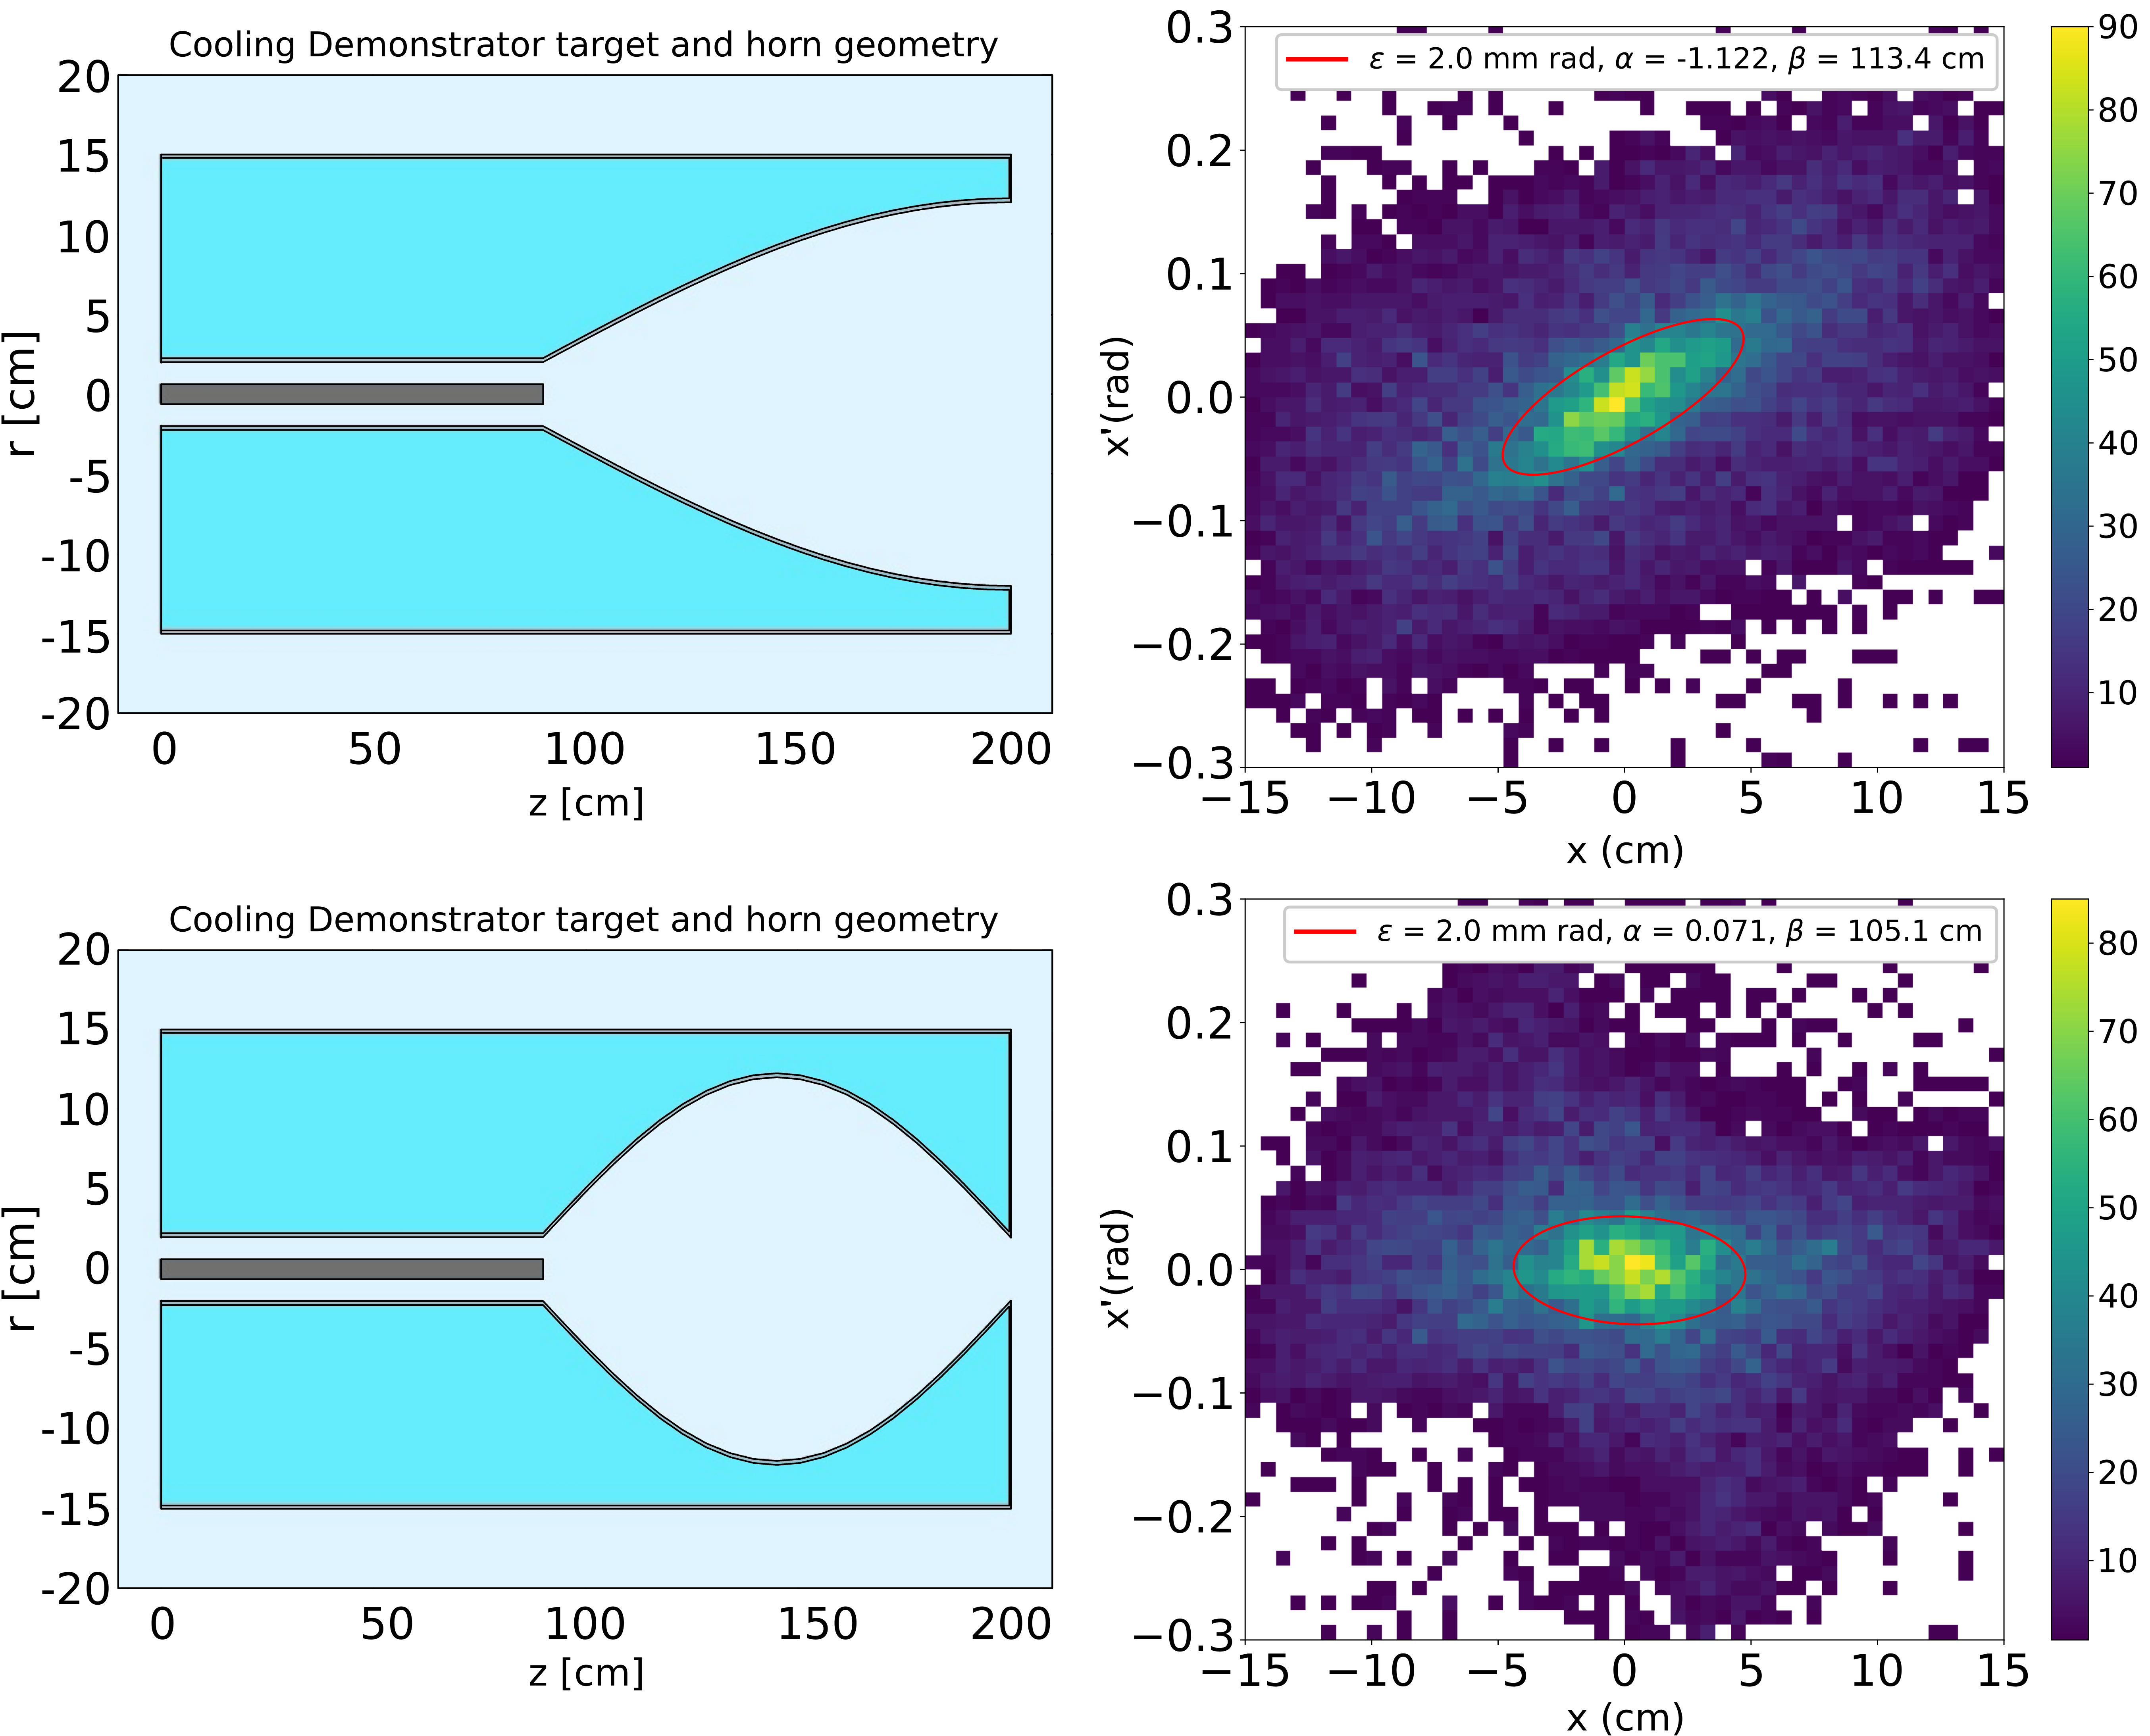
Demonstrator
Chicane & Proton dump
Target area
PS
Cooling cells and muon dump
Preparation line
CTF3
Extraction line from PS

Slide 31
Conclusion
Impressive progress in understanding the technical limits of the cooling technology
Several mitigation strategies are being studied, and more will come with iterations to be done between technologies and beam dynamics requirements.
A vibrant R&D programme is necessary : we now need to build prototypes and test the possible options
We count on the LDG and the ESPPU processes to provide resources for the R&D programme
Last but not least: for most of the technologies, our solutions will advance the state of the art and any future collider (e.g. FCC-hh) will profit!

