Slide 1
Advancement of the ISIS muon facility
Adrian Hillier, ISIS Muon Group
Muon4future, Venice
May 2025

Slide 2
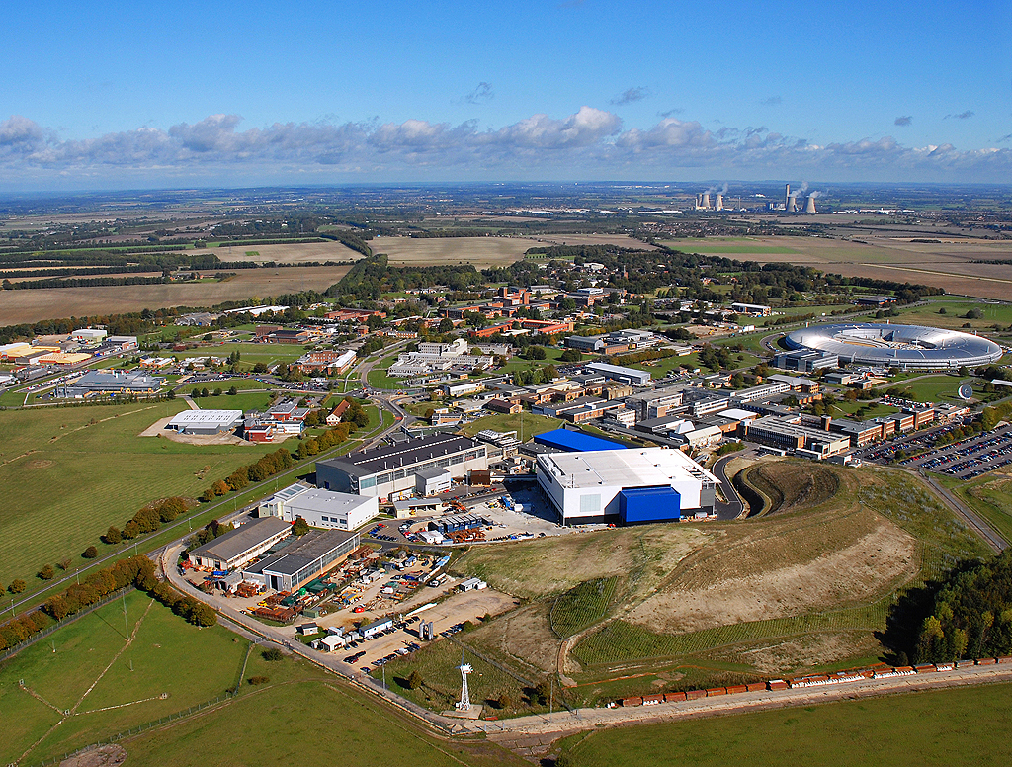

STFC Rutherford Appleton Laboratory
ISIS Pulsed Neutron and Muon Source

Slide 3
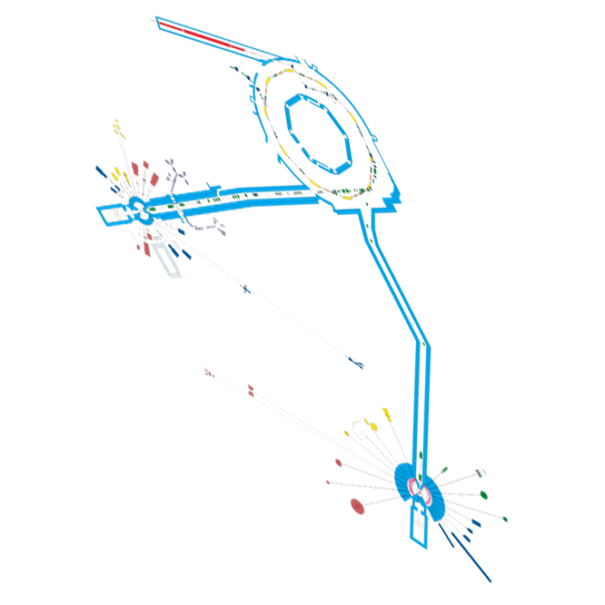
ISIS Pulsed Neutron and Muon Source

Slide 4

Notes:
This year we are celebrating 40 years of ISIS operation. Forty years characterised by scientific excellence, technical innovation and leadership. 40 years that includes 35,000 proposals to use the facility; 80,000 instrument days delivered; 60,000 user visits from 40 countries; and over 15,000 publications.
ISIS is a world-leading asset for UK science and has the potential to continue to be, well into the future.

Slide 5
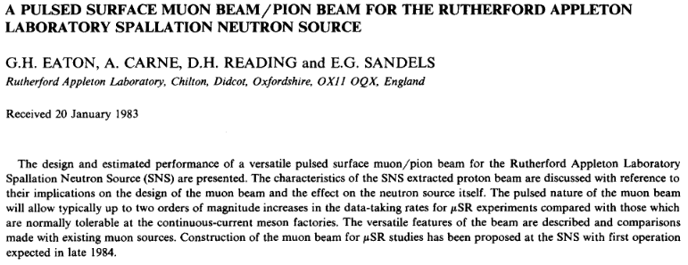
Over Forty Years ago – Muons @ISIS

Slide 6
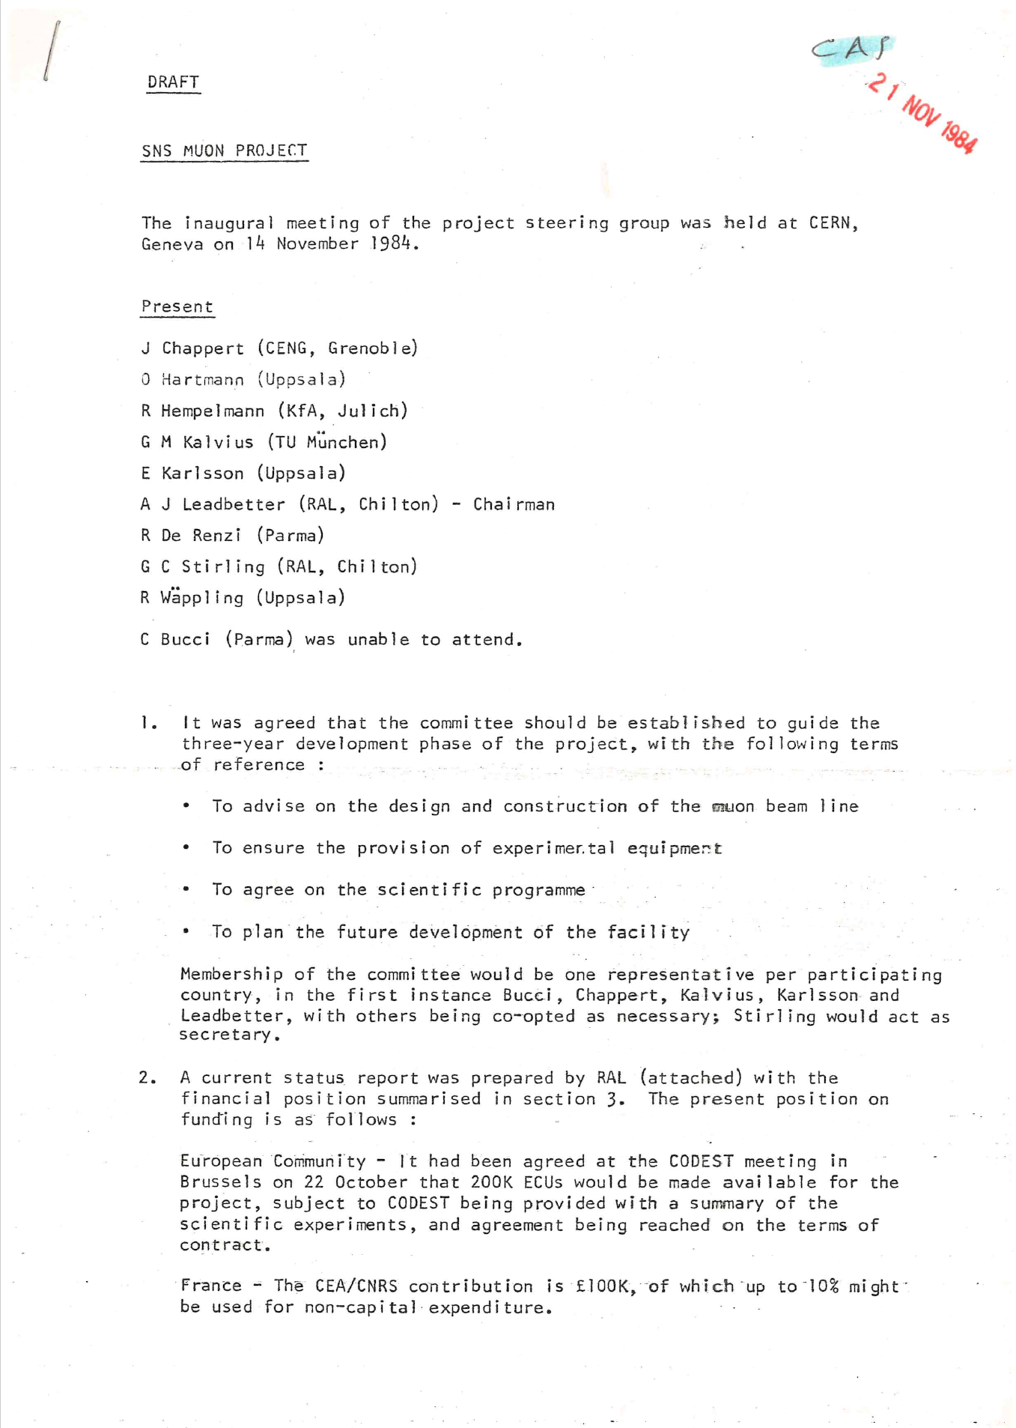
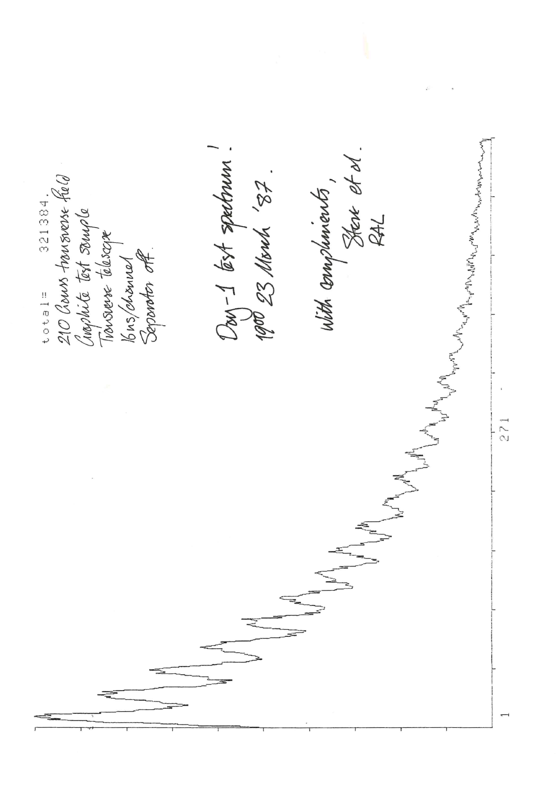
40 years since the inception of muons
14 November 1984 – first meeting to discuss the concept of muons at ISIS
2.5 years later first muons

Slide 7
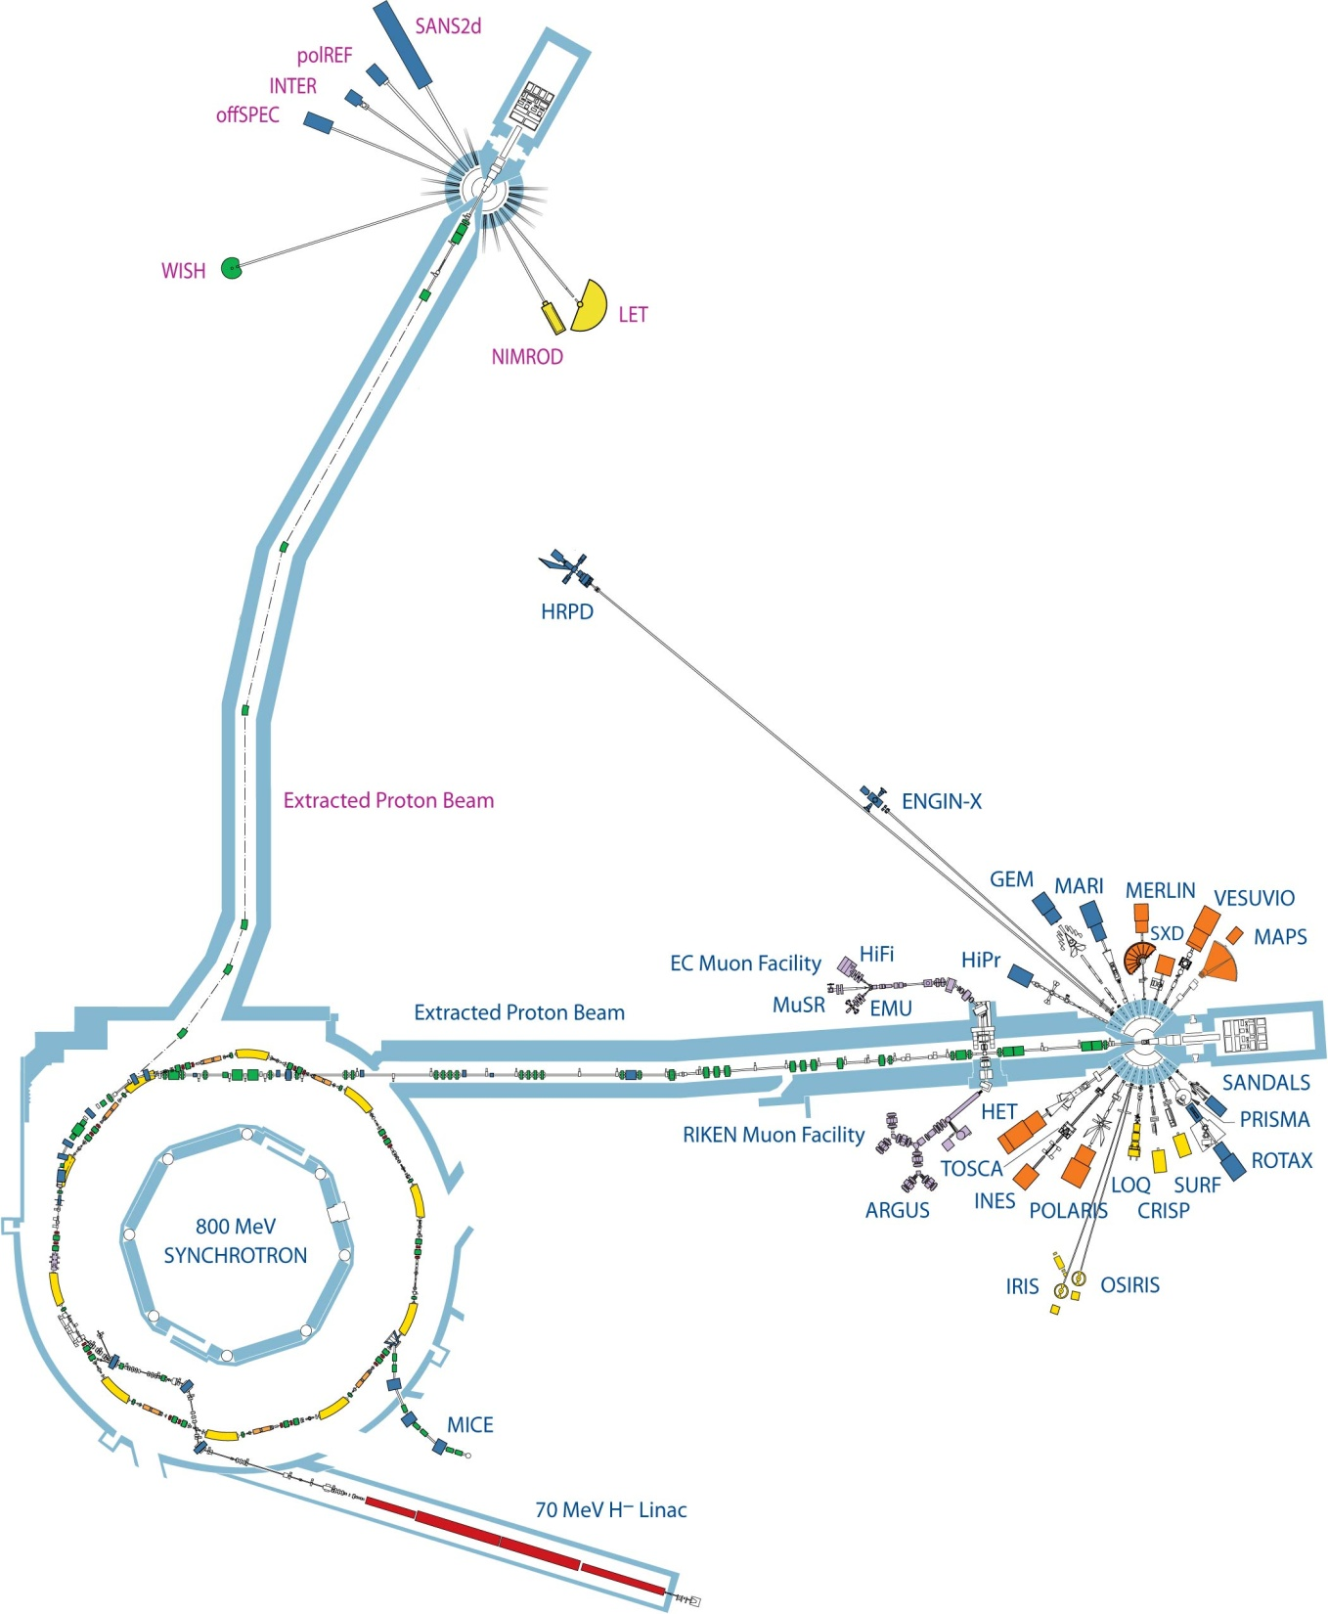
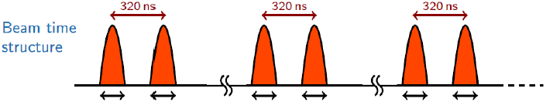
Muons at ISIS
50ns
50ns
50ns
50ns
50ns
50ns
20 ms

Slide 8
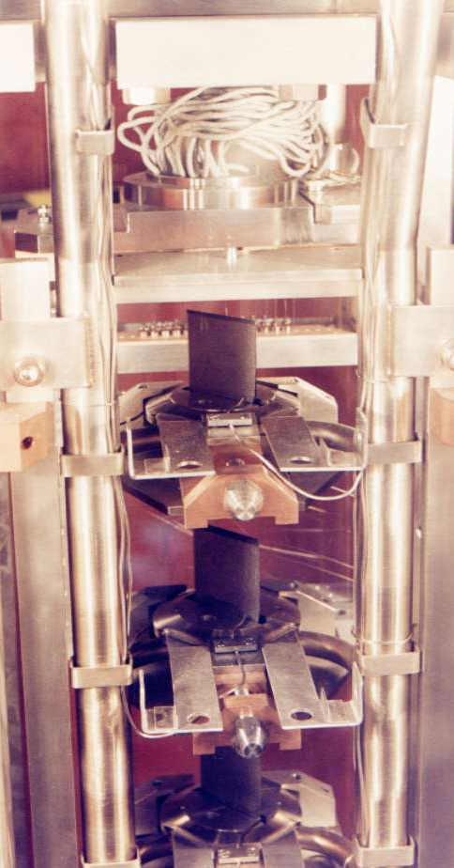
Muon Production Target
Made of graphite
Takes ~5% of the proton beam
The Muon Target
Beam focus
Protons
Target
Pions and muons

Slide 9

Muons at ISIS
MuX/MEIS

Slide 10
Muons Instruments at ISIS
EC Muons
Fixed Momentum Muons ~27MeV/c
Positive muons
Longitudinal fields upto 5 T
Transverse fields upto 600+ G (pulse width limited)
Temperature range 30mK – 2000K
Laser excitation
Pulsed techniques e.g. RF, EF, Light, ac susceptibility
RIKEN
Variable Momentum Muons ~15 – 120 MeV/c
Positive or negative muons
Longitudinal fields up to 0.4 T
Transverse fields up to 600+ G (pulse width limited)
Temperature range 30mK – 500K
Pressure
Elemental Analysis
Ports for long term experiments
e.g. proton charge radius experiment
MuX/MEIS

Slide 11
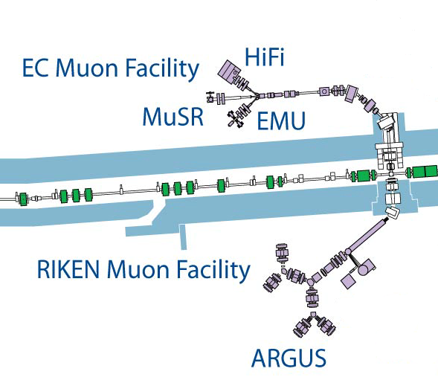
ISIS Muon Instrument Suite
Instrument | Detectors | Rate (MEv/h) [Double pulse]
ARGUS | 192 | 50 [100]
EMU | 96 | 150
HiFi | 64 | 80
MuSR | 64 | 70
Surface muons
Also within the RIKEN-RAL Muon Facility:
Negative muon elemental analysis – MuX
Effects of Muons on electronics - MEIS
FAMU muonic hydrogen experiment – Port 1
Muon development beamline – Port 3
MuX/MEIS
Surface and decay muons

Slide 12
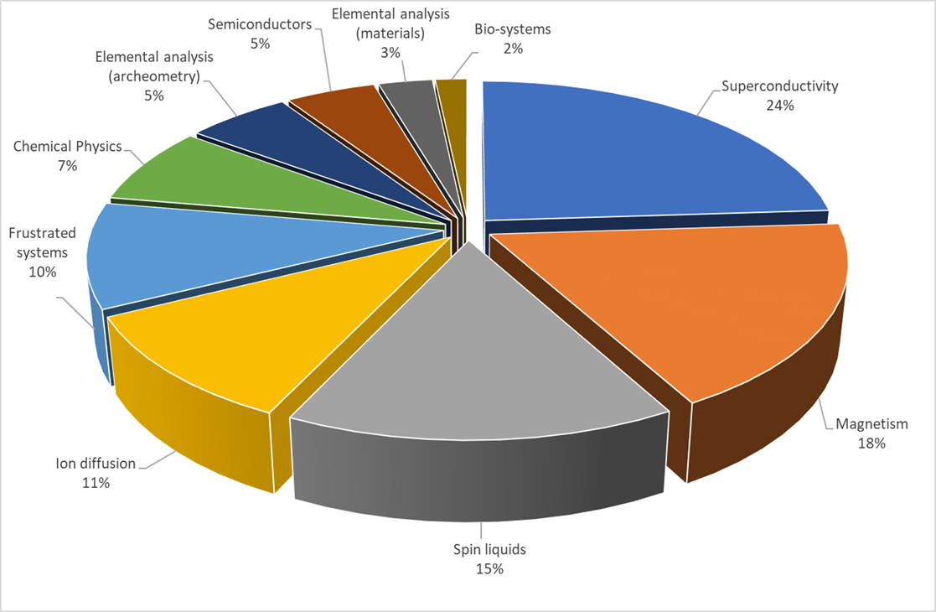
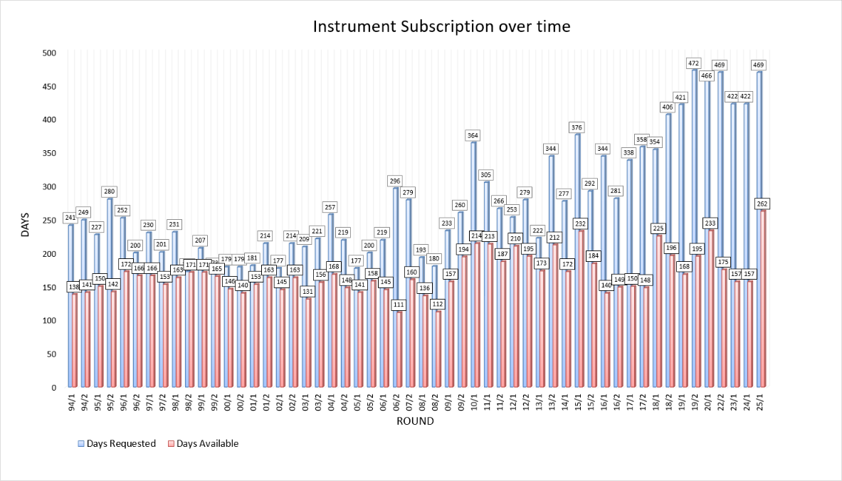
Breath of Science now

Slide 13
Current Developments

Slide 14
Current Developments – Pulse Compression

Slide 15
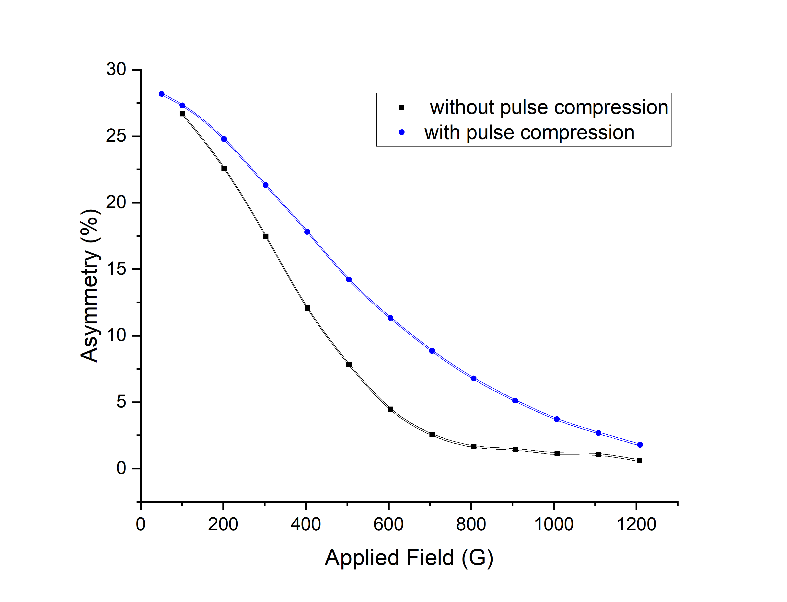
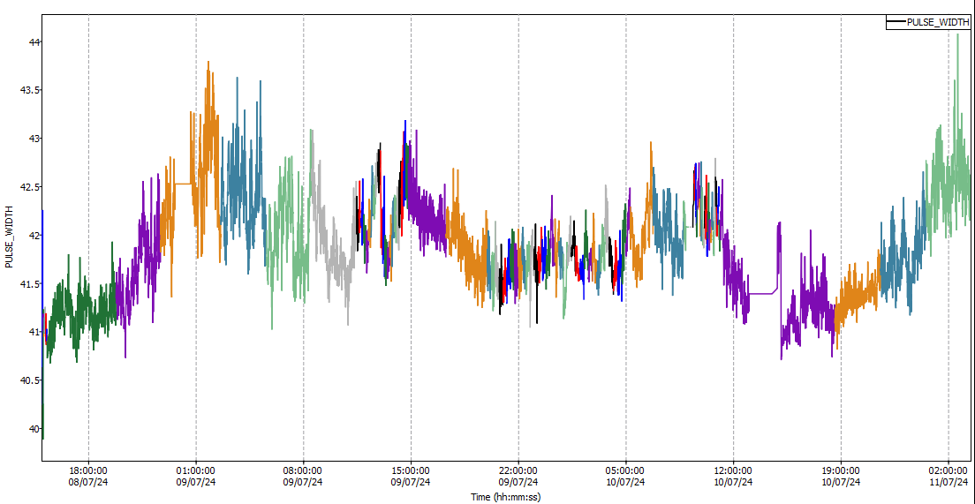
ISIS Proton Pulse Compression
Improving the performance of the muon spectrometers by optimising the proton beam
Shorter pulses give a better frequency response
Rotating phase space in the final stages of the proton acceleration reduces the pulse width (time)
Frequency response with and without pulse compression – MuSR Cycle 23_5

Slide 16
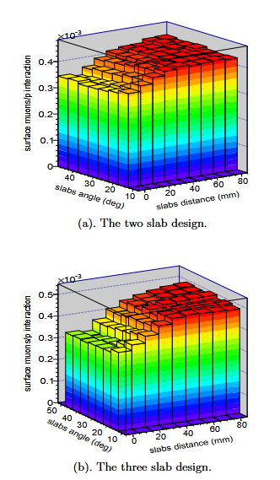
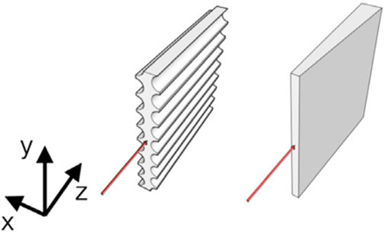
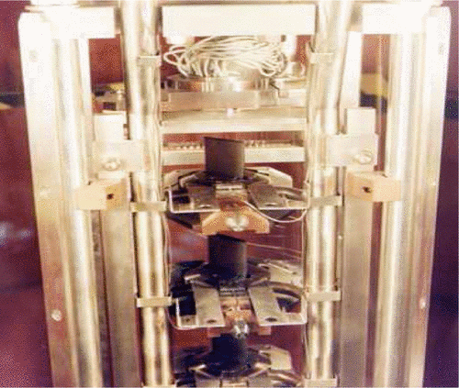
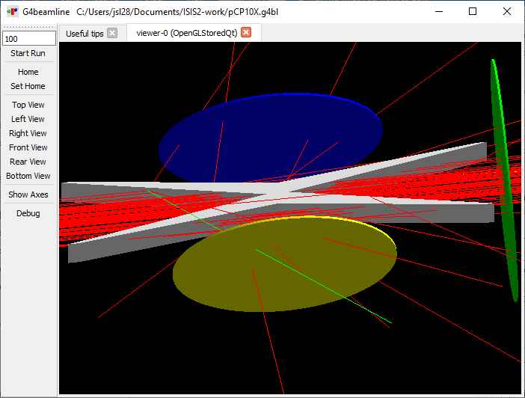
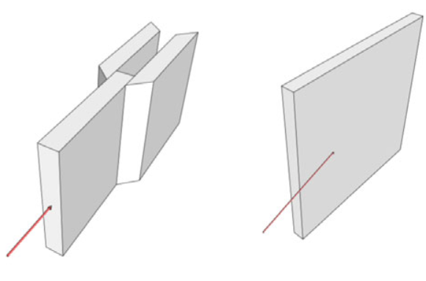
Muon target optimisation
Currently 45°, 10mm path
Previous simulations
New geometries
Bungau 2014 Berg 2016
μ⁺, π⁺, and π⁻ collected perpendicular to the proton beam axis, simulated in Bungau et al. 2014
Simulations show that a target more parallel to the proton beam increases surface muon yield (Bungau 2014, Berg 2016)
Interaction length of ISIS target less than beam diameter – opposite limit to PSI
X-shaped targets with same interaction length increase surface muon yield >50% while maintaining decay muon yield
Working to improve simulations of these targets and the coupling with the beamline transport

Slide 17
Current Developments – Super MuSR

Slide 18
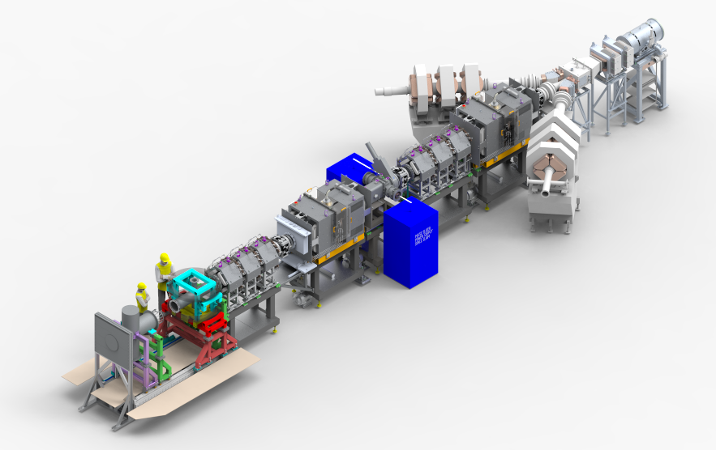
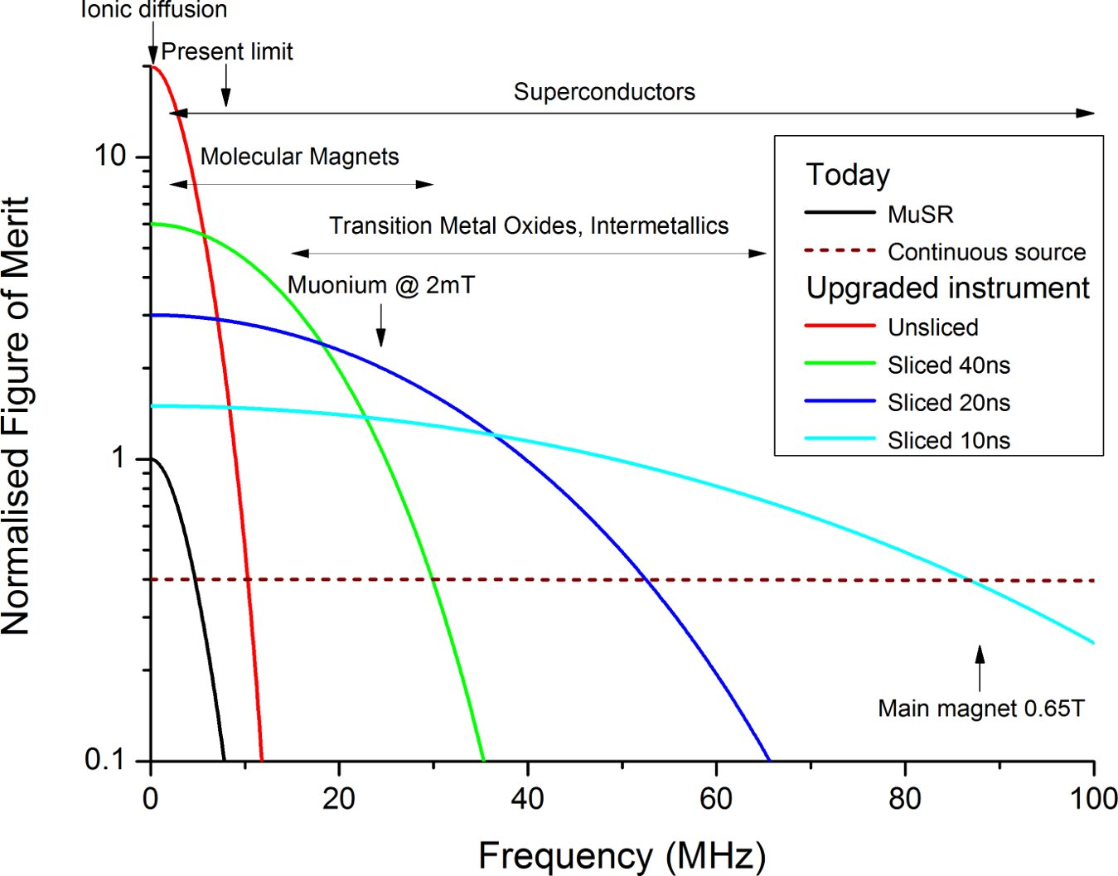
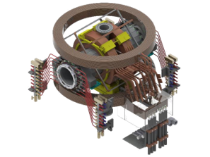
Super-MuSR
Detector and instrument improvements
Beamline improvements
  Use full muon flux and maximise information per muon
  New transverse magnet and cruciform with flypast tube
  Better zero-field (correcting quadrupolar terms)
  Pulse slicer reducing muon pulse length to ~10ns
  Spin rotators allowing higher transverse field experiments

Slide 19
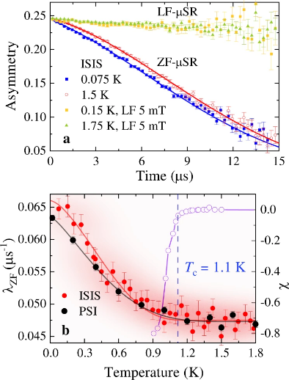
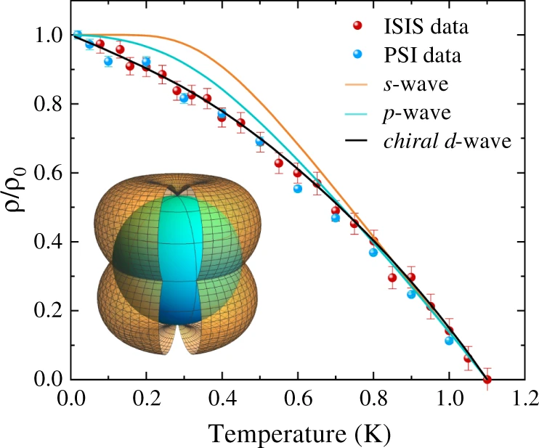
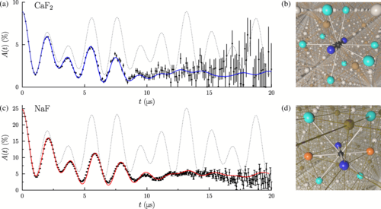
Super-MuSR Science Drivers
Weak relaxations and detailed material characterisation
Explicit calculation of
relaxation functions
Using both high rate and resolution
K. Tustain et al., npj Quantum Materials 5, 74 (2020)
J. M. Wilkinson and S. J. Blundell,
Physical Review Letters 125, 087201 (2020)
P.K. Biswas et al., Nature
Communications 12, 2504 (2021)

Slide 20
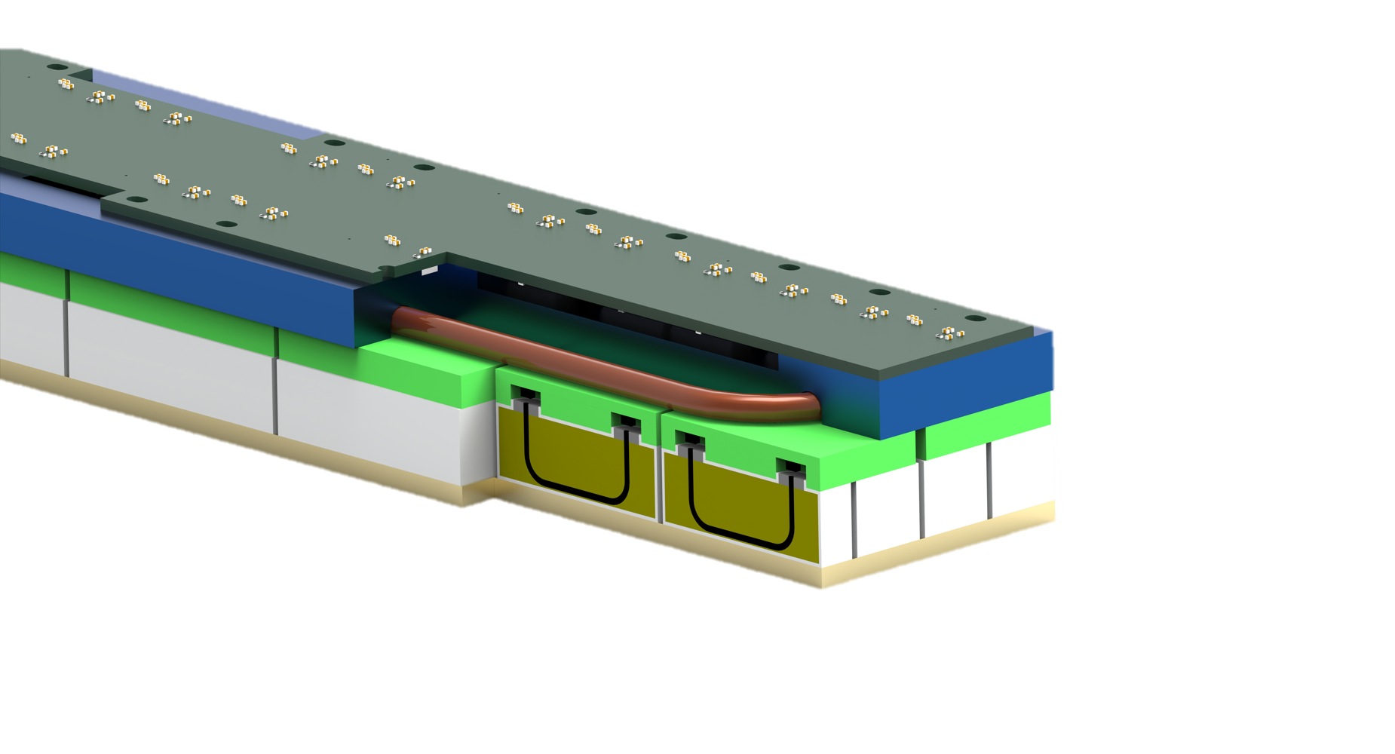

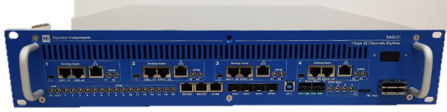
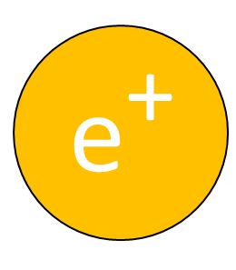
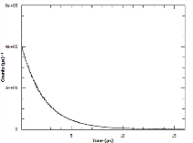

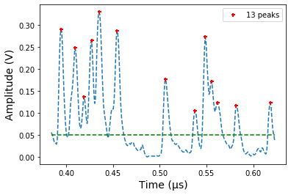



Signals are streamed directly to a broker
Lots of particles arrive at the detector
NI DAQ 121
2024: SCD Ada Lovelace Centre
Data Analysis & Retention
Event Filtering
Event Formation Unit
Creation of .nxs files and archiving
Power Signal Processing: options from peak-finders to Machine Learning.
Flexibly select the events that are important for analysis. Filter on parameters such as sample temperature or laser status.
Notes:
"The design of this pipeline is strongly influenced on the ESS streaming based data acquisition architecture, which was a collaborative project between the ESS DMSC and ISIS."
worth highlighting
that fact that the core of the architecture is the same as what was done for the ESS and
b) the fact that we are using off the shelf, standard, open source technologies wherever possible.
A large benefit is using the skills ISIS has from the ESS collaboration and taking advantage of standard/off the shelf software solutions where possible
Contact Dan Nixon / Dan Kirk

Slide 21
Current Developments – Future Instrument Plans

Slide 22
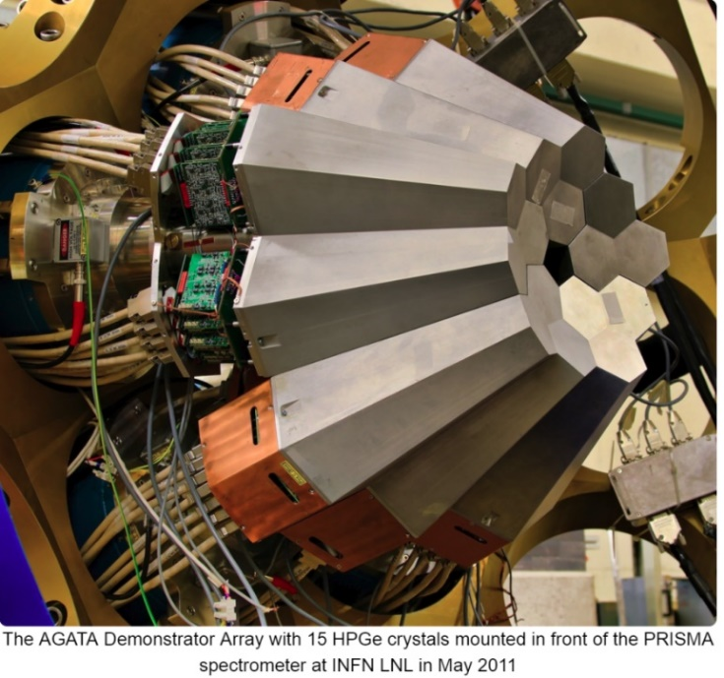
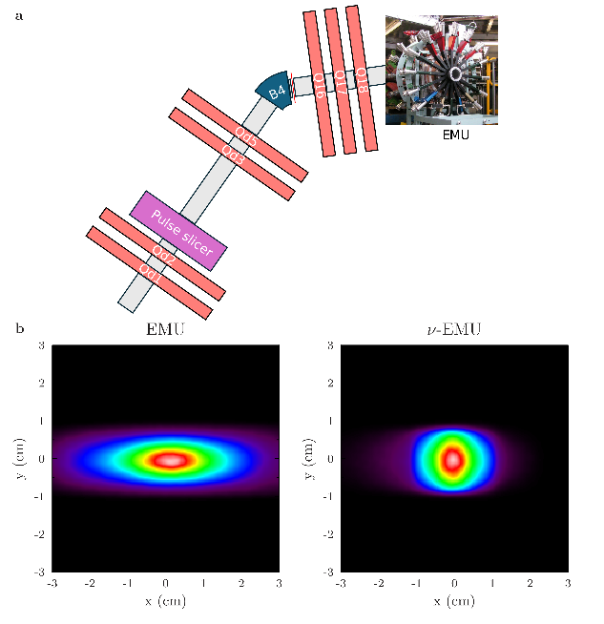
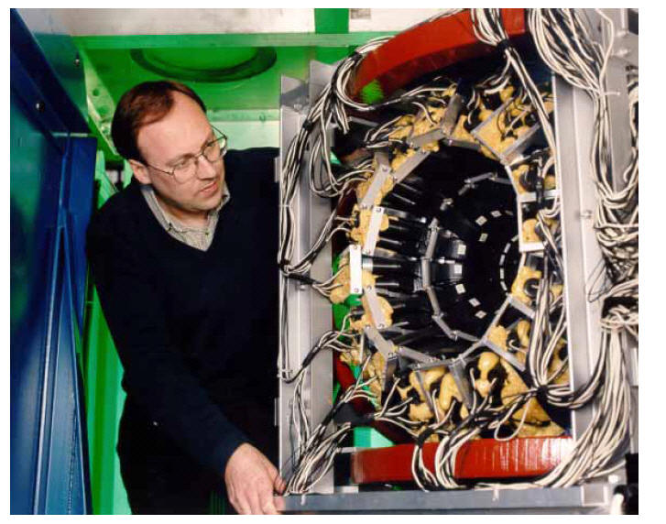
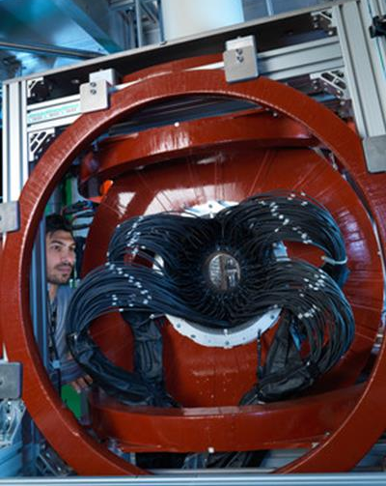
Our Future Plans:
Proposed Endeavour+ instruments
MuX
NuEMU
Chimera
New instrument for elemental analysis x100 in rate
x5 data rate, improved frequency response
Optimised µSR spectrometer for RIKEN-RAL facility

Slide 23
nuEMU
High data rate
Improved frequency response
Small samples
Enhanced Laser facility

Slide 24
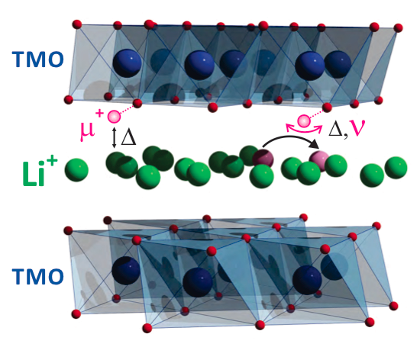
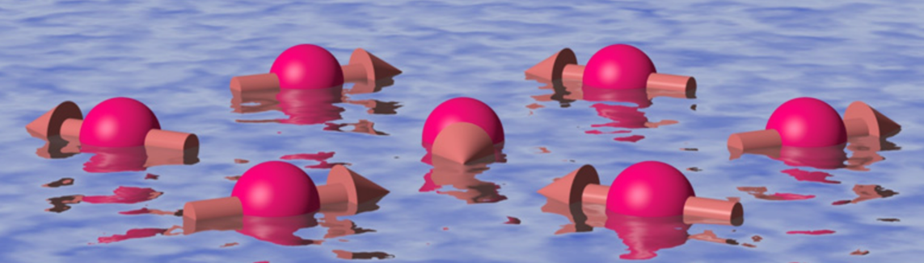
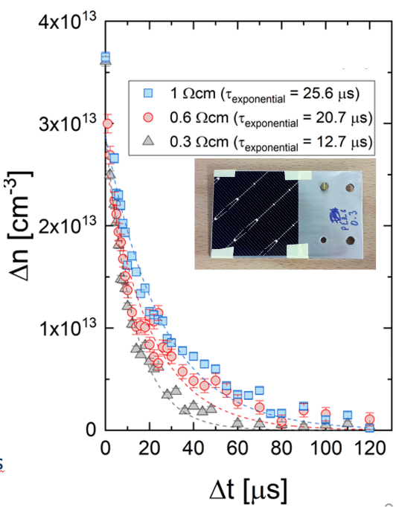
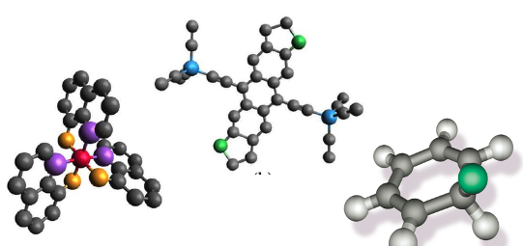
nuEMU: Science case
Magnetism
Energy materials
30 % of the current EMU programme
Measuring a family of samples
In-operando experiments
40 % of the current EMU programme
  Quantum spin liquids
  Low dimension systems
Semiconductors
Chemistry
Semiconductor systems including
  Photovoltaic materials
  Power semiconductors
  Carrier lifetime measurement
  Hydrogen dynamics
Chemical systems including
  Catalysts
  MOFs

Slide 25
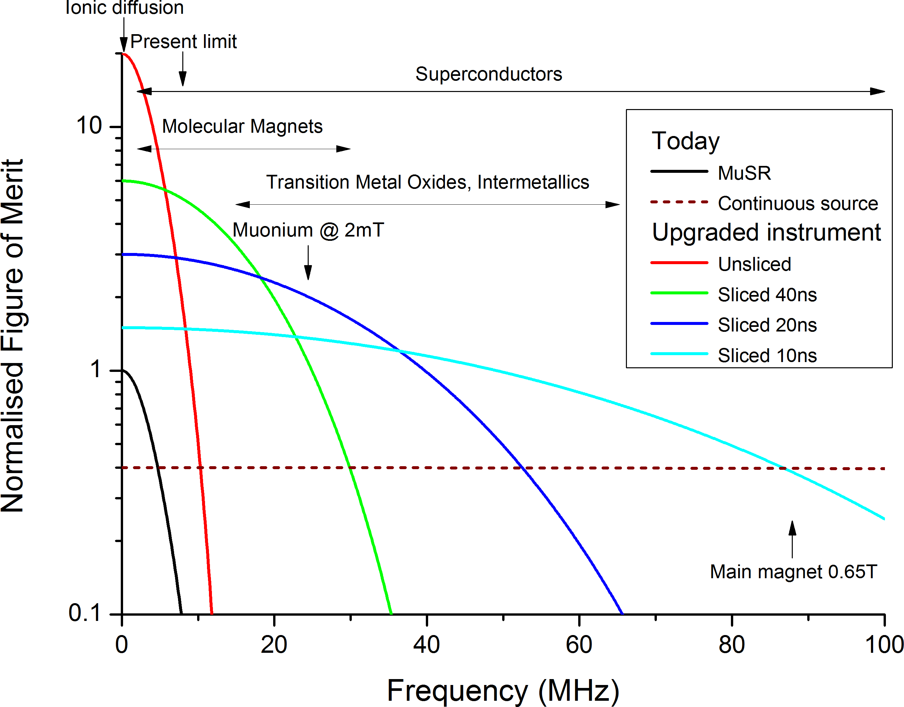
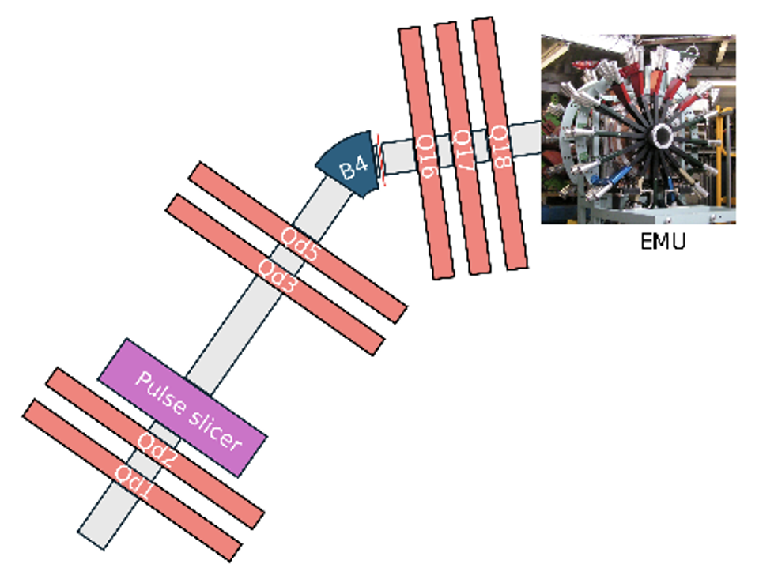
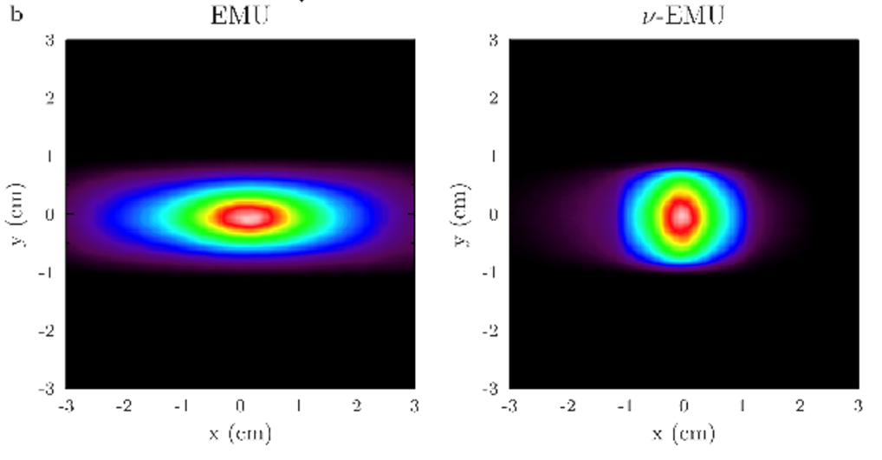
nuEMU: Beamline extension
SuperMuSR beamline
EMU
0
Current beam spot very large in horizontal direction due to dispersion from the kicker
Additional magnets in nuEMU enable
  Canceling the dispersion
  More focused beam
  (current 27 mm → 10 mm)
  10x improvement for small samples
Pulse slicer for 10 ns pulse width
  Unlocks new materials which can be studied
nuEMU

Slide 26
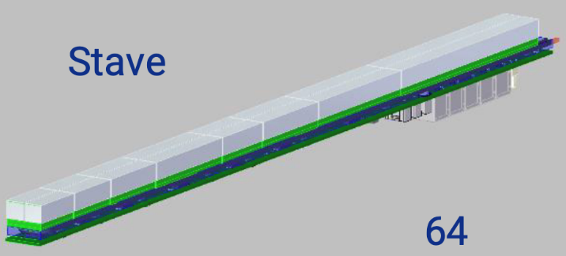
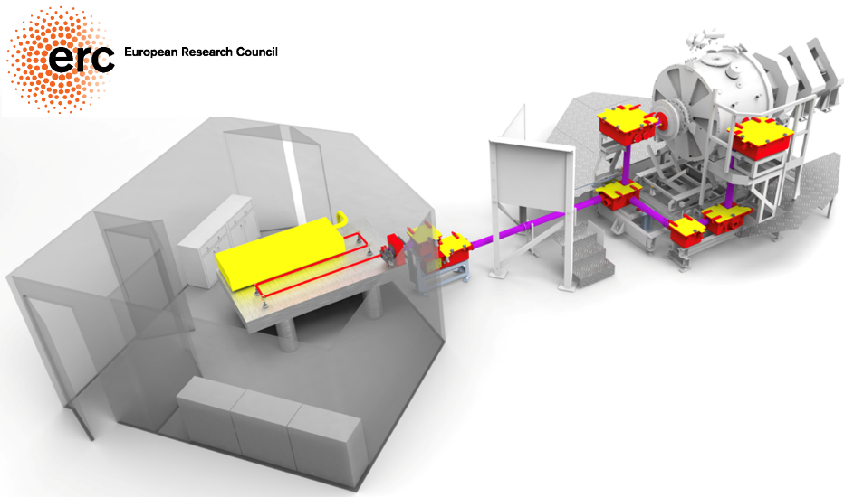
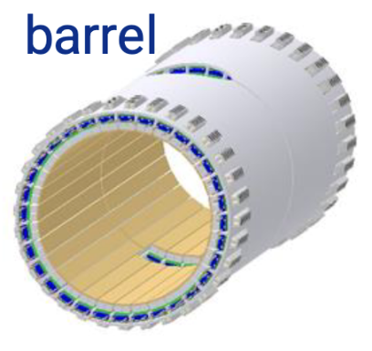
nuEMU: Major Upgrade of EMU
High data rates
Enhanced laser facility
5-fold increase in rate
The small beam allows for uniform illumination of samples
Takes advantage of good ZF compensation
Opens new photo-µSR science areas (incl. Chemistry)
Field homogeneity
New detector design
for higher count rate
Utilise the detector technology in Super-MuSR
Opens new opportunities for studying chemical kinetics
Combined with pulse slicing gives over an order of magnitude in dynamic range

Slide 27
Chimera
State-of-the-art instrument to replace a 30+ year old spectrometer
Optimised for µ⁻ and µ⁺ with variable muon momentum

Slide 28
Optimised RIKEN-RAL spectrometer - Chimera
Giving ISIS a state-of-the-art instrument to replace a 30+ year old spectrometer
Optimised spectrometer for experiments using µ⁻ and µ⁺ with variable muon momentum
Optimised for the RIKEN-RAL Muon beam characteristics
Science Areas to develop:
  Quantum materials under pressure – e.g. magnetic/superconducting phase separation
  Fundamental studies of chemical reactions – e.g. pumped hydrogen
  Life Sciences – e.g. electron transfer in DNA
  Advanced Materials – e.g. depth profile piezo-electric materials
  Energy Materials – e.g. u⁻SR giving a complementary view of ion motion
Optimised use of muon beams
  Complex experiments (days to setup) that initially do not require muons
New equipment for new experiments
  Custom cells – e.g. stress, strain, pressure – utilise variable momentum

Slide 29
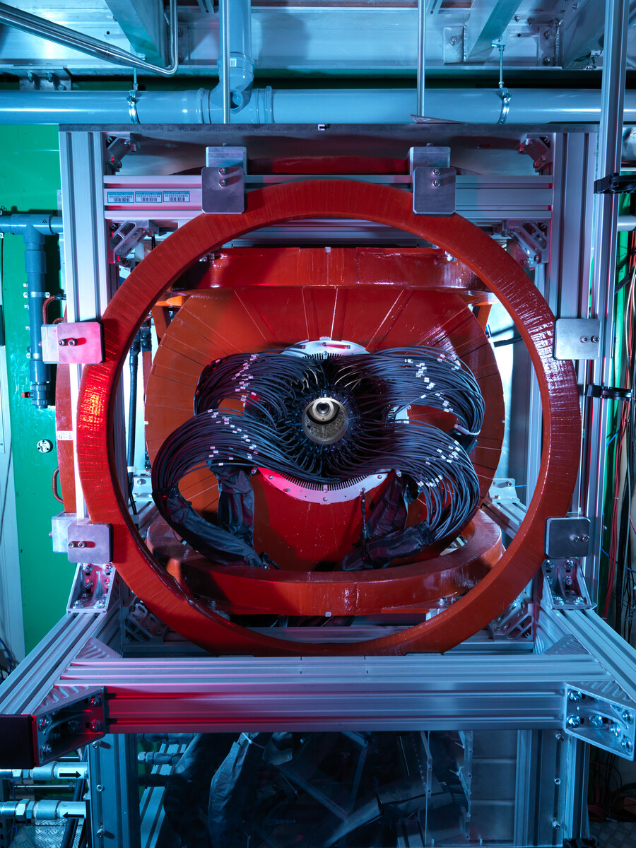
CHIMERA
Improved data quality
  New detector array matched to the beamline
  Improved Solid angle coverage
  Digital muons
Smaller Samples
  Smaller beam spot by a new slit package
Open access design for novel SE
  Large aperture magnets
  High homogeneity magnet fields

Slide 30
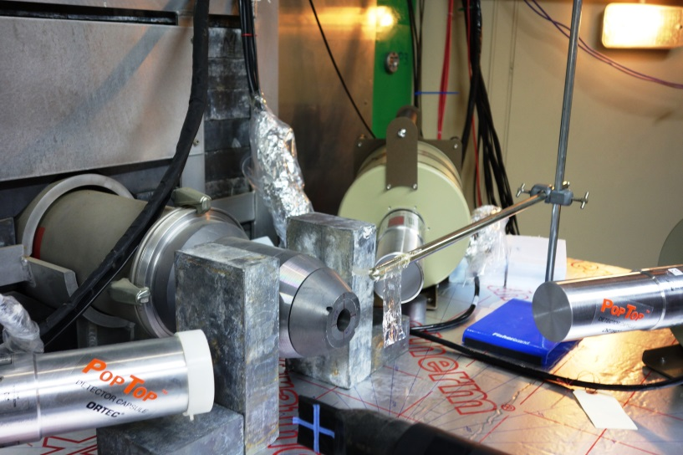
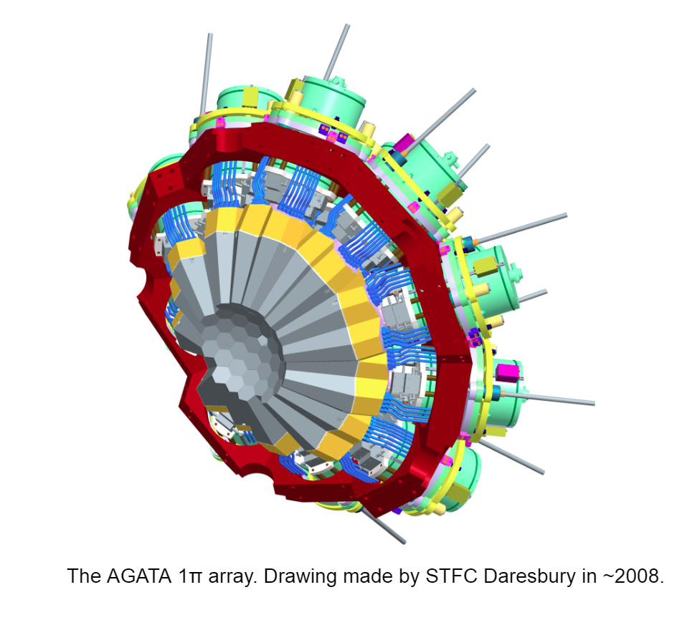
New Instrument MuX
Instrument dedicated to elemental analysis studies.
Solve the Data Rate and Sensitivity Problem:
  Aiming for two orders + magnitude in rate
  Improved detector coverage with high segmentation
Enhanced sample automation
  Automatic sample changer
How to analysis all this data!
  Easier data analysis c.f. XRF methods (EVA)
  Machine Learning
  High performance computing

Slide 31
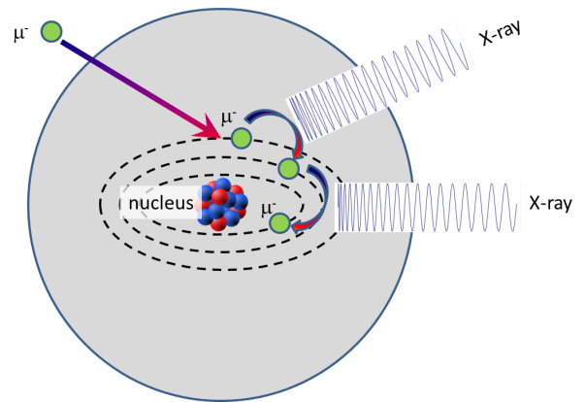
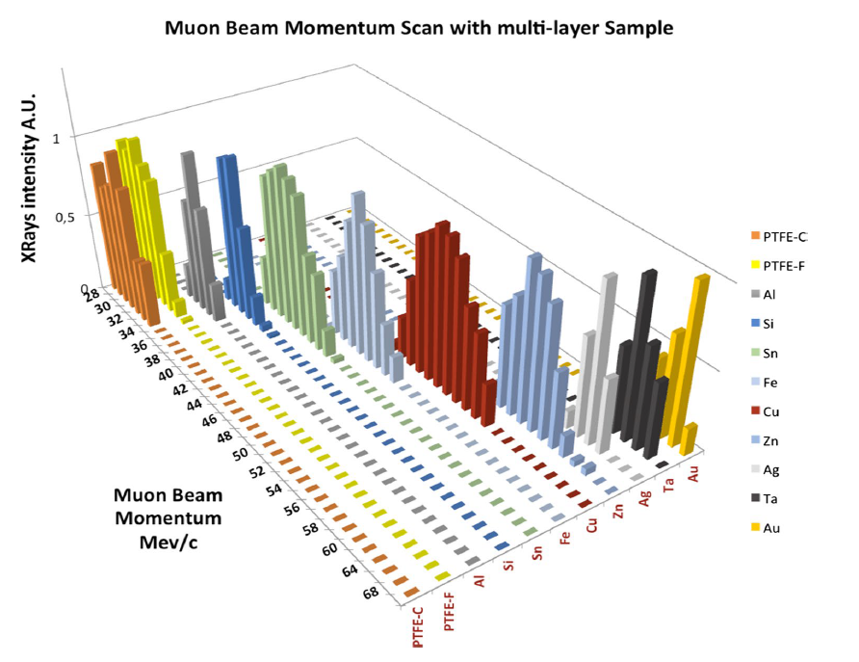
Why use muons
High Energy X-rays emitted
  0.01- 6 MeV
Energy dependent of the atom which captures the muon
Transition Energies are known from measurement and calculation
Sturniolo, Hillier X-Ray spectroscopy 50 180 (2020)

Slide 32
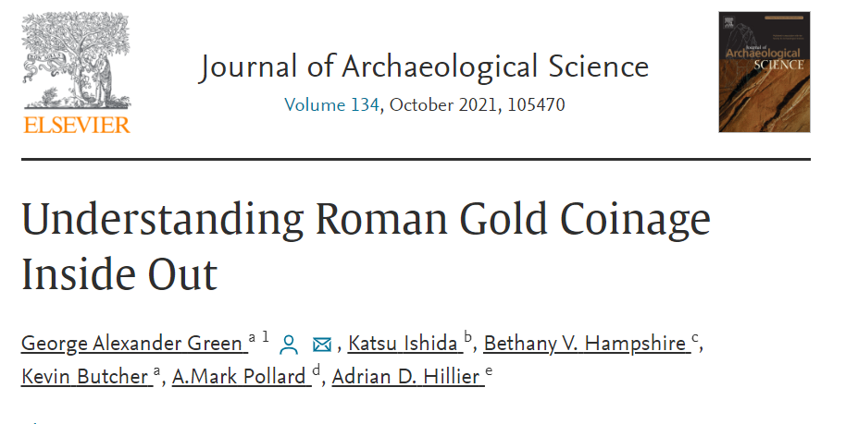
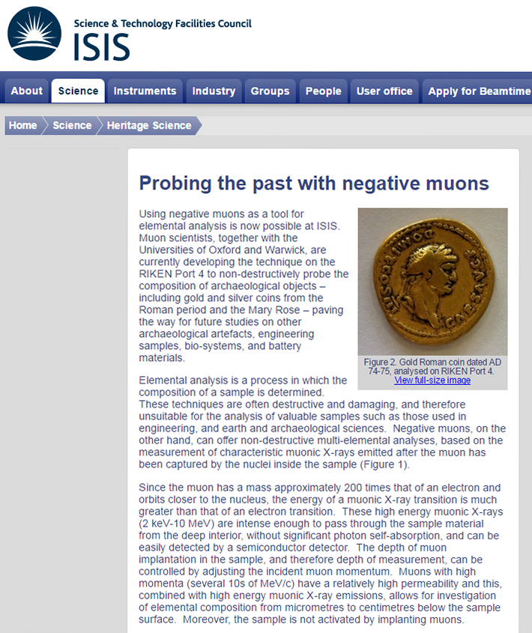









MuX Science Program
Diverse science areas
  Cultural Heritage
      Bronze Age artefacts
      Mary Rose artefacts
      Swords
      Cannon Balls
      Sundials
      Coins
      Mirrors
      Statues
      Florence baptistery gates
      (gates of paradise)
  Solar cells
  Piezoelectric devices
  Li batteries
  Steel, corrosion and carbon composition
  Meteorites
  Biomaterials
  Industrial Access ICRD

Slide 33






Examples
Depth of oxygen penetration
Core composition:
51(1) wt% Silver
49(1) wt% Copper
Compares well with a similar coin
No 83 46(1 or 2) %
Gilter and Ponting 2003
Core
Surface
Hampshire et al, Heritage 2019

Slide 34


Protecting electronics from cosmic invaders
Single event upsets (SEUs) occur when high energy particles hit microelectronics, causing devices to malfunction. Solar flares and cosmic rays are the main sources of such particles and, with the ubiquitous nature and rapid advances in microelectronics; it’s an area of intense interest. The semiconductor industry is looking ahead by understanding how and why devices might become vulnerable.
“Our experiments are about understanding the probability of these events, which represents an important contribution to the semiconductor industry. This will inform future design decisions, enabling manufacturers to develop devices that are less susceptible to muon SEUs.”
Professor Bhuva, Vanderbilt University
doi: 10.1109/IRPS.2014.6860585

Slide 35


Slide 36
Current Developments – SWARM – Low Energy Muons <100 keV

Slide 37

A slow muon beam at ISIS
Wishlist:
Cooling from MeV keV energies
Need to retain a short pulse beam
Need good efficiency
Need to retain close to 100% spin polarisation
Ideal beam spot of ~ 5mmx5mm
Plan to use frictional cooling in high purity He gas
High energy muons lose more energy
Low energy muons lose less energy
Achieve energy compression
Slowed muons extracted with a short pulse HV
Courtesy of Chris Rogers

Slide 38

Possible Cooling Schemes for ISIS
Pre-moderated muons captured by an EM wave
Fast muons slowed more, slow muons slowed less
End bunch is sharp in time and energy
Fields longitudinal, so loss of spin polarisation expected to be minimised but needs to be checked.
A very interesting concept to explore further!
1MV/m peak gradient, He gas density 0.032*stp
Courtesy of Chris Rogers, STFC

Slide 39

Test Experiments at ISIS
Upcoming (hopefully) experiment with the CSNS team, which will use the HiFi beamline and instrument at the ISIS muon facility:
A simplified muCool
E-field generated outside to reduce risk of HV breakdowns
Testing will allow simulation codes to be benchmarked and inform future designs.
Courtesy of Wu Chen, CSNS Muon Group
Follow up with future work to test Chris's RF concept – could be tested initially with a very simple RF-MuSR experiment.

Slide 40
Current Developments – Imaging

Slide 41

Elemental Mapping
µ⁻
Al
C
The spectrum from an area of 20x20 pixels next to the C, Al and Fe₂O
Image reconstruction of 5 mm aluminium rods in 20 mm carbon cylinder.
Radiating lines are artefacts from high-frequency components
Line between the Al rods is likely caused by rotation axis misalignment.
Fe₂O₃
C
Al

Slide 42

Muography
MeV/c Dependence – 10 min (decay µ⁺)
Muon Beam
27 MeV/c
Scintillator and Camera
32 MeV/c
Sample
37 MeV/c
42 MeV/c
Images from Tom Ashton UCL

Slide 43



Alkaline Battery (70 MeV/c µ⁻)
Zinc anode
(7.14 g cm³)
MnO₂ cathode
(5.03 g cm³)
SS cell casing
(≈ 8.00 g cm³)
AA
AAA
AAAA
Images from Tom Ashton UCL

Slide 44
Future Detectors

Slide 45

Challenges with Super-MuSR and beyond
Edge effects on scintillators, SiPM mounting, and wrapping leading to worst-case 12-33% dead volume
  Best case might be 4.5-13% dead volume
  Today’s MuSR is roughly 15% dead volume
Counting rate of SiPMs is slightly worse than individual PMTs – need digitisers to claw this back
Getting the counting rate for full beam will be at the limit of what is feasible

Slide 46


Si-pixel detectors
“Up to about 10 years ago, silicon sensors were not considered
mainstream MIP timing detectors. Presently, they are considered
the most likely (only?) solution for 4D trackers.”
– Nicolo Cartiglia, Position Sensitive Detectors Conference 2021
Position sensitive detector in silicon
Electronics can be in the same silicon
Provide information on:
  Position – >~50μm
  Counting – <THz/cm², often <GHz/cm²
  Timing – >30ps
Can’t have all the best performance characteristics at the same time
Also need some other characteristics specific to muon experiments
R&D is very expensive so hope to find already developed systems suitable for us
What do we really need?

Slide 47

Option 1 – Positron counting
Aim: Replace existing scintillators
  Far more pixels
  Improving solid angle coverage
  Better timing resolution
  Better count rate
What geometry works best for us?
Do we need any extra features?

Slide 48

Option 2 – Positron tracking
Aim: Track positrons out of sample
Benefits: Sample/BG separation, multiple samples, imaging samples, better field dependence
How precisely do we need to know positron source? – 1mm for BG removal?
Endcap designs are also possible
What else would we like to specify?

Slide 49


Option 3 – Muon and positron tracking
Aim: Track muons into sample and match positrons emitted
Benefits: Beat muon pulse width + benefits of positron tracking
Rate will be limited by scattering of muons through muon counter limiting precision in where they stop
Would need new sample environment to get detectors close enough
What else would we like to specify?

Slide 50
A New Source – ISIS-II

Slide 51

ISIS-II: the successor to ISIS
The UK‘s next-generation neutron and muon source
  ISIS‘s scientific leadership with (more) modern technologies
2030s
2040s
ISIS-II at RAL

Slide 52
ISIS-II project
Plans for a new facility are being developed, initially intended to be ready for construction sometime after 2030 and operation in 2040. This will maintain and enhance the UK's neutron and muon provision, in a way complementary to the ESS, in order to continue to support the UK research community. ISIS-II is expected to be a multi-billion-pound facility and has been identified as a potential ‘multi-stage mega project’.
Phase 1
Phase 2
Phase 3
£5.1m UKRI Infrastructure Funding for ISIS-II Feasibility, Design Studies and R&D – ‘Phase 1.2a’ covers FY21/22 – FY24/25.
The next bid for UKRI Infrastructure Funding will be an indicative bid for the full facility and will involve HMG scrutiny.
Timeline and requirements for bid preparation are under discussion with STFC Executive Board and Infrastructure Fund, but some bridging funding will be required.
2019
2021
2028
2032
2040
1.1
1.2a
1.2b
Feasibility, design studies and R&D
Integrated facility technical design
ISIS-II construction

Slide 53









Accelerator and target options
Greenfield facility
Three types of pulse compression ring are under consideration
  Accumulator Ring (AR) – like SNS
  Rapid Cycling Synchrotron (RCS) – like ISIS and J-PARC
  Fixed-Field Alternating-gradient accelerator (FFA) – novel concept
1.2 GeV energy has been chosen as a good working point
  AR will require a full-energy 1.2 GeV linac
  RCS and FFA will require a ~500 MeV linac and will then accelerate the beam to 1.2 GeV
Overall source power could be up to 2.4 MW, dependent on target technology
  Rotating targets required to reach high powers, but have not yet been proven – ESS and SNS plan to use them
  Fixed targets have been proven to be reliable, but power on any one target would be limited to ~500 kW
Upgrade to existing ISIS facility
180 MeV linac injection into the present ISIS RCS
  Overall source power limited to ~500 kW
  Remains reliant on ageing equipment and infrastructure
Performing an evaluation of the environmental impact of the lifetime of ISIS-II based on Life Cycle Assessment.

Slide 54





ISIS-II Science Case
Diverse key areas identified
  Materials discovery
  Discovery science
  Healthcare
  Energy
  Manufacturing
  Electronics testing
Future Grand Challenges
  Smart/personalised healthcare
  Drive to net zero
  Next generation quantum technology
  Sustainable materials and manufacturing

Slide 55


What Science do we want to do
What Instruments will deliver this science
What requirements does the place on the source
Summary of science driven source parameters
R. Ziesche
Very broad range of applications
Enhanced In-situ/ in-operando
Requirements for multiple instruments and high throughput
Smaller samples
Reduce by an order of magnitude
Faster measurements
Reduce counting time an order of magnitude
Enhanced complexity
Technological relevance
Support infrastructure

Slide 56


What Science do we want to do
What Instruments will deliver this science
What requirements does the place on the source
Summary science driven source parameters continued
More long wavelength neutrons needed!
Very broad range of applications
Enhanced In-situ/ in-operando
Requirements for multiple instruments and high throughput
To achieve the science parameters
Higher flux
Wider energy range
Higher resolution
Lower backgrounds
Source reliability
Requirements matrix – not one solution for all!

Slide 57


Muon target: Comparing two options
TS1
TS2
Simultaneously accelerates both H⁺ and H⁻
in LINAC
H⁺ used for muon generation,
H⁻ to synchrotron
Tailor the time structure for our purposes
(by changing H⁺ injection)
Flux will be moderate
Familiarity, reliable, low cost
At least 10X improvement in muon flux
  significant upgrade on TD-μSR
  future LE-μSR source
  other muon applications
... Likely option

Slide 58
Summary
Many Upgrade Opportunities – Always Science Driven
  Accelerator Improvement
  Super-MuSR
  MuX, nuEMU, CHIMERA
  SWARM
  Imaging
  Future Opportunities
Need your voice for ISIS-II

Slide 59












John Wilkinson
Adrian Hillier
Koji Yokoyama
Sayani Biswas
Steve Cottrell
Alex Louat
Rhea Stewart
James Lord
Adam Berlie
Francis Pratt
Mark Telling
Peter Baker

Slide 60
Summary
Many Upgrade Opportunities – Always Science Driven
  Accelerator Improvement
  Super-MuSR
  MuX, nuEMU, CHIMERA
  SWARM
  Imaging
  Future Opportunities
Need your voice for ISIS-II

Slide 62
Current Developments – Computation techniques

Slide 63






New ‘Instrument’ - COMET
COMET – Computationally Optimised Muon Experimental Techniques
Continued development of a sustainable interactive analysis package for muon data, WIMDA.
Development of sustainable software for simulation of the response of the muon polarisation - ‘Quantum-MuSpinSim’.
Development of DFT methods for determining the muon site/charge state in materials, ‘pymuon-suite’ to aid these calculations and ‘Muon Galaxy’ as a user interface.
Development of ‘MuDirac’ for muonic x-ray measurements.
Development of machine learning applications for muons.
Development of e-learning materials for training.

Slide 64

Developments: Software – Machine Learning
Element | Train acc (%) | Val acc (%)
Ag | 99.98 | 99.96
Al | 99.89 | 99.83
Au | 99.93 | 99.92
B | 99.90 | 99.85
C | 99.90 | 99.86
Cu | 99.97 | 99.94
Fe | 99.87 | 99.80
In | 99.97 | 99.90
Pb | 99.91 | 99.88
Si | 99.90 | 99.75
Sn | 99.93 | 99.92
Machine Learning offers the potential for a ‘black box’
Deep learning to classify the elemental composition
Trained on standard samples
  Pure
  Taking pure samples and ‘mixing them’
Physically motivated data augmentation so results will not be affected by small changes in instrument setup/calibration
Works surprisingly well –
  Work for Cu Sn real data
  found elements I would have missed
  And for noisy data
Butler, Foxley, Hillier in prep 2024

Slide 65



Bayesian model selection and parameter estimation
Given data + hypotheses; which one is best suited to the data?
Within that hypothesis, what are the most likely parameters?
kass_rafferty_assessment(Z1/Z4, model_0_name='Exponential', model_1_name='Kubo-Toyabe')
Evidence against Kubo-Toyabe in favour of Exponential: 1.00e+91
Kass and Rafferty say: Decisive

Slide 66




Possible Cooling Schemes for ISIS
Initial simulations focused on a simple system with static E field:
Pulse broadened in time as it passes through cell!
Courtesy of Henry Pentz, ISIS summer student, now a PhD student at Berkeley

Slide 67

Possible Cooling Schemes for ISIS
Initial simulations focused on a simple system with static E field:
Initial tests with a pulsed E-field indicated a ~ 4-fold improvement in the number of muons stopped.
Courtesy of Henry Pentz, ISIS summer student, now a PhD student at Berkeley

Slide 68
Possible Cooling Schemes for ISIS
Pre-moderated muons captured by an EM wave
Fast muons slowed more, slow muons slowed less
End bunch is sharp in time and energy
Fields longitudinal, so loss of spin polarisation expected to be minimised but needs to be checked.
A very interesting concept to explore further!
1MV/m peak gradient, He gas density 0.032*stp
Courtesy of Chris Rogers, STFC

Slide 69
Test Experiments at ISIS
Upcoming (hopefully) experiment with the CSNS team, which will use the HiFi beamline and instrument at the ISIS muon facility:
A simplified muCool
E-field generated outside to reduce risk of HV breakdowns
Testing will allow simulation codes to be benchmarked and inform future designs.
Courtesy of Wu Chen, CSNS Muon Group
Follow up with future work to test Chris's RF concept – could be tested initially with a very simple RF-MuSR experiment.

