Slide 1

Design and Prospect of MELODY in China
Muon4Future 2025
Yu Bao
IHEP/CSNS
On behalf of MELODY collaboration
2025.5.27

Slide 2
Outlines
MAIN CONTENT
1
Muon Physics and Applications
（1） Surface muon beam
（2） Negative muon beam
（3） Decay muon beam
2
Design and Prospect of MELODY
3
Progress and timeline
4
Summary

Slide 3
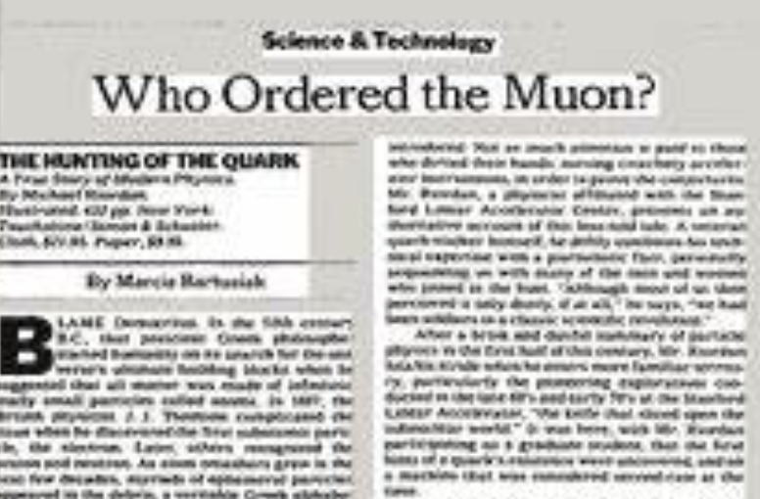
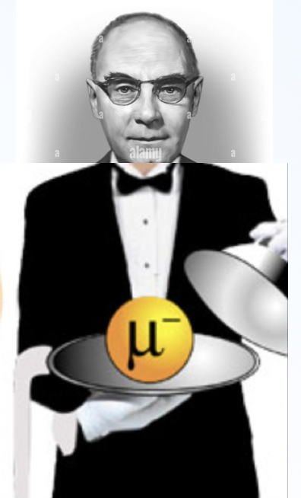

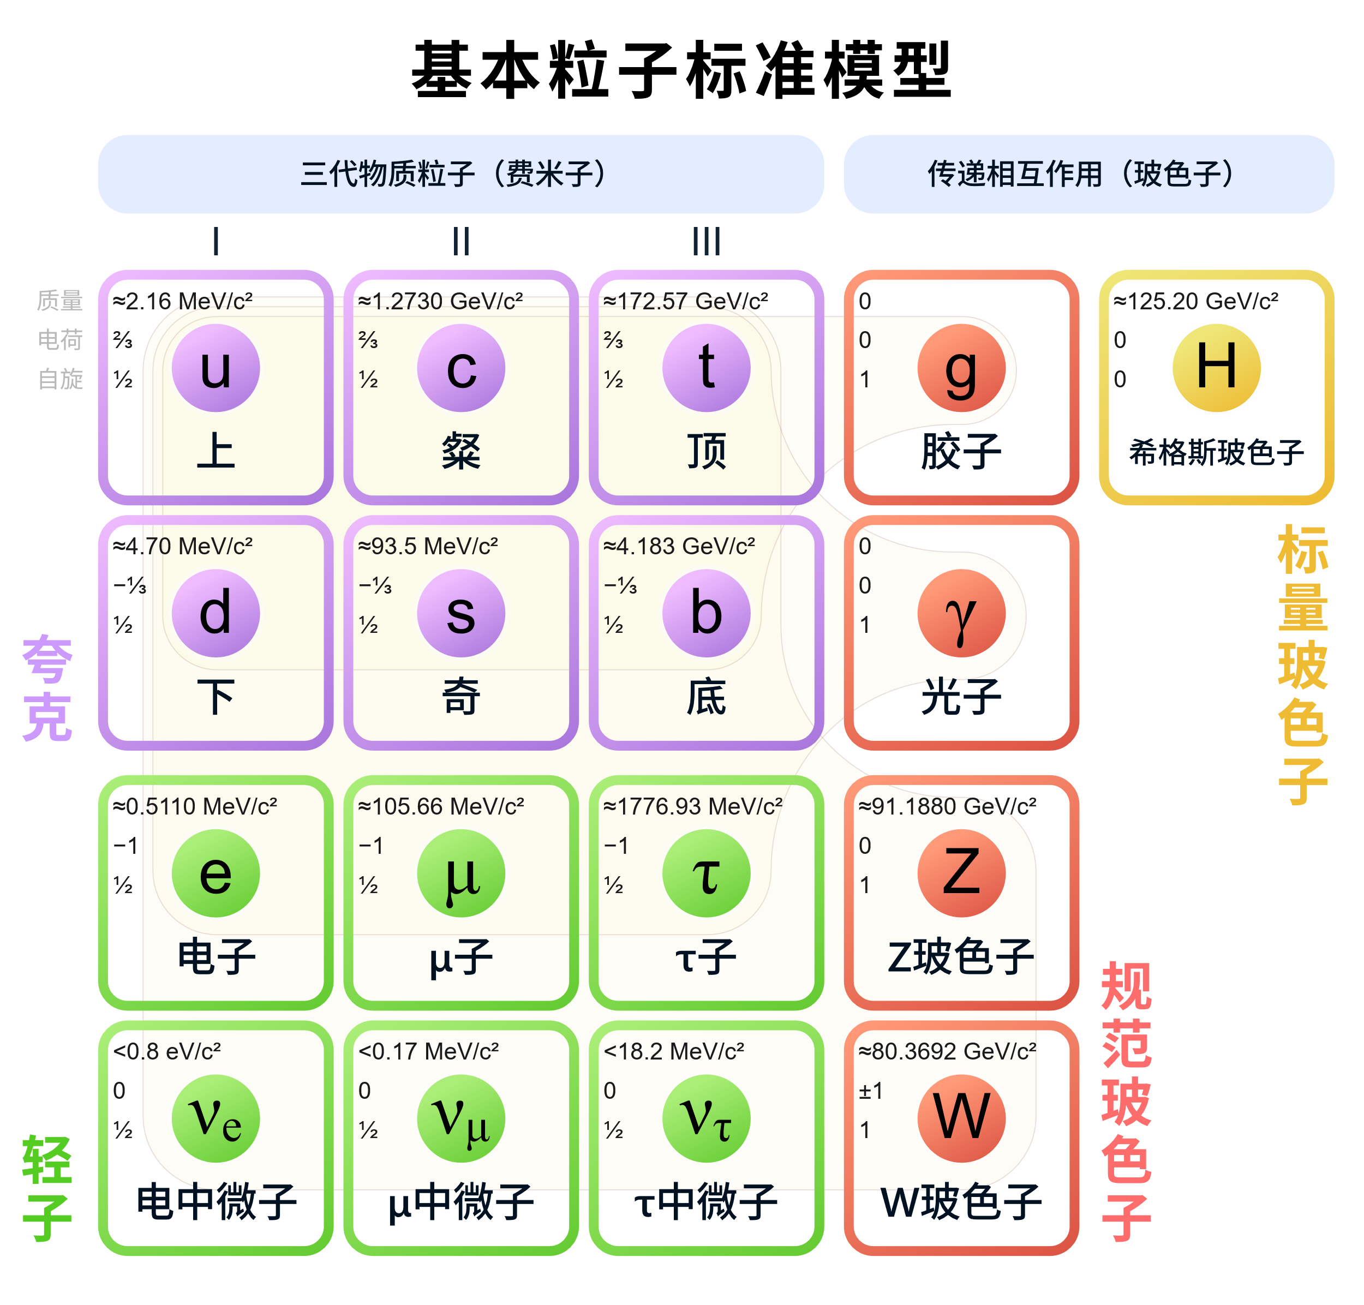
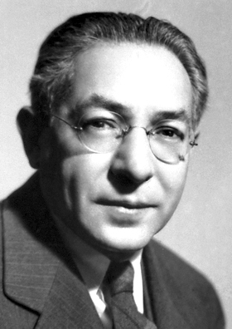
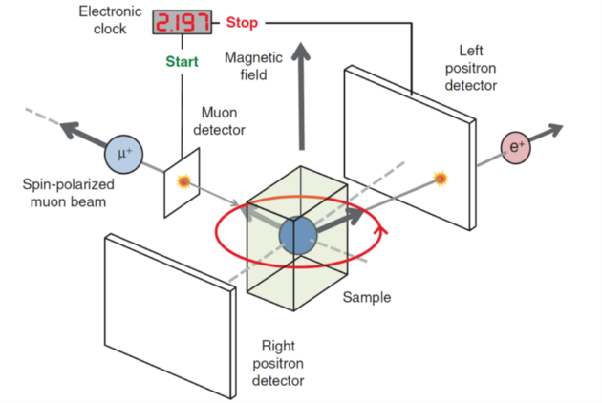
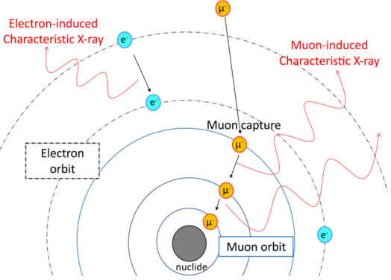
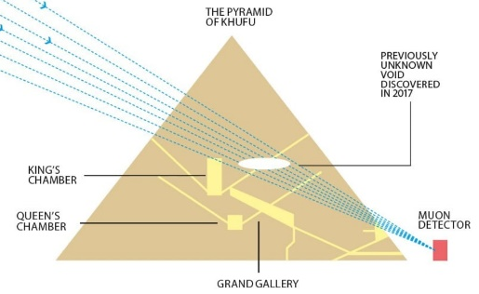
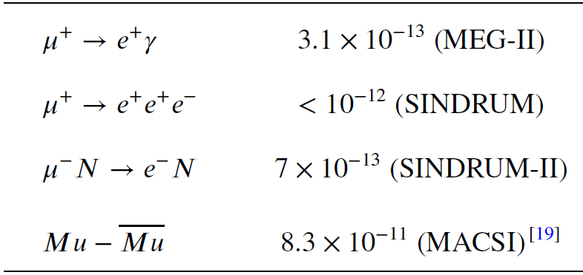
Muon – from discovery to application
Carl Anderson
Nobel Price 1936
I. I. Rabi
Nobel Price 1944
Muon Physics
Muon Applications:
Precision measurements
  g-2
  EDM
cLFV
Muon collider
μSR
MIXE/MuX
Muon tomography

Slide 4
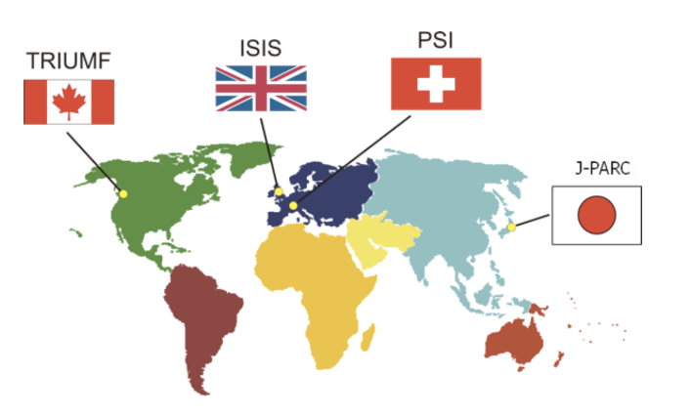


Muon Sources worldwide
  FNAL：g-2/mu2e
  RAON
40Hz
CW
CW
25Hz
MuSIC
Pulsed
CW
~ 100 ns
< 1ns
10s ms
10s ns
t
t

Slide 5
China Spallation Neutron Source
1
CSNS
Guangzhou
Dongguan
Shenzhen

Slide 6
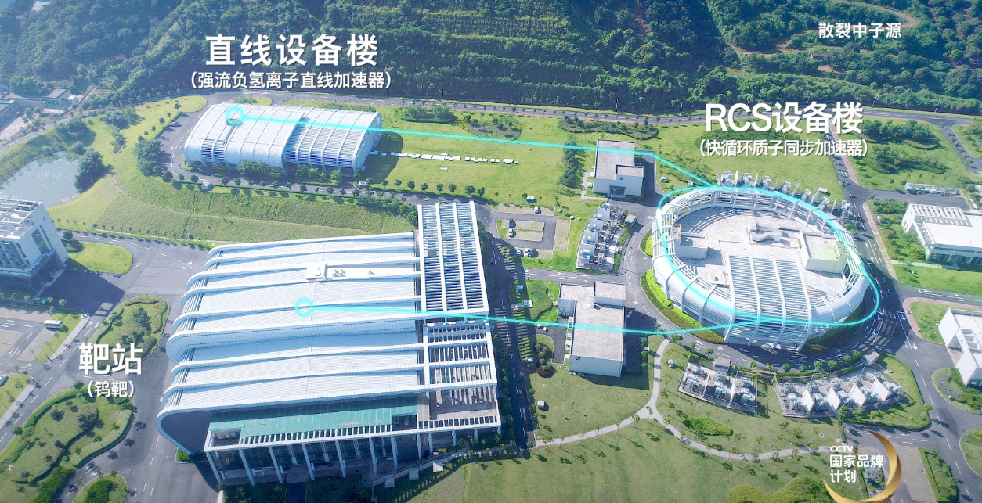
China Spallation Neutron Source（CSNS）
1
MELODY
Phase I completed in July, 2018
Phase II started in Jan, 2024
Accelerator: 170kW 25Hz 1.6GeV proton beam
Neutron Spectrometers: 9 built and 2 under construction

Slide 7
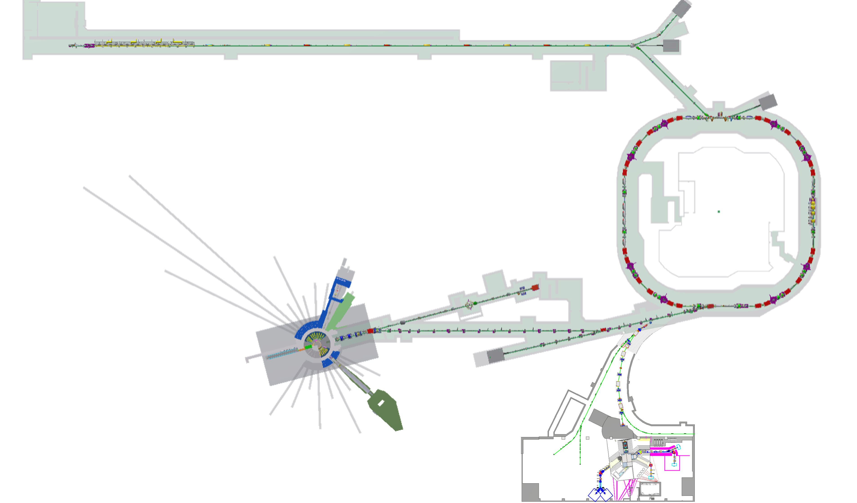
CSNS II Project (Approved on Jan. 11, 2024)
1
300MeV SC
9 more neutron spectrometers
500 kW
500 kW
MELODY
Muon station for sciEnce technoLOgy and inDustrY

Slide 8
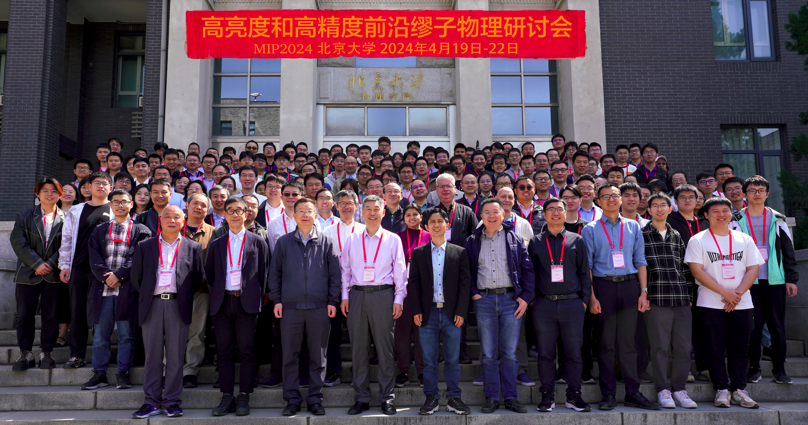
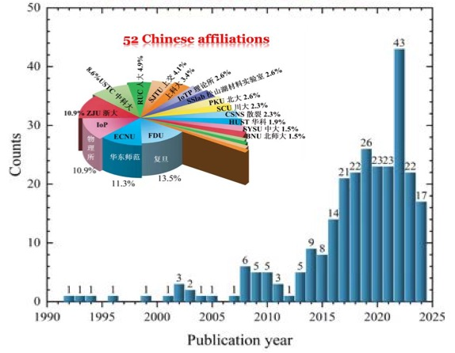
Chinese Muon Community
2
muSR users
Particle Physicists
USTC
Fudan University
IOP
Zhejiang University
…
Peking University
IHEP
SJTU
SYSU
…
Element Analysis
Palace Museum
National Museum
CIAE
IHEP
…

Slide 9
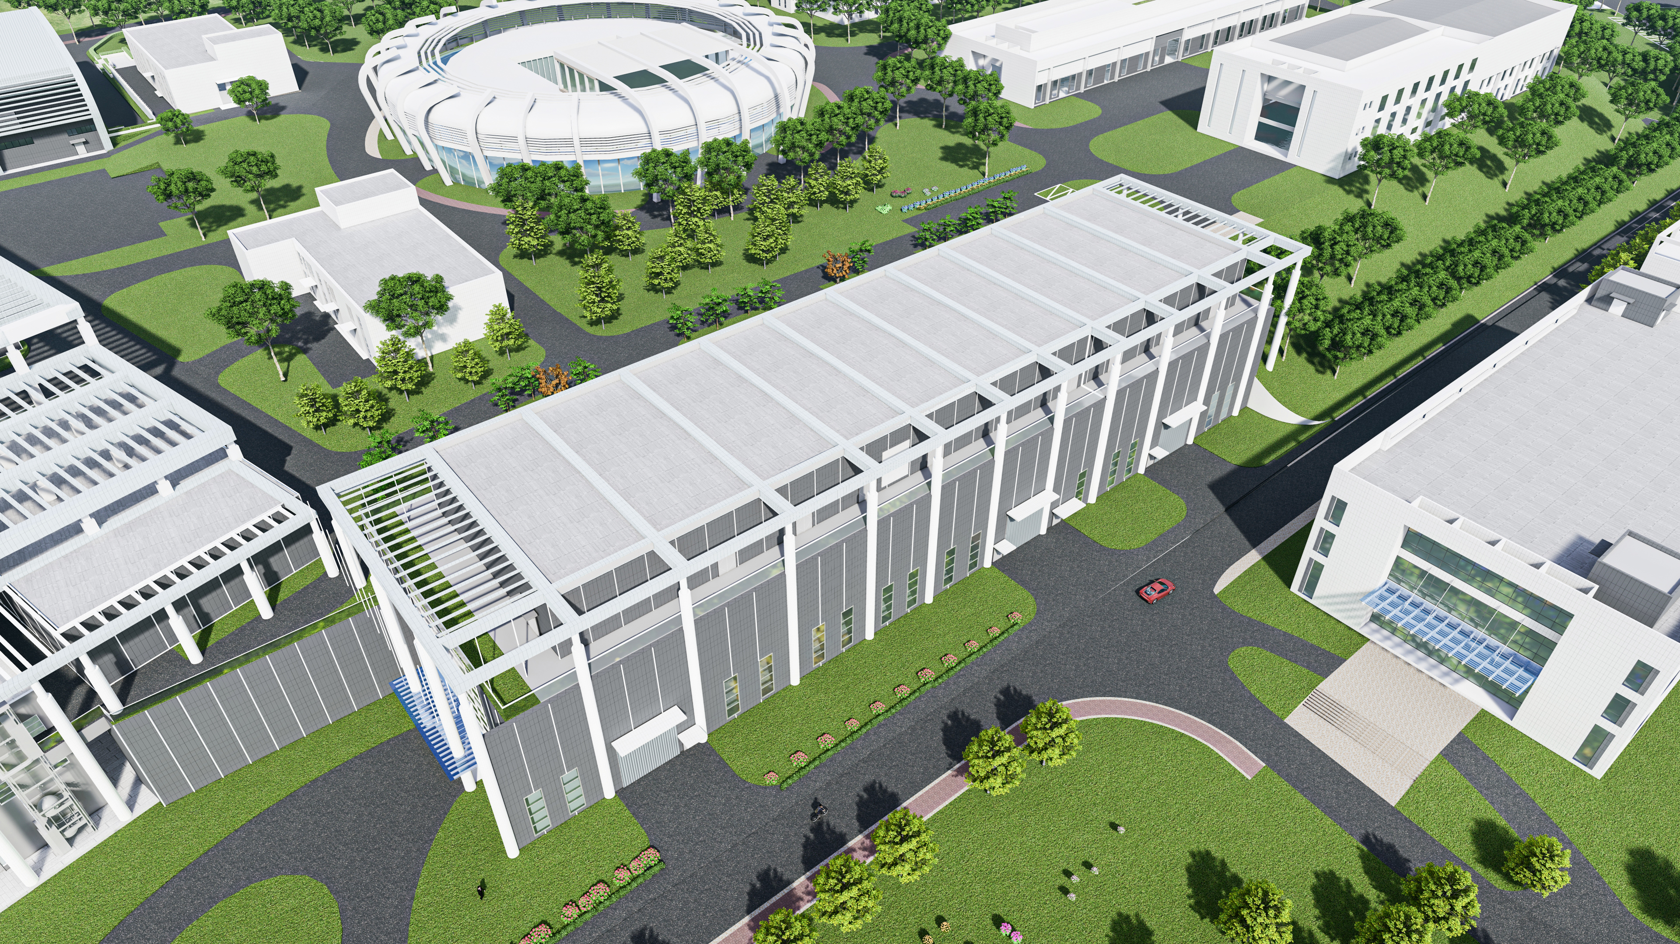
Architectural Design of MELODY
03
MELODY

Slide 10
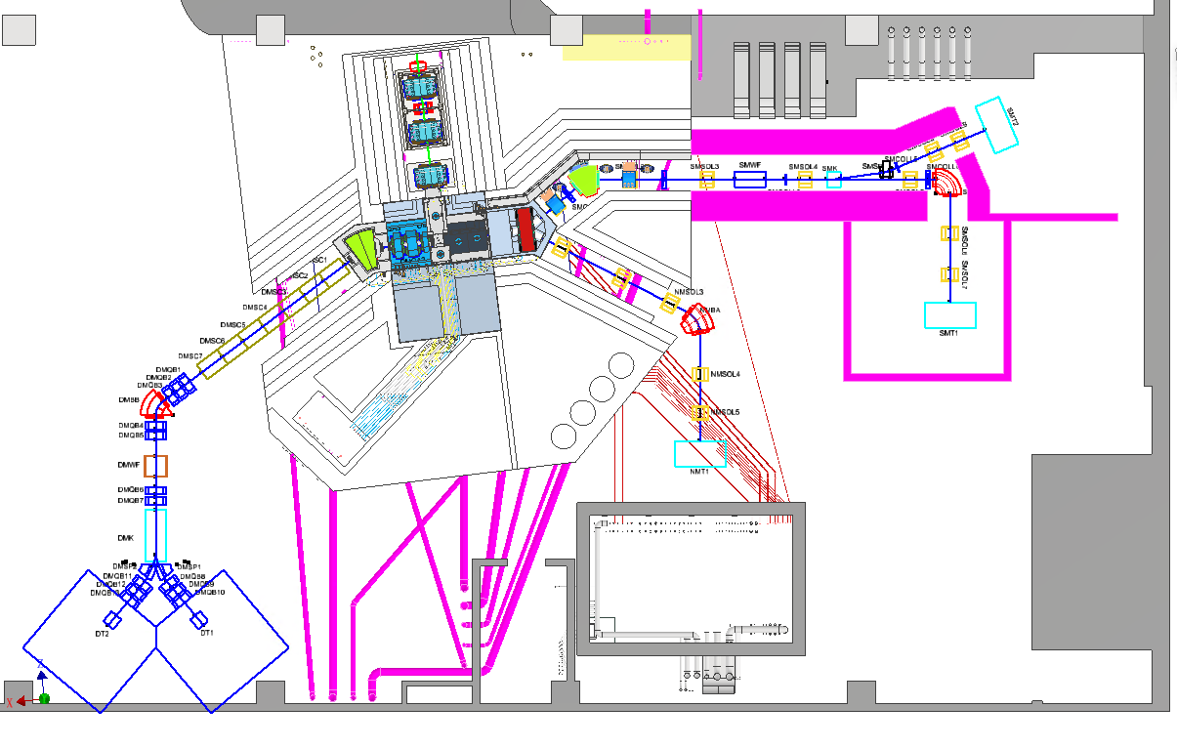
Overview of MELODY
Proton Beam
SMBT
SMT2
NMBT
DMBT
Waste Target
NMT
Reserved
SMT1
Water Cooling system (underground)
control room
Sampling room
DMT2
Reserved
DMT1 Reserved

Slide 11
3.1
Design features
Target
  Stand-alone target: more freedom to design
  Thick target: 10 cm interaction length
  Copper Target: high production
Beamlines
  Surface Muon: Solenoid focusing; AI optimized; Large acceptance
  Negative Muon: by-product, low cost, dedicated μ⁻ beam
  Decay Muon: Large acceptance; wide applications
muSR spectrometer
  High Asymmetry: 0.3
  Large number of detectors: 3024 units

Slide 12
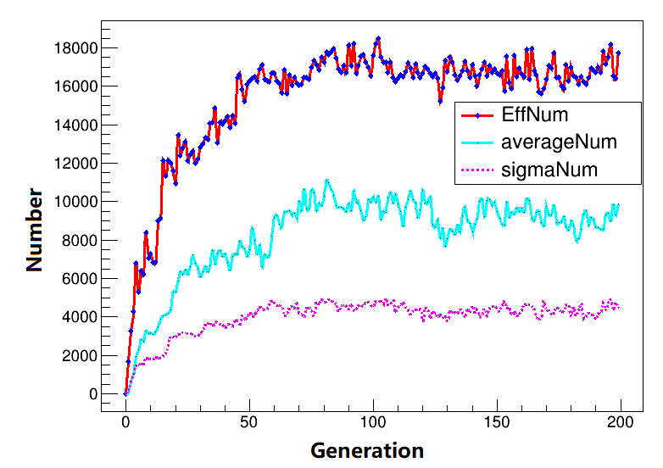
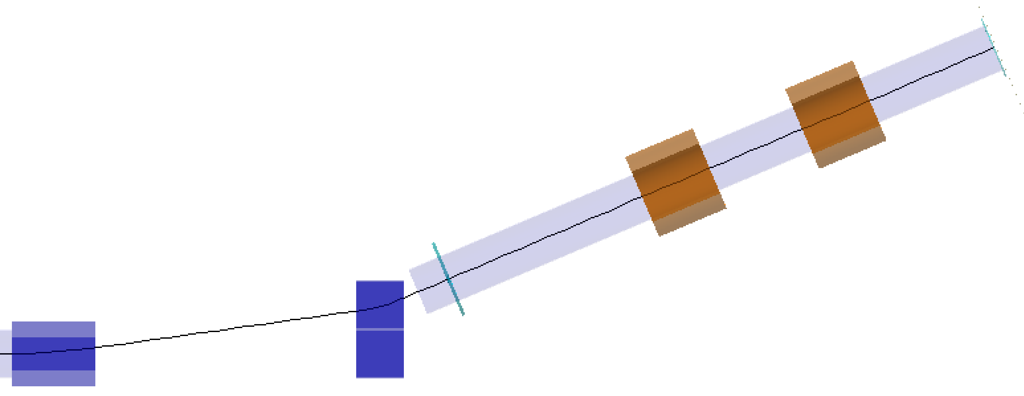
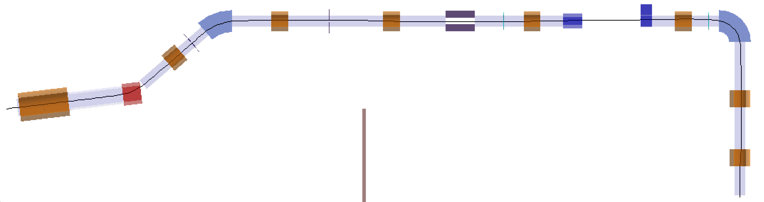
3.1
Surface Muon Beam
Design parameters
Momentum：28 MeV/c, Polarizability：>95%
Intensity：>10⁵ μ/s, Positron background：<1%
Optical design by Transport
Fully focusing solenoids, 3 dipole bending magnet.
SMWF, SMK, 5 collimators
Deflection angle: SMBA @34, SMBB @40.9, SMBC @90, Kicker @8, Septum @15
optical design
AI optimization
SMT2
SMSOL9
Features: Fixed energy @4 MeV, higher acceptance, cost-effective
SMSOL8
Coll5
2 terminals:
SMT1 for muSR
SMT2 for R&D
SMBB
Coll2
Coll3
SMK
Coll4
SMBC
Proton
Coll1
SMSOL2
SMSOL3
SMWF
SMSOL4
SMSP
SMSOL5
SMSOLX
SMSOL1
SMSOL6
SMBA
Layout of SMBT
SMSOL7
SMT1

Slide 13
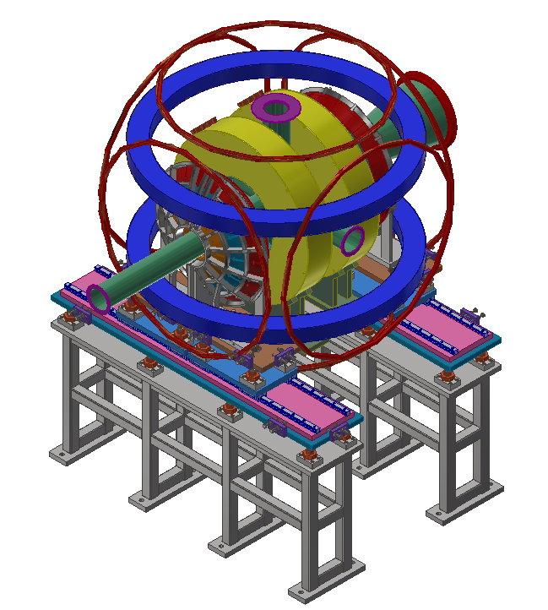
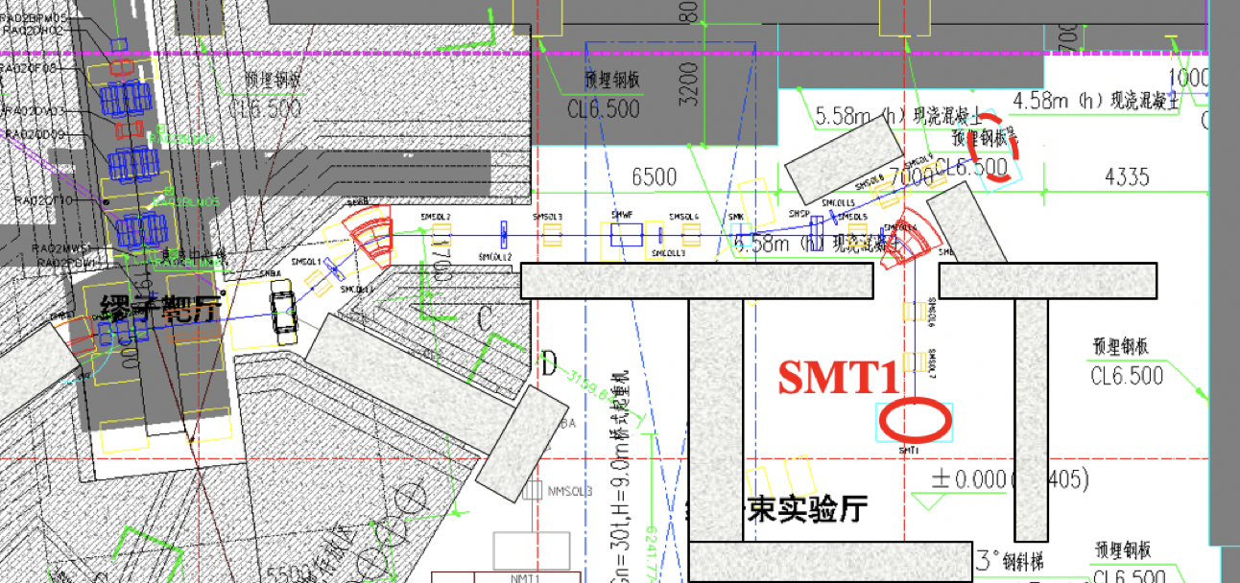
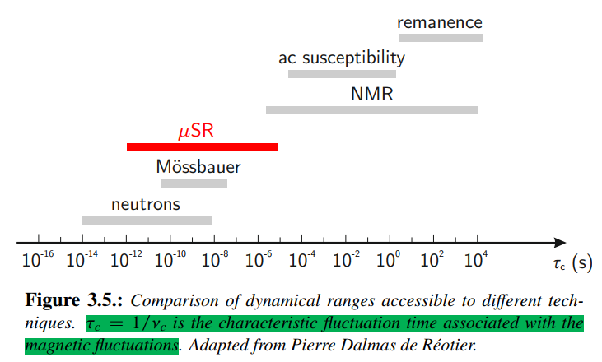
3.2
Science for SMT1
Dedicated beam for muSR
MuSR：Magnetic material, superconductivity, battery, semiconductor
Spectrometer Design
~1584 detector units in the first stage (~3024 units in total)
Counting Rate：~ 3.8×10⁷ e⁺/hour @1 Hz (~76 MEvent/hour in total)
Asymmetry：> 0.3
Pulse length：~130 ns (consider slicing to 10 ns)
Temperature: 2-300 K with cryostat
LF: 0-5000 G
TF: 0-400 G
Beam spot: Ф10-30 mm

Slide 14
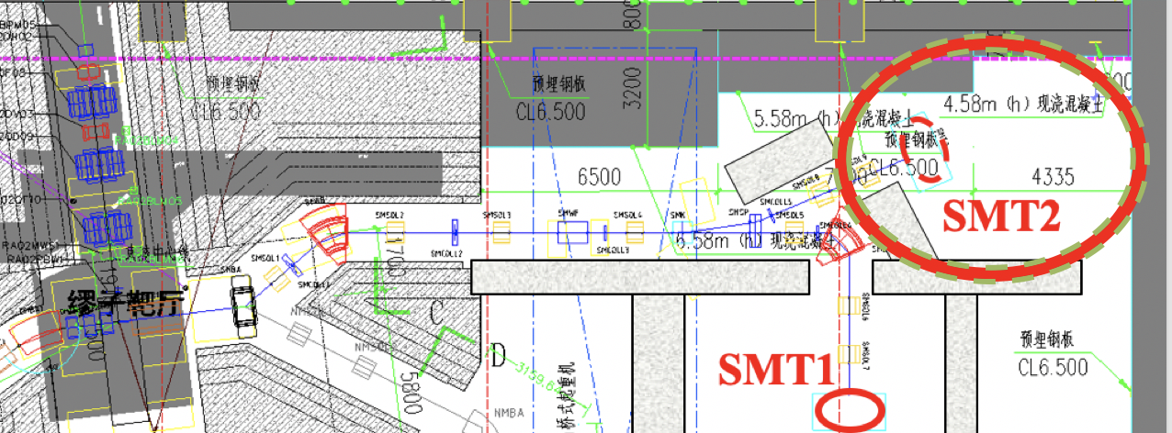
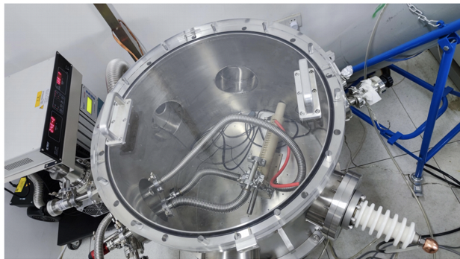
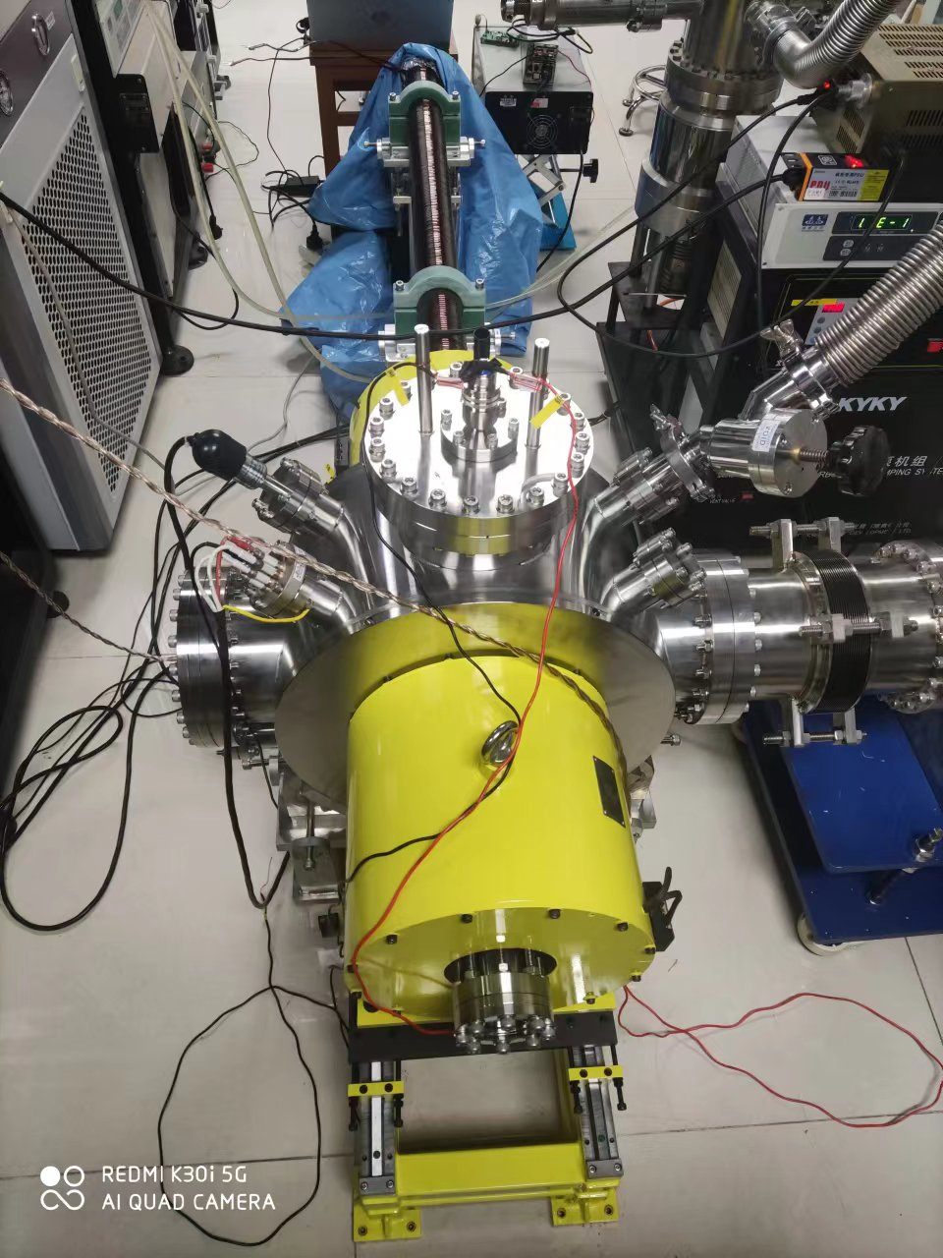
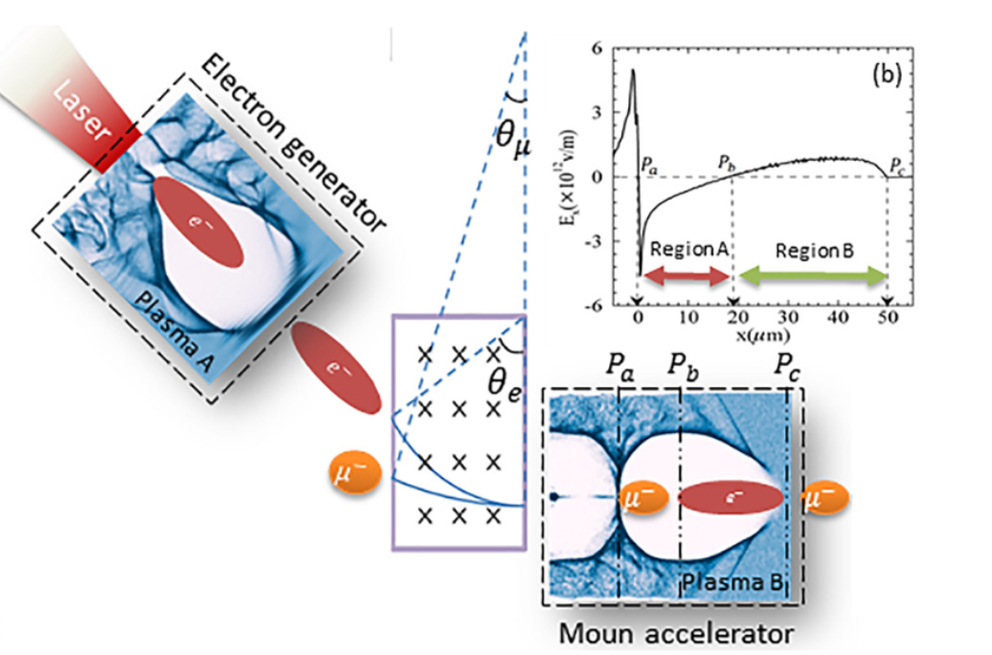
3.2
Science for SMT2
Muon technology development
Muon moderation
Muonium experiments
Muon acceleration
Potential Muon Physics
  MuMuBar
Muon moderation
Muonium production
Muon PW acceleration

Slide 15
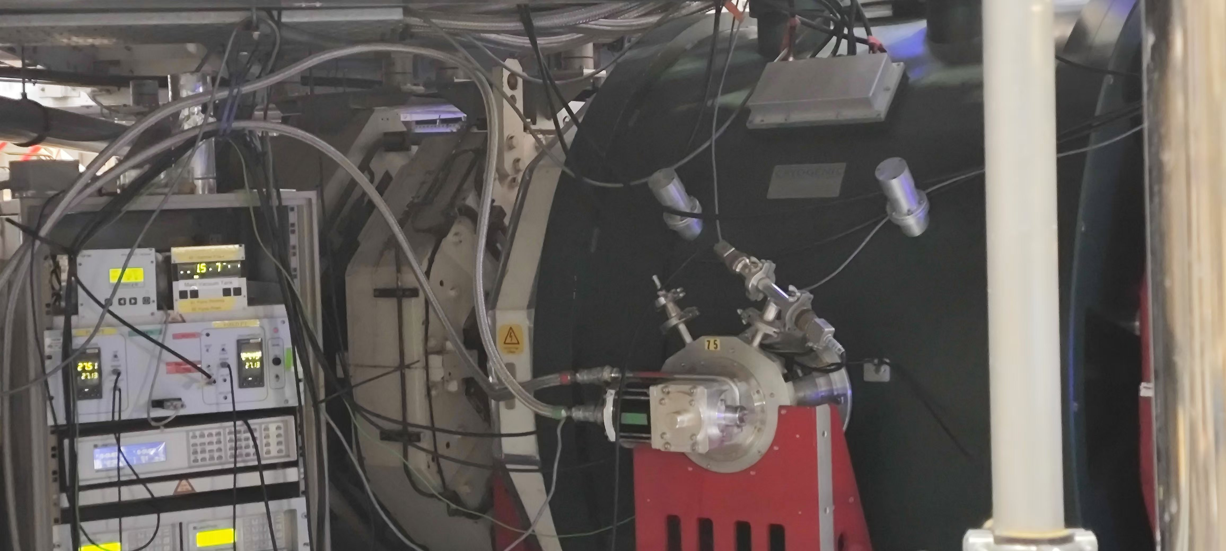
3.2
Muon moderation
Detector
Cu collimator
20
10
20
Gas cell
HV
15
5
…
…
C foil
Acc E-field
30
Muon beam
100 mbar He gas
With E-field
… …
300
Electrodes
HIFI B-field
Planned Test At ISIS

Slide 16
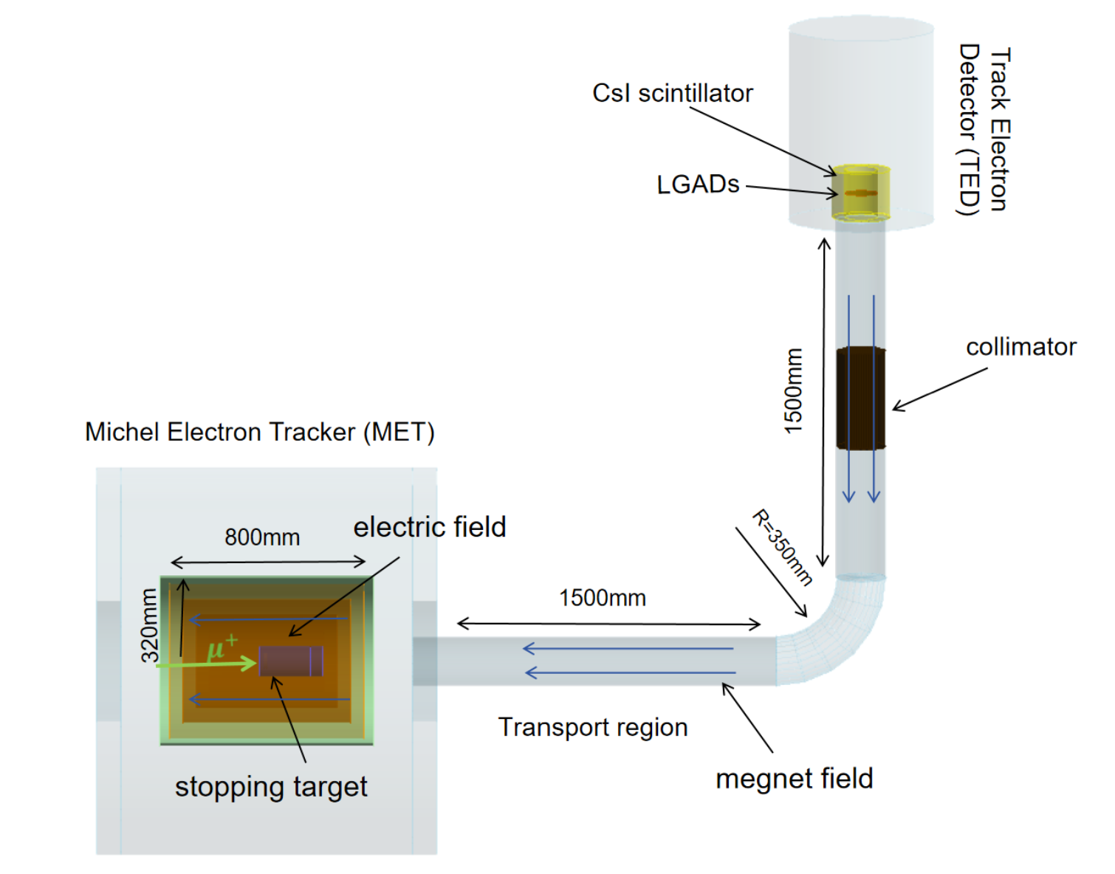
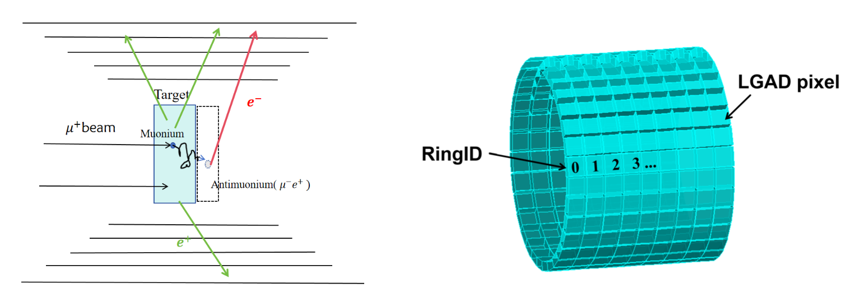
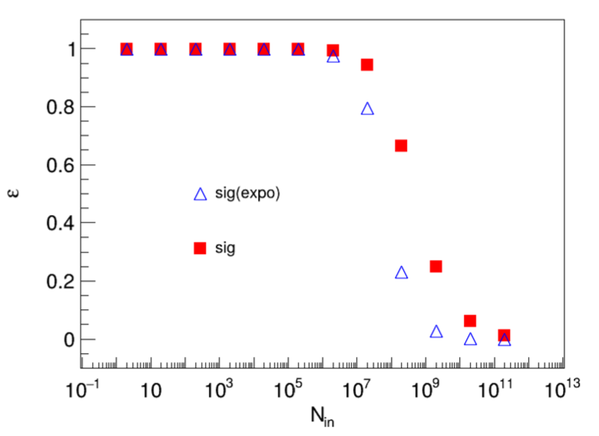
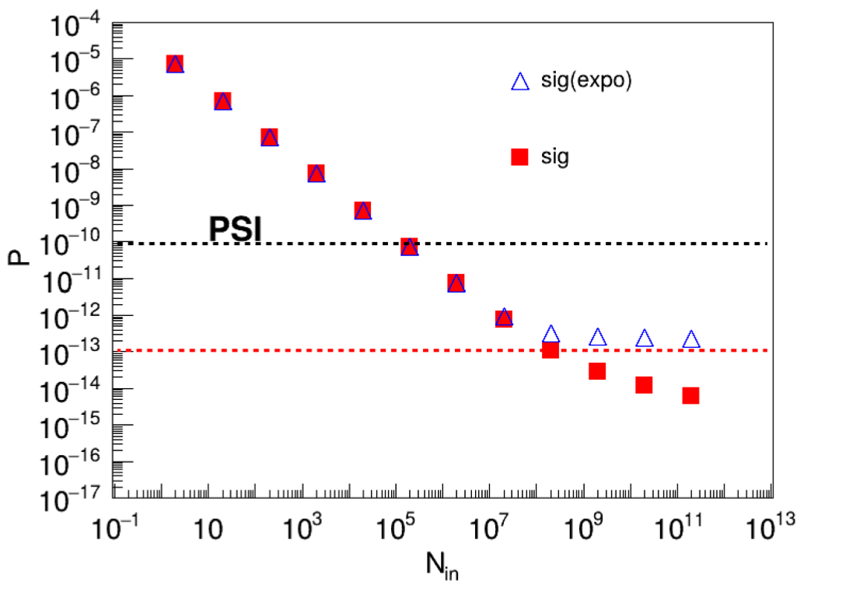
Muonium to Anti-muonium conversion
Michel Electron detection with LGAD detectors
Signals:
Michel Electron
Thermal Positron
Detection Efficiency
Total sensitivity with 10⁸μ/s

Slide 17
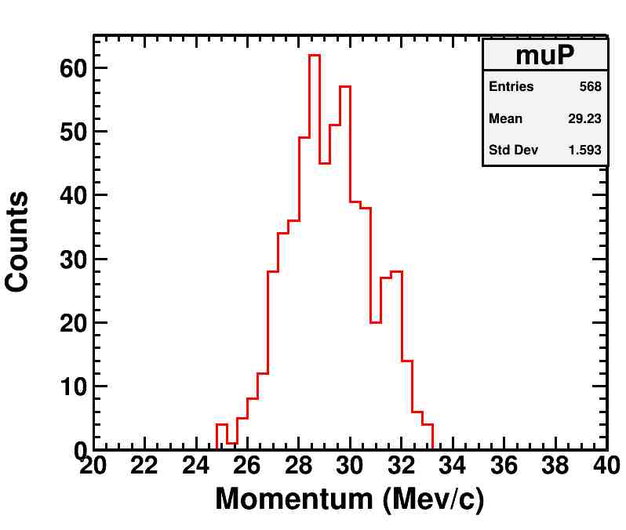
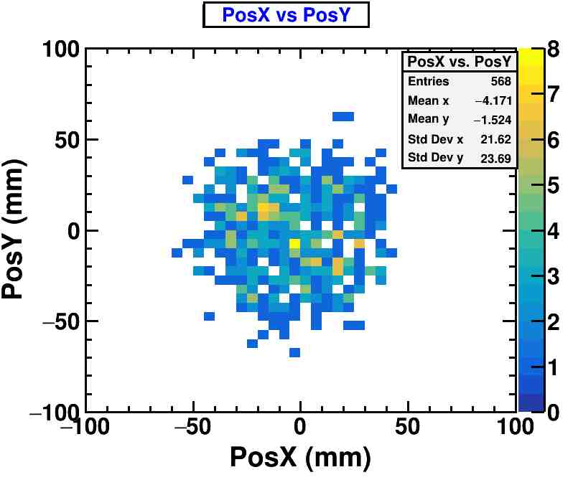
3.2
Negative Muon Beam
NMBT: Dedicated μ⁻ beam
5 focusing solenoids
1 dipole magnet
1 wien filter
Beam parameters
Momentum：29 MeV/c @13% (FWHM)
Penetration：~ 50 μm in Fe
Beam size： Φ100 mm
Beam intensity：4.4×10⁵ Hz (Φ100 ratio>90%)

Slide 18
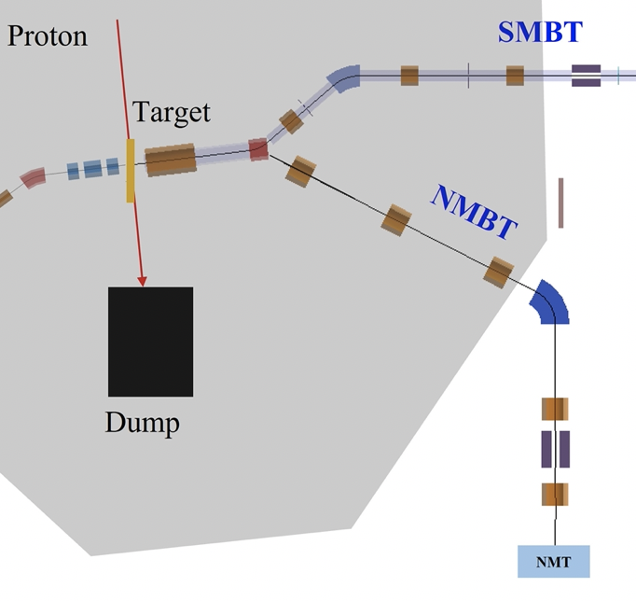
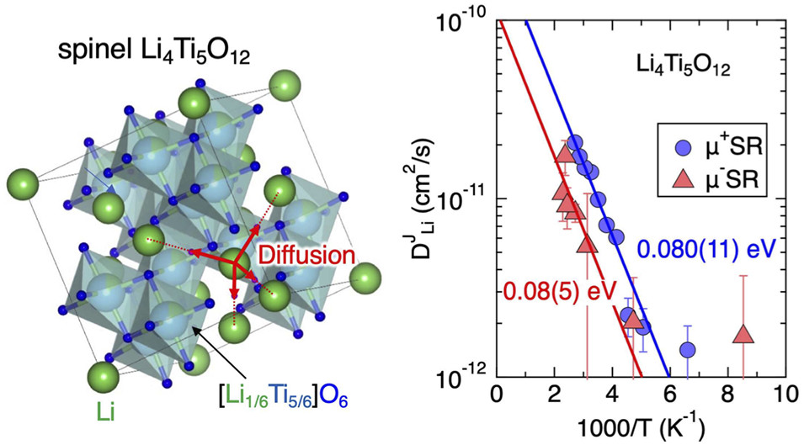
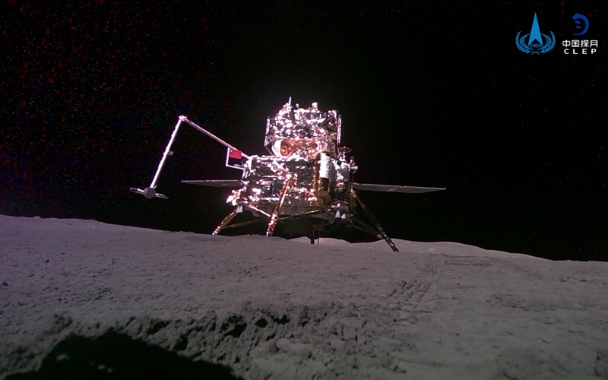
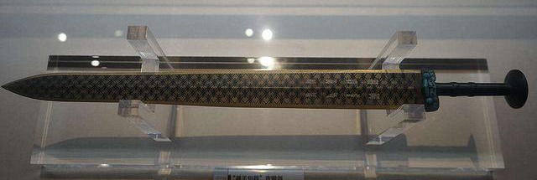
3.2
Science for NMT
Non-destructive elemental analysis:
  Sensitive for almost all elements (including C, N, O)
  No activation for samples
  Archeology:
    Palace Museum
    National Museum
    Guangdong Museum
    FURUKAGE Conservation center
μ⁻ and μ⁺ study on Li⁺ battery anodes
J. Phys. Chem. C 2022, 126, 25, 10506
Moon soil
Elemental analysis for Archeology
18

Slide 19
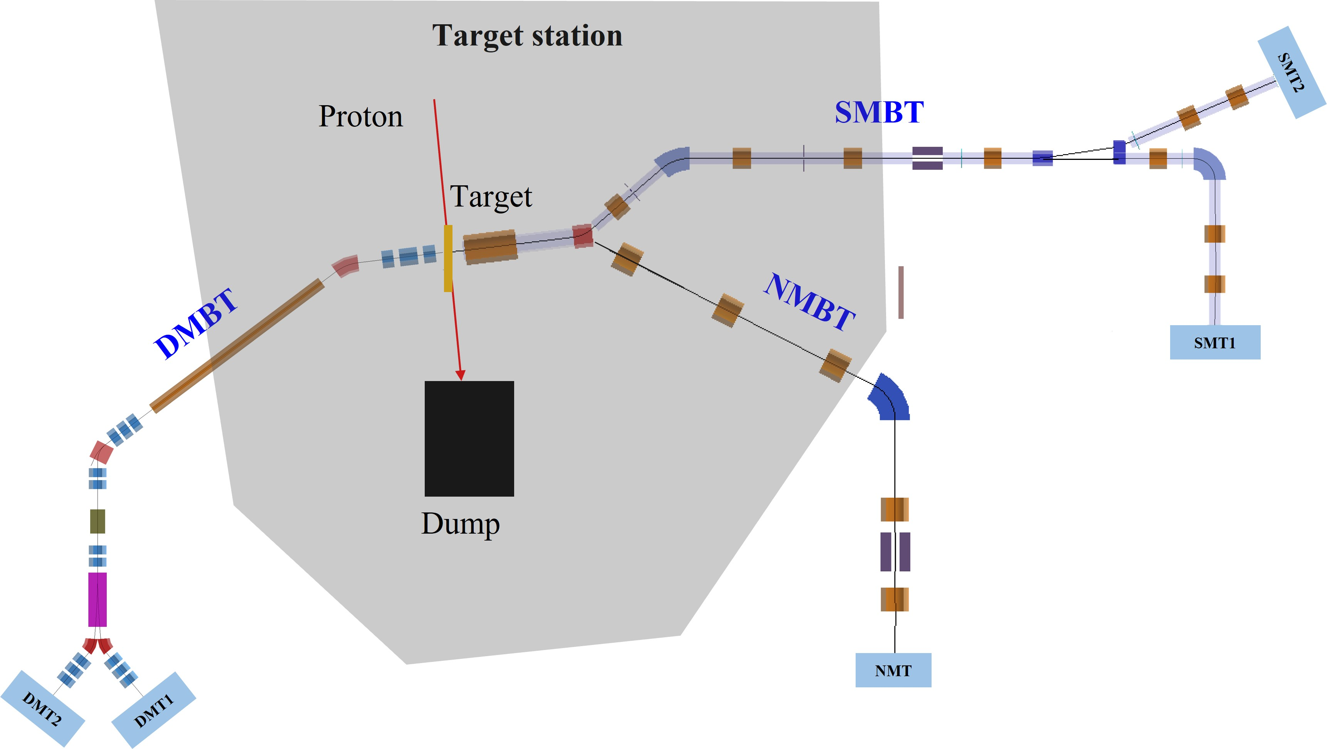
3.2
Science for DMT
High-energy MuSR
Thick Samples
Depth scan MIXE
Depth scan for archaeology
Single Event Effect
Large capture cross section of μ⁻
Muon
Imaging
Thick samples
Samples in container
High field
Thick moon rock
Batterries
Momentum: 20 ~ 120 MeV/c
Charge: + or -
Intensity: 10⁵~10⁷ muon/s
Penetration in Cu: 1 ~ 50 mm
Polarization: 50% ~ 99%
Decay muon beamline with 2 terminals

Slide 20
Design Parameters
Proton driver | Power | Repetition | Energy | Time Structure |  | σ_{x} | σ_{y}
 | 20 kW | 1 Hz | 1.6 GeV | 120ns/409ns |  | 3.1 mm | 8.5 mm
Muon beam | Surface Muon (SMBT) |  | Negative Muon (NMBT) |  |  | Decay Muon (DMBT)
Momentum | 28 MeV/c |  | 28 MeV/c |  |  | 20~120 MeV/c
dp/p | 6% |  | 13% |  |  | 8% @ 120 MeV/c
Beam spot | Φ10mm-Φ100mm |  | Φ100mm |  |  | Φ30mm
Intensity | 10⁵-10⁷ μ⁺/s |  | 4×10⁵ μ⁻/s |  |  | 4×10⁶ μ⁺/s
Polarization | > 95% |  | ~ 20 % |  |  | > 70%
Pulse width | 130 ns (SP) ~ 520ns (DP) |  | 520 ns |  |  | 130 ns (SP) ~ 520ns (DP)
Spectrometer | Segments | Asymmetry | Count Rate |  | FOM: A²*R | Temperature |  | LF/TF
 | 1584/3024* | ~0.3 | 38/76* MEv/h |  | 2.9/5.8* | 2K ~ 300K |  | 5000 G/ 400 G
* Can be upgraded to

Slide 21
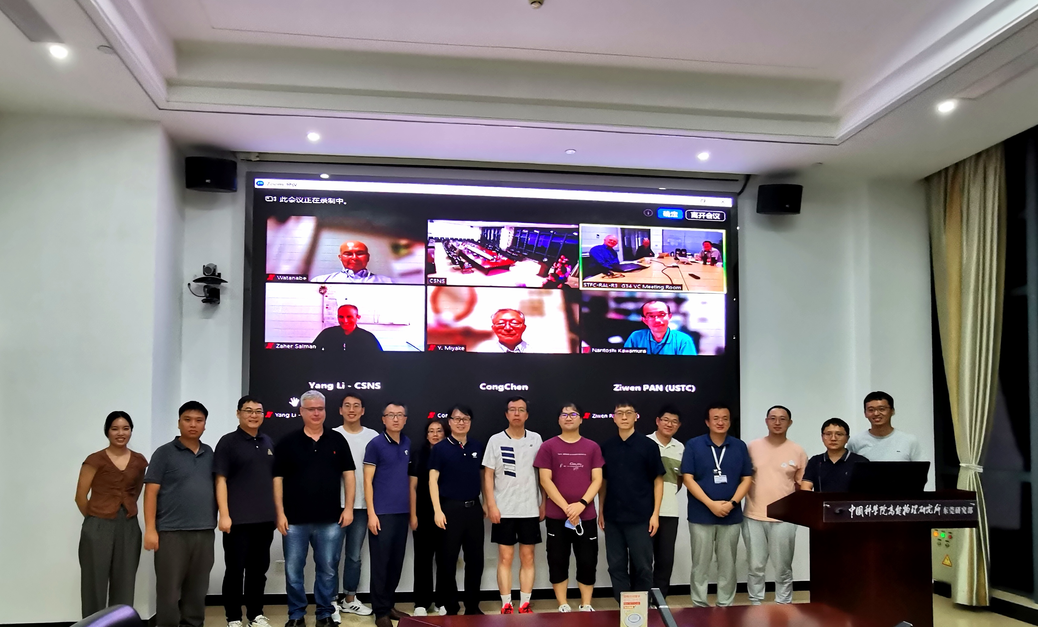
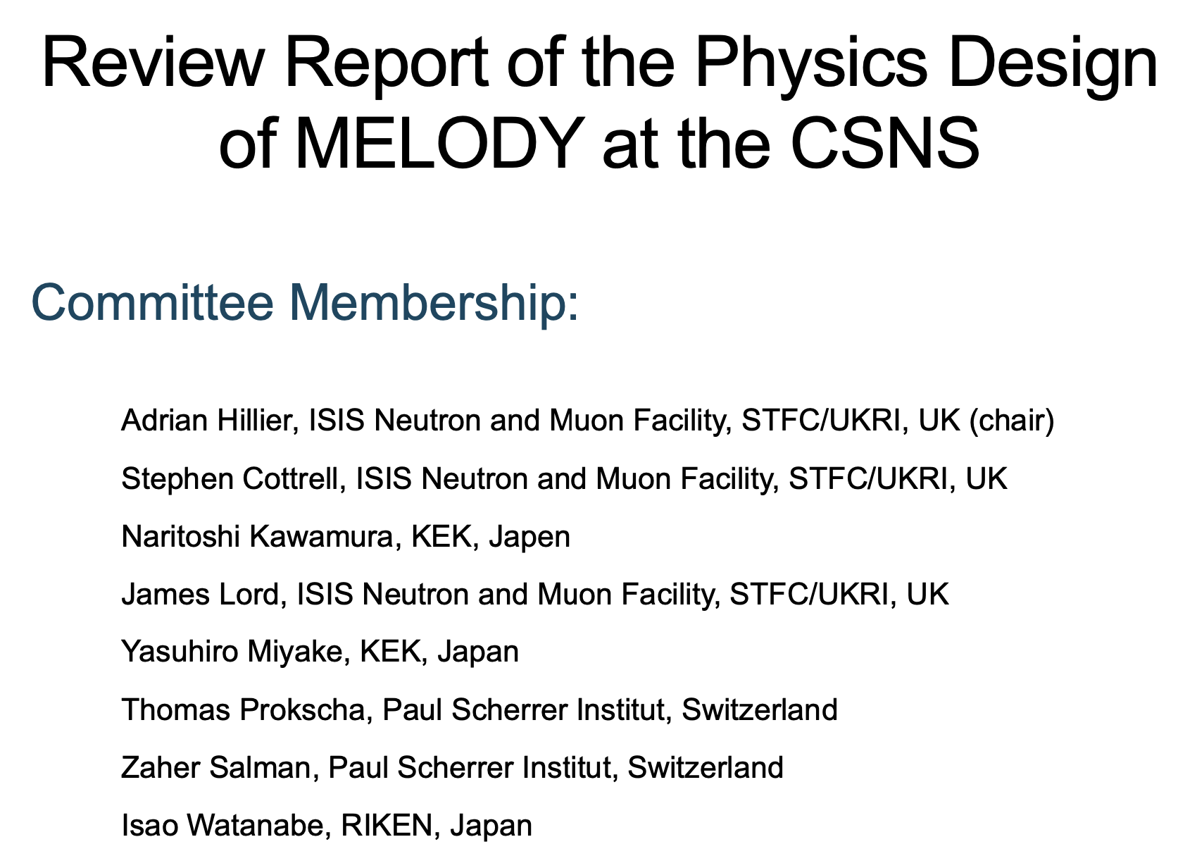
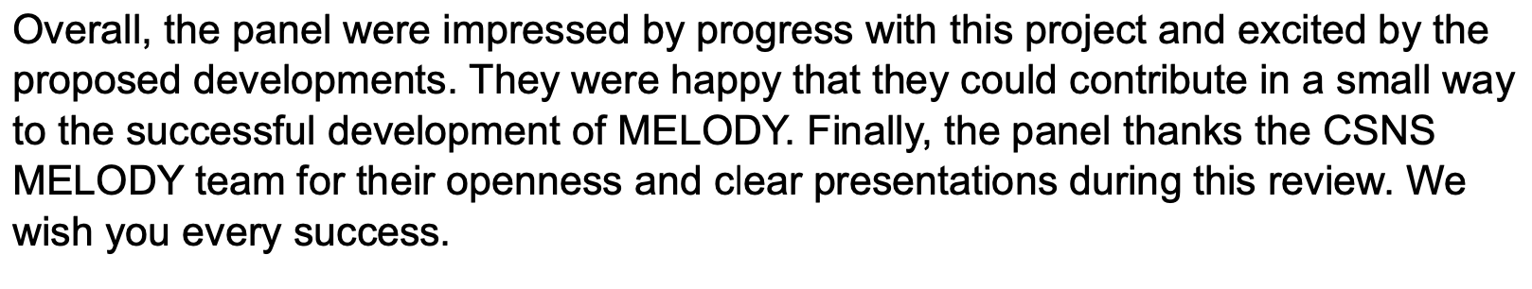
Physics Design Review
July 1st, 2024

Slide 22
4
Timeline of MELODY
Complete of Muon Hall
Start trial run

Slide 23
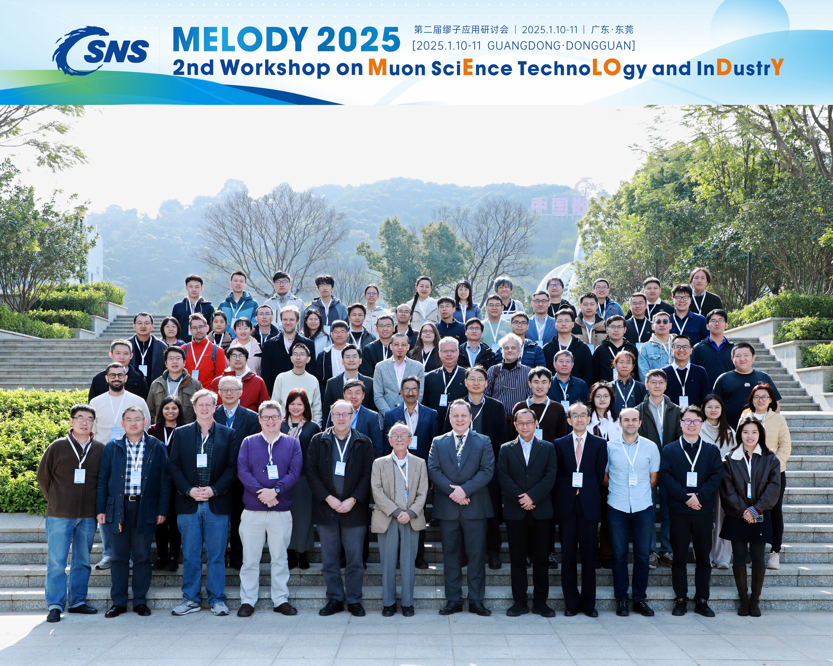
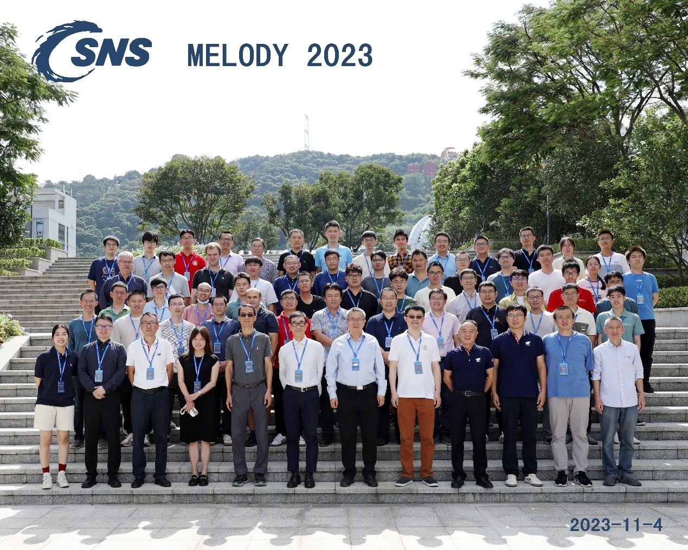
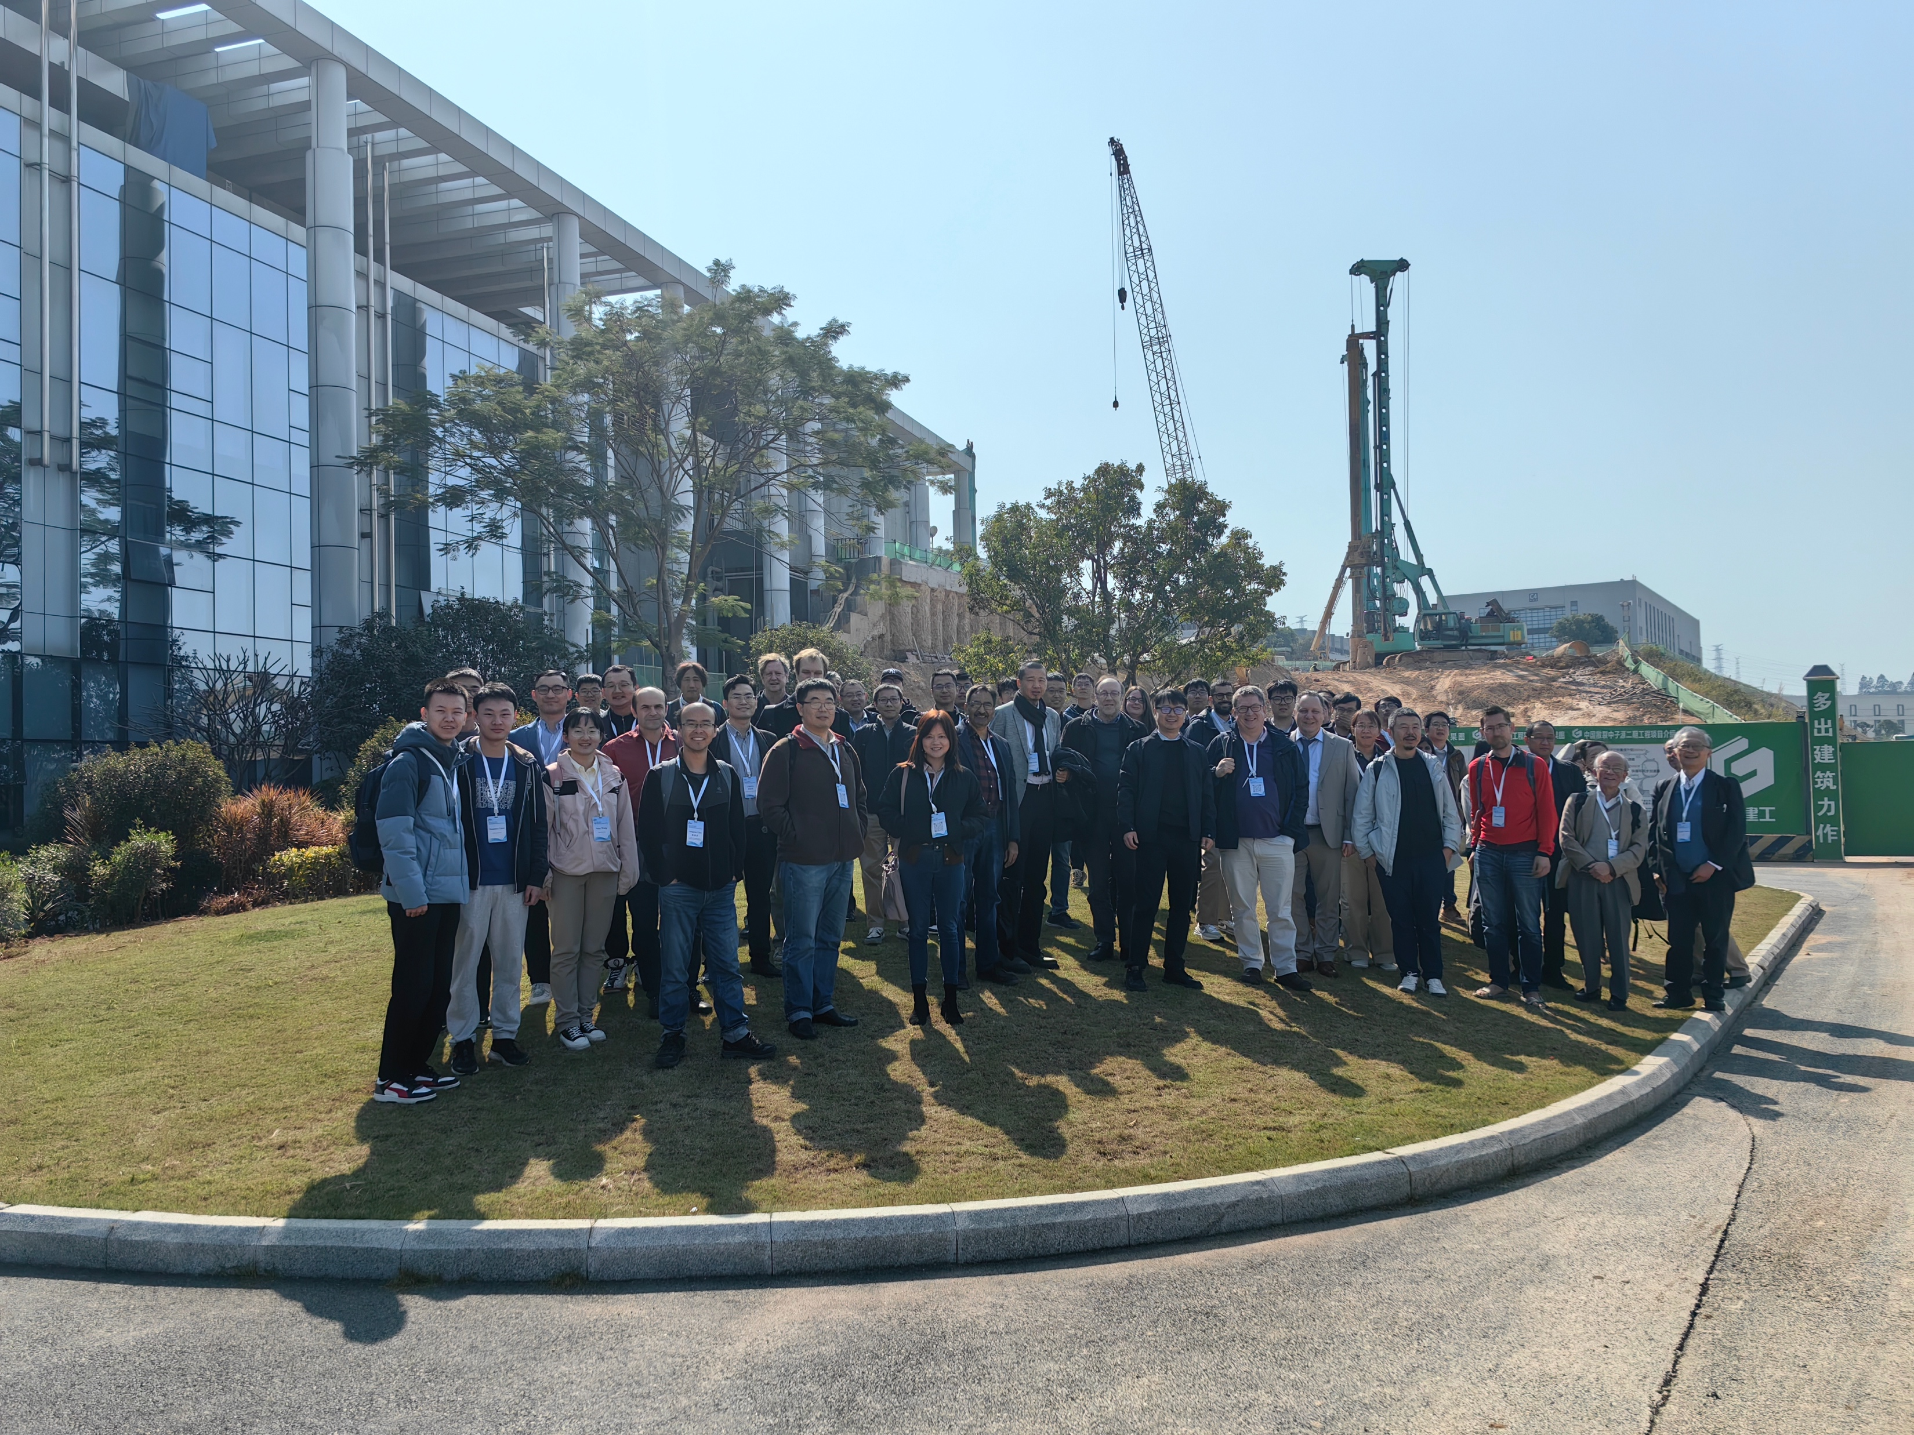
Workshops of MELODY

Slide 24
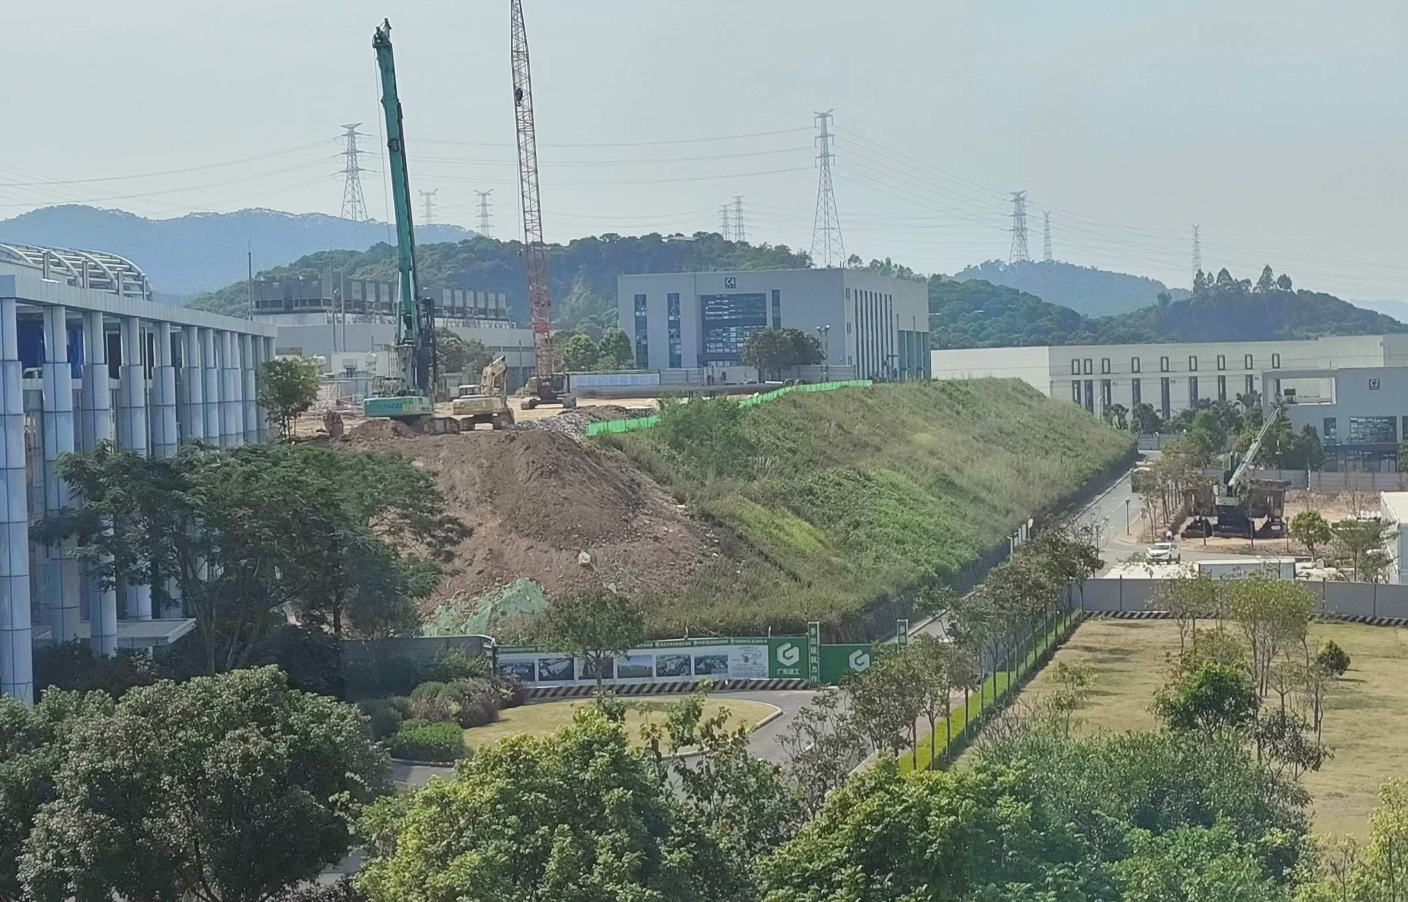
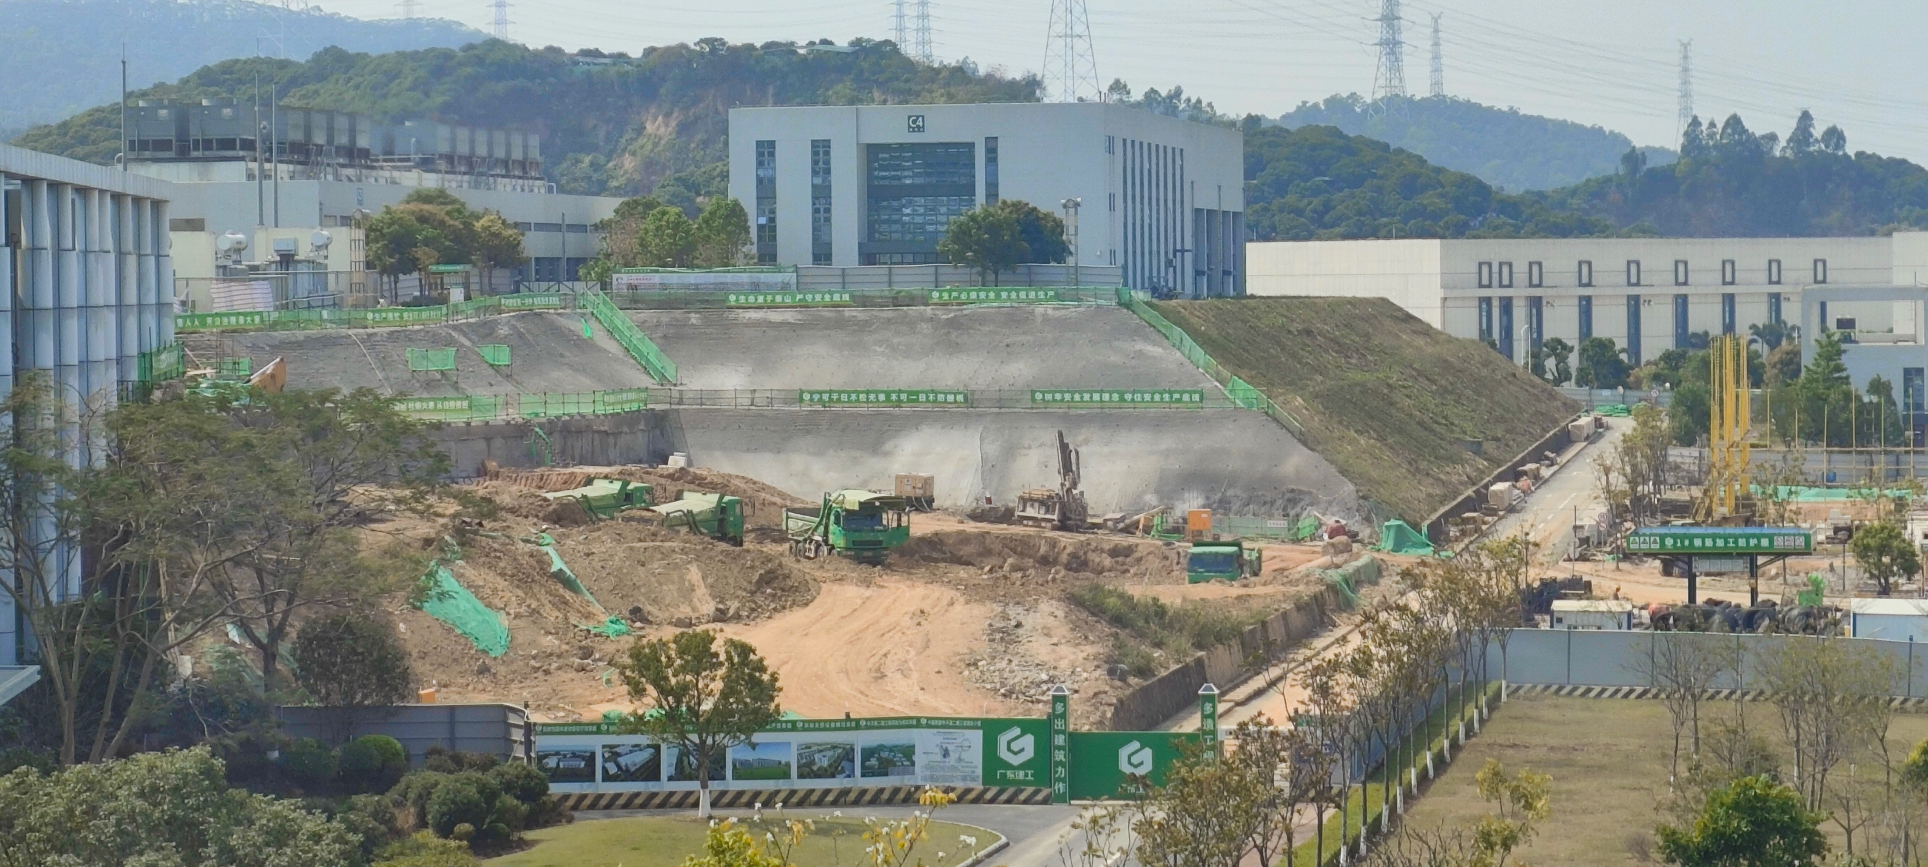
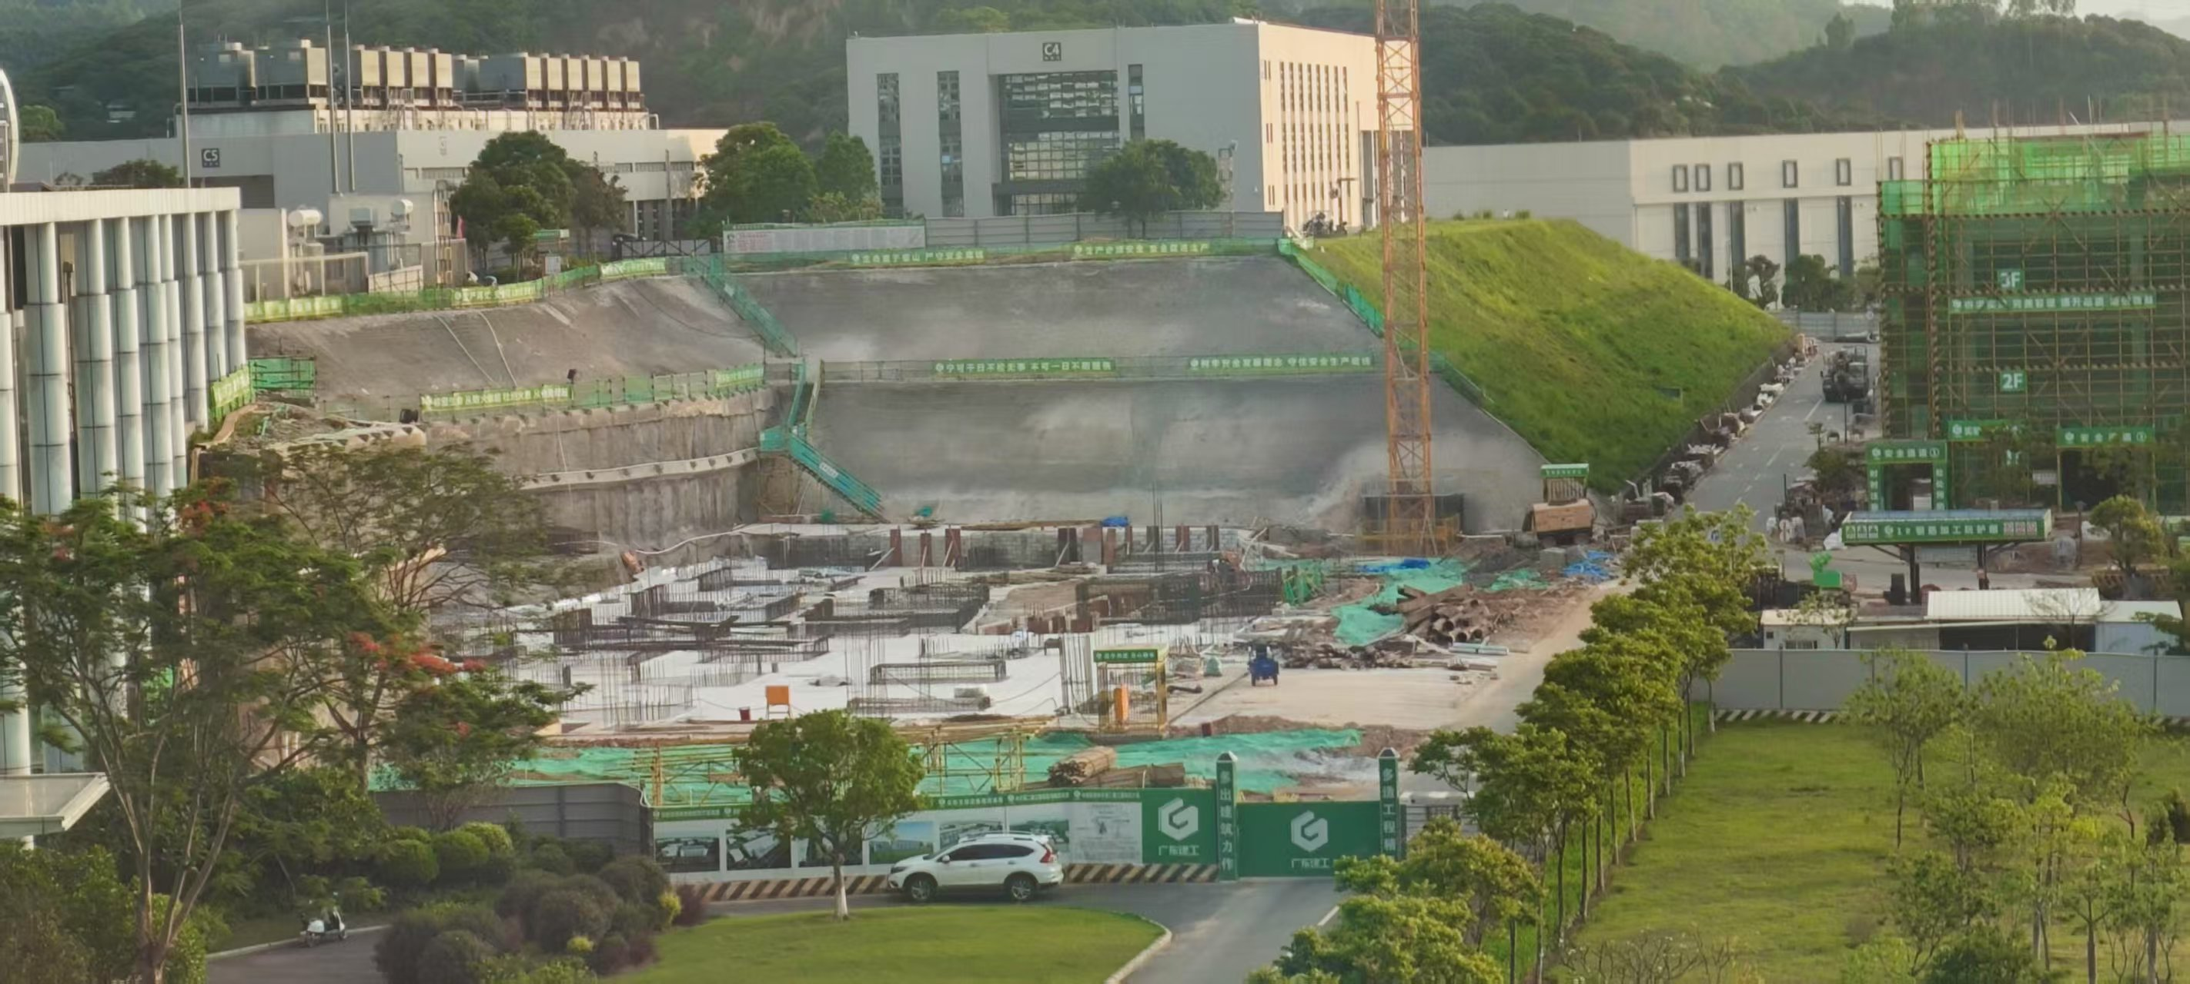
Construction Progress
2024.8.20
2025.2.20
2025.5.14

Slide 25
MELODY TEAM
Target： Chen Wu、 Lei Liu、Gang Zhang、Ning He、Zhiduo Li、Nikos Vasiloploss、Jiaxin Chen、Zhixin Tan、Yu Liu、Congju Yao、Yongji Yu、Guangyuan Wang、Junsong Zhang、Huihong Liang、Huayan He、Xiaoyin Mo
Beamlines：You Lv、Cong Chen、 Guangdong Liu 、Changdong Deng、Yuwen Wu、Junhao Wei、Xin Qi、Wenqing Zhang、Pengcheng Wang、Yuliang Zhang、Yongcheng He
Spectrometer：Qiang Li、Ziwen Pan、Yang Li、You Lv、Ruirui Fan、Haiyan Du、Yuhang Guo、Hao Liang、Tianyi Yang、Bangjiao Ye
Coordinator: Yu Bao

Slide 26
SUMMARY
05
MELODY has been approved and started construction
The surface muon beam will be constructed first. The negative muon beam and the decay muon beam will be built in the future
We will be able to welcome all of you in 4 years!
We Welcome all collaborations!
yubao@ihep.ac.cn

