Slide 1
GRAIN plan of activities
Alessandro Montanari
Meeting DUNE Italia – 21 Giu 2024

Slide 2
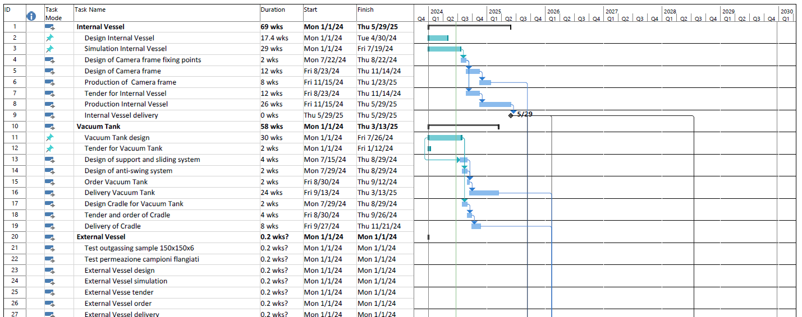
Project plan – draft 0

Slide 3
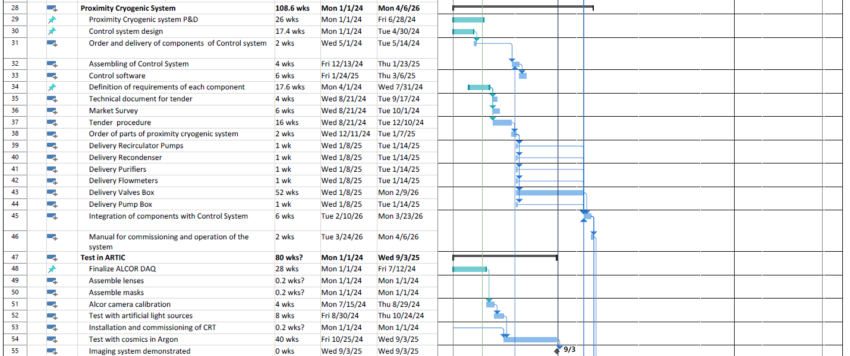
Project plan – draft 0

Slide 4
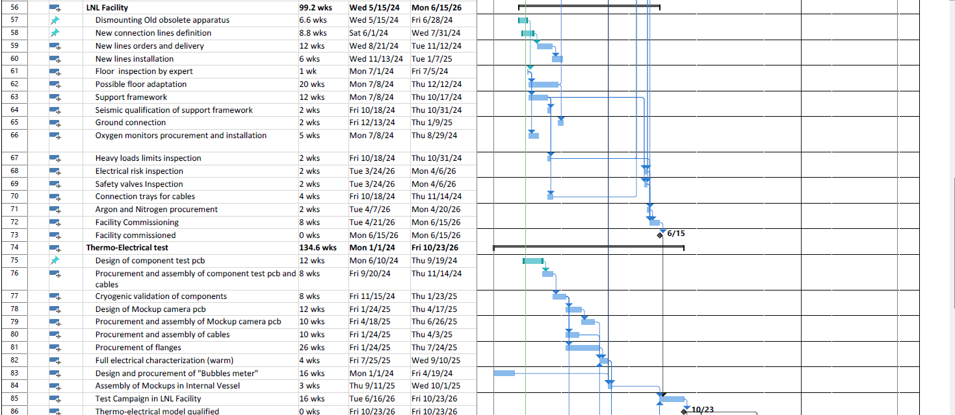
Project plan – draft 0

Slide 5
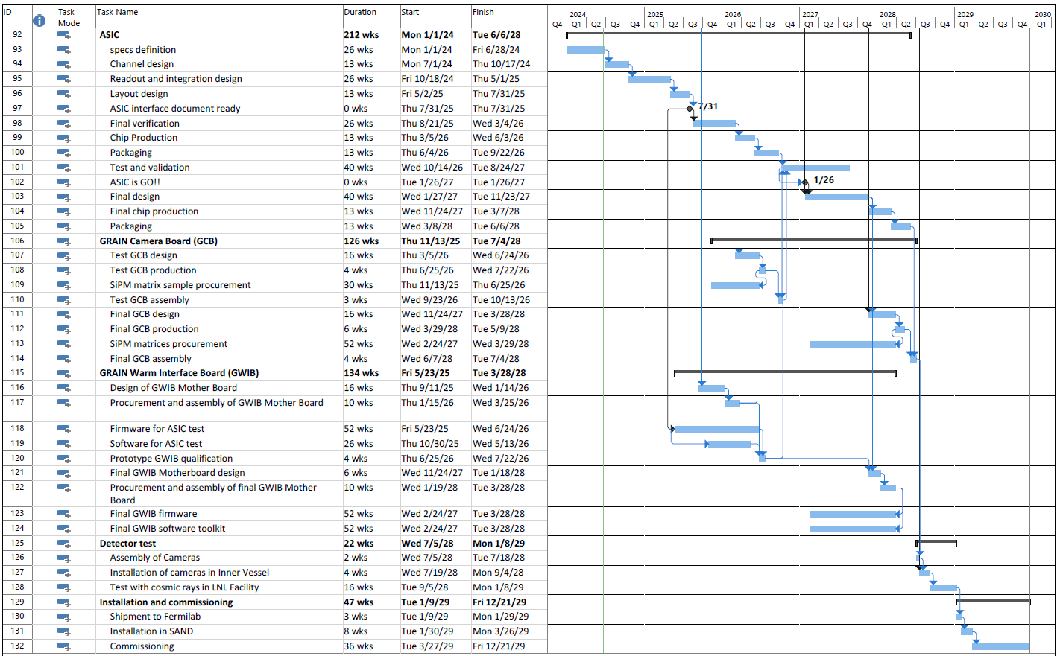
Project plan – draft 0

Slide 6
Layout LNL Test Facility

Slide 7
3D LNL Test facility

Slide 8
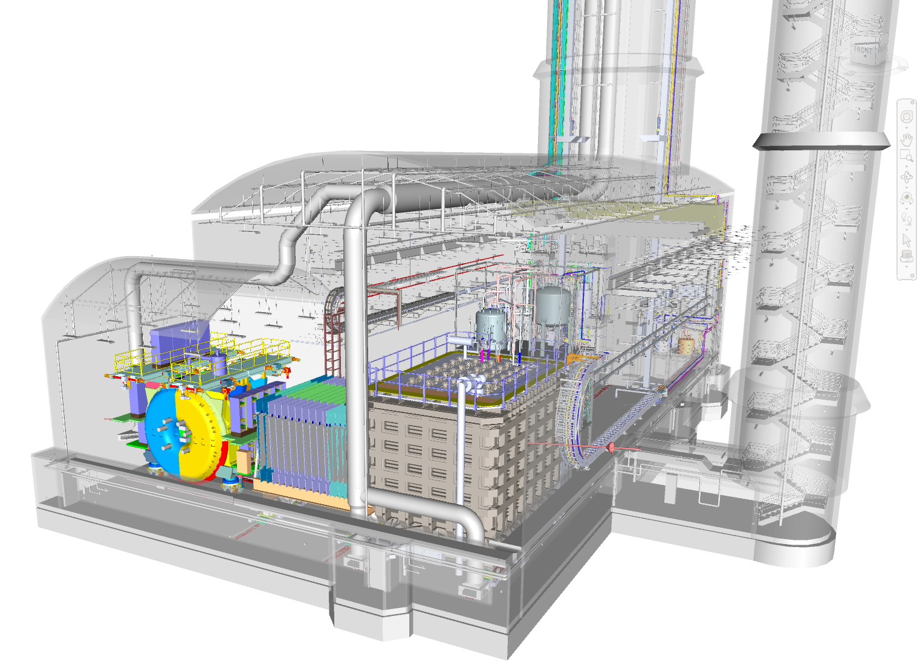
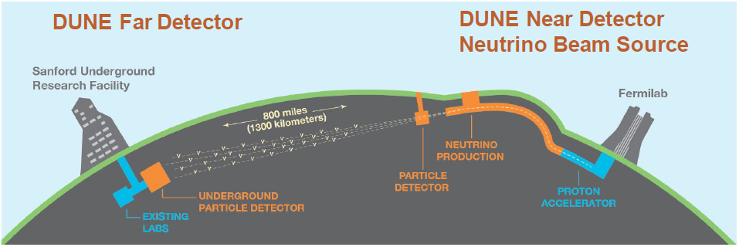
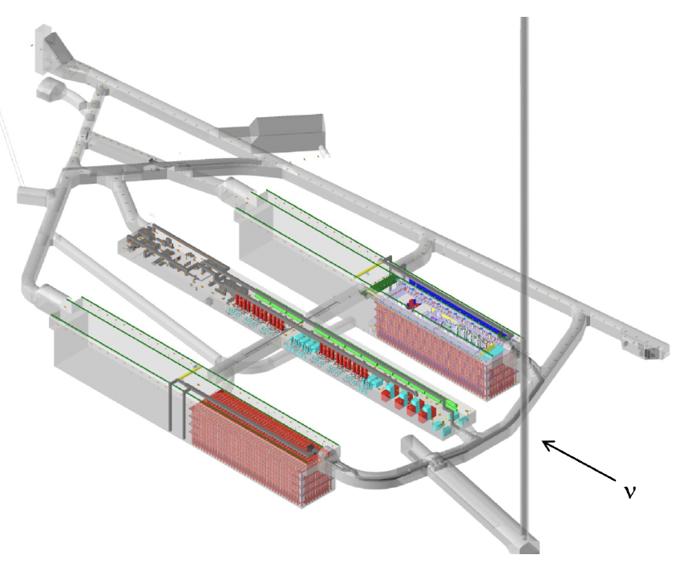
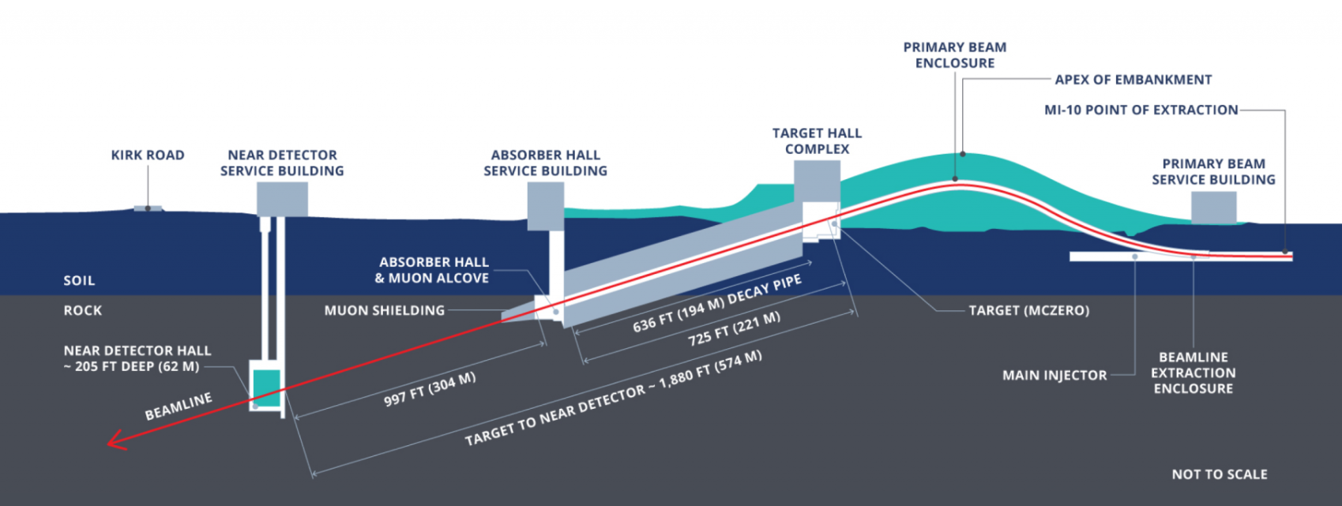
Study ν oscillations, mass ordering, CP violation, Supernova

Slide 9
Near Detector
Beam monitoring + ...

Slide 10
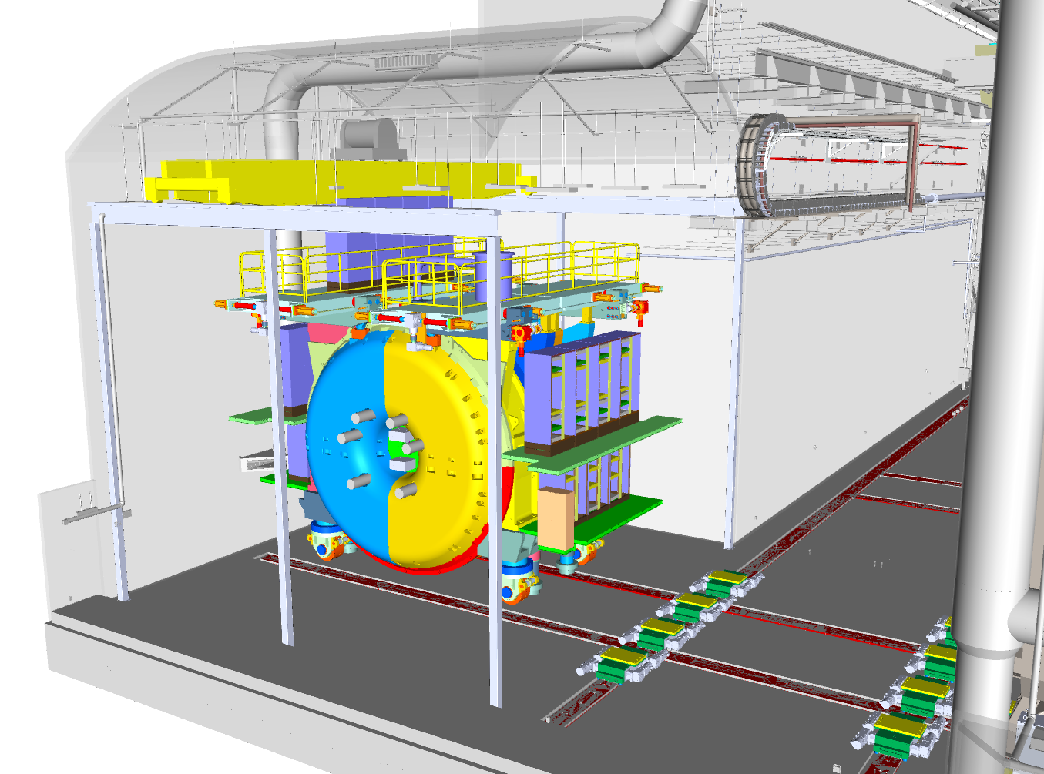
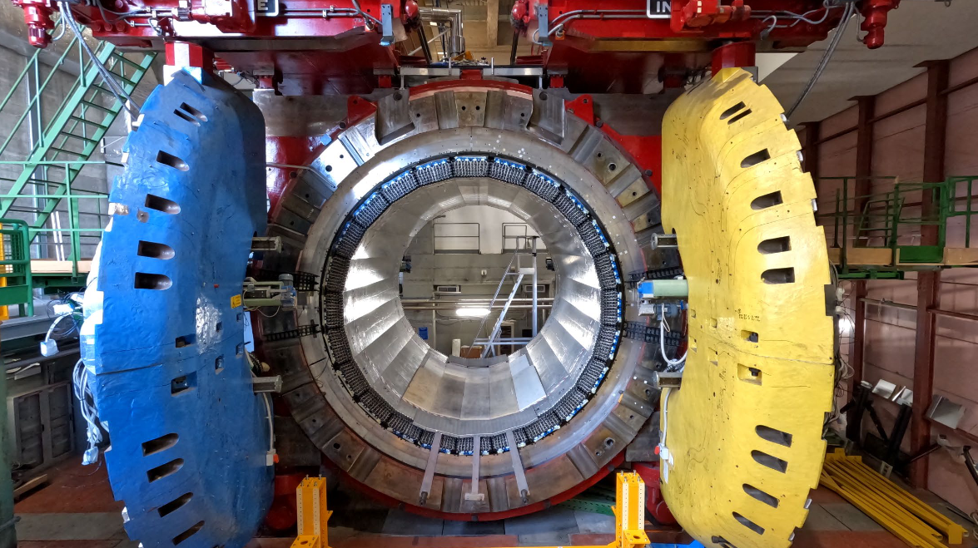
SAND Detector
KLOE Superconducting Magnet/EM Calorimeter

Slide 11
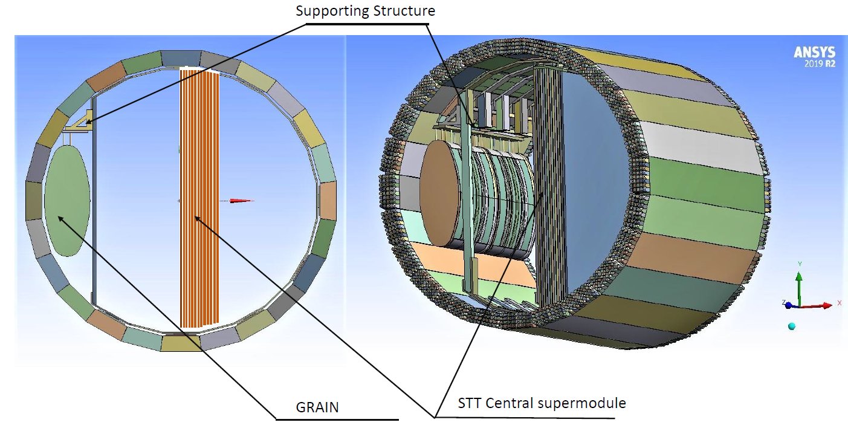
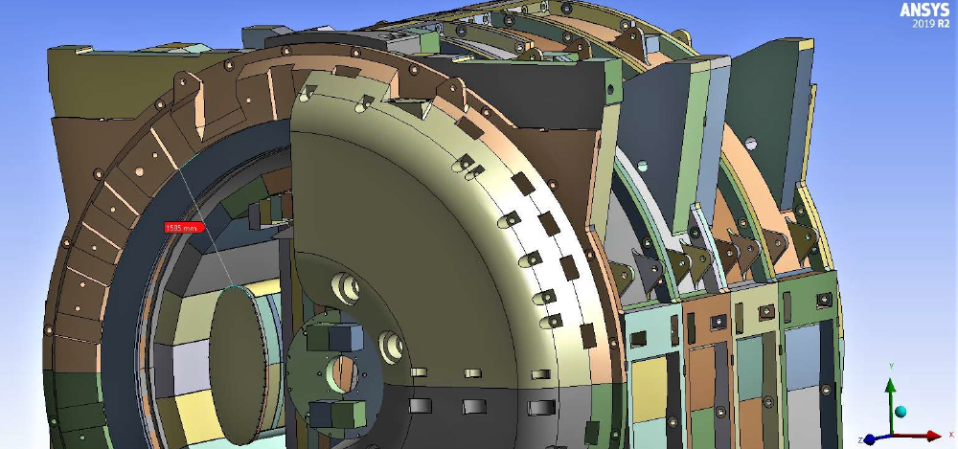
GRAIN
Argon target (control of systematics)

Slide 12
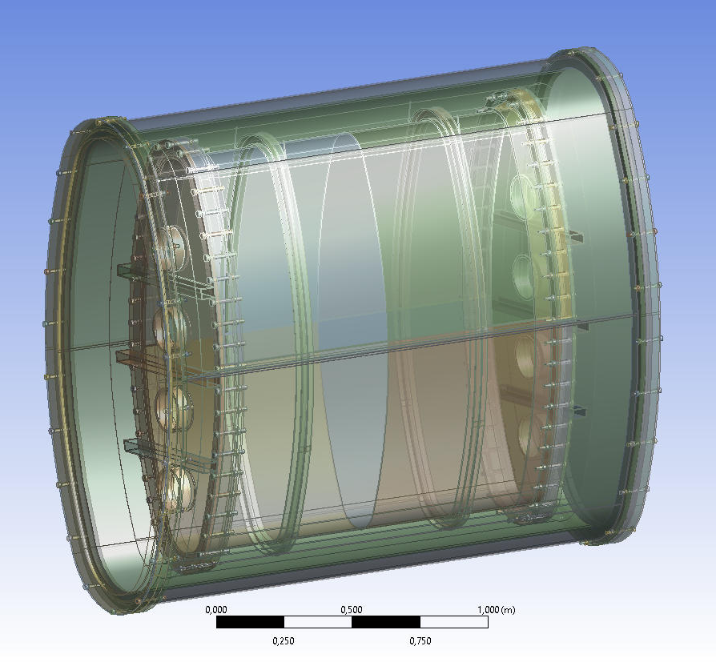
GRAIN cryostat
1 T of liquid Argon
Innovative Track imaging (instead of TPC)

Slide 13
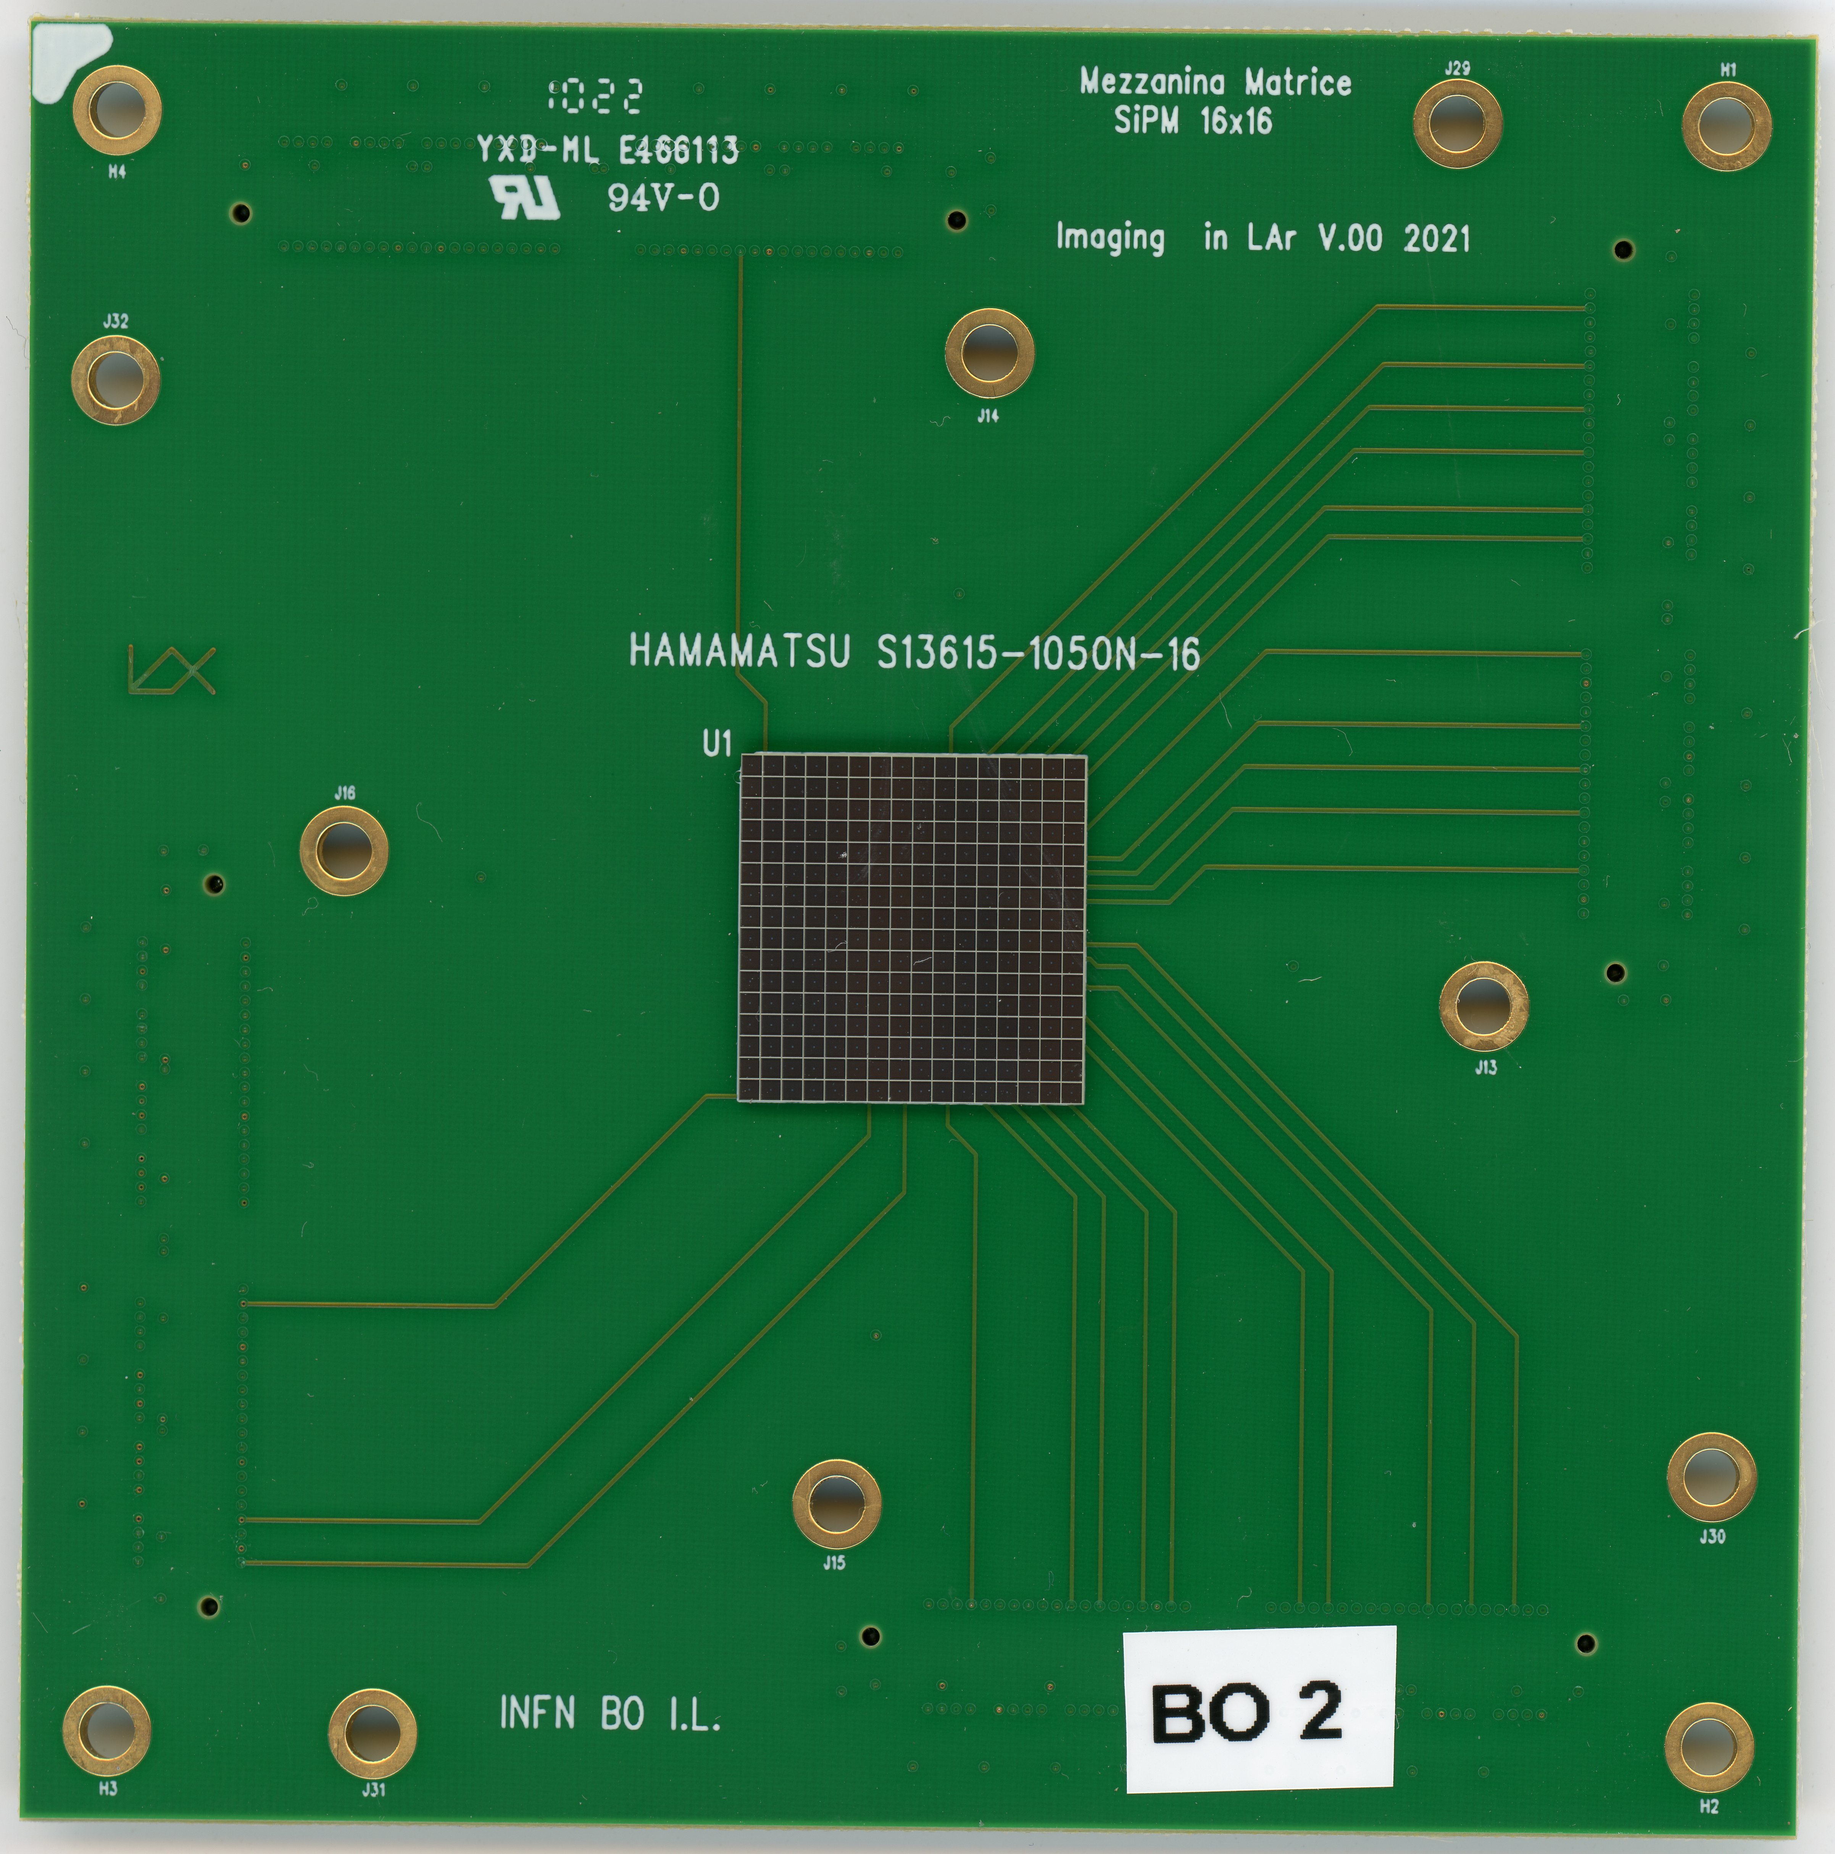
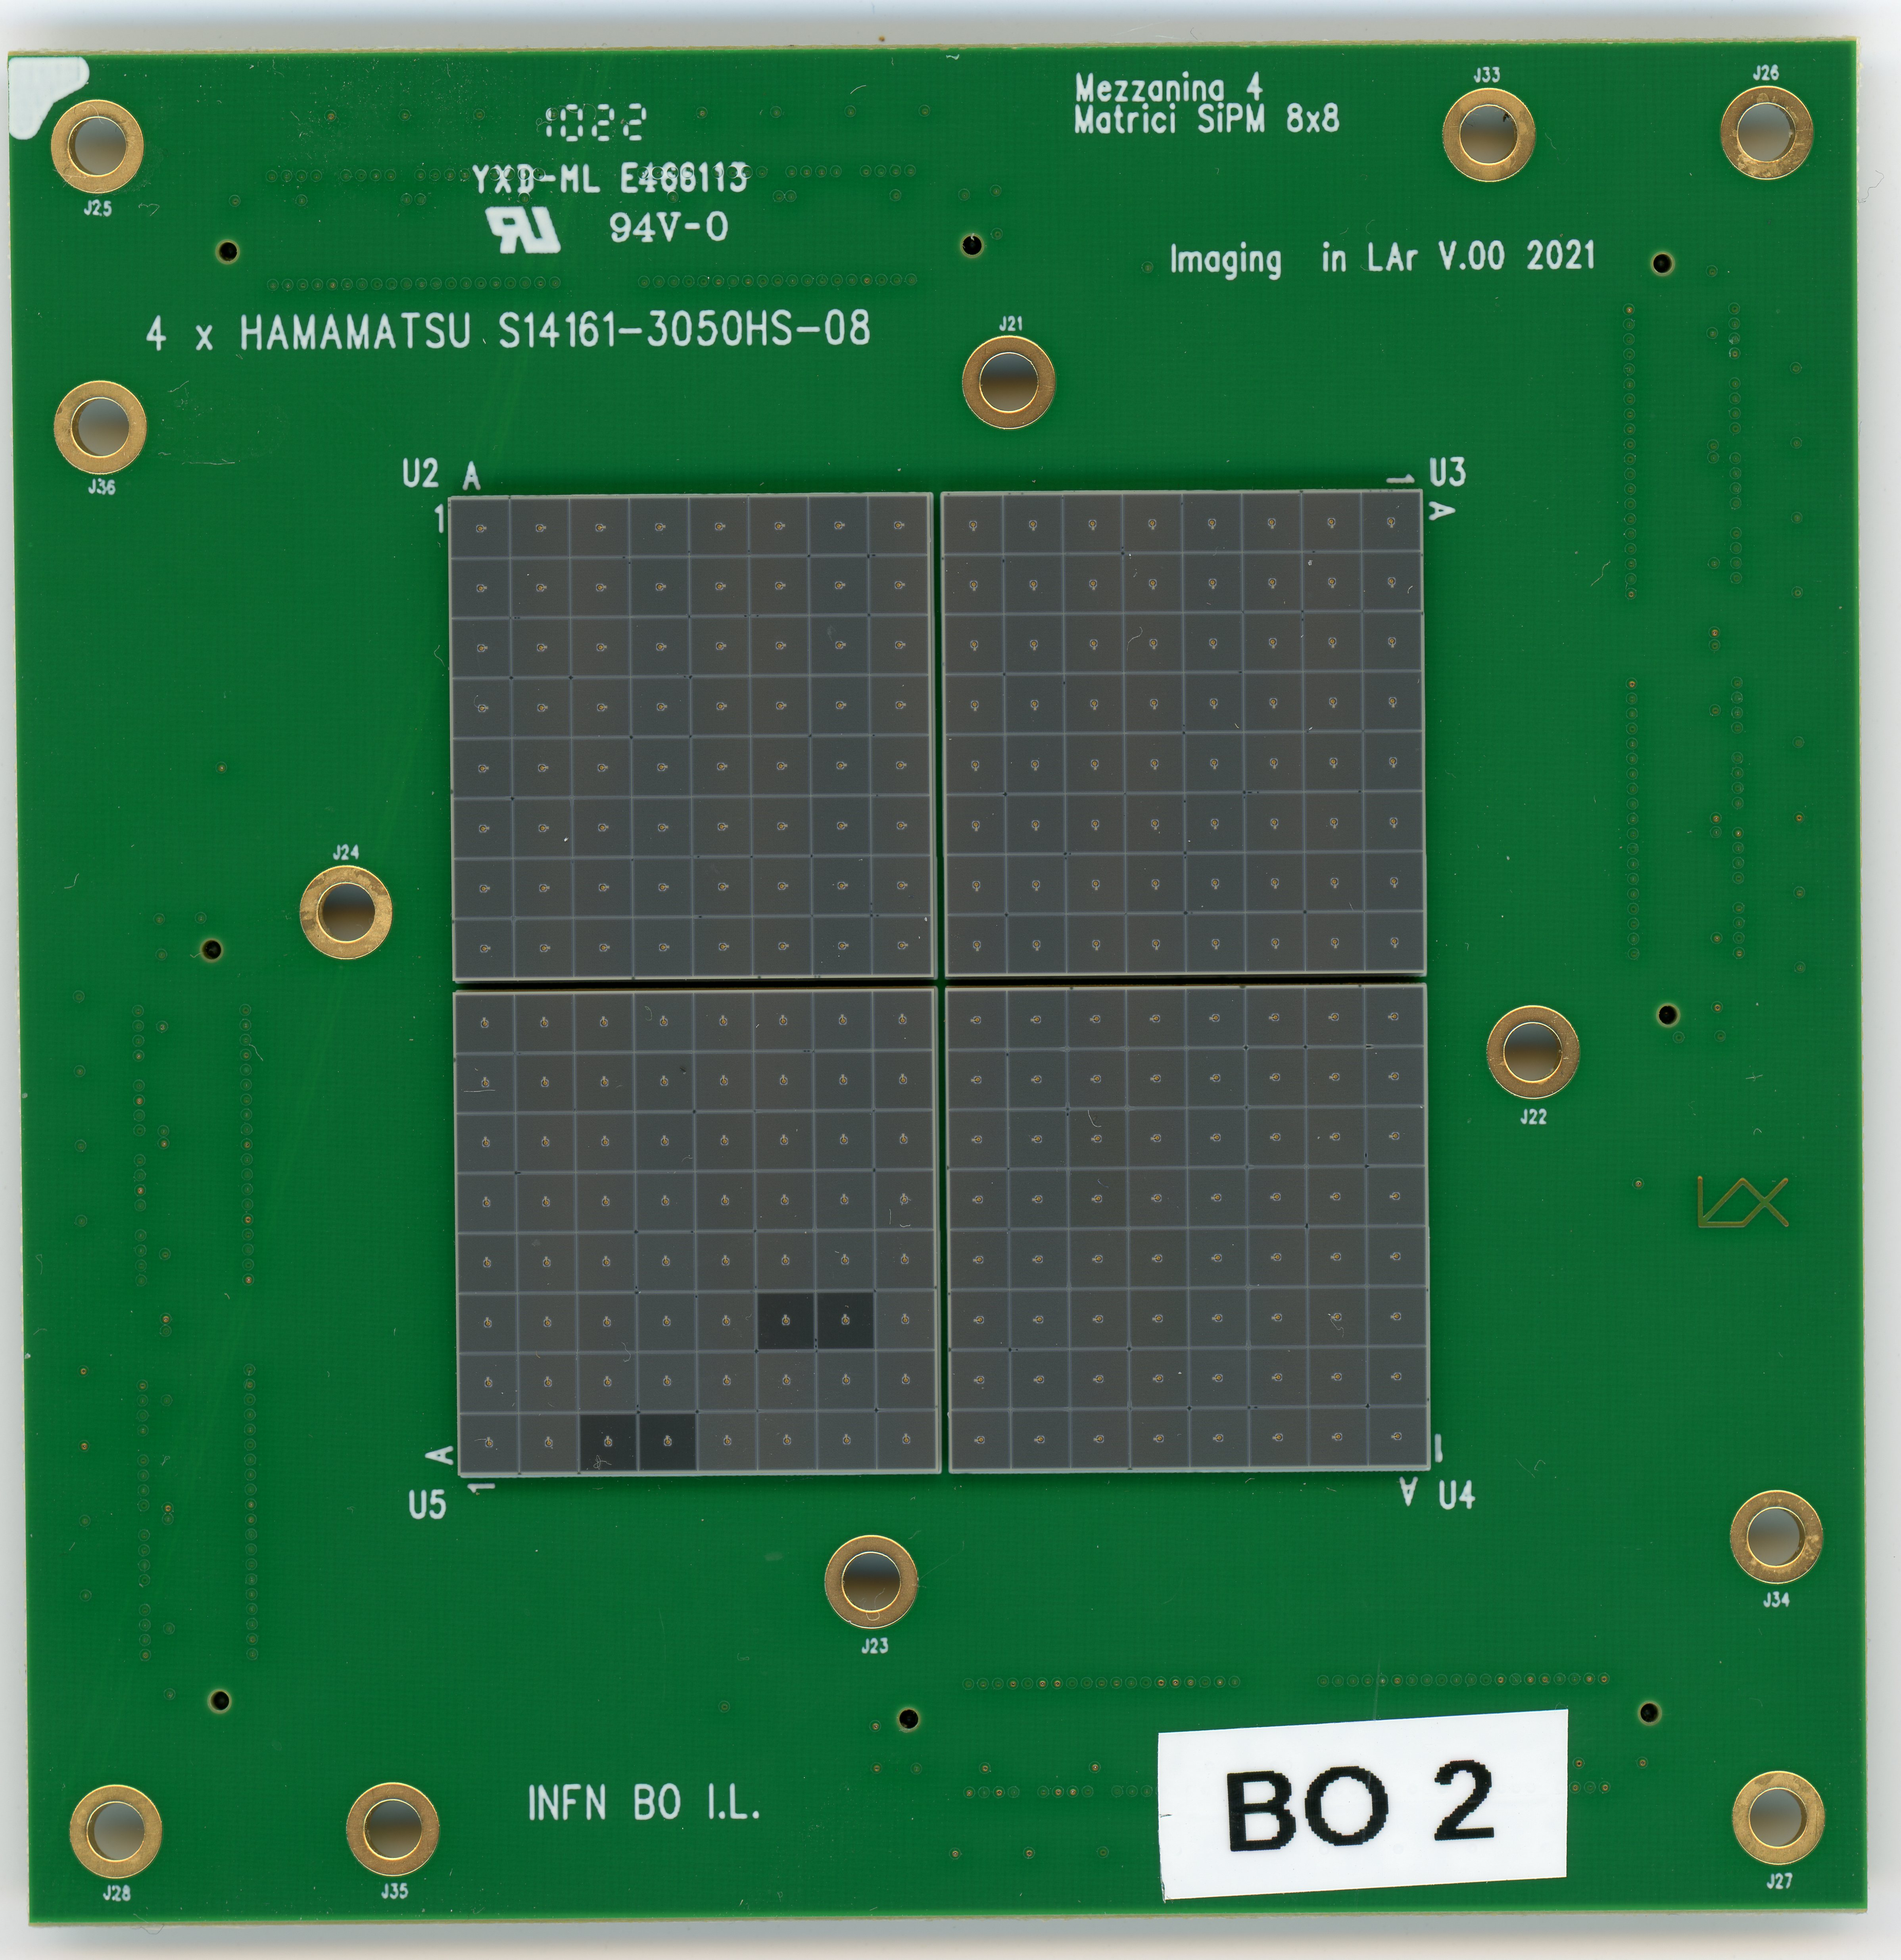
Photosensor
Matrices of Silicon PhotoMultipliers
From Hamamatsu different models and sizes
Choose to work now with 16x16 matrices of 1x1 mm² or 3x3 mm² SiPM
256 is the maximum channel count we can afford with presently available electronics (ASIC)
~ 5 cm
~ 2 cm

Slide 14
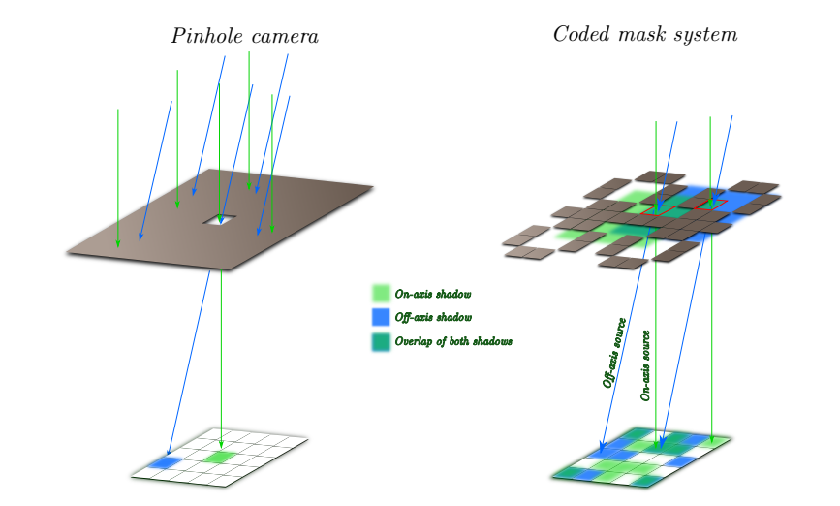
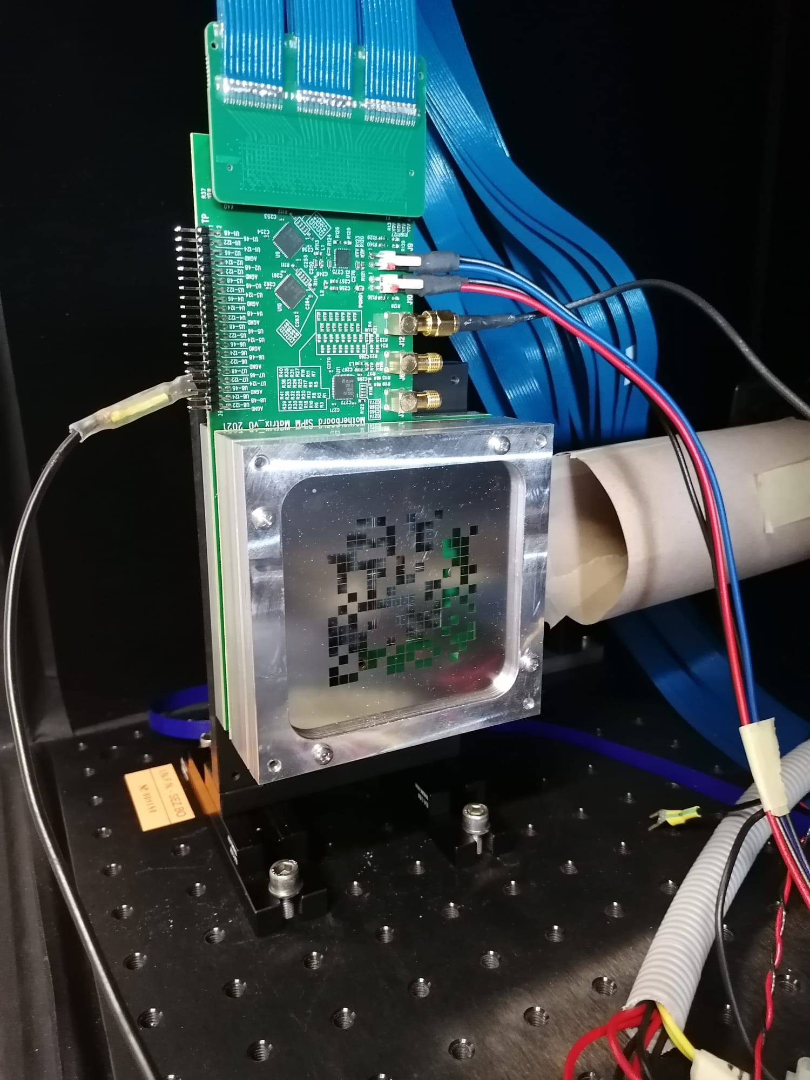
Optic with Coded Aperture masks
.
Coded aperture mask techniques were developed as the evolution of a single pinhole camera
matrix of multiple pinholes to improve light collection and reduce exposure time
Image formed on sensor is the superimposition of multiple pinhole images ….
Advantages:
Good light transmission (50%)
Good depth of field
Small required volume

Slide 15
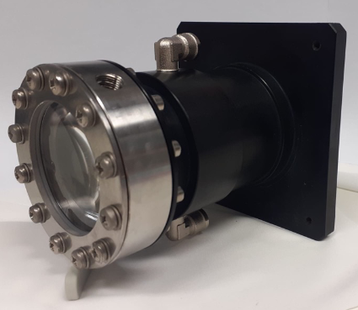
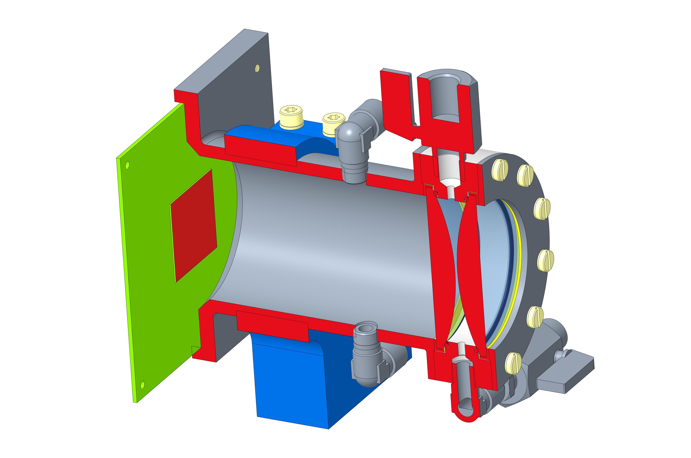
Optics with Lenses
Type A
Type B

Slide 16
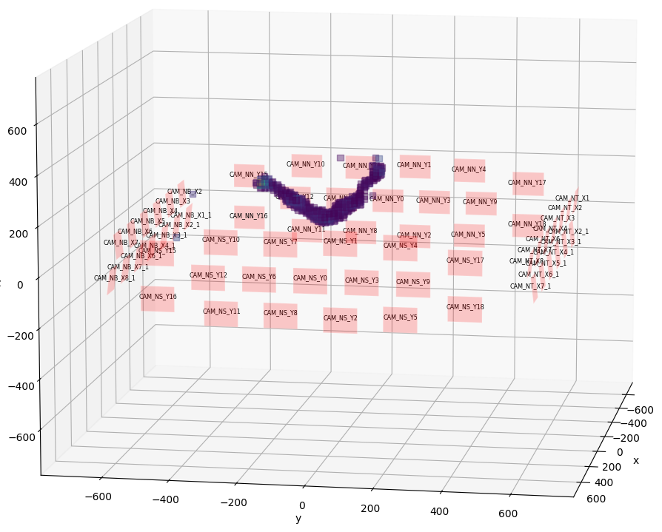
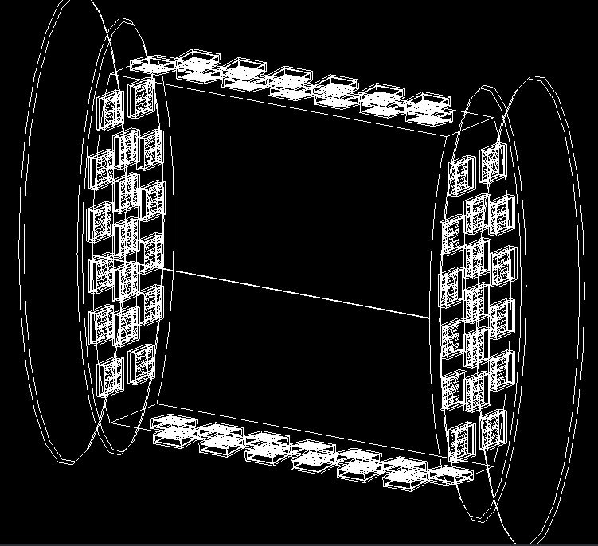
Track Reconstruction with masks
Algorythm running on GPUs
ν_{µ} → µ + p
Reconstructed photons emission point
Detector layout

Slide 17
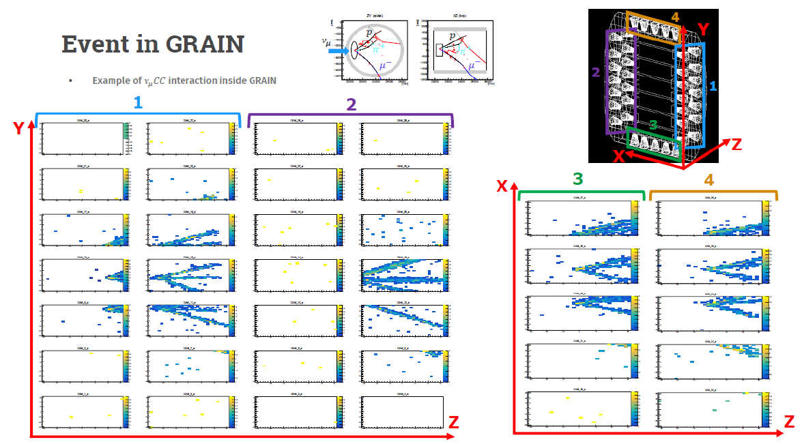
Track Reconstruction with lenses

Slide 18
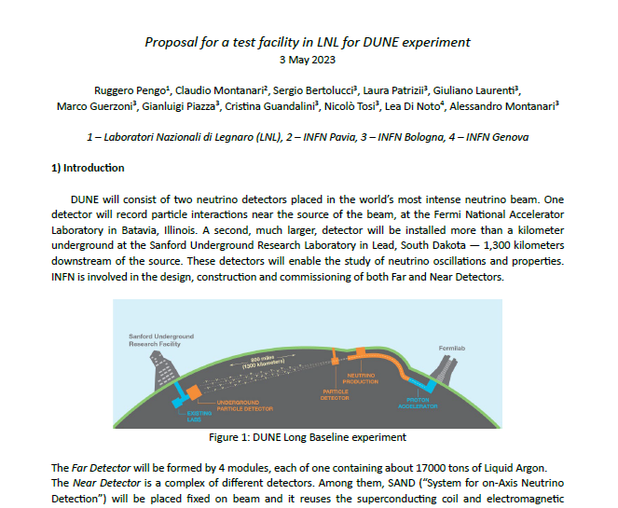
Test Facility in LNL
Document on the proposal (pdf in today’s agenda):

Slide 19
Why do we need a Test Facility ?
Test detectors and verify/fixing:
Internal Vessel mechanics and cabling
sources of electronic noise
bubble formation near cameras (subcooling, other solutions)
output signals integrity
clock distribution and frontend ASICs syncronization
:Test proximity cryogenic system:
final system that will be sent to Fermilab (see Piazza’s talk)
Real LN2 consumption during cool down and static

Slide 20
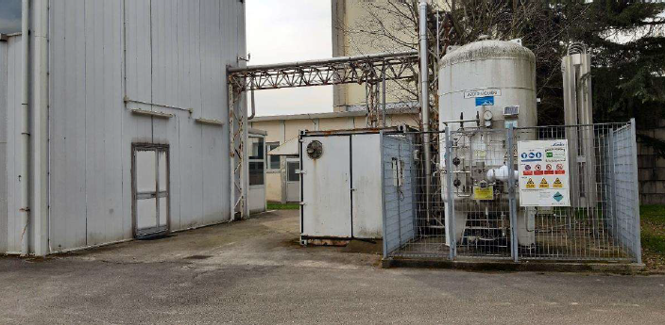
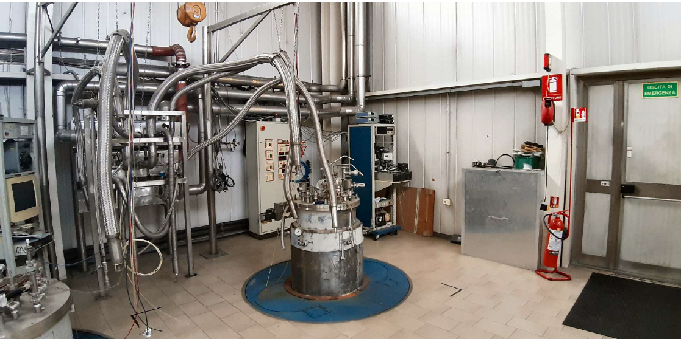
LNL area
LNL ideal location for Test Facility
Refurbishing / GRAIN cryogenic system in charge of INFN-DUNE experiment (see Piazza’s talk)
1 engineer from INFN-Bo responsible, 1 technicians (1 day/week) cryogenic division LNL), 1 technicians INFN-Bo (PD?)
Ruggero Pengo as consultant expert

Slide 21
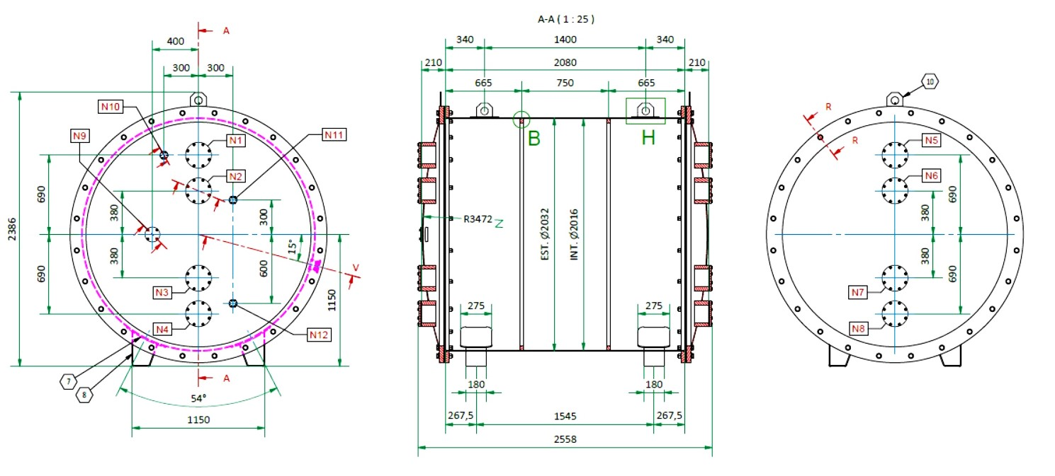
Vacuum tank
..

Slide 22
Timeline
2024
2025
2026
2027
2028
2029

Slide 23
SPARES

Slide 24
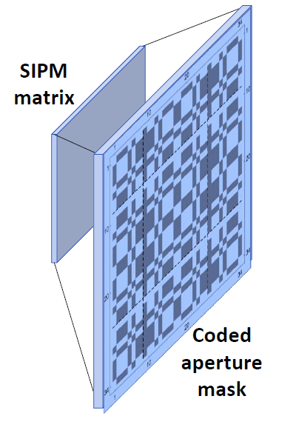
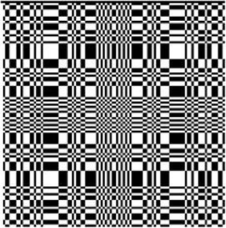

Slide 25
Refurbishment is proceeding:
New vacuum isolated transfer lines
commisioned
New electric Control Panel
to be used also in final GRAIN

Slide 26
..

Slide 27
Verification of Internal Vessel mechanics and cabling with all cameras
Verification and fixing sources of electronic noise
Studt bubble formation (power dissipation) near cameras in sub-cooling conditions
Study and fix integrity of output data signals
Verification of clock distribution and tune syncronization of all frontend ASICs

Slide 28
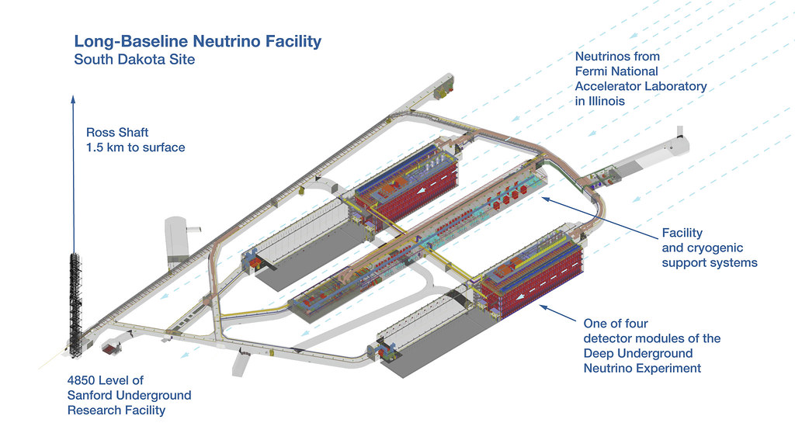
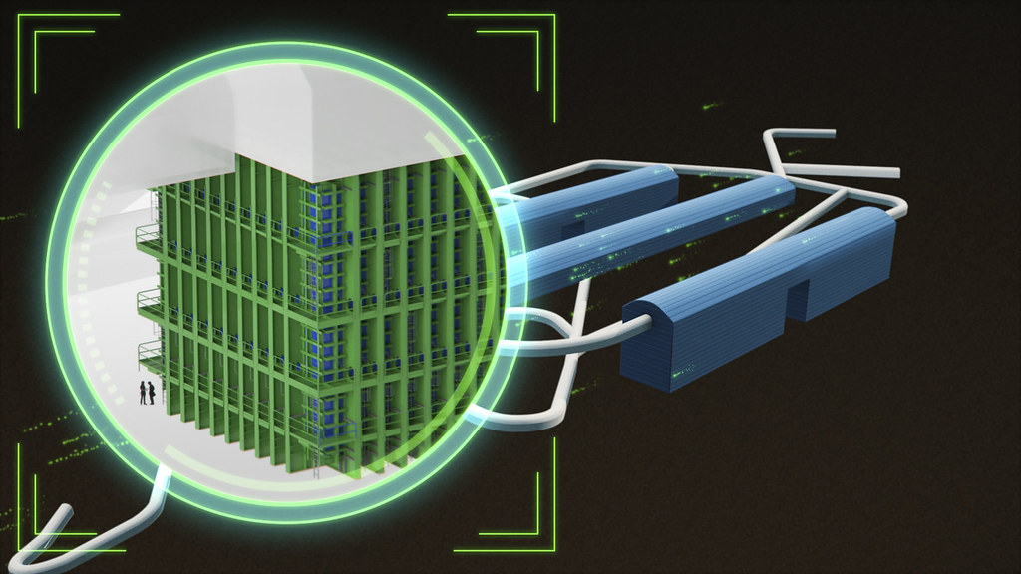
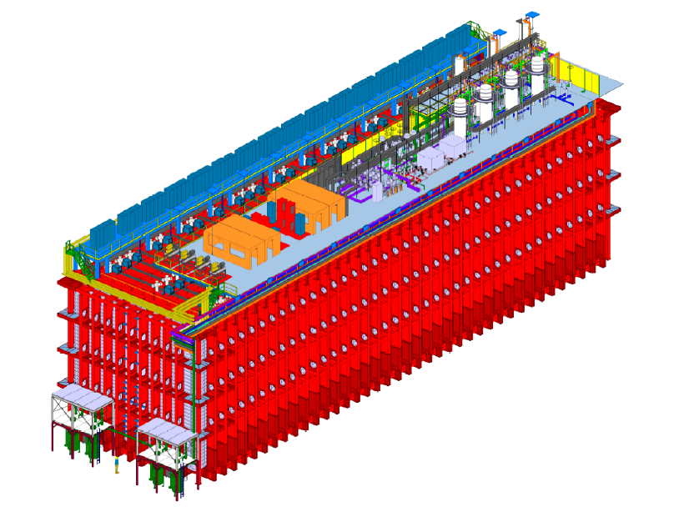
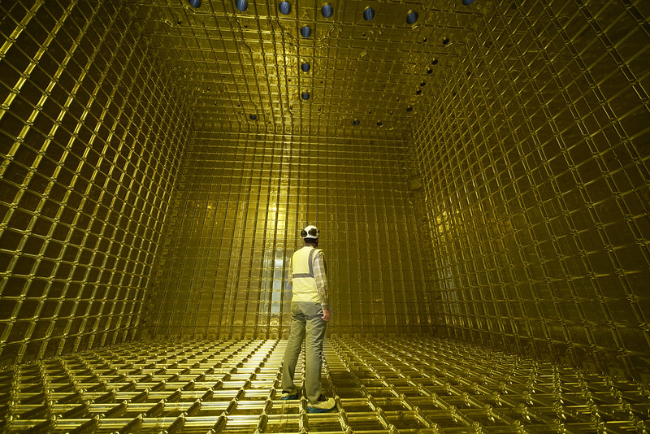
Far detector
…

Slide 29
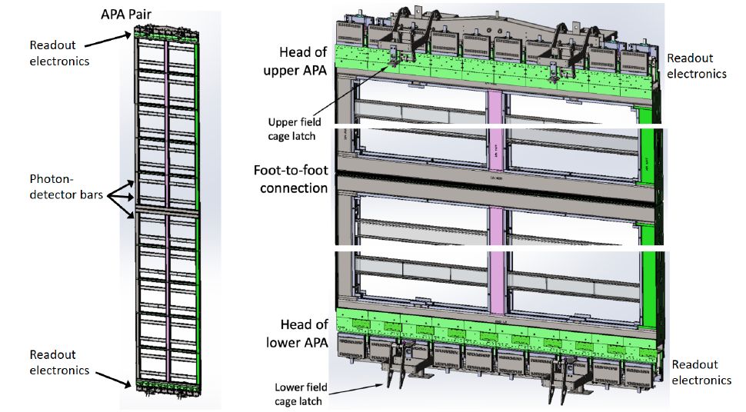
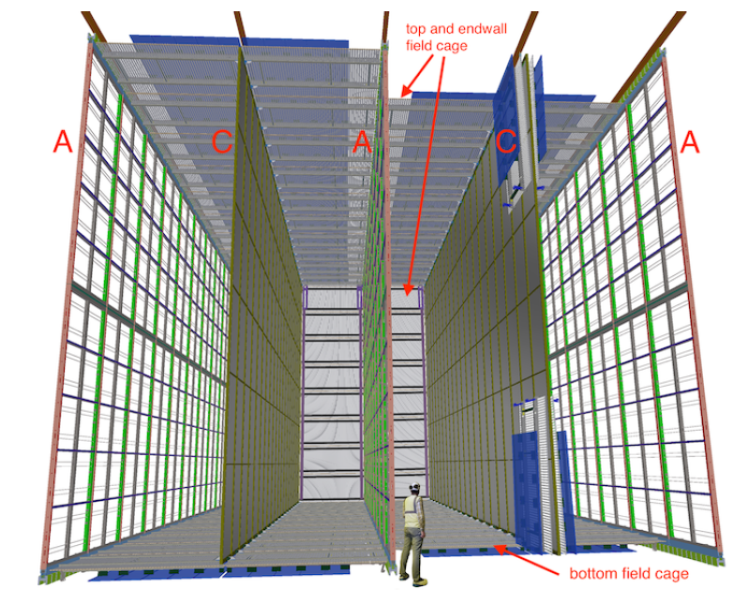
Far Detector Liquid Argon TPC
…

Slide 30
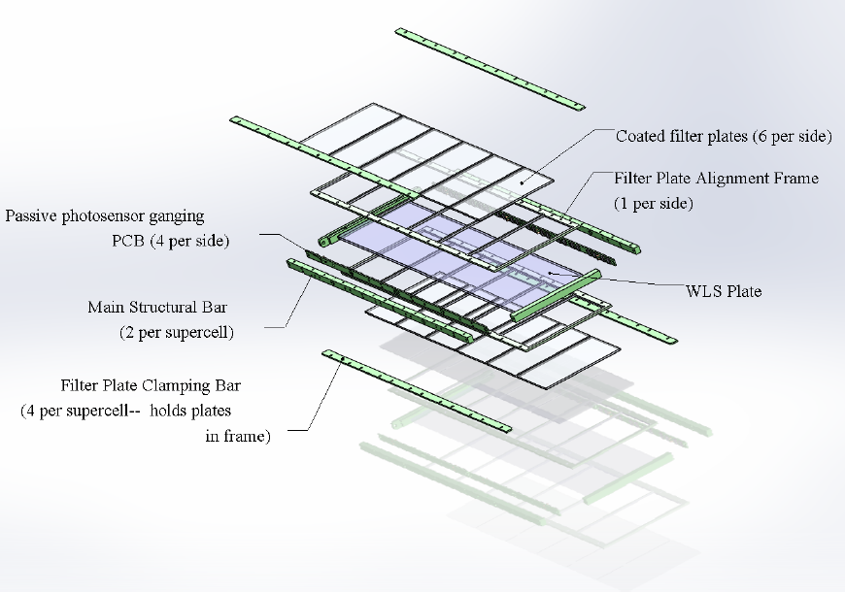
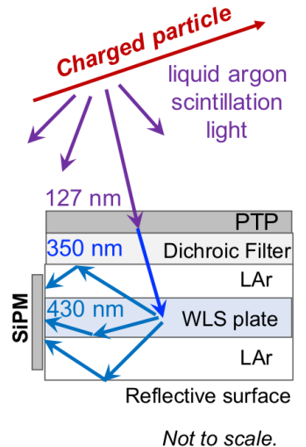
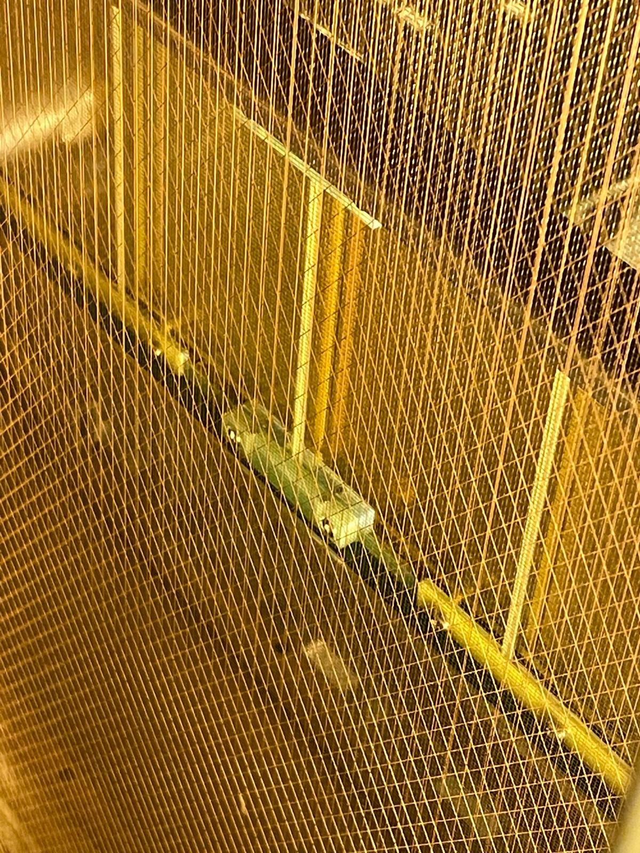
Arapuca Ligth Trap
…

Slide 31
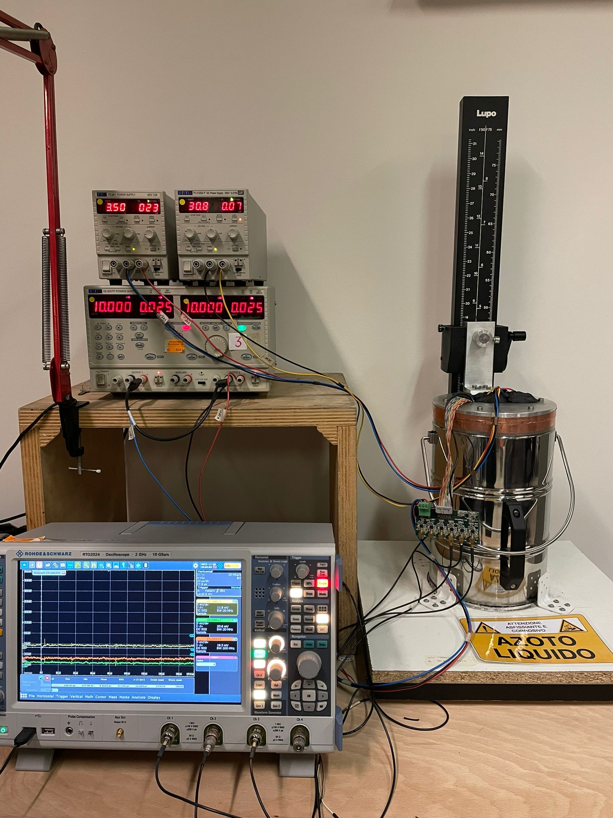
Test System
Test Hamamatsu and FBK SiPM: O(100) samples

Slide 32
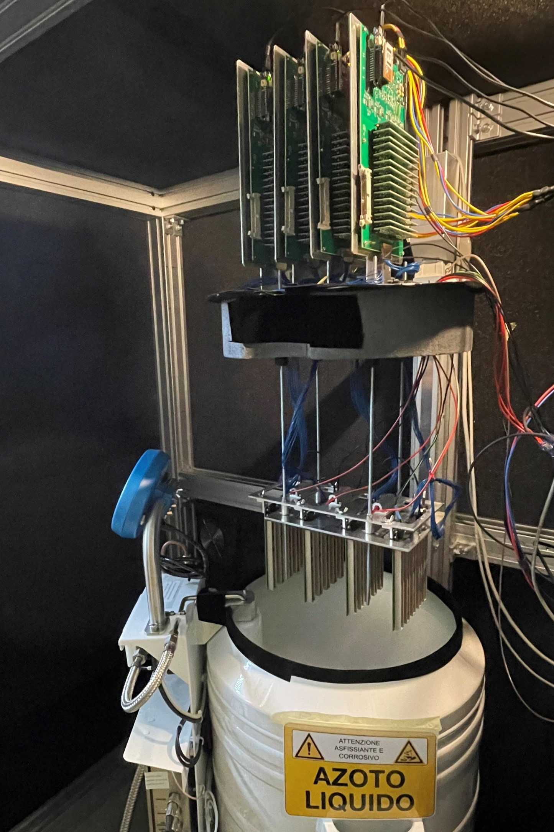
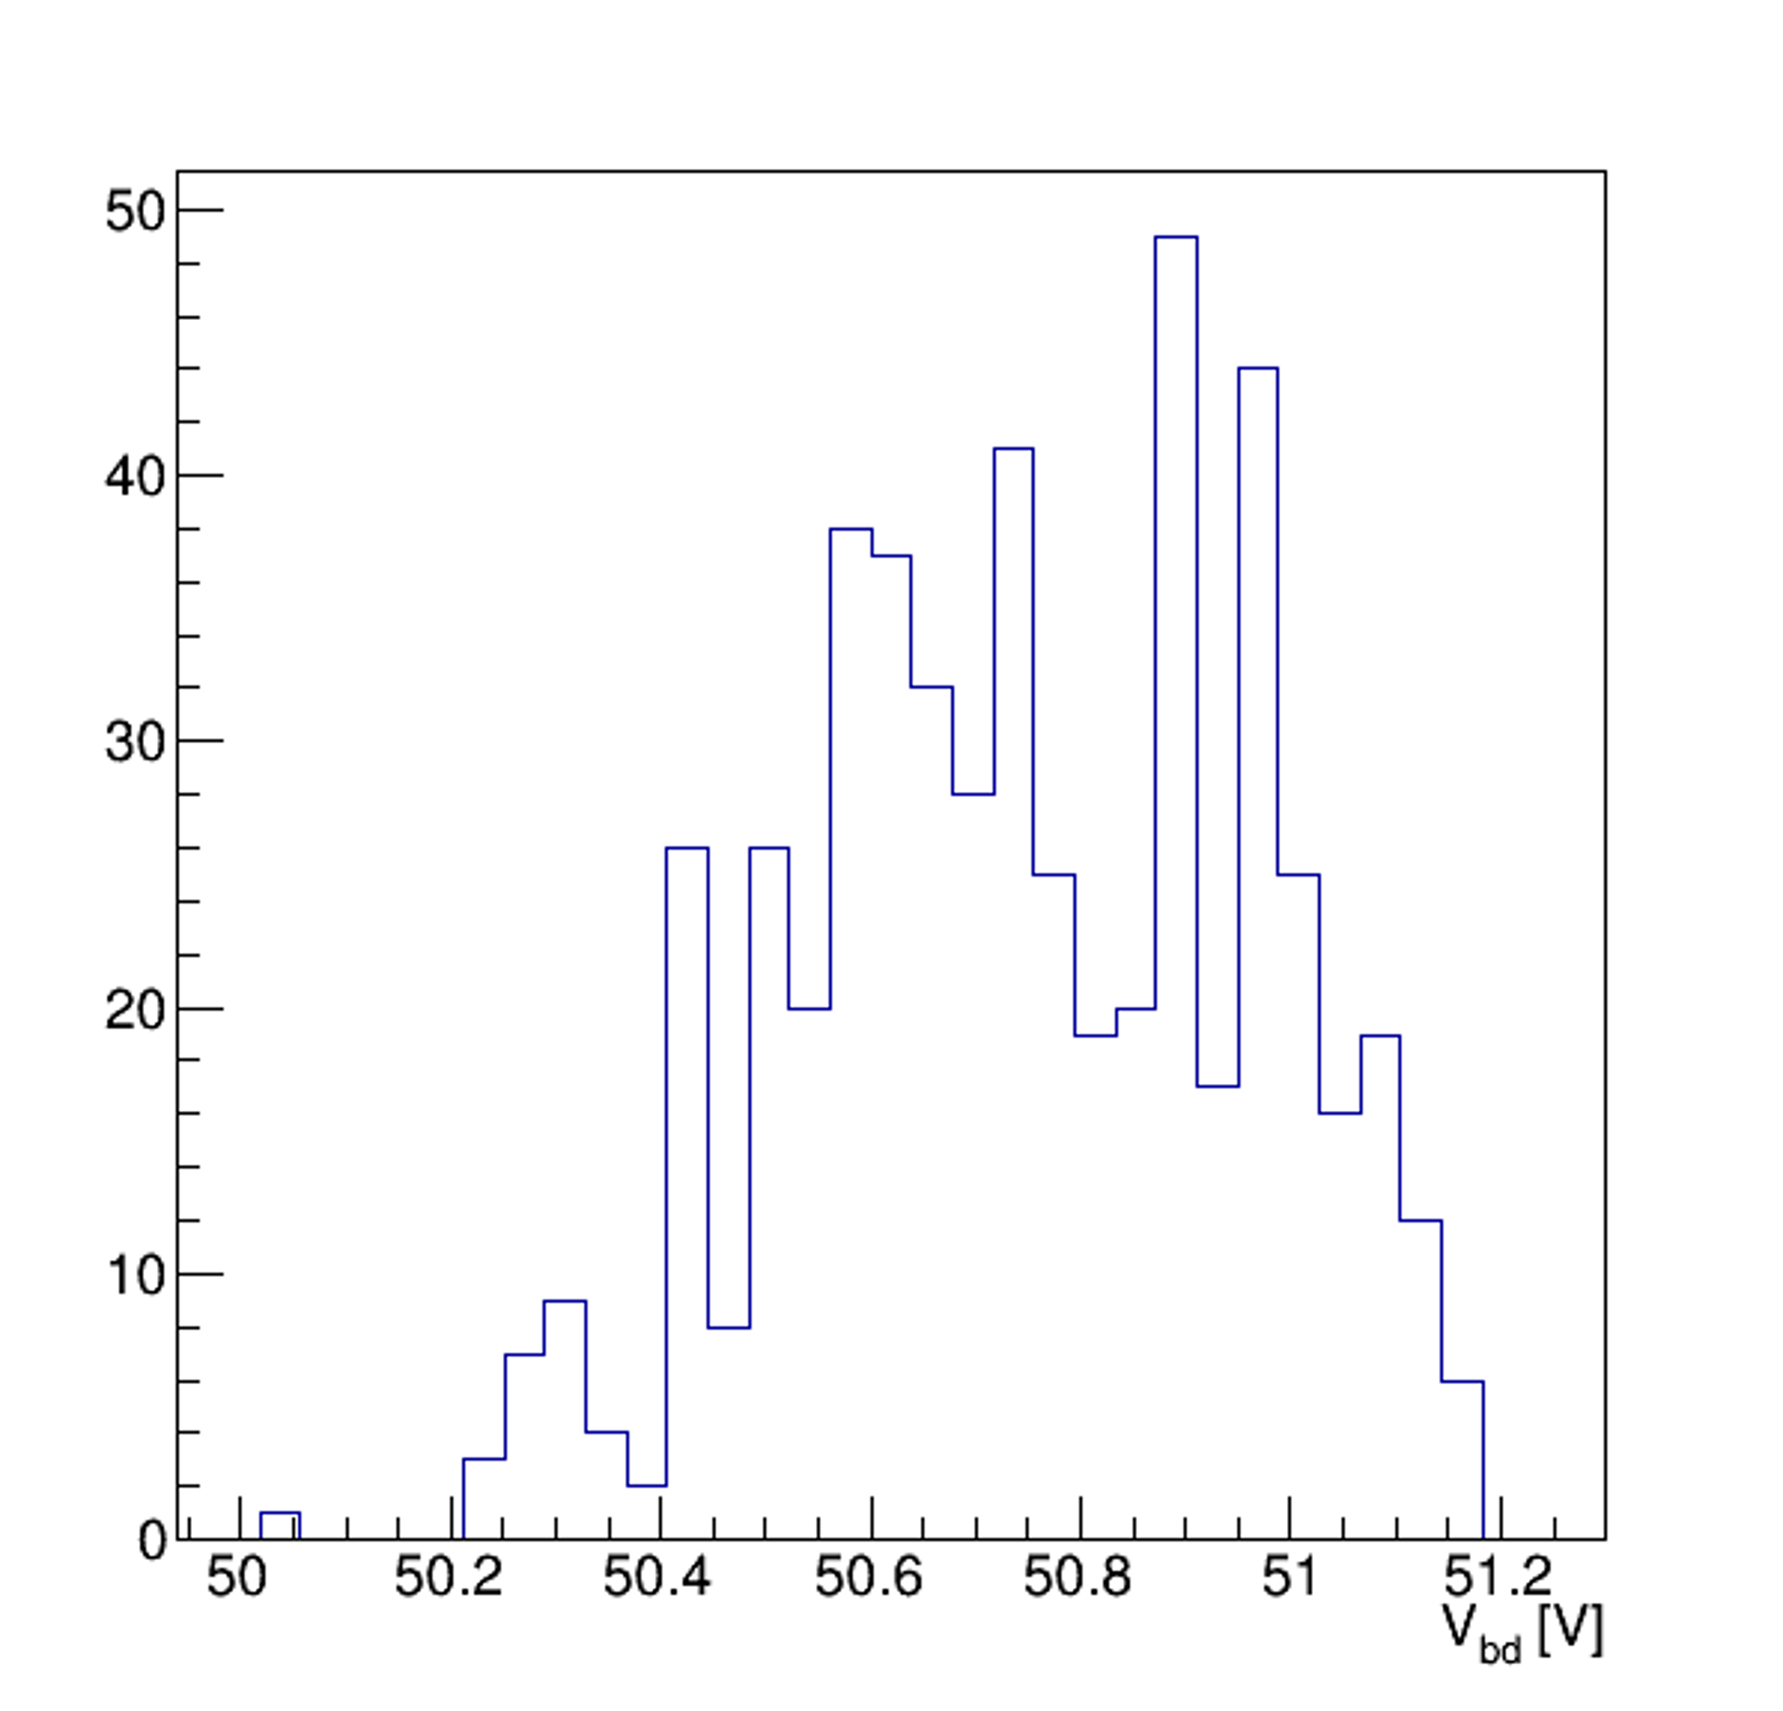
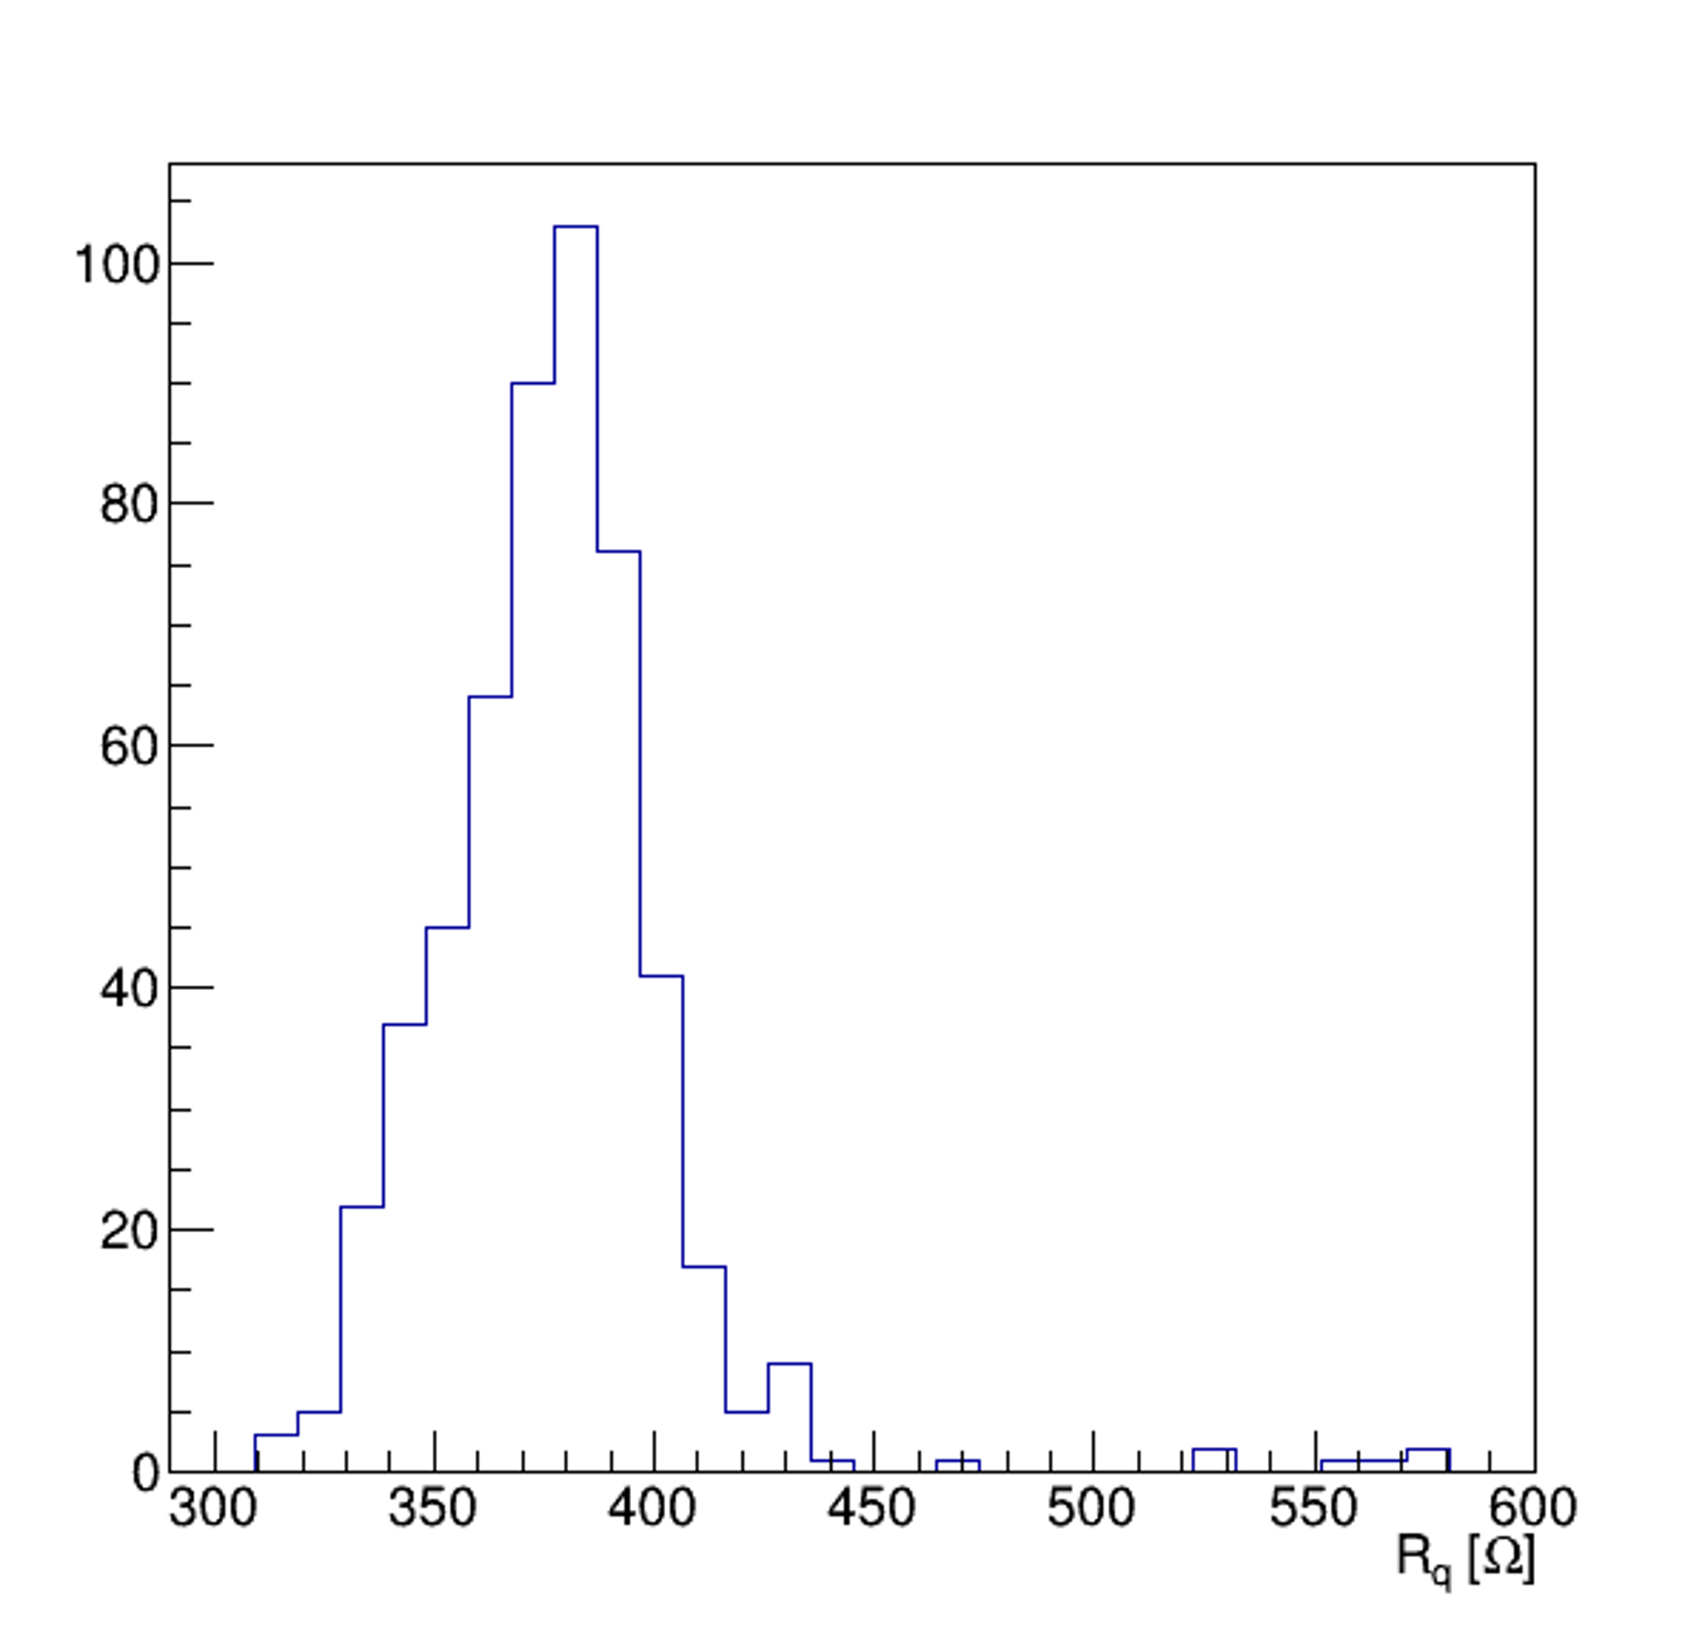
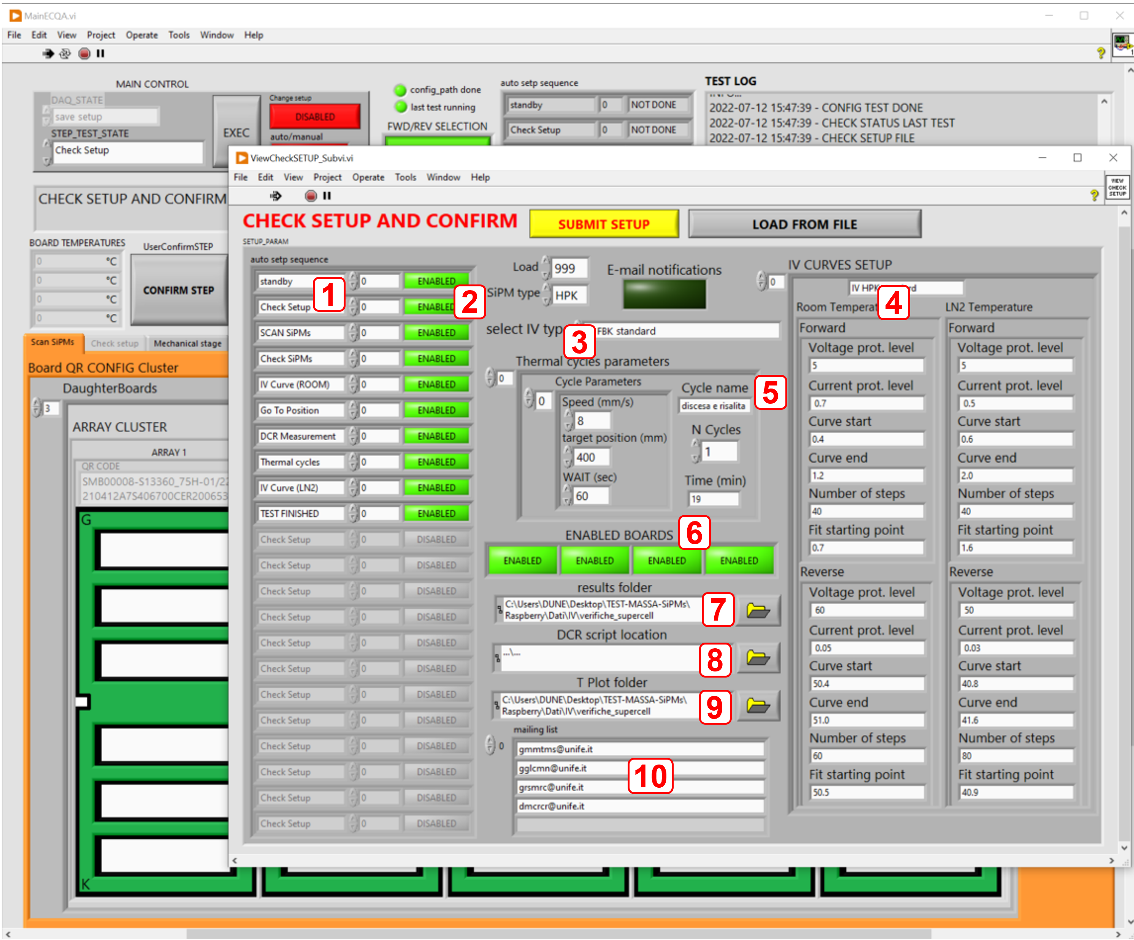
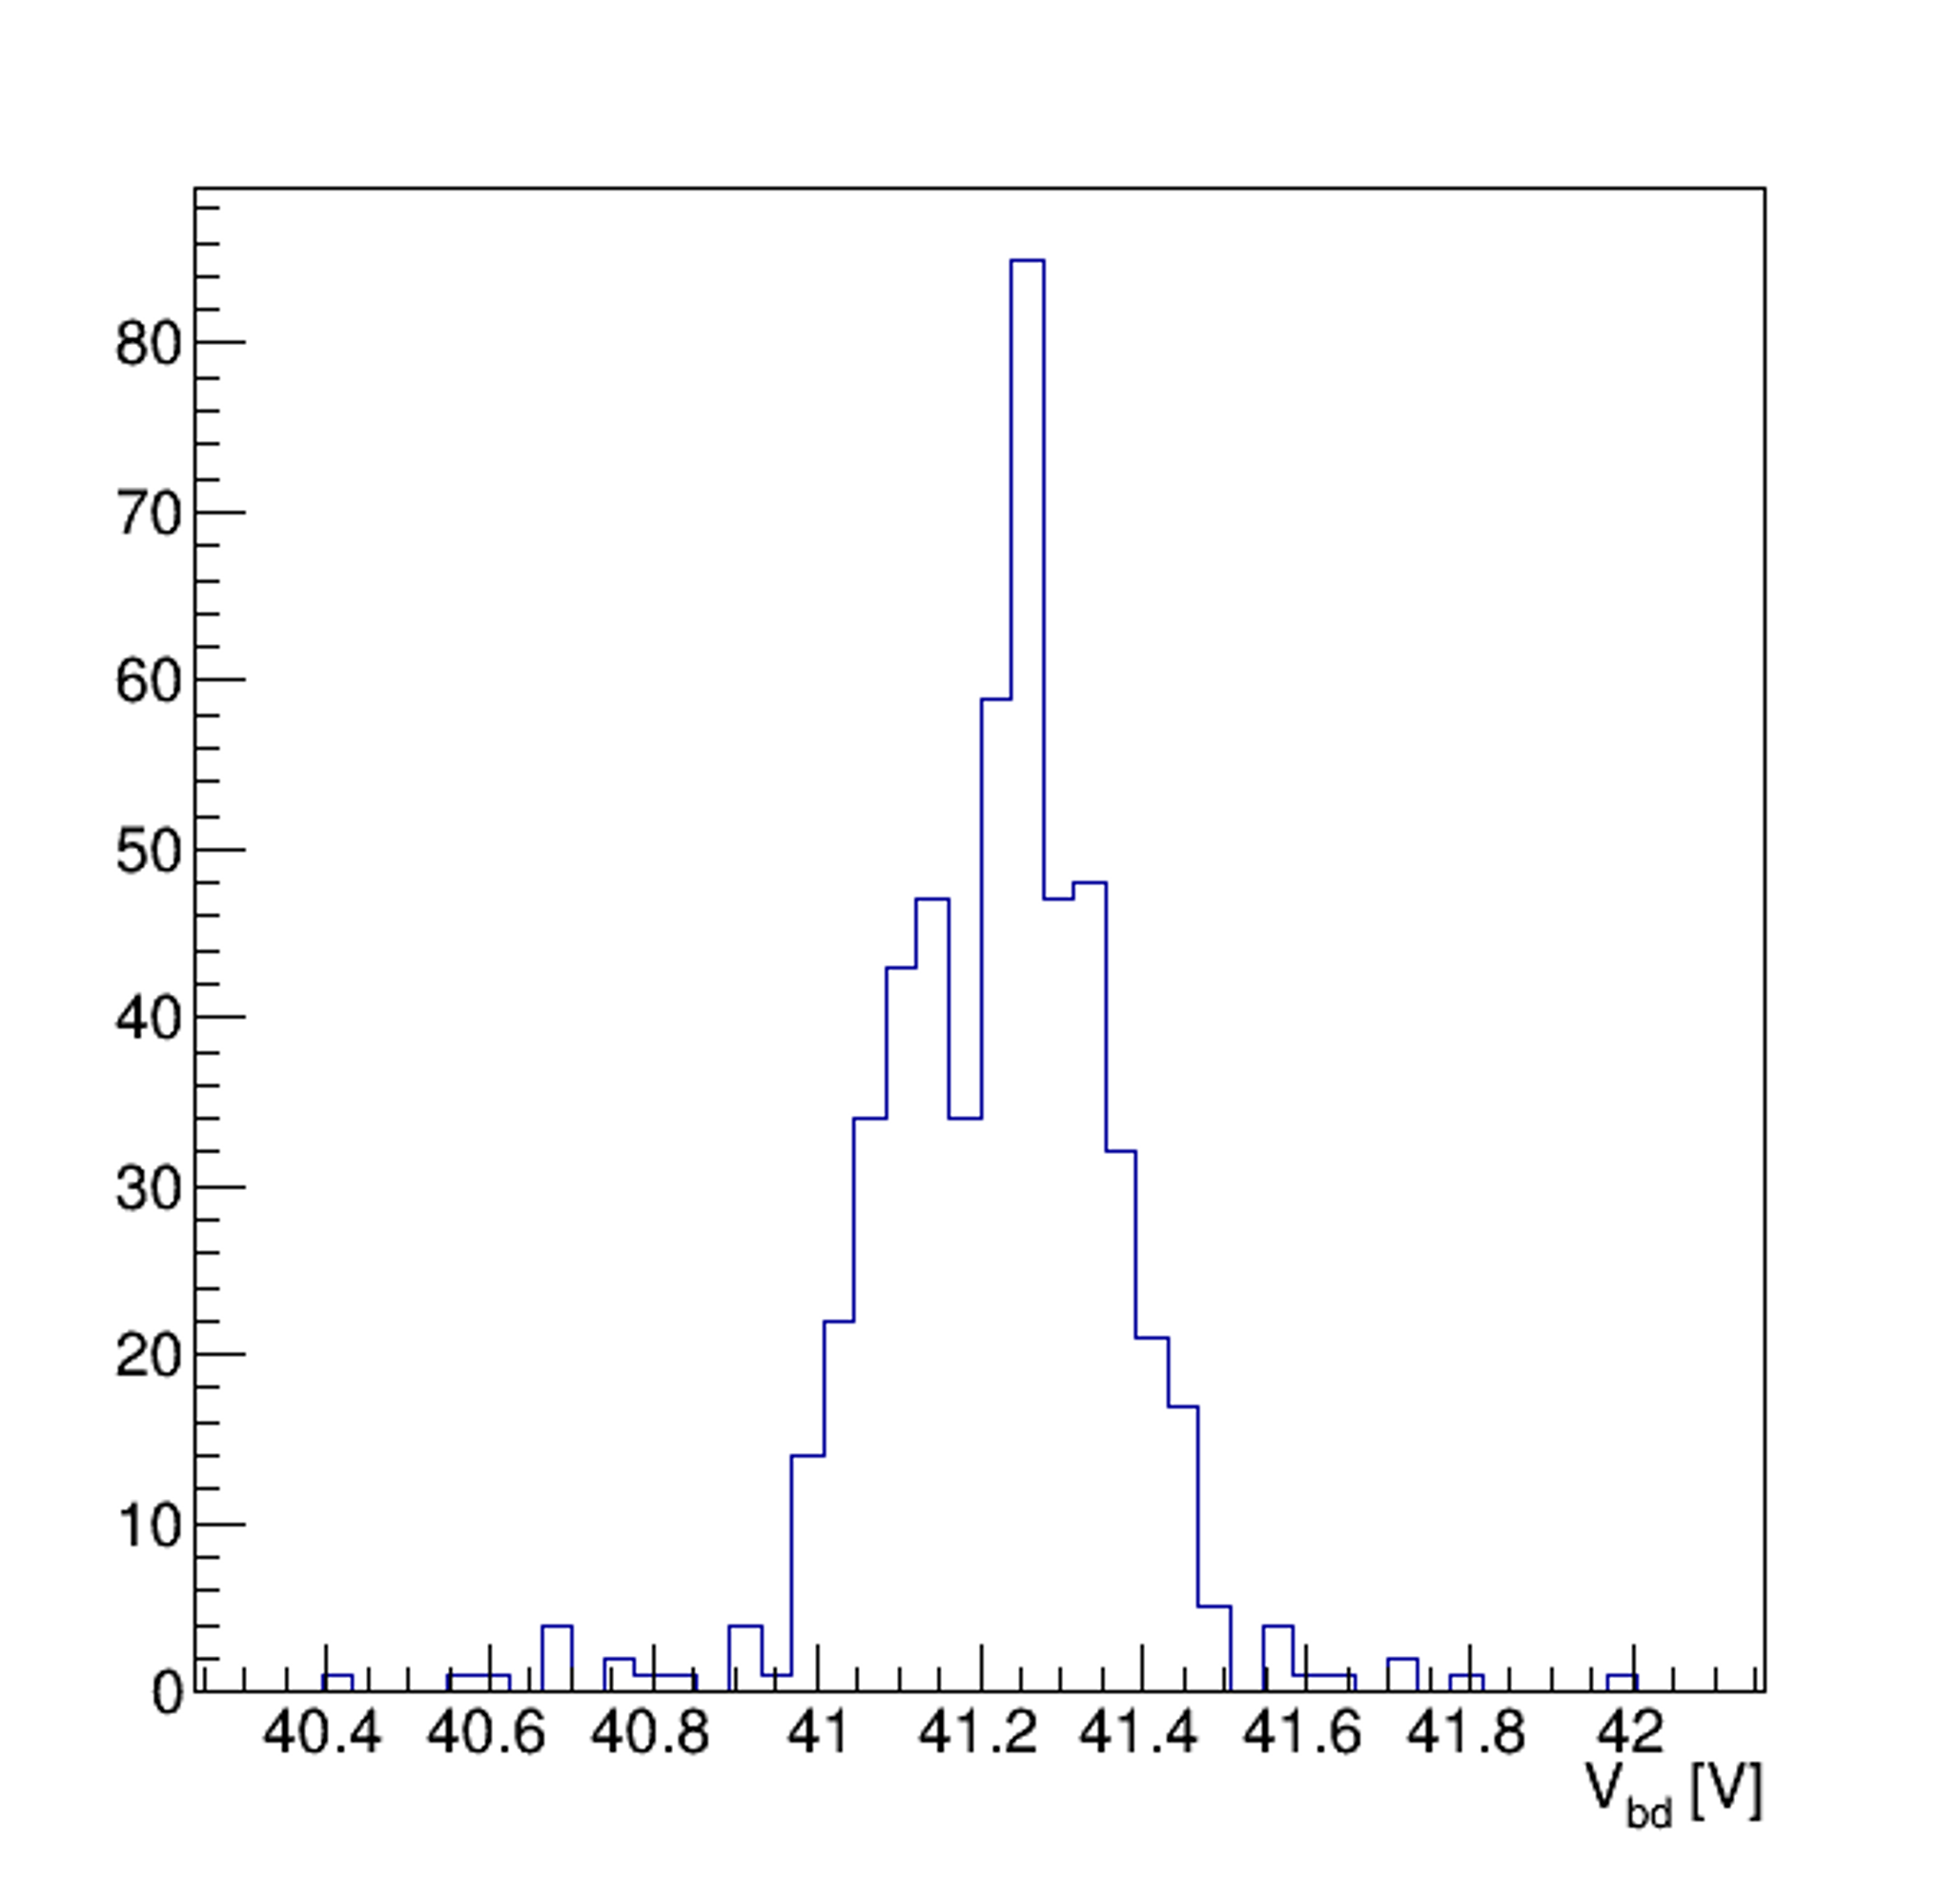
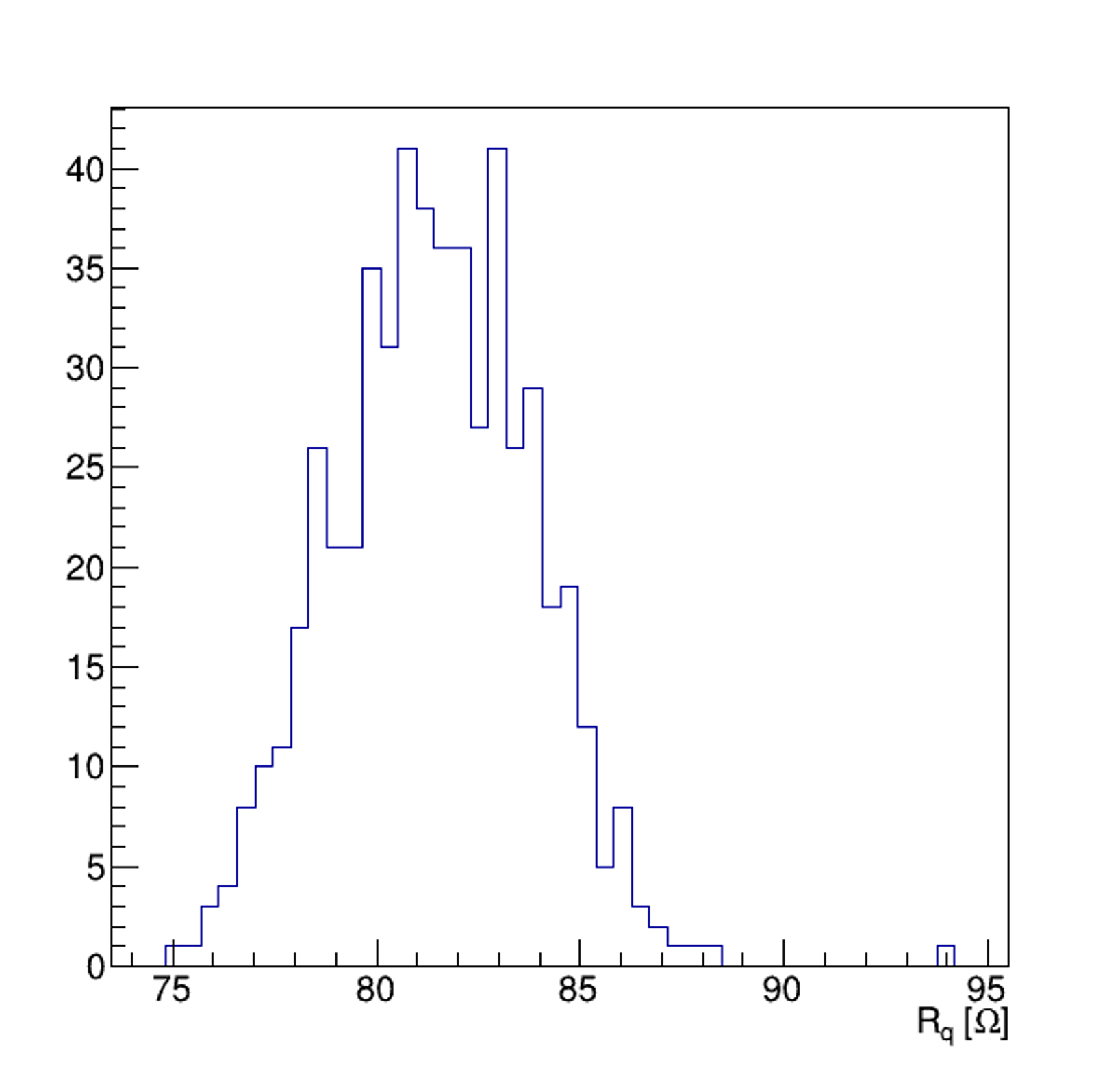
Mass Test System
Quality control of 290k: dedicated test facility
Vbd
Rq
77 k

