Slide 1
Evaporation Facility at Naples University
F. Di Capua on behalf of Napoli Group
Notes:
Write “many thanks to …” on corresponding slides

Slide 2
Group composition
Local group 2025: G. Fiorillo (UniNa), F. Di Capua (UniNa), N. Canci (INFN), Y. Suvorov (UniNa), R. Calabrese (INFN), D. Rudik (UniNA), E. Sarnelli (CNR-SPIN), G. Botogoke (INFN), G. Matteucci (UniNA)+2 Chimici (UniNa)
Ricercatori+Tecnologi: 7
PostDoc: 2
PhD: 2

Slide 3
European site for PTP wavelength shifting evaporation on Vertical Drift (FD2)
Evaporation of the cathod (320 double sided) and membrane (320+32 single sided) XA-VD modules
Evaporator design inherited from the Campinas evaporation chamber with
Relevant improvements:
larger chamber with 120 cm diameter providing +100% evaporation throughput wrt Campinas evaporator
multiple crucibles to assure more uniformity in the coatings and speed up the process
Pumping system sized to ensure 2 full coating processes/day

Slide 4
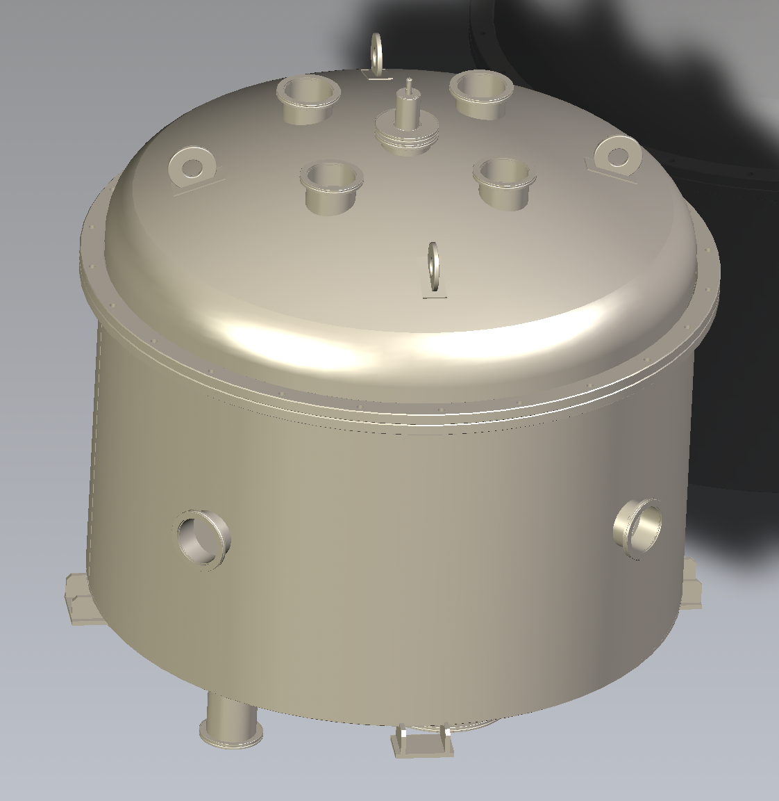
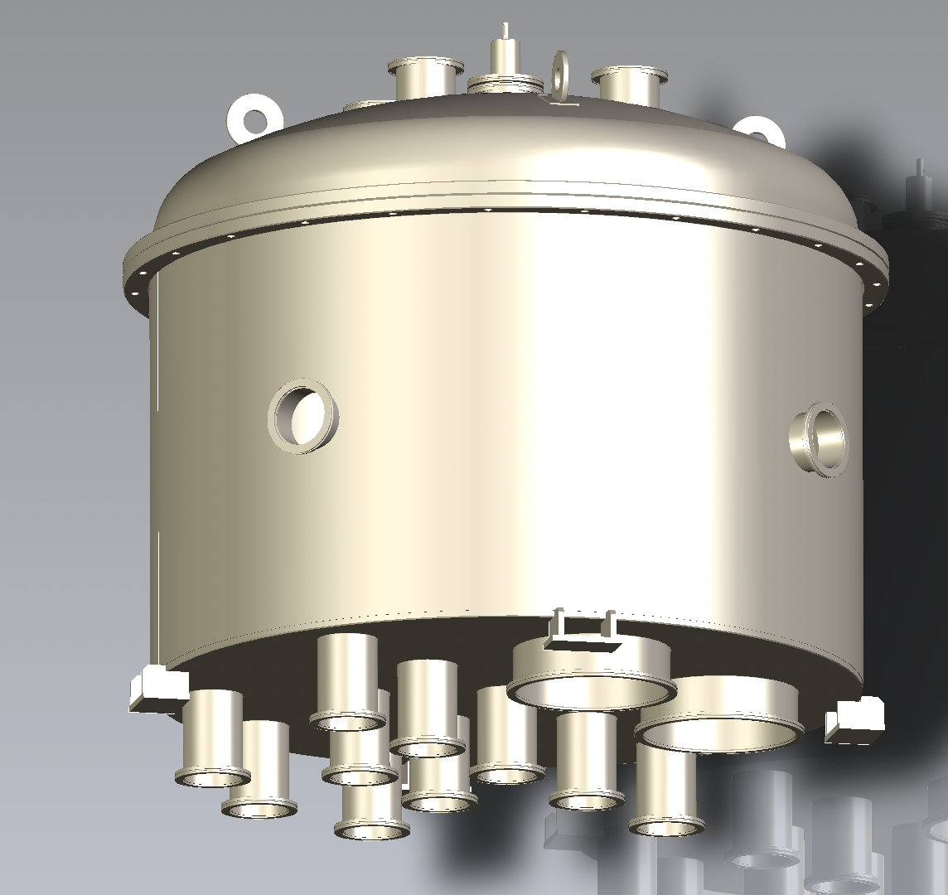
Chamber Design and Production
Chamber already designed and now in production phase
Several accommodations at the bottom base for crucibles (optimization of the position will be done in commissioning phase)
Pumping port 250 mm diameter (DN 250 ISO-F)
Several lateral and top ISO-K 100 flanges
Pumping station with a 40 m³/h and 2300 l/s turbopump Several lateral and top ISO-K 100 flanges
Motorized system on the top of dome with motion feedthrough to rotate a support structure disk to hold the filters

Slide 5
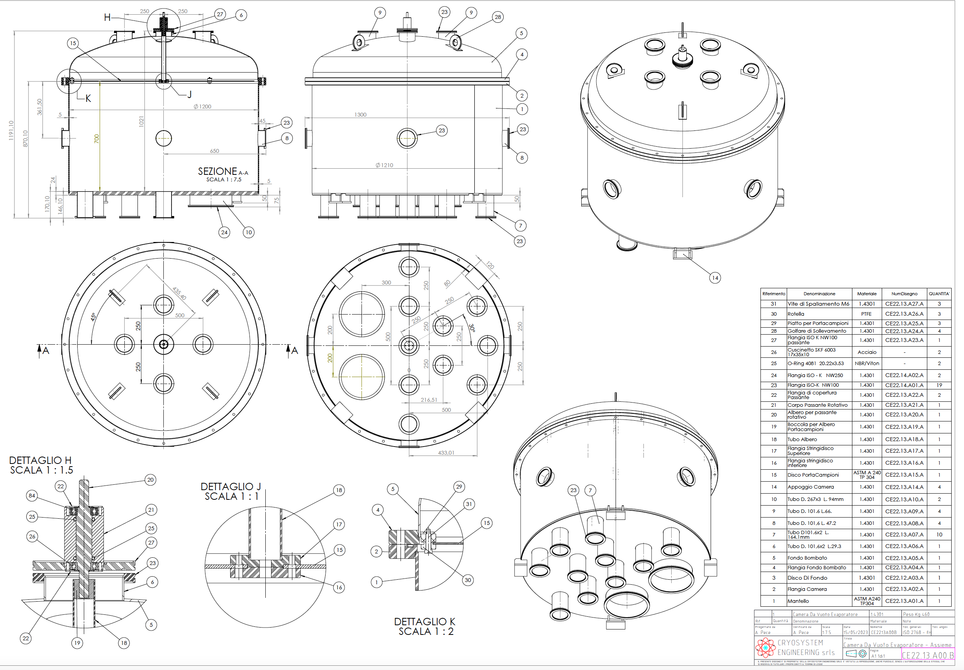

Slide 6
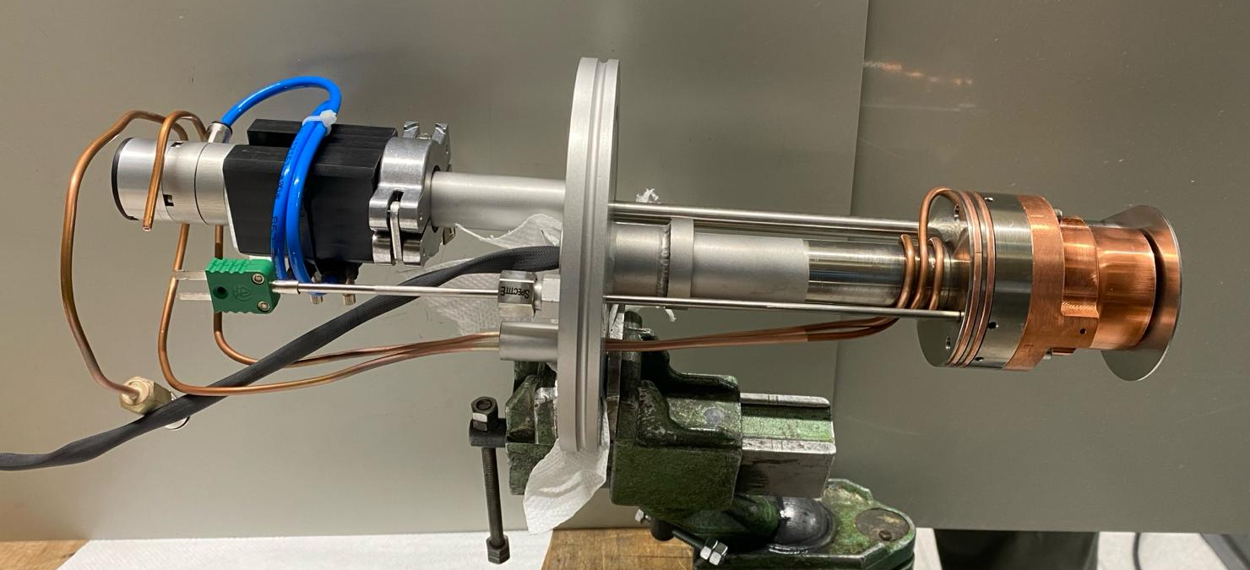
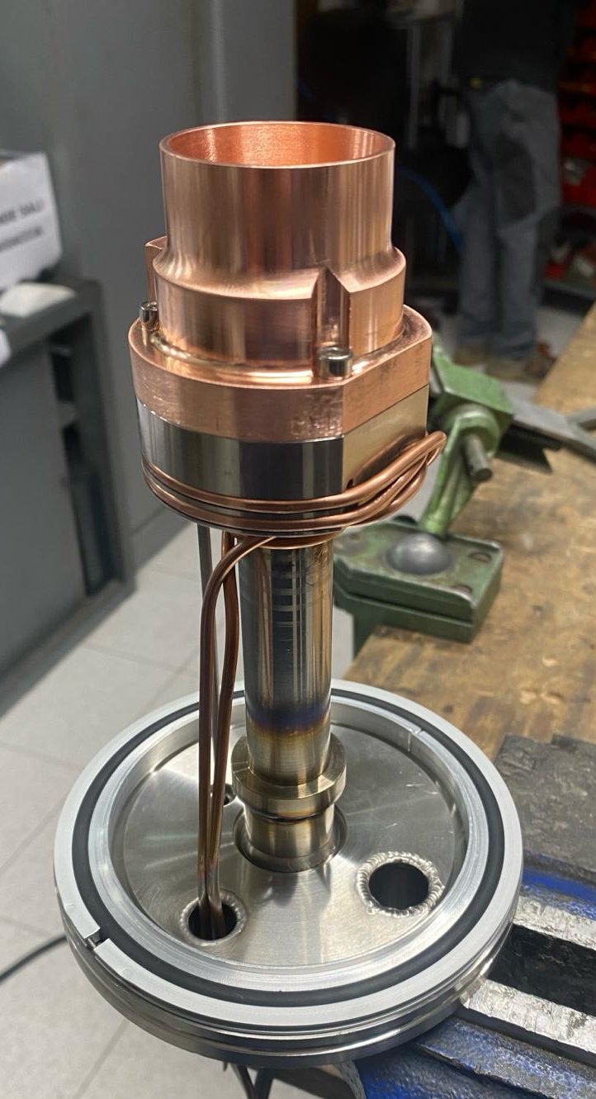
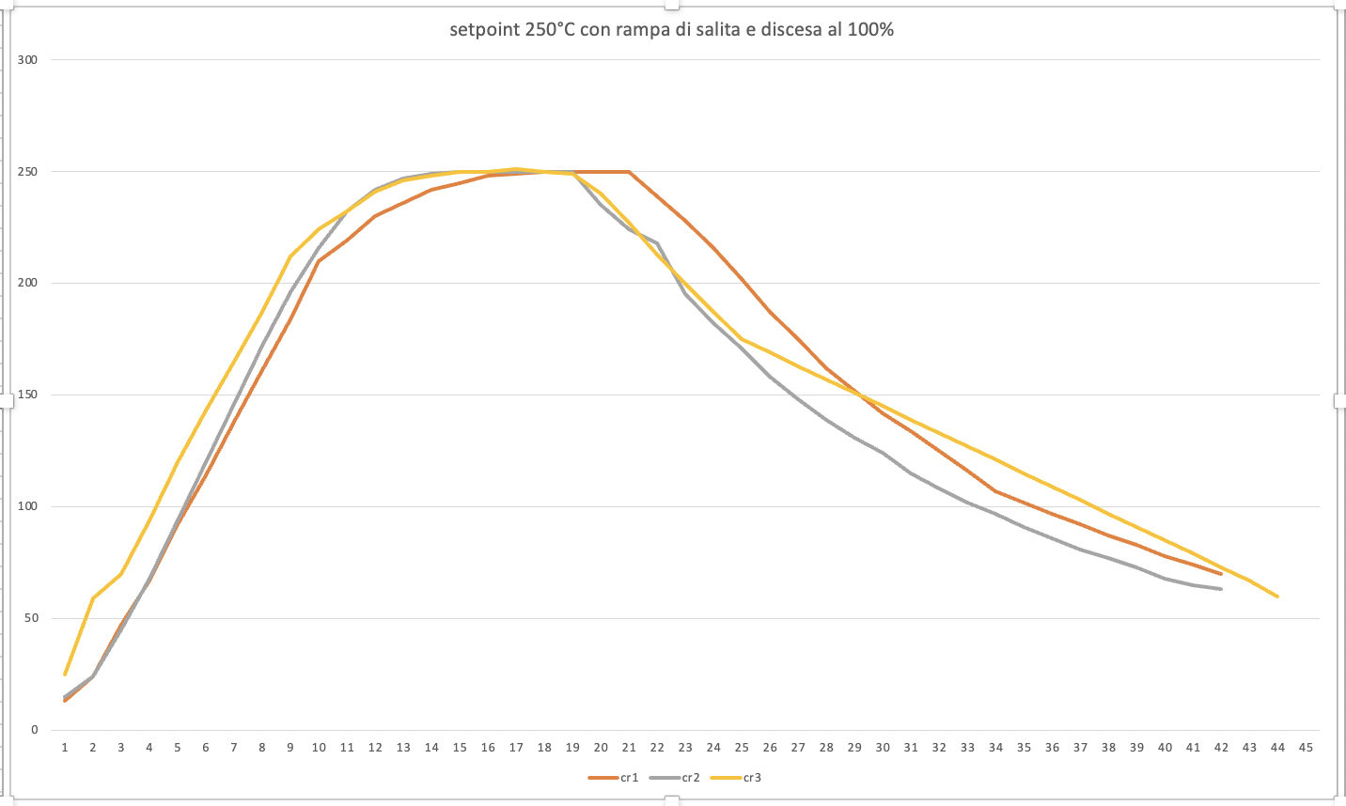
Crucibles
pneumatic opening
Crucibles produced and tested in vacuum
PID controlled temperature, with a very good set point stability
Crucible directly mounted in flange DN 100 ISO-K
Electro-pneumatic opening and cooling system
Maximum operating temperature 500°C, working temperature at 250-300 °C
water cooling system
250°C

Slide 7
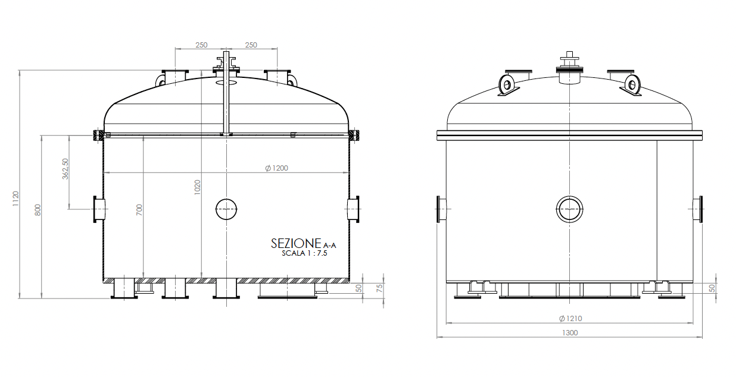
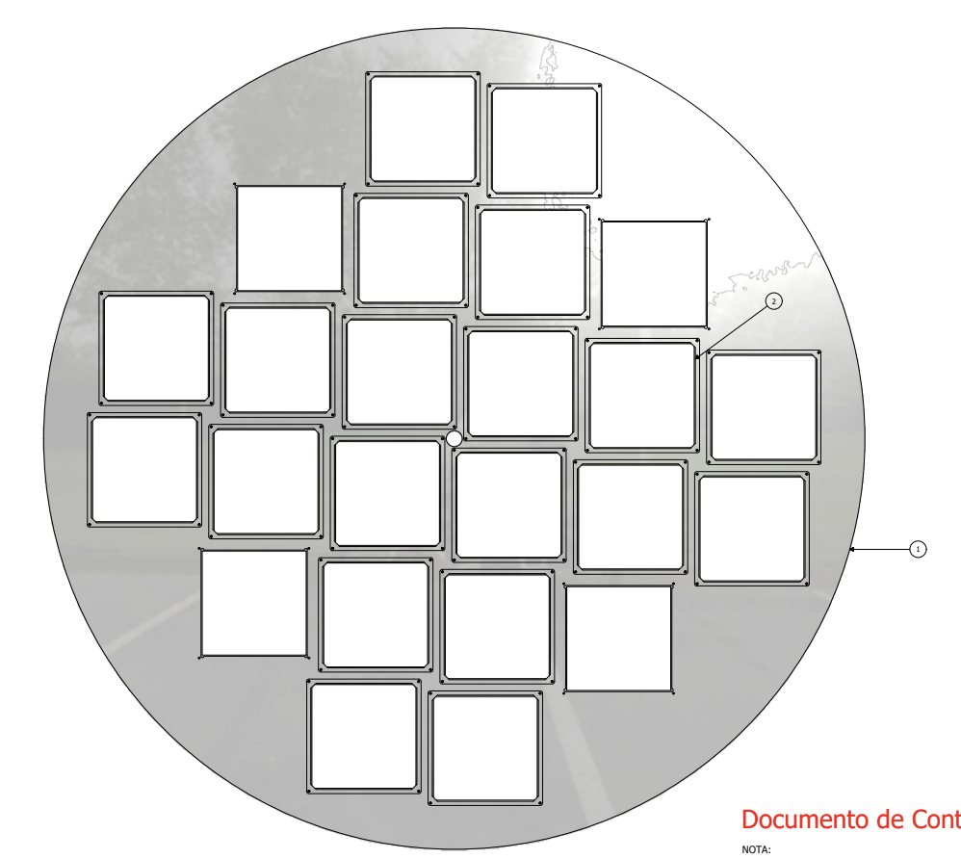
FD2 evaporation site: programming of the operations
DF/NF dimension of 14,4×14,4 cm²
Disk holder for filters with 112 cm diameter
Up to 24 filters for evaporation process can be accommodated

Slide 8
FD2 evaporation site: programming of the operations
 | Number of modules | Number of filters per module | Total number of filters
Membrane modules | 352 | 16 | 5632
Cathode modules (double side) | 320 | 32 | 10240
Spares |  | 10% | 750
Total |  |  | 16622
Duration of whole evaporation process estimated at approximately 4-5 hours
Main steps of the process:
Measure of mass for each 2 or 3 filters before and after the evaporation
Filters positioning on the holder disk
Preparation of the control samples
Insertion in the chamber
Vacuum phase
Evaporation with PTP
Opening of the chamber and removal of the disk
Removal the filter and place them in the proper boxes
Check of the control samples
2 shift for day: 8-10 hours
48 filters/day
Required 346 days (about 70 weeks)
2 years of operation involving INFN technicians and shifts of Italian collaboration.

Slide 9
FD2 evaporation site: dedicated operation tools under development
Evaporator lab will be completed by Q4 2024
Commissioning of the system and ready to start by Q1 2025
Video made by Heriques Frandini and Ana Machado

Slide 10
Quality check
Periodic check of the evaporation uniformity along the disk radius
Precise mass measurement (before and after evaporation for control sample)
Immersion in LN of one control sample for each evaporation batch: visual check of the evaporated coating surface
Transmission measurement after evaporation
Other quality controls… (TBD)
Full traceability of the entire process (filter batch, evaporation number, storage, travel info…)

Slide 11
2025 financial requests
Item | Costo (kEuro) | numero | Richiesta (kEuro) | SJ
Tecnici INFN CTER sesto livello | 40 | 2 | 80
dewar per quality check in LN | 6 |  | 6
Bilancia di precisione (accuratezza 10 microgrammi) | 3 |  | 3
1 pc di acquisizione: quarzo per misura di spessore e parametri slow control evaporatore | 2 |  | 2
Produzione di un quarto crogiolo per ottimizzazione tempi di evaporazione+1 spare (SJ) | 12 | 2 | 12 | 12
Fornitura Azoto liquido (quality checks) | 5 |  | 5
Consumabili operazioni in clean room (tute, copriscarpe, cuffie, guanti, liquidi per pulizia) | 5 |  | 5
pTP | 6 |  | 6
Lavorazione 1 disco porta filtri + 1 disco aggiuntivo | 3 |  | 3 | 20
Pompa turbo spare in caso di guasto (SJ) | 20
Trasporto 12 box a SURF | 0.7 | 15 | 11
Totale |  |  | 133 | 32

Slide 13
Missioni
Missione | Costo (kEuro)
DUNE 2025 General Meetings (1 viaggio in USA at SURF x 2 persone) 5.5k (1 viaggio al CERN x 3 persone) 4.5k (1 viaggio a Valencia x 2 persone) 3k | 13
run di ProtoDUNE VD ( 10 settimane al CERN 1PhD+1PostDoc) | 12.0
Riunione gruppi Italiani | 1.0
Presentazioni a conferenze internazionali (2 persone???) | 4.0
Totale | 30.0

Slide 14
Spares

Slide 15
Logistic to be defined
Type of filters (dichroic or neutral) to be coated needs to be defined after CIEMAT measurements
CIEMAT results in 1 month from now
verify and confirm with ProtoDUNE run
Verify with the pre-production schedule
Specify which type of substrates and from which Institute(s)
Indication of failure due from fused silica substrate/polishing
Indication of failure from cold box, no indication of damage at CIEMAT
Perform more test
Define the packaging and shipping process for the DF/NF to organize the storage space needed at the evaporation site.
Coated filters should be accommodated in dedicated shipping boxes. Define who will design and produce the boxes and determine the quantity needed.
Carla (MIB): possibility to produce up to 200 boxes in MiB mechanical workshop
Each box should contain the number of filters of 1 or 2 evaporation batches (24 or 48 filters)
Boxes with the evaporated filters should be shipped: establish if to Integration sites or directly to SURF
CIEMAT never considered to mount evaporated filters at integration site
A clean environment should foresee at SURF
Set a strategy to reduce the number of boxes to be produced: they can be shipped back while the filters are mounted on the PDS modules
Documentation about filter coating, storage, filter travels need to be agreed among all the different evaporation DUNE center sites (Naples, Campinas and third possible one)

