Slide 1
Summary
Activities summary 2024
Anagrafica 2025.
Pisa activities 2025 .
Conclusions.

Slide 2
Activities summary 2024.
Pisa group had two main commitments:
Supply the tooling and support the dismount activities for the Kloe Calorimeter.
Construction of two straw prototypes 1200x800mm to address all the problematics of this technical choice.
The calorimeter has been dismounted.
One straw prototype has been build at CERN with the contribution of other institutions. Pisa has supplied the carbon fiber support frame, all parts and all tooling to assemble the detector.

Slide 3
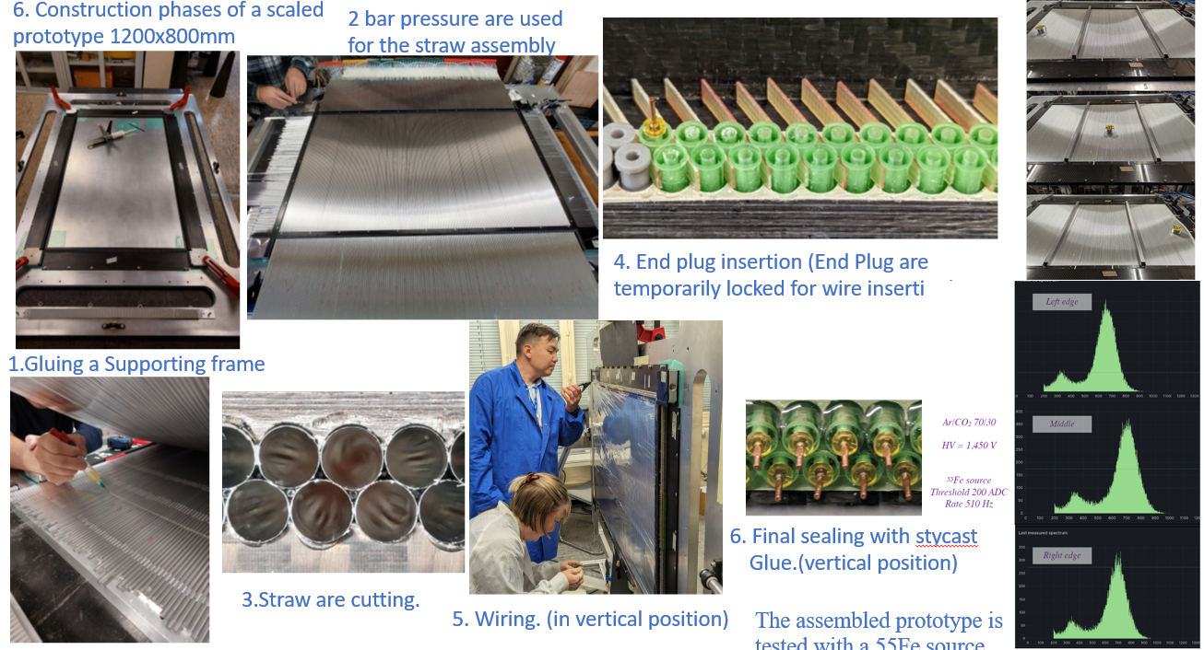

Slide 4
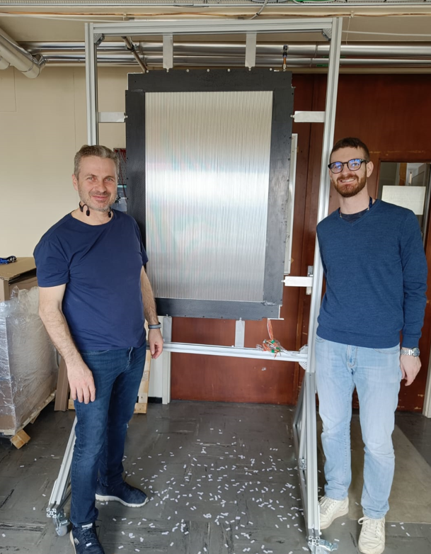
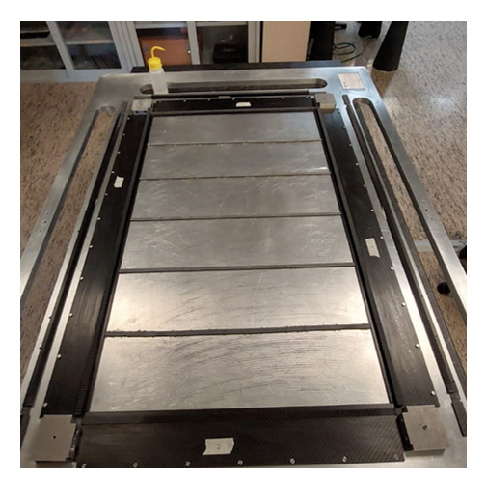
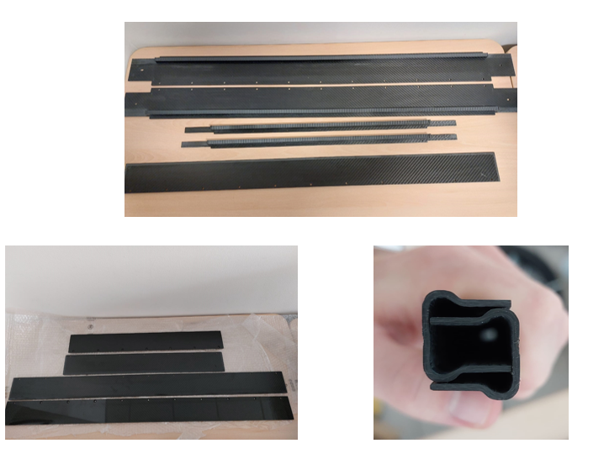
Preparation for Second prototype at Pisa
Carbon fiber parts at Pisa
First prototype at CERN

Slide 5
Activity summary 2024.
The second prototype will be completed in the 2024 and it will address other issues of the straw detector construction.

Slide 6
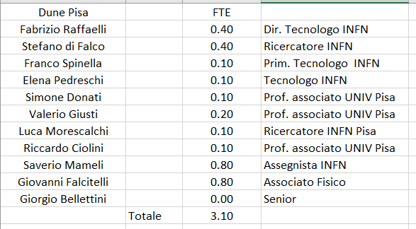
Anagrafica Pisa 2025

Slide 7
Pisa activities 2025
Activities on the calorimeter.
Supply the documentation to allow the use of the calorimeter mounting tooling at Fermilab.
Refurbishing of the calorimeter supporting structure and modules.
Upgrade some details of the tooling.

Slide 8
Pisa activity 2025
Future straw activities.
The construction of the 80x120 cm prototype doesn’t complete the work needed to validate the technical choice. Further activities include:
Test beam.
A full scale prototype is necessary to verify several things and to do the fine tune-up of the detector.
Functionality studies are necessary as well long term test on the full size prototype.

Slide 9
Conclusions.
Pisa richiede dei fondi di missioni per contribuire ai lavori sul calorimetro e i test beam degli straw.
Sulla attività future degli straw si può chiedere i fondi sub judice per la costruzione del prototipo full scale.
Lo sviluppo del progetto del tracciatore a straw richiede risorse aggiuntive in termini di man power e un organizzazione ben definita di assegnazione di compiti: frame in carbonio, tavolo ottico, gantry per incollaggio, wiring, elettronica, simulazioni termiche, sistema di gas, test di aging e di raffreddamento, test con e senza fascio, organizzazione logistica per produzione su larga scala.

