Slide 1
Optimisation Strategies for Proton Acceleration from Thin Foils with Petawatt Ultrashort Pulse Lasers
Tim Ziegler
John Dawson Thesis Prize
18.04.2025, Ischia
Notes:
Thank you very much for the kind introduction and for the great opportunity to speak hear today and present the results we got in Dresden over the course of the last years on laser-driven ion acceleration.
These results represent the central research topic I am wokring on namely how we can manage a succesfull translation from plasma acceleration studies and plasma accelerators as R&D machines towards plasma accelerators as tools for applications.

Slide 2
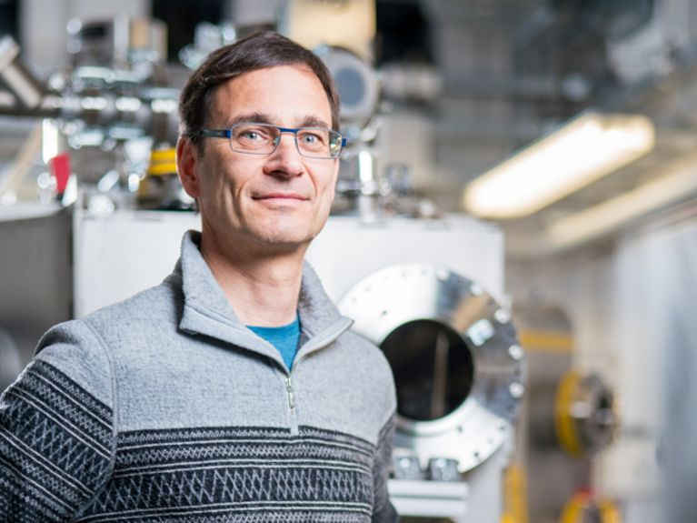
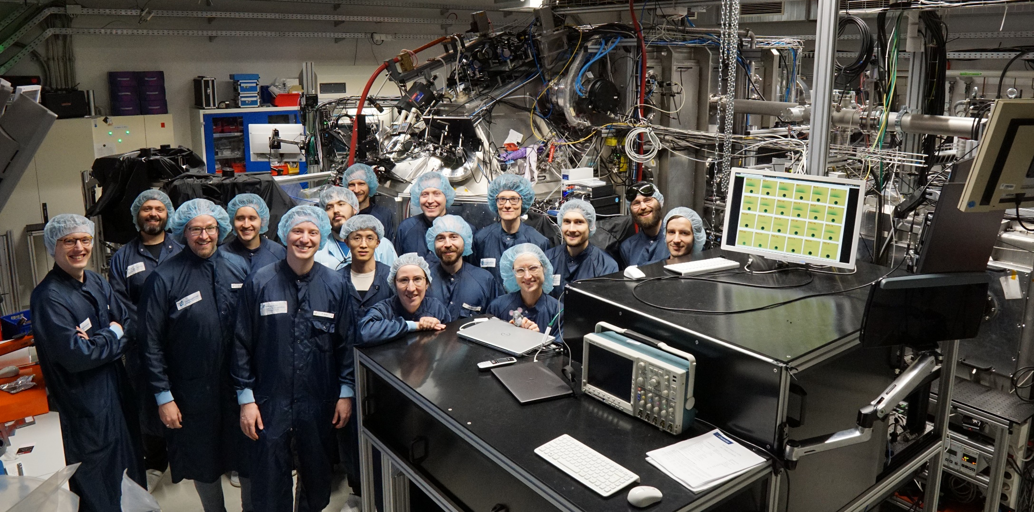
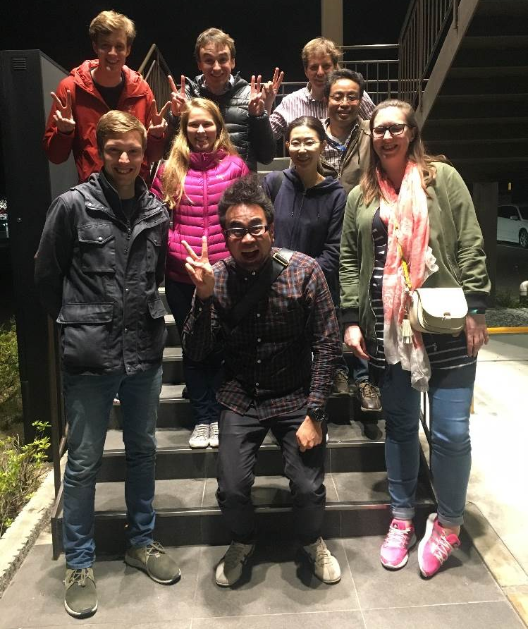
Thank you for all the support! I am lucky to work with such a great team
ありがとう

Slide 3
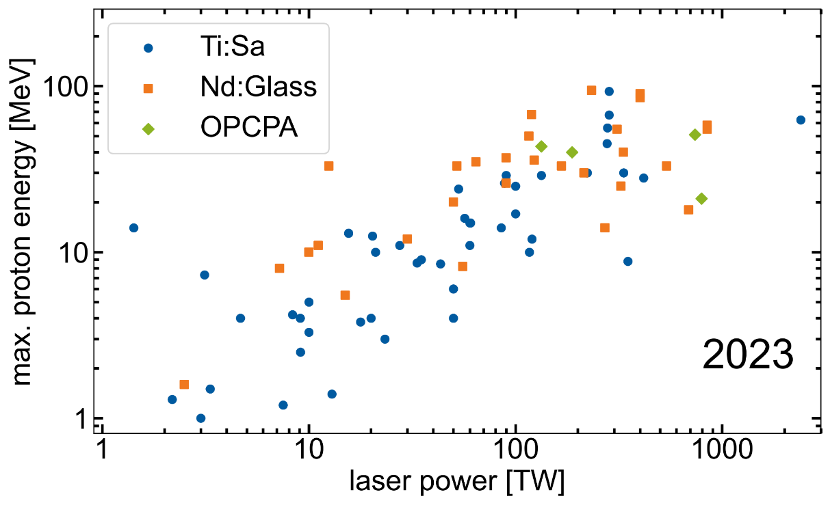
Development of laser-proton acceleration
Lasers reporting proton acc. exp. worldwide
Proton acc. performance worldwide
~5MeV
(Vulcan, 30J)
~60MeV
(NOVA, >400J)
~67 MeV
(Trident, 80 J)
~85MeV
(PHELIX, 200J)
>93MeV
(Vulcan, 210J)
Nd:Glass
1994
2000
2011
2016
2018
Ti:Sa
2002
2009
2012
2016
~20 MeV
(JanUSP, 5J)
~13MeV
(MBI, 0.7J)
~40MeV
(J-KAREN, 7.5J)
~93MeV
(CoReLS, ~8J)
Notes:
Laser-driven particle acceleration has advanced rapidly over the past 20 years, largely due to developments in laser technology.
This can be seen in the progression of achievable laser power on target over time, along with the corresponding increase in maximum proton energies.
Initially, high-energy glass laser systems dominated the field. However, we now see that many ultrashort-pulse lasers are reaching comparable performance levels in both laser output and acceleration capabilities.
This shift highlights the growing versatility and potential of newer laser technologies in plasma acceleration.

Slide 4
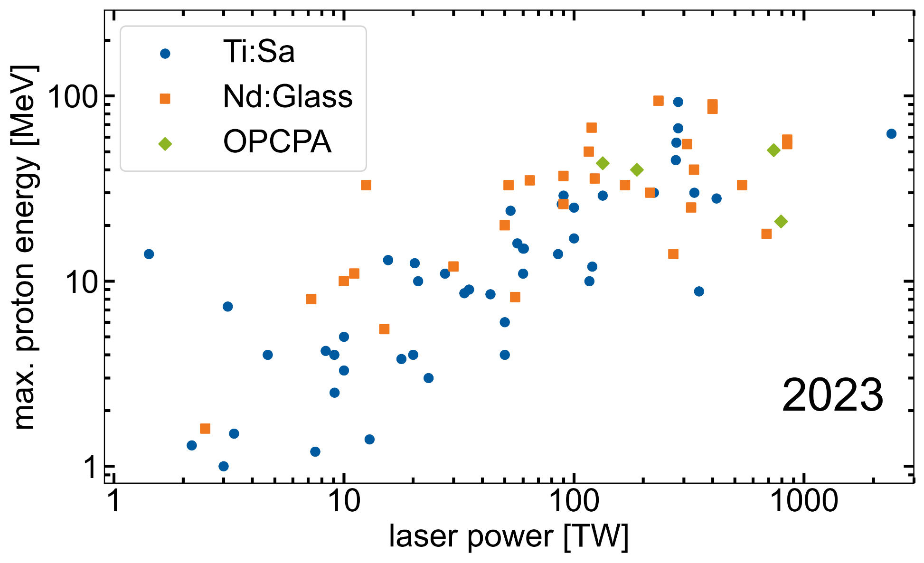
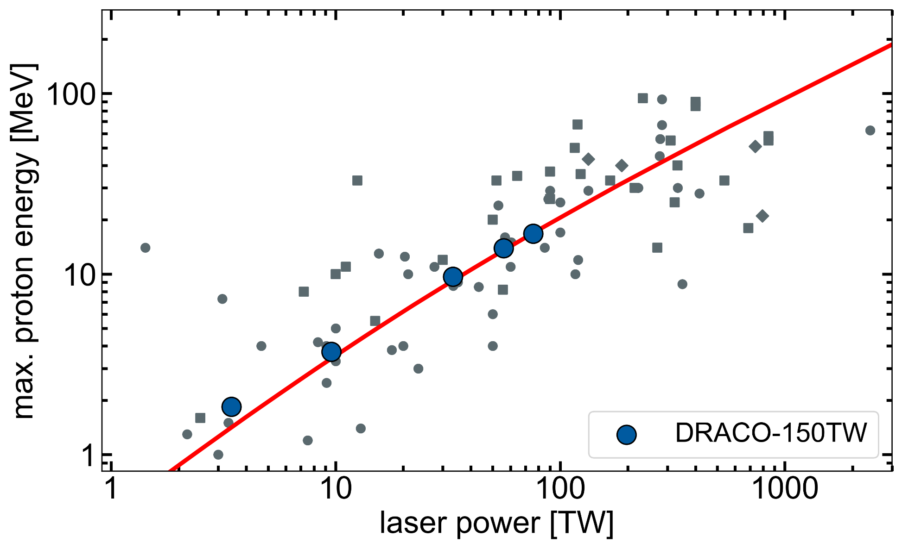
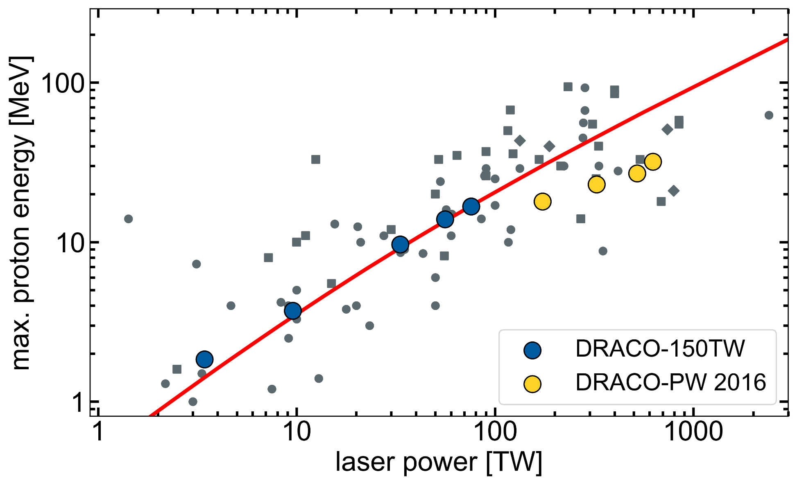
Scaling problem !
Despite increasing laser power, achievable energies plateaued for more than 10 years!
Notes:
So, this sound all great and we have these incredibly powerful tools — but here’s the catch:
Despite all the progress in laser technology, scaling the energy of laser-accelerated protons has stalled for years. Even with more powerful lasers, beams above 100MeV could not be achieved.
So there were questions coming up, if there is unknown physics involved that prevents breaking the 100MeV barrier.

Slide 5
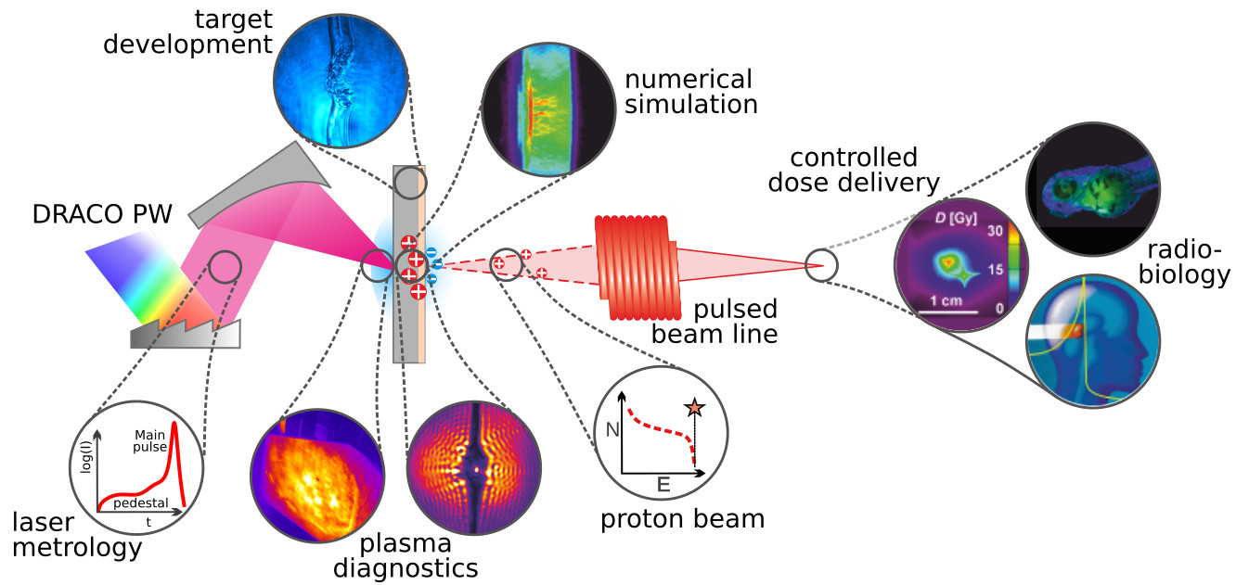
Laser-driven proton acceleration at HZDR
HZDR
U. Schramm, T. E. Cowan,
K. Zeil, J. Metzkes-Ng,
C. Bernert, F. Kroll,
T. Püschel, M. Rehwald,
M. Umlandt, M. Vescovi,
P. Wang, T. Kluge,
I. Göthel, ...
KPSI
M. Nishiuchi, H. Kiriyama
C. Liu, K. Kondo, A. Kon,
H. Sakaki, …
ICL & JAI
N. P. Dover, Z. Najmudin
Notes:
We didn’t achieve these results over night, but through a lot of perseverance, endurance and a great team

Slide 6
Our strength: interlink between laser operation, metrology and experimental benchmarks
→ understand feedback of subtle changes of laser parameters to the accelerator performance
Notes:
One of the key strengths of our work at HZDR has been the tight interlink between laser operation, metrology, and experimental benchmarks.
This approach has allowed us to carefully study how subtle changes in laser parameters directly impact accelerator performance.
By continuously refining these connections, we've been able to fine-tune the laser and optimize the entire acceleration process.
Personally, I believe this approach was crucial to achieving the outstanding results we’ve seen.
To better understand how we achieved this, let’s take a look back at the key steps along the way.

Slide 7
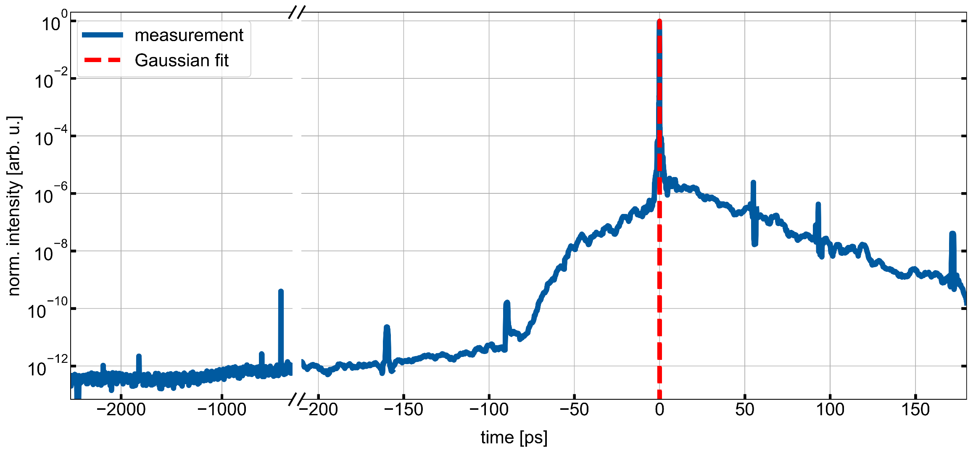
Temporal laser-pulse contrast
…as decisive control parameter
Laser-induced
breakdown [1]
[1] C. Bernert, T. Ziegler et al., Phys. Rev. Applied 19, (2023)
Notes:
For us it’s currently this intensity and temporal range that effects our interaction and which needs to be controlled This means reducing or eliminating low-intensity prepulses that arrive before the main laser pulse. These prepulses can ionize and expand the target before the real interaction even starts — and that ruins the acceleration conditions.
By improving the contrast, we can ensure that the target remains intact and sharp when the high-intensity pulse arrives — giving us a clean, high-field interaction.
And that’s why we invest so much effort into improving contrast – using techniques like plasma mirrors, XPW filtering, or OPCPA – because in our experiments, the smallest background can cause the biggest damage.

Slide 8
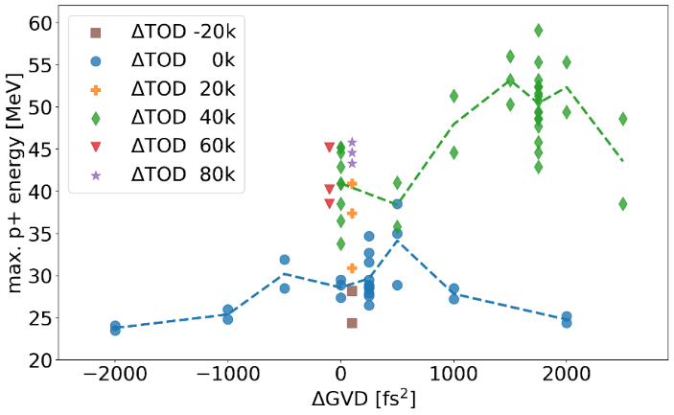
Temporal laser-pulse contrast
…as decisive control parameter
Diagnostic established + contrast improved
Excellent starting conditions for stable acc. process
Plasma dynamics restriced to last ps
Laser-induced
breakdown (new)
T. Ziegler et al., Sci. Reports (2021)
Pulse shape optimisation procedure for enhanced proton acceleration performance (>60MeV) and conversion efficiency (2% → 5%)
F. Kroll et al., Nature Physics (2022)
intensity dependent filter system applied
Notes:
optimisation procedure for enhanced proton energies (>60 MeV in routine operation)
stable proton beam generation over months
particle yield increased | conversion efficiency increase from 2% → 5% The payoff? A stable and controlled acceleration regime. Not just better beams — better understanding. In this regime, we saw both improved conversion efficiency and higher proton energies.

Slide 9
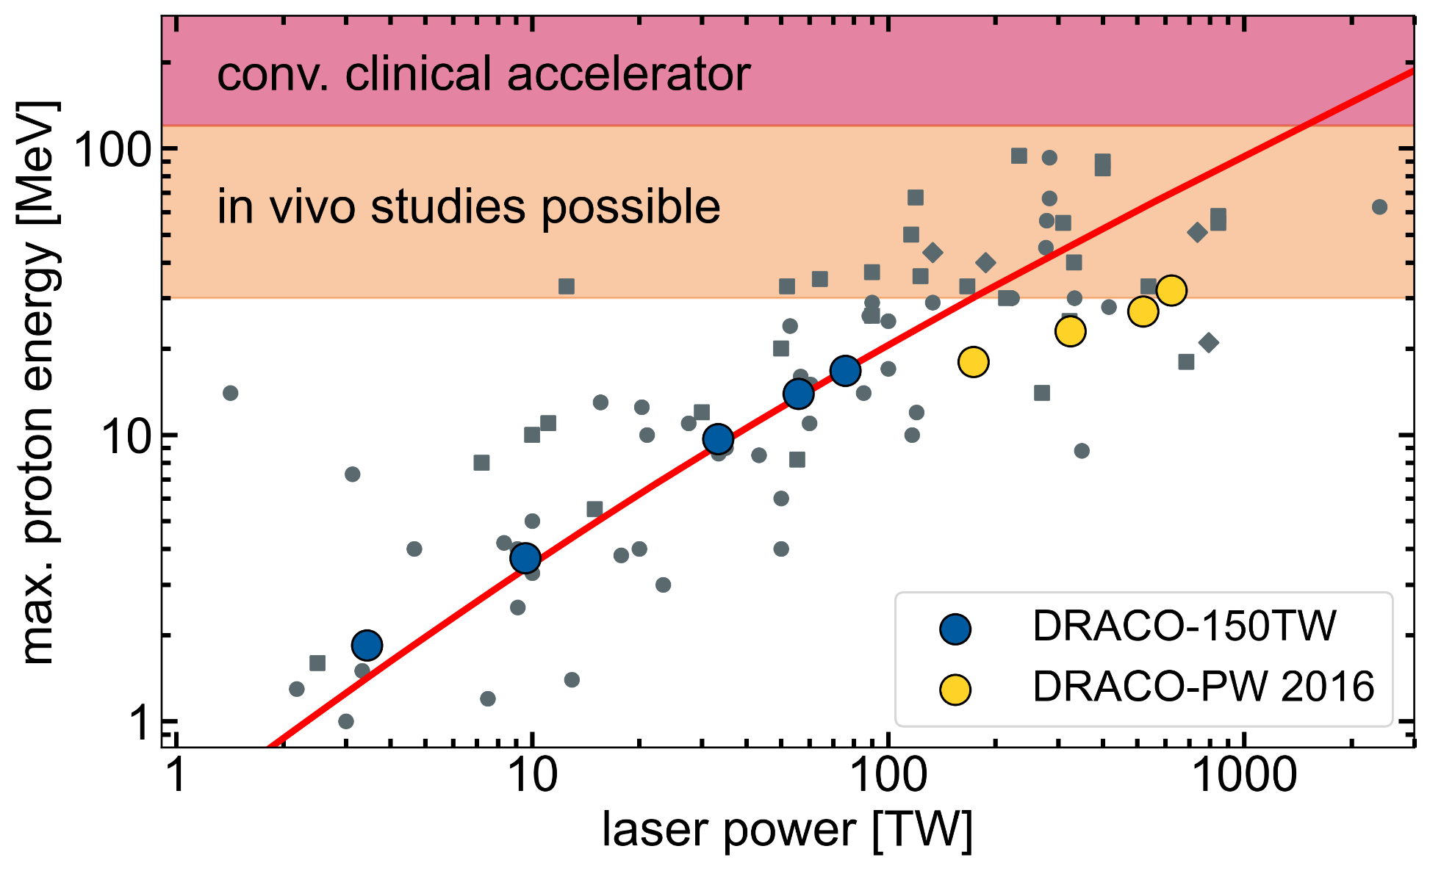
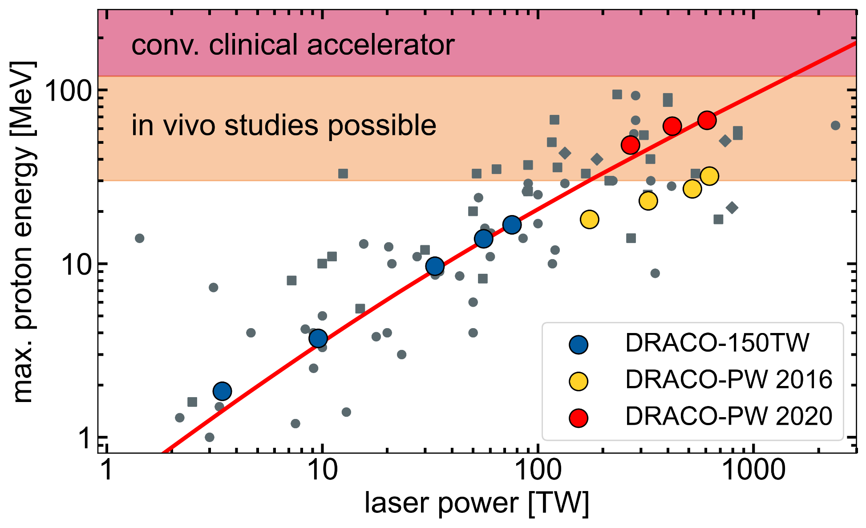
Scaling problem !
Scaling problem ! demonstrated !
Notes:
We demonstrated that the long-standing energy plateau can be overcome. With contrast under control, we’re entering new territory.”

Slide 10
Plasma tailoring for advanced acc. regimes
Overdense target
Relativistically transparent targets
Underdense target
$$n_{e}>{γn}_{c}$$
$$n_{e}\sim {γn}_{c}$$
$$n_{e}<{γn}_{c}$$
laser mostly
reflected
laser mostly
absorbed
laser mostly
transmitted
$$n_{c}= \frac{{γm}_{e}ε_{0}ω^{2}}{e^{2}}$$
$n_{c}$: critical density
$n_{e}$: electron density (target)
$ω$: laser frequency
$γ$: Lorentz factor
Notes:
The main reason for this is that the acceleration is limited to the target surface and protons only experience the maximum possible acceleration field for a short time before they detach from the back.
I focussed on another fundamental question of plasma accelerators. Namely, how to significantly increase their efficiency.
In a normal dense plasma, the laser is reflected. But at high intensities, the electrons gain relativistic mass, shifting the plasma frequency.
As a result, the plasma becomes temporarily transparent to the laser — allowing it to propagate through the target and deposit energy volumetrically.

Slide 11
Plasma tailoring for advanced acc. regimes
$$n_{e}>{γn}_{c}$$
$$n_{e}\sim {γn}_{c}$$
$$n_{e}<{γn}_{c}$$
opaque arget
near-critical density
transparent target
plasma density
skin depth interaction
propagation/volumetric
foil
pre-expansion by preceding light
Notes:
Zentral ist dabei das Verhältnis zw. der Dichte des Targets und der krit. Plasmadichte, die folgendermaßen definiert ist.
Bisher wurde nur der TNSA Mechanismus betrachtet bei dem das Target, während der gesamten WW überkritisch bleibt und der Laserpuls größtenteils reflektiert wird. Die WW findet hier nur an der Oberfläche statt.
Wird die Dichte des targets reduziert, kann der Laserpuls tiefer in das Target eindringen und volumetrisch ww. Am interessantesten ist hier der Fall wo die Plasmadichte gerade der kritischen Dichte entspricht. Hier erwartet man die beste Konvertierung in Teilchenenergien.
Wird die Targetdichte noch weiter reduziert, sodass diese deutlich unterhalb der krit. Plasmadichte ist, dann kann der Laserpulse das Target zwar durchdringen, interagiert dabei aber nur noch wenig. In diesem Szenario wird ein Großteil der Laserenergie einfach transmittiert.

Slide 12
Transparent targets yield highest energies
Maximum proton energy
Transmitted light
Experiments reveal optimal target thickness:
targets get relativistic transparent during main pulse interaction
enhanced proton energies
increase in transmitted light
simulations confirm exp. results
N. Dover & T. Ziegler et al., Nature Light (2023)
Notes:
In our experiments, we saw that under the right conditions, these ultrathin targets became transparent to the main pulse.
The laser's intrinsic contrast — which we had worked hard to optimize — ionized and pre-expanded the target just enough.
During the peak of the pulse, the plasma crossed the relativistic transparency threshold — and we observed a significant boost in proton energy.
Aus meinen Vorstudien wusste ich ja bereits, dass die Ionisierung des Targets hier an dieser Stelle einsetzt und von diesem Moment an der Laser bereits wechselwirkt.
Deswegen hatte ich ja vorher diese Reinigung durchgeführt. Genau dies habe ich dann aber weggelassen und dieses vorauslaufende Licht zur Vorexpansion des Targets genutzt.
Ergebnis: Es gibt eine otpimale Dicke, wo die Energien ein Maximum erreichen. Das ist genau dort wo das Target transparent wird.
Außerdem habe ich dabei die Targetdicke verändert und geschaut wie sich das auf die Beschleunigungsperformance auswirkt.
Diesen Einfluss haben wir mit hydrodynamischen Simulationen untersucht und das resultierende Dichteprofil 1ps vor dem Peak des lasers an eine 3D PIC Simulation übergeben. Damit haben wir dann die WW mit dem stärksten Teil des Lasers untersucht.
Ich möchte jetzt noch etas genauer in die Details dieser Simulationen einstiegen, welche Details bzw welche Physik sie zeigen und vor allem natürlich wie man damit unsere experimentellen Daten erklären kann.

Slide 13
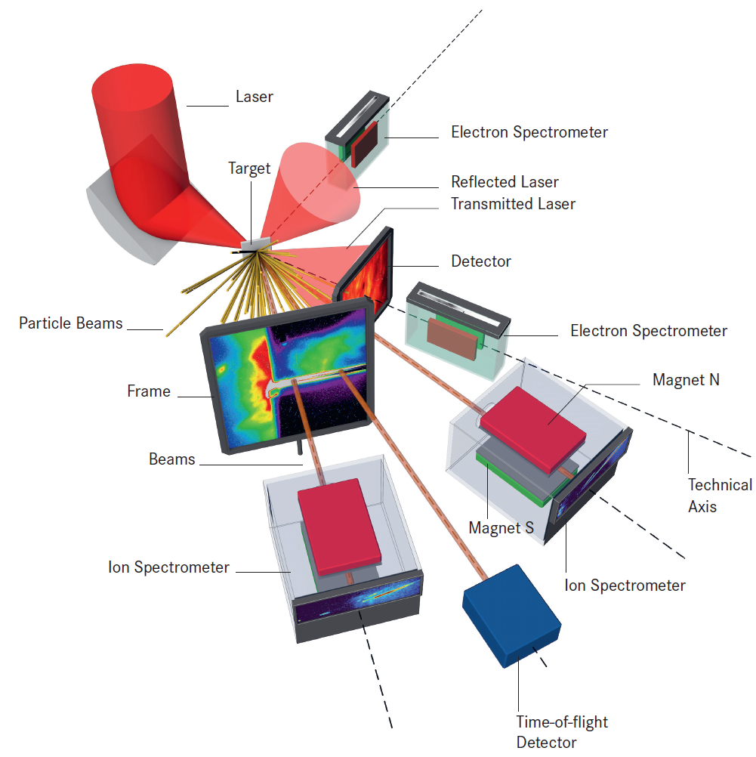
Experimental setup
DRACO-PW
E_{L} = 22.4 J (on target), τ = 30 fs
F/2.3 OAP → 2.3 µm (FWHM)
I_{peak} = 6.5 x 10²¹ W/cm² (a₀=55)
targets: 250±25 nm Formvar foils

Slide 14
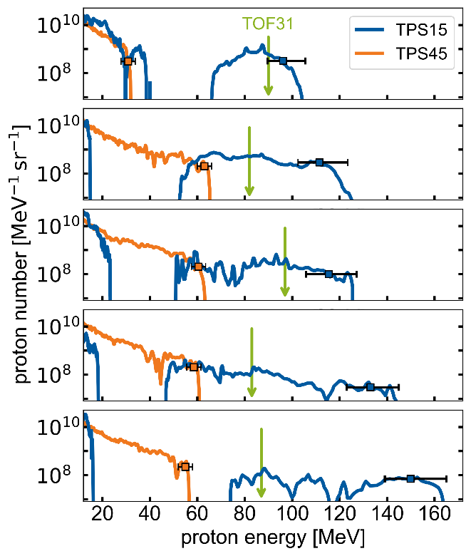
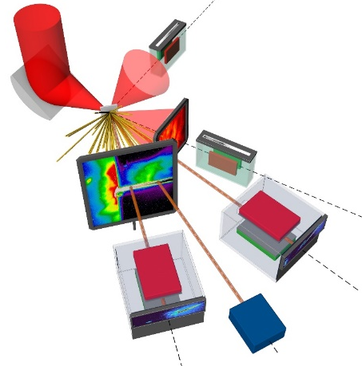
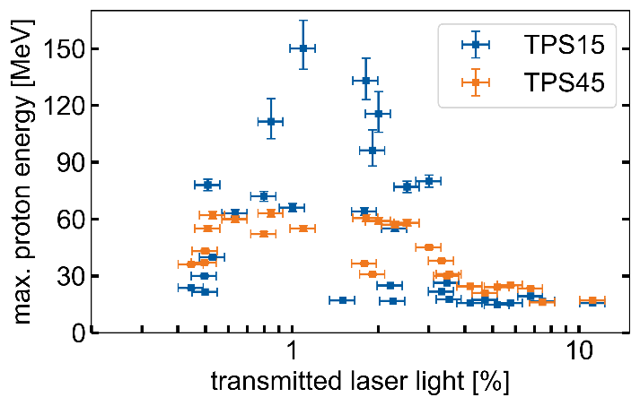
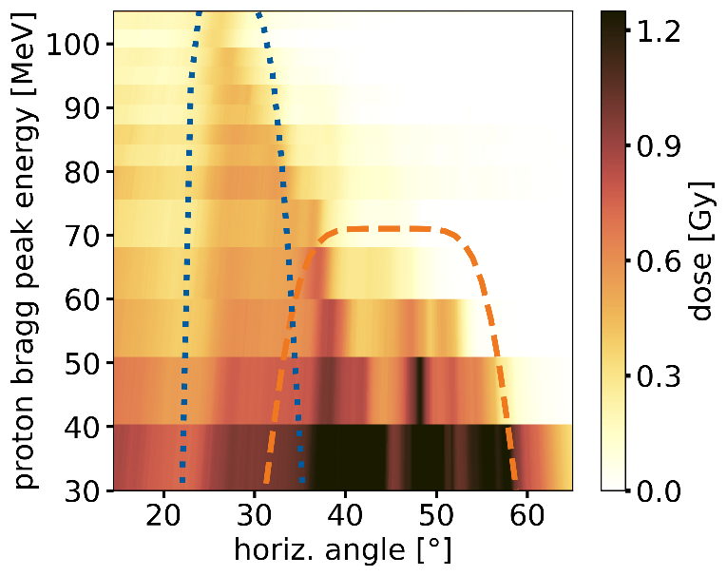
Proton energies >100MeV !
T. Ziegler et al., Nature Physics (2024)
TPS15
two components (bi-modal)
exp. decay up to 15-40MeV
separated high-energy component up to 150MeV
TPS45
one component
exp. decay up to ~60MeV
no high-energy component

Slide 15
3D PIC sims reveal a cascade of acc. regimes
Experimental data
Simulation data
multiple mechanisms contribute to energy gain:
FrontSide Acceleration (FSA)
prompt electrons
thermal sheath
Coulomb Repulsion (CR)
acceleration cascade
T. Ziegler et al., Nature Physics (2024)

Slide 16
Promising scaling with laser energy
proton energies at 15° scale much faster with laser pulse energy → different acc. mechanisms
relative amount of trans. light seems to be unaffected → ideal observation/control parameter
T. Ziegler et al., Nature Physics (2024)

Slide 17
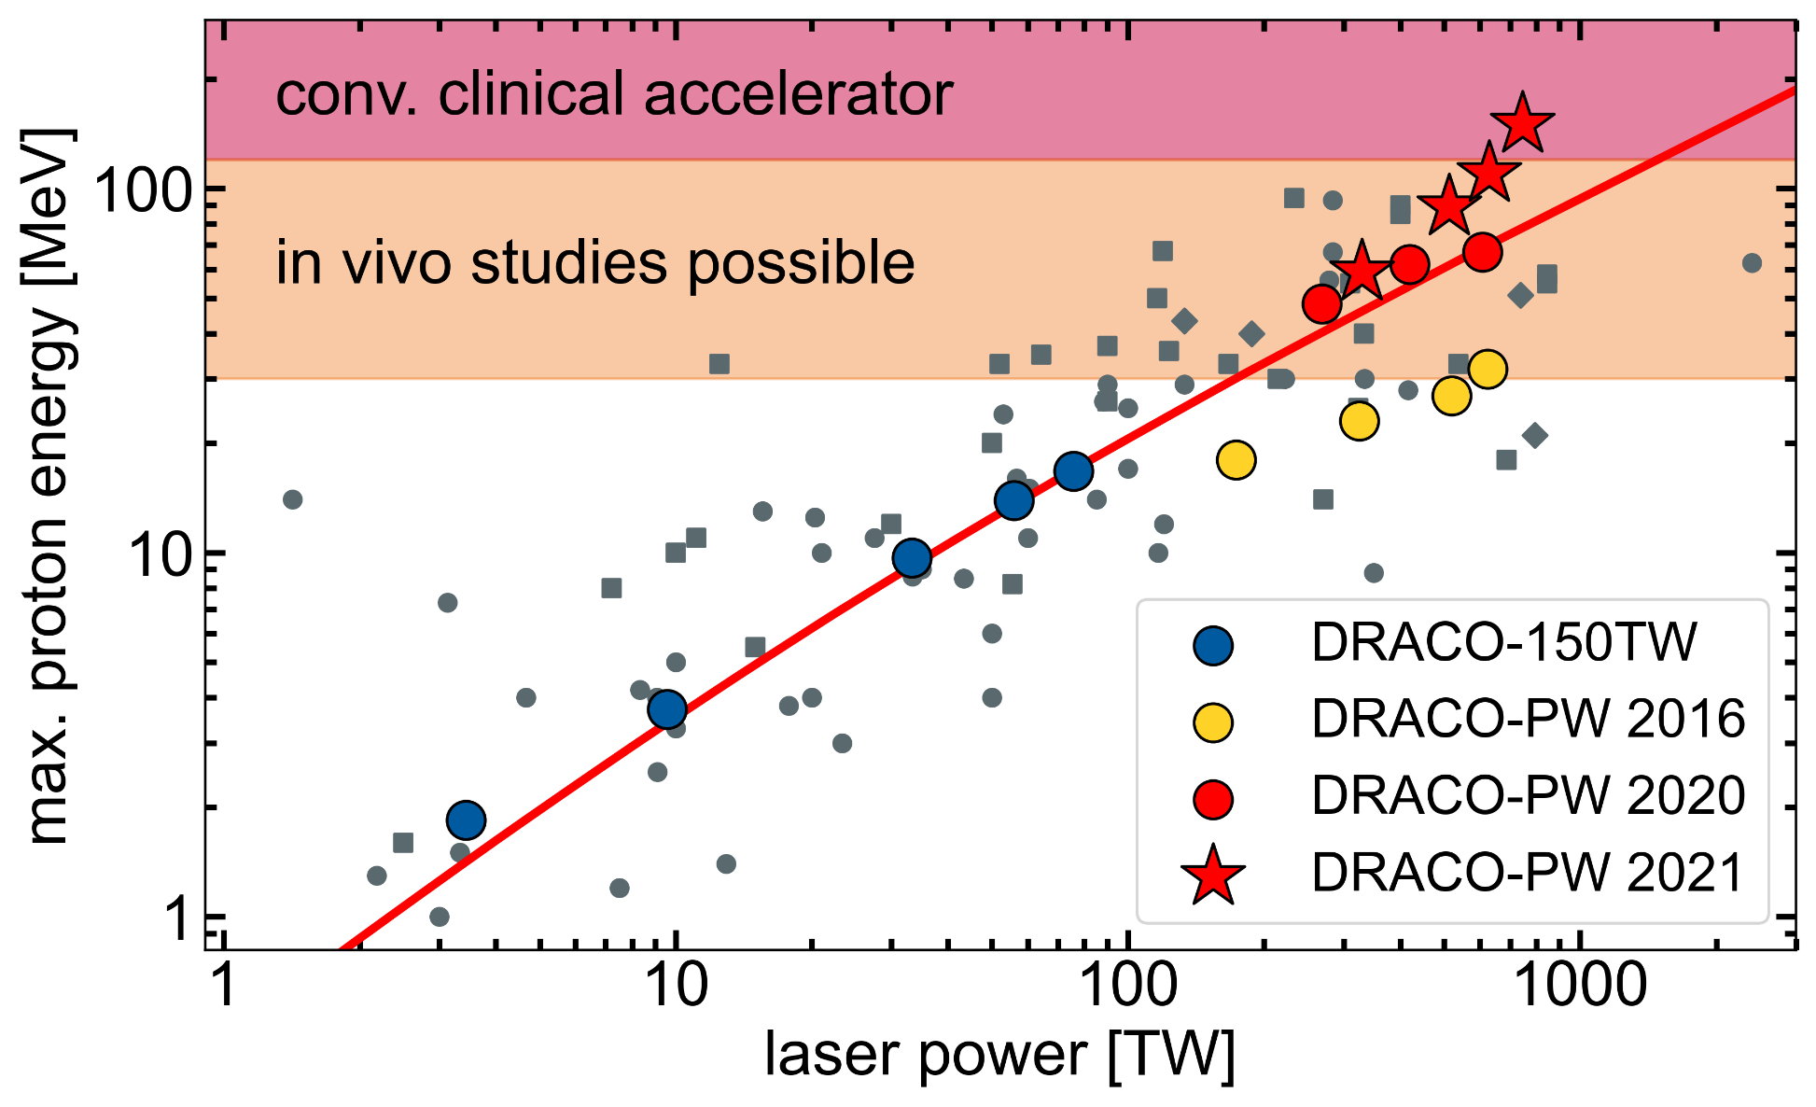
Scaling problem ! demonstrated ! surpassed !
Scaling problem ! demonstrated !
T. Ziegler et al., Nature Physics (2024)

Slide 18
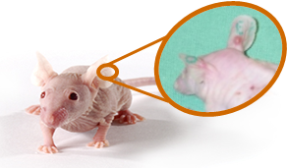
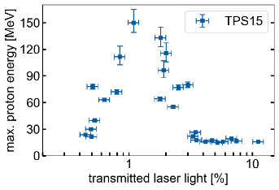
Summary
diagnostic & operation principles established [1]
→ controlled interaction conditions
“Optimisation strategies for proton acceleration from thin foils with petawatt ultrashort pulse lasers”
stable beam generation >60MeV [2,3]
→ accelerator readiness reached
[1] T. Ziegler et al., Sci. Reports 11, 7338 (2021)
[2] F. Kroll, T. Ziegler et al., Nature Physics (2022)
[3] N. Dover & T. Ziegler et al., Nature Light (2023)
[4] T. Ziegler et al., Nature Physics (2024)
new energy record of 150MeV in novel regime [4]
→ control needed
Notes:
Let me bring it all together.
The goal of my PhD was to understand how we can optimize laser-driven proton acceleration — not just to hit higher energies, but to gain control, stability, and ultimately, usability.

