Slide 1
A laser technology roadmap for plasma accelerators
Leonida Antonio GIZZI, CNR-INO Pisa, Italy
also at INFN, Pisa, Italy
Intense Laser Irradiation Laboratory

Slide 2
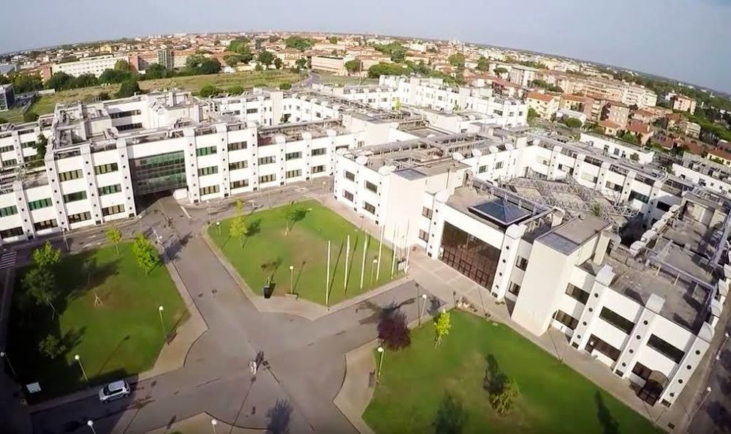
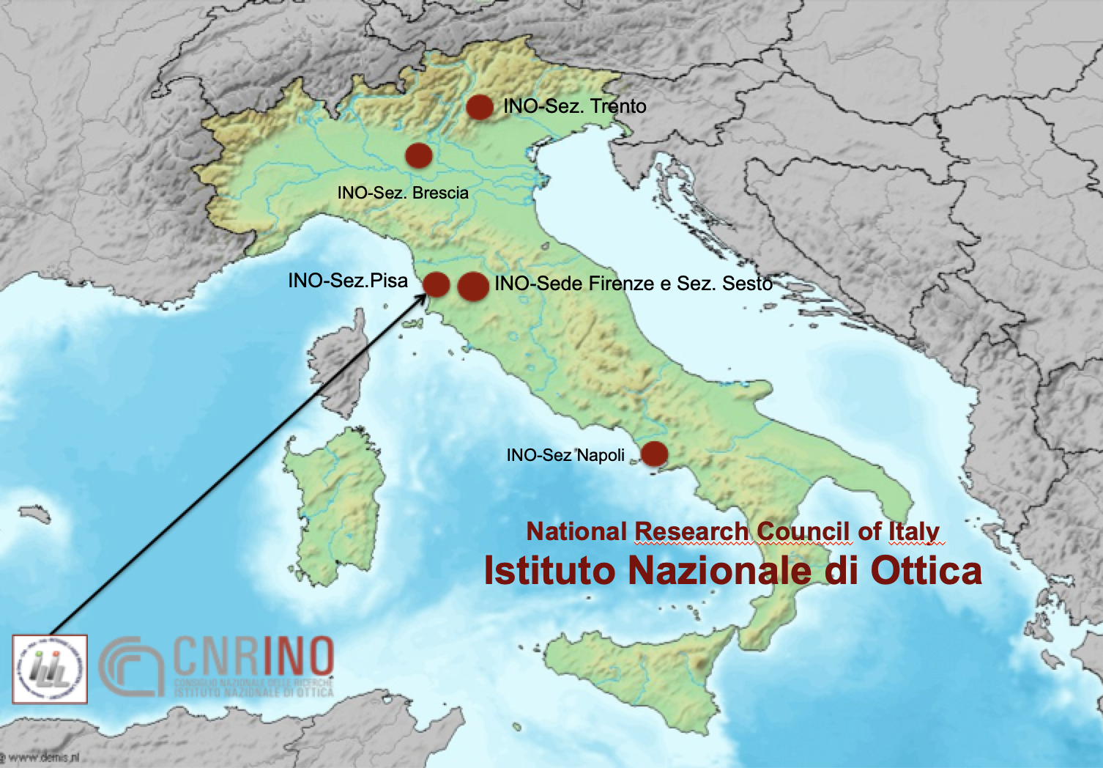
CNR Campus in Pisa
LNS-INFN, Catania

Slide 3
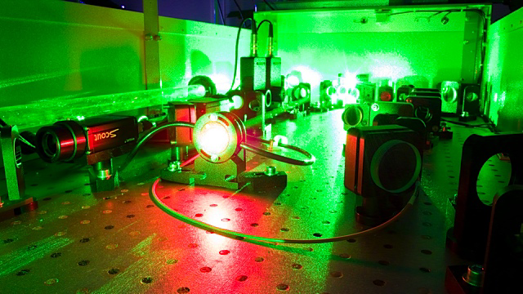
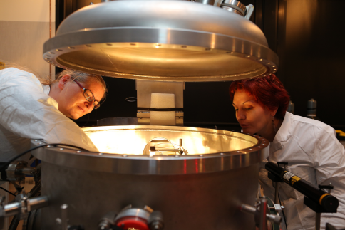
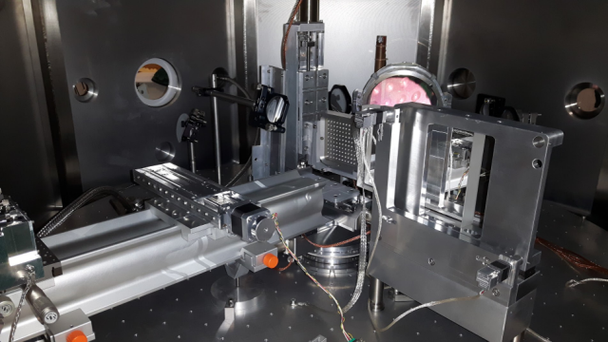
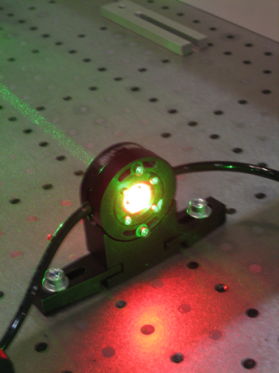
Intense Laser Irradiation Laboratory CNR, Pisa, Italy
PEOPLE
Leonida A. GIZZI (Head)
Fernando BRANDI
Gabriele CRISTOFORETTI
Petra KOESTER
Luca LABATE
Federica BAFFIGI
Lorenzo FULGENTINI
Gabriele BANDINI
Simona PICCININI
Martina SALVADORI
Emma HUME
Alessandro FREGOSI
Daniele PALLA
Federico AVELLA (PhD)
David GREGOCKI (PhD)
Simon VLACHOS (PhD)
Intense Laser Irradiation Laboratory
http://www.ilil.ino.it

Slide 4
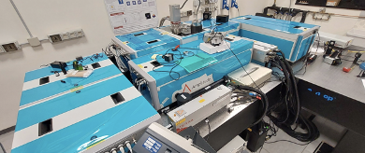
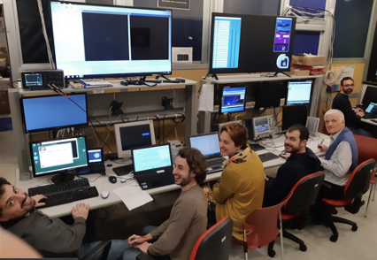
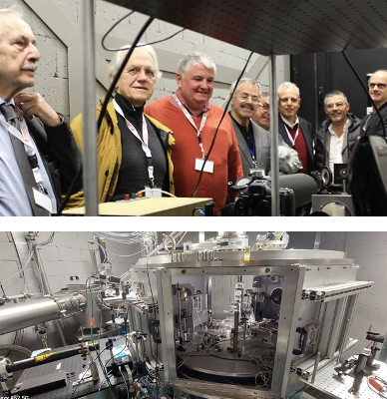
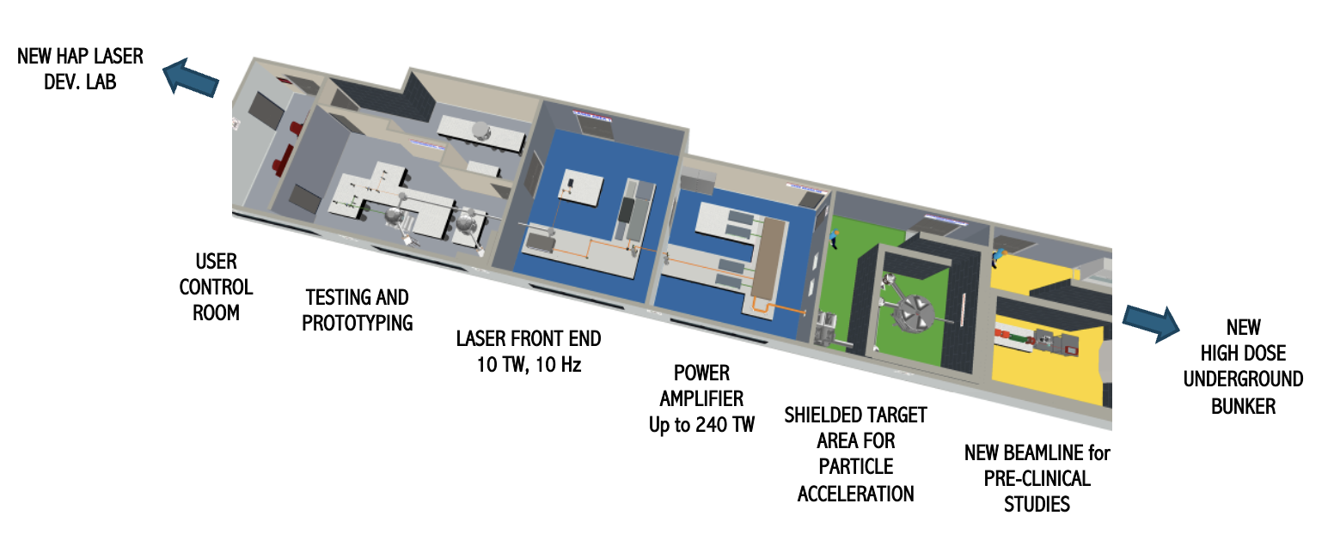
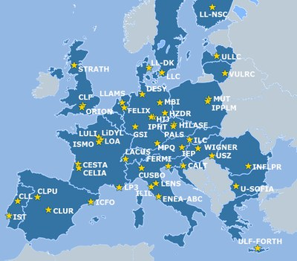
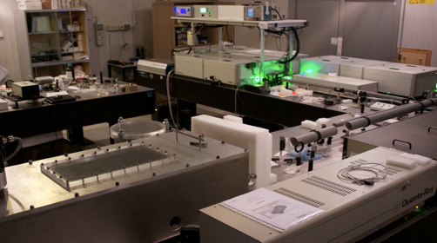
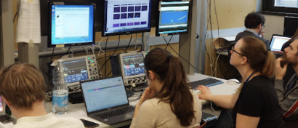
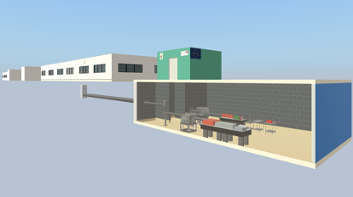
Intense Laser Irradiation Laboratory CNR, Pisa, Italy
LASER CAPABILITIES:
220 TW, Ti:Sa, 5 Hz, 27 fs (upgrade in progress);
1kHz, >20 mJ, Ti:Sa + OPA
100 Hz, >1J, TiSA (procurement in progress)
A member of Laserlab-Europe-AISBL

Slide 5
Contents
Ultraintense Lasers: overview
Motivation for laser-drivers development roadmap
Scaling laser drivers for accelerator systems
The iFAST Innovation action
a roadmap for laser drivers for accelerator systems
Roadmap initial implementation: the PACRI Infratec project
kHz laser driver for LPA
A case study

Slide 6
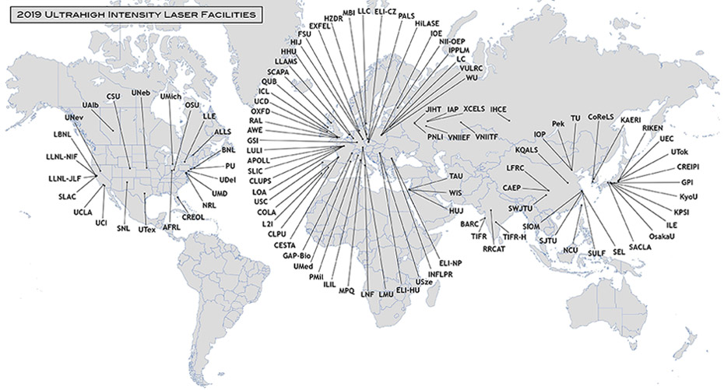
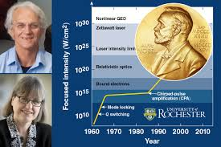
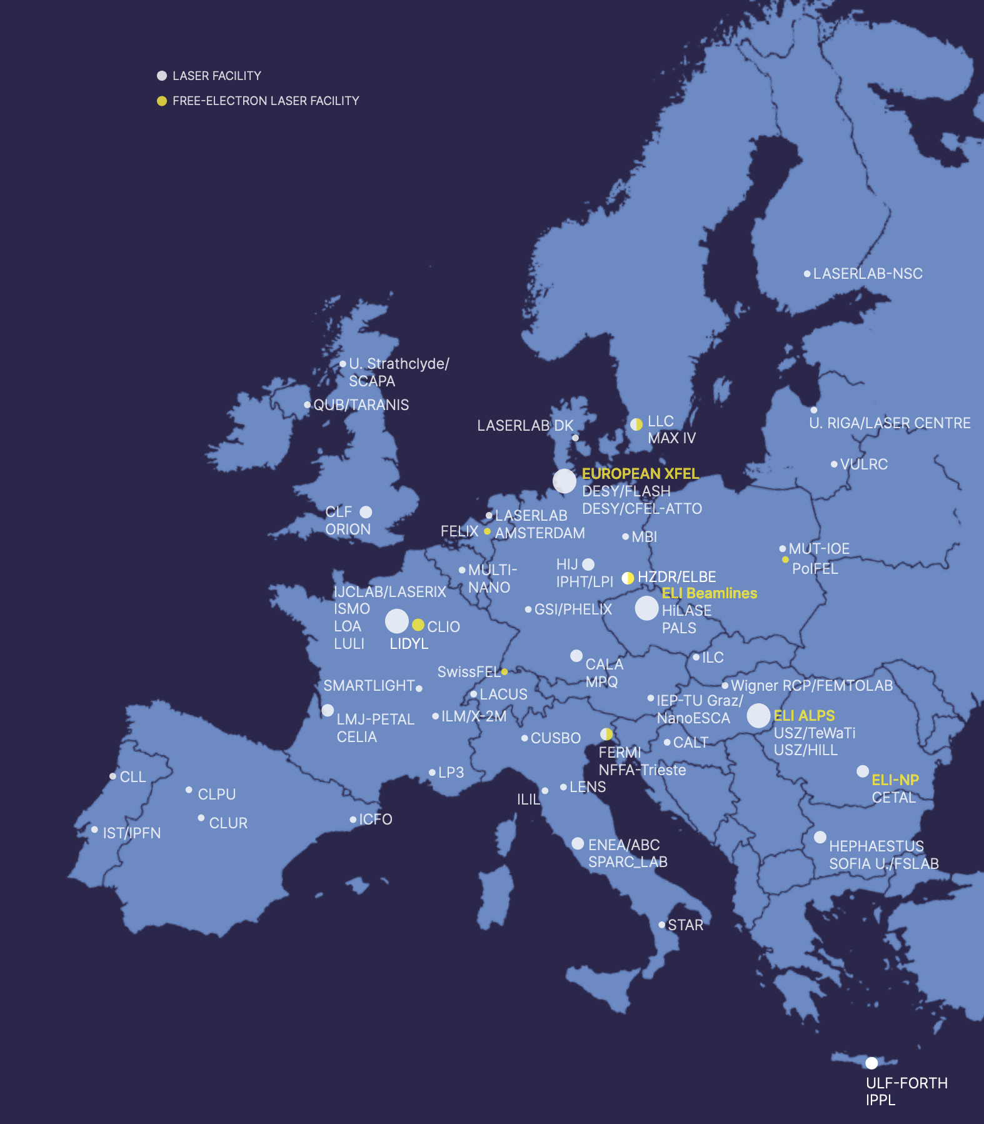
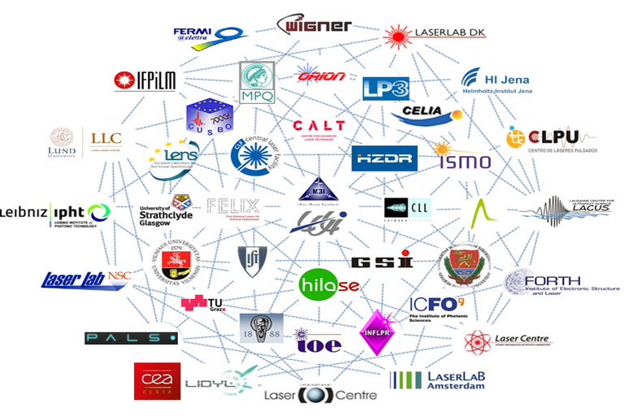
Broader view: intense laser labs and accelerators
European Laser Science and Technology Landscape and Roadmap (by LASERLAB EUROPE & ELI-ERIC)

Slide 7
Important Milestone Achieved
EuPRAXIA selects ELI for the Laser-Driven Accelerator Site
https://www.eupraxia-facility.org/post/eupraxia-selects-eli-for-second-laser-driven-accelerator-site
The EuPRAXIA Consortium selected the ELI Beamlines Facility in Dolní Břežany, Czech Republic, as the site for its laser-driven plasma accelerator pillar. ELI Beamlines was selected for its infrastructure readiness, state-of-the-art laser systems, and comprehensive technical expertise.
EuPRAXIA also recognises the important roles of the other candidates for the second site, EPAC and CNR-INO.
EPAC will contribute to EuPRAXIA as a centre for R&D, focusing on advancing research towards achieving a high-quality 5 GeV electron beam. While CNR-INO will function as EuPRAXIA's National Node in Italy and laser test facility.
Needs robust, repetitive and stable operation of intense laser drivers
Leonida A. Gizzi | LPAW2025, 18 Apr 2025, Ischia (Napoli, Italy) | la.gizzi@ino.cnr.it | http://ilil.ino.it

Slide 8
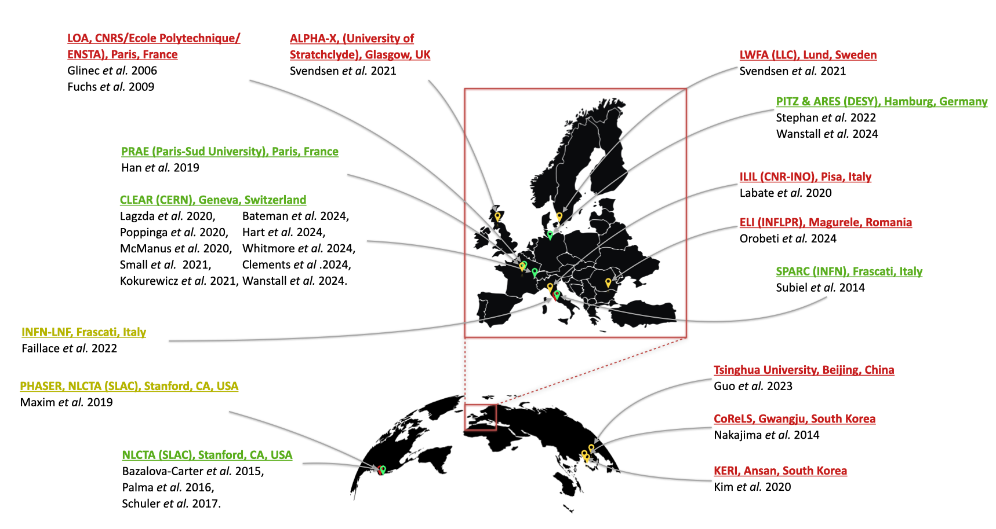
A societal application: medical accelerators for radiotherapy
Strong momentum for Very High Energy Electrons (VHEE) accelerator development
VHEE review paper
Panaino, C.M.V.; Piccinini, S.; Andreassi, M.G.; Bandini, G.; Borghini, A.; Borgia, M.; Di Naro, A.; Labate, L.U.; Maggiulli, E.; Portaluri, M.G.A.; et al. Very High-Energy Electron Therapy Toward Clinical Implementation. Cancers 2025, 17, 181. https://doi.org/10.3390/cancers17020181
Needs high average power, high repetition rate lasers to meet FLASH-RT specifications: with current VHEE-LPA performance, 100Hz-1kHz, <50 TW, 100 W to 1 kW optical

Slide 9
High intensity lasers: evolution
Major breakthrough following Chirped Pulse Amplification
Current laser technology development of CPA lasers [1] mainly driven by extreme intensity applications;
Laser-Plasma acceleration has developed along with progress in laser performance;
Recent LWFA-FEL demonstrations [2,] highlights the role of laser stability and control;
Need to focus on the technology required to achieve high-repetition rate at multi-joule (≈100 TW) scale [3], with high quality and enhanced control and stability;
Key role of industry to establish turn-key, high average/peak power ultrashort pulse technology;
1E23 W/cm2
Current highest intensity in the lab [4]
10 PW @ELI
LASER-PLASMA ACCELERATORS
[1] D. Strickland and G. Mourou, "Compression of amplified chirped optical pulses." Optics communications 55, 447 (1985)
[2] W. Wang, K.Feng et al., Free-electron lasing at 27 nanometres based on a laser wakefield accelerator, Nature 595, 516–520 (2021)
[3] L.A. Gizzi et al., A viable laser driver for a user plasma accelerator, NIM A 909 , 58 (2018); https://doi.org/10.1063/1.4984906
[4] J. W. Yoon et al., “Realization of laser intensity over 1023 W/cm2,” Optica 8, 630-635 (2021), https://doi.org/10.1364/OPTICA.420520
[5] C. Danson et al., High Power Laser Science and Engineering, (2019), Vol. 7, e54, 54 pages. https://doi.org/10.1017/hpl.2019.36

Slide 10
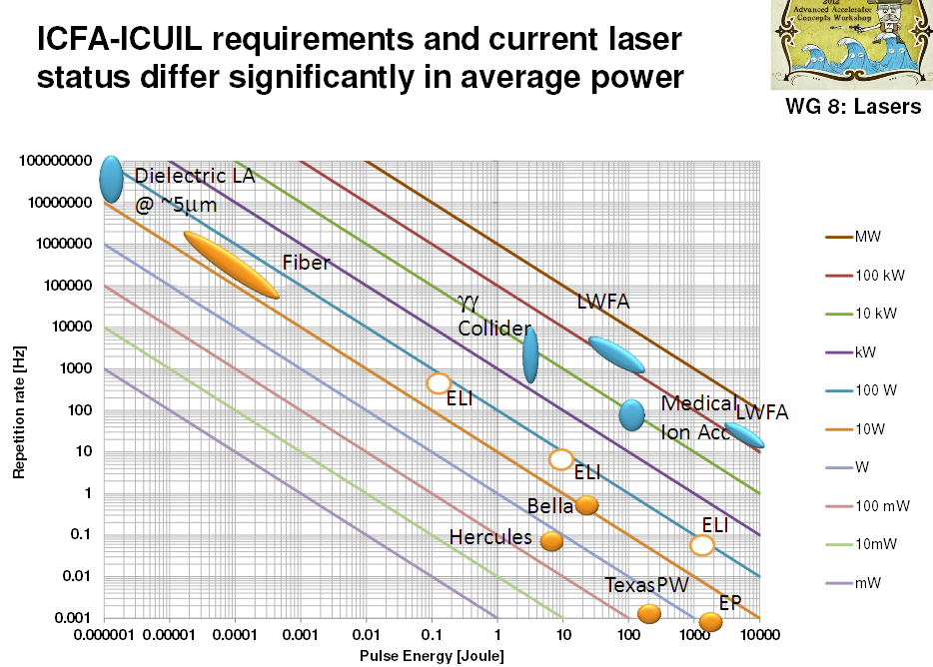
Status of laser driver development
Current reqirement for LPA driver: PW-class system, with high repetition rate (≈kHz) Demanding high average power
Machine drivers
Major effort required to fill the gap between existing and required laser technology
**L.A. Gizzi et al., A viable laser driver for a user plasma accelerator, NIM A 909 , 58 (2018); https://doi.org/10.1063/1.4984906
Leonida A. Gizzi | LPAW2025, 18 Apr 2025, Ischia (Napoli, Italy) | la.gizzi@ino.cnr.it | http://ilil.ino.it

Slide 11
Scaling laser drivers for accelerator systems
Further development of Ti:Sa

Slide 12
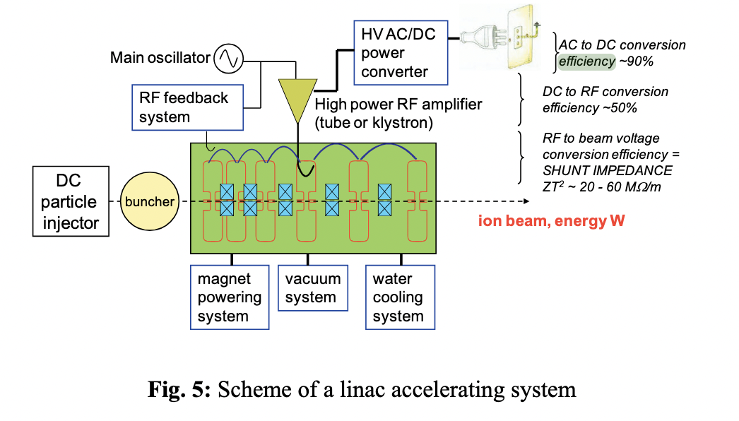
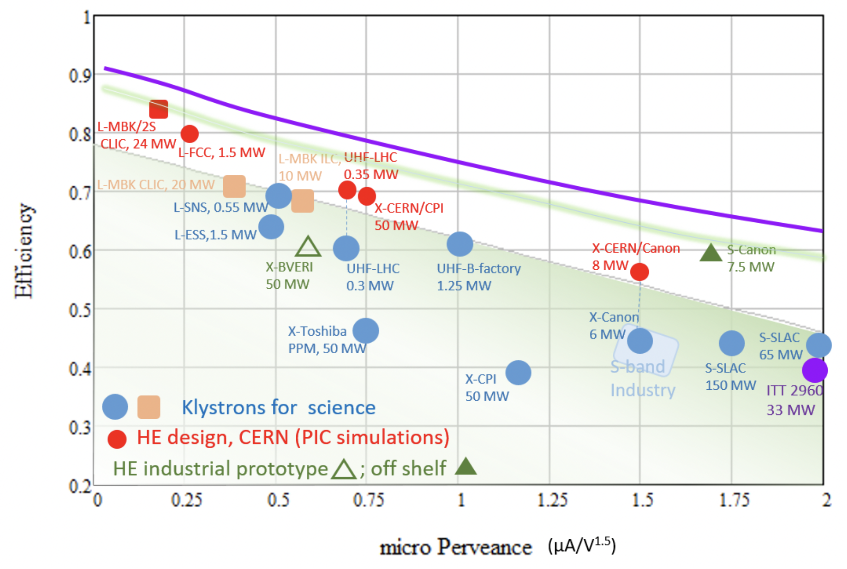
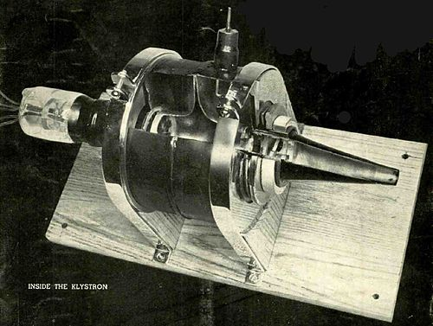
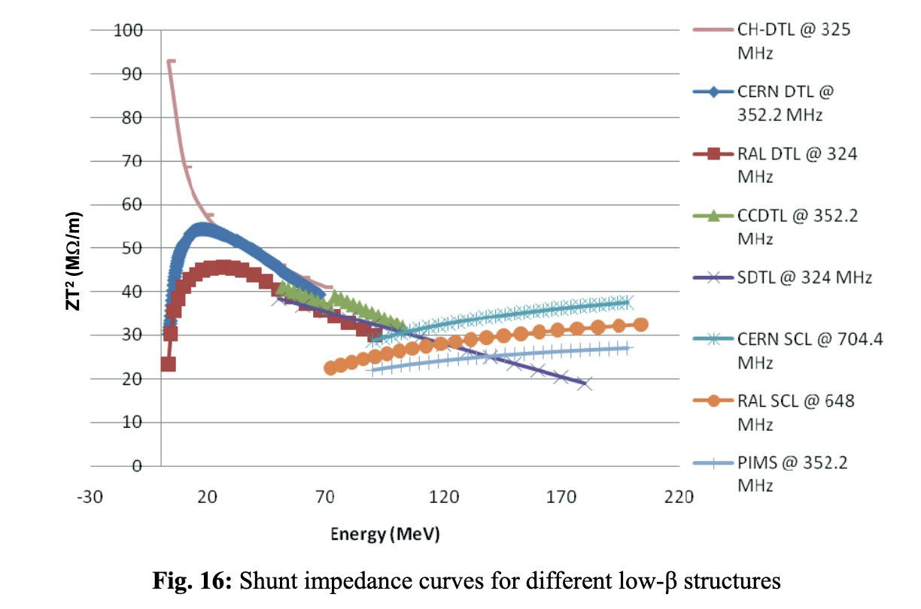
RF accelerators power source and efficiency
Klystron Efficiency (from DC power)
M.Vretenar, https://cds.cern.ch/record/1536738/files/CERN-2013-001-p225.pdf
+ RF to beam efficiency
Westinghouse, 1940
Modern industrial klystron
100s of kW average power
M.Vretenar, https://cds.cern.ch/record/1536738/files/CERN-2013-001-p225.pdf
Leonida A. Gizzi | LPAW2025, 18 Apr 2025, Ischia (Napoli, Italy) | la.gizzi@ino.cnr.it | http://ilil.ino.it

Slide 13
Relevant blocks of a laser driver
Tackle power and coupling efficiencies and losses
loss
Transmitted laser
Plasma
Cooling (loss)
Wall plug
Pump (Energy)
Use laser diodes
Gain medium
Transport and focusing
loss
Optical Compressor
(vacuum)
Transport
Cooling (loss)

Slide 14
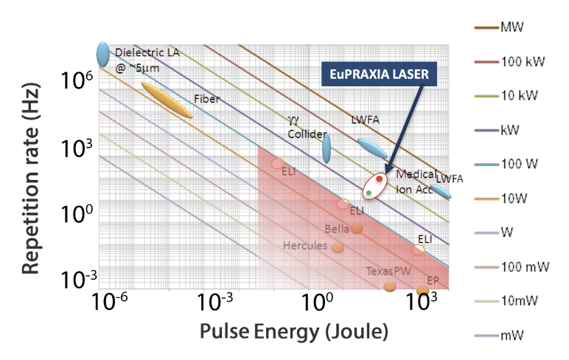
Roadmap on LPA Laser Driver technology
Laser-driven plasma acceleration needs ultrashort, high power lasers with high average power
Current industrial technology: ≈ Ti:Sa technology, pumped by flash-lamp pumped lasers
Robust, reliable industrial technology
Mature technology: ≈ Ti:Sa technology, pumped by diode-pumped lasers
Strong R&D effort in place (e.g HAPLS@ELI)
≈ 3-5 years to go to first industrial LWFA demonstrator (e.g. Eupraxia) [1]
[1] R. Assmann et al., EuPRAXIA Conceptual Design Report, The European Physical Journal Special Topics 229, 3675–4284 (2020)
[2] C. Danson et al., Petawatt and exawatt class lasers worldwide High Power Laser Sci. and Eng. 7, e54 (2019)

Slide 15
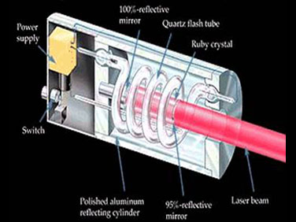
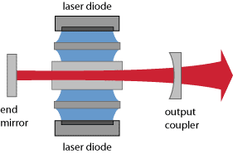
CHANGE OF OPTICAL PUMPING TECHNOLOGY
Analysis of available technologies for PW-class, multi kW average power lasers;
Comparison with the requirements of user beamlines;
Current option: TiSa pumped with diode pumped solid state lasers (DPSSL) – robust;
In progress: Direct CPA for higher rep-rate, higher efficiency.
PUMP SOURCE: Flashlamp
PUMP SOURCE: Diode laser
Major developments in laser technology occurring now!

Slide 16
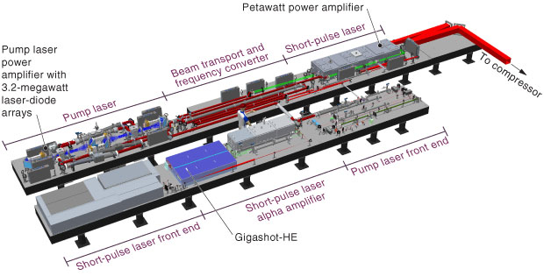
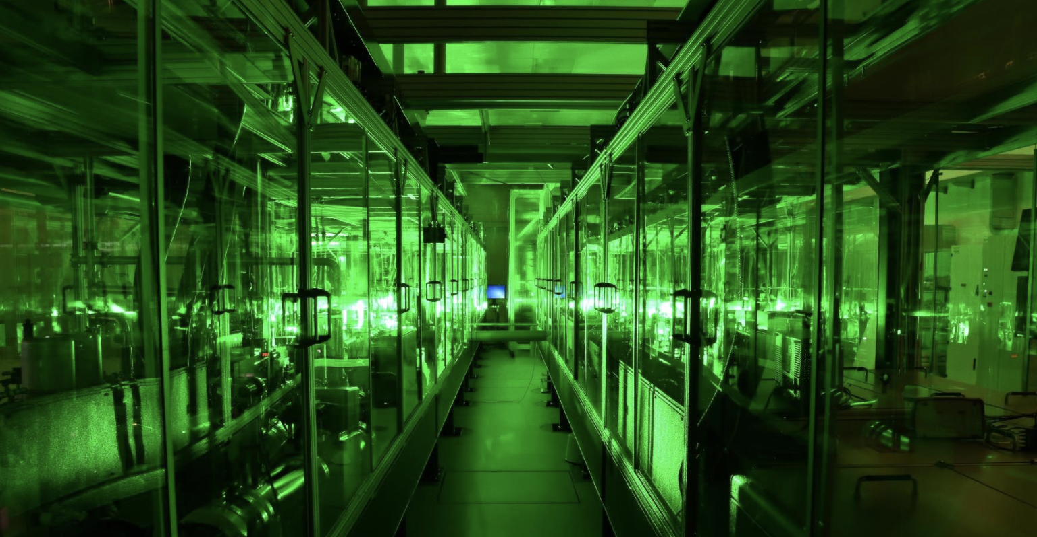
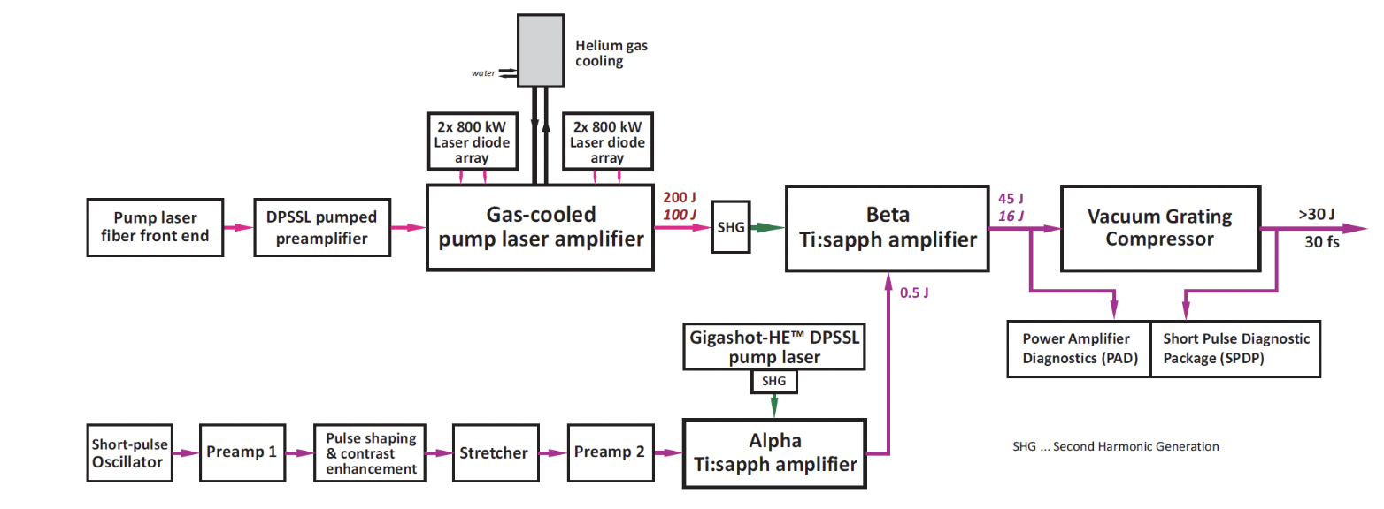
HAPLS: Fully diode-pumped rep-rated PW system
Beamline (Prague)
Nd:YAG
10 Hz
Target
300 W
Now 100 W

Slide 17
Current industrial system: 100 Hz, J-scale
OPCPA
front-end
Laser driver stability
Control
(Eupraxia DN)
HRR Data collection
Front-end
High repetition rate target
Stretcher
High averge power
transport to target
At the limit of current industrial capability
Preamplifier
Ti:SA mutipass
DPSSL pump
High average power Compressor
Ti:Sa disk amplifiers
100 W
Joule scale / 100 Hz / > 100 W

Slide 18
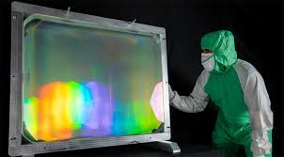
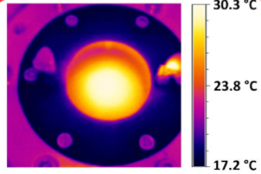
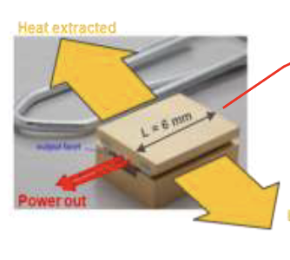
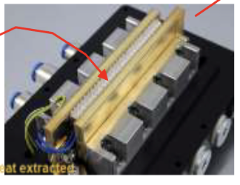
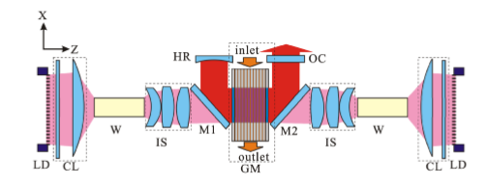
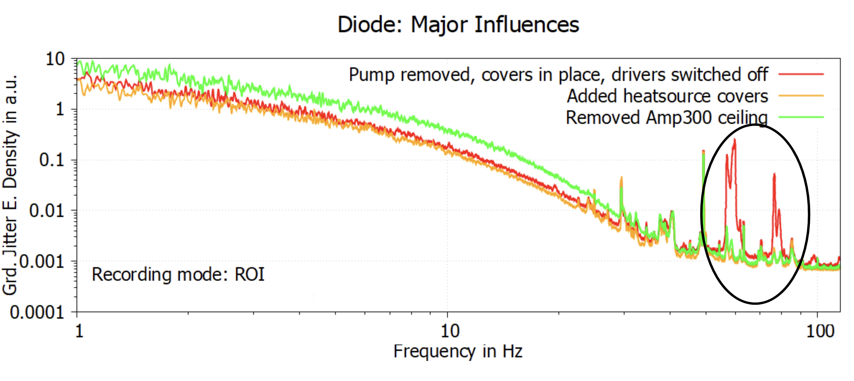
Ti:Sa developments needed
THERMAL
MANAGEMENT OF
POWER AMPLIFIERS
AMPLIFIER GEOMETRY
TRANSMISSION
VS. REFLECTION
DPSSL PUMP
SOURCES
TECHNOLOGY
DIODE LASERS EFFICIENCY,
BRIGHTNESS AND
LIFETIME
COMPRESSOR AND TRANSPORT: THERMAL AND MECHANICAL STABILITY
Multipass transmission
Gold -> MD, MLD, MMLD
reduction of the thermal load
cooling of residual heat
control of thermal effects
DiPOLE 100 (STCF)
WATER/GAS COOLING
Multipass reflection
P-60 technology (Amplitude)
Currently no solution for full system specs (P1): development
Main challenges: large optics, mechanical stability, beam quality control, pointing stability
Prototyping needed
Prototyping needed
Needs development

Slide 19
Scaling lasers drivers for accelerator systems
New schemes for high repetition rate and high WPE

Slide 20
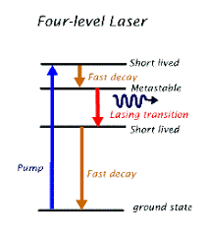
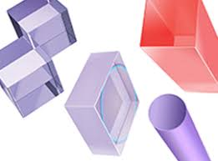
Efficiency path
TiSa technology is prompt and will demonstrate repetitive operation 24/7 and stability, but not scalable with poor efficiency (% level) due to the indirect pumping architecture:
Direct CPA is a solution for wall-plug (WP) efficiency and high rep-rate.
From flashlamp to indirect to direct diode pumping
Quantum defect
C. Siders et al., EAAC 2017
WP Efficiency > 20% possible:
We need a gain medium that can support amplification on a large bandwidth, has a low quantum defect and can be pumped directly with diode lasers: endless quest for the perfect laser medium!!

Slide 21
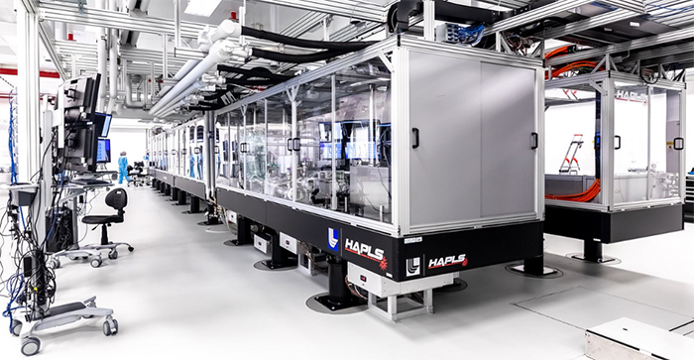
Roadmap on LPA Laser Driver technology
Laser-driven plasma acceleration needs ultrashort, high power lasers with high average power
Current technology: ≈ Ti:Sa technology, pumped by flash-lamp pumped lasers
Robust, reliable industrial technology
Mature technology: ≈ Ti:Sa technology, pumped by diode-pumped lasers
Strong R&D effort in place (e.g HAPLS@ELI)
≈ 3-5 years to go to first industrial LWFA demonstrator (e.g. Eupraxia) [1]
Beyond TiSA: targeting higher wall-plug efficiency and rep. rate, kHz and beyond, stability, control (space, time, spectral);
5-10 yrs for first efficient, multi-kW-scale demonstrator,
A strategy is needed to steer effort in the LPA laser driver direction: LASPLA
The L3-HAPLS at ELI Beamlines Research Center in the Czech Republic. Credit: ELI Beamlines*
[1] R. Assmann et al., EuPRAXIA Conceptual Design Report, The European Physical Journal Special Topics 229, 3675–4284 (2020)
[2] C. Danson et al., Petawatt and exawatt class lasers worldwide High Power Laser Sci. and Eng. 7, e54 (2019)

Slide 22
Several options under development
Fiber laser technology targeting the best WPE 30% in CW mode and coherent combination is being developed (FSU Jena-Fraunhofer IOF and Ecole Polytechnique-Thales in France).
Suited for moderate energy per pulse/high rep-rate (10s of kHz);
Now 96 fibers delivering 23 mJ and 674 W in a 235 fs pulse
Direct Chirped Pulse Amplification with lasing media pumped directly by diodes is ideal for higher efficiency and higher rep-rate;
several materials under consideration, Yb:CaF2, Tm:YLF, Tm:Lu2O3 (with cross-relaxation and multi-pulse extraction) …
PENELOPE (Jena) 150 J, 1 Hz, at 1030 nm
Available ps kW thin disk lasers using plasma modulation (Oxford²)
OPCPA optical parametric amplification within large-aperture lithium triborate (LBO) crystals;
ELI-Beamlines facility, L1 ALLEGRA (100 mJ at 1 kHz) and L2 AMOS (100 TW, 2 to 5 J between 10 and 50 Hz), and the Shenguang II Multi-PW beamline(SIOM, China) …
Thin Disk ps Lasers + spectral broadening + post compression³
Industrial technology with demonstrated >kW operation ar ≈J per pulse energy.
L.A Gizzi, F. Mathieu, P. Mason, P P Rajeev, Laser drivers for Plasma Accelerators, in Félicie Albert et al, 2020 roadmap on plasma accelerators, 2021 New J. Phys. 23 031101, https://doi.org/10.1088/1367-2630/abcc62;
O. Jakobsson, S. M. Hooker and R. Walczak, PRL, (2021)
A.L. Viotti et al., Optica 9, 197-216 (2022).

Slide 23
iFAST innovation action

Slide 24
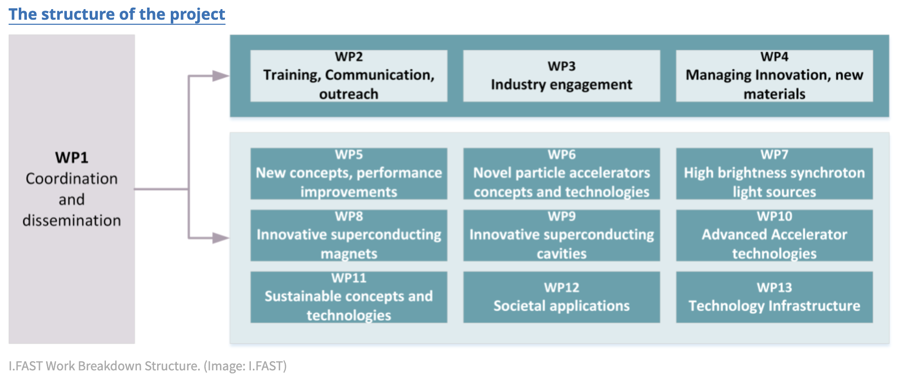
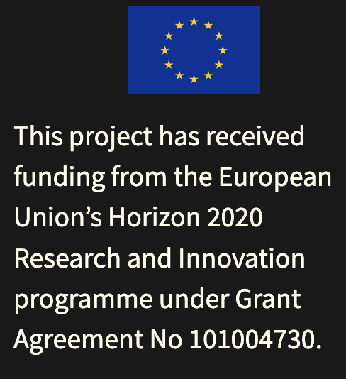
Innovation Fostering in Accelerator Science and Technology (I.FAST)
https://ifast-project.eu/
PROJECT ACRONYM: Innovation Fostering in Accelerator Science and Technology PROGRAMME: Horizon 2020 (Research Innovation Action) DURATION: May 2021 – April 2025 (extended to 31 October 2025) TOTAL BUDGET: 18.7 M€ TOTAL EC CONTRIBUTION: 10 M€ CONSORTIUM: 48 participants from 14 countries PROJECT COORDINATOR: Maurizio Vretenar (CERN)
Leonida A. Gizzi | LPAW2025, 18 Apr 2025, Ischia (Napoli, Italy) | la.gizzi@ino.cnr.it | http://ilil.ino.it

Slide 25
WP6 Novel Particle Accelerators Concepts and Technologies
Ralph Assmann coordinated WP6 until end of August 23 when he left DESY
Task 1 (R.A. + M. Ferrario): Novel Particle Accelerators Concepts and Technologies (NPACT – EuroNNAc4) Sub-task leaders: B. Holzer (CERN), D. Minenna (CEA), A. Specka (CNRS), R. Walczak (Oxford)
Task 2 (Leo Gizzi): Lasers for Plasma Acceleration (LASPLA)
Task 3 (Cedric Thaury): Multi-scale Innovative targets for laser-plasma accelerators (MILPAT)
Task 4 (Francois Mathieu): Laser focal Spot Stabilization Systems (L3S)
LASPLA Objectives
Establish a roadmap to foster delivery of advanced industrial laser drivers with high-repetition rate and higher efficiency, for the first user laser-plasma based accelerators.
Establish a coordination activity with networking and training of main laser labs and industrial partners, focused on laser-driver R&D.
Leonida A. Gizzi | LPAW2025, 18 Apr 2025, Ischia (Napoli, Italy) | la.gizzi@ino.cnr.it | http://ilil.ino.it

Slide 26
iFAST: A Roadmap outline for laser drivers for accelerator systems
Leonida A. Gizzi | LPAW2025, 18 Apr 2025, Ischia (Napoli, Italy) | la.gizzi@ino.cnr.it | http://ilil.ino.it

Slide 27
LASPLA Technical meetings
WP6 - NPACT-Novel particle accelerators concepts and technologies
Task 6.2 - LASPLA
1st Technical Meeting – 23rd June 2021
10.00 - "Introduction about IFAST/LASPLA" - Leo GIZZI/CNR, Italy
10.20 - "Overview of Laser Technology Developments @ CLF" - Paul MASON/STFC, UK
10.40 - "First acceleration experiments on Apollon" - Francois MATHIEU/CNRSApollon, France
11.00 - "Overview of laser technology developments @ Thales" - Christophe SIMON BOISSON/THALES, France
11.20 - "New materials for pulse amplification at 1 and 2 microns" - Guido TOCI/CNR-INO, Italy
11.40 - "Tm:Lu2O3 amplifier design issues" - Luca LABATE/CNR-INO, Italy
12.00 - "Challenges for diode laser pump sources: high intensity & high repetition rate & efficient & low €/W" - Paul CRUMP/FB, Germany
12.20 - Discussion and next meeting/conference - All
12.30 - Close

Slide 28
LASPLA Technical meetings
IFAST WP6 - NPACT-Novel particle accelerators concepts and technologies
Task 6.2 - LASPLA
2nd Technical Meeting – 7th October 2021
Session 1 (Convenor, L. GIZZI, CNR)
15.00 – Leonida A GIZZI, INO-CNR, Pisa, Italy, “Overview and motivation of the IFAST project”
15.15 - Georgia ADRIANAKI, HMU, Greece,“Experiencing the development of the ZEUS laser facility at IPPL for particle acceleration optimization experiments”
15.30 - Thomas M. SPINKA, LLNL, USA, - "Demonstration of a compact, multi-joule, diode-pumped Tm:YLF laser”,
15.45 – Roman WALCZAK, Clarendon Laboratory, Oxford, UK – “High-repetition-rate, GeV-scale accelerators driven by plasma-modulated laser pulses”
16.00 - Joachim HEIN, Jena University, Germany, “Prospects of high energy Tm lasers and first tests”
Session 2 (Chair Paul CRUMP, FBH)
16.30 – Luca LABATE, CNR-INO, Pisa, Italy, “Tm laser development for the ELITE infrastructure at CNR”
16.45 - Luis ROSO, CLPU, Salamanca, Spain, “Petawatt Lasers: High Repetition Rate Challenges”
17.00 - Victor MALKA, Weizmann Institute, Israel - “What about very high energy electrons radiotherapy (VHEE-RT) with compact laser plasma accelerators?”
17.15 - Andreas R. MAIER, Hamburg University, Germany - “High Average Power Laser-Plasma Acceleration”
17.30 – Conclusions/Next meeting (All)

Slide 29
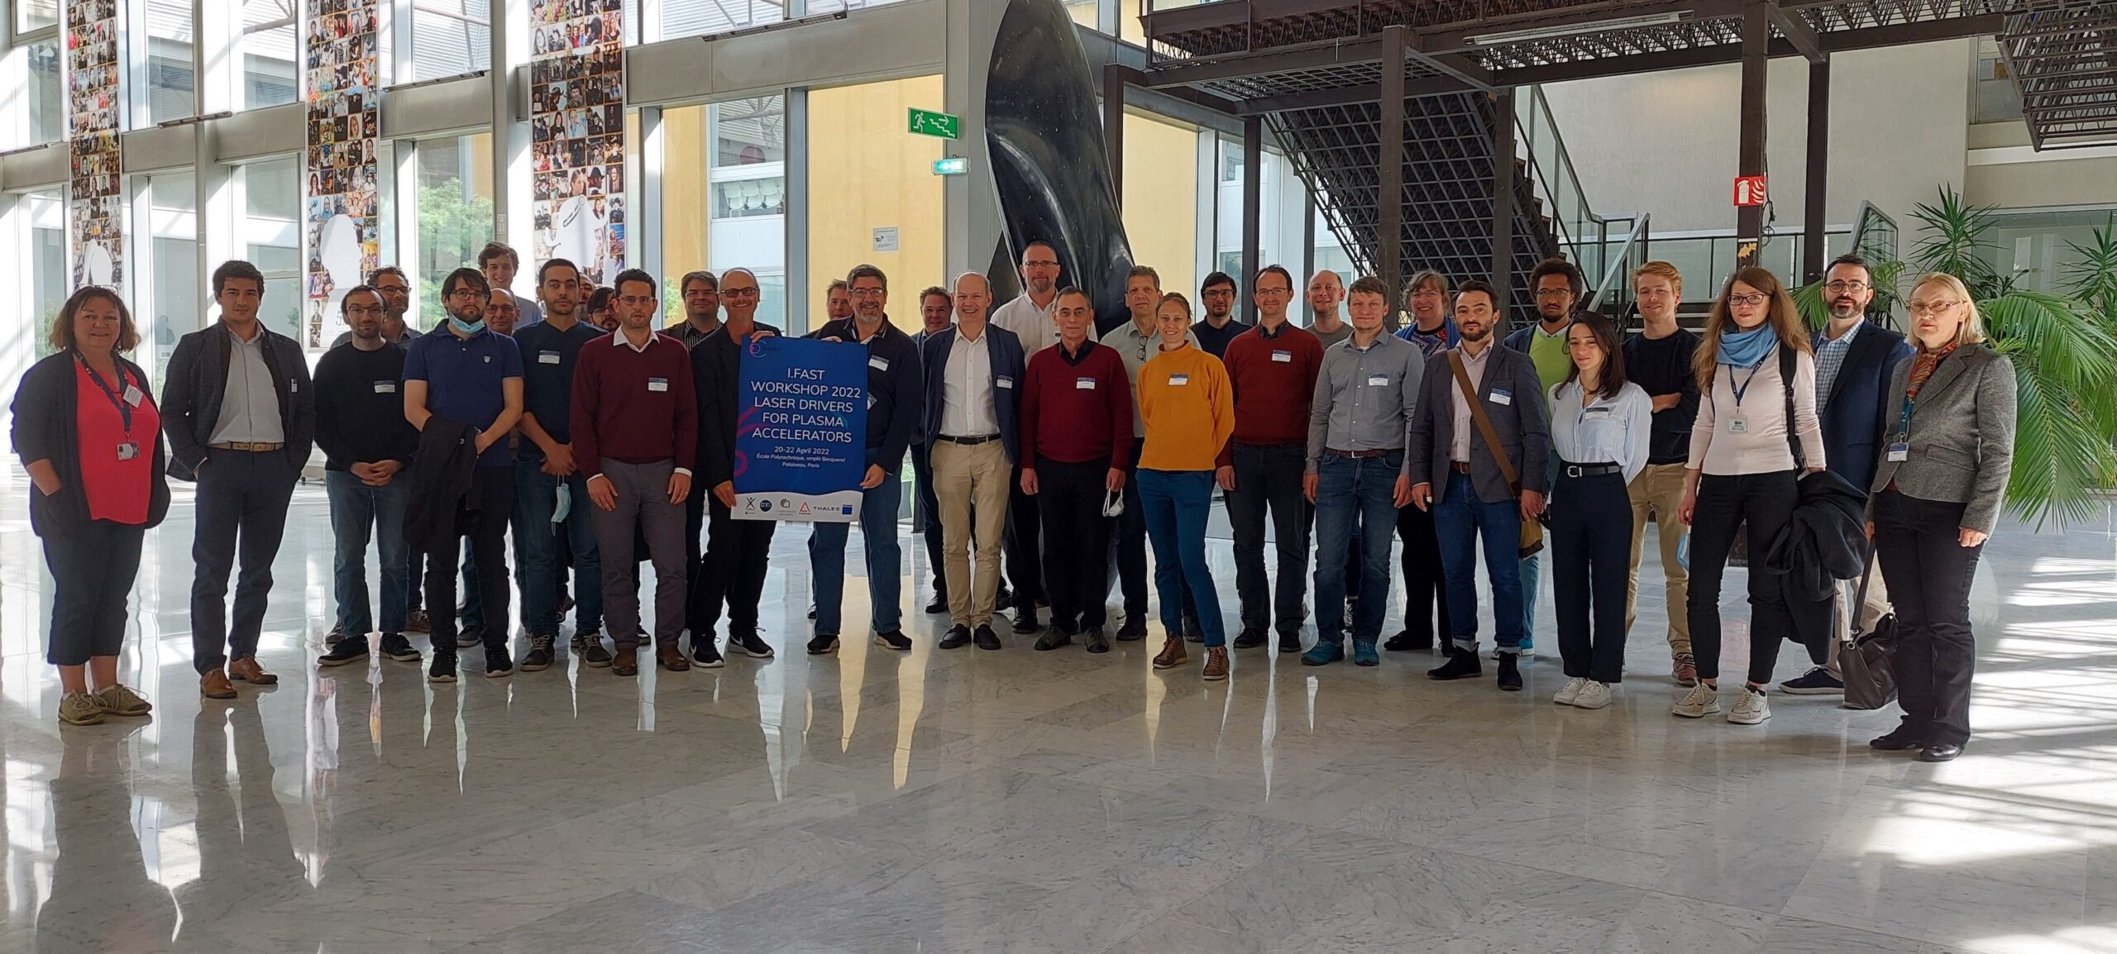
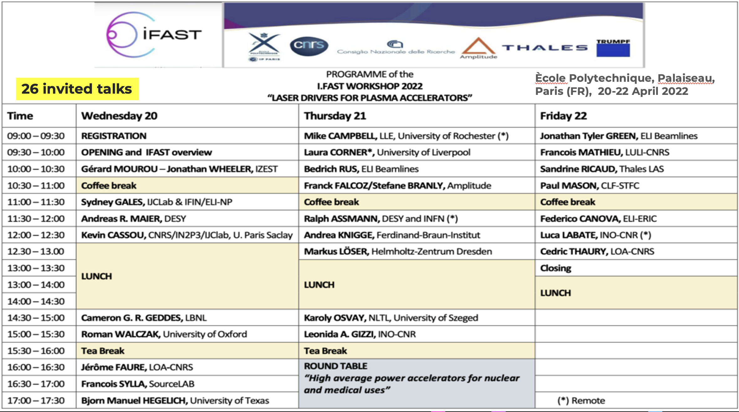
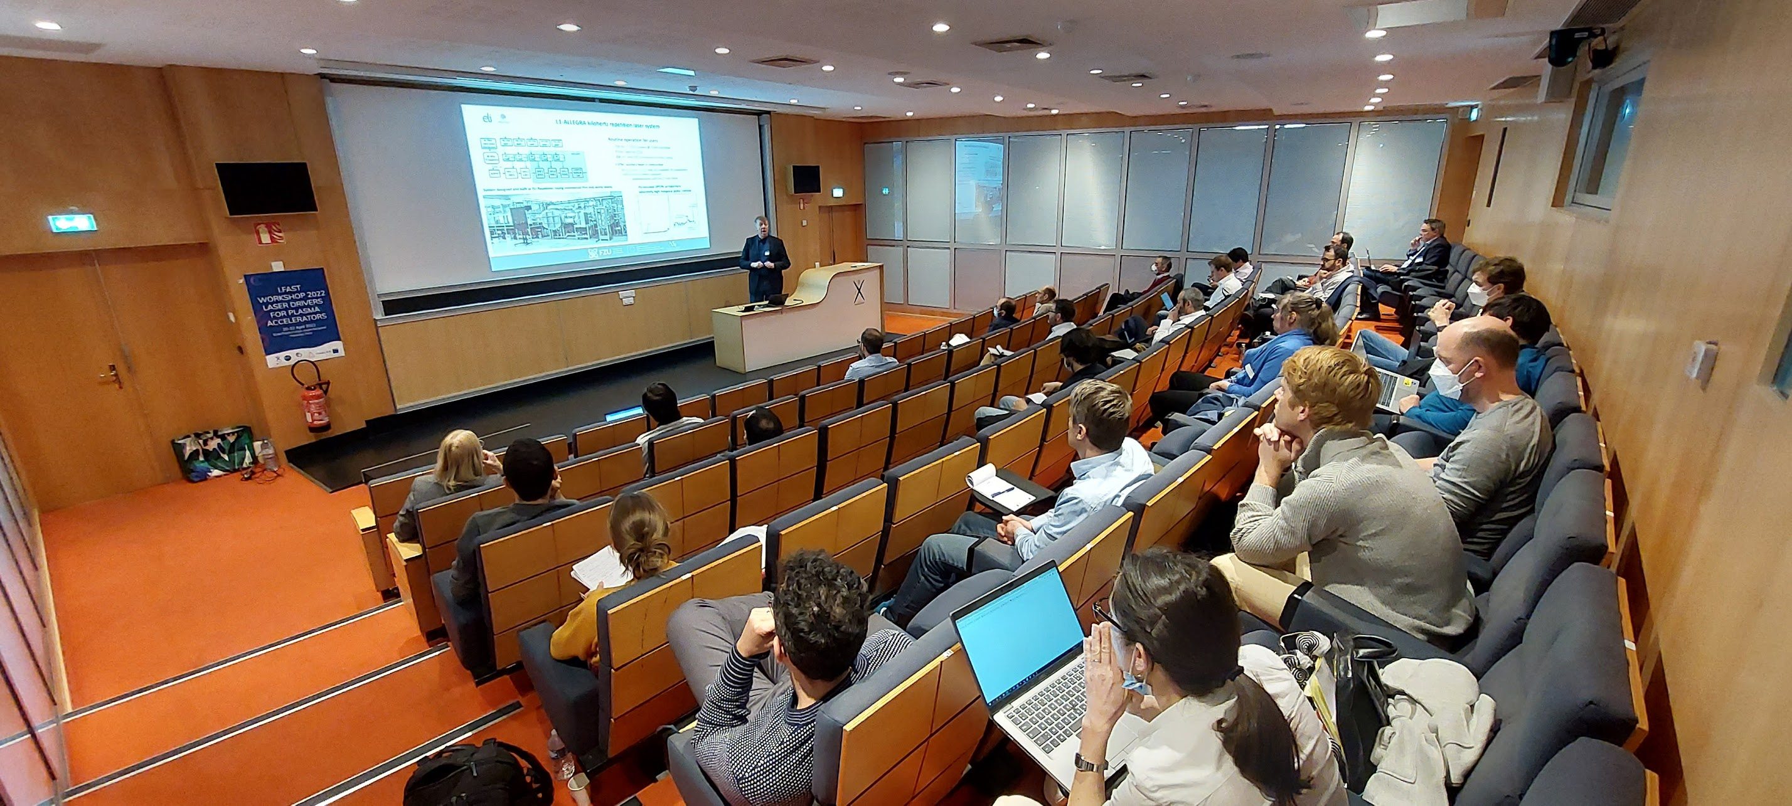
Workshop on Laser Drivers for Plasma Accelerators
3rd LASPLA technical meeting
Outcome of IFAST for Strategy from Workshop on Laser Drivers for Plasma Accelerators held on 20-23 of April 2022 at the Ecole Polytechnique (Palaiseau, France)
Leonida A. Gizzi | LPAW2025, 18 Apr 2025, Ischia (Napoli, Italy) | la.gizzi@ino.cnr.it | http://ilil.ino.it

Slide 30
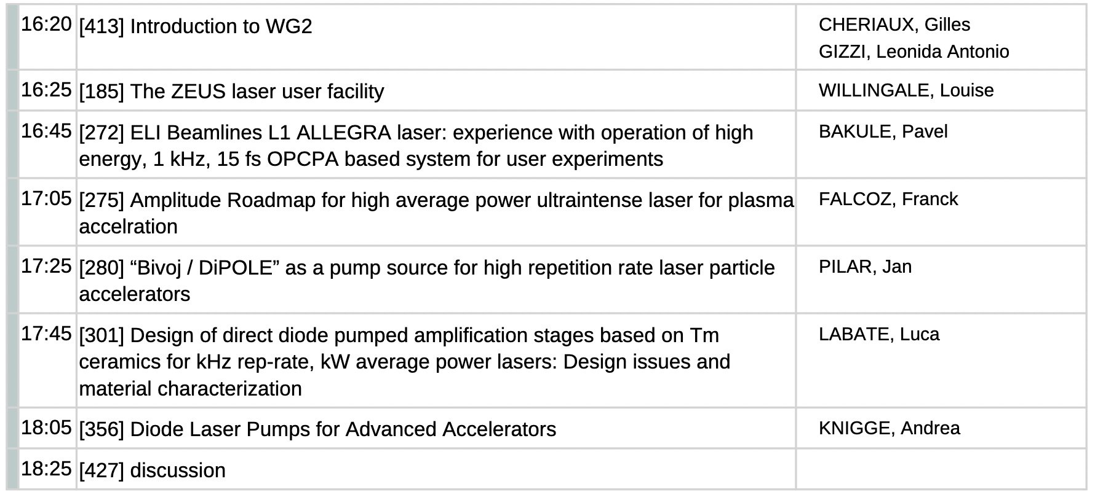
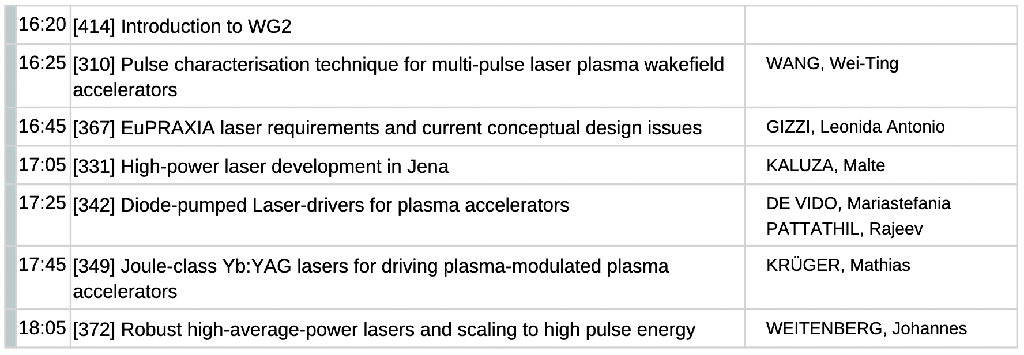
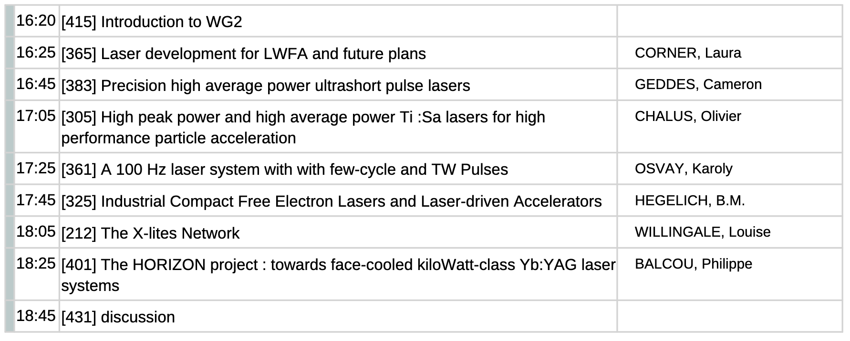
LASPLA Workshop @ EAAC - WG2: Laser technology (IFAST WP6 - Task2)
4th LASPLA technical meeting
Speakers from FR, CZ, IT, DE, UK, US,
Labs, Universities and Industry
WG2: Laser technology (WP6 - Task2)
Topics addressed:
Recent achievements and future challenges in laser drivers for LPA
Needs for laser driven accelerators (laser-plasma ion source, LWFA, IFEL, dielectric laser, ...)
State-of-the-art of high peak and average power and perspectives
Laser beam quality, contrast, stability
High repetition rate issues
TRL Studies
Co-Leader: Leonida A. Gizzi, INO-CNR
Co-Leader: Mariastefania De Vido, STFC
Co-Leader: Paul Crump, FBH – Berlin
Co-Leader: Gilles Cheriaux, CNRS
Co-Leader: Christophe Simon-Boisson, Thales
Monday
Tuesday
Thursday
Meeting focused on the roadmap for laser driver and high average power technologies for plasma accelerators. Highlights include new ideas for diode-pumped CPA lasers, laser labs networking and major industrial advances for upcoming plasma accelerators (EuPRAXIA).
LASPLA Laser Technology Workshop held on 19-22 of September 2023 in the framework of the 6th EAAC 2023 at Elba, Italy.
Leonida A. Gizzi | LPAW2025, 18 Apr 2025, Ischia (Napoli, Italy) | la.gizzi@ino.cnr.it | http://ilil.ino.it

Slide 31
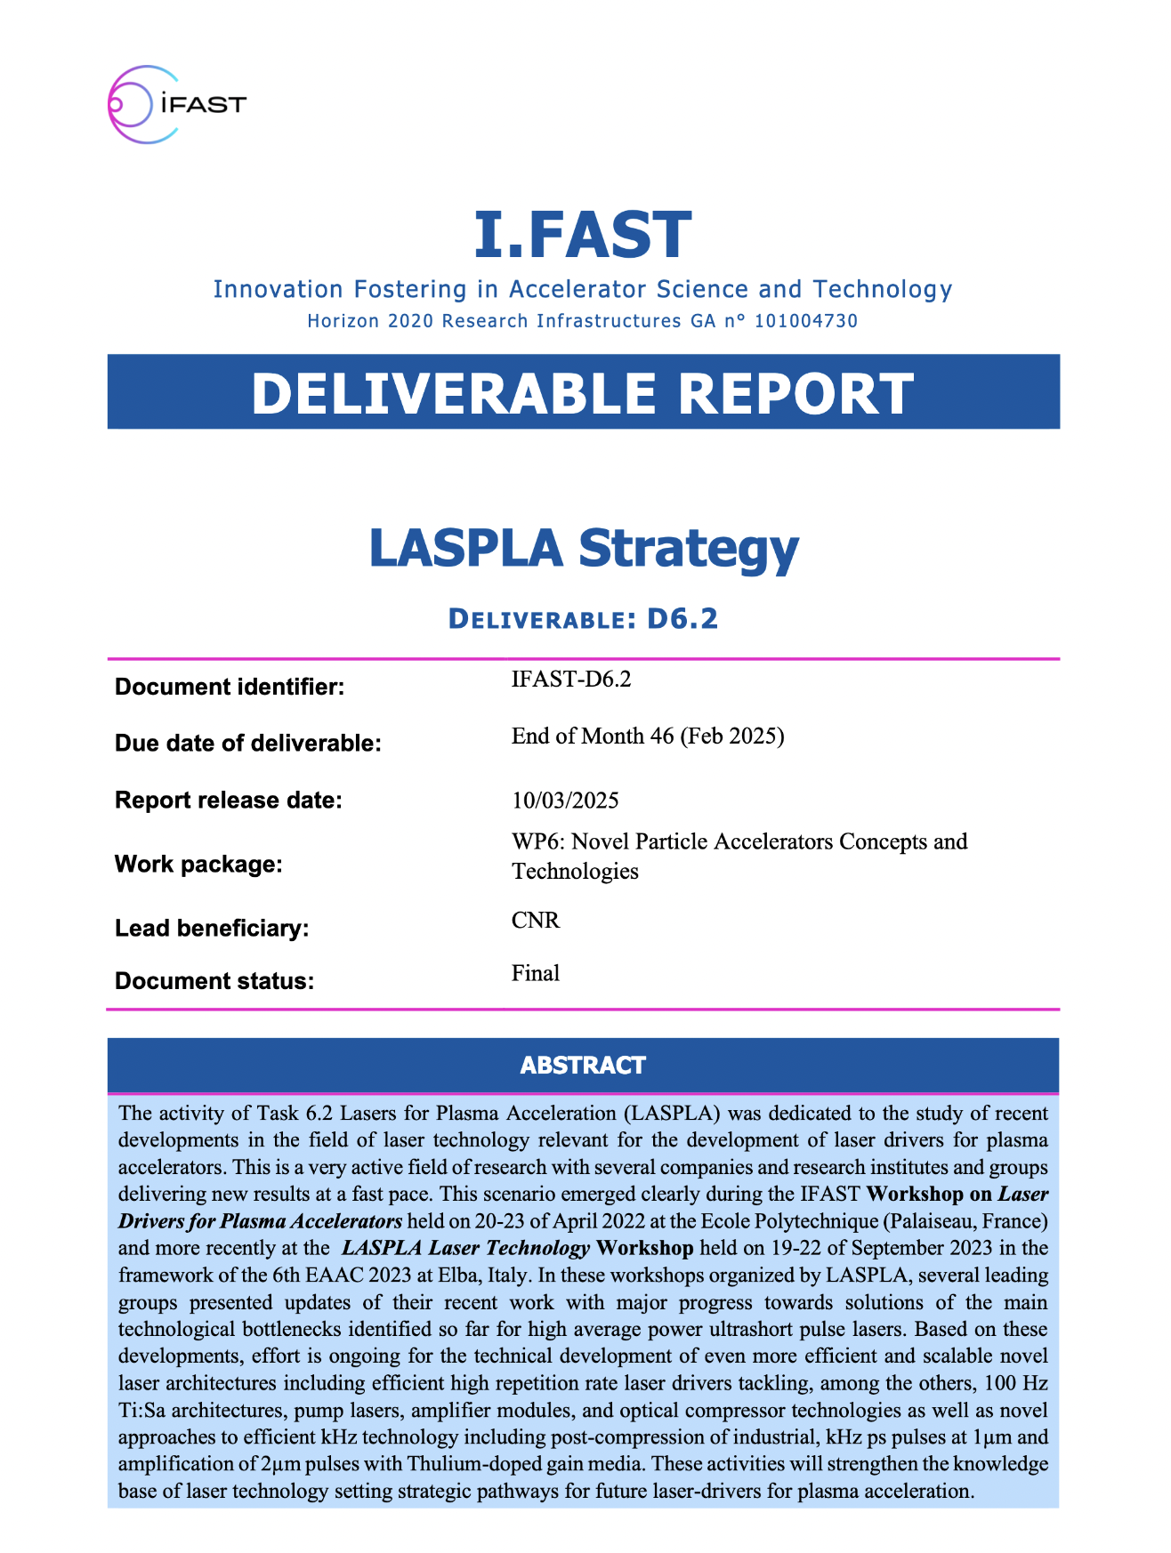
Task 6.2 (LASPLA): Roadmap for laser driver development
Parto of the WP6: Novel Particle Accelerators Concepts and Technologies of i.FAST
High TRL Ti:Sa, 100 Hz, multi Joule scale (EuPRAXIA-Like) - 1-10 kW
Coherent combination of multi-J-scale beams
High TRL – Industrial development in progress at J level
Short-medium term solution
Proof-of-principle user laser accelerator
Needs components testing
Existing “Commercial”
100 Hz,<100 W, J-SCALE front-end
&
Efficient diode laser technology
Longer term solution
Scalable, efficient
Needs high brightness, lower cost diode lasers for pumping
Needs materials and components R&D
Diode pumped, direct CPA, kHz, multi- Joule scale
High efficiency with advanced lasing materials (DPSSL)
Optical parametric chirped pulse amplification (OPCPA) with diode pumping
Post-compression of thin-disk lasers
Coherent combination of fibers
https://zenodo.org/records/15025840
Leonida A. Gizzi | LPAW2025, 18 Apr 2025, Ischia (Napoli, Italy) | la.gizzi@ino.cnr.it | http://ilil.ino.it

Slide 32
LASPLA Strategy
Report on a strategy for laser drivers for plasma acceleration (D.6.2)
1 Introduction
2 Pillars of strategy
2.1 Overview
2.2 Key Technologies
2.2.1 Cooling architectures
2.2.2 Pump lasers
2.2.3 High Quality Front-end
2.2.4 100 Hz Ti:Sa Technology
2.2.5 Diode laser technology
2.2.6 Thulium doped gain media
2.2.7 Exploitation of industrial kHz systems
3 Planned developments
3.1 Funded Laser Activities
3.1.1 Ti:Sa amplifier modules
3.1.2 Efficient kHz laser drivers
3.1.3 High Rep-rate pump sources
3.1.4 High average power compressors
3.1.5 System Architectures
4 Future plans / Conclusion / relation to other IFAST work
https://zenodo.org/records/15025840
Leonida A. Gizzi | LPAW2025, 18 Apr 2025, Ischia (Napoli, Italy) | la.gizzi@ino.cnr.it | http://ilil.ino.it

Slide 33
Roadmap initial implementation: the PACRI Infratec project

Slide 34
Plasma Accelerator systems for Compact Research Infrastructures
https://indico.elettra.eu/event/52/
PACRI – 101188004 – Funded by the European Union. Views and opinions expressed are however those of the author(s) only and do not necessarily reflect those of the European Union or the European Research Executive Agency (REA). Neither the European Union nor the granting authority can be held responsible for them.

Slide 35
PACRI Collaboration
PACRI is a collaborative effort involving:
19 International Research Laboratories and Universities
supported by 7 Industrial Partners.
It is closely linked to two ESFRI Research Infrastructures:
Project duration: 4 Years (2025 - 2028)
EU contribution: 10 M€

Slide 36
Coordination and focus
Compact & efficient plasma accelerators (M. Ferrario - INFN)
With focus on the high rep-rate plasma modules, as required for the EuPRAXIA project, extending its scientific domain to high average brightness radiation sources and possible future applications to high energy physics.
Compact & efficient X-band technology for accelerators (G. D’Auria - ELETTRA)
With focus on normal conducting RF technology for linacs (X-band), improving their efficiency and power consumption and extend their operating capabilities up to the kHz regime.
Efficient & high repetition rate Lasers (L. Gizzi - CNR).
With focus on high power laser technology, to drive high-gradient and high-repetition-rate Laser Plasma Acceleration (LPA) related to the above-mentioned applications.

Slide 37
PACRI Work Packages
WP No. | Work Package Title | Lead Partic. Short Name
1 | Coordination and project management | ELETTRA
2 | Scientific and industrial exploitation | ULIV
3 | Plasma accelerator theory and simulations | IST
4 | High repetition rate plasma structures | INFN
5 | Plasma acceleration diagnostics and instrumentation | CNRS
6 | High efficiency RF generator | Thales-MIS
7 | High repetition rate modulator | Scandinova
8 | X-band RF Pulse Compressor (BOC) | INFN
9 | RF tests and validation | CERN
10 | High repetition rate high power Ti:Sa amplifier module | UKRI
11 | Efficient kHz laser driver modules for plasma acceleration | CNR
12 | High-rep rate pump sources for laser drivers | ELI-ERIC
13 | Prototype of high average power optical compressor | Thales-LAS
14 | Laser Driver System Architecture,transport and engineering | CNRS
# | Partner | Acronym
1 | Elettra - Sincrotrone Trieste SCpA (Coordinator) | ST
2 | European Organization for Nuclear Research | CERN
3 | Istituto Nazionale Fisica Nucleare | INFN
4 | University of Liverpool | ULIV
5 | Thales-MIS | Th-MIS
6 | Scandinova Systems AB | SCND
7 | VDL ETG Technology & Development BV | VDL
8 | COMEB | COMEB
9 | United Kingdom Research and Innovation | UKRI
10 | Consiglio Nazionale delle Ricerche | CNR
11 | Extreme Light Infrastructure ERIC | ELI-ERIC
12 | Centre National de la Recherche Scientifique CNRS | CNRS
13 | Thales LAS France SAS | Th-LAS
14 | Amplitude | Amplitude
15 | Centro de LÁSERES Pulsados | CLPU
16 | Ferdinand-Braun-Institut gGmbH, Leibniz-Institut für Hoechstfrequenztechnik | FBH
17 | Associacao do instituto superior Tecnico para a Investigacao e Desenvolvimento | IST
18 | Università degli Studi di Roma La Sapienza | USAP
19 | Heinrich-Heine-Universitaet Duesseldorf | UDUS
20 | Deutsches Elektronen-Synchrotron DESY | DESY
21 | The Chancellor, Masters and Scholars of the Univ. of Oxford | UOX
22 | Ludwig-Maximilians-Universitaet Muenchen | LMU
23 | GSI Helmholtz Centre for Heavy Ion Research | GSI
24 | Università degli Studi di Roma Tor Vergata | UTOR
25 | SourceLAB | SourceLAB
26 | Paul Scherrer Institut (Associated partner) | PSI
25 Members
+
1 Associated partner
Plasma
19 Universities
and Scientific Labs.
+
7 Industries
X-band
Lasers
37

Slide 38
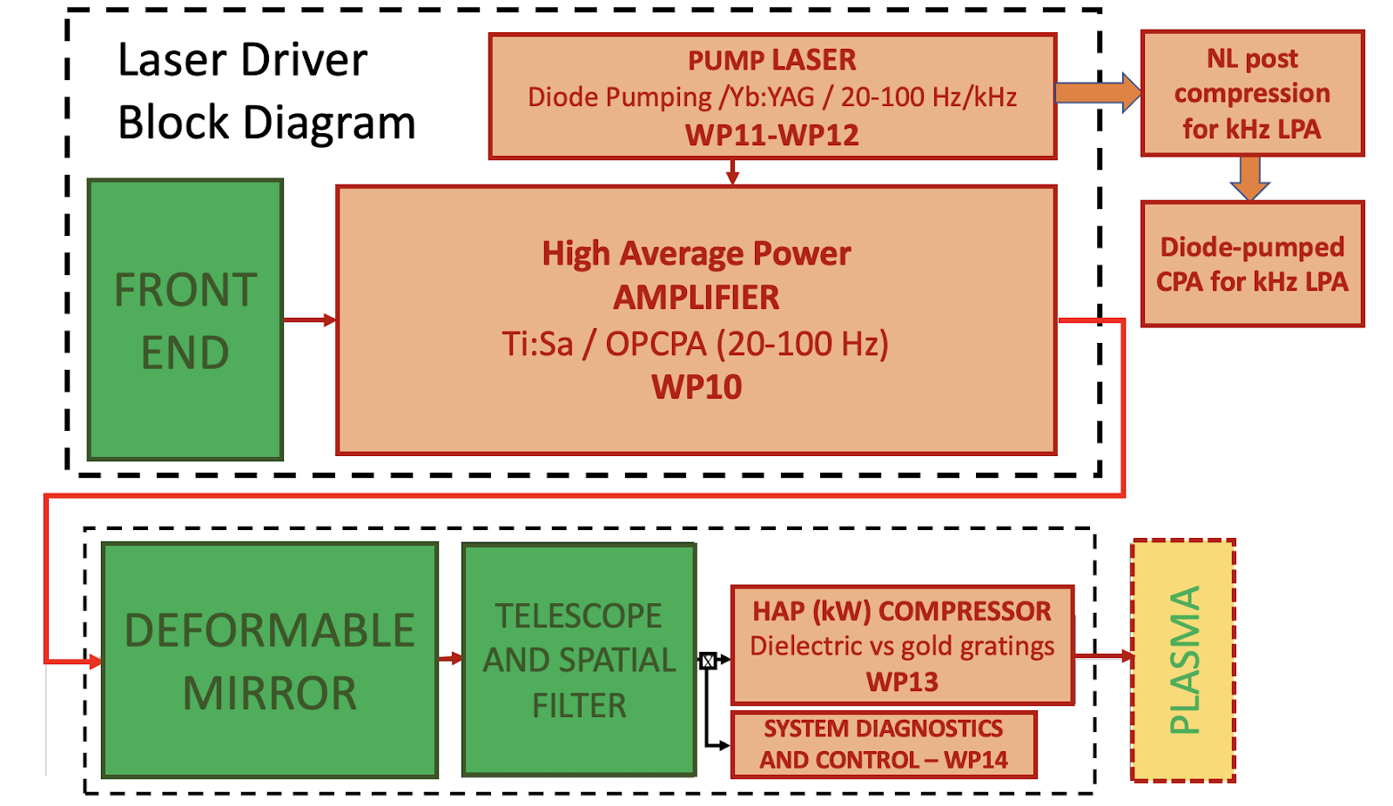
PACRI LASER WORK AHEAD
Funding for scaleup of collaborative EuPRAXIA TDR development (within Infratech proposal PACRI)
PACRI WP10
High repetition rate High power Ti:Sa amplifier module
EuPRAXIA laser driver (100 Hz) and longer term options (1 kHz)
PACRI WP12
High repetition rate pump sources for laser drivers
PACRI WP13
Prototype of High average power optical compressor
PACRI WP14
Laser driver System Architecture, transport and engineering
PACRI WP11
Efficient kHz laser driver modules for plasma acceleration
Leonida A. Gizzi | LPAW2025, 18 Apr 2025, Ischia (Napoli, Italy) | la.gizzi@ino.cnr.it | http://ilil.ino.it

Slide 39
kHz intense laser driver development
A case study: direct DPSSL CPA with Thulium-doped materials

Slide 40
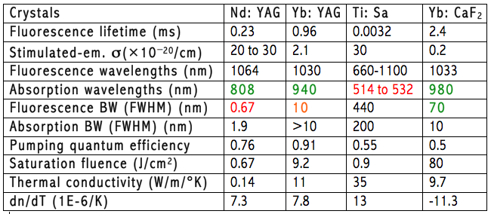
Key parameters of lasing media
Main parameters governing high power laser amplifiers:
Spectral gain bandwidth: short pulse duration
Thermal conductivity: limits repetition rate
Abs. and emis. cross sections: gain, pump absorption and saturation
Fluorescence lifetime: sets conditions on pumping
dn/dT: limits beam quality

Slide 41
Thulium based laser gain materials
Currently under investigation(*): Tm:YLF
Emission at 1,9 µm, eye safe;
Ultrashort pulse (<100 fs);
High peak power ≈ PW;
High average power(scalable from kW to 300 kW);
Direct pumping at 808 nm, using diodes operating in CW mode (available and scalable);
Multi-pulse extraction at high repetition rate
10 kHz; Ideal for accelerator technology;
High efficiency;
Mature material technology (crystal growth);
Ti:Sa
Tm:YLF
Tm: YLF Full specifications
Absorption peak wavelength 792 nm
Absorption cross-section at peak 0.55×10-20 cm2
Absorption bandwidth at peak wavelength 16 nm
Laser wavelength 1900 nm
Lifetime of 3F4 thulium energy level 16 ms
Emission cross-section @1900 nm 0.4×10-20 cm2
Refractive index @1064 nm no=1.448, ne=1.470
Crystal structure tetragonal
Density 3.95 g/cm3
Mohs’ hardness 5
Thermal conductivity 6 Wm-1K-1
dn/dT -4.6×10-6 (//c) K-1
Thermal expansion coefficient 10.1×10-6 (//c) K-1
Typical doping level 2-4 at.%
C. Haefner et al., EAAC 2017
High Efficiency enabled by multipulse extraction (energy storage)
Relatively new approach for short pulse operation: needs R&D, but promising

Slide 42
Recent advances with Tm:YLF
Demonstration of a 1 TW peak power, joule-level ultrashort Tm:YLF laser*
E=1.59 J
Pulse duration=270 fs
P=1.7 TW
Pump: 35.3 kW p.p. 40 ms
* I. Tamer et al., Optics Letters 49, 1583 (2024)
**I. Tamer, et al., "High energy operation of a diode-pumped Tm:YLF laser," Proc. SPIE 12401, High Power Lasers for Fusion Research VII, 1240109 (14 March 2023); doi:10.1117/12.2649103

Slide 43
Ceramic option: Tm in sesquioxide host
Sesquioxides doped with Tm3+, such as Tm:Lu2O3, Tm:Y2O3, and Tm:Sc2O3, are also emerging materials: their better thermo-optical properties make them promising for power scaling applications.
The growth of sesquioxide single crystals is very complicated, while it is possible to produce them in transparent ceramic form thanks to their cubic crystalline structure and optical isotropy.
Advantages of ceramic medium:
High thermal and mechanical features
Scalable size
Custom doping
Optimize energy efficiency
Tm:Lu₂O₃
Ceramic
Sample from Konoshima
C. Krankel, IEEE J. Sel. Topics Quantum Electro 21, Art. no. 1602013 (2015)

Slide 44
Ceramic option: Tm Lu₂O₃
Laser material: Tm:Lu₂O₃
Emission at 2 µm;
Large amplification bandwith
Direct pumping at 800 nm, using diodes operating in CW mode (available and scalable);
Cross relaxation partially compensates quantum defect – option of in-band pumping.
Multi-pulse extraction at high repetition rate > 10 kHz; Ideal for accelerator technology;
Mature material technology (large ceramic).
Tm:Lu₂O₃
Ceramic
Sample from Konoshima
Emission X-section (BW)
s
[Scholle et al., 2010]
[Antipov, 2011]
Commercial diode lasers

Slide 45
Ceramic option: Tm Lu₂O₃
Laser material: Tm:Lu₂O₃
Emission at 2 µm;
Large amplification bandwith
Direct pumping at 800 nm, using diodes operating in CW mode (available and scalable);
Cross relaxation partially compensates quantum defect – option of in-band pumping.
Multi-pulse extraction at high repetition rate > 10 kHz; Ideal for accelerator technology;
Mature material technology (large ceramic).
Tm:Lu₂O₃
Ceramic
Sample from Konoshima
Absorption X-section
s
Commercial diode lasers
[Scholle et al., 2010]

Slide 46
Test platform @ ILIL
An oscillator cavity has been set up for Tm:Lu₂O₃ gain material characterization

Slide 47
Fundamentals for high efficiency
Accurate characterizaton of absorbed pump energy to measure quantum efficiency
Measures for two different temperatures of 13 and 23°C
Slope efficiency
Slope efficiency ≈ 75%
Strong cross relaxation: close to the theoretical limit of 77%

Slide 48
Fundamentals for high efficiency
Accurate characterizaton of absorbed pump energy to measure quantum efficiency
Measures for two different temperatures of 13 and 23°C
Quantum efficiency
A. Fregosi, F. Brandi, L. U. Labate, F. Baffigi, G. Cellamare, M. Ezzat, D. Palla, G. Toci, A. Whitehead, and L. A. Gizzi,
A study of cross-relaxation and temporal dynamics of lasing at 2 microns in Thulium doped ceramic, accepted HPLSE, 2025
Quantum efficiency ≈ 2
Quantum efficiency close to 2 : Evidence of strong cross relaxation

Slide 49
Summary
Intense laser technology is rapidly evolving;
Scientific lasers are being optimized for highest peak power;
Industrial lasers seeing applications (e.g. high quality plasma acceleration (FEL) and societal/industrial applications;
Efficient diode pumping is gradually (slowly) replacing flashlamps;
Limited scaling (thermal, wpe) for HEP accelerator drivers;
New technologies are needed for high WPE and >kW average power;
Efficient schemes and new materials are emerging.

