Slide 1

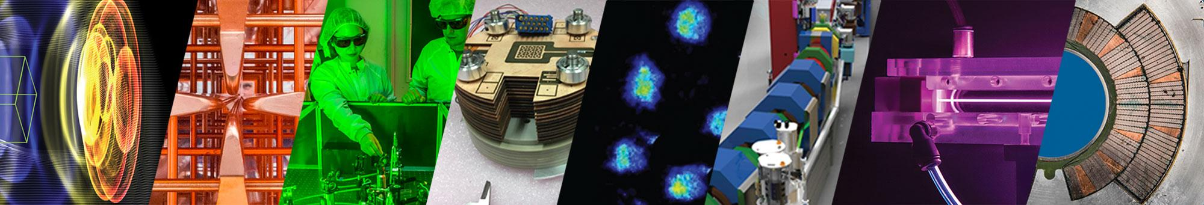
Demonstration of a reliable, high gain laser plasma accelerator driven free electron laser
Sam Barber, Research Scientist
BELLA Center
LPAW 2025, Ischia, Ischia
April 15, 2025
This work was supported by the U.S. Department of Energy (DOE), Office of Science, the Office of Basic Energy Sciences,
the Office of High Energy Physics, under Contract No. DE-AC02-05CH11231, and through a CRADA with Tau Systems.
1

Slide 2



Contributors
BELLA Center
Jeroen van Tilborg, Fumika Isono, Carl Schroeder, Eric Esarey, Jens Osteroff, Cameron Geddes, Anthony Gonsalves, Kei Nakamura, Finn Kohrell, Chris Doss, Kyle Jensen, Curtis Berger…
Tau Systems
Stephen Milton, Guillaume Plateau, Reinier van Mourik…

Slide 3
Outline
General motivation
Description of HTU
E-beam production
FEL results

Slide 4

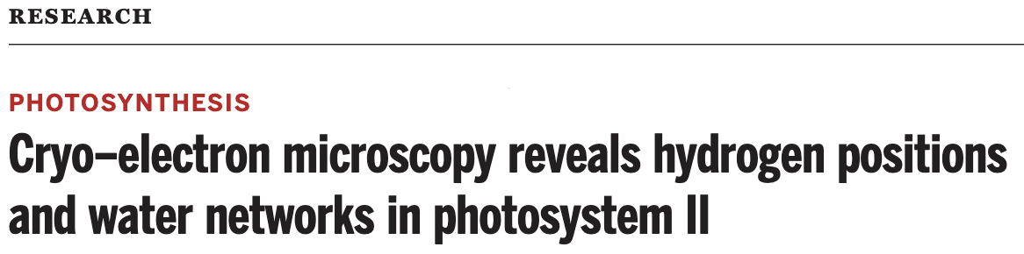

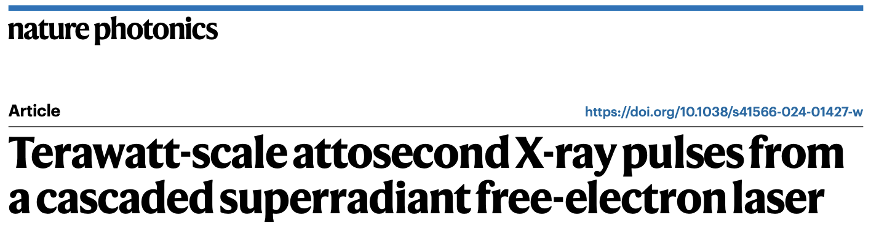


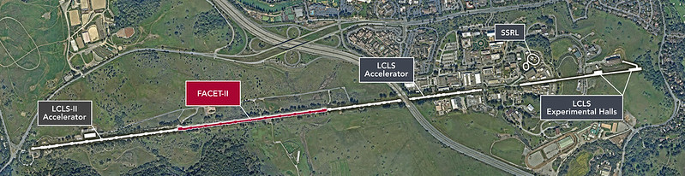

XFELs have enabled transformative science and serve broad range of scientific communities
Some metrics of success
> Unique pulse properties: XFELs generate ultra-bright, atto-femtosecond x-ray pulses enabling study of atomic-scale dynamics
> Wide scientific reach: XFELs support diverse fields, from physics to biology, enabling breakthroughs in molecular dynamics, crystallography, and high-energy physics.
> Transformative impact: XFELs have revolutionized atomic-scale research, driving major advancements in drug discovery, materials science, and energy.
> Science and Nature articles over few month period
> Commercialization of XFELs for semiconductor industry undergoing rapid growth
LCLS/LCLS II
European XFEL

Slide 5
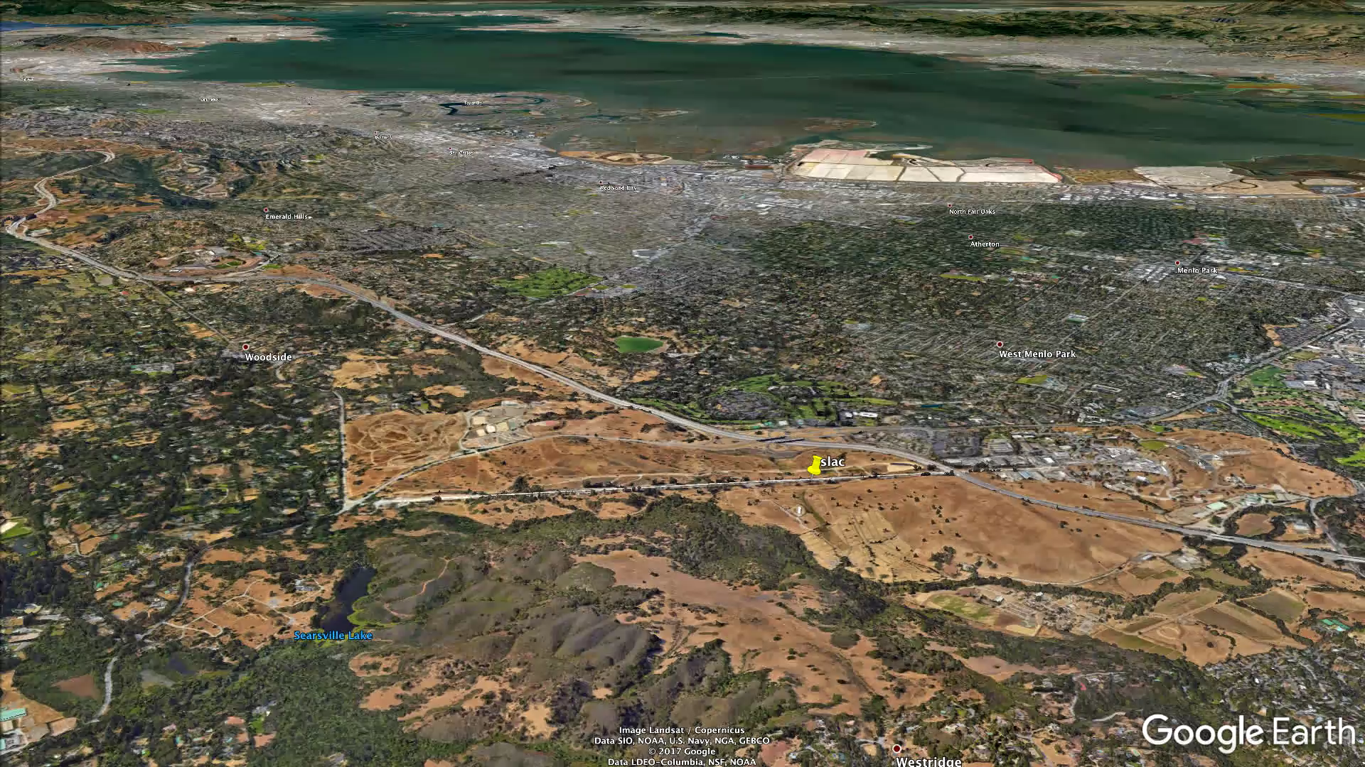
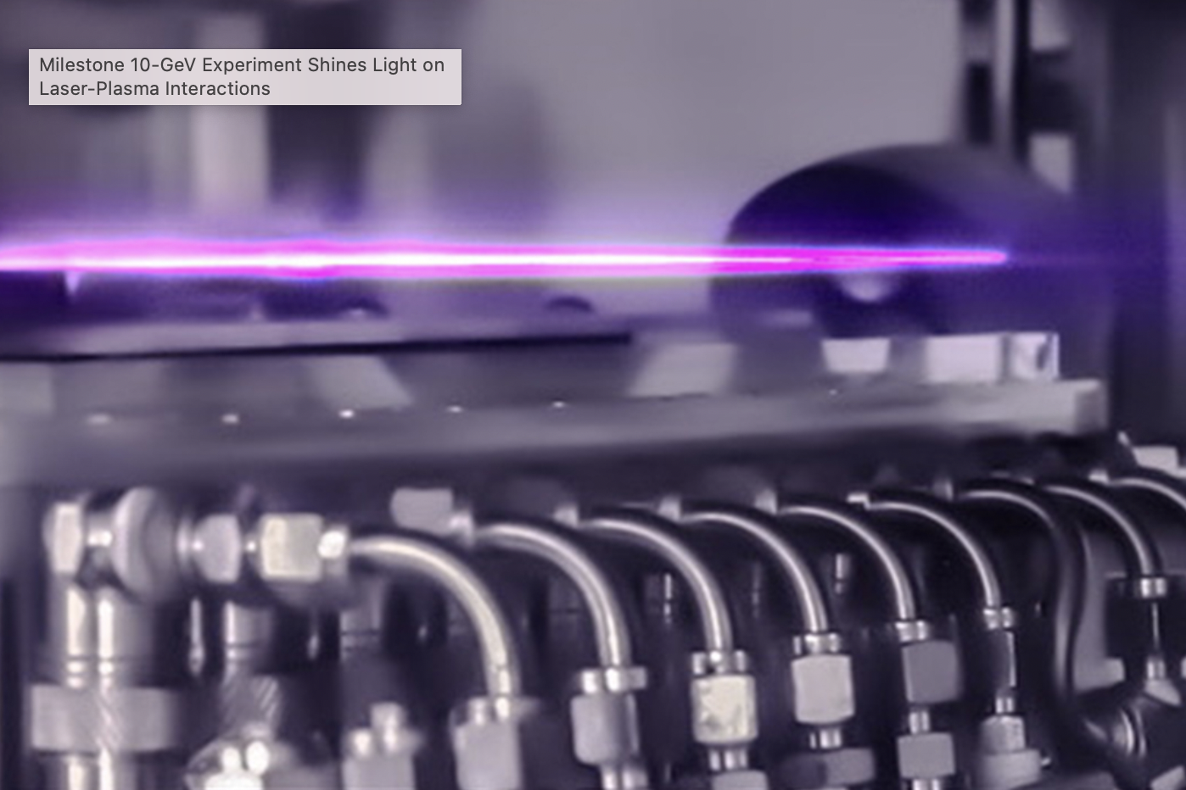
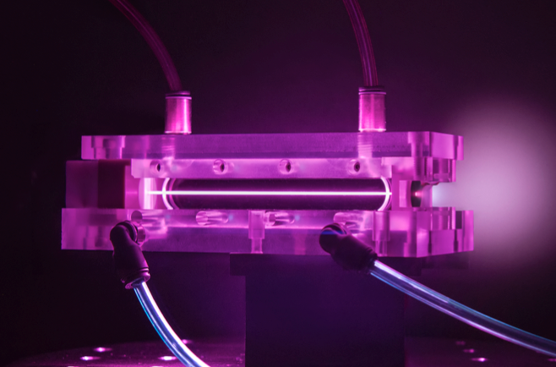
Plasma based accelerators can dramatically reduce the size of the accelerator modules
~10 GeV electrons in 1 km
~10 GeV electrons in 30 cm

Slide 6
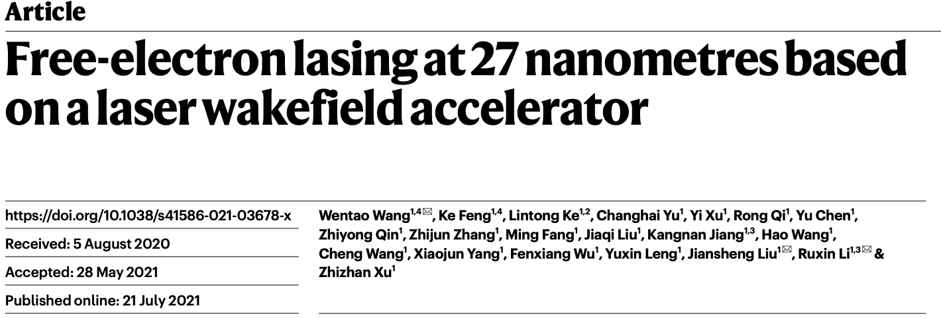
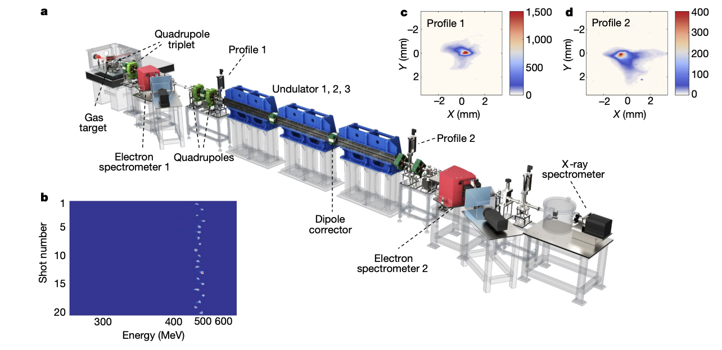

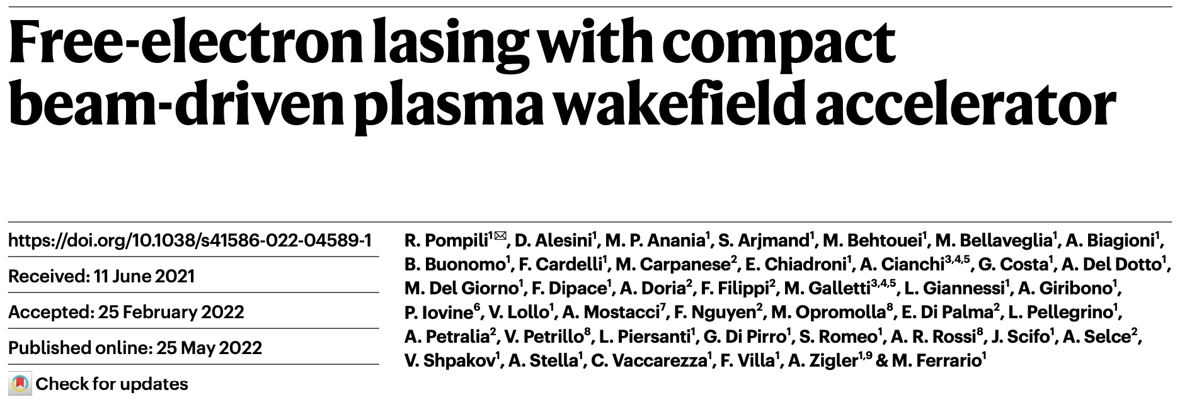
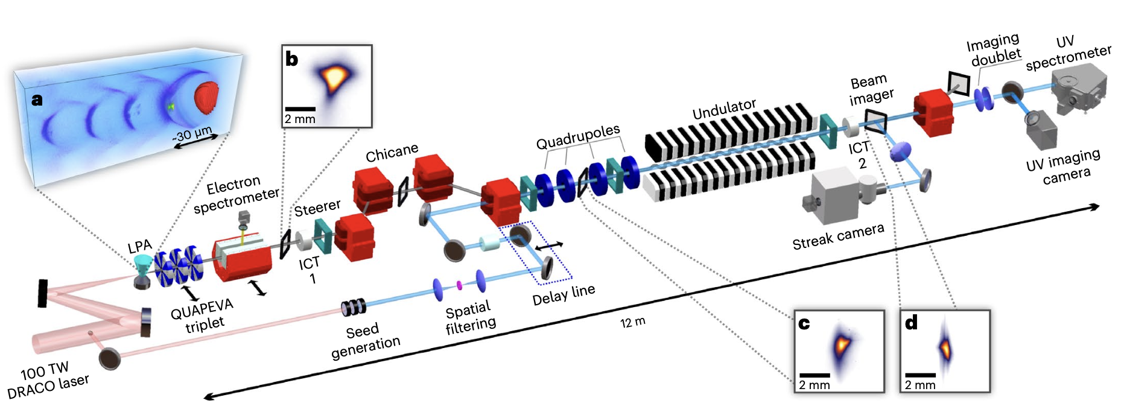
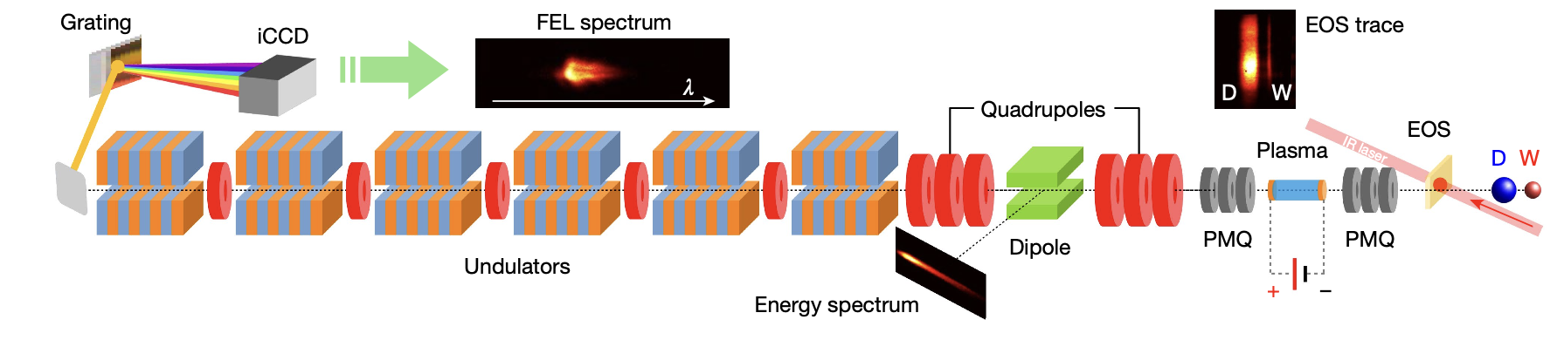
High brightness, high energy beams from compact plasma accelerators offer the potential to extend the reach of XFELs
Existing XFELs use km-scale accelerator and are billion dollar scale facilities.
With 1000x increase in acceleration gradient and potential increase in e-beam brightness, plasma-based accelerators can compactify FEL facilities, reducing cost and democratizing their accessibility
Exciting time for the field with recent milestone achievements and ambitious projects in development (e.g. Eupraxia/ELI-Beamlines, PETRA IV, etc.)
S. K. Barber, Research scientist ATAP

Slide 7
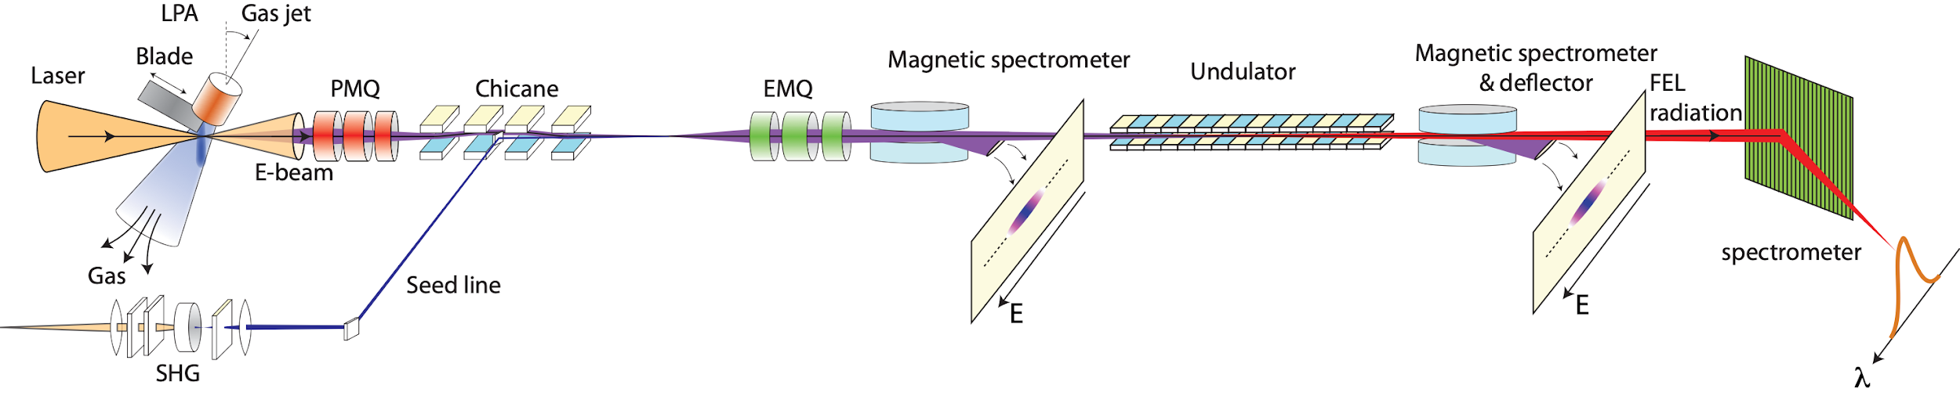
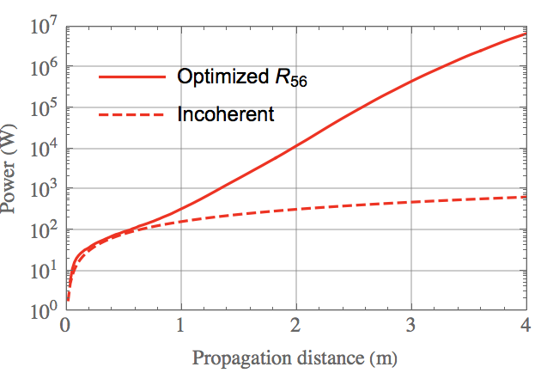
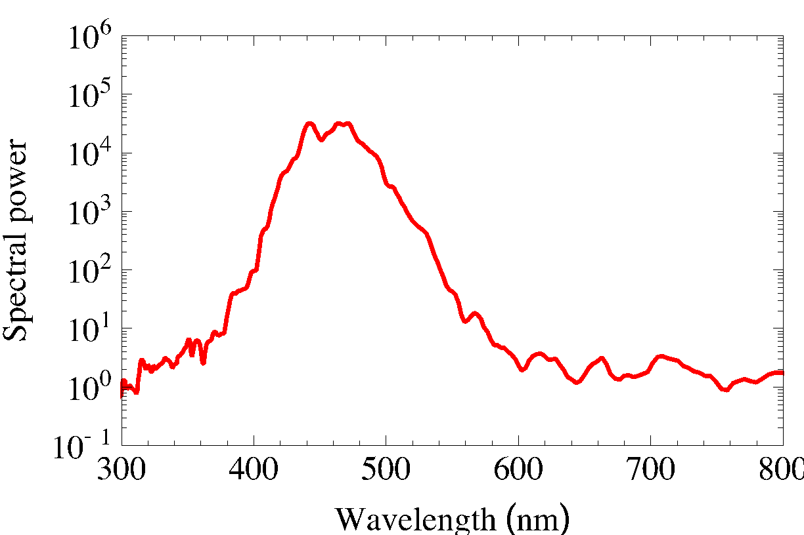
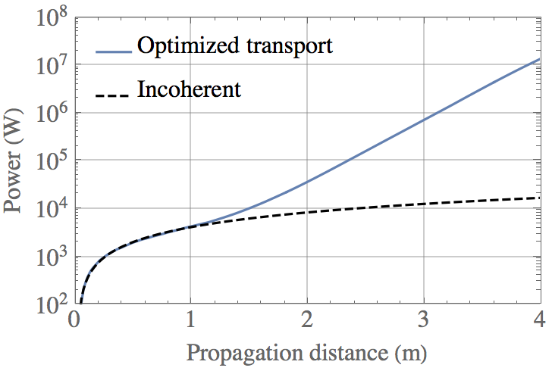
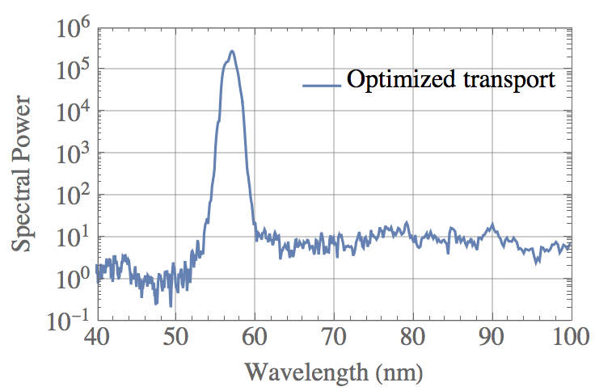
HTU system designed to establish reliable test bed for developing high-brightness beams and compact laser plasma accelerator-based FELs
Key features:
100 TW-class laser system (2.5 J, 35 fs, 40 um) @ 1-5Hz
Density downramp injection for production of tunable monoenergetic e-beams with 100-500 MeV, 50-150 pC, 1-5% RMS energy spread
Transport line with PMQs, EMQs, steering magnets, chicane, 4m 220 period strong focusing undulator
Goals: Reliable, saturated FEL operation at 100 MeV (400nm) then ramp up e-beam energy (300 MeV+) to achieve shorter wavelengths (<30 nm)
x10⁴ gain
x10³ gain
Start to end FEL simulations for HTU system for 1st and 2nd phase performance goals, e.g. 400 nm to ~<50 nm FEL

Slide 8
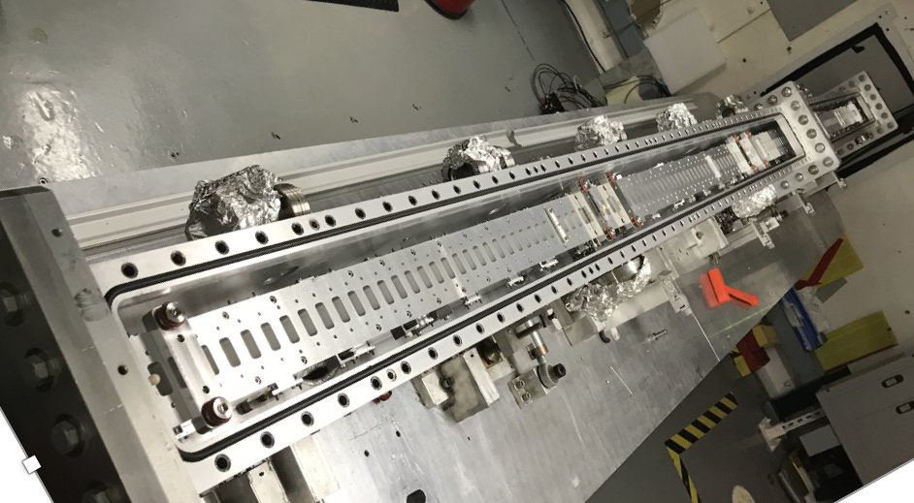
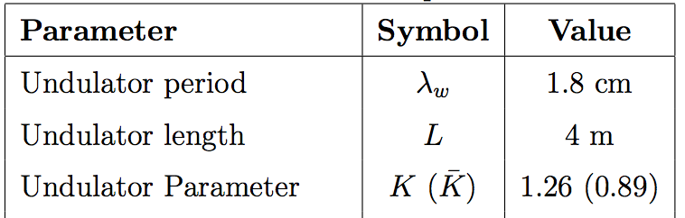
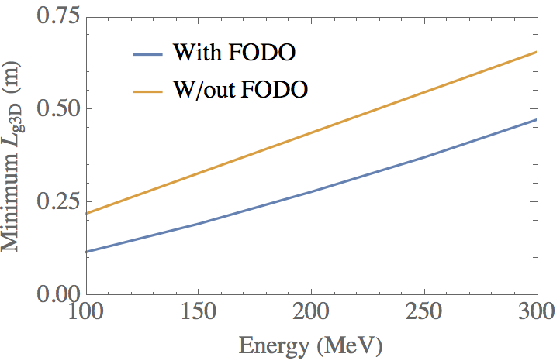
Reviving the VISA undulator for FEL R&D with a plasma-based accelerator
Original VISA program conceived and executed as experimental verification of aspects of SASE theory, precursor to development of LCLS^{1,2}
Now, VISA undulator being used for R&D of LPA-driven FELs
Unique feature: embedded permanent magnet quadrupole focusing (FODO lattice) with 33 T/m gradient
Strong guiding of e-beam allows dramatic reduction in gain length BUT imposes strict requirements on beam matching and alignment
20 cm!
¹Tremaine, A. et al. 2001.
²Murokh, A. et al. 2003

Slide 9
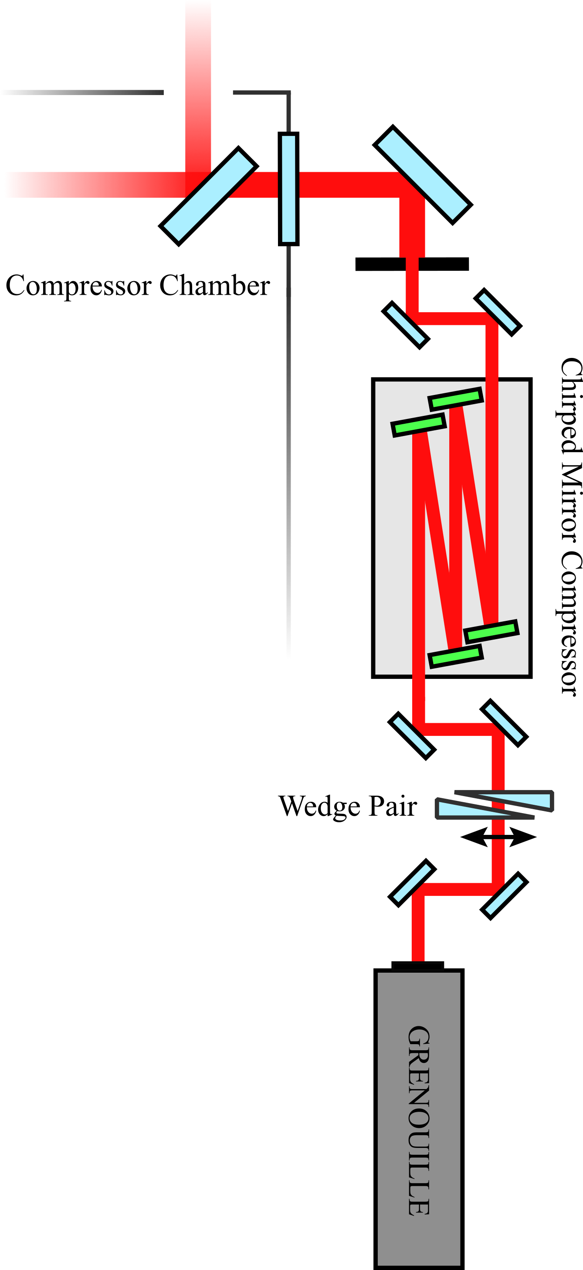
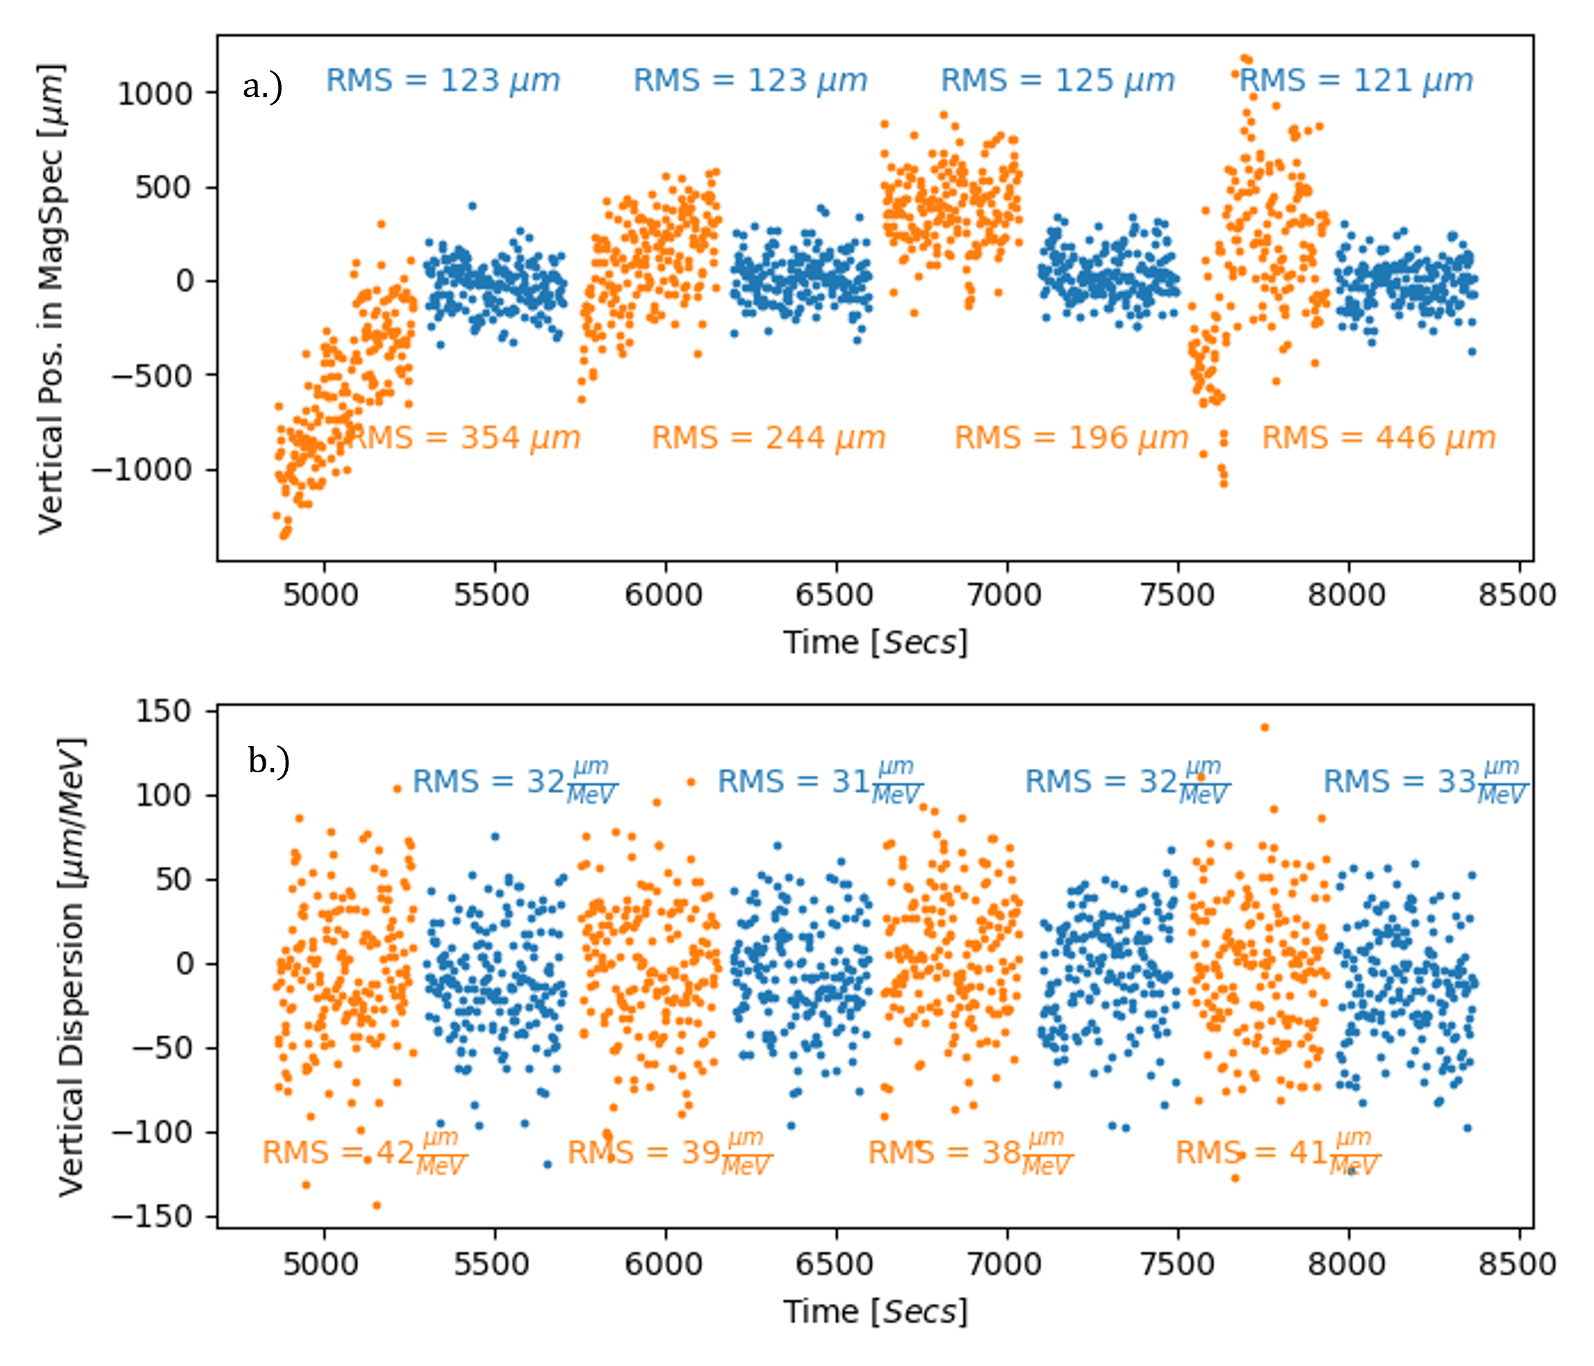
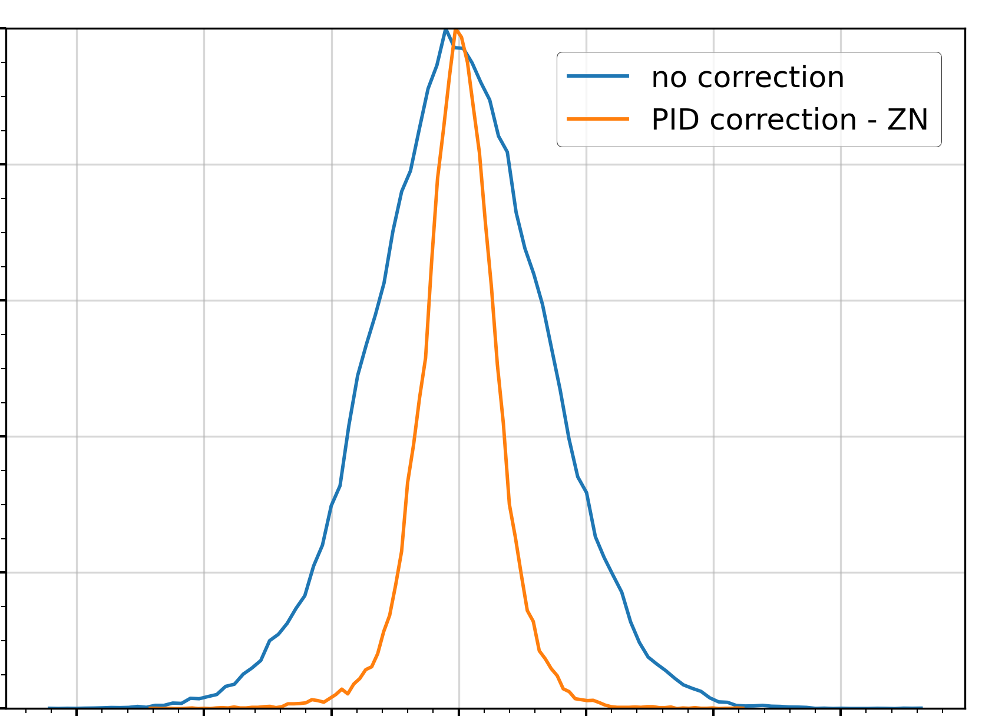
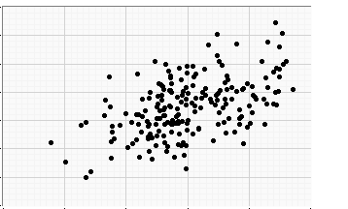
Recent efforts to improve e-beam stability through improved laser stability are paying off
Transverse stability
Longitudinal stability
Spectral phase
Wavefront sensor non destructively acquires data at ~60 Hz, sends to fast stage controller that adjusts position with simple PI loop at ~30Hz.
Low power demonstration reduced shot-to-shot jitter by factor of two
High power test show improved e-beam stability
Custom diagnostic to measure on shot spectral/temporal fluctuations developed
”Detuned” diagnostic revealed strong correlation between fluctuations in linear chirp parameter and e-beam charge
1.0
Custom, non-invasive monitoring system of on target laser allowed development of active laser pointing stabilization system
“out of the box” PID produced immediate improvement in e-beam transverse stability
Achieved ~few um transverse jitter of e-beam over hours time scale
0.8
0.6
80
Normalized counts
70
0.4
60
50
Charge (pC)
0.2
40
30
20
0.0
10
40
50
60
70
80
335
336
337
338
339
340
341
𝜏_{measured} (fs)
Radius of Curvature (mm)
*C. Berger et al, PRAB 26 032801 (2023)
K. Jensen et al, in preparation
F. Kohrell et al. in preparation

Slide 10
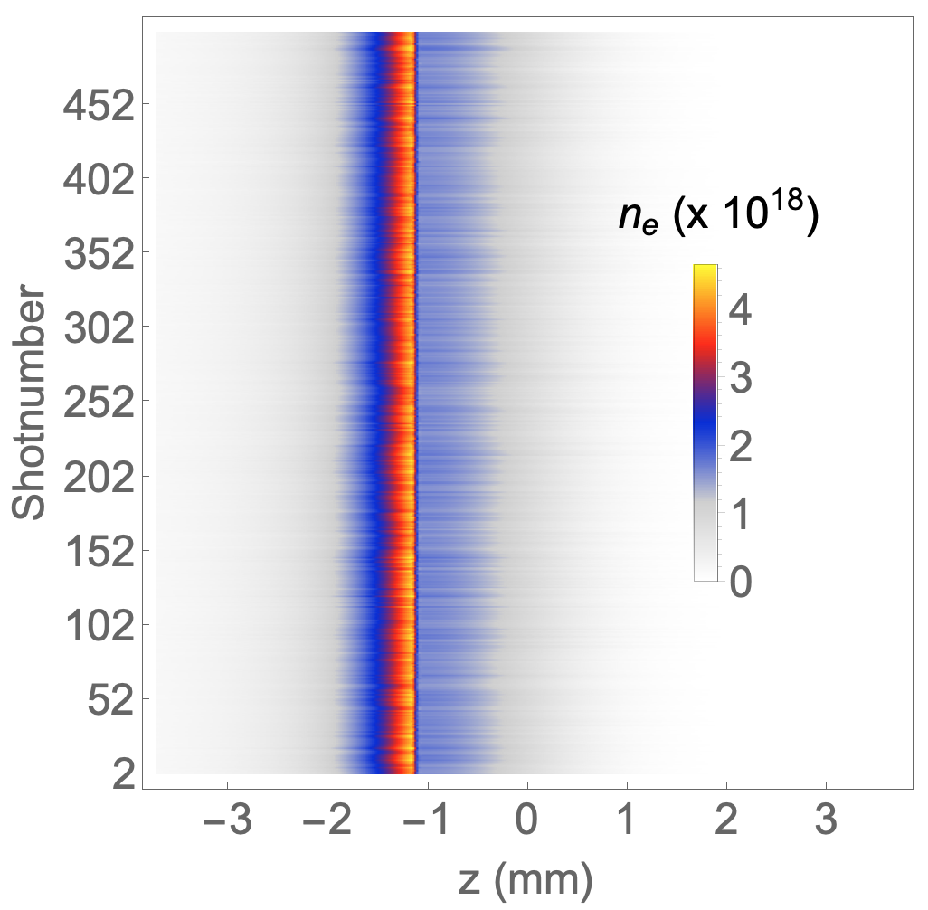
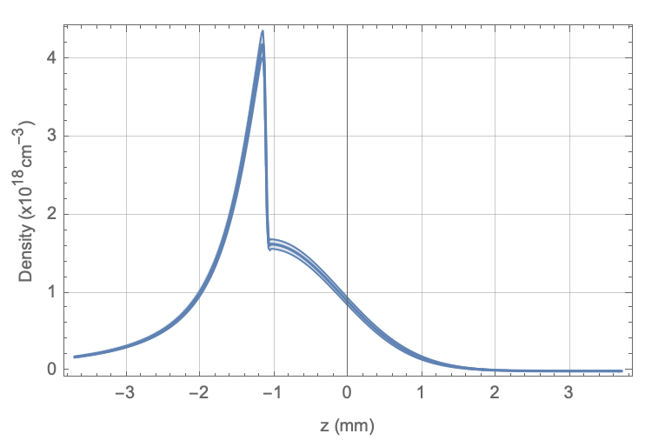
Flexible and stable target critical for generating targeted e-beam parameters
Laser
Super sonic jet and blade system engineered to be rigid but adjustable
Fluctuations in plasma density profile do not seem to be leading cause of e-beam fluctuations
blade
Translation, z
Gas jet
height
Height = 1 mm
Height = 0.4 mm
500 successive measure density lineouts (left). Average of the 500 shots, with shaded regions showing +/- 1 standard deviation (right).
Height, translation of blade give high degree of flexibility in tuning profile

Slide 11
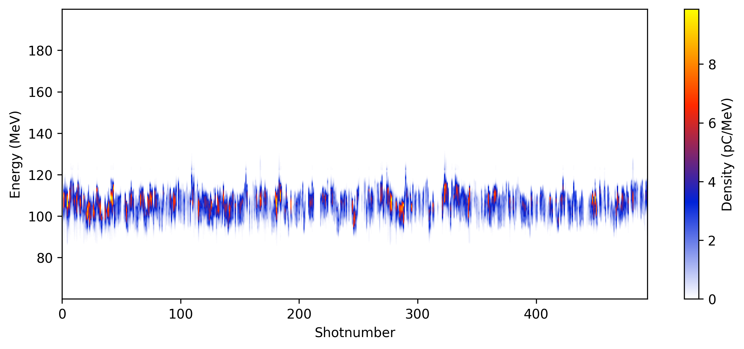
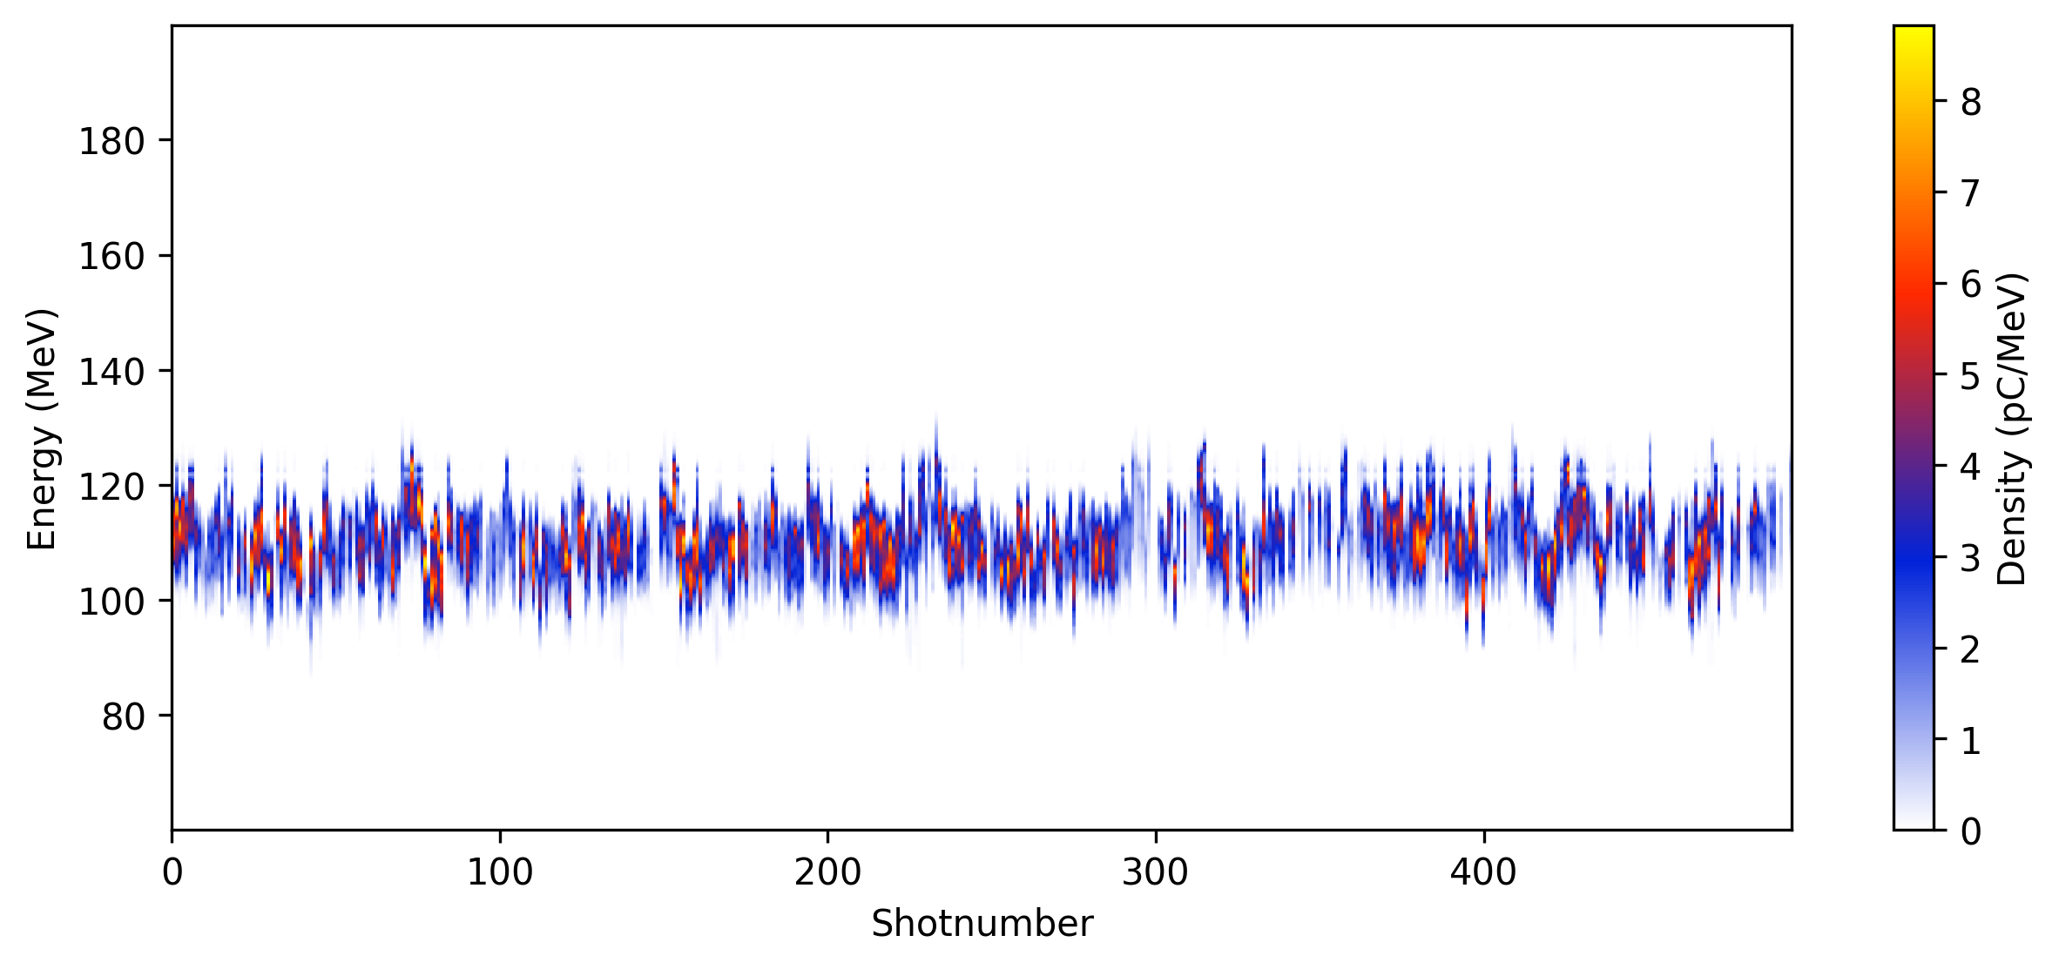
Laser and target stability enable ~days long dedicated accelerator tuning operations
125
Initial fine tuning of LPA
Stability check
100
75
Energy (MeV)
50
5 hours accelerator operations
25
0
12:00
14:00
16:00
Time
With recent efforts to stabilize e-beam on both short and long term time scales, we can use the beam for multi-hour shifts without worrying about dramatic parameter drift
Critical to enable basic accelerator operations
Notes:
Data on bottom left (right) is July 11, 2024 scan 16 (18) and scan

Slide 12
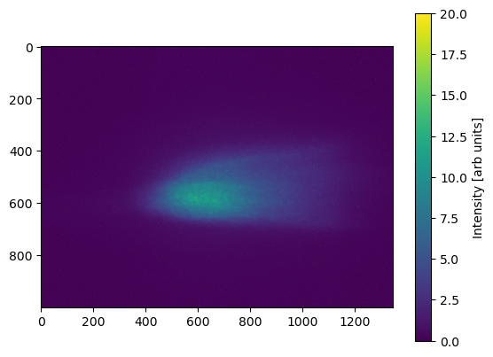
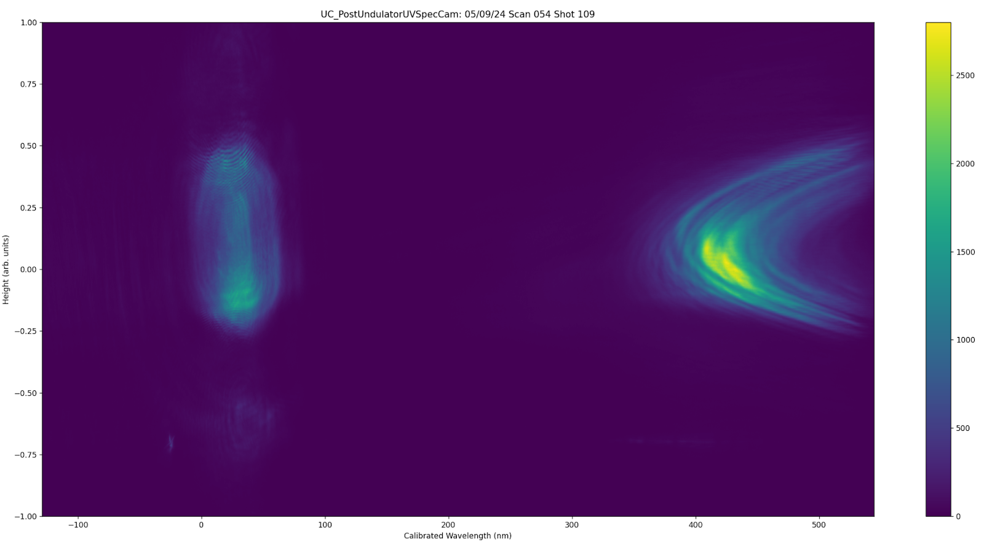
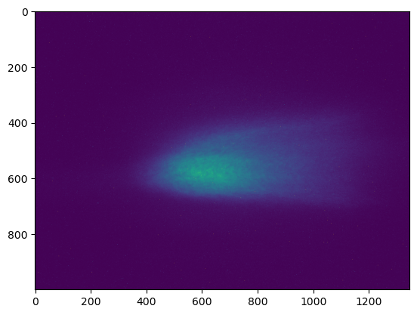
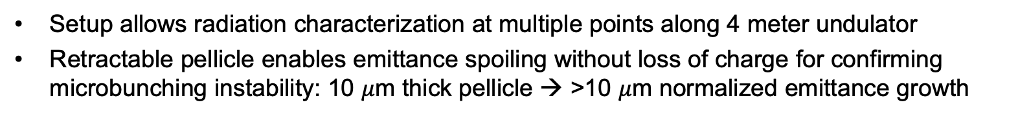
Diagnostic setup undulator radiation characterization
2000
Optical
Spectrometer
1.0
20
y (nm)
0.0
Intensity
Intensity
e⁻
1.0
300
400
500
0
0
Wavelength (nm)
ICT
Undulator
ICT
MagSpec
Retractable spoiler pellicle
Exit Pickoff Pellicle
Setup allows radiation characterization at multiple points along 4 meter undulator
Retractable pellicle enables emittance spoiling without loss of charge for confirming microbunching instability: 10 $μ$m thick pellicle → >10 $μ$m normalized emittance growth

Slide 13
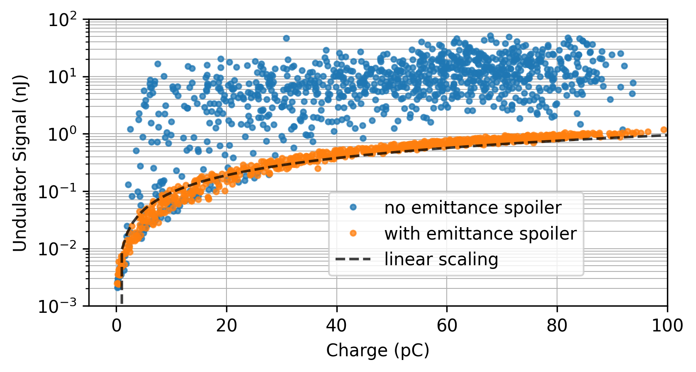
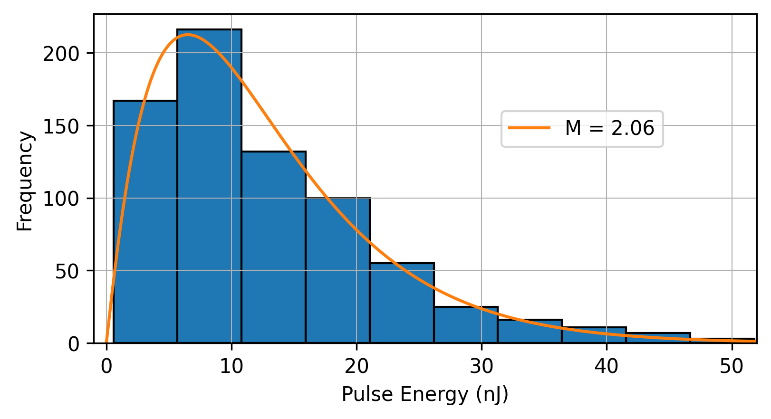
Sustained efforts on optimizing FEL signal at end of undulator through matching and alignment yielded drastic boost in performance
Undulator radiation signal vs charge for 1000 consecutive shots
Pulse energy statistics of FEL radiation
Gamma distribution fit
Statistical characteristics of high-gain SASE radiation in the exponential amplification regime follow gamma distribution
Number of longitudinal modes, characterized by M, can be used to estimate bunch length and is consistent with experimental parameters
Optimized transverse focusing and alignment using radiation signal at the end of the 4 meter undulator
Gain over incoherent undulator radiation on >90% of shots
Ratio FEL to incoherent: ~200-300x (max), 50-100x (average)
S. Barber et al. submitted

Slide 14
Optimizing for gain in first sections of undulator gives excellent performance
Energy vs distance measurements show clear exponential gain with 18 cm gain length
SASE gain >1000x
Gain plateaus after 1.5 meters, suspect undulator segment misalignment
Increasing the chicane strength from R₅₆ = 200 𝜇m to 400 𝜇m results in reduced gain; useful information for deducing e-beam parameters
Measured undulator radiation as function of distance along undulator with an R56 setting of 200 um.
S. Barber et al. submitted

Slide 15
Comparing measurements to Genesis simulations can provide information on difficult to measure beam parameters
Measured values: 100 MeV, 75 pC, 5% rms energy spread, R₅₆ = 200 𝜇m , post chicane current = ~1kA, 𝛽_{x,y} = 1 m, 𝛼_{x,y} = 0
Unknown quantities: Slice emittance and slice energy spread
Simulation shows good agreement with data for sub 0.5 um slice emittance and sub 0.5% slice energy spread (green line)
 | 𝜀_{x,y} [𝜇m] | slice energy spread [%]
Config 1 | 0.25 | 0.4
Config 2 | 0.75 | 0.4
Config 3 | 0.25 | 0.7
Direct comparison of measurements to Genesis simulations for 3 different configurations. 20 time dependent simulations performed for each configuration
*𝜎_{z,0} + R56 -> slice energy spread
S. Barber et al. submitted

Slide 16
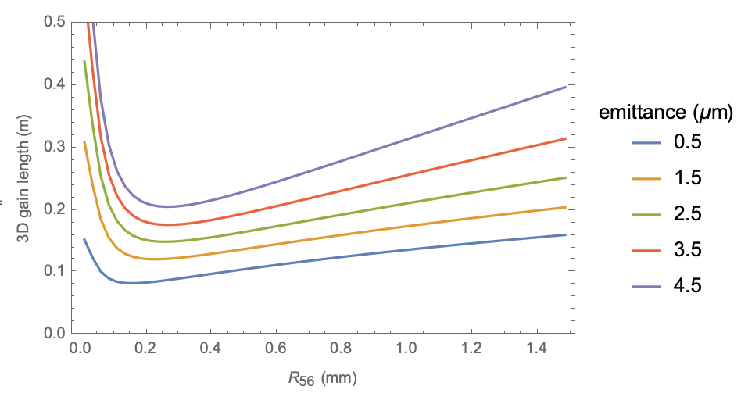
Starting to map out FEL dependence on R₅₆: very preliminary
Gain length estimates
Recent measurements (from Thursday) start to show clear dependence of FEL performance on R₅₆
14 pC/MeV
Preliminary
8 pC/MeV
Measurements at multiple longitudinal locations can be used to estimate gain length vs R₅₆
Preliminary
E-beam decompression using chicane (R₅₆) helps mitigate energy spread issue with LPA beams
Optimal decompression depends on full 6D phase space: very hard to measure
*Note: no error bars added yet
A. R. Maier et al, PRX (2012)

Slide 17
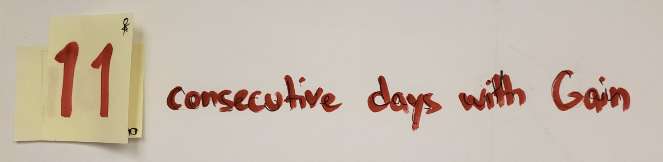
Summary and next steps
HTU regularly delivering high quality e-beams that are lasing
System reliability probably the biggest impact due to the need to perform time consuming accelerator tuning
Pushing towards full saturation at ~400 nm…
E-beam transport (mostly) capable of scaling to ~300 MeV, enables 40 nm FEL
(in which we try)
20
X
(and send beam to undulator)

