Slide 1









UNIVERSITY OF MARYLAND AT COLLEGE PARK
Dept. of Physics
Dept. of Electrical and Computer Engineering
Institute for Research in Electronics and Applied Physics
High charge laser acceleration of electrons to 10 GeV
Ela Rockafellow¹, Bo Miao¹, Jaron E. Shrock¹, Ari Sloss¹, Nishchal Tripathi¹, Manh S. Le¹, Scott W. Hancock¹, Frederica Sorkin¹, Mayank Gupta¹, Sina Zahedpour², Reed C. Hollinger², Shoujun Wang², James King², Ping Zhang², Jiří Šišma^{3,4}, Gabriele M. Grittani³, Roberto Versaci³, Daniel F. Gordon⁵, Jackson Williams⁶, Brendan A. Reagan⁶, Jorge J. Rocca^{2,7}, Howard M. Milchberg^{1,8}
¹Institute for Research in Electronics and Applied Physics and Department of Physics, University of Maryland, College Park, Maryland 20742, USA
²Department of Electrical and Computer Engineering, Colorado State University, Fort Collins, Colorado 80523, USA
³ELI Beamlines Facility, The Extreme Light Infrastructure ERIC, Dolni Brezany 25241, Czech Republic
⁴Faculty of Nuclear Sciences and Physical Engineering, Czech Technical University in Prague, Brehova 7, 11519 Prague, Czech Republic
⁵Naval Research Laboratory, Washington DC 20375, USA
⁶Lawrence Livermore National Laboratory, Livermore, CA 94550, USA
⁷Department of Physics, Colorado State University, Fort Collins, Colorado 80523, USA
⁸Department of Electrical and Computer Engineering, University of Maryland, College Park, Maryland 20742, USA
Supported by DARPA under the Muons for Science and Society (MuS2) program
LLNL work done under Contract DE-AC52-07NA27344
E. Rockafellow supported by NSF GRFP (Grant No. DGE 1840340)

Slide 2




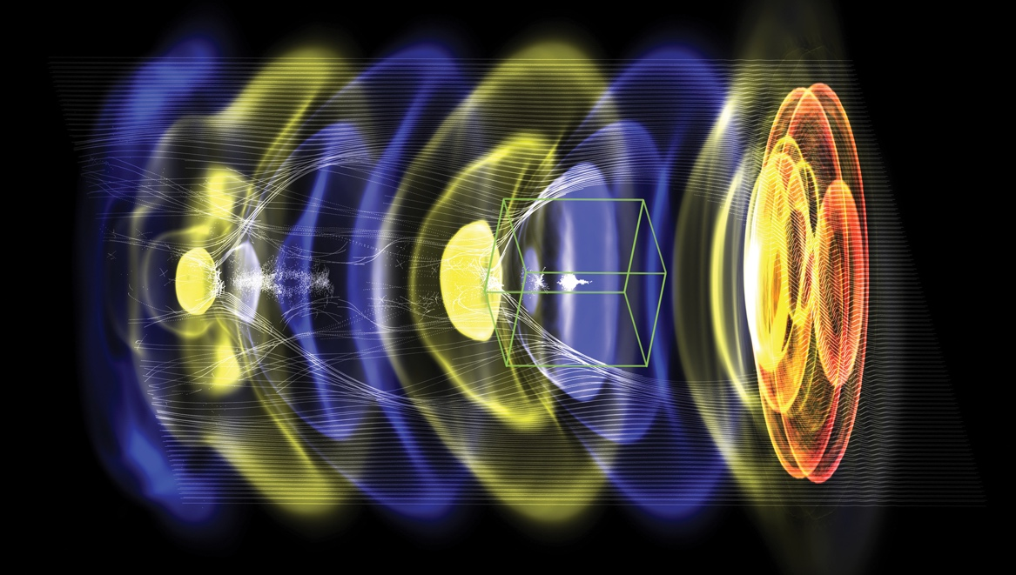


Acknowledgements
WarpX: open-source particle-in-cell code with advanced algorithms at Exascale
PI: Jean-Luc Vay (LBNL)
DoE Exascale Computing Project
S. Zahedpour, R. C. Hollinger, S. Wang, J. King, P. Zhang, J.J. Rocca, K. Zhu, D. Warner, N. Durand, J. Jablonski, J. Harton
Advanced algorithms for plasma acceleration
Performance-portability
Built on AMReX (LBNL, ECP co-design center)
Users/contributors welcome!
>30 contributors from LBNL, LLNL, CEA, DESY, SLAC
2021: 10 multi-GeV stages
Goal 2023: TeV multi-stage collider
B. Reagan, J. Williams, S. Wilks, J. Ludwig
G. Grittani, J. Sisma, C. Lazzarini, A. Cimmino, R. Versaci
https://ecp-warpx.github.io
Vay, J-L., et al., Nucl. Instrum. Meth. A 909 (2018)
FBPIC: Fourier Bessel Particle-in-Cell code
open-source
R. Lehe et al., CPC, 2016
R. Lehe et al., PRE, 2016
M. Kirchen et al., PoP, 2016
A. Picksley, J. Stackhouse, A. Gonsalves
Remi Lehe (LBNL)

Slide 3
Outline
Brief introduction to laser wakefield acceleration (LWFA) and self waveguiding
New model for benchmarking optical field ionized hydrodynamic plasma waveguides
New model of pulse propagation in meter-scale low density plasma waveguides
Recent 10 GeV experimental results from ALEPH at Colorado State University
Use of multi-GeV electron source for secondary particle/radiation generation
Development for future experiments

Slide 4
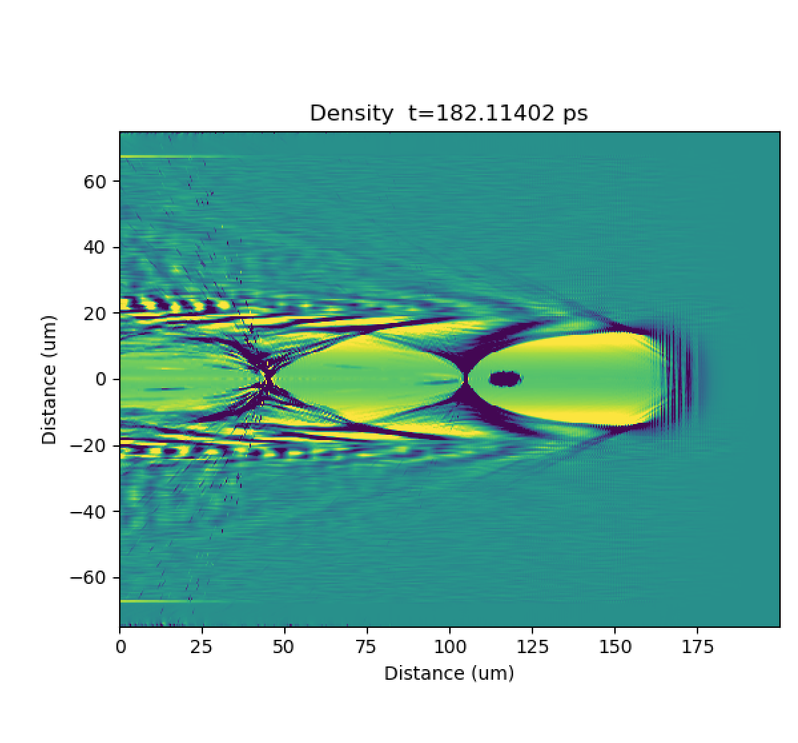

Introduction
Three key limitations on energy gain in LWFA:
High density of electrons creating accelerating E-field
Electron density depression ‘bucket’
  Depletion
  Dephasing
  Diffraction
Electrons being accelerated by electric field
Laser pulse

Slide 5
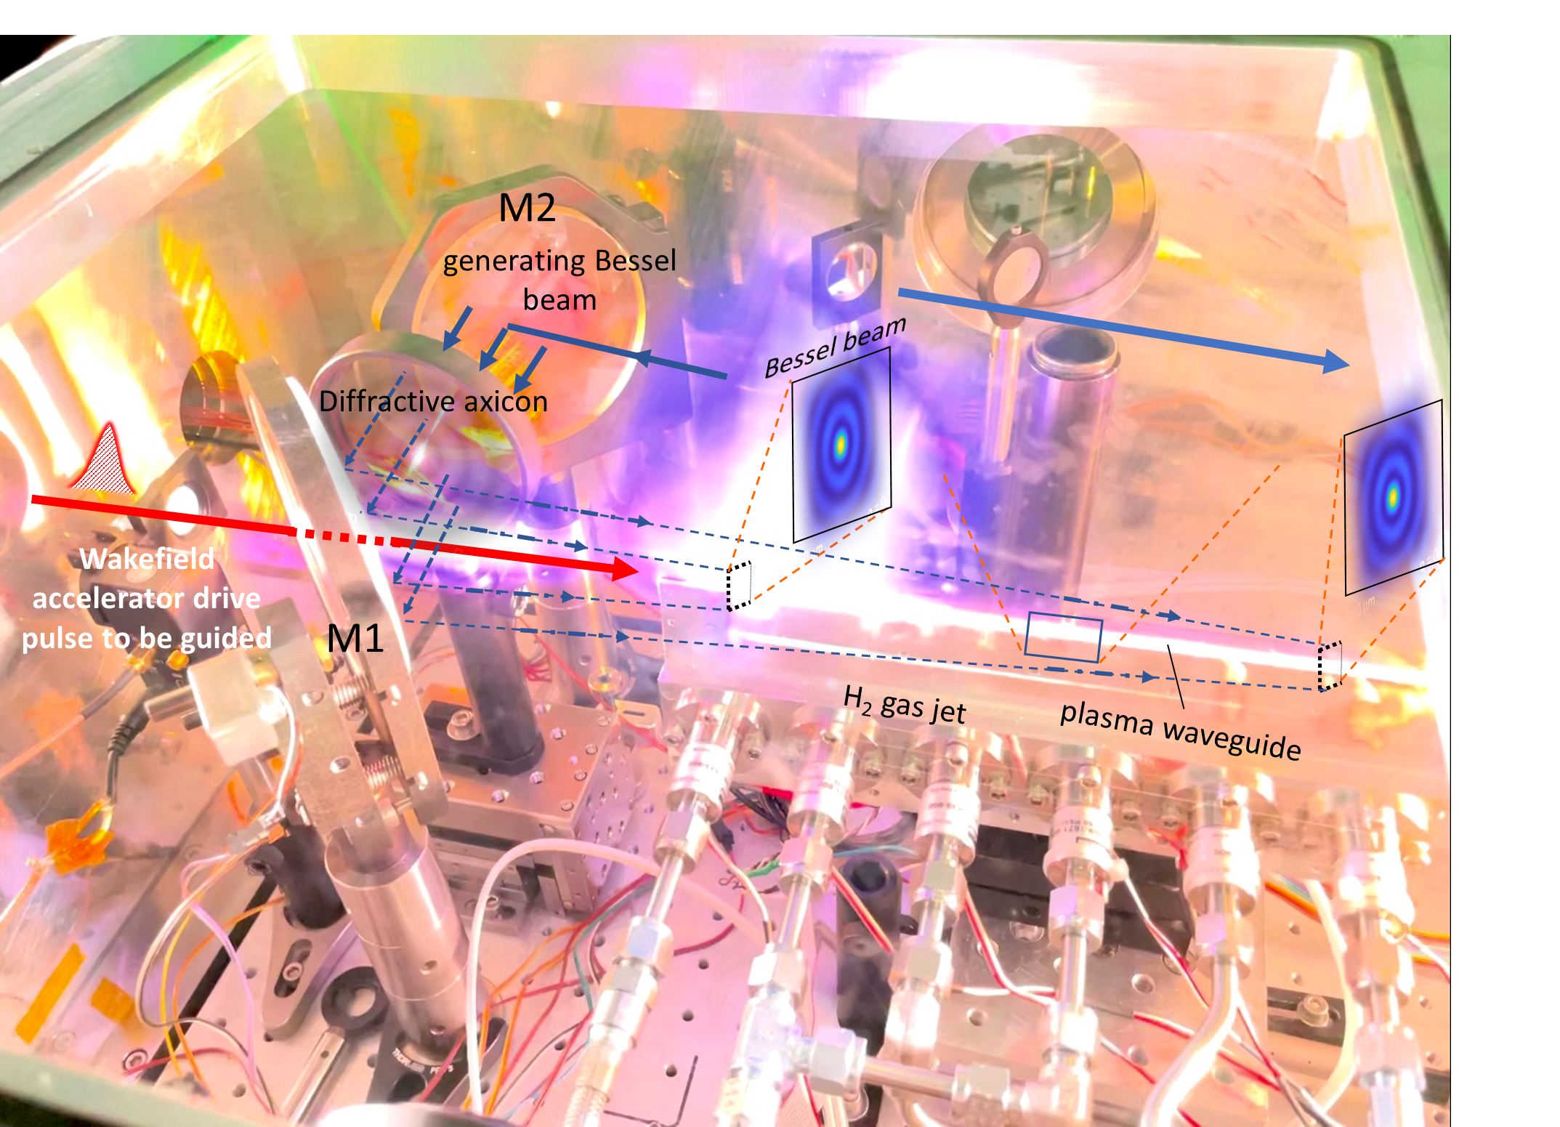
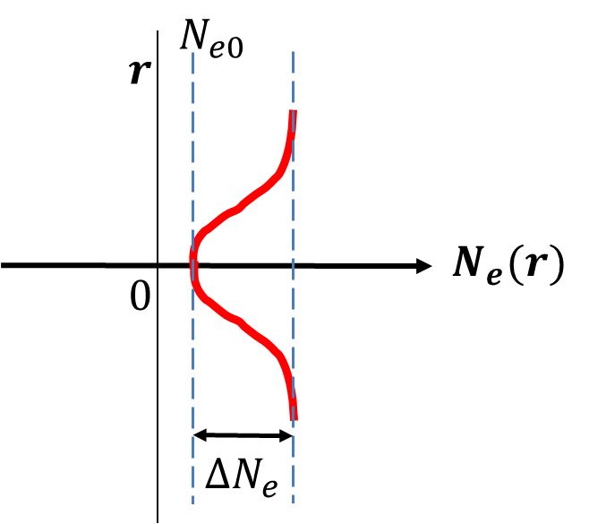
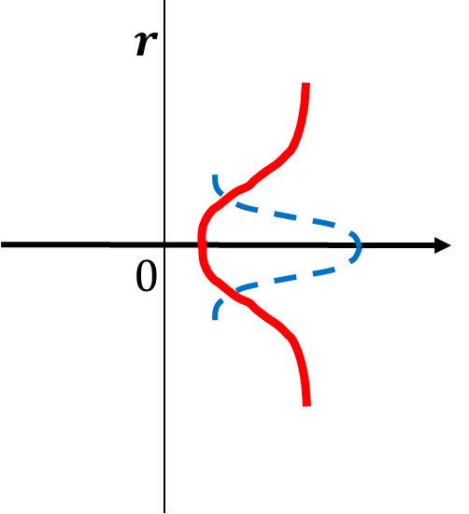

Plasma waveguides
New hydrodynamic waveguide formation mechanisms using elongated gas jets enable optical production of meter-scale waveguides with low density
Plasma waveguides extend acceleration distance by preventing diffraction of the drive laser
Concave plasma density profile
guiding
$$∆N_{eg}$$
Hydrodynamic plasma waveguides:
Durfee and Milchberg, PRL 71, 2409 (1993)
Physics Today, Aug. 2023
PRX, Sept. 2022
Generation IV Maryland Gas Jet (2021)

Slide 6
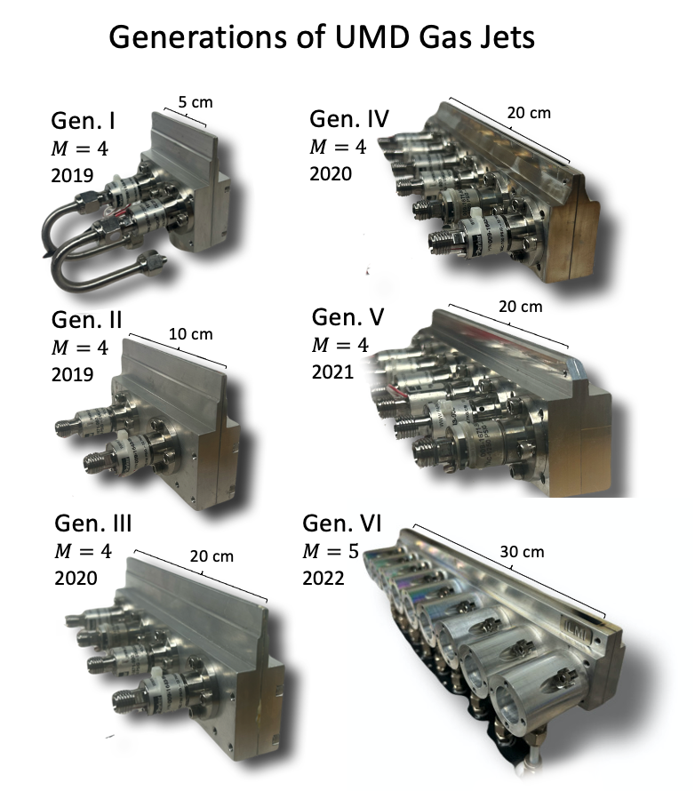
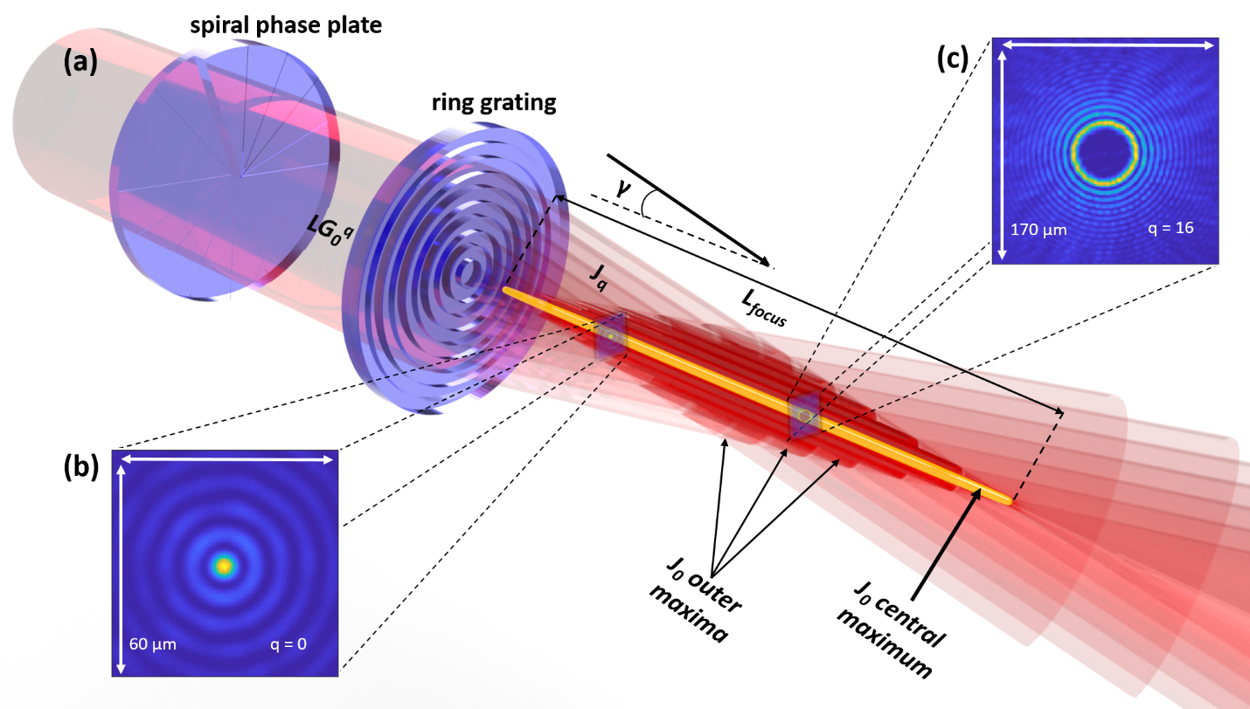


Generating plasma waveguides: Gas Jets and Bessel beams
(self-interfering conical wavefronts)
Waveguide-forming pulse
$J16$ beam
$J0$ beam
B. Miao et al., Opt. Express 30, 11360 (2022)
J. E. Shrock et al., Phys. Plasmas 29, 073101 (2022)
E. Rockafellow et al., Phys. Plasmas, in press (2025)

Slide 7
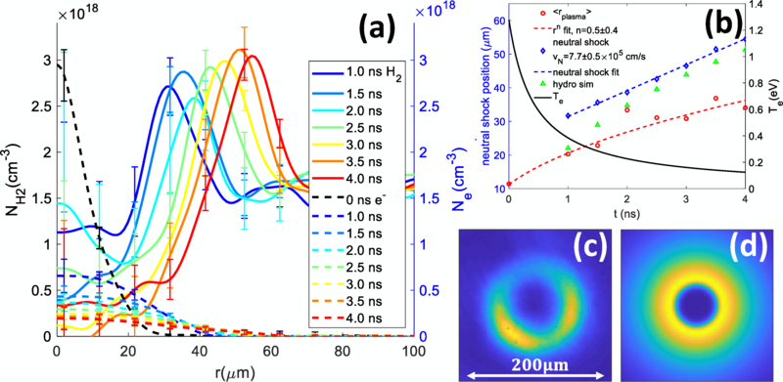

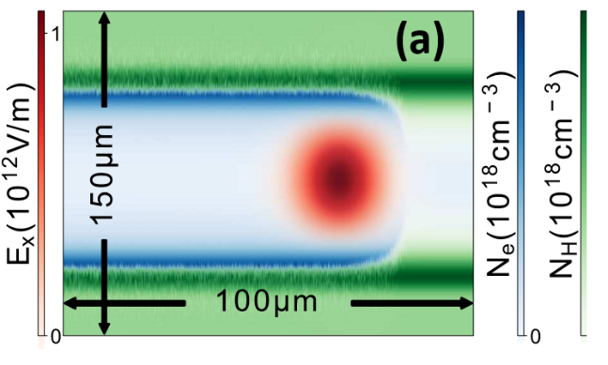


Self-waveguiding
Self-waveguiding: LWFA drive pulse ionizes neutral shock driven by expanding OFI plasma column
Leading wings of injected high intensity pulse ionize neutral shock
elongated plasma
(b)
(a)
launches
single-cycle acoustic wave
(c)
into
ambient gas
*2-color interferometry
A. Morozov et al., Phys. Plasmas 25, 053110 (2018)
B. Miao et al., Phys. Rev. Lett. 129, 074801 (2020)
*L. Feder et al., Phys. Rev. Res. 2, 043173 (2020)
A. Picksley et al., Phys. Rev. Accel. Beams 23, 1 (2020).
J. E. Shrock et al., Phys. Plasmas 29, 073101 (2022)
*B. Miao et al., Phys. Rev. Accel. Beams 27, 08132 (2024)

Slide 8
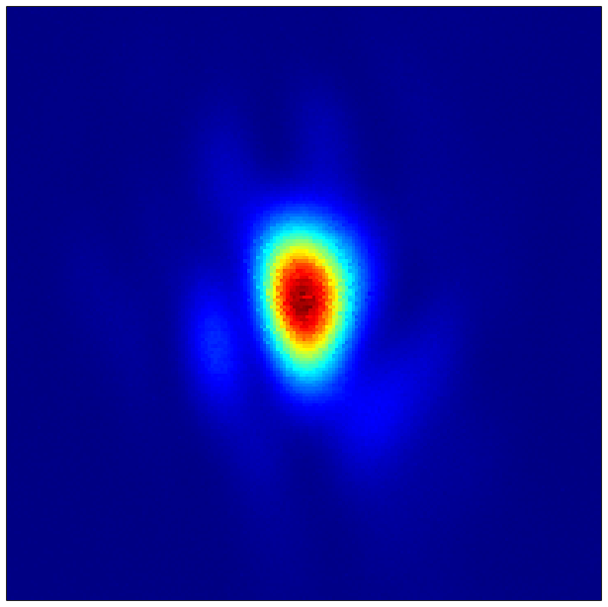
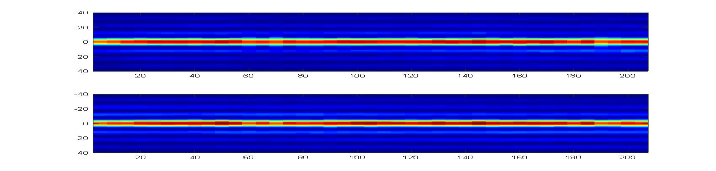
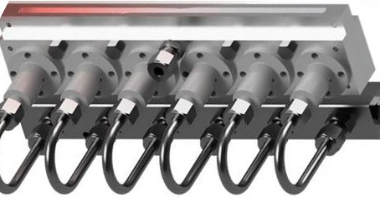
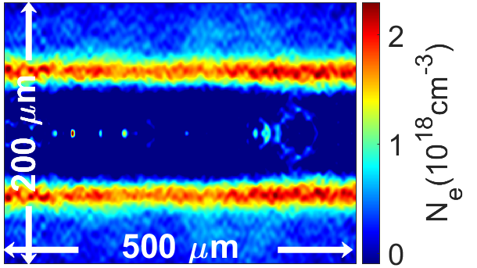
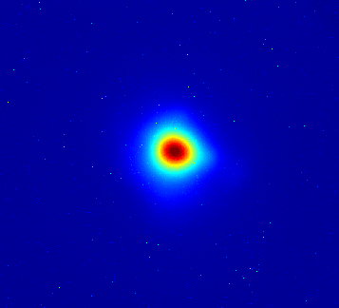


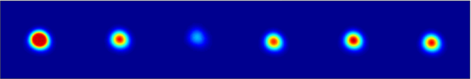
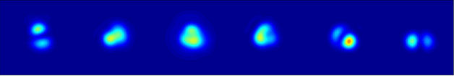
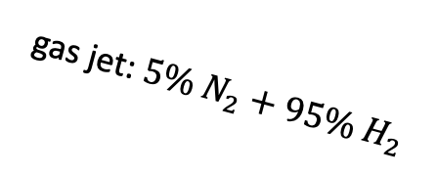


General schematic for self-waveguided LWFA experiments
B. Miao et al., PRX 12, 031038 (2022)
(d)
< 15 J, 45 fs
x-y pointing fluctuations
9 µm
M1
200 µm
20 cm
Extended multi-valve generation VI supersonic gas jet for meter-scale, low density waveguide
−developed at UMD−
P1
2-color probe
P2
diffractive axicon
gas flow
M2
LA1
SL
gas jet: $5\% N_{2}+95\% H_{2}$
magnets
LA2
(e)
200 μm
$$N_{e0}=1.3 × {10}^{17} cm^{−3}$$
200μm
200 μm
$$N_{e0}=3.2 × 10^{17} cm^{−3}$$

Slide 9
Outline
Brief introduction to laser wakefield acceleration (LWFA) and self waveguiding
New model for benchmarking optical field ionized hydrodynamic plasma waveguides
New model of pulse propagation in meter-scale low density plasma waveguides
Recent 10 GeV experimental results from ALEPH at Colorado State University
Use of multi-GeV electron source for secondary particle/radiation generation
Development for future experiments

Slide 10
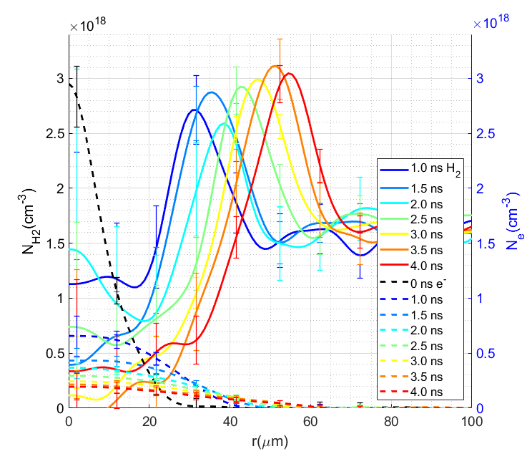
2-color interferometry of hydrodynamic waveguides
Makes clear that expanding OFI plasma from Bessel beam alone does not form a waveguide structure at low density
Expanding plasma drives a shock in neutral H₂ that forms the waveguide cladding after auxiliary ionization
2-Bessel method
Miao et al., PRL 129, 074801 (2020)
Self-waveguiding method
Feder et al., PRR 2, 043173 (2020)
L. Feder et al., Phys. Rev. Res. 2, 043173 (2020)
B. Miao et al., Phys. Rev. Accel. Beams 27, 08132 (2024)

Slide 11
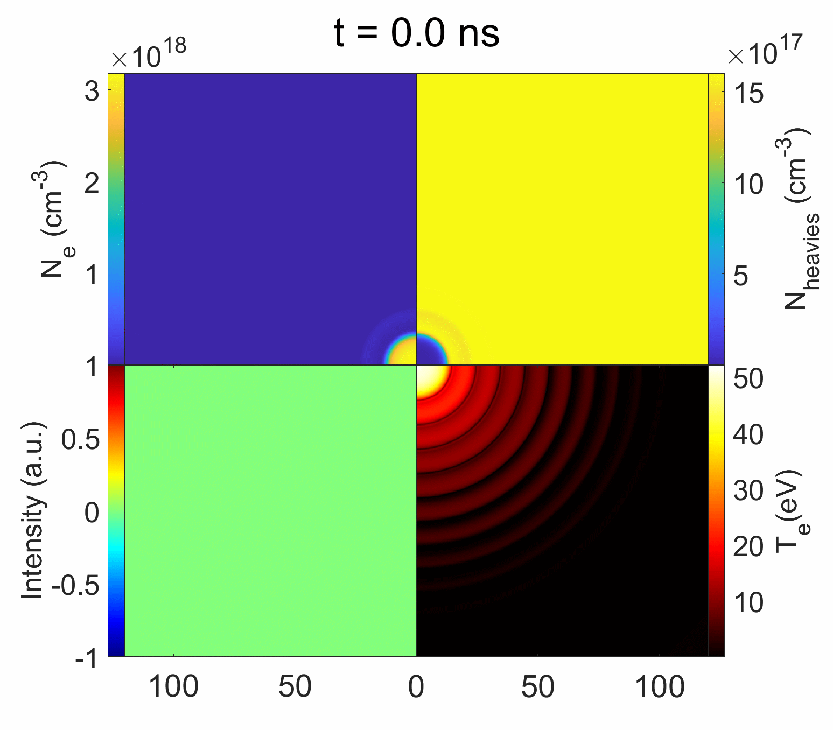
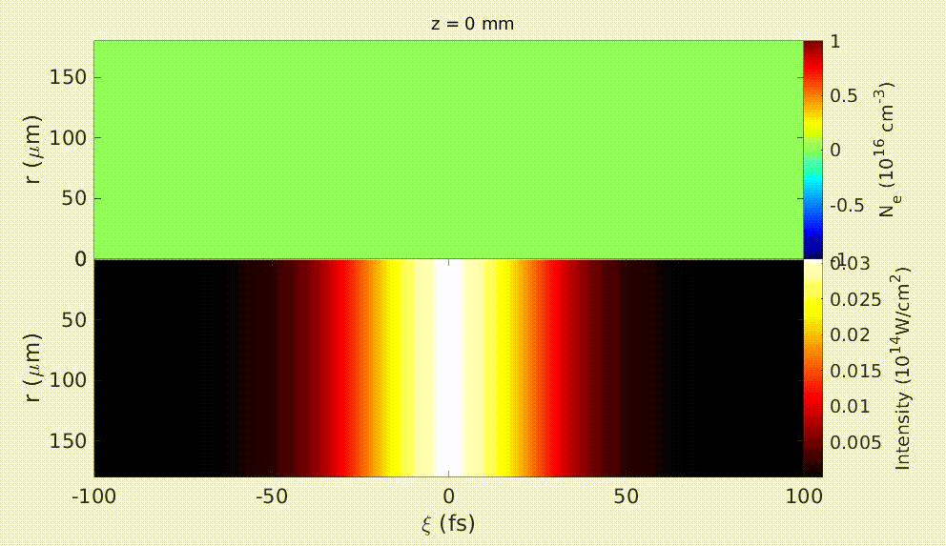
Bessel-hydro waveguide model
Hydro-model SPARC used in collaboration with Dan Gordon (NRL)
Media1.gif
Neutrals density
Electron density
atom/ion/H₂ density
3D YAPPE* self-consistent simulation of Bessel beam OFI heating.
Guided mode intensity
Electron temperature
intensity
Electron temperature
* B. Miao et al., Phys. Rev. Accel. Beams 27, 08132 (2024)
A. Goffin et al., Phys. Rev. X 13, 011006 (2023).
r (µm)
11

Slide 12
Outline
Brief introduction to laser wakefield acceleration (LWFA) and self waveguiding
New model for benchmarking optical field ionized hydrodynamic plasma waveguides
New model of pulse propagation in meter-scale low density plasma waveguides
Recent 10 GeV experimental results from ALEPH at Colorado State University
Use of multi-GeV electron source for secondary particle/radiation generation
Development for future experiments

Slide 13
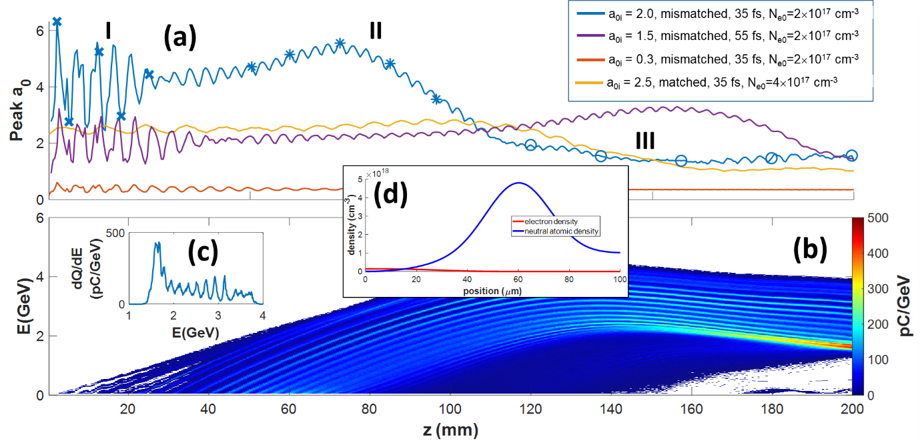
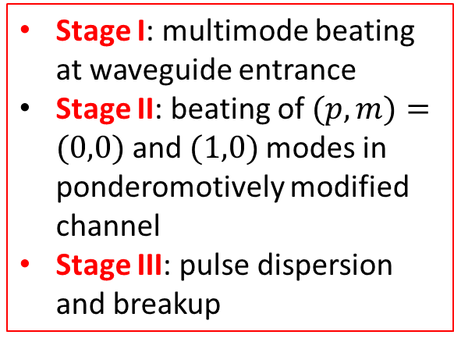
3-stage pulse evolution in meter-scale waveguides
3 propagation stages: I, II, III
Stage I: multimode beating at waveguide entrance
Stage II: beating of $(p,m)=(0,0)$and $(1,0)$modes in ponderomotively modified channel
Stage III: pulse dispersion and breakup
Striated ionization injection from Stage II
J. E. Shrock et al., Phys. Rev. Lett. 132, 045002 (2024)
Notes:
Blue curve—mismatched input field $a_{0i}=2.0, w_{0}=30 μm, τ_{fwhm}=41 fs$, $N_{e0}=2.0×{10}^{17} cm^{−3},$
Purple curve—mismatched input field $a_{0i}=1.5, { w}_{0}=30 μm, τ_{fwhm}=65 fs$, $N_{e0}=2.0×{10}^{17} cm^{−3}$,
Orange curve—mismatched $a_{0i}=0.3, w_{0}=30 μm, τ_{fwhm}=41 fs$, $N_{e0}=2.0×{10}^{17} cm^{−3}.$
Blue, Purple and Orange curve all propagate in mismatched waveguide formed from the prepared index structure shown in (d), with $w_{ch}= 20 μm$.
Gold curve—matched Gaussian input $a_{0i}=2.5, w_{0}=30 μm, τ_{fwhm}=41 fs$propagating in matched parabolic channel with $w_{ch} = 30 μm$, $N_{e0}=4.0×{10}^{17} cm^{−3}$.

Slide 14
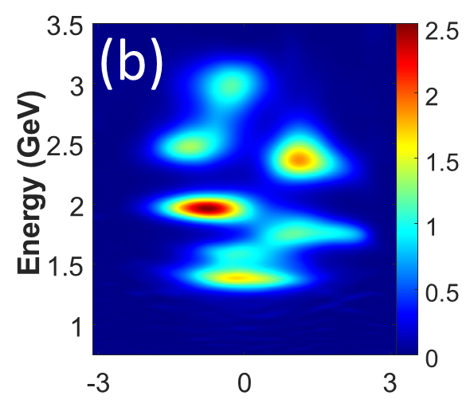

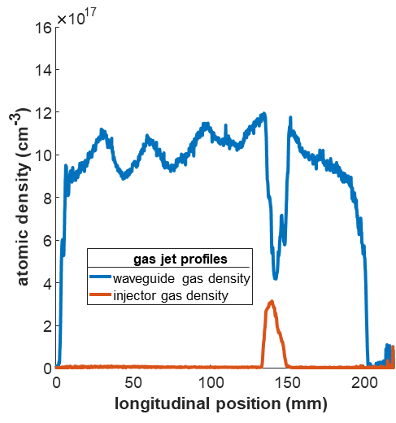
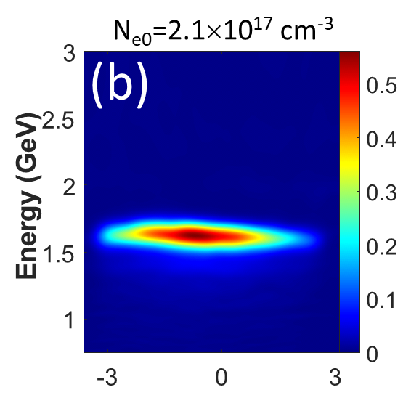
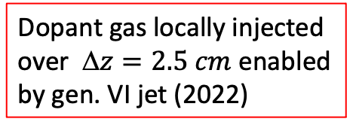
Controlling ionization injection via locally doped jet
Multi-peaked spectra over range of densities
Dopant gas locally injected over $ z=2.5 cm$ enabled by gen. VI jet (2022)
(a)
(a’)
(c)
Single-peaked spectra over a range of densities
(b)
(b’)
Controlled ionization injection produced quasi-monoenergetic electron bunches with <10% energy spread
J. E. Shrock et al., Phys. Rev. Lett. 132, 045002 (2024)

Slide 15
Outline
Brief introduction to laser wakefield acceleration (LWFA) and self waveguiding
New model for benchmarking optical field ionized hydrodynamic plasma waveguides
New model of pulse propagation in meter-scale low density plasma waveguides
Recent 10 GeV experimental results from ALEPH at Colorado State University
Use of multi-GeV electron source for secondary particle/radiation generation
Development for future experiments

Slide 16
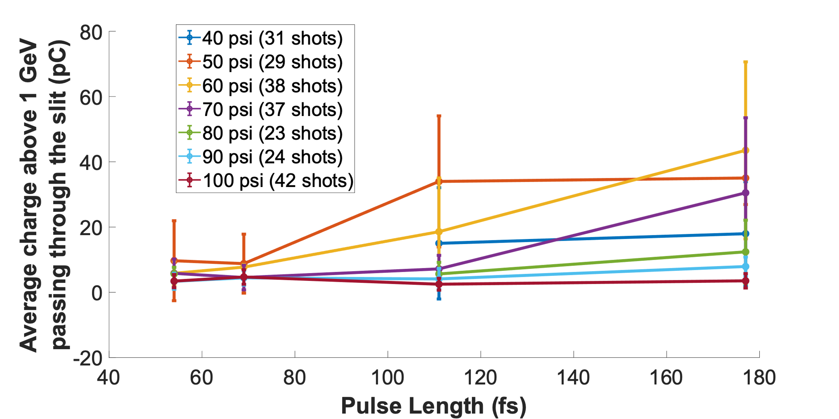
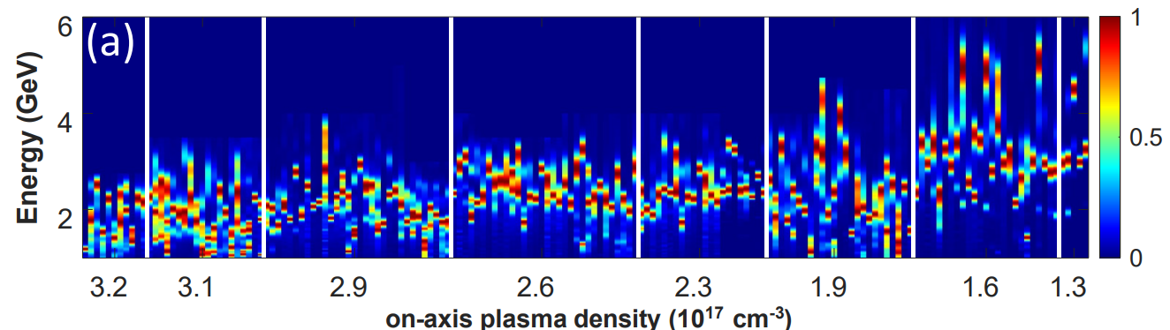
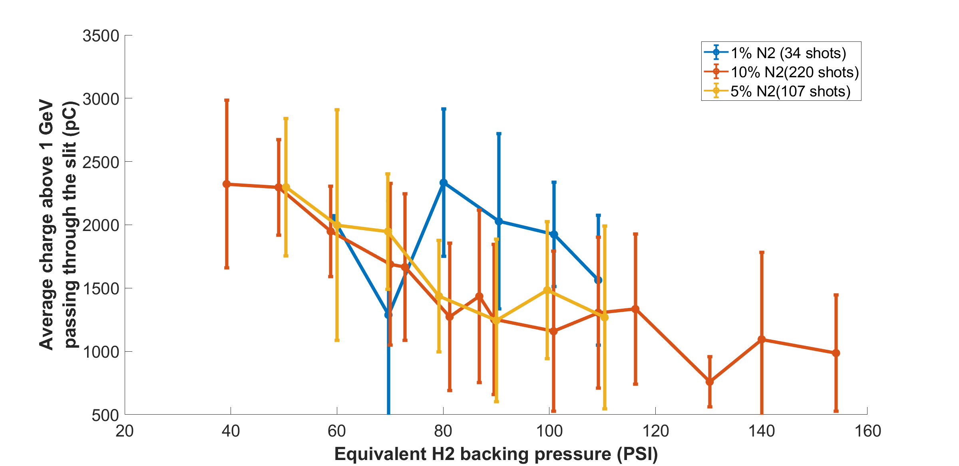
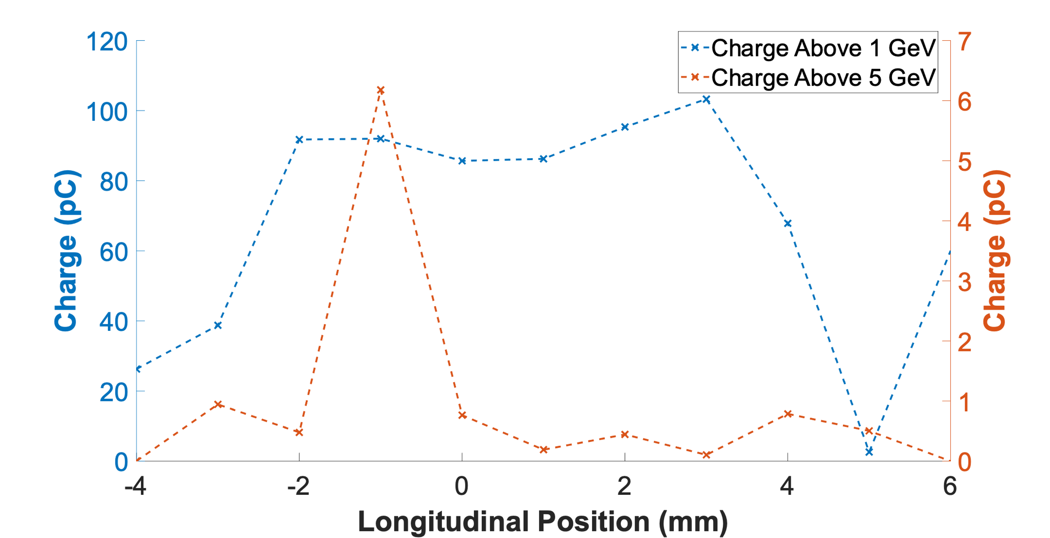
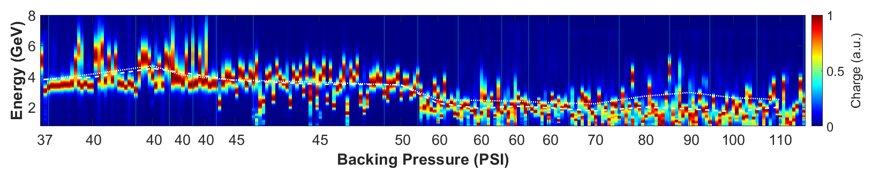
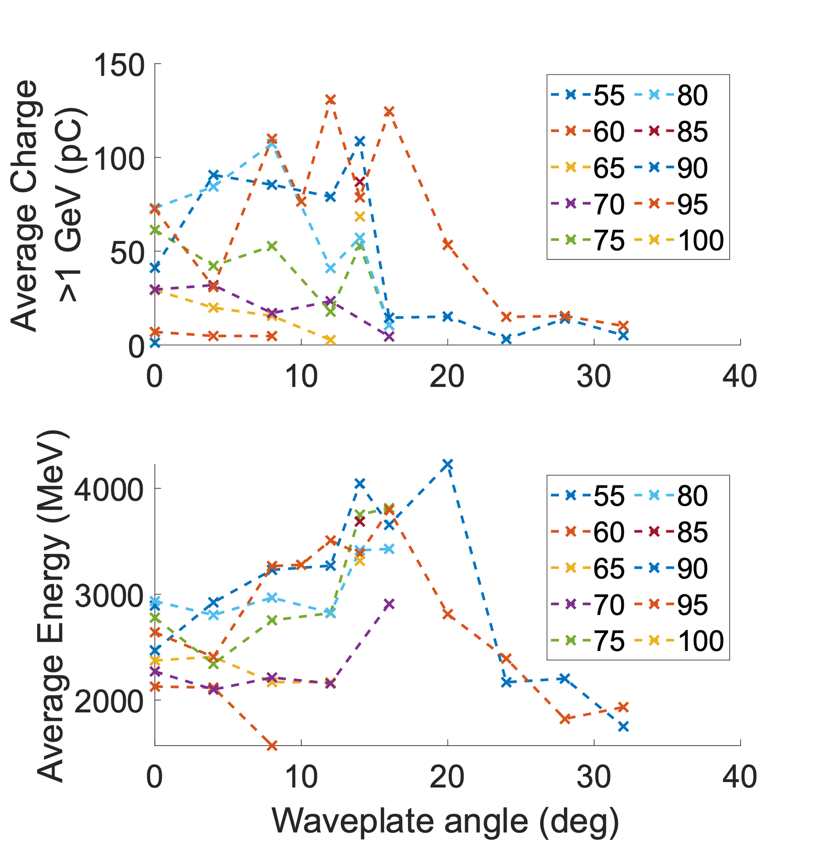
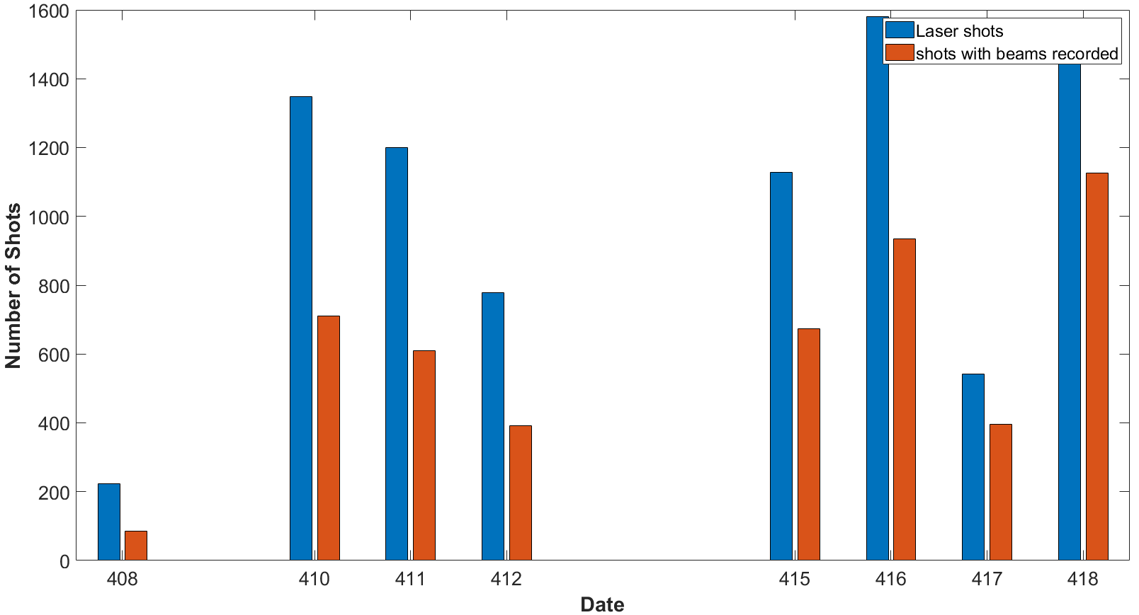
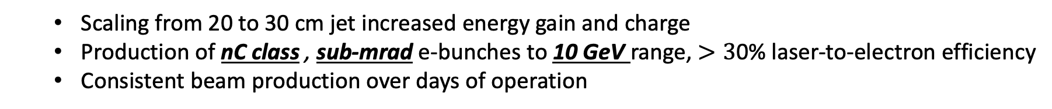
Rapid Improvement in Electron Beam Quality
  Scaling from 20 to 30 cm jet increased energy gain and charge
  Production of nC class , sub-mrad e-bunches to 10 GeV range, $>3$0% laser-to-electron efficiency
  Consistent beam production over days of operation
<13 J
on-target
*all experiments performed on ALEPH at CSU
Driver optimization
2022: 20 cm, ~ 5.5 GeV, 10’s pC
<15 J
on-target
Dopant optimization
(b)
2023: 30 cm, ~ 7.5 GeV, 100’s pC
Coupling optimization
<18 J
on-target
(c)
2024 (campaign 1): 30 cm, ~ 10 GeV, nC
*manuscript in preparation*
Channel optimization
1000’s of beams for muon statistics
B. Miao et al., Phys. Rev. X 12, 031038 (2022)
B. Miao et al., Physics Today (Aug. 2023)
E. Rockafellow et al., Phys. Plasmas, in press (2025)

Slide 17
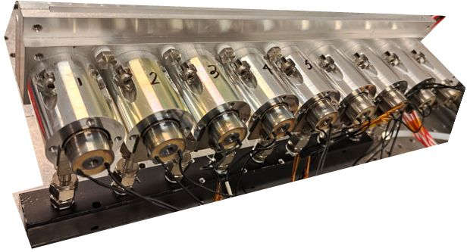
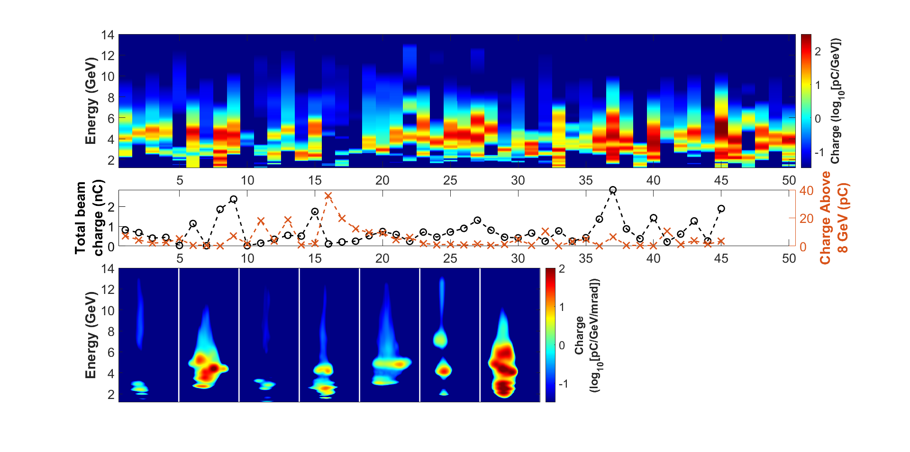
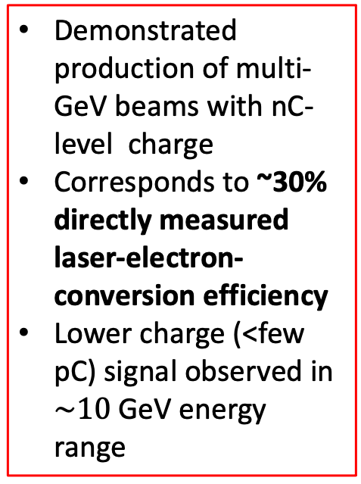
30 cm
Multi-GeV beams with nC-level charge
50 highest charge shots from 2024 campaign
UMD 30 cm jet
Demonstrated production of multi-GeV beams with nC-level charge
Corresponds to ~30% directly measured laser-electron-conversion efficiency
Lower charge (<few pC) signal observed in $\sim 10$GeV energy range
50 highest energy shots from 2024 campaign
E. Rockafellow et al., Phys. Plasmas, in press (2025)
J.E. Shrock et al., in preparation

Slide 18
High energy examples
Examples of high energy electron spectra, resulting from optimization of temporal envelope and channel size.
Stage I injection leads to low charge, high energy tails/peaks
Stage II injection leads to high charge, lower energy peaks
*9.2 GeV electrons from self-waveguided LWFA observed by collaborators @ LBNL (see J. Stackhouse’s talk this session and A. Picksley, et al., PRL 133(25), 255001 (2024))
E. Rockafellow et al., Phys. Plasmas, in press (2025)
J.E. Shrock et al., in preparation

Slide 19
Outline
Brief introduction to laser wakefield acceleration (LWFA) and self waveguiding
New model for benchmarking optical field ionized hydrodynamic plasma waveguides
New model of pulse propagation in meter-scale low density plasma waveguides
Recent 10 GeV experimental results from ALEPH at Colorado State University
Use of multi-GeV electron source for secondary particle/radiation generation
Development for future experiments

Slide 20
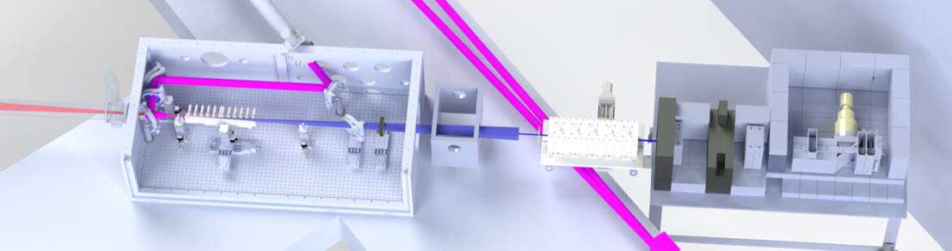
Use as a multi-GeV electron source
Muon Detector Array
Channel-forming pulse
Self-waveguiding LWFA drive beam
Electron spectrometer
Super-sonic gen. VI gas jet
CSU High Energy Physics team: Kaixin Zhu, David Warner, Nikola Durand, Jay Jablonski, and John Harton
ELI-BL team: Anna Cimmino and Roberto Versaci
Multi-GeV, nC beams used as driver for muon generation and positron generation experiments
Setup capable of producing up to ~1000 multi-GeV beams/day at .1 Hz rep rate

Slide 21
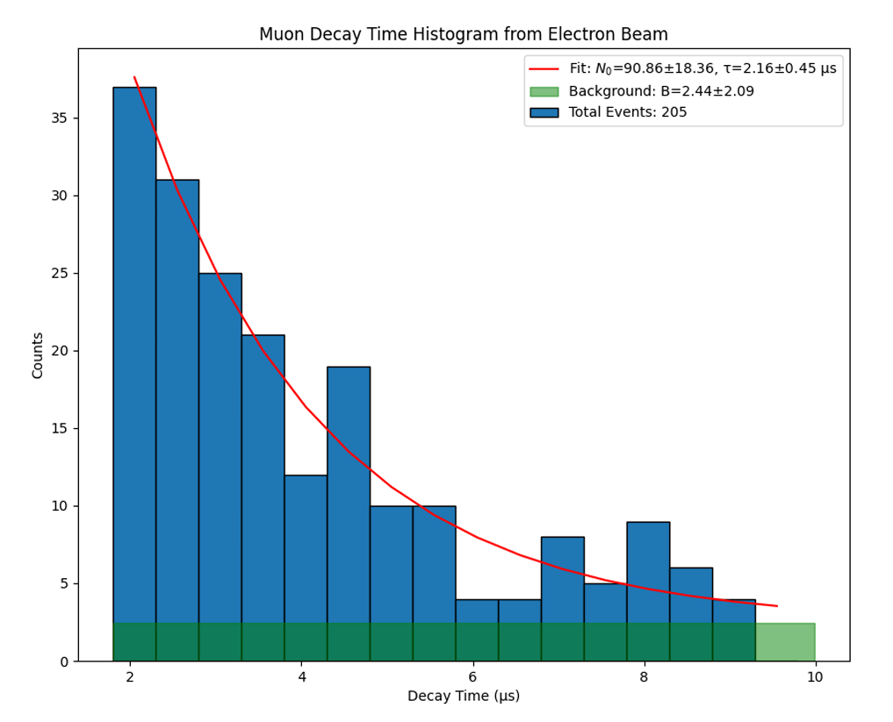
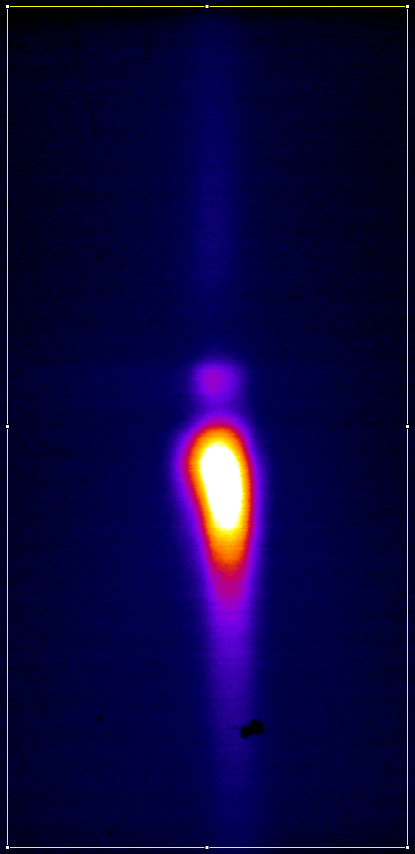
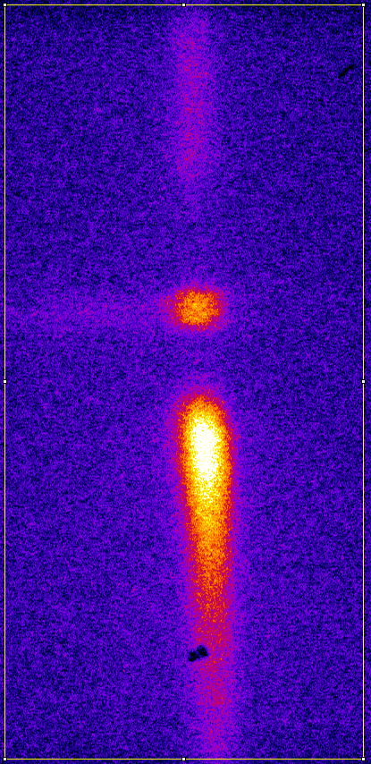
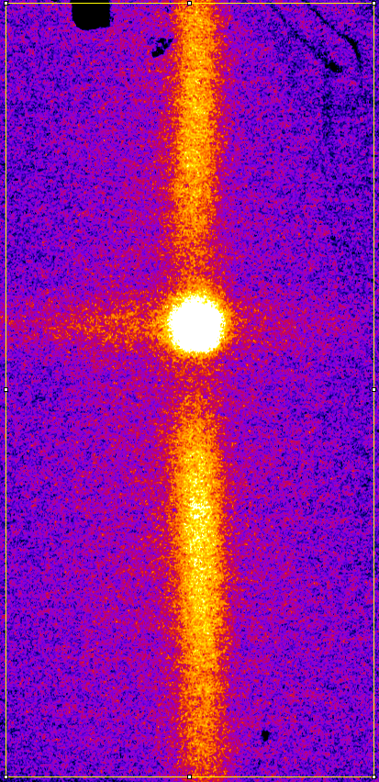
Measurements of positrons and muons
Positron/electron pairs and muons produced by interaction of GeV electrons with high-Z material
1 day of CSU muon candidate signals
Raw Data of Positrons and Electrons
2 mm W
4 mm W
6 mm W
e+ energy
Positrons
Fit = 2.16 ± 0.45 μs
~500 MeV
Electrons
e- energy
Normalized color scales
~50 MeV
Time (μs)
Increasing converter target thickness
CSU High Energy Physics team: Kaixin Zhu, David Warner, Nikola Durand, Jay Jablonski, and John Harton
ELI-BL team: Anna Cimmino and Roberto Versaci
Notes:
Bethe-Heitler Pair production
e- + ion → gamma
gamma + ion → muon+, muon – pair
Photoproduced charge pions
Gamma + ion -> pi+
Pi+ → muon+, muon-neutrino

Slide 22
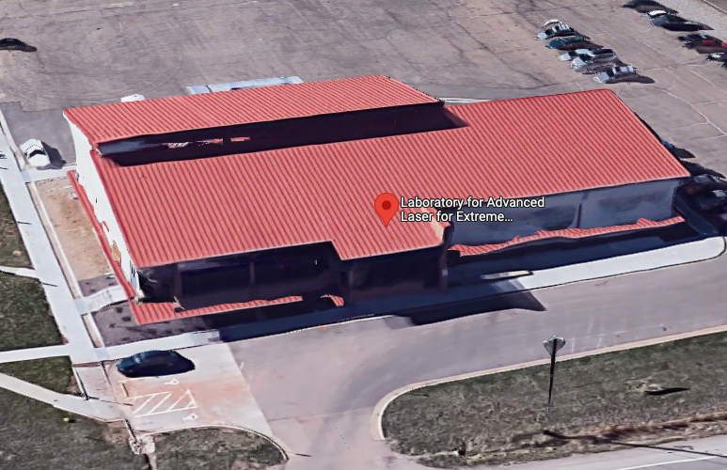
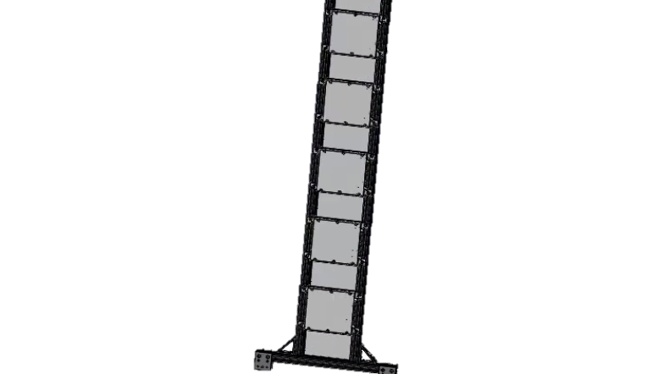
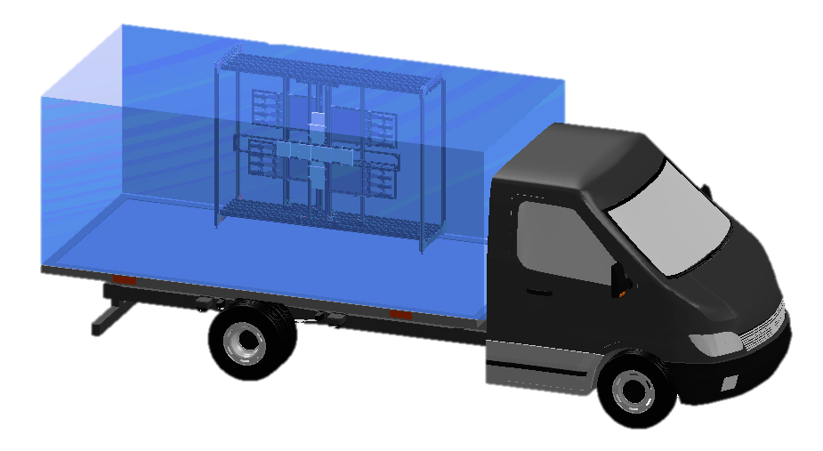
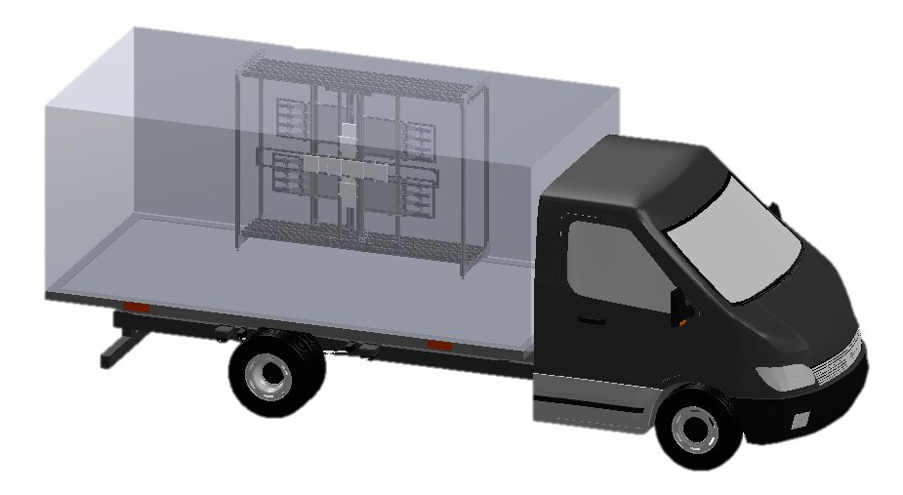
Demonstration of lab-generated muon imaging
Scintillator/SiPM Detector Array
Single shot “imaging” demonstration
All Particles (no object)
Object obscuring two detectors
Ratio
laser accelerator
Muon Beam
Lead “object”
Object
Detection and analysis team: K. Zhu, D. Warner, N. Durand, J. Jablonski, J. Harton, J. Williams, B. Reagan, A. Cimmino, R. Versaci

Slide 23
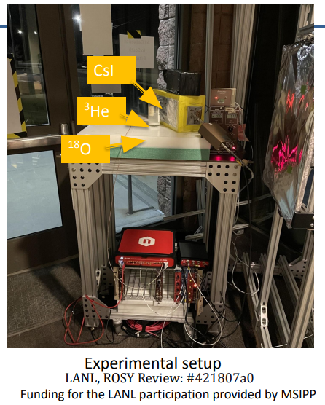


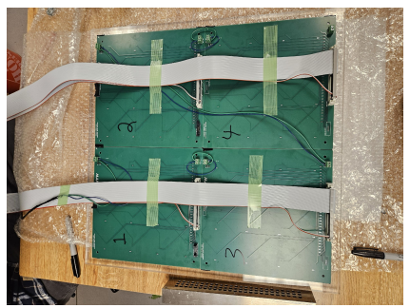
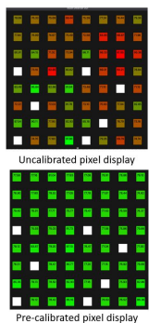
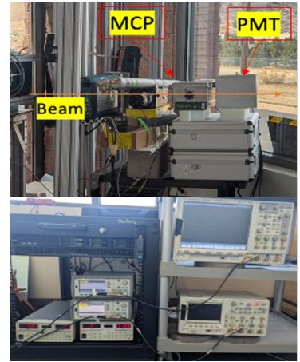

Ongoing use as a muon source (2025)
High-charge, multi-GeV beams provide a university-based muon source
Feb. 2025 campaign provided beams for multiple teams to field new muon hardware
³He detector for neutrons from muon-driven fission
H₂ plasma fluorescence above 1 meter jet
CsI muon detector
Drift tubes for muon tomography
1 m jet + Bessel beam in situ
Photo credit: Jirka Sisma
1 m log axicon used to make the plasma
Localized injection section (N₂)
PMT and microchannel plates with different scintillators
Pixelated detector arrays for muon radiography

Slide 24
Outline
Brief introduction to laser wakefield acceleration (LWFA) and self waveguiding
New model for benchmarking optical field ionized hydrodynamic plasma waveguides
New model of pulse propagation in meter-scale low density plasma waveguides
Recent 10 GeV experimental results from ALEPH at Colorado State University
Use of multi-GeV electron source for secondary particle/radiation generation
Development for future experiments

Slide 25


Improved coupling with funnels
Log-axicons employed in recent campaigns generate funnel-mouthed waveguides
Allowed generation of electron beams even when mis-aligned by ~60 $μm$
Phase shift from funnel-mouthed plasma
N. Tripathi et al., available on arXiv:2503.01786

Slide 26



Longitudinal control of >1 m plasmas
H₂ plasma fluorescence above 1 meter jet
Localized injection section (N₂)
1 m log axicon used to make the plasma
Generation VII Maryland gas jet:
Modular gas jet with controllable axial density and dopant locations
Extendable to any length
B. Miao et al., Rev. Sci. Instrum., in press (2025)

Slide 27



Longitudinal control of >1 m plasmas
Preliminary FBPIC simulations show stair-case style up-ramps can increase energy by 30%
(b)
(b’)
E. Rockafellow et al., Phys. Plasmas, in press (2025)
Notes:
$τ_{FWHM}=55 fs$, λ=800 nm, $w_{0}$=30 µm $a_{0i}$=3.2

Slide 28

Summary
Benchmarked OFI plasma waveguides with measurements and simulations
Identified 3-stage model describing meter-scale LWFA in OFI channels
Experimentally demonstrated the first examples of controlled ionization injection in OFI plasma waveguides
Achieved 10 GeV electron energies and >30% electron-to-laser conversion efficiency
Used LWFA for several secondary particle generation experiments
Developed hardware that allows accelerators of any length or density profile, and improves coupling and stability of LWFA
1 meter
We are working towards applying these techniques in a meter-long accelerator!

Slide 29
Thank you!

Slide 30

Simulation snapshots of pulse evolution
Group velocity walkoff of higher order modes (p>1) leaves (0,0) and (1,0) modes
Occurs more quickly for smaller w_{ch}
Waist size at the highest intensity is smaller than nominal ‘matched’ condition due to ponderomotive channel modification
Evolution of LWFA drive pulse with $a_{0i}=2.0, w_{0}=30 μm, τ_{fwhm}=35 fs$ in a prepared index structure with $w_{ch} ≈ 20 μm$ and on axis plasma density $N_{e0}=2.0×{10}^{17} cm^{−3}$.
J. E. Shrock et al., Phys. Rev. Lett. 132, 045002 (2024)

Slide 31
Stage II: Beating of $(p,m)=(0,0)$ and $(1,0)$ modes
The early part of the pulse propagates in an unmodified channel
As the early part of the pulse redshifts, it is coupled into the ponderomotively modified channel
It couples into (0,0) and (1,0) modes, causing the steady stage II beating
Pulse envelope and wake plasma density for a cycle of stage II intensity modulation. Higher order modes are shown undergoing group velocity walkoff, with the remaining (0,0) and (1,0) components of the pulse doing Stage II beating
J. E. Shrock et al., Phys. Rev. Lett. 132, 045002 (2024)

Slide 32

Pulse Propagation Evolution
Pulse propagation corresponding to blue curve from Fig. 1a.
Stage I: dramatic transverse modulation of pulse
Stage II: longitudinal modulation as modes fall behind pulse
Stage III: dispersed and depleted pulse
J. E. Shrock et al., Phys. Rev. Lett. 132, 045002 (2024)

Slide 33


Ionization injection from stage II beating (FBPIC sims)
Stage I
Stage II
Stage I: injects little charge due to wake deformation
Stage II: most of charge injected by back-and-forth oscillations of peak $a_{0}$ in the pulse frame and relative deceleration of the pulse
Snapshots show the points of origin of freed electrons that are trapped and accelerated
J. E. Shrock et al., Phys. Rev. Lett. 132, 045002 (2024)

Slide 34



Bessel beam propagation and heating for 1m waveguide
3D YAPPE* self-consistent simulation of Bessel beam OFI heating
Electron density
Input parameters
Pulse length, FWHM | $$τ_{FWHM}$$ | 300 fs
Laser beam radius, super Gaussian | $$w_{0}$$ | 1 cm
Bessel beam ray approach angle | $$α$$ | 10 mrad
Uniform hydrogen molecular density | $$N_{H2}$$ | $$1×{10}^{17}cm^{−3}$$
Laser energy | E | 1 J
Electron temp.
z=4 cm
z=60 cm
$$ξ=(v_{g}t−z)/c$$
* B. Miao et al., Phys. Rev. Accel. Beams 27, 08132 (2024)
A. Goffin et al., Phys. Rev. X 13, 011006 (2023).

Slide 35

Longitudinal control of >1m plasmas
Intensity measurements from axicon for longer channels and improved coupling
N. Tripathi et al., available on arXiv:2503.01786

