Slide 1
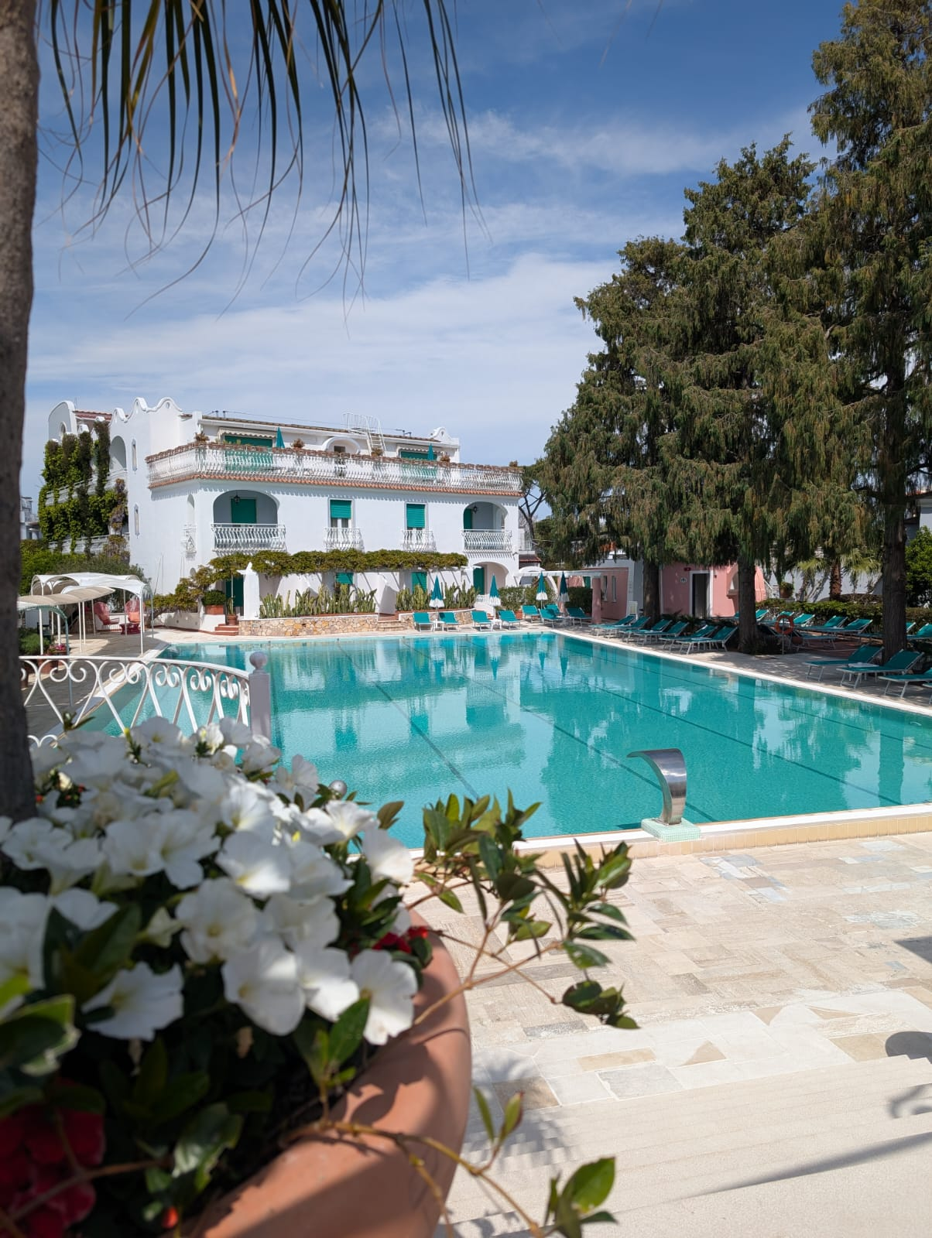



Welcome to
13–19 Apr 2025
Hotel Continental, Ischia Island
(Naples, Italy)

Slide 2
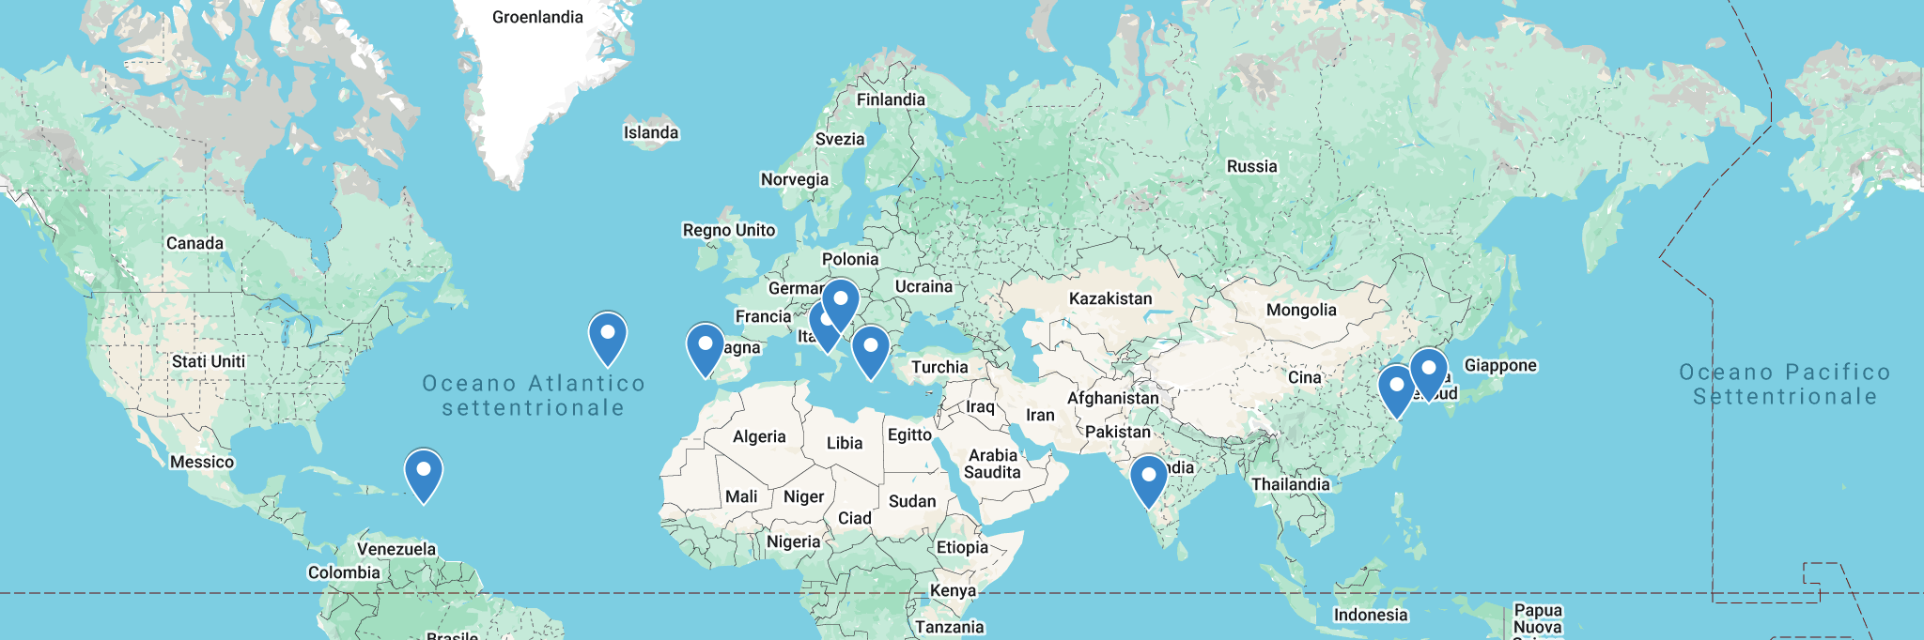
XV LPAW since 1993 Kardamyli (Greece)
2007
Azores
2019
Split
2001
Gien
2017
Jeju
2003
Porto
venere
1993
Kardamyli
1995
1999
2009
2015
Guadeloupe
2023
Algarve
2025
Ischia
1997
Kyoto
2011
Wuzhen
2005
Taipei
2013
Goa

Slide 3
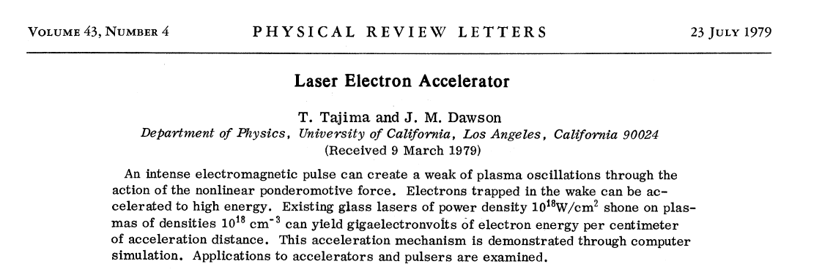
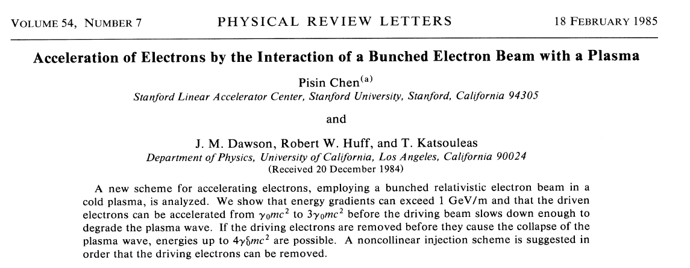
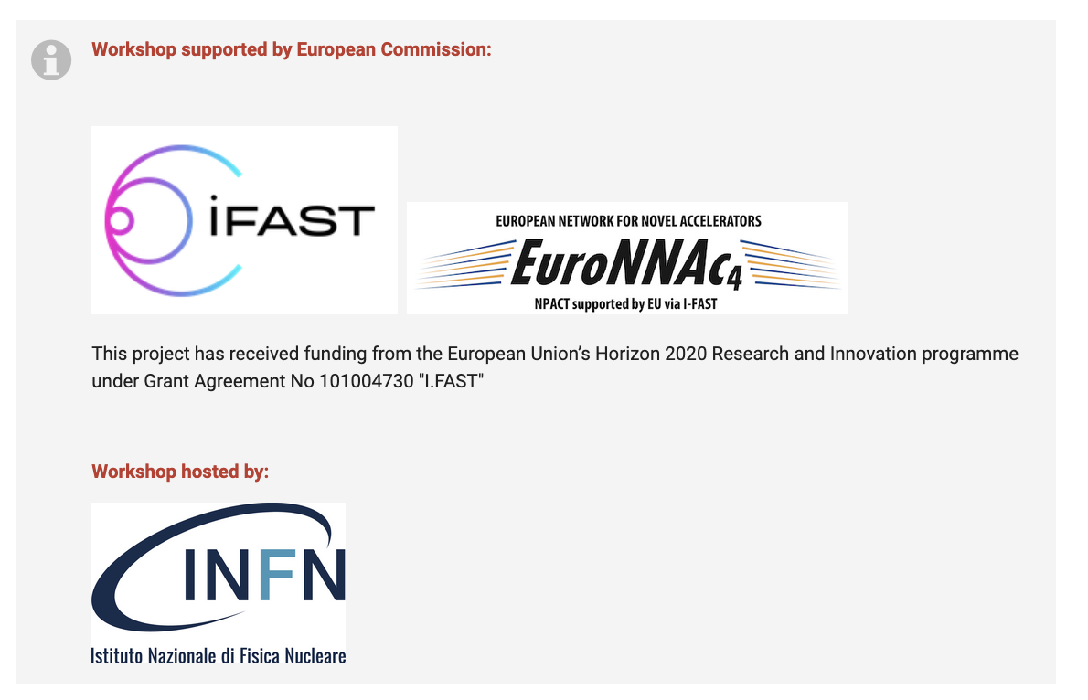
J. M. Dawson Prize Ceremony on Friday at 17:40
3 Dawson Prizes
and 14 Fellowships

Slide 4
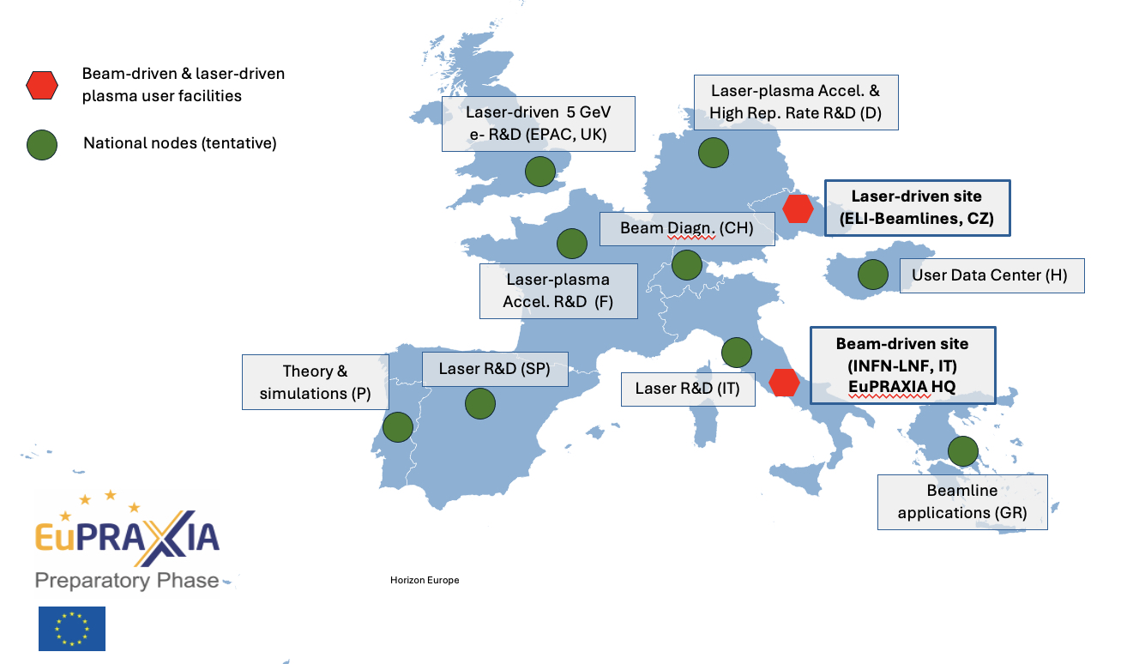
Important Milestone Achieved
EuPRAXIA selects ELI for the Laser-Driven Accelerator Site
https://www.eupraxia-facility.org/post/eupraxia-selects-eli-for-second-laser-driven-accelerator-site
The EuPRAXIA Consortium selected the ELI Beamlines Facility in Dolní Břežany, Czech Republic, as the site for its laser-driven plasma accelerator pillar. ELI Beamlines was selected for its infrastructure readiness, state-of-the-art laser systems, and comprehensive technical expertise.
EuPRAXIA also recognises the important roles of the other candidates for the second site, EPAC and CNR-INO.
EPAC will contribute to EuPRAXIA as a centre for R&D, focusing on advancing research towards achieving a high-quality 5 GeV electron beam. While CNR-INO will function as EuPRAXIA's National Node in Italy and laser test facility.

Slide 5

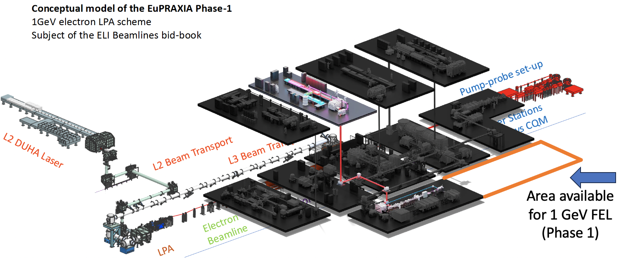
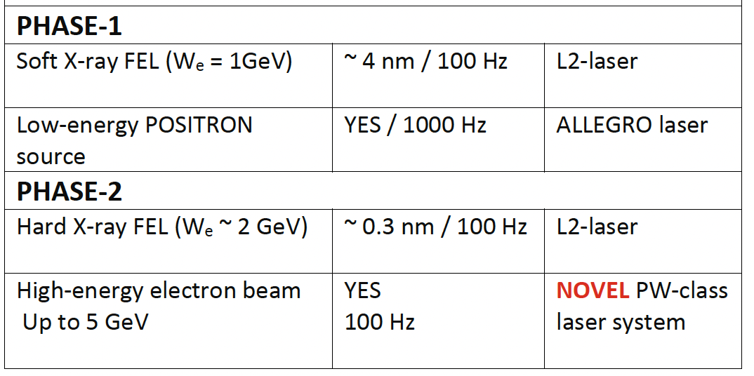
EuPRAXIA@ELI LPAW based facility
With it’s advanced high-power, high-repetition-rate laser systems, including the newly developed L2 DUHA laser (aiming to 200 TW, 100 Hz) , and versatile experimental setups, ELI is ideally equipped to implement and operate the Laser-Plasma-Accelerator-based 1-GeV Free-Electron Laser (FEL) envisioned by EuPRAXIA.

Slide 7
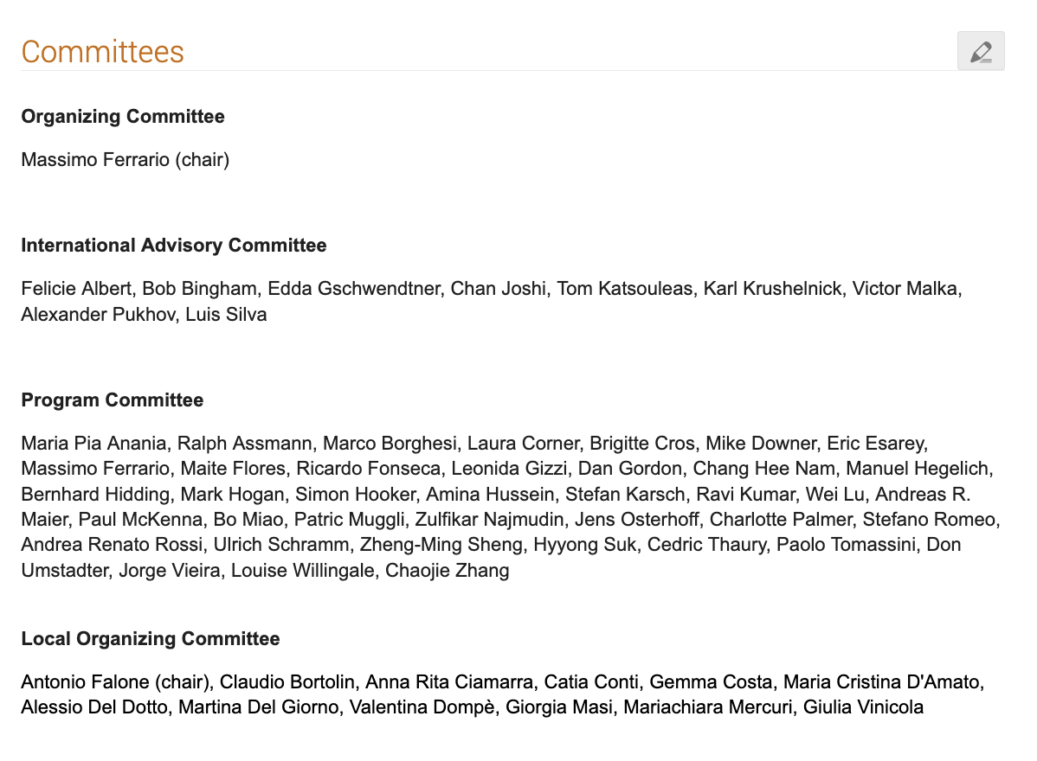
We apolgise not to be able to accommodate all the high level contributions received.
But there will be soon another chance:

Slide 8
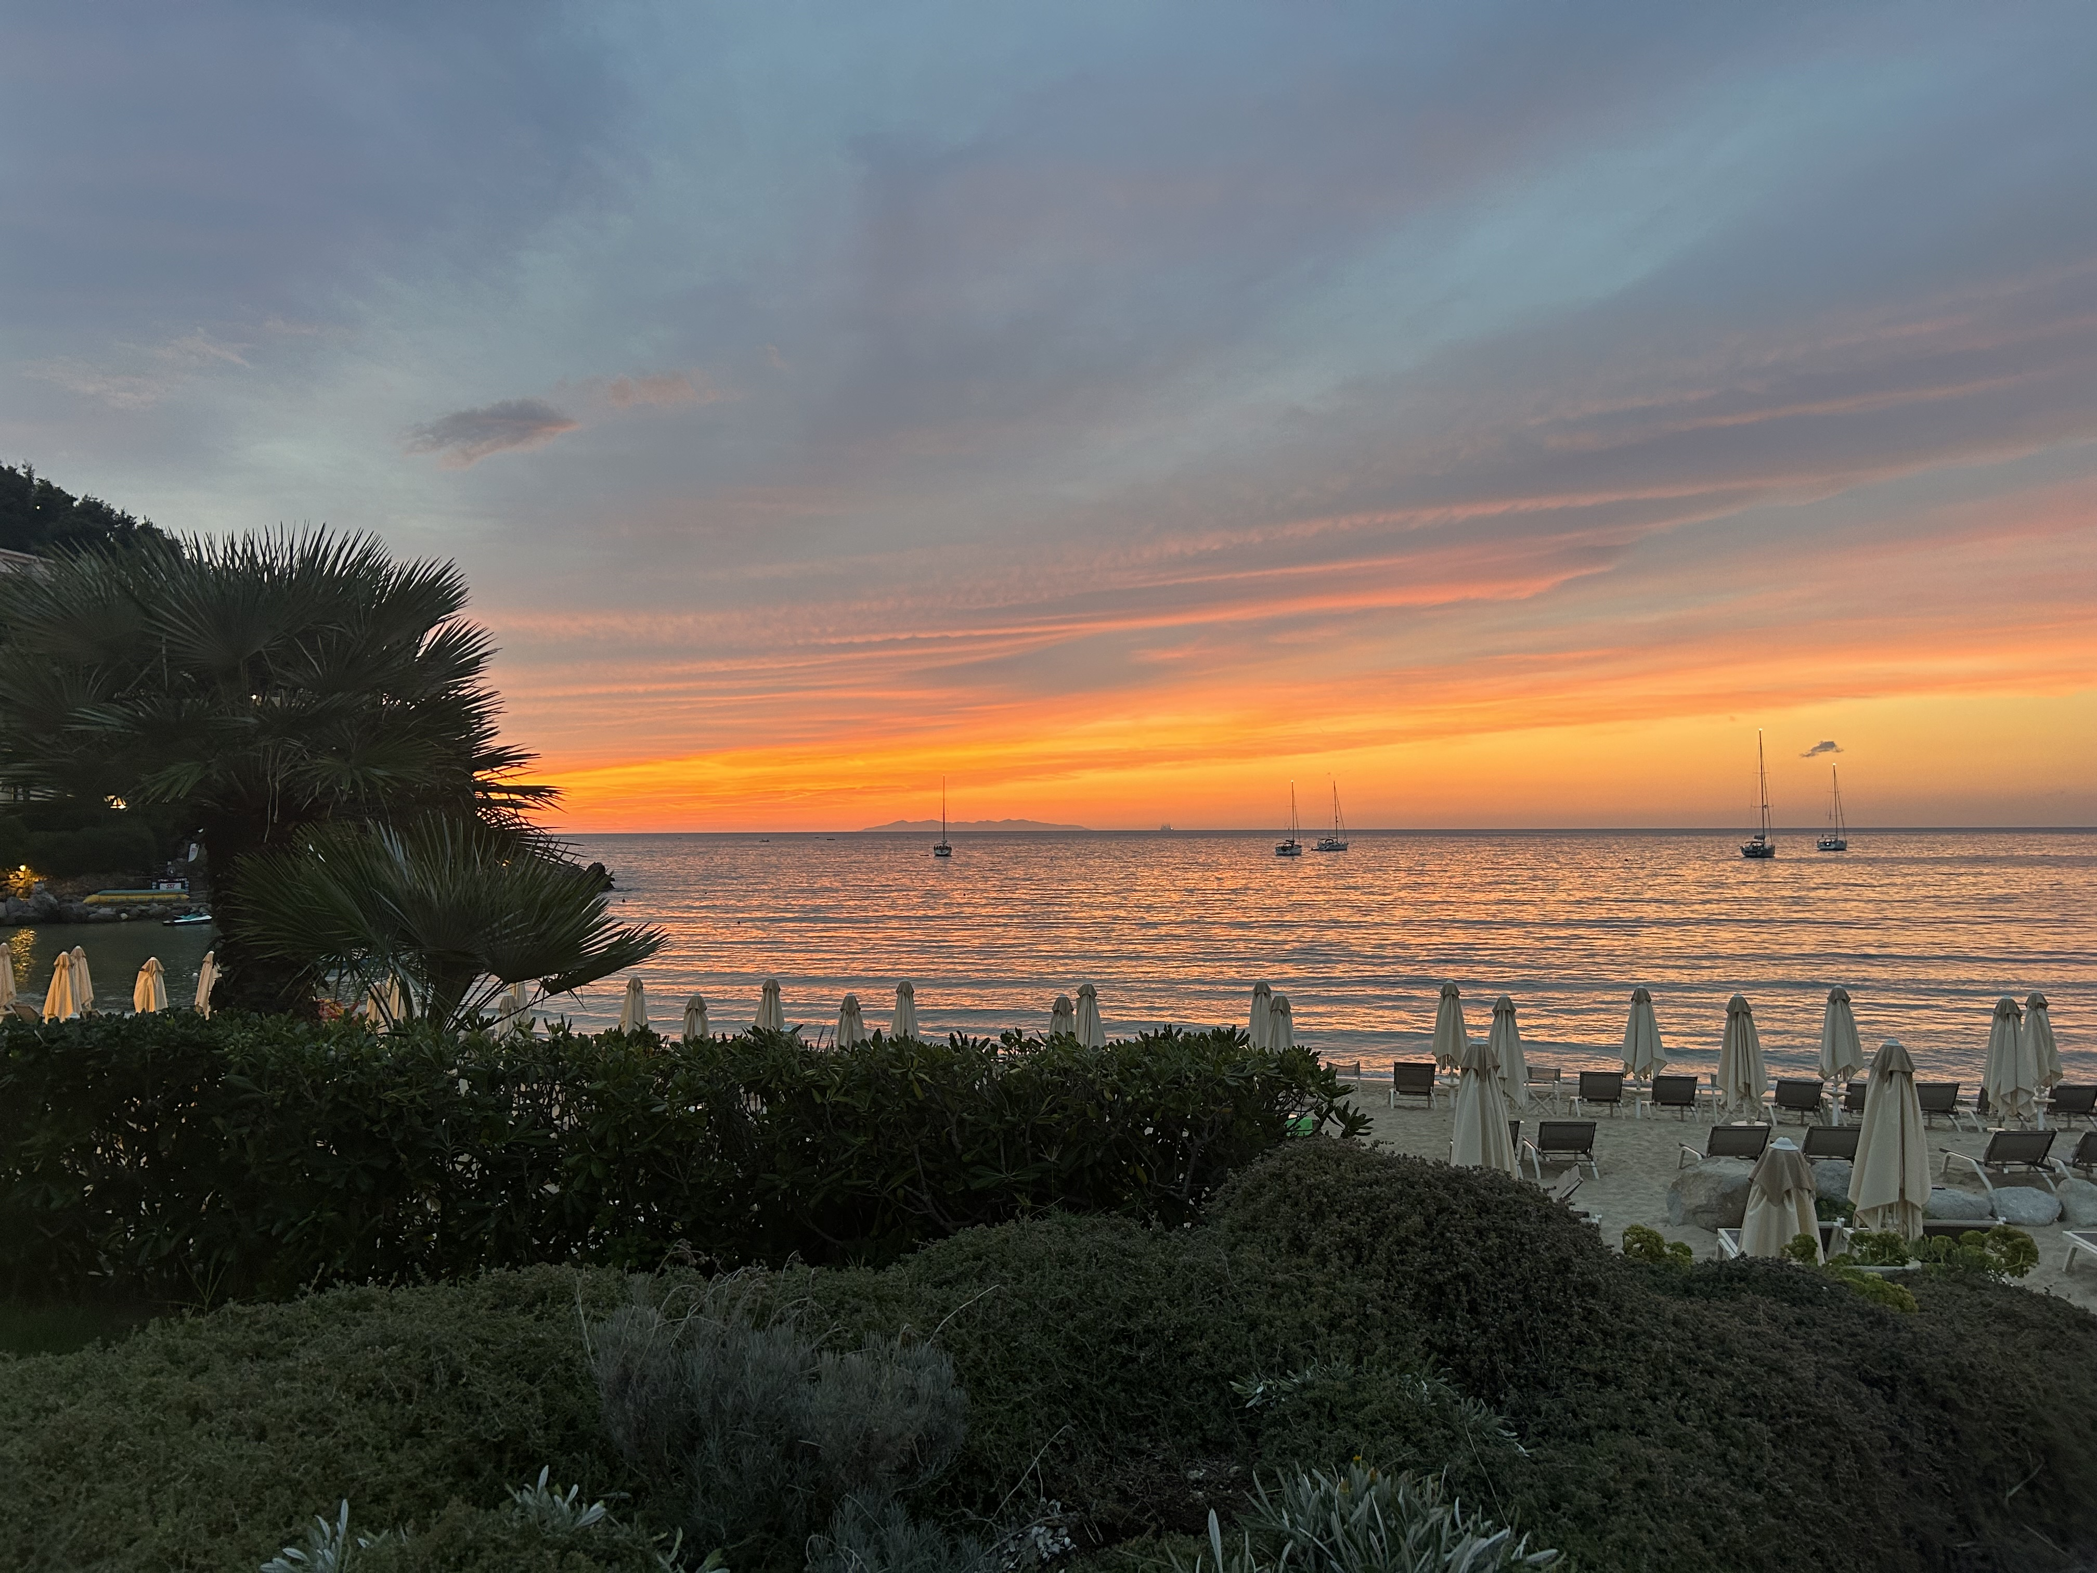
7th European Advanced Acceleration Conference
Elba, September 21-27, 2025
Pre-Registrations are now open https://agenda.infn.it/event/46259/overview

Slide 9
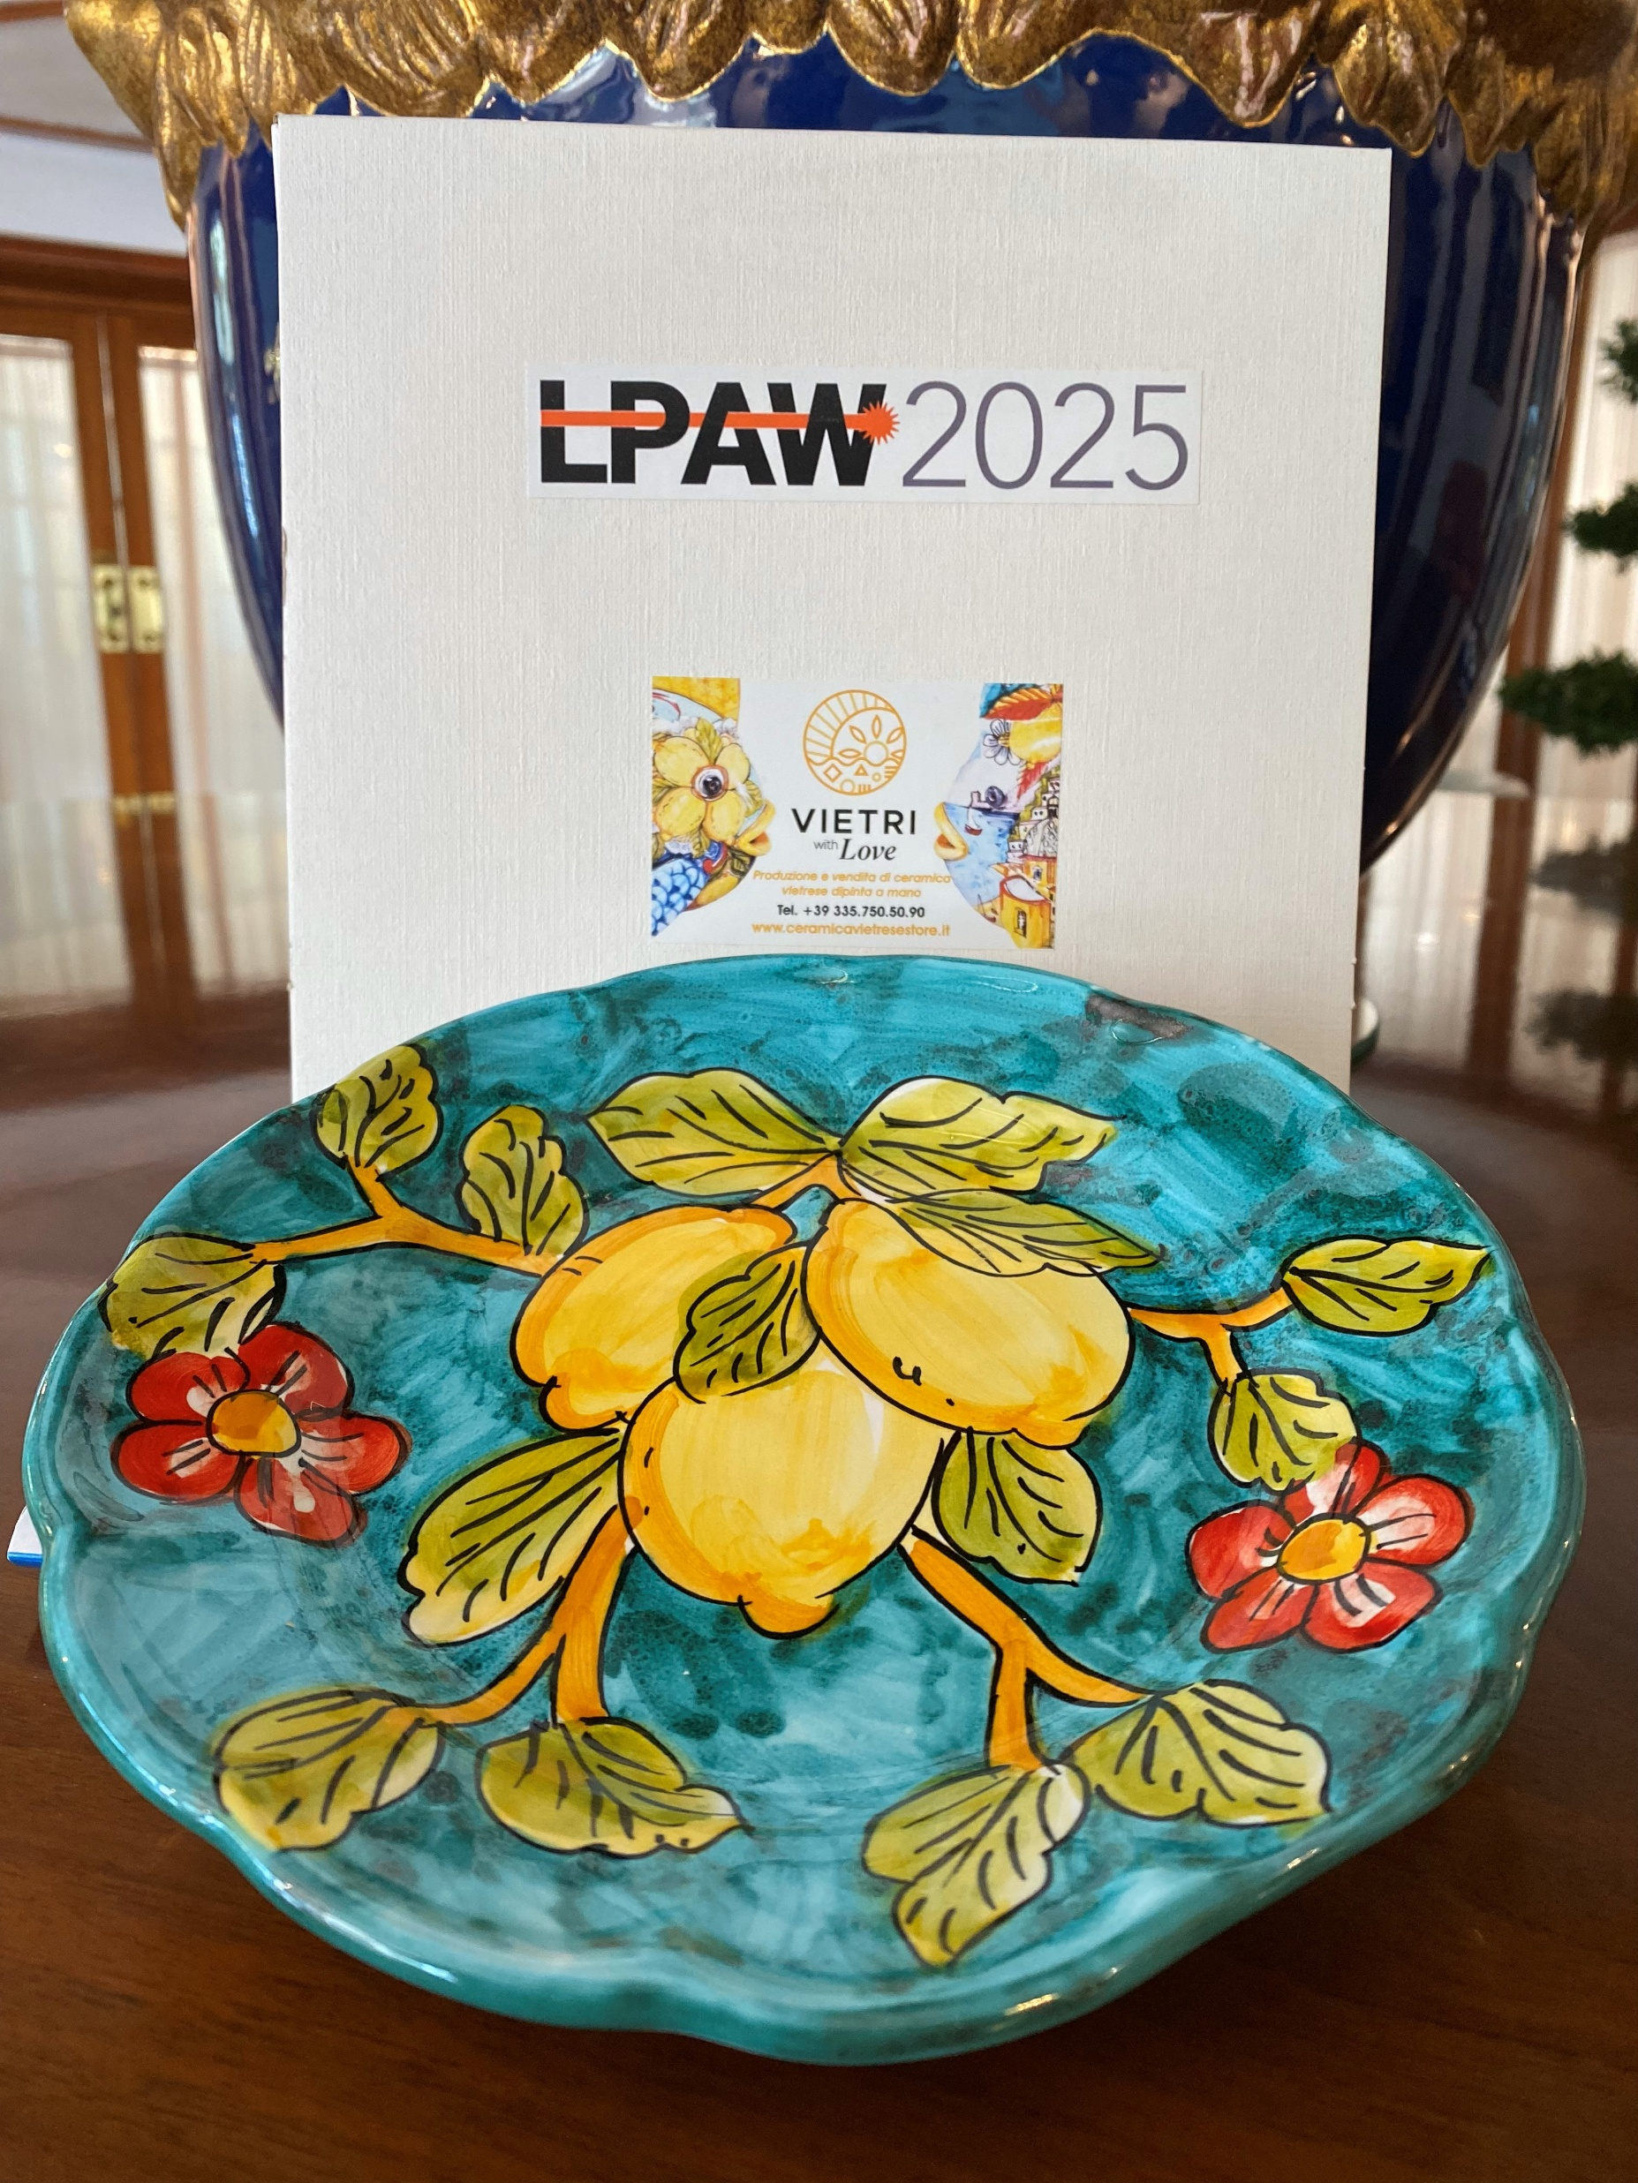
Your welcome Kit The Ceramic Plate: a long standing local tradition
This ceramic plate comes from the Campania region, a place known not only for its natural beauty and thermal springs, but also for its long-standing tradition of ceramic craftsmanship.
Each piece is handmade by local artisans, shaped by fire and earth—elements that are deeply rooted in nature and transformed through knowledge and skill.
The colors and motifs reflect the spirit of the island: vibrant, warm, and full of character.
Every ceramic piece carries the touch of the artisan—a unique signature, a fusion of material and imagination.

Slide 10
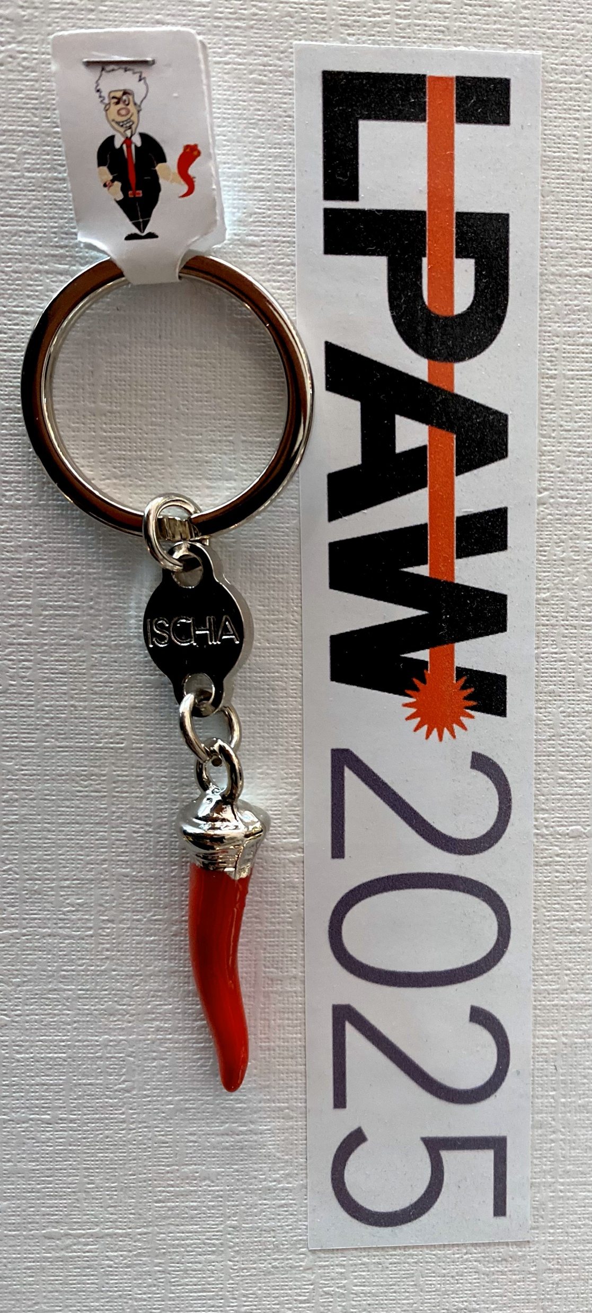
Your welcome Kit The Red Horn: A Lucky Charm and Italian Tradition
If you ask to some old fisherman (or to ChatGPT) they can explain you that the red horn (Cornicello) is a symbol of good luck and protection against the "evil eye," a belief especially common in Southern Italy.
According to tradition, the cornicello keeps bad luck away and protects against envy, jealousy, and so-called "negative energies."
According to superstition, the red horn works best if it’s given as a gift, rather than bought for oneself.
And even if not everyone truly believes in its powers, the red horn remains a symbol full of affection, fun, and deeply rooted in Italian culture. It’s a small gesture, a charm that stands for hope, protection, and a touch of folk magic. So, if you ever receive one, don’t think of it as just a souvenir — it’s a little piece of Italian tradition and heart.

Slide 11
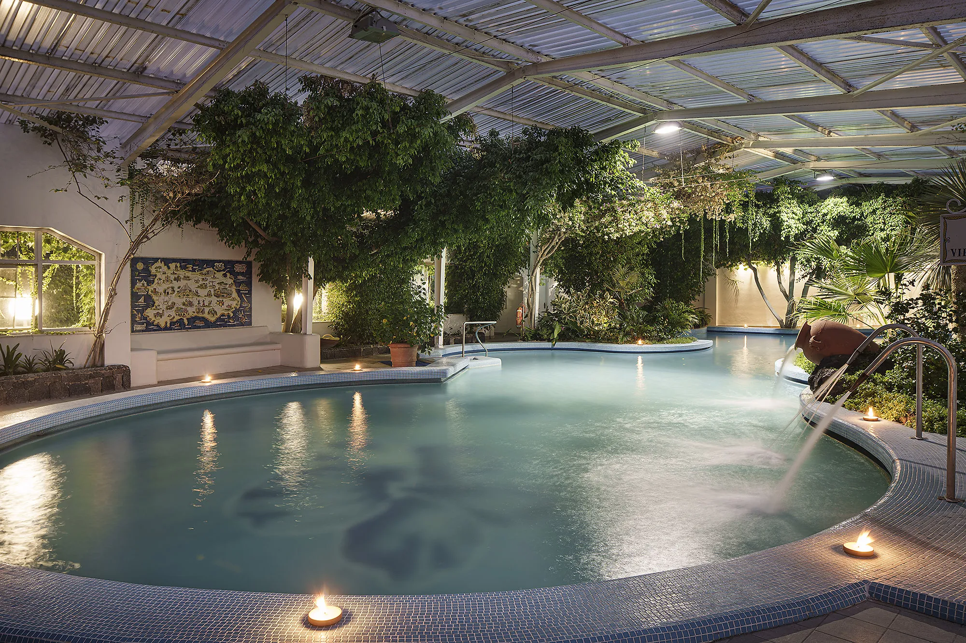
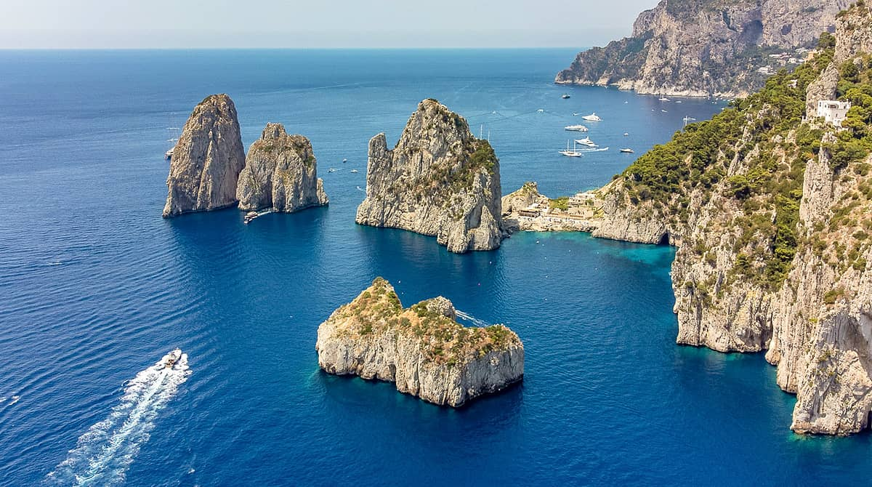
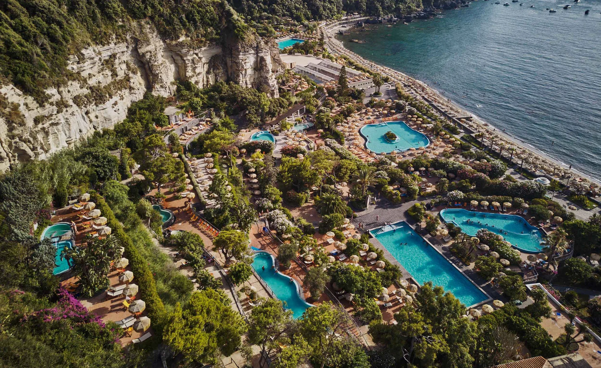
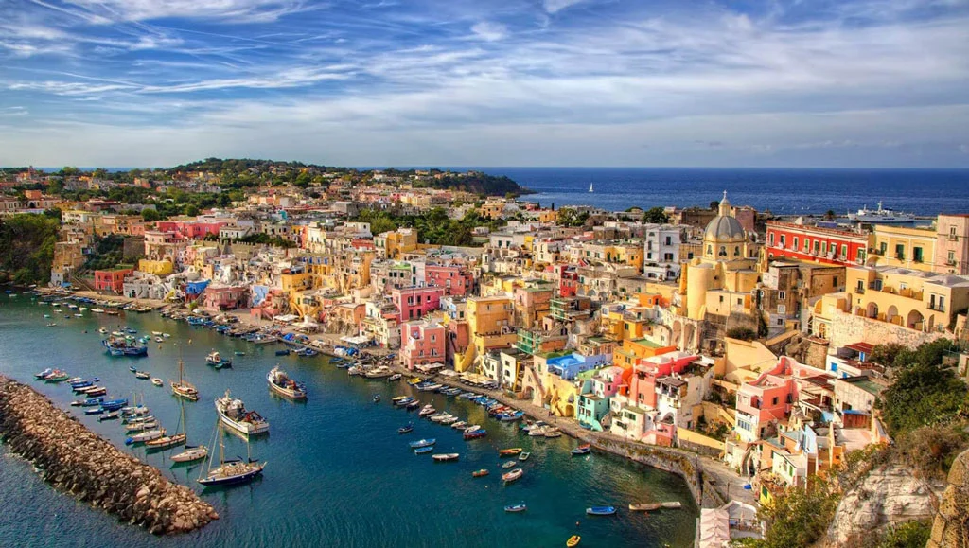
Daily tours around Ischia or to Capri or Procida possible.
Just ask to the Hotel reception desk

Slide 12
Useful info:
-For speakers: upload your slides on Indico;
-Always wear your badge to access all the Conference utilities;
-The Hotel Continental’s guest should not confirm meals at the Hotel reception;
-Diet requirements: show your empty badge during meals to the restaurant staff;
-Free SPA (upon reservation) and pools access for Hotel Continental’s guests from 2:00 to 4:00 PM;
-Social events: Castello Aragonese Tour on April, 16 – Social Dinner on April, 17
WI FI credentials for Congress Area:
Network: Sala Pitecusa/Sala Primavera/Sale Nitrodi password: Congressi2025

Slide 13
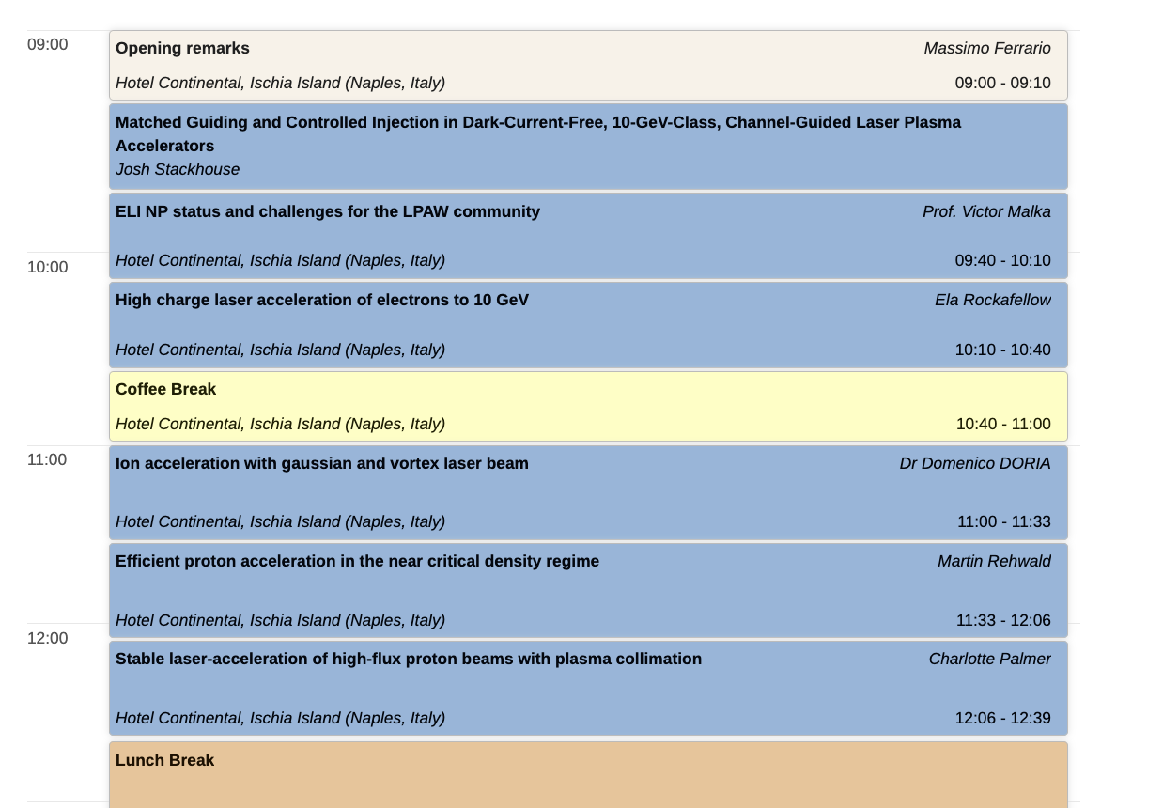
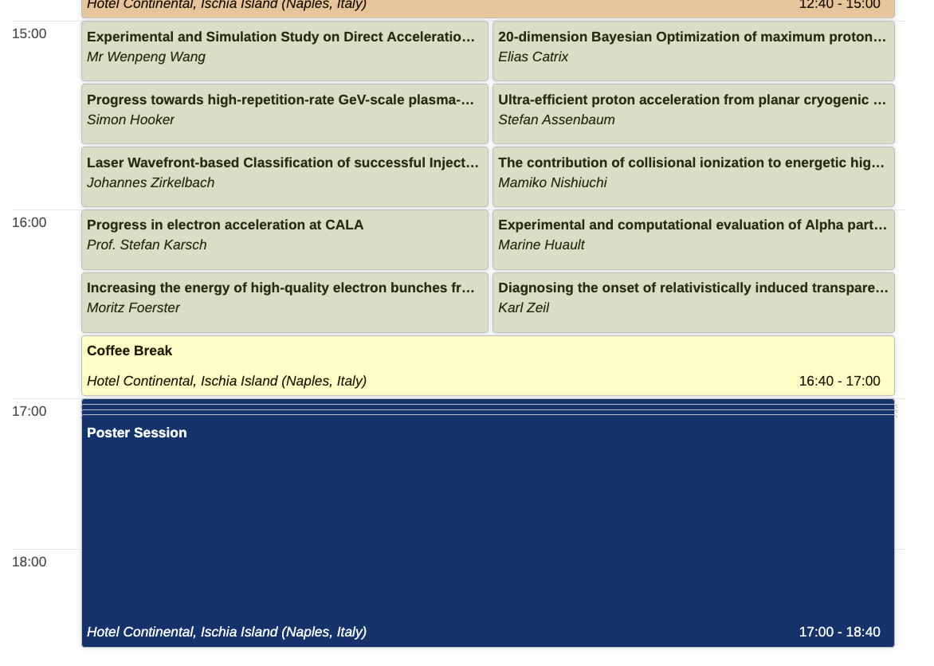
Have a nice and fruitful workshop

