Slide 1
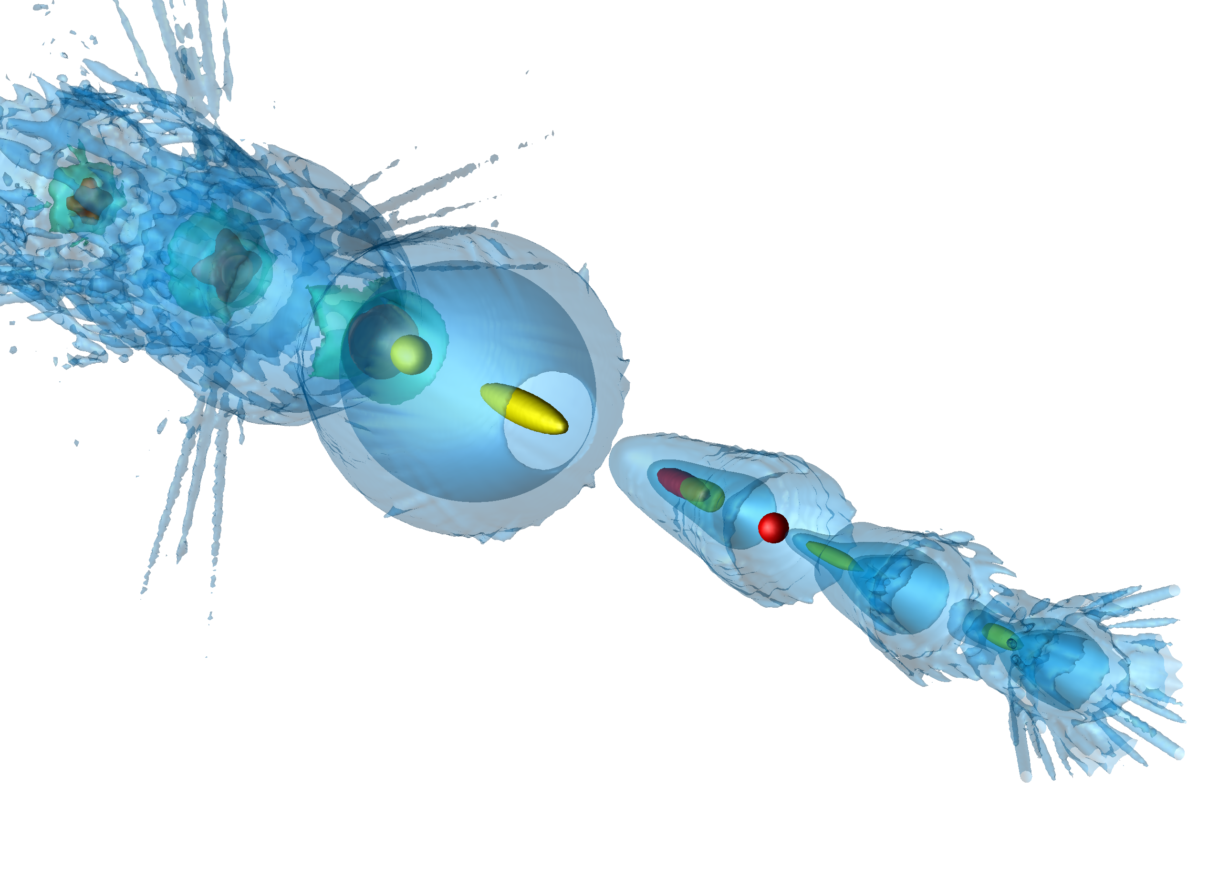
First Results from FACET II Compact plasma wakefield transformer produces ultrabright, narrow-energy-spread bunches of greater than 20 GeV electrons with pump depletion Positrons
Chaojie Zhang and Chan Joshi
University of California Los Angeles
E300 and E304 Colleagues
Electrons
Positrons
Work supported by U.S. D.O.E. HEP , NSF
OSIRIS simulation by F. Tsung UCLA

Slide 2
SLAC National Accelerator laboratory
Was one of the premier high energy physics lab and premier
linear accelerator lab (1960-2010)
Since 2010 it has become one of the main centers in the world
to do atto- and femto second science using X-ray Free electron laser
1)Our work on Plasma-based acceleration is driven by working
Towards a ee+ collider at the energy frontier
2) Expanding the capabilities of the LCSS X-FEL

Slide 3
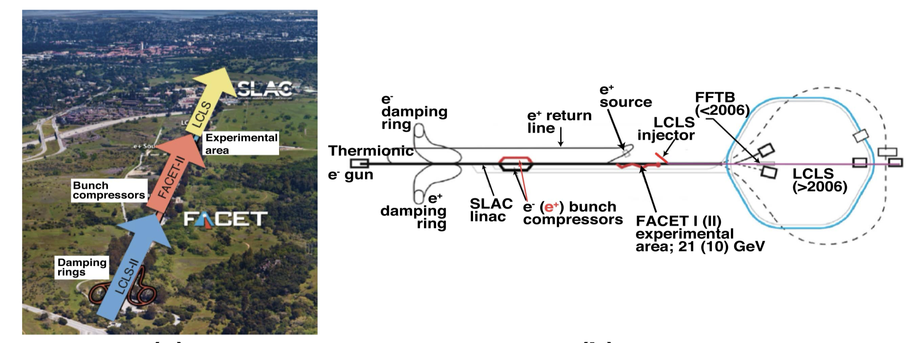
What and where is FACET II?
SLAC Sight in Menlo Park, CA today
SLC : First 100 GeV CM e-e+ Linear Collider in the World
Glorious history of PWFA Experiments at SLAC
1998 First non-HEP experiment-plasma wakefield accelerator approved
2004 PWFA produces 3.5 GeV energy gain
2006 PWFA doubles the energy of the SLAC’s 42 GeV beam
2014 High efficiency acceleration of a distinct second bunch, beam loading
2015 High gradient acceleration of positrons
2009 SLAC ‘s LCLS X_FEL comes on line
2023 LCLS II produces first light

Slide 4
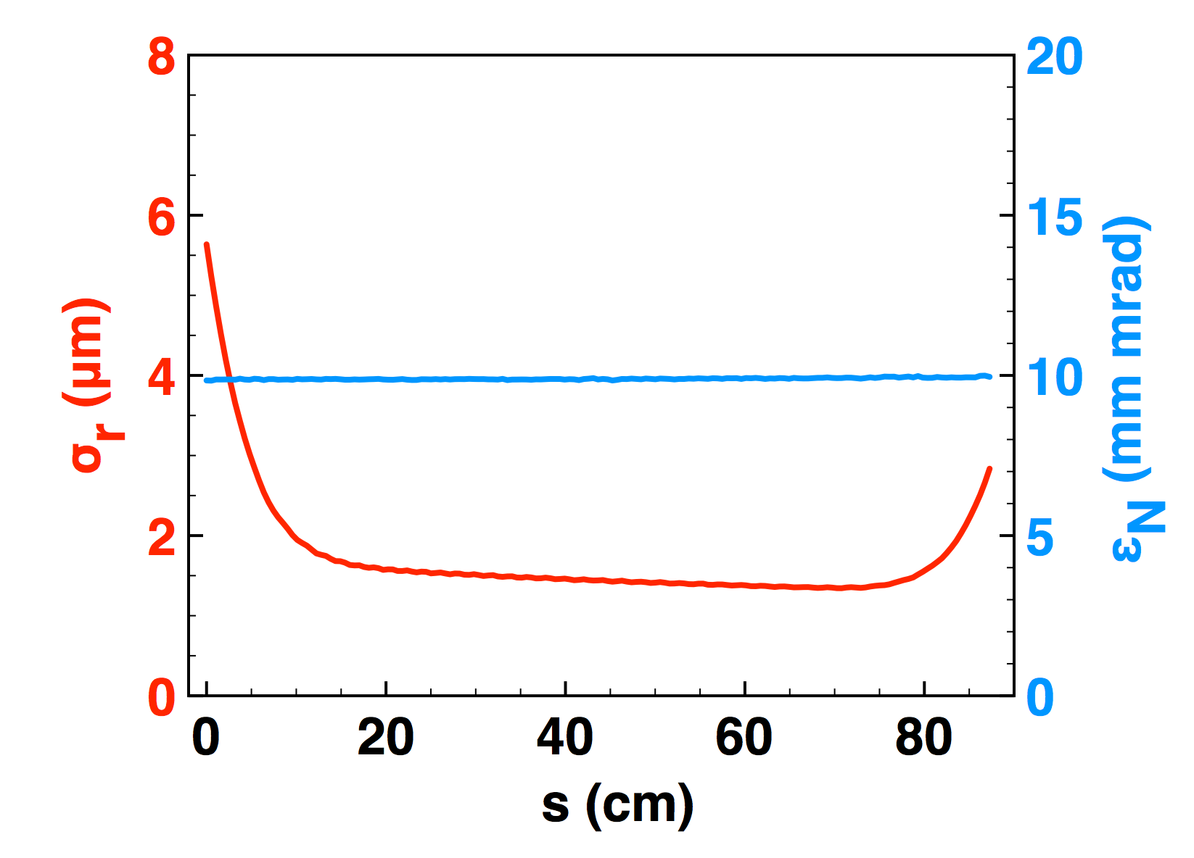
Two-bunch PWFA
Energy Doubling (10-20+ GeV) with < 1% Energy Spread, Low Emittance preservation, Pump Depletion and > 40% energy transfer efficiency
Plasma and beam density
with on-axis Ez line out
Beam matching and
emittance preservation
Beam Energy
Energy Doubling
Drive Bunch
Drive
Bunch
Trailing Bunch
Trailing
Bunch
SLAC Linac can not provide micron-level transverse emittance bunches, :produce our own
Simulations by W. An UCLA, .Joshi et al. PPCF 2018

Slide 5
We have characterized and demonstrated use of a~2 m long hydrogen plasma

Slide 6
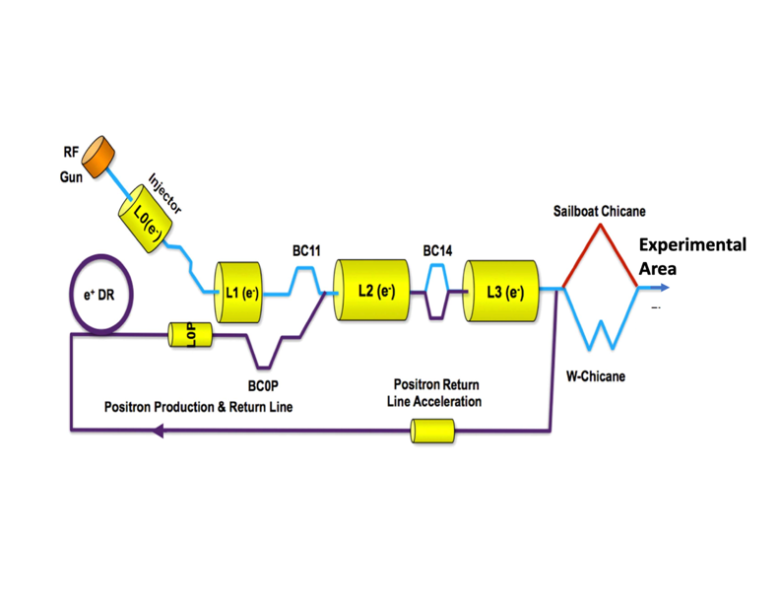
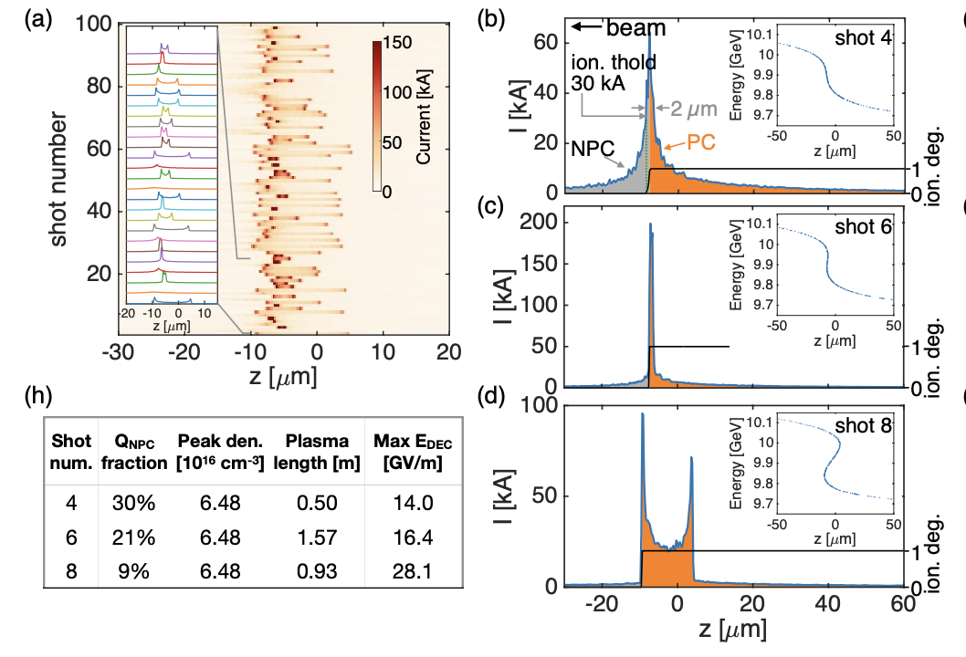
0.5-degree amplitude and phase fluctuations in RF
100 Beamline simulations of the FACET II Linac and the W
compressor shows gross variations of beam current profiles
because of amplitude and Phase variation of RF .
This did not matter when we used Li vapor to produce plasma Li (IP 6 eV)
With hydrogen (IP >13 eV need Ipeak > 30 KA to ionize H atoms)
Also the length of the fully ionized plasma produced depends on peak current

Slide 7
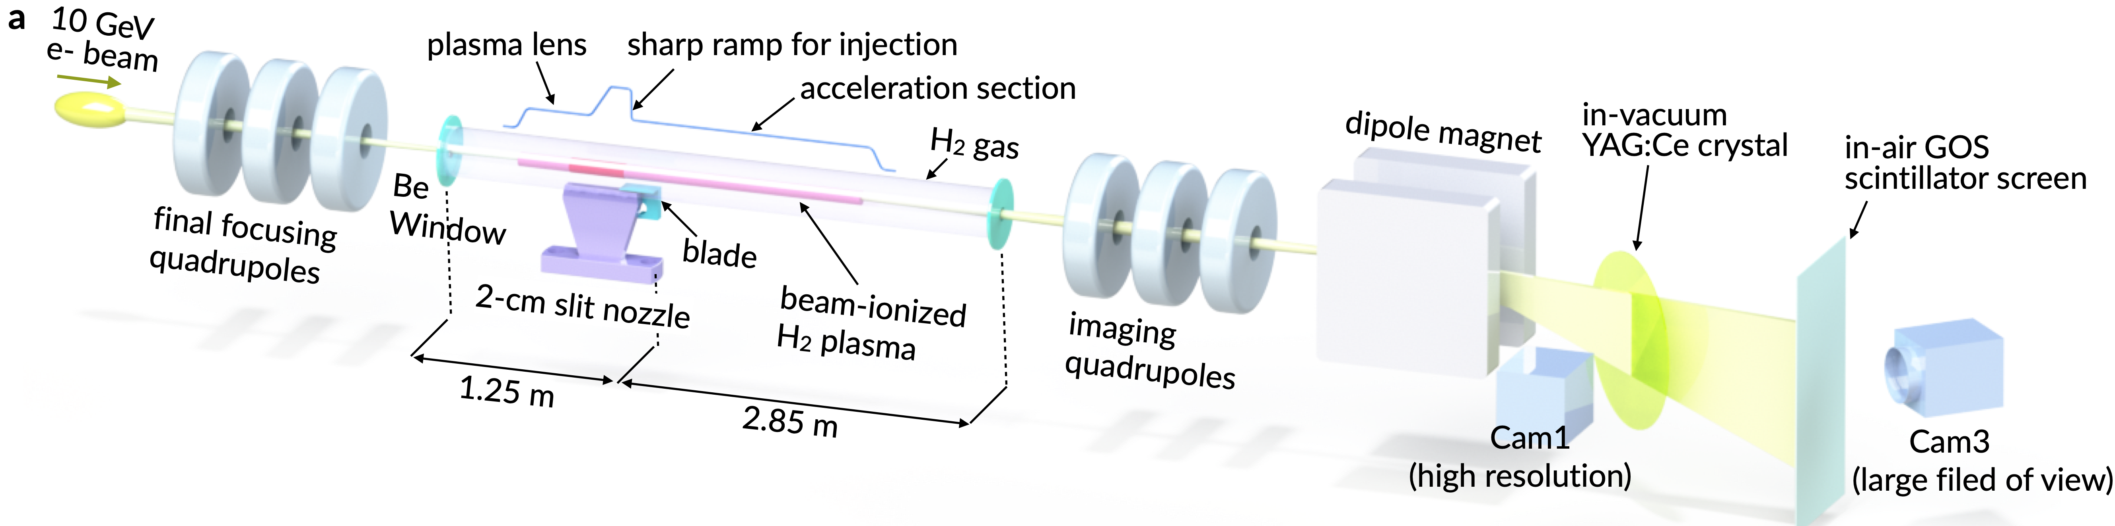
Experimental Set-up
(3-stage hydrogen source that enabled plasma formation thru plasma focusing
downramp injection, self-matching into a meter scale wake without emittance blowup )
Slowly flowing H gas between two Be foils 4.1 m apart with 0.5 mm holes for differential pumping
2 cm long hydrogen gas jet after 1.25 m of lower density (6x 10¹⁶ cm-³) gas region
Insertable gas jet that produces a variable scale-length
downramp, peak density 1-2x10¹⁷ cm⁻³
Downramp followed by a second 2.85m long low density (6x 10¹⁶ cm-³) H region

Slide 8
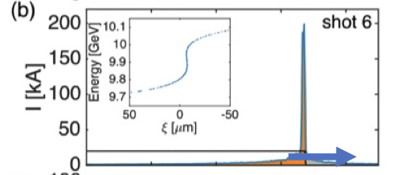
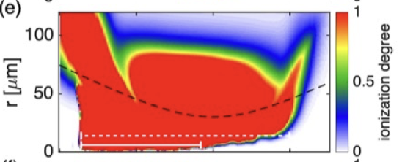
Three Stage (region) plasma source
3D PIC CODE SIMULATIONS OF FIELD IONIZATION OF H SHOWING
PLASMA LENSING SHIFT OF THE
PLASMA BACKWARD TOWARDS
FIRST BE FOIL, I_{peak} = `100 kA
Ref. C. Zhang et.al., PPCF , 66,025013 (2024)
Vaccum Focus
$β$*=50 cm
Blade
Longitudinal Current
profile of the drive
Beam, about 1-5% of
shots so at 5 Hz,1
data point per 4-20
seconds
Vacuum Focus
0.5 m
1.7 m
Region 1
Plasma Lens
Region2
Down
ramo
Region 3
Acceleration
of matched
beam
PUMP Depletion
Length

Slide 9
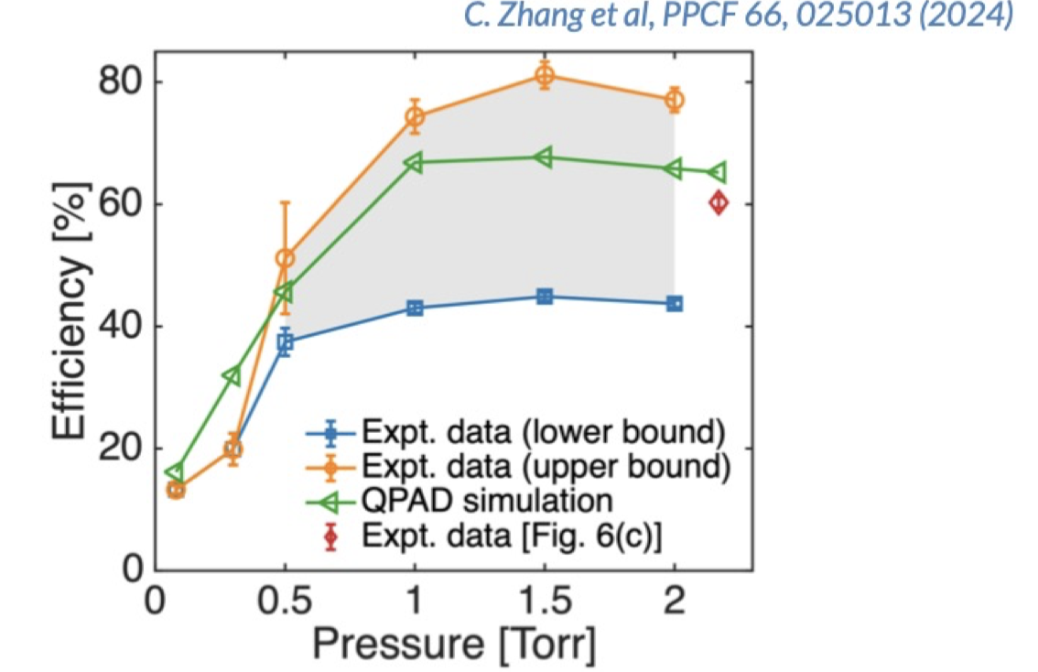
Energy Transfer Efficiency from the Drive Bunch to the Wake
60% $≤ η$

Slide 10
3D PIC CODE SIMULATIONS OF FIELD IONIZATION OF H SHOWING
PLASMA LENSING SHIFT OF THE
PLASMA BACKWARD TOWARDS
FIRST BE FOIL, I_{peak} = 100 kA
Three Stage (region) plasma source
at Z=0
Ref. C. Zhang et.al., PPCF , 66,025013 (2024)
Vaccum Focus
$β$*=50 cm
Longitudinal Current
profile of the drive
beam
Vacuum Focus
0.5 m
1.7 m
Region 1
Plasma Lens
Region2
Down
ramo
Region 3
Acceleration
of matched
beam
PUMP Depletion
Length

Slide 11
3D PIC CODE SIMULATIONS OF FIELD IONIZATION OF H SHOWING
PLASMA LENSING SHIFT OF THE
PLASMA BACKWARD TOWARDS
FIRST BE FOIL, I_{peak} = 100 kA
Three Stage (region) plasma source
at Z = +25 cm
Ref. C. Zhang et.al., PPCF , 66,025013 (2024)
Vaccum Focus
$β$*=50 cm
Longitudinal Current
profile of the drive
beam
Vacuum Focus
0.5 m
1.7 m
Region 1
Plasma Lens
Region2
Down
ramo
Region 3
Acceleration
of matched
beam
PUMP Depletion
Length

Slide 12
3D PIC CODE SIMULATIONS OF FIELD IONIZATION OF H SHOWING
PLASMA LENSING SHIFT OF THE
PLASMA BACKWARD TOWARDS
FIRST BE FOIL, I_{peak} = 100 kA
Three Stage (region) plasma source
at Z = +50 cm
Ref. C. Zhang et.al., PPCF , 66,025013 (2024)
Vaccum Focus
$β$*=50 cm
Longitudinal Current
profile of the drive
beam
Vacuum Focus
0.5 m
1.7 m
Region 1
Plasma Lens
Region2
Down
ramo
Region 3
Acceleration
of matched
beam
PUMP Depletion
Length

Slide 13
3D PIC CODE SIMULATIONS OF FIELD IONIZATION OF H SHOWING
PLASMA LENSING SHIFT OF THE
PLASMA BACKWARD TOWARDS
FIRST BE FOIL, I_{peak} = 100 kA
Three Stage (region) plasma source
at Z = +75 cm
Ref. C. Zhang et.al., PPCF , 66,025013 (2024)
Vaccum Focus
$β$*=50 cm
Longitudinal Current
profile of the drive
beam
Vacuum Focus
0.5 m
1.7 m
Region 1
Plasma Lens
Region2
Down
ramo
Region 3
Acceleration
of matched
beam
PUMP Depletion
Length

Slide 14
3D PIC CODE SIMULATIONS OF FIELD IONIZATION OF H SHOWING
PLASMA LENSING SHIFT OF THE
PLASMA BACKWARD TOWARDS
FIRST BE FOIL, I_{peak} = 100 kA
Three Stage (region) plasma source
at Z = +100 cm
Ref. C. Zhang et.al., PPCF , 66,025013 (2024)
Vaccum Focus
$β$*=50 cm
Longitudinal Current
profile of the drive
beam
Vacuum Focus
0.5 m
1.7 m
Region 1
Plasma Lens
Region2
Down
ramo
Region 3
Acceleration
of matched
beam
PUMP Depletion
Length

Slide 15
What about voltage transformer ratio?
If the wake is non-evolving the energy transformer ratio = voltage transformer ratio
BUT with a 10 GeV drive bunch , that pump depletes this may not be the case
Also the beam ionized plasma develops a hole on axis as the current drops
-> partial energy gain in a hollow channel
Experimentally: average decelerating gradient from envelope modulation diagnostic
10 GeV/ 1.7 m= 5.8 GeV/m
Experimentally we know that the acceleration gradient is 12.3 GeV
So the voltage transformer rato is 12.3/5.8=2.1 in excellent agreement with E-TR

Slide 16
Many Collaborators over the years My apologies if I have forgotten anyone. Truism: A team that has diverse expertise, bright young people eager to make their mark and good leadership is essential to success.
J. M. Dawson, F.F. Chen, Tudor Johnston, Bob Bingham, C. Clayton, T. Katsouleas, W. Mori , K. Marsh, V. Malka, S. Tochitsky, D.Froula
P. Kaw, L. Silva, S. Martins, R. Fonseca, F. Fiuza, N. Lemos, F. Tsung , P. Muggli
Bucker Dangor,, Zulfikar Najmudin
Yoniyoshi Kitagawa, Bob Siemann, Mark Hogan, Vitaly Yakimenklo, C. Clarke
R.Assmann, Sebastien Corde, Erik Adli, Mike Litos, Spencer Gessner, C. Zhang (Lead on this work), D.Storey, C. Emma R. Arniello
Felicie Albert, Dustin Froula, Brad Pollock,, Yang Wan, Yiping Wu, Bo Gu , Jianfei Hua, Nie Zan, F. Li
J. Wang, C.H. Pai, C.K. Huang
Miaomiao Zu, Picheng Yu, Thamine Dalichaaouch, Weiming An, Xinlu Xu
All my former students: C. Darrow, D. Umstadter, W. Leemans, D. Gordon, A. Pak, J. Shaw, C. Filip, B. Blue, S. Wang, N. Najafabadi, J. Ralph, R. Narang & others

Slide 17
Next Challenges
1) E-TR of up to 2.6 but weakly loaded wake.
Need to increase loaded charge from 20-30pc to 200 pC
2) Use machine learning tools to improve the reliability
3) Measure slice emittance
4) Compress the chirped pulse to get a single attosecond pulse with
> 100kA peak current
5) Send this compressed pulse through a chicane to get an attosecond
X-ray pulse

