Slide 1
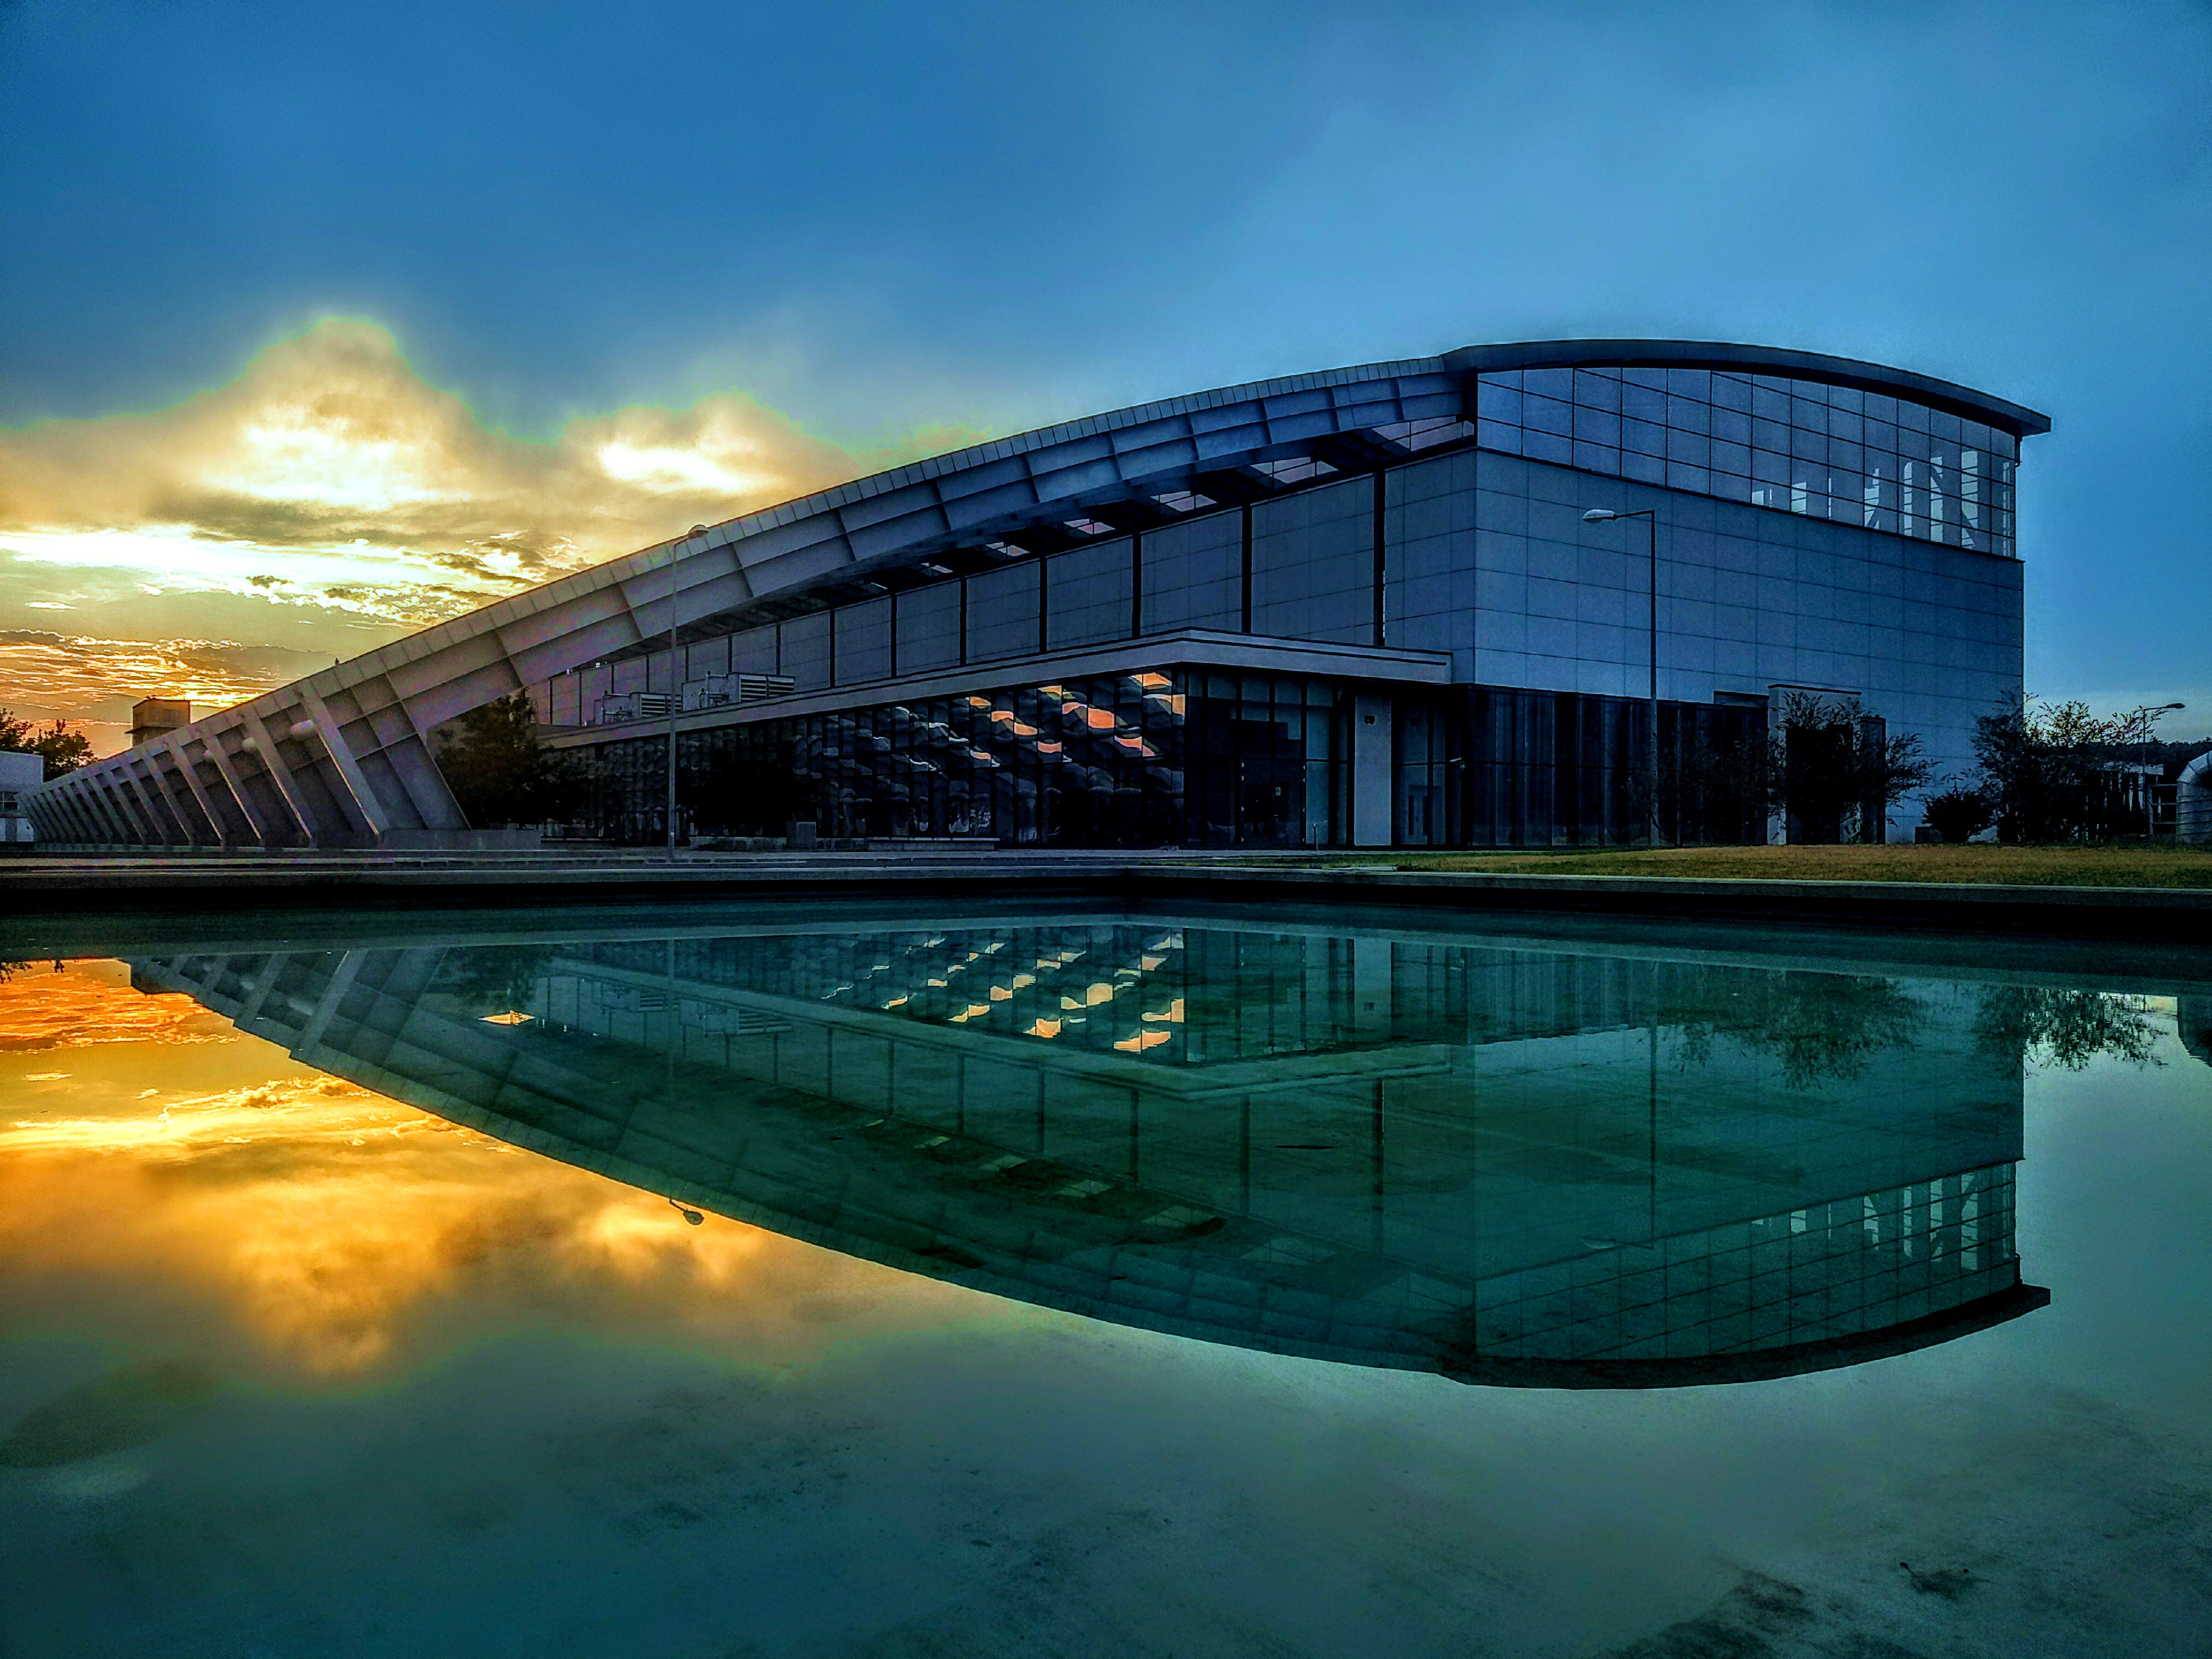

ELI NP status and challenges
for the LPAW community
Victor Malka
ELI-NP, Magurele, Romania
Weizmann Institute of Science, Rehovot, Israel
LPAW, Ischia Island (Naples, Italy), April 14-18 (2025)

Slide 2
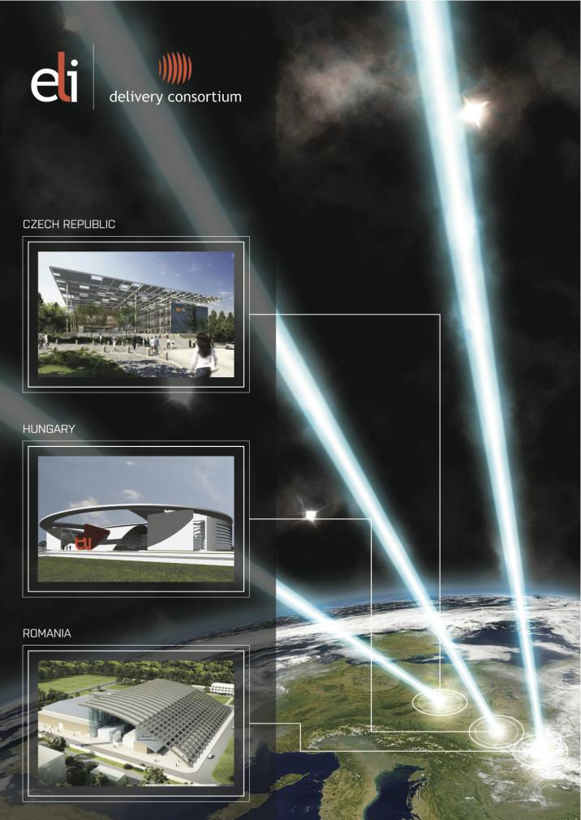
Extreme Light Infrastructure
Attosecond Light Pulse Source, offering unique time-resolved investigation possibilities for both nonrelativistic and relativistic interaction of light with all the four states of matter” (ELI ALPS, Szeged, HU)
High-Energy Beamlines Facility, developing and applying short pulses of ultra-intense radiation to explore extreme conditions or produce high-energy particles and radiation
(ELI Beamlines, Prague, CZ)
Nuclear Physics Facility with ultra-intense lasers and brilliant gamma beams to produce and explore new nuclear states or generate neutron beams (ELI NP, Magurele, RO)
LPAW, Ischia Island (Naples, Italy), April 14-18 (2025)

Slide 3
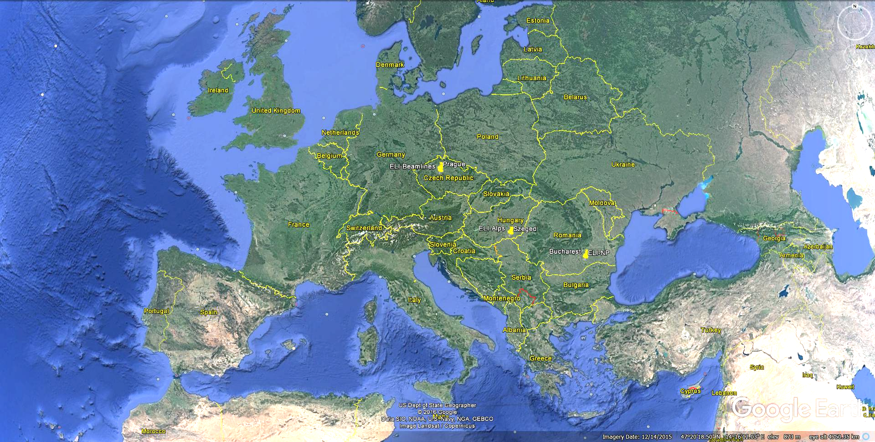
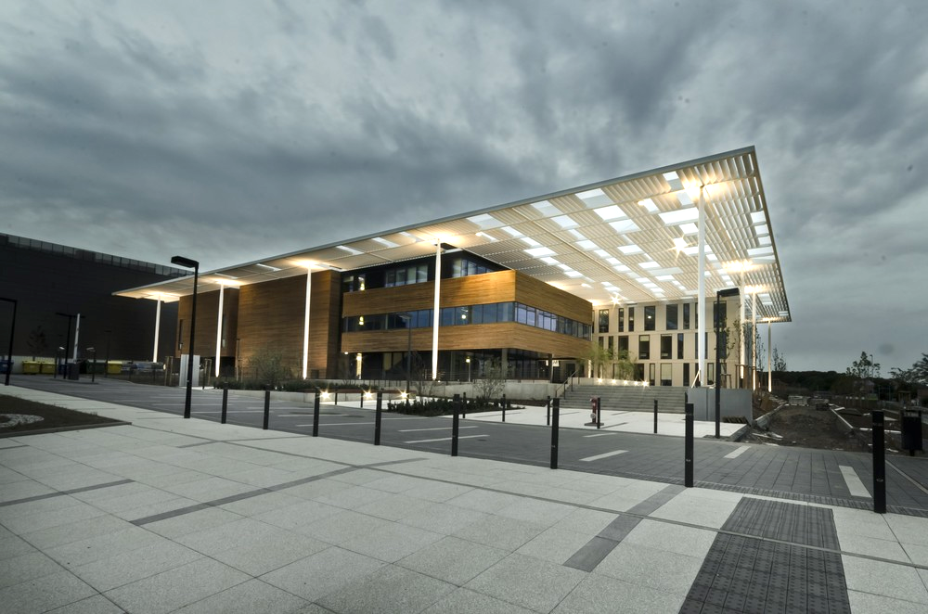

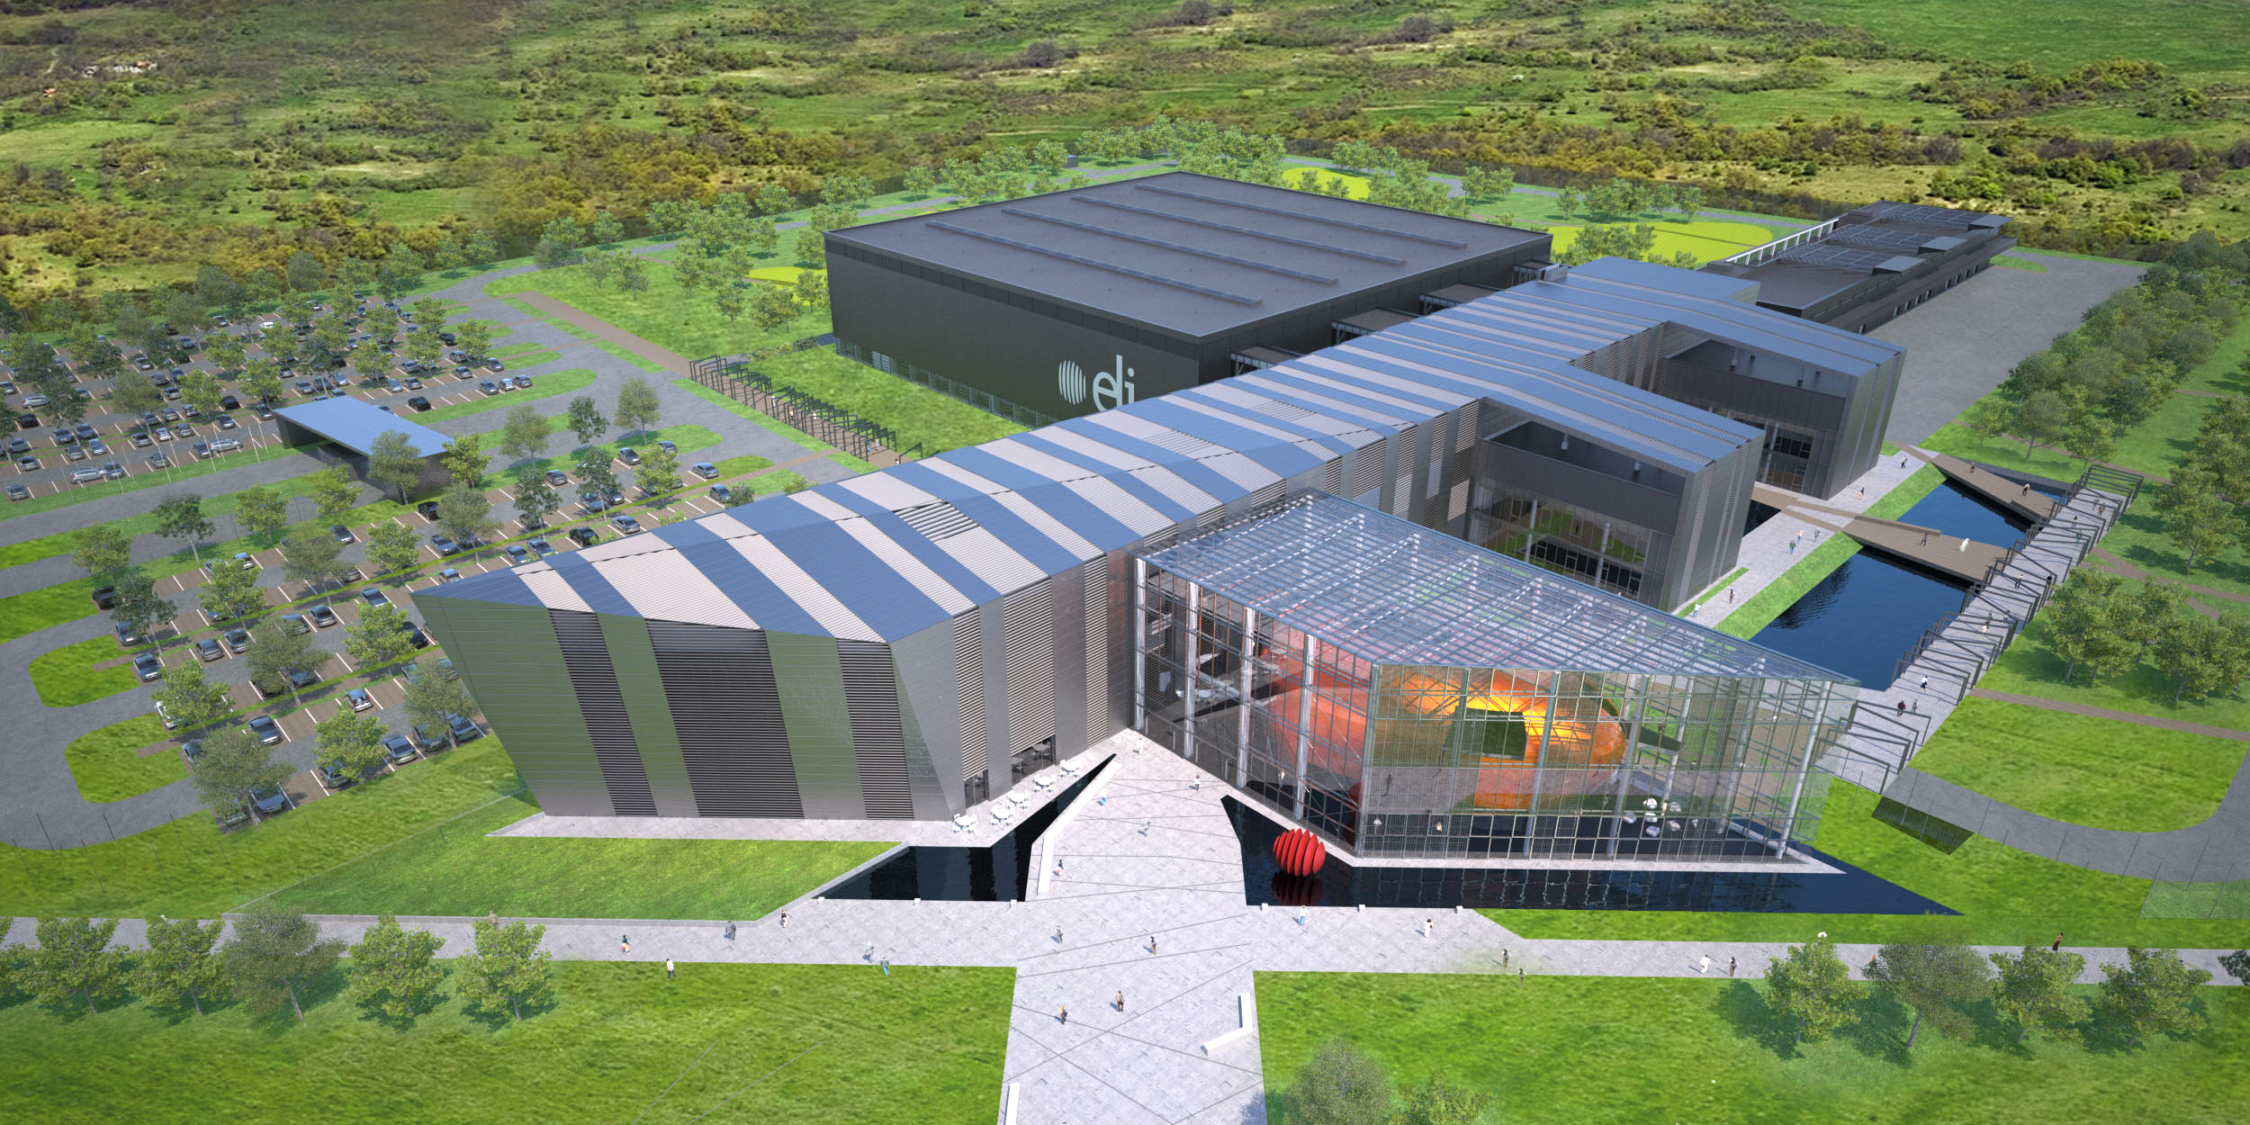
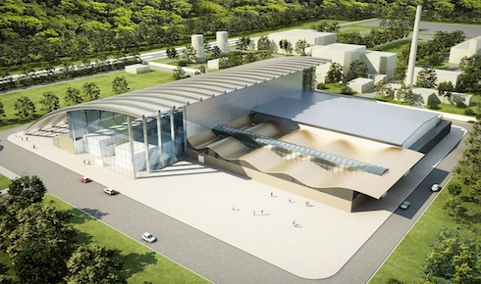


Extreme Light Infrastructure: The laser road
ELI Beamlines
ELI ALPS
ELI-NP
LPAW, Ischia Island (Naples, Italy), April 14-18 (2025)

Slide 4
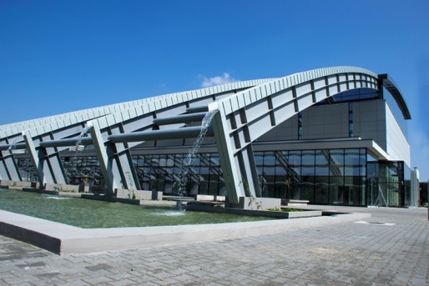
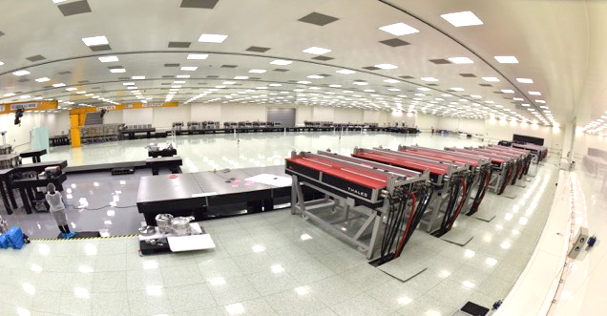
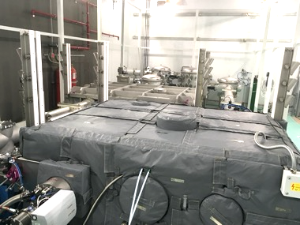
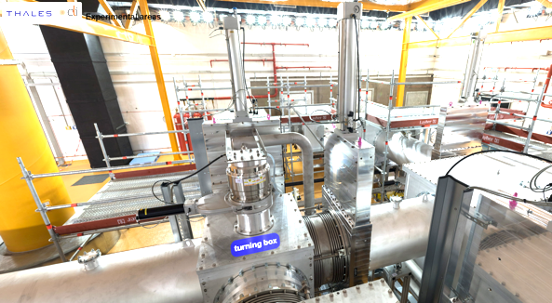
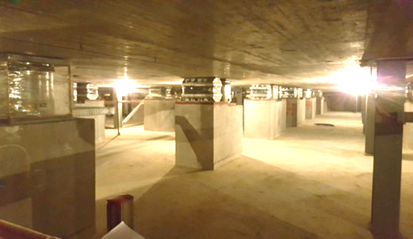
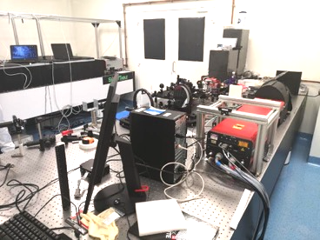
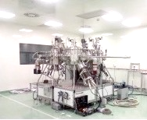
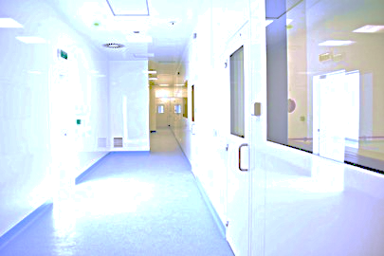
ELI-NP in a nutshell
Geothermal system
2 x 10 PW Laser System
Over 32.000 sqm of built area and 270.000 cubic meter of air to condition
9 Experimental areas
Laser Beam Transport System
120,000 tons antivibration platform
Laboratories and workshops
Clean rooms ISO6 - ISO7
LPAW, Ischia Island (Naples, Italy), April 14-18 (2025)

Slide 5
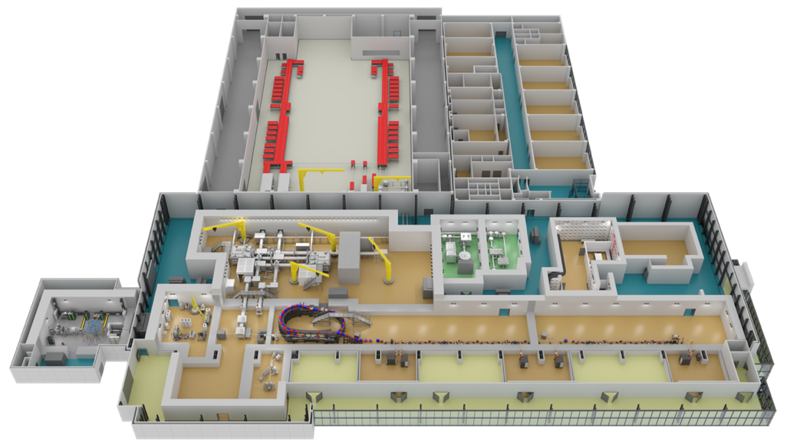
ELI-NP: Where do we stand today
Overall implementation status: more than 85%
Major Components:
High power laser system (HPLS) + Laser beam transport system (LBTS)
  100% – fully implemented and operational (2019 HPLS, 2020 LBTS)
Gamma beam system
  45% – completion delayed
Experimental setups and laboratories
  100% – fully implemented and operatonal
Civil constructions
  100% – fully implemented and operational (since 2016)
2 x 10 PW High Power Laser System
Laboratories and Workshops
Laser Beam Transport System
Experimental Rooms
Gamma Beam System
LPAW, Ischia Island (Naples, Italy), April 14-18 (2025)

Slide 6
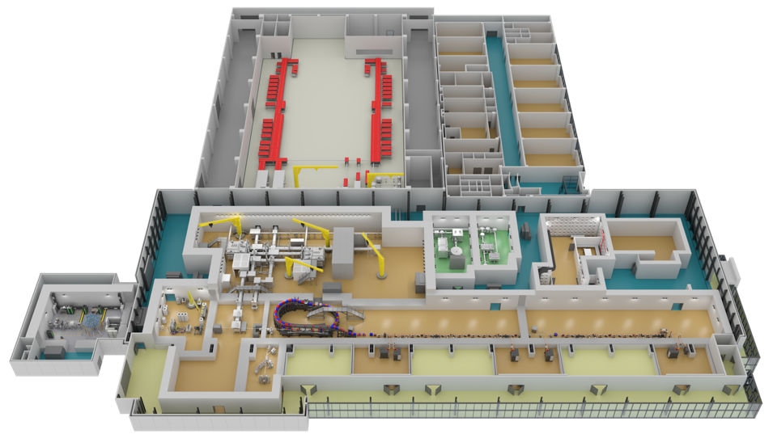
Combined Experimental Areas
E1: 10 PW @ 1/min
High Field Physics
Laser driven
Nuclear Physics
E5: 1 PW @ 1 Hz
E6: 10 PW @ 1/min
High Field QED
E4: 0.1PW@10 Hz
Photon-photon int., LWFA, betatron
E8 & E9: 𝛾 beams
Photonuclear Reactions
E3: X rays
Test/develop instrumentation and technology
E7: 10 PW + 1 PW + 𝛾/e–
High Field QED
ERA: positrons Material Studies
LPAW, Ischia Island (Naples, Italy), April 14-18 (2025)

Slide 7
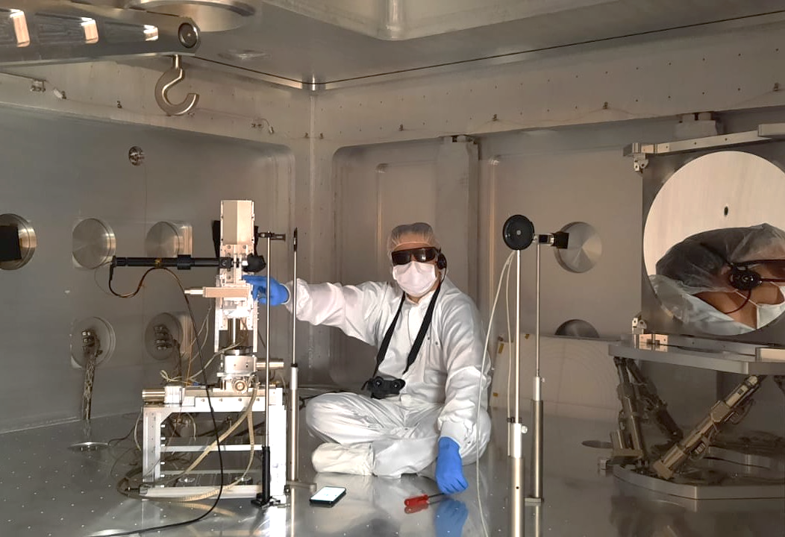
High Power Laser System operation
2021 – Delivered beam time – Total of 36 weeks
  16 weeks @ 100 TW output
  20 weeks @ 1 PW output
First tests at 10 PW show focal spot below 3 µm
⟹ ≲ 10²³ W/cm²
April 13th 2023 – a landmark in the history of plasma physics
  the most powerful laser system in the world, at ELI–NP, has focused for the first time in the world 10 PW laser pulses on solid targets marking an important milestone in laser plasma physics
2022 – Delivered beam time – Total of 59 weeks
  20 weeks @ 100 TW output
  28 weeks @ 1 PW output
  11 weeks @ 10 PW output
Inside E1 10 PW interaction chamber
2023 – Delivered beam time – Total of 52 weeks
  7.5 weeks @ 100 TW output
  20 weeks @ 1 PW output
  24.5 weeks @ 10 PW output
Microscope
objective
Parabola
Commissioning experiments
  Experiments approved by ELI-NP ISAB
  Performed with expert users from Italy, Germany, Czech Republic, Israel, Japan, UK, US,
LPAW, Ischia Island (Naples, Italy), April 14-18 (2025)

Slide 8
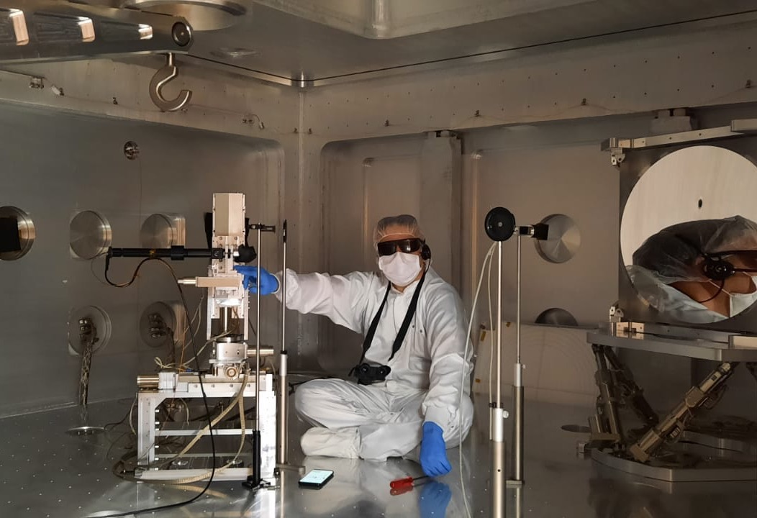
High Power Laser System operation
2021 – Delivered beam time – Total of 36 weeks
  16 weeks @ 100 TW output
  20 weeks @ 1 PW output
First tests at 10 PW show focal spot below 3 µm
⟹ ≲ 10²³ W/cm²
April 13th 2023 – a landmark in the history of plasma physics
  the most powerful laser system in the world, at ELI–NP, has focused for the first time in the world 10 PW laser pulses on solid targets marking an important milestone in laser plasma physics
2022 – Delivered beam time – Total of 59 weeks
  20 weeks @ 100 TW output
  28 weeks @ 1 PW output
  11 weeks @ 10 PW output
Inside E1 10 PW interaction chamber
2023 – Delivered beam time – Total of 52 weeks
  7.5 weeks @ 100 TW output
  20 weeks @ 1 PW output
  24.5 weeks @ 10 PW output
Microscope
objective
Parabola
Commissioning experiments
  Experiments approved by ELI-NP ISAB
  Performed with expert users from Italy, Germany, Israel, UK, US, Czech Republic, Japan
LPAW, Ischia Island (Naples, Italy), April 14-18 (2025)

Slide 9
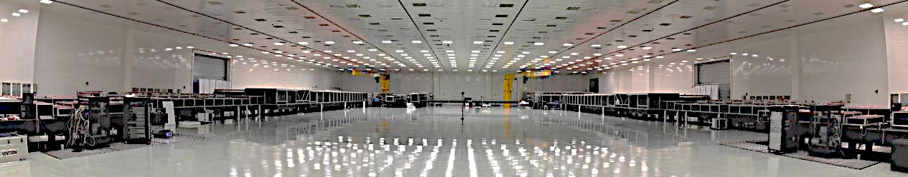
ELI-NP Infrastructure
Laser bay
ISO 7 cleanroom
Measured parameters of HPLS
Output type | 100 TW | 1 PW | 10 PW
Pulse energy (J) | 2.7 | 25 | 242
Pulse duration (fs) | < 25 | < 24 | <23
Repetition rate (Hz) | 10 | 1 | 1/60
Calculated Strehl ratio from measured wavefront | > 0.9 | > 0.9 | > 0.9
Pointing stability (µrad RMS) | < 3.4 | < 1.78 | < 1.27
Pulse energy stability (rms) | < 2.6 % | < 1.8 % | < 1.8 %
E4: 2x0.1PW, 10Hz, experiments
E5: 2x1PW, 1Hz experiments
Routine operation with the two laser arms in parallel
HPLS architecture
100TW compressor
1PW compressor
E1:
2x10PW, 1shot/min
Nuclear Physics exp.
Oscillator+
OPCPA + XPW
100TW amplifier
Ti:Sapphire
1PW amplifier
Ti:Sapphire
10PW amplifier
Ti:Sapphire
1PW block
Ti:Sapph
Flashlamp based
1PW block
Ti:Sapph
Flashlamp based
10PW compressor
L
B
T
S
10mJ@10Hz <20fs
2.5J@10Hz/ <25fs
25J@1Hz/ <25fs
220J@1shot/min
E6:
2x10PW, 1shot/min
QED experiments
100TW compressor
1PW compressor
Oscillator+
OPCPA + XPW
100TW amplifier
Ti:Sapphire
1PW amplifier
Ti:Sapphire
10PW amplifier
Ti:Sapphire
1PW block
Ti:Sapph
Flashlamp based
1PW block
Ti:Sapph
Flashlamp based
10PW compressor
E7:
Combined laser-gamma experiments
10mJ@10Hz <20fs
2.5J@10Hz/ <25fs
25J@1Hz/ <25fs
220J@1shot/min
LPAW, Ischia Island (Naples, Italy), April 14-18 (2025)

Slide 10
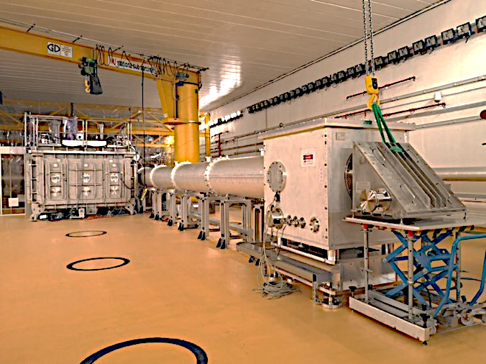
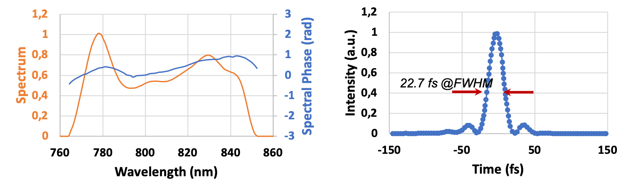
Most Powerful Laser in the World
Unique system in the world:
power, intensity, number of beams, versatility and flexibility
demonstrated power level 10 PW
combination of 2 high-power lasers
Laser peak power
Spectral characteristics
Time characteristics
LPAW, Ischia Island (Naples, Italy), April 14-18 (2025)

Slide 11

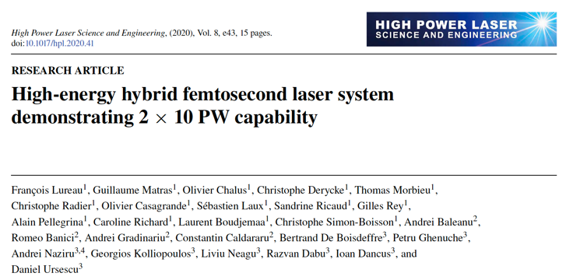
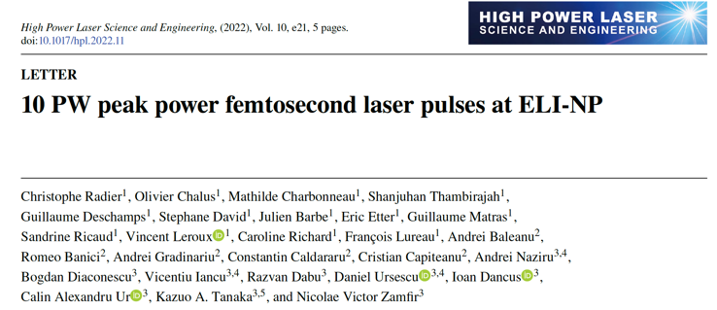
ELI–NP @ 10 PW
ELI-NP Romania
LFRC China
GIST S Korea
Inst Physics China
SIOM China
QST Japan
U Michigan USA
Berkeley USA
IAP, RAS Russia
Colorado S. U. USA
Ohio S U USA
LPAW, Ischia Island (Naples, Italy), April 14-18 (2025)

Slide 12
Transition Implementation ⇒ Operation: 2020-2023
Year
2021
2022
2023
2024
Experiments
Apr.
Jul.
Oct.
Jan.
Apr.
Jul.
Oct.
Jan.
Apr.
Jul.
Oct.
Jan.
Apr.
100 TW Comm. Exp. E4
2020
1 PW Commissioning Exp. E5 1 PW Commissioning Exp. E7
Mar.
10 PW Commissioning Exp. E1 10 PW Commissioning Exp. E6 Flagship Exp. (IMPULSE)
user 1 PW
user 10 PW
Commissioning experiments
user 100 TW
  100 TW (E4): 2022 Four-wave mixing in vacuum, in search of dark matter candidates
    X ray production through betatron emission
  1 PW (E5 - E7): 2022 - 2023 Benchmark TNSA proton acceleration
  Benchmark LWFA electron acceleration
    Optimization of high charge, stable electron acceleration
  10 PW solid target (E1): 2023 Demonstrate extreme focal intensity through laser‐γ conversion (“γ‐flash”)
    Demonstrate over 200 MeV proton acceleration (neutron generation add‐on)
    Dense heavy ion beams for nuclear physics
  10 PW gas target (E6): 2023 10 PW laser wakefield acceleration of multi GeV electron beams
LPAW, Ischia Island (Naples, Italy), April 14-18 (2025)

Slide 13
Recent development: ps Contrast improvement
Scientific collaboration with Marvel Fusion and Thales LAS France in the field of ICF
10¹
10⁰
10⁻¹
10⁻²
10⁻³
10⁻⁴
10⁻⁵
10⁻⁶
10⁻⁷
10⁻⁸
10⁻⁹
10⁻¹⁰
10⁻¹¹
10⁻¹²
10⁻¹³
contrast
Old Contrast
Improved Contrast
-60 -50 -40 -30 -20 -10 0 10
Time (ps)
LPAW, Ischia Island (Naples, Italy), April 14-18 (2025)

Slide 14
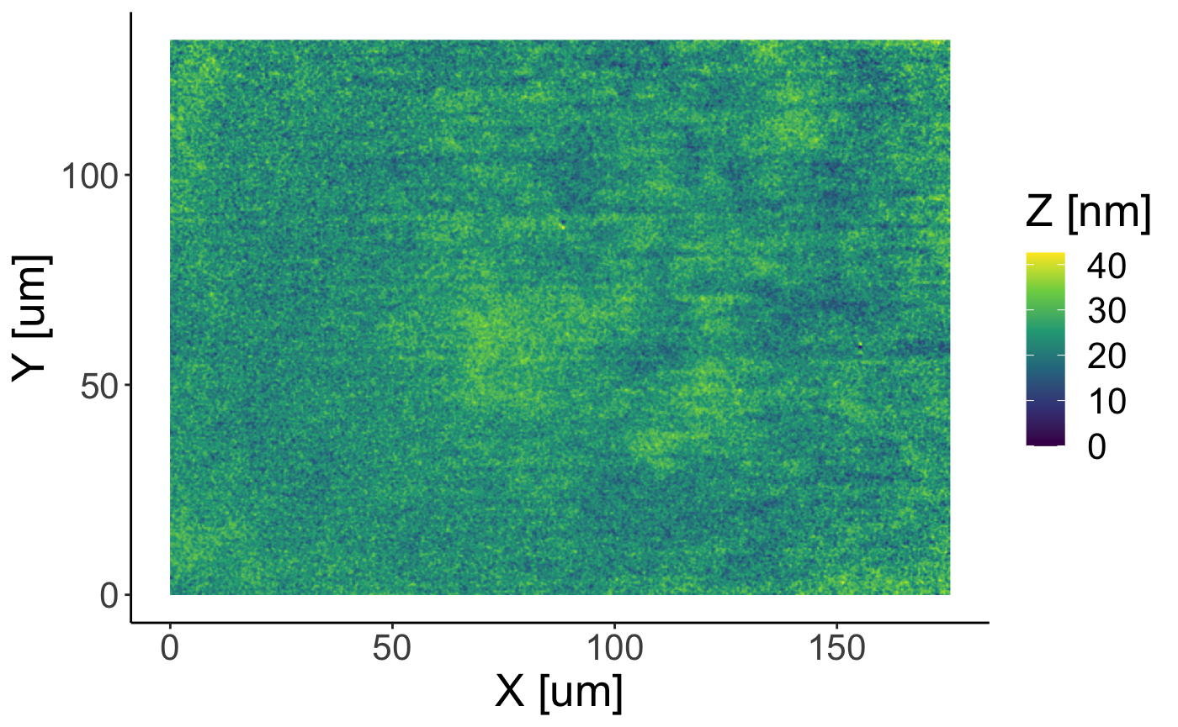
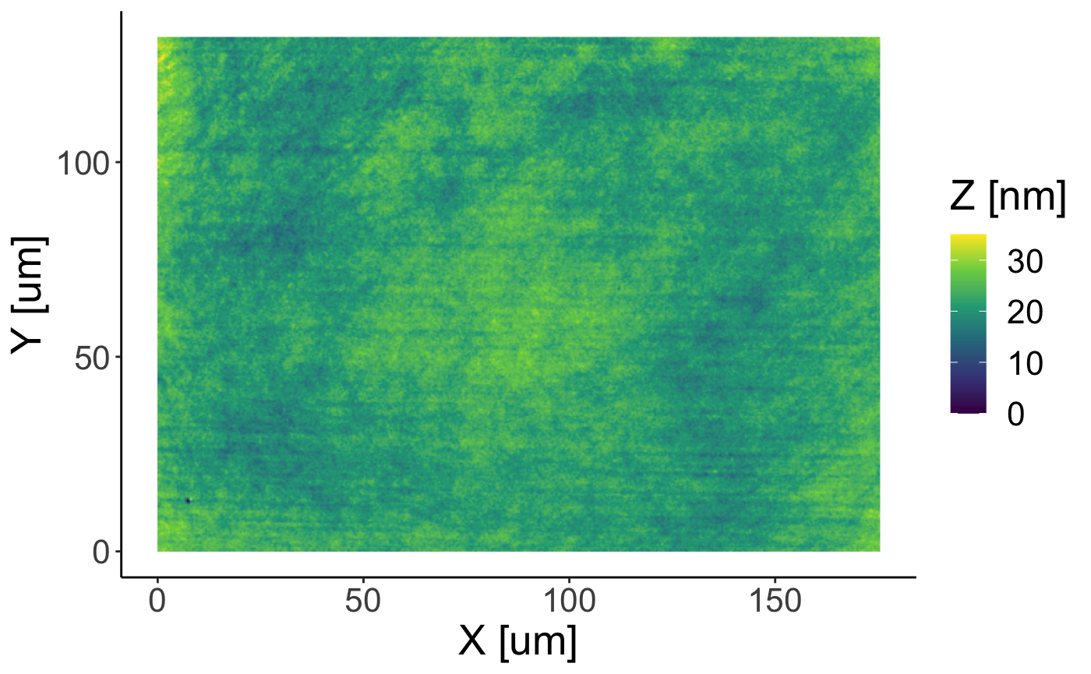
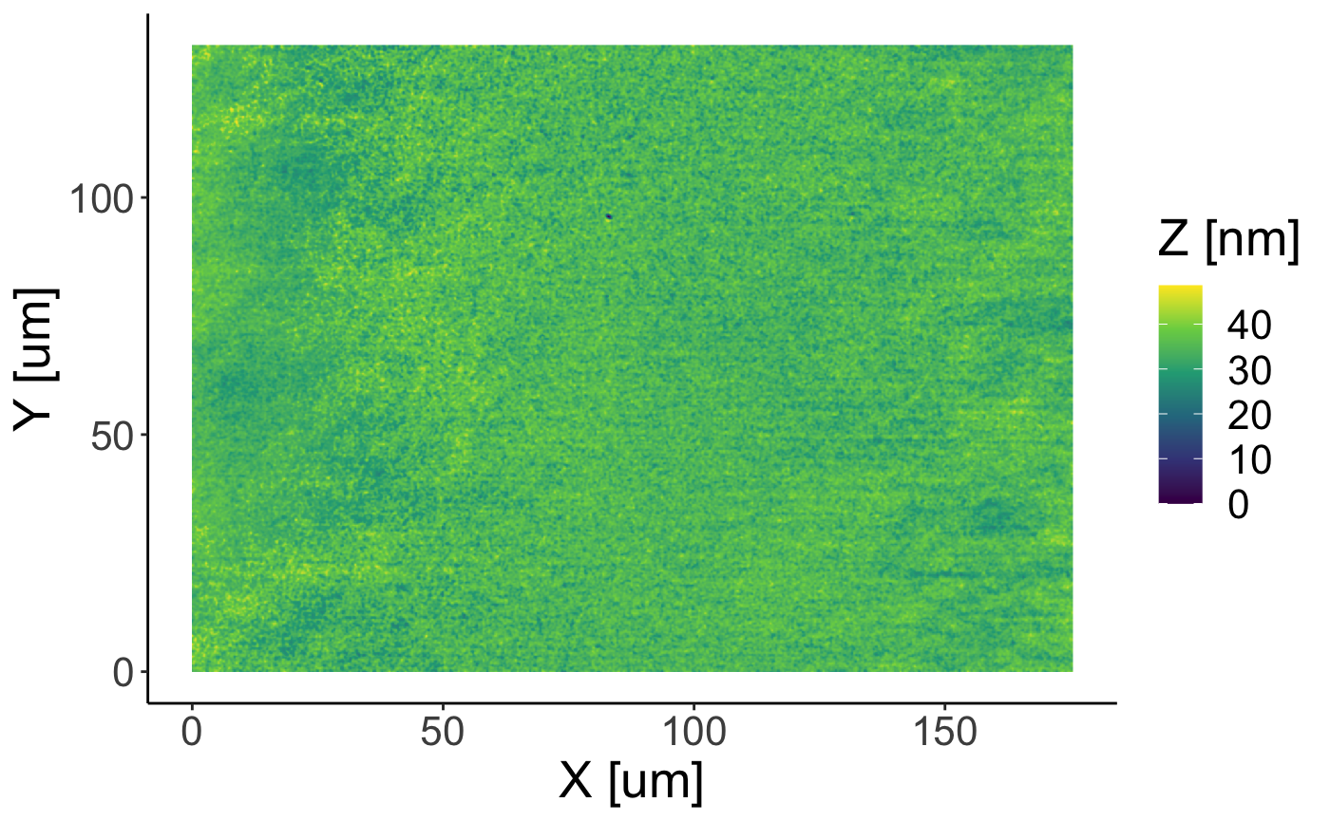
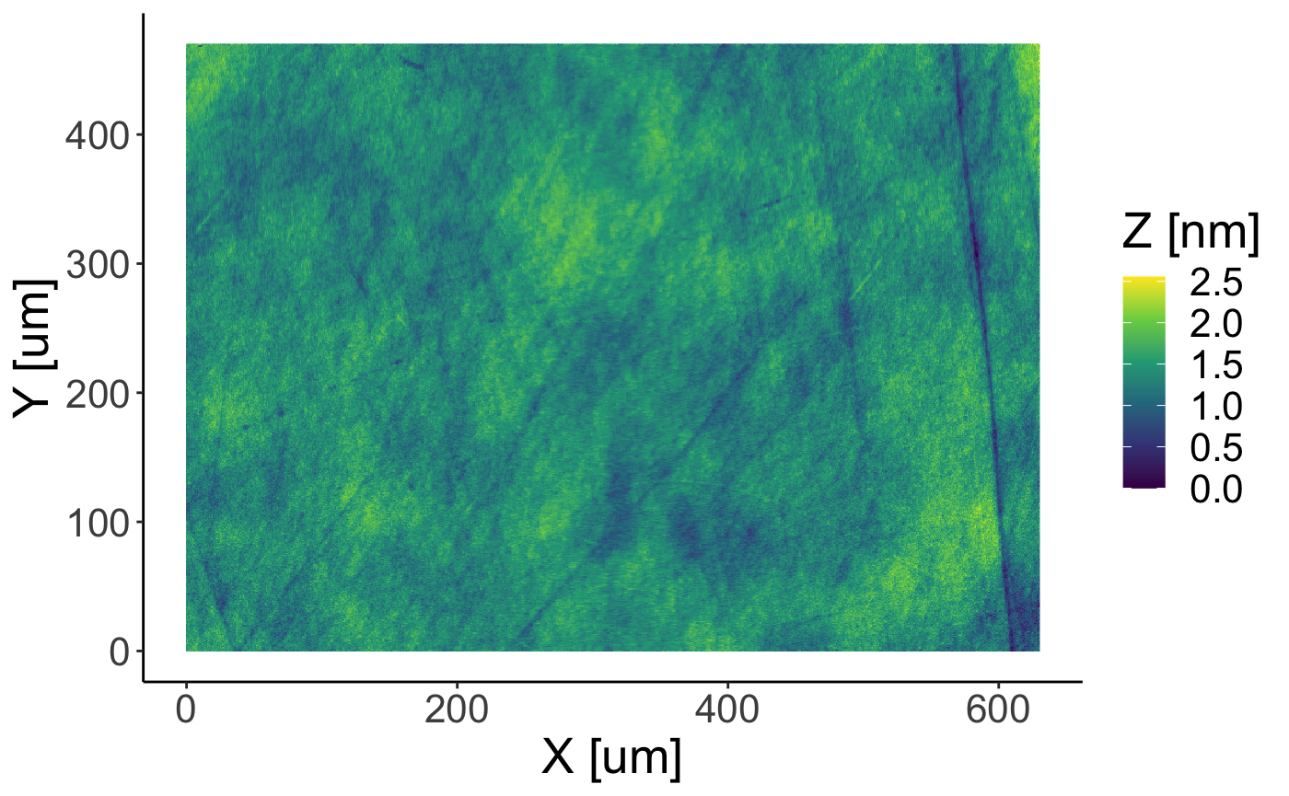
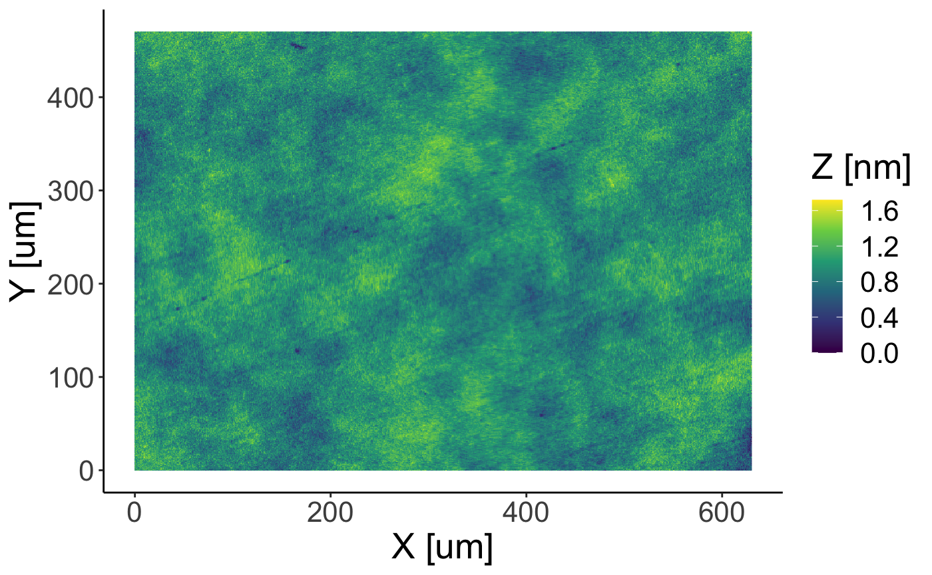
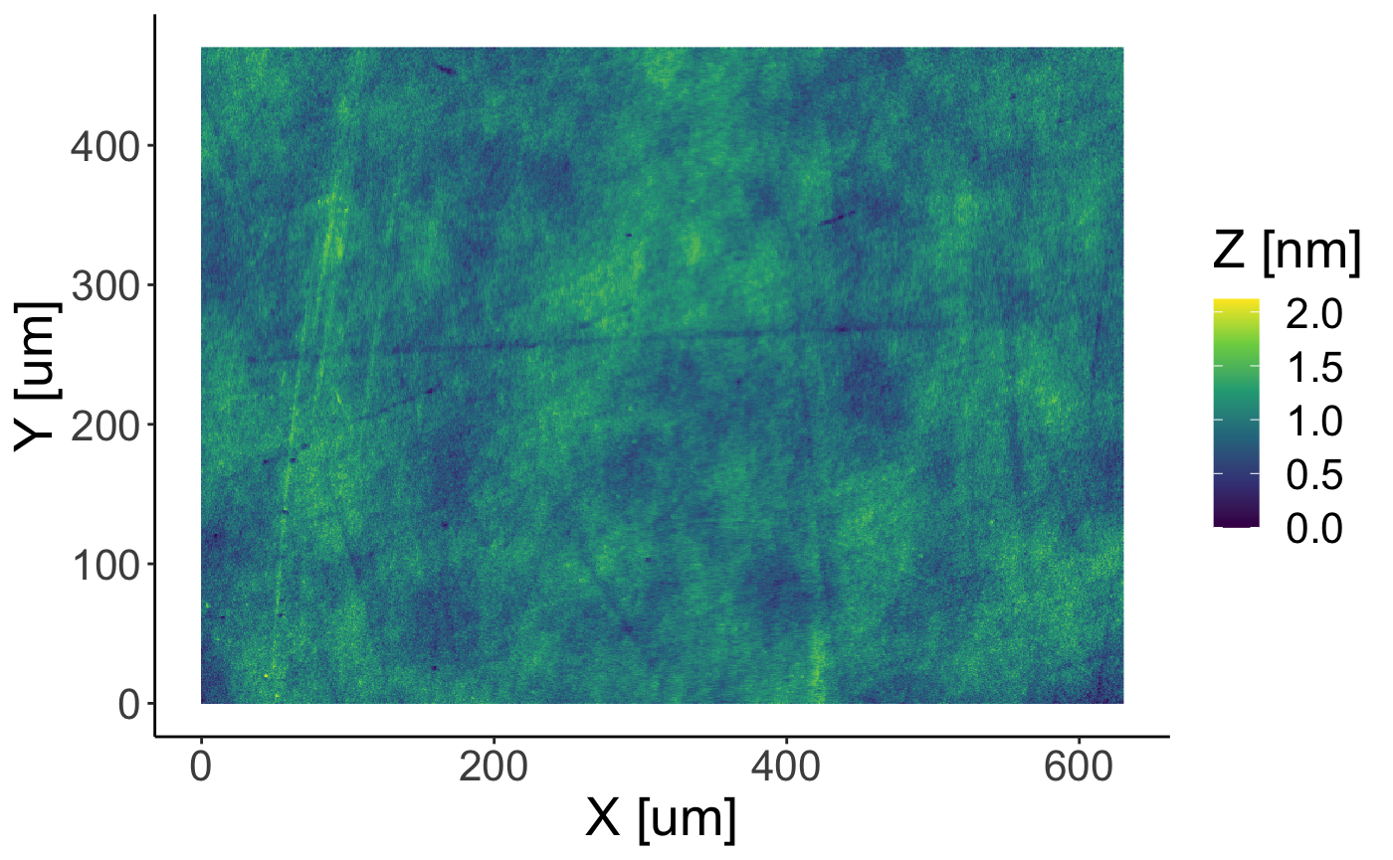
Recent development: Stretcher convex mirror
Old mirror – RMS roughness - 3.5 nm
New mirror – RMS roughness - 0.2 nm
LPAW, Ischia Island (Naples, Italy), April 14-18 (2025)

Slide 15
ns contrast on the 10 PW output
10¹
10⁰
10⁻¹
10⁻²
10⁻³
10⁻⁴
10⁻⁵
10⁻⁶
10⁻⁷
10⁻⁸
10⁻⁹
10⁻¹⁰
Previous Contrast
contrast
Improved Contrast
-70 -60 -50 -40 -30 -20 -10 0 10
Time (ns)
LPAW, Ischia Island (Naples, Italy), April 14-18 (2025)

Slide 16
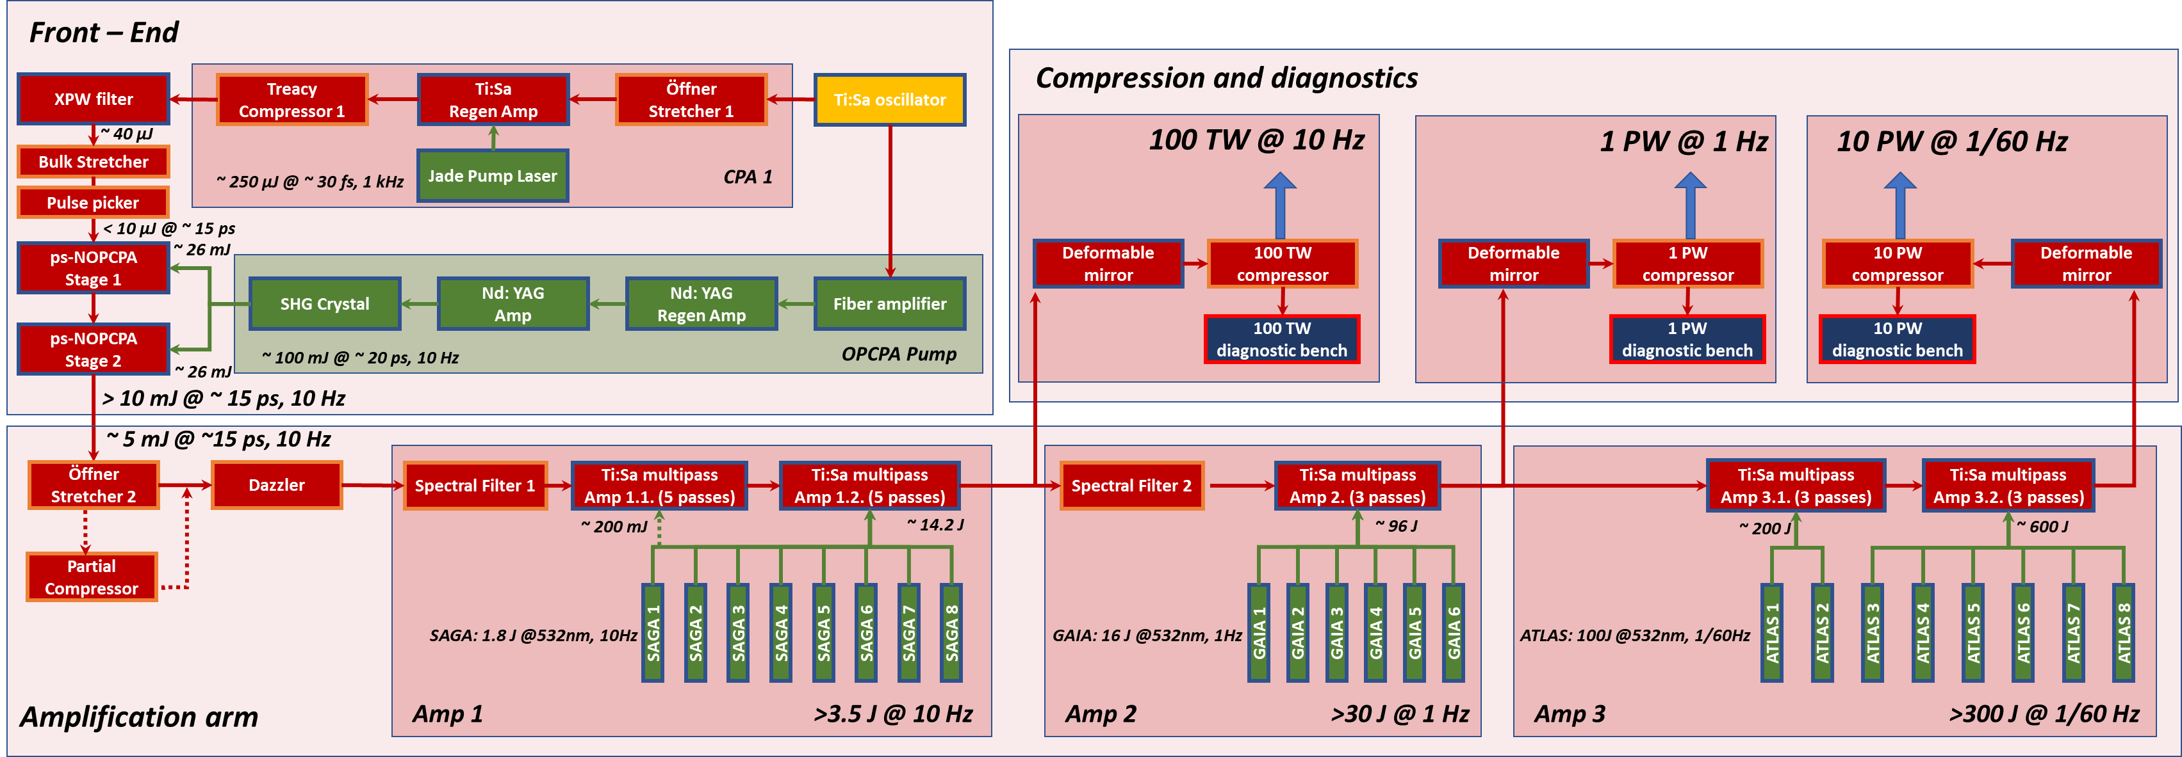
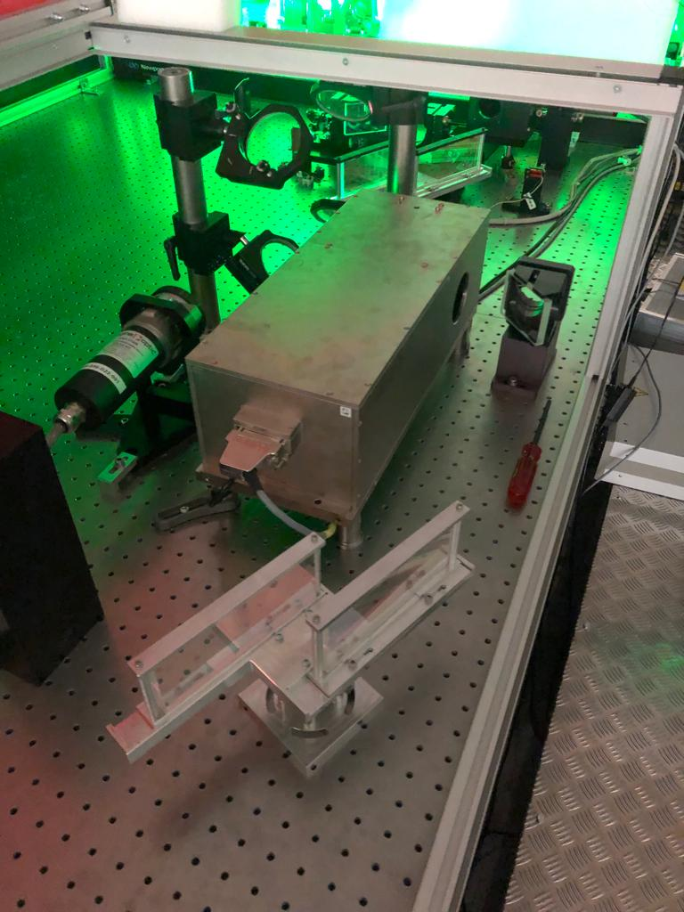
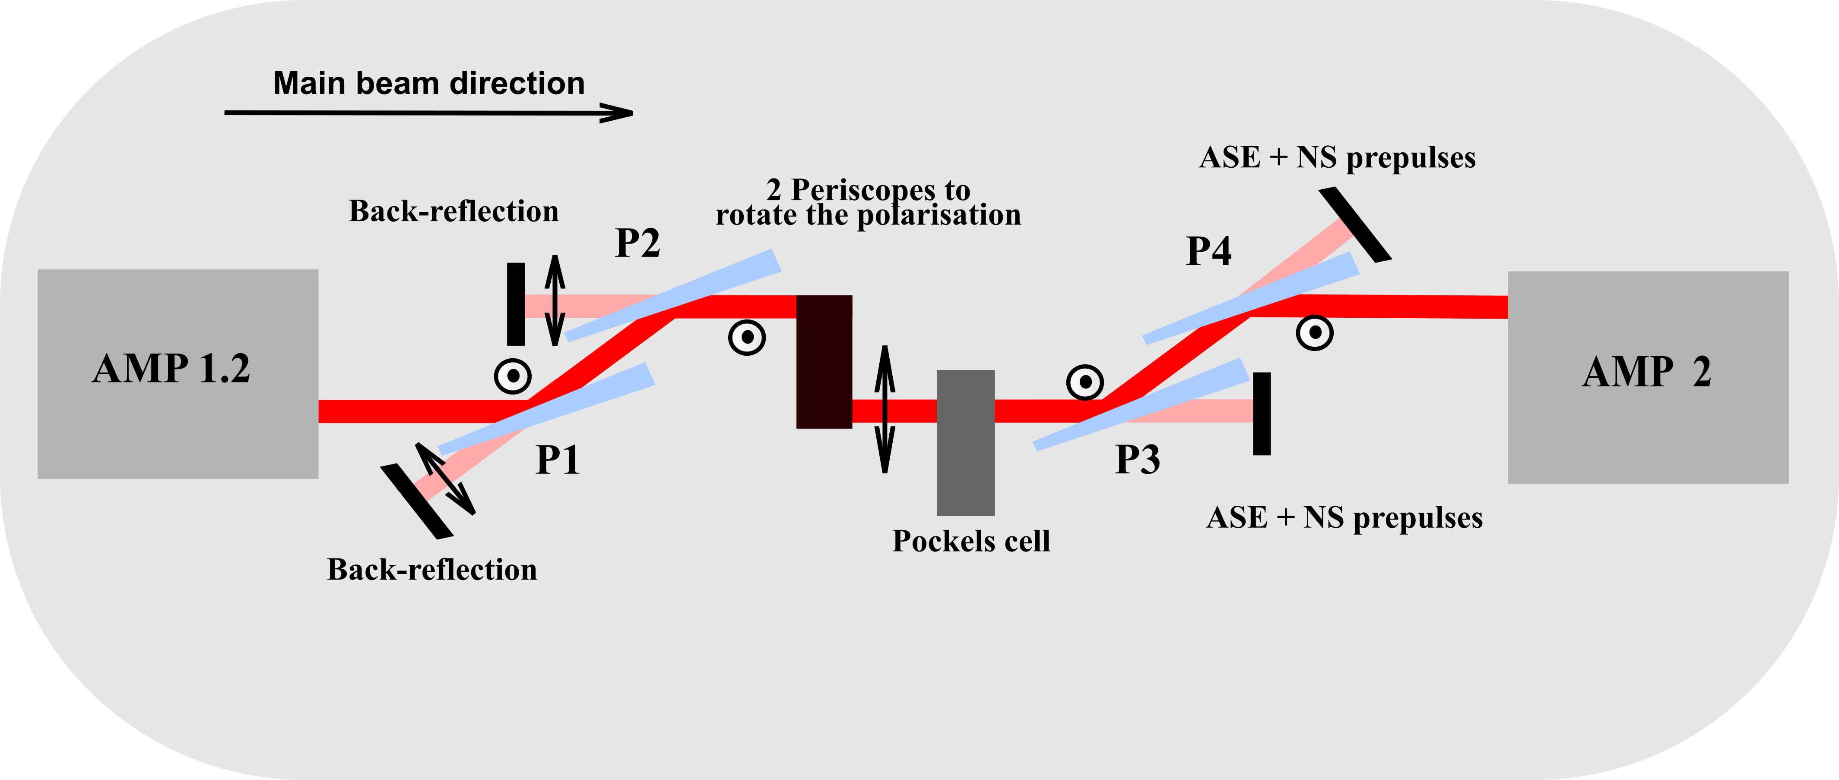
ns contrast improvement/ pockels cell
Pockels cell for back reflection protection used for ns contrast improvement
Pockels cell:
Leysop LTD
50mm aperture
98% Deuterated KD*P
P1, P2, P3, P4:
Polarizers
Laser Components
72° AOI
LPAW, Ischia Island (Naples, Italy), April 14-18 (2025)

Slide 17
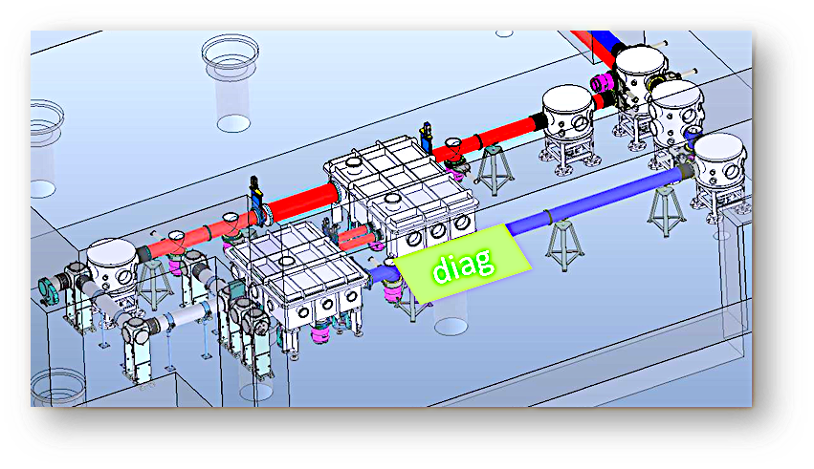
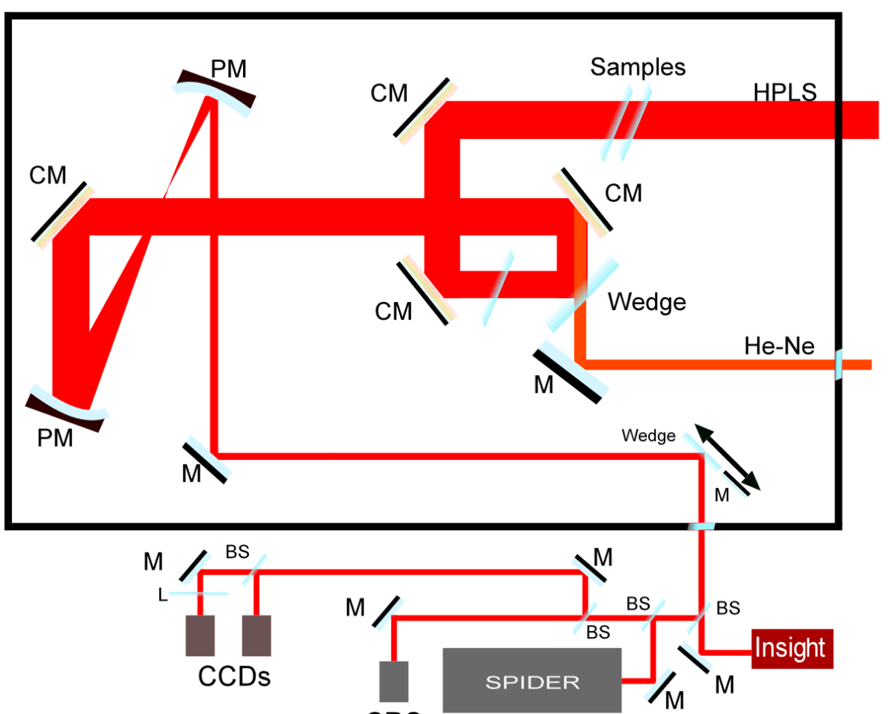
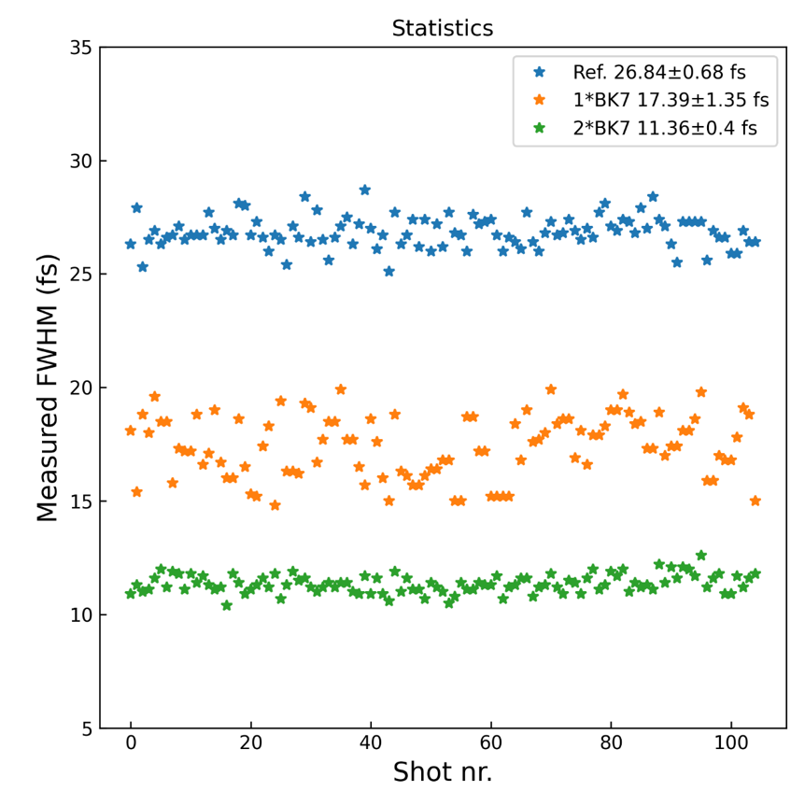
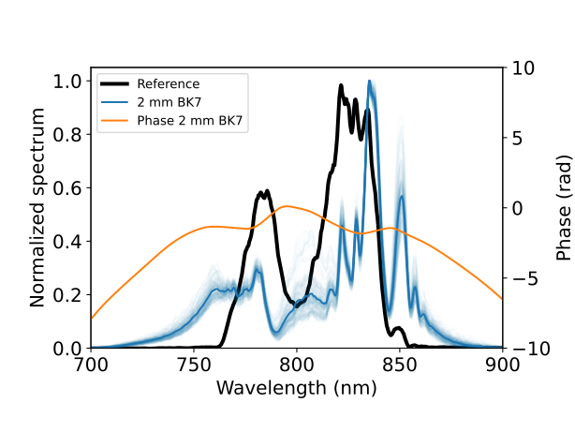
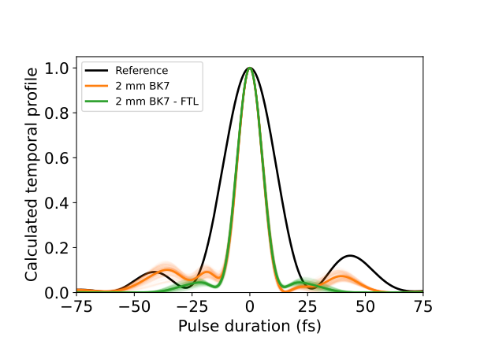
Recent development: 11 fs post-compression at 1 J
1J pulses post-compressed
@11.36 +/- 0.4 fs
Experimental set-up:
1 J, 26 fs input pulses @10 Hz
full aperture metrology
Spectrum: Initial and after 2 mm BK7
SPIDER duration: Initial and after 2 mm BK7
LPAW, Ischia Island (Naples, Italy), April 14-18 (2025)

Slide 18
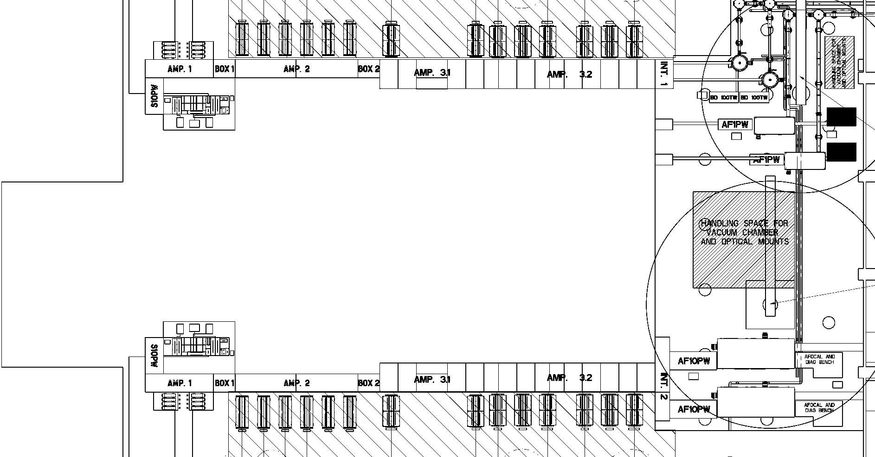
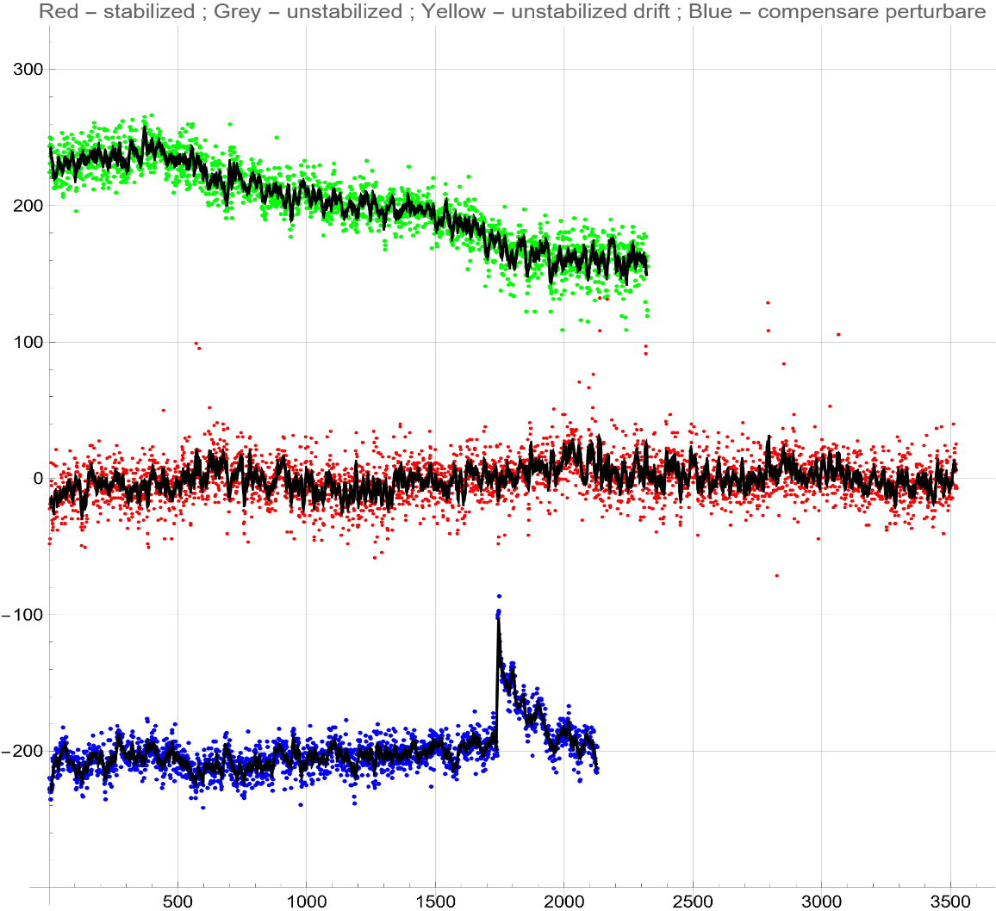
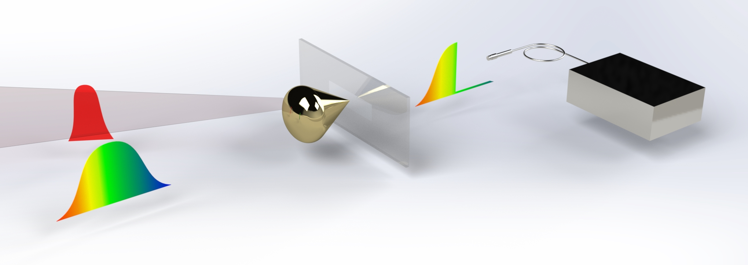
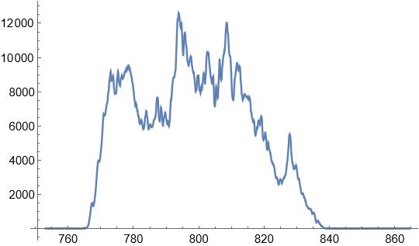
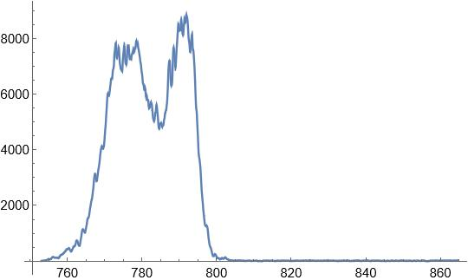
About 10 fs temporal drift stabilization for 1 PW outputs
LP-01 – LASER Room
170 m parallel propagation
Running amplifiers
Measurement after 1 PW compressors
Laser
control room
100 fs drift in 30 min
Laser source: front-end B
Figure 3: HPLS layout
11 fs rms for 50 min
Optical fiber & spectrometer
Relative delay between the pulses (fs)
Compressed ultrashort pulse
Laser target
Temporal fluctuations suppression after 129 pulses
Plasma mirror
Spectral cut pulse
Stretched probe pulse
A
B
Method: Plasma mirror ultrafast optical switch
scanning time (s)
LPAW, Ischia Island (Naples, Italy), April 14-18 (2025)

Slide 19
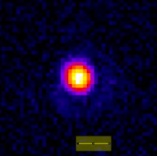
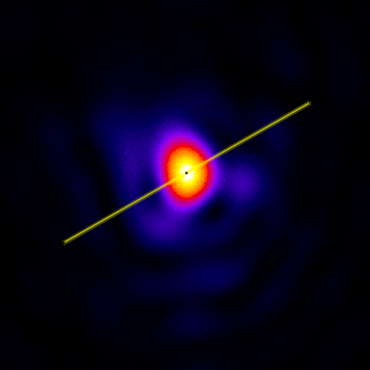
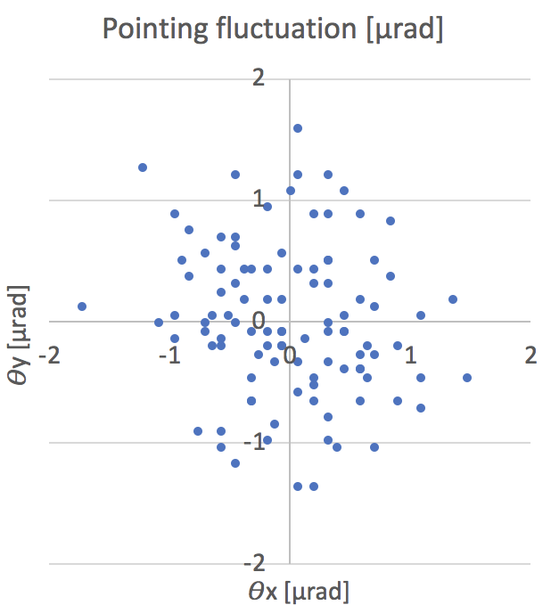
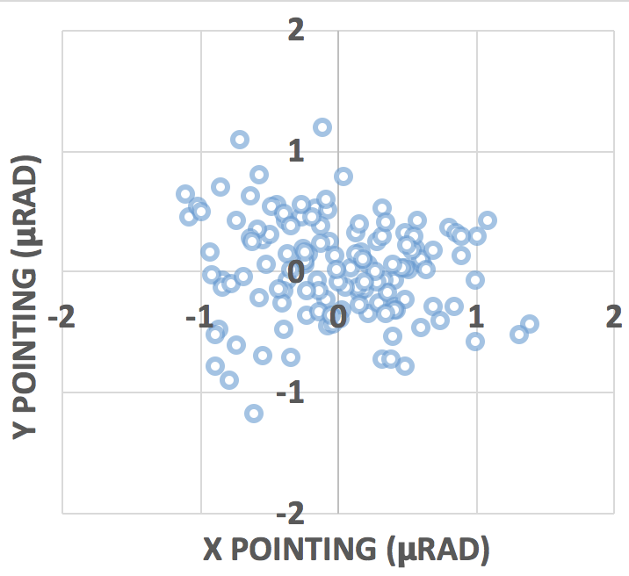
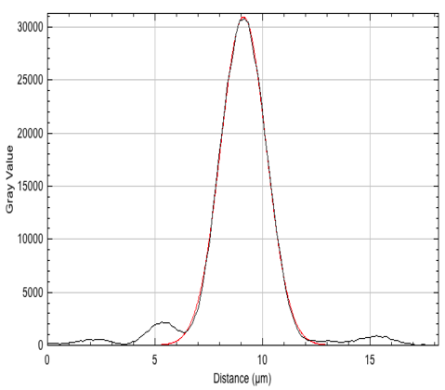
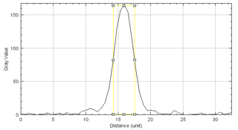
Far-field at 1 PW & 10 PW: HPLS focal spot & stability
1 PW focal spot and pointing stability
10 PW focal spot and pointing stability
  Short focal mirror: 707 mm focal length (F# ~3.7)
  Spot size diameter: ~ ﻿3.6 ± 2 µm at FWHM
  Short focal mirror: 1500 mm focal length (F# ~2.7)
  Spot size diameter: ~ ﻿2.9 ± 2 µm at FWHM
Best focal spot
Typical focal spot
Far-field
Focal spot image
Focal spot RAW image
Pointing fluctuation (μrad)
Pointing fluctuation (μrad)
5 µm
y Pointing (μrad)
y Pointing (μrad)
40 µJ, 25 fs
Laser beam profile
Gaussian fit
x Pointing (μrad)
FWHM ~ 2.8 µm
x Pointing (μrad)
µm
LPAW, Ischia Island (Naples, Italy), April 14-18 (2025)

Slide 20
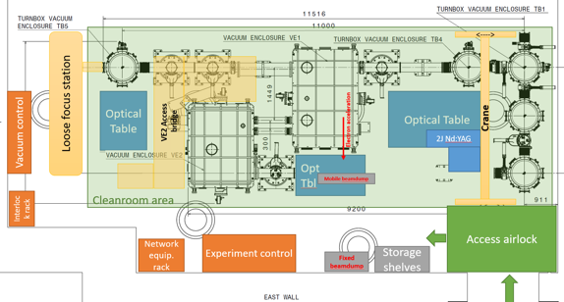
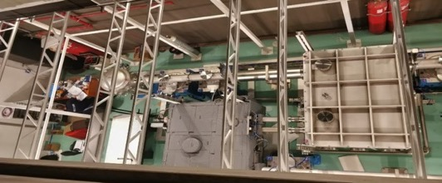


100 TW Experimental area E4
Laser
100 TW laser beam features
  Energy: < 2.5 J
  Pulse duration: < 25 fs
  Central wavelength: ~ 810 nm
  Beam diameter: ~ 54 mm
  Laser pointing fluctuation on target: ~ ±7 µrad
  Energy stability: <2.5%
  Repetition rate: 10 Hz (single shot possible)
Interaction chambers
HV
UHV
Example of focus properties
  Parabolic mirror: 1.5 m focal length (F# ~28)
  Spot size diameter: ~ ﻿22±2 µm at FWHM
  Encircled energy ~ 70% @ 1/e²
VE1: HV
Laser beam profile
VE2: UHV
25 µm
LPAW, Ischia Island (Naples, Italy), April 14-18 (2025)

Slide 21







Complex wavefronts generation for ion acceleration
Helical laser beam (Laguerre-Gaussian beam)
Helical PM, novel technique
Laguerre modes
Mid-field
full power with 25 µJ
Helical wavefront
Near-field high power shot 23 J, 900 TW
Helical mirror element
Lower divergence H+ beam with increased helical order
25
20
15
10
5
0
Experimental results
(far-field: focal spot at full power with but 25 µJ)
l=0
l=1
l=2
l=3
Divergence (degree)
Typical Gaussian
1.1 3.2 4.5 5.6. 7.5 9.7 12.3 14.5 16.8
M. Cernaianu et al., in preparation
Proton cutoff energy (MeV)
LPAW, Ischia Island (Naples, Italy), April 14-18 (2025)

Slide 22

100 TW LWFA example of results
LWFA electron acceleration in gas jet
Experimental setup
I₀ ~ 10¹⁹ W/cm²
plasma channel
laser
E4
gas
2 mm
~0.7 T
nozzle
Electron diagnostics: spectrometer (up to 500 MeV) – 16 cm long dipole magnet
with 3 cm gap and ~0.7 T B-field, and a Lanex screen
Acceleration field of ~ 1 GV/cm
Gas: He
Gas: He + 2% N₂
LPAW, Ischia Island (Naples, Italy), April 14-18 (2025)

Slide 23





1 PW commissioning with gas targets
Gas jet target and gas cell from 2mm to 2 cm long
SourceLab variable metal gas cell, fix 3D printed gas cell, 2 mm metal gas jet
Pure He and mixture He +2% N₂ were used
F=5000mm parabola
Max. electron energy attained with both Helium gas and admixture of ≈ 2 GeV
Electron diagnostics: spectrometer (up to 3 GeV) – 30 cm long dipole magnet with 3 cm gap and ~1 T B-field, and a Lanex screen
Experimental setup
zero point
Electron deviation on lanex
Electron Beam Energy Spectra for pure He
Shadowgraphy and WFS (plasma channel)
Electron Beam Pointing in a typical day from gas admixture
>2 GeV electron beam obtained with 2 cm gas cell
LPAW, Ischia Island (Naples, Italy), April 14-18 (2025)

Slide 24


1 PW commissioning with solid targets
Scan of maximum proton energy with target thickness, and laser energy with different temporal contrast
40
35
30
25
20
15
10
PM triggered later, estimated intensity contrast < 10⁻⁸ @ -15 ps
Laser energy on target
16 J
5.7 J
13 J
14 J
Intensity contrast ~10⁻⁷ – 10⁻⁸ @ -15 ps
Solid line: w PM
Dashed line: w/o PM
Proton cutoff energy (MeV)
PM triggered earlier contrast estimated < 10⁻⁸ @ -15 ps
Preliminary analysis
Intensity contrast ~10⁻⁷ – 10⁻⁸ @ -15 ps
0 1 2 3 4 5 6 7 8 9 10 11 12 13 14 15
target thickness (μm)
Temporal contrast improvement allowed the increasing of the cutoff energy for thin targets
LPAW, Ischia Island (Naples, Italy), April 14-18 (2025)

Slide 25







1 PW electron acceleration in hollow micro-channel
Electron acceleration with longitudinal laser fields
Alexey Arefiev (UC San Diego)
Mihail Cernaianu (ELI-NP)
Traditional direct laser acceleration (DLA) uses $E_{⊥}$, making large electron divergence unavoidable.
$E_{∥}$ that is present in a tightly focused laser to accelerate electrons directly forward without transverse oscillations.
Prolonged acceleration is ensured by an empty micro-channel target that guides the laser without allowing it to defocus.
Preliminary experimental results:
I = 4x10²¹ W/cm², 200µm length cylinder,
12µm diameter
CsI gamma detector
e- spectrometer trace
Transmitted
laser light
LPAW, Ischia Island (Naples, Italy), April 14-18 (2025)

Slide 26











10 PW proton acceleration
Radiochromic and CR39 stack detector
I_{L} = 3.6 x 10²² Wcm⁻² on 400nm Al foil
1 MeV
9.5 MeV
20 MeV
31 MeV
Al foil thickness scan
PM anti-ref improved
0.3% -> 0.1%
Proton energy (MeV)
Hole at 6um to show
10¹ 10² 10³ 10⁴ 10⁵
Target thickness (nm)
121 MeV
132 MeV
LPAW, Ischia Island (Naples, Italy), April 14-18 (2025)

Slide 27



10 PW proton acceleration
Examples of parametric studies
400 nm Al foil thickness
Focus scan on 1.5 mm Al foil (I$\sim$3.5x10²²W/cm²)
160
140
120
100
80
60
40
20
0
140
120
100
80
60
40
20
0
E$\sim I^{1/2}$
Proton energy (MeV)
Proton energy (MeV)
0 1 2 3 4
-60 -40 -20 0 20 40 60
Laser peak intensity on target (10²²W/cm²)
Focus position from the target (μm)
LPAW, Ischia Island (Naples, Italy), April 14-18 (2025)

Slide 28
Perspectives: Studies under Extreme Conditions
Extreme light intensity (10 PW ⟹ 10²³ W/cm²)
Extreme electric fields (10¹⁵ V/m)
Extreme light pressures (Tbar)
Strong-field QED
Nuclear Physics with Lasers
10 PW laser + solid target
10 PW laser + GeV LWFA electrons
10 PW radiation pressure acceleration of dense ion beams
PW 𝛾-source
Radiation reaction Breit-Wheeler pairs
QED vacuum
Nuclear reactions in plasma
Ultra-intense
neutron source
Neutron-rich nuclei
Develop particle beams for nuclear and QED experiments and for Societal Applications (muons imaging, hadrontherapy, Cancer detection, radioisotopes production, security)
LPAW, Ischia Island (Naples, Italy), April 14-18 (2025)

Slide 29





All optical Compton experiment at Apollon/ELI NP
γ lanex
Lyso
Plasma mirror
dipole
γ Rays
e- Lanex
laser
gas jet
Courtesy of Aimé Matheron
LPAW, Ischia Island (Naples, Italy), April 14-18 (2025)

Slide 30



All optical Compton experiment at Apollon/ELI NP
f/60 spherical, 6 cm gaz jet
3-5 GeV, 1 nC (>2 GeV), 1.6 mrad
Successive shots ($γ$ signal)
Apollon
ELI-NP
A. Matheron et al., submitted
LPAW, Ischia Island (Naples, Italy), April 14-18 (2025)

Slide 31


All optical Compton experiment at Apollon/ELI NP
APOLLON
ELI-NP
MAX
MAX
Critical photon energy of 0.14 GeV
Critical photon energy of 0.55 GeV
Quantum effects may start to play a role
A. Matheron et al., submitted
LPAW, Ischia Island (Naples, Italy), April 14-18 (2025)

Slide 32

It is all about people ...
269 employees
48 foreign researchers and engineers
1 Armenia, 2 Bulgaria, 2 China, 1 Czech Republic, 5 France, 1 Russia, 5 Germany, 1 Greece, 9 India, 1 Israel, 3 Italy, 4 Japan, 2 Malesia, 1 Pakistan, 3 Poland, 1 USA, 1 Sweden,1 Taiwan, 2 Turkey, 1 Uzbekistan
more than 120 young researchers below 35
56 Students PhD, master and bachelor
Journal Club & Board of Study
LPAW, Ischia Island (Naples, Italy), April 14-18 (2025)

Slide 33



ELI ERIC is Open to the World: the 3 Access Mode
Excellence-Based Access – Evaluation of proposals by international peer-review panels. Results of experiments published and open.
Mission-Based Access – Thematic research granted on the basis of scientific missions pursuing challenges. Proposals reviewed by international panels. Results published and open.
Proprietary Access – Paid access for industrial or other users. Results are retained by the user, consistent with ELI ERIC’s Data and IPR Policy.
LPAW, Ischia Island (Naples, Italy), April 14-18 (2025)

Slide 34

Conclusion and perspectives
Unique and versatile facility
Commissioning is almost finished
Access capability is validated and may be improved
Attractivity has to be be improved (PhD/Post-Doc/Engineers)
Scientific grand challenges are on the way
Single laser : simple setup
Auto-alignment : 100 % collision rate
$γ$-rays in the GeV range
Quantum effects may start to play a role
New opportunities for Collaborations (Japan, Germany, …)
LPAW, Ischia Island (Naples, Italy), April 14-18 (2025)

Slide 35

Conclusion: ELI NP welcomes you !
200
150
100
0
Pulse energy (J)
Time
9:00 11:00
13:00 15:00 17:00
9:00 11:00 13:00 15:00 17:00
Time
Time of the day
LPAW, Ischia Island (Naples, Italy), April 14-18 (2025)

