Slide 1

Full Inverse Compton Scattering, Unruh photons and maximal acceleration
Luca Serafini, Vittoria Petrillo , Richardo Gallego and Sanae Samsam
INFN-Milano and Università degli Studi di Milano
What is the Full Inverse Compton Scattering (FICS)?
How to produce and detect it?
Why is important and what can it be used for?

Slide 2
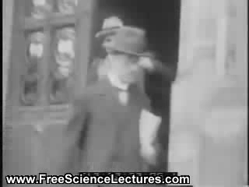
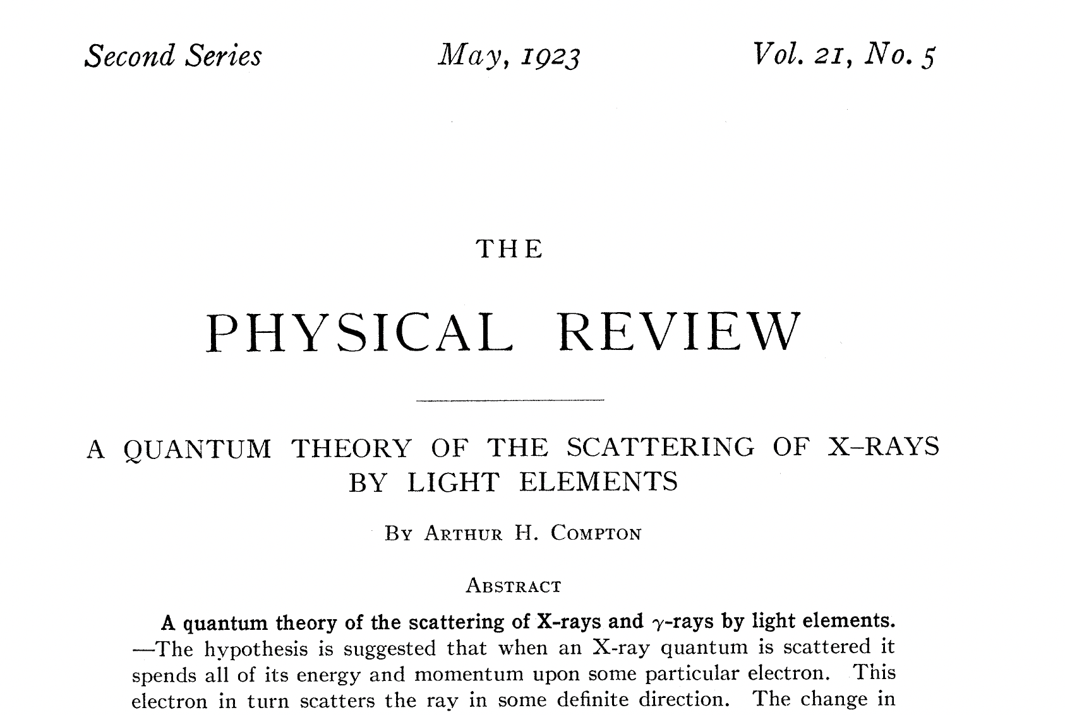
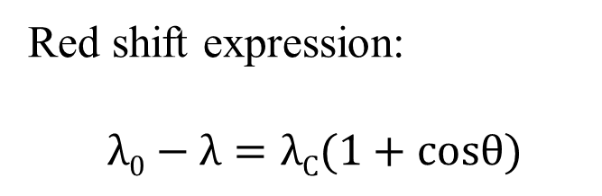
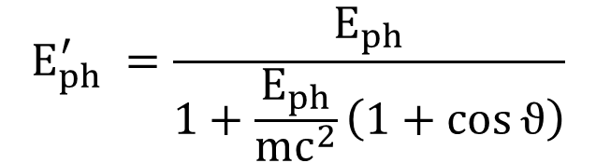


beginning of the story: the photon, quantum of energy
$${\underline{e}}_{X}$$
hν_{γ}
$${\underline{β}}_{}$$
e⁻ in a target
e⁻
hν_{γ}
Quadrivector conservation
p₁^{before}+p₂^{before}=p₁^{after}+p₂^{after}
Arthur Holly Compton
at the Solvay conference 1927
Red shift expression:
$$λ0−λ=λC(1+cosθ)$$
$$E_{ph}^{′} =\frac{E_{ph}}{1+\frac{E_{ph}}{{mc}^{2}}\left(1+\cos{ϑ}\right)}$$
Notes:
In the quantum model, one cannot rely anymore on the concept of trajectory, so it is impossible to access to the details of the scattering. What can be known is that the photon emerges from the collision with an upgraded frequency and that the electron undergoes a recoil. The conservation laws of energy and momentum permit to evaluate these quantities as a function of the angular coordinates, and , in particular the blueshifted frequency turns out to be ……. that is similar to the classical one apart for a term due to the electron recoil. The classical and quantum contribution are clearer in the wavelength expression, where they appear to be distinguished.

Slide 3

….continuation of the story: the bomb….
First considerations and study of Inverse Compton Scattering….
During the development of the
nuclear bomb!
Will the back-scattered photons,
by hot electrons of the plasma
created in the initial stage of the
nuclear bomb explosion, release
energy from the fire-ball decreasing
its temperature???

Slide 4
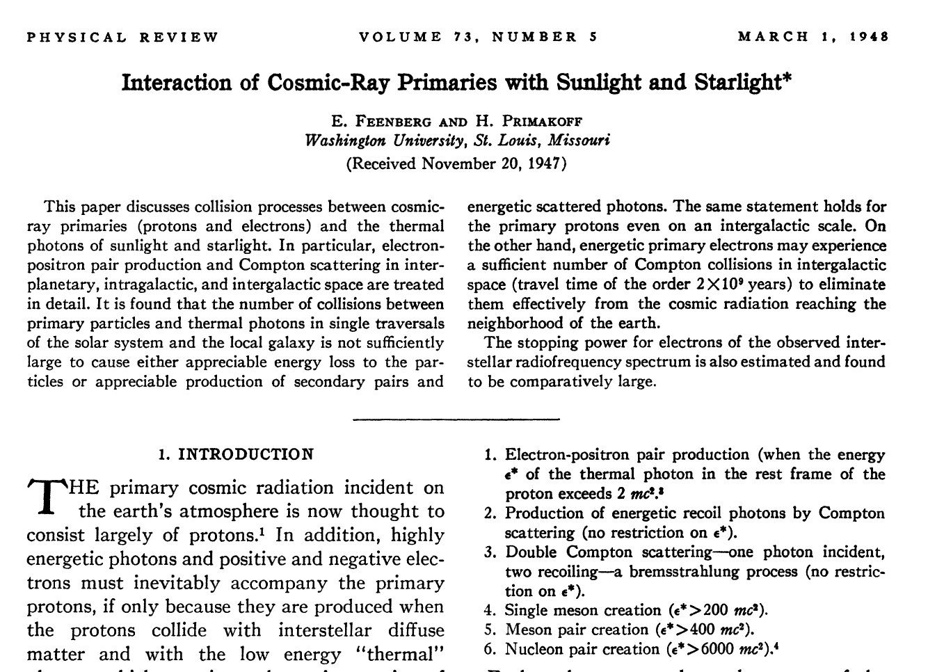
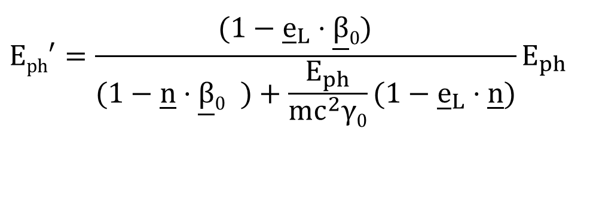

….continuation of the story, the inverse Compton scattering (ICS)….
Follin, Feenberg and Primakoff
studied the kinematics and probability of head-on
scattering with moving
electron beams.
$${\underline{e}}_{L}$$
hν_{L}
e⁻
α
e⁻
hν_{γ}
Quadrivector conservation
p₁^{before}+p₂^{before}=p₁^{after}+p₂^{after}
Conservation laws Of energy and momentum
to arrive to:
$$Eph′=\frac{(1−{\underline{e}}_{L}⋅\underline{β}0)^{}}{(1−\underline{n}⋅{\underline{β}0}^{})+\frac{E_{ph}}{mc^{2}γ0}(1−{\underline{e}}_{L}⋅\underline{n})}E_{ph}$$
X=4γ₀mc²/E_{L}
Recoil term
Where E’_{ph} is the radiation energy, Ε_{ph} is the laser energy, e_{L} is the direction of the laser, n is the radiation direction , β₀ =v/c is the electron velocity adimensioned to the speed of light before the scattering.
Notes:
In the quantum model, one cannot rely anymore on the concept of trajectory, so it is impossible to access to the details of the scattering. What can be known is that the photon emerges from the collision with an upgraded frequency and that the electron undergoes a recoil. The conservation laws of energy and momentum permit to evaluate these quantities as a function of the angular coordinates, and , in particular the blueshifted frequency turns out to be ……. that is similar to the classical one apart for a term due to the electron recoil. The classical and quantum contribution are clearer in the wavelength expression, where they appear to be distinguished.

Slide 5
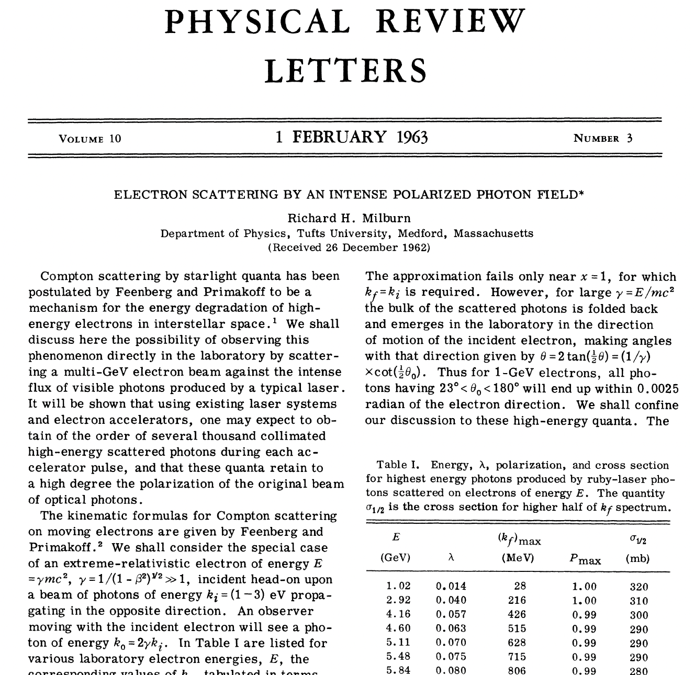
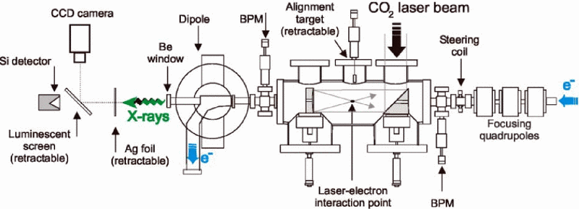
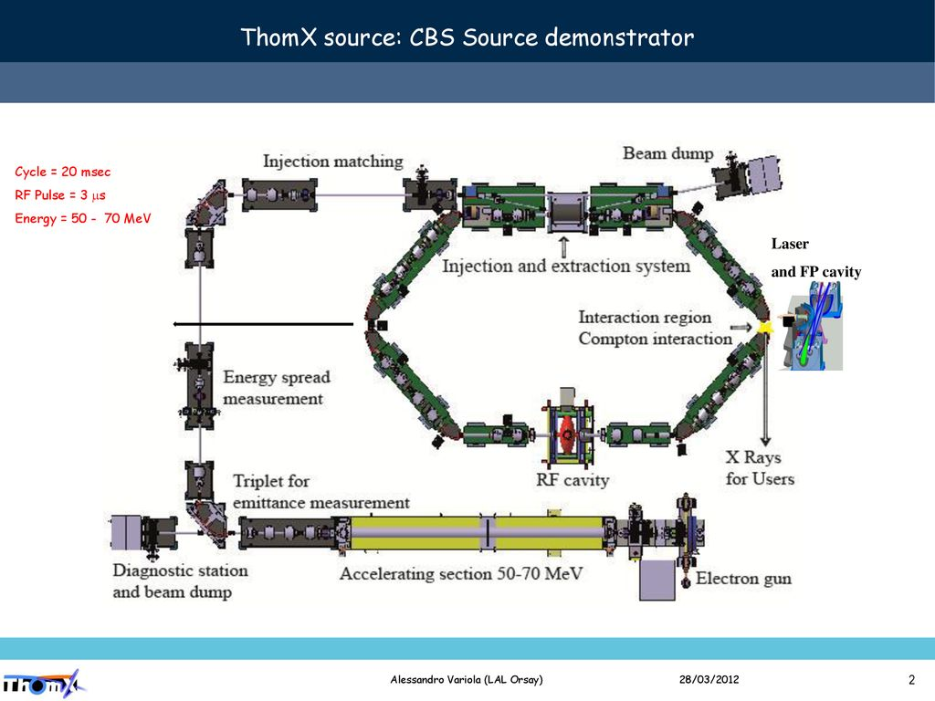
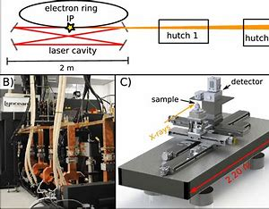
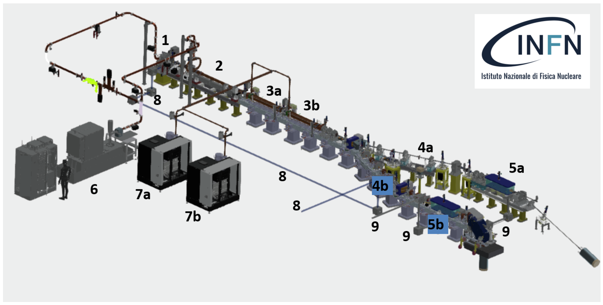
and then, the acceleratorists (first, Milburn) proposed
and exploited the idea….
of using electron accelerators to perform
Inverse Compton Scattering in the laboratory

Slide 6

Where we are with the sources?
$$Eph′=\frac{(1−{\underline{e}}_{L}⋅\underline{β}0)^{}}{(1−\underline{n}⋅{\underline{β}0}^{})+\frac{E_{L}}{mc^{2}γ0}(1−{\underline{e}}_{L}⋅\underline{n})}E_{L}$$
X=4γ₀mc²/E_{L}
E_{e}=50 MeV
8MeV<E_{e}<2 GeV
E_{ph}<10 eV
X<10⁻²

Slide 7
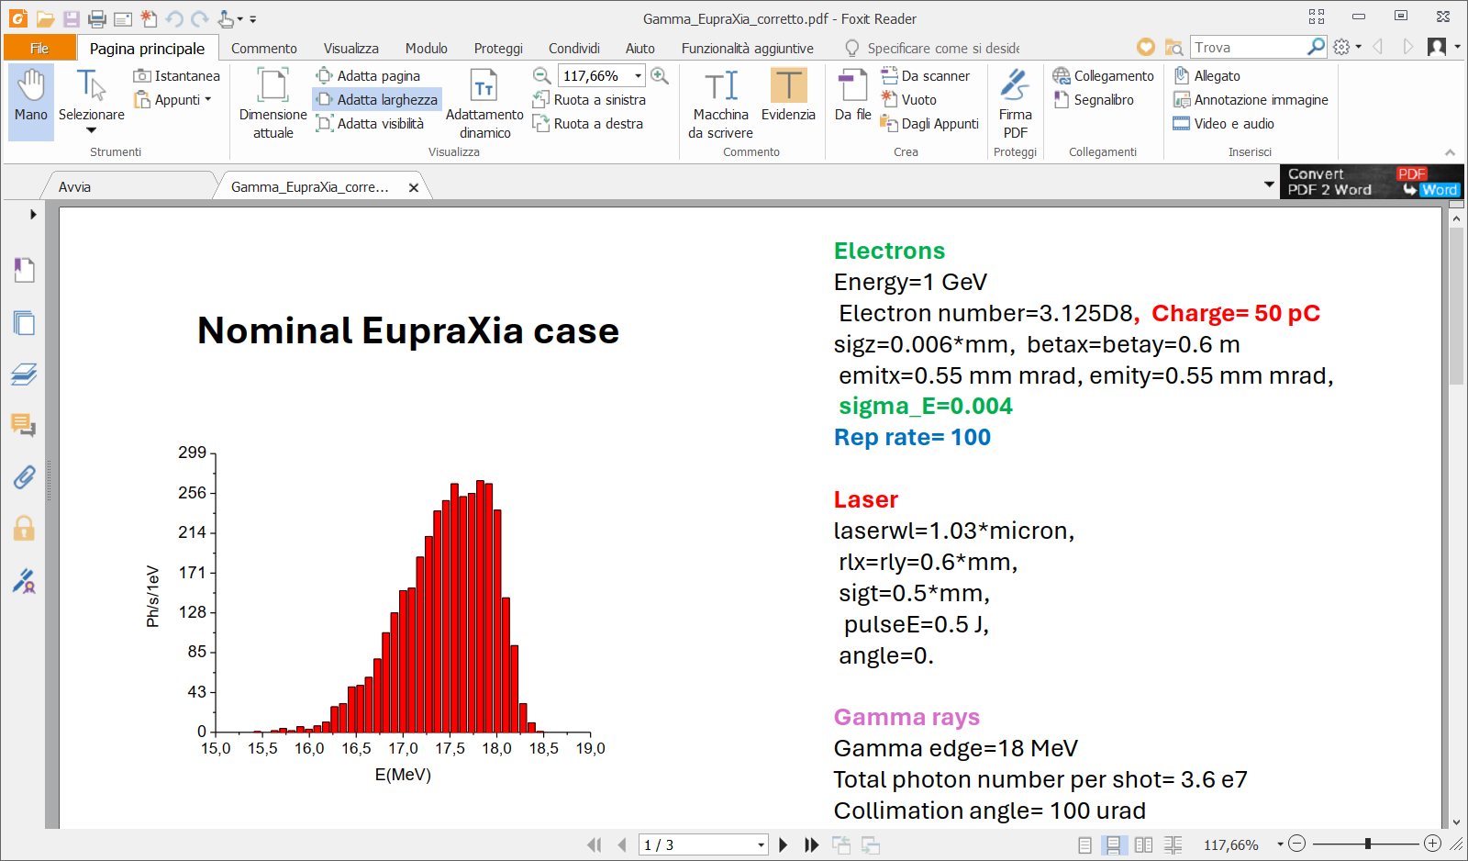
Is it possible to think to a gamma source at EupraXia?

Slide 8
Where would it be with respect to the state of the art?
EupraXia-now1: 50 pC, 0.7 GeV, DE/E=4 per mill,
emit= 0.55 mmmrad, rep rate= 100 Hz
EupraXia-now2: 50 pC, 1GeV, DE/E=4 per mill,
emit= 0.55 mmmrad, rep rate= 100 Hz
EupraXia-next: 100 pC, 2.2 GeV, DE/E= 2 per mill,
emit=0.55 mmmrad, rep rate= 400 Hz
 | Higs measured | EupraXia- now1 | Eli_np simulated | EupraXia- now2 | Higs measured | EupraXia- next
Energy | 8 MeV | 8 MeV | 18 MeV | 18MeV | 87 MeV | 87 MeV
Bw | 3% | 3% | 0.3% | 2.7 % | 3 % | 3%
Total ph number/s |  | 2.7x10^7 | 1.x10^9 | 3.6 x10^7 | 10^8 | 4.9e10
Collimated ph number/s |  | 3x10^6 | 4x10^5 | 3.2x10^6 | 2.3x10^6 | 2 x10^9
Spectral density | 1000 | 500 | 10^4 | 300 |  | 700

Slide 9
and going towards larger photon energy?
FICS:
Full Inverse Compton Scattering
E’_{e}=0.511 MeV=mc²
X=2γ=204
E_{ph}=0.255 MeV=mc²/2 !!!!

Slide 10
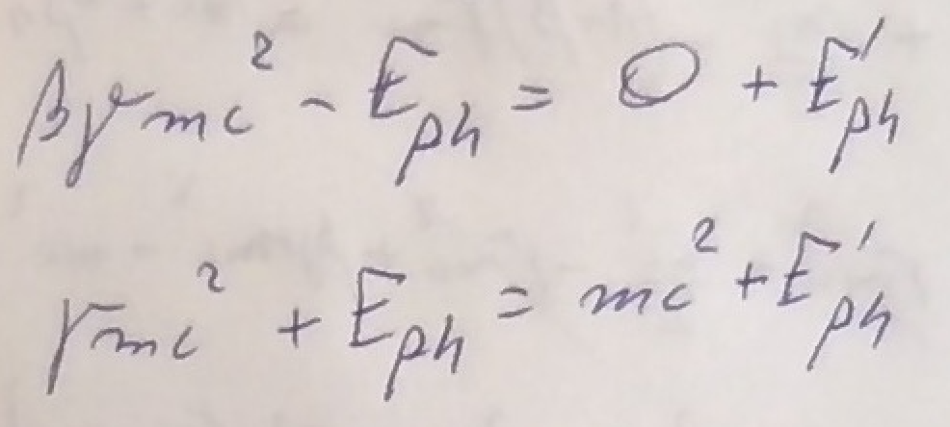
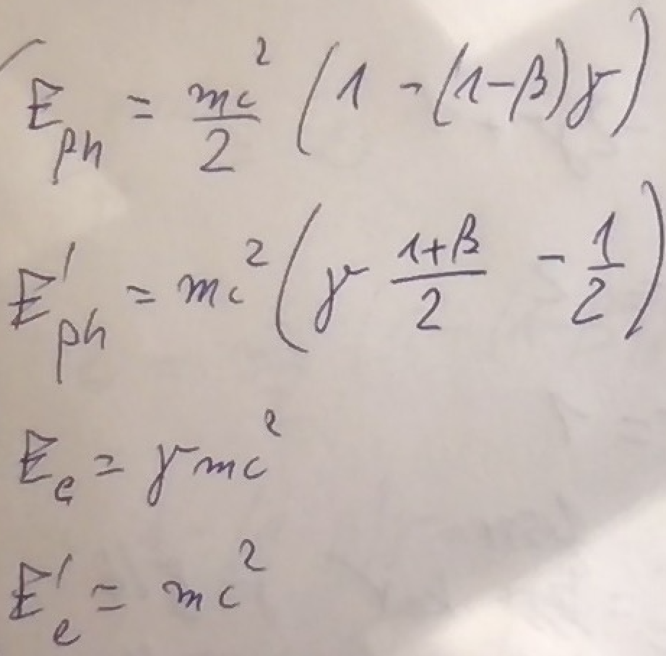






Kinematics equations are straightforward.
FICS equations
$$E_{e}$$
$$E_{ph}$$
$${E′}_{ph}$$
$${E′}_{e}$$
$${E′}_{e}=mc^{2}$$
$${T′}_{e}=0$$
FICS solutions
Let’s focus on the
“turning point”
where electron starts
to be back-scattered:
FICS - Full Inverse Compton Scattering
for any value of γ !

Slide 11
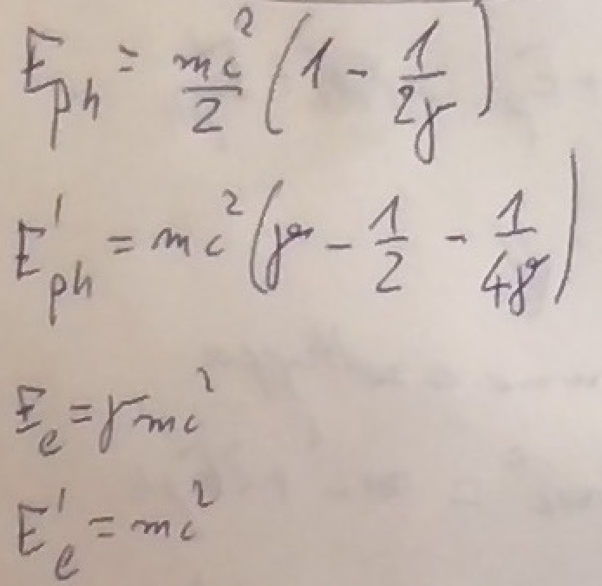
When γ >> 1 FICS solution becomes:
mc²/2 photons can stop any relativistic electron !
The fractional energy loss of FICS is 100%

Slide 12
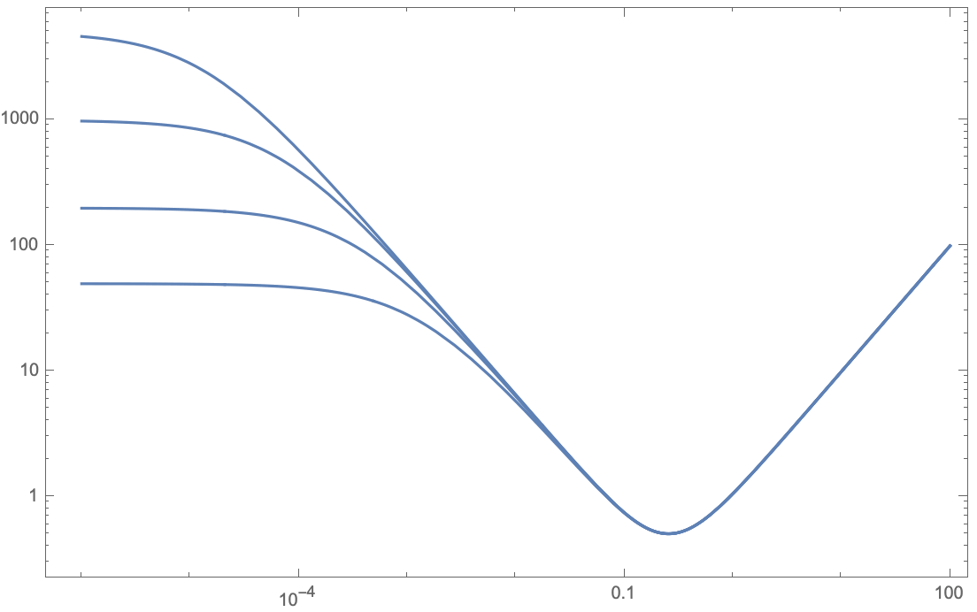




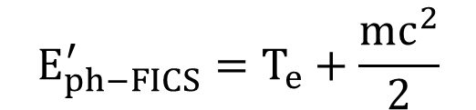
With different electron initial energy?
$$E_{e}$$
$${E′}_{ph}$$
in vacuum electron-photon collision
$${E′}_{e}$$
$$E_{ph}$$
5 GeV
FICS – Full Inverse
Compton Scattering
1 GeV
200 MeV
E’_{e} (MeV)
E_{e} = 50 MeV
$$E_{ph−FICS}^{′}=T_{e}+\frac{{mc}^{2}}{2}$$
E’_{e} =511 keV , T’_{e}=0
E_{ph} (MeV)
E_{ph} = 1 eV
E_{ph} = 1 keV
E_{ph} =0.5mc²

Slide 13
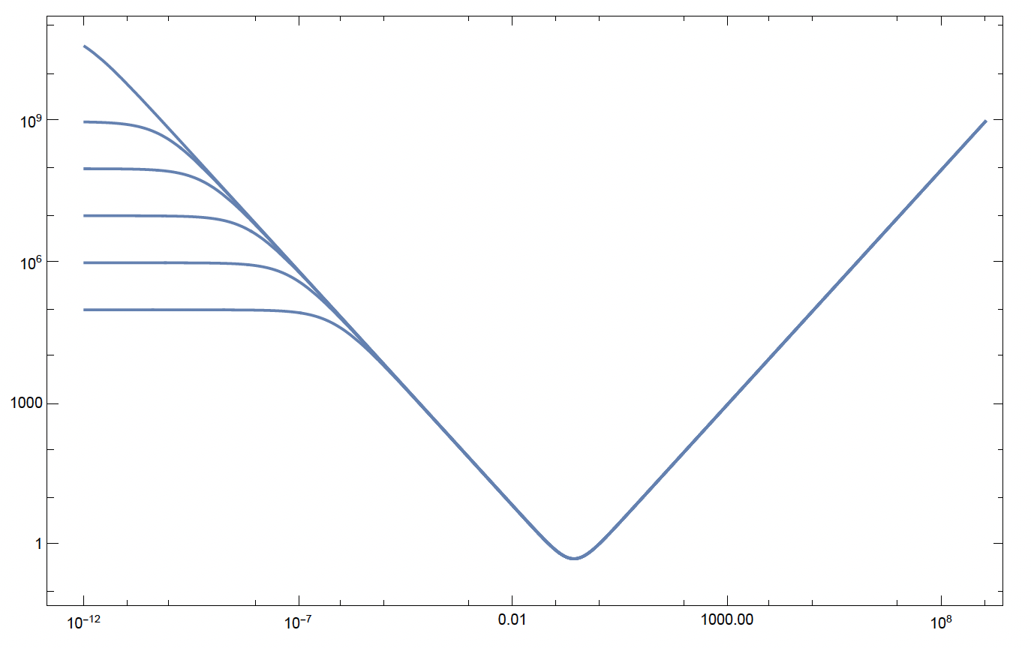

Full Inverse Compton Scattering: amazing power
of 255.5 keV photons to stop ANY colliding electron
100 PeV
0.5mc² = 255.5 keV colliding photons will
stop relativistic electrons of any energy E_{e} !
1 PeV
100 TeV
10 TeV
1 TeV
100 GeV
E’_{e} (MeV)
E’_{e}
e⁻ at rest E’_{e}=mc²
E_{ph} (MeV)
E_{ph}=1 meV
E_{ph}=1 eV
E_{ph} =0.5mc²
E_{ph}=1 μeV
*hadronic threshold (E_{cm} < 600 MeV) with 255.5 keV photons ≈ 360 GeV

Slide 14
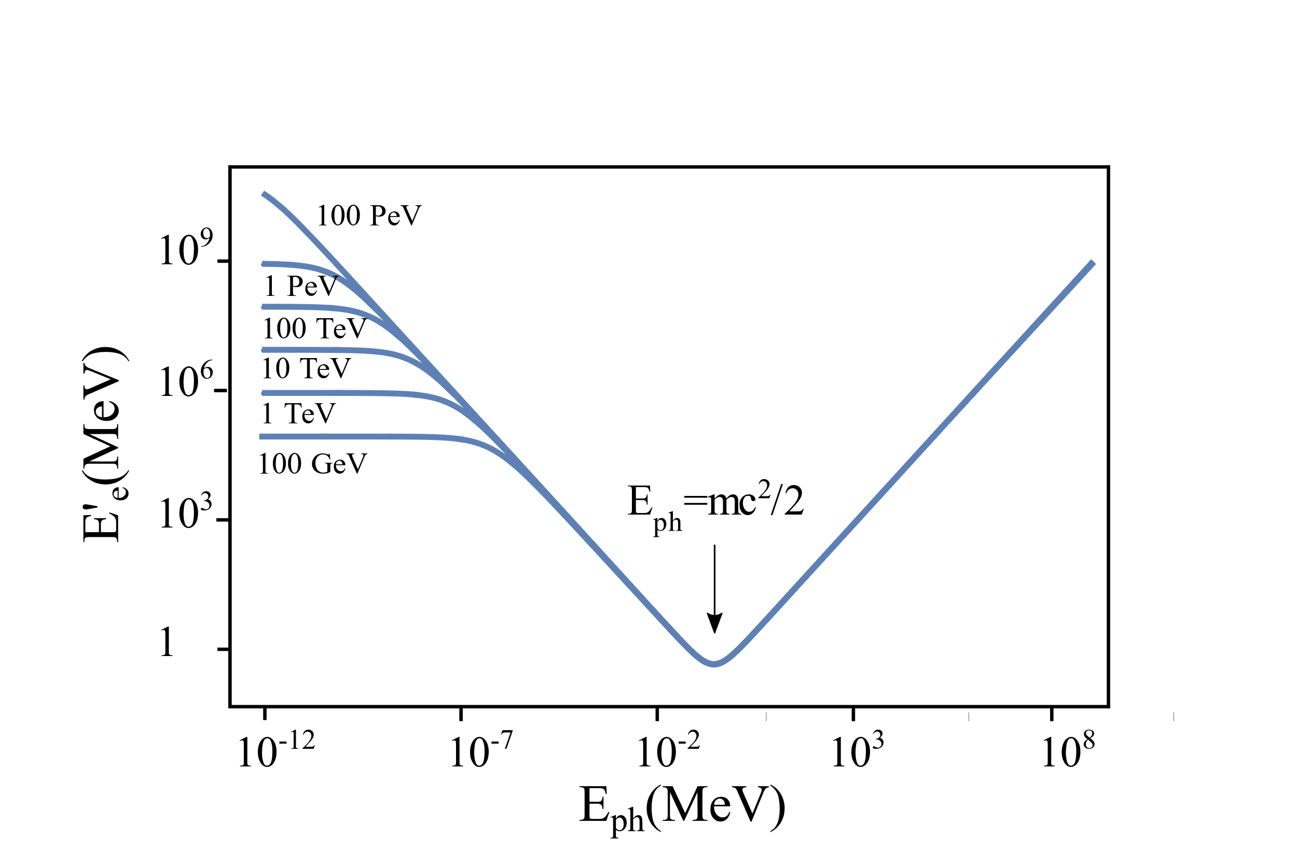
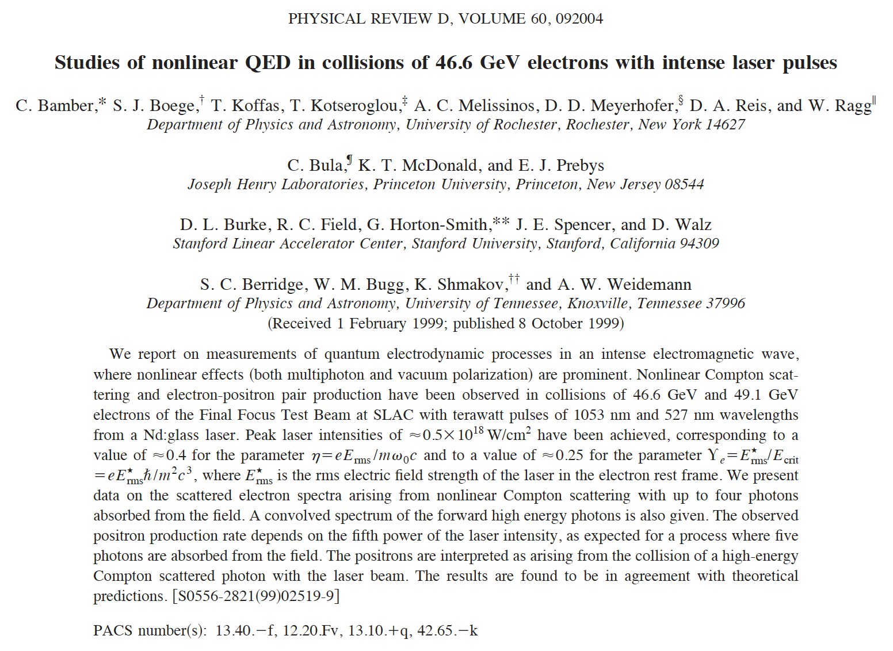
What is the larger measured X value?
Largest value of recoil factor X achieved in experiments
so far is X=1.8 at SLAC in 1999
*hadronic threshold (E_{cm} < 600 MeV) with 255.5 keV photons ≈ 360 GeV

Slide 15
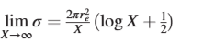
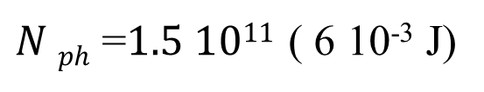
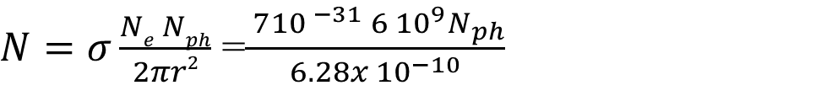
Klein-Nishina cross section
Is the probability too low to see something?
E_{e}=50 MeV
E_{ph}=255 keV
X=204
σ=7 10⁻³¹ m² =1/100 σ _{Thomson}
$N=σ\frac{Ne Nph}{2πr2}$ =$\frac{ 7{10 }^{−31}{ 6 10}^{9}N_{ph}}{6.28x {10}^{−10}}$
To have 1 phot/shot
$N ph$ =$1.5 1011$ ( 6 10⁻³ J)

Slide 16
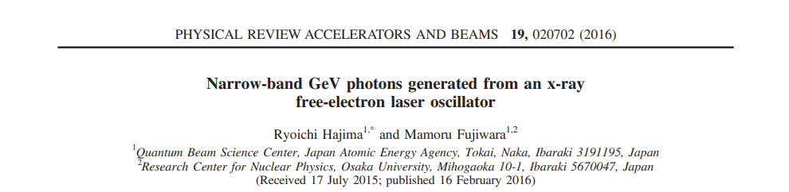
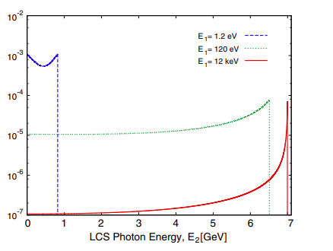
When X <<1
σ=πr₀²/(2γX)
When X >>1
σ=πr₀²/(2γ)
Energy-differential cross section of Compton scattering for 7 GeV electrons and laser photons at three different energies of 1.2 eV, 120 eV and 12 keV.

Slide 17
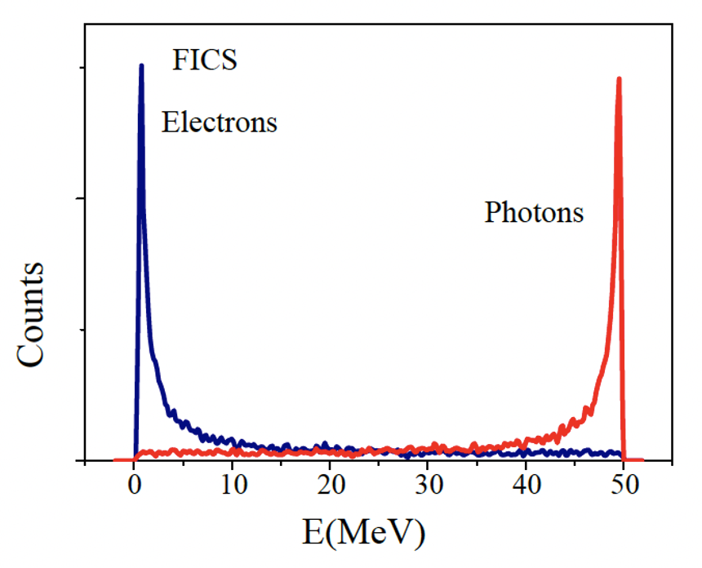
Simulation results with an homemade MonteCarlo code (E_{e}=50 MeV)
What do MonteCarlo codes say?

Slide 18
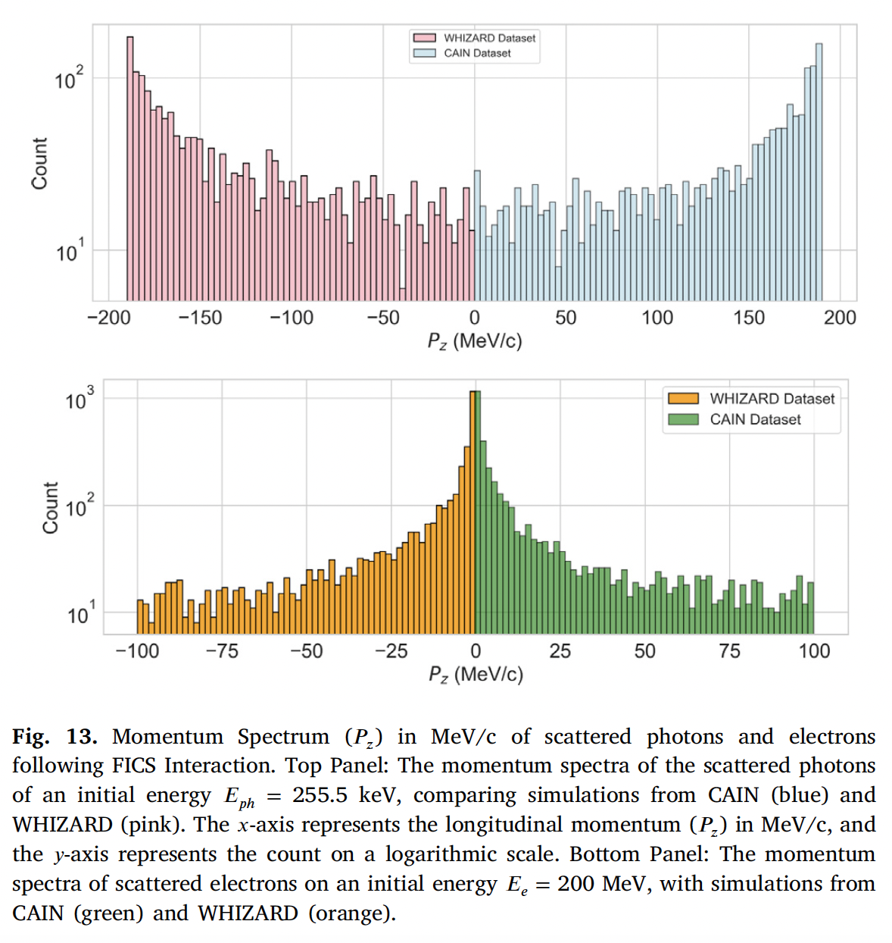
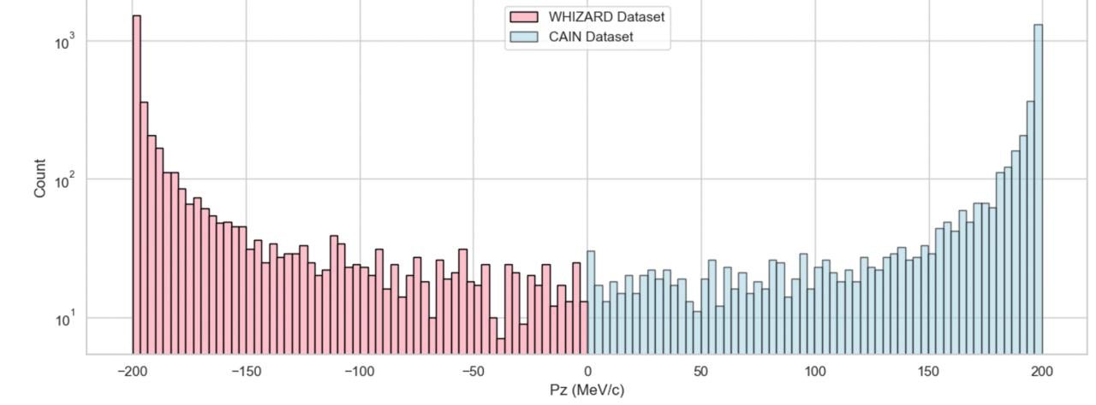
scattered photons
Not convinced,
we tried with other
codes:
With Wizard (left)
and CAIN (rigth)
scattered electrons
better statistics
with 200 MeV e⁻

Slide 19
How many photons?
Clear experimental
signature of FICS events:
50 MeV photons emitted forward
1 nC electrons@ 50 MeV
100 mJ of photon energy @ 255 keV
17 photon total per shot, 7 collimated
photons in 0.02 rad
If Rep. Rate= 100 Hz
1700 phot/s
Electrons

Slide 20
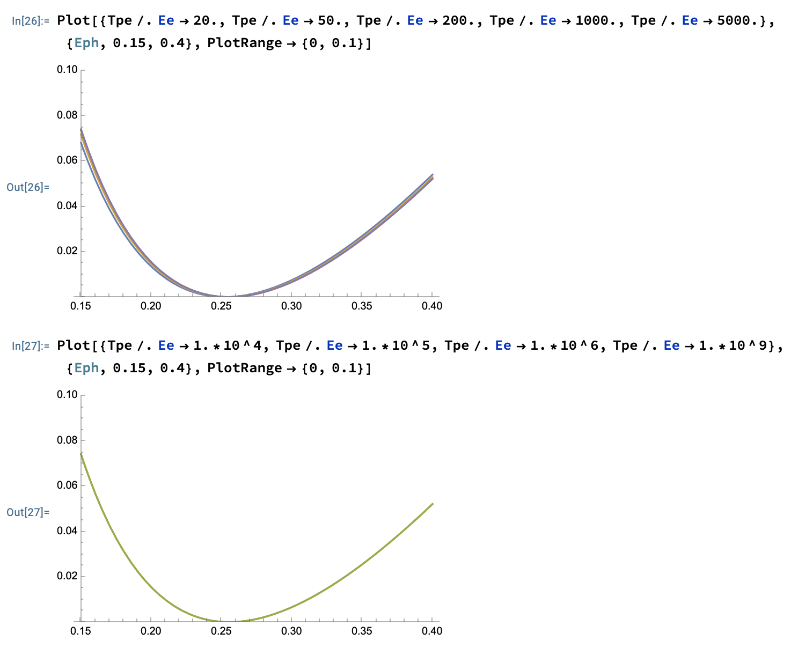
FICS has a shallow minimum:
residual electron kinetic energy T’_{e} around FICS is small,
so the tuning of the pump is not problematic
T’_{e} (MeV)
T_{e} = 20, 50, 200 (MeV),
1, 5 (GeV)
T_{e} = 10, 100 (GeV),
1 TeV , 1 PeV
T’_{e} (MeV)

Slide 21
Making a 255 keV bright photon beam is not an easy task…
FEL is challenging/expensive, ICS and betatron are not that bright, X-ray tube is even less bright --> very low luminosity
But…..

Slide 22
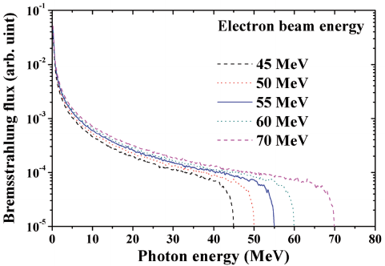
How produce 255 keV photons?
Bremsstrahlung is clearly not an option:
total electron energy loss not actually achievable
brilliance of bremsstrahlung sources is orders of magnitude smaller
f_{BREM} < 1
100% e⁻ energy loss

Slide 23
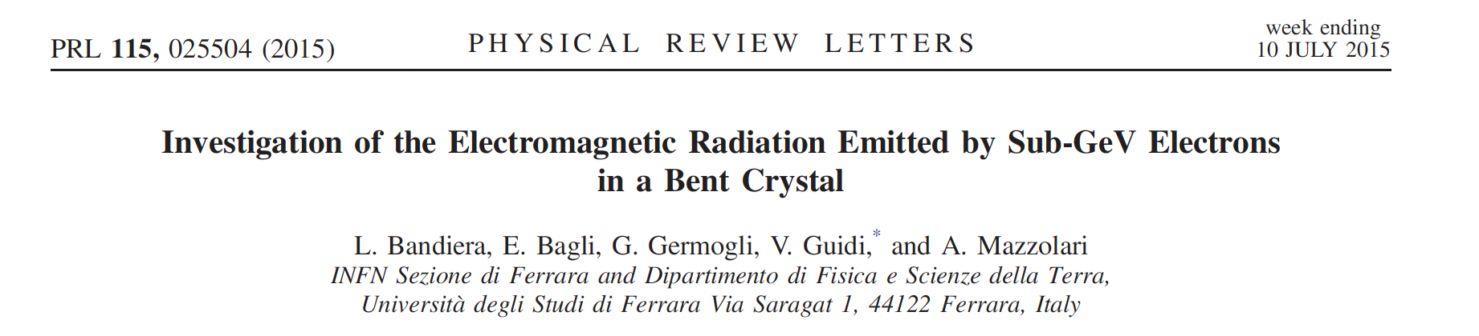
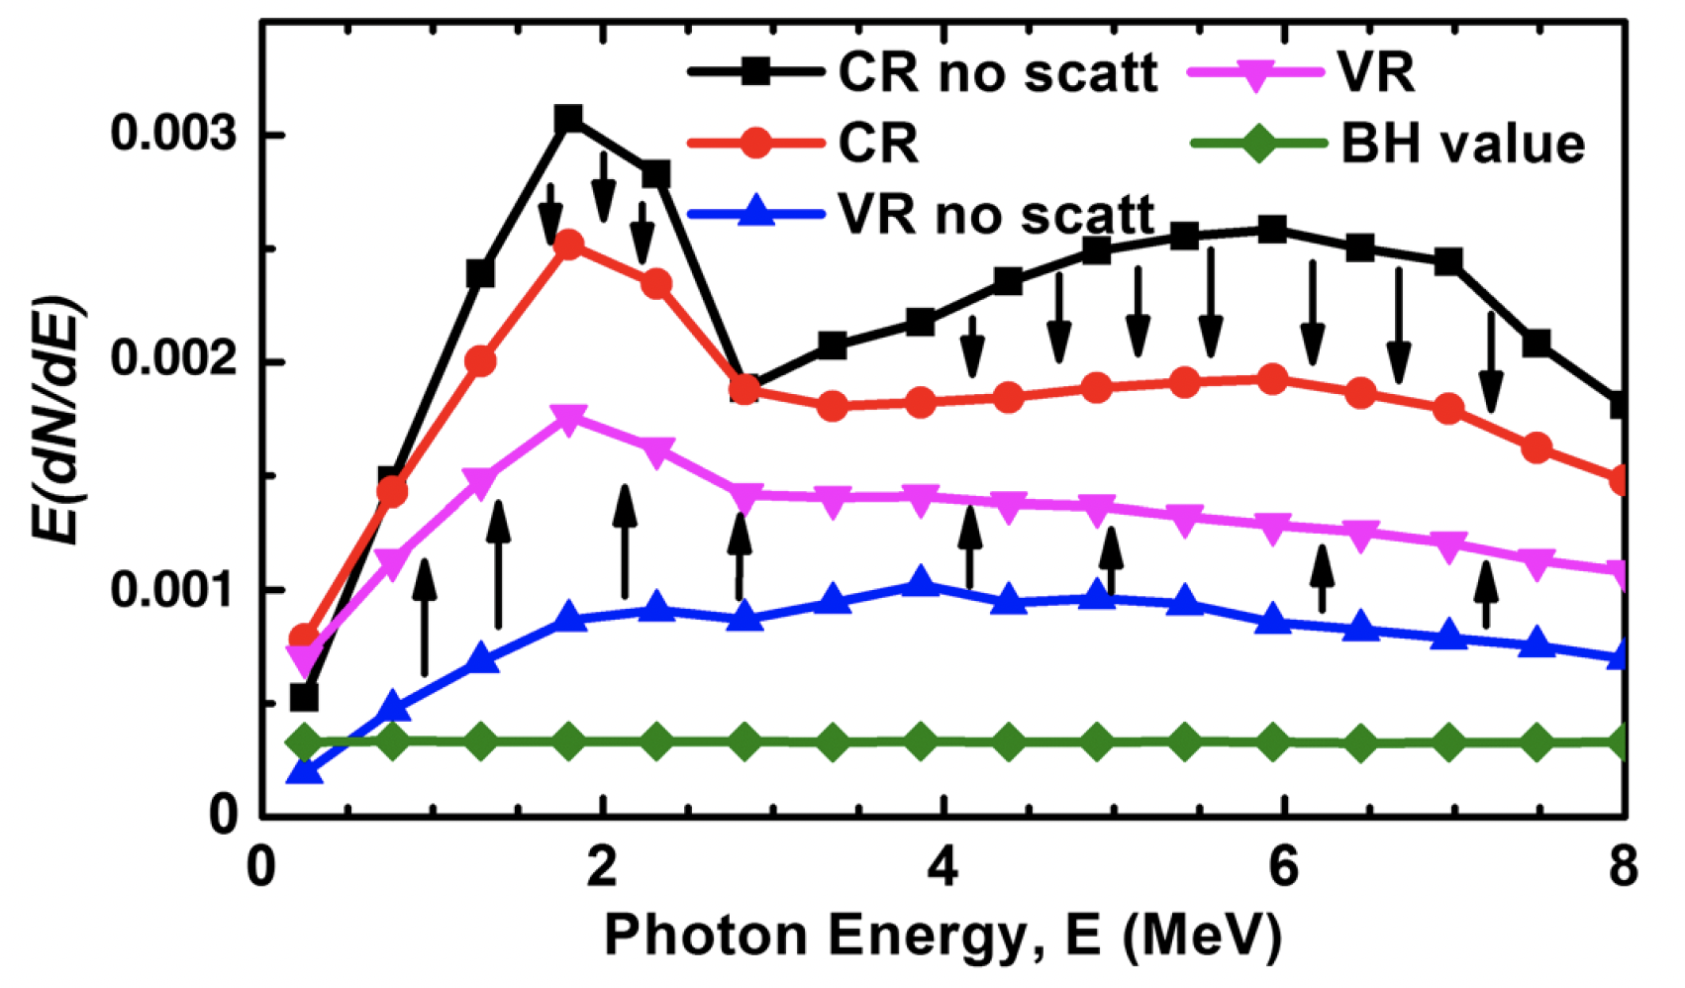
Channellig radiation is better
Courtesy L. Bandiera

Slide 24
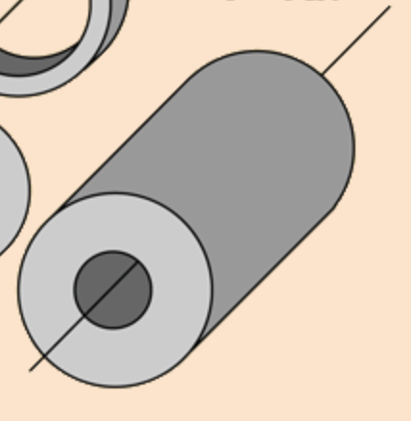

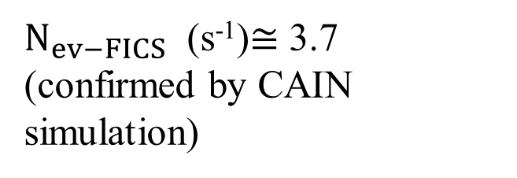
A photonic target may be a viable alternative option!
If we cannot take the photons onto the electrons we’ll take the electrons to the photons…
Credits: Adolfo Esposito (LNF) private communication
Ba-133 hollow cylinder
Specific activity 9.3 PetaBq/kg
equivalent to N_{ph} =3.4*10¹³ photons / cm³
gamma emission @ 276 keV and 356 keV
FICS
photons
FICS with 1 GeV EupraXia’s
drive beam before dump
e⁻ beam
X=4080 Σ_{KN}=1.1 mbarn
$N_{ev−FICS}$ (s⁻¹)= $N_{e−}f(Hz)N_{ph}({cm}^{−3})L(cm)Σ_{KN} ({cm}^{2})$
$N_{ev−FICS}$ (s⁻¹)$≅$ 3.7
(confirmed by CAIN simulation)
20 cm
1.1 mbarn

Slide 25
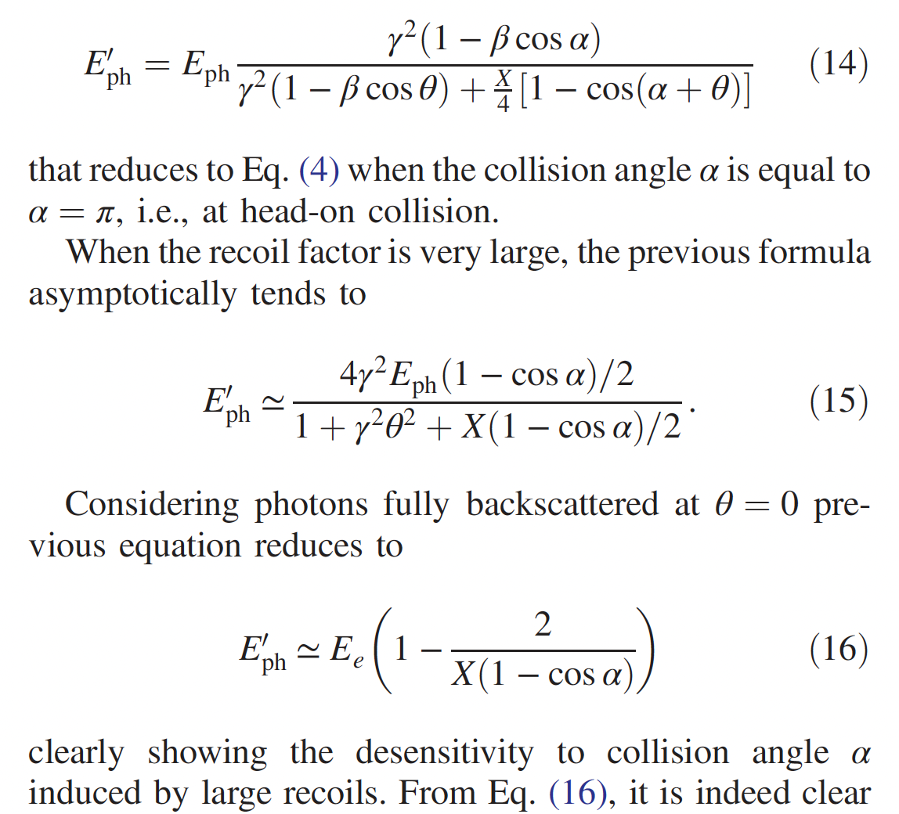
Clear experimental signature of FICS events:
1 GeV photons emitted forward within 1/γ angle (0.5 mrad)
Key aspect of deep recoil (X >>1) Compton back-scattering
(FICS is in deep recoil: X_{FICS} = 2γ )
X (1 GeV vs. 255 keV) = 4000.
Photon spectra do not depend on collision angle!

Slide 26
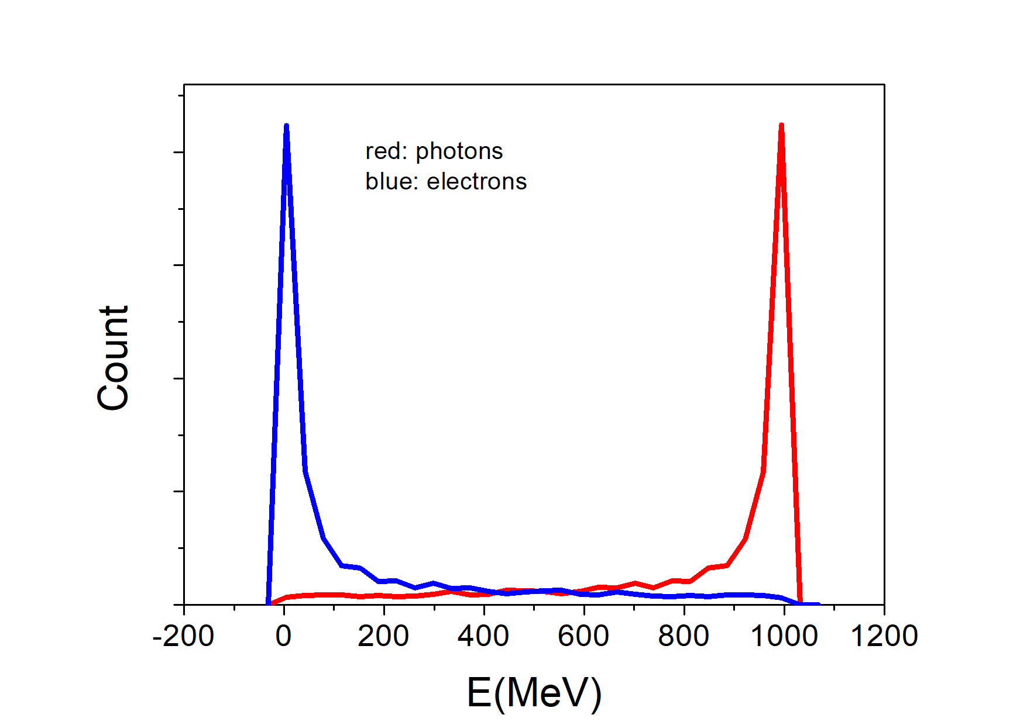
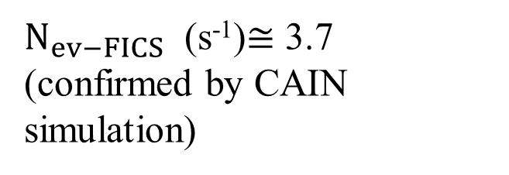
FICS @ EupraXia with photonic target
Spectra integrated over collision angle α
(from 45º to 180º, 85% of total solid angle)
and scattering angle θ: in deep recoil no angular dependence (deep recoil)
$N_{ev−FICS}$ (s⁻¹)$≅$ 3.7
(confirmed by CAIN simulation)

Slide 27
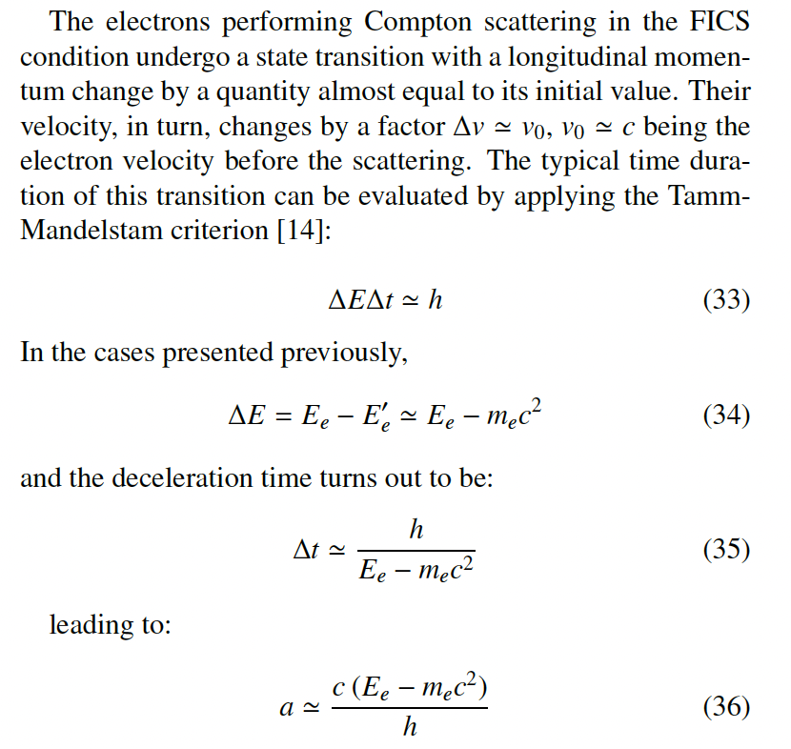
General foundamental applications
In the laboratory at zero order.
The electron stops and
therefore, it experiences
a deceleration.

Slide 28
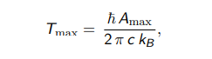
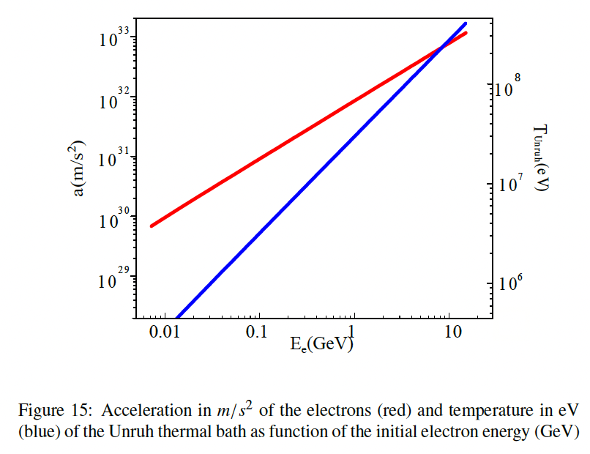
Unruh radiation and temperature
Thermal bath=Unruh radiation
In the accelerated electron frame
a_{FICS} (m/s²) = 7.3.10²⁸ * E_{e}(MeV)
T_{Unruh-FICS} (K) =3.1.10⁸ * E_{e}(MeV)
T_{Unruh-FICS} (MeV) = 0.026 * E_{e}(MeV)
the most extreme acceleration
achieved in the universe ??

Slide 29
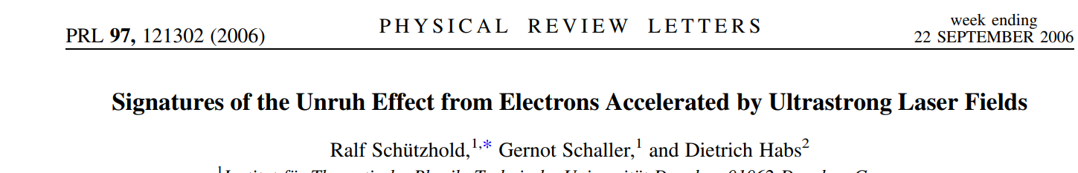
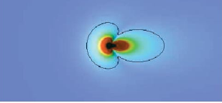
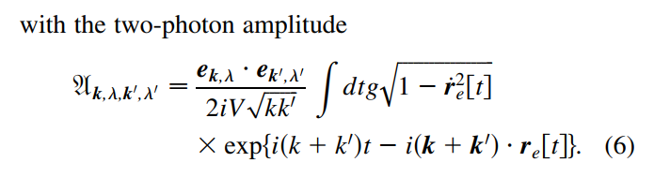
Due to the interaction in the accelerated frame between electron and
Unruh photons, in the laboratory we see a couple of entangled photons
Single and Double Compton scattering
F. Bell et al.

Slide 30
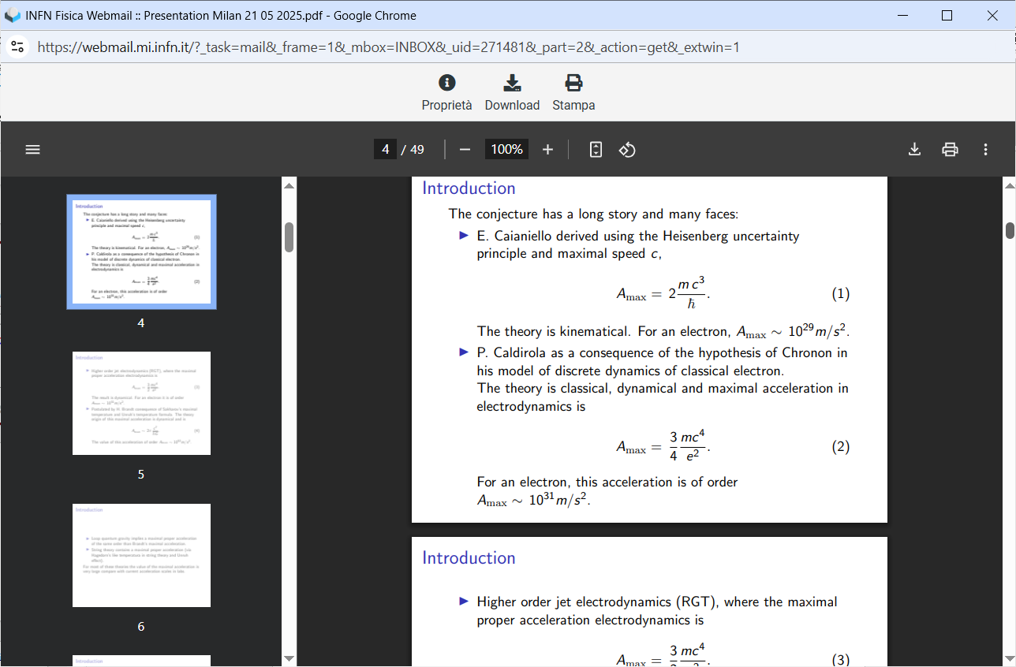
Maximum acceleration, many theories (credit Richardo Gallego)
a_{MAX} (Caldirola and RGT)
a_{MAX} (Caianiello, Schwinger)

Slide 31
Thank You for the attention!!

Slide 32
Energy Budget towards γ -rays with high spectral density
25 GeV electrons would be needed to generate 2 MeV photons via synchrotron radiation (highest spectral density S 10¹² s⁻¹eV⁻¹, very small bdw 10⁻⁴)
850 MeV electrons were used to Channeling Radiate 2 MeV γ -rays (high S 10⁵-10⁶ s⁻¹eV⁻¹, broad bdw 10 %)
350 MeV e⁻s are needed to Inverse Compton Scatter 2 MeV γ -rays (good S 10⁴-10⁵ s⁻¹eV⁻¹, small bdw 10⁻³)
3.5 MeV electrons to bremsstrahlung 2 MeV γ -rays (poor S 1 s⁻¹eV⁻¹, very broad bandwidth)
2 MeV e⁻s to Symmetric Compton Scatter a photon target 2 MeV γ -ray photons (S 10⁴ s⁻¹eV⁻¹) spectral purification!

Slide 33
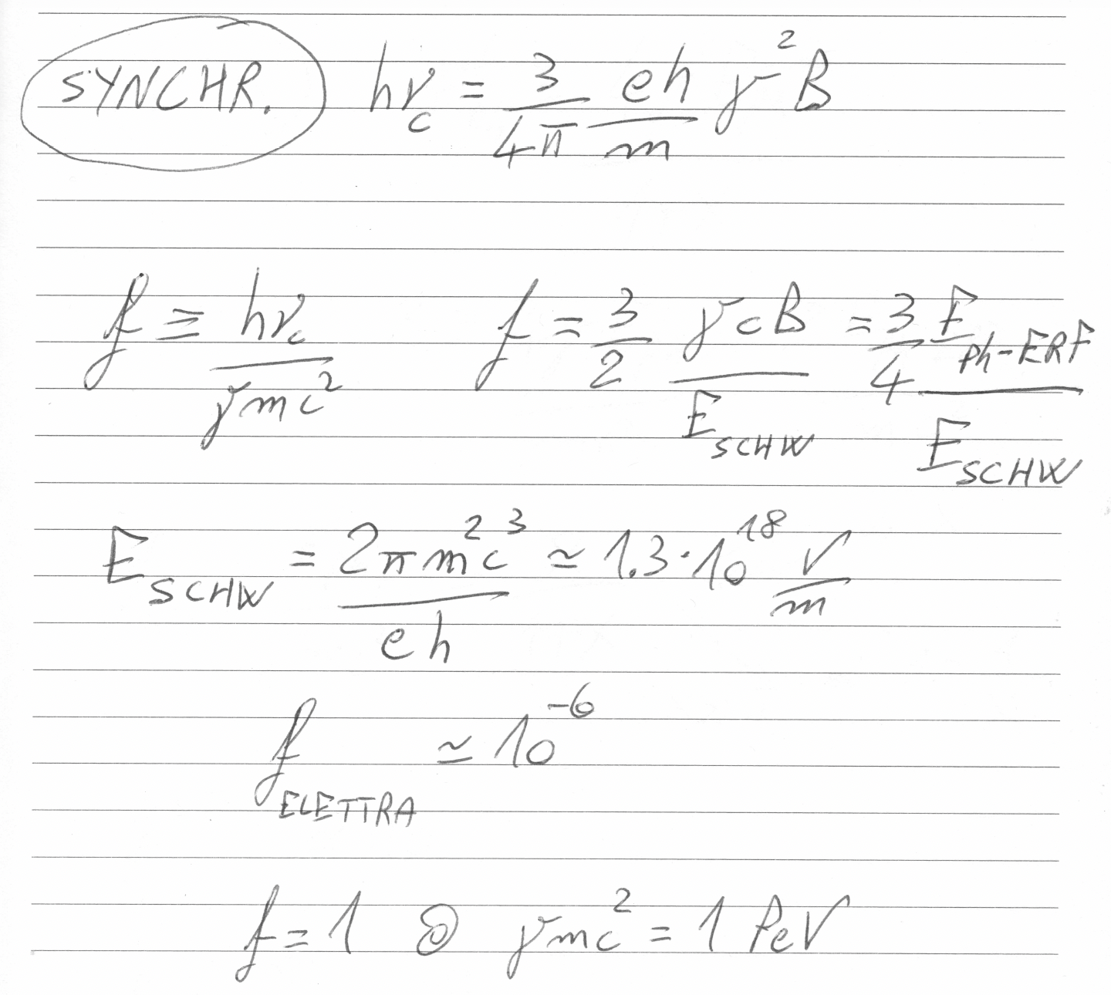

Slide 34
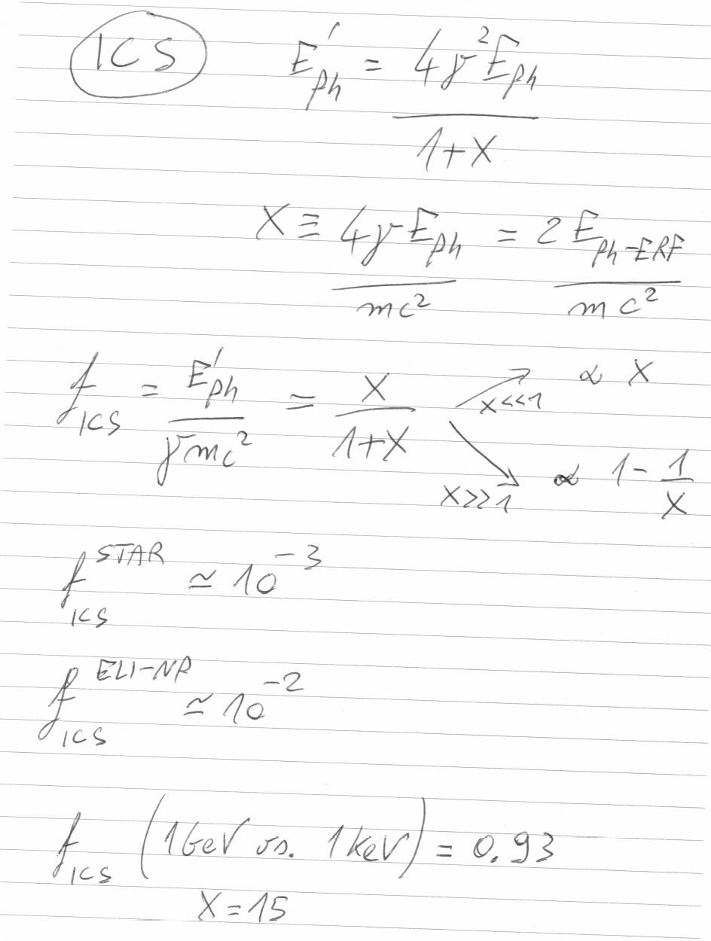

Slide 35
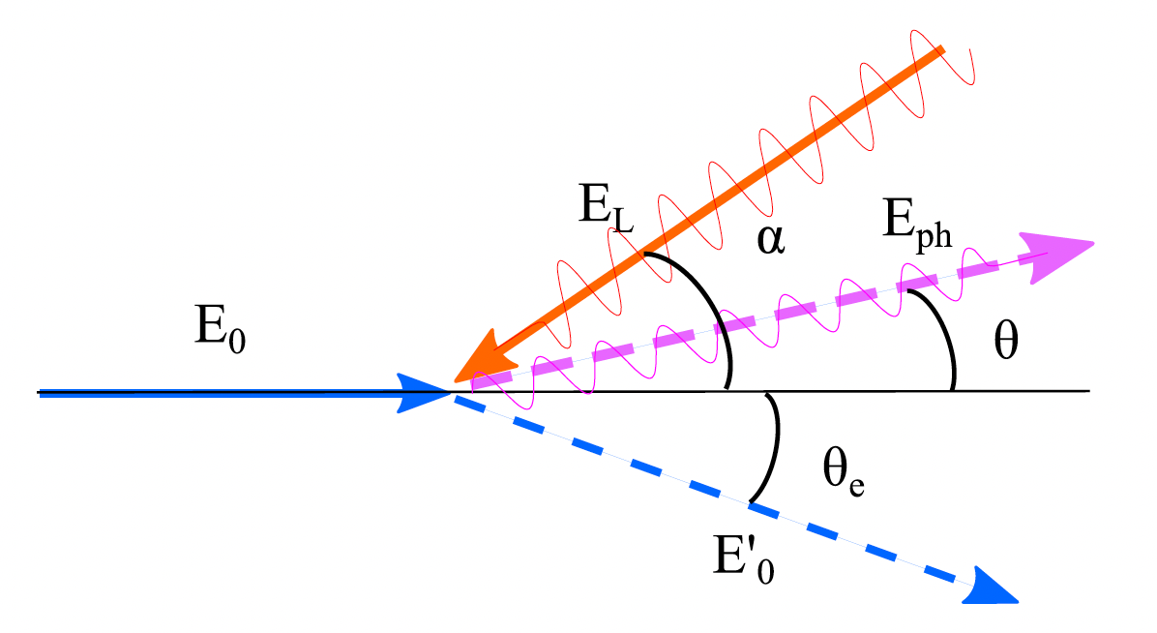
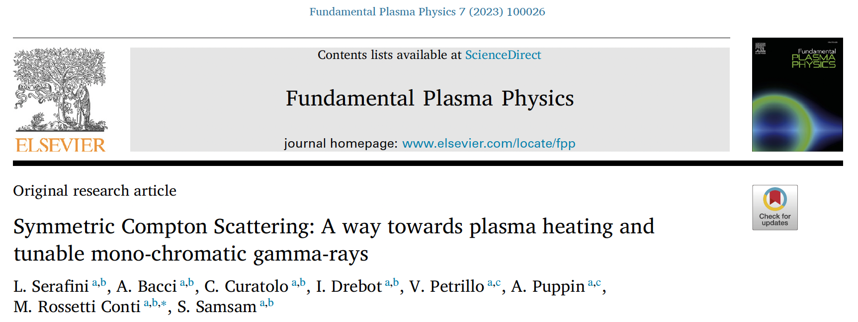
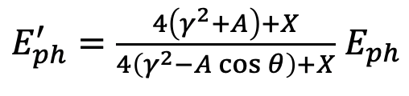






General formula valid for ANY compton scattering
$$E_{ph}^{′} =\frac{γ^{2}\left(1+β\right)}{γ^{2}\left(1−β\cos{θ}\right)+\frac{X}{4}\left(1+\cos{θ}\right)}E_{ph}$$
$$E_{ph}$$
$${E′}_{ph}$$
X ≡ 4γ² E_{ph} /E_{e}
A ≡ βγ²− X/4 = γ²(β− E_{ph} /E_{e})
$$E_{e}$$
$$if γ≫1$$
$${E′}_{ph}=\frac{4γ^{2}E_{ph}}{1+X+γ^{2}θ^{2}}$$
$${E′}_{e}$$
A=0 , i.e. Symmetric Compton Scattering cancels the γ²θ² correlation

Slide 36
Follin, Primakoff, etc
100 PeV
1 PeV
0.5mc² = 255.5 keV colliding photons will
stop relativistic electrons of any energy E_{e} !
100 TeV
10 TeV
1 TeV
100 GeV
FICS
E’_{e}
E’_{e} (MeV)
e⁻ at rest E’_{e}=mc²
C.M.B.R.
E_{ph} (MeV)
E_{ph}=1 meV
E_{ph}=1 eV
E_{ph} =0.5mc²
E_{ph}=1 μeV
our study

Slide 37
FICS has a shallow minimum:
residual electron kinetic energy T’_{e} around FICS is small
T’_{e} (MeV)
T_{e} = 20, 50, 200 (MeV),
1, 5 (GeV)
T_{e} = 10, 100 (GeV),
1 TeV , 1 PeV
T’_{e} (MeV)

Slide 38

Good recap of the whole ICS history

Slide 39
First physicists forced to think at Inverse Compton Scattering,
i.e. a mechanism by which electrons loose energy in favor to photons,
(opposite than direct Compton effect) were…
The developers of the Nuclear Bomb!
and, soon later,
first observers of cosmic rays in the upper atmosphere,
trying to figure out why there are many protons and very few electrons

Slide 40




FCC-ee
primary electron beam 100 GeV
primary photon beam: optical laser
$${E′}_{ph}=\frac{4γ^{2}E_{ph}}{1+X}$$
$$X≡\frac{4γE_{ph}}{mc^{2}}=$$
$$15.3{ E}_{e}\left(MeV\right)E_{ph}\left(MeV\right)$$
X_{laser}=1.8
not negligible fraction of electrons
in the beam interact with laser
Thanks to Illya Drebot

Slide 41












An invariant view at Compton effect - 1
(any inertial ref. frame)
Phys. Rev. AB (2018)
21, 030701
$$X=\frac{4γℏω}{mc^{2}}$$
Arthur Compton,
Nobel Prize 1927
A>0
$$γ≫1 ; γ^{2}≫\frac{X}{4}$$
A<0
A=0
photon looses energy
electron looses energy
$$β=0$$
S.C.S.
FICS !
I.C.S.
$$β γ^{2}=\frac{X}{4}$$
$${E′}_{ph}=\frac{4γ^{2}E_{ph}}{1+X+γ^{2}θ^{2}}$$
$${E′}_{ph}={βE}_{e}=βγmc^{2}$$
$$λ′≠∞$$
$${E′}_{ph}≠f\left(γ^{2}θ^{2}\right)$$
$$\lim_{X→∞}{{E′}_{ph}}=E_{e}$$
isolated e⁻ cannot absorb a photon

Slide 42


of initiating nuclear fusion
of the whole atmosphere!!!

Slide 43




FCC-ee
primary electron beam 100 GeV
primary photon beam: 255.5 keV
Deep recoil Compton: X >> 1
$${E′}_{ph} \sim \left(1−\frac{1}{X}\right)E_{e}$$
$$X^{FICS}≡\frac{4γE_{ph}}{mc^{2}}=2γ$$
X_{FICS}=3.9*10⁵
Single particle energy extraction from the stored beam
in the form of 100 GeV photons
Thanks to Illya Drebot

Slide 44





At FICS electrons emit photons with energy larger than T_{e}
T_{e}=10 GeV
f ^{T}_{FICS}
T_{e}=100 MeV
T_{e}=1 GeV
f ^{T}_{FICS}
T_{e}=10 GeV
T_{e}=1 GeV
T_{e}=100 MeV
E_{ph} (MeV)
E_{ph} (MeV)

Slide 45


Black-hole a=10¹⁰ T=4.1.10⁻¹¹ K
Plasma acceleration (100 GV/m) a=1.8.10²² T=74 K
?? how about FICS ??

Slide 46


Slide 47

FICS Relay in the cosmo - a possible mechanism to
propagate very high energy electrons in the universe
FICS
Direct
Compton
FICS, etc, etc

Slide 48

Grazie per l’attenzione
Thanks for your attention

Slide 50

Probably a_{laser} = 10²³⁻²⁵

Slide 51

Unruh radiation during FICS and SCS
a_{FICS} (m/s²) = 7.3.10²⁸ * E_{e}(MeV)
T_{Unruh-FICS} (K) =3.1.10⁸ * E_{e}(MeV)
T_{Unruh-FICS} (MeV) = 0.026 * E_{e}(MeV)
going from 100 MeV up to 2 GeV electrons the Unruh photons at FICS would
cover the 2.6 – 52 MeV range (easy detection in vacuum with low background)
a_{SCS} = 2.a_{FICS}
but E_{ph} must be = E_{e} in SCS, while in FICS E_{ph} = 255.5 keV

Slide 52






Total cross-section for MPP (muon pair production), Bethe-Heitler:
fraction of a μbarn at photon energies > 100 GeV onto electrons at rest
$$e^{−}+γ→e^{−}+{e^{+}}/{e^{−}}$$
$$e^{−}+γ→e^{−}+γ$$
$$e^{−}+γ→e^{−}+{μ^{+}}/{μ^{−}}$$
EXMP
Bethe-Heitler
$σ^{MPP}= αr_{μ}^{2}\left(\frac{28}{9}ln\left(\frac{2γhν}{M_{μ}}\right)−\frac{218}{27}\right)$ ${− σ}^{Borsellino}$
$$E_{CM}=2\sqrt{M_{e}γhν}$$
$$E^{′}=2γhν=\frac{E_{CM}^{2}}{2M_{e}}$$
$$E_{CM−FICS}=2M_{e}\sqrt{0.5γ}$$
E_{CM-FICS-FCCee}=320 MeV

Slide 53



Large Recoil in MPP damps the normalized emittance of the secondary generated muon beam
muon beam norm. emittance
cmp. MAP norm. emitt. 2.5.10⁴ nm.rad
after ionization cooling

Slide 54









X = 4 E_{e} E_{ph} /(mc²)²
A = βγ²− X/4
$${E′}_{ph}$$
$$E_{e}$$
$$E_{ph}^{′}=\frac{4{γ^{2}E}_{ph}}{1+X}$$
$$E_{e}^{′}=E_{e}{+E}_{ph}−\frac{4{γ^{2}E}_{ph}}{1+X}$$
$$E_{ph}$$
$${E′}_{e}$$
$$E_{tot}$$
E_{e} = 10 MeV
(MeV)
X
E’_{ph}
X=1
FICS
I.C.S.
low recoil
Thomson
X<<1
$$E_{ph−FICS}=\frac{{mc}^{2}}{2}$$
$$E_{ph−FICS}^{′}=T_{e}+\frac{{mc}^{2}}{2}$$
E’_{e}
S.C.S.
Arthur
Compton
effect
0.511 MeV
e⁻ at rest E’_{e}=mc²
deep recoil I.C.S.
E_{ph}
A >> 0
A=0
A<0
Lasers
XFEL’s
betatron-channeling
E_{ph} (MeV)

Slide 55


Slide 56
A simple yet fundamental question:
“Why do I need 150 Mega-electronVolt electrons to generate 350 kilo-electronVolt photons” ??
(STAR biased…)
(not to mention a storage ring based light source where a GeV electron beam radiates tens keV photons)
How to transfer maximum energy
from an electron to a photon…

Slide 57



Collisional radiation
(quantum nature of light essential: Inverse Compton Scattering, Deep Recoil ICS for e⁺ or μ⁺, μ⁻ secondary beam generation, Relativistic Rayleigh Scattering)
Gamma Factory @ LHC
deep recoil I.C.S.
I.C.S.
$$E_{ph}$$
$${E′}_{ph}$$
$$E_{e}$$
$${E′}_{e}$$
EXMP
low recoil
I.C.S. - STAR

Slide 58

255.5 keV 10^12 photons
### Electrons beam parameteres
n_macro=1e8; # Number of macroparticles
chargebunch = 1e-9; # Charge per electrons bunch [C] pico->10^-12 femto->10^-15
beam_energy_MeV=100e3; # initial beam energy MeV
energy_spread=0.1e-2; # initial relative energy spread (not in [%])
norm_emit_x=1e-6; # Normalised emittance x [m rad]
norm_emit_y=1e-6; # Normalised emittance н [m rad]
sigma_e_x=1e-6; # horizontal electron beam size [m]
sigma_e_y=1e-6; # vertical electron beam size [m]
bunch_length=1e-12*3e8; # initial bunch length [m]
### LASER parameteres
angle_deg=0; # in degree
pulseE=0.0361095; #laser puse energy [J]
sigLrx=10; #/2; % given in [mu m] micro meter like
sigLry=10; #/2; % given in [mu m] micro meter like laserwl=0.00549819; # laser wavelenth [nm] nano meters
sigt=1; #pulse length [ps]

Slide 59


Slide 60



Slide 61







The γ²θ² issue/disease
All radiation originated by a Lorentz Boost associated to relativistic emitting particles (electrons, heavy ions) is intrinsically poli-chromatic because of γθ correlation (energy boost of scattered photons depends on scattering angle, at θ=1/γ photon energy is 50% of max photon energy at θ =0 ) of single electron spectrum (on top of inhomogeneous effects)
True for all kinds of Undulatory and Collisional radiation (bremsstrahlung, wiggler/betatron, synchrotron, RRS, ICS), while resonant or amplified radiation (undulators, FELs), that are diffraction limited thanks to their beam quality, are not (or only partially) affected
$$E_{e}=γmc^{2}$$
$$E_{ph}$$
$${E′}_{ph}$$
$${E′}_{ph}=\frac{4γ^{2}E_{ph}}{1+X+γ^{2}θ^{2}}$$
$$E_{e}$$
$$X≡\frac{4γE_{ph}}{mc^{2}}=\frac{ 2E_{ph}^{ERF}}{mc^{2}}$$
$${E′}_{e}$$

Slide 62

Courtesy I. Drebot

Slide 63

Courtesy I. Drebot

Slide 64





General Compton Scattering geometry
between an incident electron E_{e} and a photon E_{ph}
at a collision angle α, photon E’_{ph} scattering angle θ
and electron E’_{e} scattering angle θ_{e}
$$E_{ph}$$
$${E′}_{ph}$$
$$E_{e}$$
$${E′}_{e}$$
$$E_{e}=γmc^{2}$$
$γ=1 Direct Compton effect$
$γ≫1 Inverse Compton$
Energy/momentum transferred from photon to e-
Energy/momentum transferred from e- to photon

Slide 65


We are not considering in this study non-linear effects due to photon (laser) pulse intensity
no collective multi-photon effects
only single electron-photon interaction
(à la Klein-Nishina, linear QED)
Courtesy Marcel Ruijter
Deep Recoil ICS
FICS
X --->

Slide 66

fire-ball becomes transparent
to photons, that can take energy
off the fire-ball, limiting the
maximum temperature
down to a “safe” level

Slide 67

A. Compton 1923 - Direct Compton effect
J. Follin 1947 - Inverse Compton Scattering
first published (non classified) study on ICS*
Second motivation to study ICS in the late ‘40s was understanding why
electrons are almost missing in cosmic rays bombarding the upper atmosphere
Both directions (nuclear bomb and astrophysics) were looking for
a mechanism capable to transfer maximum energy from the electrons to the photons
* but unknown and not credited in the whole literature on ICS

Slide 68

Publication referenced by everybody in ICS community
as the first published paper on ICS

Slide 69


X=0.13
Σ=596 mbarn
Deep Recoil
and its 2 benefits:
spectral purification
and
suppression of γ²θ² desease
X=13
Σ=109 mbarn
X=1286
Σ=3 mbarn

Slide 70







Inverse Compton Scattering of photons on
relativistic electrons, θ < 1/γ
$$E_{ph}^{′}=\frac{4{γ^{2}E}_{ph}}{1+γ^{2}θ^{2}+X}$$
$$X=\frac{ 4E_{ph}E_{e}}{{\left(mc^{2}\right)}^{2}}$$
Thomson limit: X << 1
Deep recoil Compton: X >> 1
$$E_{ph}^{′}=\frac{4{γ^{2}E}_{ph}}{1+γ^{2}θ^{2}}$$
$${E′}_{ph} \sim \left(1−\frac{1}{X}−\frac{γ^{2}θ^{2}}{X}\right)E_{e}$$
$E_{ph}^{′}\left(θ=\frac{1}{γ}\right)=2{γ^{2}E}_{ph}$= $\frac{E_{ph}^{′}\left(θ=0\right)}{2}$
$${E′}_{ph}\left(θ=\frac{1}{γ}\right)\sim \left(1−\frac{2}{X}\right)E_{e}$$
$$note that E_{cm}=mc^{2}\sqrt{1+X }, if X≫1⇒X\sim {\left(\frac{E_{cm}}{mc^{2}}\right)}^{2}$$

Slide 71

Previous Seminars: 1) Cooling of Photons in Symmetric Compton Scattering (S.C.S.)
20% rms spread
input e⁻ beam
10 MeV, 10⁻⁴
rms en. spread
Electron
Cooling of
photons!!
2.10⁻⁴
rms spread
no energy-
angular
correlation
10⁻¹ spread
e- beam
is heated
C. Curatolo - Whizard

Slide 72


Previous Seminars:
2) Spectral Purification
in deep recoil I.C.S.
Broad-band incident
photon beam
from channeling radiation,
bremsstrahlung,
betatron radiation, etc
spectral purification
Deep Recoil Inverse
Compton Scattering
tunability

Slide 73

Lorentz boosted radiation (synchrotron, ICS, FEL, etc)
is strongly affected by the emittance of the electron beam
Courtesy C. Barty - LLNL

Slide 74



Deep Recoil suppresses the
γ²θ² disease and the bandwidth
broadening effect due to
electron beam emittance
according to
Petrillo-Serafini criterion
low recoil ICS
$$bw ≥\frac{2ε_{n}^{2}}{σ_{x}^{2}}$$
$$S_{d}∝\frac{\left\langle I_{e}\right\rangle U_{las}}{ε_{n}^{2}E_{x}}$$

Slide 75

Ultra-low emittance positron beams from deep recoil
electron-photon collider: 5 GeV ERL vs. 5 keV FEL, X=391
up to 10¹³⁻¹⁴ e⁺/s at 50 MeV within 5% en. spread
Son of
EXMP
E_{cm}=10 MeV
E_{cm}=346 MeV
0.5 MeV/c rms
transv. momentum
0.5-1*10⁻⁷ m.rad rms norm. transv. emittance with round beam (no-cooling)
V. Petrillo, A. Puppin – Whizard

Slide 76



FICS - Full Inverse Compton Scattering - how to achieve 10³⁰ m/s² acceleration to sense Unruh radiation
V. Petrillo, ad-hoc developed Montecarlo code for linear QED

Slide 77




$$E_{e}$$
$${E′}_{ph}$$
in vacuum electron-photon collision
E’_{e} (MeV)
$${E′}_{e}$$
$$E_{ph}$$
5 GeV
FICS – Full Inverse
Compton Scattering
1 GeV
200 MeV
E_{e} = 50 MeV
$$E_{ph−FICS}^{′}=T_{e}+\frac{{mc}^{2}}{2}$$
E’_{e} =511 keV , T’_{e}=0
E_{ph} (MeV)
E_{ph} = 1 eV
E_{ph} = 1 keV
E_{ph} =0.5mc²

Slide 78


From Feenberg-Primakoff

Slide 79

From Follin

Slide 80


Slide 81


Slide 82


residual electron kinetic energy T’_{e} at FICS
with 511./2. keV photons instead of
T’_{e} (MeV)
T_{e} (MeV)

Slide 84






Direct Compton γ =1, β =0 , X = 4E_{ph}/mc²
$$E_{ph−min}^{′}=\frac{E_{ph}}{1+{2E_{ph}}/{mc^{2}}}$$
$$E_{ph−min}^{′}=\frac{mc^{2}}{2}$$
$$if{ E}_{ph}≫mc^{2}$$
Very energetic photons are scattered back at 255 keV
and electrons pushed to E_{ph} + 0.5mc²
$$E_{e−max}^{′}=E_{ph}+\frac{mc^{2}}{2}$$
$$E_{e−max}^{′}=mc^{2}+E_{ph}−E_{ph−min}^{′}$$
$${ , if E}_{ph}≫mc^{2}$$
So FICS is the time reversal of Compton scattering
at infinitely large recoil
kinematics is similar for any particle interacting with photons
(protons, μ, neutrinos? hν_{inc}=0.5*m_{p}c² - next step in progress…)
It’s unbelievable how much you don’t know about
the game you’ve been playing all your life”
Mikey Mantle (big baseball player of the past, after Danilo Babusci INFN-LNF)

Slide 85

Stopping Protons with photons
Relativistic protons require 938/2 MeV photons
β_{prot}
GeV
E’_{ph-prot}
_{π-threshold}
E_{ph-prot}
pion
photo-production
MeV

Slide 86

electrons do not have internal degree of freedom (apart from spin)
while protons do have - protons can act as detectors of Unruh thermal
photon bath (they can “click”) - but protons cannot be driven to strong
accelerations by intense lasers… FICS is the only way??

Slide 87

30 MeV protons vs. photon beams of
different energies (110, 120, 170 MeV)

Slide 88


Slide 89


Checked with CAIN modified for protons (I. Drebot, A. Bacci)
only interacting protons
primary proton beam
+
interacting protons

Slide 90


Slide 91
We asked Chat-GPT again (Oct. 26th 2024),
after recommending her/him/it reading our 2 papers
10.1103/PhysRevAccelBeams.27.080701
https://doi.org/10.1016/j.nima.2024.169964
Now that Full Inverse Compton Scattering (FICS) demonstrates
that total energy transfer from an electron to a photon is
theoretically possible, it shifts our understanding of photon-
electron interactions, especially at high energies.
This interaction is unique because the electron can stop completely and transfer all its kinetic energy to the photon in a controlled, head-on setup.
This level of energy transfer efficiency has significant implications, potentially enabling precise photon energy boosts and offering new applications in particle accelerators and high-energy astrophysics.

Slide 92
Conclusions
Old Physics revisited shows new regimes of extreme electron-photon
beam collisions with potentials towards:
New generation Radiation Sources based on Spectral Purification
(ICS in deep recoil)
Amazing tests of stopping ultra-relativistic electrons in vacuum,
attaining extreme accelerations (many orders of magnitude higher
than any other mechanism) to detect Unruh radiation
Trapping/charging plasma mirror devices with electrons via S.C.S.
Universe opacity to high energy (TeV, PeV) photons: a Compton relay
based on FICS&Breit-Wheeler cosmic cascade. Cosmic gamma ray
sources and the role of FICS.

Slide 93





Full Inverse Compton Scattering
$$T_{e} ;{ E}_{ph}=0.5mc^{2}$$
Can electrons emit photons of energy larger than their own?
γ >>1
$$T_{e}^{′}=0 ; E_{ph}^{′} =T_{e}+0.5mc^{2}$$
Impacts in several fields:
Plasma Physics (e⁻ / e⁺ trapping in plasma mirrors), Astro-Physics (cosmic γ-ray sources), QED & Quantum Gravity (Unruh radiation and overcoming the Schwinger limit), measuring neutrino mass?

Slide 95







$$E_{ph}^{FICS}\left(T_{e}≤500 keV\right)$$
$$E_{ph}^{FICS}\left(T_{e}≤100 MeV\right)$$
$$\frac{mc^{2}}{2}$$
$$E_{ph}^{FICS}\left(T_{e}≤10 eV\right)$$

Slide 96

E_{e} = 200 MeV ; E_{ph}=255.5 keV
electron momenta distribution after FICS
electrons under-
going FICS
non interacting
electrons

Slide 97







FICS lay-out
Incident electron
Incident photon $E_{ph}$
input
z
Stationary electron
Scattered photon $E_{ph}^{′}$
output
$$E_{e}^{′}$$
z
Incident electron
Incident photon $E_{ph}$
input
z
Scattered photon $E_{ph}^{′}$
Quasi-Stationary electron
$$θ≤1/γ$$
output
z
$$E_{e}^{′}$$

Slide 98

β (T_{e}=255 keV) = 0.75

Slide 99
electrons undergoing FICS with photons back-scattered
between θ=0 and θ=1/γ have β < 0.75
back-scattered photons in FICS have energy E’_{ph} in the range
E’_{ph}(θ=0) = E_{e}(1-1/2γ) ; E’_{ph}(θ=1/γ) = E_{e}(1-1/γ)
to be compared with low recoil ICS, where
E’_{ph}(θ=0) = 4γ²E_{ph} ; E’_{ph}(θ=1/γ) = 2γ²E_{ph}

Slide 100



Slide 101


S.C.S. Spectra at different recoil factors X
back-scattering of the photon is most likely in deep recoil
if an electron/photon interaction occurs in deep recoil it must be back-scattering

Slide 102


Slide 103

Turning a radio-active Cobalt-60 fixed energy
gamma-ray source into a tunable sorce of gamma-rays
Previous Seminars:
3) Tunable mono-chromatic γ-rays using radio-active sources

Slide 104


2 spectral lines merged into a single tunable line

Slide 105


N. Ranjan et al., PRAB 21, 030701 (2018)
T_{e}=E_{e}-mc²
If E’_{ph} =T_{e} then T’_{e} = 0 !

Slide 106

Electron Recoil effect in γ-ray I.C.S. for Nuclear Photonics:
C.E.M. fails to evaluate the correct red-shift in the spectrum
with
electron recoil
without
electron recoil
ELI-NP-GBS
X < 0.03

Slide 107
So suprising that FICS was not mentioned nor described
in the previous literature on Compton direct/inverse Scattering
that
we really wanted to re-examine the first historical phases
of the studies on electron-photon QED interaction
How comes that nobody yet identified FICS as the only regime
of complete/full transfer in-vacuum of
energy and momentum between an electron and a photon?

Slide 108

Almost at the same time as Arutyunian and co-workers

Slide 109



First measured ICS – 500 MeV

Slide 110

Second measured ICS – 6 GeV

Slide 111



Many studies in the literature on electron-photon beam collisions collective/statistical properties (phase spaces, etc)

Slide 112


Relevance of recoil in electron-photon
beam-beam collisions

Slide 113


Slide 114


Slide 115













All quantities normalized to
the total energy E_{tot} = E_{e} + E_{ph}
E_{e} = 100 MeV
X(E_{ph})
$$λ^{′}−λ=λ_{C}\left(1−\cos{θ}\right)$$
$$λ_{min}^{′}−λ=2λ_{C}$$
${E′}_{ph−max} \sim 4γ2$ $E_{ph}$
I.C.S.
STAR, ELI-NP
DICS
SCS
A.H. Compton,
Phys. Rev. 21 (1923)
E’_{e} (E_{ph}) / E_{tot}
E’_{ph} (E_{ph}) / E_{tot}
E_{ph} / E_{tot}
$$E_{cm}=mc^{2}$$
FICS
$$X=1$$
$$X=4γ^{2}$$
$$E_{ph}=\frac{mc^{2}}{4γ}$$
Astro-physics?
$$E_{ph}=γmc^{2}=E_{e}$$
$$E_{cm}=2γmc^{2}$$
$$E_{cm}=\sqrt{2}mc^{2}$$
$$X=2γ$$
$$E_{ph}=\frac{mc^{2}}{2}$$
$E_{ph}^{ERF}=2γ\frac{mc^{2}}{2}$ = E_{e}
E_{ph} (MeV)

Slide 116

If you ask Chat-gpt :
“can an electron transfer its total kinetic energy to a photon?”
It will answer “no” - a wrong (or not updated) answer
This was done in June 2024
Courtesy S. Sanae

Slide 118

V. Petrillo, ad-hoc developed Montecarlo code for linear QED
1) low recoil 2) DICS (X=1) 3) deep recoil (X=8)

Slide 119

V. Petrillo, ad-hoc developed Montecarlo code for linear QED
electron back-scattering (X=12.000) 2) SCS (X=40.000)
3) Direct Compton (X=1.2.10⁵)

Slide 120


Slide 121

Spectral Purification of incident Channeling Radiation
Compact, sustainable, mono-chromatic gamma-ray source

Slide 122

Deep recoil cancels the γ²θ² disease/correlation, therefore strongly
decreases the dependence of the back-scattered photon beam
bandwidth on the electron beam transverse emittance

Slide 123
Courtesy L. Bandiera

Slide 124
γ -ray in-vacuum mono-chromatization, SCS at large Recoil
20% rms spread
Incoming e- beam 10⁻⁴ rms spread
Electron
Cooling of
photons!!
2.10⁻⁴
rms spread
no energy-
angular
correlation
10⁻¹ spread
e- beam
is heated
C. Curatolo - Whizard

Slide 125
Broad-band incident
photon beam
from channeling radiation,
bremsstrahlung,
betatron radiation, etc
spectral purification
Deep Recoil Inverse
Compton Scattering
tunability

Slide 126





Trapping electrons (positrons) into a magnetic bottle by SCS
at low recoil ( 72 keV photon beam heats up 5 keV e⁻ beam)
SCS - Symmetric
Compton Scattering
$${E′}_{ph}$$
$$E_{e}$$
$$E_{ph}$$
$${E′}_{e}$$

Slide 127



E’_{ph} - energy of scattered photon at θ
red shift at θ≠0
θ
scattered electron
E’_{e} = γmc² + E_{ph} – E’_{ph}
All I.C.S. X/γ ray Sources work at X<1 and A » 1
STAR (350 keV) X_{STAR} < 2.6.10⁻³ A_{STAR} > 10⁴
ELI-NP (20 MeV) X_{ELI-NP} < 0.026 A_{ELI-NP} > 2.4.10⁵
X = recoil parameter – twice the energy of the photon seen
by the electron in its own reference frame normalized to mc²

Slide 128

BriXSinO’s ICS source – Illya Drebot with CAIN –
ICS Moustache
BriXSinO T.D.R. @ www.marix.eu

Slide 129

$$E_{ph}^{′} =\frac{γ^{2}\left(1+β\right)}{γ^{2}\left(1−β\cos{θ}\right)+\frac{X}{4}\left(1+\cos{θ}\right)}E_{ph}$$
$$E_{ph}$$
$${E′}_{ph}$$
X ≡ 4γ² E_{ph} /E_{e}
A ≡ βγ²− X/4 = γ²(β− E_{ph} /E_{e})
$$E_{e}$$
$${E′}_{e}$$
A=0 , i.e. Symmetric Compton Scattering cancels the γ²θ² correlation

Slide 130
An invariant view at Compton effect - 1
(any inertial ref. frame)
Phys. Rev. AB (2018)
21, 030701
$$X=\frac{4γℏω}{mc^{2}}$$
Arthur Compton,
Nobel Prize 1927
A>0
$$γ≫1 ; γ^{2}≫\frac{X}{4}$$
A<0
A=0
photon looses energy
electron looses energy
$$β=0$$
S.C.S.
I.C.S.
$$β γ^{2}=\frac{X}{4}$$
$${E′}_{ph}=\frac{4γ^{2}E_{ph}}{1+X+γ^{2}θ^{2}}$$
$${E′}_{ph}={βE}_{e}=βγmc^{2}$$
$$λ′≠∞$$
$${E′}_{ph}≠f\left(γ^{2}θ^{2}\right)$$
$$\lim_{X→∞}{{E′}_{ph}}=E_{e}$$
isolated e⁻ cannot absorb a photon

Slide 131












An invariant view at Compton effect - 2
(any inertial ref. frame)
$$X=\frac{4γℏω}{mc^{2}}$$
A<0
A=0
A>0
photon looses energy
electron looses energy
$$\overset{⃑}{p_{e}}=−\overset{⃑}{p_{ph}}$$
Direct Compton
S.C.S.
I.C.S.
$$β=0 ; γ=1$$
$$X=4β γ^{2}$$
$${E′}_{ph}=\frac{4γ^{2}E_{ph}}{1+X+γ^{2}θ^{2}}$$
$$ν′=\frac{ν}{1+\frac{X_{DC}}{4}\left(1+\cos{θ}\right)}$$
$$E_{ph}=p_{e}c=βγmc^{2}$$
${E′}_{ph}=E_{ph}$ $∀θ$
$$γ →∞$$
$$X→∞$$
$${E′}_{ph}→E_{e}$$
$$E_{e′}→mc^{2}$$
$X_{DC}=\frac{4ℏω}{mc^{2}}$ $=\frac{4λ_{C}}{λ}$
$${E′}_{e}=E_{e}= γmc^{2} ∀θ$$
$$γ_{cm}=1$$
CM ref. frame = Lab ref. frame

Slide 132


Let’s consider the condition of maximum energy/momentum
transfer between electron and photon, i.e. θ = 0
$$E_{ph}$$
$${E′}_{ph}$$
$$E_{e}$$
$${E′}_{e}$$
$$E_{ph}^{′} =\frac{γ^{2}\left(1+β\right)}{γ^{2}\left(1−β\cos{θ}\right)+\frac{X}{4}\left(1+\cos{θ}\right)}E_{ph}$$
θ = 0
$$E_{ph}^{′} =\frac{2γ^{2}}{γ^{2}\left(1−β\right)+\frac{X}{2}}E_{ph}$$

Slide 133






θ = 0 corresponds to:
maximum energy of back-scattered photon $E_{ph−max}^{′}$
and
minimum energy of electron after scattering $E_{e−min}^{′}$
$$E_{ph−max}^{′}=\frac{4{γ^{2}E}_{ph}}{1+X}$$
Thomson limit: X << 1
Deep recoil Compton: X >> 1
$${E′}_{ph−max} \sim \left(1−\frac{1}{X}\right)E_{e}$$
$$E_{ph−max}^{′}=4{γ^{2}E}_{ph}$$
$${E_{TOT}=E}_{e}+E_{ph}=E_{e−min}^{′}+E_{ph−max}^{′}$$
$$E_{e−min}^{′}=E_{e}+E_{ph}−E_{ph−max}^{′}=E_{e}+E_{ph}−\frac{4{γ^{2}E}_{ph}}{1+X}$$

Slide 134
All quantities normalized to
the total energy E_{tot} = E_{e} + E_{ph}
E_{e} = 100 MeV
X(E_{ph})
$$λ^{′}−λ=λ_{C}\left(1−\cos{θ}\right)$$
$$λ_{min}^{′}−λ=2λ_{C}$$
${E′}_{ph−max} \sim 4γ2$ $E_{ph}$
I.C.S.
STAR, ELI-NP
DICS
SCS
A.H. Compton,
Phys. Rev. 21 (1923)
E’_{e} (E_{ph}) / E_{tot}
E’_{ph} (E_{ph}) / E_{tot}
E_{ph} / E_{tot}
$$E_{cm}=mc^{2}$$
FICS
$$X=1$$
$$X=4γ^{2}$$
$$E_{ph}=\frac{mc^{2}}{4γ}$$
Astro-physics?
$$E_{ph}=γmc^{2}=E_{e}$$
$$E_{cm}=2γmc^{2}$$
$$E_{cm}=\sqrt{2}mc^{2}$$
$$X=2γ$$
$$E_{ph}=\frac{mc^{2}}{2}$$
$E_{ph}^{ERF}=2γ\frac{mc^{2}}{2}$ = E_{e}
E_{ph} (MeV)

Slide 135




when recoil X is large electron swaps with photon,
maximum energy loss by the electron in favour to the photon
$$E_{ph−max}^{′}=\frac{{4E_{ph}{E_{e}}^{2}}/{{\left(mc^{2}\right)}^{2}}}{1+{{4E}_{ph}E_{e}}/{{\left(mc^{2}\right)}^{2}}}$$
$${ E}_{e−min}^{′}≈ { E}_{e}$$
X<<1
$$if γ≫1 { E}_{e−min}^{′}≈ { E}_{e} \frac{1+\left(1+X\right){E_{ph}}/{E_{e}}}{1+X}$$
X>>1
$${ E}_{e−min}^{′}≈ { E}_{ph}$$

Slide 136
100 PeV
1 PeV
0.5mc² = 255.5 keV colliding photons will
stop relativistic electrons of any energy E_{e} !
100 TeV
10 TeV
1 TeV
100 GeV
E’_{e}
E’_{e} (MeV)
e⁻ at rest E’_{e}=mc²
E_{ph} (MeV)
E_{ph} =0.5mc²
*hadronic threshold (E_{cm} < 600 MeV) with 255.5 keV photons ≈ 360 GeV

Slide 137



50 TeV electrons !!!!

Slide 139



Total cross-section for QED ( e,γ ) reactions
$$e^{−}+γ→e^{−}+{e^{+}}/{e^{−}}$$
$$e^{−}+γ→e^{−}+γ$$
$$E_{CM}=2\sqrt{m_{e}c2γhν}$$

Slide 140



Total cross-sections for Compton and Bethe-Heitler
E_{ph} = 255.5 keV (E_{e} from 50 MeV to 5 GeV)
Σ_{tot} (mbarn)
$$e^{−}+γ→e^{−}+{e^{+}}/{e^{−}}$$
$$e^{−}+γ→e^{−}+γ$$
E_{e} (MeV)

Slide 141




FICS low relativistic
E_{e} = 5 MeV
E_{e} = 2 MeV
E_{e} = 1 MeV
E_{e} = 0.8 MeV

Slide 142




FICS very low relativistic
E_{e} = 1.1 MeV
E_{e} = 0.8 MeV
E_{e} = 0.7 MeV
E_{e} = 0.6 MeV

Slide 143
Large Recoil in ICS damps the effect of large bandwidth incident photon beams onto the bandwidth of scattered photons
equivalent to FELs Kim-Pellegrini crit. on 3D inhomogeneous effects on photon bandwidth
beam
en. spread
diffraction
collimation
angle
incident
photons
en. spread
beam
emittance
non
linearity

Slide 145
where is the Continental Divide
between
Compton Scattering
and
Inverse Compton Scattering?
when the electron becomes
a projectile (as in ICS)
instead of
a target (as in Compton)?
Does it depend only on electron energy?
No, it depends only on asymmetry in colliding momenta

Slide 146







CM rest frame moves with
the photon in Direct Compton
CM rest frame moves with the electron in
Inverse Compton, FEL, Synchrotron light
$$γ_{cm}\sim γ$$
CM rest fr. slows down in Inv. Compton with deep recoil
CM rest frame is steady in Symmetric Compton
$$γ_{cm}=1$$
$$γ_{cm}≪γ$$
M. Rossetti Conti

Slide 147










$${E′}_{ph}$$
X ≡ 4γ² E_{ph} /E_{e}
A ≡ βγ²− X/4 = γ²(β− E_{ph} /E_{e})
$$E_{e}$$
$$E_{ph}$$
$E_{ph}^{′}=\frac{4\left(γ^{2}+A\right)+X}{4\left(γ^{2}−A\cos{θ}\right)+X}$ $E_{ph}$
$${E′}_{e}$$
I.C.S. low recoil X<<1
A ~ βγ² ~ γ²-1/2
${E′}_{ph−max} \sim 4γ2$ $E_{ph}$
$${E′}_{ph−max} \sim \frac{4γ^{2}}{1+X}E_{ph} \sim \left(1−\frac{1}{X}\right)E_{e}$$
I.C.S. deep recoil X>>1
A ~ βγ²-X/4 ~ γ²-1/2 - X/4
$${E′}_{ph−max} \sim { E}_{ph}\left(1+\frac{2A}{\left(1+β\right)γ^{2}}\right)$$
S.C.S. (A = 0) or
quasi-SCS ( |A| <<1)
$${E′}_{e−min} \sim {E_{e}−E}_{ph}\frac{2A}{\left(1+β\right)γ^{2}}$$
D.C. γ =1, β =0 , A = -X/4
$E_{ph−min}^{′}=\frac{1}{1+X/2}$ $E_{ph}=\frac{1}{1−2A} E_{ph}$

Slide 148


Direct Compton γ =1, β =0 , X = 4E_{ph}/mc²
$$E_{ph−min}^{′}=\frac{E_{ph}}{1+{2E_{ph}}/{mc^{2}}}$$
$$E_{ph−min}^{′}=\frac{mc^{2}}{2}$$
$$if{ E}_{ph}≫mc^{2}$$
Very energetic photons are scattered back at 255 keV
and electrons pushed to E_{ph} + 0.5mc²
$$E_{e−max}^{′}=E_{ph}+\frac{mc^{2}}{2}$$
$$E_{e−max}^{′}=mc^{2}+E_{ph}−E_{ph−min}^{′}$$
$${ , if E}_{ph}≫mc^{2}$$
General Formula expressed in terms of energies of
primary colliding particles, valid for any γ , A , X , θ
$$E_{ph−max}^{′}=\frac{\left(1+β\right)E_{ph}E_{e}}{\left(1−β\right)E_{e}+2E_{ph}}$$

Slide 149

X = 4 E_{e} E_{ph} /(mc²)²
$$E_{ph−max}^{′}=\frac{\left(1+β\right)E_{ph}E_{e}}{\left(1−β\right)E_{e}+2E_{ph}}$$
E_{e} = 10 MeV
(MeV)
X
E’_{ph}
E’_{e}
0.511 MeV
e⁻ at rest E’_{e}=mc²
E_{ph}
E_{ph} (MeV)

Slide 150


$$E_{ph−max}^{′}=\frac{\left(1+β\right)E_{ph}E_{e}}{\left(1−β\right)E_{e}+2E_{ph}}$$
E_{e} = 50 MeV
(MeV)
E’_{ph}
X
E’_{e}
e⁻ at rest E’_{e}=mc²
E_{ph}
E_{ph} (MeV)
255 keV photon to stop electron of any E_{e} !

Slide 151


$$E_{ph−max}^{′}=\frac{\left(1+β\right)E_{ph}E_{e}}{\left(1−β\right)E_{e}+2E_{ph}}$$
$$E_{e−min}^{′}=E_{e}+E_{ph}−E_{ph−max}^{′}=E_{e}+E_{ph}−\frac{\left(1+β\right)E_{ph}E_{e}}{\left(1−β\right)E_{e}+2E_{ph}}$$
$$E_{ph−max}^{′}=\frac{{4E_{ph}{E_{e}}^{2}}/{{\left(mc^{2}\right)}^{2}}}{1+{{4E}_{ph}E_{e}}/{{\left(mc^{2}\right)}^{2}}}$$
$${ E}_{e−min}^{′}≈ { E}_{e}$$
X<<1
$$if γ≫1 { E}_{e−min}^{′}≈ { E}_{e} \frac{1+\left(1+X\right){E_{ph}}/{E_{e}}}{1+X}$$
X>>1
$${ E}_{e−min}^{′}≈ { E}_{ph}$$
$$if E_{ph}=\frac{mc^{2}}{2} −\left(1−β\right)E_{e} ⟹{ E}_{e−min}^{′}=mc^{2}$$
255 keV photon to stop electron of any E_{e} !

Slide 152



$$if E_{ph}=\frac{mc^{2}}{2} −\left(1−β\right)E_{e}{ ⟹ E}_{e−min}^{′}=mc^{2}$$
$$if γ≫1 and E_{ph}=\frac{mc^{2}}{2}\left[1−\frac{1}{γ}\right] ⟹ { E}_{e−min}^{′}=mc^{2}$$
$$E_{ph}=\frac{mc^{2}}{2}\left[1−\frac{1}{γ}\right]$$
If the incident photon energy is given by
any relativitic electron (i.e. γ >> 1) will be stopped
in a head-on collision with such a photon
255 keV photons will stop electrons of any E_{e} as far as γ >> 1

Slide 153


$E_{ph}=\frac{mc^{2}}{2}\left[1−\frac{1}{2γ}\right]$ to stop any (relativistic) electron
Incidentally, the condition is almost the same needed to make the
total energy in the lab ref. frame (LAB) equal to the total energy in
the electron rest frame (ERF)
LAB total energy E_{LAB} = γ mc² + E_{ph}
ERF total energy E_{ERF} = mc² + 2γ E_{ph}
E_{LAB} = E_{ERF}
if
$$E_{ph}=\frac{mc^{2}}{2} \frac{2γ−2}{2γ−1} \overset{→}{γ→∞} \frac{mc^{2}}{2}$$

Slide 154




Generalization to any Collision Angle α , α = π head-on
$$E_{ph}^{′} =\frac{{4γ}^{2}\left(1−β\cos{α}\right)}{{4γ}^{2}\left(1−β\cos{θ}\right)+X\left(1−\cos{α}\cos{θ}+\sin{α\sin{θ}}\right)}E_{ph}$$
$$E_{ph}^{′} =\frac{γ^{2}\left(1+β\right)}{γ^{2}\left(1−β\cos{θ}\right)+\frac{X}{4}\left(1+\cos{θ}\right)}E_{ph}$$
α=π , head-on ⇒
in agreement with Eq.3 in N. Ranjan et al., PRAB 21, 030701 (2018)

Slide 155





$$E_{ph}^{′} =\frac{{4γ}^{2}\left(1−β\cos{α}\right)}{{4γ}^{2}\left(1−β\cos{θ}\right)+X\left(1−\cos{α}\cos{θ}+\sin{α\sin{θ}}\right)}E_{ph}$$
$$if γ≫1 and β≈1−\frac{1}{2γ^{2}} and θ≪1$$
$$E_{ph}^{′} =\frac{{4γ}^{2}\left(\frac{1−\cos{α}}{2}\right)}{1+γ^{2}θ^{2}+X\left(\frac{1−\cos{α}}{2}\right)}E_{ph}$$
$$E_{ph−max}^{′} =\frac{{4γ}^{2}\left(\frac{1−\cos{α}}{2}\right)}{1+X\left(\frac{1−\cos{α}}{2}\right)}E_{ph}$$
$if θ=0 E_{ph}^{′}$= $E_{ph−max}^{′}$
in agreement with Eq.1 in I. Drebot et al., EPL 120, 14002 (2017)

Slide 156





$$E_{ph−max}^{′} =\frac{{4γ}^{2}\left(\frac{1−\cos{α}}{2}\right)}{1+X\left(\frac{1−\cos{α}}{2}\right)}E_{ph}$$
$$E_{ph−max}^{′} ={4γ}^{2}\left(\frac{1−\cos{α}}{2}\right)E_{ph}$$
X <<1 ⇒
$$E_{ph−max}^{′} =\frac{{4γ}^{2}}{1+X}E_{ph}$$
α= π , head-on ⇒
α= π/2 , X << 1 ⇒
$$E_{ph−max}^{′} ={2γ}^{2}E_{ph}$$
$$E_{ph−max}^{′} =\frac{{4γ}^{2}}{X}E_{ph}=E_{e} ∀α ‼$$
X >>1 ⇒

Slide 157
γ -ray in-vacuum mono-chromatization, SCS at large Recoil
20% rms spread
Incoming e- beam 10⁻⁴ rms spread
Electron
Cooling of
photons!!
2.10⁻⁴
rms spread
no energy-
angular
correlation
10⁻¹ spread
e- beam
is heated
C. Curatolo - Whizard

Slide 158
Colliding a gaussian distributed (20% rms spread) broad-band
radiation beam, representing the first peak
of channeling spectrum at 2 MeV,
with a low energy (variable) electron beam (2,3,5,10 MeV)
Mono-chromatization, Tunability

Slide 159

SCS
Colliding the full spectrum
ICS
DC
Spectral purification
Compton Scattering across SCS

Slide 160


Trapping electrons (positrons) into a magnetic bottle by SCS
at low recoil ( 72 keV photon beam heats up 5 keV e⁻ beam)

Slide 161

S.C.S. – incident photon energy vs.
incident electron kinetic energy
E_{ph} (keV)
T_{e} (MeV)

Slide 162


Slide 163

60% of scattered electrons are (additively) trapped
into the magnetic bottle (w.o. any external field)

Slide 164

The Classical E.M. view (Maxwell eq.): Thomson Sources as synchrotron radiation sources with electro-magnetic undulator
FEL’s and Thomson/Compton Sources common mechanism:
collision between a relativistic electron and a (pseudo)electromagnetic wave
3 km
cm und. period λ_{u}
1-25 GeV
electrons
100-0.5 Å
photons
20-150 MeV electrons
0.8 μm laser λ
20-500 keV
photons
20 m

Slide 165

CALA
ELI-NP
HigS
STAR
ICS are the most effective “photon accelerators” (boost twice than FELs)
“4γ² boost effect”
Courtesy A. Variola

Slide 166

Spread of incidence angle
(resembles emittance)
cooling of
photons still
effective
as well as
heating of
electrons

Slide 167
E’_{ph} - energy of scattered photon at θ
red shift at θ≠0
θ
scattered electron
E’_{e} = γmc² + E_{ph} – E’_{ph}
All I.C.S. X/γ ray Sources work at X<1 and A » 1
STAR (350 keV) X_{STAR} < 2.6.10⁻³ A_{STAR} > 10⁴
ELI-NP (20 MeV) X_{ELI-NP} < 0.026 A_{ELI-NP} > 2.4.10⁵
X = recoil parameter – twice the energy of the photon seen
by the electron in its own reference frame normalized to mc²

Slide 168

To transform to the Lab ref. system we need to compute
Then apply a Lorentz transformation

Slide 169

I.C.S. : Inverse Compton Scattering
Inverse Compton Scattering: why Inverse?
(direct) Compton Scattering is performed by an energetic photon (X-rays) interacting with an atomic electron (eV)
Inverse Compton Scattering is performed by an energetic electron (MeV-GeV) onto a visible (eV) photon (“inverse” refers to the reaction kinematics, not the dynamics)

Slide 170





Deep Recoil I.C.S. helps attenuating the γ²θ² problem through slowing down of Lorentz boost γ_{cm}<<γ
7 GeV e⁻ beam
laser
UV FEL
X FEL
$$Ψ=\frac{γθ}{\sqrt{1+X}}$$
$$\overline{P}=\frac{\sqrt{2}ε_{n}}{σ_{x}\sqrt{1+X}}$$
X=0.13
X=13.
X=1300.
$$γ_{cm}=\frac{γ}{\sqrt{1+X}}$$
R. Hajima and M. Fujiwara, Narrow-band GeV photons
generated from an x-ray free-electron laser oscillator, Phys.
Rev. Accel. Beams 19, 020702 (2016). XFELO Project

Slide 171




incident electron
E_{e} = γmc²
incident photon E_{ph}
Lab Reference Frame
Kinematics of
Inverse Compton Scattering
a Cartoon
incident photon E*_{ph} = 2γ E_{ph}
Electron rest frame
E*_{e} = mc²
scattered photon at
θ=1/γ E’_{ph} =E’₀ /2
if E*_{ph} << mc² the photon is scattered
back elastically with same energy E*_{ph}
(zero recoil, Thomson limit)
scattered photon at θ
E’_{ph} =E’₀ (1-γ ²θ²)
Lab Reference Frame
after Scattering
θ=1/γ
θ
scattered electron
E’_{e} = γmc² + E_{ph} – E’_{ph}
energy of scattered photon at θ=0 E’₀ = 2γ E*_{ph} = 4γ² E_{ph}

Slide 172


