Slide 1
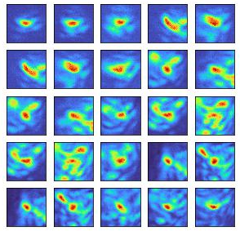
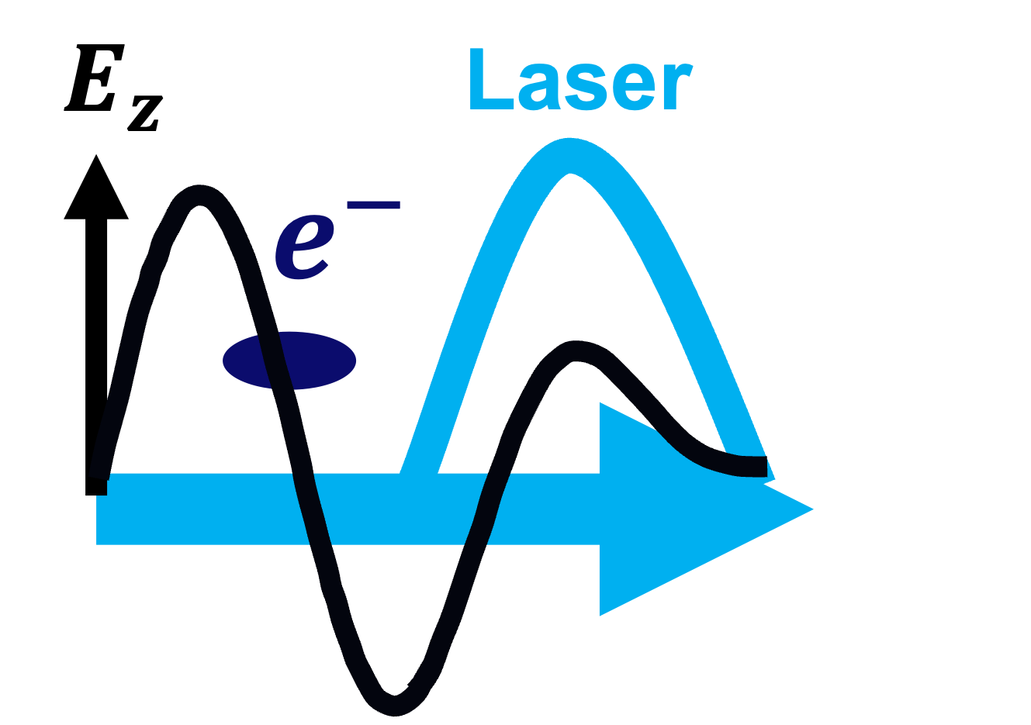
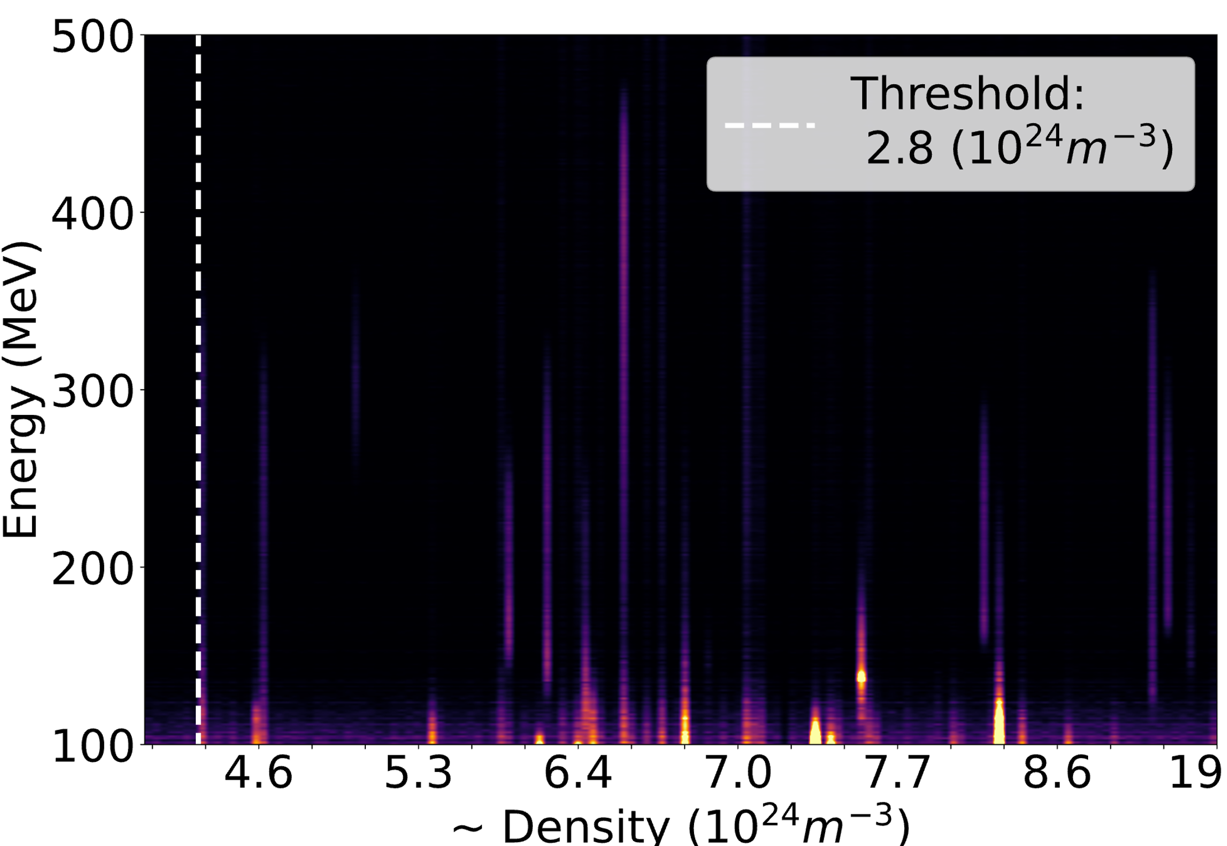
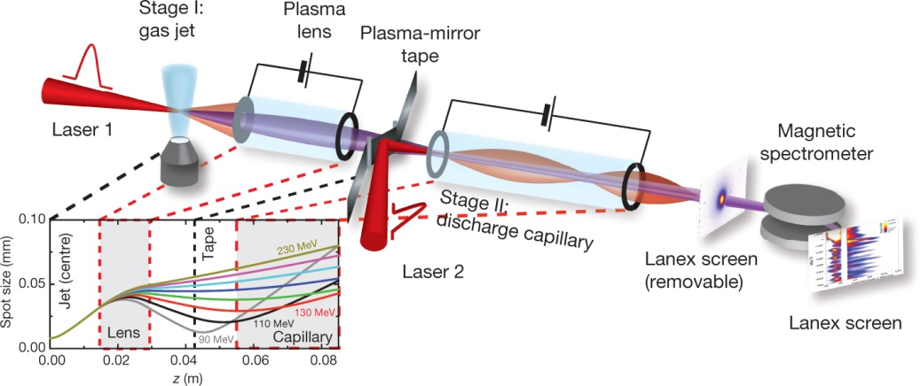
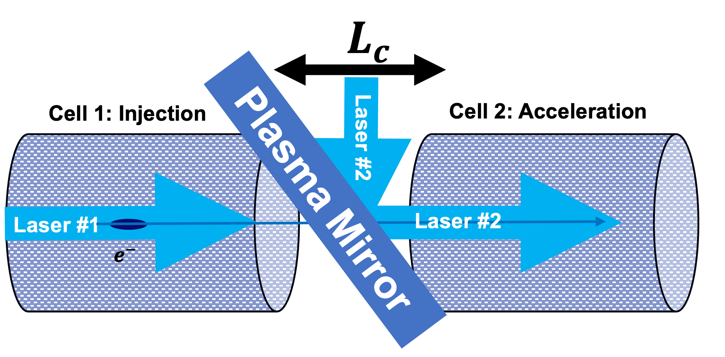
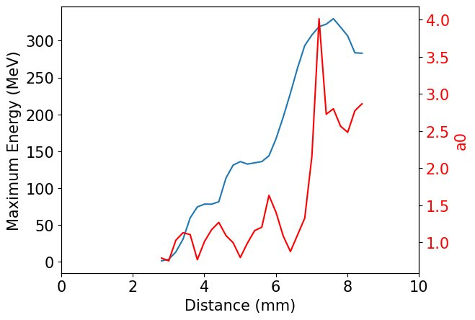
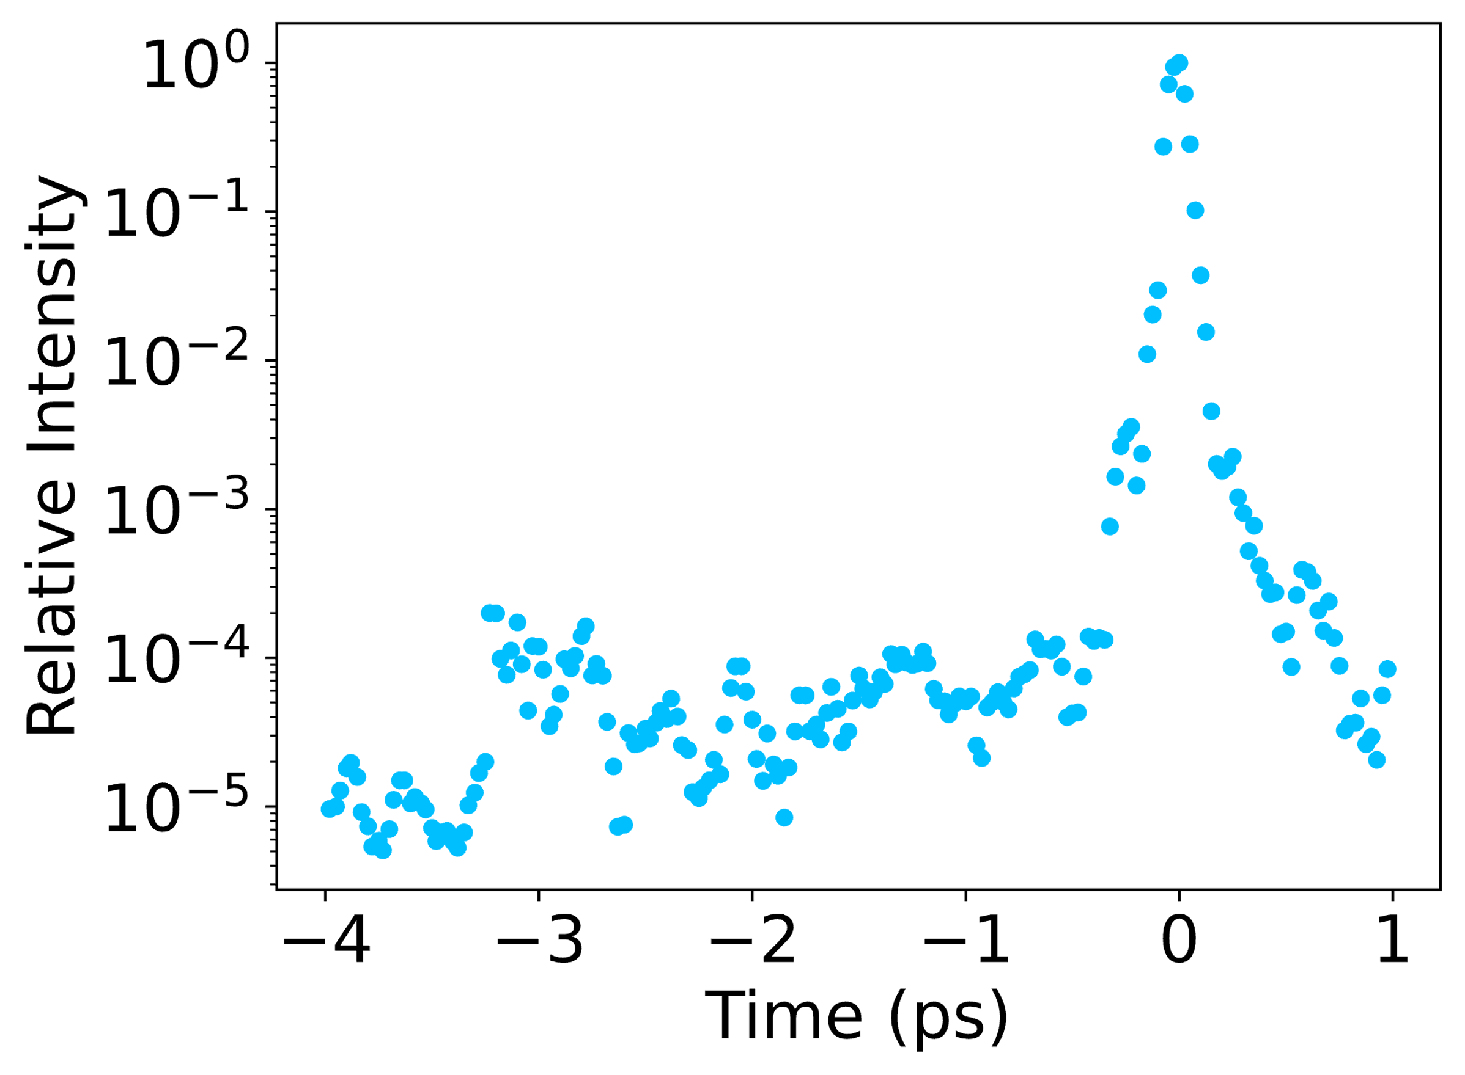
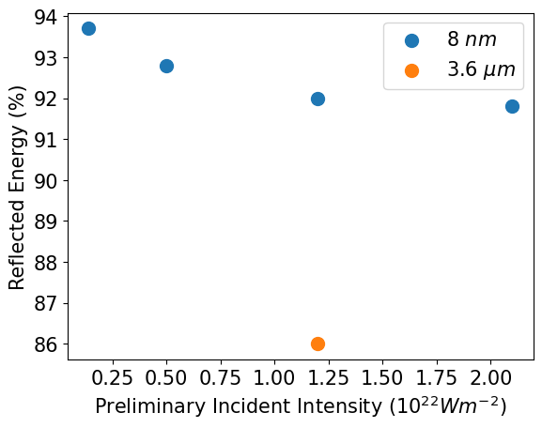
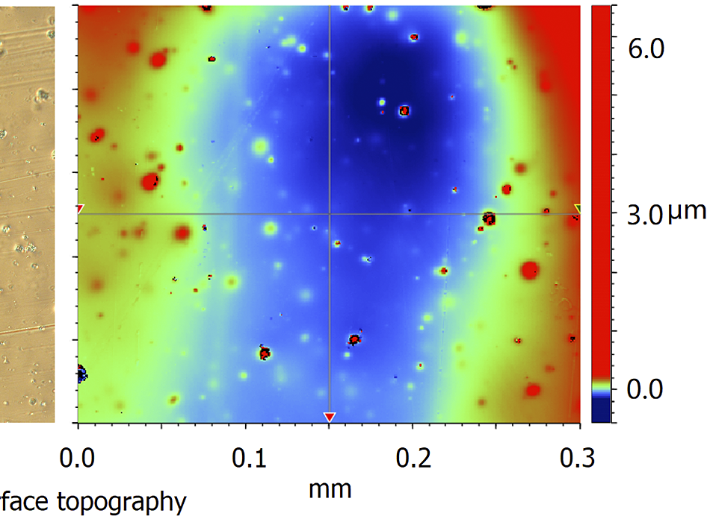
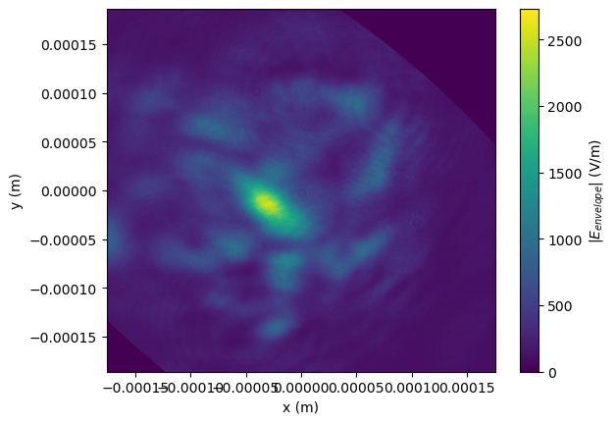
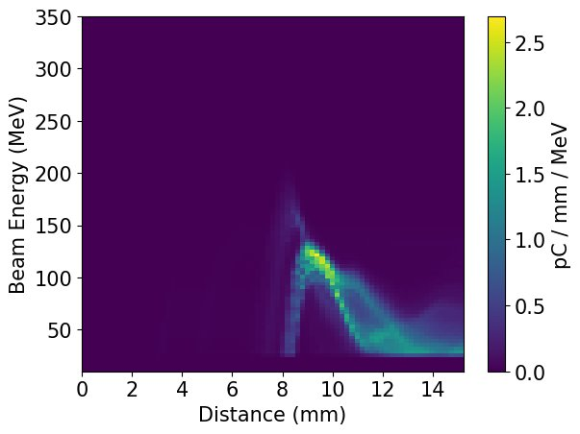
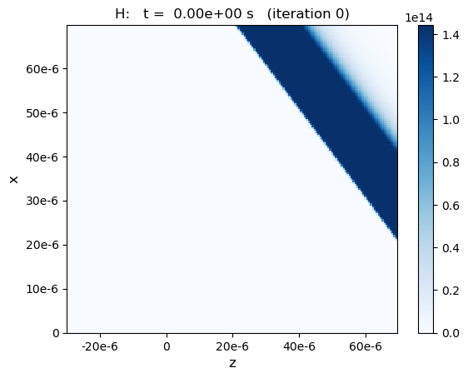
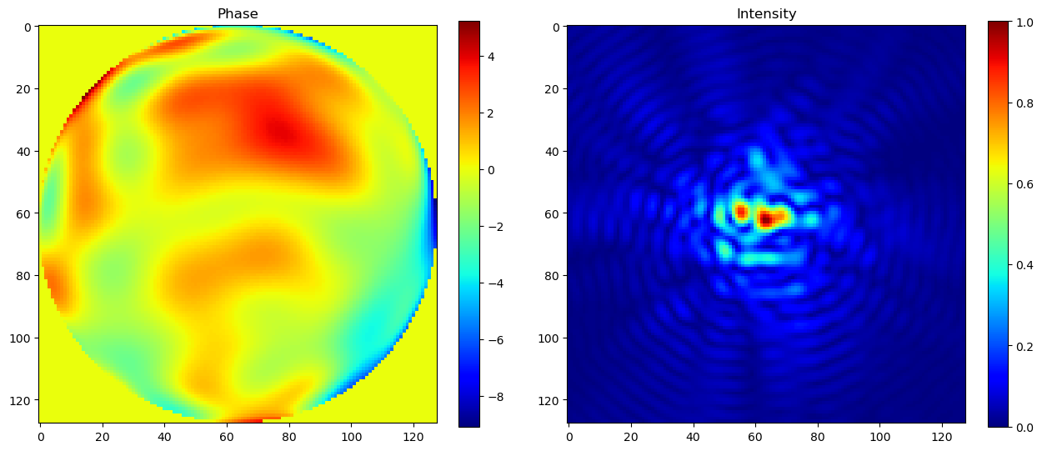
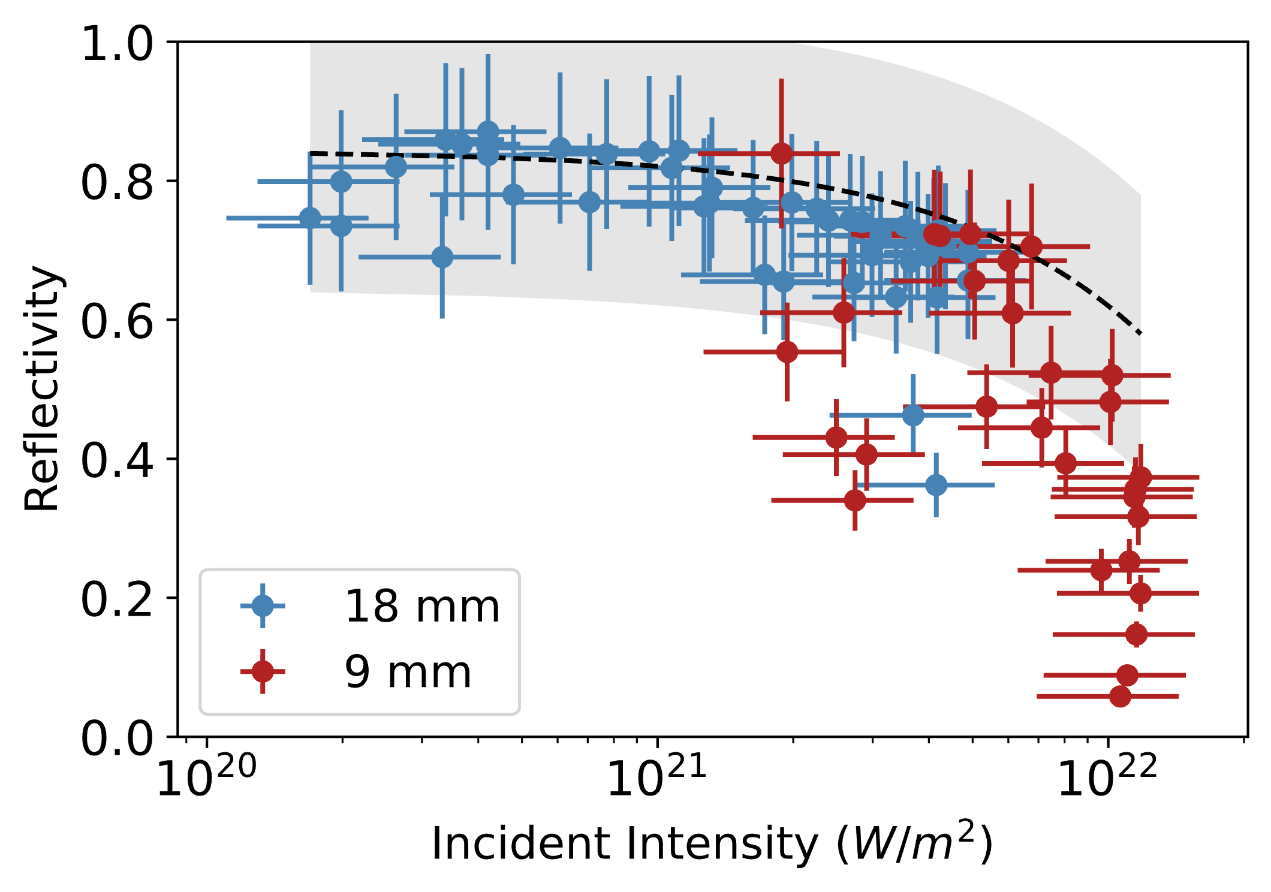
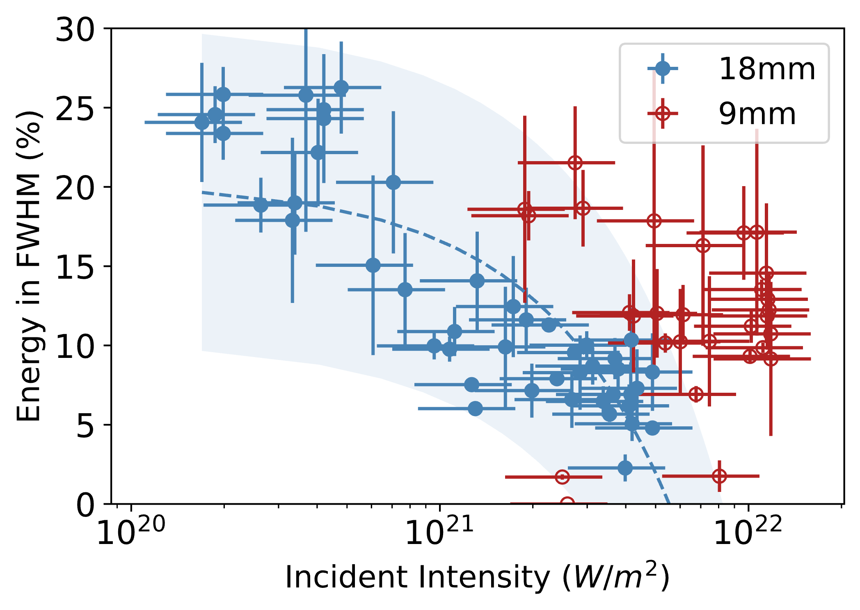
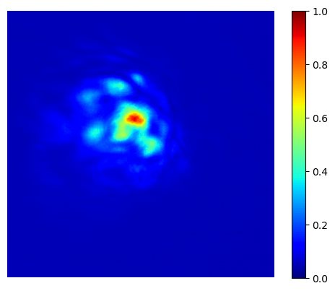
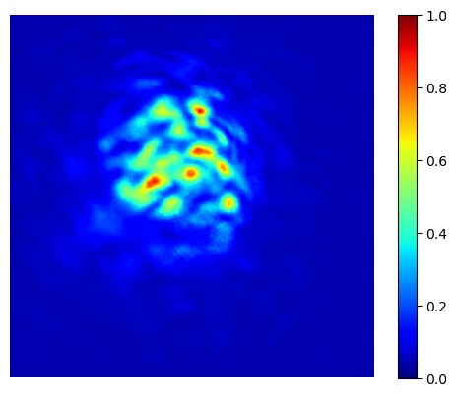
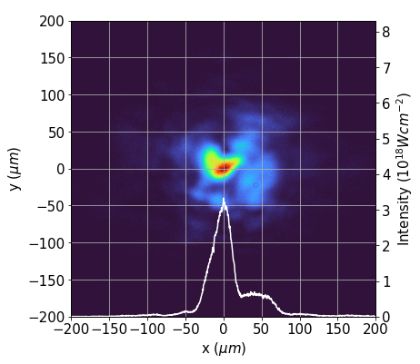
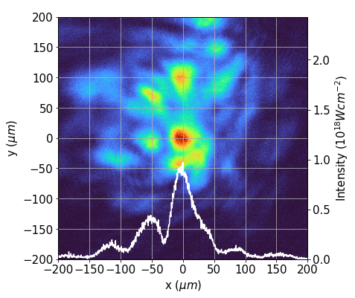
Plasma Mirrors for Laser Wakefield Acceleration
J. Hills¹, M. P. Backhouse¹, R. Luo¹, L. Kennedy¹, C. Cobo¹, E. Los¹, N. Lopes², P. Blum³, E. Gerstmayr⁴, J. Sharma⁴, N. Bourgeois⁵, and Z Najmudin¹
¹The John Adams Institute for Accelerator Science, The Blackett Laboratory, Imperial College London, London, UK
²GoLP, IPFN, Instituto Superior Tecnico, U. Lisboa, Portugal
³Deutsches Elektronen-Synchrotron (DESY), Notkestrasse 85, Hamburg, Germany
⁴ School of Mathematics and Physics, Queen’s University, Belfast, UK
⁵Central Laser Facility, STFC Rutherford Appleton Laboratory, Didcot OX11 0QX, UK
High fields enable acceleration over small scales
Intense pulses cause injection
1. Motivations and Background (Staging)
Ionisation Injection Driven by a Plasma Mirror Reflected Pulse
$${× 10}^{3}$$
A laser pulse generates charge displacements and high electric fields
Background electrons injected into the accelerating phase of the fields gain energy
Energy gain is limited by depletion and dephasing
Staging presents a solution: making use of multiple accelerating cells and laser pulses in a row
The plasma mirror reflected pulse (fig. 3b) was directed to a gas cell.
Injection occurred above a density of $2.8×{10}^{24}{ m}^{−3}$ and electrons were accelerated up to $455±28 MeV$(fig. 4)
The injection threshold was lower and the maximum energy higher than predicted by analytical scaling's [9] for our input pulse.
Generate GeV electron beams over cm scales (current record is ~8 GeV)
$$455±28 MeV$$
First demonstration of staging [1]
Fig 4: Electron energies across different densities, generated using a plasma mirror reflected pulse
(a)
Coupling in a laser pulse at high intensities is challenging -conventional optics would burn
Plasma mirrors offer a solution
3. Simulations and Analysis
Reductions in Reflectivity
Critical Surface
$$n>n_{c}$$
Plasma Mirrors
Surface ionisation $5 ps$before the main pulse and expansion at $c_{s}= 7.6×10^{7} ms^{−1}$would generate 3.6 $μm$ of pre-plasma, reducing reflected energy (fig. 6-7)
Kapton Tape
A laser ionises a surface, generating an overdense plasma. The remainder of the laser is reflected from this critical surface.
Pre-plasma
Laser scattering and poor pulse profiles may result from:
Roughness of tape target (fig. 8)
Non-uniformities in incident pulse profile [2]
Fig 6: Simulation of early ionization with a realistic temporal profile (intensity indicated by blue dots) using WarpX [7] and LaSY [5]
$$c_{s}=7.6×10^{7}$$
3.6 $μm$ expansion
Fig. 1: Waterfall plot of electron spectra minus a reference shot (b), as a function of delay between two drive pulses, demonstrating acceleration beyond the first stage, from [1]
Pre-pulses result in early ionisation (Fig.1) and pre-plasma formation
The critical surface, from which the pulse is reflected, may be rough
Energy is lost during propagation through pre-plasma and scattering from the critical surface
Fig 7: Reflectivity across a range of intensities near those at Gemini with no pre-pulse and 3.6 $μm$ of pre-plasma.
Fig 8: Surface roughness of Kapton tape [6]
Fig. 1: Pulse trace showing contrast of Astra-Gemini beam
Ionisation injection with a realistic pulse
2. Experiment: Gemini Staging 2024
Fig 5: FBPIC [4] simulations exploring propagation of a realistic pulse (a) (from LaSY [5]), and generation and acceleration of electrons (b) with electrons reaching 200-300 MeV
(a)
(b)
$10^{17} Wm^{−2}$
Ionization
Experiment at the CLF using Astra-Gemini: $15$J, $τ_{FWHM}\sim 42$fs at $λ_{0}$= 800 nm [3]
Changes in input pulse energy and focal distance from the tape were used to vary on-tape intensity.
The resultant reflectivity and reflected pulse quality were evaluated (fig 2-3).
Laser #2
Far field Camera
Plasma Mirror
Calorimeter
Unable to recreate high electron energies and low threshold observed experimentally with realistic input pulse (fig. 3b, fig. 5a-b)
Plasma Mirror at High Intensities
Wavefront modulations and spatiotemporal features resulting from reflection may impact electron injection and acceleration.
Simulating a plasma mirror at comparable intensities may help to extract spatiotemporal features
The reflected wavefront may be approximated with a CNN (U-Net) (fig. 9)
(a)
(b)
Fig 9: Input phase and resultant focal spot as example of generated training data (using soapy [8], aotools [9] and LaSY [5])
4. Summary
A plasma mirror was operated at intensities between ${10}^{20}−{10}^{22} Wm^{−2}$ with a maximum reflectivity of 80%. Energy throughput and beam quality fell at high intensities.
Despite poor reflected spot quality, a wake was driven to ionisation injection in a gas cell. Electron energies exceeded those predicted by simulations, even including realistic focal spots.
Evaluating the origin of reduced spot quality and enhanced acceleration is important for future runs.
Fig 2: (a) Reflectivity and (b) reflected pulse quality of laser pulse at on-tape intensities of ${10}^{20}−{10}^{22}Wm^{−2}$
(a)
9 mm
(b)
18 mm
Fig 3: Plasma mirror reflected spot imaged at focus, at distances of (a) 9 mm and (b) 18 mm from the plasma mirror
10%
4.5 J
0.4 J
This project has received funding from the European Union’s Horizon 2020 Research and Innovation programme under Grant Agreement No 101004730 "I.FAST" and the STFC John Adams Institute #ST/V001639/1
Steinke, S., et al, Multistage coupling of independent laser-plasma accelerators. Nature, 530(7589), 190–193, (2016).
Scott, G. G. et al, Optimization of plasma mirror reflectivity and optical quality using double laser pulses. New Journal of Physics, 17(3), 033027, (2015).
Lehe, R. et al, A spectral, quasi-cylindrical and dispersion-free Particle-In-Cell algorithm. Computer Physics Communications, 203, 66–82. (2016)
Thévenet, M, et al. LAser manipulations made eaSY. arXiv (2024)
Xu, N., Versatile tape-drive target for high-repetition-rate laser-driven proton acceleration. High Power Laser Science and Engineering, 11, (2023)‌.
Vay, J.-L., Warp-X: A new exascale computing platform for beam–plasma simulations. Nuclear Instruments and Methods in Physics Research Section a Accelerators Spectrometers Detectors and Associated Equipment, 909, 476–479. (2018).
Soapy: an adaptive optics simulation written purely in Python for rapid concept development | Request PDF. (2020).
Townson, M. J., Farley, AOtools: a Python package for adaptive optics modelling and analysis. Optics Express, 27(22), 31316. (2019)‌
Lu, W., Tzoufras, M., Joshi, C., Tsung, F. S., Mori, W. B., Vieira, J., … Silva, L. O. (2007). Generating multi-GeV electron bunches using single stage laser wakefield acceleration in a 3D nonlinear regime. Physical Review Special Topics - Accelerators and Beams, 10(6). https://doi.org/10.1103/physrevstab.10.061301
‌
Notes:
Intense pulses drive strong fields to produce relativistic electrons- to reach TeV require10^15 cm, = 1km
Needs to be in p polarization to avoid brunel absorption, energy in wings contributes to guiding of laser pulse – amplifying self focusing - maybe mention non gauss
Standard deviation of beams centroid
The beam post reflection was imaged with a far field camera
Had a total reflectivity of 72% at 5.5j input energy with a significant decrease in total energy in fwhm – 12.2% from 19.2%. Vector potential of 0.6 – therefore expect to drive wakefield
After reflection the beam enters a 18mm helium gas cell, important to test its suitability for driving wakefields- looking for self guiding, i.e. see how focal spot increases. If we assumed a ideal beam it should self guide at these intensities, however the spotty profile means simulations/experiments had to be used to determinine guiding properties. Experimentally – density was vasrie and found that there was a large transmitted energy drop at high density – unaccounted for by ionization and the energy to drive wakefield.
Looking into evolution of beam spot size and
Not yet demonstrated at GeV level or with large capture efficiency
Fig 4(a-b). Sum of focal spot measurements after reflection off a (a) mirror ($22\%±0.2\%$ in fwhm) and (b) tape drive ($12\%±2\%$ in fwhm), where peak intensity in (a) is a factor of 8 greater than that measured in (b)
8x lower peak intensity, 55% of energy in fwhm kept

Slide 2
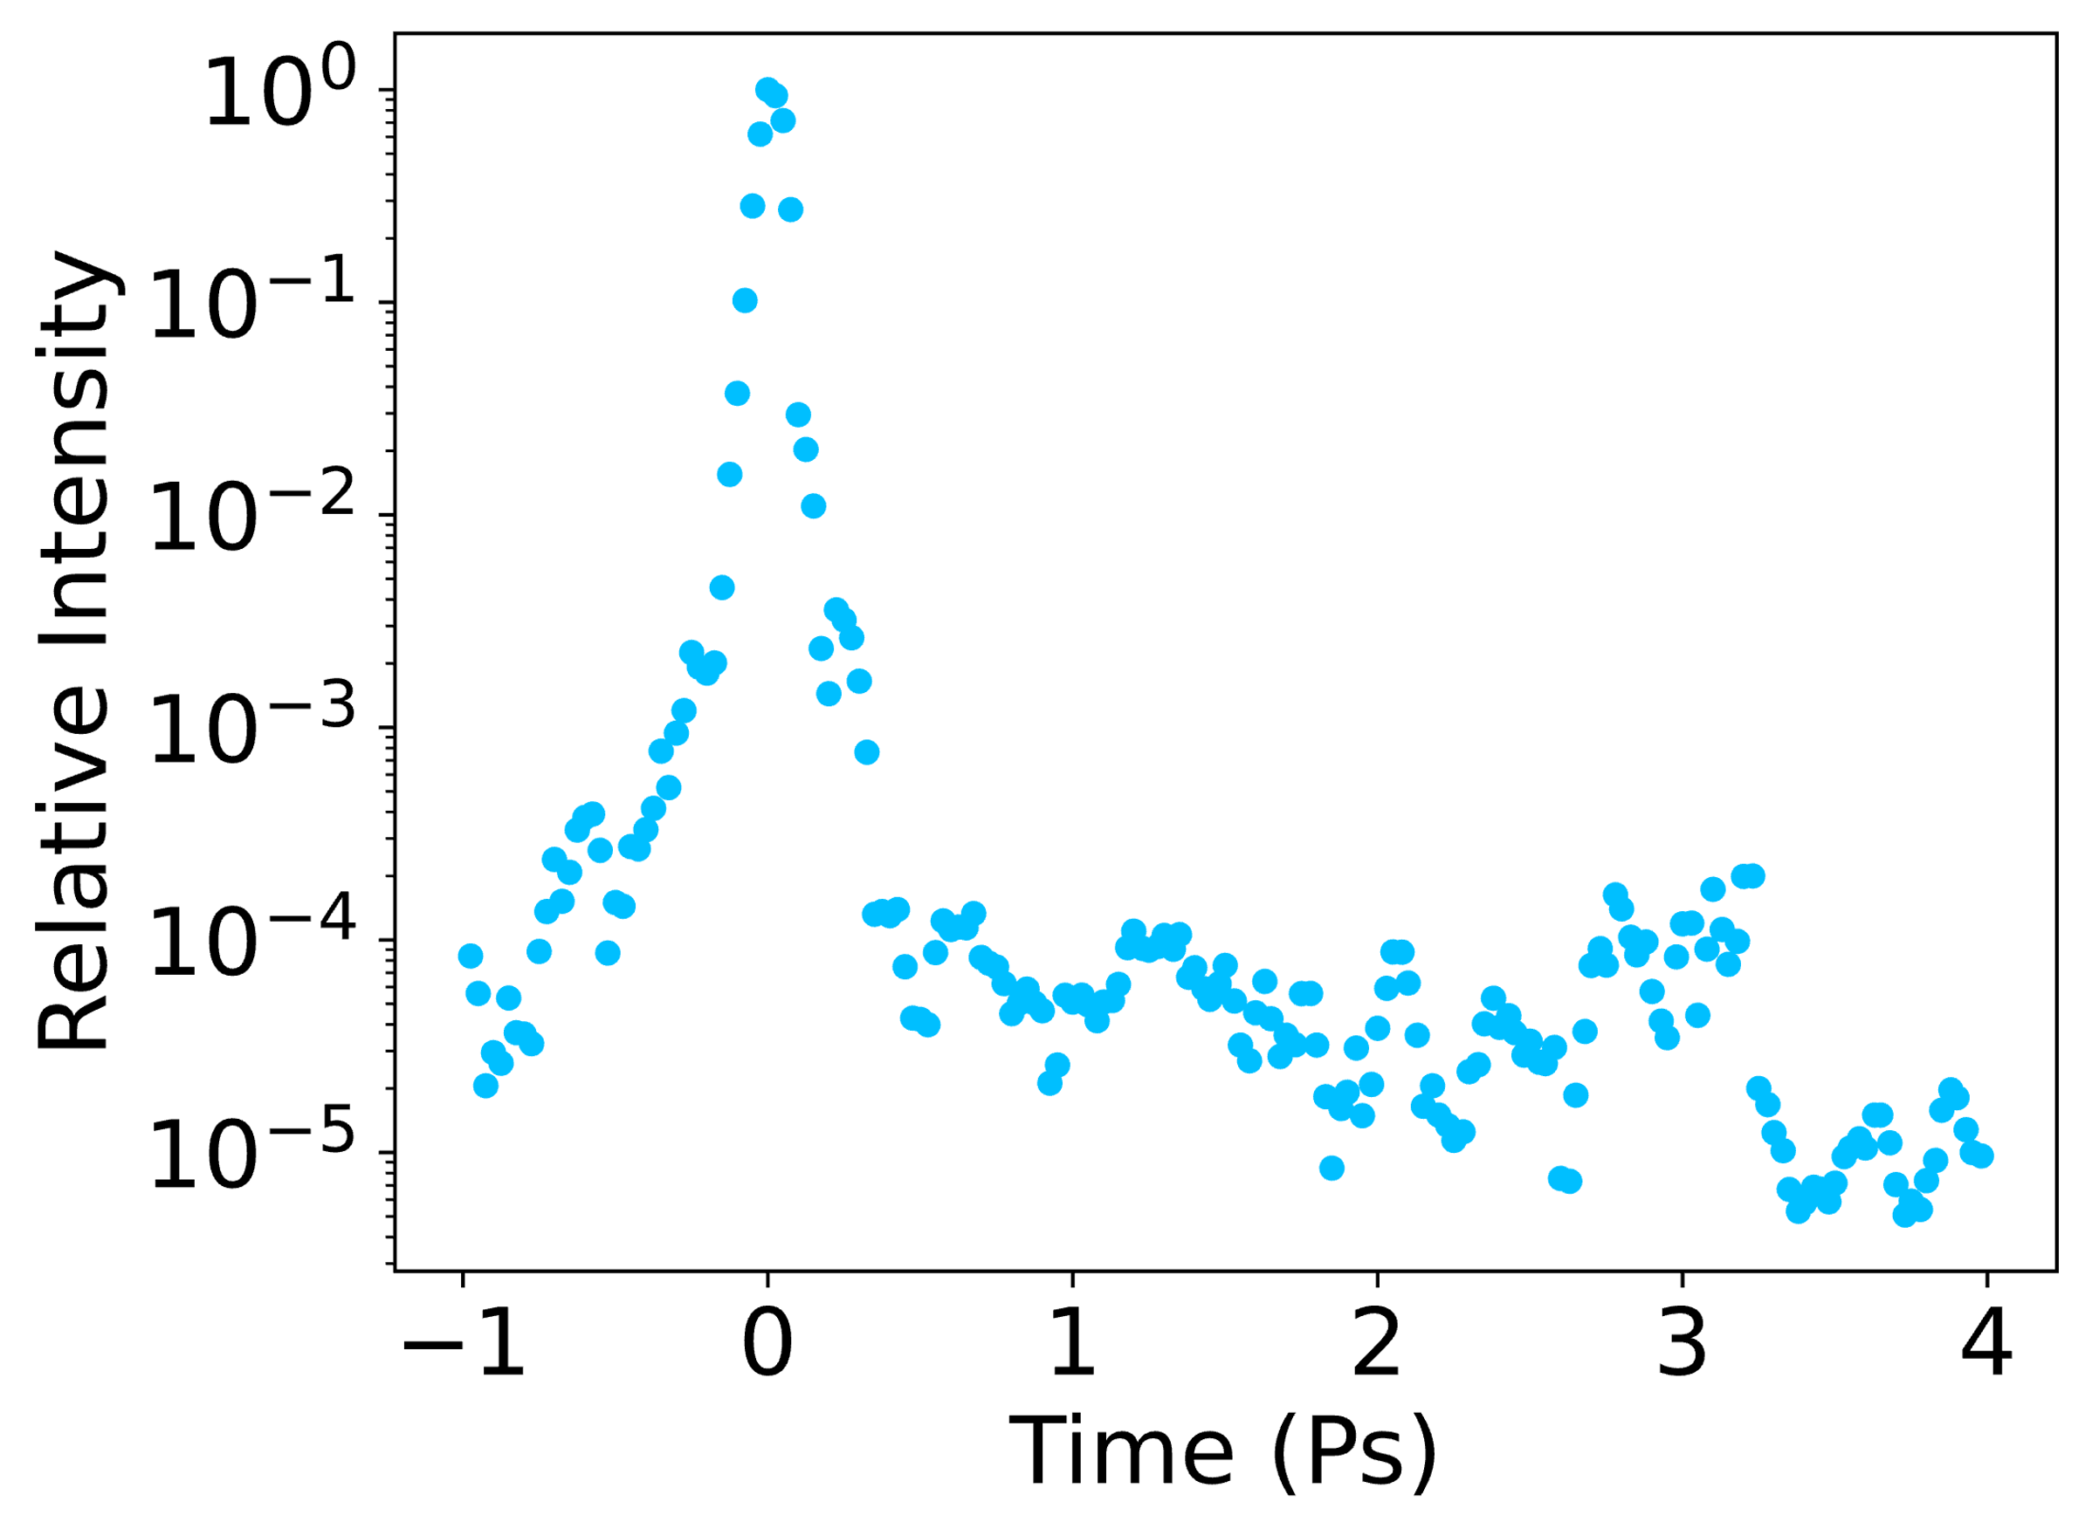
Plasma Mirrors for Laser Wakefield Acceleration
J. Hills¹, M. P. Backhouse¹, R. Luo¹, L. Kennedy¹, C. Cobo¹, E. Los¹, N. Lopes², P. Blum³, E. Gerstmayr⁴, J. Sharma⁴, N. Bourgeois⁵, and Z Najmudin¹
¹The John Adams Institute for Accelerator Science, The Blackett Laboratory, Imperial College London, London, UK
²GoLP, IPFN, Instituto Superior Tecnico, U. Lisboa, Portugal
³Deutsches Elektronen-Synchrotron (DESY), Notkestrasse 85, Hamburg, Germany
⁴ School of Mathematics and Physics, Queen’s University, Belfast, UK
⁵Central Laser Facility, STFC Rutherford Appleton Laboratory, Didcot OX11 0QX, UK
High fields enable acceleration over small scales
Intense pulses cause injection
1. Summary
(a)
9 mm
(b)
18 mm
Fig 3: Plasma mirror reflected spot imaged at focus, at distances of (a) 9 mm and (b) 18 mm from the plasma mirror
A plasma mirror was operated at intensities between ${10}^{20}−{10}^{22}Wm^{−2}$ with a maximum reflectivity of 80%. Energy throughput and beam quality fell at high intensities. Despite poor reflected spot quality, a wake was driven to ionisation injection in a gas cell. Electron energies exceeded those predicted by simulations, even including realistic focal spots. Evaluating the origin of reduced spot quality and enhanced acceleration is important for future runs.
10%
4.5 J
0.4 J
Generate GeV electron beams over cm scales (current record is ~8 GeV)
2. Motivations and Background (Staging)
Ionisation Injection Driven by a Plasma Mirror Reflected Pulse
$${× 10}^{3}$$
A laser pulse generates charge displacements and high electric fields
Background electrons injected into the accelerating phase of the fields gain energy
Energy gain is limited by depletion and dephasing
Staging presents a solution: making use of multiple accelerating cells and laser pulses in a row
The plasma mirror reflected pulse (fig. 3b) was directed to a gas cell.
Injection occurred above a density of $2.8×{10}^{24}m^{−3}$ and electrons were accelerated up to $455±28 MeV$(fig. 4)
The injection threshold was lower and the maximum energy higher than predicted by analytical scalings [8] for our input pulse.
(a)
$$455±28 MeV$$
First demonstration of staging [1]
Fig 4: Electron energies across different densities, generated using a plasma mirror reflected pulse
Coupling in a laser pulse at high intensities is challenging -conventional optics would burn
Plasma mirrors offer a solution
4. Simulations and Analysis
$$c_{s}=7.6×10^{7}$$
3.6 $μm$ expansion
Fig. 1: Waterfall plot of electron spectra minus a reference shot (b), as a function of delay between two drive pulses, demonstrating acceleration beyond the first stage, from [1]
Reductions in Reflectivity
Critical Surface
$$n>n_{c}$$
Plasma Mirrors
Expansion over ~ $5 ps$at $c_{s}= 7.6×10^{7}ms^{−1}$, would generate 3.6 $μm$ of pre-plasma, reducing reflected energy (fig. 6-7)
Kapton Tape
A laser ionises a surface, generating an overdense plasma. The remainder of the laser is reflected from this critical surface.
Pre-plasma
Critical surface deformations, resulting in scattering and poor pulse profiles
Roughness of tape target (fig. 8)
Non-uniformities in incident pulse profile [2]
Fig 6: Determining early ionisation using WarpX [7] and LaSY [5] with a realistic temporal profile
Pre-pulses result in early ionisation (Fig.1) and pre-plasma formation
The critical surface, from which the pulse is reflected, may be rough
Energy is lost during propagation through pre-plasma and scattering from the critical surface
Fig 7: Reflectivity across intensities with no pre-pulse and 3.6 $μm$ of pre-plasma.
Fig 8: Surface roughness of Kapton tape [6]
$10^{17} Wm^{−2}$
Ionization
Fig. 1: Pulse trace showing contrast of Astra-Gemini beam
3. Experiment: Gemini Staging 2024
Ionisation injection with a realistic pulse
Experiment at the CLF using Astra-Gemini: $15$J, $τ_{FWHM}\sim 42$fs at $λ_{0}$= 800 nm [3]
Changes in input pulse energy and focal distance from the tape were used to vary on-tape intensity.
The resultant reflectivity and reflected pulse quality were evaluated (fig 2-3).
Fig 5: FBPIC [4] simulations exploring propagation of a realistic pulse (a) (from LaSY [5]), and generation and acceleration of electrons (b) with electrons reaching 200-300 MeV
(a)
(b)
Laser #2
Far field Camera
Plasma Mirror
Calorimeter
Unable to recreate high electron energies and low threshold observed experimentally with realistic input pulse (fig. 3b, fig. 5a-b)
Plasma Mirror at High Intensities
Wavefront modulations and spatiotemporal features resulting from plasma mirror reflection may impact electron injection and acceleration
Simulating plasma mirror operation at comparable intensities to extract spatiotemporal features
Training a CNN (U-Net) to extract reflected wavefront (fig. 9)
(a)
(b)
Fig 9: Input phase and resultant focal spot as example of generated training data (using soapy [8], aotools [9] and LaSY [5])
Fig 2: (a) Reflectivity and (b) reflected pulse quality of laser pulse at on-tape intensities of ${10}^{20}−{10}^{22}Wm^{−2}$
This project has received funding from the European Union’s Horizon 2020 Research and Innovation programme under Grant Agreement No 101004730 "I.FAST". and the STFC John Adams Institute #ST/V001639/1
Steinke, S., et al, Multistage coupling of independent laser-plasma accelerators. Nature, 530(7589), 190–193, (2016).
Scott, G. G. et al, Optimization of plasma mirror reflectivity and optical quality using double laser pulses. New Journal of Physics, 17(3), 033027, (2015).
Lehe, R. et al, A spectral, quasi-cylindrical and dispersion-free Particle-In-Cell algorithm. Computer Physics Communications, 203, 66–82. (2016)
Thévenet, M, et al. LAser manipulations made eaSY. arXiv (2024)
Xu, N., Versatile tape-drive target for high-repetition-rate laser-driven proton acceleration. High Power Laser Science and Engineering, 11, (2023)‌.
Vay, J.-L., Warp-X: A new exascale computing platform for beam–plasma simulations. Nuclear Instruments and Methods in Physics Research Section a Accelerators Spectrometers Detectors and Associated Equipment, 909, 476–479. (2018).
Soapy: an adaptive optics simulation written purely in Python for rapid concept development | Request PDF. (2020).
Townson, M. J., Farley, AOtools: a Python package for adaptive optics modelling and analysis. Optics Express, 27(22), 31316. (2019)‌
‌
Notes:
Intense pulses drive strong fields to produce relativistic electrons- to reach TeV require10^15 cm, = 1km
Needs to be in p polarization to avoid brunel absorption, energy in wings contributes to guiding of laser pulse – amplifying self focusing - maybe mention non gauss
Standard deviation of beams centroid
The beam post reflection was imaged with a far field camera
Had a total reflectivity of 72% at 5.5j input energy with a significant decrease in total energy in fwhm – 12.2% from 19.2%. Vector potential of 0.6 – therefore expect to drive wakefield
After reflection the beam enters a 18mm helium gas cell, important to test its suitability for driving wakefields- looking for self guiding, i.e. see how focal spot increases. If we assumed a ideal beam it should self guide at these intensities, however the spotty profile means simulations/experiments had to be used to determinine guiding properties. Experimentally – density was vasrie and found that there was a large transmitted energy drop at high density – unaccounted for by ionization and the energy to drive wakefield.
Looking into evolution of beam spot size and
Not yet demonstrated at GeV level or with large capture efficiency
Fig 4(a-b). Sum of focal spot measurements after reflection off a (a) mirror ($22\%±0.2\%$ in fwhm) and (b) tape drive ($12\%±2\%$ in fwhm), where peak intensity in (a) is a factor of 8 greater than that measured in (b)
8x lower peak intensity, 55% of energy in fwhm kept

Slide 3
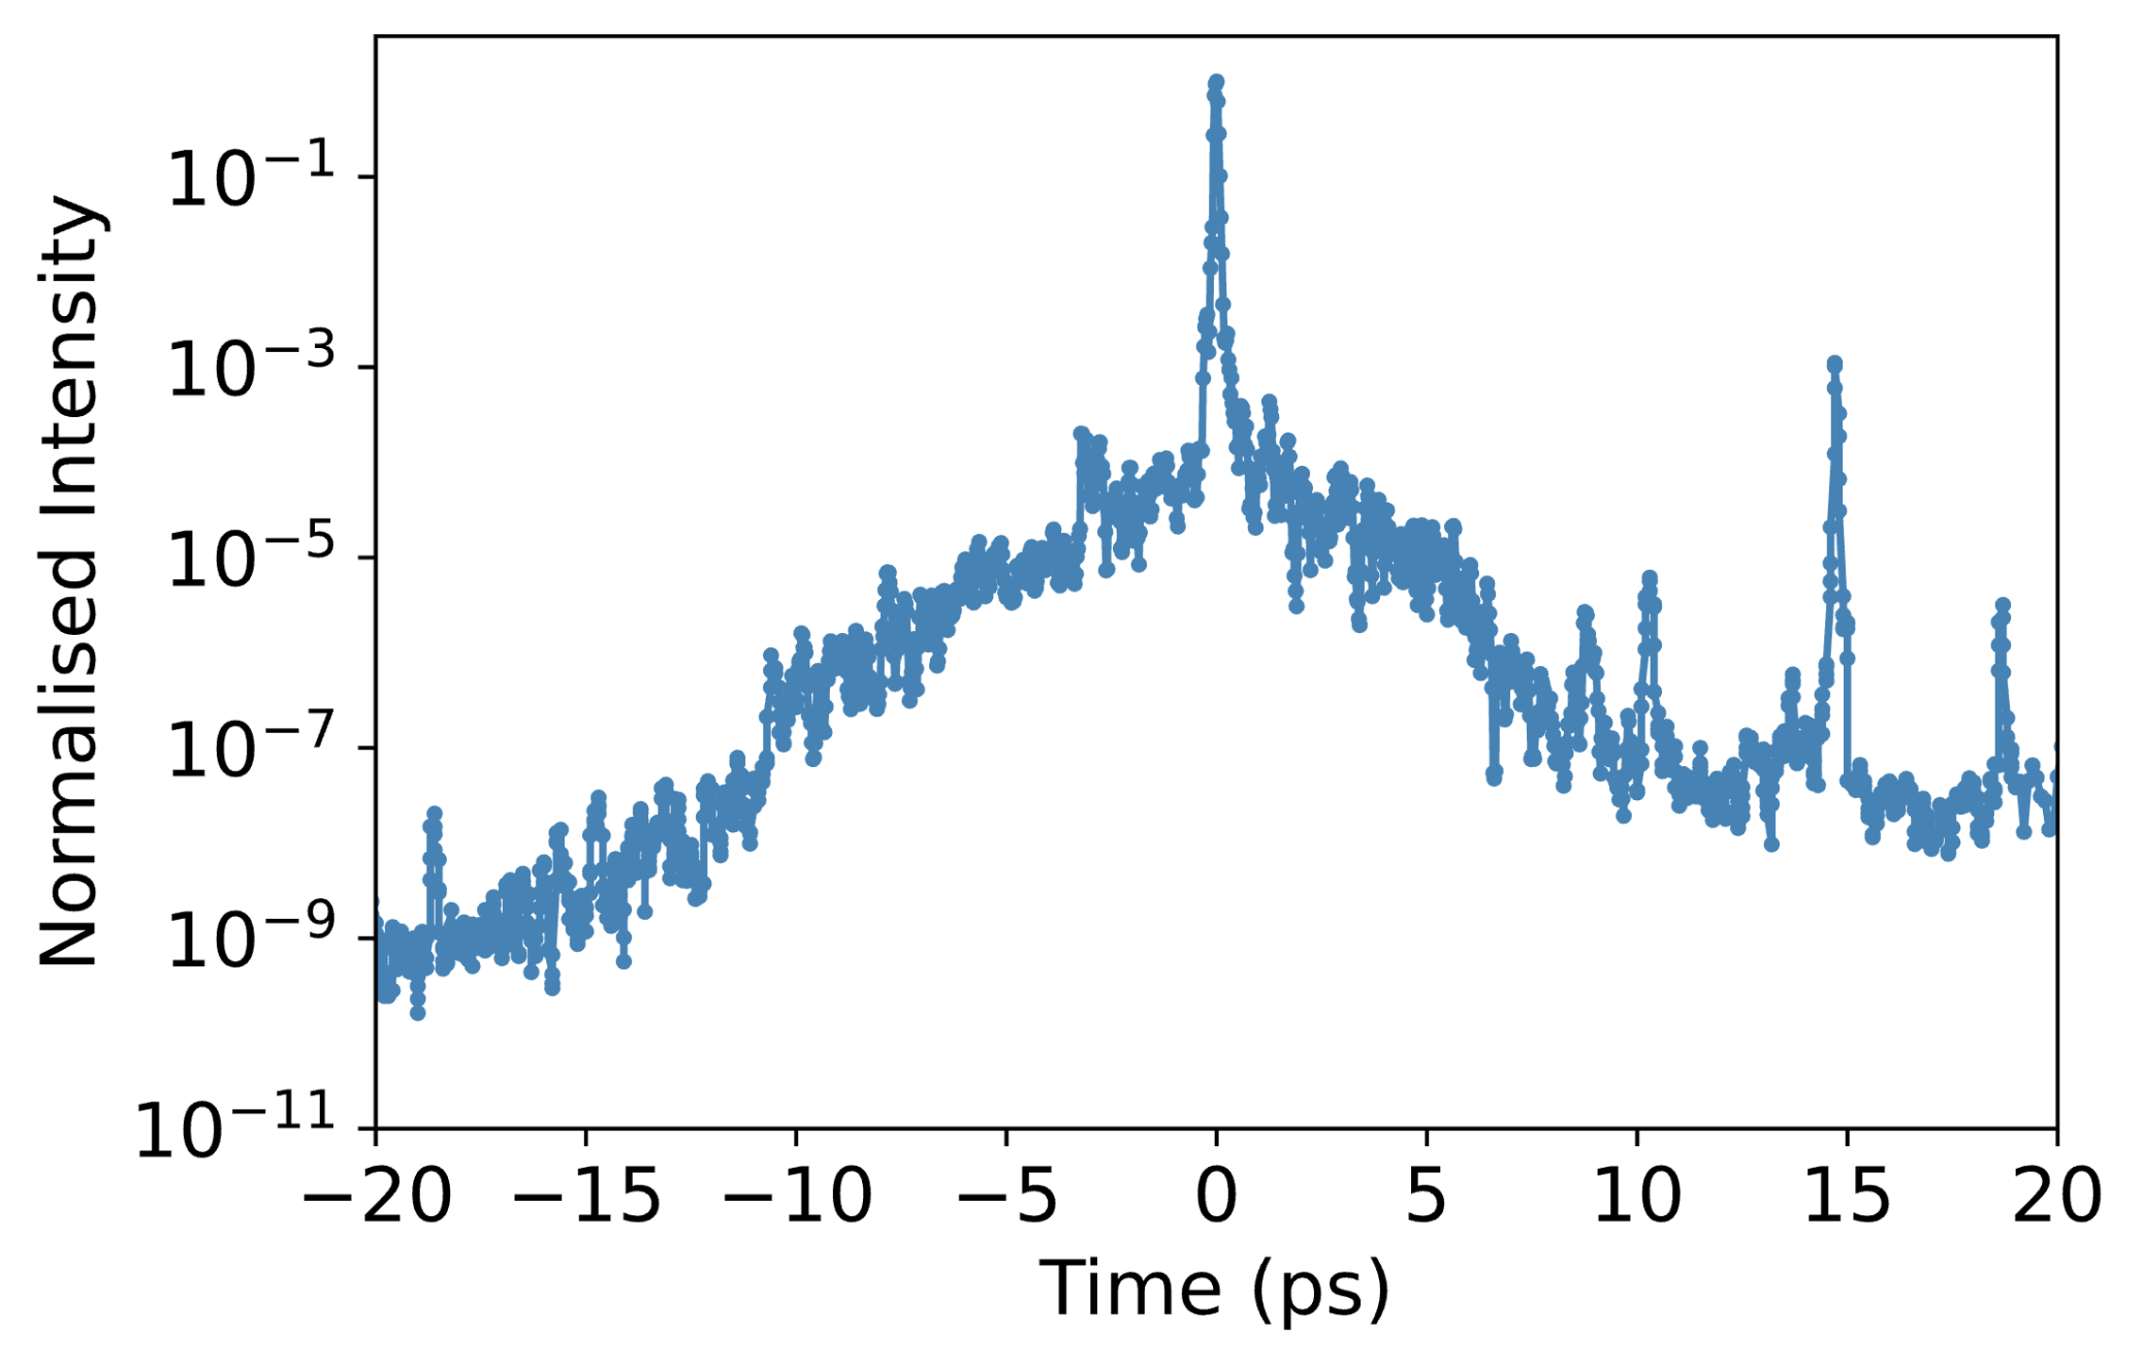
Plasma Mirrors for LWFA
J Hills¹, M Backhouse¹, NLopes^{1,2}, Z Najmudin¹
¹The John Adams Institute for Accelerator Science, The Blackett Laboratory, Imperial College London, London, UK
²GoLP, IPFN, Instituto Superior Tecnico, U. Lisboa, Portugal
³Central Laser Facility, STFC Rutherford Appleton Laboratory, Didcot OX11 0QX, UK
⁴School of Mathematics and Physics, Queen’s University, Belfast, UK
High fields enable acceleration over small scales
Intense pulses cause injection
$$E_{z}$$
Laser
Laser pulse generates charge displacements and high electric field gradients
Background electrons are injected into the accelerating phase of the fields
$L_{acc}$ and $W_{gain}$ are limited by depletion and dephasing ($W_{gain}∝L_{acc}E_{z}$ )
2. Driving Ionisation Injection with a Plasma Mirror Reflected Pulse
$$e^{−}$$
Generate GeV electron beams over cm scales (current record is ~8 GeV)
$$L_{c}$$
Cell 1: Injection
Laser #2
Cell 2: Acceleration
Plasma Mirror
Staging demonstrated with low charge capture and energy gain [1]
Laser #1
Laser #2
$$e^{−}$$
High intensity laser generates and is reflected by an overdense plasma
Reflected pulse quality can be reduced by an uneven critical surface
Pre-pulses and ASE pedestal result in early ionisation (Fig.1)
Pre-plasma formation results from early ionisation of the surface
Laser loses energy during propagation through underdense plasma
Fig 1: Pulse trace showing contrast
Fig. 1: Waterfall plot of electron spectra minus a reference shot (b), as a function of delay between two drive pulses, demonstrating acceleration beyond the first stage, from [1]
Critical Surface
$$n>n_{c}$$
Kapton Tape
Pre-plasma
Experiment: Gemini Staging 2024
Experiment performed at the CLF using Gemini with $τ_{FWHM}\sim 42$fs at $λ_{0}$=800 nm
Laser #2
Far field Camera
Plasma mirror optimised for maximum energy throughput
Changes in input pulse energy and focal distance from the tape were used to vary on-tape intensity
Plasma Mirror
Calorimeter
1. Operation of Plasma Mirror at High Intensities
(a)
(b)
Fig 2: (a) Reflectivity and (b) pulse quality of laser pulse at on-tape intensities of ${10}^{20}−{10}^{22}Wm^{−2}$
(a)
9 mm
(b)
18 mm
9mm and 18mm
10%
4.5 J
0.4 J
Fig 3: Plasma mirror reflected spot imaged at focus, at different focal distances, (a) 9 mm and (b) 18 mm, from the plasma mirror
Notes:
Intense pulses drive strong fields to produce relativistic electrons- to reach TeV require10^15 cm, = 1km
Needs to be in p polarization to avoid brunel absorption, energy in wings contributes to guiding of laser pulse – amplifying self focusing - maybe mention non gauss
Standard deviation of beams centroid
The beam post reflection was imaged with a far field camera
Had a total reflectivity of 72% at 5.5j input energy with a significant decrease in total energy in fwhm – 12.2% from 19.2%. Vector potential of 0.6 – therefore expect to drive wakefield
After reflection the beam enters a 18mm helium gas cell, important to test its suitability for driving wakefields- looking for self guiding, i.e. see how focal spot increases. If we assumed a ideal beam it should self guide at these intensities, however the spotty profile means simulations/experiments had to be used to determinine guiding properties. Experimentally – density was vasrie and found that there was a large transmitted energy drop at high density – unaccounted for by ionization and the energy to drive wakefield.
Looking into evolution of beam spot size and
Not yet demonstrated at GeV level or with large capture efficiency
Fig 4(a-b). Sum of focal spot measurements after reflection off a (a) mirror ($22\%±0.2\%$ in fwhm) and (b) tape drive ($12\%±2\%$ in fwhm), where peak intensity in (a) is a factor of 8 greater than that measured in (b)
8x lower peak intensity, 55% of energy in fwhm kept

Slide 4
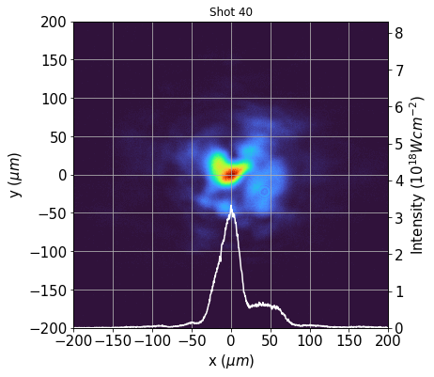
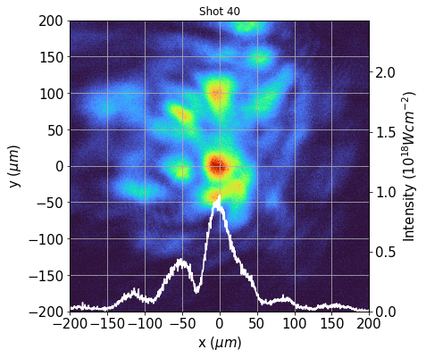
Plasma Mirrors for Staging Applications
J Hills¹, M Backhouse¹, NLopes^{1,2}, Z Najmudin¹
¹The John Adams Institute for Accelerator Science, The Blackett Laboratory, Imperial College London, London, UK
²GoLP, IPFN, Instituto Superior Tecnico, U. Lisboa, Portugal
³Central Laser Facility, STFC Rutherford Appleton Laboratory, Didcot OX11 0QX, UK
⁴School of Mathematics and Physics, Queen’s University, Belfast, UK
High fields enable acceleration over small scales
Intense pulses cause injection
$$E_{z}$$
Laser
Laser pulse generates charge displacements and high electric field gradients
Background electrons are injected into the accelerating phase of the fields
$L_{acc}$ and $W_{gain}$ are limited by depletion and dephasing ($W_{gain}∝L_{acc}E_{z}$ )
$$e^{−}$$
Generate GeV electron beams over cm scales (current record is ~8 GeV)
$$L_{c}$$
Cell 1: Injection
Laser #2
Cell 2: Acceleration
Plasma Mirror
Staging demonstrated with low charge capture and energy gain [1]
Laser #1
Laser #2
$$e^{−}$$
Far field Camera
Plasma Mirror
2
High intensity laser generates and is reflected by an overdense plasma
Reflected pulse quality can be reduced by an uneven critical surface
Pre-plasma formation results from early ionisation of the surface
Laser loses energy during propagation through underdense plasma
Calorimeter
Critical Surface
$$n>n_{c}$$
Fig. 1: Waterfall plot of electron spectra minus a reference shot (b), as a function of delay between two drive pulses, demonstrating acceleration beyond the first stage, from [1]
Kapton Tape
Pre-plasma
Experiment: Gemini Staging 2024
Experiment performed at the CLF using Gemini with $τ_{FWHM}\sim 42$fs at $λ_{0}$=800 nm
9mm and 18mm
9 mm
18 mm
10%
Using a Plasma Mirror Reflected Pulse to Drive Ionisation Injection
Notes:
Intense pulses drive strong fields to produce relativistic electrons- to reach TeV require10^15 cm, = 1km
Needs to be in p polarization to avoid brunel absorption, energy in wings contributes to guiding of laser pulse – amplifying self focusing - maybe mention non gauss
Standard deviation of beams centroid
The beam post reflection was imaged with a far field camera
Had a total reflectivity of 72% at 5.5j input energy with a significant decrease in total energy in fwhm – 12.2% from 19.2%. Vector potential of 0.6 – therefore expect to drive wakefield
After reflection the beam enters a 18mm helium gas cell, important to test its suitability for driving wakefields- looking for self guiding, i.e. see how focal spot increases. If we assumed a ideal beam it should self guide at these intensities, however the spotty profile means simulations/experiments had to be used to determinine guiding properties. Experimentally – density was vasrie and found that there was a large transmitted energy drop at high density – unaccounted for by ionization and the energy to drive wakefield.
Looking into evolution of beam spot size and
Not yet demonstrated at GeV level or with large capture efficiency
Fig 4(a-b). Sum of focal spot measurements after reflection off a (a) mirror ($22\%±0.2\%$ in fwhm) and (b) tape drive ($12\%±2\%$ in fwhm), where peak intensity in (a) is a factor of 8 greater than that measured in (b)
8x lower peak intensity, 55% of energy in fwhm kept

Slide 5
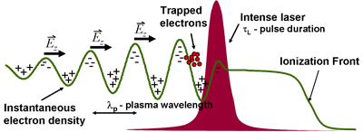
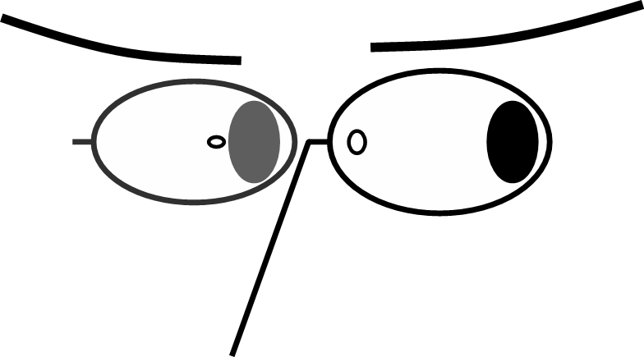
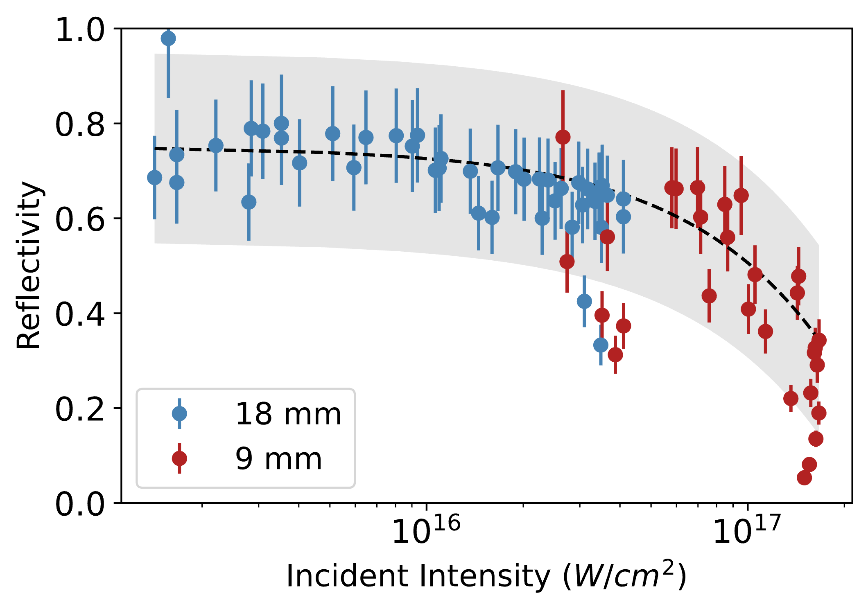
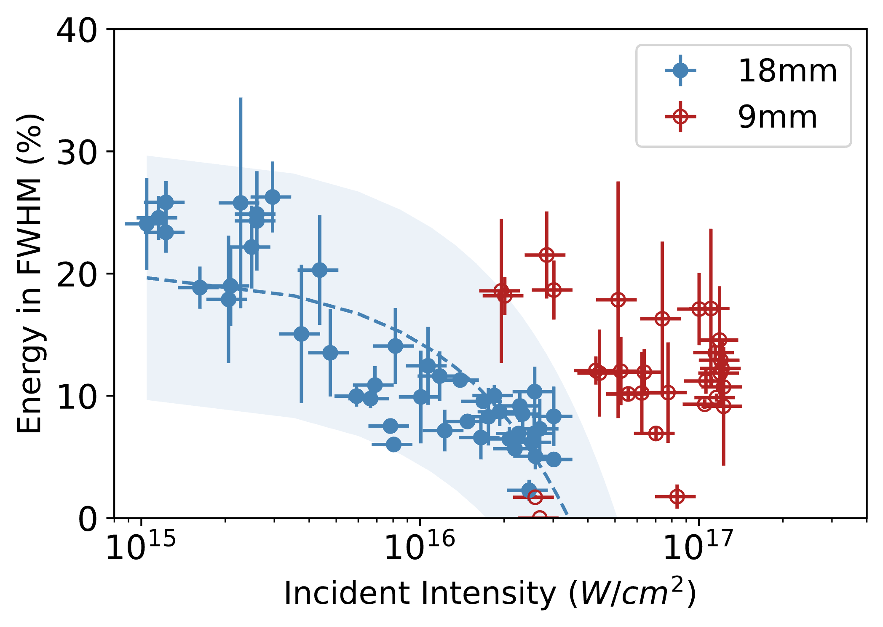
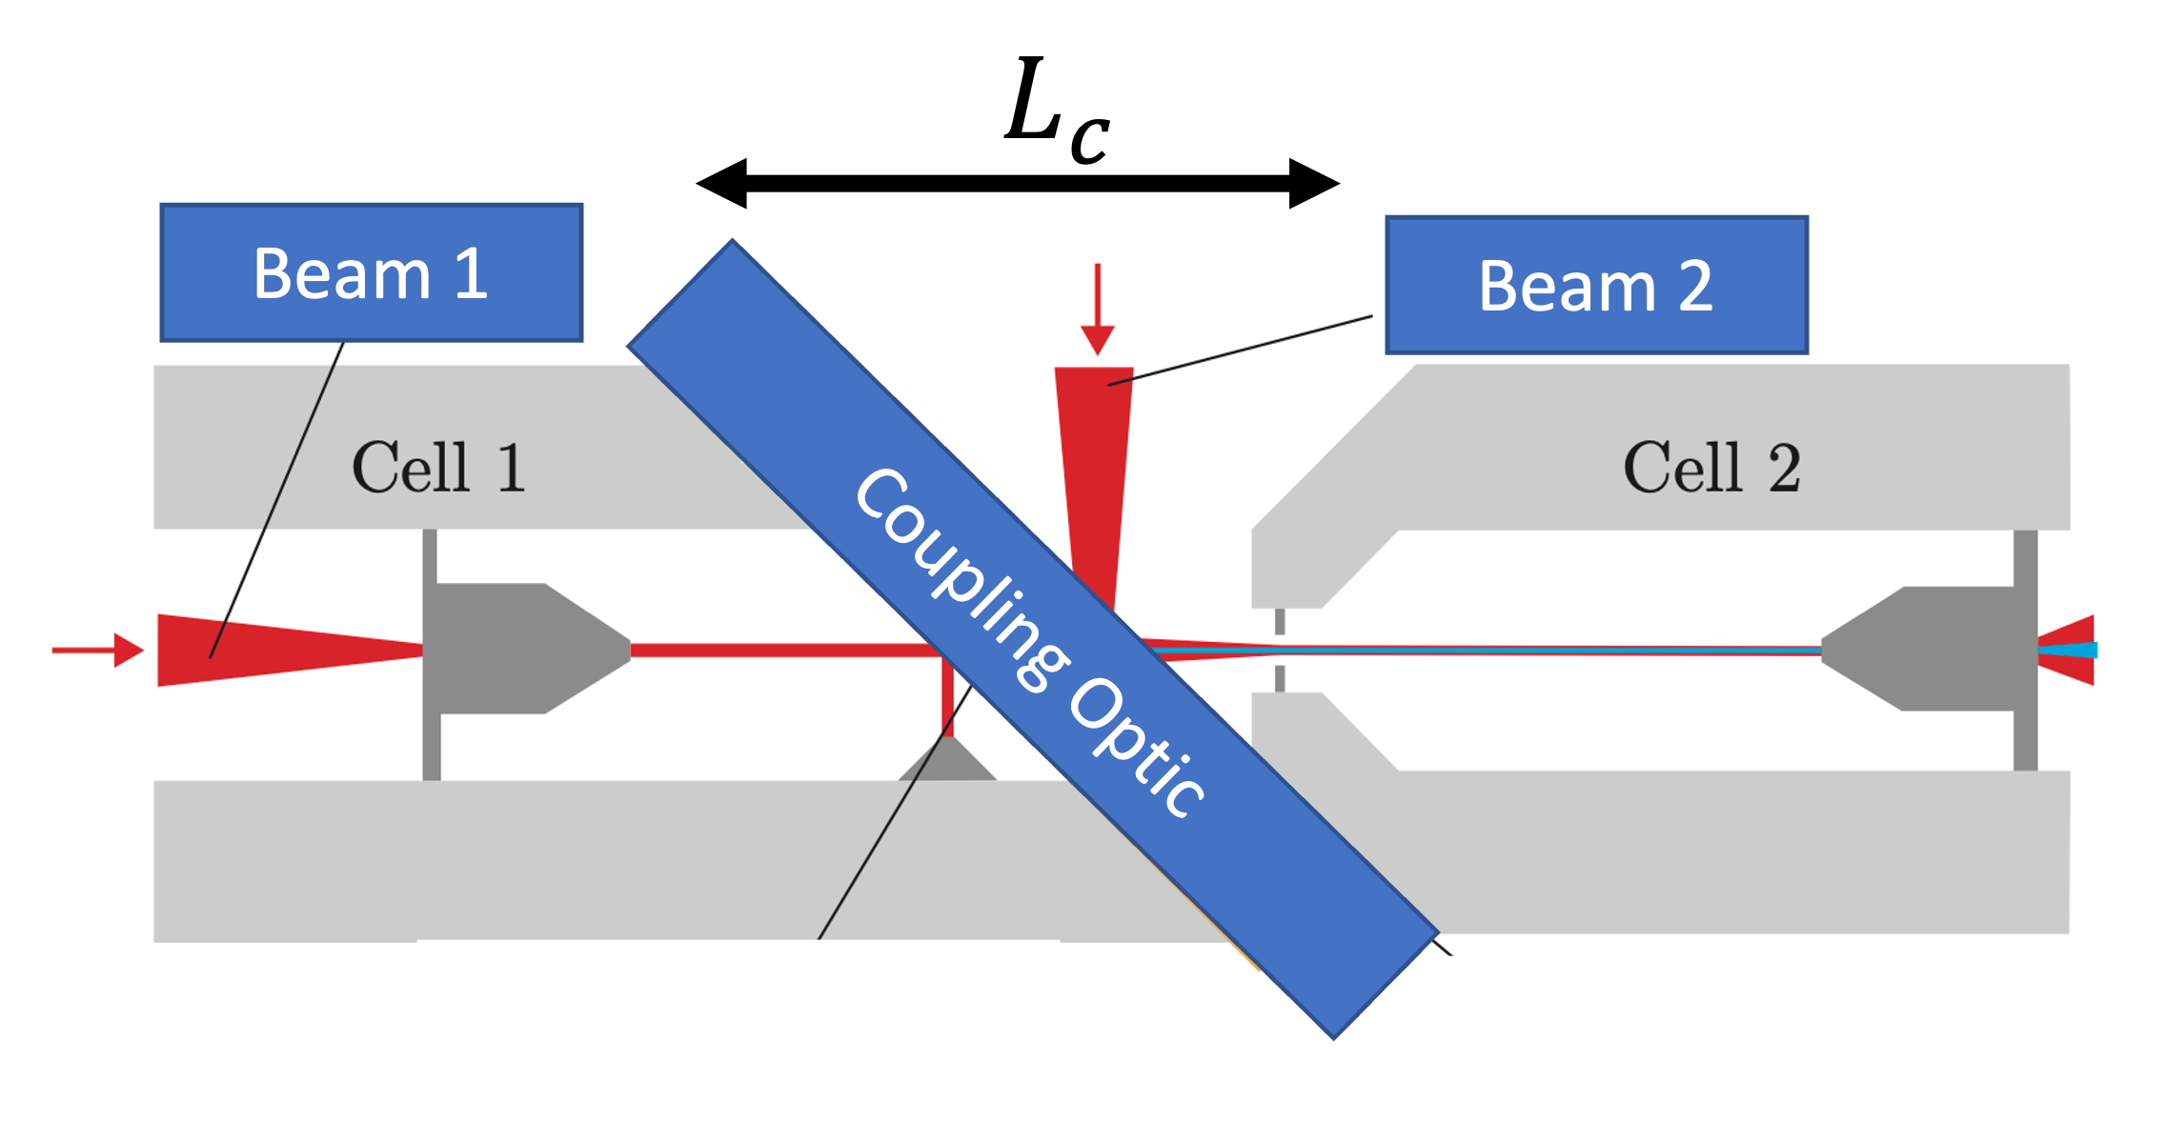
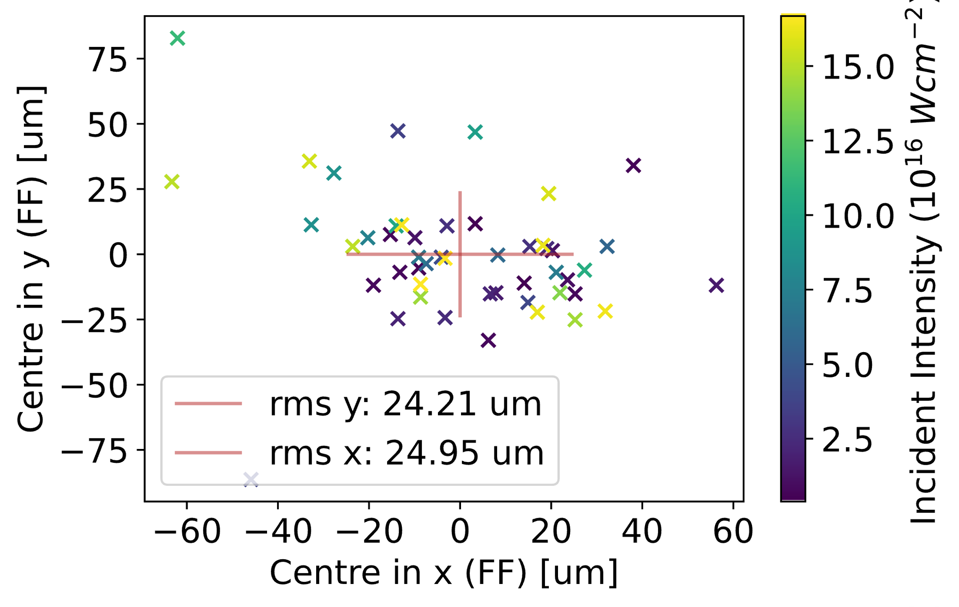
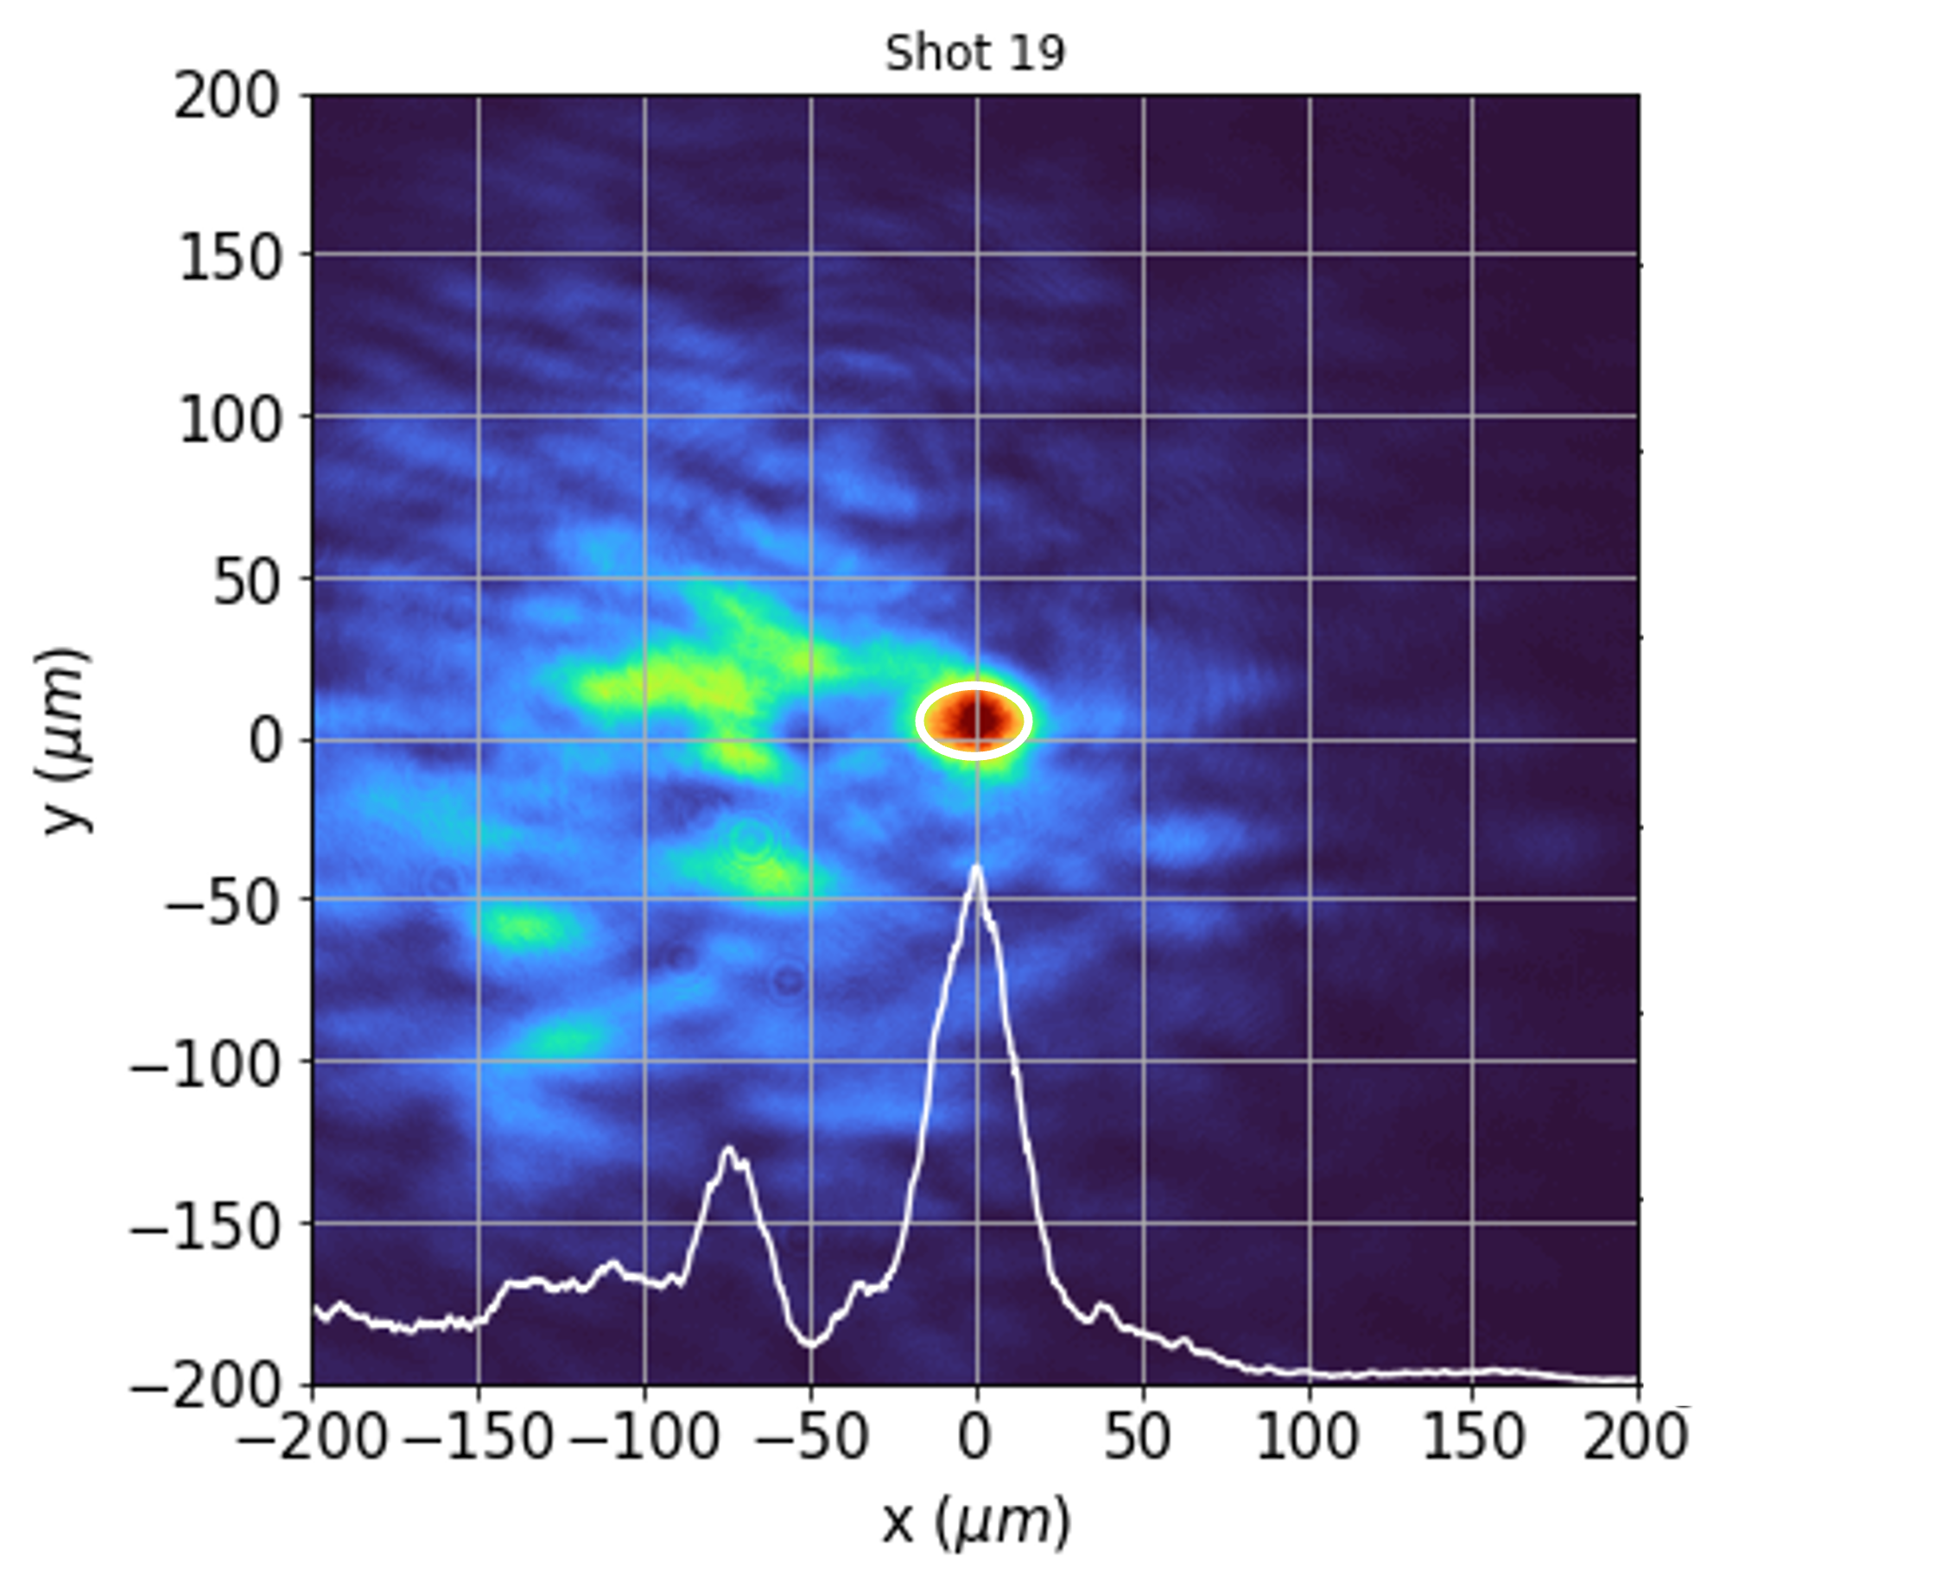
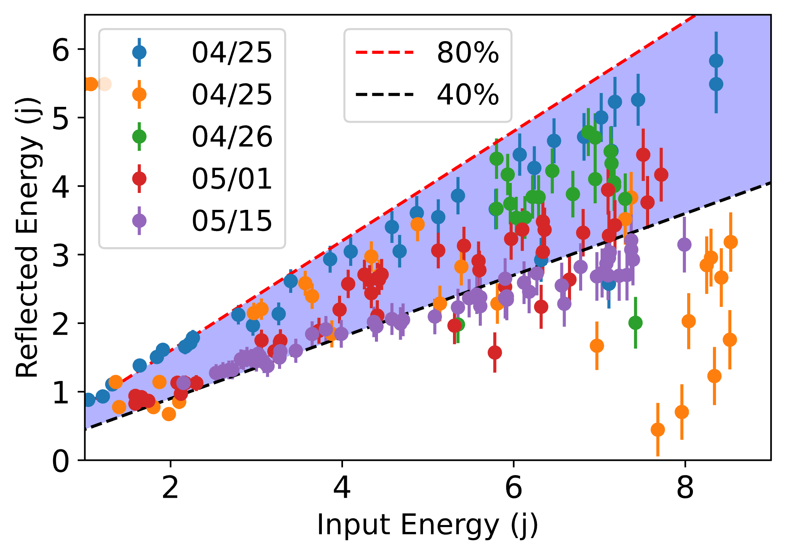
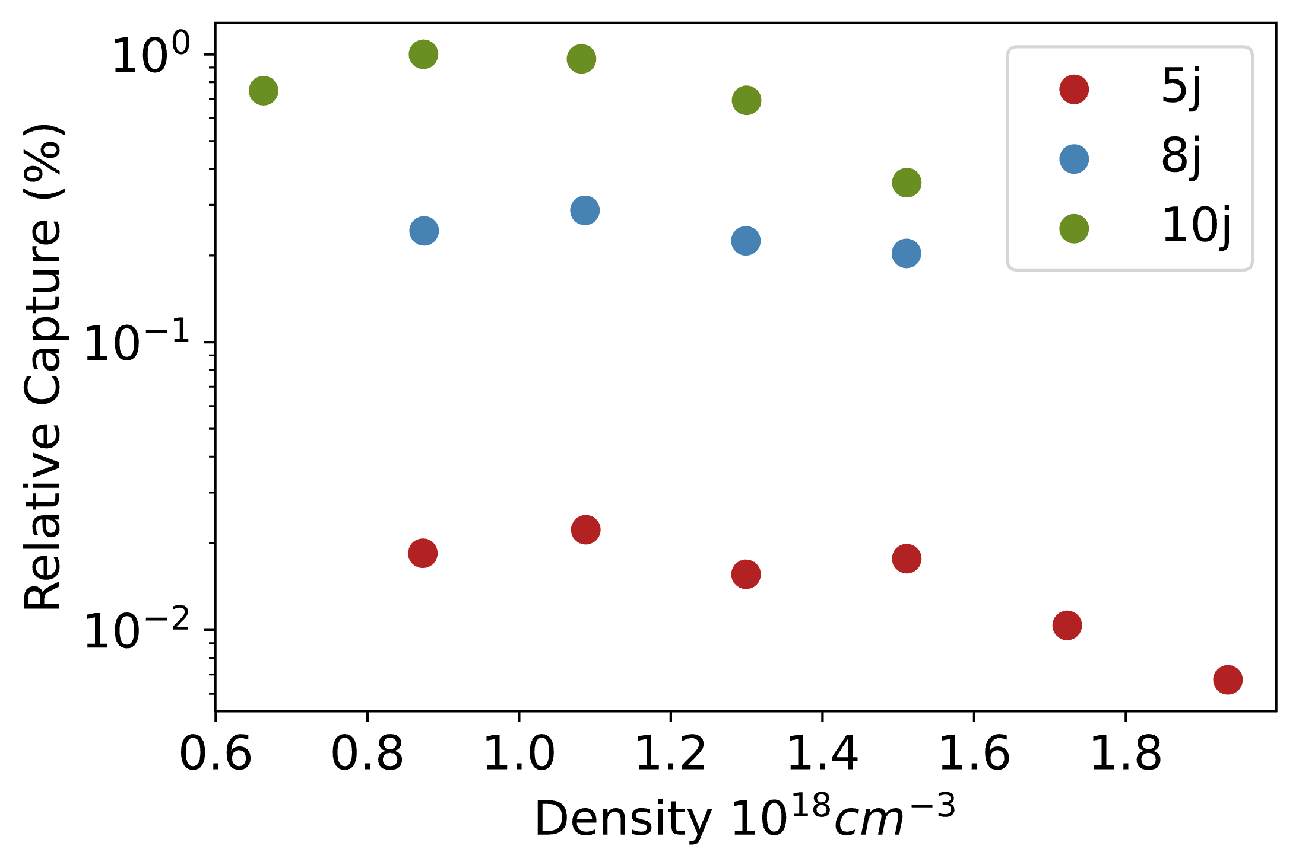
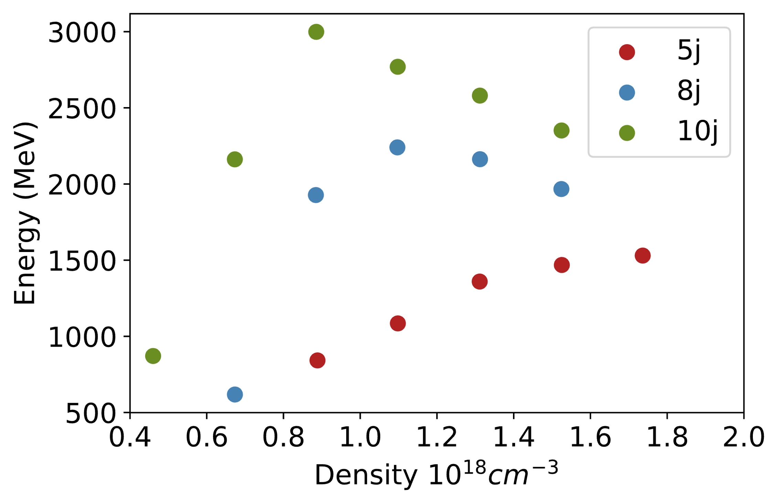
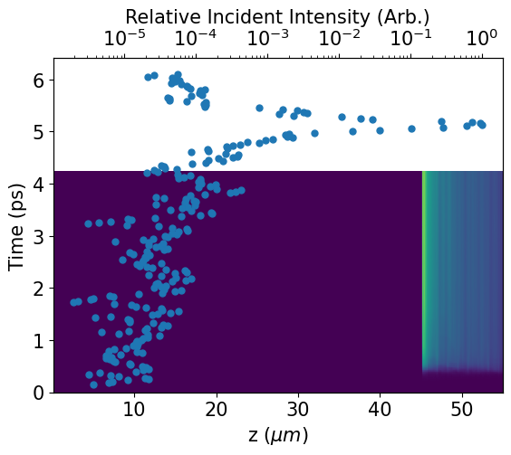
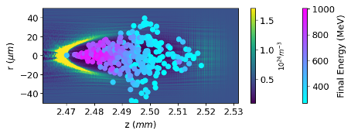
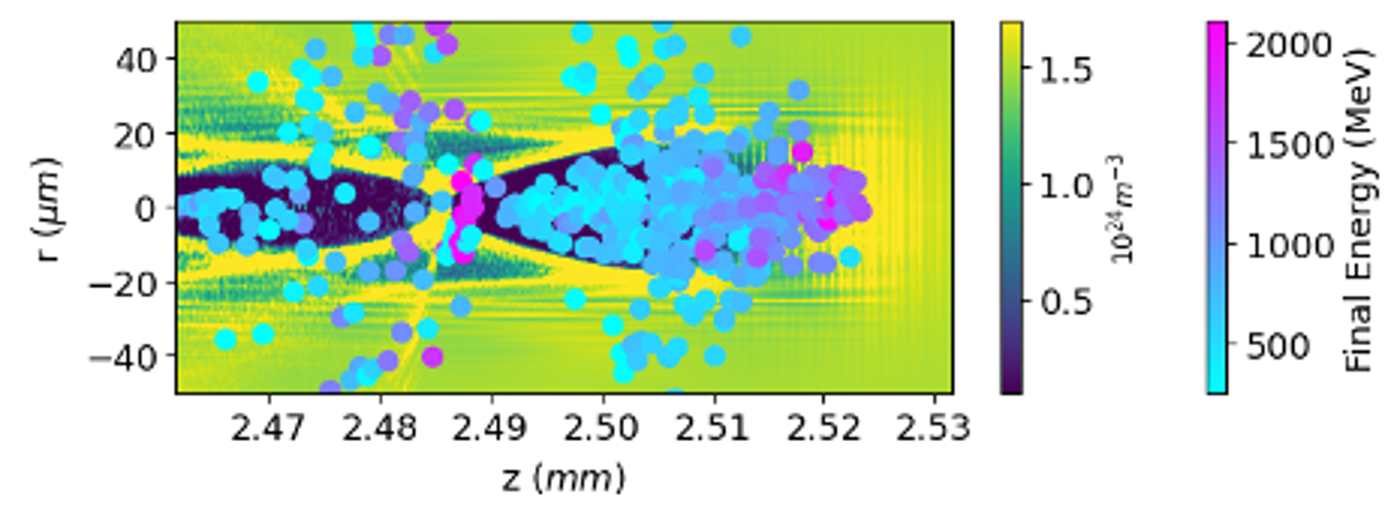
High Intensity Operation of Plasma Mirrors for Staging Applications
J Hills¹, M Backhouse¹, NLopes^{1,2}, Z Najmudin¹
1. Wakefield Acceleration
4. Plasma Mirrors in Practice
Experiment performed at the CLF using Gemini with $τ_{FWHM}\sim 42$fs at $λ_{0}$=800 nm
Incident pulse ionises a Kapton tape generating an overdense plasma which reflects the remainder of the pulse
Ionisation before main pulse results in underdense pre-plasma and absorption of pulse energy
$$λ_{p}∝n_{0}^{−\frac{1}{2}}$$
A driving pulse generates charge displacements, leading to high electric field gradients, on which electrons can be accelerated
Temporal profile of incident pulse (~${10}^{18} Wcm^{−2}$ on tape)
Guiding of the driving pulse over long distances is necessary. Only occurs above a certain power threshold.
4. Results
Far field Camera
7N
Limitations to energy gain include pulse depletion (driving pulse losing energy) reduce the available accelerating length
Plasma Mirror
2
Calorimeter
$L_{d}∝n_{e}^{−\frac{3}{2}}, E_{z}∝n_{e}^{1/2}$ , $W_{gain}∝n_{e}^{−1}$
The incident pulse was focused just after (9-18mm) the plasma mirror. The focal plane was imaged and energy contained within the pulse measured.
2. Staging
Fig. 1: Waterfall plot of electron spectra minus a reference shot (b), as a function of delay between two drive pulses, demonstrating acceleration beyond the first stage, from [1]
Limits on energy gain (dephasing and depletion) can be overcome using staging
High intensities and space constraints mean conventional optics are not an option
Plasma mirrors (PM’s) provide a compact solution, but impact reflected spot quality
Focus closer to the tape results in higher incident intensity, ionising the tape earlier, and less total energy reflected
Focus further from the tape results in a worse spot quality as more area is exposed to tape fluctuations
(b)
Tape added on average 4 $mrad$pointing variation, over 1cm on order of $λ_{p}$, Less variation with focus closer to tape
This reflected pulse was used to drive injection and guiding in cell 2.
Beam 1 drives electron injection and acceleration in cell 1.
Beam 2 generates and is reflected from a plasma mirror into cell 2. Beam 2 drives a wake in which the injected beam from cell 1 is captured.
3. FBPIC Exploration
5. Next Steps
Energy gain and electron capture in the second cell are maximised at lower densities and higher input laser energies
${↑a}_{0}$ and $↓n_{e}$, increases the accelerating region size and electron capture
Variability in reflection quality to be explored on a similar in-house set up
Simulations of plasma mirror behaviour with realistic pulse profile.
Notes:
Intense pulses drive strong fields to produce relativistic electrons- to reach TeV require10^15 cm, = 1km
Needs to be in p polarization to avoid brunel absorption, energy in wings contributes to guiding of laser pulse – amplifying self focusing - maybe mention non gauss
Standard deviation of beams centroid
The beam post reflection was imaged with a far field camera
Had a total reflectivity of 72% at 5.5j input energy with a significant decrease in total energy in fwhm – 12.2% from 19.2%. Vector potential of 0.6 – therefore expect to drive wakefield
After reflection the beam enters a 18mm helium gas cell, important to test its suitability for driving wakefields- looking for self guiding, i.e. see how focal spot increases. If we assumed a ideal beam it should self guide at these intensities, however the spotty profile means simulations/experiments had to be used to determinine guiding properties. Experimentally – density was vasrie and found that there was a large transmitted energy drop at high density – unaccounted for by ionization and the energy to drive wakefield.
Looking into evolution of beam spot size and
Not yet demonstrated at GeV level or with large capture efficiency
Fig 4(a-b). Sum of focal spot measurements after reflection off a (a) mirror ($22\%±0.2\%$ in fwhm) and (b) tape drive ($12\%±2\%$ in fwhm), where peak intensity in (a) is a factor of 8 greater than that measured in (b)
8x lower peak intensity, 55% of energy in fwhm kept

