Slide 1




Characterization and recent results of the
LWFA driven seeded COXINEL FEL at HZDR
U. Schramm
Institute for Radiation Physics
Helmholtz-Zentrum Dresden-Rossendorf
LPAW 2025, Ischia Island, Italy

Slide 2
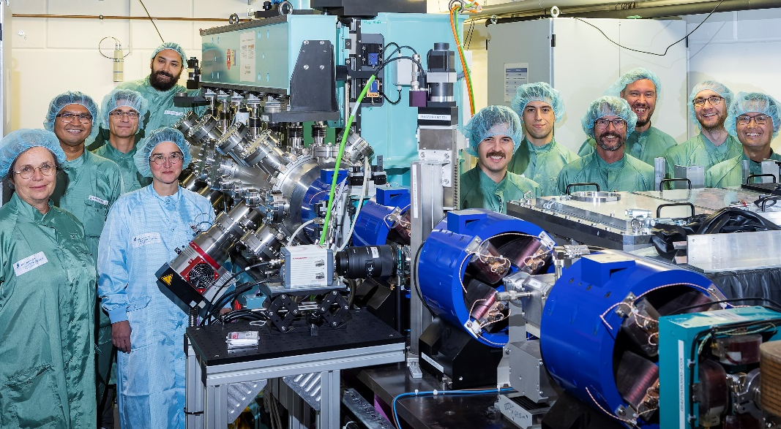
HZDR LWFA - Synchrotron Soleil COXINEL collaboration
M. Labat, M.E. Couprie, E. Rousssel, A. Ghaith, et al.
A. Irman, J. Couperus, Y.Y. Chang, S. Schöbel, M. Laberge, P. Ufer, et al.

Slide 3
HZDR LWFA - Synchrotron Soleil COXINEL collaboration
M. Labat, M.E. Couprie, E. Rousssel, A. Ghaith, et al.
A. Irman, J. Couperus, Y.Y. Chang, S. Schöbel, M. Laberge, P. Ufer, et al.
Idea: 2019 LPAW Split
(high peak current, self truncated
ionization injection STII)
Independent control of energy and charge
Beam loading for low energy spread
Robust scheme if laser mode is „nice“
Many 100 pC at ~5% energy spread with
~3 J laser energy on target
J. Couperus, et al., Nat. Commun. 8, 487 (2017)

Slide 4
HZDR LWFA - Synchrotron Soleil COXINEL collaboration
M. Labat, M.E. Couprie, E. Rousssel, A. Ghaith, et al.
A. Irman, J. Couperus, Y.Y. Chang, S. Schöbel, M. Laberge, P. Ufer, et al.
Idea: 2019 LPAW Split
(high peak current, STII)
Transfer of the beamline
from LOA to HZDR
in 10 / 2021
First light 02 / 2022
M. Labat, et al., Nat. Photonics 17, 150 (2023)

Slide 5

Motivation
demonstrate feasibility (after two decades …)
collocation of (X)FEL and PW lasers
unique backlighting capabilities
(coherence, spectral range and brightness, …)
matched repetition rate (even if low)
so far, laser labs had to be built at XFELs …
F. Grüner, et al., Appl. Phys. B 86, 431 (2007)
T. Eichner, et al., PR AB 10, 082401 (2007)
M. Fuchs, et al., Nat. Phys. 5, 826 (2009)

Slide 6
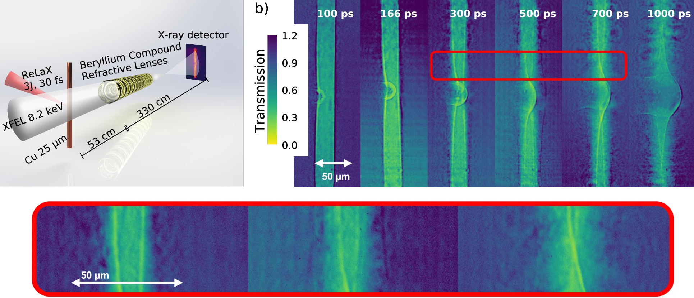
Probing micron-scale effects in compressed matter
via high resolution phase contrast imaging
2
3
1) Initial laser impact
and spherical shock
1
2) Surface return current to
compensate charge loss
3) Heated surface ablation
driving wire implosion
A. Laso Garcia et al., Nature Commun. 15, 7896 (2024)

Slide 7
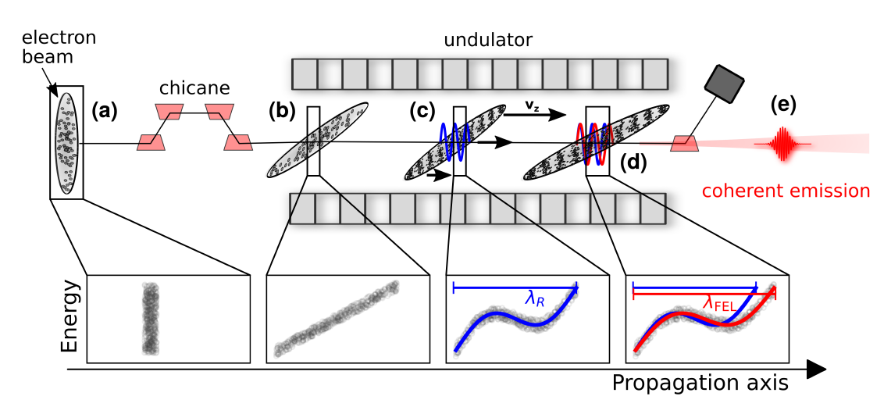
FEL concept for “poor” beam quality (10% energy spread)
stretch (chirp) electron bunch in chicane to reduce slice energy spread
[10 fs -> 1 ps, slice energy spread ideally drops to 0.1%]
requires high initial charge to maintain high peak current ~10 pC/MeV

Slide 8
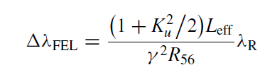
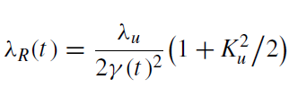
(Seeded) FEL concept for “poor” beam quality
leads to strong red-shift of the emitted FEL light wrt the resonance wavelength
M. Labat, et al., NJP 22, 013051 (2020)

Slide 9
The COXINEL beam (transport) line (for large energy spread)
Fast capture of initial divergence to avoid chromatic emittance growth
A. Loulergue, at al., NJP 17, 023028 (2015)

Slide 10
The COXINEL beam (transport) line (for large energy spread)
U20, period 20 mm, N=100,
gap~4 mm, K_{u} <2.47
Chromatic matching (i.e. energy dependent focus position in undulator)
T. André, et al., Nature Commun 9, 1334 (2018)

Slide 11
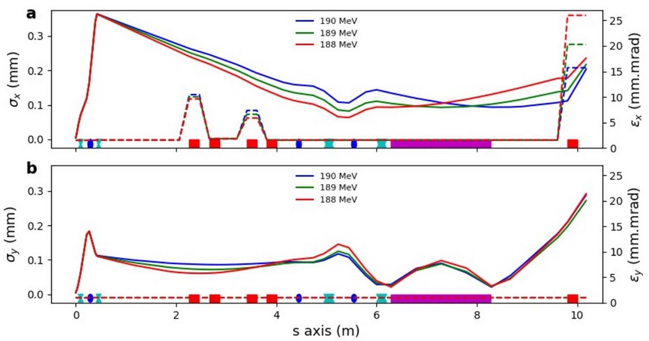
The COXINEL beam (transport) line (for large energy spread)
Chromatic matching (i.e. energy dependent focus position in undulator)

Slide 12
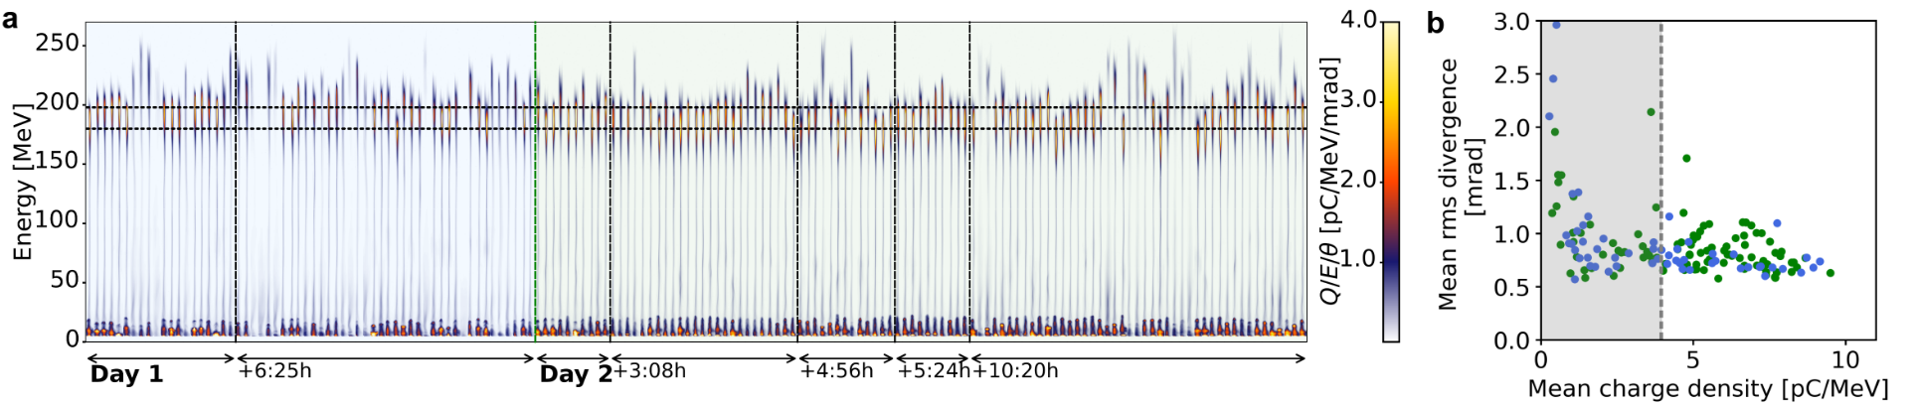
Passive electron beam stability and beam quality (in 2022)
Total charge (FWHM): 213 ±13 pC
Analysis for 200±1 MeV energy slice:
Charge density: 8.1 ± 0.9 pC/MeV
Divergence: 1.2 ± 0.3 mrad
Y. Chang, et al., PR Appl. 20, L061001 (2023)

Slide 13
First light (in 2022)
y-pos
260 270 280
Wavelength [nm]
Seeding eases microbunching and improves FEL performance
M. Labat, et al., Nat. Photonics 17, 150 (2023)

Slide 14
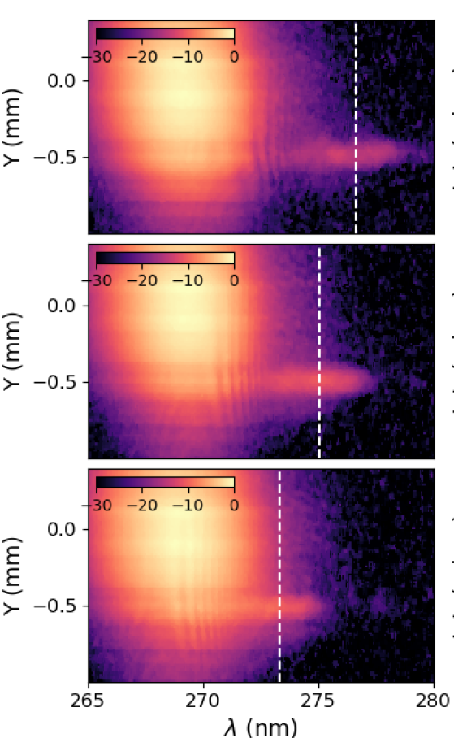

Tunability of a red-shifted seeded (low gain) FEL
seed delay scan
FEL
Slight tuning is possible through
undulator gap
seed and beam chirp (R₅₆)
seed delay
τ = +500fs
τ = 0
τ = -500fs
M. Labat, et al., PRAB 28, 020702 (2025)

Slide 15
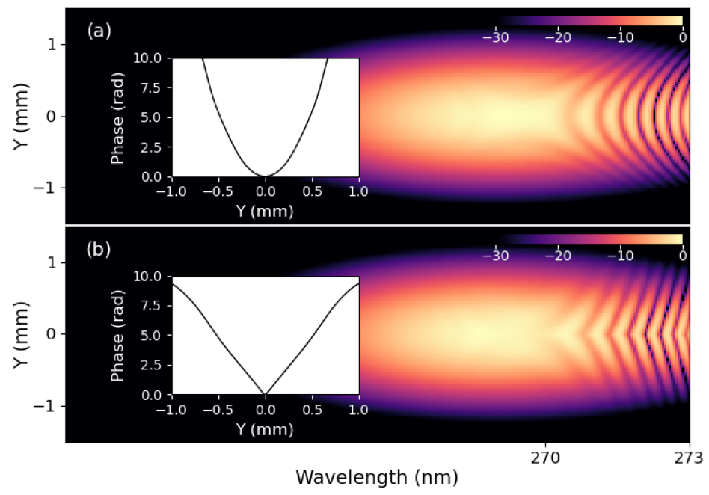
Interference between seed and red shifted FEL
At undulator exit different transverse phase at resonant and red-shifted
FEL wavelength implies different interference pattern with seed beam
Actually representing a feature of
undulator radiation¹ (and source
position)
Genesis
268nm
Experiment
M. Labat, et al., Phys. Rev. Res. 7, 023061 (2025)
277nm
¹ A. Hofmann, „The physics of Synchrotron Radiation“, Cambridge Monographs of Particle Physics, Nuclear Physics and Cosmology (Cambridge University Press, 2004)

Slide 16
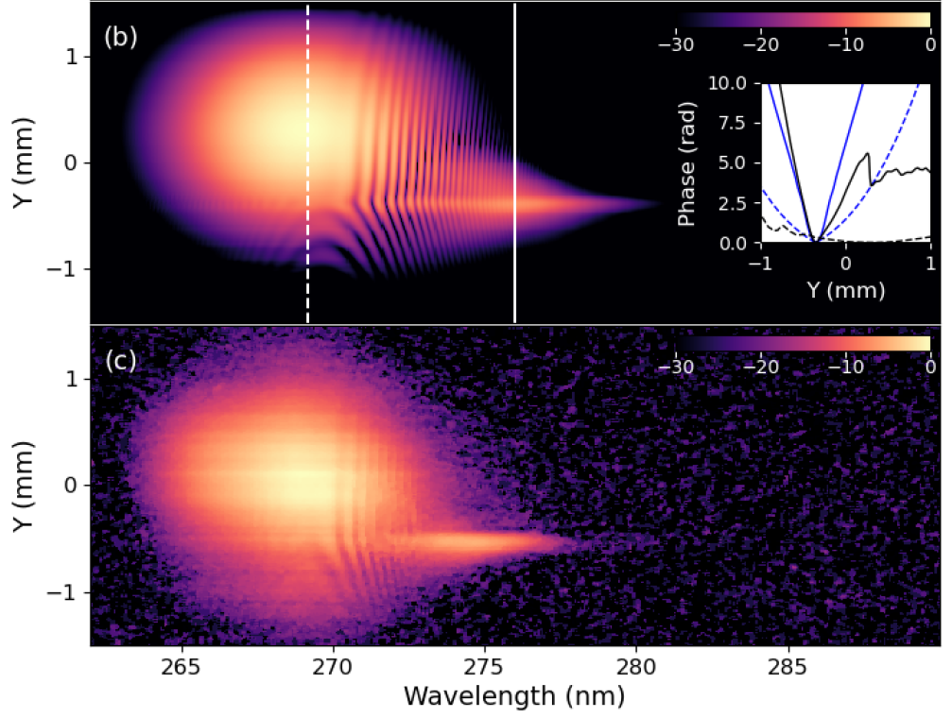
Interference between seed and red shifted FEL
At undulator exit different transverse phase at resonant and red-shifted
FEL wavelength implies different interference pattern with seed beam
Genesis
Experiment
M. Labat, et al., Phys. Rev. Res. 7, 023061 (2025)

Slide 17
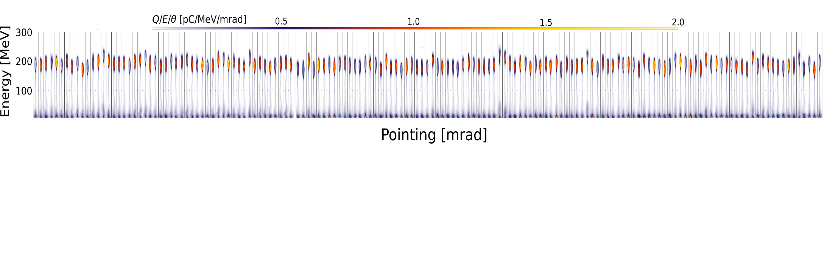
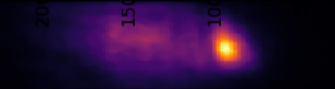
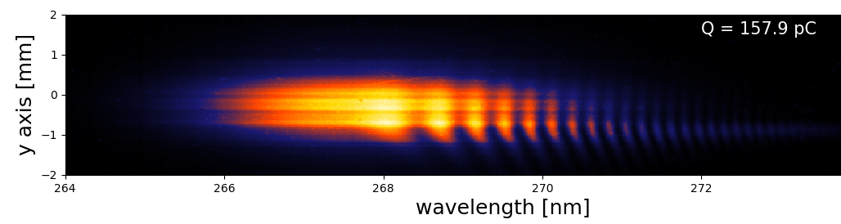
Latest preliminary results from Coxinel (12/2024)
Improved LPA beam parameters: 350 pC-fwhm, ~10 pC/MeV, no plasma lense
Consistent beams for 2 weeks
05.12.2024 ……..
11.12.2024
allowing for precise transport and alignment through the undulator
Stronger FEL signal with improved statistic
up to 50 nJ/pulse with total seed energy of ~ 200nJ (not fully overlapping)
FEL
seed

Slide 18
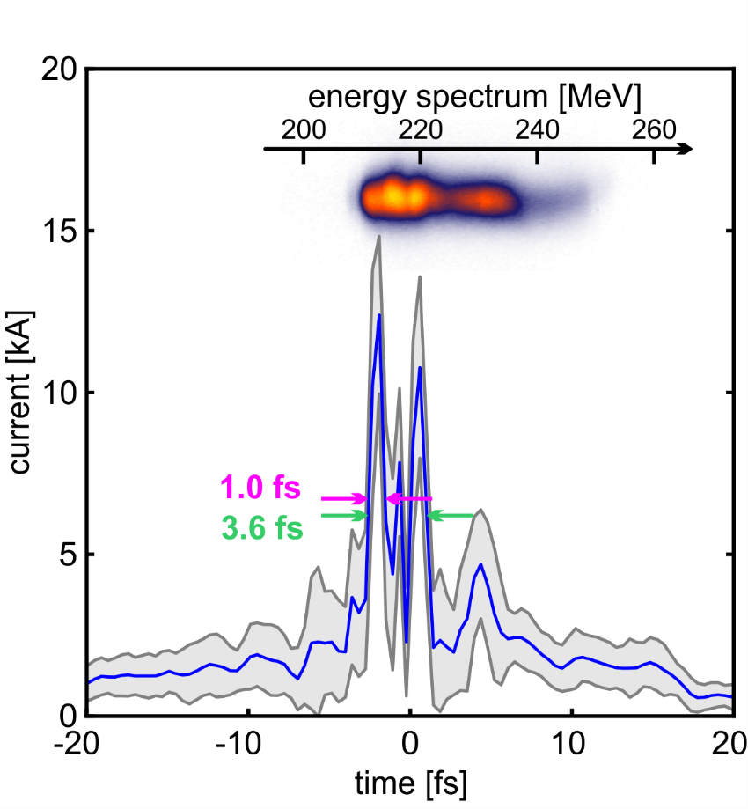
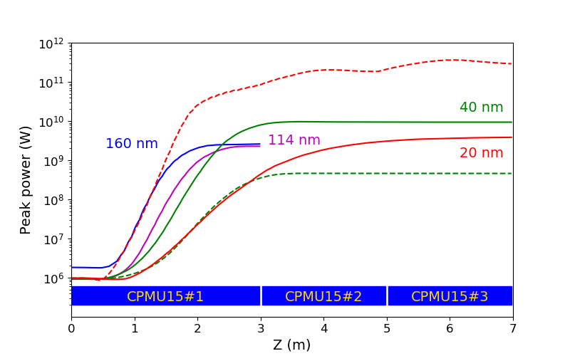
Outlook
Reach saturation (undulator length)
Advance to shorter wavelength
(requires improved e-beam quality
of typ. x0.5 in emittance and/or x3 in
charge density )
Exploit (or investigate) potential
influence of pulse sub-structure

Slide 19
Thanks for your attention
and to all people who contributed at Soleil and HZDR

