Slide 1
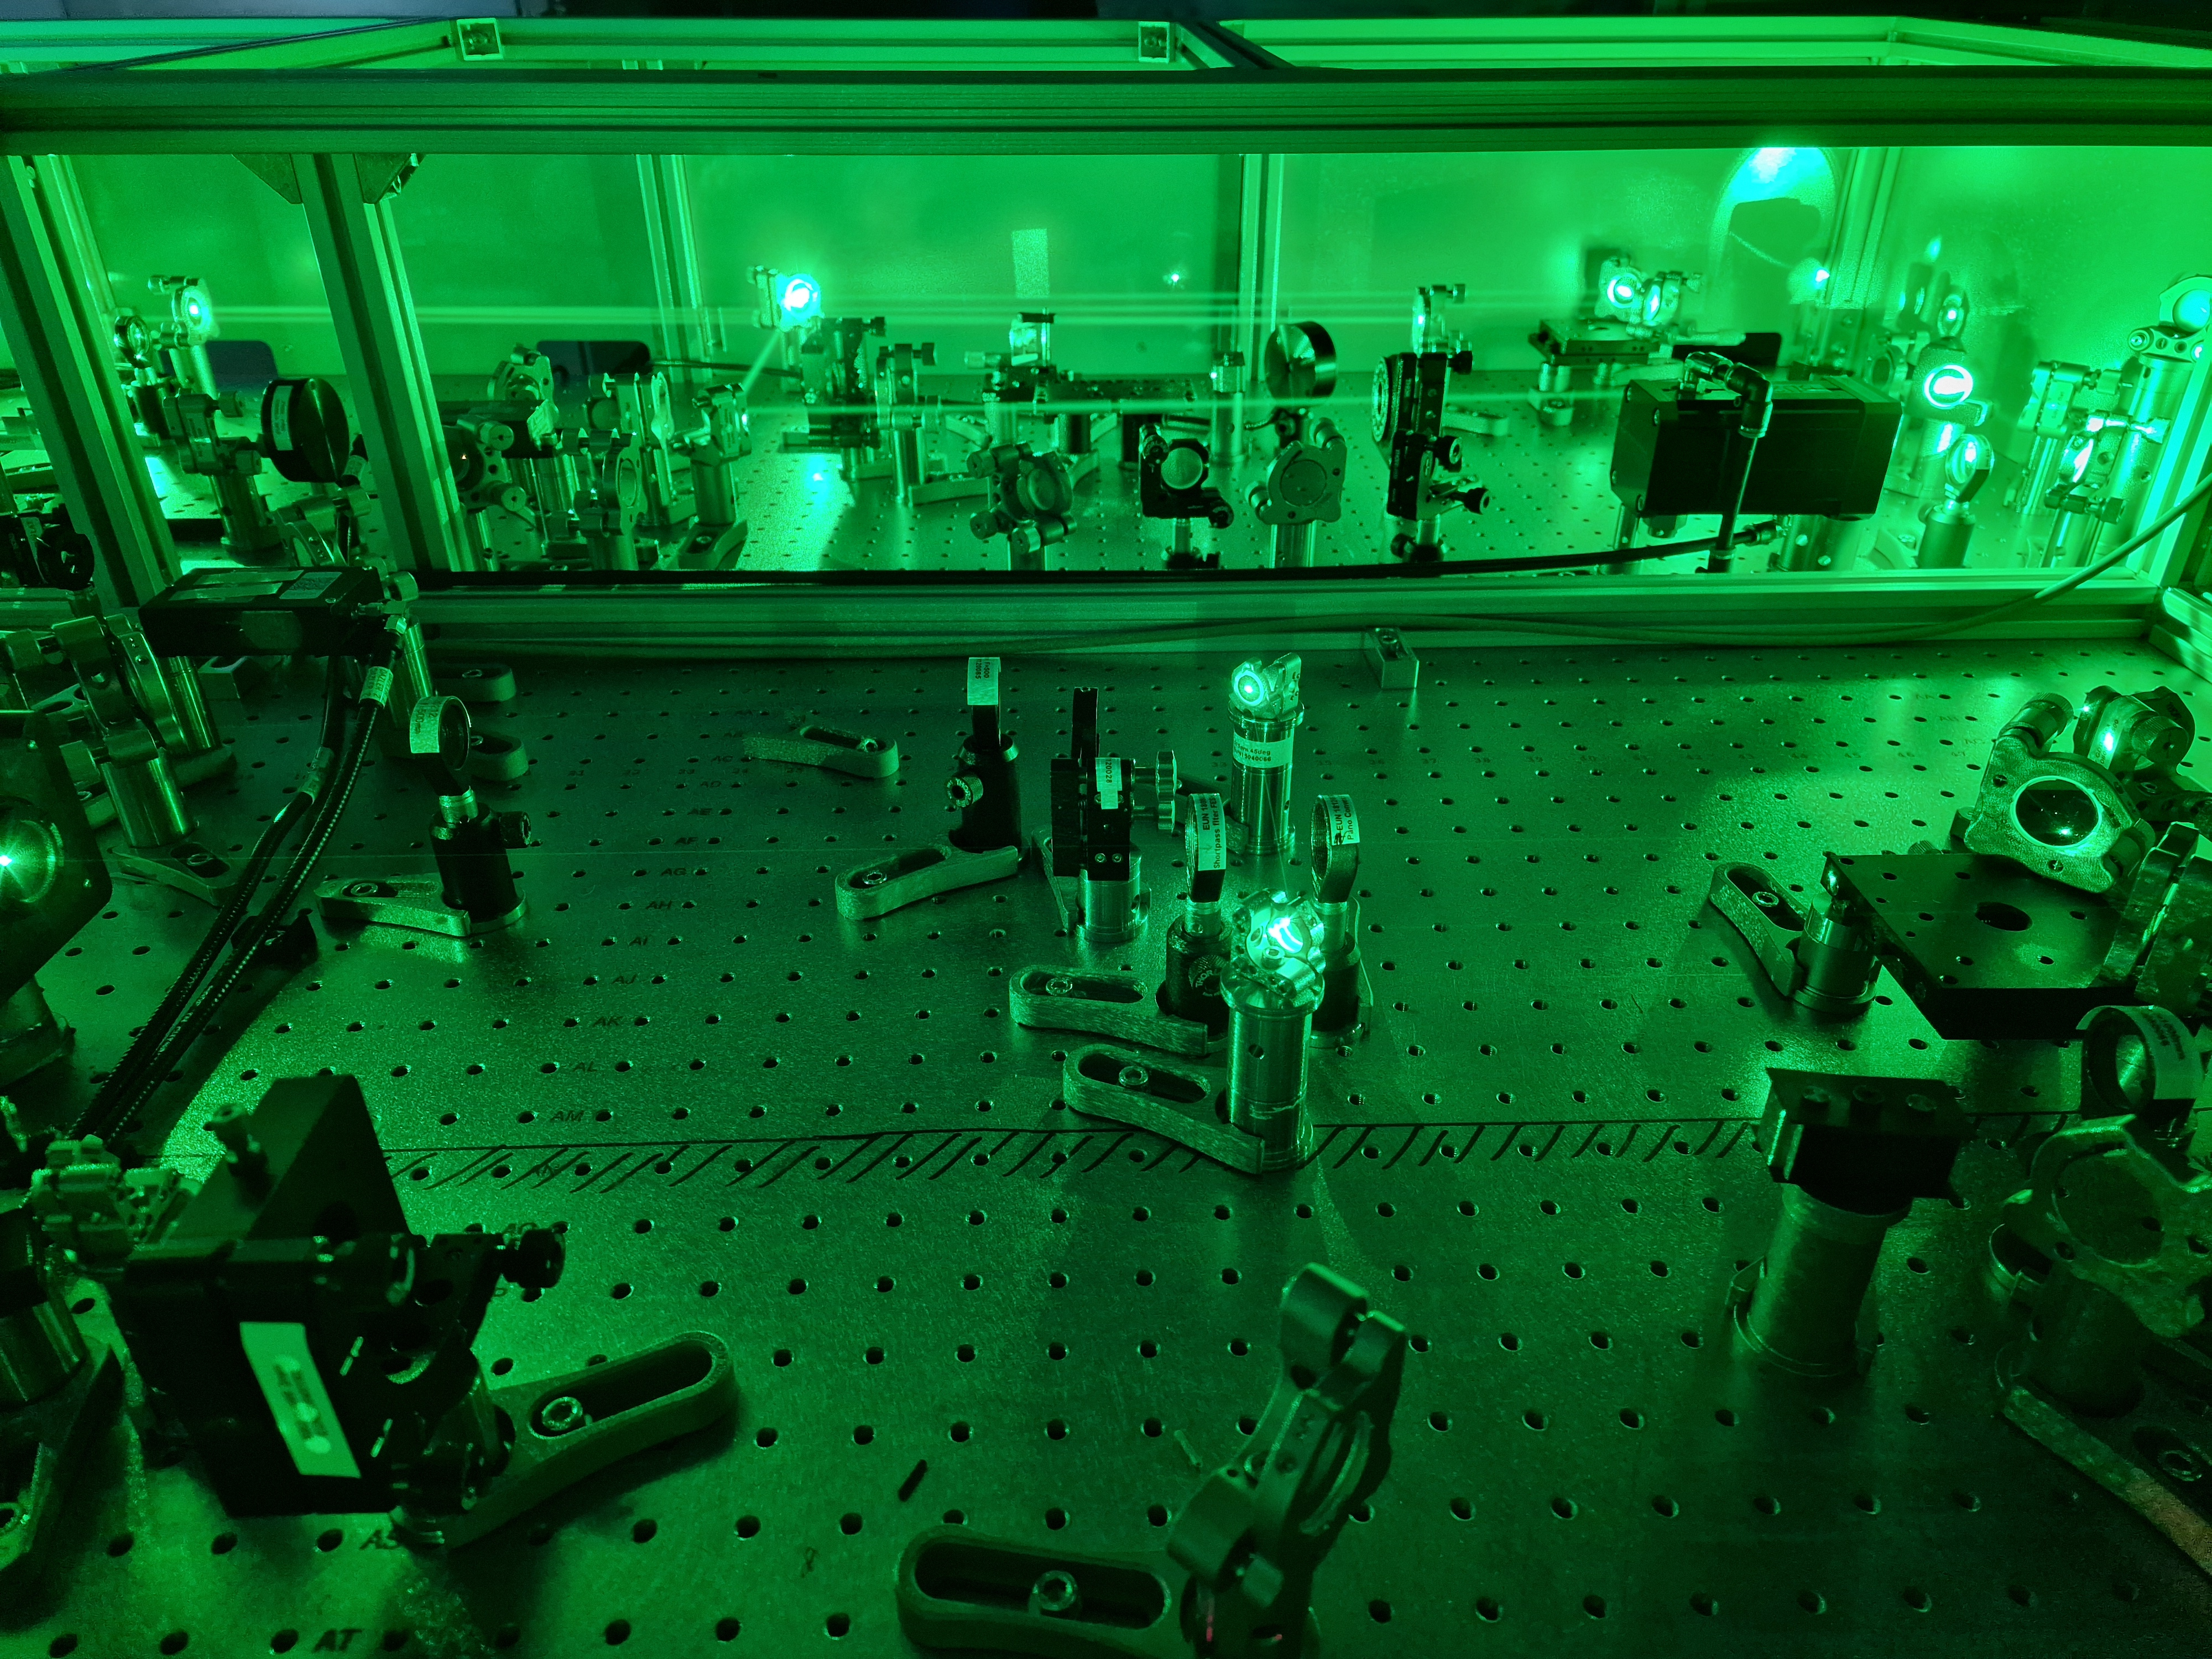



Development of the L2-DUHA dual output front end at ELI-ERIC
Alex Whitehead, Lukáš Indra, Jonathan T. Green
The Extreme Light Infrastructure ERIC - ELI Beamlines Facility, Dolní Břežany, Czech Republic
Czech Technical University, Prague, Czech Republic
This project has received funding from the European Union´s Horizon Europe research and innovation programme under grant agreement no. 101073480.
1

Slide 2

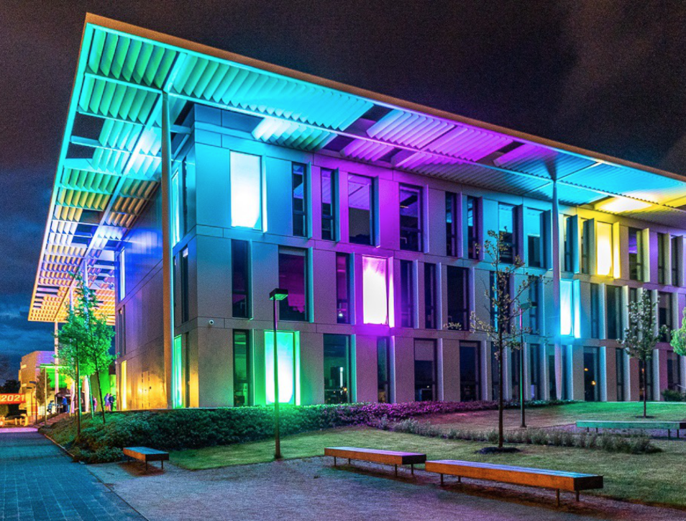
ELI-ERIC – ELI Beamlines facility
Located in Dolní Břežany (Czech Republic)
ELI Beamlines explores the
interaction of light with matter at intensities 10 times higher than previously achievable.
4 High power laser systems: From mJ kHz to PW 1shot/min systems
7 Secondary sources – EUV - X-rays, Electron and Ion Accelerators
10 User stations
2

Slide 3
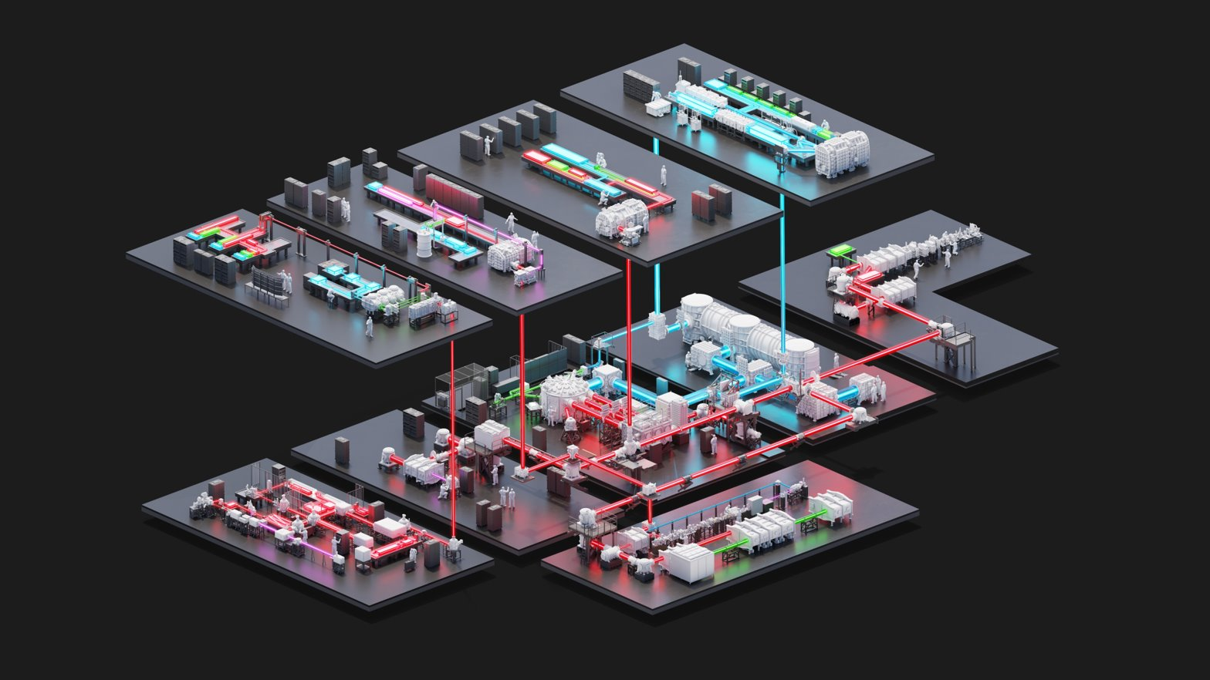

ELI-ERIC – ELI Beamlines facility
L4 ATON
10 PW, 1shot/min
L3 HALPS
1.5 PW, 10Hz
L2 DUHA
100 TW, 50Hz
L1 ALLEGRA
6 TW, 1 kHz
Proton/ion acceleration
Plasma physics
L4 compressor
Material & biomolecular applications
Electron acceleration
X-ray generation
3

Slide 4
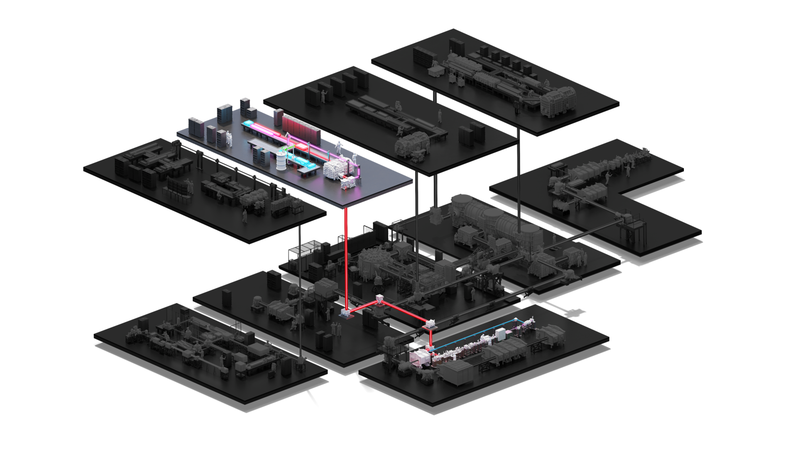
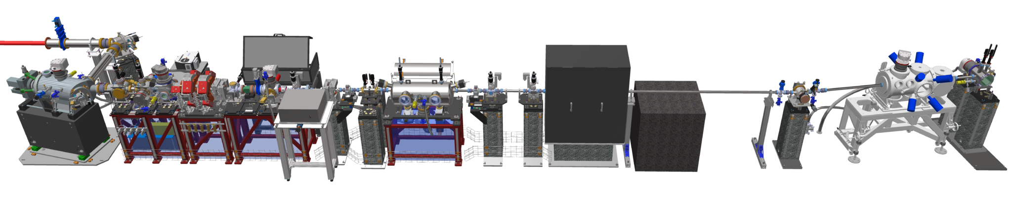
LUIS beamline
L2 DUHA
100 TW, 50Hz
Compact laser driven incoherent source
4

Slide 5

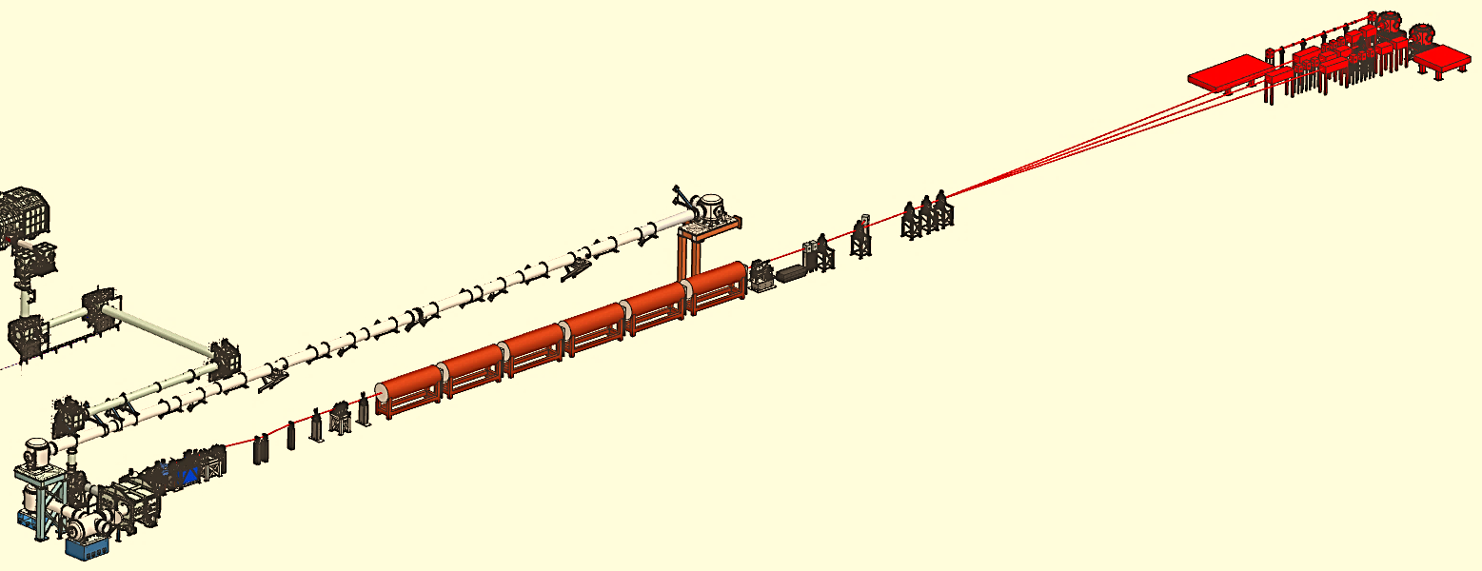
Laser driven soft x-ray free electron laser
Host of the EuPRAXIA laser driven plasma accelerator
Pump-probe set-up
User 2-3 Stations
Photon beamline
Undulator line
LP-Accelerator
Electron Beamline
5

Slide 6
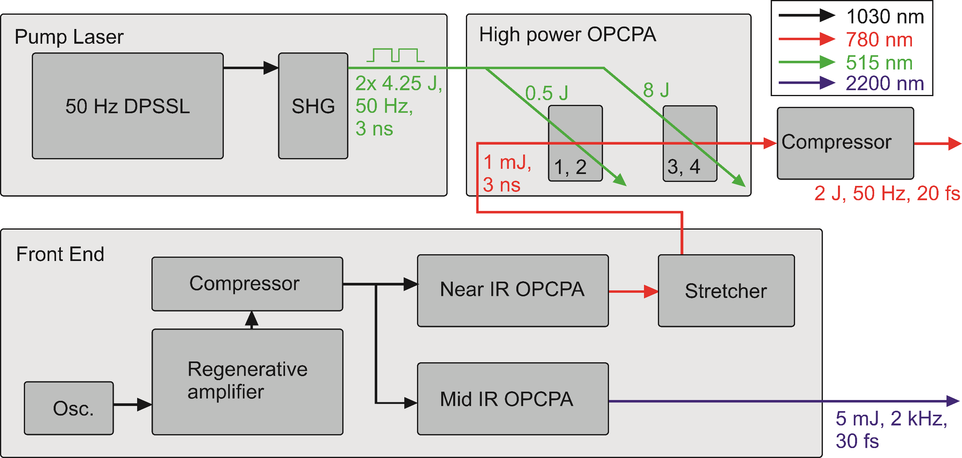
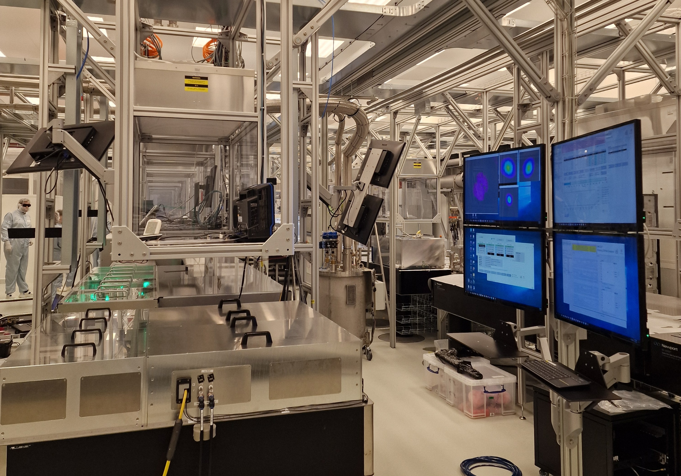
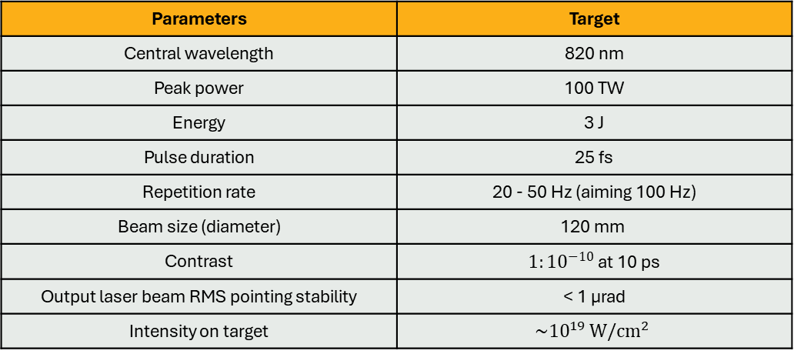
L2 DUHA
High energy, high repetition rate, OPCPA system
3
25
Parameters | Target
Central wavelength | 820 nm
Peak power | 100 TW
Energy | 3 J
Pulse duration | 25 fs
Repetition rate | 20 - 50 Hz (aiming 100 Hz)
Beam size (diameter) | 120 mm
Contrast | $1:{10}^{−10 }$at 10 ps
Output laser beam RMS pointing stability | < 1 µrad
Intensity on target | $$\sim {10}^{19 }W/{cm}^{2}$$
6

Slide 7
Dual output front-end
Seeded by a fiber oscillator (Orange model, 80 mW output power, 80 MHz, 1030 nm).
In-house developed diode-pumped Yb:YAG thin-disk amplifier delivers 75 W average power at a 2 kHz, generating pulses compressed to 3 ps.
Single pump laser for both outputs
7

Slide 8
Near IR OPCPA
Seed for high power OPCPA used for laser-plasma acceleration.
2 OPA stages reaching over 1 mJ
Stretched to 3 ns, and repetition rate reduced to 50 Hz for the high power OPCPA
8

Slide 9
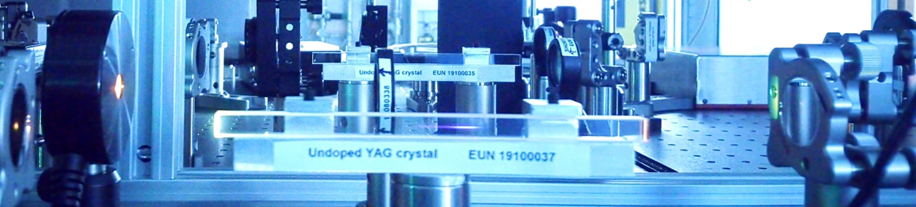
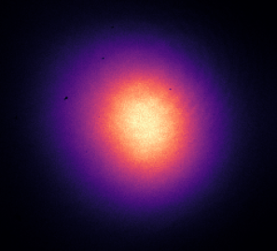
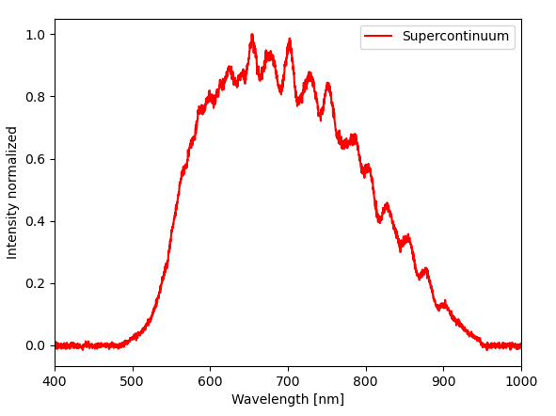
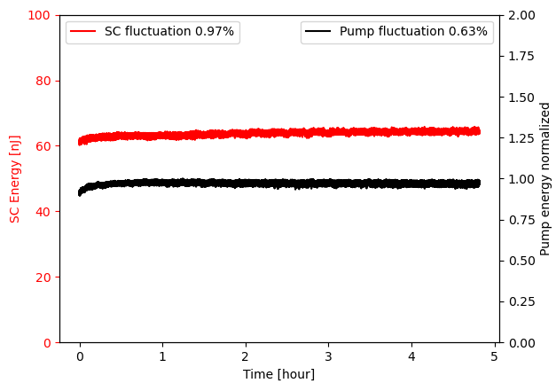
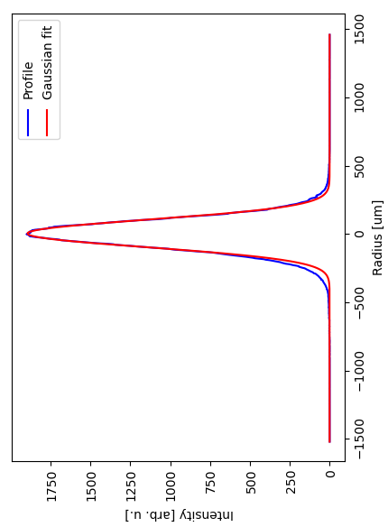
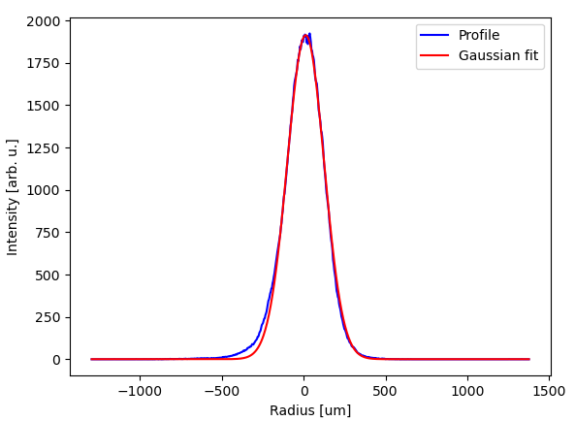
Near IR OPCPA – supercontinuum generation
Seed created via supercontinuum generation in a 13 cm long YAG crystal
Stable, and high contrast method for broadband beam generation*
*Lukáš Indra, and al., "Picosecond pulse generated supercontinuum as a stable seed for OPCPA," Opt. Lett. 42, 843-846 (2017)
*Alexandr Špaček, and al., "Stability mechanism of picosecond supercontinuum in YAG," Opt. Express 28, 20205-20214 (2020)
9

Slide 10
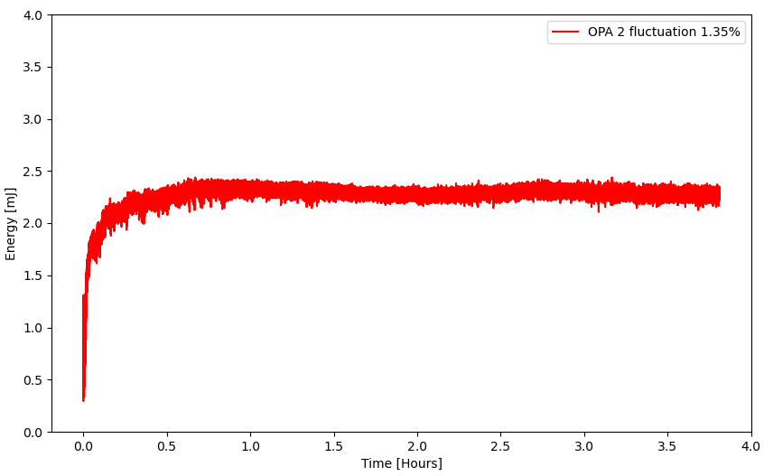
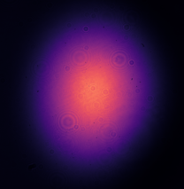
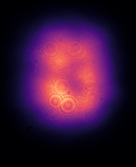
Near IR OPCPA – OPA stages
2 OPA stages reached over 2 mJ with fluctuations around 1% rms
Inhomogeneity in the near field intensity distribution of the output of OPA 2
Output of OPA 1
Output of OPA 2
10

Slide 11
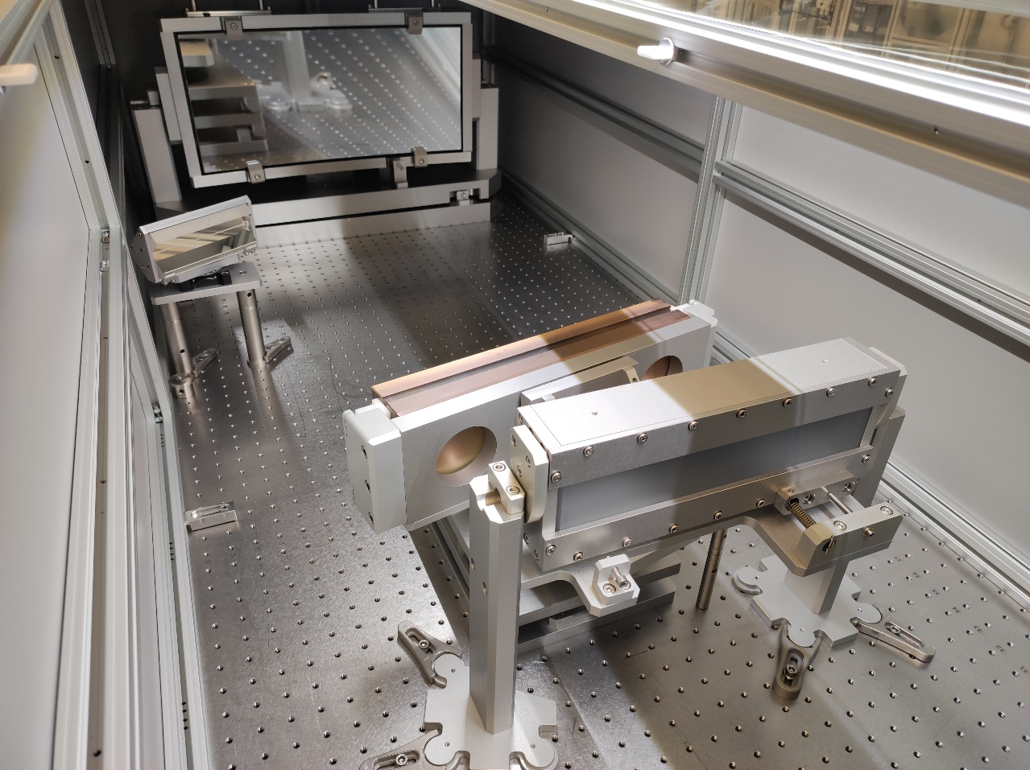
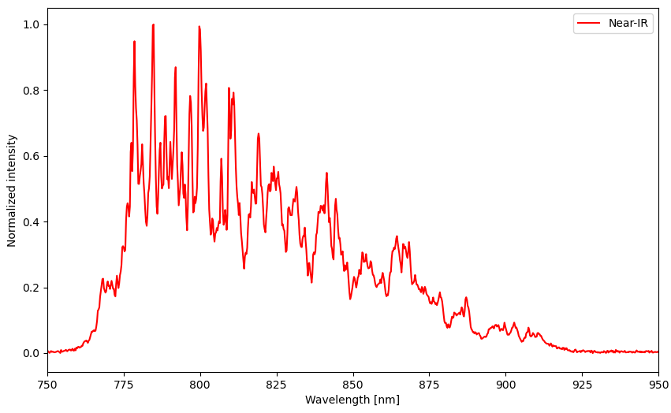
Near IR OPCPA - stretcher
Spectrum between 760 and 900 nm
Stretcher alignment in progress to reach 3 ns
11

Slide 12
Mid IR OPCPA
Usage for high harmonics generation for seeding the FEL of the LUIS beamline, and drive a laser plasma X-ray source in L2 hall
Mid-IR beam generated in DFG crystal
3 OPA stages reaching 5 mJ at 2 kHz
Compressed to 30 fs with a long suprasil rod
12

Slide 13
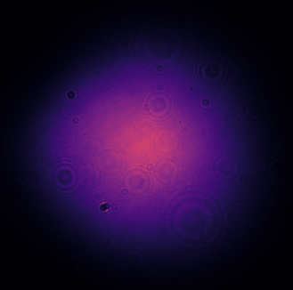
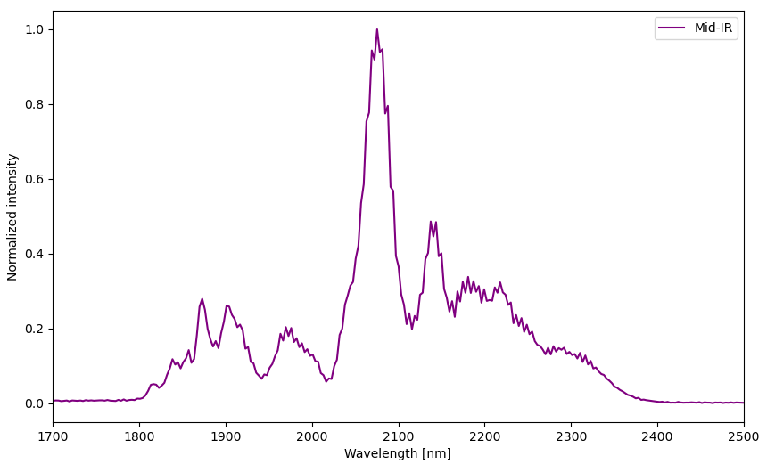
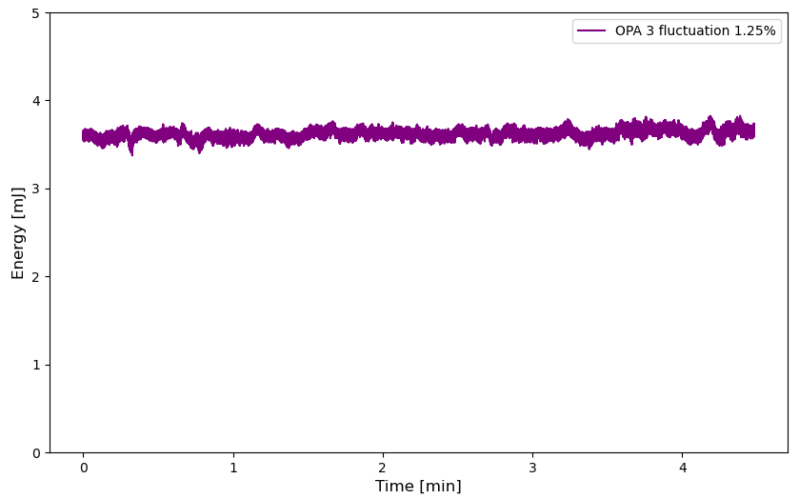
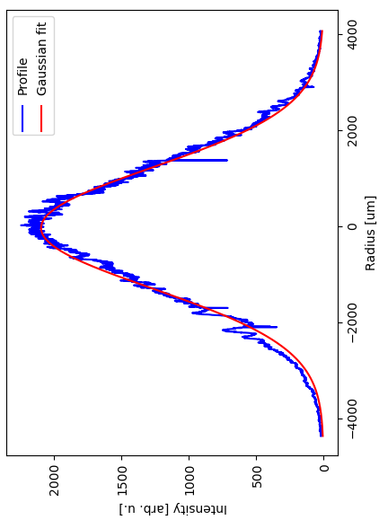
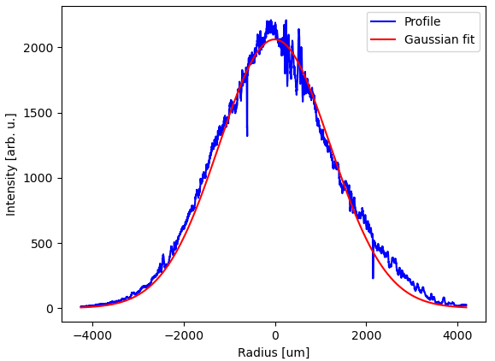
Mid IR OPCPA – OPA stages
Spectrum between 1800 and 2400 nm
Output of OPA 3 reached over 3.5 mJ with fluctuations around 1% rms
Output of SHG generated in OPA 3
13

Slide 14
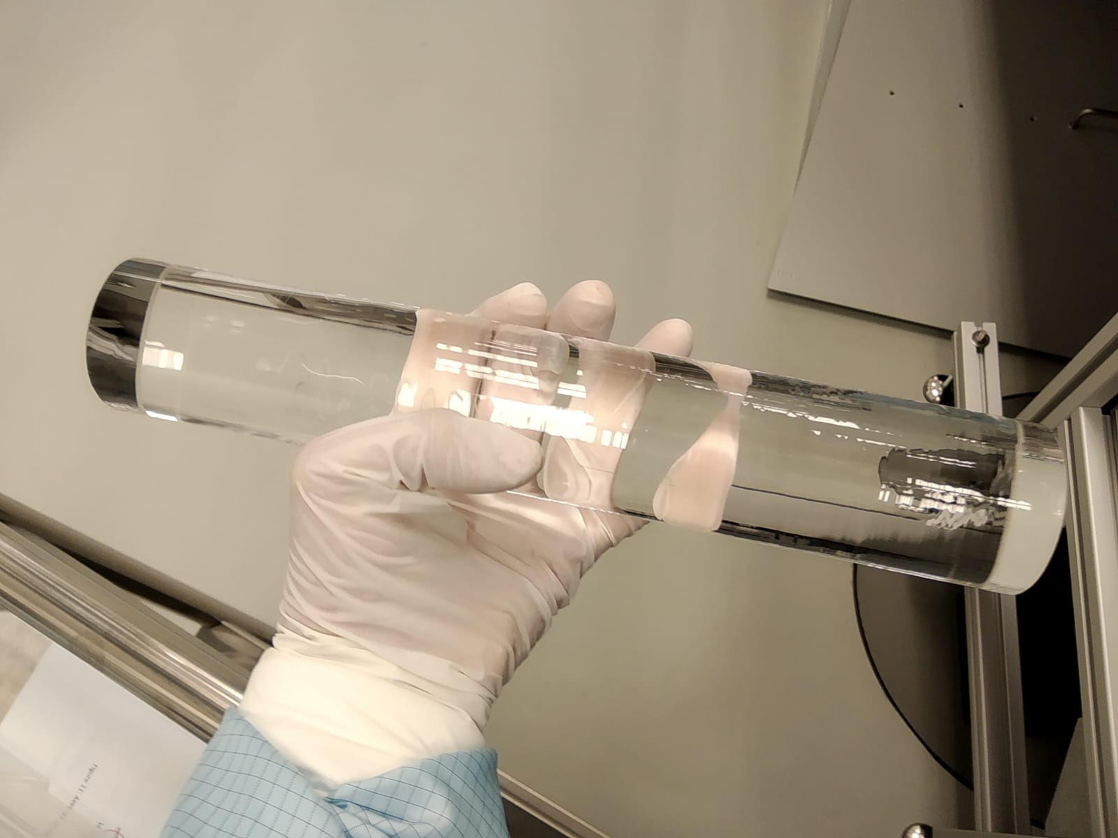
Mid IR OPCPA - compressor
Work in progress to compress to 30 fs
Compression in bulk using a suprasil rod
Dazzler for high order dispersion optimization
14

Slide 15
Conclusion
Summary
Offering a dual output source capable to run simultaneously
N-IR: > 2 mJ achieved after 2 OPA stages
Mid-IR: > 3 mJ achieved after 3 OPA stages
Next steps
N-IR: Optimizing the beam profile and stretching to 3 ns
Mid-IR: Amplification to 5 mJ and compression to < 30 fs
15

Slide 16


Thank you for your attention
This project has received funding from the European Union´s Horizon Europe research and innovation programme under grant agreement no. 101073480.
16

Slide 17
Pump laser

