Slide 1
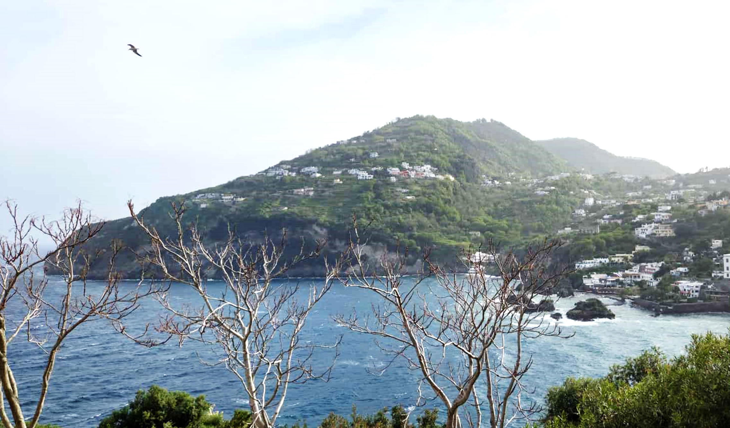
Laser production and magnetic self-confinement of e−e+ plasma using structured targets
LPAW 2025, Ischia, IT
Alexander Pukhov & Alexander Samsonov
Heinrich-Heine-University Dusseldorf

Slide 2
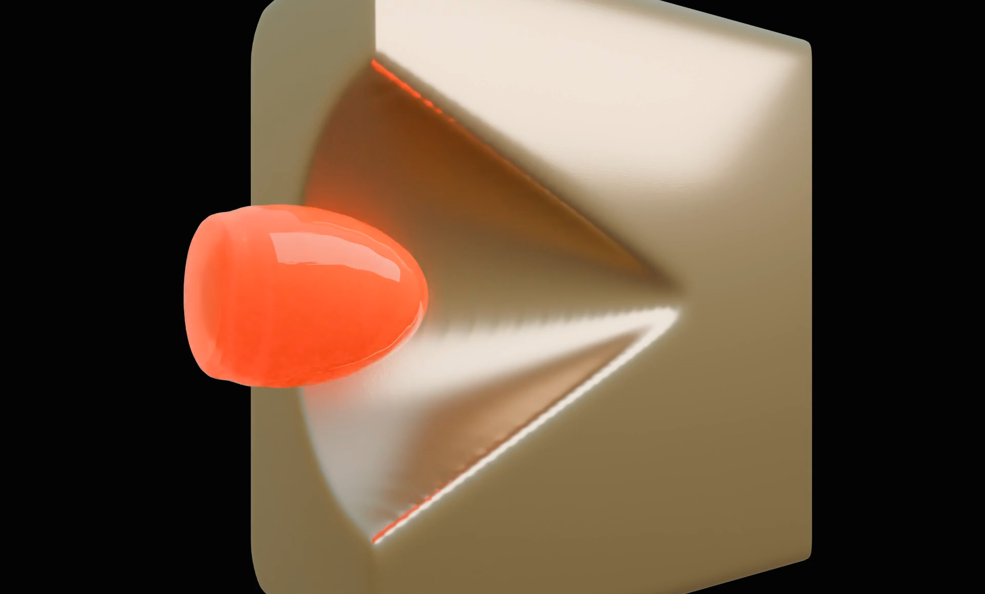
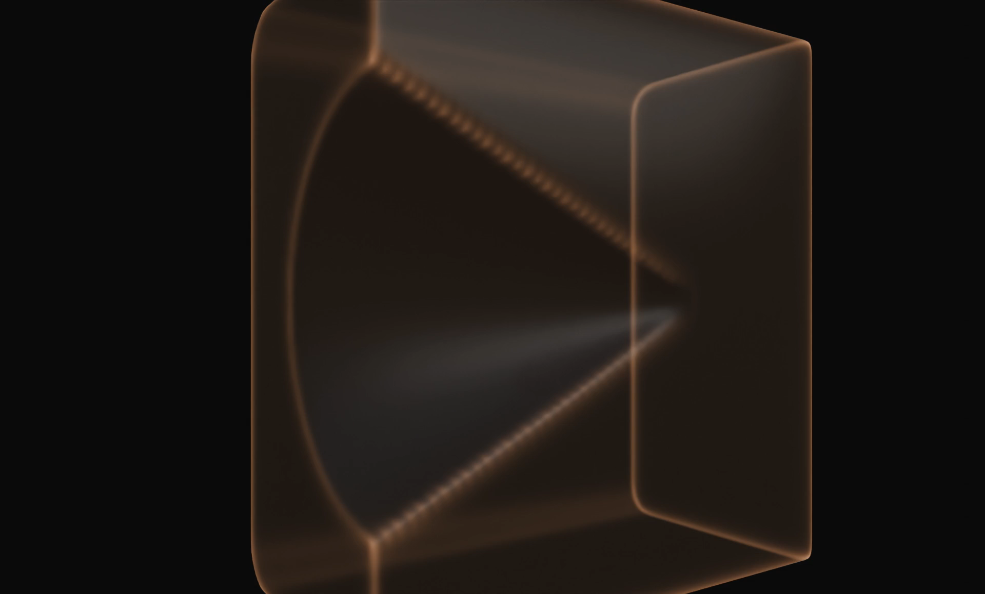
Magnetic mirror and e-e+ plasma confinement
e-e+ pairs get reflected and trapped
B-field configuration, 10 GGauss
Long-living MHD dynamics of true e-e+ plasma
Samsonov & Pukhov arXiv:2409.09131 (2024)

Slide 3
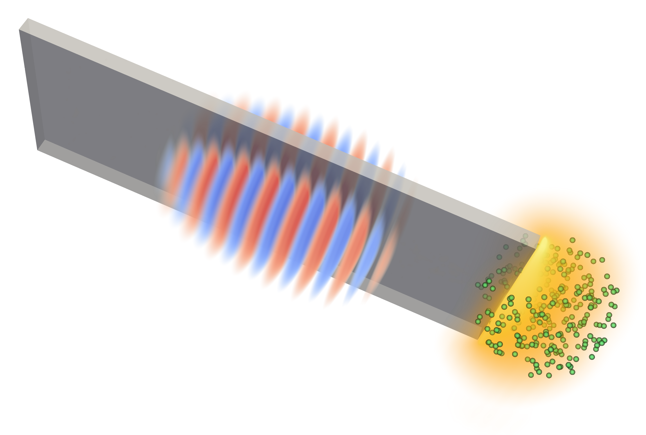
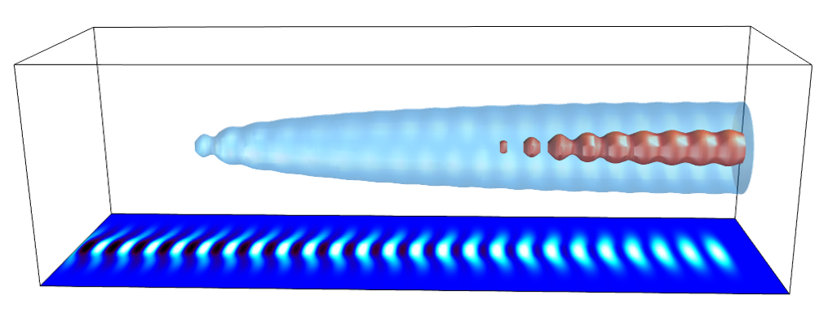
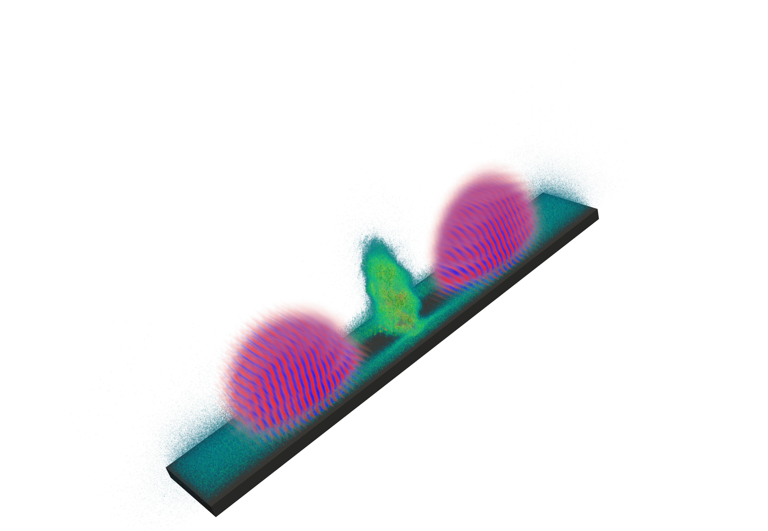
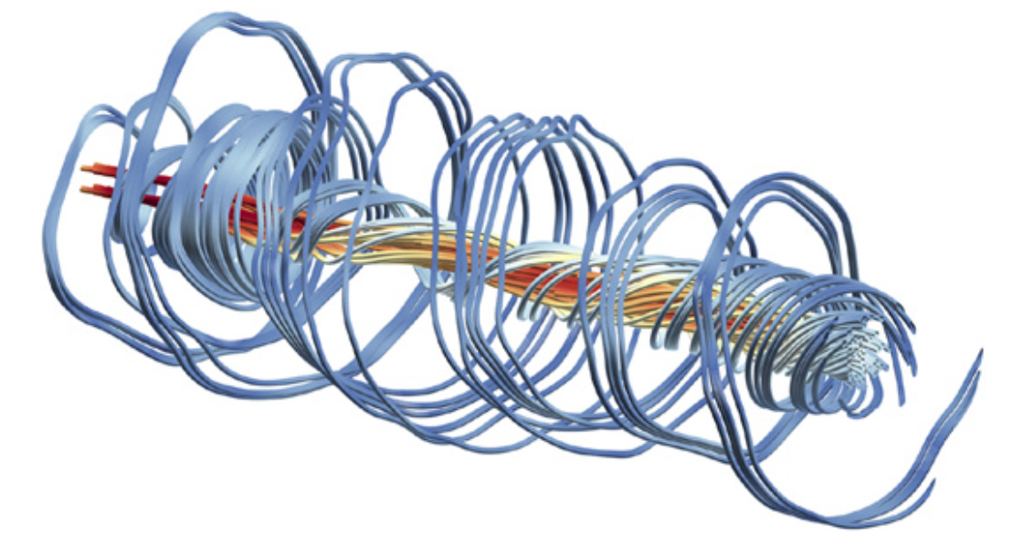
Research subjects of our group
Shen, Pukhov, Qiao
Comm. Phys. 7, 84 (2024)
AWAKE at CERN
peeler scheme
Jiang, Pukhov, Zhou NJP 23, 063054 (2021)
QED processes
magnetic field
amplification
we will focus on this today

Slide 4
Evolution of laser intensity
QED effects become important for future laser facilities
G. Mourou, Rev. Mod. Phys. 91, 030501 (2019)

Slide 5
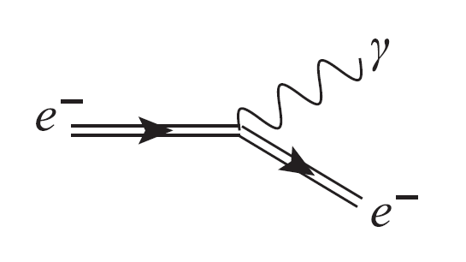
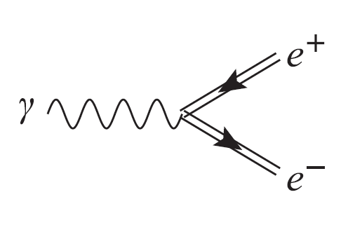
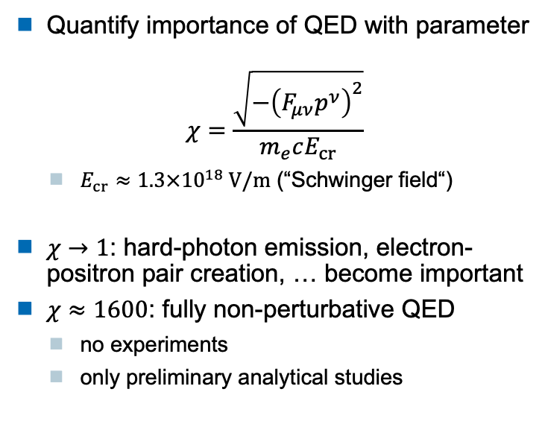
Quantum electrodynamics (QED)
Quantify importance of QED with parameter
$$χ=\frac{\sqrt{−{\left(F_{μν}p^{ν}\right)}^{2}}}{m_{e}cE_{cr}}$$
  $E_{cr}≈1.3×{10}^{18} V/m$ (“Schwinger field“)
$χ→1$: hard-photon emission, electron-positron pair creation, … become important
$χ≈1600$: fully non-perturbative QED
  no experiments
  only preliminary analytical studies
Photon emission
Pair production
V. Ritus, Ann. Phys. 69, 555 (1972)
V. Yakimenko et al., PRL 122, 190404 (2019)

Slide 6
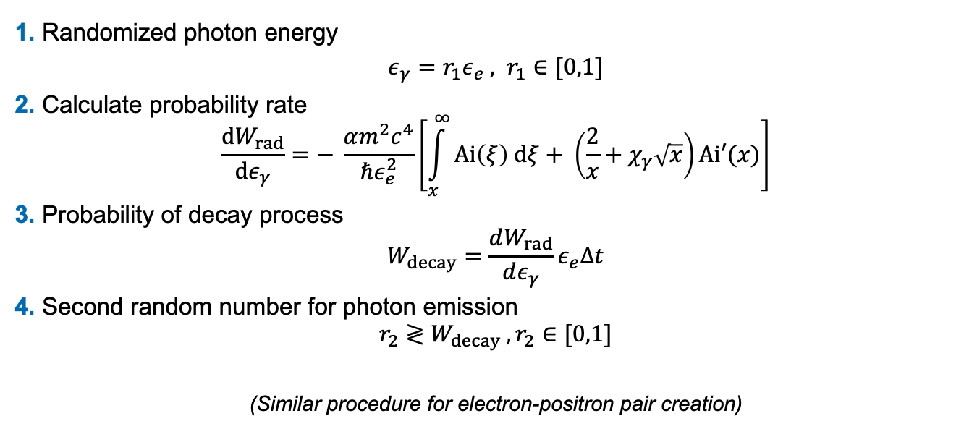
Modeling QED effects
Monte-Carlo QED loop (Photon emission)
1. Randomized photon energy
$ε_{γ}=r_{1}ε_{e} , r_{1}∈[0,1]$
2. Calculate probability rate
$$\frac{dW_{rad}}{dε_{γ}}=− \frac{αm^{2}c^{4}}{ℏε_{e}^{2}}\left[\int_{x}^{∞}{Ai\left(ξ\right) dξ+ \left(\frac{2}{x}+χ_{γ}\sqrt{x}\right)Ai′(x)}\right]$$
3. Probability of decay process
$$W_{decay}=\frac{dW_{rad}}{dε_{γ}}ε_{e}Δt$$
4. Second random number for photon emission
$$r_{2}≷W_{decay} , r_{2}∈[0,1]$$
(Similar procedure for electron-positron pair creation)
N. Elkina, PRAB 14, 054401 (2011)

Slide 7
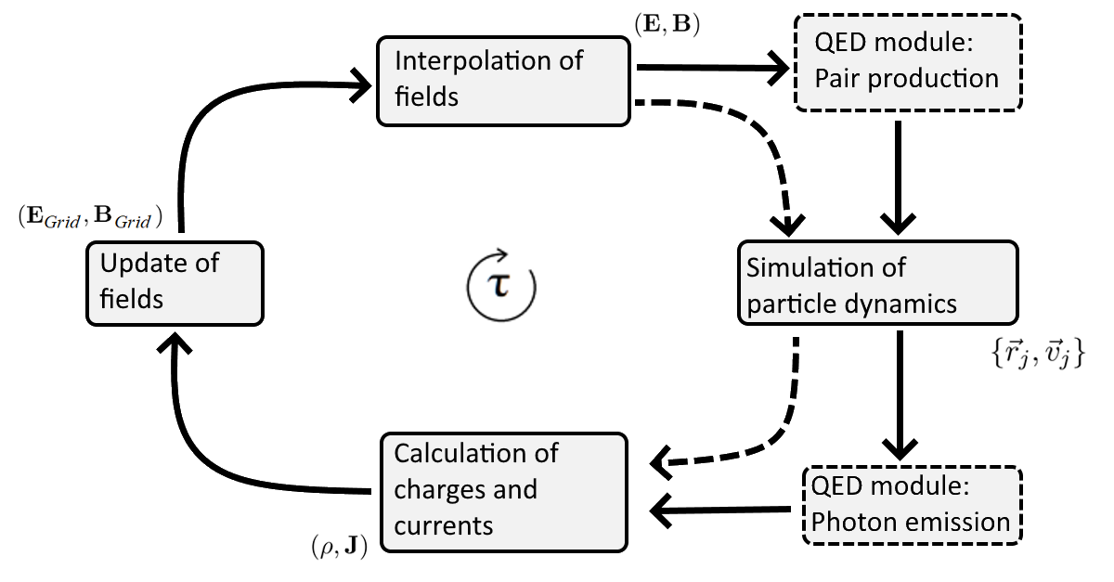
Modeling QED effects in VLPL
Modified PIC cycle

Slide 8
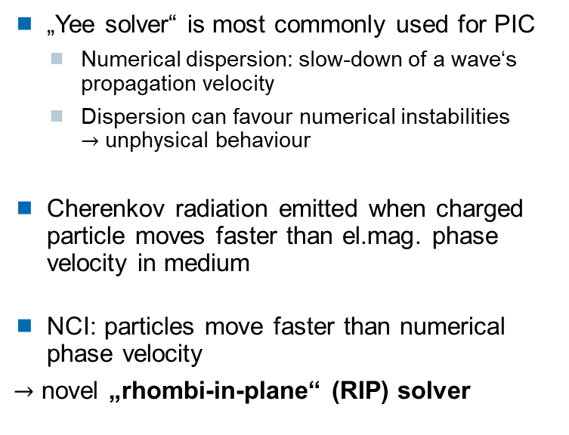
Removing Numerical Cherenkov Instability
„Yee solver“ is most commonly used for PIC
  Numerical dispersion: slow-down of a wave‘s propagation velocity
  Dispersion can favour numerical instabilities $→$ unphysical behaviour
Cherenkov radiation emitted when charged particle moves faster than el.mag. phase velocity in medium
NCI: particles move faster than numerical phase velocity
$→$ novel „rhombi-in-plane“ (RIP) solver
A. Pukhov, J. Comp. Phys. 418, 109622 (2020)

Slide 9
VLPL vs Yee solvers
Ultra-relativistic electron bunch moving in vacuum
M. Filipovic et al., PRAB 25, 054405 (2022)
Yee solver:
full NCI
VLPL solver:
stable

Slide 10
VLPL vs Yee solver
Fourier transform
Radiative energy loss
Yee solver:
full NCI
VLPL solver:
stable
Radiative losses using the Yee solver
NCI effectively suppressed for the RIP solver
M. Filipovic et al., PRAB 25, 054405 (2022)

Slide 11
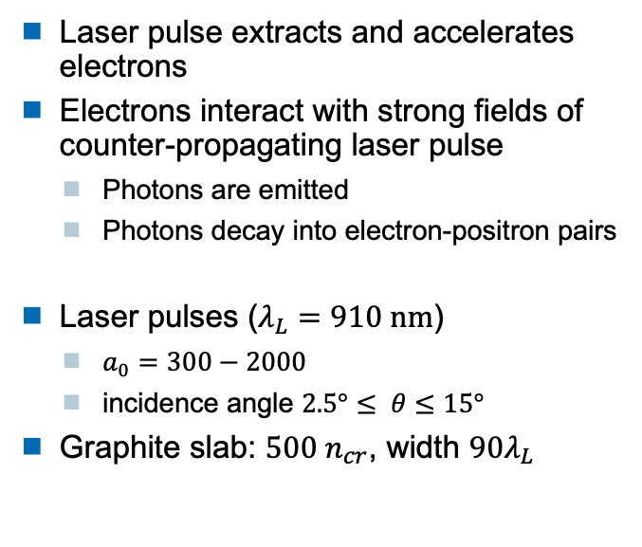
Grazing incidence
M. Filipovic et al., EPJD 76,187 (2022)
Setup
Laser pulse extracts and accelerates electrons
Electrons interact with strong fields of counter-propagating laser pulse
  Photons are emitted
  Photons decay into electron-positron pairs
Laser pulses ($λ_{L}=910 nm$)
  $a_{0}=300−2000$
  incidence angle $2.5°≤ θ≤15°$
Graphite slab: $500 n_{cr}$, width $90λ_{L}$
laser pulse 2
laser pulse 1
Secondary particles
Solid-state target (graphite)

Slide 12
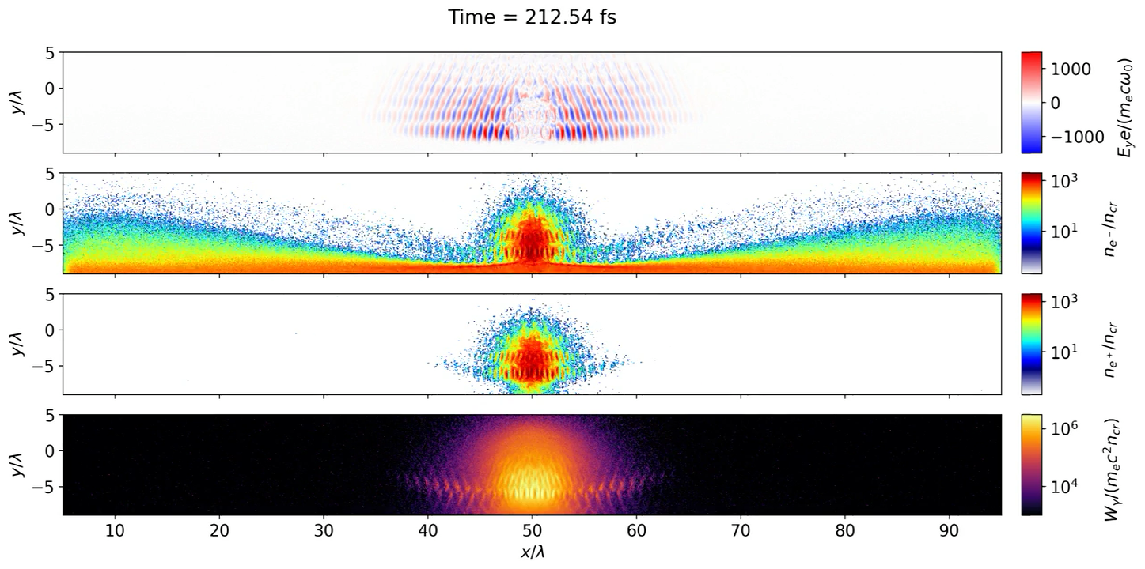
Grazing incidence
$a_{0}=1200, θ=15°$ (Movie)
M. Filipovic et al., EPJD 76,187 (2022)

Slide 13
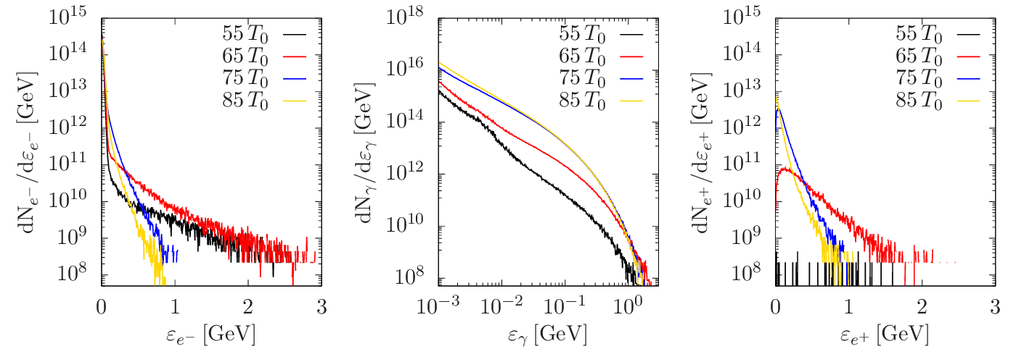

Grazing incidence
M. Filipovic et al., EPJD 76,187 (2022)
Beam overlap ($75T_{0}$): number of $γ$-photons increases by three orders of magnitude
Pair production only possible with counter-propagating laser pulse

Slide 14
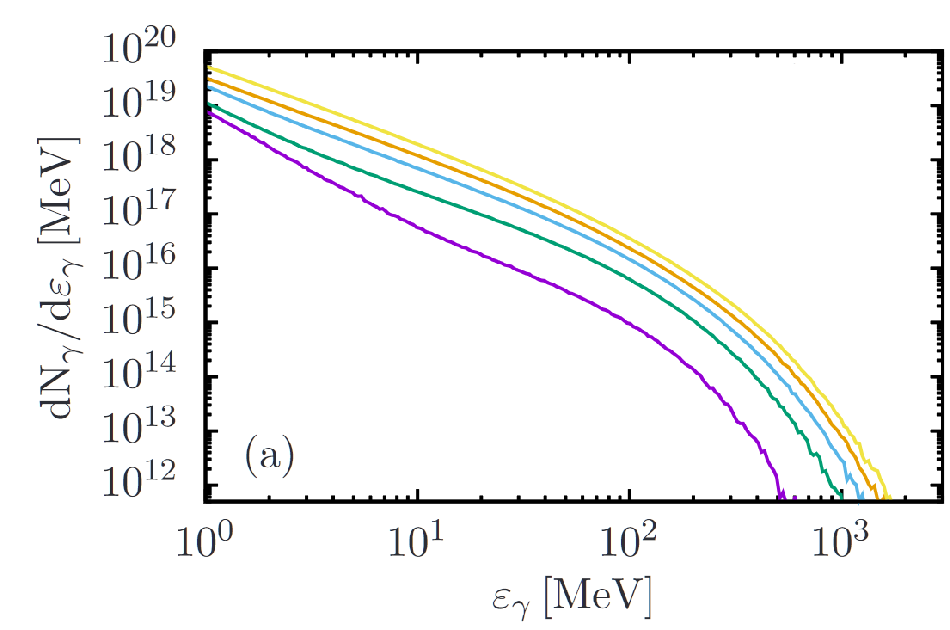
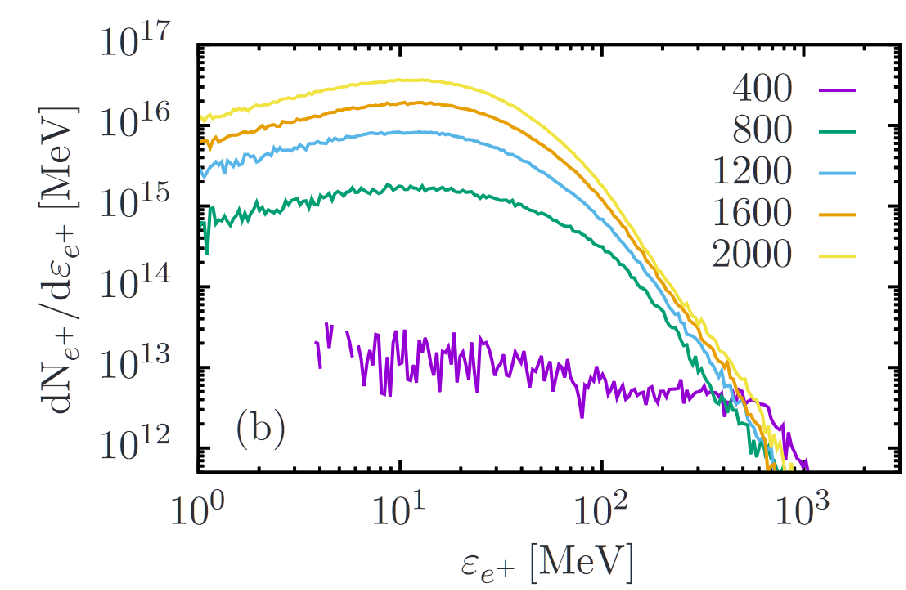

Grazing incidence
Spectrum secondary particles
M. Filipovic et al., EPJD 76,187 (2022)
$a_{0}∼800$ for pair production to be significant
Maximum cut-off energy slightly dependent on $a_{0}$

Slide 15
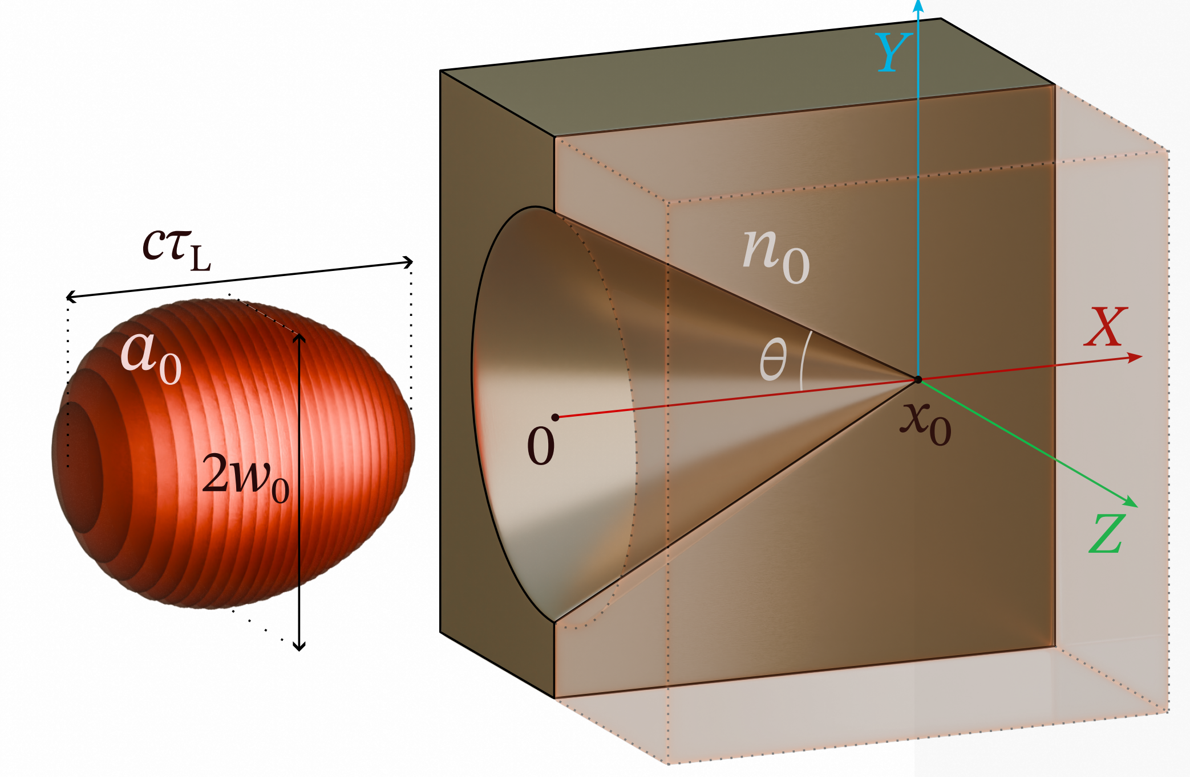
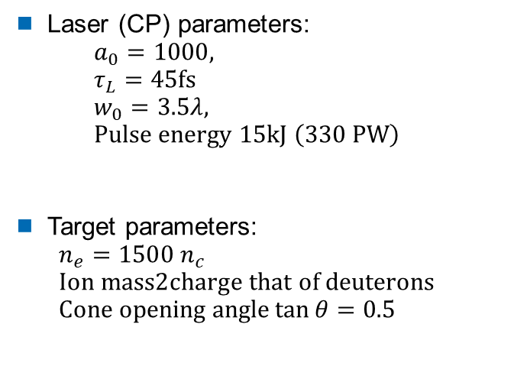
Structured target: conical cavity
No need for a second laser. The laser pulse is reflected from the target
Laser (CP) parameters:
$a_{0}=1000,$
$τ_{L}=45fs$
$w_{0}=3.5λ,$
$Pulse energy 15kJ \left(330 PW\right)$
Target parameters:
$n_{e}=1500 n_{c}$
$Ion mass2charge that of deuterons$
$Cone opening angle\tan{θ}=0.5$
Samsonov & Pukhov arXiv:2409.09131 (2024)

Slide 16
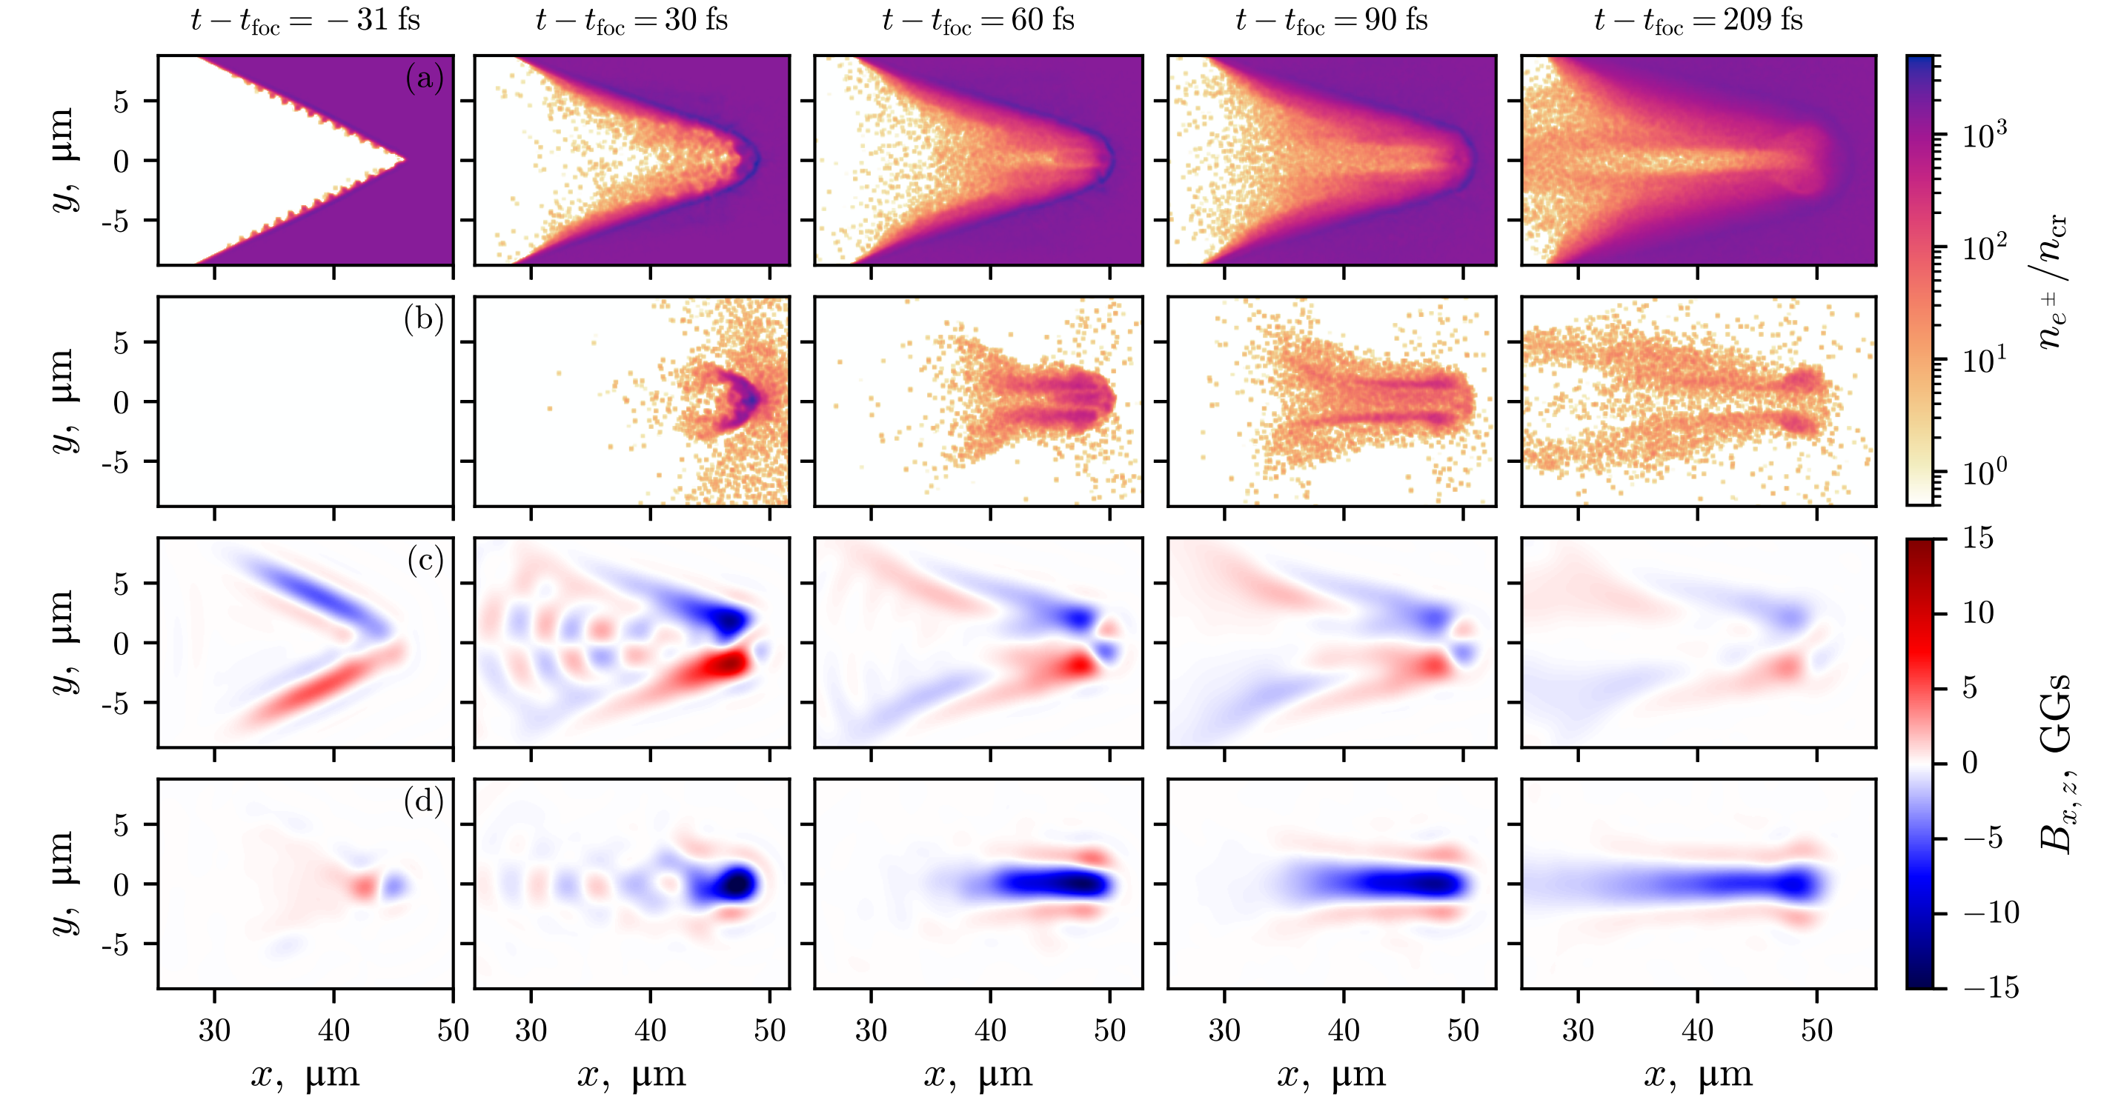
Interaction dynamics
positrons
Samsonov & Pukhov arXiv:2409.09131 (2024)

Slide 17
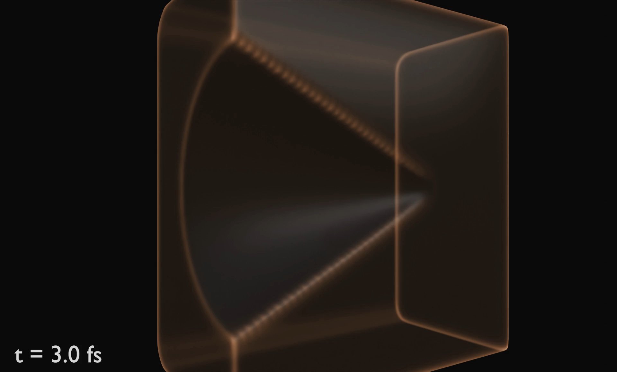
Magnetic mirror and e-e+ plasma confinement
e-e+ pairs get reflected and trapped
B-field configuration, 10 GGauss
Long-living MHD dynamics of true e-e+ plasma
Samsonov & Pukhov arXiv:2409.09131 (2024)

Slide 18
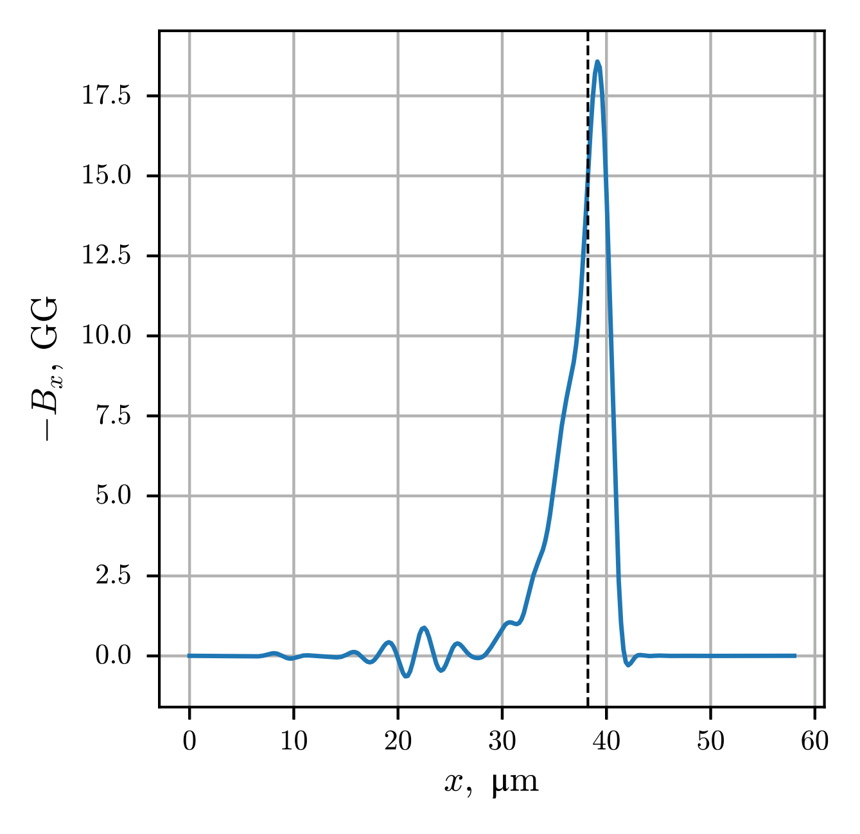
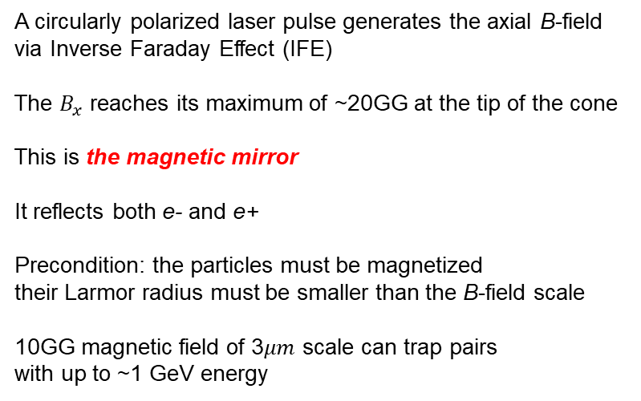
Axial B-field: the magnetic mirror
A circularly polarized laser pulse generates the axial B-field
via Inverse Faraday Effect (IFE)
The $B_{x}$ reaches its maximum of ~20GG at the tip of the cone
This is the magnetic mirror
It reflects both e- and e+
Precondition: the particles must be magnetized
their Larmor radius must be smaller than the B-field scale
10GG magnetic field of 3$μm$ scale can trap pairs
with up to ~1 GeV energy
Samsonov & Pukhov arXiv:2409.09131 (2024)

Slide 19
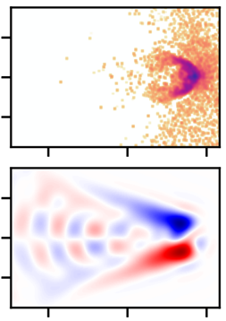
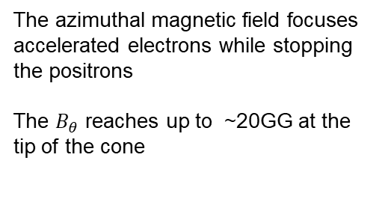

Azimuthal B-field: stopper for positrons
Positron density
The azimuthal magnetic field focuses accelerated electrons while stopping the positrons
The $B_{θ}$ reaches up to ~20GG at the tip of the cone
$$B_{θ}$$
Samsonov & Pukhov arXiv:2409.09131 (2024)

Slide 20
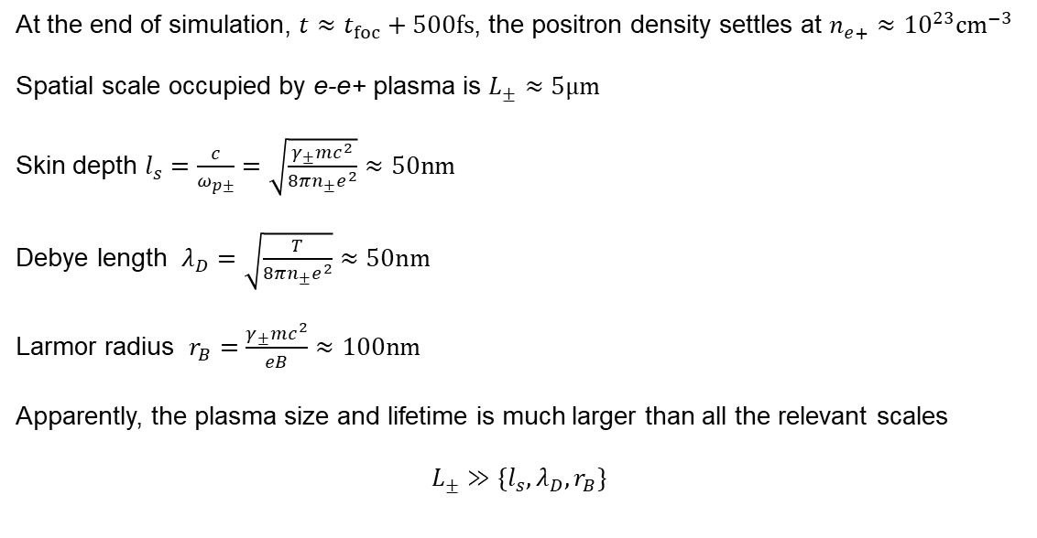
Why is this a true e-e+ plasma?
At the end of simulation, $t≈t_{foc}+500fs$, the positron density settles at $n_{e+}≈{10}^{23}{cm}^{−3}$
Spatial scale occupied by e-e+ plasma is $L_{±}≈5μm$
Skin depth $l_{s}=\frac{c}{ω_{p±}}=\sqrt{\frac{γ_{±}mc^{2}}{8πn_{±}e^{2}}}≈50nm$
Debye length $λ_{D}=\sqrt{\frac{T}{8πn_{±}e^{2}}}≈50nm$
Larmor radius $r_{B}=\frac{γ_{±}mc^{2}}{eB}≈100nm$
Apparently, the plasma size and lifetime is much larger than all the relevant scales
$$L_{±}≫\{l_{s},λ_{D},r_{B}\}$$
Samsonov & Pukhov arXiv:2409.09131 (2024)

Slide 21
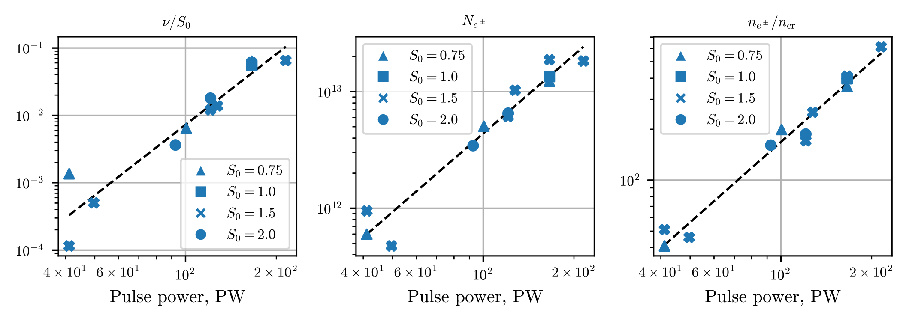

Dependence on laser parameters
Trapped fraction Peak positron density Pair density
$S_{0}=\frac{n_{e}}{n_{c}a_{0}}$ is the relativistic similarity parameter
Samsonov & Pukhov arXiv:2409.09131 (2024)

Slide 22
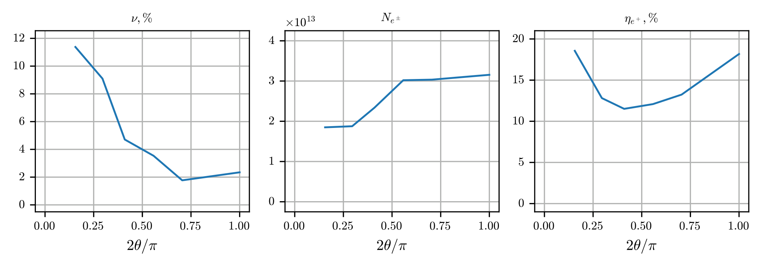

Dependence on cone parameters
Trapped fraction Peak positron density Positron fraction in plasma
$θ$ is the cone opening angle
Samsonov & Pukhov arXiv:2409.09131 (2024)

Slide 23
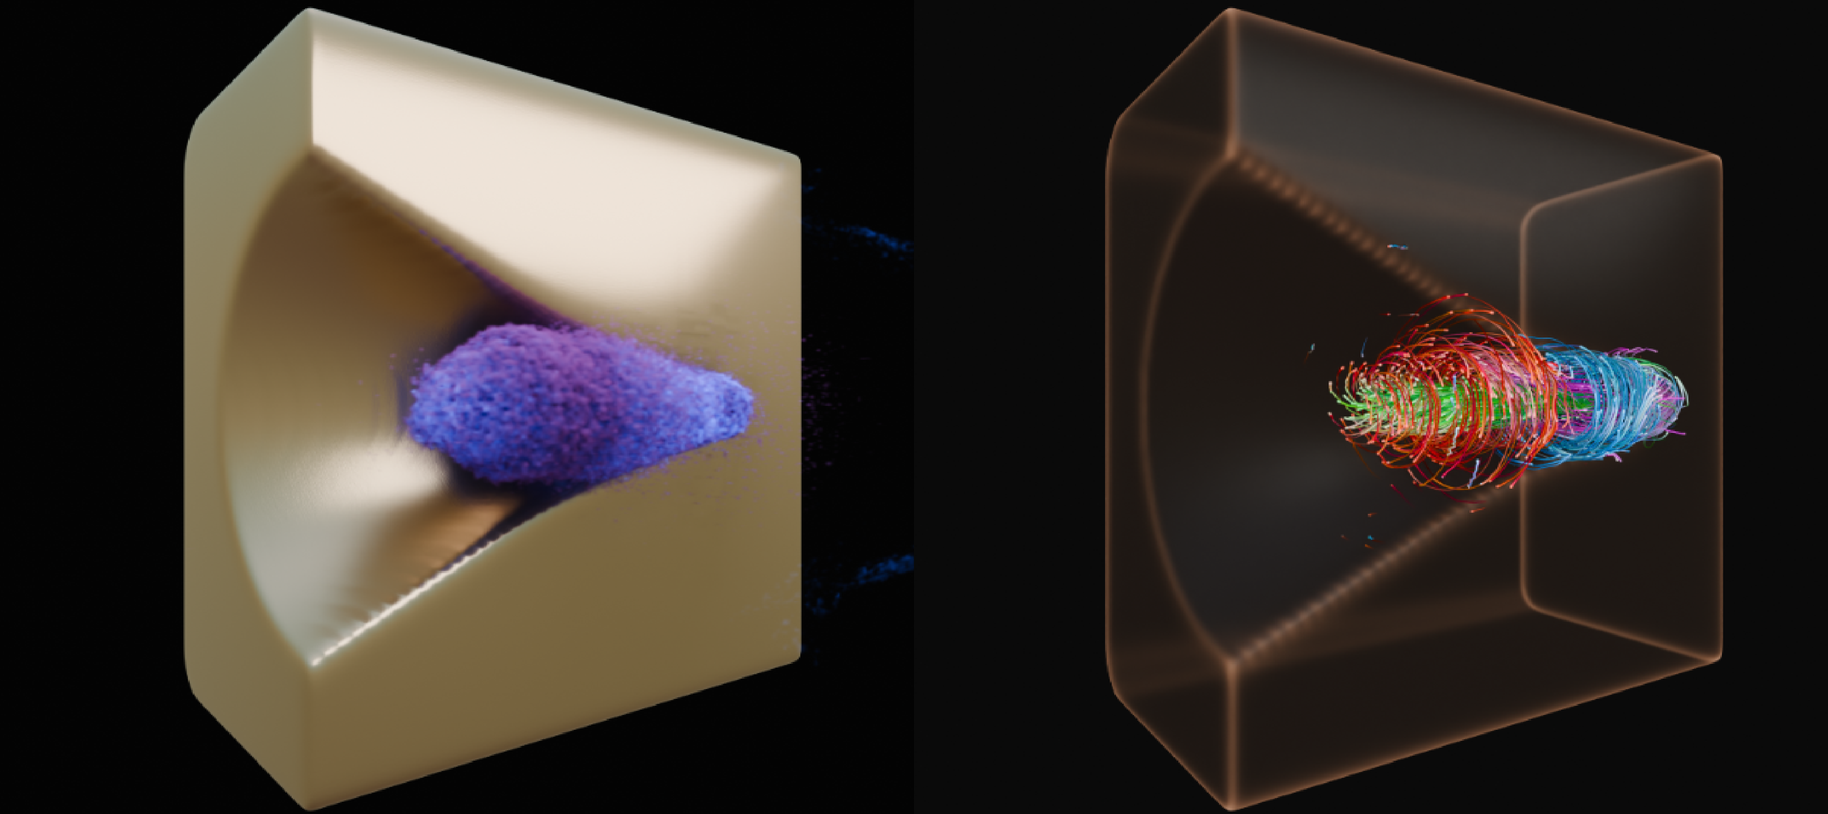
Conclusion
True e-e+ plasma can be created and confined for long time in structured laser-plasma targets
Only a single laser pulse is required
This should allow to study physics of rather extreme astrophysical objects in laboratory
Samsonov & Pukhov arXiv:2409.09131 (2024)

