Slide 1
Simulating relativistic beam-plasma instabilities with the quasi-static PIC code QuaSSis
Quentin LABRO^{1, 2}, Xavier DAVOINE^{1, 2}, Laurent GREMILLET^{1, 2}, Luc BERGÉ^{1, 2, 3}
¹ CEA, DAM, DIF, 91297 Arpajon, France
² Université Paris-Saclay, CEA, LMCE, F-91680 Bruyères-le-Châtel, France
³ Université de Bordeaux, CNRS, CELIA, 33405 Talence Cedex, France
LPAW2025
17/04/2025

Slide 2
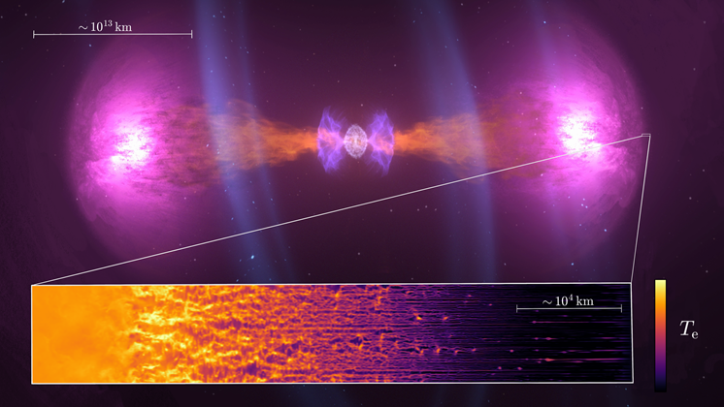
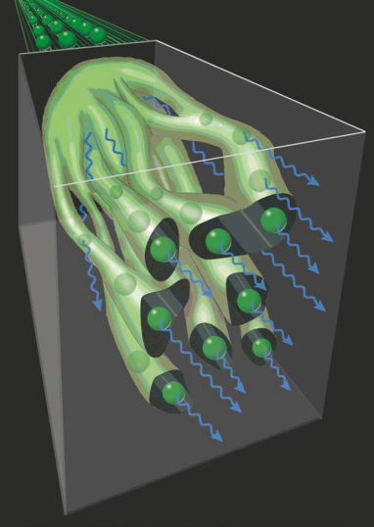
Relativistic beam-plasma instabilities: context
Extreme astrophysical events
Neutron star merger
Accelerator: beam propagation in ionized targets
SLAC’s $10 GeV$ electron beam¹
Final beam
Initial beam
© NASA’s Goddard Space Flight Center/CI Lab, Arno Vanthieghem (PU).
$$5 μm$$
Laser-plasma interaction
UHI-solid target interaction
[1]. P. San Miguel Claveria et al., PRR 4, 023085 (2022).
Beam-plasma instabilities can be an energetic source of 𝛾-photons².
[2]. A. Benedetti et al., Nat. Photonics 12, 319 (2018).

Slide 3
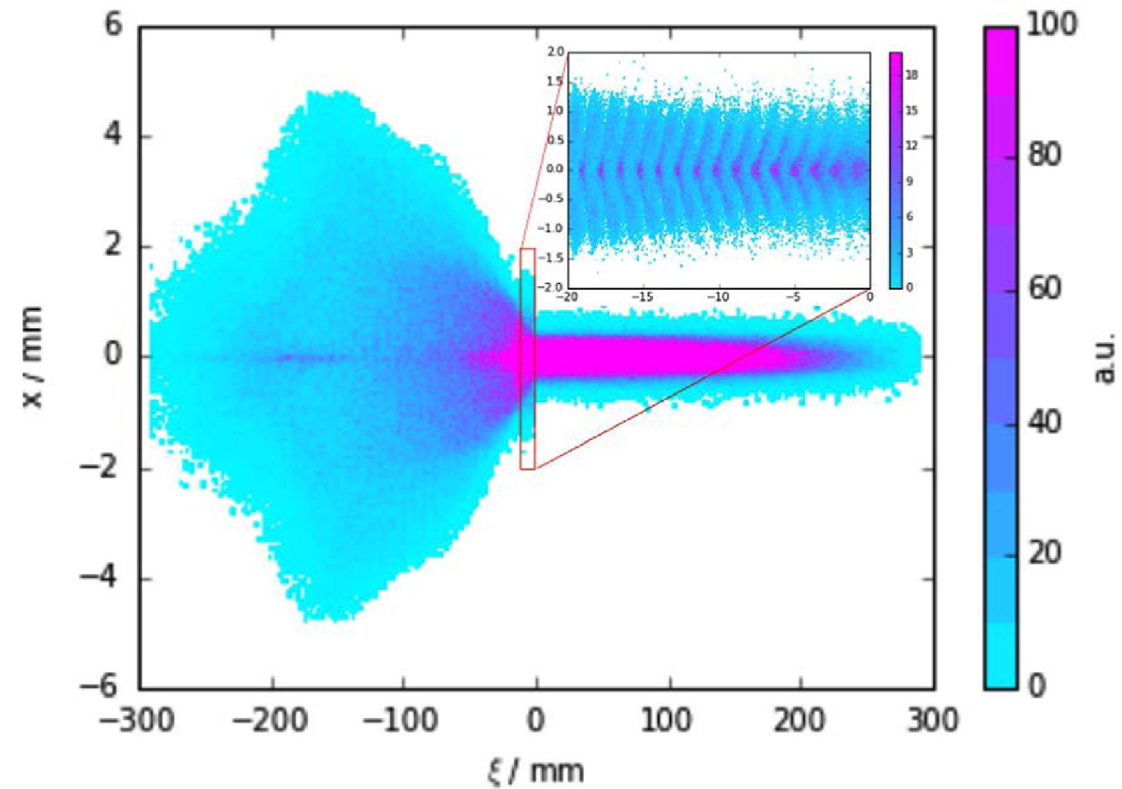
Introduction to Oblique Two Stream Instabilities (OTSI)
We want to simulate the Oblique Two Stream Instabilities (OTSI).
A phenomenon similar to
AWAKE: Self-modulation instability (SMI) for proton beam-plasma interaction¹
$$n_{b} [a.u.]$$
$$x [μm]$$
$$x$$
2d density plot of a proton beam²
$$z$$
$$y$$
$$z−ct [μm]$$
[1] M. Turner et al., NIM-A 829, 314-317, (2016)

Slide 4
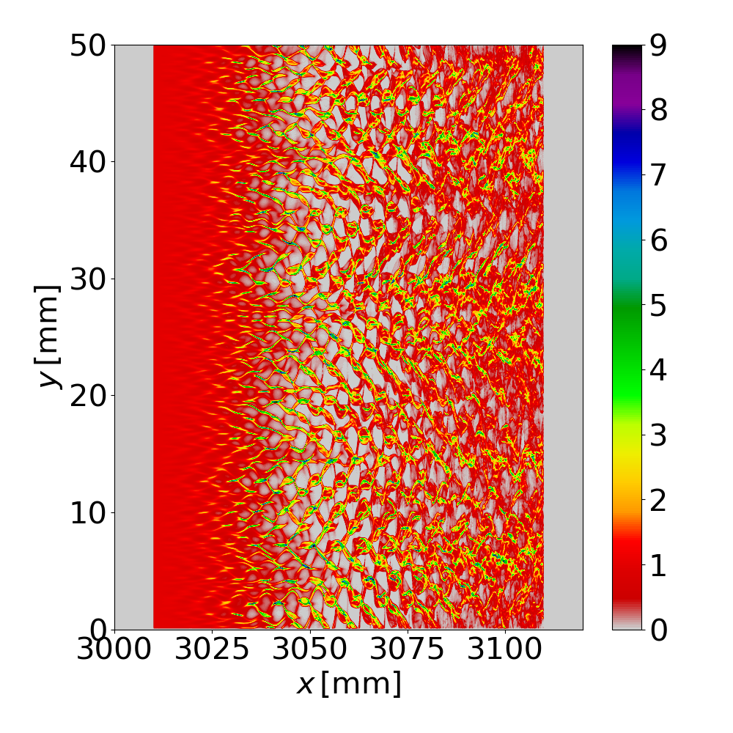
Introduction to Oblique Two Stream Instabilities (OTSI)
The Oblique Two Stream Instabilities ² (OTSI) governs the dynamics of ultrarelativistic ($γ_{b}≫1$), dilute electron beam (${n_{b}}/{n_{p}≪1}$)
AWAKE: Self-modulation instability (SMI) for proton beam-plasma interaction¹
Electron beam dominated by OTSI
$$k_{1}$$
Oblique modes
$$k_{2}$$
$$n_{b} [a.u.]$$
$$y [μm]$$
$$n_{b} [a.u.]$$
$$x [μm]$$
$$x$$
2d density plot of a proton beam²
$$y$$
$$z$$
$$y$$
$$z−ct [μm]$$
$$x$$
$$z$$
$$x [μm]$$
[1] M. Turner et al., NIM-A 829, 314-317, (2016)
[2] A. Bret, et al., PoP 17, 120501 (2010)

Slide 5
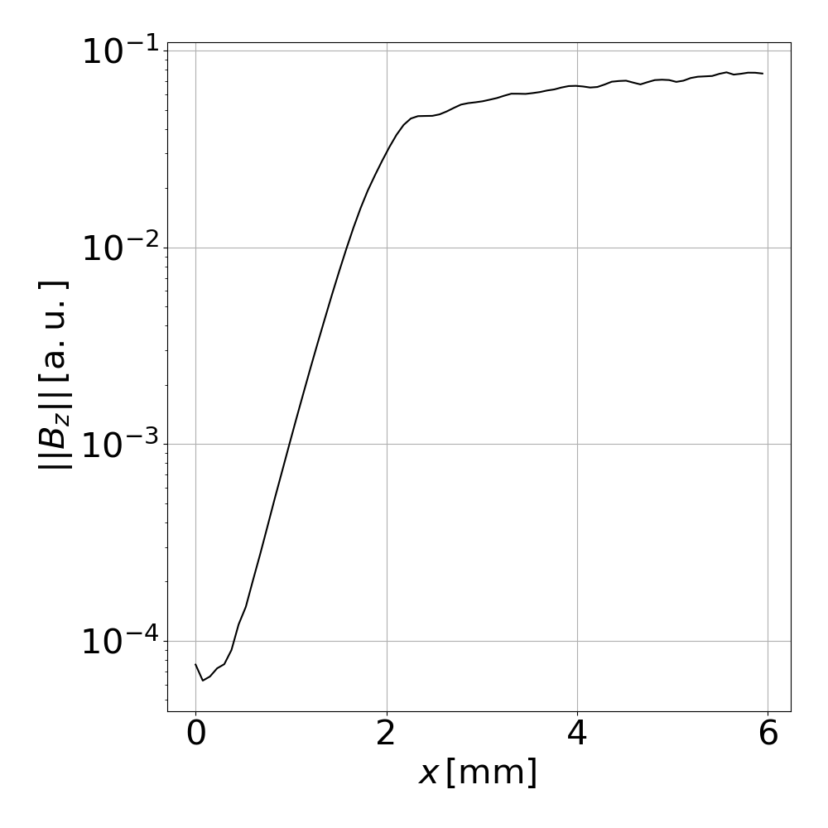
Introduction to Oblique Two Stream Instabilities (OTSI)
The Oblique Two Stream Instabilities ² (OTSI) governs the dynamics of ultrarelativistic ($γ_{b}≫1$), dilute electron beam (${n_{b}}/{n_{p}≪1}$)
Electron beam dominated by OTSI
Evolution of the $E_{y}$ field
$$k_{1}$$
Oblique modes
$$k_{2}$$
Saturation of the instability
$$y [μm]$$
$$n_{b} [a.u.]$$
$$|E_{y}| [a.u.]$$
Growth of the instability
$$y$$
$$x [mm]$$
$$x$$
$$z$$
$$x [μm]$$
[2] A. Bret, et al., PoP 17, 120501 (2010)

Slide 6
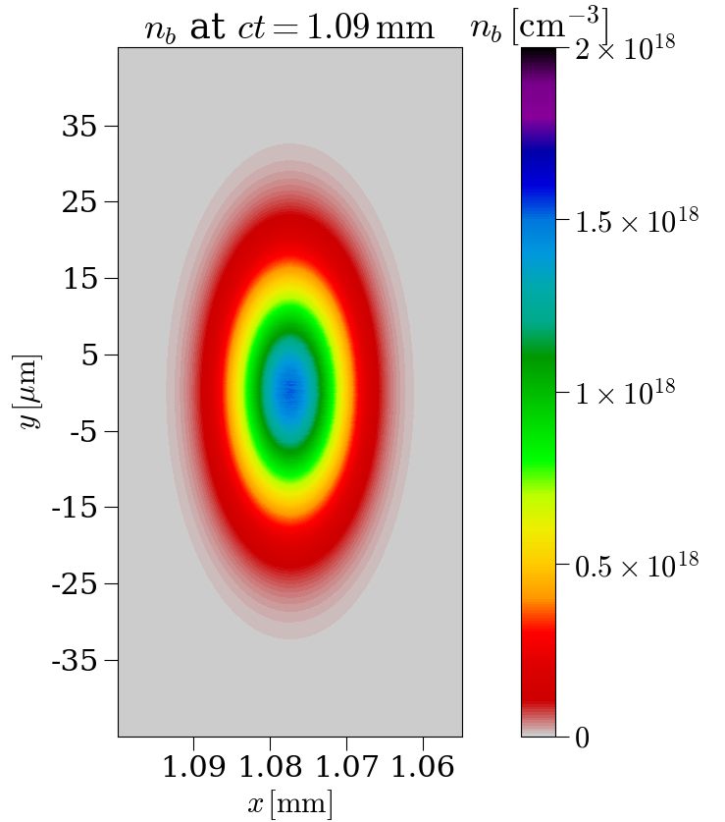
PIC simulation over a large number of time steps
CALDER PIC code¹
Electron beam: $10 GeV$, $2 nC,$ $n_{b}=1.5 × {10}^{18} cm^{−3}$ and $n_{p} = 5 × {10}^{19} cm^{−3}$
Cell size: $Δx=Δy=37.6 nm$
Numerical stability: $Δt<Δx/c⇒cΔt=26.3 nm$.
$$20 μm$$
$$+10 000 Δt$$
$$+70 000 Δt$$
[1] E. Lefebvre et al., Nucl. Fusion 43, 629 (2003)

Slide 7
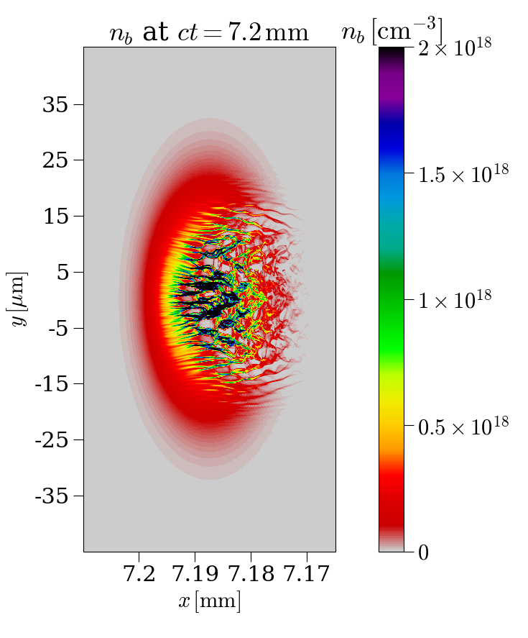
PIC simulation over a large number of time steps
CALDER PIC code¹
Electron beam: $10 GeV$, $2 nC,$ $n_{b}=1.5 × {10}^{18} cm^{−3}$ and $n_{p} = 5 × {10}^{19} cm^{−3}$
Cell size: $Δx=Δy=37.6 nm$
Numerical stability: $Δt<Δx/c⇒cΔt=26.3 nm$.
$$+232 000 Δt$$
[1] E. Lefebvre et al., Nucl. Fusion 43, 629 (2003)

Slide 8
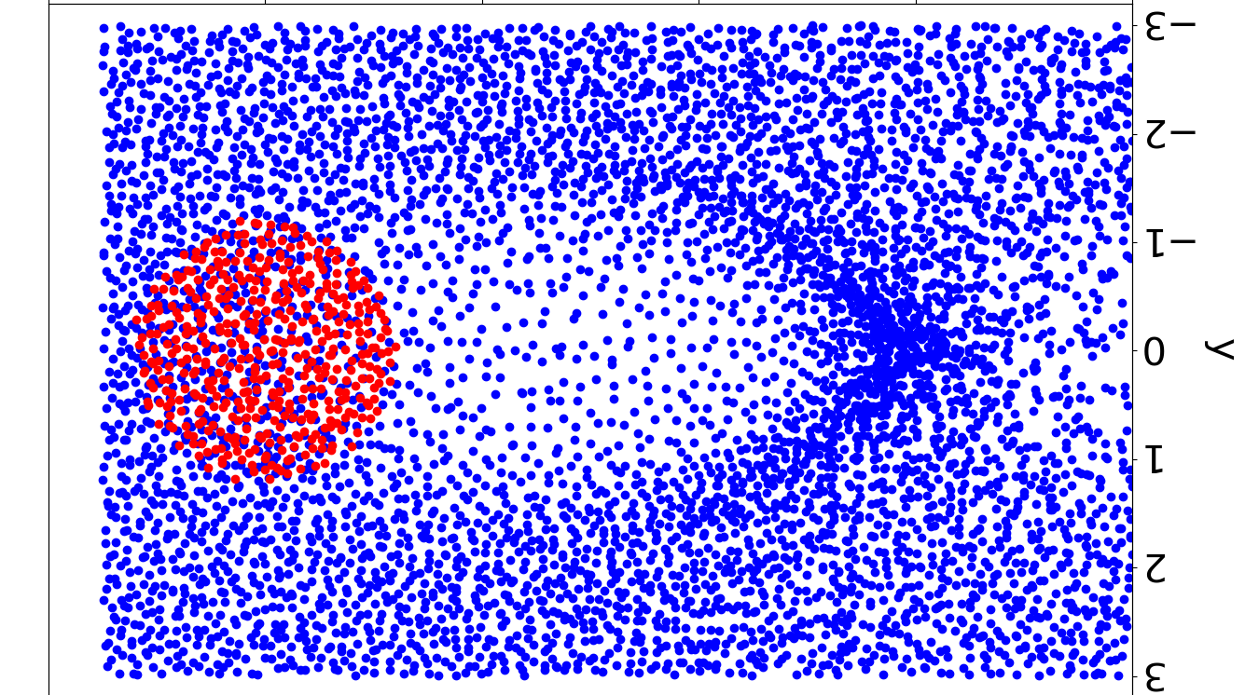
Quasi-static approximation (QSA)
Standard PIC
$$y [μm]$$
Beam and plasma evolution over $∼100 Δt$
$$x [μm]$$

Slide 9
Quasi-static approximation (QSA)
Standard PIC
Starting point: An ultra-relativistic beam slowly evolving as it propagates along $x$.
Change of variables $\left(x, y, z, t\right)⟶(ξ, y, z, s)$
$\left\{\begin{aligned}ξ=ct −x \text{(}\sim μm/nm) \\ s =x \text{(}\sim mm) \end{aligned}\right.$
Quasi-static approximation^{1,2} for plasma and fields: $\frac{∂}{∂s}≪\frac{∂}{∂ξ}$
$⇒$ Loss of a dimension: $f\left(ξ,y,z,s\right)≈ f\left(ξ,y,z\right)$
$$y [μm]$$
Beam and plasma evolution over $∼100 Δt$
$$x [μm]$$
[1]. P. Mora et al., PoP 4, 217 (1997) [2]. C. Huang et al., JoCP 217, 658–679 (2006)

Slide 10
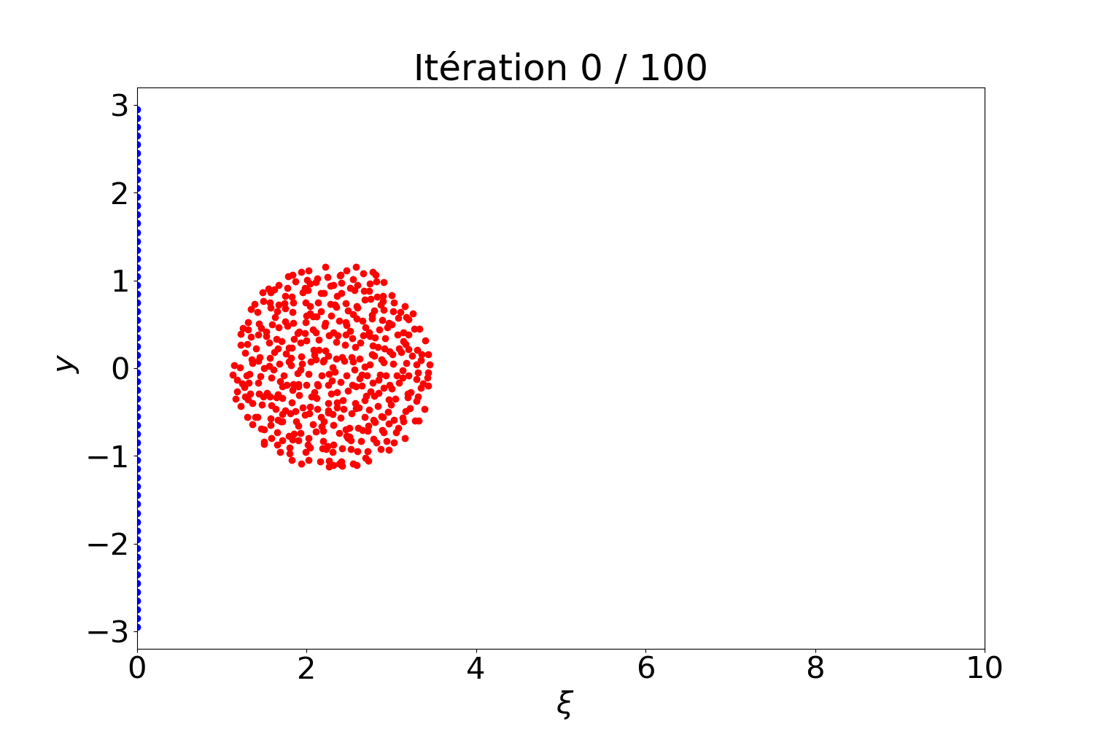
Quasi-static approximation (QSA)
Standard PIC
Starting point: An ultra-relativistic beam slowly evolving as it propagates along $x$.
Change of variables $\left(x, y, z, t\right)⟶(ξ, y, z, s)$
$\left\{\begin{aligned}ξ=ct −x \text{(}\sim μm/nm) \\ s =x \text{(}\sim mm) \end{aligned}\right.$
Quasi-static approximation^{1,2} for plasma and fields: $\frac{∂}{∂s}≪\frac{∂}{∂ξ}$
$⇒$ Loss of a dimension: $f\left(ξ,y,z,s\right)≈ f\left(ξ,y,z\right)$
$$y [μm]$$
Beam and plasma evolution over $∼100 Δt$
$$x [μm]$$
Quasi-static PIC
$μm/nm$ scale
Frozen beam
Plasma and fields evolution over several “time steps” Δ𝜉
$$y [μm]$$
Plasma evolution over $∼100 Δξ$
[1]. P. Mora et al., PoP 4, 217 (1997) [2]. C. Huang et al., JoCP 217, 658–679 (2006)
$$ξ [μm]$$

Slide 11
Quasi-static approximation (QSA)
Standard PIC
Starting point: An ultra-relativistic beam slowly evolving as it propagates along $x$.
Change of variables $\left(x, y, z, t\right)⟶(ξ, y, z, s)$
$\left\{\begin{aligned}ξ=ct −x \text{(}\sim μm/nm) \\ s =x \text{(}\sim mm) \end{aligned}\right.$
Quasi-static approximation^{1,2} for plasma and fields: $\frac{∂}{∂s}≪\frac{∂}{∂ξ}$
$⇒$ Loss of a dimension: $f\left(ξ,y,z,s\right)≈ f\left(ξ,y,z\right)$
2 calculation steps:
$$y [μm]$$
Beam and plasma evolution over $∼100 Δt$
$$x [μm]$$
Quasi-static PIC
$μm/nm$ scale
Frozen beam
Plasma and fields evolution over several “time steps” Δ𝜉
$mm$ scale
Plasma frozen
Beam propagation over
a suitable space interval $Δs≫Δξ$
$$y [μm]$$
Plasma evolution over $∼100 Δξ$
[1]. P. Mora et al., PoP 4, 217 (1997) [2]. C. Huang et al., JoCP 217, 658–679 (2006)
$$ξ [μm]$$

Slide 12
Quasi-static PIC code: QuaSSis (2D)
QuaSSis’s numerical scheme based on
HiPACE¹
WandPIC²
[1] T. Mehrling et al, Plasma Phys. Control. Fusion 56, 084012, (2014)
[2] T. Wang, et al., PoP 24, 103117, (2017)

Slide 13
Quasi-static PIC code: QuaSSis (2D)
QuaSSis benchmark against CALDER³: a very good agreement
QuaSSis’s numerical scheme based on
HiPACE¹
WandPIC²
[1] T. Mehrling et al., Plasma Phys. Control. Fusion, 56, 084012, (2014)
[2] T. Wang, et al., PoP 24, 103117, (2017)
[3] E. Lefebvre et al., Nucl. Fusion 43, 629 (2003)

Slide 14
Quasi-static PIC code: QuaSSis (2D)
QuaSSis benchmark against CALDER³: a very good agreement
QuaSSis’s numerical scheme based on
HiPACE¹
WandPIC²
CALDER:
$$Δx=Δy=3,76× {10}^{−2} μm$$
$$cΔt=2,63× {10}^{−2} μm.$$
Simulation time:
2.07 h on 2500 CPU
5170 CPU.hours
137 000 iterations
68 000 iterations
[1] T. Mehrling et al., Plasma Phys. Control. Fusion, 56, 084012, (2014)
[2] T. Wang, et al., PoP 24, 103117, (2017)
[3] E. Lefebvre et al., Nucl. Fusion 43, 629 (2003)

Slide 15
Quasi-static PIC code: QuaSSis (2D)
QuaSSis benchmark against CALDER³: a very good agreement
QuaSSis’s numerical scheme based on
HiPACE¹
WandPIC²
24 iterations
CALDER:
$$Δx=Δy=3,76× {10}^{−2} μm$$
$$cΔt=2,63× {10}^{−2} μm.$$
Simulation time:
2.07 h on 2500 CPU
5170 CPU.hours
12 iterations
137 000 iterations
68 000 iterations
QuaSSis:
$Δξ=Δy=3,76× {10}^{−2} μm$ $Δs=150 μm=5714 cΔt$
Simulation time:
8.21 h on 1 CPU
[1] T. Mehrling et al., Plasma Phys. Control. Fusion, 56, 084012, (2014)
[2] T. Wang, et al., PoP 24, 103117, (2017)
[3] E. Lefebvre et al., Nucl. Fusion 43, 629 (2003)

Slide 16
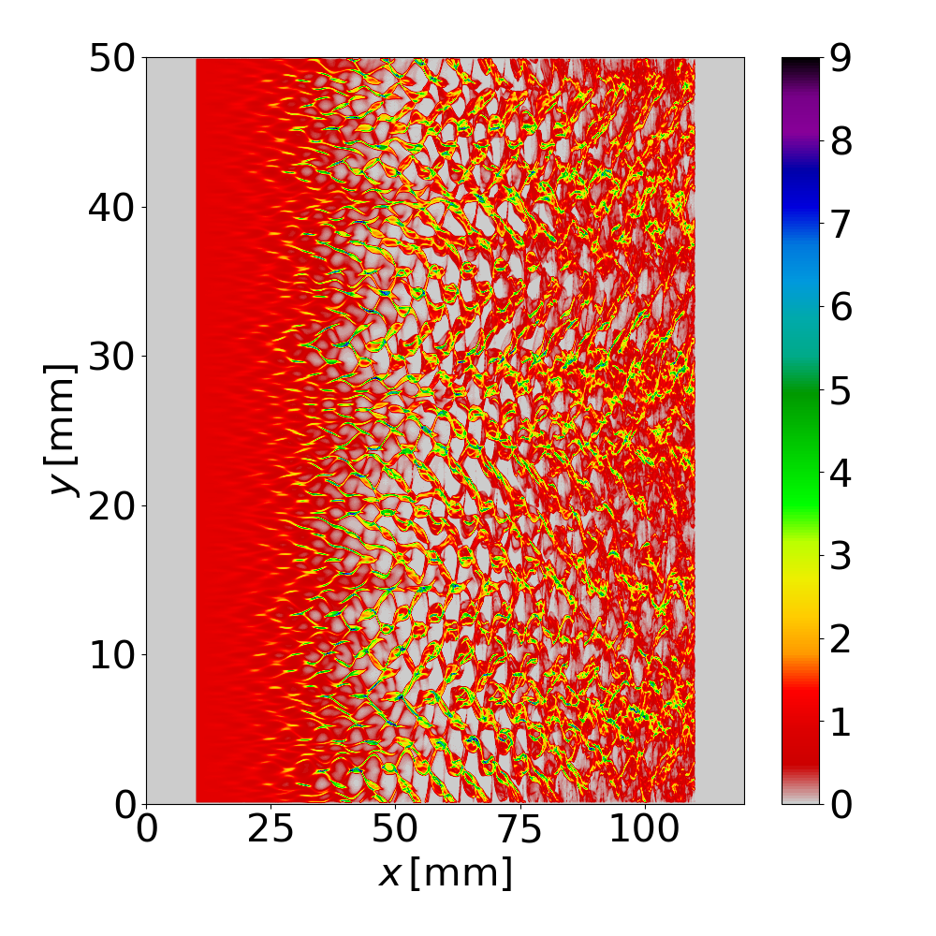
Periodic boundary conditions in the
$y$-direction
Simulation of transversally infinite beam (quasi-1D)
$$n_{b} [a.u.]$$
Comparing with quasi-1D analytical models for OTSI growth and saturation…
Requires transversely infinite beams
$$y [μm]$$
Transverse periodic boundary conditions are required
QSA: 2D electromagnetic field equations¹
$\frac{∂^{2}E_{x}}{∂y^{2}}=\frac{{∂J}_{y}}{∂y}$
$\frac{∂^{2}B_{x}}{∂y^{2}}=\frac{{∂J}_{z}}{∂y}$
$\frac{∂^{2}ψ}{∂y^{2}}=$ $−ρ+J_{x}$with $ψ$a pseudo-potential $(ψ=φ−A_{x})$
$\frac{∂^{2}B_{⊥}}{∂y^{2}}+KB_{⊥}=S_{⊥}$
$E_{y}=B_{z}−\frac{∂ψ}{∂y}$
$E_{z}=−B_{y}$
$$ξ [μm]$$
[1] T. Wang, et al., PoP 24, 103117, (2017)

Slide 17
Periodic boundary conditions in the
$y$-direction
Simulation of transversally infinite beam (quasi-1D)
$$n_{b} [a.u.]$$
Comparing with quasi-1D analytical models for OTSI growth and saturation…
Requires transversely infinite beams
$$y [μm]$$
Transverse periodic boundary conditions are required
QSA: 2D electromagnetic field equations¹
$\frac{∂^{2}E_{x}}{∂y^{2}}=\frac{{∂J}_{y}}{∂y}$
$\frac{∂^{2}B_{x}}{∂y^{2}}=\frac{{∂J}_{z}}{∂y}$
$\frac{∂^{2}ψ}{∂y^{2}}=$ $−ρ+J_{x}$with $ψ$a pseudo-potential $(ψ=φ−A_{x})$
$\frac{∂^{2}B_{⊥}}{∂y^{2}}+KB_{⊥}=S_{⊥}$
$E_{y}=B_{z}−\frac{∂ψ}{∂y}$
$E_{z}=−B_{y}$
$$ξ [μm]$$
Poisson’s-like equations are solved
[1] T. Wang, et al., PoP 24, 103117, (2017)

Slide 18
Transverse periodic boundary conditions:
lack of information
Standard boundary condition
Periodic boundary condition
Mesh in the $y−$direction
Mesh in the $y−$direction
$$f\left(y=0\right)=f\left(y=L_{y}\right)$$
$$⇒ f_{0}=f_{N_{y}}= ?$$
$$0$$
$$0$$
$$f\left(y=0\right)=0$$
$$0$$
$$0$$
$$y [mm]$$
Lack of information at the boundary to solve Poisson's equation !
$$y [mm]$$
$$Δy$$
$$1$$
$$Δy$$
$$1$$
$$2Δy$$
$$2$$
$$2Δy$$
$$2$$
$$ξ [μm]$$
…
…
$$(k−1)Δy$$
$$k−1$$
$$(k−1)Δy$$
$$k−1$$
$$ξ [μm]$$
$$kΔy$$
$$k$$
$$\frac{∂^{2}f}{∂y^{2}}(y=k.Δy)=\frac{f^{k+1}−2f^{k}+f^{k−1}}{Δy^{2}}$$
$$kΔy$$
$$k$$
$$(k+1)Δy$$
$$k+1$$
$$(k+1)Δy$$
$$k+1$$
…
…
$$L_{y}−Δy$$
$$N_{y}−1$$
$$L_{y}−Δy$$
$$N_{y}−1$$
$$L_{y}$$
$$N_{y}$$
$$f\left(y=L_{y}\right)=0$$
$$L_{y}$$
$$N_{y}$$

Slide 19
Numerical scheme for transverse periodic boundary conditions
Step 1: Prediction of boundary values
Equations handled by the numerical scheme
$\frac{∂E_{x}}{∂ξ}=\frac{{∂B}_{z}}{∂y}−J_{x}$
$\frac{∂B_{x}}{∂ξ}=\frac{{∂E}_{z}}{∂y}$
$\frac{∂ψ}{∂ξ}=E_{x}$
Numerical scheme:
Step 1: Prediction of $ψ, E_{x}$ and $B_{x}$ via $ξ$-derivatives at the mesh boundary using 5th-order Adams-Bashforth method
$$\frac{∂f}{∂ξ}=S⟹f^{n+1}=f^{n}+Δξ \sum_{i=1}^{5}{α_{i}S^{n+1−i}}$$
with ${\left(α_{i}\right)}_{i∈[\left|1,5\right|]}$ the Adams-Bashforth coefficients.
Known slice
…
…
…
…
…
$$y$$
$$ξ$$
$$z$$

Slide 20
Numerical scheme for transverse periodic boundary conditions
Step 1: Prediction of boundary values
Equations handled by the numerical scheme
$\frac{∂E_{x}}{∂ξ}=\frac{{∂B}_{z}}{∂y}−J_{x} \text{and} \frac{∂^{2}E_{x}}{∂y^{2}}=\frac{{∂J}_{y}}{∂y}$
$\frac{∂B_{x}}{∂ξ}=\frac{{∂E}_{z}}{∂y}$ and $\frac{∂^{2}B_{x}}{∂y^{2}}=\frac{{∂J}_{z}}{∂y}$
$\frac{∂ψ}{∂ξ}=E_{x}$ and $\frac{∂^{2}ψ}{∂y^{2}}=−ρ+J_{x}$
Numerical scheme:
Step 1: Prediction of $ψ, E_{x}$ and $B_{x}$ via $ξ$-derivatives at the mesh boundary using 5th-order Adams-Bashforth method
$$\frac{∂f}{∂ξ}=S⟹f^{n+1}=f^{n}+Δξ \sum_{i=1}^{5}{α_{i}S^{n+1−i}}$$
with ${\left(α_{i}\right)}_{i∈[\left|1,5\right|]}$ the Adams-Bashforth coefficients.
Step 2: Solving Poisson's equations by finite differences with Dirichlet boundary conditions
Known slice
…
…
…
Step 2: Calculating fields at the center of the mesh
…
…
$$y$$
$$ξ$$
$$z$$

Slide 21
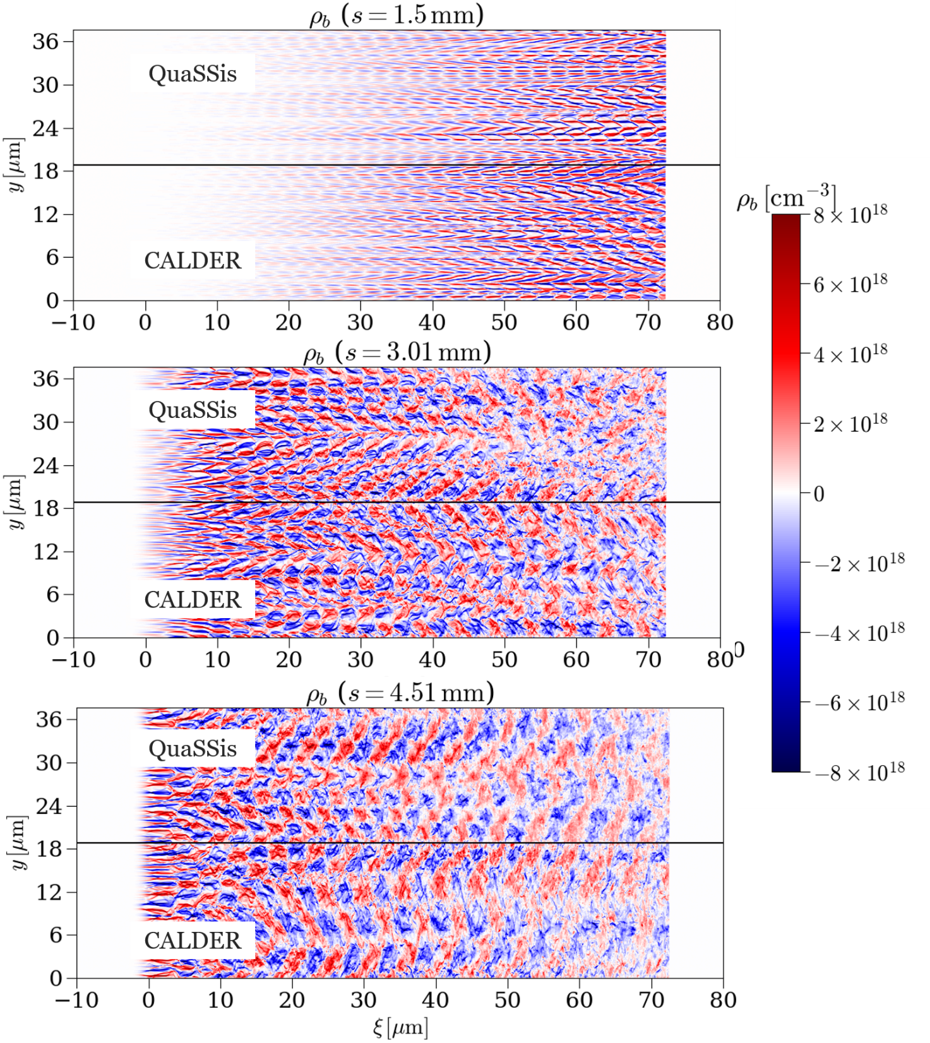
Benchmark of transverse periodic boundary conditions
Flat-top 10 GeV neutral pair beam (e+ e-)
$n_{b,e−}=1.5 × {10}^{18} cm^{−3}$
$n_{b,e+}=1.5 × {10}^{18} cm^{−3}$
$n_{p} = 5 × {10}^{19} cm^{−3}$
Very good agreement with CALDER
CALDER simulation times: 3572 CPU.hours
QuaSSis simulation times: 3.1 CPU.hours
Huge speed up of OTSI simulation

Slide 22
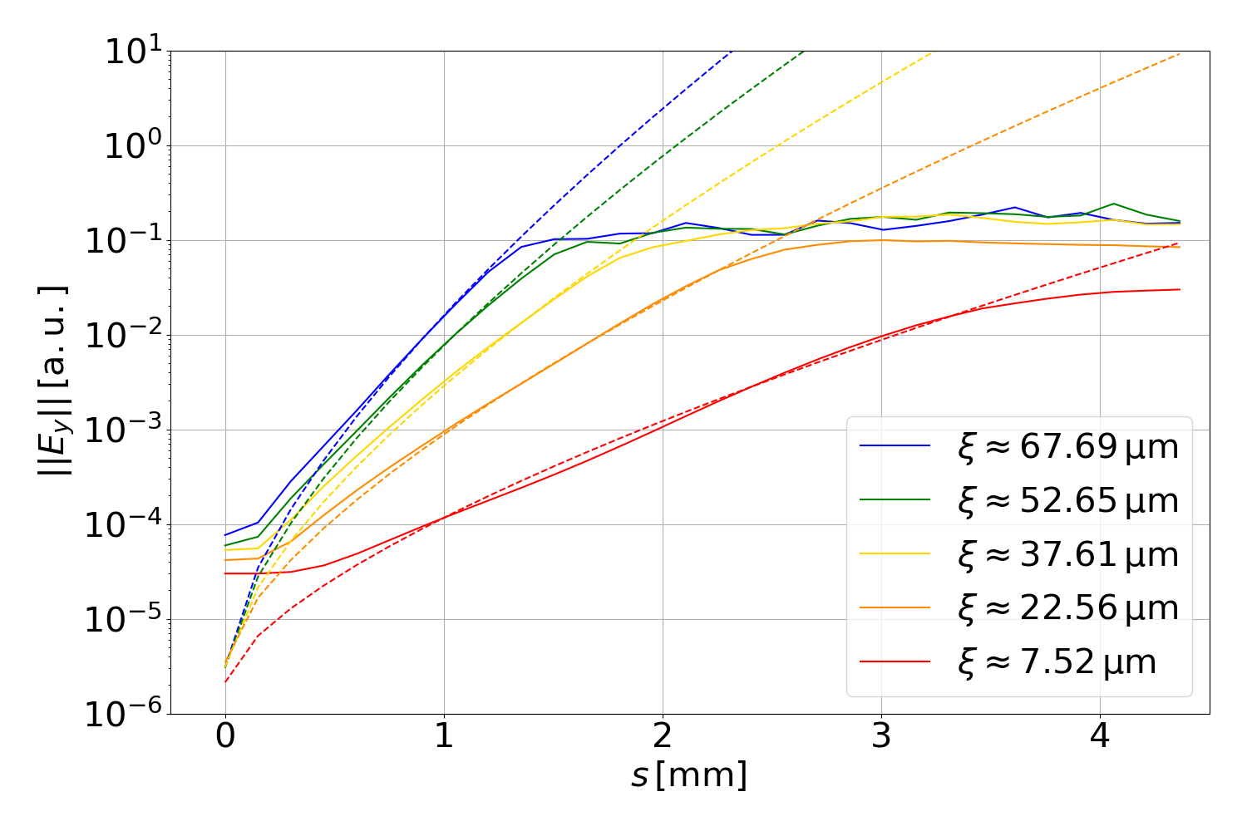
Comparison with an
analytical model
Spatio-temporal analytical model for the linear growth of OTSI¹: $E_{y}∝exp\left(Γξ^{\frac{1}{3}}s^{\frac{2}{3}}\right)$
[1] P. San Miguel Claveria et al., Phys. Rev. Res., 2022

Slide 23
Conclusions
Development of the quasi-static PIC code QuaSSis
Validation with benchmark against CALDER
New scheme for transverse periodic boundary conditions
Comparison of QuaSSis with a spatio-temporal analytical model of OTSI growth
$⇒$ OTSI can be simulated using a quasi-static
PIC code with a huge speed up!

Slide 24
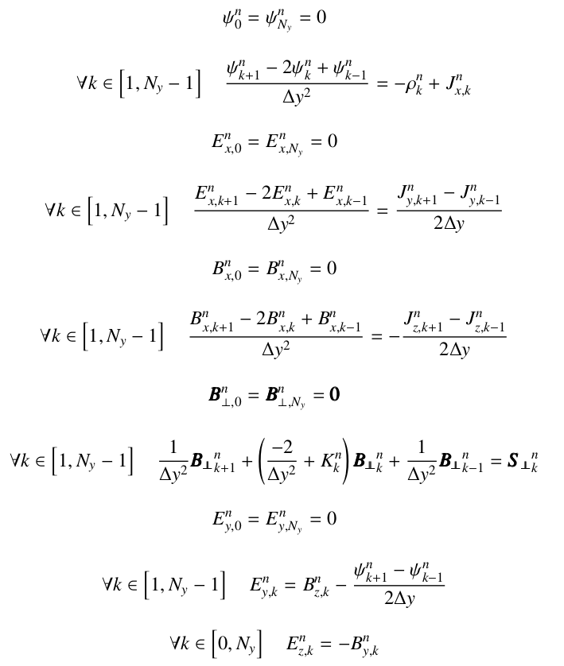
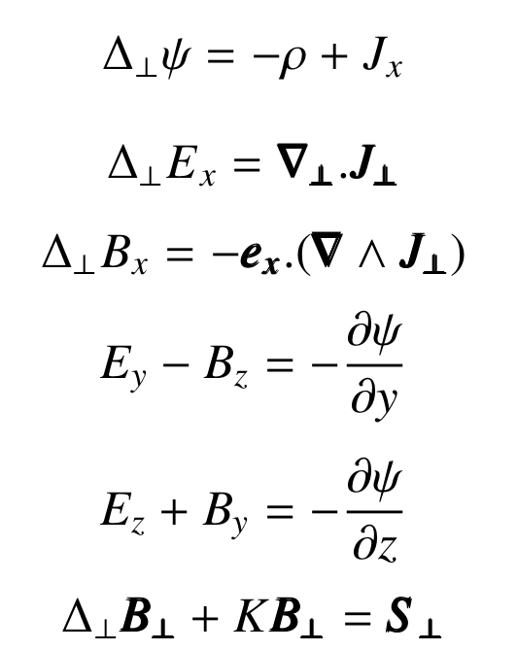
Quasi-static field equations
2D discretized quasi-static field equations
3D quasi-static field equations

Slide 25
Particles In Cell (PIC) code
Iterative algorithm
Gather the individual behavior of particles at nodes of a mesh to compute the collective behavior of the plasma through the Maxwell equations and reinterpolate
Equations du mouvement résolues
aux coordonnées des macro-particules
$$\frac{dx}{dt} = \frac{p}{mγ}$$
$$\frac{dp}{dt} = q\left(E\left(x\right)+\frac{p}{mγ}×B\left(x\right)\right)$$
$$ρ, J$$
Calculation of plasma/beam evolution represented
by macro-particles (kinetic and relativistic)
Calculation of the electromagnetic field on a mesh
Particle push
Update of $x_{i}$ and $p_{i}$ knowing $E$ and $B$
$$\frac{dx_{i}}{dt} = \frac{p_{i}}{{m_{i}γ}_{i}}$$
$$\frac{dp_{i}}{dt} = q\left(E\left(x_{i}\right)+ \frac{p_{i}}{{m_{i}γ}_{i}}×B\left(x_{i}\right)\right)$$
$$y$$
Example of PIC simulation
$$Δt$$
Field interpolation
determine $E\left(x_{i}\right)$ and $B(x_{i})$
Current deposition,
determine $J$ from ${(x}_{i},p_{i})$
$$Δt$$
$$E, B$$
Equations de Maxwell résolues
aux coordonnées du maillage
$$\frac{dB}{dt} = −∇×E$$
$$\frac{dE}{dt} =c^{2}∇×B −μ_{0}c^{2}J$$
Electromagnetic field at mesh nodes
Update of $E$ and $B$ knowing $J$
$$\frac{dB}{dt} = −∇×E$$
$$\frac{dE}{dt} =c^{2}∇×B −μ_{0}c^{2}J$$
$$x$$
Plasma electron initially at rest
Relativistic electron beam
C. K. Birdsall and A.B. Langdon , Plasma Physics via Computer Simulation, Springer, (1991).

Slide 26
3D quasi-static doube PIC loop
Beam current deposition on 3D mesh $(ξ, y,z)$
Plasma macroscopic quantity deposition on 2D mesh $(y,z)$
Beam macro-particle pusher on $Δs$
$$Δs$$
Plasma macro-particle pusher on $Δξ$
$$Δξ$$
Electromagnetic field at mesh $(y,z)$nodes
Field interpolation
at plasma macro-particle
Field interpolation
at beam macro-particle

Slide 27
Modified equations of motion
For a variable $X$ :
$$\frac{dX}{dt}=c\frac{dX}{ds} + \left(c−v_{x}\right)\frac{dX}{dξ}$$
The beam moves at 𝑐.
Standard equations of motion :
$\frac{dx}{ds} = \frac{p}{mγ},$
$\frac{dp}{ds} =q\left(E+\frac{p}{mγ}∧B \right)$.
For a plasma particle :
$$\frac{d}{ds}≪\frac{d}{dξ}$$
Quasi-static equations of motion :
$x=cτ −ξ,$
$\frac{dx_{⊥}}{dξ} = \frac{p_{⊥}}{C_{0}−qψ}$,
$\frac{dp}{dξ} =q\frac{mcγ}{C_{0}−qψ}\left(E+\frac{p}{mγ}∧B \right)$
Pseudo-potentiel
$ψ=φ−A_{x}$
Integration constant
$C_{0}=mcγ(ξ=0)−p_{x}(ξ=0)$

