Slide 1
Diagnosing a metre-scale plasma discharge for plasma wakefield acceleration
Claudia Cobo, Louis Forrester, Bingxue Wu, Nuo Xu and Zulfikar Najmudin
Laser-Plasma Accelerators Workshop
17th April 2025

Slide 2
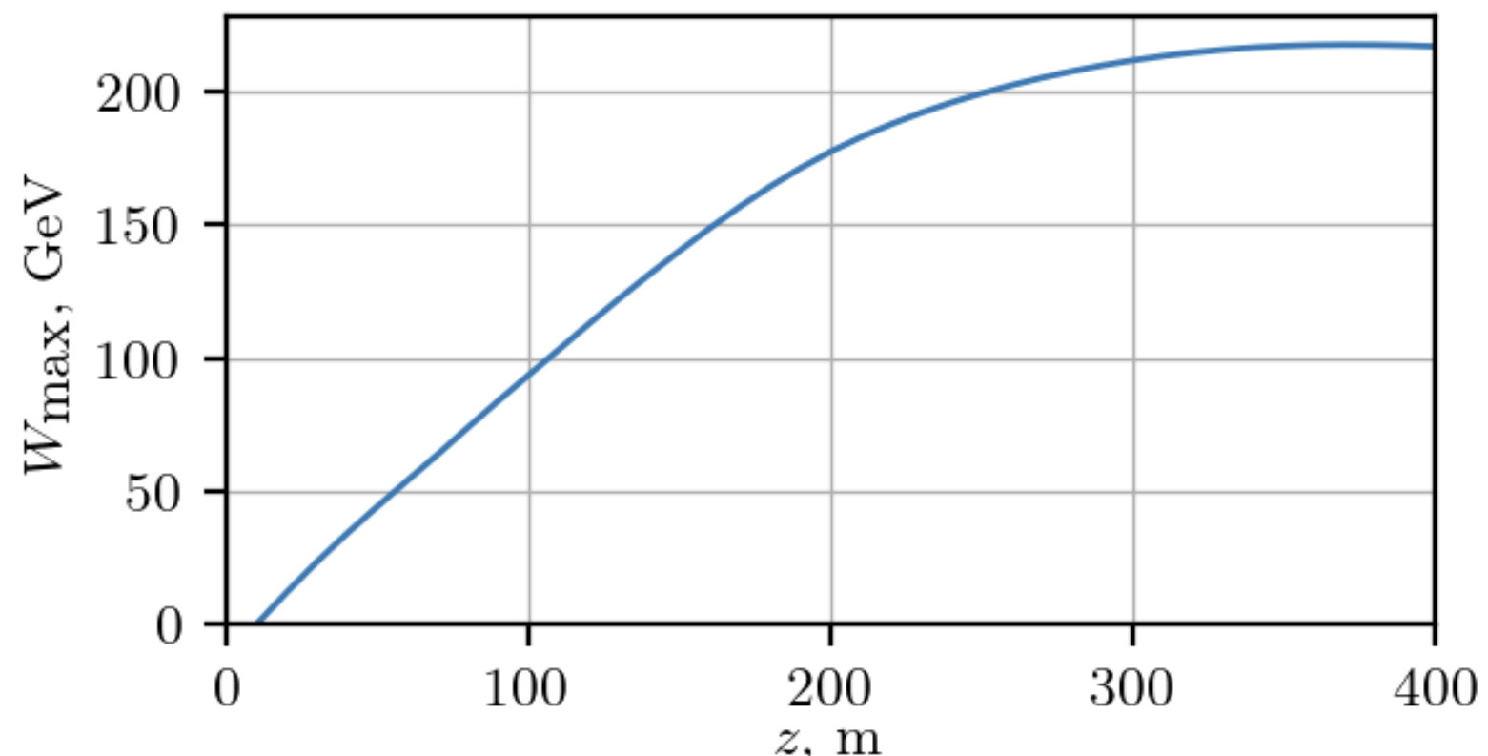
Scalable Plasma Sources
P. Tuev, K. Lotov, PPCF (2021)
A. Caldwell and K. Lotov, PoP (2011)
Large energy content of proton drivers allows single stage electron acceleration to TeV level
AWAKE proof of principle demonstrations in 10 m rubidium vapour source (laser ionised)
Need to scale up to > 100 m for particle physics applications
AWAKE requirements
0.1 Hz operation
High reproducibility
Plasma density: n_{e} = 7 × 10²⁰ m⁻³
Transverse profile: constant n_{e} over 3 mm
Axial uniformity: ∆n_{e} < 0.2 % over 10 m
This talk
Claudia Cobo c.cobo@imperial.ac.uk
Notes:
Beam radius = 0.2 mm

Slide 3
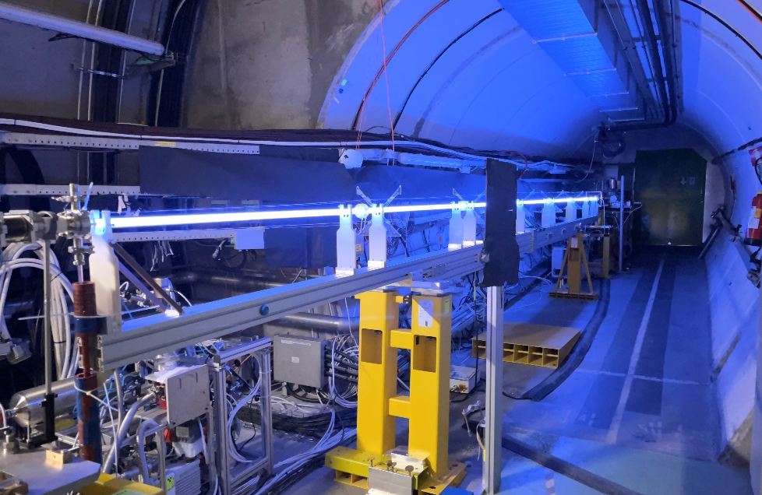
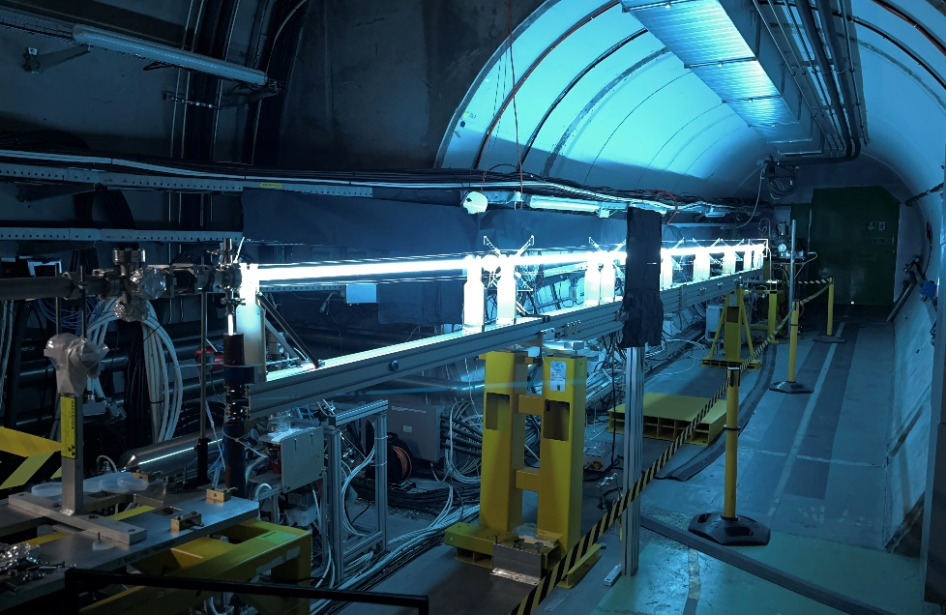
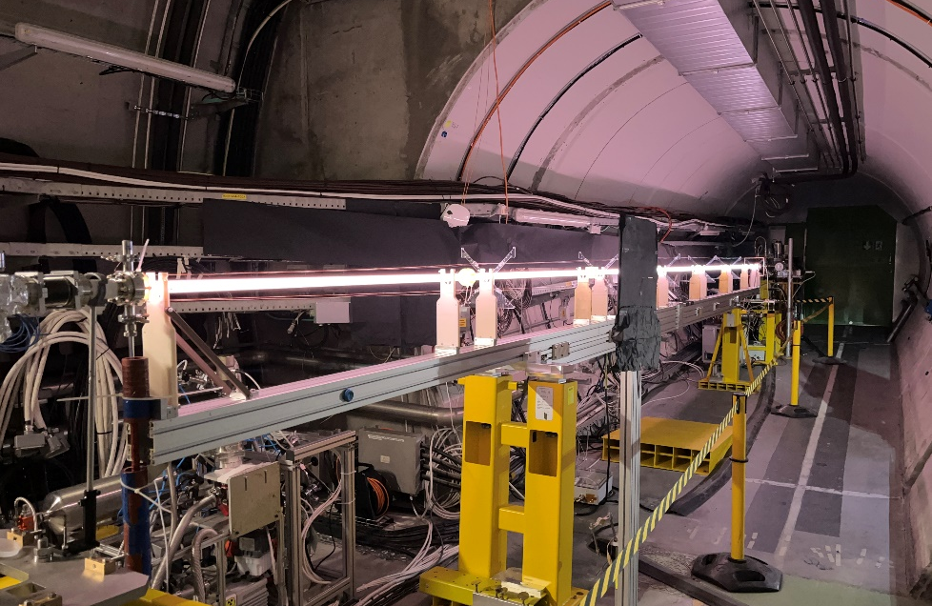
Discharge Plasma Source at AWAKE
Discharge used in AWAKE tunnel C. Amoedo talk, Wed 09:30
Multiple gases, pressures, lengths
Enabled interesting physics measurements
Filamentation of a relativistic proton bunch in plasma L. Verra et al. PRE (2024)
Ion motion in a resonantly driven PWFA M. Turner et al. PRL (2025)
Light diagnostics for wakefields at AWAKE J. Mezger et al. NIMA (2025)
Claudia Cobo c.cobo@imperial.ac.uk

Slide 4
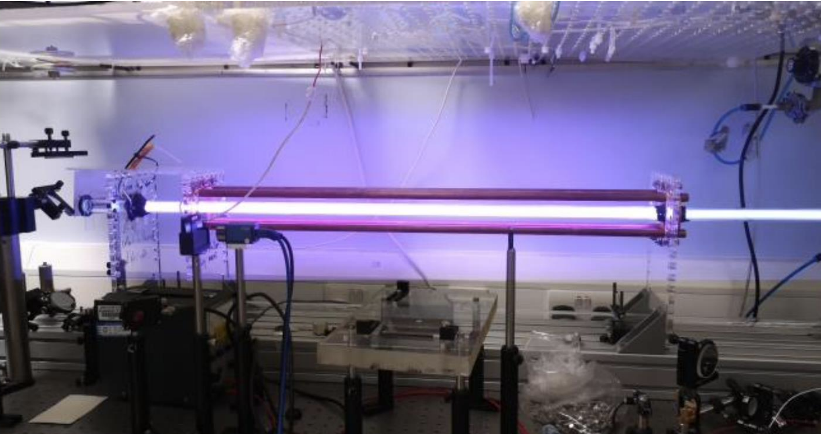
Discharge Plasma Source at ICL
Parameter | ICL Value | CERN Value | Unit
Tube length | 1 | 10 | m
Diameter | 19.5 | 26 | mm
Discharge gap | 15 | 25 | cm
Gas pressure | 0.01 – 1.5 | 0.01 – 1 | mbar
Discharge current | 100 – 500 | 100 – 500 | A
Discharge time | 0.5 – 100 | ~25 | μs
Claudia Cobo c.cobo@imperial.ac.uk

Slide 5
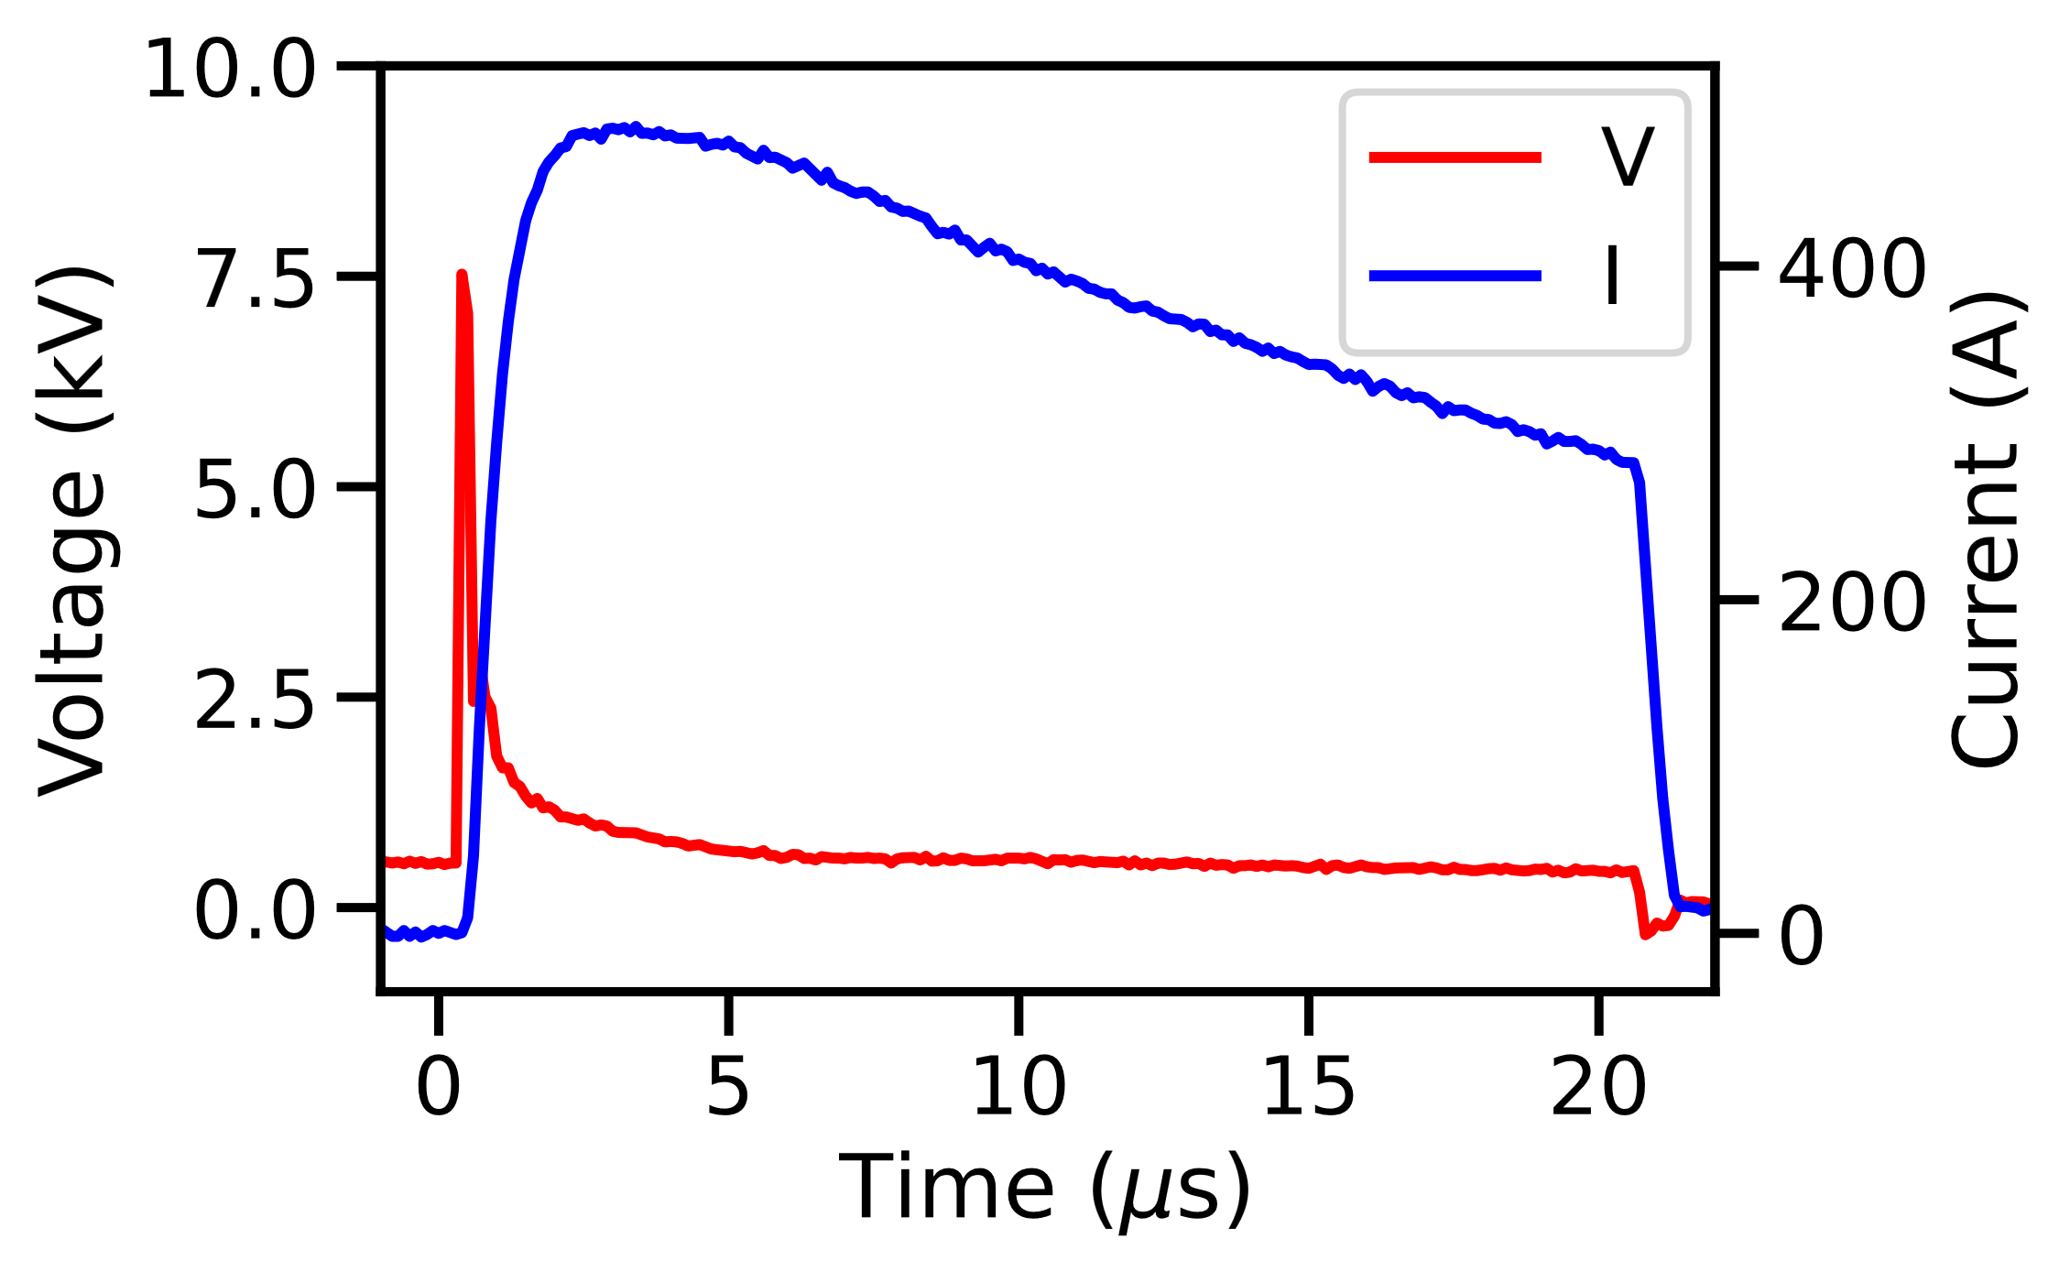
Plasma Formation
HV Supply
Pulse Generator
2 kΩ
Voltage leak (~1 kV) produces glow discharge (~ mA)
Weakly ionised plasma
Pulse generator (8 kV) drives ~100 A through plasma
Transition from glow to arc discharge plasma regime
High ionisation level → high uniformity
C
R
HV switch
Gas + vacuum
Virtual anode
Discharge gap
Anode
Return cage
Cathode
Claudia Cobo c.cobo@imperial.ac.uk
Notes:
Power consumption, I say 1 kA * 10 kV = 10^7 W. Operating for 25 µs = 250 J per shot. At 1 Hz, 250 W, at kHz, 250 kW per metre (but probably similar for 10 metre) - so for 100 m of acceleration need 25 MW (a lot of energy!)

Slide 6
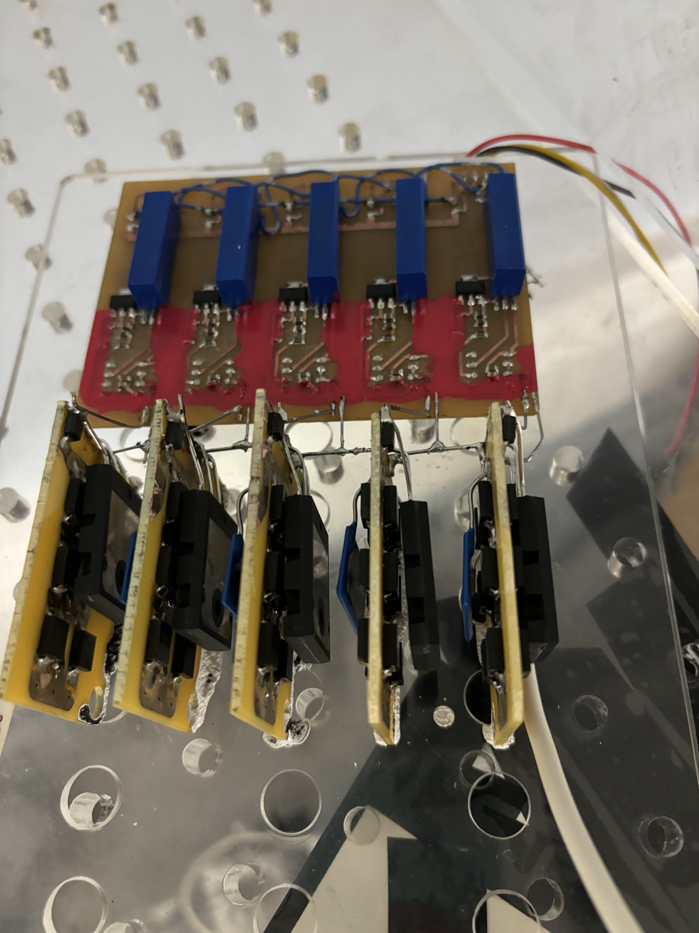
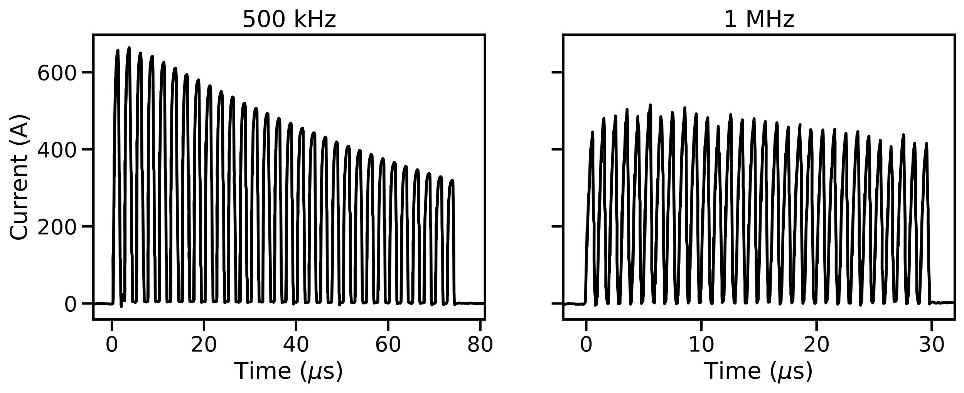
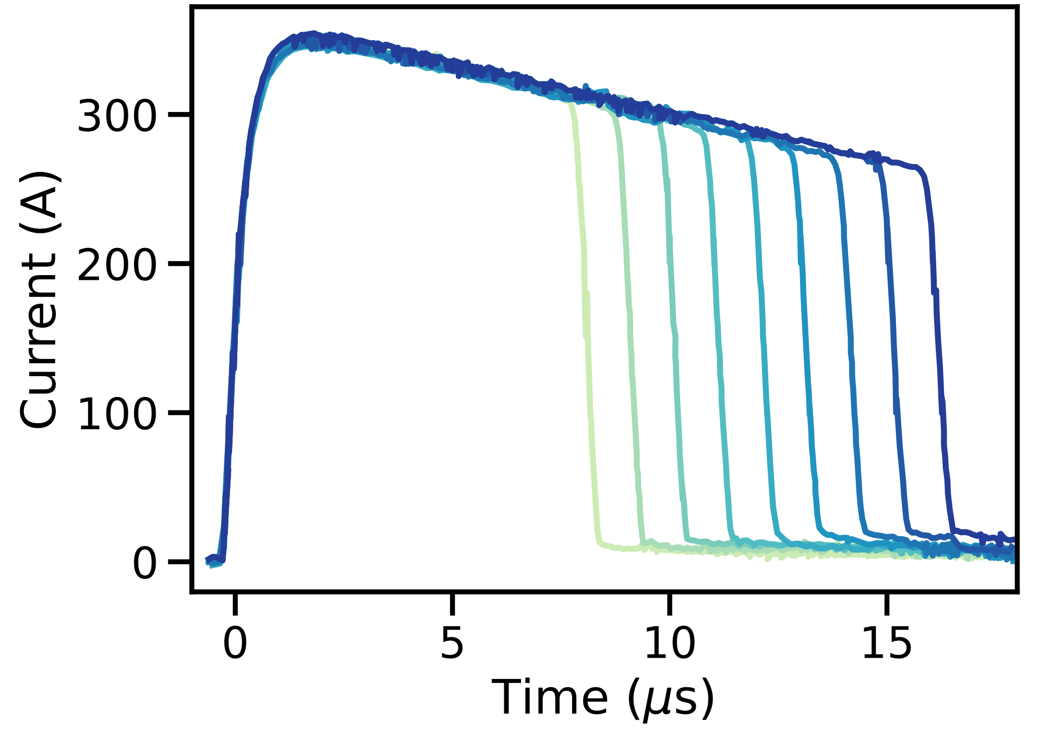
High Voltage Pulse Generator
Semiconductor-based pulse generator
Multi-stage optically isolated trigger
Controllable pulse duration 0.5 – 100 μs
High repetition rate operation tested on resistive-inductive dummy load
630 A peak at 500 kHz
500 A peak at 1 MHz
< ns jitter
Claudia Cobo c.cobo@imperial.ac.uk

Slide 7
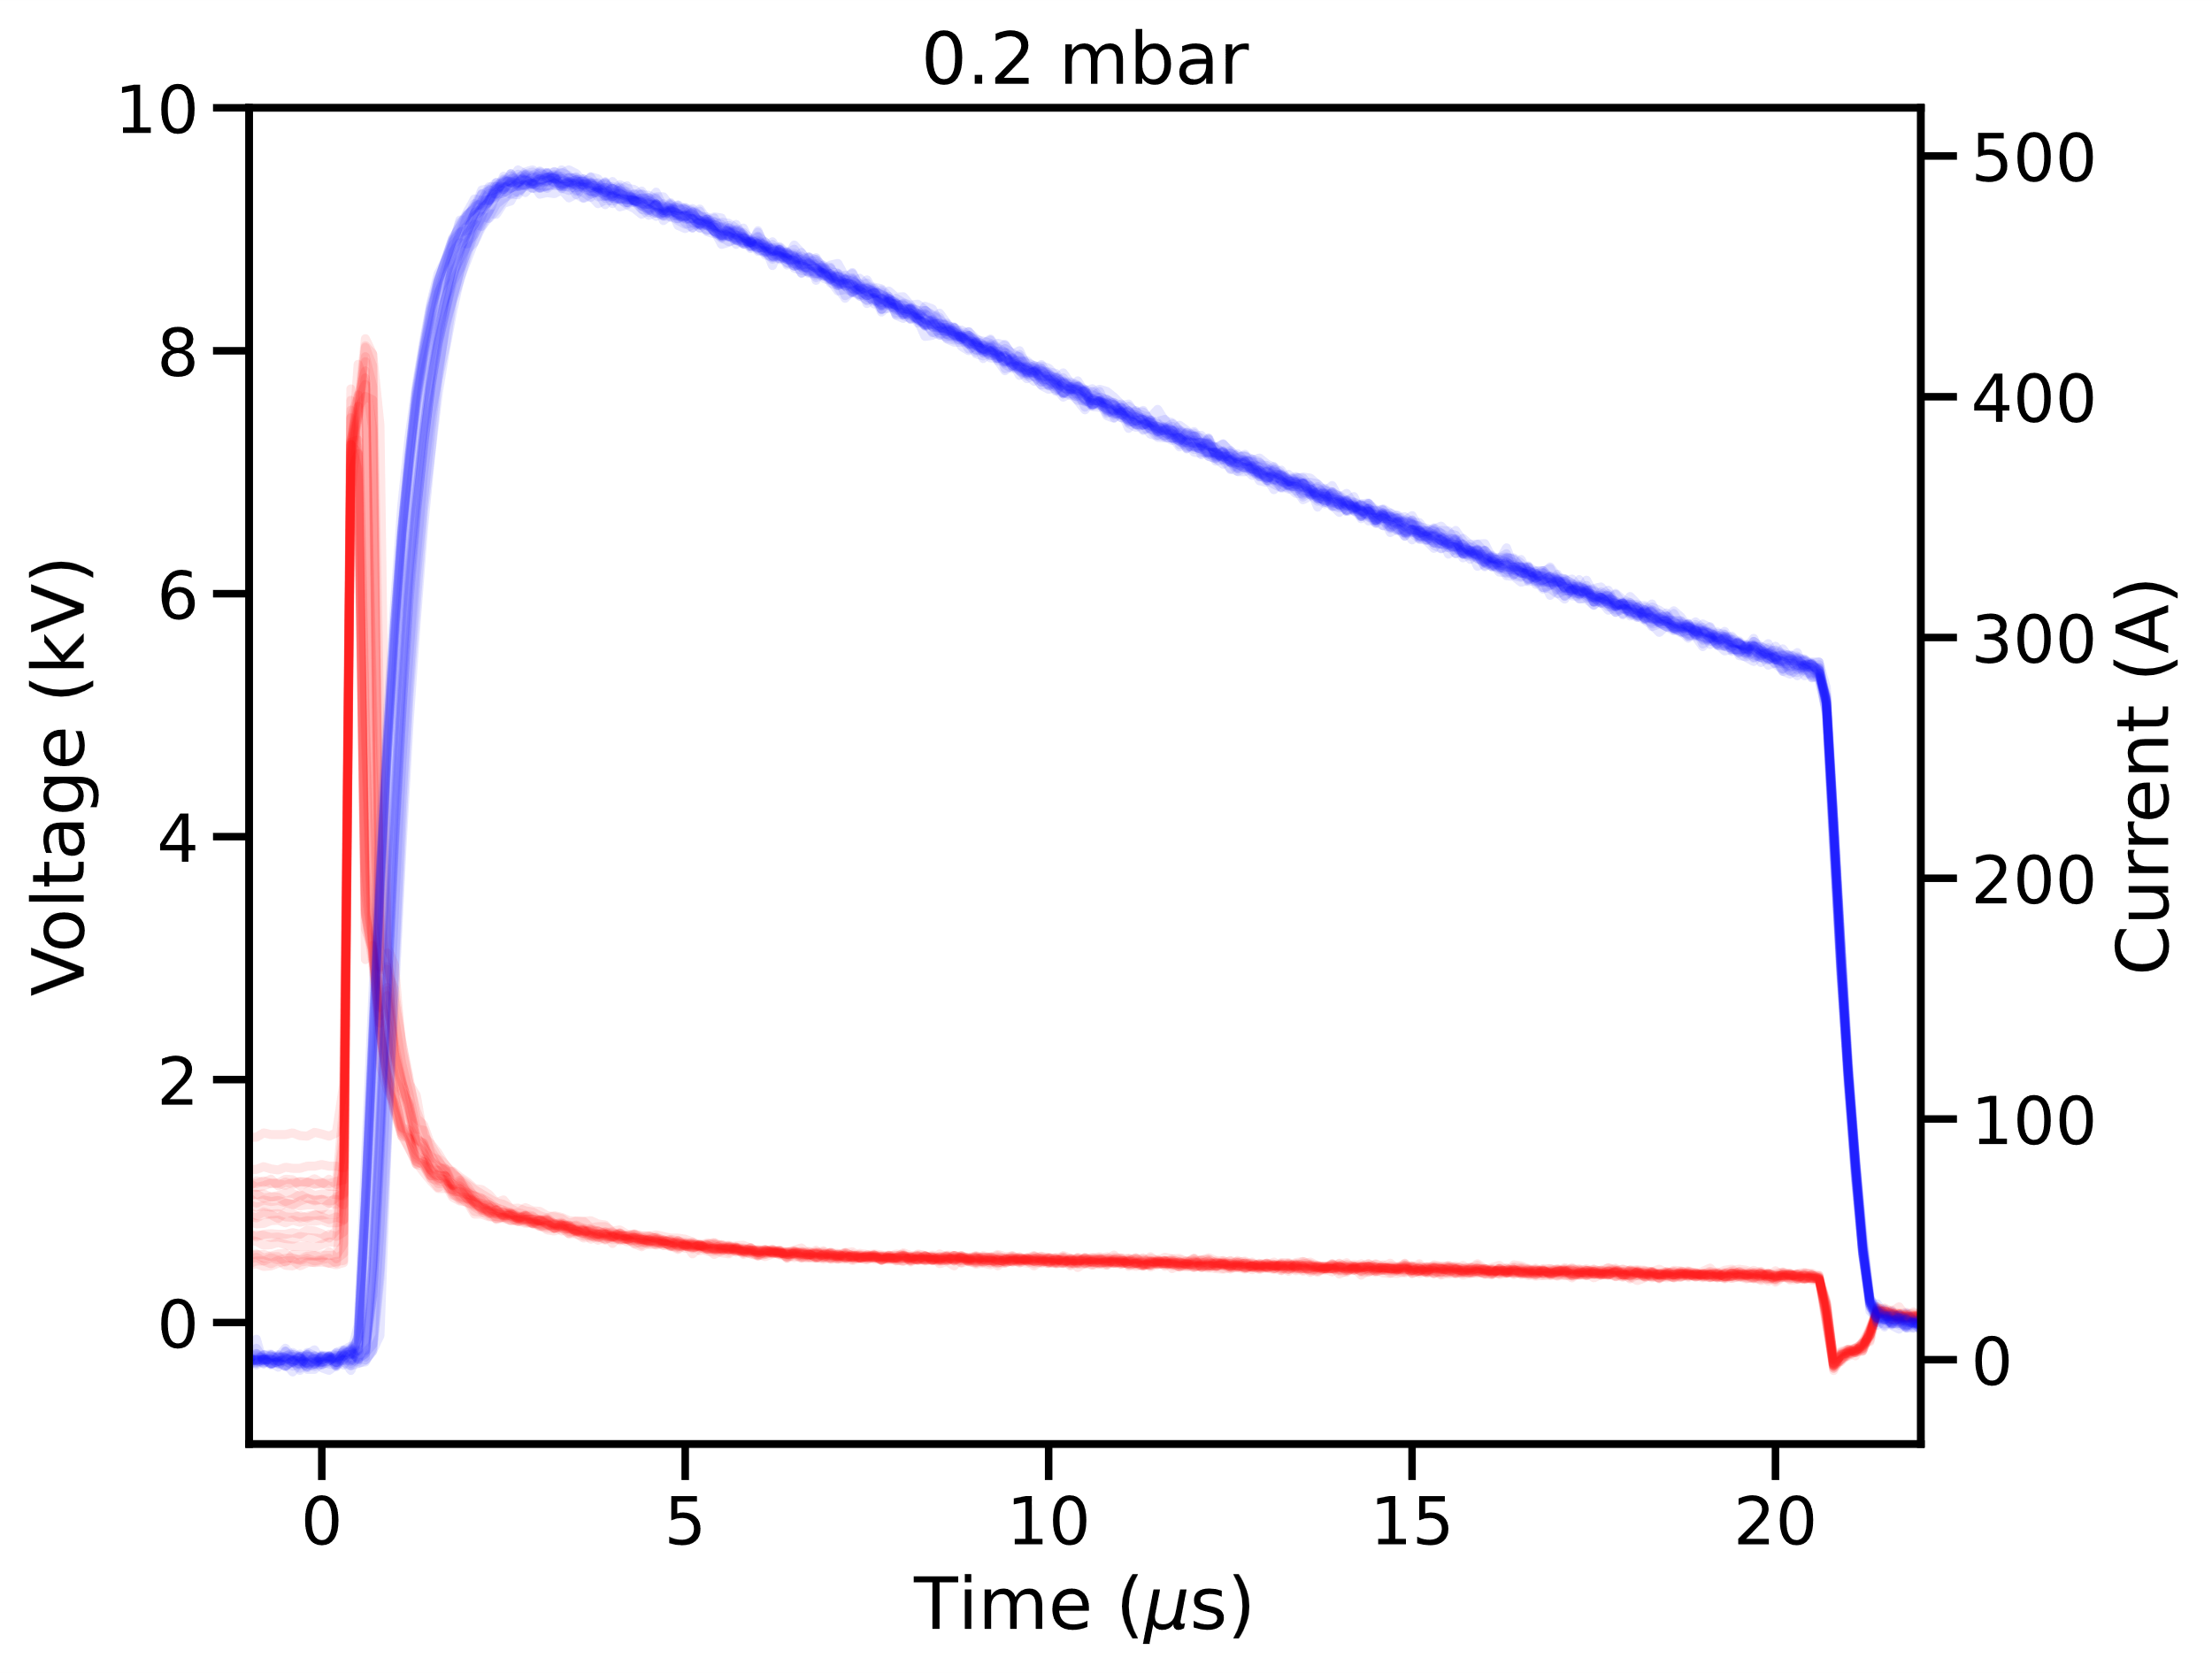
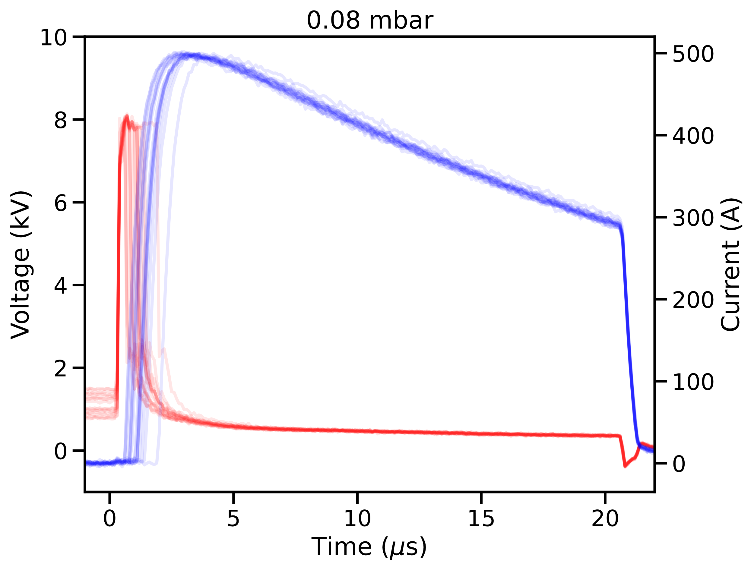
Discharge Reproducibility
Argon, 8 kV
330 A (R = 22 Ω)
500 A (R = 15 Ω)
Microsecond-level jitter of 330 A discharge
Jitter worsens at lower pressures
Reduced jitter by increasing discharge current
5× decrease with 500 A discharge
Claudia Cobo c.cobo@imperial.ac.uk

Slide 8
Longitudinal Interferometry
Mach-Zehnder interferometer
Longitudinally-integrated density measurement
Transversely resolved
Time scan possible by varying laser – discharge timing
Photodiode
CMOS sensor
Fibre laser
500 μJ
100 ns
1064 nm
Plasma tube
Claudia Cobo c.cobo@imperial.ac.uk

Slide 9
Plasma Current Scan
Gas | Argon
Pressure | 0.2 mbar
Laser timing | 3.5 μs
Peak densities ~ 10²¹ m^{–3} → 30% ionisation
Plasma density (ionisation fraction) increases with current
Claudia Cobo c.cobo@imperial.ac.uk

Slide 10
Plasma Channel Evolution
Low Current
Argon, 0.2 mbar, 8 kV, 330 A (R = 22 Ω)
Claudia Cobo c.cobo@imperial.ac.uk

Slide 11
Plasma Channel Evolution
High Current
Argon, 0.2 mbar, 8 kV, 500 A (R = 15 Ω)
Claudia Cobo c.cobo@imperial.ac.uk

Slide 12
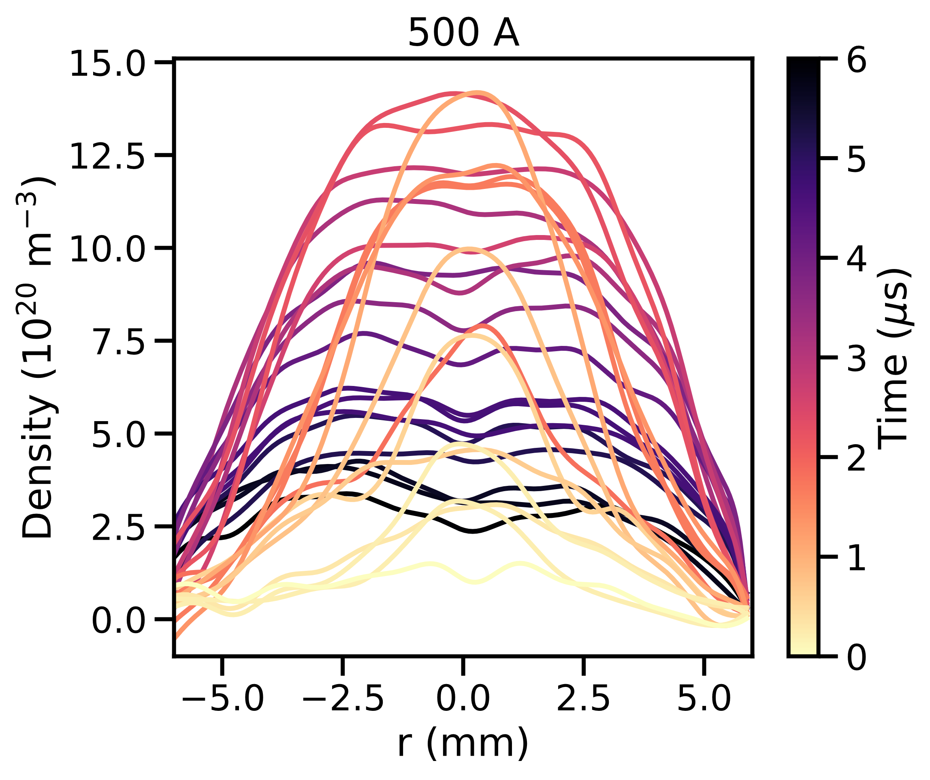
Plasma Density Evolution
Gas | Argon
Pressure | 0.2 mbar
Voltage | 8 kV
Rapid expansion early in the 500 A discharge counteracts faster ionisation by higher current
Similar peak densities achieved with 330 A and 500 A
Claudia Cobo c.cobo@imperial.ac.uk

Slide 13
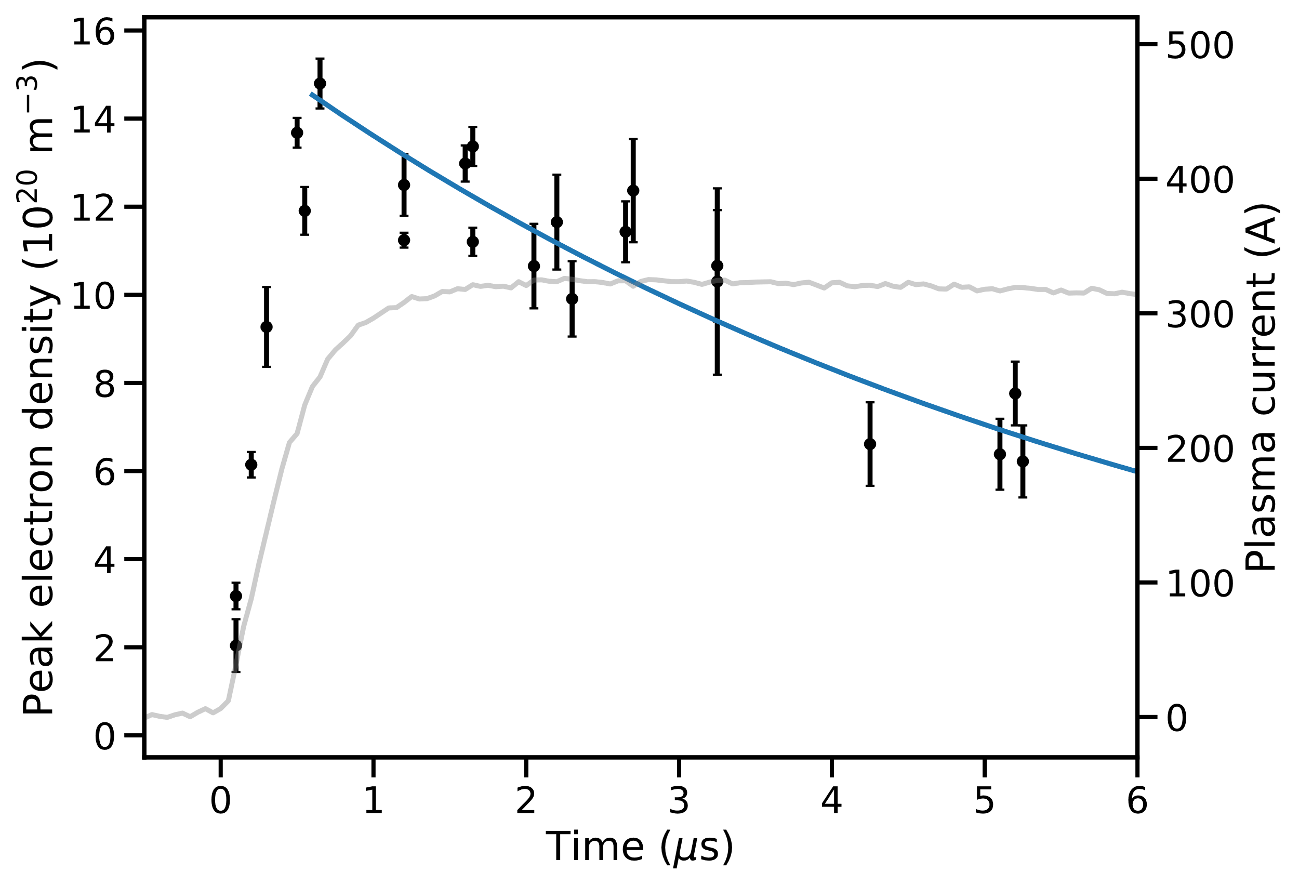
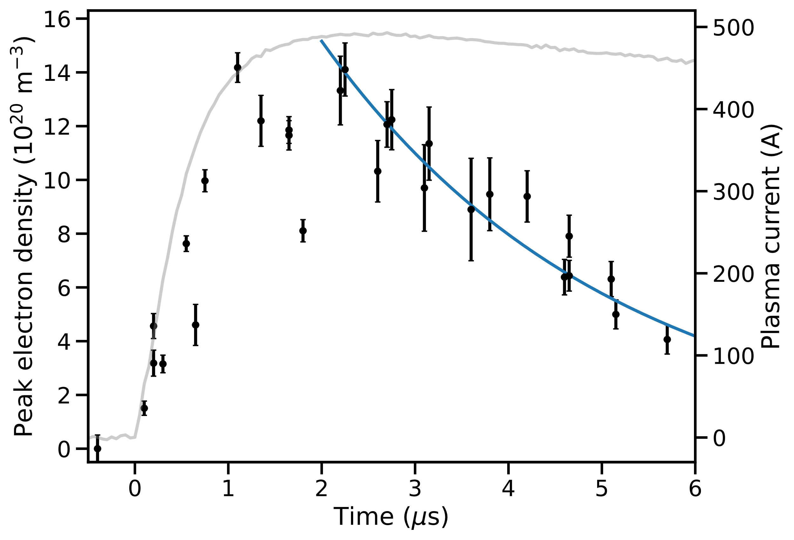
Plasma Density Evolution
Gas | Argon
Pressure | 0.2 mbar
Voltage | 8 kV
Ambipolar diffusion in weakly ionised plasma
Exponential fits imply T_{e} = 2.6 eV for 330 A discharge and T_{e} = 10.5 eV for 500 A discharge
Claudia Cobo c.cobo@imperial.ac.uk
Notes:
66 ns propagation time over 10 m. Rate of change of density relative to this propagation time?
2.6 eV for 330 A, 5.5 eV (from 1 us), 10.5 eV (from 2 us) for 500 A

Slide 14
Plasma Emission Spectroscopy
Gas | Argon
Voltage | 8 kV
Current | 500 A
Bentham M300 Czerny-Turner spectrometer used to measure spectrum of plasma emission.
Integrated over discharge pulse
Plasma spectrum dominated by Ar II (singly ionised argon)
Plasma tube
Spectrometer
CMOS camera
Claudia Cobo c.cobo@imperial.ac.uk

Slide 15
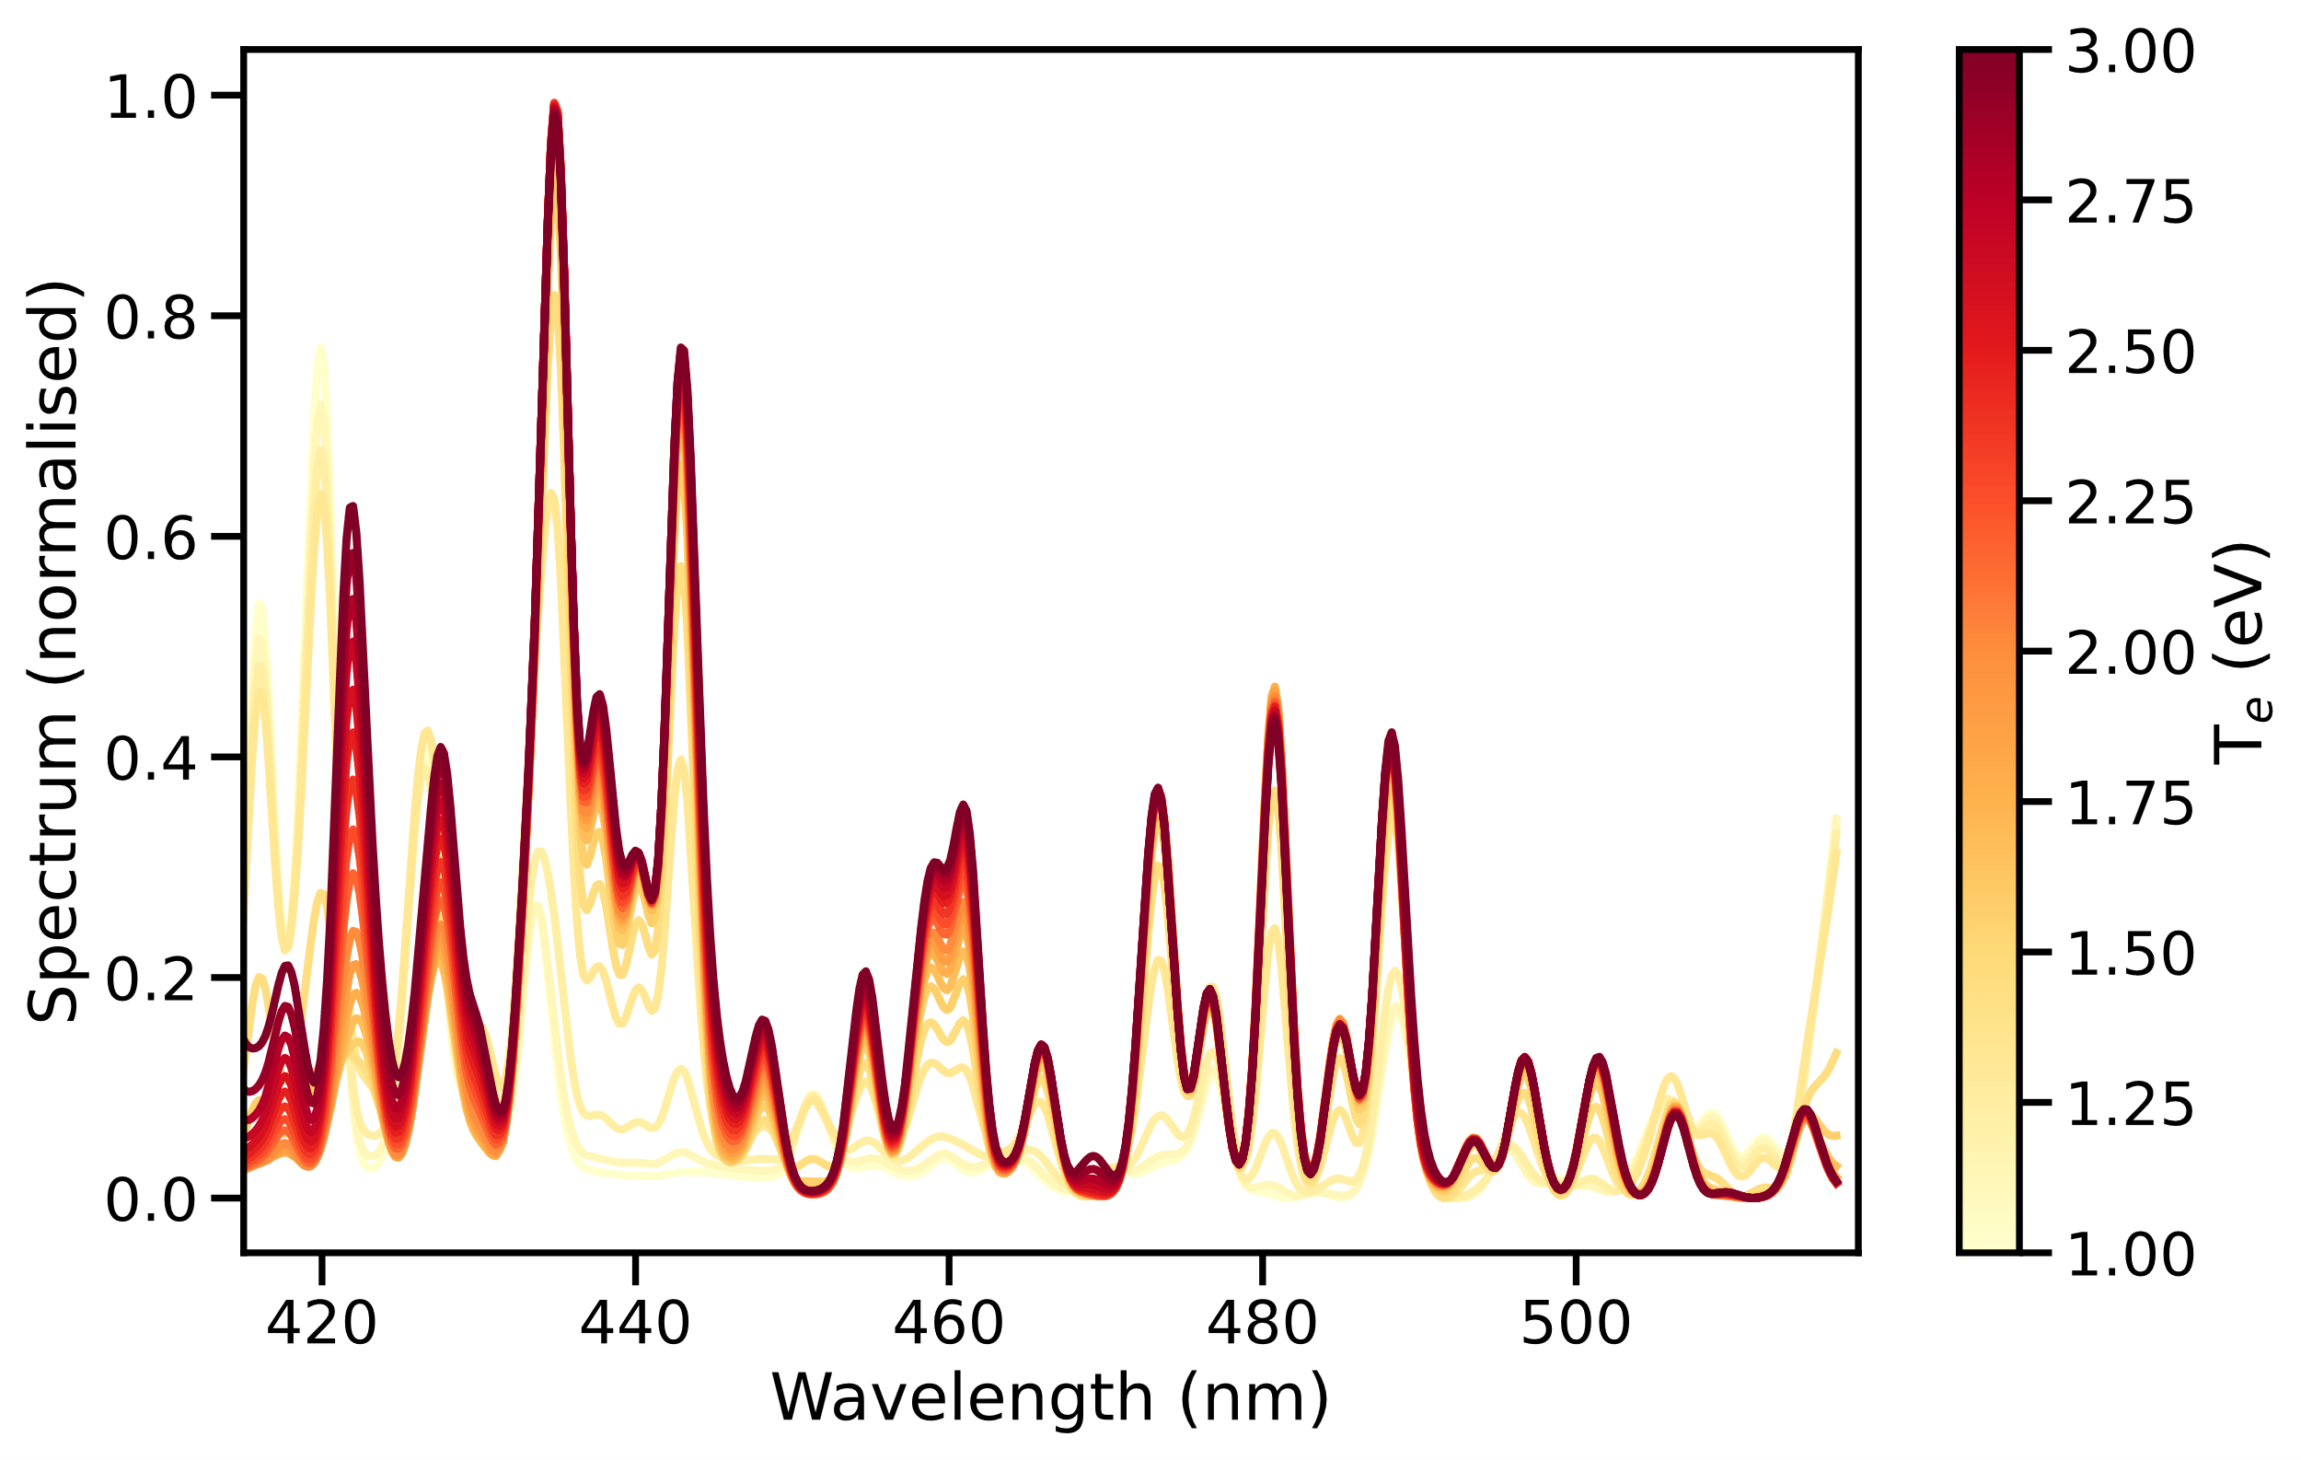
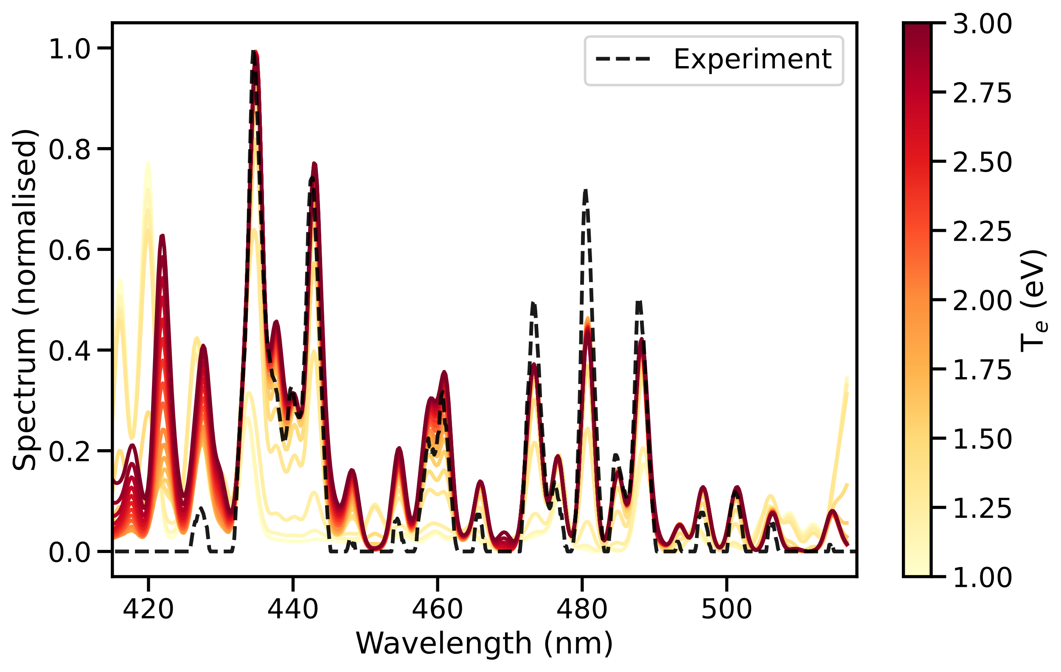
Plasma Emission Spectroscopy
Gas | Argon
Pressure | 0.06 mbar
∆λ | 2 nm
PrismSPECT Simulations
Collisional-radiative spectral analysis code
Low temperature spectroscopy
Zero width geometry
Non-LTE
Spectra suggest T_{e} ≈ 1.5 – 2 eV
Result from ambipolar diffusion (T_{e} ~ 2 – 10 eV) likely overestimated
Claudia Cobo c.cobo@imperial.ac.uk

Slide 16
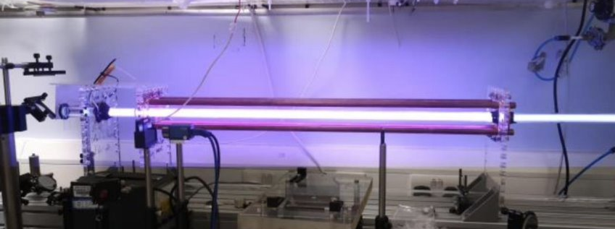
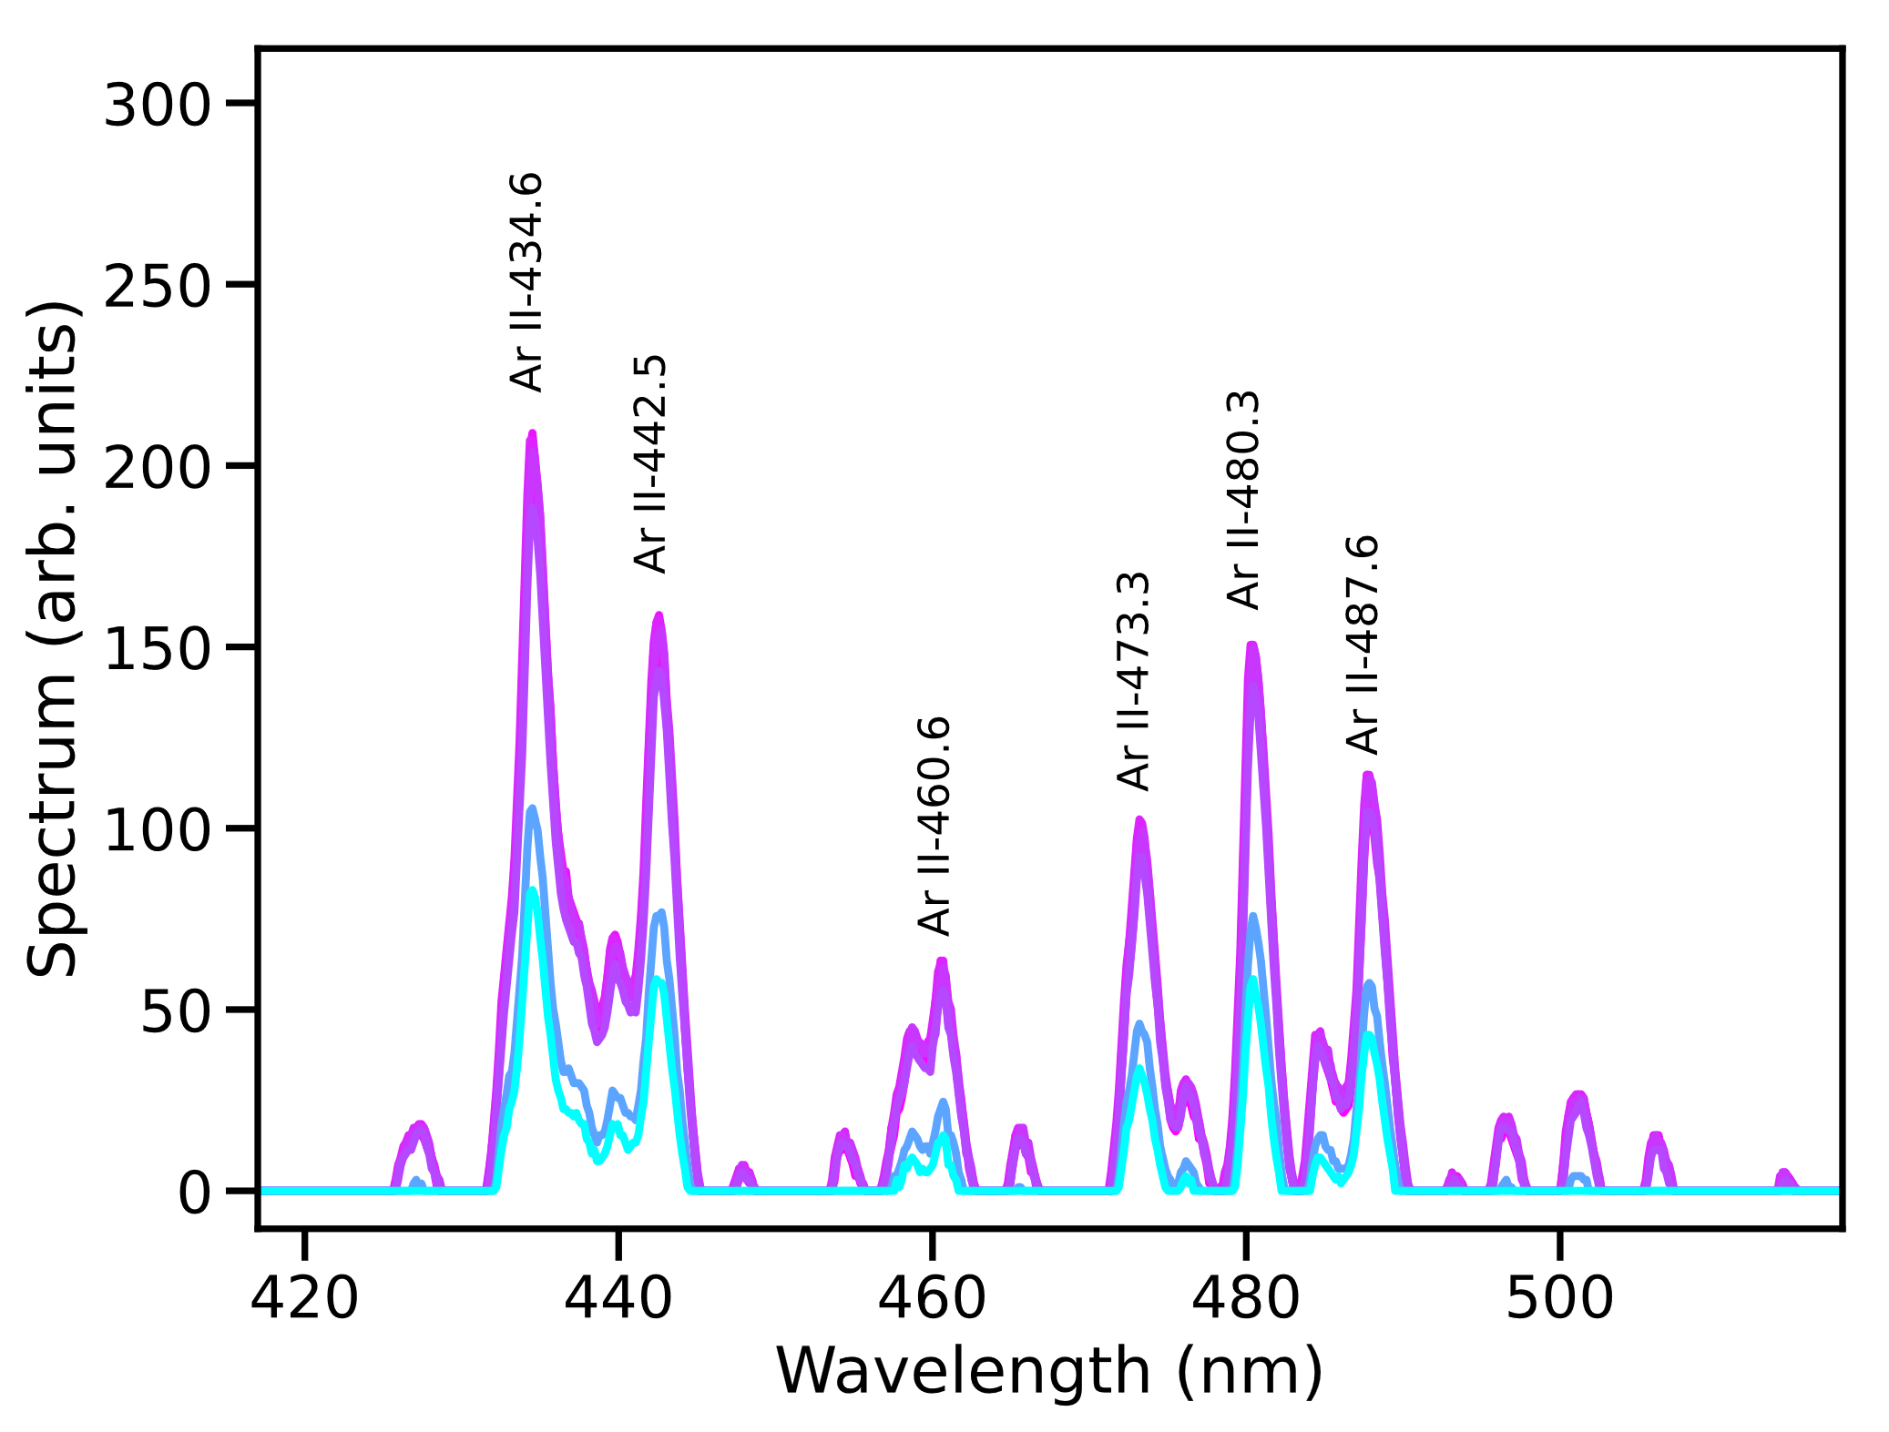
Conclusions
1 m argon arc discharge using 8 kV pulse generator
Higher current leads to more reproducible discharge
Longitudinal interferometry reveals radial expansion of plasma during discharge pulse
n_{e} ~ 10²⁰ – 10²¹ m⁻³ densities reached
Complex ionisation and diffusion dynamics to be investigated further with PIC simulations
Plasma emission spectroscopy provides information about the plasma temperature
Acknowledgements
AWAKE scalable plasma sources R&D team
Claudia Cobo c.cobo@imperial.ac.uk

