Slide 1
Laser-driven Particle Induced X-Ray Emission for Rapid Real-Time Analysis of Aerosols
Canan Yağmur Boynukara
Research Director: Prof. Patrizio Antici

Slide 2
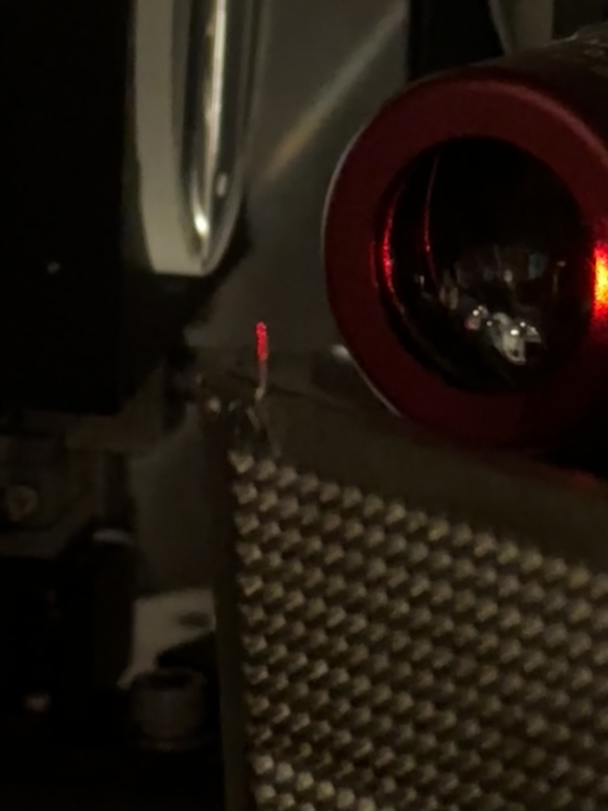
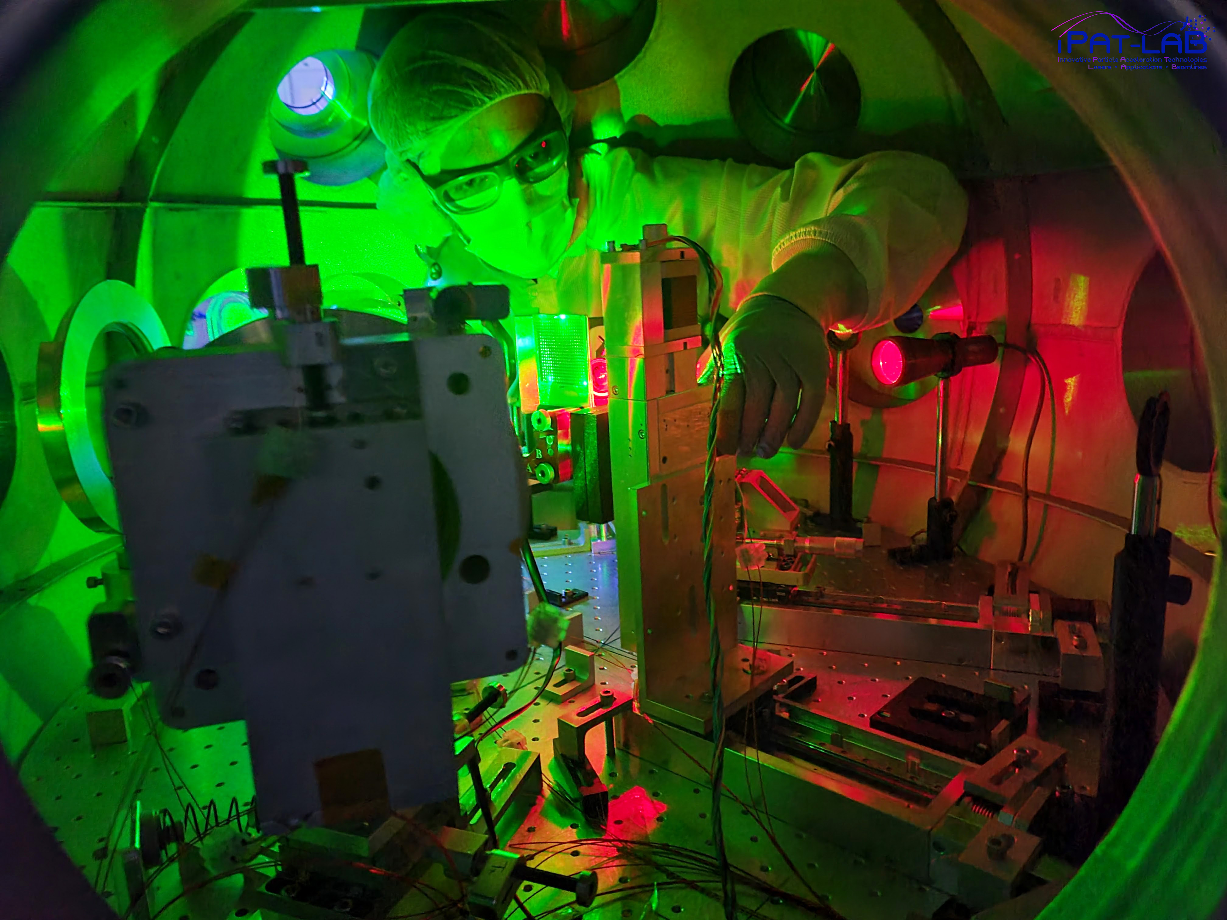
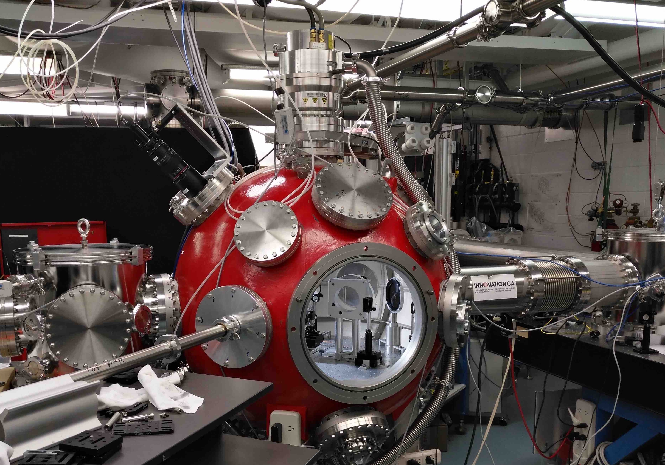
Outline
Introduction
Objectives
Experimental Setup
Analysis and Results
Conclusion
Outlook

Slide 3
Introduction

Slide 4
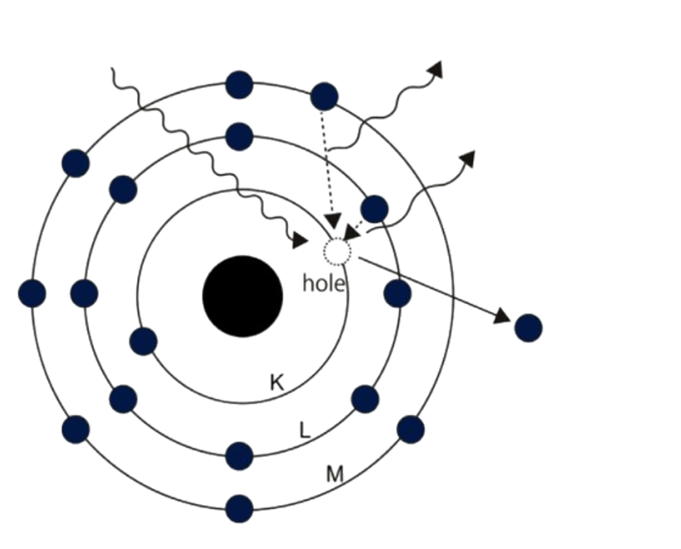
Introduction
How does Particle Induced X-Ray Emission (PIXE) work?
Incoming Particles
• The protons kick out electrons!
Characteristic (fluorescent) X-rays
• The vacancy is filled with an electron from a higher level!
• A photon gets emitted!
Photoelectron
The photon energy is characteristic for each element!
• A continuous spectrum featuring clearly distinguishable peaks!
Uo, M., Wada, T., & Sugiyama, T. (2014). Applications of X-ray fluorescence analysis (XRF) to dental and medical specimens. Japanese Dental Science Review, 50(2), 63–68.
Notes:
What happens is that a high energy particle (in our case protons and X-rays) kick out an electron from an inner shell of an atom. The vacancy then gets filled by an outer shell electron. The excess energy then gets released as a photon.
The energy of the emitted photon is characteristic for each element. And the result of that happening a few times in our sample is a continuous X-ray spectrum with distinct peaks which we can use to identify which elements are present in our sample.

Slide 5
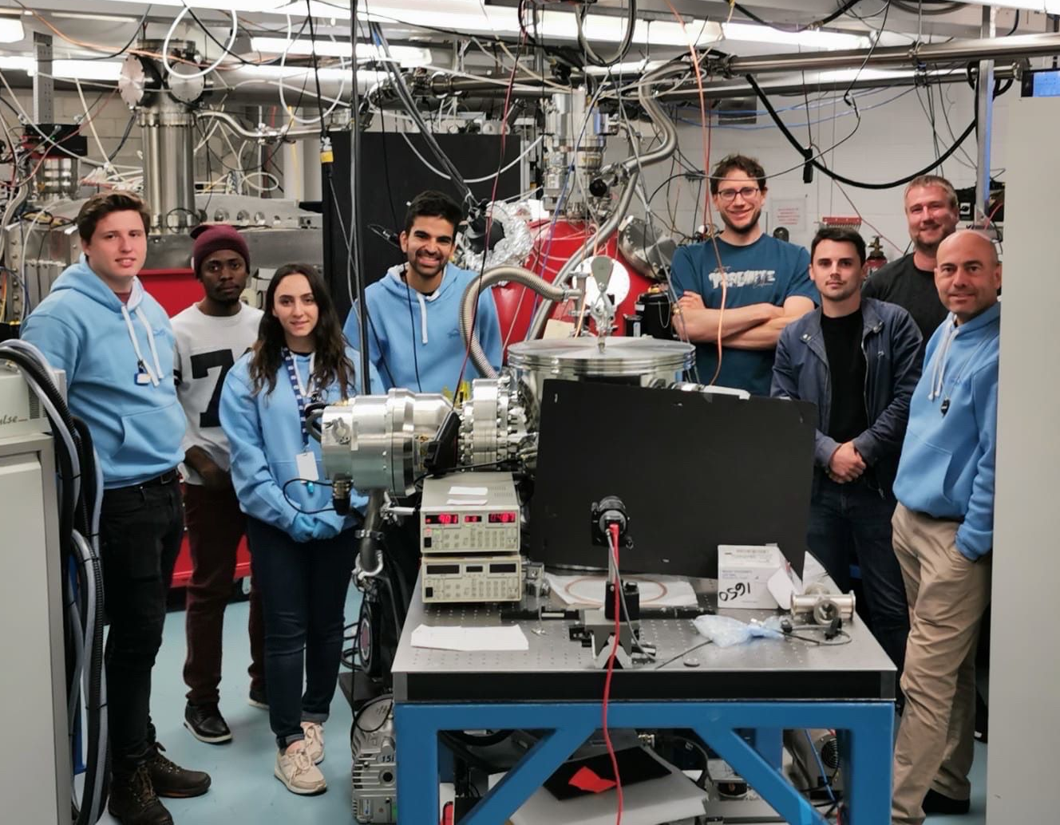
Introduction
What is Laser-Driven PIXE?
► Utilizes high-intensity, short laser pulses for sample excitation.
► Eliminates the need for large particle accelerators, potentially reducing equipment costs and complexity.
Notes:
Relies on high-energy particle beams (e.g., protons or alpha particles) for sample bombardment. ► Typically requires large, dedicated accelerators for generating particle beams.
10’18 W%cm2

Slide 6
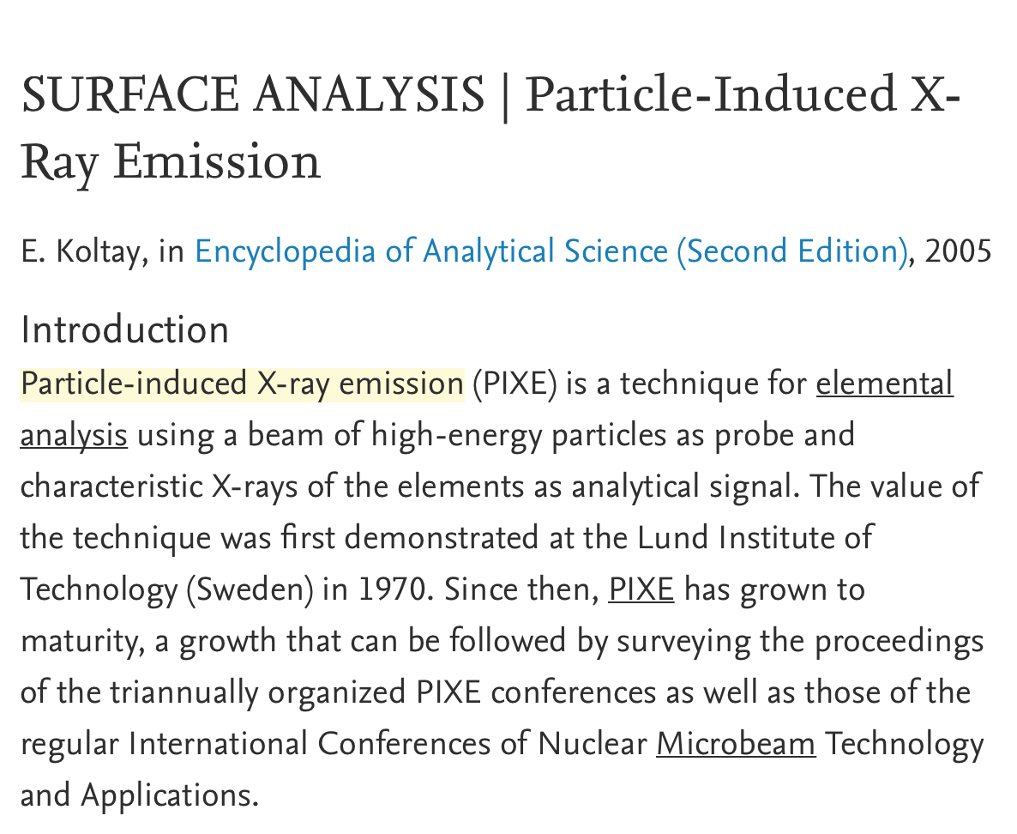
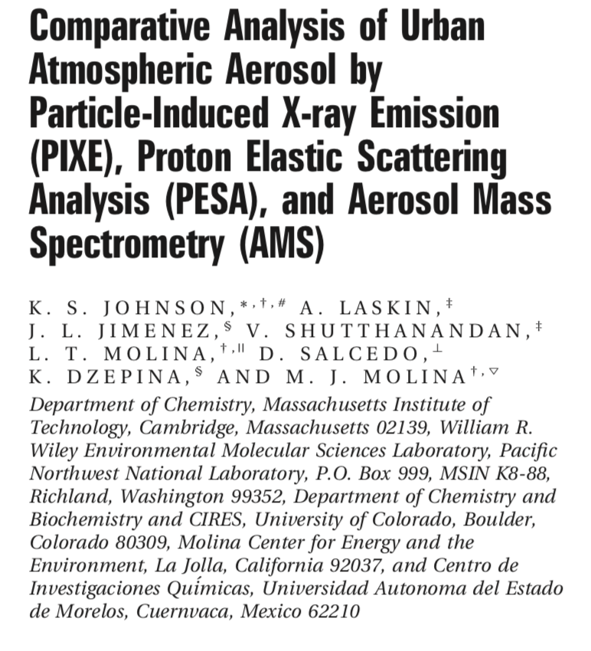
Introduction
Application Areas
Biomedical
Laser-accelerated
Ions
Cultural Heritage
Material Science
Environmental Applications

Slide 7
Objectives

Slide 8
Objectives
Why a New Approach Is Needed?
Laser-Driven PIXE as a Solution!
• Large RF accelerators → bulky and immobile
• Compact particle source via laser-plasma acceleration
• Requires gas sampling + offline filter analysis
• Enables portable, real-time analysis
• Compatible with XRF/EDX for hybrid diagnostics
• Real-time, on-site detection is not possible
• Low ion flux and small analysis area
• Proton cross-sections ≫ electron-based methods
• SEM/EDX unsuitable for direct gas-phase detection
• Overcomes limits of both PIXE and SEM/EDX
• Sample prep for EDX is complex, thresholds uncertain
• Opens new opportunities for aerosol trace detection
Notes:
“Conventional PIXE has been successfully used for aerosol analysis, but it relies on large, immobile accelerators. That means you can’t bring the system to the field — instead, you collect the gas, trap it on a filter, and send that filter to the lab for analysis.”
“Not only is this time-consuming, but also the ion flux is low, the analyzed surface is small, and real-time analysis is out of reach.”
“Alternatives like SEM or EDX also fall short. They can’t directly analyze gas mixtures without filtering, and their detection thresholds are not well defined.”
“So, what can we do differently?”
“With laser-plasma acceleration, we can generate particles on demand — using a compact system that could eventually become portable.”
“This enables the possibility of real-time, on-site elemental analysis of aerosols.”
“Even more, we can combine laser-driven PIXE with techniques like XRF or EDX in a hybrid configuration. And because proton cross-sections are up to a thousand times higher than electron-based methods, we gain sensitivity — especially for light elements in gas mixtures.”
“Together, these advantages open new opportunities for fast, sensitive, and direct analysis of trace elements in the air.

Slide 9
Material and Methods

Slide 10
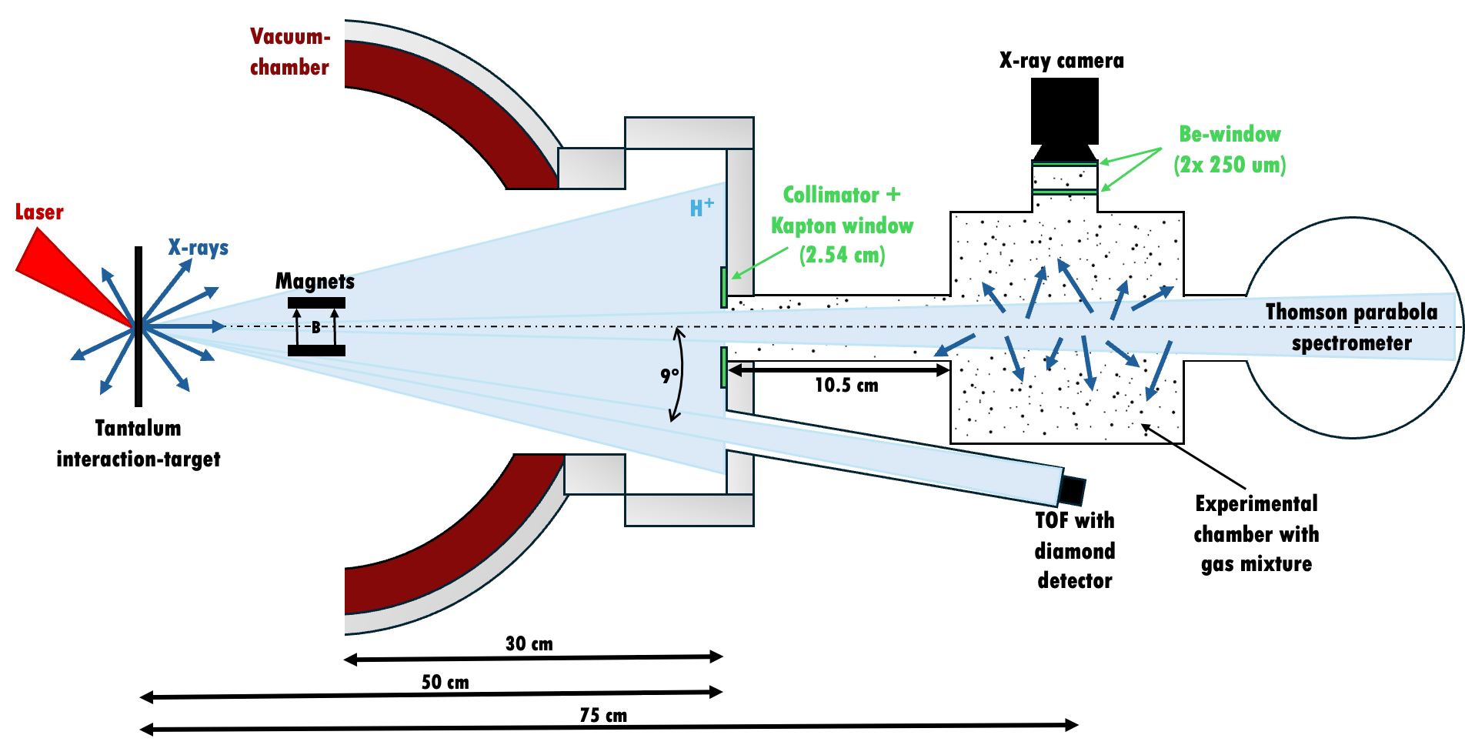
Materials and Methods
Experimental Setup
150TW Ti:Sapphire Laser:
•λ = 800 nm
•Pulse duration = 22 fs
•Peak energy = 3.2 J
•Repetition rate = 0.625 Hz
•Vacuum ≅ 10⁻⁶ Torr
Notes:
Here you can see our experimental setup. It might be a bit overwhelming at first but I will explain to you the main working principle in the following slides. After which I go into more detail on the generation of the proton beam

Slide 11
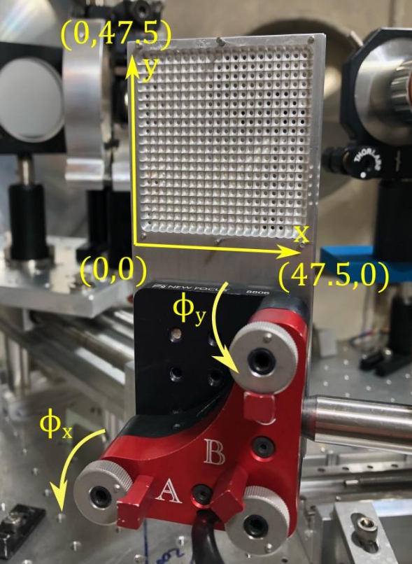
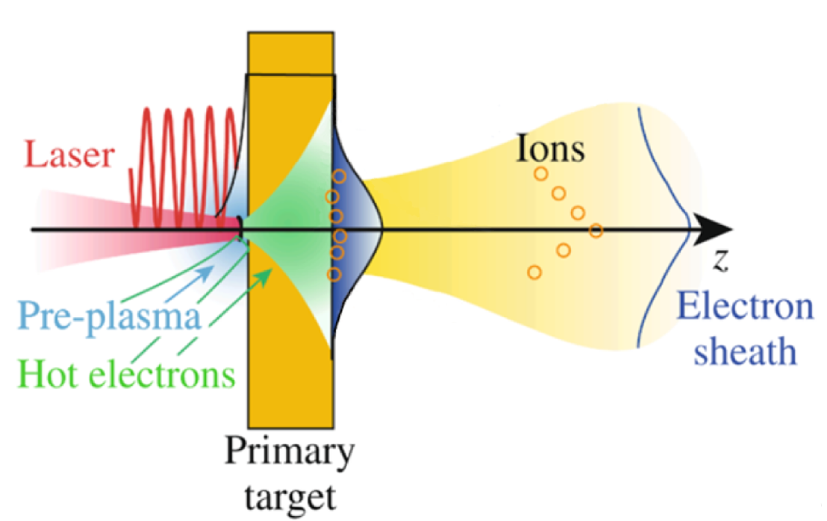
Materials and Methods
Experimental Setup
Intraction target holder for 400 shots
TNSA regime
C. Stoeckl et al., Nuclear Instruments and Methods in Physics Research Section B: Beam Interactions with Materials
and Atoms, A platform for nuclear physics experiments with laser-accelerated light ions
Notes:
We used an interaction target holder designed for automated operation, which allows us to perform up to 400 consecutive laser shots per vacuum cycle without manual intervention

Slide 12
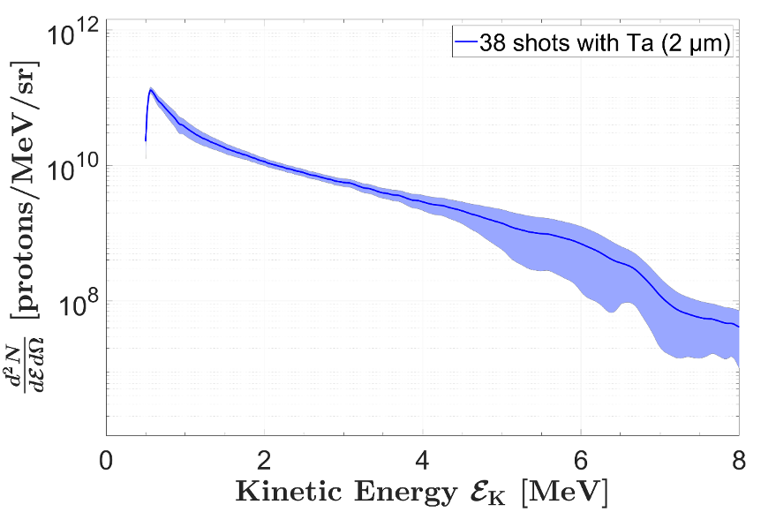
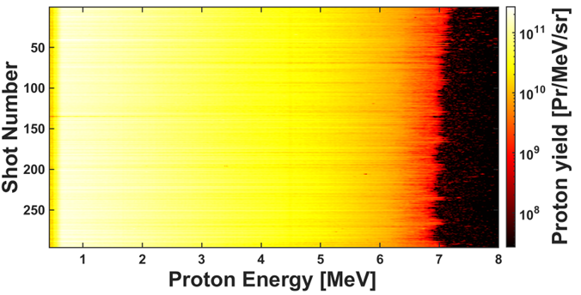
Materials and Methods
Experimental Setup
ALLS 150 TW ion beamline stability
Average proton spectrum over 38 shots
Notes:
ALLS 150 TW ion beamline stability 5.4 micrometer Alimunum foil
Ta high Z target, using it inables us laser XRF and we called it XPIF. Proton Spectrum to caractrize proton sourse.

Slide 13
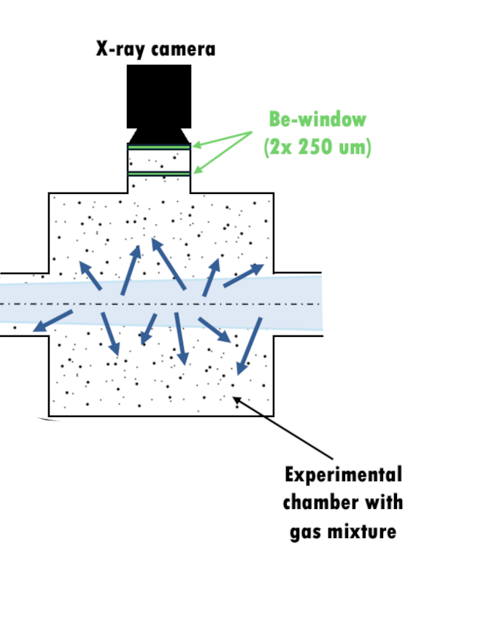
Materials and Methods
Experimental Setup
The chamber was first pumped down to 10⁻³ mbar
Krypton (Kr) was introduced using a manual valve
The chamber was then filled with nitrogen or ambient air to reach atmospheric pressure
For low Kr concentrations, air was used directly (contains ~1 ppm Kr naturally)
Partial pressures were monitored using a pressure sensor
Kr concentration was estimated using the ideal gas law!

Slide 14
Analysis and Results

Slide 15
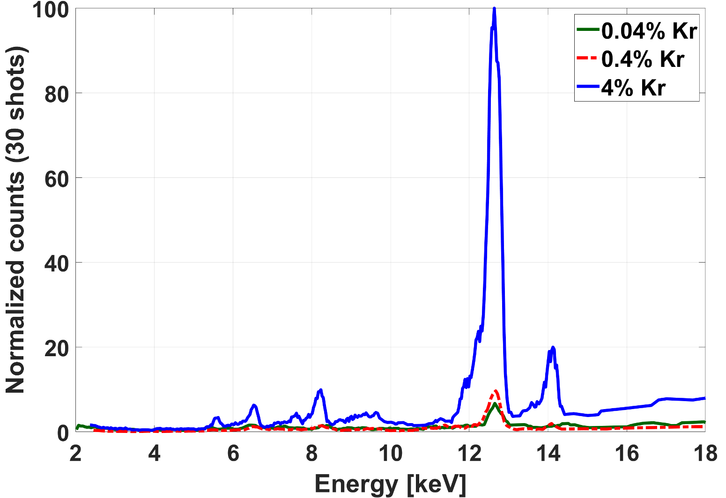
Analysis and Results
• Three Kr concentrations tested: 4%, 0.4%, and 0.04%
• Clear Kα peak at 12.65 keV identified for all three concentrations
• 0.04% is the lowest achievable and detectable level with current setup
• Multiple laser shots needed for sufficient SNR:
4% → 60 shots
0.4% → 100 shots
0.04% → 120 shots
Notes:
At this point, the key question is whether the observed peak — especially at 0.04% Kr — is actually a true signal or just background noise.

Slide 16
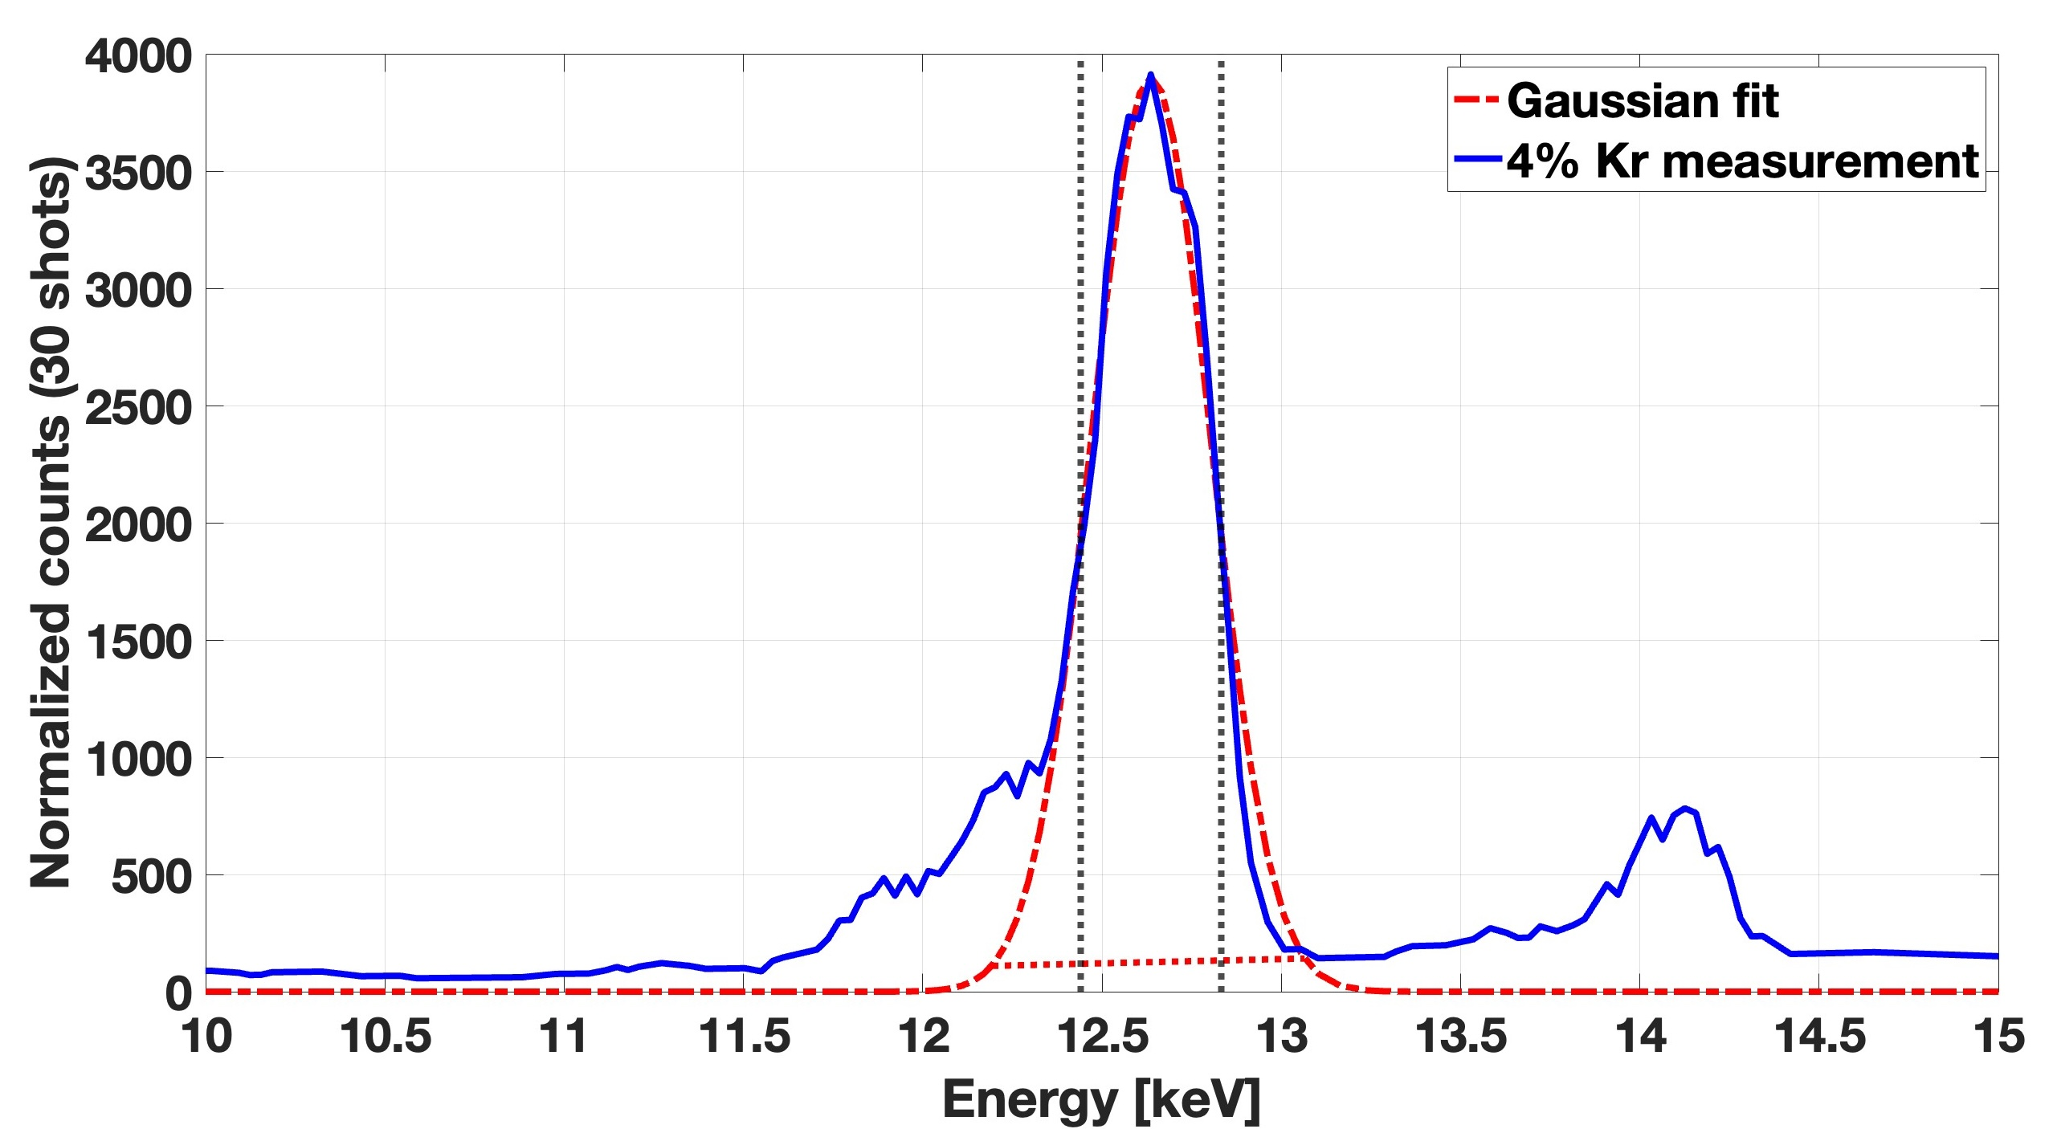
Analysis and Results
Minimum Detectable Limit
•A peak is considered “real” if:
$$Y_{MDL}=3⋅\sqrt{Y_{background}}$$
•Reference = 4% Kr signal (set as 100%)
•0.4% Kr → 8.6% of reference
•0.04% Kr → 5.5% of reference
Deviations explained by:
• Low SNR
• Shot-to-shot proton beam fluctuation
• Manual gas dilution
• Wall desorption of Kr at low concentrations
Gaussian peak fitting (dashed red) of 4 % Kr data (blue). The dotted black lines indicate the integration range. The background, indicated by the red dashed line, was subtracted to calculate the accumulated photon yield over 30 shots.
Notes:
“To answer that,We used the MDL method to confirm whether a peak truly originates from Kr or if it could just be background noise.” “We performed Gaussian fitting to isolate the Kr Kα peak and estimate its area precisely. The background signal — mainly due to camera noise and Bremsstrahlung — was subtracted to ensure that only characteristic X-ray counts were included in the yield calculation.”
“This step is essential for accurate quantification and for comparing peak intensities across different gas concentrations.”
• Peak area (reference = 4% Kr):
• 0.4% Kr → 8.6% (expected: 10%)
• 0.04% Kr → 5.5% (expected: 1%)
• Peak height (reference = 4% Kr):
• 0.4% Kr → 9.7%
• 0.04% Kr → 6.7%

Slide 17
Conclusion

Slide 18
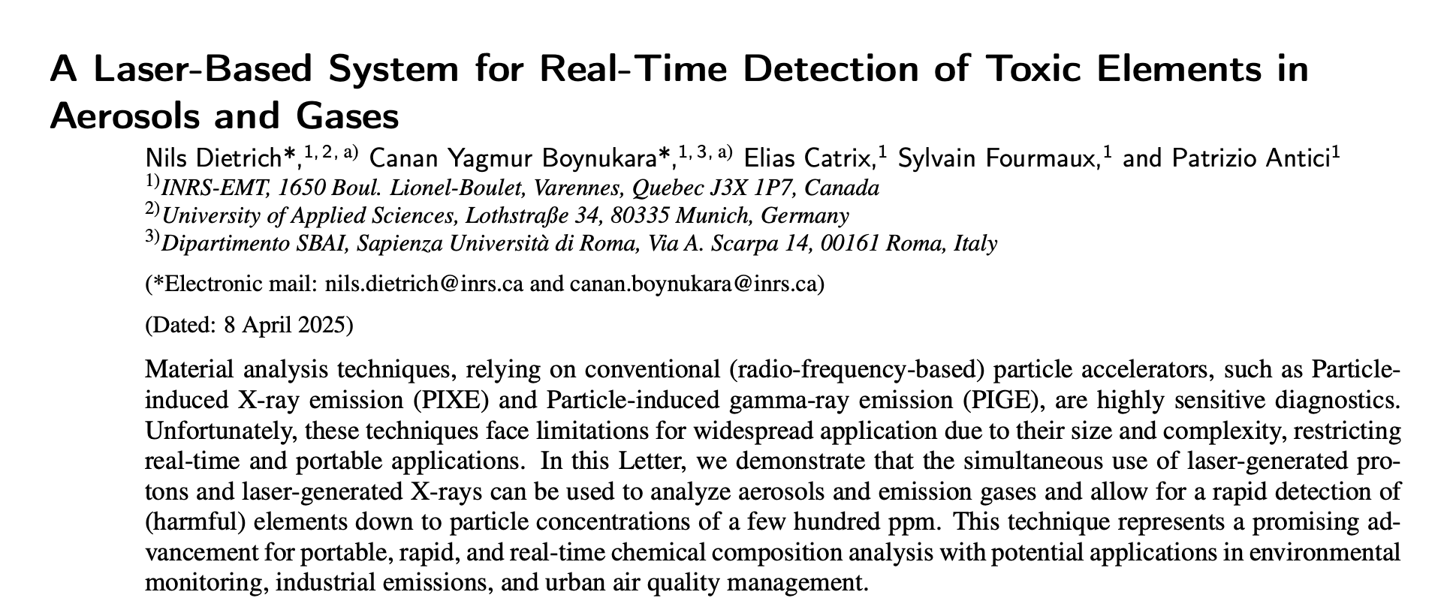
Conclusion
• Laser-driven PIXE enables detection of gas-phase elements down to ~100 ppm, even 0.04% Kr
• No complex sample preparation is needed!
• Peak intensity can be used to estimate gas concentration (if reference is available)
Under submission process!
Planned System Improvements:
• Reduce shot-to-shot fluctuations of the proton beam!
• Adding multiple detectors would improve signal-to-noise ratio!
• Shot number can be increased!

Slide 19
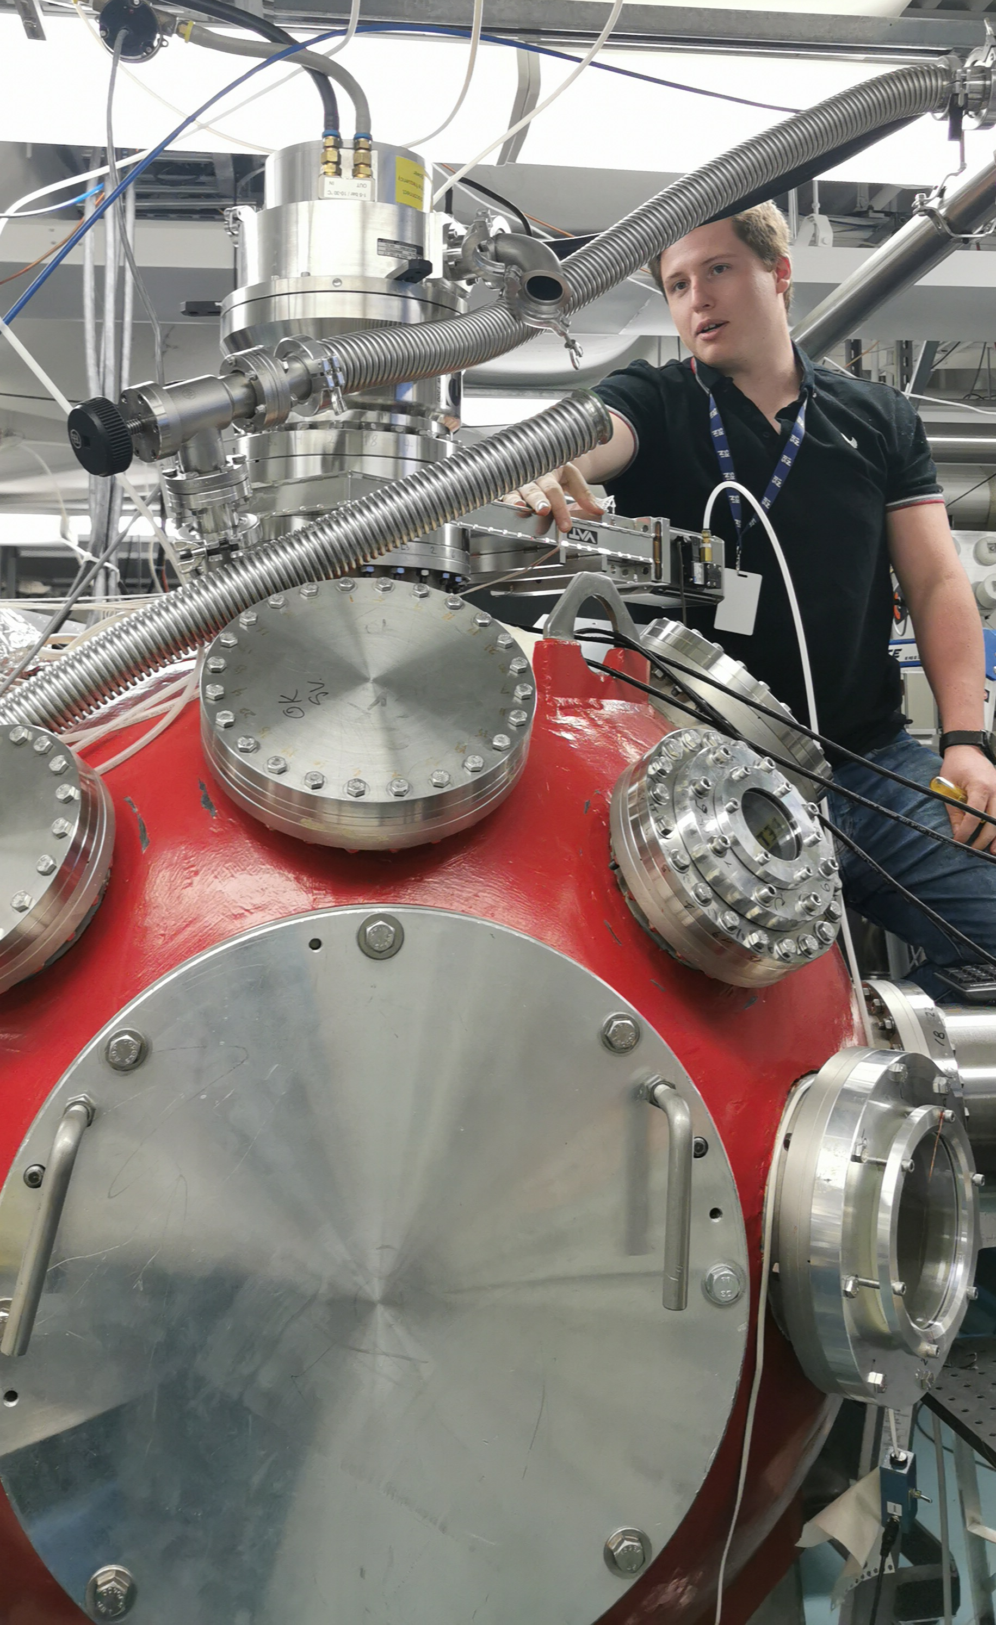
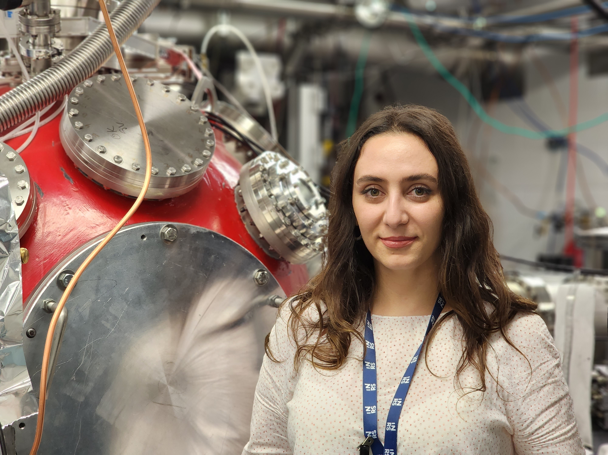
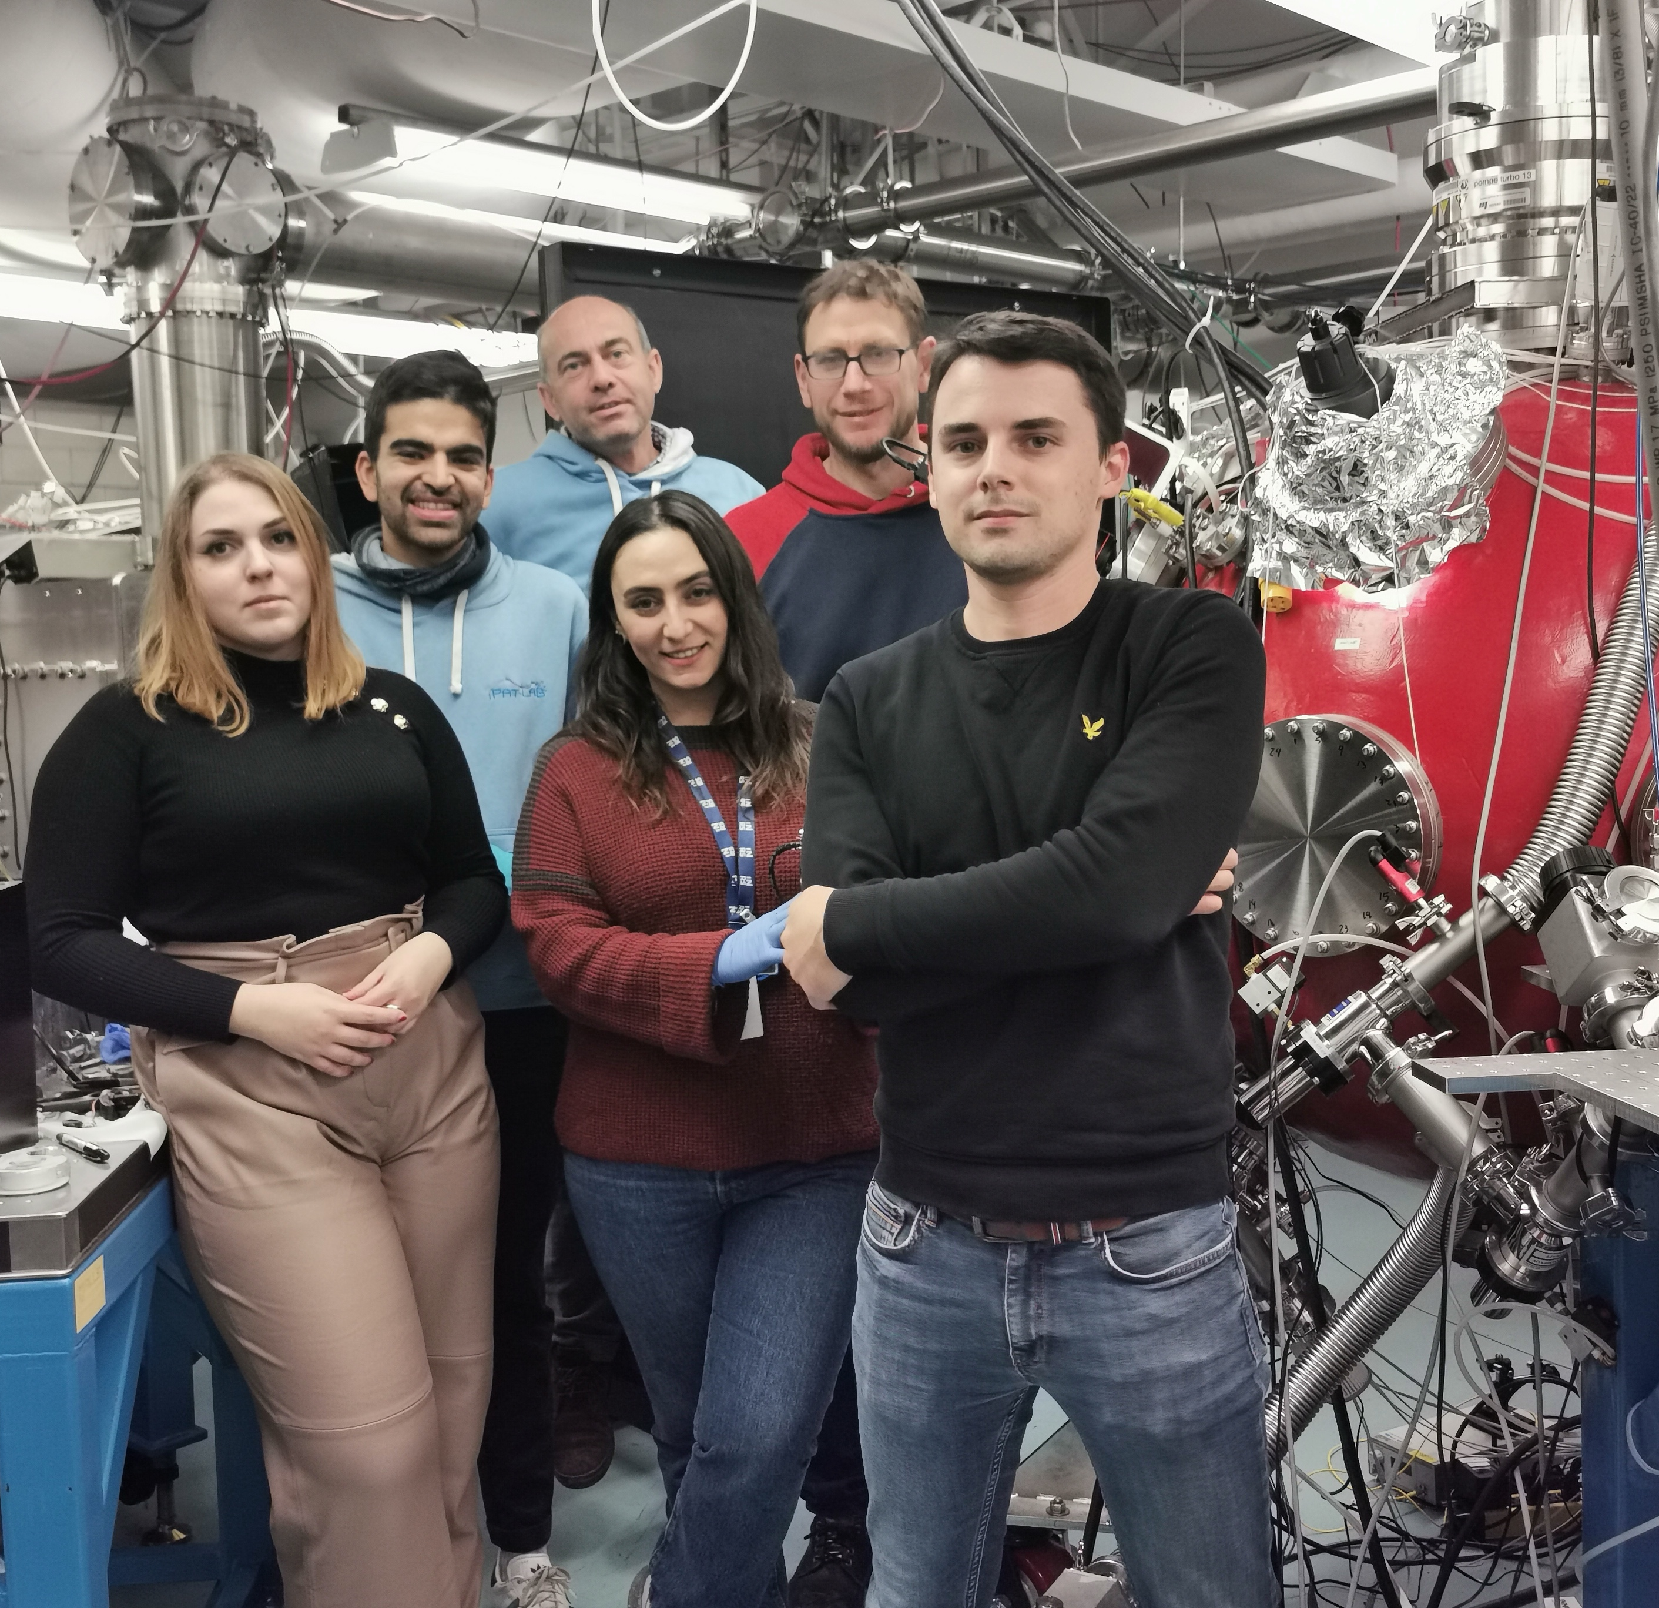
Thank you!

Slide 21
Estimating Kr Concentration Using Ideal Gas Law
We used the ideal gas law to calculate the molar ratio of Kr in the mixture:
$$χ_{\text{Kr}}=\frac{P_{\text{Kr}}}{P_{\text{total}}}$$
Where: $χ_{Kr}:$ Molar fraction of krypton
$P_{Kr}:$Partial pressure of Kr (measured during gas injection)
$P_{total}:$Total pressure after filling the chamber
Example:
If 40 mbar of Kr is injected and total pressure is 1000 mbar,
$$χ_{\text{Kr}}=\frac{40}{1000}=0.04⇒4\%\text{Kr} \text{concentration}$$

Slide 22
Catrix, E., Boivin, F., Langlois, K., Vallières, S., Boynukara, C. Y., Fourmaux, S., & Antici, P. (2023). Stable high repetition-rate laser-driven proton beam production for multidisciplinary applications on the Advanced Laser Light Source ion beamline. Review of Scientific Instruments, 94(5), 053301. https://doi.org/10.1063/5.0141284

Slide 23
Materials and Methods
•High intensities (>10¹⁸ W/cm²), short pulses (<ps) and very thin/pure foils
•Interaction of Laser with pre-plasma and the target
•Creation of charge separation fields (~TV/m) by hot electrons
•Acceleration of surface ions
•Additional generation of X-rays based on target material (Kα, Kβ )
C. Stoeckl et al., Nuclear Instruments and Methods in Physics Research Section B: Beam Interactions with Materials
and Atoms, A platform for nuclear physics experiments with laser-accelerated light ions
Notes:
The process is called Target Normal sheath acceleration. This is because we eject the proton beam into the target normal direction of our foil by creating a dense electron sheath at the rear surface.
But let’s go through it step by step:
TNSA occurs when a high-intensity short-pulse laser hits a target, typically a solid target in the micrometric thickness range.(We use a thickness of ~2 um and 99.9% purity)
The intense EM wave pushes the electrons from the target, which are easily ionized mainly through high field tunnel ionization in the laser’s forward direction through the relativistic ponderomotive force.
The electrons undergo strong heating. Hot electrons then propagate through the target at relativistic velocities and exit the target rear side where some of them are retained due to strong charge separation, and form an electron cloud (“the sheath”) that establishes an intense quasi-electrostatic field.
The longitudinal electric field completely ionizes the water and hydrocarbon molecules instantaneously , which are naturally present on the surface and ions (Mainly protons) get accelerated along the target-normal direction by the electron sheath.
Besides protons we also accelerate electrons, other heavy ions and X-rays (Alpha and Beta of the target element)
The electrons are deviated and don’t hit the sample
The heavy ions are negligibly due to their low number
The X-rays are used by us

