Slide 1
Plasma density shaping for beam control and brilliant X-rays
Olle Lundh, Lund University, Sweden
Laser Plasma Accelerator Workshop April 14-18, 2025

Slide 2
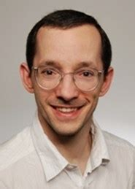
Acknowledgement
Cornelia Gustafsson
Erik Löfquist
Andrea Angella
Flanish D’Souza
Kristoffer
Svendsen
Jonas Björklund Svensson
Julien Ferri
Chalmers
Isabel Gallardo Gonzalez
Diego Guenot
Henrik Ekerfelt
Chen Guo
Anders Persson
Claes-Göran Wahlström
Laszlo Veisz
Umeå Univ.

Slide 3
Motivation: Divergence and Dephasing
Electrons outrunning wake
Limits beam energy
Betatron motion leads to divergent beams
Inefficient beam transport
Ion cavity
Ion cavity
Electron
+ + + +
+ + + + + + + +
+ + + + + + + + +
+ + + + + + + + + +
+ + + + + + + + + +
+ + + + + + + + +
+ + + + + + + +
+ + + +
Betatron orbit
+ + + +
+ + + + + + + +
+ + + + + + + + +
+ + + + + + + + + +
+ + + + + + + + + +
+ + + + + + + + +
+ + + + + + + +
+ + + +
$$v_{e}$$
Laser pulse
X-rays
$$v_{g}<v_{e}$$
Laser pulse
Electrons
Electric field

Slide 4
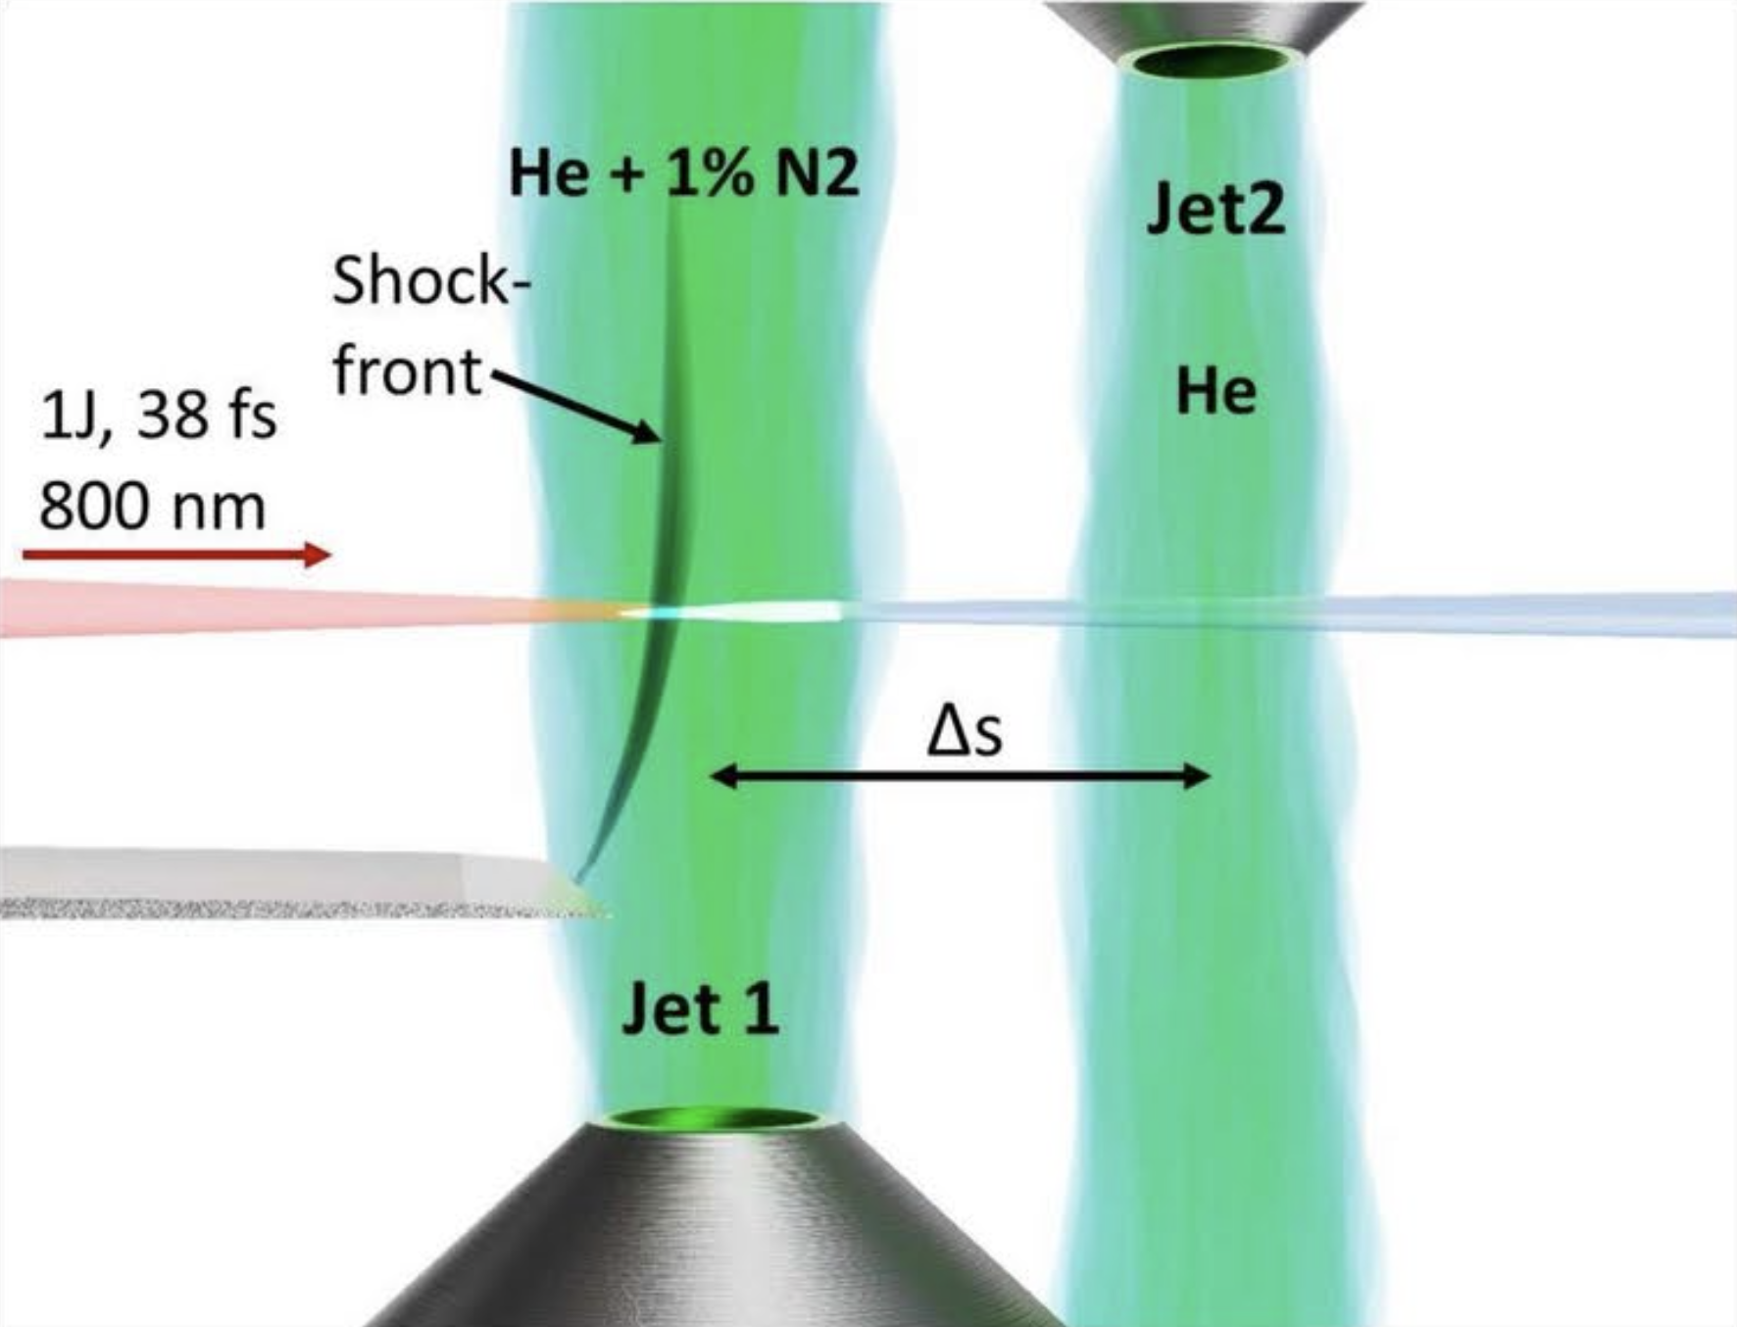
Density shaping by combining two gas jets
Jet 1: Controlled injection via shock + ionization
Jet 2: Independent control of density and position → energy boost, focusing, X-rays
Goal: Control of beam quality and radiation
or
N₂

Slide 5
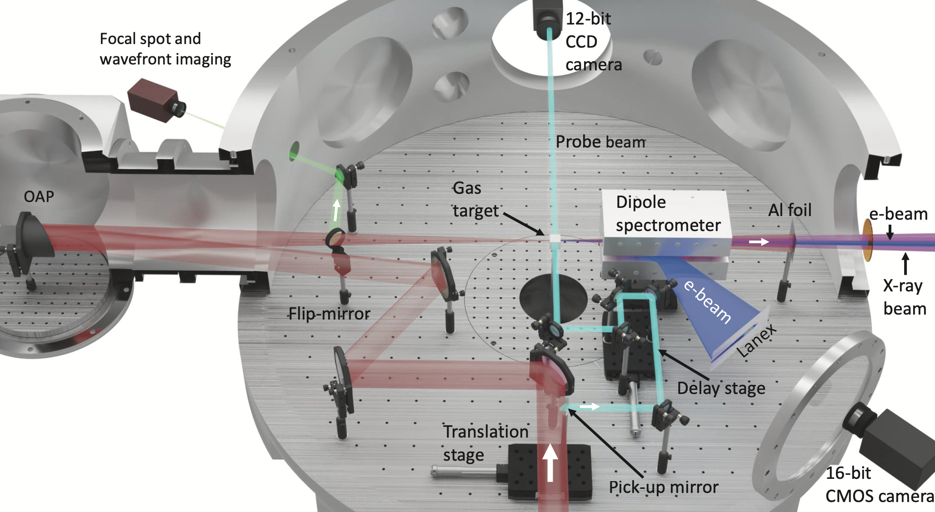
Experimental setup
Laser: 1 J | 35 fs | focused to 12 µm FWHM
Jet 1 | 1.5 mm | He+1%N₂| 2–8･10¹⁸ e-/cm³
Jet 2 | 1.0 mm | He or N₂ | 2–16･10¹⁹ e-/cm³
Notes:
Experimental setup

Slide 6
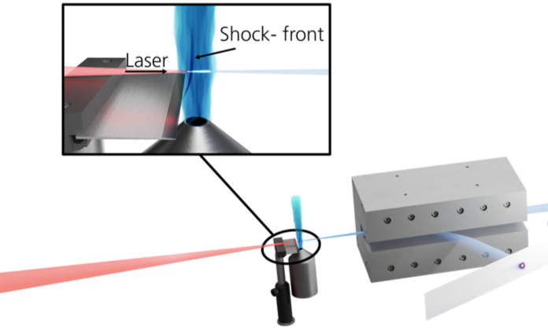
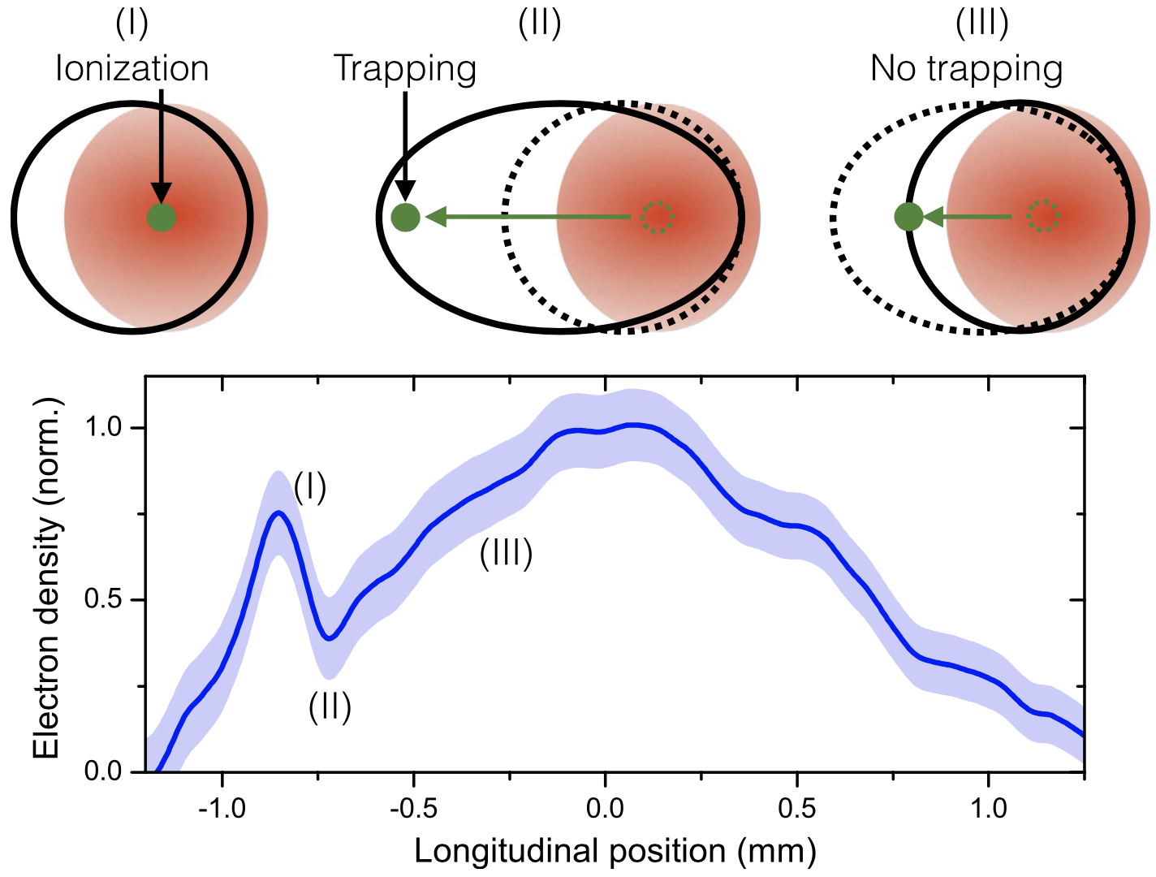
Shock-assisted ionization injection
0.8 T dipole magnet
Razor blade
Scintillator screen
1.5 mm jet 99% He 1% N₂
Shock-assisted ionization injection: electrons are ionized and trapped at a sharp density transition.
Expanded plasma cavity at the shock front allows prolonged acceleration and easier trapping.
Localized injection achieved when laser intensity and plasma density are sufficiently low.
Thaury et al, Sci. Rep. 5, 16310 (2015)

Slide 7
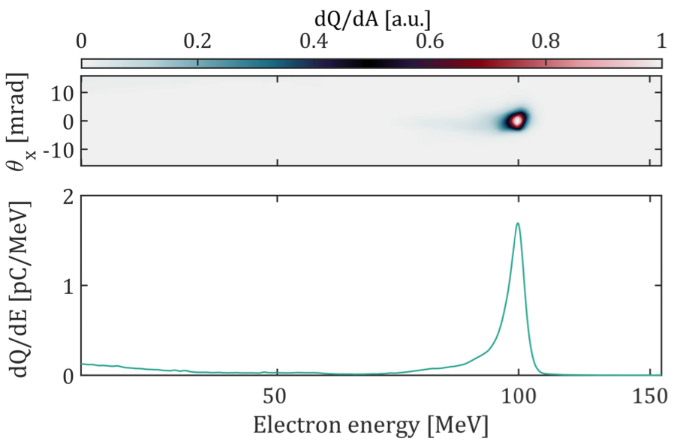
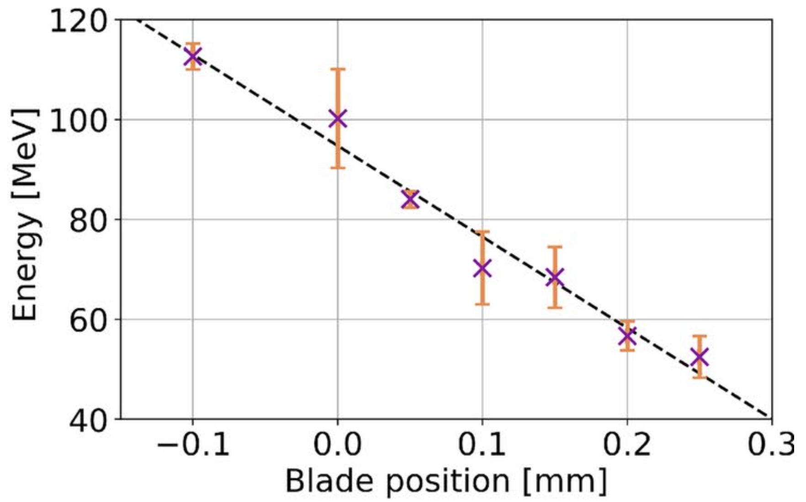
Beam quality and tunability
$$E=100 MeV$$
$$ΔE=4 MeV$$
$$Q=15 pC$$
$$E_{acc}=180 GV/m$$
$$n_{e}=3⋅{10}^{18} {cm}^{−3}$$
Gustafsson et al, Sci. Rep. 14, 26286 (2024)

Slide 8
Energy boost via density jump
Typical beam
One gas jet
$$n_{1}=3⋅{10}^{18} {cm}^{−3}$$
$$E_{peak}=104 MeV$$
Jet 1
$$n_{1}=3⋅{10}^{18} {cm}^{−3}$$
$$n_{2}=14⋅{10}^{18} {cm}^{−3}$$
$$Δs=2.7 mm$$
$$E_{peak}=126 MeV$$
Energy boost
Two gas jets
24 MeV
Jet 1
Jet 2
Rephasing
Schematic

Slide 9
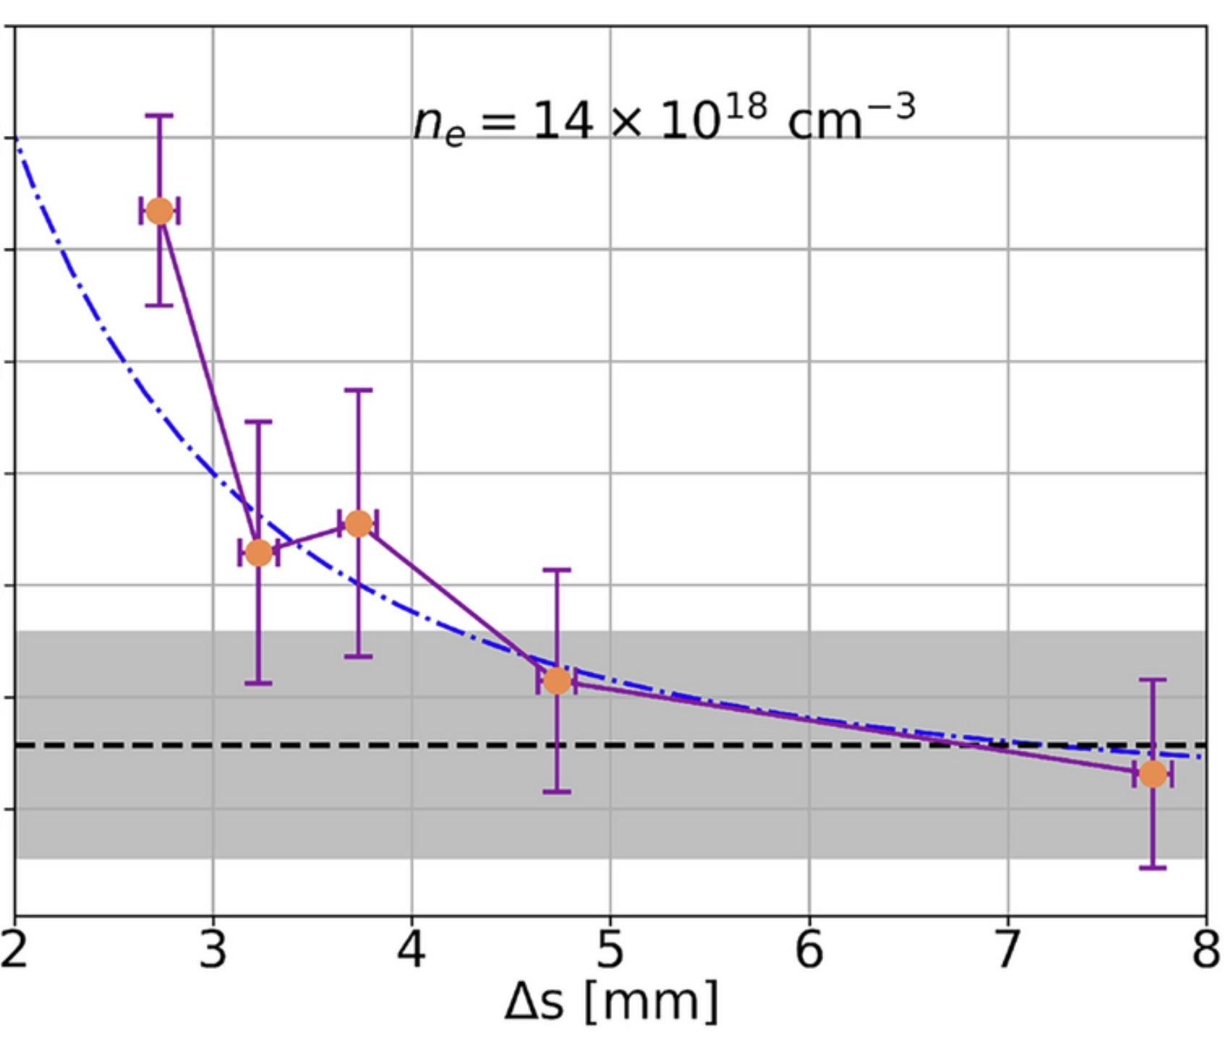
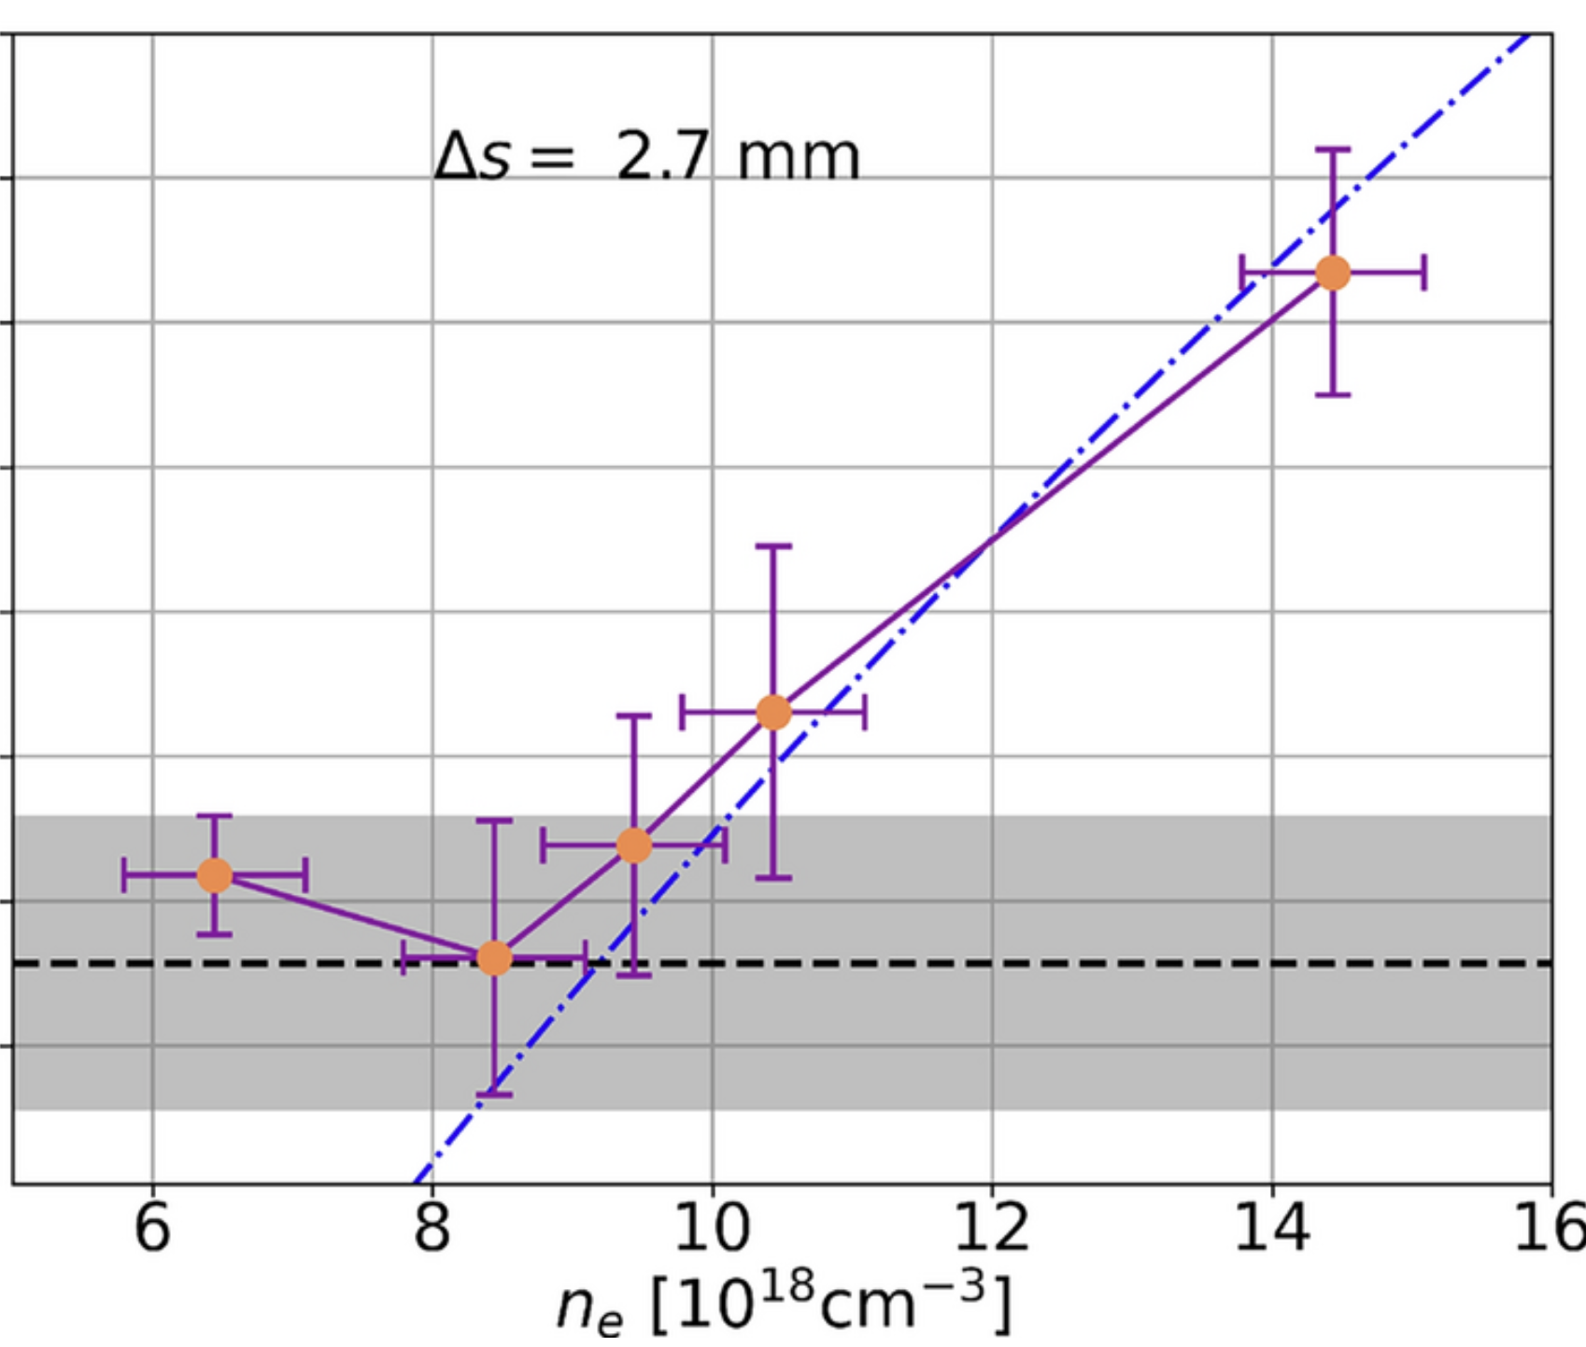
Rephasing – Energy boost via density jump
Jet separation
Plasma density (jet 2)
Gustafsson et al, Sci. Rep. 14, 26286 (2024)
$$Energy boost ∝\frac{\sqrt{n_{e}}}{1+{Δs^{2}}/{z_{R}^{2}}}$$

Slide 10
Divergence reduction – Plasma lens
Typical beam
One gas jet
$$n_{1}=3⋅{10}^{18} {cm}^{−3}$$
$$E_{peak}=104 MeV$$
Jet 1
$$n_{1}=3⋅{10}^{18} {cm}^{−3}$$
$$n_{2}=14⋅{10}^{18} {cm}^{−3}$$
$$Δs=2.7 mm$$
$$E_{peak}=126 MeV$$
Energy boost
Two gas jets
Jet 1
Jet 2
$$n_{1}=3⋅{10}^{18} {cm}^{−3}$$
$$n_{2}=14⋅{10}^{18} {cm}^{−3}$$
$$Δs=4.7 mm$$
$$E_{peak}=106 MeV$$
Beam focusing
Two gas jets
Jet 1
Jet 2

Slide 11
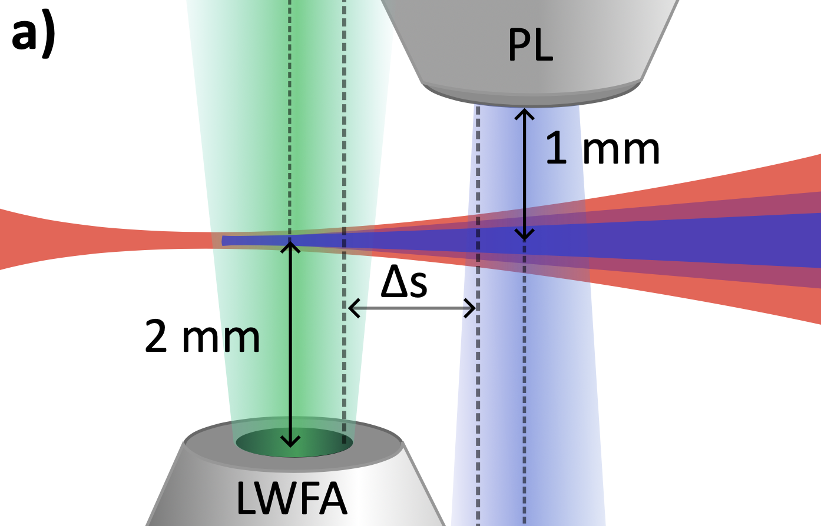
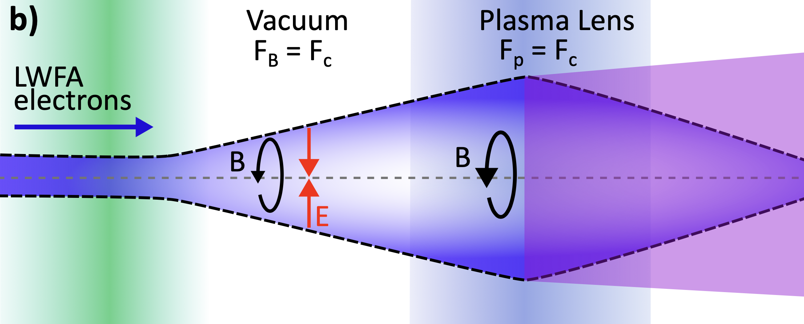
Overdense plasma lens
$$15 pC \left| 5 mrad \right| σ_{r}=σ_{z}=2 µm|$$
$$Δs=4 mm→n_{b}≈{10}^{17} cm^{−3}$$
Laser pulse diffracts – ionizes Jet 2 – drives weak wake ($a_{0}≲0.1$)
In vacuum: space charge repulsion cancelled by attractive force of the self-magnetic field
Overdense plasma lens ($n_{b}≪n_{0}$): neutralizes space-charge → magnetic focusing remains
Focusing strength scales with bunch charge and bunch radius:
$$F_{r}=\frac{n_{b}q_{e}^{2}}{2ε_{0}}r$$
Kuschel et al, Phys Rev AB 2016
Su, Katsouleas, Dawson & Fedele, Phys Rev A 1990

Slide 12
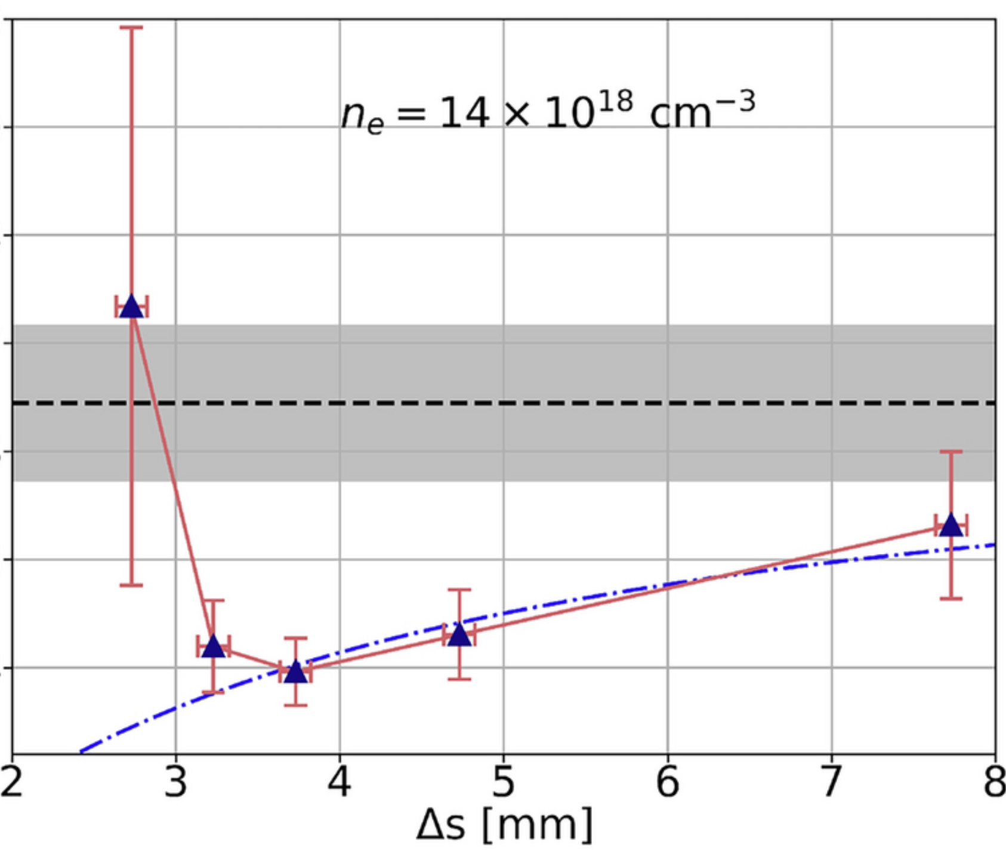
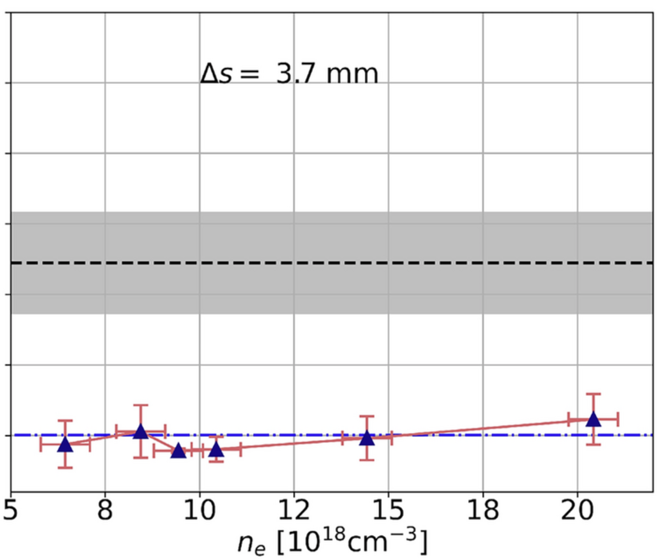
Plasma lensing – Divergence reduction
Jet separation
Plasma density (jet 2)
$$F_{r}=\frac{n_{b}q_{e}^{2}}{2ε_{0}}r$$

Slide 13
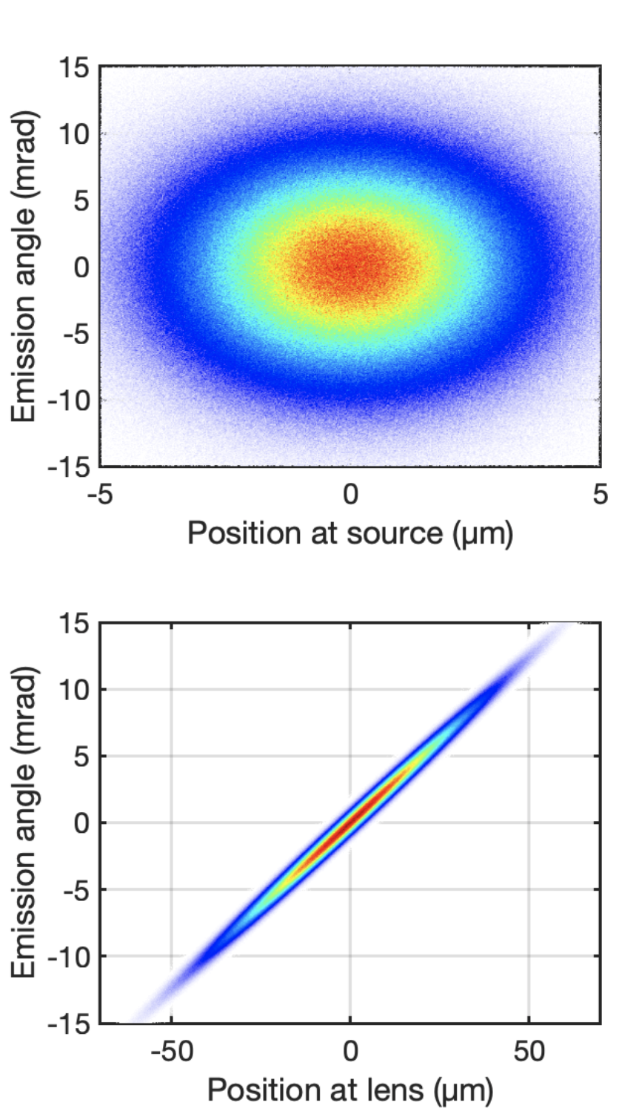
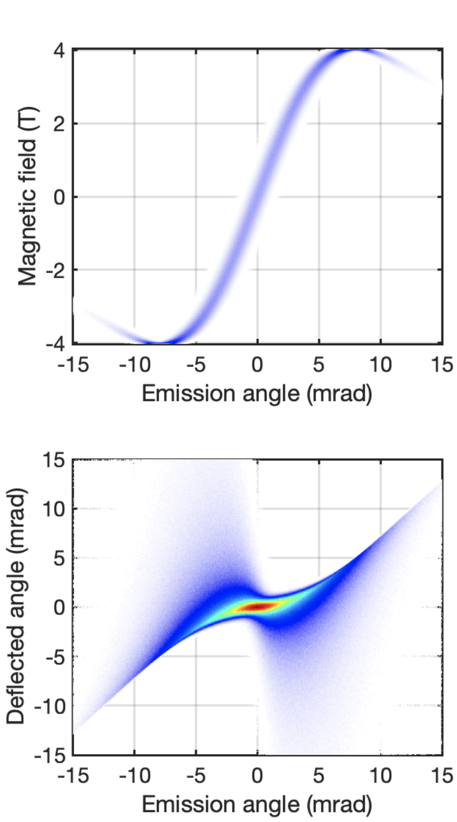
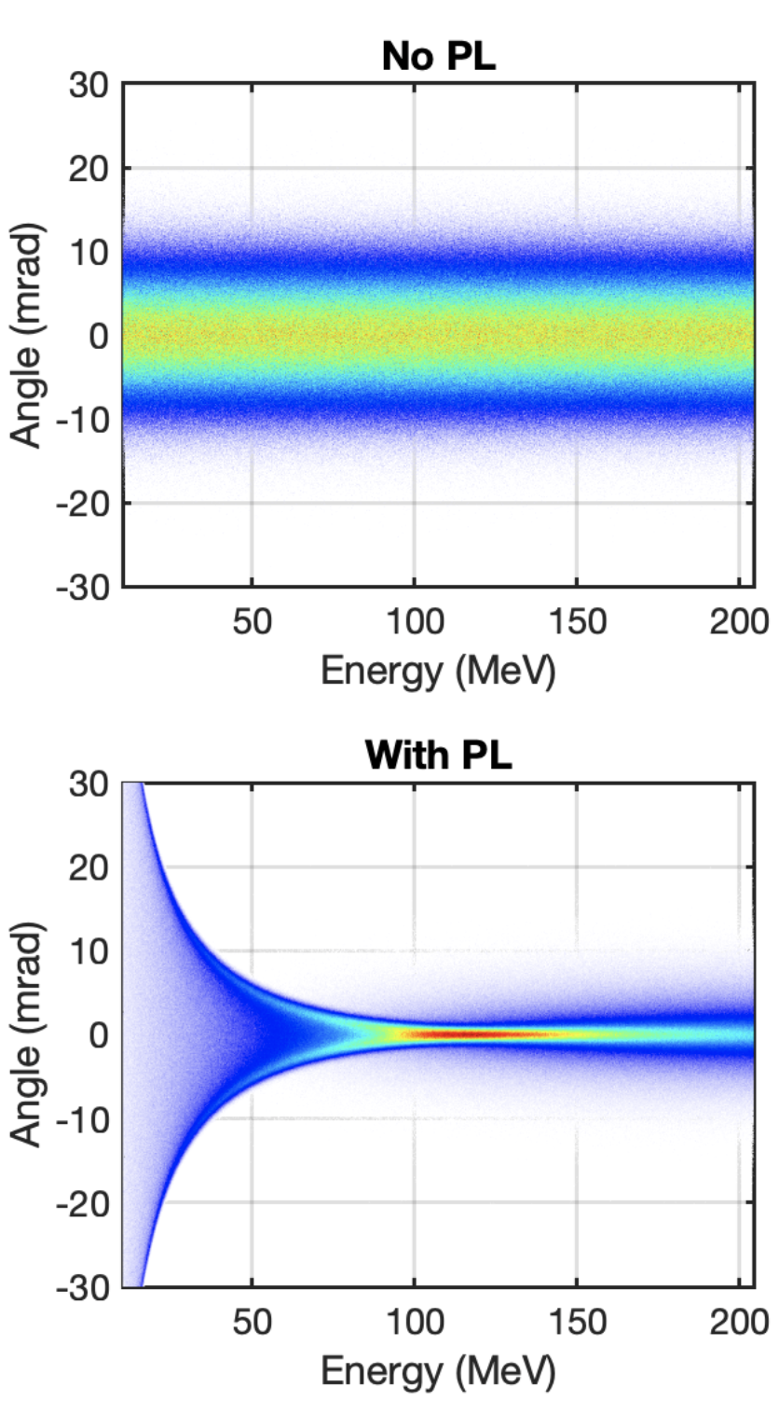
Monte-Carlo simulation
$$15 pC \left| 5 mrad \right| σ_{r}=σ_{z}=2 µm|$$
$$Δs=4 mm→n_{b}≈{10}^{17} cm^{−3}$$
Propagation
Deflection
Focusing

Slide 14
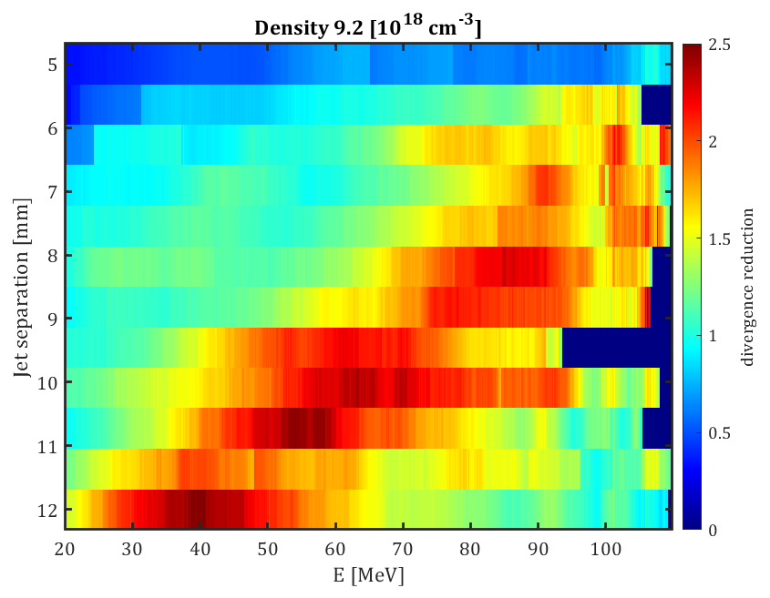
Tunable chromaticity
Increased jet separation
→ Lower $n_{b}$ at jet 2
→ Smaller $F_{r}$
→ Focusing lower energies
Divergence reduction (${θ_{0}}/{θ_{PL}}$)

Slide 15
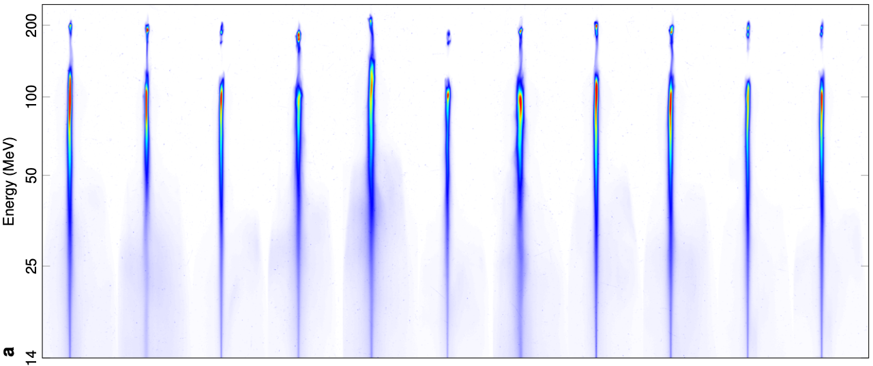
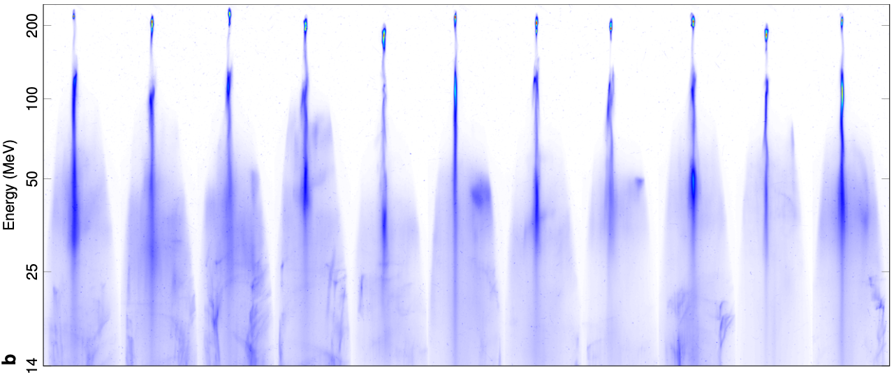
Effect on the high-charge electron beam
22 consecutive shots, with Jet 2 on/off
$n_{1}=6⋅{10}^{18}cm^{−3} | n_{2}=$ $4⋅{10}^{19} cm^{−3} | \left\langle Q\right\rangle =104 pC$
Jet 2 off
Jet 2 on
Divergence of below 120 MeV is greatly increased (from 8.5 to 47 mrad FWHM)
Divergence above 120 MeV is decreased (from 4.5 to 3 mrad)
Björklund Svensson et al, Nat. Phys. 17, 639-645 (2021)

Slide 16
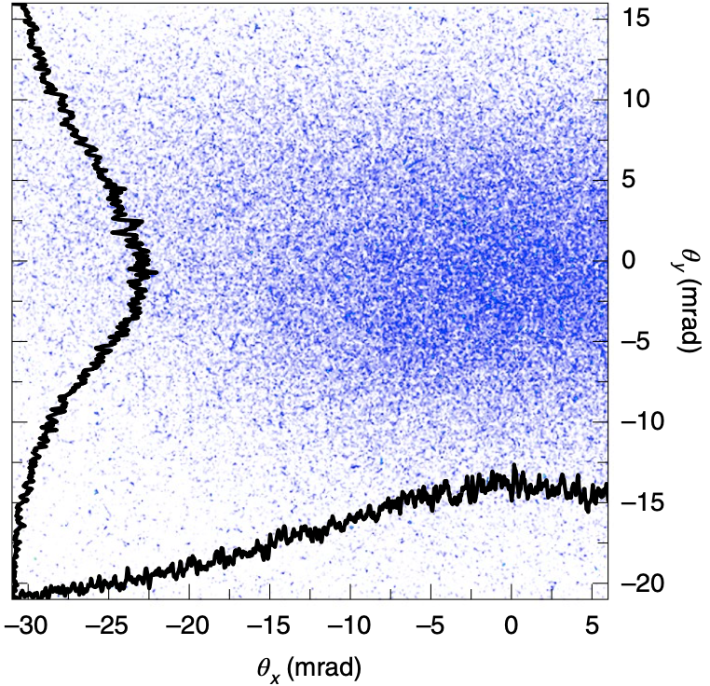
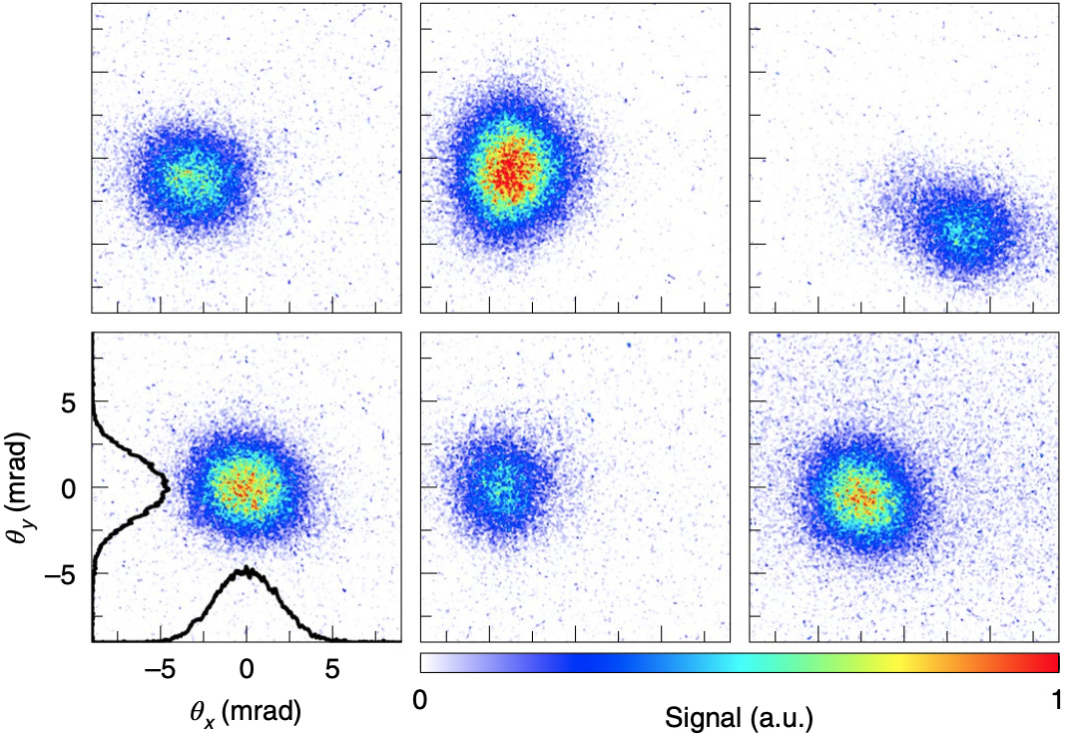
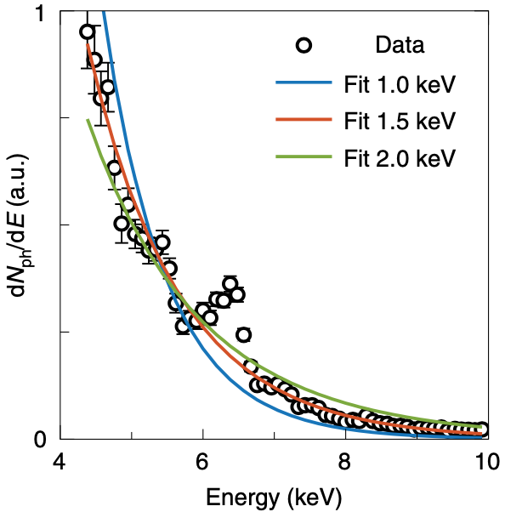
Typical betatron X-rays
Narrow X-ray beams
X-ray spectrum
Jet 2 off
Jet 2 on
Jet 2 on
15 mrad
$$E_{crit}=1.5 keV$$
5 mrad
30 mrad
5 mrad
Björklund Svensson et al, Nat. Phys. 17, 639-645 (2021)

Slide 17
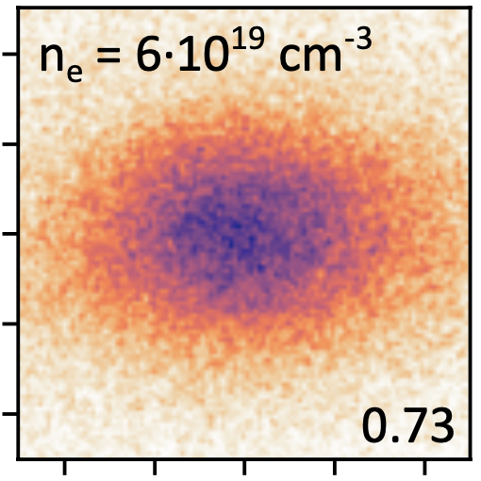
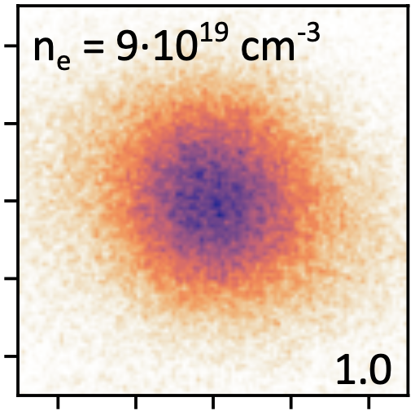
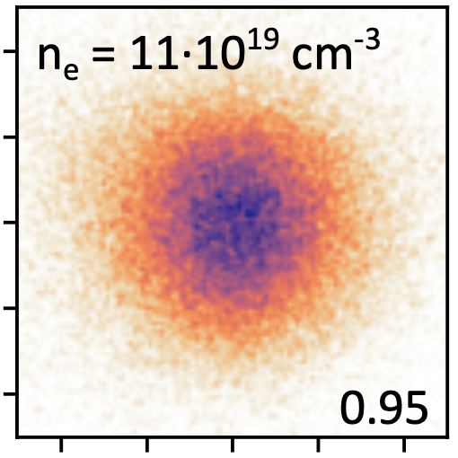
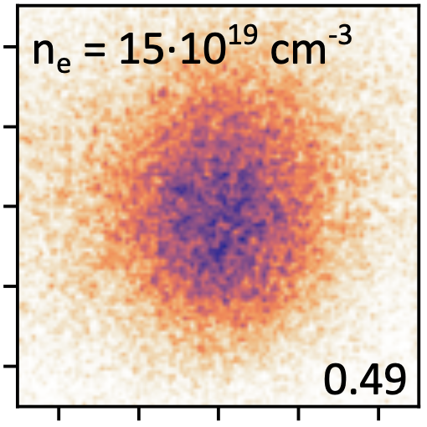
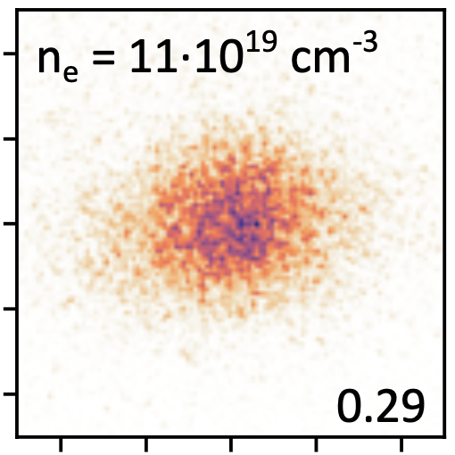
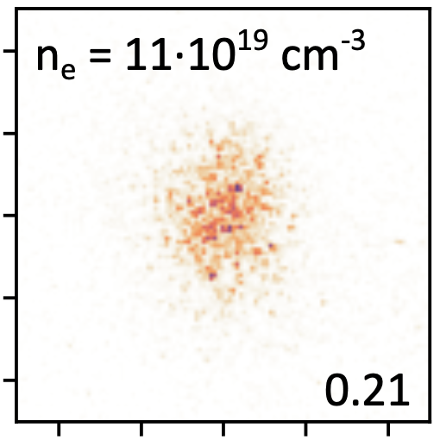
Narrow X-ray beams
Density Jet 2
∆s = 2.7 mm
∆s = 2.7 mm
∆s = 2.7 mm
∆s = 2.7 mm
Jet separation
∆s = 2.7 mm
∆s = 3.2 mm
∆s = 3.7 mm
∆s = 4.2 mm
0.0

Slide 18
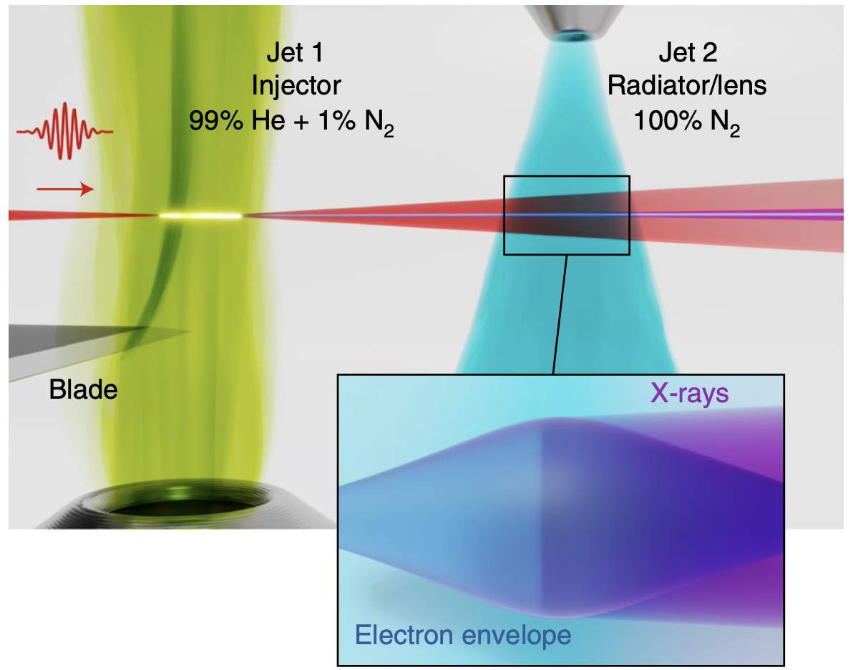
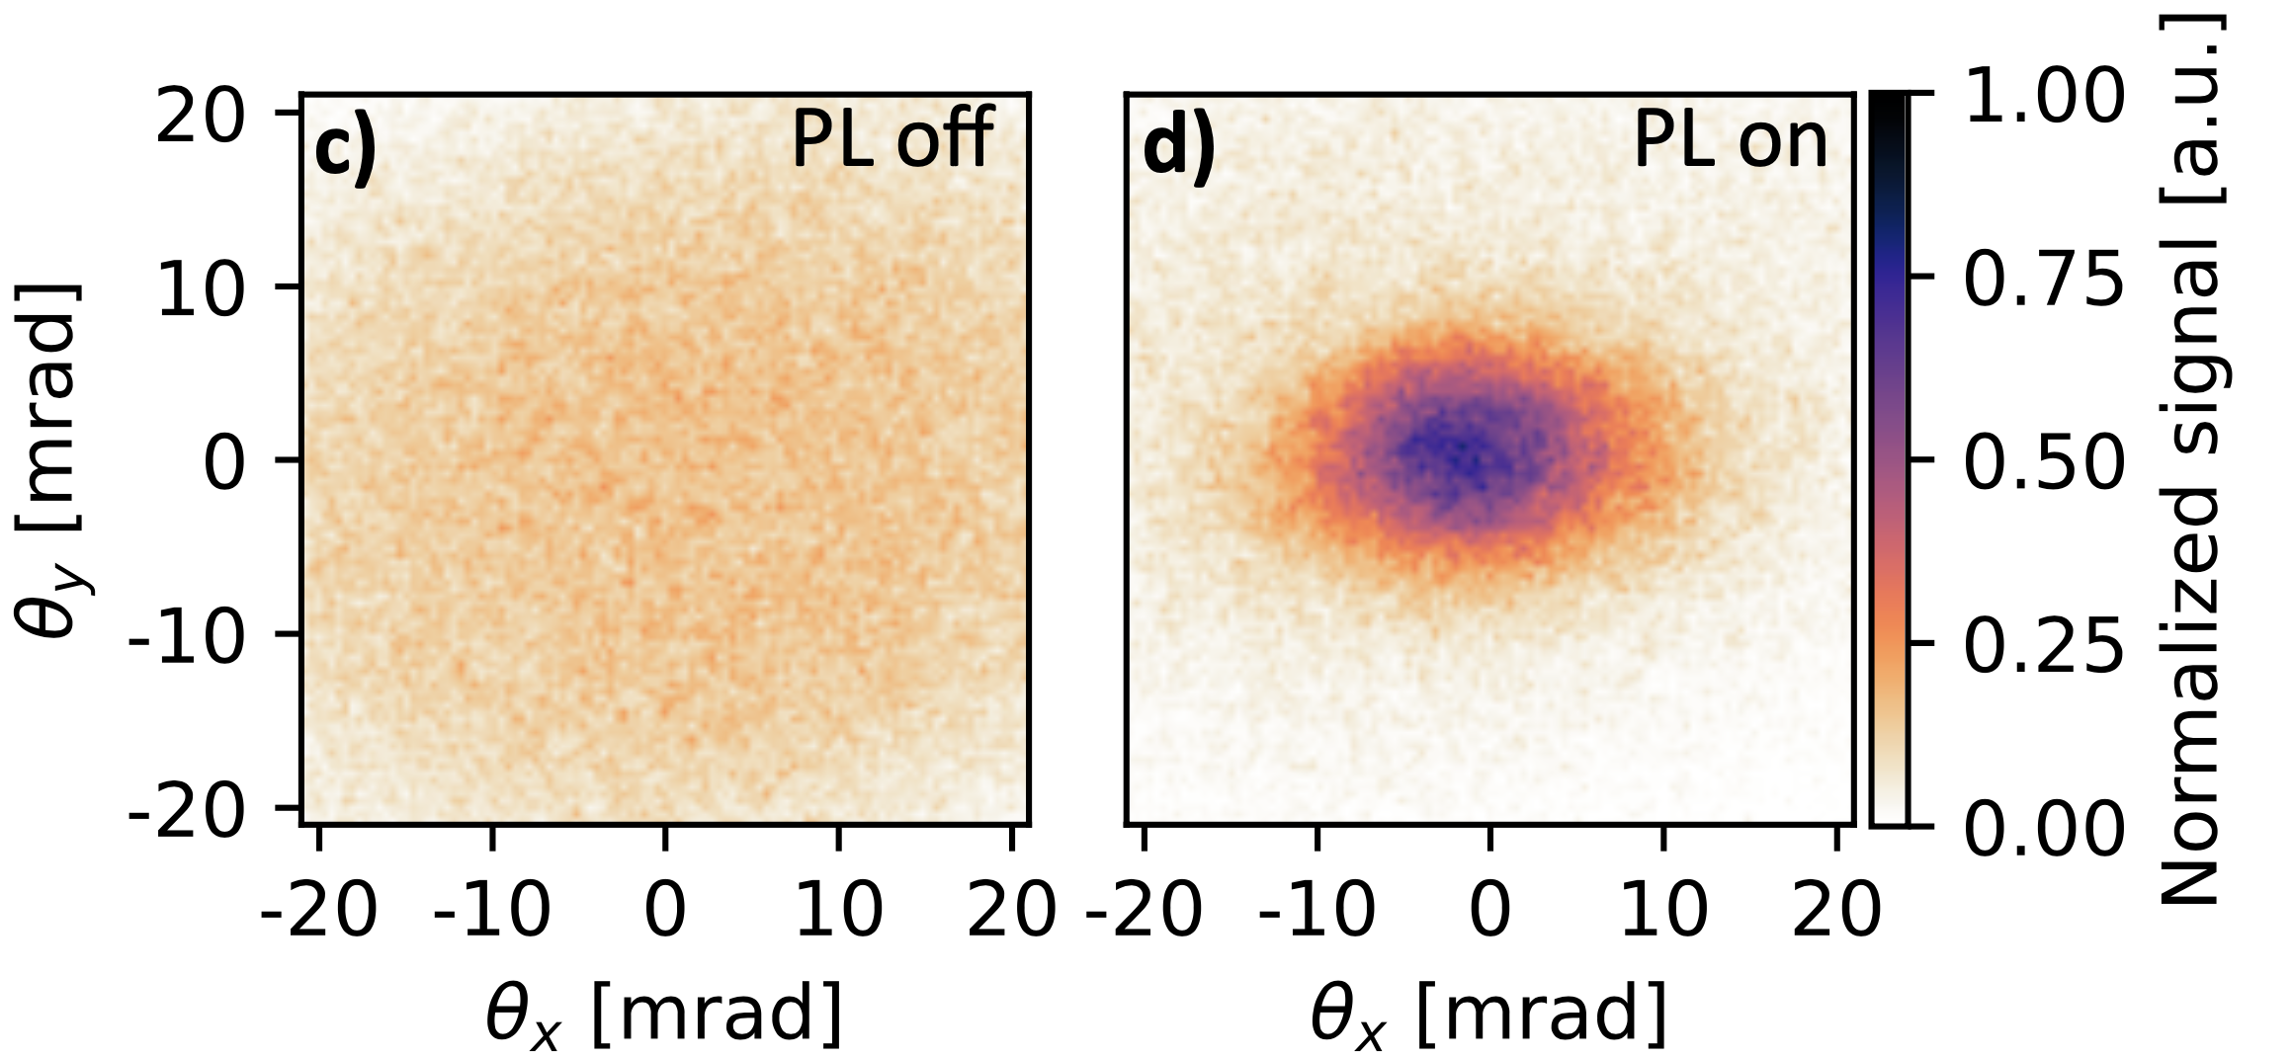
Summary
Plasma density shaping enables simultaneous control of electron beam energy and divergence in LWFA.
Overdense plasma lensing yields stable, few-mrad X-ray divergence through magnetic focusing.
Flexible two-stage design allows tuning between energy gain and collimation.

